Slide 1
Biomedical Data Science (GersteinLab.org/courses/452)
Technical Approaches To Genomic Privacy (25m11a)
Last edit in spring ’25. New slide pack which is associated with a newly created video.
Mark Gerstein
Yale U.

Slide 2
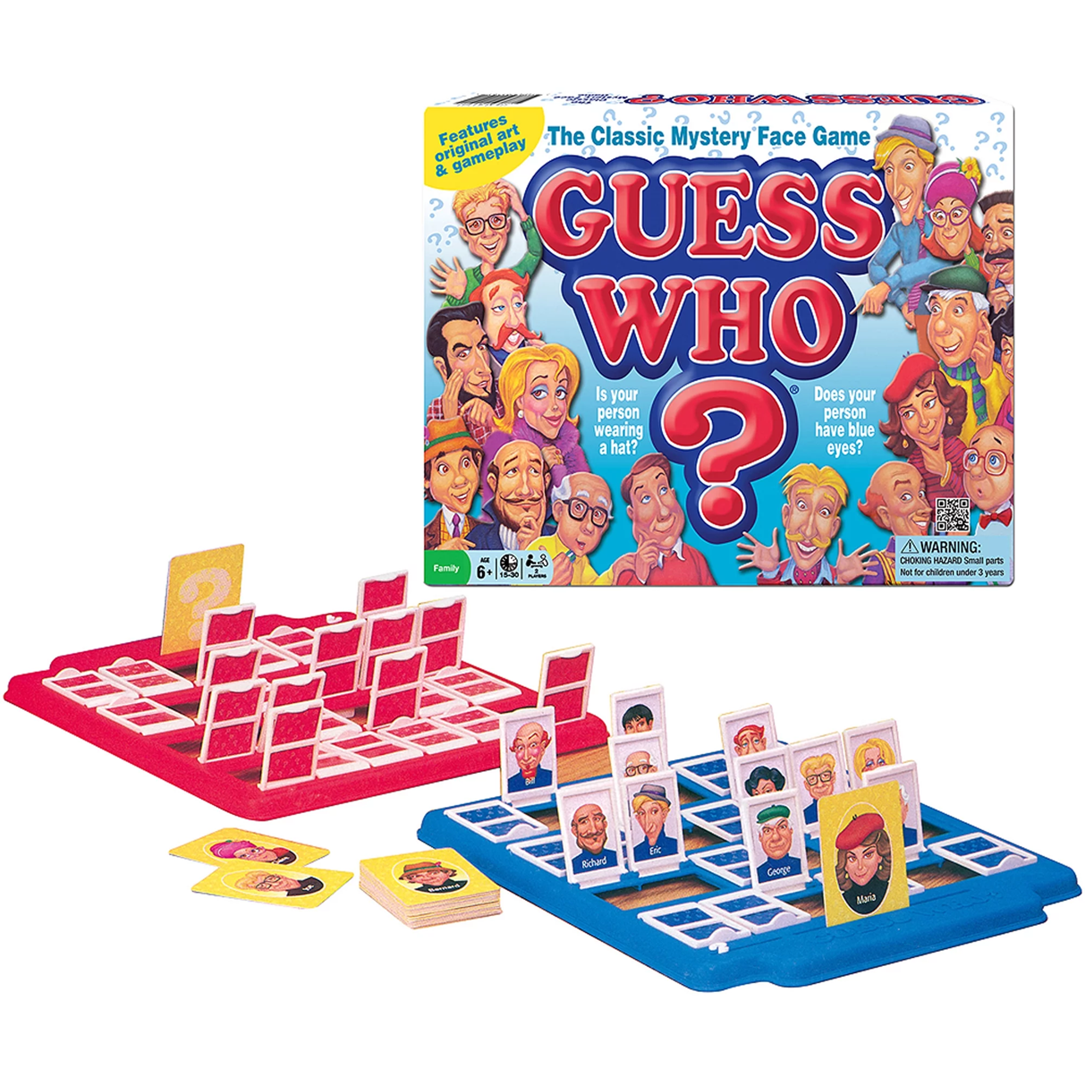
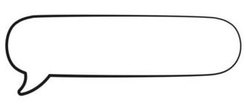
How do we do a privacy attack?
(Technical
Details)
Does your person have
chr11_66561248_T_C_b38?
Lectures.gersteinlab.org (Slide from E Ni)

Slide 3


Linking Attacks: Case of Netflix Prize
Names available for many users!
User (ID) | Movie (ID) | Date of Grade | Grade [1,2,3,4,5]
NTFLX-0 | NTFLX-19 | 10/12/2008 | 1
NTFLX-1 | NTFLX-116 | 4/23/2009 | 3
NTFLX-2 | NTFLX-92 | 5/27/2010 | 2
NTFLX-1 | NTFLX-666 | 6/6/2016 | 5
… | … | … | …
… | … | … | …
User (ID) | Movie (ID) | Date of Grade | Grade [0-10]
IMDB-0 | IMDB-173 | 4/20/2009 | 5
IMDB-1 | IMDB-18 | 10/18/2008 | 0
IMDB-2 | IMDB-341 | 5/27/2010 | -
… | … | … | …
… | … | … | …
… | … | … | …
Narayanan, A., & Shmatikov, V. (2006, October 18). https://arxiv.org/abs/cs/0610105
Anonymized Netflix Prize Training Dataset
made available to contestants
Notes:
This figure illustrates what these datasets look like. The movie titles can be matched directly. Date of ratings and rating values are expected to be similar to each other

Slide 4
Linking Attacks: Case of Netflix Prize
Names available for many users!
User (ID) | Movie (ID) | Date of Grade | Grade [1,2,3,4,5]
NTFLX-0 | NTFLX-19 | 10/12/2008 | 1
NTFLX-1 | NTFLX-116 | 4/23/2009 | 3
NTFLX-2 | NTFLX-92 | 5/27/2010 | 2
NTFLX-1 | NTFLX-666 | 6/6/2016 | 5
… | … | … | …
… | … | … | …
User (ID) | Movie (ID) | Date of Grade | Grade [0-10]
IMDB-0 | IMDB-173 | 4/20/2009 | 5
IMDB-1 | IMDB-18 | 10/18/2008 | 0
IMDB-2 | IMDB-341 | 5/27/2010 | -
… | … | … | …
… | … | … | …
… | … | … | …
Narayanan, A., & Shmatikov, V. (2006, October 18). https://arxiv.org/abs/cs/0610105
Many users are shared
The grades of same users are correlated
A user grades one movie around the same date in two databases
IMDB users are public
NetFLIX and IMDb moves are public
Notes:
As you can see, Netflx-1 user can be matched to IMDB-0 user since the date of rating is very close and the ratings are very similar. The rating in imdb is from 0 to 10. So 5 is a similar score to 3 in Netflix rating system.

Slide 5
Linking Attacks: Case of Netflix Prize
Names available for many users!
User (ID) | Movie (ID) | Date of Grade | Grade [1,2,3,4,5]
NTFLX-0 | NTFLX-19 | 10/12/2008 | 1
NTFLX-1 | NTFLX-116 | 4/23/2009 | 3
NTFLX-2 | NTFLX-92 | 5/27/2010 | 2
NTFLX-1 | NTFLX-666 | 6/6/2016 | 5
… | … | … | …
… | … | … | …
User (ID) | Movie (ID) | Date of Grade | Grade [0-10]
IMDB-0 | IMDB-173 | 4/20/2009 | 5
IMDB-1 | IMDB-18 | 10/18/2008 | 0
IMDB-2 | IMDB-341 | 5/27/2010 | -
… | … | … | …
… | … | … | …
… | … | … | …
Narayanan, A., & Shmatikov, V. (2006, October 18). https://arxiv.org/abs/cs/0610105
Notes:
The key idea is that in imdb, the names are available for many users. Also,
Secondly, although another movie in Netflix system is not rated by this user in imdb system, namely the netflx666, the adversary can see the rating of the individual for this movie.

Slide 6
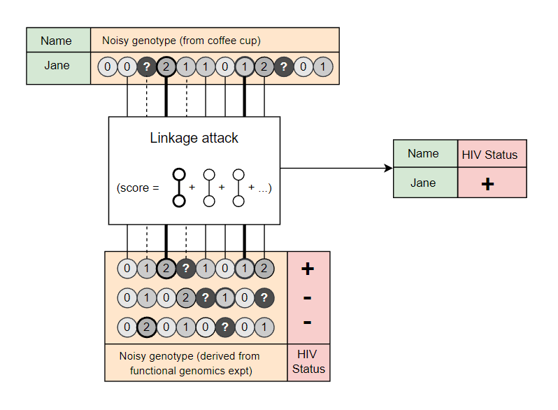

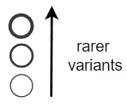

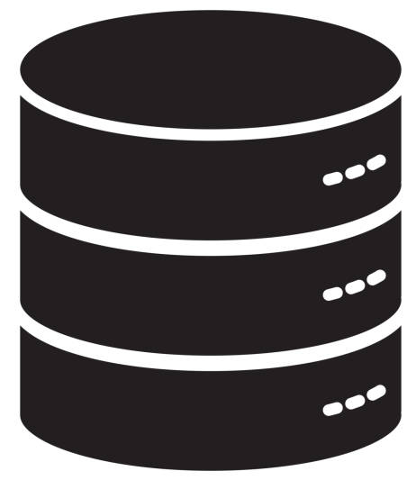
  Genomic Linkage Attacks: private information leakage from noisy SNP sets
6 - Lectures.GersteinLab.org
“Anonymized” Medical DB
[A Harmanci & Gerstein, Nat. Meth. ('16)]
[G Gursoy et al., Cell ('20)]

Slide 7
Quantifying identifying information in the limit of small SNP sets
lectures.gersteinlab.org - [Emani et al. (‘24) Gen. Res.]

Slide 8
The Li & Stephens HMM: Effect of mutation/genotyping error
(Li, N.; Stephens, M. Genetics 2003, 165, 2213–2233. )
When identifying individuals, can include the effects of genotyping error/noise using a population genetics approach:
lectures.gersteinlab.org - [Emani et al. (‘24) Gen. Res.]
Error rate
Probability of observing a genotype G of 0, conditional on the sum of the haplotypes being 1

Slide 9
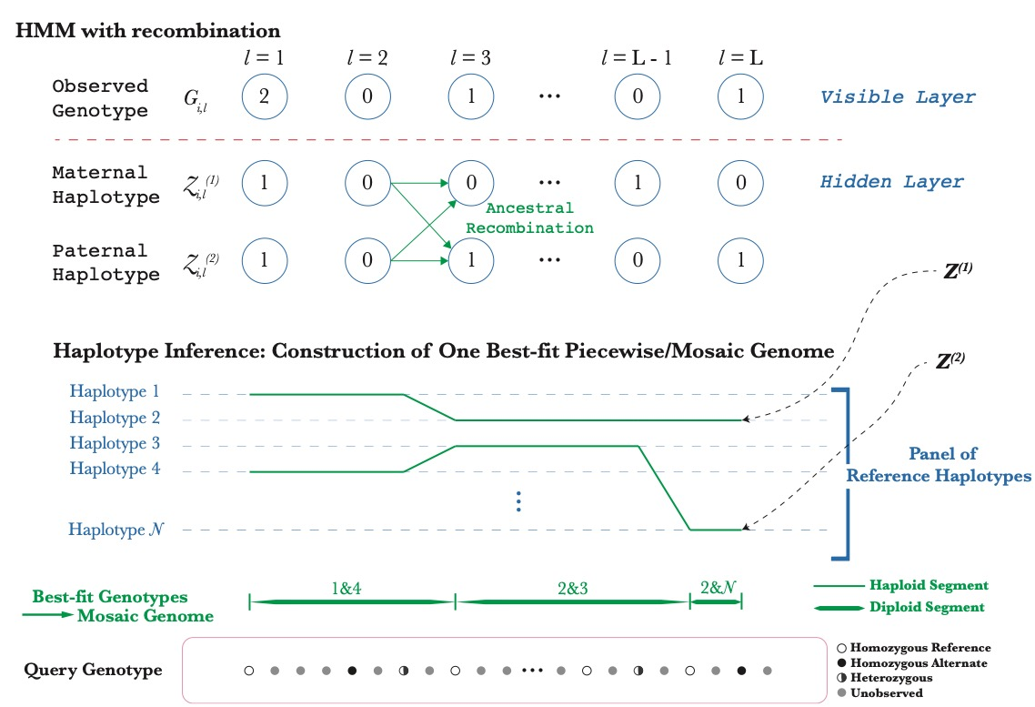
The Li & Stephens HMM: Effect of ancestral recombination
(Li, N.; Stephens, M. Genetics 2003, 165, 2213–2233. )
lectures.gersteinlab.org - [Emani et al. (‘24) Gen. Res.]

Slide 10
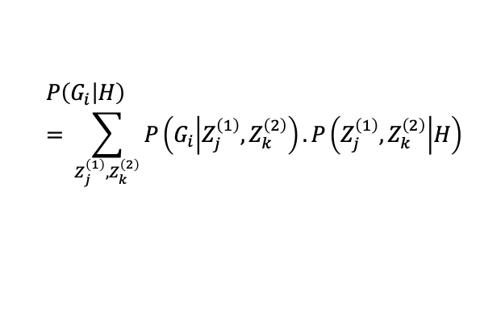

The Li & Stephens HMM
(Li, N.; Stephens, M. Genetics 2003, 165, 2213–2233. )
Addresses: What is the probability of observing a set of genotypes, based on underlying panel of haplotypes?
$$P\left(G_{i} | H\right)= \sum_{Z_{j}^{\left(1\right)},Z_{k}^{\left(2\right)}}{P\left(G_{i} | Z_{j}^{\left(1\right)},Z_{k}^{\left(2\right)}\right).P\left(Z_{j}^{\left(1\right)},Z_{k}^{\left(2\right)} | H\right)}$$
Encodes recombination
Encodes mutations or
genotyping error
$H=$ Set of all reference phased genotypes
$Z_{j}^{\left(α\right)}={\left\{Z_{j\left(l\right),l}^{\left(α\right)}\right\}}_{l=1}^{L}$= Set of all possible haplotypes at the observed loci $l$
lectures.gersteinlab.org - [Emani et al. (‘24) Gen. Res.]

Slide 11
PLIGHT
Viterbi algorithm for most-likely path
Search through the space of haplotype pairs (total dimension = N✕N) to match the diploid genotypes
Each of the two haplotypes can independently recombine with other haplotypes
Allow for mutations/genotyping error
Result: Piecewise matches of reference haplotypes to observed genotype
lectures.gersteinlab.org - [Emani et al. (‘24) Gen. Res.]

Slide 12

PLIGHT
Viterbi algorithm for all equally likely “best-fit” paths
$$\underset{Z_{j}^{\left(1\right)},Z_{k}^{\left(2\right)}∈ Set of all possible haplotypes}{argmax}{P\left(G_{i} | Z_{j}^{\left(1\right)},Z_{k}^{\left(2\right)}\right).P\left(Z_{j}^{\left(1\right)},Z_{k}^{\left(2\right)} | H\right)}$$
For very sparse data, several paths may be equally likely.
We term these paths
‘Genotypic Trajectories’:
to signify the sequential
exploration of haplotype
space.
The number of independent
trajectories in any region
gives a sense of genotypic
‘entropy’
lectures.gersteinlab.org - [Emani et al. (‘24) Gen. Res.]

Slide 13
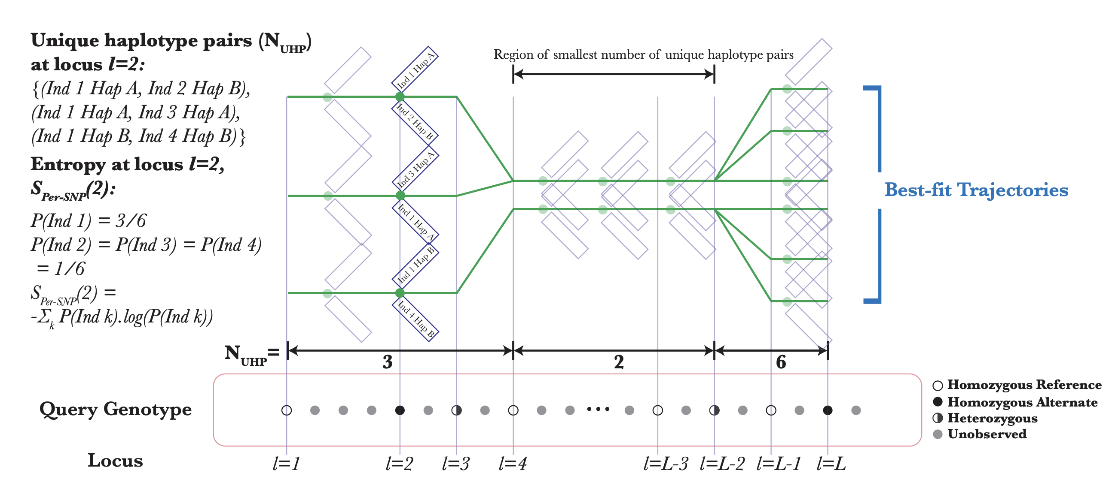
Developing of a Metric of “Trajectory Entropy” to Quantify Information Leakage from SNP sets
(Rare SNPs are most private)
Best SNPs to Sanitize
lectures.gersteinlab.org - [Emani et al. (‘24) Gen. Res.]
Entropy
13

Slide 14
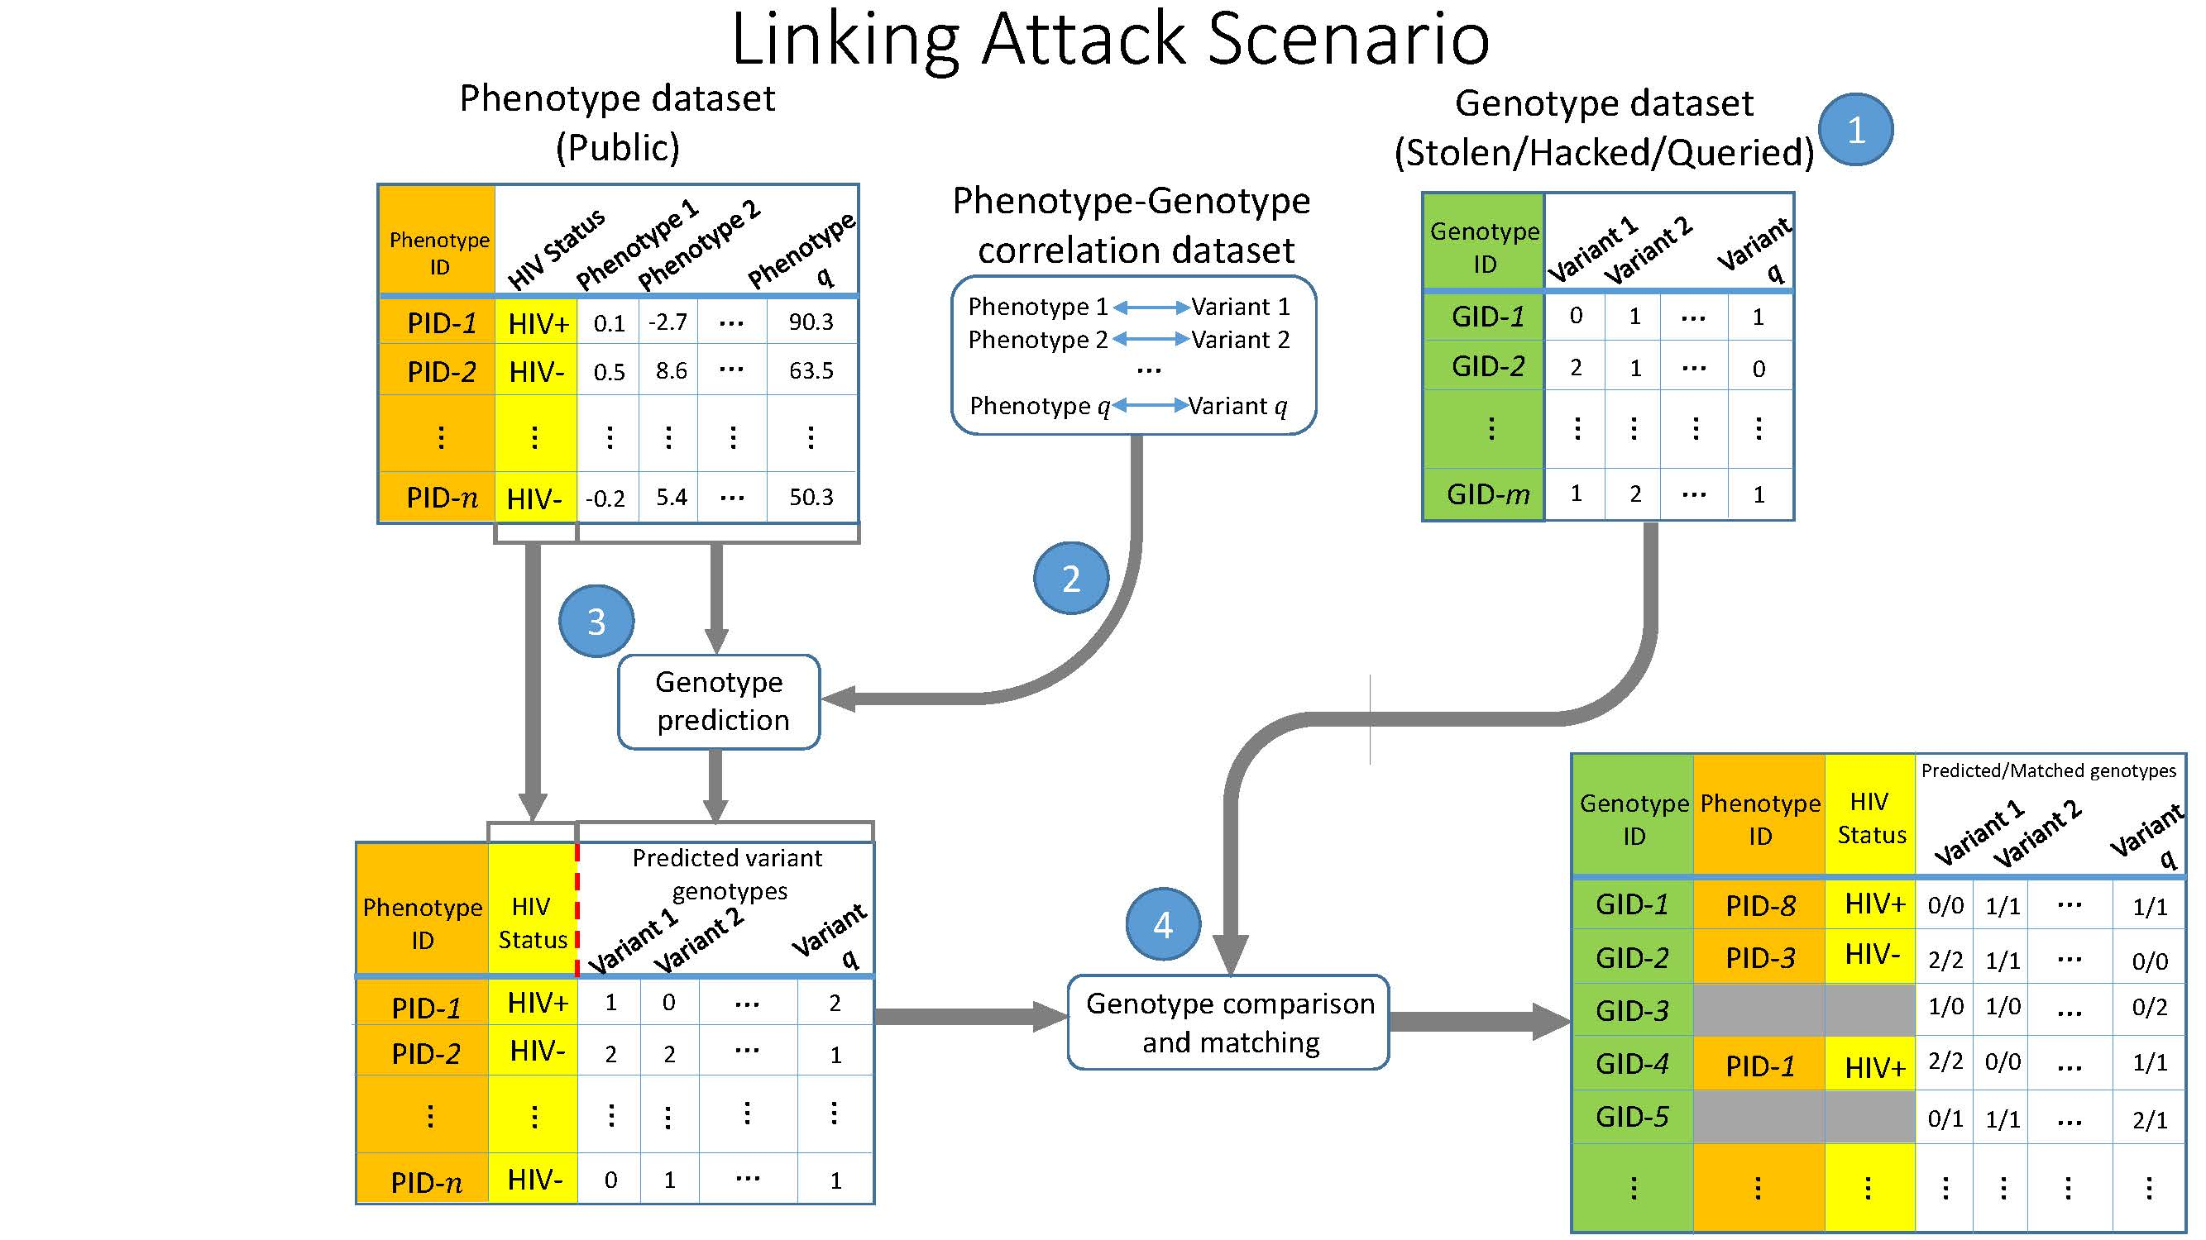
Linking Attack Scenario with gene expression data
[Harmanciet al. Nat. Meth. (‘16)]

Slide 15
Information Content and Predictability
Naive measure of information (no LD, distant correlations, pop. struc., &c)
Higher frequency: Lower ICI
Additive for multiple variants
Condition specific entropy
Higher cond. entropy: Lower predictability
Additive for multiple eQTLs
[Harmanci et al. Nat. Meth. 2016]

Slide 16
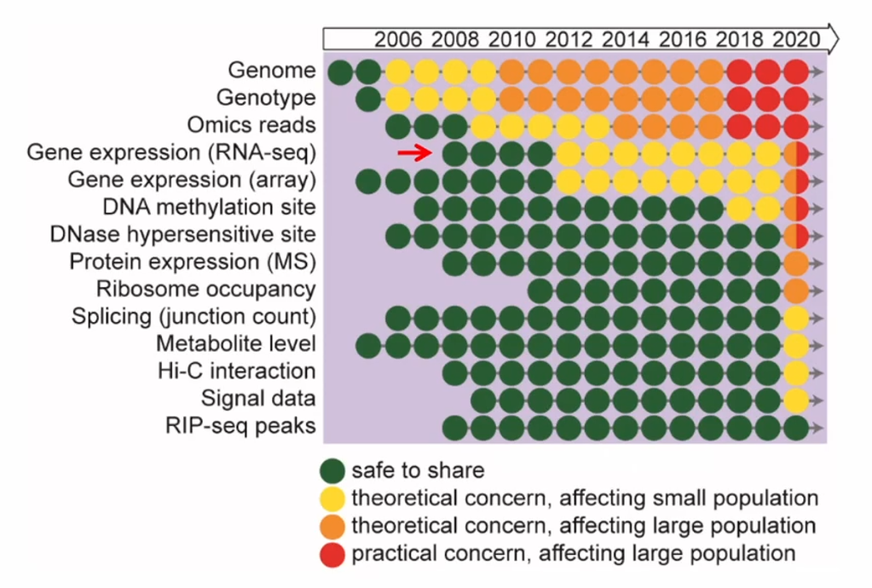
Latent functional risk in genomics data manifests over time
Slide from Zhiqiang Hu, GenoPri’21

Slide 17
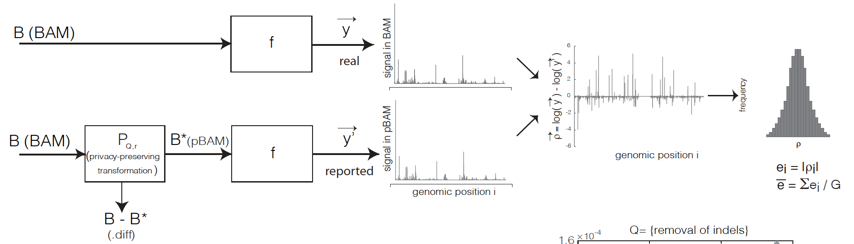
What to do? Privacy-preserving File Formats (pBAM)
Definitions:
1. Privacy: B∗ = P_{Q,r}(B) can be viewed as δ-private with respect to operation Q, if δ = r/t,
r = non-observable (sanitized) variants in pBAM
t = all observed variants in BAM
We can reach 100% privacy when r = t.
2. Utility: B∗ = P_{Q,r}(B) can be viewed as having ε -γ -utility with respect to operation Q, if ε = (G − m)/G,
G = total number of units
m = the total number of units with e_{i} > γ
Practically, ε is the fraction of the genomic bases affected by the sanitization
& γ can be set based on difference between replicates
Note: Variants can have different effect on privacy based on their rarity; however that will make definitions to be dependent on
the composition of attacked database
[Gursoy et al., Cell, in press]

Slide 18
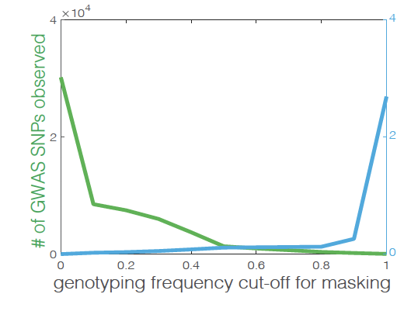
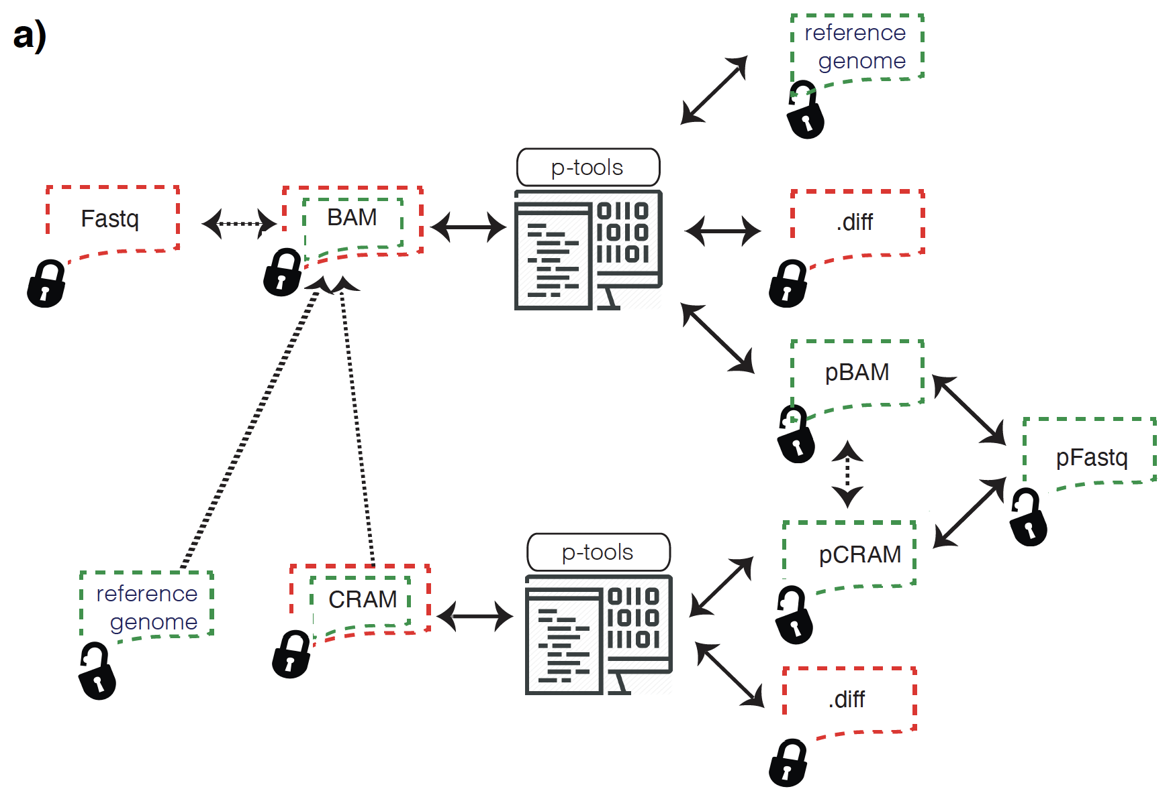
Creating Sanitizing Read Files via the pBAM
(Privacy-preserving Binary Alignment Mapping)
x10⁻⁶
Amount of “error” introduced
into the Sanitized BAM
Sanitizing BAM files by masking most identifying variants & moving them to a small private "diff" file
Privacy increases as we mask more variants
[G Gursoy et al., Cell ('20)]

Slide 19
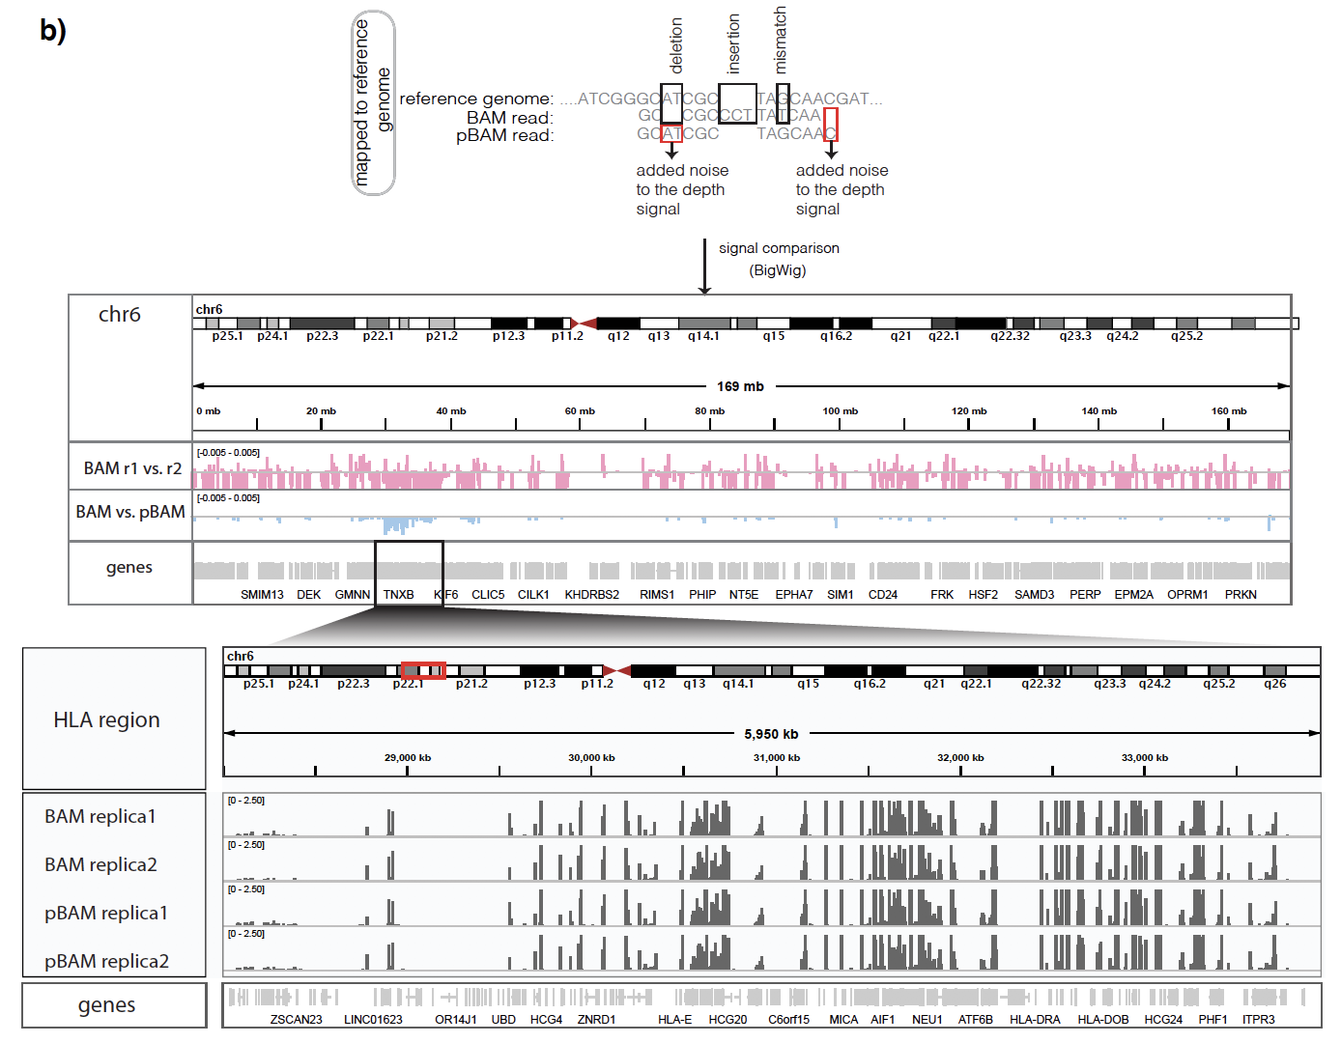
Privacy-preserving Binary Alignment Mapping (pBAM)
(empirical utility observations)
NA12878 RNA-Seq BAM files
Variation between replicates
Variation between BAM-pBAM
[Gursoy et al., Cell, in press]

Slide 20
References
G Gursoy et al. (2021). Nat Rev Genet 23: 245-258
https://www.nature.com/articles/s41576-021-00428-7
Functional genomics data: privacy risk assessment and technological mitigation.
(Read up to the heading “Cryptographic Approaches.”)
Lectures.gersteinlab.org

