Slide 1
Single Cell Applications - Pseudotime Cell Trajectories
Donglu Bai
1

Slide 2
Outline
What is pseudotime
Monocle
RNA Velocity
Challenges of Computational Inferences
2

Slide 3
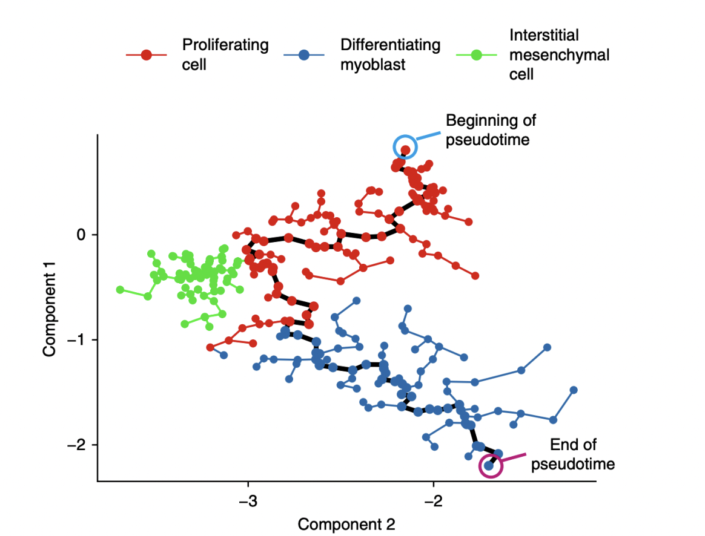
What is Pseudotime/Trajectory Inference?
Cell differentiation occurs through dynamic developmental processes
Pseudotime orders cells along trajectories that represent these process
Trajectory inference (TI) reconstructs these cellular transitions
Trapnell, C et al. Nat Biotechnology 2014
3
Saelens, W et al. Nat Biotechnology 2019
Notes:
"This figure represents the concept of pseudotime, which helps us understand how cells progress through differentiation."
"Each dot represents a single cell, and their placement along the trajectory reflects their developmental state."
"The colors indicate different cell states: red represents proliferating cells, blue represents differentiating myoblasts, and green represents interstitial mesenchymal cells."
"These different cell states are organized along a developmental trajectory."
"The black path represents the inferred developmental trajectory.”
"Pseudotime does not measure real time but rather the relative progress of cells along this differentiation pathway."
"Cells at the beginning of pseudotime (circled in blue) are in an early state, while those at the end of pseudotime (circled in pink) are more differentiated."
"Trajectory inference (TI) computationally reconstructs this process from single-cell data."
"

Slide 4
Monocle 2
Step 1: Choose genes that define progress
1
Step 2: Reduce data dimensionality (ICA)
2
Step 3: Construct minimum spanning tree (MST) on the cells
3
Step 4: Find the longest path through the MST
4
Step 5: Order cells along the trajectory
5
4
Notes:
"We need to reconstruct how cells transition through differentiation using only single-cell gene expression data.""Monocle provides a graph-based approach to infer the most likely developmental pathway.”
"First, we identify genes that define biological transitions.""Then, we reduce dimensionality to make the problem computationally feasible.""Next, we build a minimum spanning tree to connect cells based on similarity.""Finally, we extract the longest path, order cells, and assign pseudotime."

Slide 5
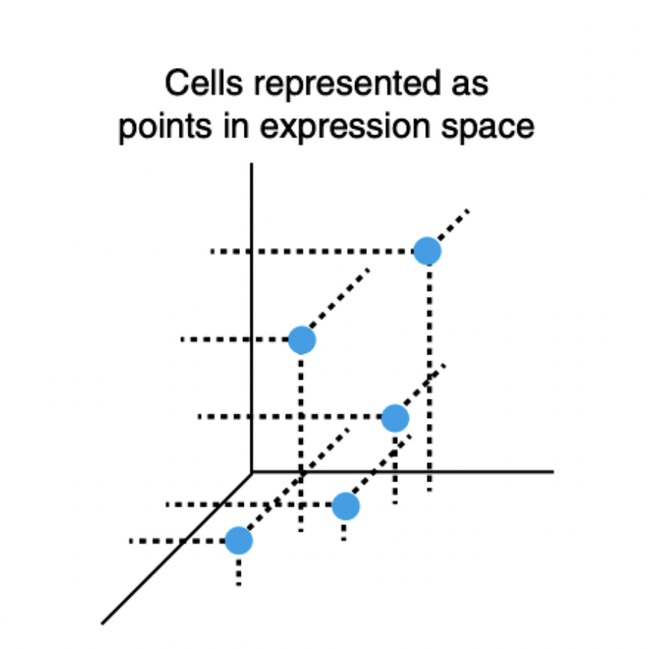
Step 1: Identify genes that define the progress
1) Cells exist in a high-dimensional space
Each cell $X_{i}$ is a point in $d$dimensional space
Select high variance genes or based on differential expression patterns
High variability across cells
Compute the variance across cells for each gene
Genes that define biologically relevant processes (e.g., stem cell markers)
C. Differential expression along cell states
Trapnell, C et al. Nat Biotechnology 2014
5
Notes:
not all genes are informative, many genes may not change significantly across cell states
so we prioritize genes that change along differentiation paths
use statistical test like likelihood ratio test or t test to compare gene expression between different cell groups, u1 and u2 are the mean expression levels in two cell states gene with significant p values (p < 0.05) are selected

Slide 6
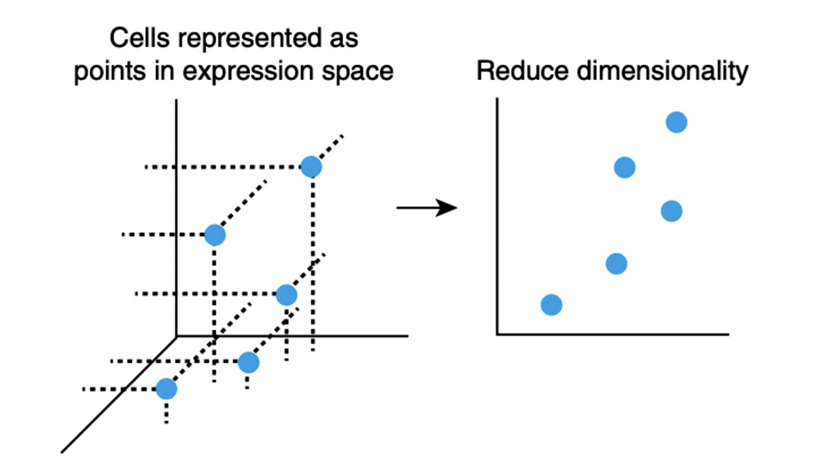
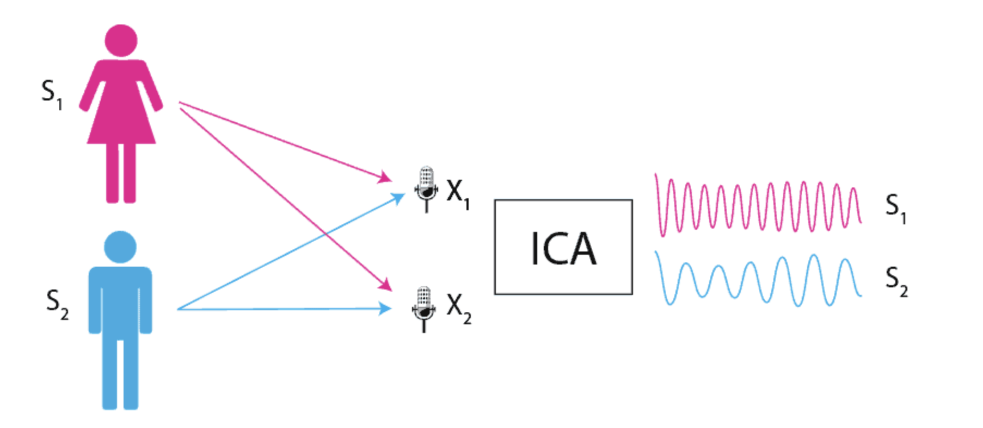
Step 2: Reduce data dimensionality (ICA)
Mathematical equations:
$x$ is the observed mixed signals
$A$ is the mixing matrix
$s$ is the original independent source signals
Goals:
$y$ is the estimated independent components
$W$ is the unmixing matrix, computed by ICA
$$s$$
$$A$$
$$x=As$$
$$y=Wx$$
Trapnell, C et al. Nat Biotechnology 2014
6
Notes:
cells are initially represented as points in a high-dimensional expression space. Each dimension represents a gene, so each cell is embedded in a multi-dimensional space. To make analysis easier, we need to reduce this high-dimensional representation while still capturing the most important biological signals.
We assume that the observed gene expression x is a mixture of independent biological signals s.
This relationship can be written as:
x=As:
x is the observed mixed gene expression data.
A is the mixing matrix, which determines how independent biological signals get combined.
s is the original independent source signals, which we want to extract.
ICA's goal is to find the unmixing matrix W such that:
y=Wx
Where y is our estimated independent components.
Imagine two people are talking in a room, and two microphones record a mixed audio signal from both voices. Our goal is to separate the voices of the two speakers. Similarly, in gene expression data, genes may be co-regulated, meaning that their signals are mixed due to common biological processes. ICA allows us to recover the original independent signals driving cell differentiation.

Slide 7
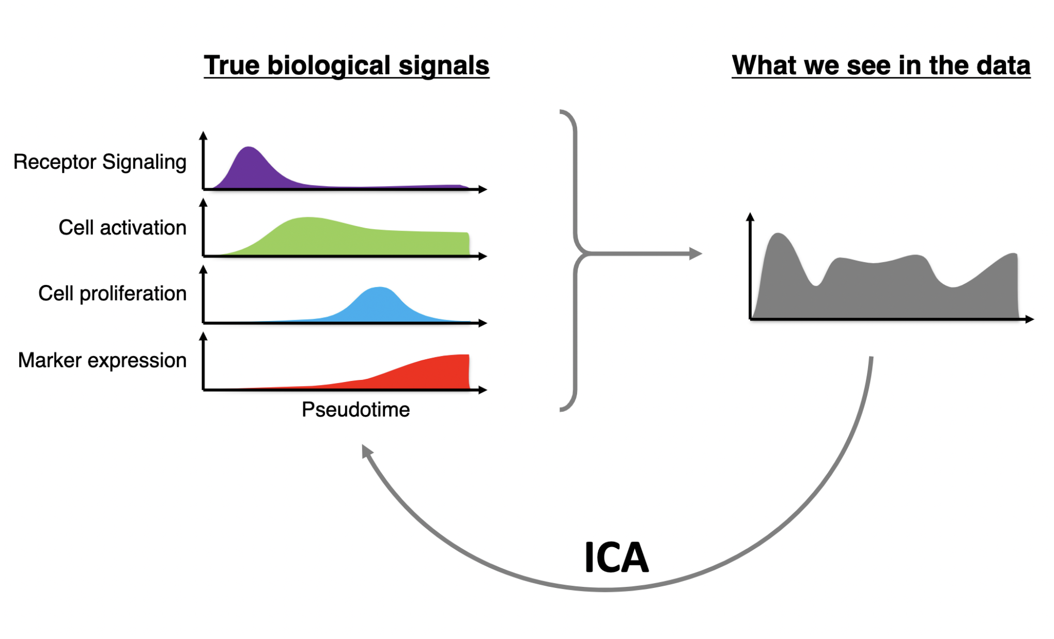
Why ICA
PCA : find the directions of maximal variance
Find the loudest sound in the room (dominant but may be mixed)
ICA: find the direction of maximal independence
Find individual voices in a conversion
https://github.com/NBISweden/excelerate-scRNAseq/blob/master/session-trajectories/trajectory_inference_analysis.pdf
7
Notes:
gene expression is driven by multiple biological processes happening at the same time—things like differentiation, cell cycle, and receptor signaling."
"The problem is that when we measure gene expression, these signals get mixed together, making it difficult to interpret what’s actually happening inside a cell."
"ICA solves this problem by mathematically separating mixed signals into their original, independent sources."
helps us recover real biological processes from noisy gene expression data."
PCA: PCs that explain the most variance
ICA find directions where resouces are statistically independent
PCA is like finding the loudest sounds in a room—these are the dominant signals but might be mixed together.ICA is like separating individual voices in a conversation—each voice is an independent signal, even if one is louder than the others.

Slide 8
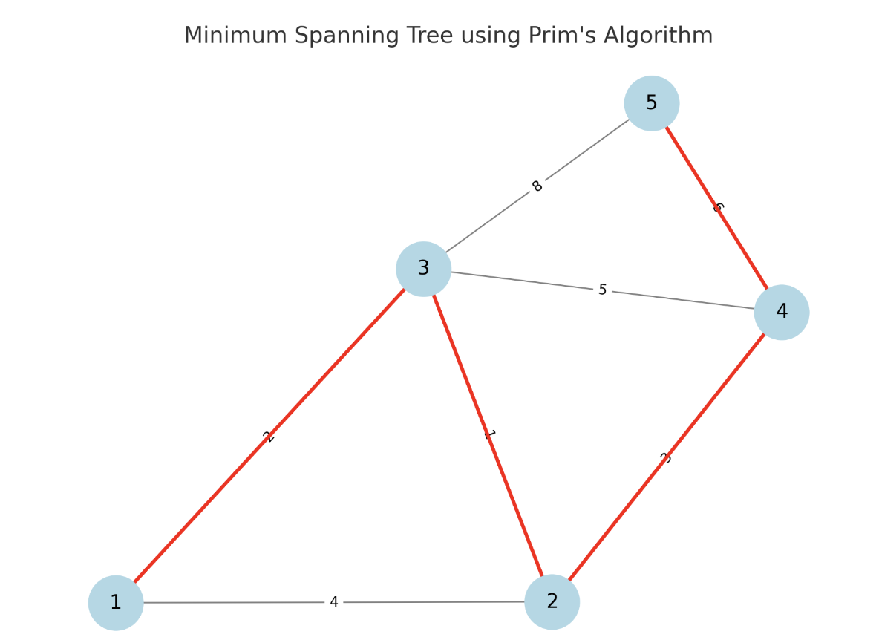
Step 3: Construct minimum spanning tree (MST) on the cells
Connect all vertices (cells) in $V$ in $G=\left(V,E\right)$
Has no cycles
Minimizes the total sum of edge weights
Compute the pairwise distance in reduced-dimensional space
Prim’s algorithm
Trapnell, C et al. Nat Biotechnology 2014
8
Notes:
After reducing the dimensionality of the gene expression data (Step 2), we now have cells positioned in a lower-dimensional space.
Our goal is to connect all cells in a way that best represents how cells transition through differentiation.
A Minimum Spanning Tree (MST) is an optimal structure because:
It connects all cells (vertices) with the minimum total edge length.
It has no cycles.
It preserves relationships between cells while keeping the structure simple.
2) The Process of Constructing an MST
Compute Pairwise Distances
First, we calculate the distances between all pairs of cells in the reduced-dimensional space.
This gives us a weighted graph where the vertices are the cells and the edges represent their distances.
Apply Prim’s Algorithm
We use Prim’s algorithm, which is a greedy approach to finding the MST:
Start from an arbitrary cell.
Iteratively add the shortest edge that connects a new cell to the MST.
Repeat until all cells are included.

Slide 9
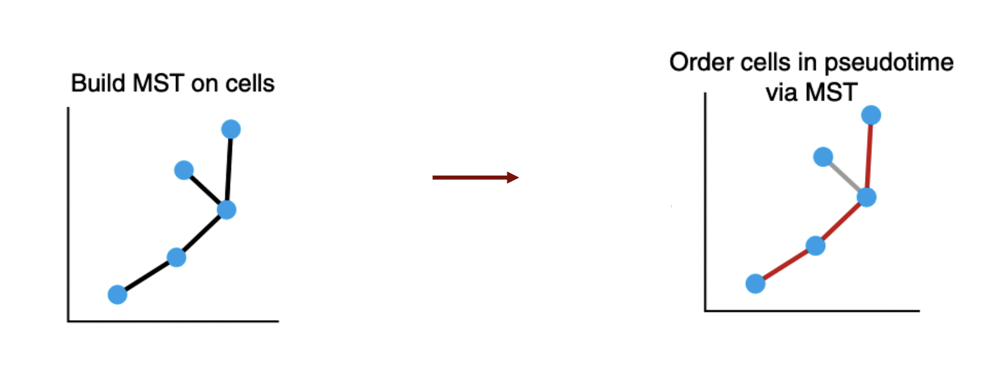
Step 4: Find the longest path through the MST
The longest continuous path is the best proxy for the differentiation timeline
Longest path is called the diameter
Trapnell, C et al. Nat Biotechnology 2014
9
Notes:
🔹 At this point, we now have a fully connected MST that represents the underlying differentiation process in a tree-like form.
The MST does not tell us which cells come first and which come later in differentiation.
Idea: The longest continuous path in the MST is the best proxy for the differentiation timeline.
Cells that are far apart in this path likely represent early vs. late differentiation states.
This longest path provides a sequence of cells that we interpret as "pseudotime order."

Slide 10
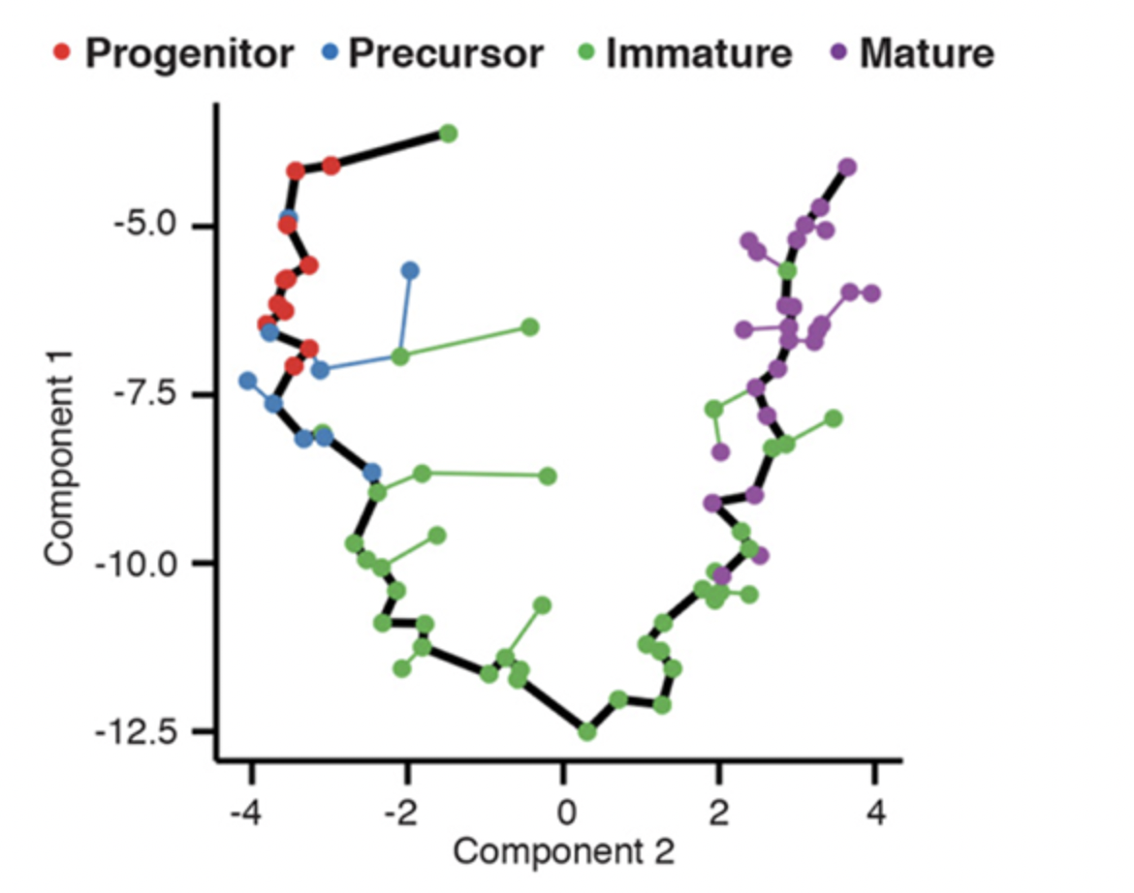
Step 5: Order cells along the trajectory
Assign a pseudotime value to each cell
Cells early in the path: undifferentiated states
Cells later in the path: fully differentiated states
Developmental trajectory of olfactory neurons in mice
https://cole-trapnell-lab.github.io/projects/sc-trajectories/
10
Trapnell, C et al. Nat Biotechnology 2014
Notes:
After constructing the Minimum Spanning Tree (MST) (Step 3) and identifying the longest path (Step 4), we now need to assign a pseudotime value to each cell.
Cells at the beginning of the path are considered undifferentiated, while cells at the end of the path are more differentiated.
in the diagram, the blue-colored cells represent early-stage progenitors.
We move along the tree structure and assign a pseudotime value to each cell.
Cells that are further along the longest path get higher pseudotime values.
how Monocle’s trajectory inference method successfully captures real biological transitions.

Slide 11
RNA Velocity: spliced and unspliced RNA levels indicate changing gene expression
Bioinformatics, 2021: tinyurl.com/veloviz
Sofrware +tutorials : jef.works/veloviz
11
Notes:
cannot follow what a single gene is doing over time in a single cell
RNA velocity is a concept that helps predict how gene expression is changing over time.
It is based on tracking two types of RNA:Unspliced RNA: The newly transcribed pre-mRNA, which still contains introns.
Spliced RNA: The mature, processed mRNA, after introns have been removed.
Gene X is transcribed into unspliced RNA.
the transcript becomes spliced RNA
Over time, the spliced RNA degrades, reducing the gene’s expression level.

Slide 12
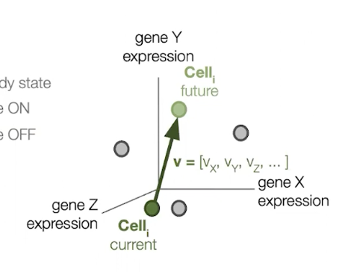
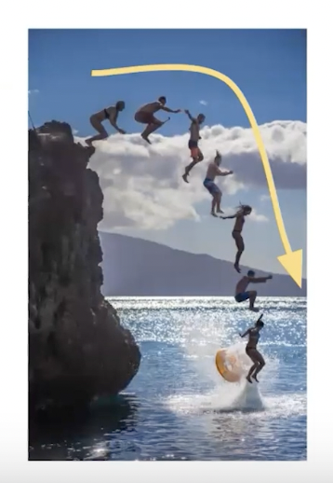
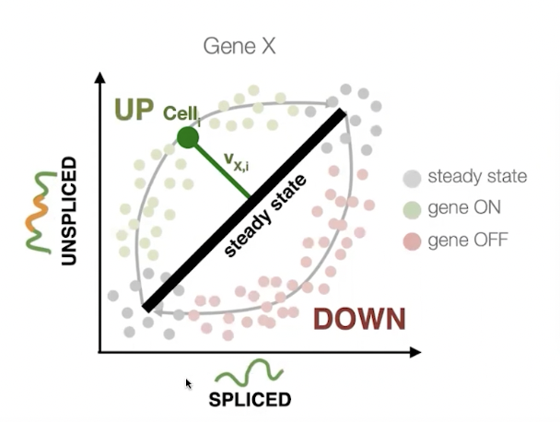
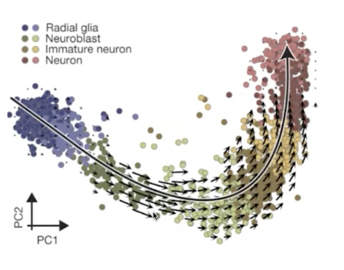
RNA Velocity: spliced dynamics predict future cell state
Bioinformatics, 2021: tinyurl.com/veloviz
Sofrware +tutorials : jef.works/veloviz
12
Notes:
By measuring both spliced and unspliced RNA levels, we can infer:
If a gene is upregulating: High levels of unspliced RNA suggest more transcription is occurring, meaning the gene is increasing in expression.
If a gene is downregulating: High levels of spliced RNA but low unspliced RNA indicate transcription has slowed, and the gene is decreasing in expression.
for every cell, each gene’s velocity represent one component of cell’s overall velocity, by looking at cell’s overall velocity we can predict future
states and direction they are occurring
The person at the top represents a cell at its current state.The trajectory of the dive represents RNA velocity, showing where the cell is heading.The final splash represents the predicted cell fate.This analogy highlights that RNA velocity doesn’t just capture where the cell is but predicts where it will be in the future.
single cell sequencing of neuron differentiation each little arrow represent cell’s rna velocity projected to pc space
The cells follow a curved trajectory

Slide 13
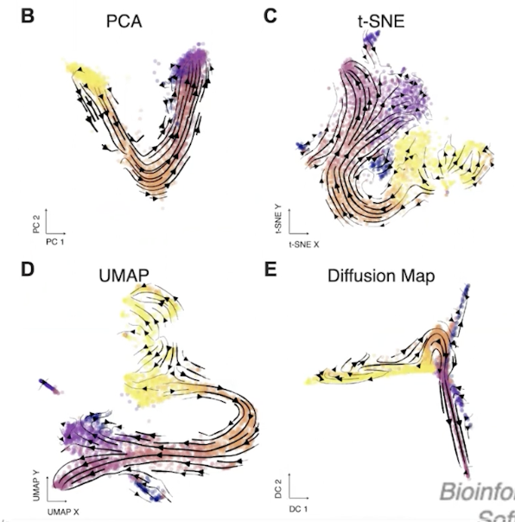
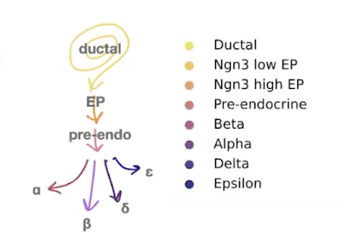
Visualizing RNA velocity trends: projecting onto existing 2D-embeddings
Bioinformatics, 2021: tinyurl.com/veloviz
Sofrware +tutorials : jef.works/veloviz
13
Notes:
mouse pancreas developmental data collected by scRNAseq , on b, c, d, e,
2D embeddings we commonly used to visualize RNA present a challenge to visualize RNA velocity trends
different embeddings yield different relationships
so projecting velocities on these different embeddings present different interpretations
the cycling of ductal cells represented well by t-sne diffusion map and umap
but the branching of terminal cell types is well represented by t-sne and umap but not pca and diffusion maps

Slide 14
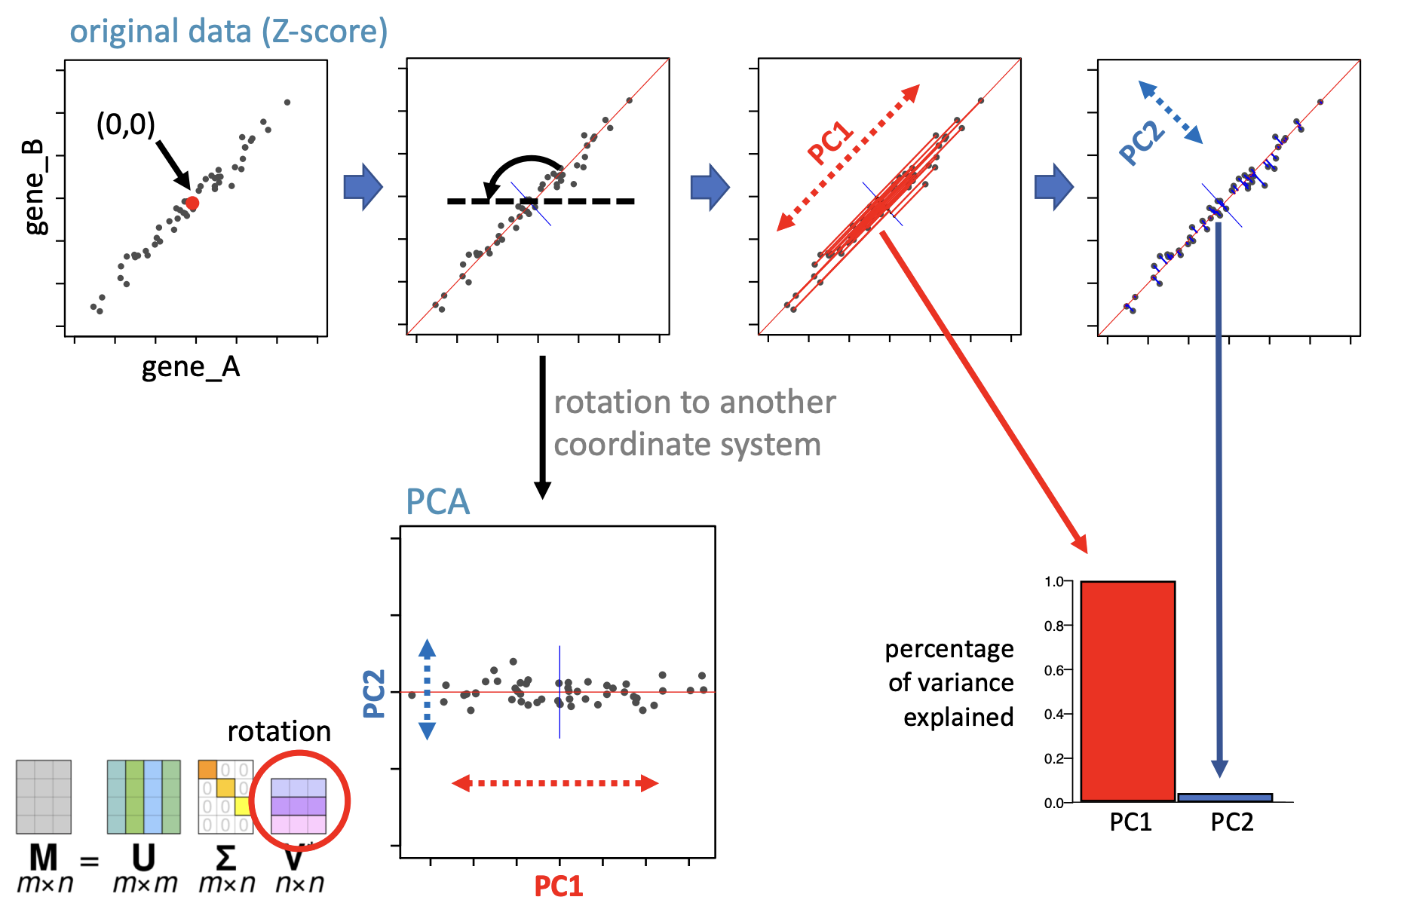
Limitations of PCA for RNA velocity
Only capture linear trends
PCA prioritizes global variance and ignores local trajectories
https://nbisweden.github.io/excelerate-scRNAseq/session-dim-reduction/lecture_dimensionality_reduction.pdf
14
Notes:
It does this by finding new axes, called principal components, that explain the most variation in the data.”
Cells that are more similar to each other in expression are placed closer together in this space.”
PCA rotates the data to a new coordinate system where the first principal component (PC1) captures the most variance.""In the middle panel, we see that PCA identifies the direction of highest variance (red PC1 axis), while PC2 is orthogonal to it and captures less variance.”
"After rotation, the data is now aligned along the new PC1-PC2 coordinate system, as shown in the bottom-left PCA embedding plot."
"Most of the data's variance is along PC1 (horizontal), while PC2 captures very little information.”
RNA velocity is a measure of how gene expression changes over time. It’s a local property, and PCA prioritizes global variance

Slide 15
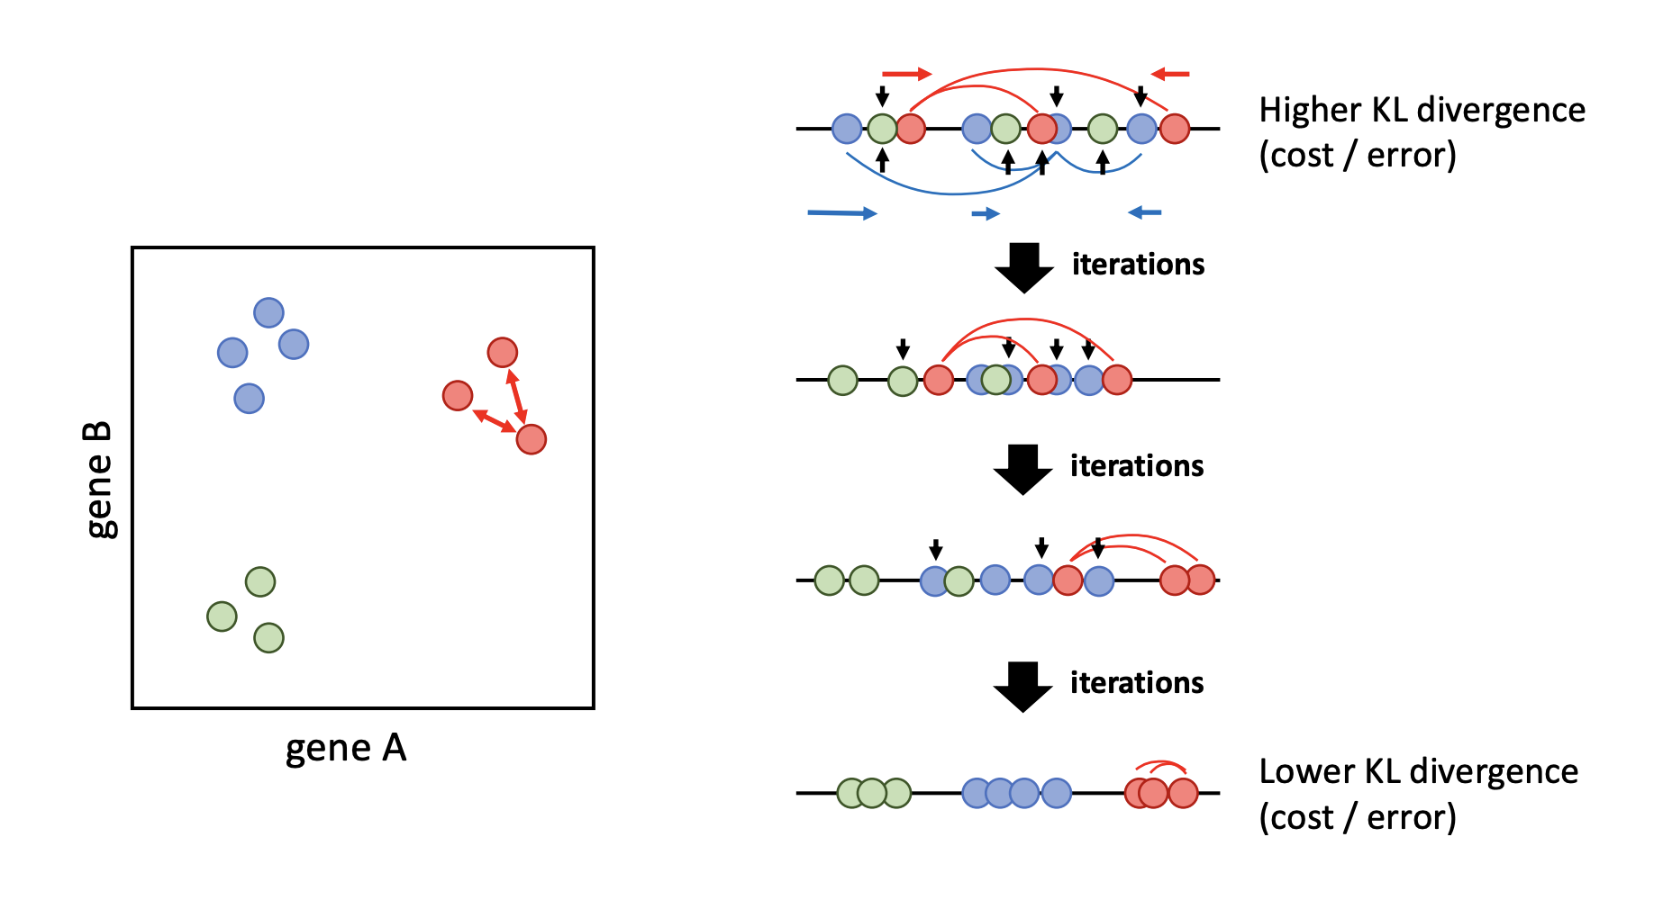
Limitations of t-SNE for RNA velocity
Focus on clustering rather than continuity (cells should be connected may end up in different clusters)
Stochastic and no fixed geometric structure
No global structure
https://nbisweden.github.io/excelerate-scRNAseq/session-dim-reduction/lecture_dimensionality_reduction.pdf
15
Notes:
It does this by minimizing Kullback-Leibler (KL) divergence between pairwise similarities in high and low-dimensional spaces."”
"Here, each dot represents a single cell, and the axes correspond to two genes (Gene A and Gene B).”
"Initially, t-SNE places cells in a random low-dimensional space.""The KL divergence (error) is high because distances in this space do not yet match those in the original high-dimensional space.”
"t-SNE refines the embedding by adjusting distances based on the probability distributions of neighbors.""Over multiple iterations, the KL divergence is reduced, and clusters start forming.”
Eventually, t-SNE forms well-separated clusters, as seen at the bottom.""The algorithm achieves a low KL divergence

Slide 16
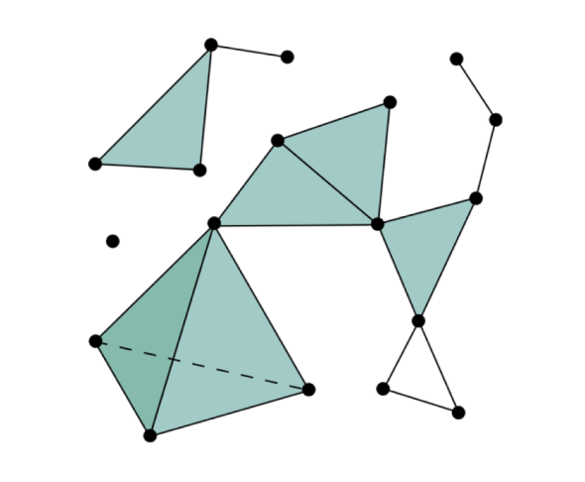
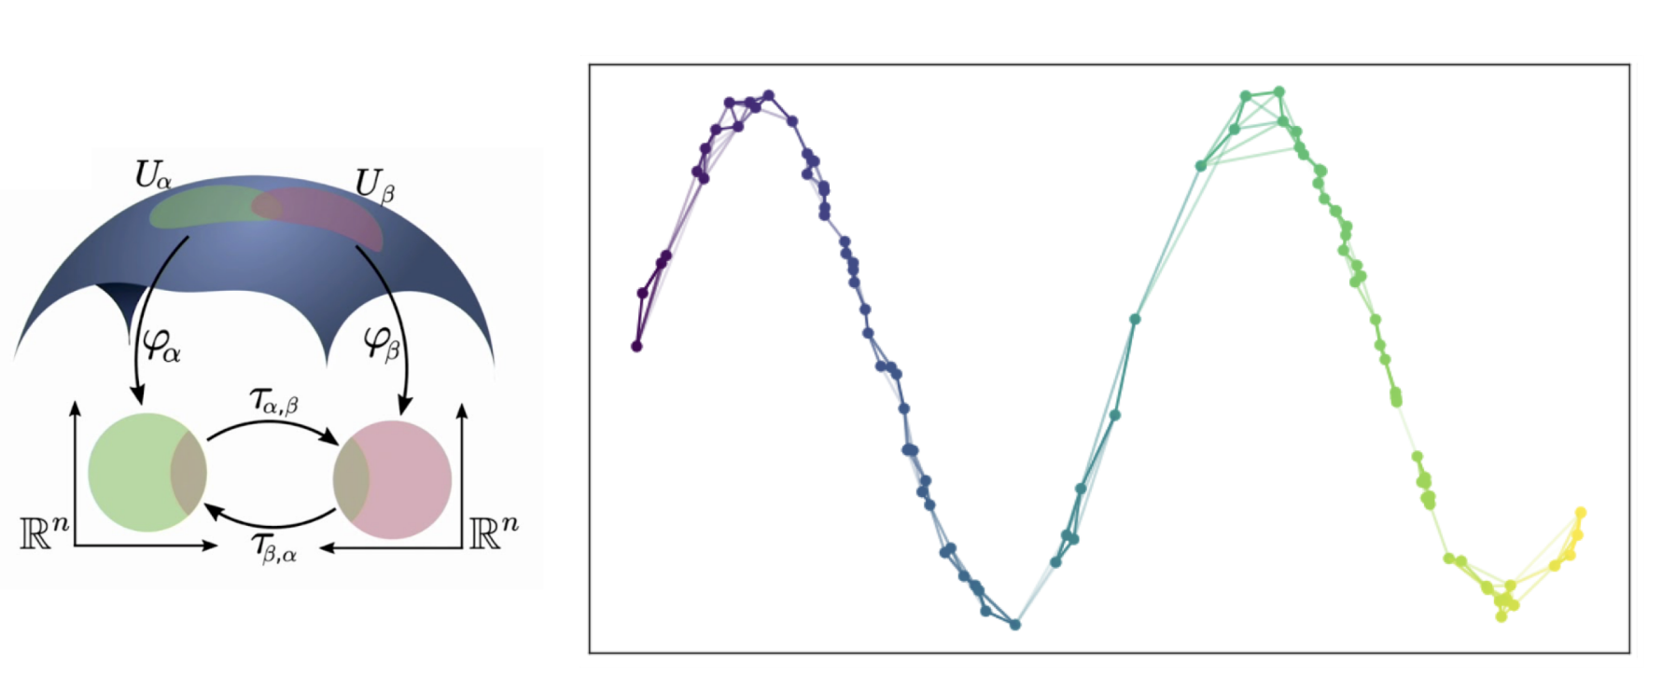
Limitations of UMAP for RNA velocity
Based on topological structures
Points are connected if the distance is below a threshold
Manifold alignment while preserving topology
1) Distance-based but not descriptive of directional process and transcriptional dynamics
https://nbisweden.github.io/excelerate-scRNAseq/session-dim-reduction/lecture_dimensionality_reduction.pdf
16
Notes:
UMAP (Uniform Manifold Approximation and Projection) is a topology-preserving dimensionality reduction technique.It connects points based on a distance threshold in the original high-dimensional space.The diagram on the left shows how UMAP builds a graph, where:Each dot represents a cell.
Lines (edges) represent distances between cells, and triangles form local clusters.
It is distance-based rather than vector-based.It does not inherently model transcriptional dynamics or cell-state transitions.

Slide 17
Limitations of diffusion maps for RNA velocity
Diffusion maps assume Markovian diffusion (reversible transitions) while RNA velocity is irreversible
2) Global manifold structure and they tend to over smooth local velocity variations
Haghverdi et al 2015
17
Notes:
Panel A: Shows the gene expression matrix, which is the input data.
Panel B: Diffusion maps construct a global manifold representation of the data.
Panel C: Transition probability matrix used in diffusion maps, which enforces reversibility.
Panel D: A low-dimensional embedding of the data using diffusion maps, which fails to retain local velocity dynamics.
Conclusion
Diffusion maps work well for capturing broad trajectories but fail to represent directional transcriptional trends due to their Markovian assumption and global structure prioritization.

Slide 18
Visualizing RNA velocity: RNA-velocity informed 2D-embeddings using VeloViz
$A_{c}$ the observed transcriptomic profile
$A_{p}$ the predicted future state
transition vectors $A_{c} to B_{c}$
Cells with small composite distances are more likely transitions
https://nbisweden.github.io/excelerate-scRNAseq/session-dim-reduction/lecture_dimensionality_reduction.pdf
18
Notes:
VeloViz addresses this issue by incorporating RNA velocity into its embedding process, producing a biologically meaningful representation of cellular transitions.
These states are embedded in a common principal component (PC) space for consistency.
Identify kkk-Nearest Neighbors with Minimum Composite Distance
Each cell is represented as a node in a graph.
For each node (cell), edges are assigned to the k closest cells with the smallest composite distances.
Prune Edges Using Similarity Thresholds
Edges with high similarity are retained, while others are discarded (grayed out).
Visualize the Graph Using Graph-Based Embeddings
The refined graph structure is then embedded into 2D or 3D space.
Unlike PCA, t-SNE, or UMAP, this embedding retains RNA velocity flow, providing an accurate visualization of transcriptional dynamics.
how different Cell B’s gene expression is compared to Cell A.
cos(θAX​) → Cosine similarity between the cell’s rna velocity and transition vector (how well the RNA velocity aligns) if the angle is small, cosine is close to 1, if the angle is big cos is close to -1
dAXd_{AX}dAX​ → Euclidean distance between cells predicted future state and the neighbor cell’s current state
the composite distance will be minimized when the rna velocity aligns with the transition from A to its neighbor cell B and when the distance between predicted A future state is close to neighbor cell b

Slide 19
Challenges in Inferring cellular time
1) Learning ‘pseudo time’ trajectories
Assume cells take smooth paths
Does the learnt trajectory reflect real biological path?
19
Notes:
not only cells in steady state
but the transition between states (temporal components)
they are computational inferences, are the trajectories they inferred real biological path?
inject biological truth

Slide 20
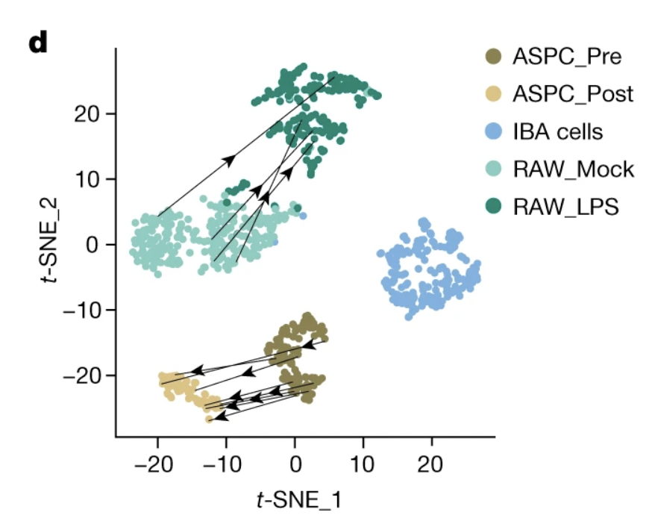
LIVE-seq
1) Cytoplasmic cellular biopsies
miniaturized RNA-seq protocols for profiling gene expression
2) Repeated cellular sampling
time-lapse microscopy enables sequential extractions and profiling
challenging to scale protocol to large numbers of cells
Chen et al, Nature 2022
20
Notes:
small amount of mRNA in cell cytoplasm non disruptive biopsy, cell stay alive,
arrow represent same cell at different time points (repeated measurement successful for only about ten cells)
In LIVE-seq, you repeatedly sample cytoplasmic mRNA from the same cell at different time points.
Since the cell remains alive, you can measure gene expression changes dynamically in the same cell.
This allows tracking how an individual cell evolves over time without killing it.

Slide 21
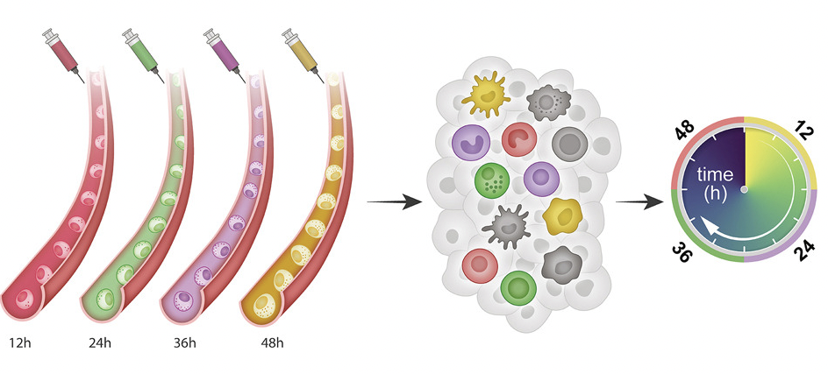
Zman-seq
Barcoding cellular time in-vivo
use fluorescent pulse labels
Time-stamped cellular dynamics
cells retain their fluorescent label as a temporal barcode
can build cellular trajectories with ground truth time-stamps
Kirschenbaum et al, Cell 2024
21
Notes:
fluorescent labeled antibody into mouse, different colors in different time points
they study how immune cells change their state over time that’s exactly what time stamp give them
use time stamp to guide the trajectory
Inject fluorescent labels at different time points (12h, 24h, 36h, 48h).Cells take up these labels and retain them as a temporal barcode.Later, single-cell sequencing identifies cells based on when they were labeled.
Tracks how immune cells change their states over time.Builds cellular trajectories with real ground truth time-stamps.

Slide 22
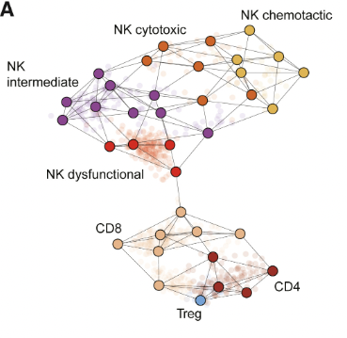
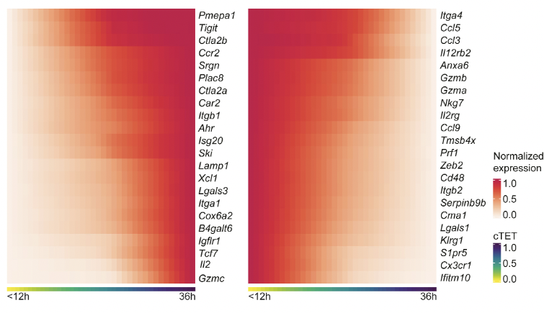
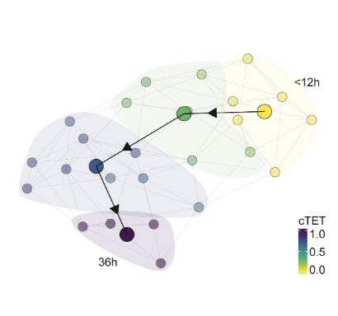
Zman-seq
Barcoding cellular time in-vivo
use fluorescent pulse labels
Time-stamped cellular dynamics
cells retain their fluorescent label as a temporal barcode
can build cellular trajectories with ground truth time-stamps
Kirschenbaum et al, Cell 2024
22
Notes:
nk cells in tumor present in a variety of states
infer cellular trajectory overtime from this data
which genes are more regulated or downregulated as cells spend more and more time in tumor
Uses time-stamp data as a ground-truth benchmark instead of inferred pseudotime.
Zman-seq is a conceptual leap because it replaces estimated pseudotime with actual, experimentally verified timestamps.
Both methods overcome traditional RNA velocity limitations by incorporating real temporal information rather than estimating cell state transitions computationally.

Slide 23
Thank you!
23

