Slide 1
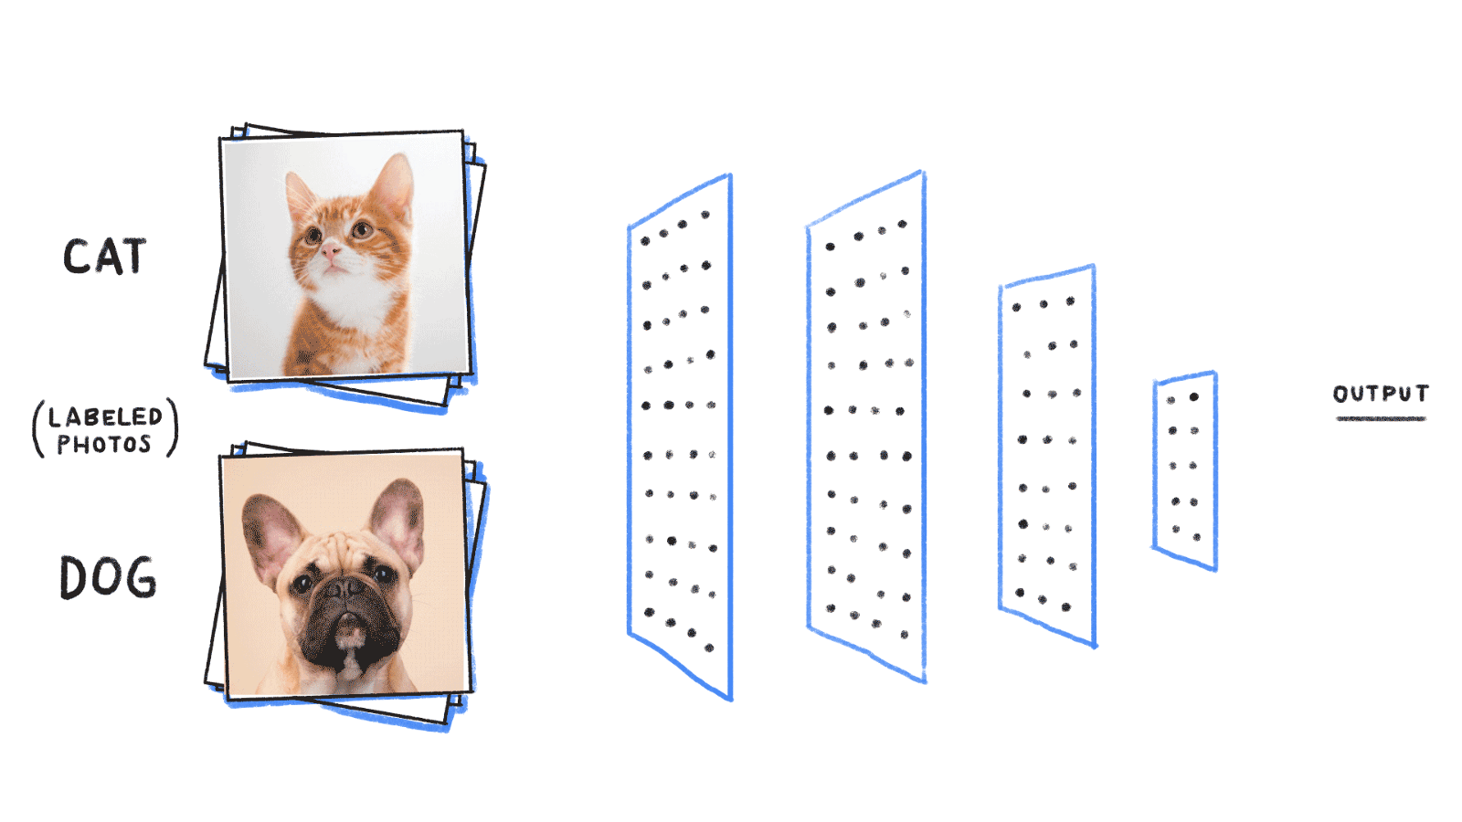
Deep Learning Fundamentals 2 – Convolution Neural Networks (25t4)
Michelle Yu
CBB 752 Spring 2025
Photo credit: bit.ly/2ScVugE

Slide 2
Overview
Convolutional operations in image classification
Application of CNNs in regulatory genomics
Learn meaningful representations from DNA sequences (Basset)
Predict and precisely locate functional genomic regions (DECODE)
Map DNA sequences to enhancer activity and uncover TF motif syntax rules (DeepSTARR)

Slide 3
Convolutional Neural Network: LeNet (1998)

Slide 4
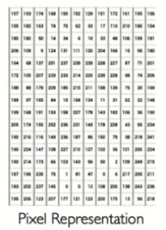
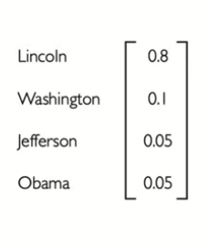
Classification in computer vision
Classification
Adaptative feature learning w NN
How do we effectively extract and detect features from image data?

Slide 5
Why CNN over Feed-Forward Neural Nets?
Represent an image with a flattened tensor
Problems of using fully connected layers for image classification:
Too many weights
224 x 224 x 3
Loss of spatial structure!

Slide 6
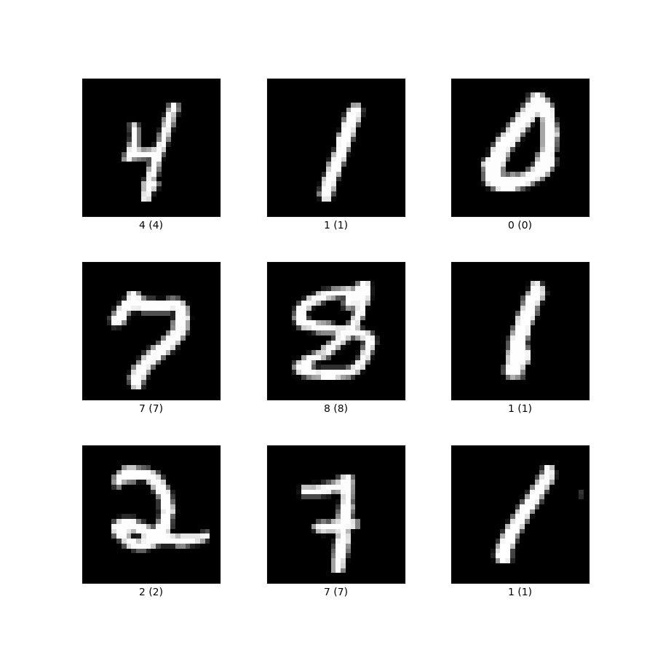
Why CNN over Feed-Forward Neural Nets?
DNN works much worse than a shallow CNN even on MNIST!
Error rate: ~1.0% vs. ~0.60%
MNIST Task
Adapted from Martin Min’s slides

Slide 7
Classification in computer vision
Classification
Adaptative feature learning w NN
How do we effectively extract and detect features from image data?
Use convolutional filters

Slide 8
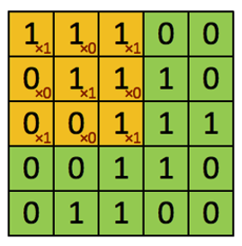
Detect features in an image via Kernel / Filter
1
0
1
(1×1)+(1×0)+(1×1)+(0×0)+(1×1)
+(1×0)+(0×1)+(0×0)+(1×1)
0
1
0
1
0
1
Image
Filter of shape “X”
Convolution operation on a 5x5 matrix with a 3x3 kernel
A filter (weight matrix) detects features in the input.
They are initialized randomly and updated through backpropagation during training.
Convolution identifies where these features appear in the image.
Element-wise multiplication between filter and image region.
Sum the results.

Slide 9
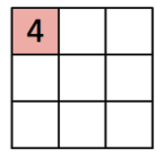
Detect features in an image via Kernel / Filter
1
0
1
0
1
0
1
0
1
Image
Filter of shape “X”
Convolved features
The filter is applied to 3x3 image patches to detect patterns or features.
Convolution produces higher values when the filter matches the pattern in the image; Lower values indicate weaker matches or opposing patterns.
The resulting feature map highlights where the feature appears in the image.

Slide 10
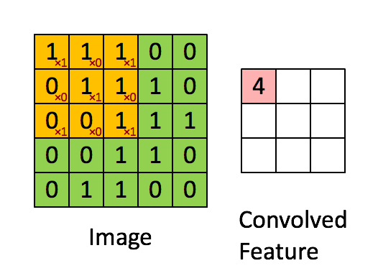
Detect features in an image via Kernel / Filter
The filter is applied to 3x3 image patches to detect patterns or features.
Convolution produces higher values when the filter matches the pattern in the image; Lower values indicate weaker matches or opposing patterns.
The resulting feature map highlights where the feature appears in the image.

Slide 11
Detect features in an image via Kernel / Filter
Parameter sharing. In convolutional layers, the same weights / same filters (parameters) are applied across different spatial positions of the input.
For each feature map, neurons share weights, resulting in far fewer parameters compared to fully connected layers.
Depth. Each convolution operation applies multiple filters (kernels) to the input, producing multiple feature layers (feature maps).
Each filter detects a different pattern, such as edges, textures, or shapes.
By stacking these feature maps, the network can capture a wide variety of features in the input image.

Slide 12
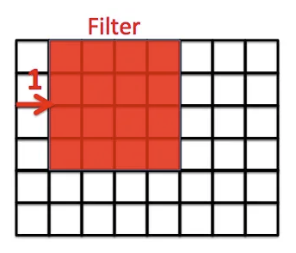
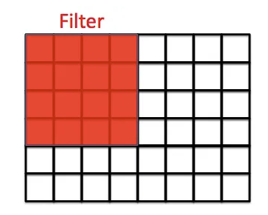
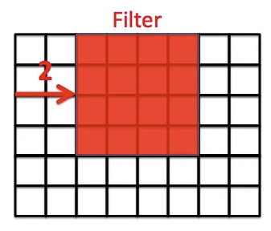
Stride
Stride = 1
Stride = 2
Stride determines how far the filter moves with each step (e.g., 1 pixel, 2 pixels).

Slide 13
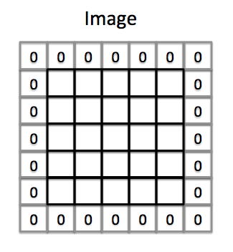
Zero-Padding
Padding adds extra pixels (commonly zeros) around the image boundary to prevent loss of information at the edges.
Without padding, pixels at the edges are used less in convolution, leading to loss of information and reduced output size.

Slide 14
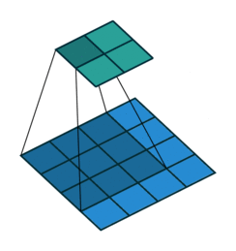
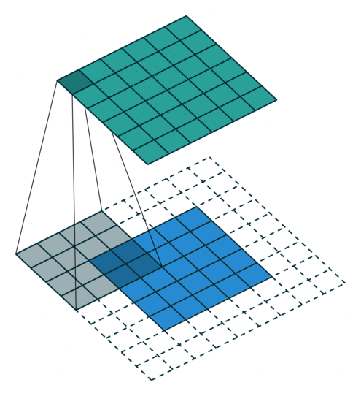
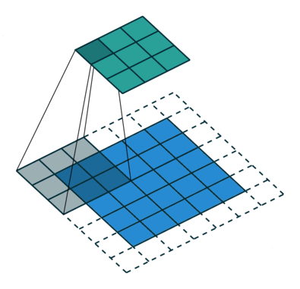
2D convolution examples
No padding,
Stride = 1
Padding = 2,
Stride = 1
Padding = 1,
Stride = 2
https://github.com/vdumoulin/conv_arithmetic?tab=readme-ov-file

Slide 15
Pooling
Pooling is often applied after convolution operation to simplify the output data.
Max Pooling:
Selects the maximum value within each region covered by the kernel.
Average Pooling:
Computes the average value within each region covered by the kernel.

Slide 16
Pooling
Max Pooling also acts as a noise suppressant by discarding noisy activations.
Pooling simplifies data and improves computational efficiency.
Convolution performs a linear operation; non-linearity is often introduced through subsequent ReLU activations and pooling layers.

Slide 17
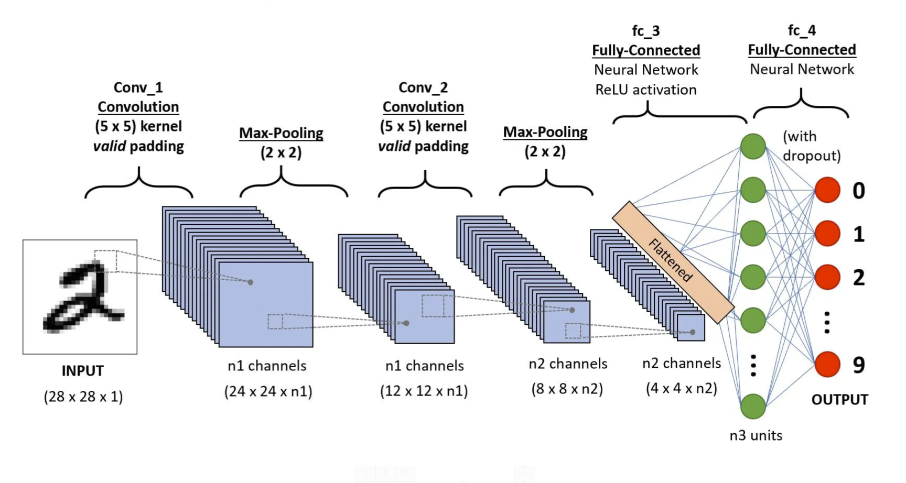
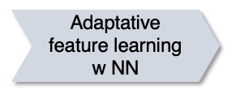
CNN learns features directly from the data
1
0
1
The classification task drives the feature extraction in CNN
0
1
0
1
0
1
Again, a convolutional filter is a matrix of weights, initialized randomly and updated through backpropagation during training.

Slide 18
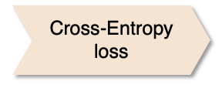
CNN learns hierarchy of features
Low-level features:
Pixel intensity changes
Edge detection
Local texture variations
High-level features: (later layers of CNN)
Digit shapes (e.g., circular for "0", vertical line for "1")
Stroke thickness and curvature
Spatial relationships between different parts of a digit

Slide 19
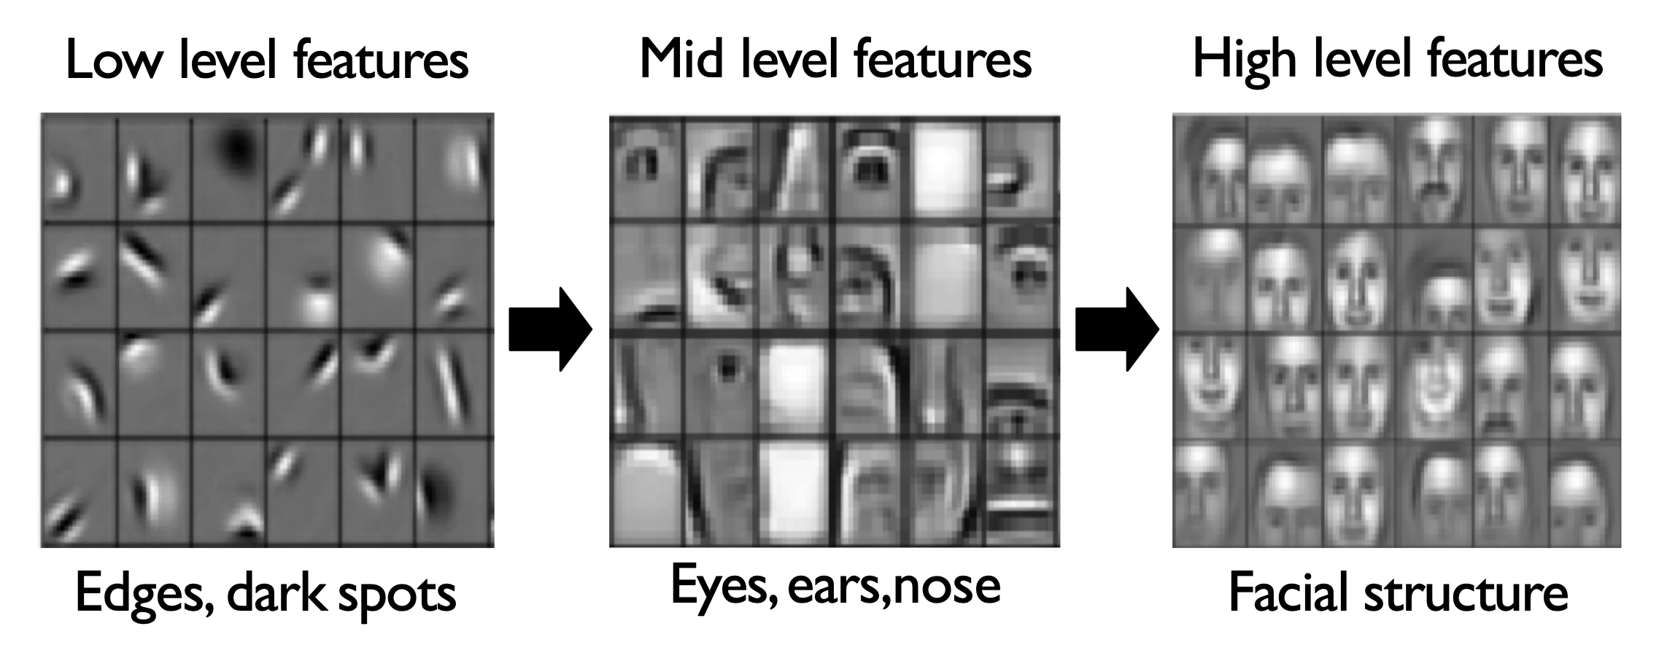
Hierarchical representation learning
Learn hierarchy of features directly from data (rather than hand-engineering them)
The above images are not direct filter weights (this visualization is for demonstration purposes; they are filters projected back into pixel space, to show what features each layer is detecting).
In practice, CNN filters are often less visually interpretable.
Lee ICML 2019
Convolutional Deep Belief Network

Slide 20
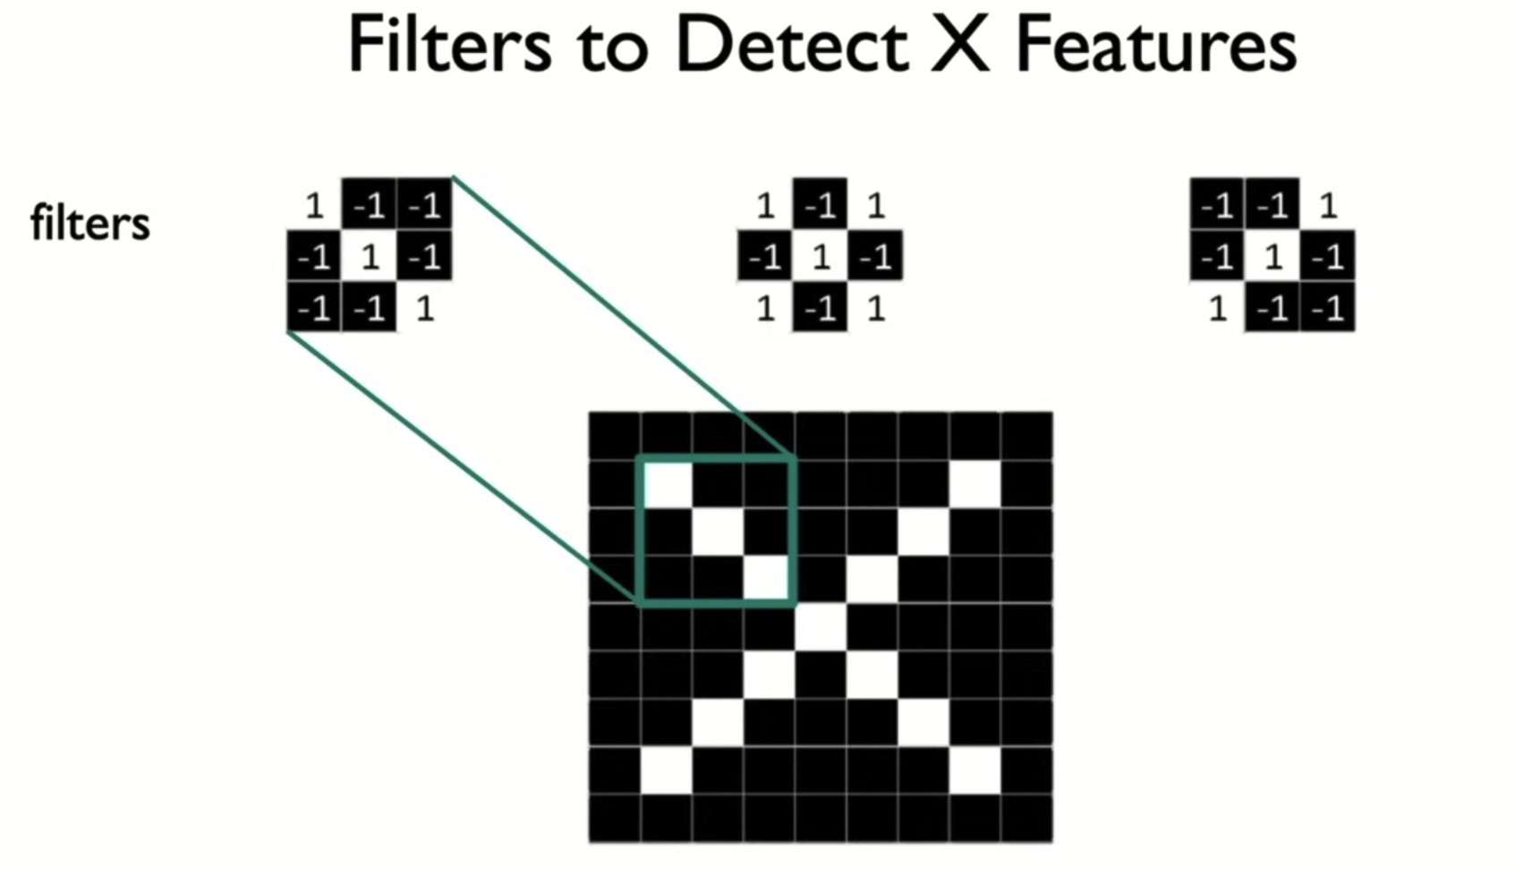
Filters to detect X features
CNN filters are learnable weight matrices with defined sizes (e.g., 3×3, 5×5) and learned features from data during training.
Filters stack hierarchically:
lower layers: simple features (e.g., edges)
deeper layers: complex patterns (e.g. “X”).
Modern CNNs can go very deep—e.g., ResNet: 34 layers (uses skip connections to avoid information loss).
https://introtodeeplearning.com/slides/6S191_MIT_DeepLearning_L3.pdf

Slide 21
Overview
CNNs in image classification
Application of CNNs in regulatory genomics
Learn meaningful representations from DNA sequences (Basset)
Predict and precisely locate functional genomic regions (DECODE)
Map DNA sequences to enhancer activity and uncover TF motif syntax rules (DeepSTARR)
Kelley et al. 2016
Chen Z., Zhang J. et al., ISMB 2021
de Almeida, Bernardo P., et al. 2022

Slide 22
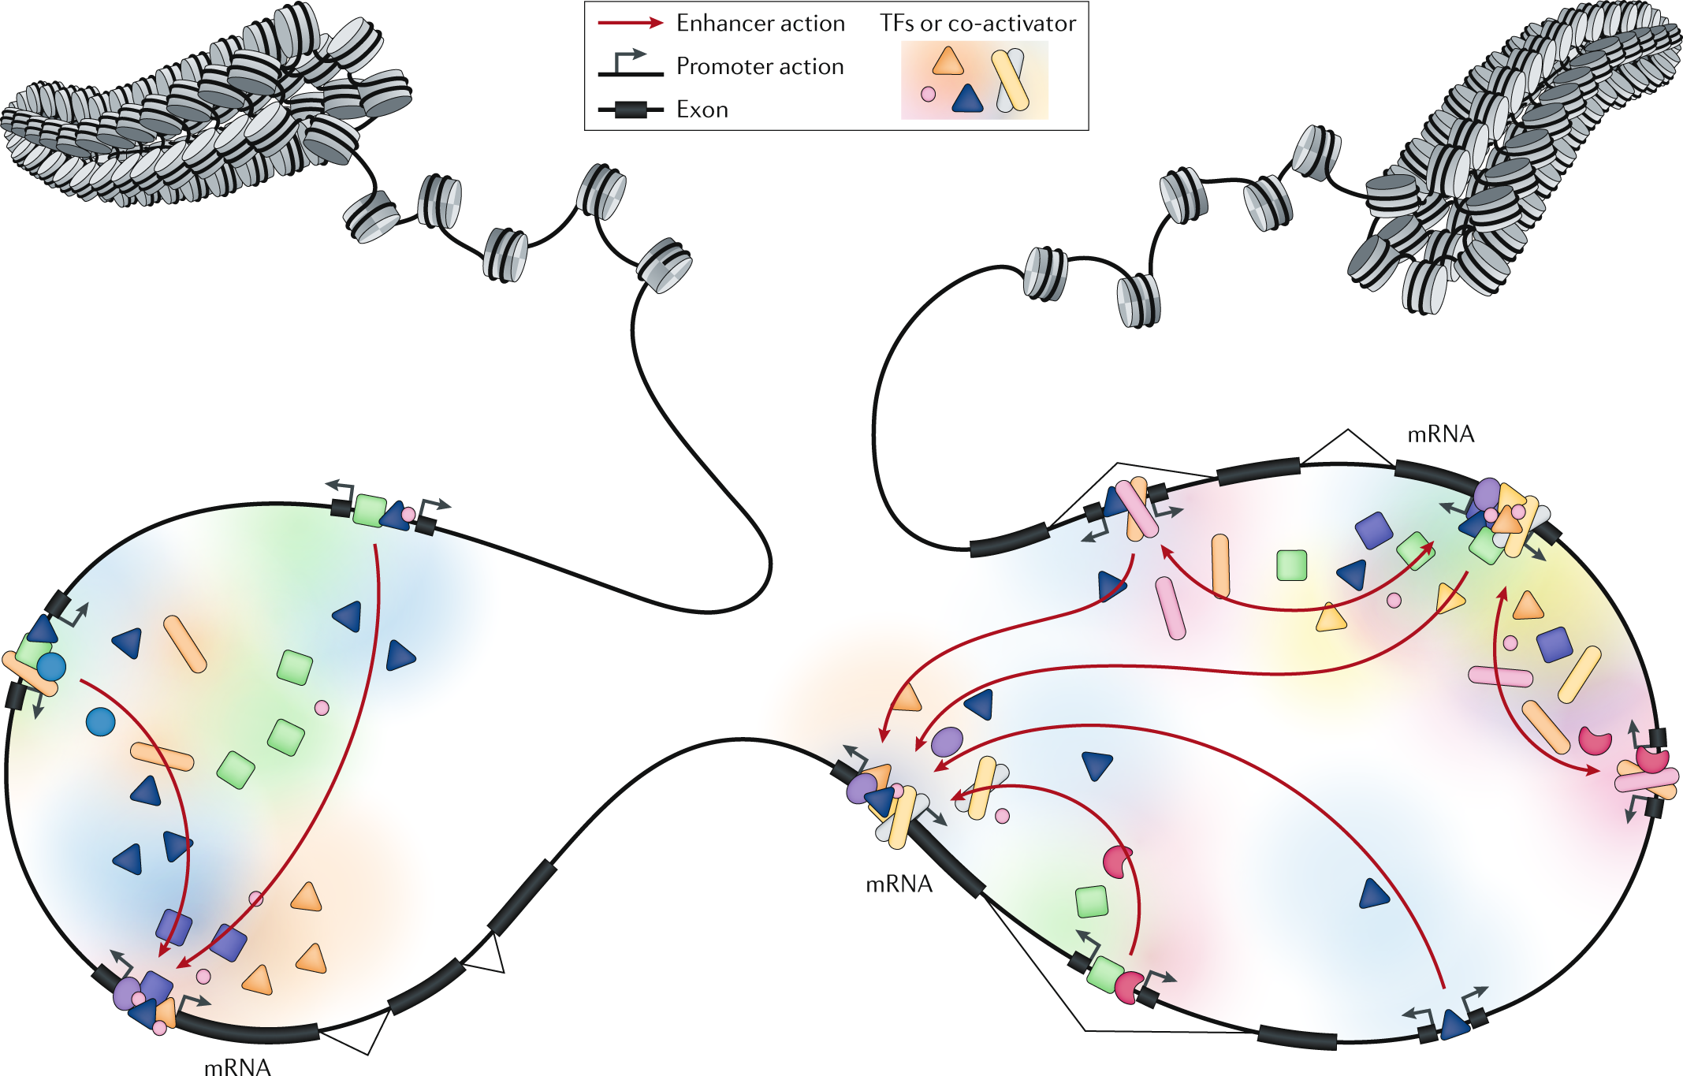
Transcriptional regulation requires the complex coordination of many proteins
CREs – cis-regulatory elements
Promoters: Initiate transcription near the gene
Enhancers: Regulate gene expression from a distance
Motifs: Short DNA patterns for TF binding
Anderrson, Nat Rev Genetics, 2020

Slide 23
Overview of gene regulation
Where are the regulatory regions and protein binding motifs located?
How strongly do transcription factors bind to DNA?
How do these motifs interact with each other (within CREs or across different CREs)?
e.g. Competitive binding, collaborative binding.
Anderrson, Nat Rev Genetics, 2020

Slide 24
How DNA Sequences Drive Transcription?
How does DNA sequence encode gene regulation?
What regulatory logic is embedded in the sequence?
Adapted from Genomics I slides

Slide 25
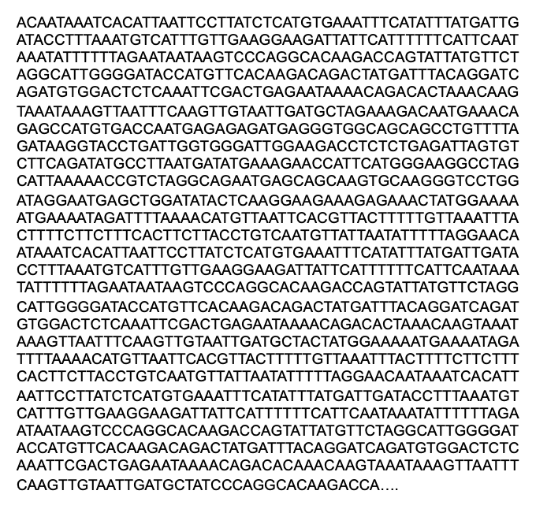
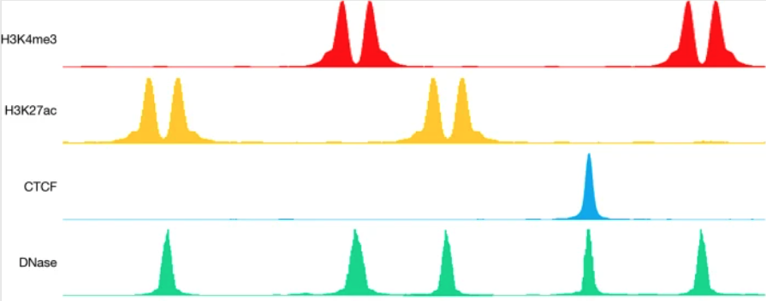
How DNA Sequences Drive Transcription?
Input
Output
Functional assays:
ATAC-seq/DNase-seq
ChIP-seq, CUT&RUN
STARR-seq, MPRA
RNA-seq, CAGE, PRO-seq
Hi-C, ChIA-PET, micro-C
ML / DL
Learn meaningful representations from DNA sequences (Basset).

Slide 26
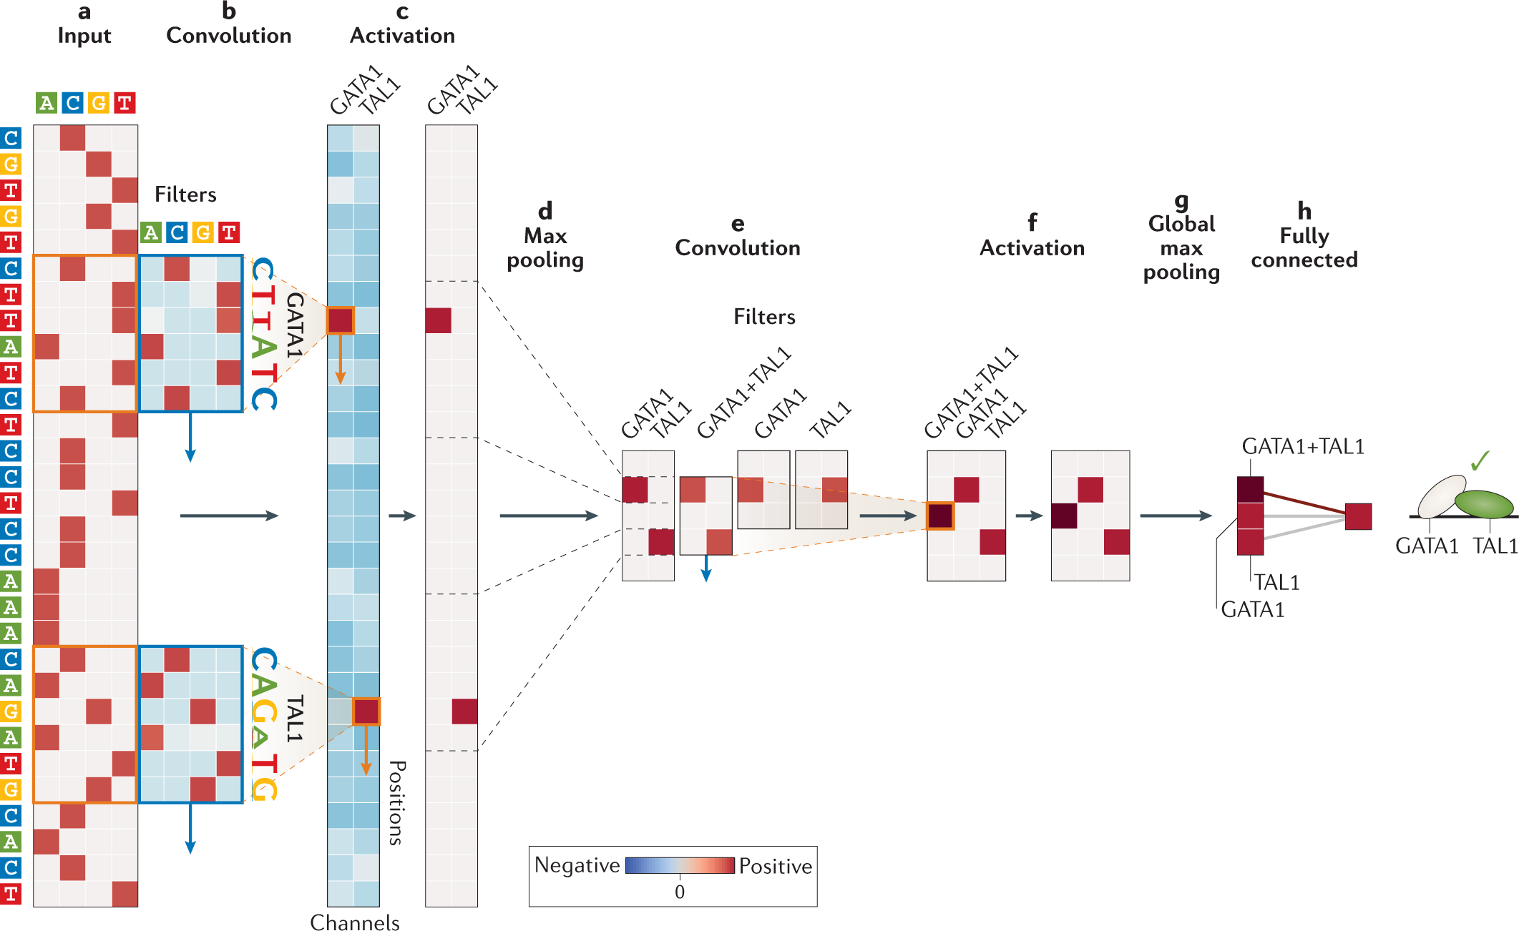
Basset: Representation Learning of DNA Sequences Using CNNs
Convolutional filters / ReLU / Max pooing
Basset: Kelley et al. 2016
Diagram from: Eraslan et al., Nature Reviews Genetics, 2019

Slide 27
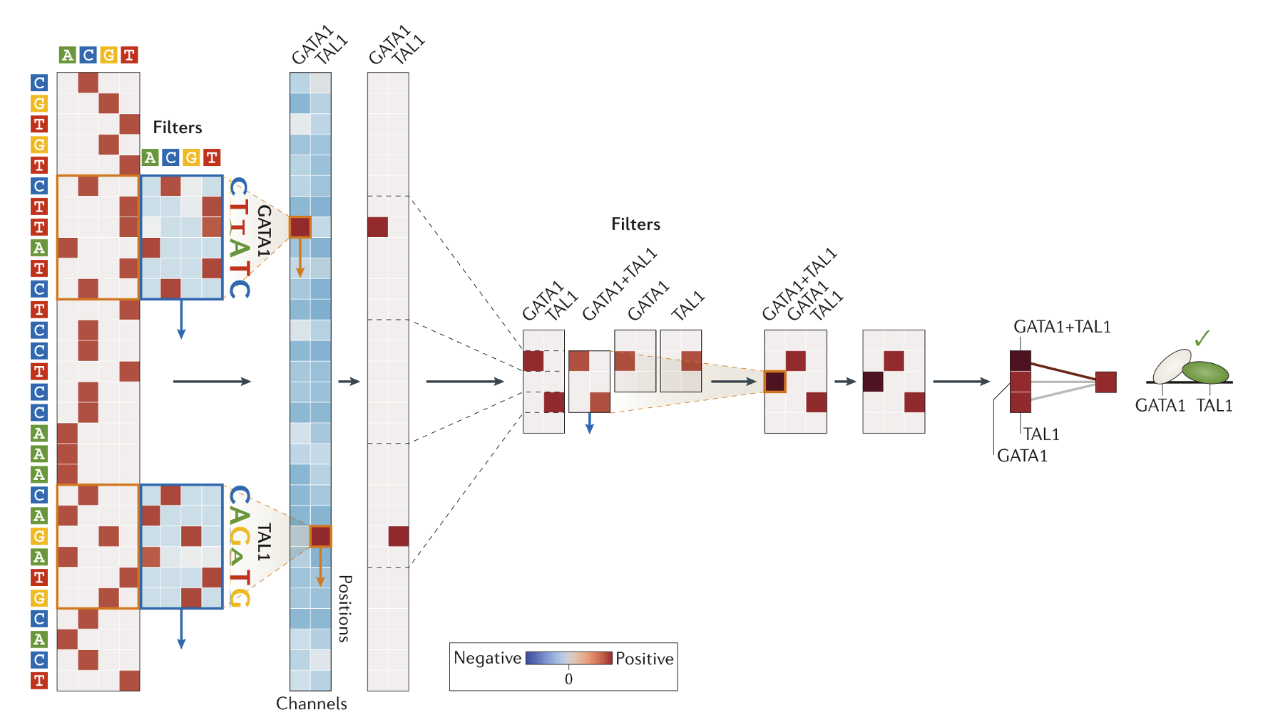
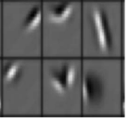
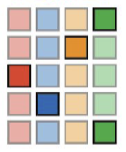
DNA convolutional filters
In image:
Feature maps indicate detection of certain motifs (filters) in the sequence
In DNA: PWM
Scan the filters across the input sequence
Produces feature map: each column corresponds to a convolutional filters
Kelley et al. 2016

Slide 28
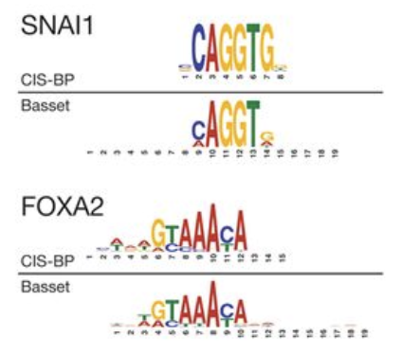
First-Layer Filters Align with Known TF Binding Motifs
Motif information is derived by converting first-layer filter activations into probabilistic PWMs, counting nucleotide occurrences above a threshold.
Overall, 45% of filters could be annotated in the motif database

Slide 29
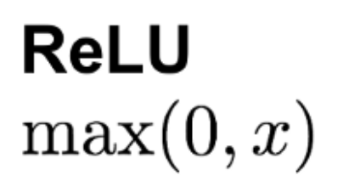
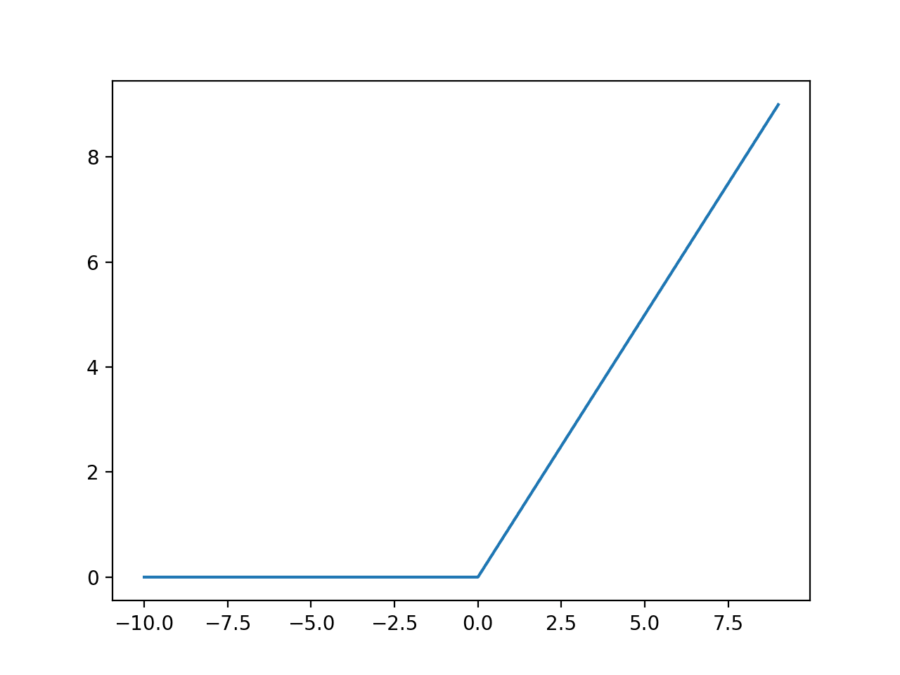
ReLU activation ignores misalignment

Slide 30
Max pooling summarizes features
Max pooling
Summarize / aggregate information
Reduces the dimension of the input
Provides invariance to small sequence shifts to the left or right.

Slide 31
Representation Learning of DNA Sequences Using CNNs
2nd and 3rd convolutional layers identify local motif interactions and uncover regulatory interactions across broader regions
Convolution
Activation
Max pooling
MLP

Slide 32
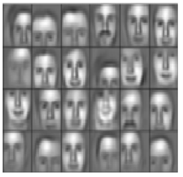
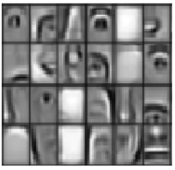
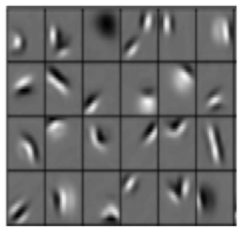
Hierarchical representation learning
Regulatory syntax across broader regions
Layer 3
Local motif interactions
Layer 2
Sequence motifs
Layer 1

Slide 33
Representation Learning of DNA Sequences Using CNNs
Regulatory syntax across broader regions
CNNs have inherent limitations in capturing long-range interactions
Basset: 20k nt range; distal enhancers can act thousands of nts away
Sequence models (RNNs, LSTMs, and Transformers) extend the visible range of sequence interactions by modeling long-range dependencies.
More on this in Martin’s lecture.
Layer 3
Local motif interactions
Layer 2
Sequence motifs
Layer 1

Slide 34
How DNA Sequences Drive Transcription?
Learn meaningful representations directly from DNA sequences (Basset)
Predict and locate functional genomic regions (i.e. enhancers) (DECODE)
Map DNA sequences to enhancer activity and uncover TF motif syntax rules (DeepSTARR)
Chen Z., Zhang J. et al. (ISMB 2021)

Slide 35
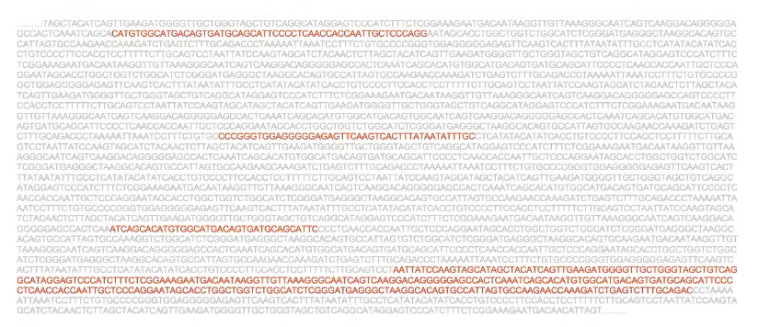
STARR-seq allows direct measurement of enhancer activity
Localize enhancer regions
STARR-seq provides direct readouts of enhancer activity
STARR-seq is massively parallel reporter assay that measures enhancer activity from arbitrary sources of DNA.
Genomic fragments are transfected into target cells in front of a luciferase gene, and enhancer activity is quantified by measuring luciferase expression.
Limitation: STARR-seq lacks the resolution needed for precise enhancer localization.
Chen Z., Zhang J. et al. (ISMB 2021)
https://starr-seq.starklab.org/overview/

Slide 36
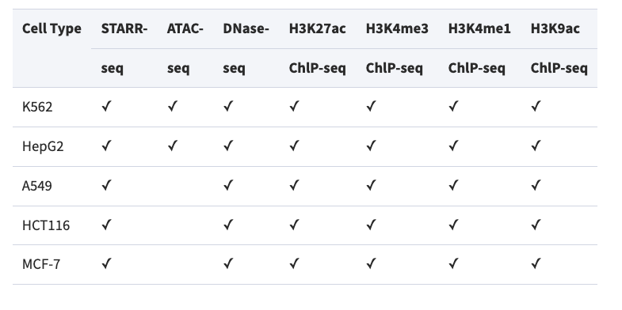
Epigenetic Features as Inputs → STARR-seq as Output
Labels
Training datasets. Histone marks and ATAC-seq across cell types.
Chen Z., Zhang J. et al. (ISMB 2021)

Slide 37
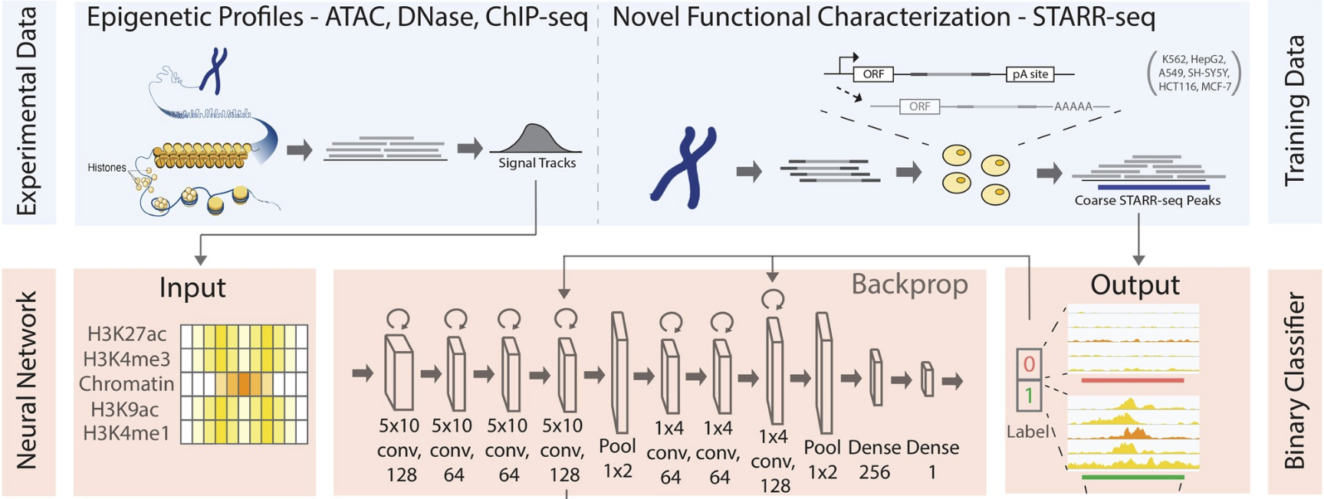
Predicting and Localizing Regulatory Regions with CNNs
Overall Workflow
Input: High-resolution epigenetic features across a 4kb genomic window.
Model: A CNN-based binary classifier predicts the presence of enhancers.
Target: STARR-seq peaks, representing enhancer activity regions.
Grad-CAM is further applied to generate a feature importance score, justifying key features and precisely localizing enhancer regions.
Chen Z., Zhang J. et al. (ISMB 2021)

Slide 38
Leverage Feature Maps to Localize Enhancer Regions
Gradient-weighted Class Activation Mapping (Grad-CAM)
Problem: Enhancer localization?
Convolutional Filters: Learn features critical for enhancer prediction, outputting activation maps.
Feature Maps: Highlight genomic regions containing these essential features
Selvaraju R.R. et al. (2017)

Slide 39
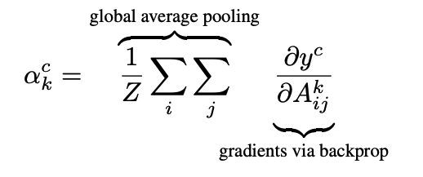
Leverage Feature Maps to Localize Enhancer Regions
Gradient-weighted Class Activation Mapping (Grad-CAM)
Problem: Enhancer localization?
By superimposing activation maps ($A^{k}$) weighted by gradient-based importance scores ($a_{k}$), Grad-CAM highlights the most salient features for making predictions and reveals high-resolution core enhancer annotations.
Selvaraju R.R. et al. (2017)

Slide 40
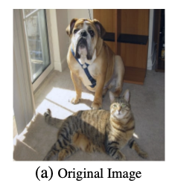
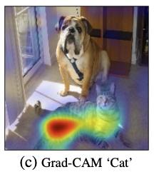
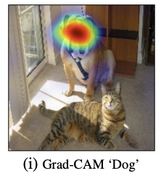
Leverage Feature Maps to Localize Enhancer Regions
Gradient-weighted Class Activation Mapping (Grad-CAM)
Problem: Enhancer localization?
Grad-CAM enables precise enhancer localization at a much higher resolution compared to the original 4 kb input.
Selvaraju R.R. et al. (2017)

Slide 41
How DNA Sequences Drive Transcription?
Learn meaningful representations directly from DNA sequences (Basset)
Predict and locate functional genomic regions (DECODE)
Map DNA sequences to enhancer activity and uncover TF motif syntax rules (DeepSTARR)
de Almeida, Bernardo P., et al. 2022

Slide 42
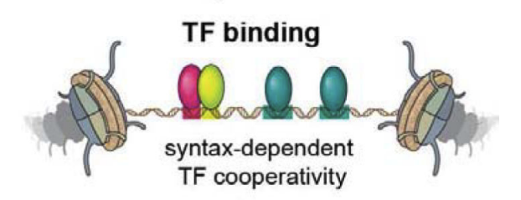
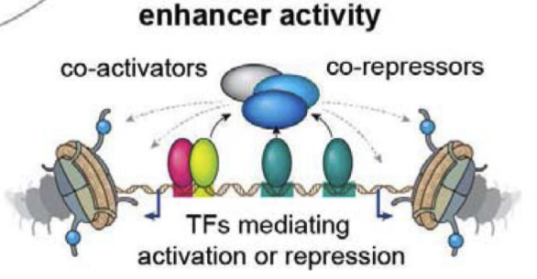
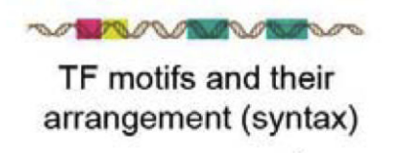
The cis-regulatory code that regulates enhancer activity
Enhancer sequence
TF motif arrangements/syntax
(number, order, orientation, flanks, and spacing)
de Almeida, Bernardo P., et al. 2022

Slide 43
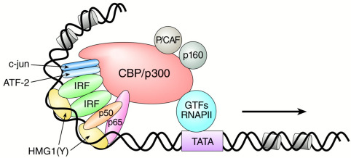
The spatial arrangement of TF binding is critical
Enhancer sequence
Vo and Goodman, JBC, 2001
Adapted from Kellis and Gifford, Regulatory Logic Lecture, 2020

Slide 44
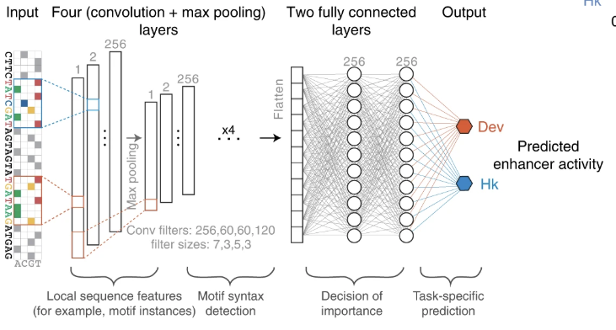
Quantitatively predicting enhancer activity from DNA sequence
Quantitative prediction of enhancer activity (STARR-seq)
Input: 1-hot encoding of 249-bp DNA sequences.
Architecture: 4-layer CNN with max-pooling after each layer, followed by two fully connected layers.
Convolutional filters:
Early convolutional layers identify TF motifs.
Later layers capture more complex patterns like motif syntax and local motif interactions.
Output: Simultaneous prediction of quantitative enhancer activities for developmental (Dev) and housekeeping (Hk) enhancers.
de Almeida, Bernardo P., et al. 2022

Slide 45
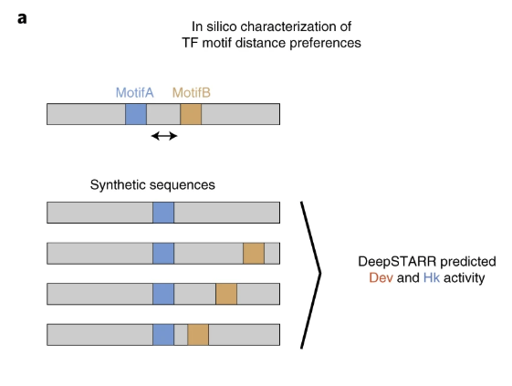
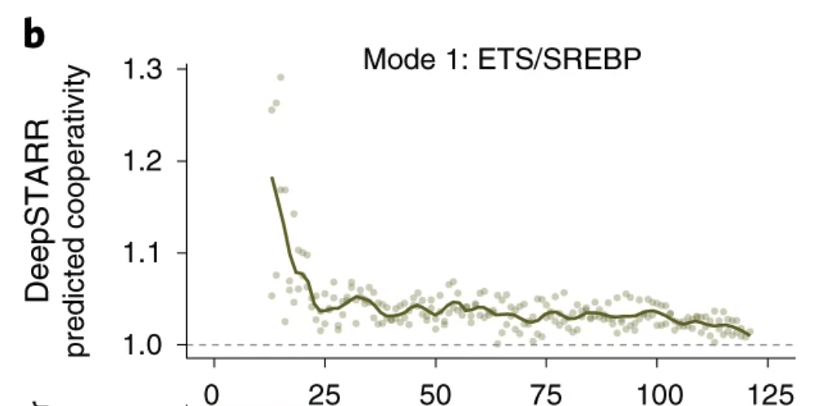
In silico analysis of motif distances
DeepSTARR
Quantitative enhancer activity prediction

Slide 46
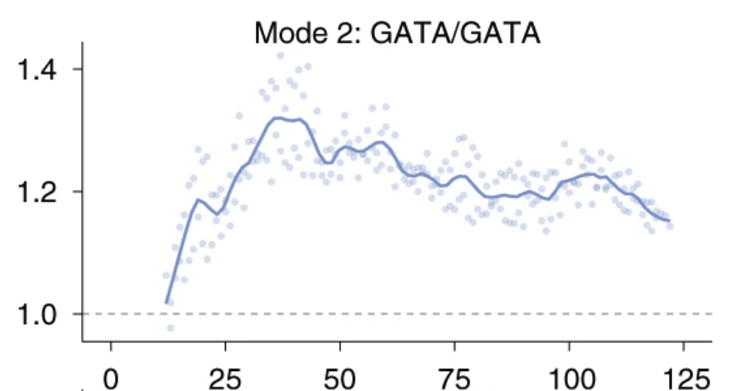
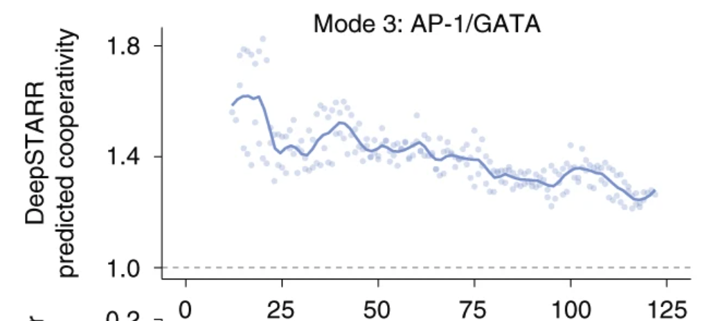
In silico analysis reveals distinct modes of motif cooperativity
Cooperativity mode (1/2/3) depends on the TF and motif pair
ETS: always mode 1
AP-1: always mode 3
GATA: modes 1/2/3 depending on partner TF
Also validated with experimental data

Slide 47
Summary
Convolutional operations in image classification
Use convolutional filters to learn features in the image (as well as genome)
Introduce non-linearity through ReLU activation
Pooling is commonly use to summarize information and preserve spatial invariance
Application of CNNs in regulatory genomics
Learn meaningful representations from DNA sequences (Basset)
Predict and precisely locate functional genomic regions (DECODE)
Map DNA sequences to enhancer activity and uncover TF motif syntax rules (DeepSTARR)

Slide 48
Suggested Readings
ISLR v2: Chapter 10.3 Convolutional Neural Networks
Greener et al., 2022 – A guide to machine learning for biologists, Nat Rev Mol Cell Biol.
Kelley et al., 2016 – Basset: learning the regulatory code with CNNs, Genome Res.
Chen et al., 2021 – DECODE: deep-learning framework for enhancer analysis, Bioinformatics.
de Almeida et al., 2022 – DeepSTARR: predicting enhancer activity from DNA, Nat Genet.

Slide 49
(Optional) Suggested Readings
Kelley et al., 2016 – Basset: learning the regulatory code with CNNs, Genome Res.
Kelley et al., 2018 – Dilated CNNs for sequential regulatory activity prediction, Genome Res.
Avsec et al., 2021 – Enformer: gene expression prediction with long-range interactions, Nat Methods.
Linder et al., 2025 – Borzoi: predicting RNA-seq coverage from DNA sequence, Nat Genet.

