Slide 1
Biomedical Data Science (GersteinLab.org/courses/452)
Single Cell Analysis (25m9e)
Mark Gerstein
Yale U.
Last edit in spring ’25. Mostly unchanged since ’23, which has a corresponding video

Slide 2
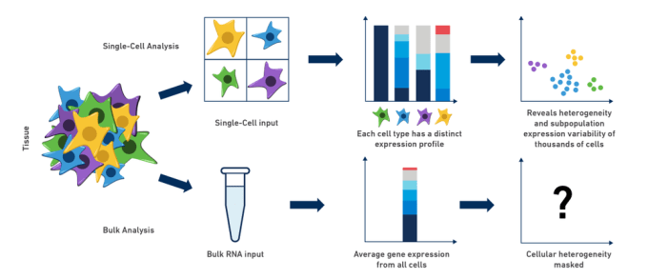
Single-cell vs. bulk RNA
Single-Cell Analysis
Single-Cell Input
Reveals heterogeneity
of all cells
Tissue
Cell type
expression profile
Bulk Analysis
Bulk RNA Input
Average expression profile
from all cells
Cellular heterogeneity
is masked
Lectures.GersteinLab.org -
https://www.10xgenomics.com/blog/single-cell-rna-seq-an-introductory-overview-and-tools-for-getting-started

Slide 3



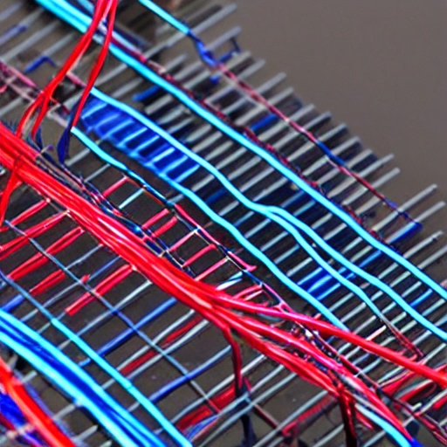
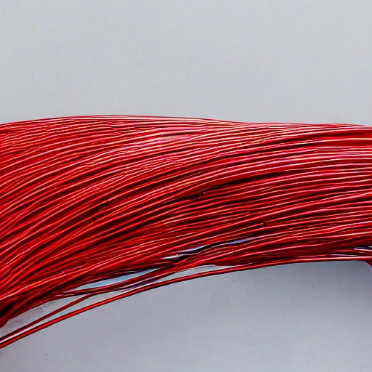
Advantages of single-cell resolution for the brain
Bulk Datasets
Single-cell Datasets
Spatial Analysis
Cell-to-cell Connectivity
Images generated using the DeepAI Image Generator tool
lectures.gersteinlab.org
Notes:
As a metaphor for this, (which I modified from the famous “fruit salad” metaphor) bulk tissue datasets in the brain combine many types of neurons at once, like this indiscriminate bundle of wires. Single-cell datasets now allow you to isolate individual cell types for analysis, while spatial-based data allow you to see how the wires are arranged within the tissue. In the brain, we can go a step further and query how individual cells are arranged in a network with each other, identifying cell communication networks or, eventually, neuronal circuits. In each case, we can query how these cell types and networks are perturbed in individuals with disease, although many of these analysis require population-scale datasets to achieve statistical power.

Slide 4
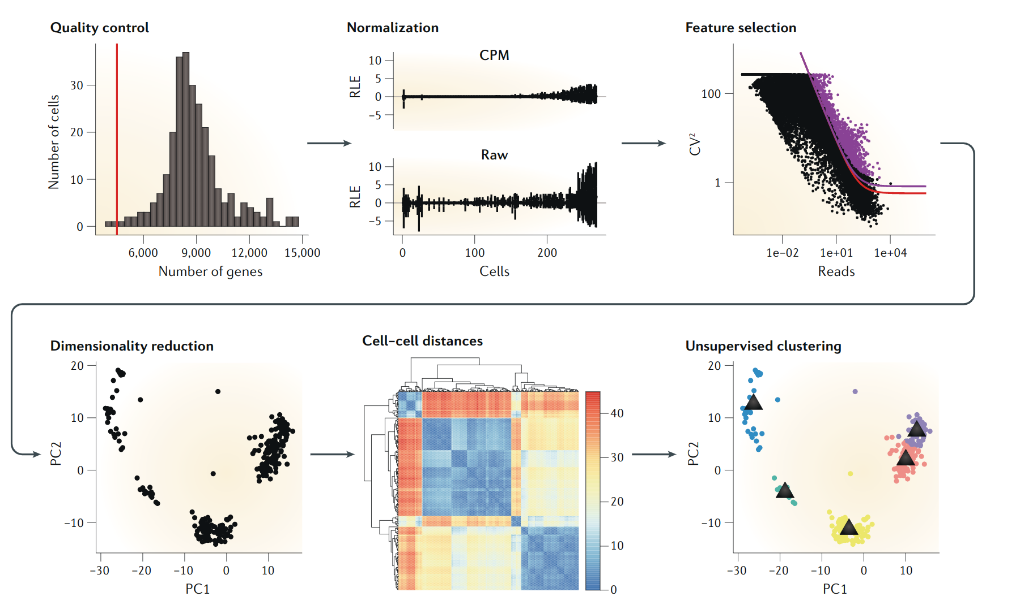
Overview of Single Cell Analysis Workflow
Kiselev et al. Nature Review Genetics 2019
Lectures.GersteinLab.org -
Notes:
Quality control: remove unreliable cells (and possible doublets)
Normalization: Normalized to correct for differences in read coverage and other technical confounders
Feature selection: the most informative genes
Dimensionality reduction:strongest signals from background noise
Cell-cell distances: construct a cell–cell distance graph or used directly by clustering algorithms

Slide 5
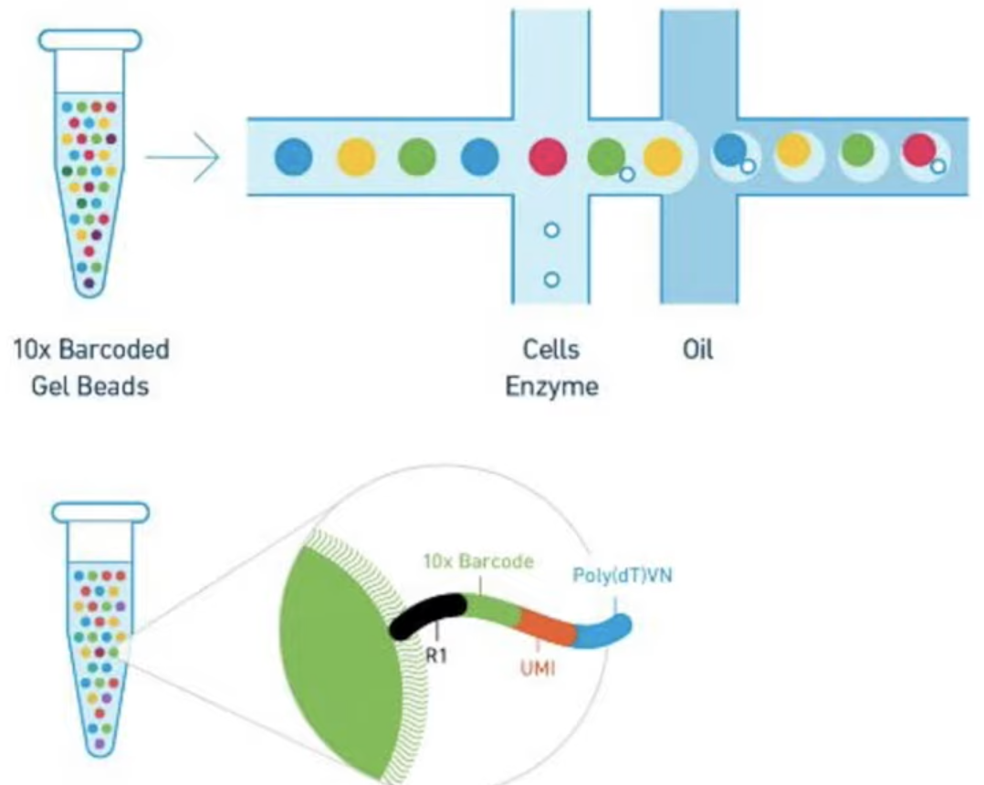
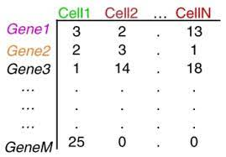
Building the Expression (Count) Matrix
,
UMI (Unique Molecular Identifier)
counts the number of transcripts observed
for each gene and cell
10x is specific to cell, UMI is specific to each RNA molecule.
UMI helps to differentiate between amplification copies and the original reads.
Lectures.GersteinLab.org -
Gudodagi et al. International Journal of Electrical and Computer Engineering 2022

Slide 6
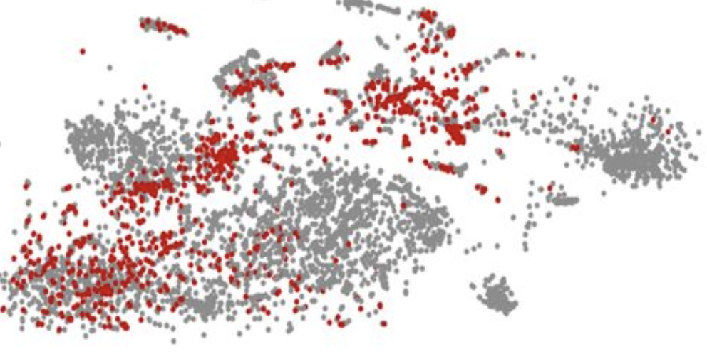
Doublet Detection & Removal
Singlet
Doublet
,
DePasquale et al. BioRxiv 2018
Original Data
Simulate Doublets
knn classifier
Doublets Removed
+
______
2
=
Lectures.GersteinLab.org -
McGinnis et al. Cell Systems 2019

Slide 7
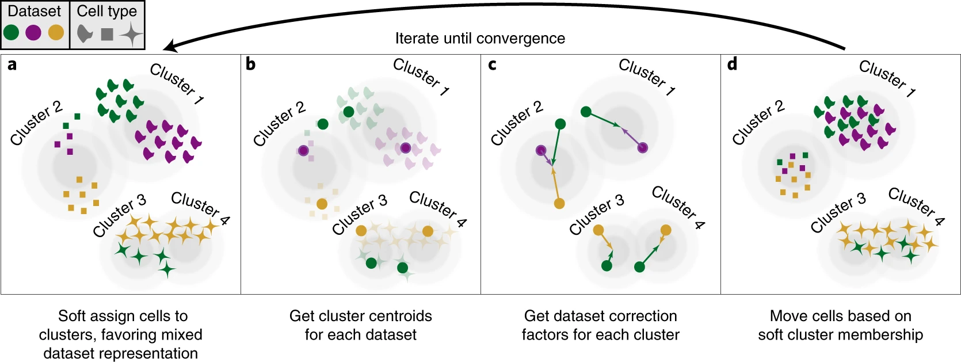
Batch Effect Correction
log(μ_{gcb} ) ~ log(N_{b} ) + α_{gs} + γ_{sb} where g=gene, c=cell, b=batch, s=cluster
Mean genetic expression value is affected by total counts in each batch (N_{b}),
natural expression (α_{gs}), and cluster-dependent batch effect (γ_{sb})
Lectures.GersteinLab.org -
Korsunski et al. Nature Methods 2019 (“Harmony”)

Slide 8
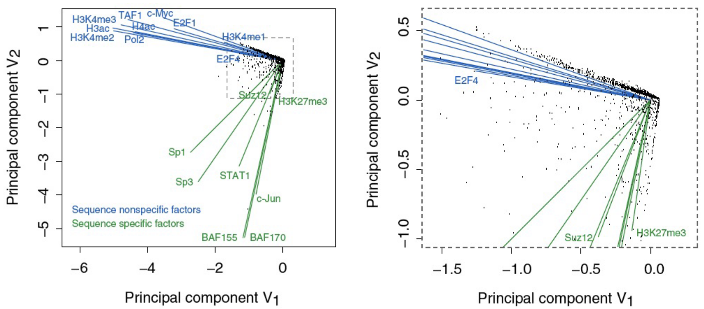
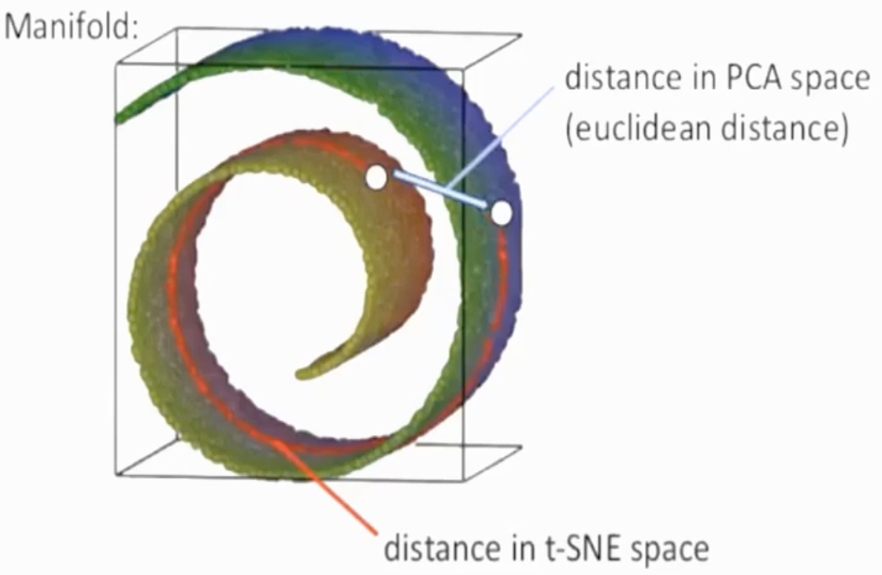
Dimensionality Reduction
Previous
Discussion
of SVD/PCA
Each gene represents a dimension (~10k-D expression)
Dimensionality reduction is necessary for
visualization of high-dimensional datasets, and
distance estimates in high dimensions are unreliable
UMAP and t-SNE sacrifice global distance measurements
to better capture local distances,
so distances between clusters are not meaningful.
Lectures.GersteinLab.org -
Takahashi et al. IEEE Transactions on Visualization and Computer Graphics 2009

Slide 9
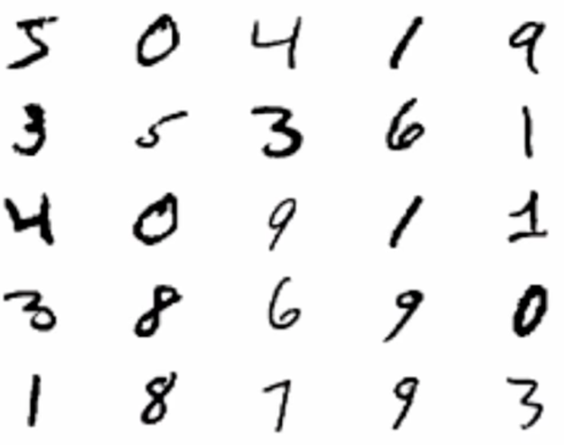
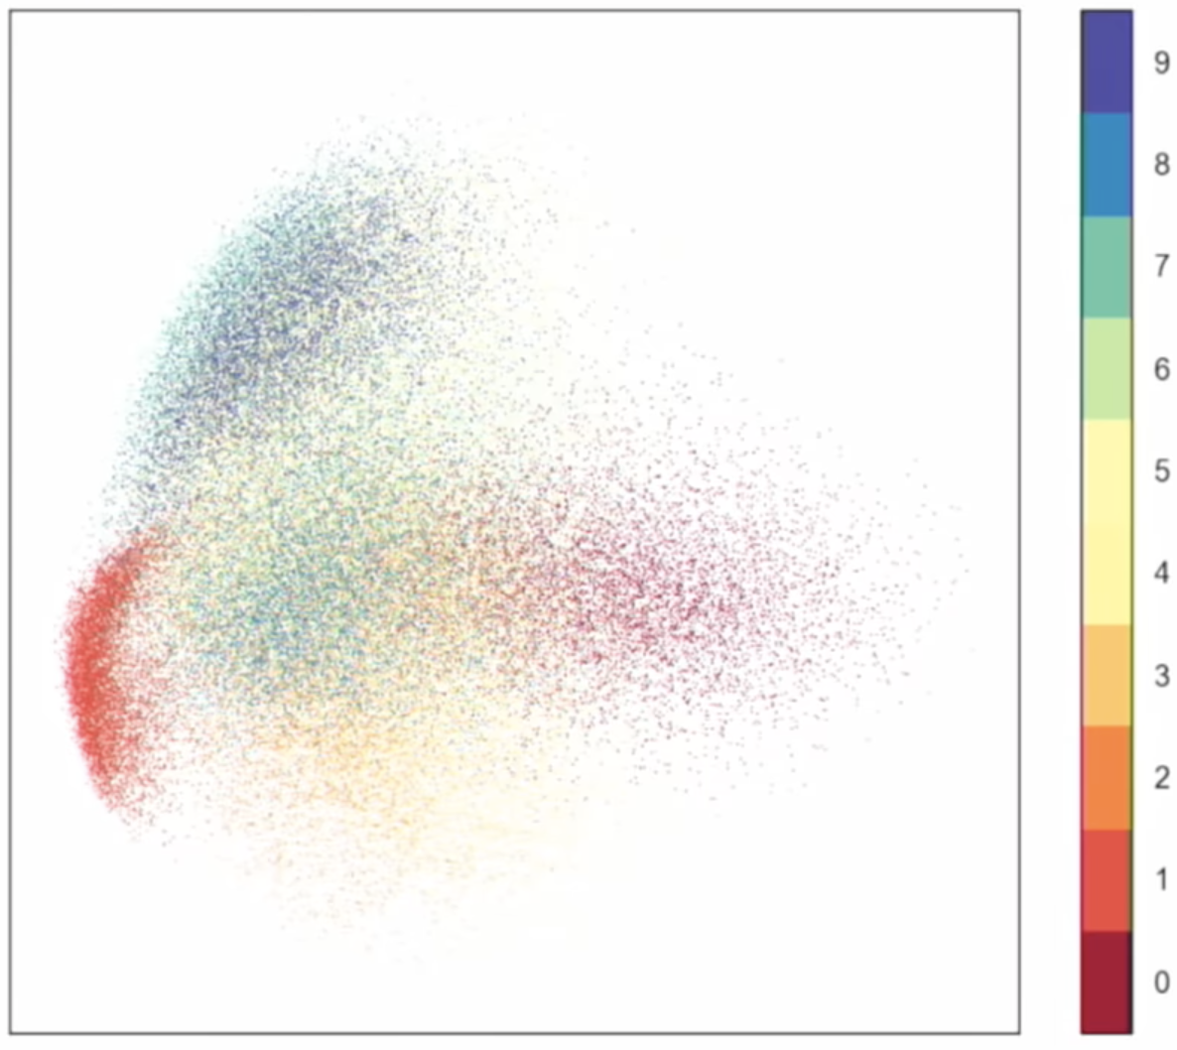
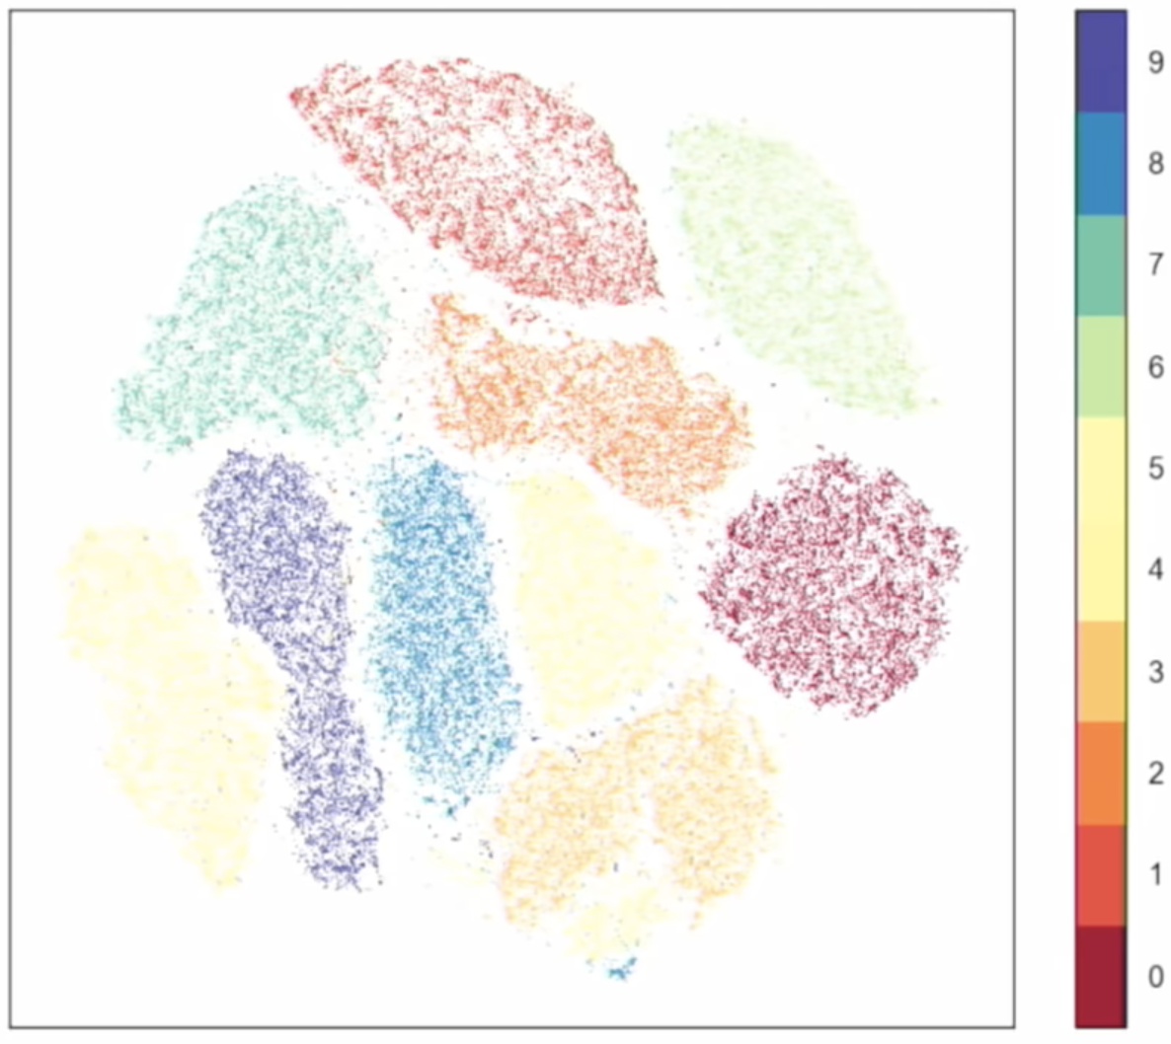
PCA vs t-SNE
Lectures.GersteinLab.org -
https://meta.caspershire.net/umap/

Slide 10
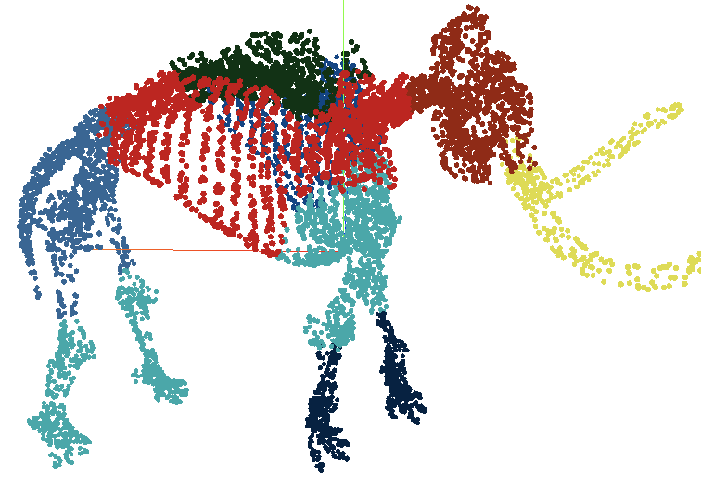
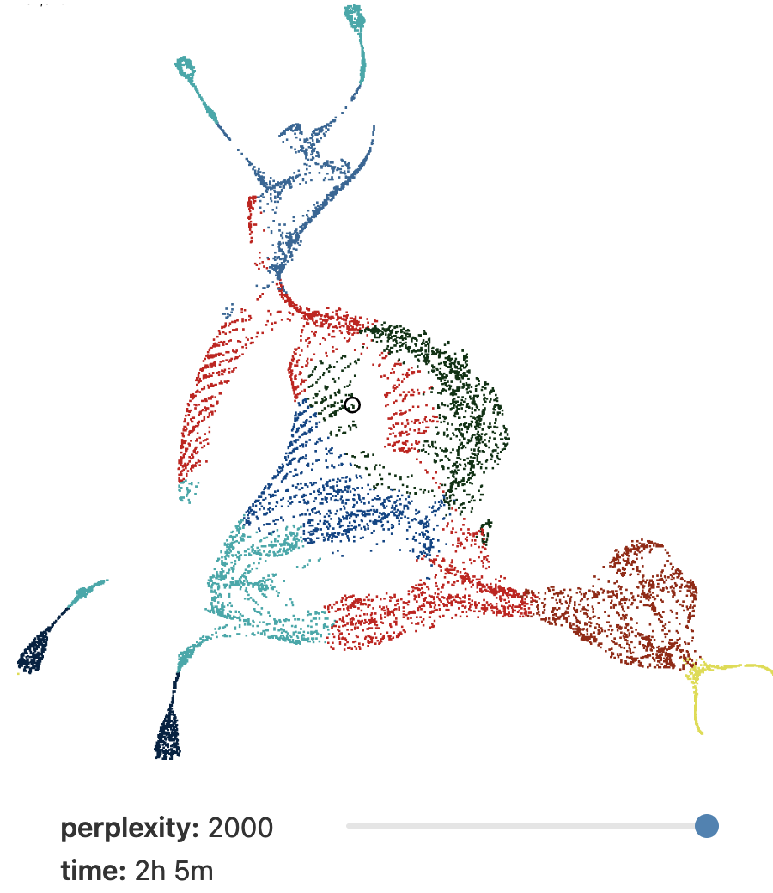
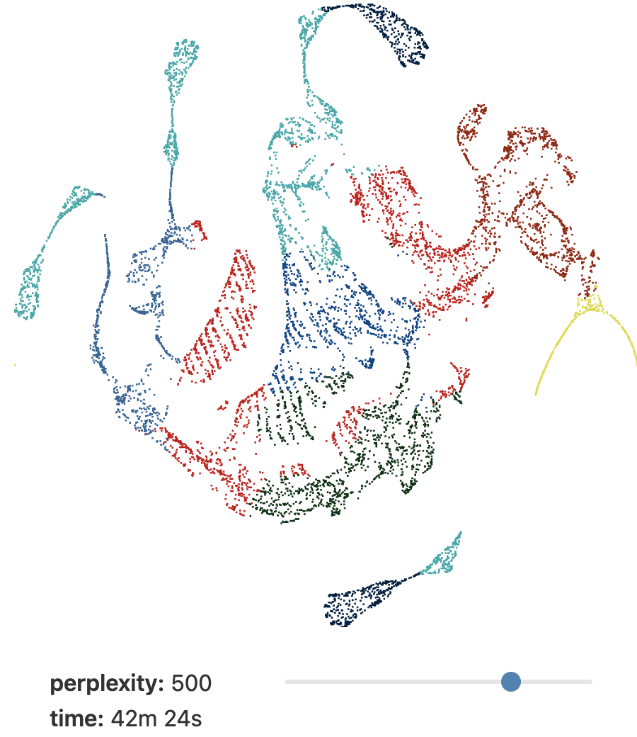
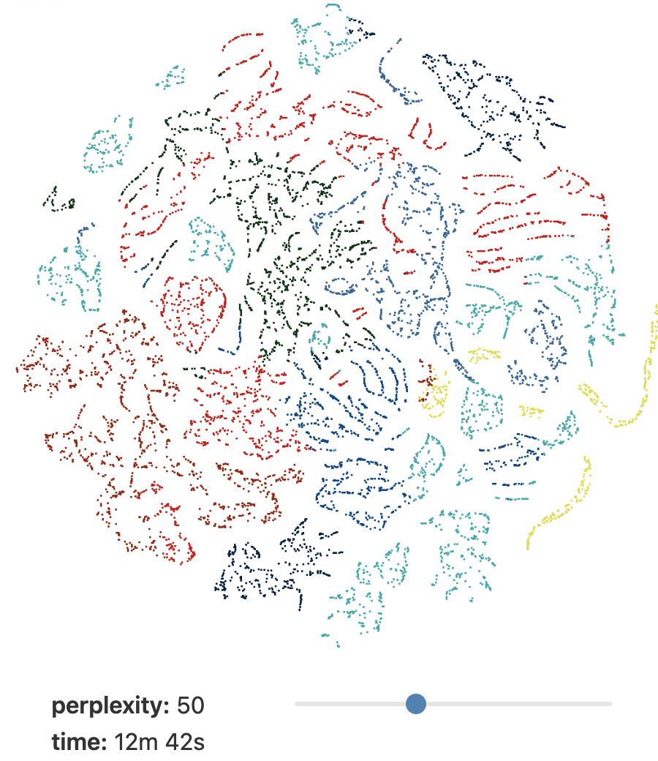
Loss of Global Distance in UMAP
‘perplexity’ represents significance of the global distance info.
perplexity = 2000
perplexity = 500
perplexity = 50
Lectures.GersteinLab.org -
https://pair-code.github.io/understanding-umap/

Slide 11
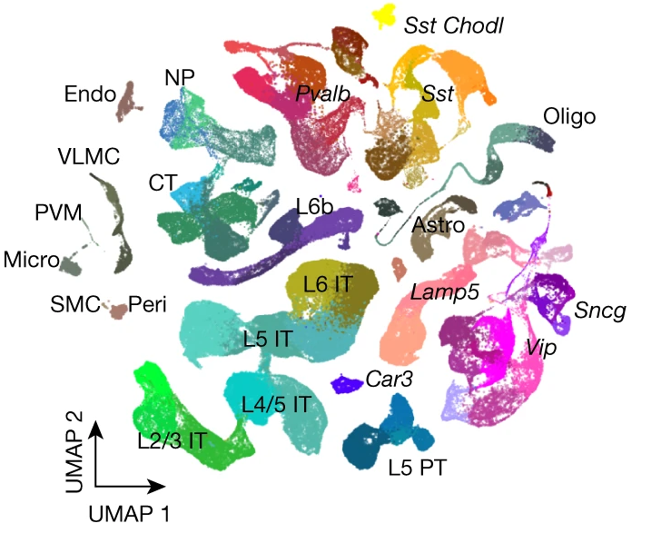
Clustering to
Determine
Cell Types
Communities are dense groups of nodes
They could be related to cell types, cell states, or a disease. The goal is to identify communities of cells with similar expression profiles
Clustering for cell typing often uses connectivity based approaches (discussed earlier)…
[Yao et al. (‘21) Nature]
Lectures.GersteinLab.org -

Slide 12
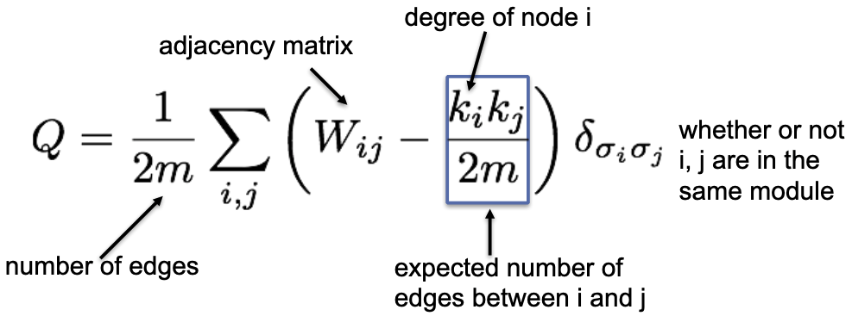
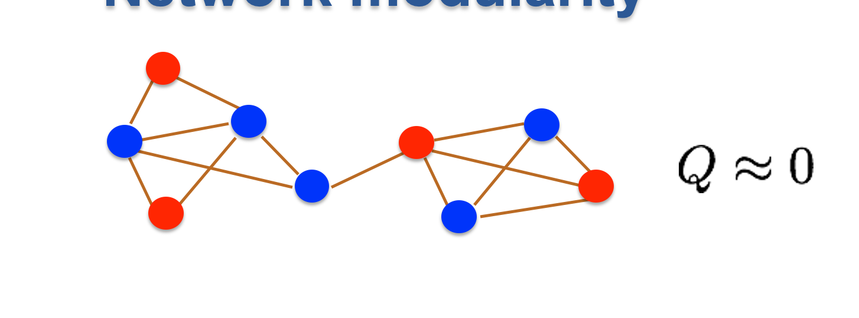
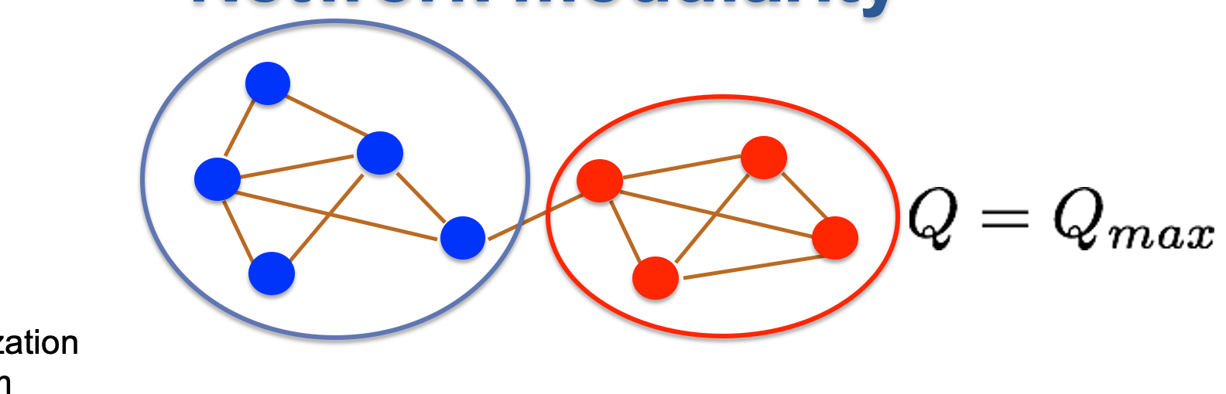
Louvain Maximizes Modularity
(Calculation of Modularity Q)
B
1
D
9
Q ∝ 41
A
10
9
E
Q ∝ 22
8
C
3
W_ij | A | B | C | D | E
A | - | 9 | 8 | - | -
B | 9 | - | 10 | 1 | -
C | 8 | 10 | - | - | 2
D | - | 1 | - | - | 9
E | - | - | 2 | 9 | -
 | A | B | C | D | E
k_i | 17 | 20 | 21 | 10 | 12
Lectures.GersteinLab.org -
Newman Phys. Rev. E 2004

Slide 13
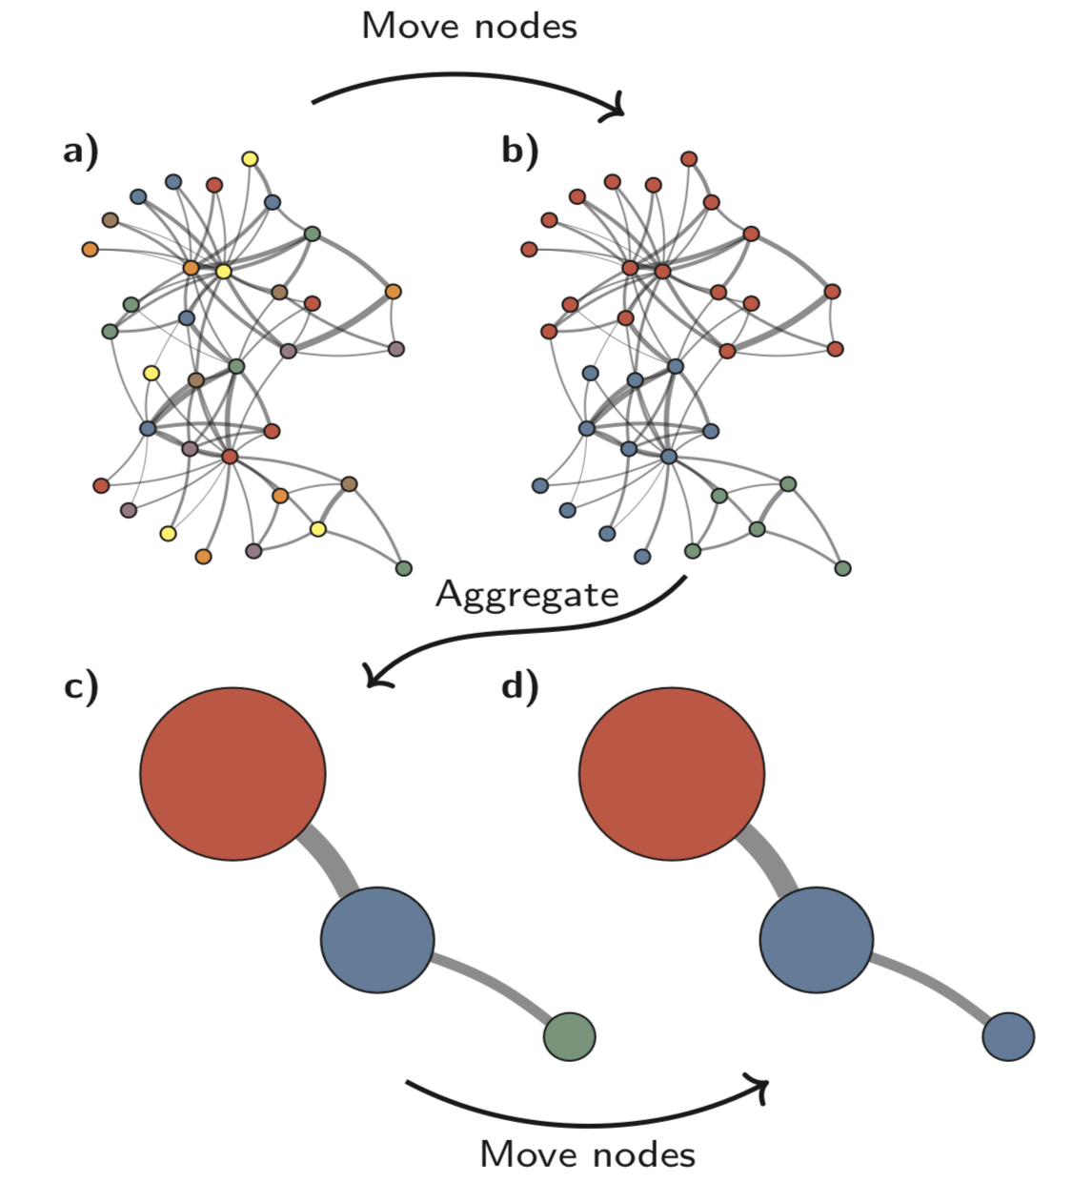
Louvain maximizes modularity
(Overall Algorithm Flow)
#1 Start:
Each node (cell) having its own community.
#2 Moving nodes:
Repeat scanning all nodes until no change increases Q (from a to b)
{{
Move each node to the one of its neighbor communities
that maximizes ΔQ;
Or start a new community
}}
#3 Aggregate:
Turn each community into a node.
Edges between communities are added up as the weight.
#4 Repeat from #2
Stop at desired resolution
Traag et al. Scientific Reports 2019
Lectures.GersteinLab.org -

Slide 14
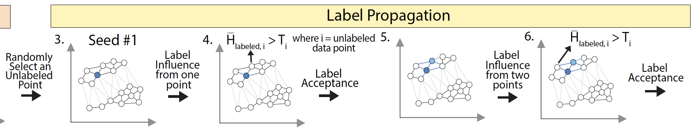
Forest Fire Clustering: To Find One Cluster
Randomly select a points (seed) to label
Label influence radiate from the labeled points
Check if other unlabeled points experience label influence higher than their threshold
  If so, the unlabeled points receives the same label as the seed.
  If not, check later when more points are labeled and see if the cumulative label influence is able to cross the threshold.
Repeat from step 2
Chen et al. Nat. Comm. '22

Slide 15
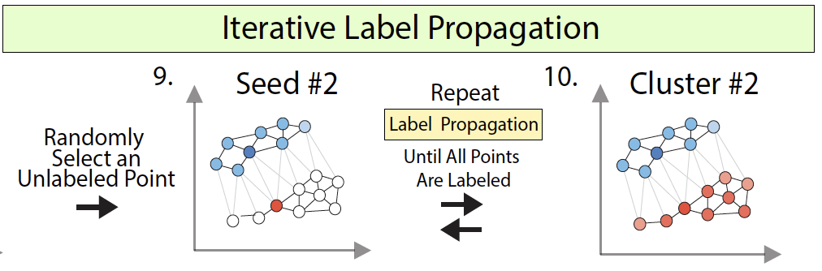
Forest Fire Clustering: To Find All Clusters
Select a new unlabeled points (seed) to label
Repeat Label Propagation for as many times as needed to label every data point.
Chen et al. Nat. Comm. '22

Slide 16
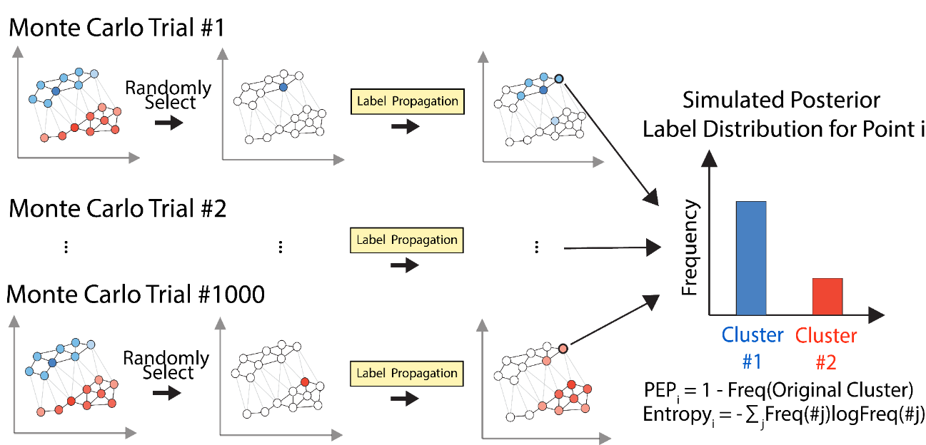
Forest Fire Clustering: Internal Validation via Monte Carlo Simulation
P-value for pt. to be in a cluster
Chen et al. Nat. Comm. '22

Slide 17
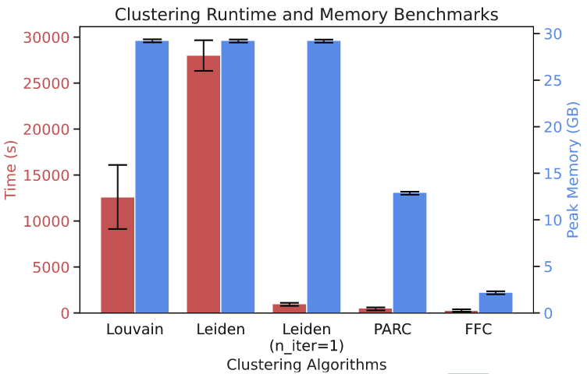
Forrest Fire is Substantially Faster than Louvain
Chen et al. Nat. Comm. 2022

Slide 18
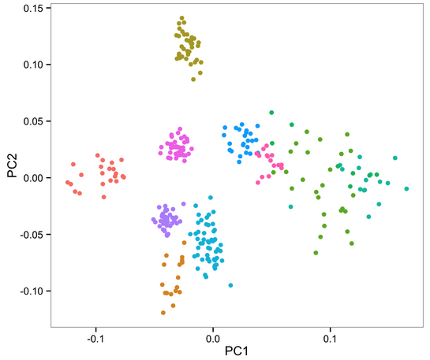
Imputation
Some genes will fail to be detected, even if they are expressed.
Find a structure within the whole data
Fill in a derived mathematical estimate for undetected genes
Minimize ‘false’ effects of the underlying model
MAGIC, SAVER, DrImpute
Cells 4 & 7 are dropouts
10
12
PC2
6
8
Expression of
chosen gene
2
4
1
7
9
11
3
5
x
x
PC1
1
2
3
4
5
6
7
8
9
10
11
12
Cells arranged along PC1
Lectures.GersteinLab.org -
Van Dijk et al. Cell 2018 (“MAGIC”)

Slide 19
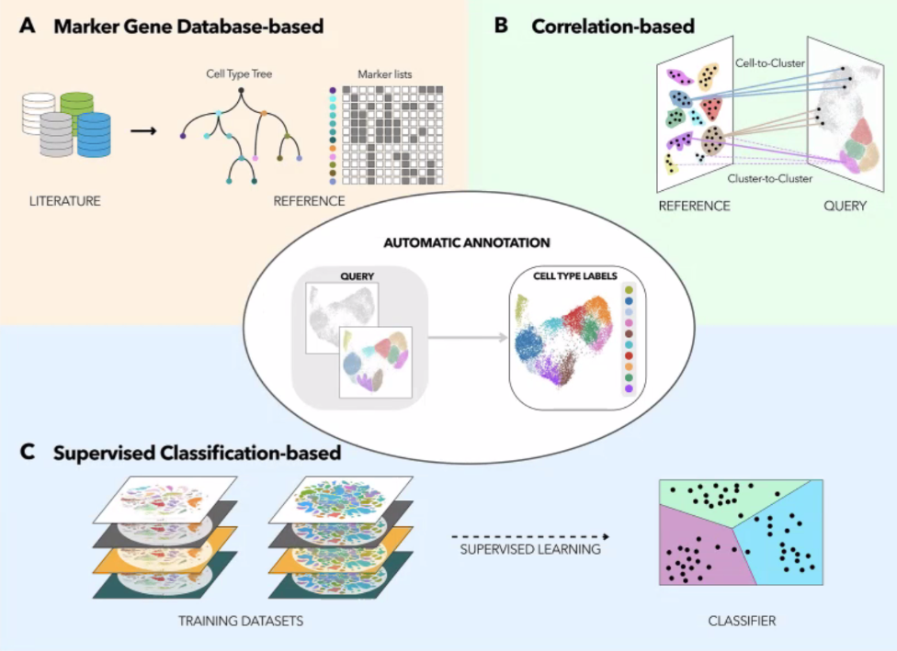
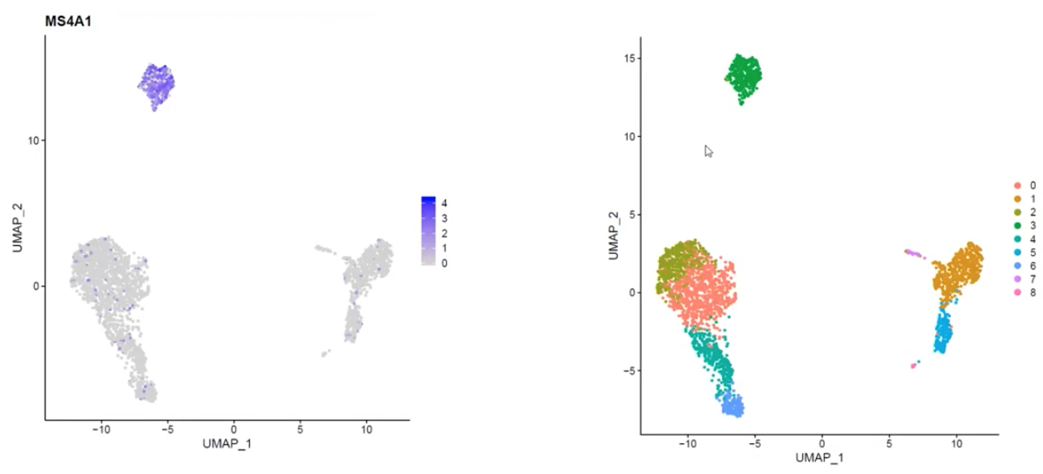

Transferring Cell-type Annotation
Marker Genes are active only in a specific cluster (i.e. cell type)
The alternative is to compare g.e. profiles of different experiments
Azimuth uses weighted-nearest neighbor method,
where the weights are determined for each cell and each modality
such that the marker genes are consistent (shared biological state)
across different data qualities and modalities.
Lectures.GersteinLab.org -
https://chipster.csc.fi/material/single-cell/scrnaseq2020.pdf
Pasquini et al. Comp. and Struct. Biotech. Journal 2021

Slide 20
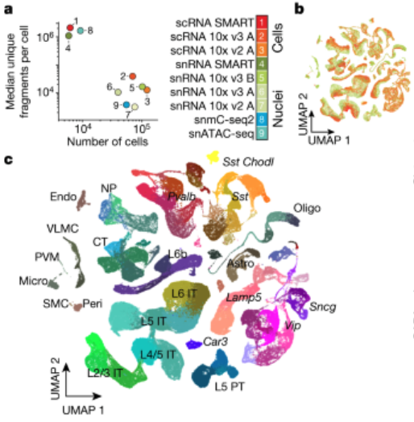
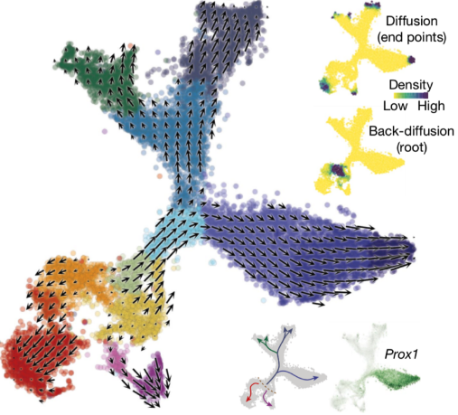
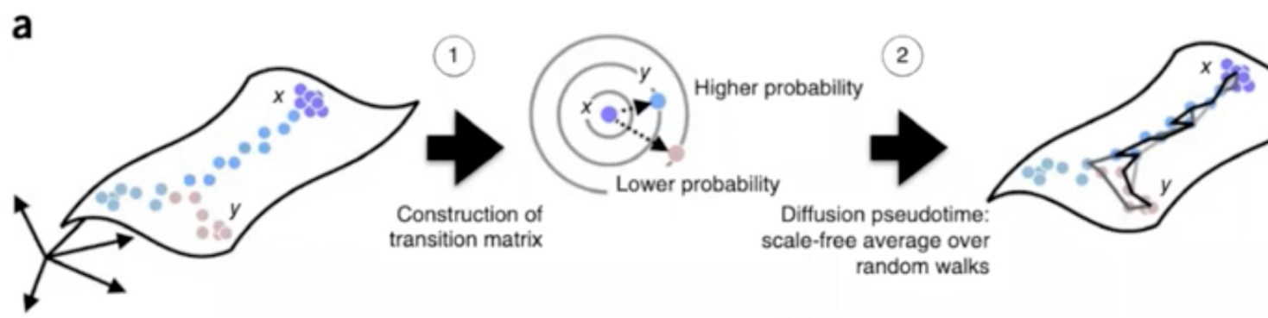
Using Pseudo-time – going beyond discrete cell-type clusters
Where discrete categorization is not suitable;
pseudotime could represent time, chemical concentrations or spatial positions
Diffusion Pseudotime
Determine probability of transition between cell positions,
by constructing a weighted nearest-neighbor graph.
Find shortest random walk paths using transition matrix
Number of steps represents the amount the pseudotime
DeepVelo
L3
L2
L1
Haghverdi et al. Nature Methods 2016
La Manno et al. Nature 2018
Lectures.GersteinLab.org -

Slide 21
References
Andrews, T. S., Kiselev, V. Y., McCarthy, D., & Hemberg, M. (2020). Nature Protocols, 16(1), 1–9.
Tutorial: guidelines for the computational analysis of single-cell RNA sequencing data.
https://doi.org/10.1038/s41596-020-00409-w
(Single Cell overview; goes over every step)
Blondel, V. D., Guillaume, J., Lambiotte, R., & Lefebvre, E. (2008). J Stat Mech Theory & Expt., 2008(10), P10008.
Fast unfolding of communities in large networks.
https://doi.org/10.1088/1742-5468/2008/10/p10008
(Overview of Louvain clustering upgrade; read the methods section)
Haghverdi, L., Büttner, M., Wolf, F. A., Buettner, F., & Theis, F. J. (2016). Nature Methods, 13(10), 845–848.
Diffusion pseudotime robustly reconstructs lineage branching.
https://doi.org/10.1038/nmeth.3971
(Optional: First page summarizes the Pseudotime algorithm)
Stuart, T. et al. (2019). Cell, 177(7), 1888-1902.e21.
Comprehensive integration of Single-Cell data.
https://doi.org/10.1016/j.cell.2019.05.031
(Optional: Description of cell type annotation. See fig. 1, which is explained in the beginning of Results section)
Andy Coenen, Adam Pearce
Understanding UMAP
https://pair-code.github.io/understanding-umap
(Optional: tSNE UMAP key concepts with great interactive visualization)
Lectures.gersteinlab.org

