Slide 1
Biomedical Data Science (GersteinLab.org/courses/452)
Network Prediction (25m10e)
Last edit in spring ’25. Substantially edited compared to ‘23 with a new video in ‘25.
Mark Gerstein
Yale U.

Slide 2
Predicting Networks via Bayesian Integration
Problem Motivation

Slide 3
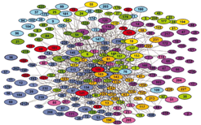
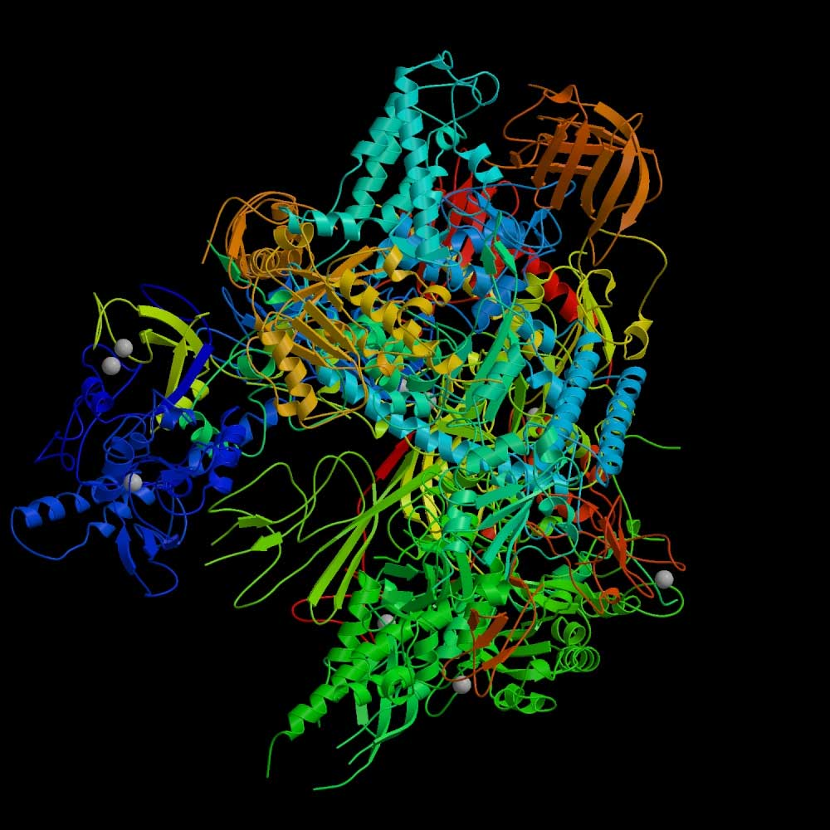
RNA polymerase II: Structure
Which subunits interact?
Based on Binding
experiments
Compare with Gold Std. Structure
5
3
6
2
8
1
9
12
10
11
Source: Cramer et al., 2000, Science, 288:632-633
Source: Edwards et al., 2002, Trends in Genetics

Slide 4
Binding Experiments on Subunit Pairs
Subunits
1
1
1
1
1
1
1
1
1
2
2
2
2
2
2
2
2
3
3
3
3
3
3
3
5
5
5
5
5
5
6
6
6
6
6
8
8
8
8
9
9
9
10
10
12
Subunits
2
3
5
6
8
9
10
11
12
3
5
6
8
9
10
11
12
5
6
8
9
10
11
12
6
8
9
10
11
12
8
9
10
11
12
9
10
11
12
10
11
12
11
11
12
Pull-down 1
1
1
0
1
0
1
0
1
1
0
1
0
1
0
1
1
1
0
1
1
1
1
0
1
0
0
0
0
0
0
1
0
0
0
0
Pull-down 2
1
1
1
1
0
1
0
1
1
0
1
0
1
0
1
1
1
0
1
1
0
1
0
1
0
0
0
0
0
0
0
0
0
0
0
Pull-down 3
1
1
1
0
1
0
0
1
0
Cross-linking
1
1
1
1
1
0
1
1
1
1
1
0
1
1
1
1
1
1
0
1
Far Western 1
1
1
1
1
1
0
0
0
0
0
0
1
0
0
0
Far Western 2
1
1
1
1
1
1
1
1
1
1
0
0
0
1
0
0
0
0
0
0
0
0
0
0
0
0
0
0
0
0
Far Western 3
1
0
0
0
1
0
Interaction experiments
before structure was known

Slide 5
Gold-Standard Positives
Subunits
1
1
1
1
1
1
1
1
1
2
2
2
2
2
2
2
2
3
3
3
3
3
3
3
5
5
5
5
5
5
6
6
6
6
6
8
8
8
8
9
9
9
10
10
12
Subunits
2
3
5
6
8
9
10
11
12
3
5
6
8
9
10
11
12
5
6
8
9
10
11
12
6
8
9
10
11
12
8
9
10
11
12
9
10
11
12
10
11
12
11
11
12
Gold-Standard Positive (GSTD+): 13
5
3
6
2
8
1
9
12
10
11

Slide 6
Gold-Standard Negatives
Subunits
1
1
1
1
1
1
1
1
1
2
2
2
2
2
2
2
2
3
3
3
3
3
3
3
5
5
5
5
5
5
6
6
6
6
6
8
8
8
8
9
9
9
10
10
12
Subunits
2
3
5
6
8
9
10
11
12
3
5
6
8
9
10
11
12
5
6
8
9
10
11
12
6
8
9
10
11
12
8
9
10
11
12
9
10
11
12
10
11
12
11
11
12
Gold-Standard Negative (GSTD-): 32
5
3
6
2
8
1
9
12
10
11

Slide 7
RNA Polymerase II: Gold-Standards
Subunits
1
1
1
1
1
1
1
1
1
2
2
2
2
2
2
2
2
3
3
3
3
3
3
3
5
5
5
5
5
5
6
6
6
6
6
8
8
8
8
9
9
9
10
10
12
Subunits
2
3
5
6
8
9
10
11
12
3
5
6
8
9
10
11
12
5
6
8
9
10
11
12
6
8
9
10
11
12
8
9
10
11
12
9
10
11
12
10
11
12
11
11
12
Gold-Standard Positive (GSTD+): 13
Gold-Standard Negative (GSTD-): 32
5
3
6
2
8
1
9
12
10
11

Slide 8
Assess Quality and Coverage of PPints
Subunits
1
1
1
1
1
1
1
1
1
2
2
2
2
2
2
2
2
3
3
3
3
3
3
3
5
5
5
5
5
5
6
6
6
6
6
8
8
8
8
9
9
9
10
10
12
Subunits
2
3
5
6
8
9
10
11
12
3
5
6
8
9
10
11
12
5
6
8
9
10
11
12
6
8
9
10
11
12
8
9
10
11
12
9
10
11
12
10
11
12
11
11
12
Pull-down 1
1
1
0
1
0
1
0
1
1
0
1
0
1
0
1
1
1
0
1
1
1
1
0
1
0
0
0
0
0
0
1
0
0
0
0
Pull-down 2
1
1
1
1
0
1
0
1
1
0
1
0
1
0
1
1
1
0
1
1
0
1
0
1
0
0
0
0
0
0
0
0
0
0
0
Pull-down 3
1
1
1
0
1
0
0
1
0
Cross-linking
1
1
1
1
1
0
1
1
1
1
1
0
1
1
1
1
1
1
0
1
Far Western 1
1
1
1
1
1
0
0
0
0
0
0
1
0
0
0
Far Western 2
1
1
1
1
1
1
1
1
1
1
0
0
0
1
0
0
0
0
0
0
0
0
0
0
0
0
0
0
0
0
Far Western 3
1
0
0
0
1
0
GSTD+
GSTD-
True
False

Slide 9
Re-drawn in a different color scheme

Slide 10
Data integration: RNA polymerase II
Integrate using naive Bayes classifier

Slide 11
Data integration: RNA polymerase II
Integrate using naive Bayes classifier

Slide 12
Data integration: RNA polymerase II
Integrate using naive Bayes classifier
(Cross validate)

Slide 13
Weighted Voting: the Likelihood Ratio
Maj. Vote: 0 = round(avg( 0 + 0 + 0 + 1 + 1 + 0 + 0 )
With weights: likelihood ratio L = L₁ + L₂ + L₃ …

Slide 14
Predicting Networks via Bayesian Integration
Formalism

Slide 15
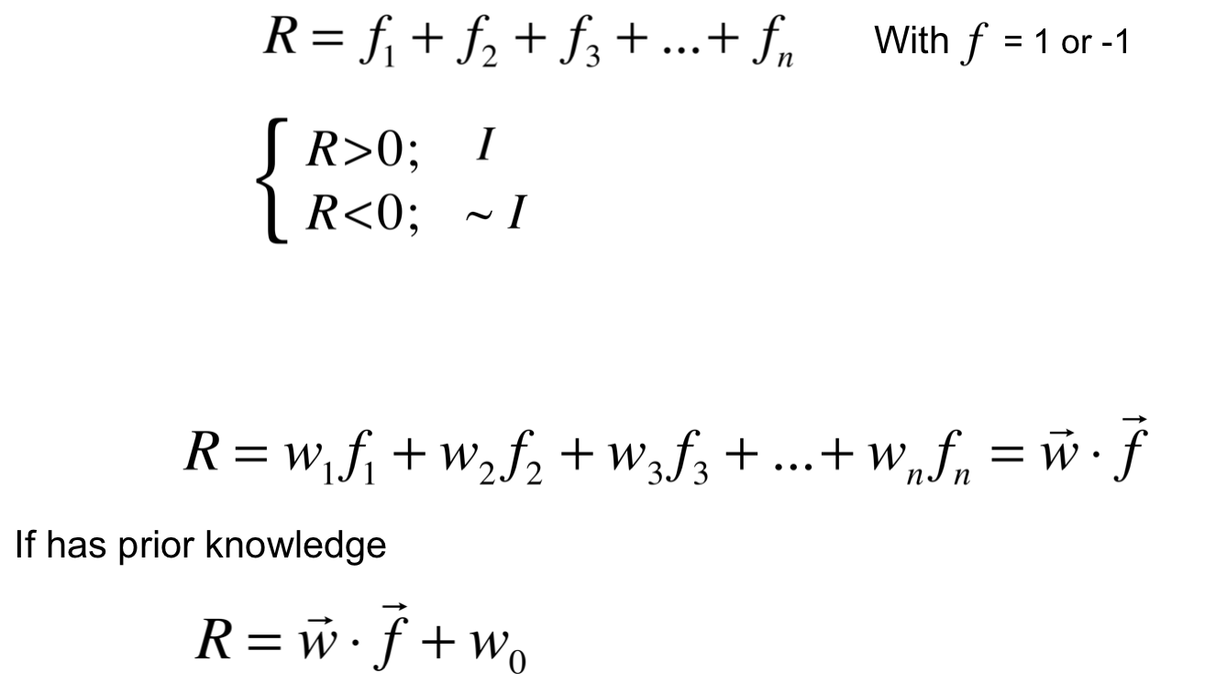
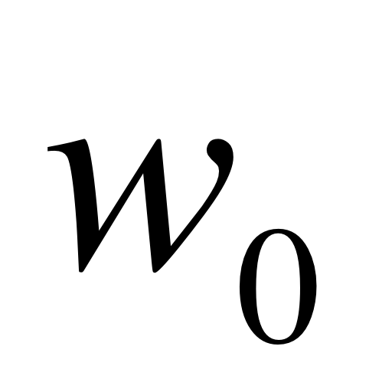
Supervised
Classification by Weighted Voting
Similar form to many other classifiers – e.g. SVC, LDA, logistic
(see ISLR for comparison)
Simple Vote:
Interact
If
No interaction
Modify with feature weight:

Slide 16
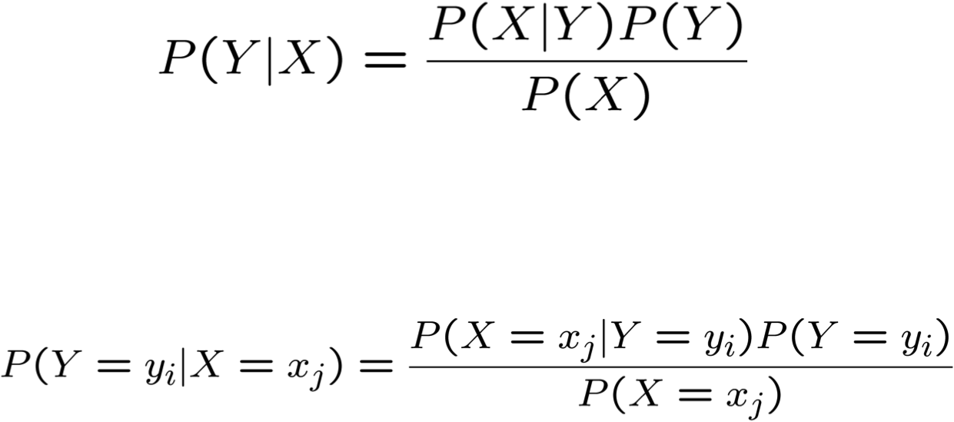
Bayes Rule
Which is shorthand for:
[From Mitchell, Machine Learning]

Slide 17
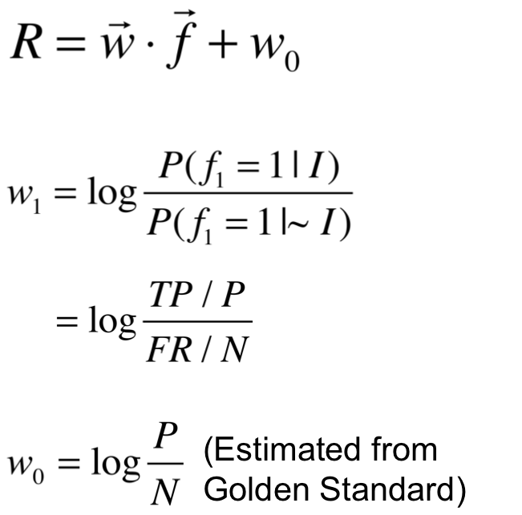
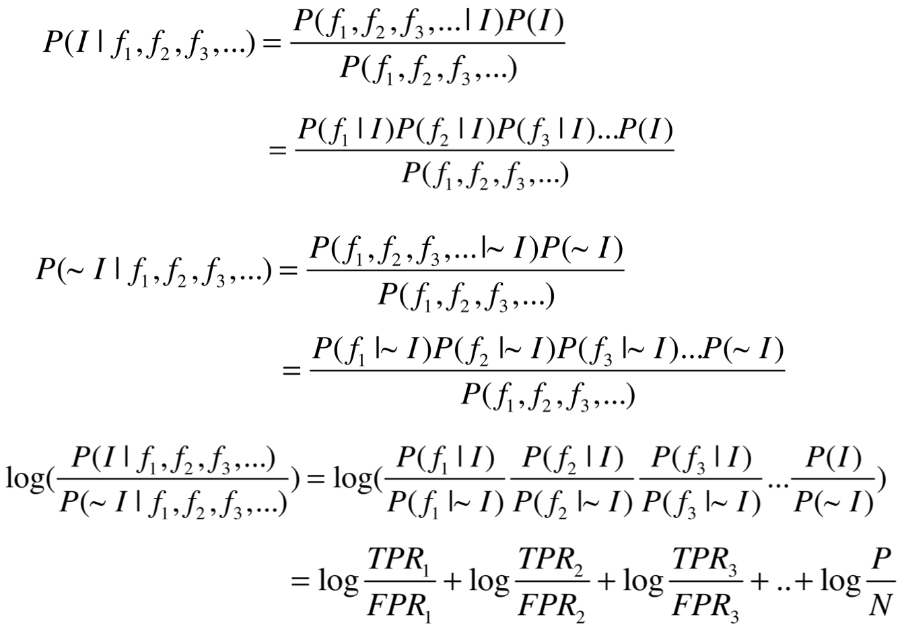
More Bayes Rule
FP / N
Assume
independent
(Naïve Bayes)

Slide 18
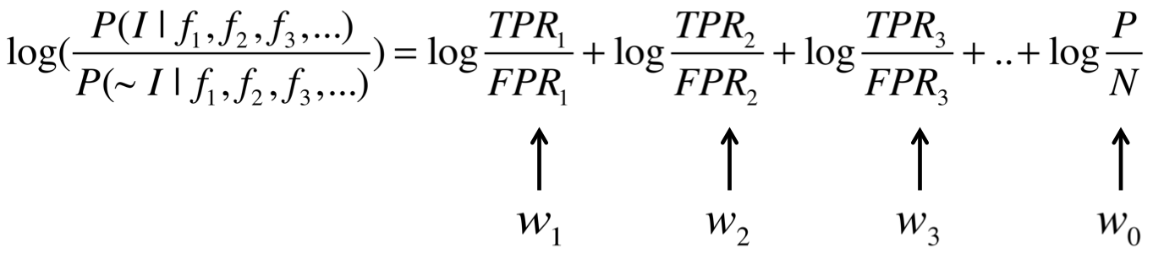
Update form of Bayes Rule
Updating our prior odds (w₀) by successively adding
likelihood ratio terms (w₁,w₂,w₃)
for each feature to get a final posterior odds
This simple additive update form supposedly,
secretly invented by A Turing during WWII
[Spiegelhalter & Brooks, The Art of Uncertainty (‘25)]

Slide 19
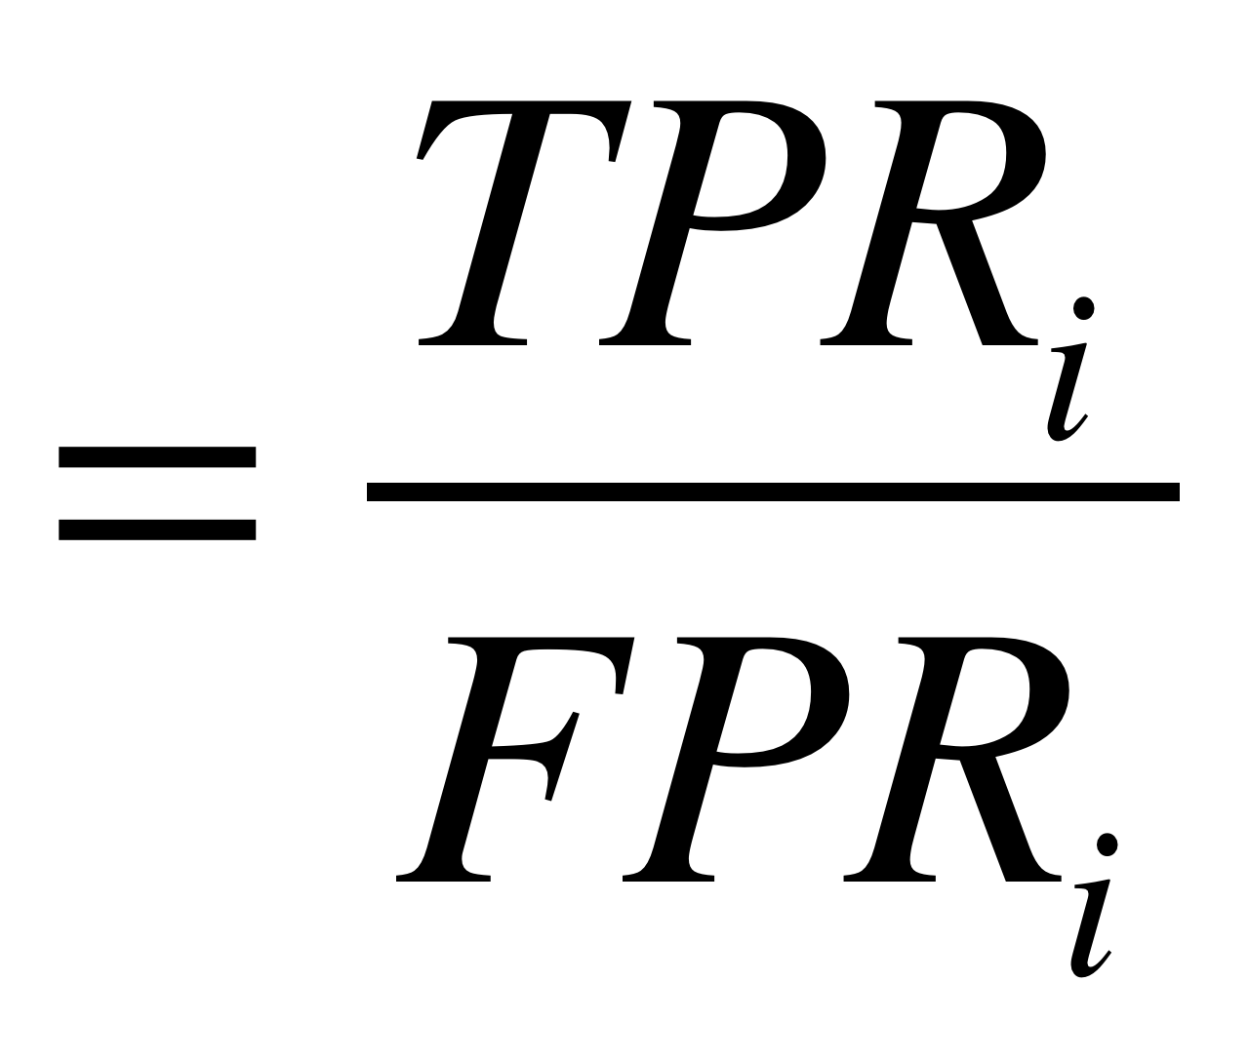
We have so far estimated P(X=x | Y=y) by the fraction n_{x|y}/n_{y},
where n_{y} is the number of instances for which Y=y
and n_{x|y} is the number of these for which X=x
This is a problem when n_{x} is small
  E.g., assume P(X=x | Y=y)=0.05 and the training set is s.t. that n_{y}=5.
  Then it is highly probable that n_{x|y}=0
  The fraction is thus an underestimate of the actual probability
  It will dominate the Bayes classifier for all new queries with X=x
# count with feature i in GS+
# count with feature i in GS-
Dummy Counts
Replace n_{x|y}/n_{y} by:
Estimating Probabilities &
Dummy Counts
Where p is our prior estimate of the probability
we wish to determine and m is a constant
  Typically, p = 1/k (where k is the number of possible values of X)
  m acts as a weight
  (similar to adding m virtual instances distributed according to p)

Slide 20
Predicting Networks via Bayesian Integration
Worked Example
(for reference)

Slide 21
Likelihood Ratios
Subunits
1
1
1
1
1
1
1
1
1
2
2
2
2
2
2
2
2
3
3
3
3
3
3
3
5
5
5
5
5
5
6
6
6
6
6
8
8
8
8
9
9
9
10
10
12
Subunits
2
3
5
6
8
9
10
11
12
3
5
6
8
9
10
11
12
5
6
8
9
10
11
12
6
8
9
10
11
12
8
9
10
11
12
9
10
11
12
10
11
12
11
11
12
Pull-down 1
1
1
0
1
0
1
0
1
1
0
1
0
1
0
1
1
1
0
1
1
1
1
0
1
0
0
0
0
0
0
1
0
0
0
0
Likelihood Ratio
for Feature f:
GSTD+
GSTD-
True
False

Slide 22
Calculating Likelihood Ratios
Subunits
1
1
1
1
1
1
1
1
1
2
2
2
2
2
2
2
2
3
3
3
3
3
3
3
5
5
5
5
5
5
6
6
6
6
6
8
8
8
8
9
9
9
10
10
12
Subunits
2
3
5
6
8
9
10
11
12
3
5
6
8
9
10
11
12
5
6
8
9
10
11
12
6
8
9
10
11
12
8
9
10
11
12
9
10
11
12
10
11
12
11
11
12
Pull-down 1
1
0
1
0
0
1
0
1
1
1
GSTD+
GSTD-
True
False

Slide 23
Calculating Likelihood Ratios
Subunits
1
1
1
1
1
1
1
1
1
2
2
2
2
2
2
2
2
3
3
3
3
3
3
3
5
5
5
5
5
5
6
6
6
6
6
8
8
8
8
9
9
9
10
10
12
Subunits
2
3
5
6
8
9
10
11
12
3
5
6
8
9
10
11
12
5
6
8
9
10
11
12
6
8
9
10
11
12
8
9
10
11
12
9
10
11
12
10
11
12
11
11
12
Pull-down 1
Pull-down 1
1
1
1
0
1
0
1
1
0
1
1
1
0
0
1
1
0
1
0
0
1
1
1
1
1
1
0
0
1
1
1
1
1
1
0
0
1
1
0
0
0
0
0
0
0
0
0
0
0
0
1
1
0
0
0
0
0
0
0
0
=1.34
=0.70
GSTD+
GSTD-
True
False

Slide 24
Calculating Likelihood Ratios
Subunits
1
1
1
1
1
1
1
1
1
2
2
2
2
2
2
2
2
3
3
3
3
3
3
3
5
5
5
5
5
5
6
6
6
6
6
8
8
8
8
9
9
9
10
10
12
Subunits
2
3
5
6
8
9
10
11
12
3
5
6
8
9
10
11
12
5
6
8
9
10
11
12
6
8
9
10
11
12
8
9
10
11
12
9
10
11
12
10
11
12
11
11
12
Pull-down 1
1
1
0
1
0
1
0
1
1
0
1
0
1
0
1
1
1
0
1
1
1
1
0
1
0
0
0
0
0
0
1
0
0
0
0
Pull-down 2
1
1
1
1
0
1
0
1
1
0
1
0
1
0
1
1
1
0
1
1
0
1
0
1
0
0
0
0
0
0
0
0
0
0
0
Pull-down 3
1
1
1
0
1
0
0
1
0
Cross-linking
1
1
1
1
1
0
1
1
1
1
1
0
1
1
1
1
1
1
0
1
Far Western 1
1
1
1
1
1
0
0
0
0
0
0
1
0
0
0
Far Western 2
1
1
1
1
1
1
1
1
1
1
0
0
0
1
0
0
0
0
0
0
0
0
0
0
0
0
0
0
0
0
Far Western 3
1
0
0
0
1
0
Pull-down 1
L1 = (6/13) / (11/32) = 1.34
L0 = (4/13) / (14/32) = 0.70
Pull-down 2
L1 = (7/13) / (9/32) = 1.91
L0 = (2/13) / (16/32) = 0.31
Pull-down 3
L1 = (2/13) / (3/32) = 1.64
L0 = (2/13) / (2/32) = 2.46
Cross-linking
L1 = (10/13) / (7/32) = 3.52
L0 = (0/13) / (3/32) = 0
Far Western 1
L1 = (2/13) / (4/32) = 1.23
L0 = (3/13) / (6/32) = 1.23
Far Western 2
L1 = (6/13) / (5/32) = 2.95
L0 = (2/13) / (17/32) = 0.29
Far Western 3
L1 = (1/13) / (1/32) = 2.46
L0 = (2/13) / (2/32) = 2.46
GSTD+
GSTD-
True
False

Slide 25
Data Integration: ROC-Curve
Subunits
1
1
1
1
1
1
1
1
1
2
2
2
2
2
2
2
2
3
3
3
3
3
3
3
5
5
5
5
5
5
6
6
6
6
6
8
8
8
8
9
9
9
10
10
12
Subunits
2
3
5
6
8
9
10
11
12
3
5
6
8
9
10
11
12
5
6
8
9
10
11
12
6
8
9
10
11
12
8
9
10
11
12
9
10
11
12
10
11
12
11
11
12
Pull-down 1
1
1
0
1
0
1
0
1
1
0
1
0
1
0
1
1
1
0
1
1
1
1
0
1
0
0
0
0
0
0
1
0
0
0
0
Pull-down 2
1
1
1
1
0
1
0
1
1
0
1
0
1
0
1
1
1
0
1
1
0
1
0
1
0
0
0
0
0
0
0
0
0
0
0
Pull-down 3
1
1
1
0
1
0
0
1
0
Cross-linking
1
1
1
1
1
0
1
1
1
1
1
0
1
1
1
1
1
1
0
1
Far Western 1
1
1
1
1
1
0
0
0
0
0
0
1
0
0
0
Far Western 2
1
1
1
1
1
1
1
1
1
1
0
0
0
1
0
0
0
0
0
0
0
0
0
0
0
0
0
0
0
0
Far Western 3
1
0
0
0
1
0
3.52
18.2
11.1
13.9
26.6
0.22
0
2.25
10.4
18.2
11.1
2.25
0
0.22
26.6
2.25
10.4
12.7
5.52
3.68
0.53
19.5
132
2.16
0.52
0
0.22
0.91
0.08
0.36
0.22
0.22
0.06
0.06
0.29
0.22
0.12
0.06
0.29
0.22
0.22
0
0.06
0.29
0.29
Combined (Bayes)
1
1
1
1
1
0
0
0
1
1
1
0
0
0
1
0
1
1
0
0
0
1
1
0
0
0
0
0
0
0
0
0
0
0
0
0
0
0
0
0
0
0
0
0
0
GSTD+
“Weighted Voting”
GSTD-
True
False

Slide 26
Data Integration: ROC Curve
Subunits
1
1
1
1
1
1
1
1
1
2
2
2
2
2
2
2
2
3
3
3
3
3
3
3
5
5
5
5
5
5
6
6
6
6
6
8
8
8
8
9
9
9
10
10
12
Subunits
2
3
5
6
8
9
10
11
12
3
5
6
8
9
10
11
12
5
6
8
9
10
11
12
6
8
9
10
11
12
8
9
10
11
12
9
10
11
12
10
11
12
11
11
12
3.52
18.2
11.1
13.9
26.6
0.22
0
2.25
10.4
18.2
11.1
2.25
0
0.22
26.6
2.25
10.4
12.7
5.52
3.68
0.53
19.5
132
2.16
0.52
0
0.22
0.91
0.08
0.36
0.22
0.22
0.06
0.06
0.29
0.22
0.12
0.06
0.29
0.22
0.22
0
0.06
0.29
0.29
Combined (Bayes)
1
1
1
1
1
0
0
0
1
1
1
0
0
0
1
0
1
1
0
0
0
1
1
0
0
0
0
0
0
0
0
0
0
0
0
0
0
0
0
0
0
0
0
0
0
Majority
1
1
1
1
1
0
1
0
1
1
1
0
1
0
1
0
1
1
0
0
0
0
1
0
0
1
0
0
0
0
0
0
0
0
0
0
0
0
0
0
0
0
0
0
0
Intersection
1
1
1
0
1
0
0
0
1
1
1
0
0
0
1
0
1
1
0
0
0
0
0
0
0
0
0
0
0
0
0
0
0
0
0
0
0
0
0
0
0
0
0
0
0
Union
1
1
1
1
1
0
1
1
1
1
1
1
1
0
1
1
1
1
1
1
0
1
1
0
1
1
0
1
0
0
1
0
0
0
0
0
1
0
0
0
0
0
0
0
0
1.0
0.8
0.6
Bayesian Integration
Majority
Intersection
Union
TPR=TP/P=Sensitivity
0.4
GSTD+
GSTD-
0.2
True
ROC Curves of RNA Polymerase II
False
0.2
0.4
0.6
0.8
1.0
FPR=FP/N=1-Specificity

Slide 27
Predicting Networks via Bayesian Integration
Feature Correlation

Slide 28
Correlations between similar features

Slide 29
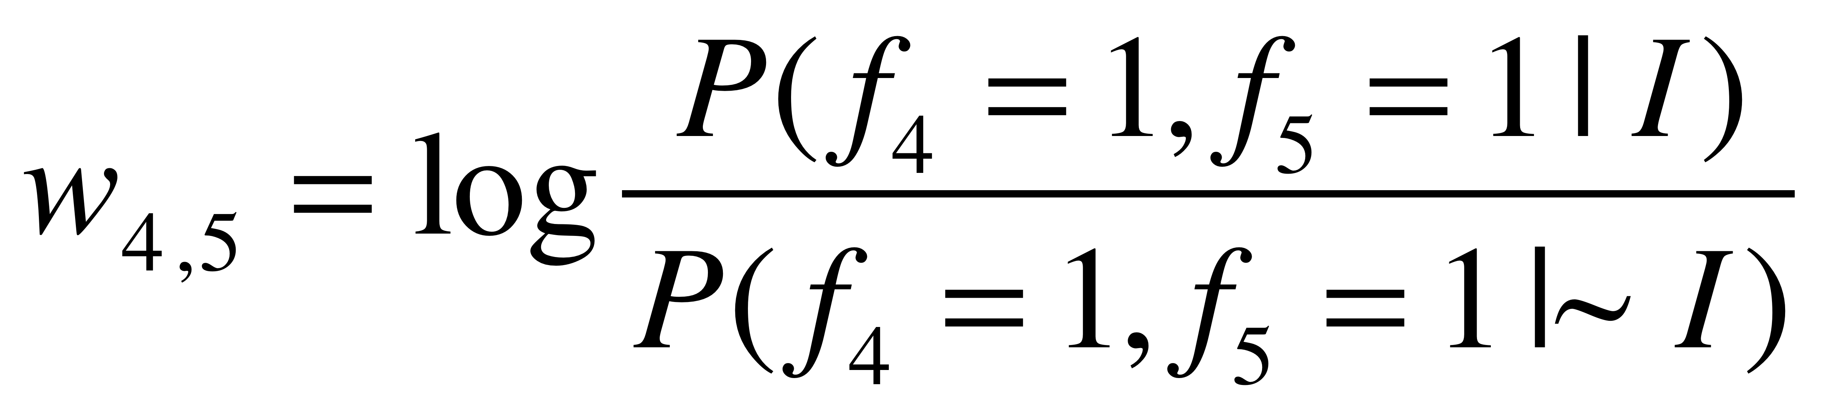
Feature Correlation and Fully Connected Bayes
GS | 1 | 0 | 0 | 1 | 1 | 1 | …
F1 | 1 | 0 | 0 | 1 | 0 | 0 | ...
F2 | 1 | 0 | 0 | 1 | 0 | 0 | …
F3 | 0 | 0 | 1 | 0 | 1 | 0 | …
F4 | 0 | 1 | 0 | 0 | 1 | 0 | …
F5 | 0 | 1 | 0 | 0 | 1 | 0 | …
F6 | 1 | 0 | 1 | 1 | 0 | 0 | …

Slide 30
Predicting Networks via Bayesian Integration
Bayesian Networks

Slide 31
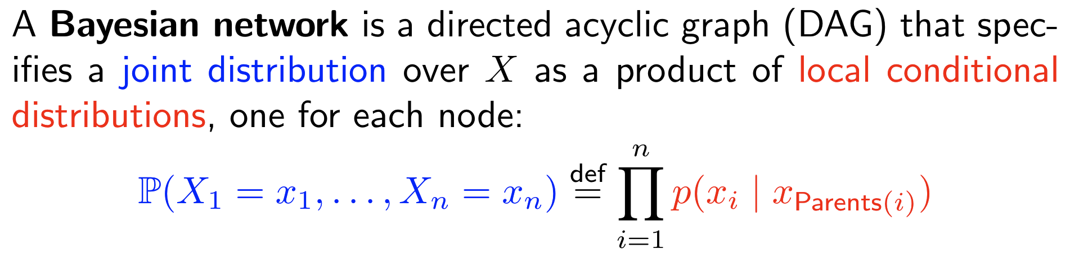
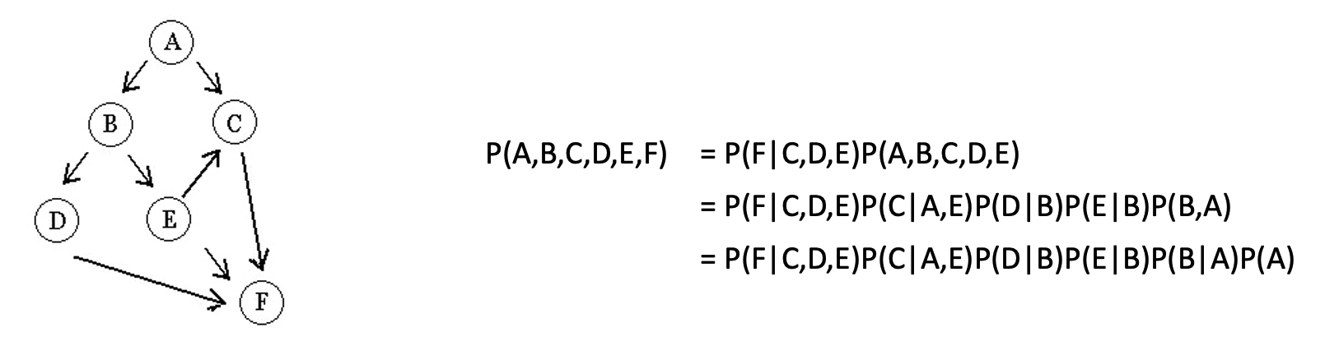
Bayesian network is a model that represent the relationship between variables
lectures.gersteinlab.org - [Gao et al. (‘24) Bioinfo. (submitted)]
Notes:
https://web.stanford.edu/class/archive/cs/cs221/cs221.1196/lectures/bayes1.pdf

Slide 32
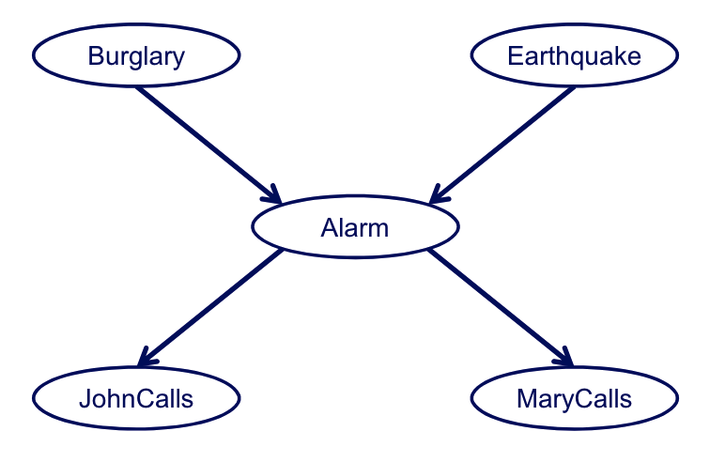
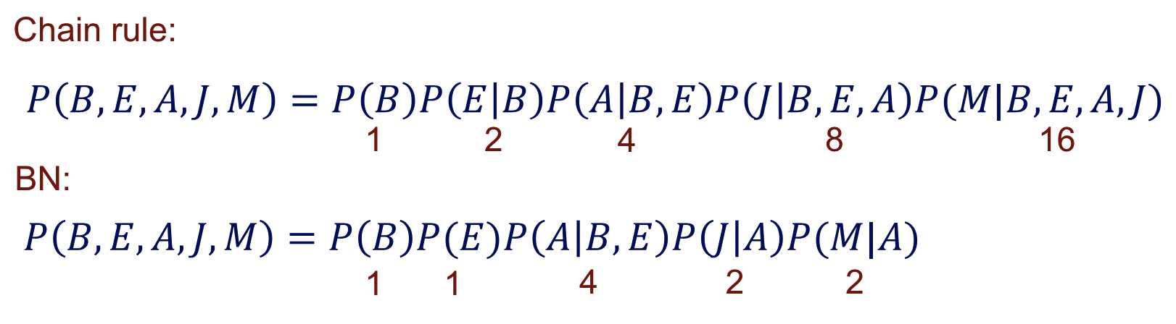
With the network structure (local conditional probabilities), the model describes the joint probability in a more compact manner
Number of parameters (assuming all variables are binary):
lectures.gersteinlab.org - [Gao et al. (‘24) Bioinfo. (submitted)]
Notes:
And structure is based on prior knowledge, or provide potential causal info
https://pages.cs.wisc.edu/~dpage/cs760/BNs1_handout.pdf

Slide 33
Naive Bayes

Slide 34
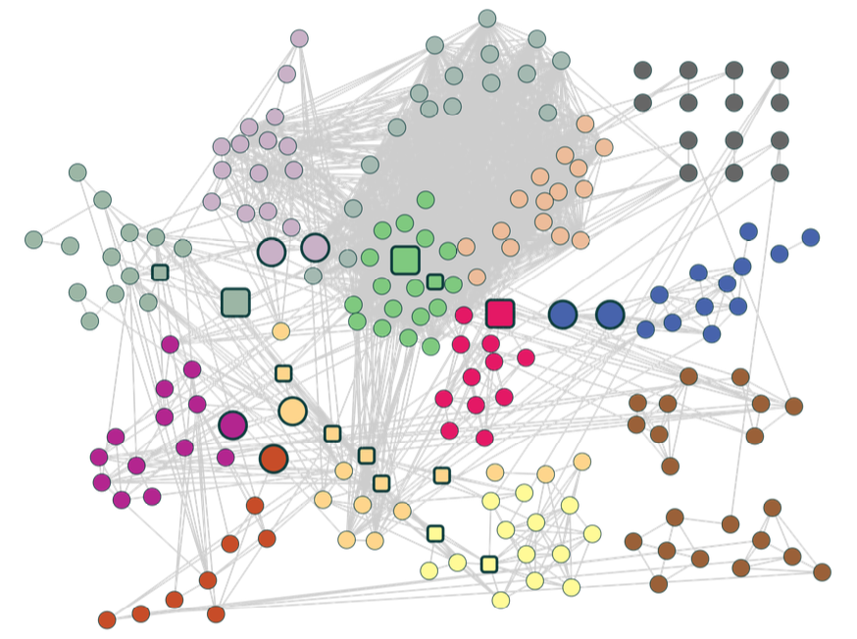
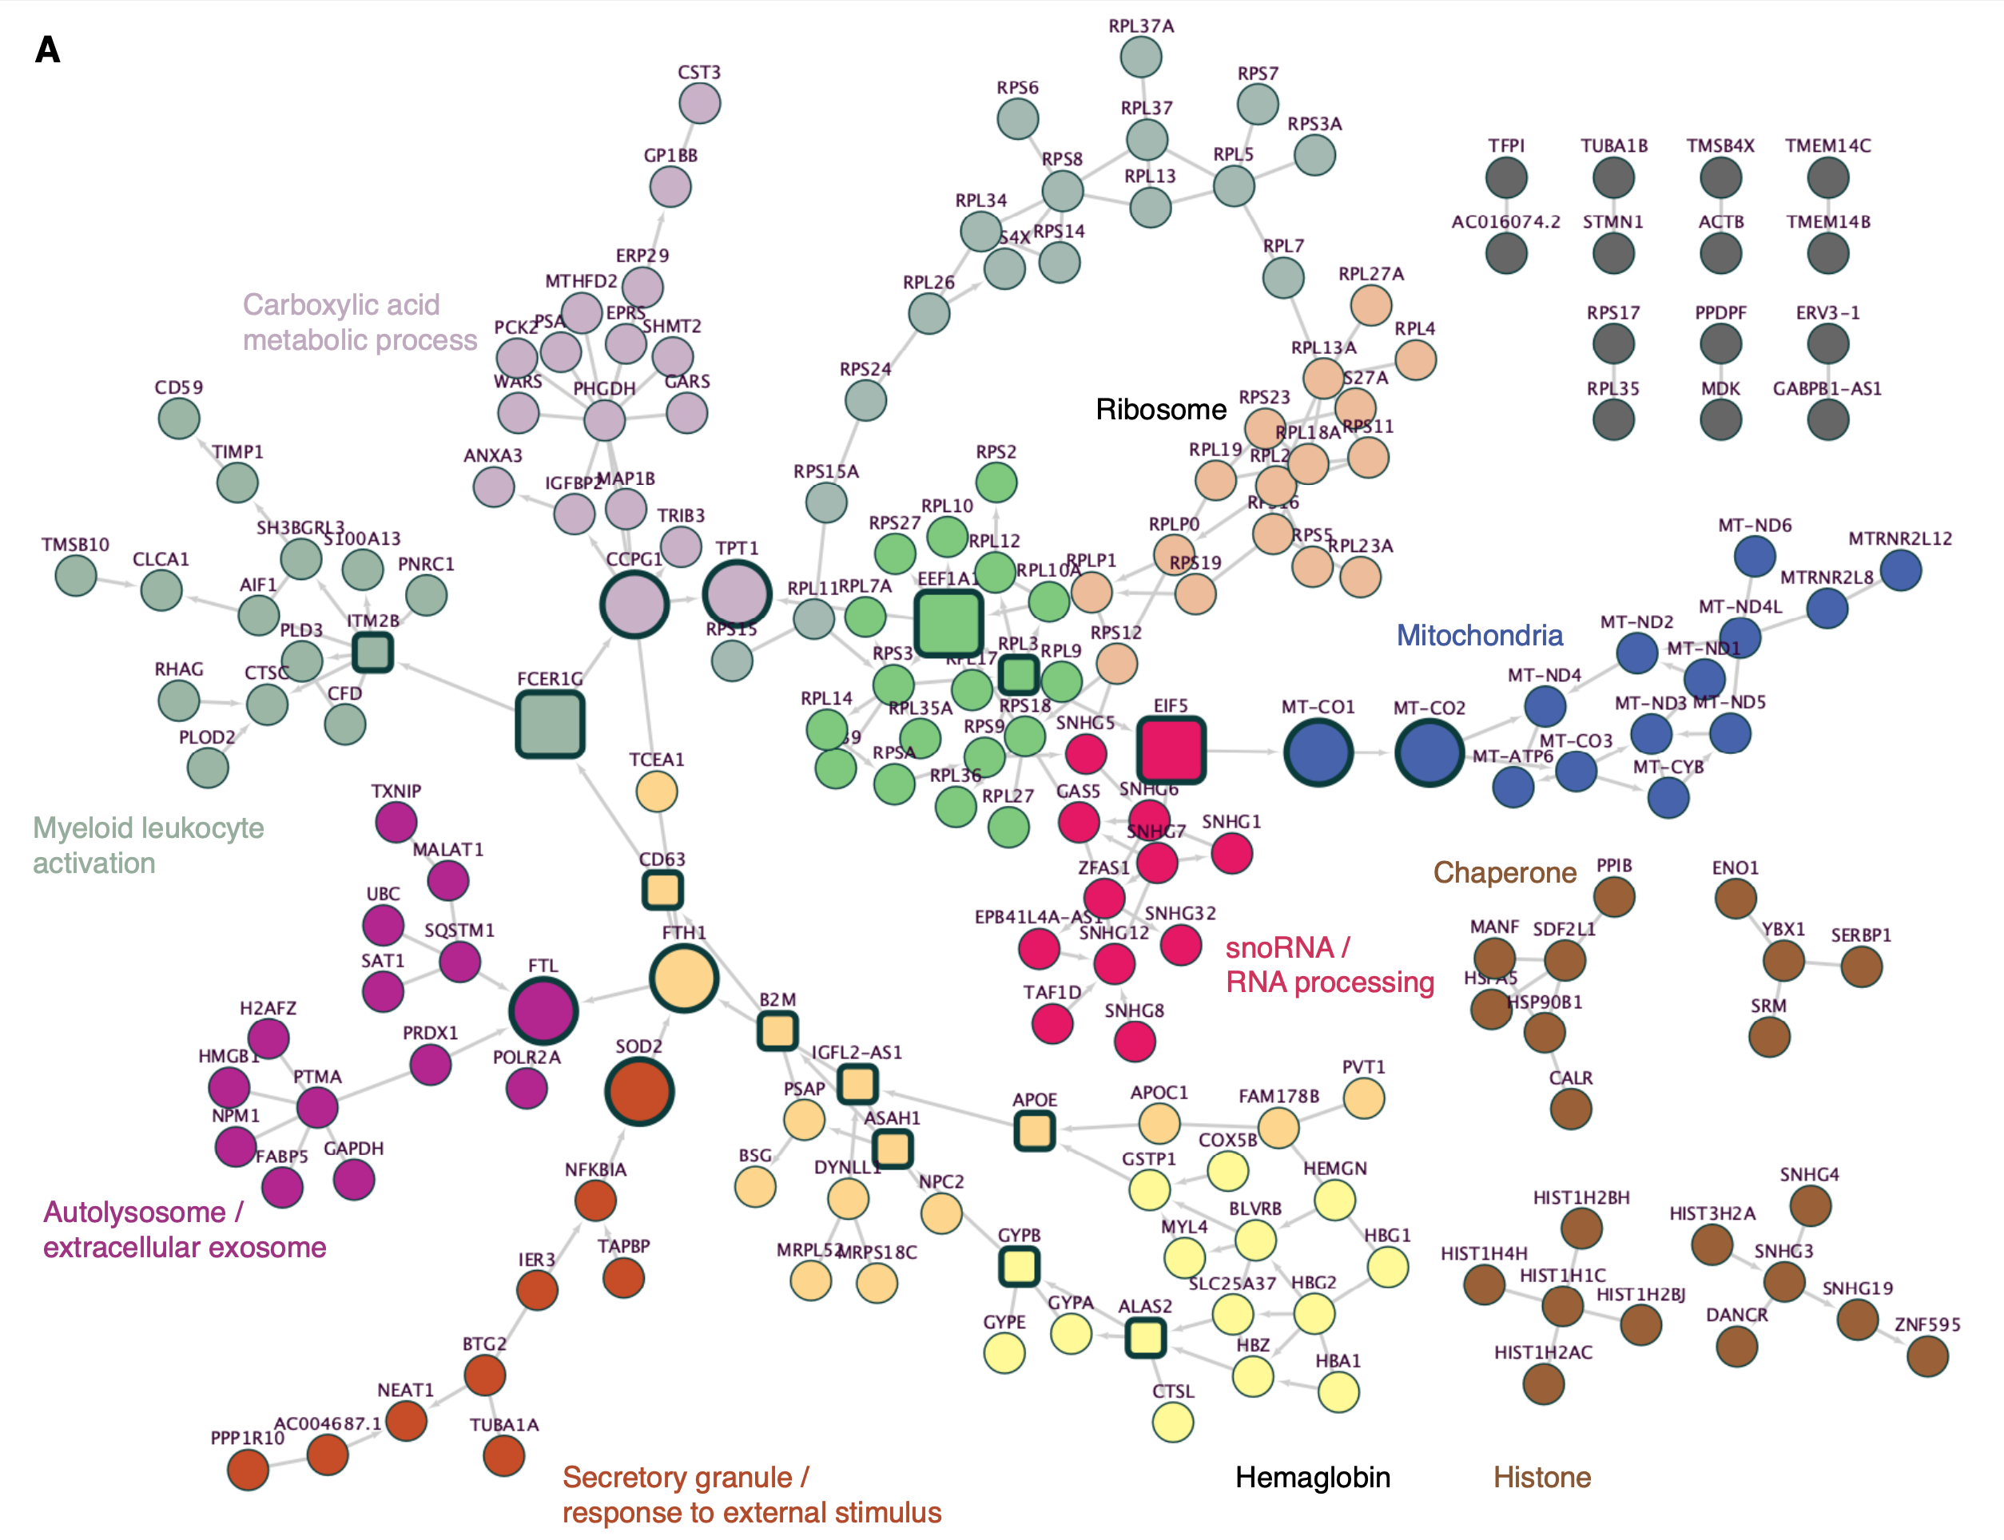
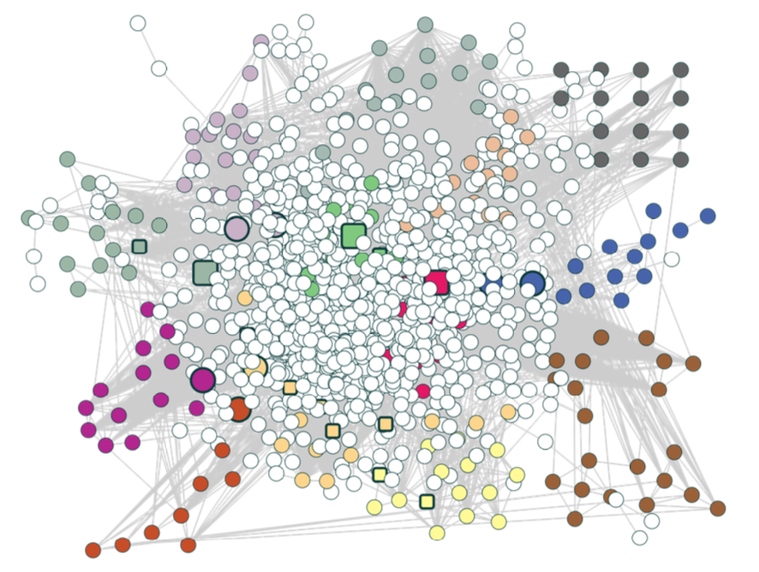
Co-expression
lectures.gersteinlab.org - [Gao et al. (‘24) Bioinfo. (submitted)]
Co-expression +
uninformative genes
Bayesian Network

Slide 35
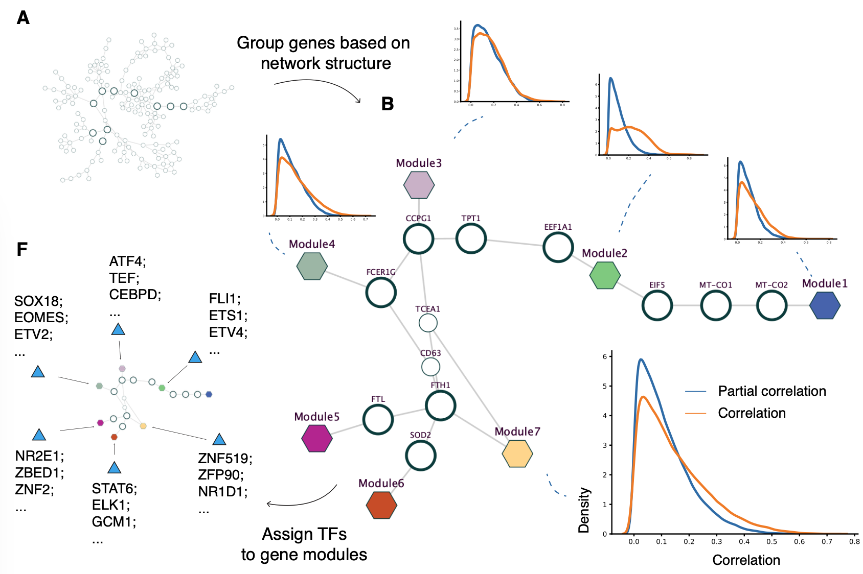
Relatively independent gene modules, after fixing the “connector” genes
(“Markov Blanket”)
lectures.gersteinlab.org - [Gao et al. (‘24) Bioinfo.]

Slide 36
References
James, Gareth, Witten, Daniela, Hastie, Trevor, Tibshirani, Robert
An Introduction to Statistical Learning: with Applications in R
[ ISLR (2nd edition) ]
https://www.amazon.com/Introduction-Statistical-Learning-Applications-Statistics/dp/1071614177/ + https://www.statlearning.com
(Chapter 4.4.4 and 4.7.5 gives background on Naive Bayes.)
Edwards et al. (2002). Trends in Genetics, 18(10), 529–536.
Bridging structural biology and genomics: assessing protein interaction data with known complexes.
https://doi.org/10.1016/s0168-9525(02)02763-4
(Relates to the worked example.)
Lectures.gersteinlab.org

