Slide 1
Biomedical Data Science (GersteinLab.org/courses/452)
Network Topology -- Intro (25m10a)
Last edit in spring ’25. Very similar to 2022’s 22m10a &
2021’s M10a [which has a video].
Mark Gerstein
Yale U.

Slide 2
Network Topology
Reasons for Networks: Overcome shortcomings
of linear genome annotation

Slide 3
Current Annotation:
1D Browser Tracks
Will this scale to 1000+ tracks? What will next-gen annotation look like?...
Systems from Parts

Slide 4
Current Annotation:
1D Browser Tracks
Will this scale to 1000+ tracks? What will next-gen annotation look like?...
Systems from Parts

Slide 5
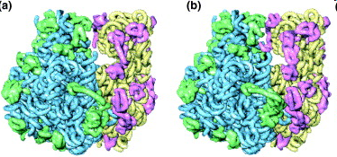
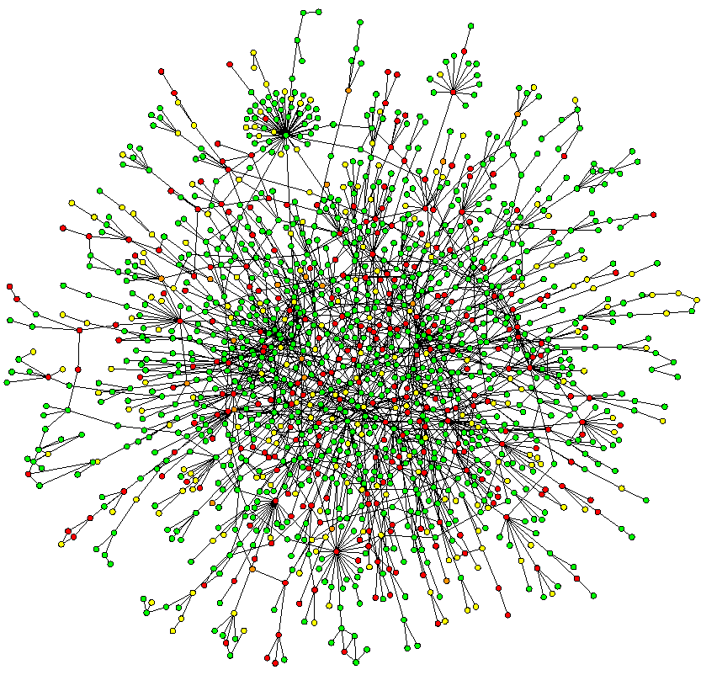
Networks occupy a midway point in terms of level of understanding
~2D: Network
Wiring Diagram of a Molecular System
3D & 4D:
Detailed structural understanding of cellular machinery
(e.g. ribosome in different functional states)
1D: Complete
Partslist
(“Elements” in genomic tracks)
[UCSC genome browser]
[Jeong et al. Nature, 41:411]
[Chiu et al. Trends in Cell Biol, 16:144]

Slide 6
Network Topology
Reasons for Networks: Useful way of thinking about disease

Slide 7
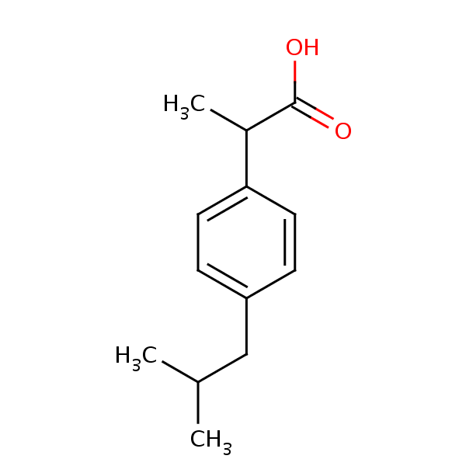
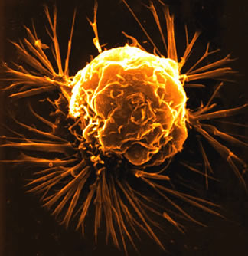

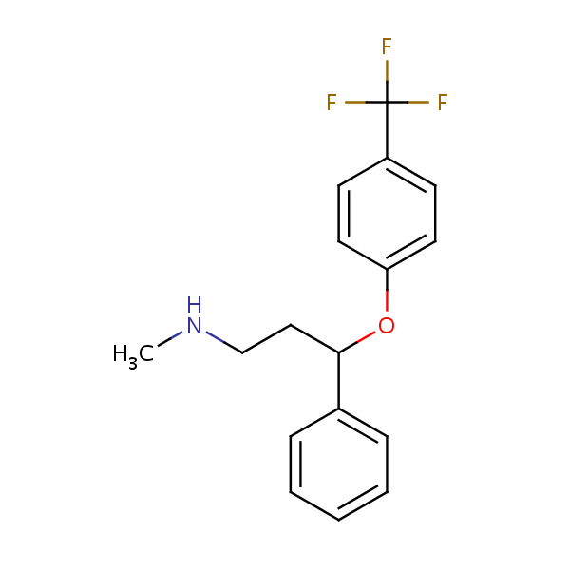
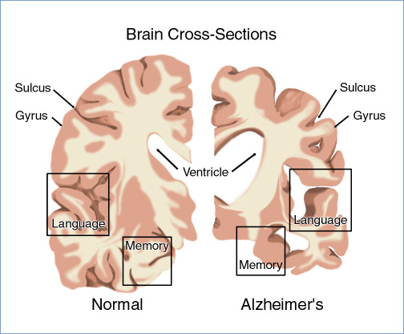
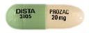
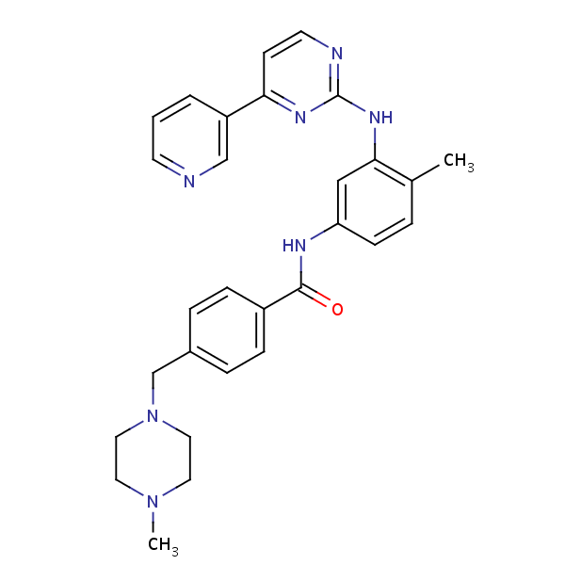

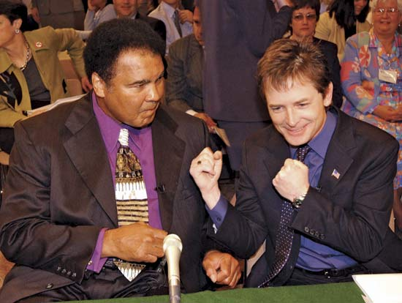
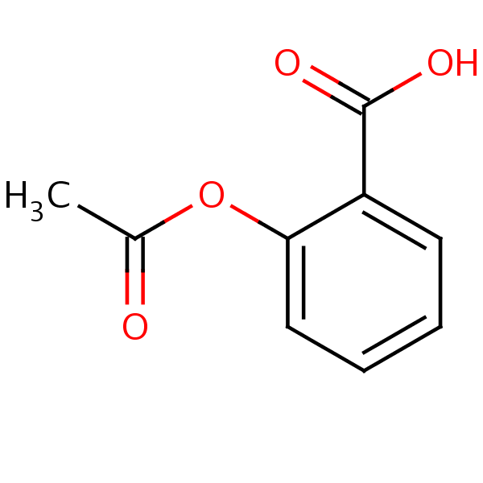
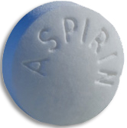
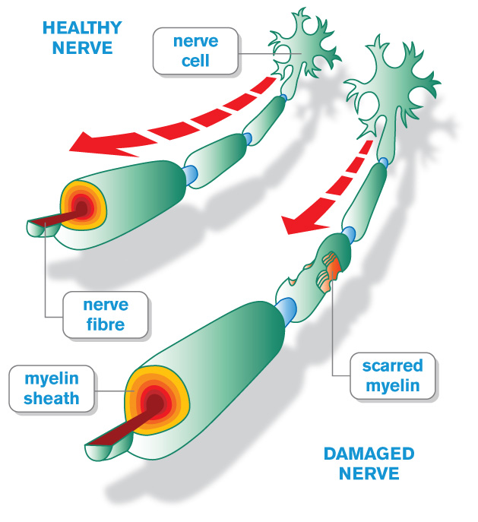
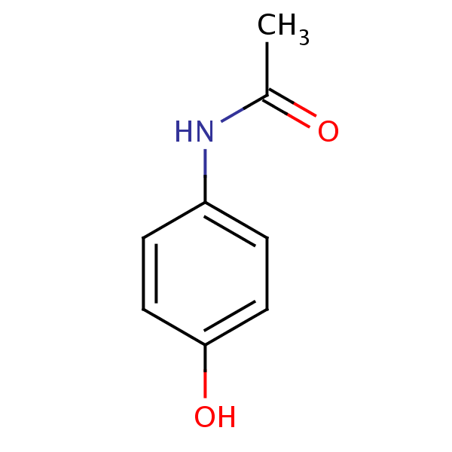

Network pathology & pharmacology
Breast
Cancer
Alzheimer’s
Disease
Parkinson’s
Disease
Multiple
Sclerosis
Interactome networks
[Adapted from H Yu]

Slide 8
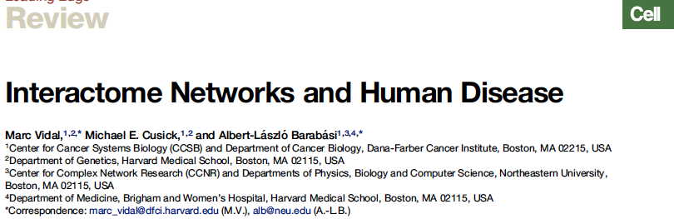
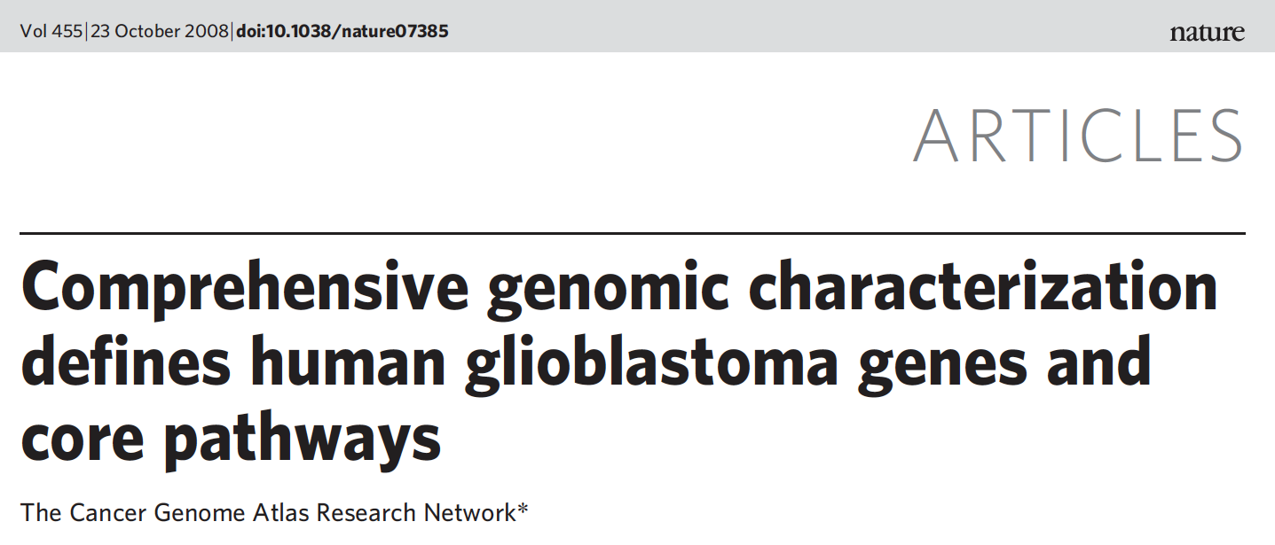
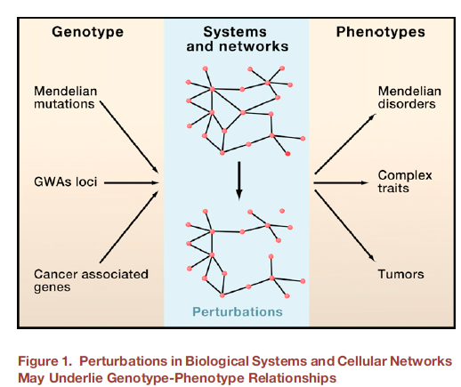
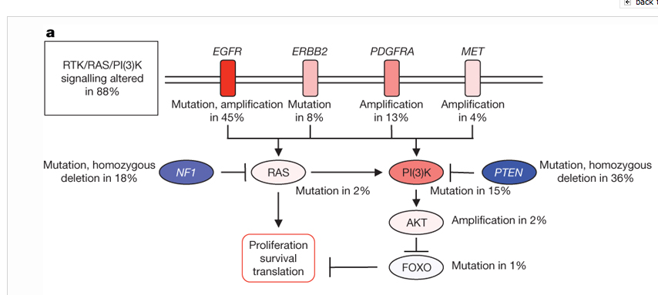

Slide 9
Network Topology
Reasons for Networks: Comprehensive representation, capable of representing many types of biological & non-biological data & bridging between disciplines

Slide 10
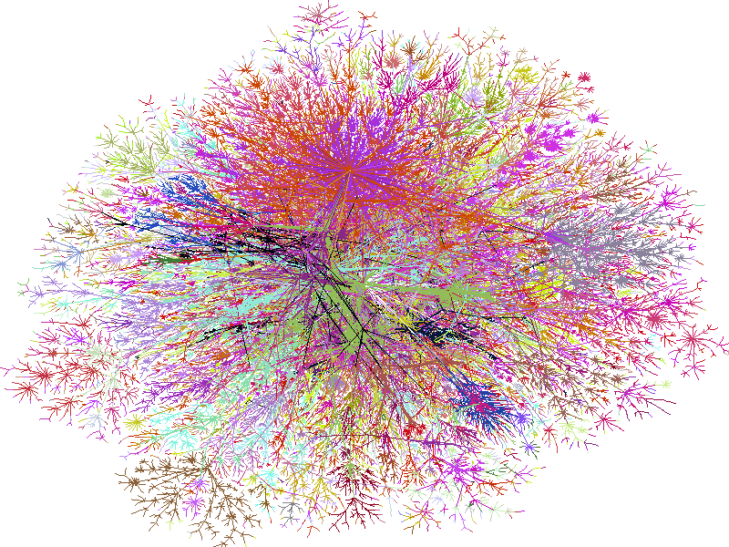
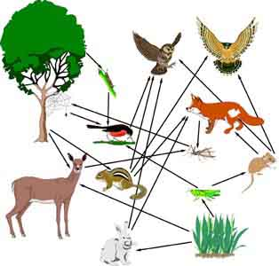
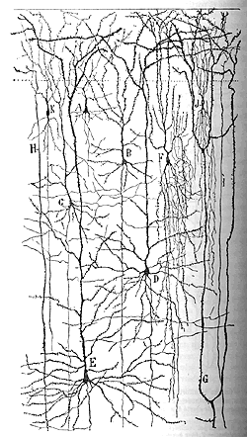
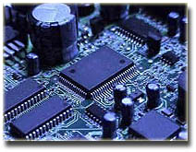
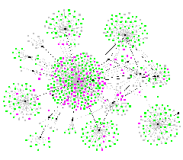
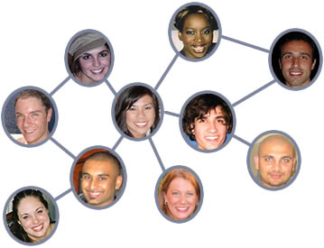
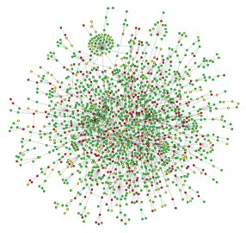
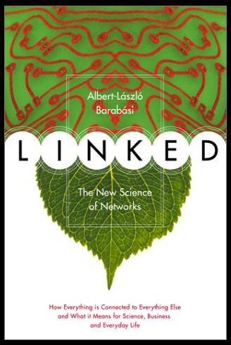
Networks as a universal language
Internet
[Burch & Cheswick]
Electronic
Circuit
Food Web
Disease Spread
[Krebs]
Neural Network
[Cajal]
Protein
Interactions
[Barabasi]
Social Network

Slide 11
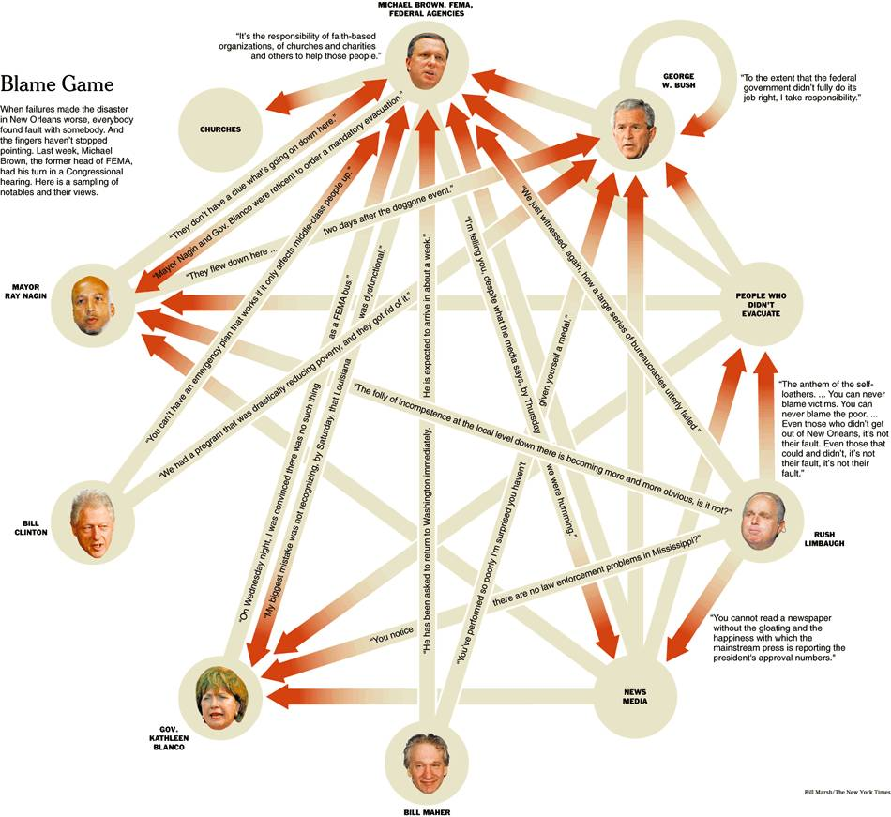
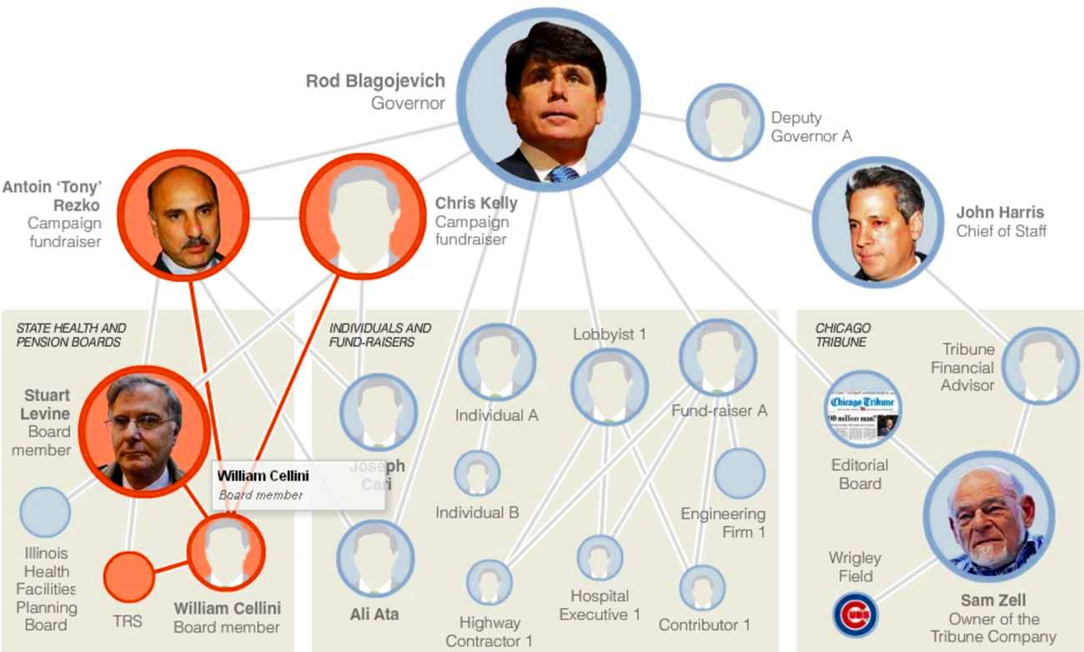
Using the position in networks to describe function
Guilt by association
Finding the causal regulator
(the "Blame Game")
[NY Times, 2-Oct-05, 9-Dec-08]

Slide 12
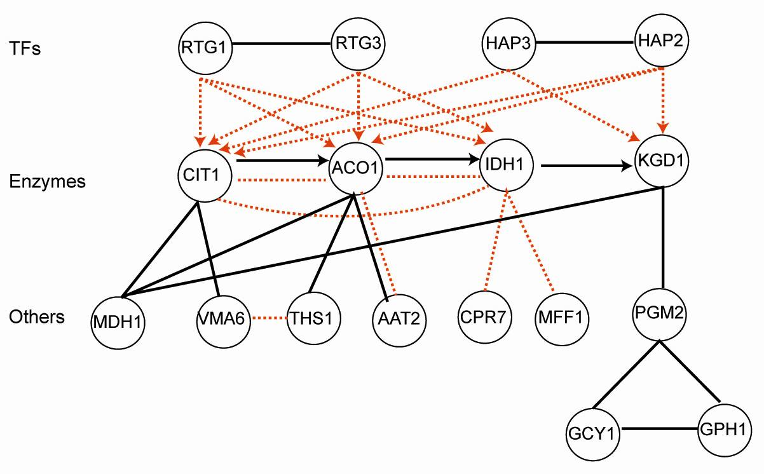
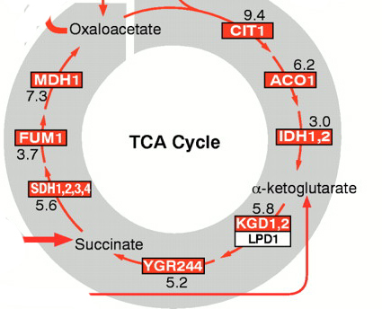
Combining networks forms an ideal way of integrating diverse information
Metabolic pathway
Transcriptional regulatory network
Physical protein-protein Interaction
Co-expression Relationship
Part of the
TCA cycle
Genetic interaction (synthetic lethal)
Signaling pathways

Slide 13
References
McGillivray, P., Clarke, D., Meyerson, W., Zhang, J., Lee, D., Gu, M., Kumar, S., Zhou, H., & Gerstein, M. (2018). Annual Review of Biomedical Data Science, 1(1), 153–180.
Network analysis as a grand unifier in biomedical data science. https://doi.org/10.1146/annurev-biodatasci-080917-013444
(Section 1.)
Lectures.gersteinlab.org

