Slide 1
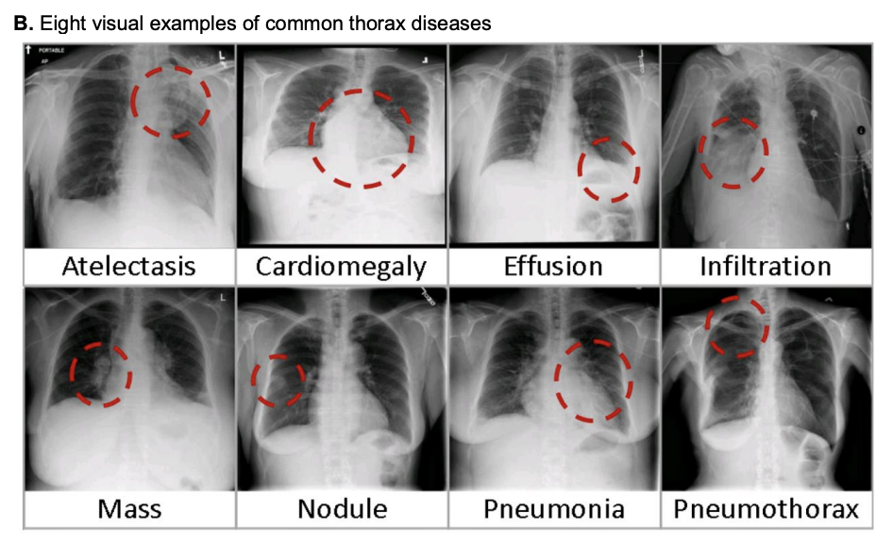
Medical Image Data Analysis (25t2)
Suchen Zheng
CBB 752 Spring 2025

Slide 2
Medical Image Data Analysis
Medical image analysis involves various tasks such as image segmentation, image registration, feature extraction, classification, and visualization.
The primary objective of medical image processing is to extract meaningful information from medical images to aid in diagnosis, treatment planning, and therapeutic interventions

Slide 3
Motivation
Americans experience 12 million diagnostic errors a year
(1 out of 20)
[Source: The Institute of Medicine; in the news: goo.gl/b7B1iq]
Approximately 795,000 Americans experience permanent disability or death annually due to misdiagnosis of serious conditions
[Source: JHU; https://bit.ly/4ih2TrQ]
Breast cancer misdiagnosis costs $4B/year
[Source: CNBC https://goo.gl/2THOG7 ]
Notes:
Here we look at the motivation in medical image analysis, we look at numbers of America,
A 2017 study found that at least 1 in 20 U.S. adults experiences a diagnostic error each year, translating to approximately 12 million cases annually. ​
A more recent study from JHU in 2023 estimated that, 795 000 Americans become permanently disabled or die annually
across care settings because dangerous diseases are misdiagnosed.
just as an example for breast cancer Misdiagnosis costs almost 4 billion a year so when we look at the economic side of things

Slide 4
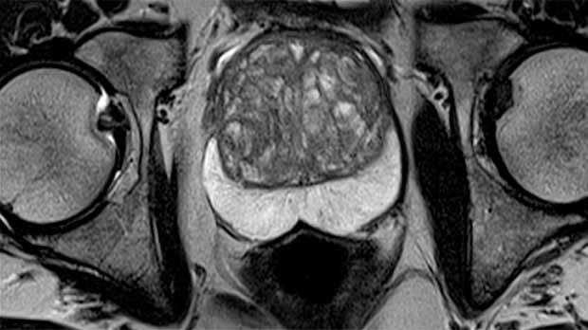
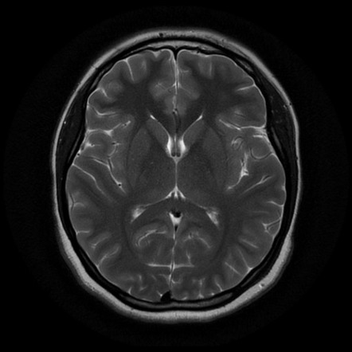
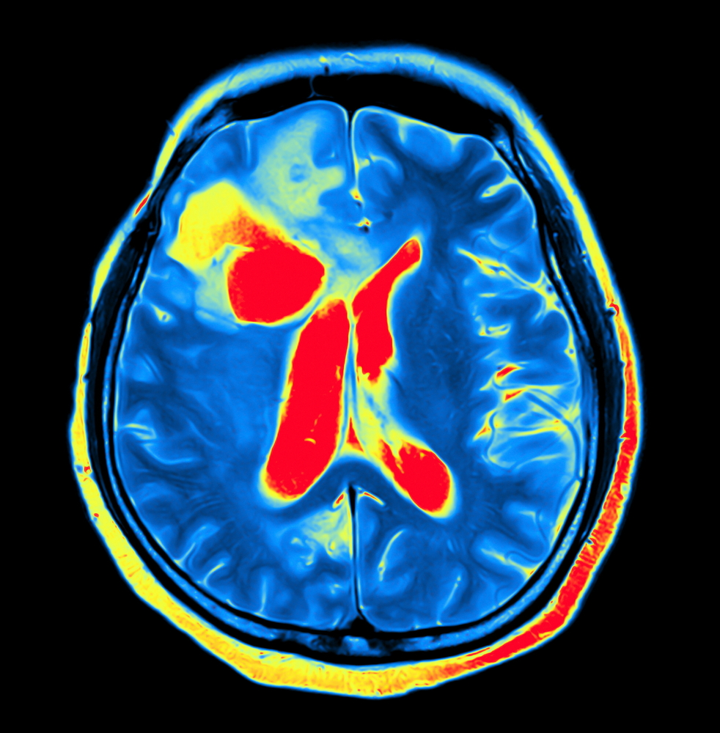
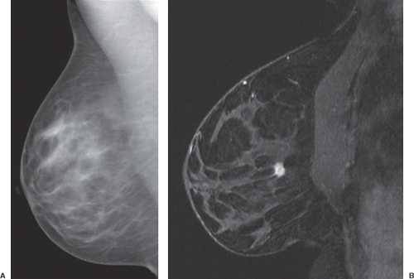
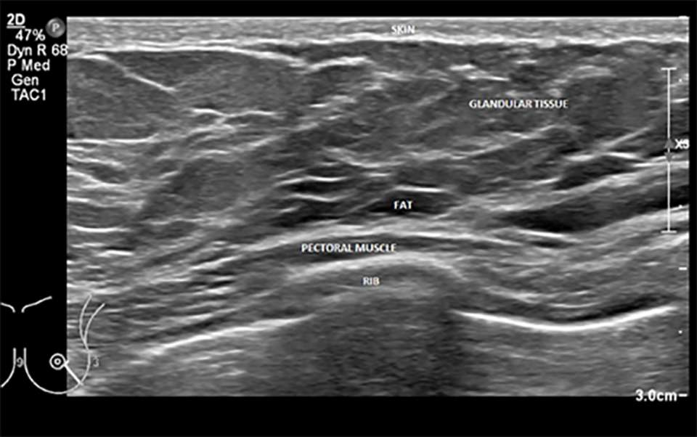
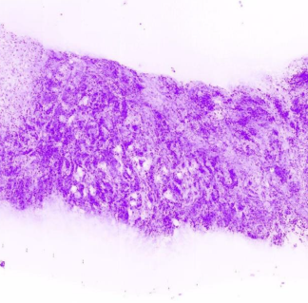
Medical Imaging
700 Billion images/year in the US alone
Prostate MR
Brain MRI
Parkinson PET
Breast cancer x-ray
Breast ultrasound (U/S)
Breast biopsy
Notes:
so we have many modalities in medical imaging as you can image, from MRI to CT , to PET, to x-ray, to ultrasound, to Light Microscopy
There are many many different modalities for different body parts for different purpose
so more than 700 billion images in US alone – you can double and triple this umber and you get the number globally how many images we might have…

Slide 5
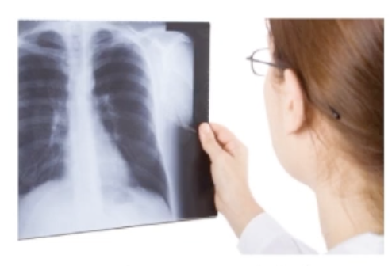
Misdiagnosis
There types of error:
1) Scanning error
[radiologist fails to fixate in area of lesion]
2) Recognition error
[radiologist fails to detect the lesion]
3) Decision-making error
[almost 50% of error by incorrect interpretation
of a malignant/benign as a benign/malignant
lesion]
Example: 85% of cases sent for breast needle biopsy come back negative.
Is there a nodule?
Radiology is one of the specialties most liable to claims of medical negligence. Most often, a plaintiff's complaint against a radiologist will focus on a failure to diagnose.
Pinto and Brunese, "Spectrum of diagnostic errors in radiology", World
J Radiol. 2010 Oct 28; 2(10): 377-383
Notes:
Misdiagnosis is clearly a problem in medical imaging so when we look at a x-ray
The question is is there nodule, and we will be accused of negligence if there was a nodule and we didn’t see it,
And is basically we failed to diagnosis
There are different type of erros
It could be scanning error, so the radiology is filed to fixiate the area of interest
Or it could be recognition error, fail to detect the lesion
Or it could be decision making error which is most of the time that the radiologist don’t know if it benign, is it malignant,
Is it something that we should worry about or not
So as an example, 85% of cases that send for breast biopsy come back negative which is great.
it means the patient didn’t have cancer but from efficiency of the health care system this s really bad.
But we cannot reduce this by jeopardizing the life of the patient

Slide 6
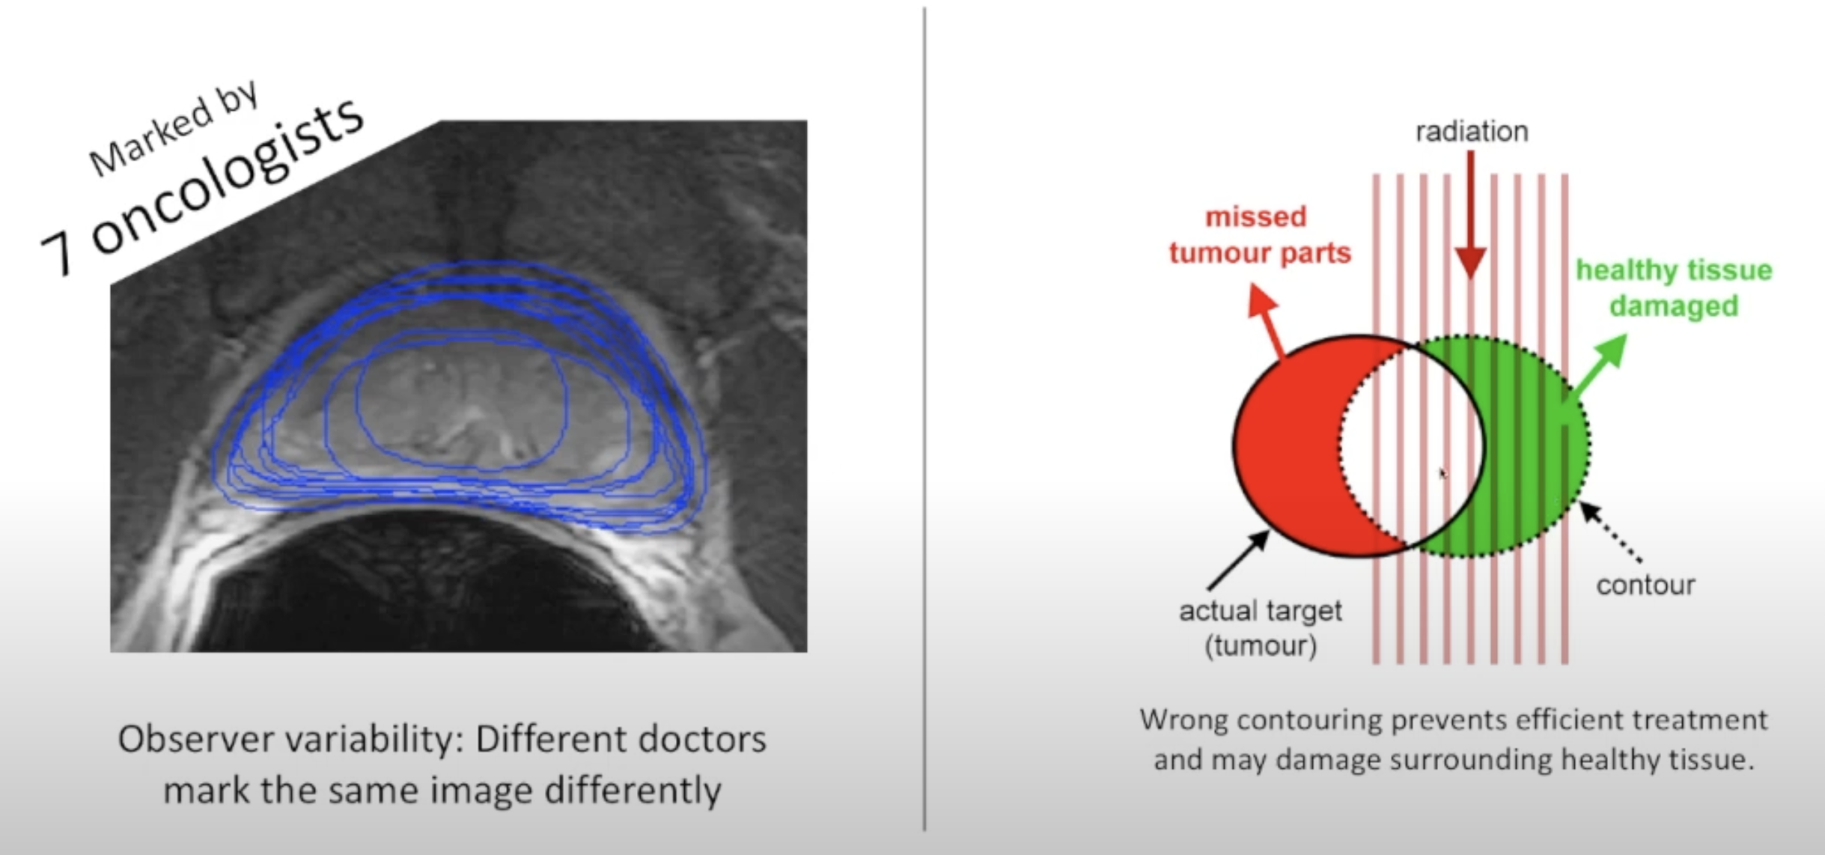
The Source of Problems:
Notes:
So how does this problem comes from
Take this prostate gland MRI image as an example that we might wan to calculate the psa density for diagnosis purpose
Or for treatment for focus of ultrasound so that we give this to radiologist or to another type of experts
And they will draw a contour around the prostate - this is segamentation
But if we give it to another doctor, he or she will do another one,
Here is a prostate makred by 7 concologist, the middle two ones are really off, which is very scary, and prostate is suppose to be easy
If we have so much variability, and we then go for radiation therapy,
Let’s say the red part if the tumor area,and we are radiating the tupot to kill the tumor.
If those. Coutour are not accurate, not only we will miss the the tpor part but we will also hit the healthy part.
While prostate is one of the easiest to do

Slide 7
The Source of Problems:
Inter-Observer Variability (= error):
Prostate 18%
Bladder 32%
Abdominal aorta 40%
Breast lumpectomy cavity 45%
Pulmonary nodules 54%
Notes:
there's a lot of literature in the on the clinical side
prostate 18
bladder 32 percent
abdominal 40
breast cavity 45 percent
up to the lung nodules 54 basically there is no agreement
so and uh the question is okay what do we do

Slide 8
The Source of Problems:
• What is going wrong in medical imaging?
- Misdiagnosis
Inaccurate/improper treatment planning
• What is the reason for variability?
- Imperfect information
- Complexity of diseases
- Subjective perception
• What are the consequences?
- Side-effects for the patient
- Prolonged treatment
- Reduced patient throughput
- Financial burden for patients/healthcare
- Legal ramifications

Slide 9
Precision Medicine
...predicting what treatment protocols are likely
to succeed on a patient based on various patient
attributes and the treatment context.
A machine learning approach to integrate big data for precision medicine in acute myeloid leukemia.
Lee Sl, et al. Nat Commun. 2018 Jan 3; 9(1):42.
Notes:
Everybody is talking about precision medicine, it’s very important for us, it’s very important to make use of what we have which is the huge amount of image data to increase the accuracy and precision in medical image diagnosis

Slide 10
Historical Perspective (1990s - 2020s)
Early Approaches (1990s):
  Traditional image processing techniques:
    Image enhancement (gray-level mapping, filtering)
    Segmentation and region extraction
  Focused on improving image quality for manual interpretation
Machine Learning Era (2010s):
  Feature-based models for classification and segmentation
  Big data workflows for processing large medical image datasets
  More automation, but feature engineering was required
Deep Learning Revolution (2020s):
  CNNs, GANs, RNNs, and hybrid models dominate the field
  Shift from manual feature extraction to end-to-end learning
  Real-time processing, higher accuracy, clinical applications
Notes:
So the journey of medical image data analysis starts after digital image become available

Slide 11
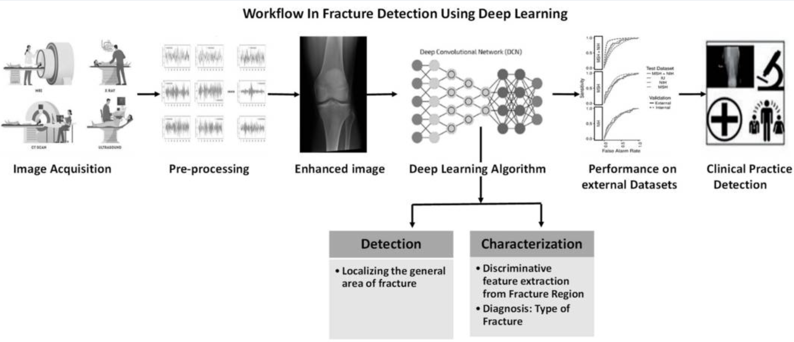
Examples
Bone Fracture Detection Using Deep Supervised Learning
from Radiological Images
Meena T, Roy S. Bone Fracture Detection Using Deep Supervised Learning from Radiological Images: A Paradigm Shift. Diagnostics (Basel). 2022 Oct 7;12(10):2420. doi: 10.3390/diagnostics12102420. PMID: 36292109; PMCID: PMC9600559.

Slide 12
Examples
Chest X-ray analysis for tuberculosis detection
Nafisah, S.I., Muhammad, G. Tuberculosis detection in chest radiograph using convolutional neural network architecture and explainable artificial intelligence. Neural Comput & Applic 36, 111–131 (2024). https://doi.org/10.1007/s00521-022-07258-6
Notes:
Use a CNN model achive 99.1% accuracy

Slide 13
Key Techniques in Medical Image Analysis
1. Traditional Image Processing
  Image Enhancement: Histogram equalization, noise reduction
  Segmentation: Edge detection, thresholding, region growing
  Feature Extraction: Shape, texture, intensity-based features
2. Machine Learning Approaches
  SVM, Random Forests for classification
  Feature selection and dimensionality reduction
3. Deep Learning Approaches
  CNNs (Convolutional Neural Networks): Used for segmentation, classification
  GANs (Generative Adversarial Networks): Synthetic data generation, image augmentation
  RNNs/LSTMs (Recurrent Neural Networks): Time-series medical images (e.g., MRI scans over time)
  LLM (large language models):

Slide 14
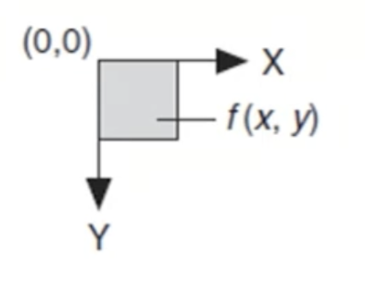
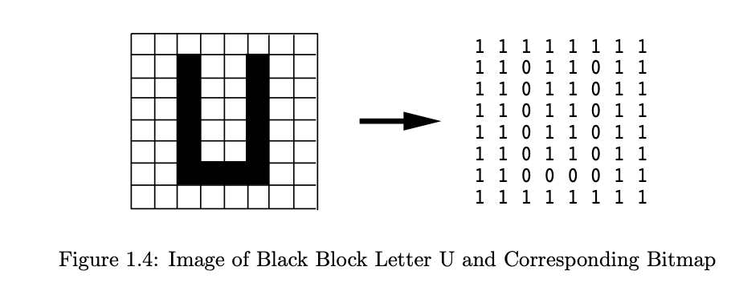
Digital Image
A digital image is a 2D array of values representing light intensity → f(x,y)
Notes:
A digital image is a 2D array of values representing light intensities.
2D array means the image can be represented as a matrix, has X columns, as Y rows. Each cell in the matrix represented by an x and a y, is a pixel
Each pixel hold a value that represent the light intensity
For example, on the right here, is a simple image of a letter U, when we look at the digital image representation of this letter u, there are only two different light intensity in this image
Black and white, where 1s representing where we have white, and 0s representing where we have black pixel. If we have a more complex image containing different level of grey colors, we will have light intensity values between 0 and 1.

Slide 15
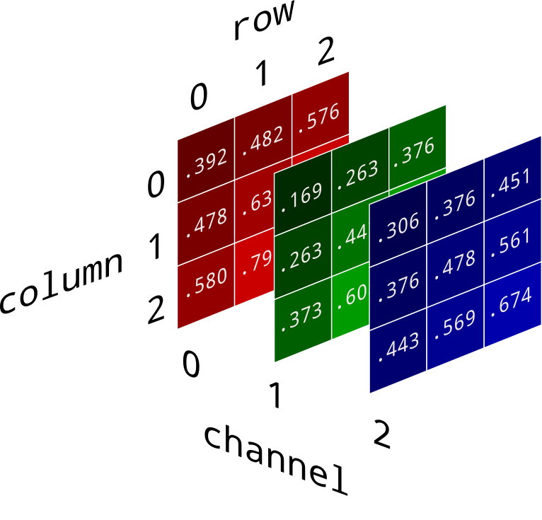
Properties of Digital Images
Image resolution/ Spatial resolution: m x n → Columns x Rows
dpi (Dots Per Inch)
e.g. An 8" x 10" document that is scanned at 300 dpi has the pixel dimensions of 2,400 pixels (8" x 300 dpi) by 3,000 pixels (10" x 300 dpi).
Image Definition: Number of shades→ 2^n , n= bit depth
(e.g. 8 bit image → 256 shades, 16 bit image → 65, 536 shades)
Images → 8-bit, 10-bit, 12-bit, 14-bit, 16-bit, color encoded
Number of Planes: Number of arrays of pixel.
Grayscale → 1 plane,
True-color Image → 3 planes (RGB)
More about digital image: http://preservationtutorial.library.cornell.edu/tutorial/contents.html
Notes:
What are the different properties of digital images:
First if the resolutions. It’s the number of pixels, number of columns multiplied by the number of rows
a common concept when interacting with digital image is dpi, says dots per inch. How many pixel per inch
The pixel dimensions may be determined by multiplying both the width and the height by the dpi.
An example of calculating the resolution is An 8" x 10" document that is scanned at 300 dpi has the
pixel dimensions of 2,400 pixels (8" x 300 dpi) by 3,000 pixels (10" x 300 dpi).
Second the number of shades, how many number of shades are there. Say how many different values your pixel can have. Say 2 to the power n, where n is the bit depth.
BIT DEPTH is determined by the number of bits used to define each pixel. The greater the bit depth, the greater the number of tones (grayscale or color) that can be represented.
Digital images may be produced in black and white (bitonal), grayscale, or color. This is because when information stored, they stored in binary format. The number of bit the computer used to represent a pixel define the number of different possible shades your color can have.
8 bits image can have 256 different shades, 16 bits can have 65k different shades
In Biomedical images, 8-bits is sufficient, no need for higher bits. With higher, you need more storage, image size goes higher.
Then coming to the Number of planes – it’s the number of array of pixel.
For grey scale image, you only have 1 plane, which is the light intensity.
for true-color image, you have 3 planes. RGB, red green, and blue
It is says, for each color image, you will be having a red plane, a green plane, and a blue plane, they have the same number of pixels,
What they do is that they combines information from all planes. On a pixel to pixel manner. That represent the true color information.
So you can synthesize any color, just by synthesize the different shade of red green and blue
True color information.

Slide 16
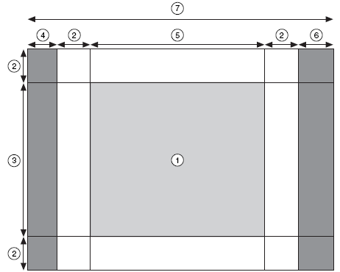
Image representation
1 Image 2 Image Border | 3 Vertical Resolution 4 Left Alignment | 5 Horizontal Resolution 6 Right Alignment | 7 Line Width
Notes:
Now that we've discussed the fundamental properties of digital images, let's take a closer look at how images are represented in a structured way. This slide breaks down an image into different components, helping us understand how an image is stored, displayed, and processed in medical imaging and other applications.
The main image labeled as 1, in the center area is the actual content of the image, where useful visual data is stored. In medical image, this could be an MRI scan, an X-ray or any diagnostic image
The image is represented as a grid of pixels where each pixels holds intensity or color information
An image is not just the visible pixels; it also includes additional components like borders and alignment regions, which help with efficient processing.
The image border consists of extra rows and columns of pixels to help maintain accuracy in image analysis by preventing artifacts at the edges.
Another important aspect is image alignment, which ensures that the image data is stored efficiently in memory. Aligning images to specific memory addresses—such as 64-byte boundaries—can significantly speed up processing,
The line width represents the total number of pixels in a row, including the main image content, border pixels, and alignment regions. In some cases, the line width matches the horizontal resolution, but often, additional pixels are added to maintain alignment. While these technical details are more relevant in specialized computing applications, understanding them helps in fields like medical imaging, machine learning, and data visualization, where efficient image processing is essential.

Slide 17
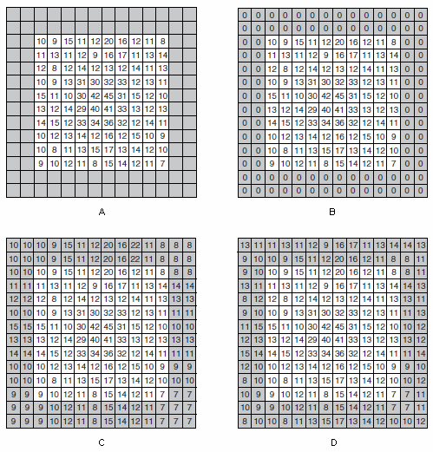
Image border
A – pixel value of the image
B – ‘0’ padding
C – copying of edge pixel values
D – mirror the pixel values at the edge
Notes:
Here we have a bit more explanations of image borders. This slide explains different ways to handle image borders, which are essential in biomedical image processing. Borders help when applying image filters, segmentation, or machine learning models, especially when working with convolution-based techniques.
The original image (A) consists of pixel values without any modifications. However, during processing, we often need to extend the image beyond its actual size to avoid losing information at the edges.
Method B, known as zero padding, adds a border filled with zeros. This is useful when we want to maintain image size but avoid introducing new pixel values. However, it may create artificial black edges that can affect image analysis.
Method C, or edge copying, replicates the outermost pixel values along the border. This approach helps preserve intensity patterns, where maintaining brightness consistency.
Method D, called mirror padding, reflects the pixel values at the edge, creating a more natural extension.
Choosing the right border handling method depends on the application. For example, in MRI or CT scans, preserving edge information is crucial, so methods like copying or mirroring are often preferred. Understanding these techniques ensures that medical image processing remains accurate and reliable.

Slide 18
Image Mask
An image mask isolates parts of an image for processing.
An image mask is used to highlight specific regions of interest (ROI)
An image mask is typically a grayscale or binary image where:
  White (1) or a specific intensity level represents the region of interest (e.g., a tumor, blood vessel, or organ).
  Black (0) or another intensity level represents the background or non-relevant areas.

Slide 19
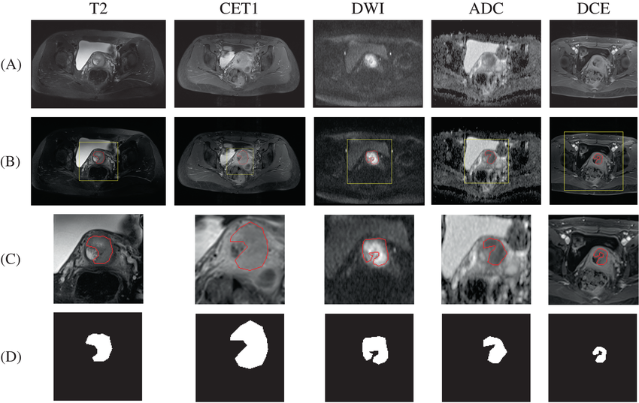
Image Mask
Within a biomedical image. In medical imaging, masks play a crucial role in segmentation, classification, and feature extraction, helping in tasks such as tumor detection, organ segmentation, and lesion analysis.
Raw MRI images;
cervical cancer annotations drawn by clinicians.
cropped MRI images overlapped with tumor annotations
cropped binary masks with tumor regions
Examples of MRI and mask preprocessing.
Notes:
In biomedical imaging, masks play a crucial role in segmentation, classification, and feature extraction.
Masks are particularly useful in applications like tumor detection, organ segmentation, and lesion analysis.
This slide provides a practical example of how image masks are applied to MRI scans for medical diagnosis.
The top row (A) shows raw MRI images taken using different imaging techniques (T2, CET1, DWI, ADC, DCE), which provide varying levels of contrast to highlight different tissue properties.
The second row (B) represents annotations drawn by clinicians, which outline regions of interest, such as potential tumor sites. These annotations serve as ground truth data for training AI models or guiding clinical decision-making.
In row C, the MRI images are overlapped with the tumor annotations, providing a clearer view of how the identified region compares to the original scan. This technique helps radiologists and AI systems validate whether a suspected lesion is correctly segmented.
Finally, in row D, we see the binary masks, where only the tumor regions remain as foreground (white), while the rest of the image is blacked out. This kind of masking is crucial for AI-driven image segmentation, where deep learning models rely on binary masks to learn patterns and improve detection accuracy.

Slide 20
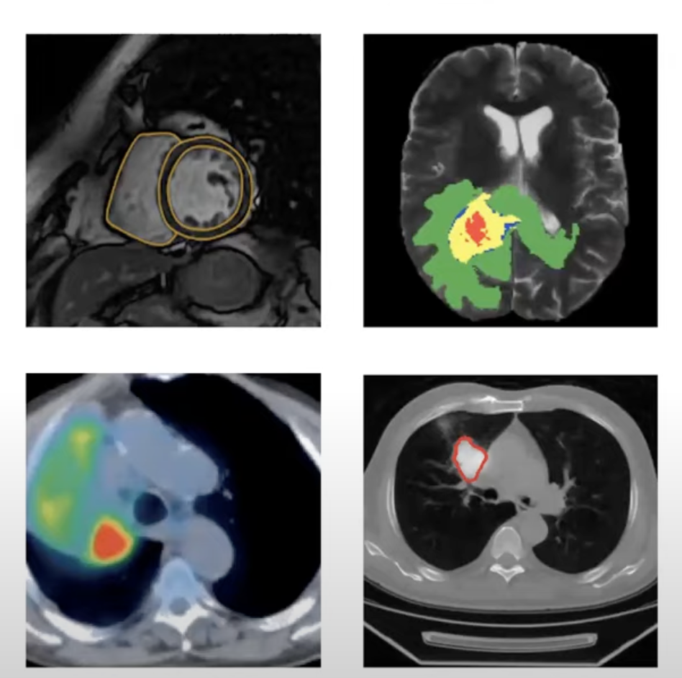
Image segmentation
Definition: Label each pixel in the image with a category label
Do not differentiate planes/instances, only care about pixels
The process of medical image segmentation can be divided into the following stages:
1. Obtain medical imaging data set
2. Preprocess the images
3. Use appropriate medical image segmentation method
4. Performance evaluation
Notes:
Image mask is very important for image segmentation, where it can highlight the area of interest when preprocessing the image
But you can apply multiple mask to a single image than just one, to focus on different part of the medical image or annotate regions with different importance, look at the whole region or just marking the contour
This is very important for medical image analysis

Slide 21
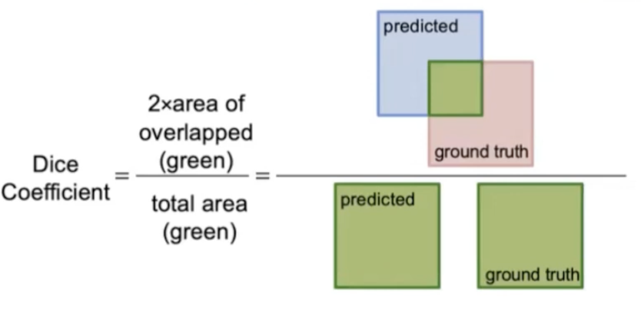
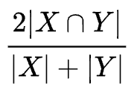
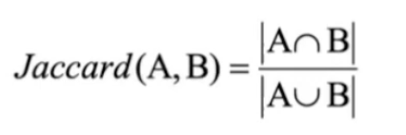
Image segmentation
Evaluation metrics
Diced index =
Jaccard Index

Slide 22
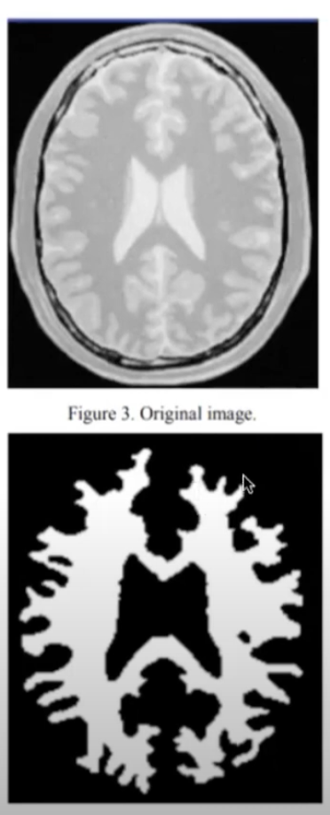
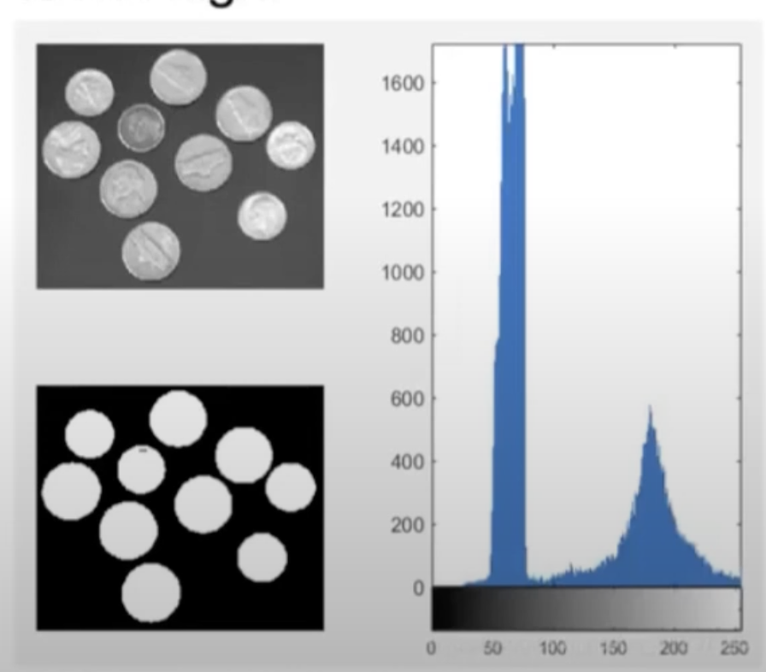
Image segmentation
Traditional Method
1. Threshold method
  Simple calculation, high efficiency
  Only consider the characteristics of the pixel point grayscale value itself, generally do not consider space characteristics
  more sensitive to noise, and the robustness is not high.
Notes:
Thresholding is one of the simplest and most widely used techniques for image segmentation, especially in biomedical imaging. This method works by setting an intensity threshold to separate different regions in an image based on pixel brightness. Pixels above the threshold value are classified as one region (often the foreground, such as an organ or tumor), while those below the threshold are classified as another region (often the background).
generate right by looking at this segmentation map it's actually pretty good right we are able to uh identify this corn region right the circle region
very accurately right so this is because the nature of the pixel intensity distribution of this particular image
um you know another example which is the actual medical image right this may be a imri image um by on the first glance that we can roughly see that right more or less you can see that there’s possibly there's a couple a few groups of pixel intensity right there's a darker region right pure black
here we'll just select one threshold right so in this case we generate a binary uh segmentation mask as you can see
We are able to generate uh a very rough segmentation map right you kind of Identify some of the structure of the
brains right but not to a very great details right/ we want to classify this gray matter or white matter but we are not able to um clearly distinguish these different classes but overall we still get a rough structure so you can see this capability of this threshold based method is very
limited right but for some of the simple cases this may work

Slide 23
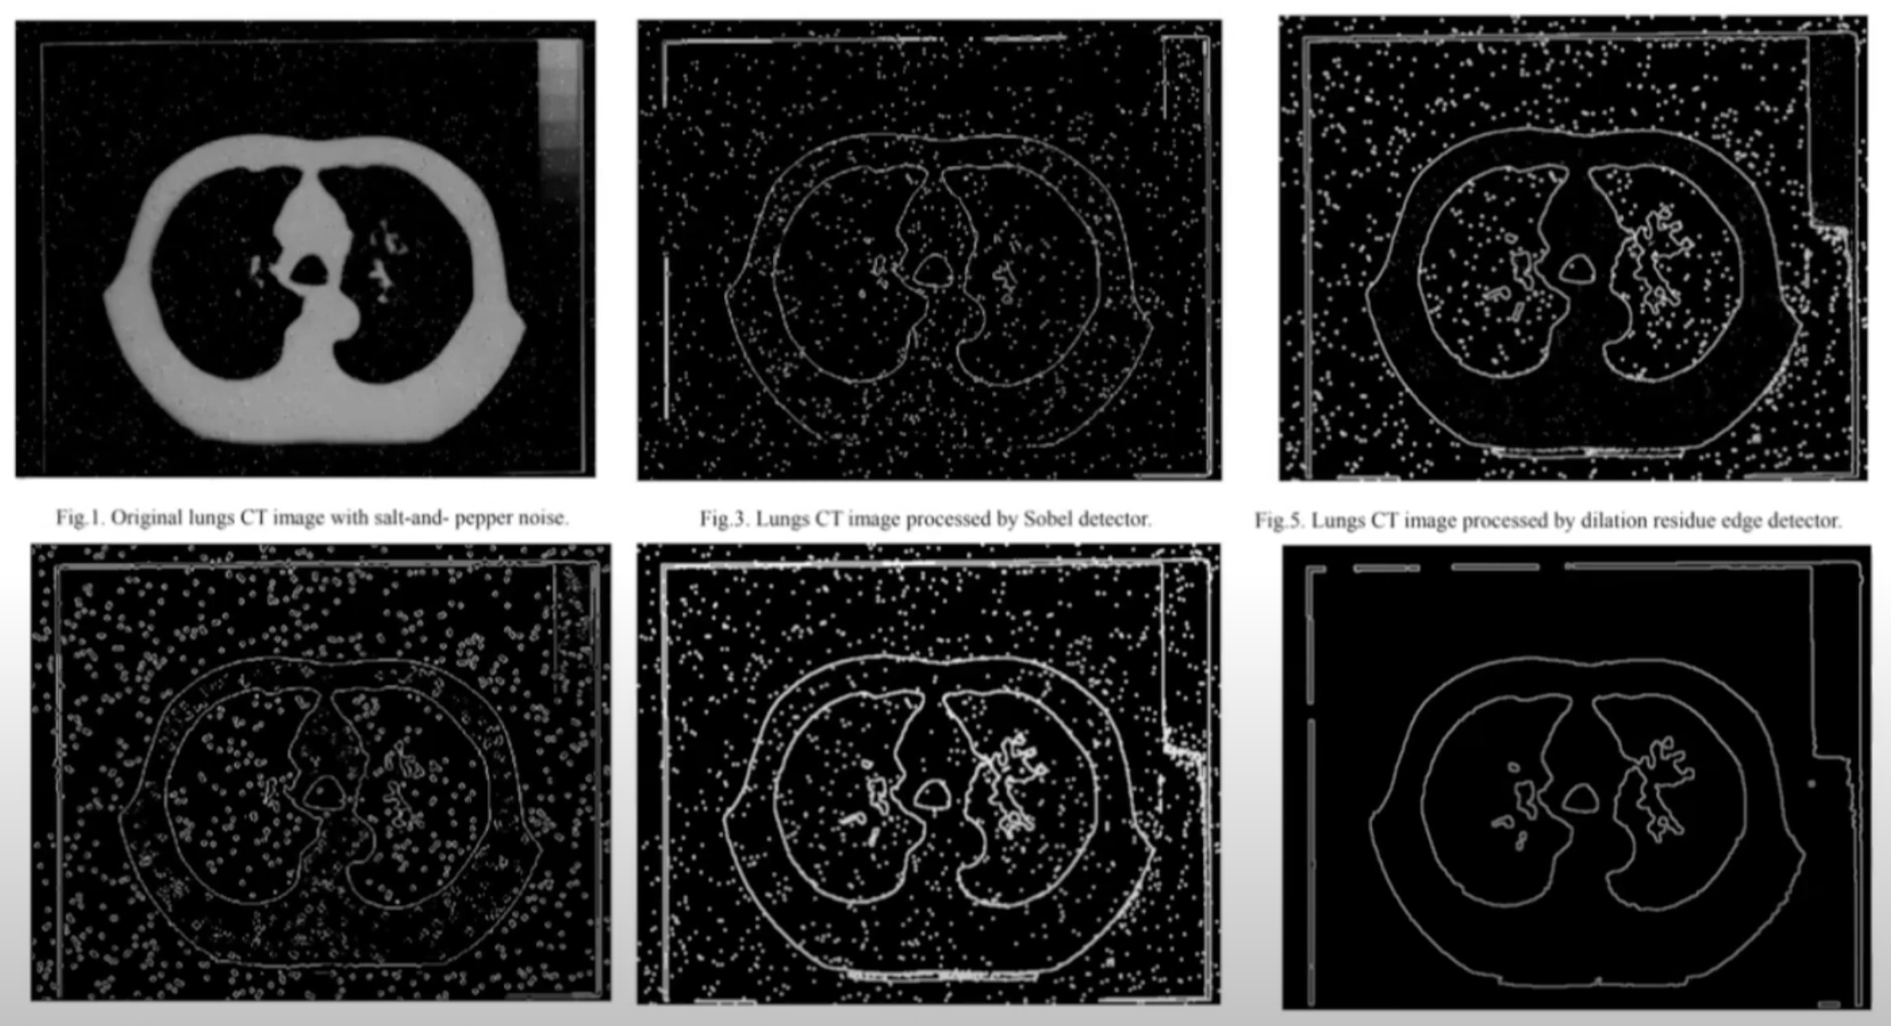
Image segmentation
Traditional Method
2. Edge detection-based Method

Slide 24
Image segmentation
Traditional Method
3. Region based segmentation
4. Segmenttion based on Graph theory
5. Segmentation based on Energy Function
Notes:
Not going through

Slide 25
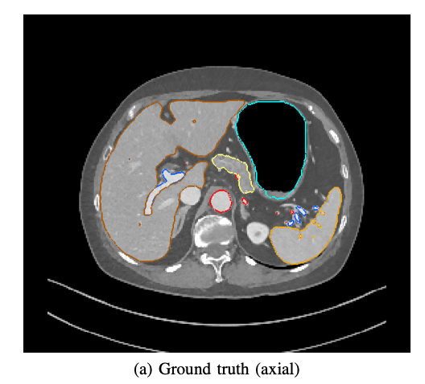
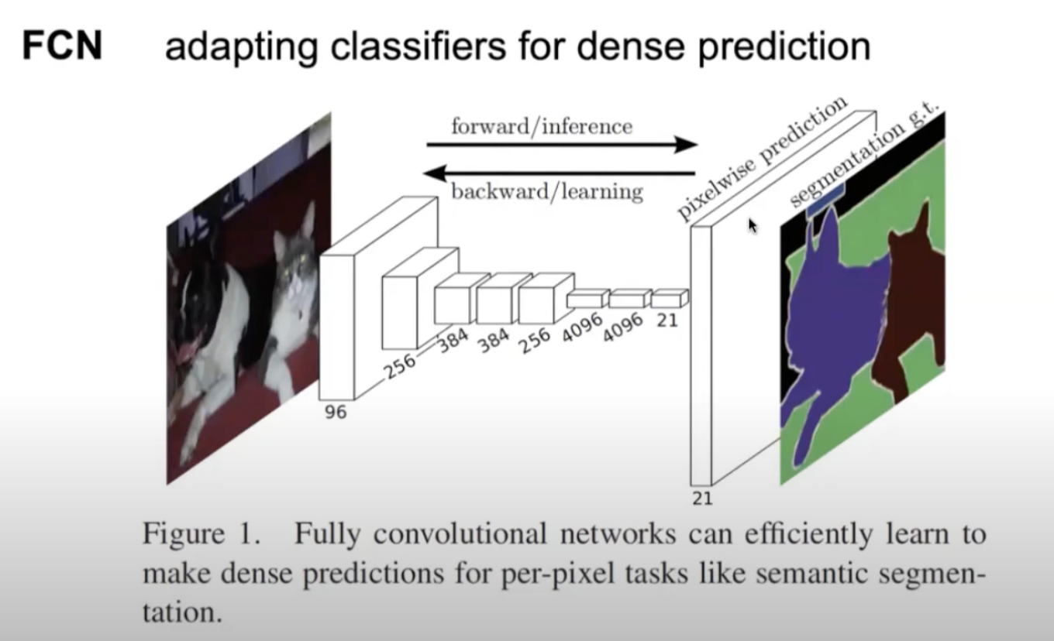
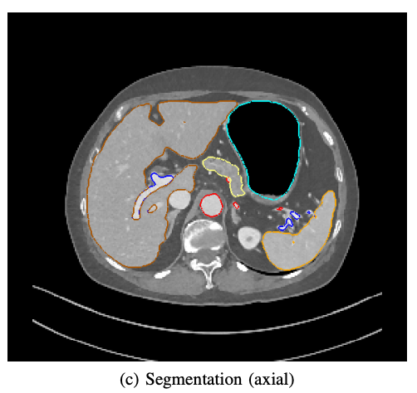
Image segmentation
Deep learning based method - FCN
Roth, Holger R., et al. "Deep learning and its application to medical image segmentation." Medical Imaging Technology 36.2 (2018): 63-71.
Notes:
You have the ground truth, on the top, annotated by the human expert
And use the fully connected network to learn the segmentation

Slide 26
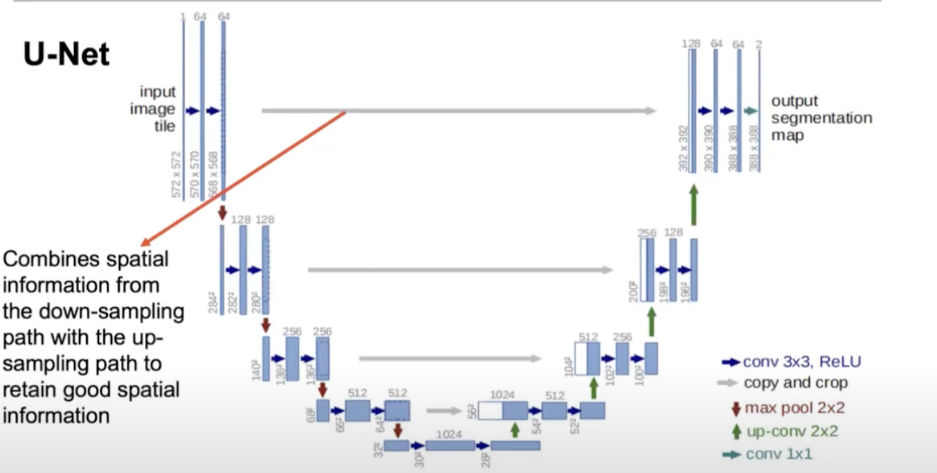
Image segmentation
Deep learning based method – U-Net
Notes:
The most popular method in biomedical image segmentation
Downsampleing then upsampling
Encoder-decoder like network
Put forward the spatial information from downsampleing to compensate the information lost during compression
- somewhat similar to resNet

Slide 27
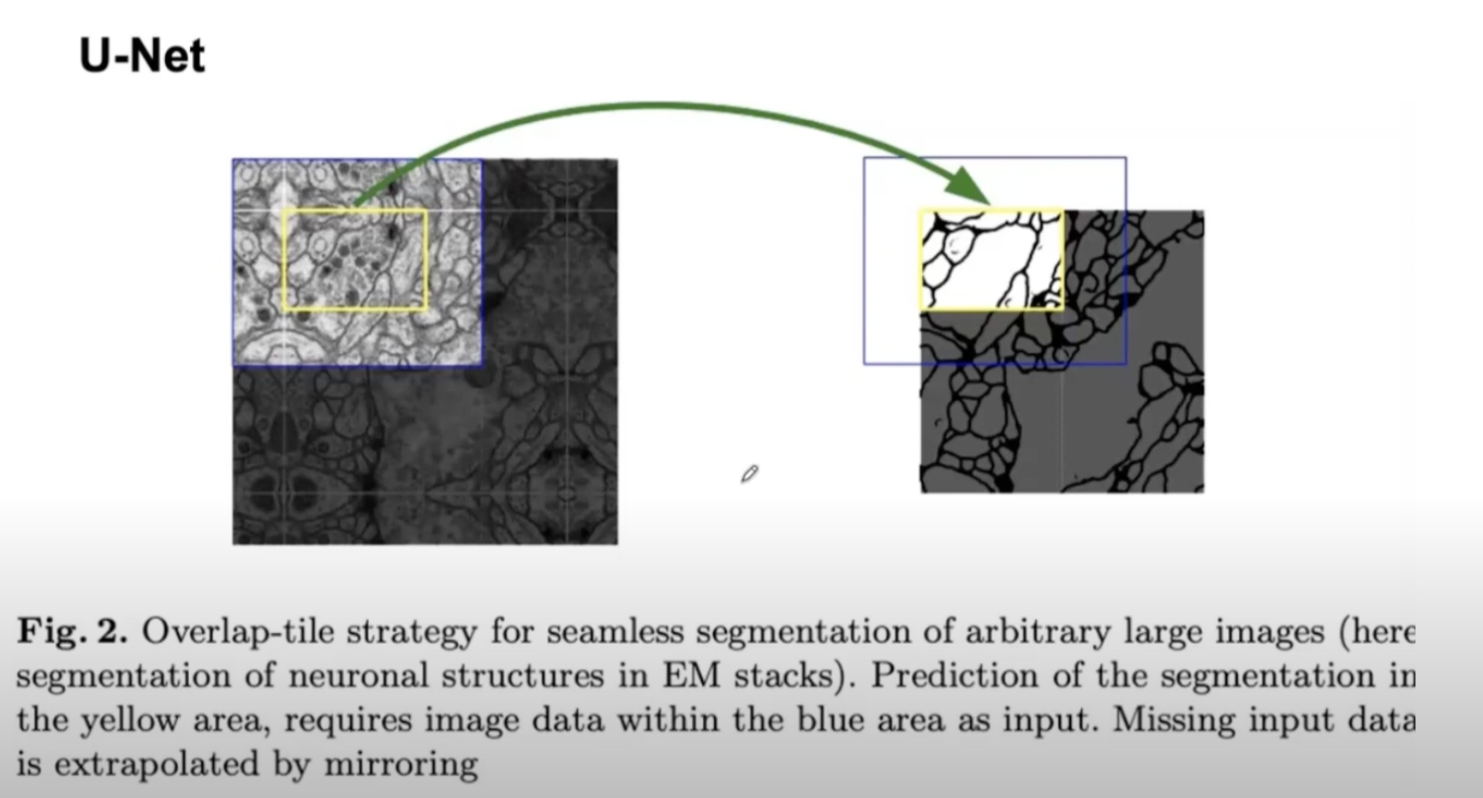
Image segmentation
Deep learning based method – U-Net
Notes:
electron microscopy (EM)

Slide 28
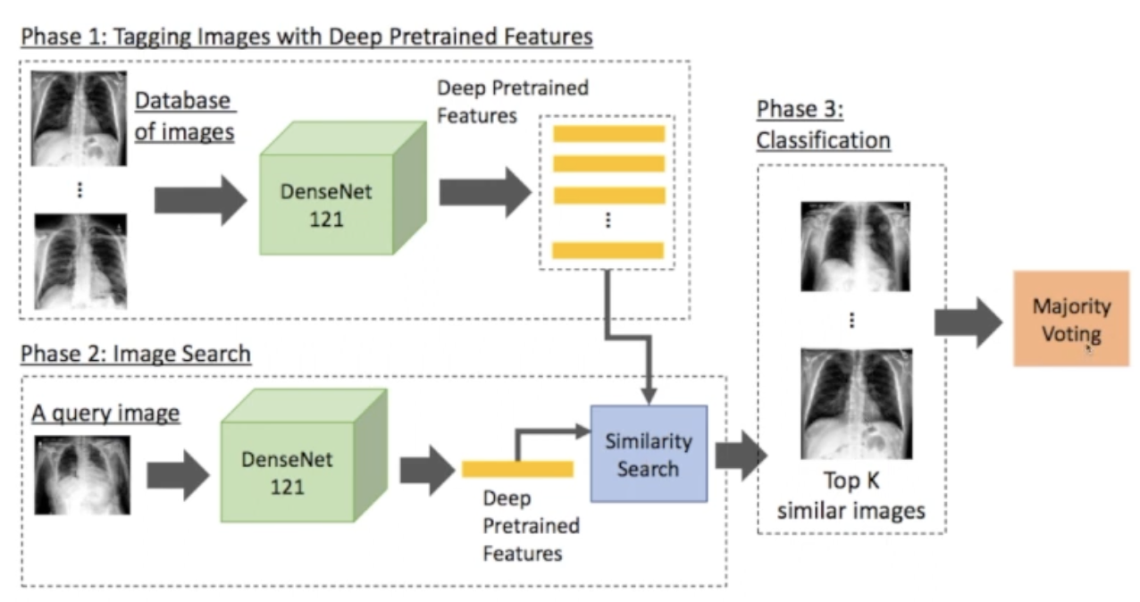
Image Classification
Use deep features for identification of Chest Issues
Sze-To, A., Riasatian, A. & Tizhoosh, H.R. Searching for pneumothorax in x-ray images using autoencoded deep features. Sci Rep 11, 9817 (2021). https://doi.org/10.1038/s41598-021-89194-4

Slide 29
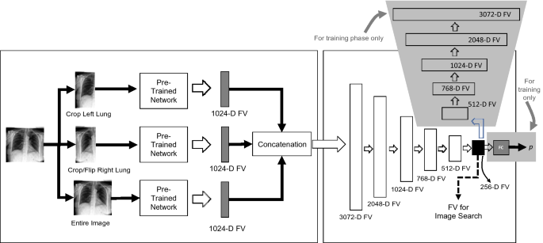
Image Classification
Customized deep features
Sze-To, A., Riasatian, A. & Tizhoosh, H.R. Searching for pneumothorax in x-ray images using autoencoded deep features. Sci Rep 11, 9817 (2021). https://doi.org/10.1038/s41598-021-89194-4
Notes:
You can be more specific in the search, in this case, they separate the left lung, right lung, and make three network focus on
1- left lung, 2- right lung 3-entire lung, to learn the features from them separately and then compresss them in to a single representation
Then do the search to find the similar image and provide classification or diagnosis

Slide 30
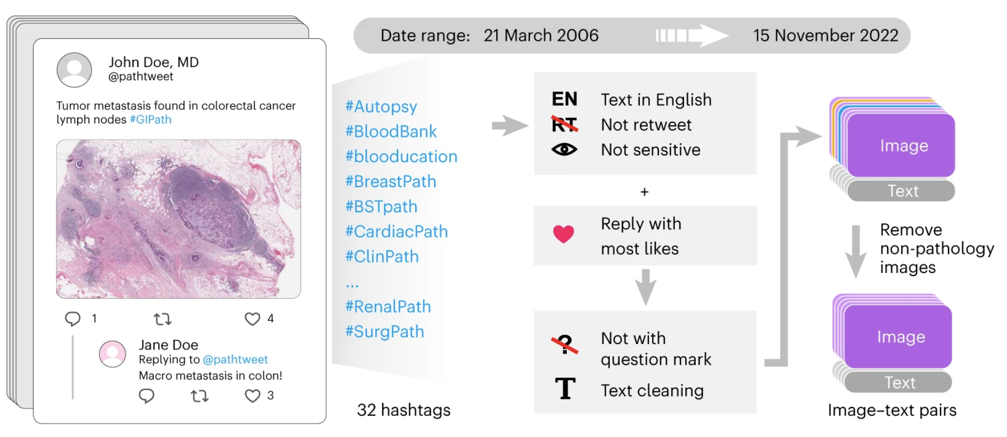
LLM - Text & Images
Pathology text-image data pair from Twitter (X)
Huang Z, Bianchi F, Yuksekgonul M, Montine TJ, Zou J. A visual-language foundation model for pathology image analysis using medical Twitter. Nat Med. 2023 Sep;29(9):2307-2316. doi: 10.1038/s41591-023-02504-3. Epub 2023 Aug 17. PMID: 37592105.
Notes:
Not only there are a lot of official medical image database available, clinicians many times discuss about de-identified images on public forums such as twitter. Clinicians might post some de-identified images and ask for advices and raise discussions.
A goup of researcher from Stanford collect these image based on topic tags, and filtered them by some of their curated criteiria, such as it’s not a retweet, it does not contain questions mark – reply with most likes…
By doing so they curated a set of image –text pairs on pathology images

Slide 31
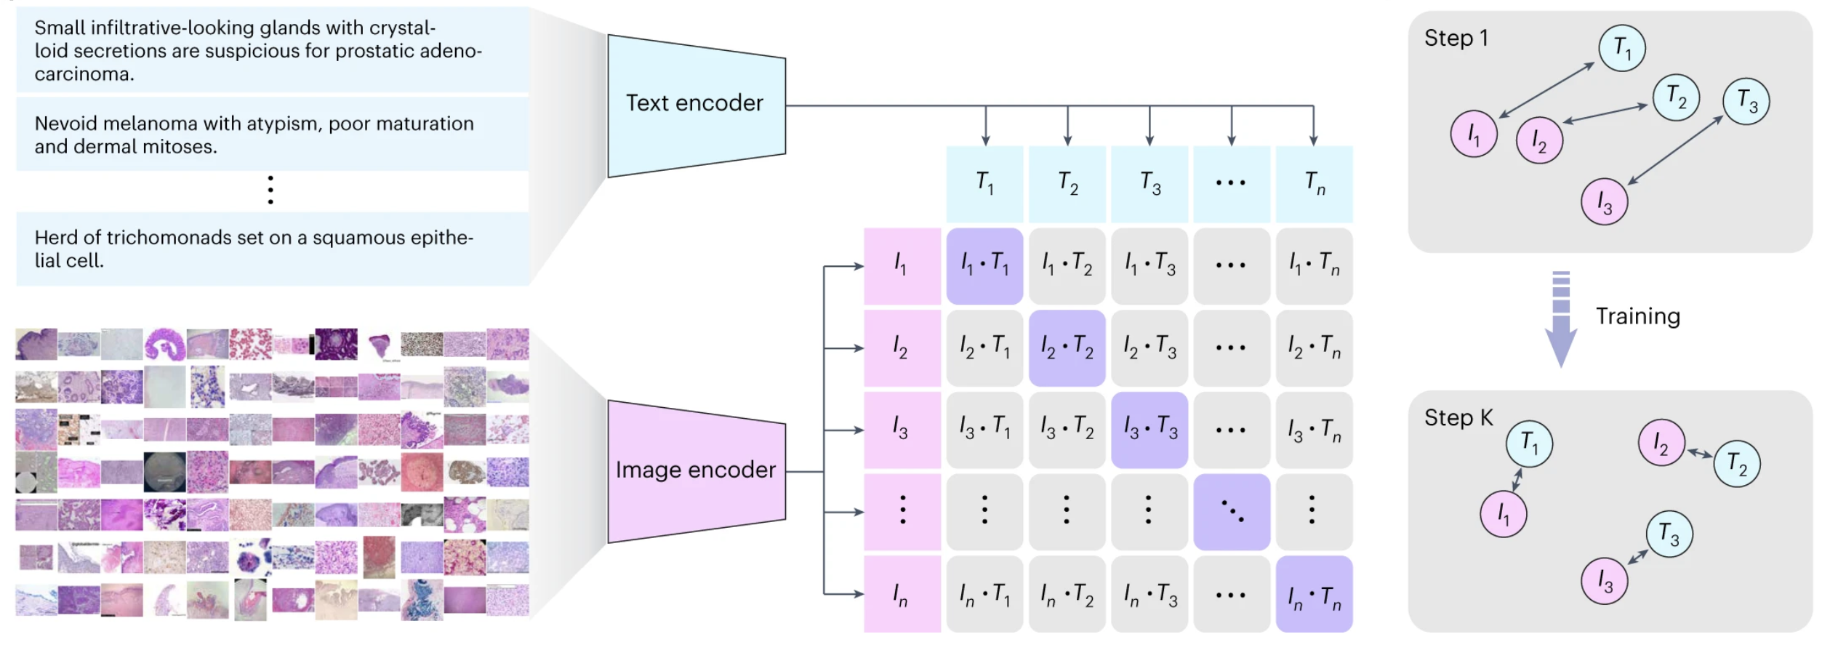
LLM - Text & Images
Contrastive learning for multi-modality data
Huang Z, Bianchi F, Yuksekgonul M, Montine TJ, Zou J. A visual-language foundation model for pathology image analysis using medical Twitter. Nat Med. 2023 Sep;29(9):2307-2316. doi: 10.1038/s41591-023-02504-3. Epub 2023 Aug 17. PMID: 37592105.
Notes:
They then find tune a pretrained contrastive language–image pretraining (CLIP) model on their text data and image data
This model use a contrastive learning method, to bring two modality close to each other in the latent space.

Slide 32
Suggested readings
Huang, Z., Bianchi, F., Yuksekgonul, M. et al. A visual–language foundation model for pathology image analysis using medical Twitter. Nat Med 29, 2307–2316 (2023). https://doi.org/10.1038/s41591-023-02504-3
Recent Trends in Image Processing and Pattern Recognition P84-94
5th International Conference, RTIP2R 2022, Kingsville, TX, USA, December 1-2, 2022, Revised Selected Papers
An optimal big data workflow for biomedical image analysis
Informatics in Medicine Unlocked, Volume 11, 2018, Pages 68-74

Slide 33
Thanks!

