Slide 1
Biomedical Data Science (GersteinLab.org/courses/452)
Unsupervised Mining – General Clustering (25m9a)
Last edit in spring ’25. Adding in semi-supervised clustering + more on K-means + ISLR reference. Similar to
2022’s 22m9a &
2021’s M9a [which has a video].
Mark Gerstein
Yale U.

Slide 2
Unsupervised Mining
Columns & Rows
of the Data Matrix

Slide 3
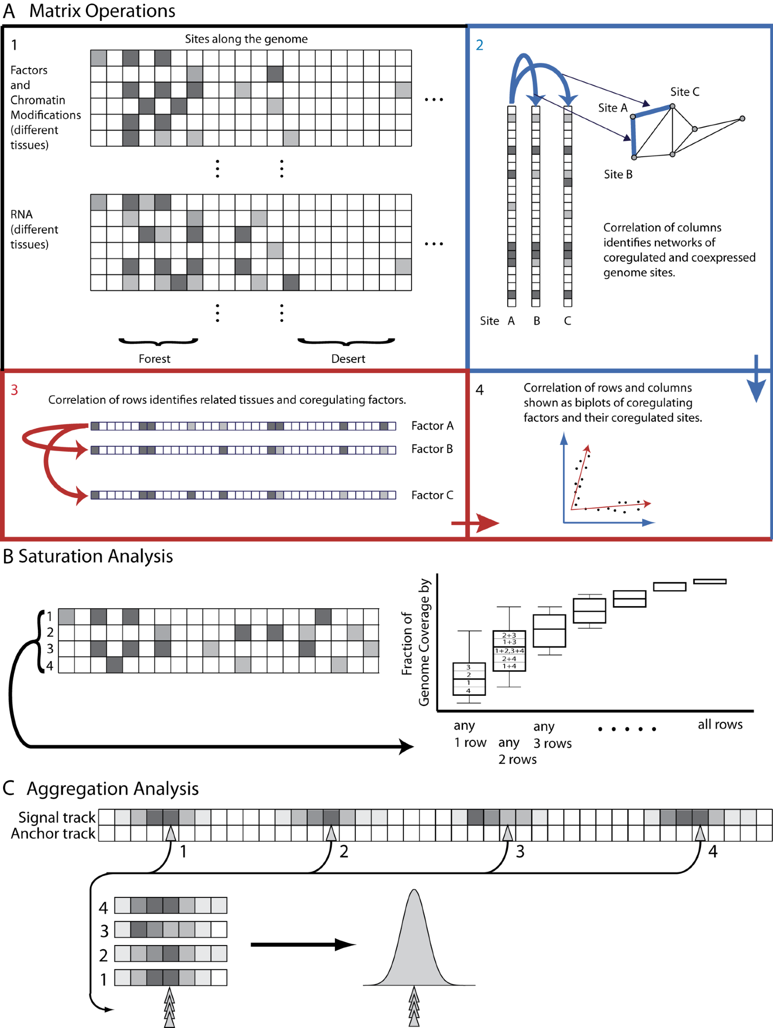
Structure of Genomic Features Matrix

Slide 4
Unsupervised Mining
  Simple overlaps & enriched regions
  Clustering rows & columns (networks)
  PCA/SVD (theory + appl.)
  Biplot
  RCA
  CCA
  tSNE
  LDA
  (Embedding from Variational Autoencoders)

Slide 5
Genomic Features Matrix: Deserts & Forests

Slide 6
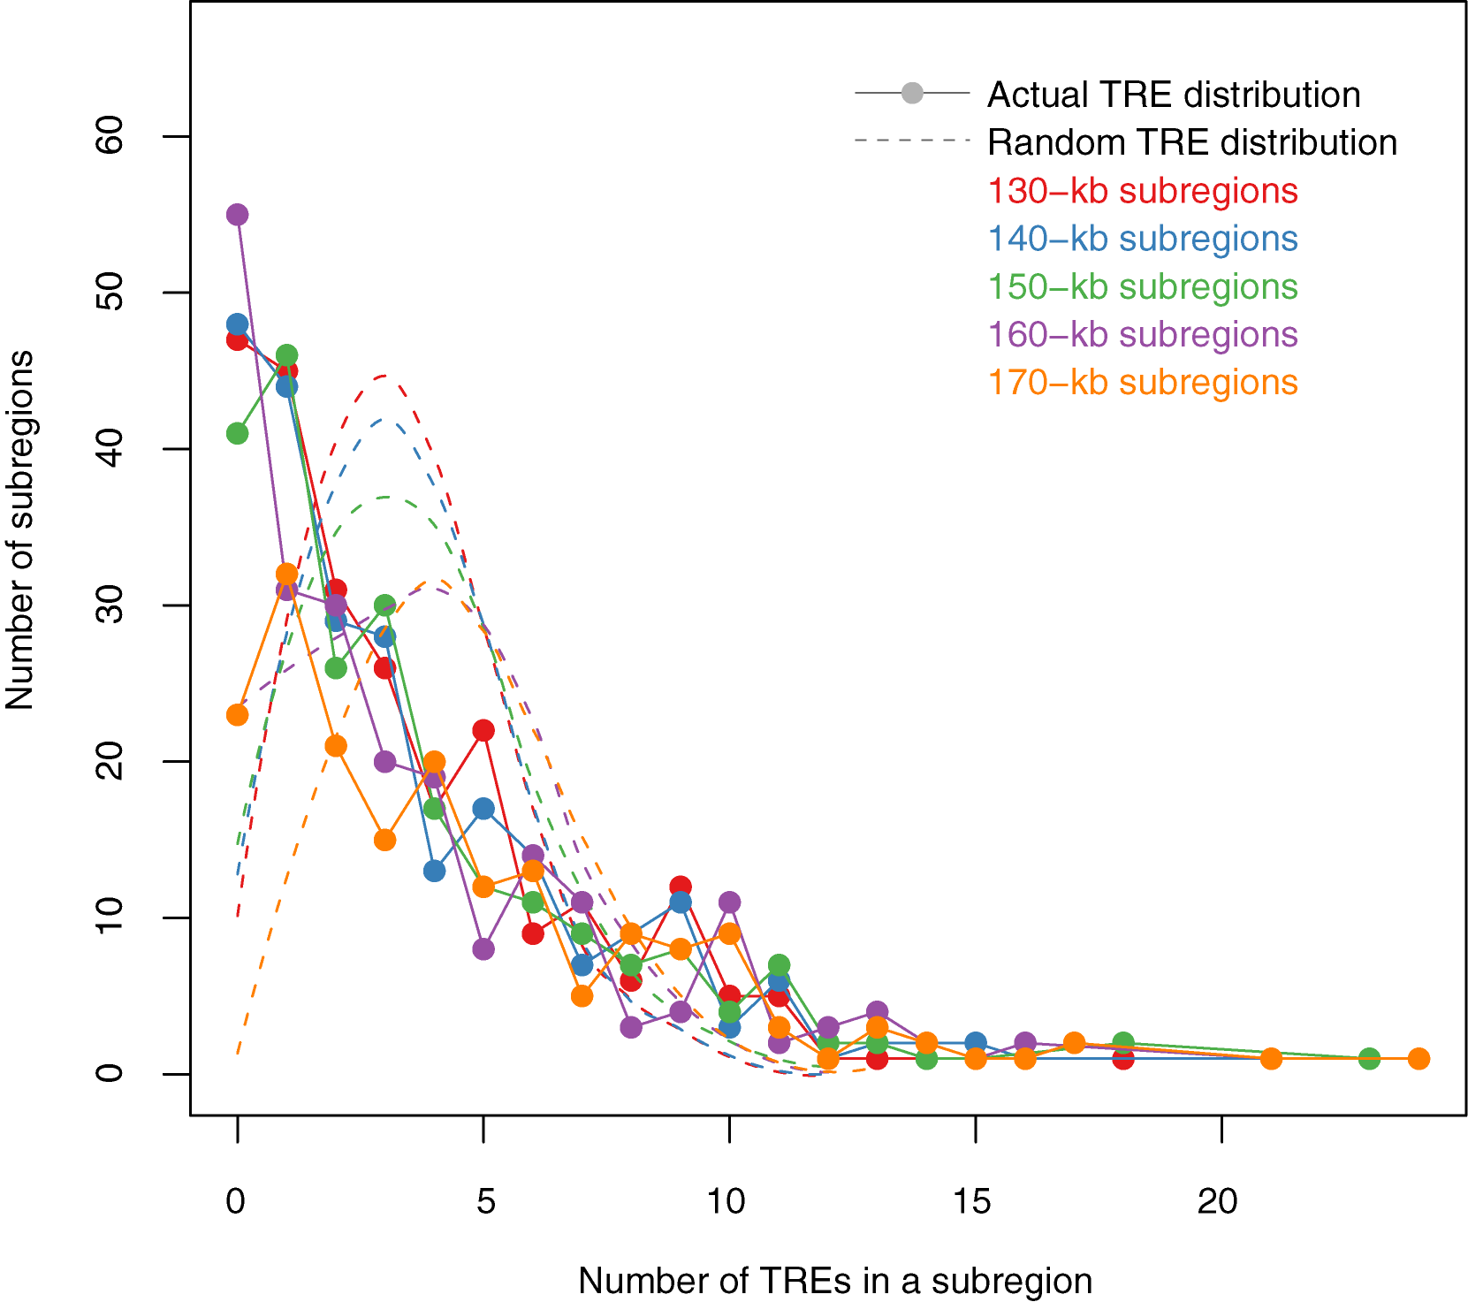
Modelling Distribution of Genomic Elements & Looking for Outliers
TREs (Genomic Elements) are not evenly distributed throughout the genome
The actual TRE distribution is power-law.
The null distribution is ‘Poissonesque.’
Many genomic subregions with extreme numbers of TREs.
Zhang et al. (2007) Gen. Res.

Slide 7
Aggregation & Saturation
[Nat. Rev. Genet. (2010) 11: 559]

Slide 8
Expression Clustering

Slide 9
Correlating Rows & Columns
[Nat. Rev. Genet. (2010) 11: 559]

Slide 10
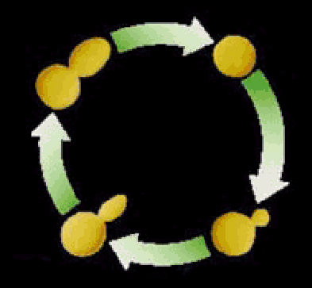

Clustering the yeast cell cycle to uncover interacting proteins
[Brown, Davis]
mRNA expression level (ratio)
Time->
Microarray timecourse of
1 ribosomal protein
Notes:
REM: Picking interesting relationships between genes pairs from ~18M possibilities

Slide 11
Clustering the yeast cell cycle to uncover interacting proteins
mRNA expression level (ratio)
Time->
Random relationship from ~18M
Notes:
REM: Picking interesting relationships between genes pairs from ~18M possibilities

Slide 12
Clustering the yeast cell cycle to uncover interacting proteins
[Botstein; Church, Vidal]
mRNA expression level (ratio)
Time->
Close relationship from 18M
(2 Interacting Ribosomal Proteins)
Notes:
REM: Picking interesting relationships between genes pairs from ~18M possibilities

Slide 13
Clustering the yeast cell cycle to uncover interacting proteins
mRNA expression level (ratio)
Time->
Predict Functional Interaction of
Unknown Member of Cluster
Notes:
REM: Picking interesting relationships between genes pairs from ~18M possibilities

Slide 14
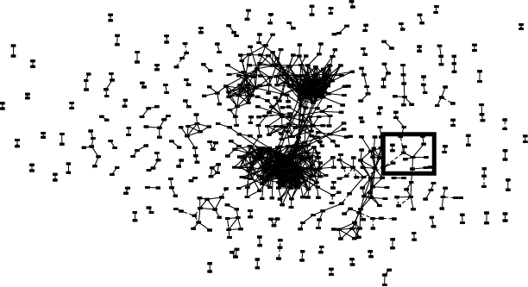
Global Network of Relationships
~470K significant
relationships
from ~18M possible

Slide 15
Unsupervised Mining
General Thoughts on Clustering

Slide 16
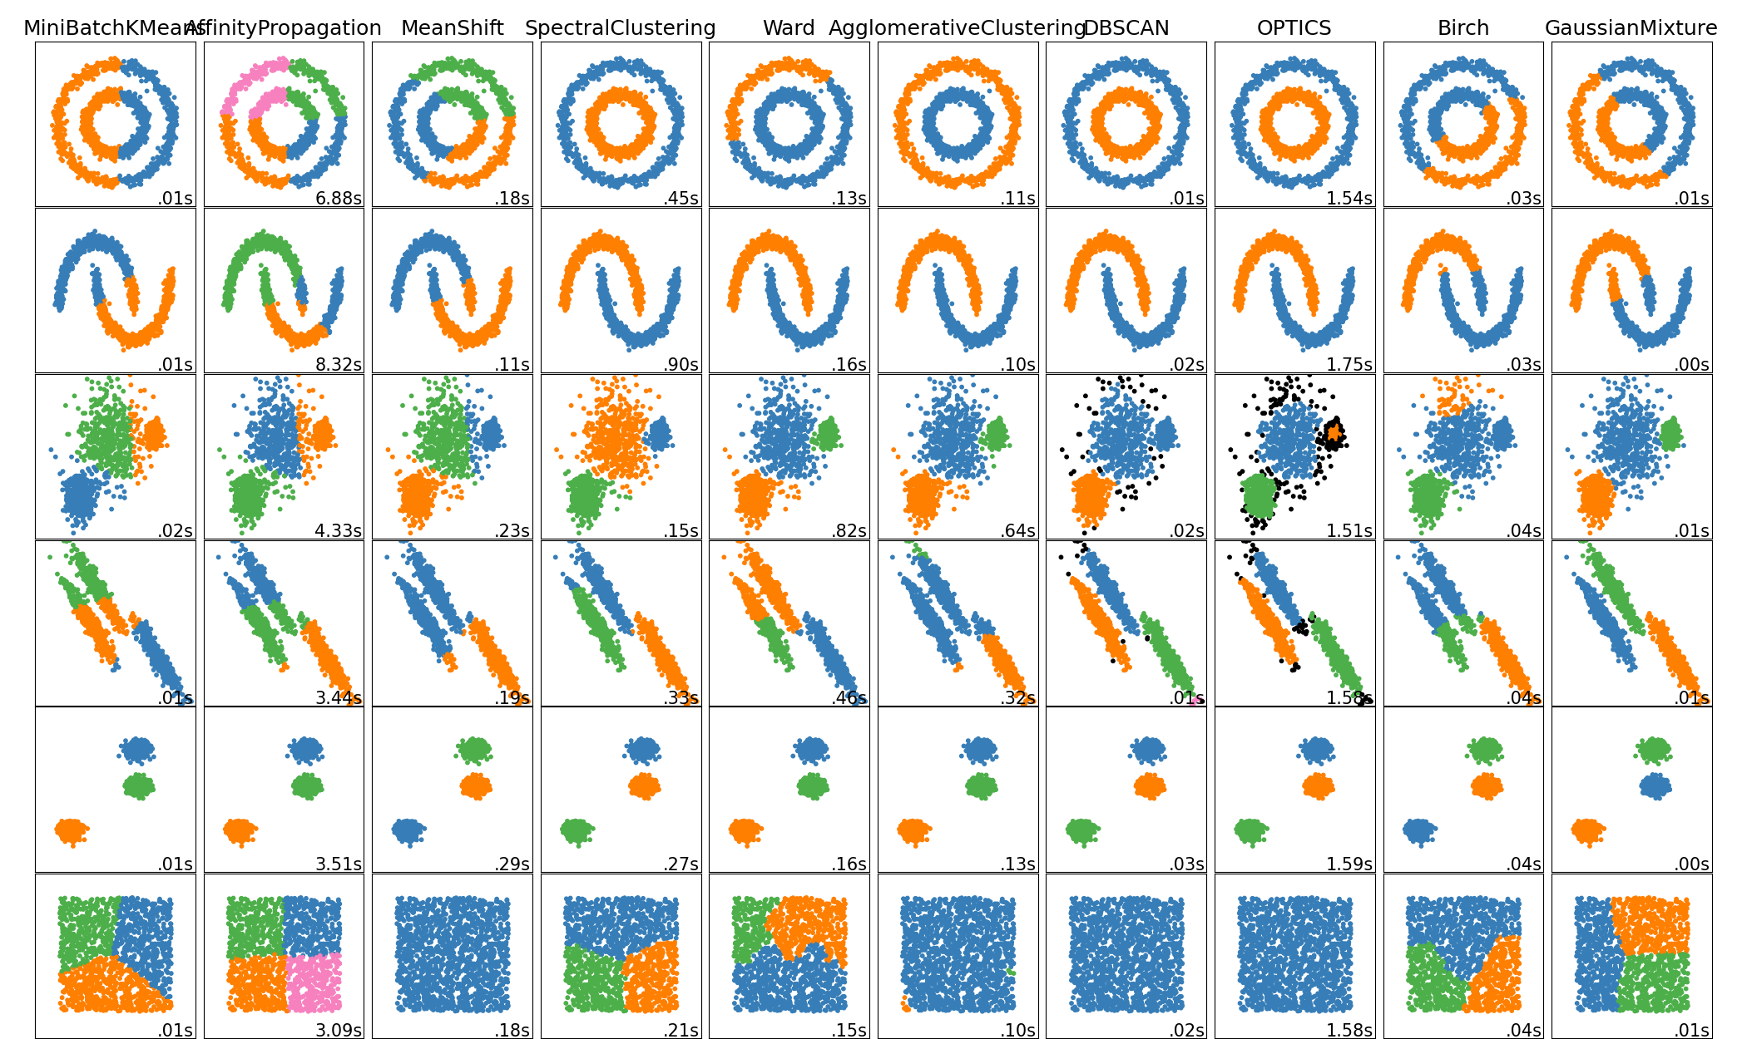
Overview of Clustering Methods
(Very High Level)
Connectivity-based
Centroid-based
Distribution-based
Density-based
Community Detection
Image reference: https://scikit-learn.org/stable/modules/clustering.html

Slide 17
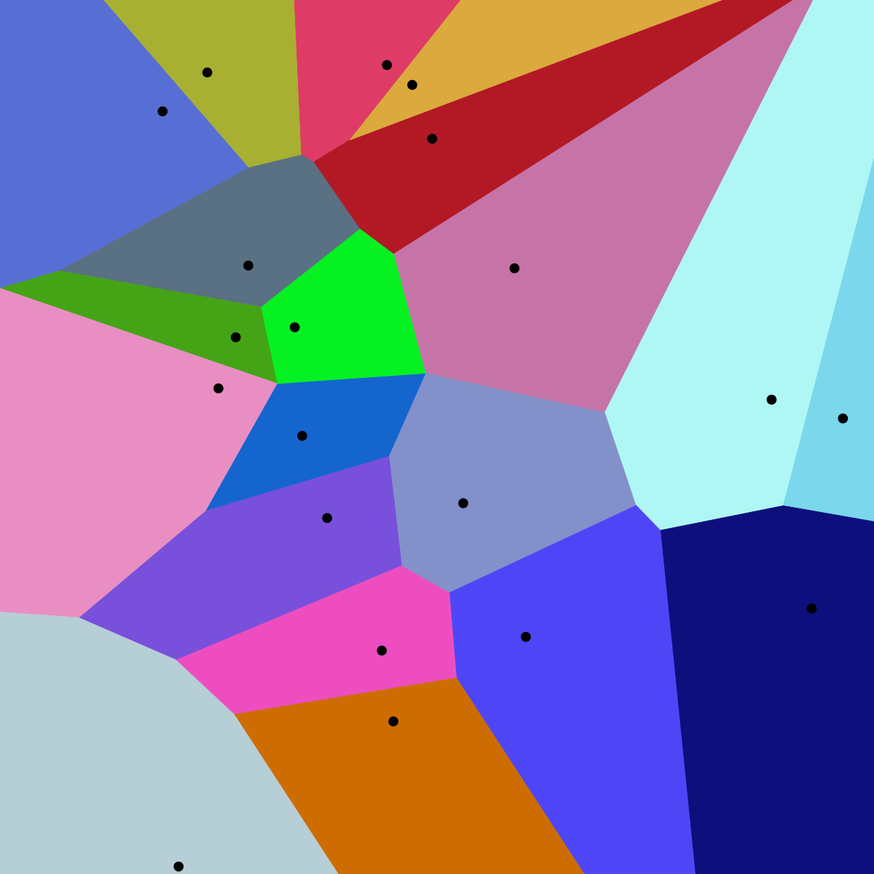
Centroid-based Methods
Optimizes a center vector to find data clusters
Clusters data into a Voronoi diagram, which is interpretable
Assumes a spherical shape for the clusters centered around the center vector
E.g. K-means clustering
  Heavily parameterized by K
  Optimized by Lloyd’s algorithm
Image reference:
https://upload.wikimedia.org/wikipedia/commons/thumb/5/54/Euclidean_Voronoi_diagram.svg/1200px-Euclidean_Voronoi_diagram.svg.png

Slide 18
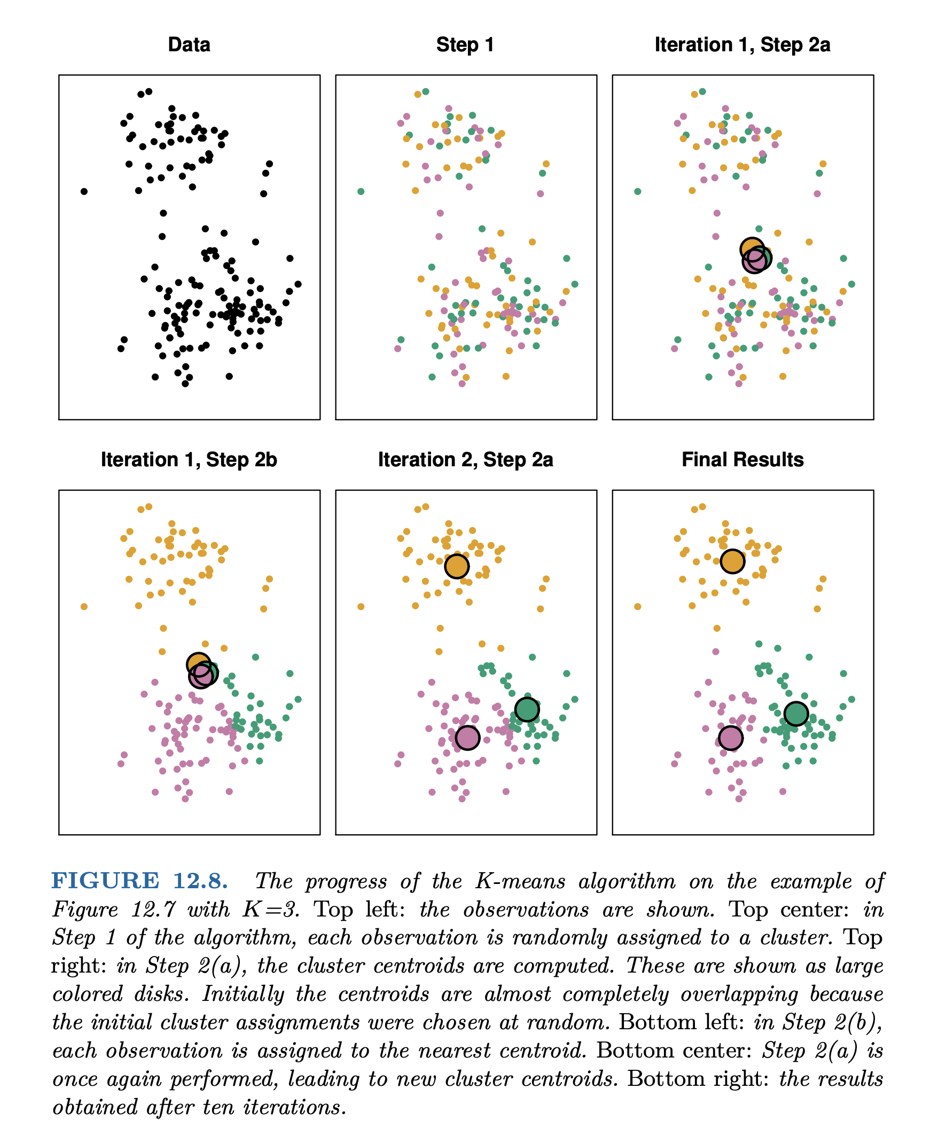
K-means
(1) Pick k (e.g. 3) random points as putative cluster centers.
(2) Group the points to be clustered by the center to which they are closest.
(3) Take the mean of each group and repeat, with the means now at the cluster center.
(4) Stop when the centers stop moving.
[ISLR, Chapter 12]

Slide 19
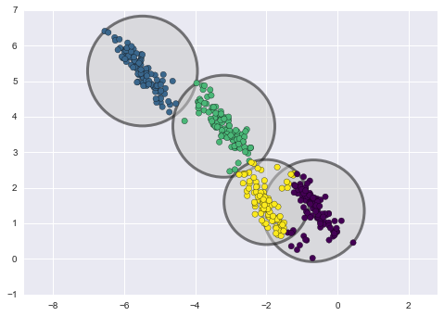
Distribution-based Methods
(More Later)
Clusters are defined as samples from certain distributions
Assumes the shape and number of distributions
E.g. Gaussian Mixture Model Clustering
  Can easily overfit by increasing the number of distributions
LDA & tSNE
Image reference: https://towardsdatascience.com/gaussian-mixture-models-d13a5e915c8e

Slide 20
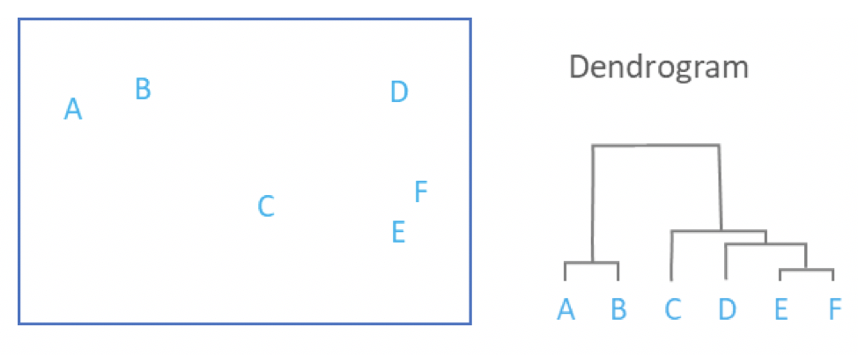
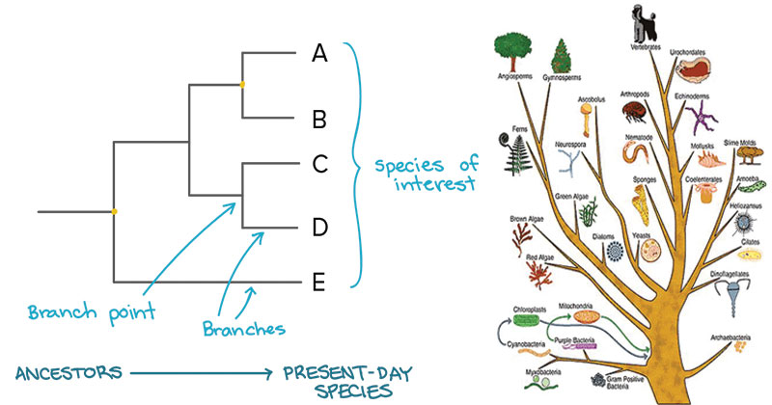
Connectivity-based Methods
Each data point start in their own cluster
Iteratively merge clusters together based on some evaluation of distance to form a hierarchical structure
Can be represented by a dendrogram (data point on one axis while tracking merge history on another axis)
No definitive cut off, but can be used to trace developmental pseudo-time
E.g. Hierarchical clustering & sequence trees (such as those for multiple alignment [mentioned earlier])
Image references:
https://46gyn61z4i0t1u1pnq2bbk2e-wpengine.netdna-ssl.com/wp-content/uploads/2018/03/Screen-Shot-2018-03-28-at-11.48.48-am.png
https://microbenotes.com/how-to-construct-a-phylogenetic-tree/

Slide 21
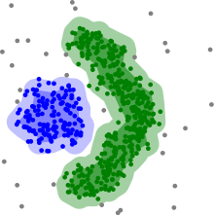
Density-based Methods
Utilize sparse regions and reachability to define clusters
Assumes some range parameter
E.g. DBSCAN
Pro: Fast - O(nlogn) runtime
Con: Some data points will not be assigned a cluster (undefined) because they are unreachable
Edge detection
Image reference: https://upload.wikimedia.org/wikipedia/commons/thumb/0/05/DBSCAN-density-data.svg/440px-DBSCAN-density-data.svg.png

Slide 22
Semi-supervised Approaches

Slide 23
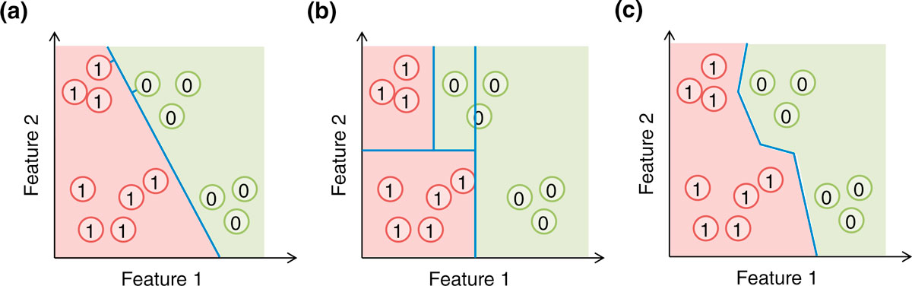
Decision boundaries:
SVM v Tree v Nearest NBR
(a) A support vector machine (SVM) forms an affine decision surface (a straight line in the case of two dimensions) in the original feature space or a vector space defined by the similarity matrix (the kernel), to separate the positive and negative examples and maximize the distance of it from the closest training examples (the support vectors, those with a perpendicular line from the decision surface drawn). It predicts the label of a genomic region based on its direction from the decision surface. In the case a kernel is used, the decision surface in the original feature space could be highly non-linear. (b) A basic decision tree uses feature-parallel decision surfaces to repeatedly partition the feature space, and predicts the label of a genomic region based on the partition it falls within. (c) The one-nearest neighbor (1-NN) method predicts the label of a genomic region based on the label of its closest labeled example. In all three cases, the areas predicted to be positive and negative are indicated by the red and green background colors, respectively.
[Yip et al. Genome Biology 2013 14:205 doi:10.1186/gb-2013-14-5-205]

Slide 24
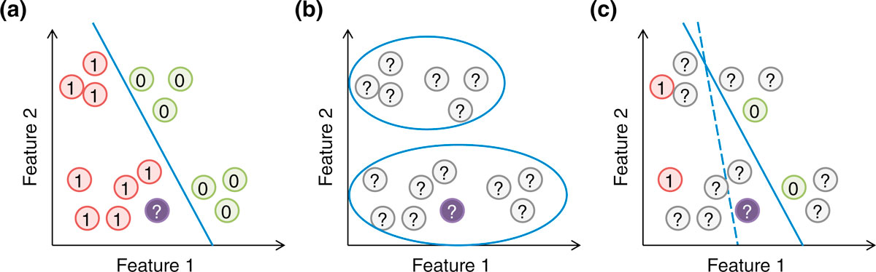
Semi-supervised Methods
Supervised & Unsupervised:
Can you combine them? YES
  RHS (c) shows modifying the optimum decision boundary in (a) by "clustering" of unlabeled points
[Yip et al. Genome Biol. ('13)]
Supervised, unsupervised and semi-supervised learning. (a) In supervised learning, the model (blue line) is learned based on the positive and negative training examples, and the genomic region without a known class label (purple circle) is classified as positive according to the model. (b) In unsupervised learning, all examples are unlabeled, and they are grouped according to the data distribution. (c) In semi-supervised learning, information of both labeled and unlabeled examples is used to learn the parameters of the model. In this illustration, a purely supervised model (dashed blue line) classifies the purple object as negative, while a semi-supervised model that avoids cutting at regions with a high density of genomic regions (solid blue line) classifies it as positive.

Slide 25
References
James, Gareth, Witten, Daniela, Hastie, Trevor, Tibshirani, Robert
An Introduction to Statistical Learning: with Applications in R
[ ISLR (2nd edition) ]
https://www.amazon.com/Introduction-Statistical-Learning-Applications-Statistics/dp/1071614177/ + https://www.statlearning.com
(Chapter 12.1 and 12.4 gives background on Clustering.)
Peixeiro, M. (2021, December 11). Towards Data Science. Medium.
The complete Guide to Unsupervised Learning
https://towardsdatascience.com/the-complete-guide-to-unsupervised-learning-ecf8b676f2af
(Optional extra background on clustering)

