Slide 1
Biomedical Data Science (GersteinLab.org/courses/452)
Supervised Mining – SVMs (25m8c)
Last edit in spring ’25. Condensed (with ~2 slide deletion) and adding connection to ISLR. Similar to
2021’s M8c [which has a video].
Mark Gerstein
Yale U.

Slide 2
Supervised Mining:
LDA & Linear Methods

Slide 3
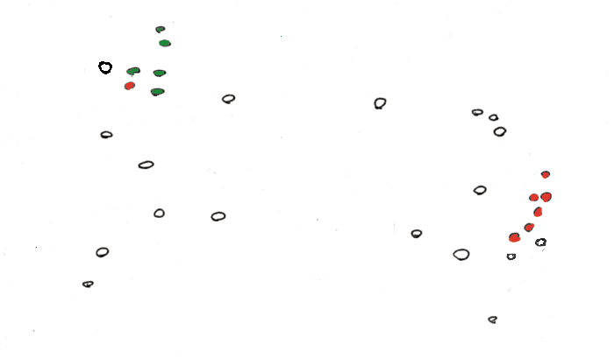
Find a Division to Separate Tagged Points

Slide 4
Discriminant to Position Plane

Slide 5
Fisher discriminant analysis & LDA
y = w₁x₁ + w₂x₂ + ... + w_{n}x_{n} which maximizes the ratio of the separation of the class means to the sum of each class variance (within class variance). This linear combination is called the first linear discriminant or first canonical variate.
Classification of a future case is then determined by choosing the nearest class in the space of the first linear discriminant and significant subsequent discriminants, which maximally separate the class means and are constrained to be uncorrelated with previous ones.
LDA is a generalization of Fisher's linear discriminant
Solution of 1st variate

Slide 6
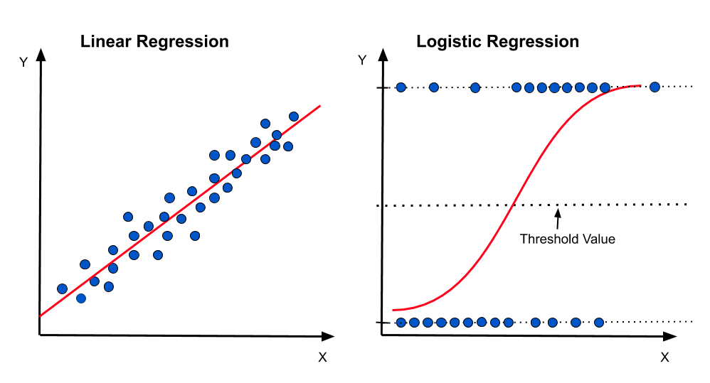
Other Classic Linear Methods
We have already covered lin. regression for GWAS & QTL earlier
Not going to cover
more here
(covered in a basic stats class) but
very good to know!!!
ISLR has very good chapters on this.
Linear Regression to fit a line &
Logistic Regression “Classifier”
Image from https://medium.com/@praveenraj.gowd/why-is-logistic-regression-called-logistic-regression-and-not-a-logistic-classification-5a418293040d

Slide 7
Supervised Mining:
SVM

Slide 8
Support Vector Machines
A very powerful tool for classifications.
More flexible than LDA.
Example Applications:
  Text categorization
  Image classification
  Spam email recognition, etc
It has also been successfully applied in many biological problems:
  Disease diagnosis
  Automatic genome functional annotation
  Prediction of protein-protein interactions
  and more…
8 - Lectures.gersteinlab.org

Slide 9
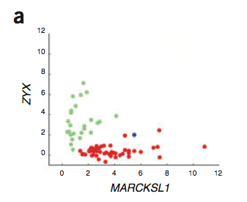
Example: Leukemia patient classification
ALL: acute lymphoblastic leukemia
AML: acute myeloid leukemia
9 - Lectures.gersteinlab.org
William S Nobel. What is a support vector machine? Nature Biotechnology. 2006

Slide 10
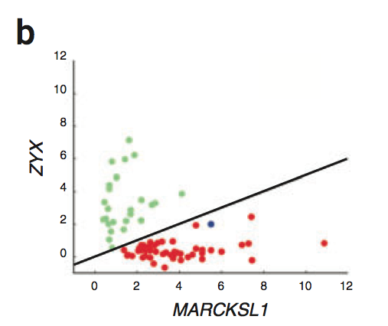
A simple line suffices to separate the expression profiles of ALL and AML
10 - Lectures.gersteinlab.org
William S Nobel. What is a support vector machine? Nature Biotechnology. 2006

Slide 11
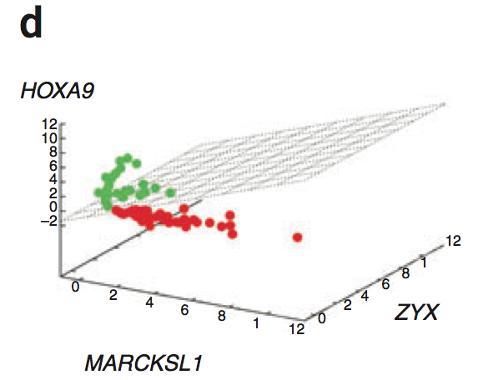
In the case of more than two genes, a line generalizes to a plane or “hyperplane”.
For generality, we refer to them all as “hyperplane”
11 - Lectures.gersteinlab.org
William S Nobel. What is a support vector machine? Nature Biotechnology. 2006

Slide 12
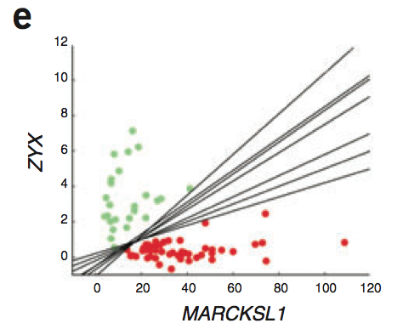
Is there a “best” line?
12 - Lectures.gersteinlab.org
William S Nobel. What is a support vector machine? Nature Biotechnology. 2006

Slide 13
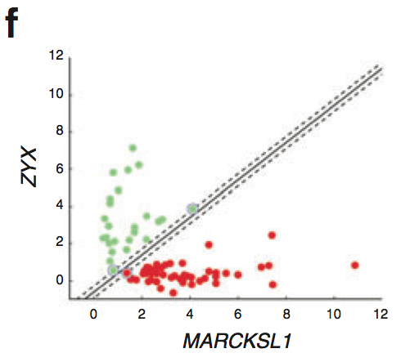
The maximum margin hyperplane
13 - Lectures.gersteinlab.org
William S Nobel. What is a support vector machine? Nature Biotechnology. 2006

Slide 14
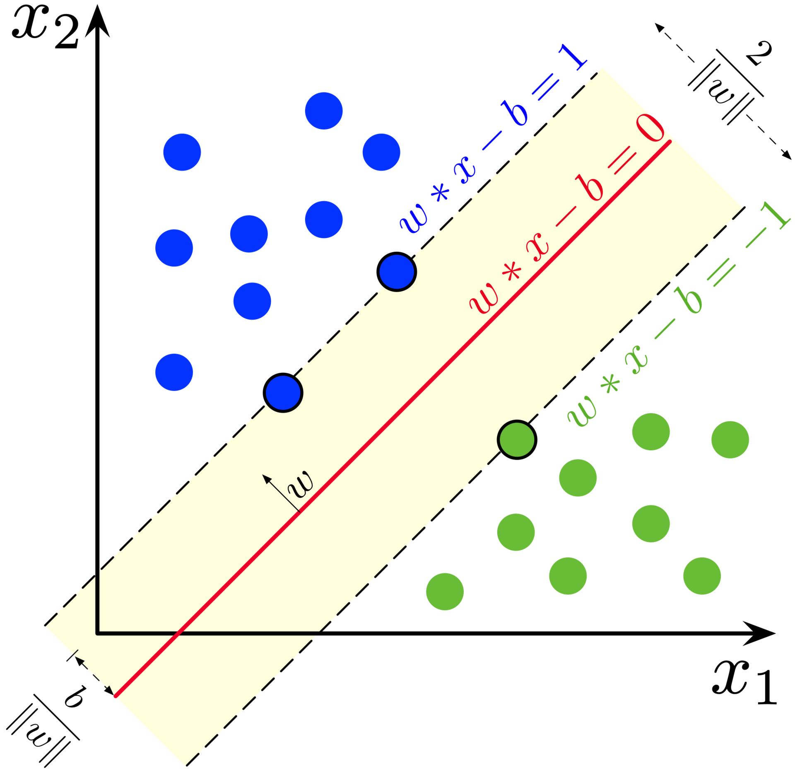
Denote each data point as (x_{i}, y_{i}) – e.g. x_{i} is a vector of the expression profiles & y_{i} = -1 or 1, which labels the class
hyperplane: w*x + b = 0
The margin-width equals to:
We can maximize this.
Closest points define the margin & are called
support vectors
We’re assuming the points are linearly separable. (Also, we could allow a
“soft margin” via slack parameters – something we are not covering.)
http://en.wikipedia.org/wiki/Support_vector_machine

Slide 15
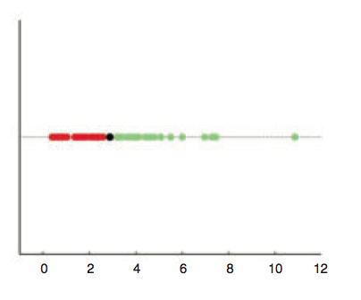
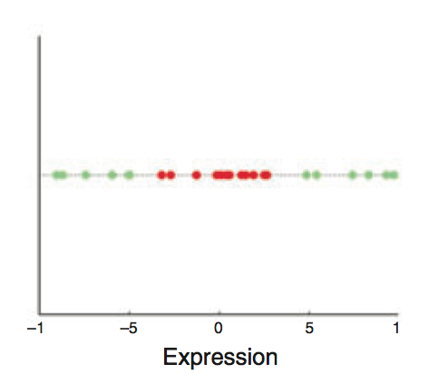
Are linear separating hyperplanes enough?
Yes
(by a 1D-hyperplane
= dot)
NO
15 - Lectures.gersteinlab.org
William S Nobel. What is a support vector machine? Nature Biotechnology. 2006

Slide 16
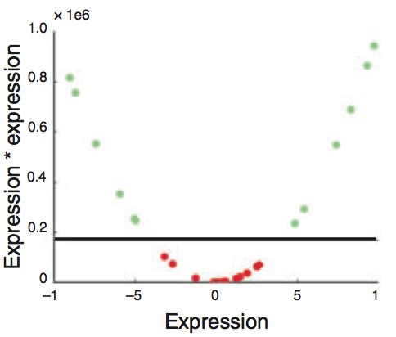
Transform (x_{i}) into (x_{i}, x_{i}²)
16 - Lectures.gersteinlab.org
William S Nobel. What is a support vector machine? Nature Biotechnology. 2006

Slide 17
Non-linear SVM
  Generally speaking, we can apply some function to the original data points so that different classes become linearly separable (maybe with the help of soft-margin)
  In the above example, the function is f(x) = (x, x²)
  The most import trick in SVM: to allow for the transformation, we only need to define the “kernel function”,
17 - Lectures.gersteinlab.org

Slide 18
Key idea in the Kernel Trick
Original SVM optimization for refining the hyperplane parameters w & b in terms of a linear combination of x_{i} can be replaced by a different optimization problem using "Lagrange multipliers" α_{i}
  One only optimizes using the product of x_{i}*x_{j}, now expressing the solution in terms of α_{i} which are non-zero for x_{i} that function as support vectors
In a non-linear SVM x_{i}*x_{j} is replaced by f(x_{i})*f(x_{j}), so you don't need to know f(x_{i}) itself only the product
  This is further formalized in the kernel trick where f(x_{i})*f(x_{j}) is just replaced by k(x_{i}, x_{j}). That is, one only has to know the “distance” between x_{i} & x_{j} in the high-dimensional space -- not their actual representation

Slide 19
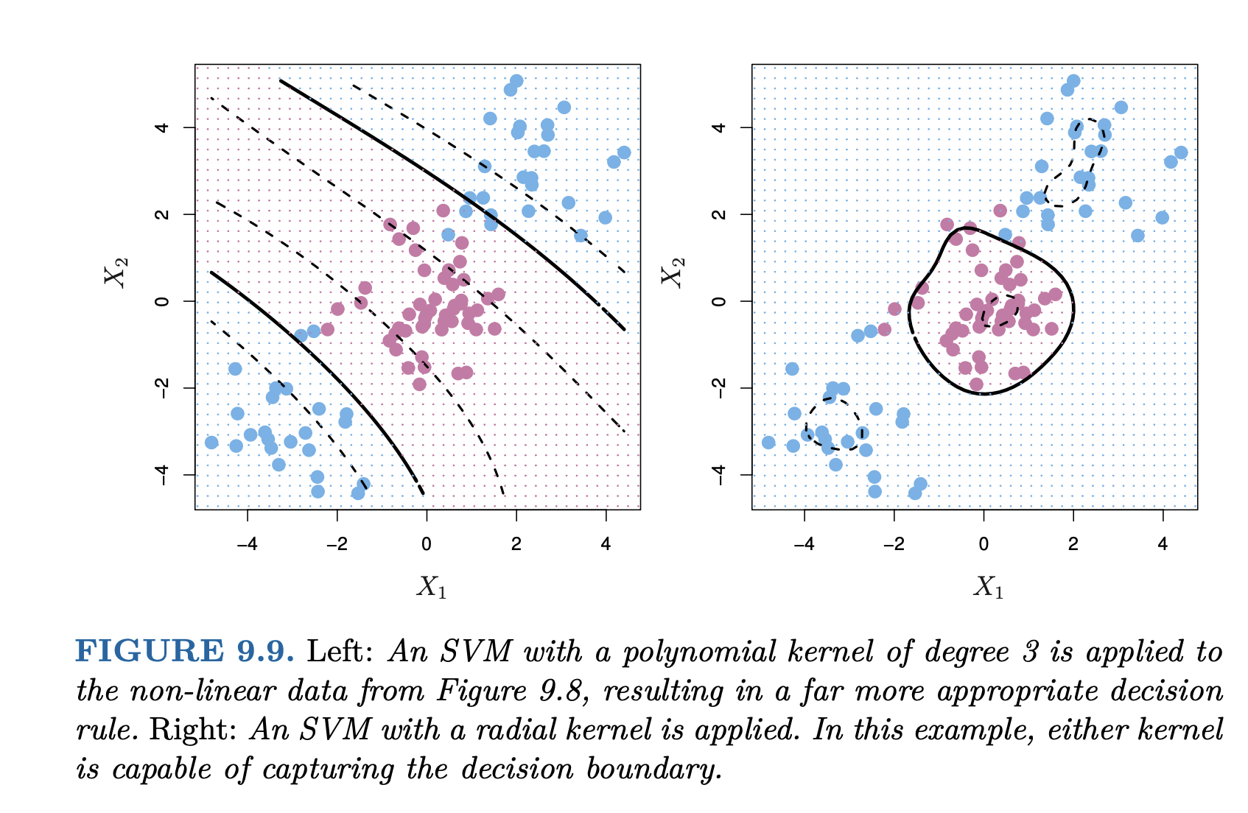
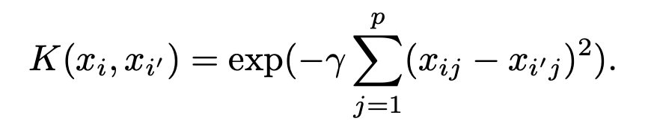
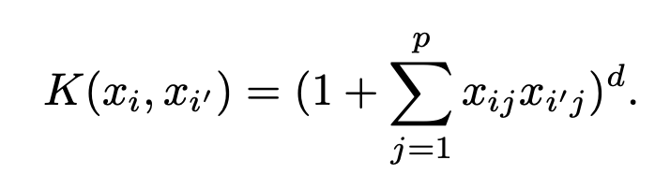
Common
Kernels
Radial Kernel K
Polynomial Kernel K of degree d (d = 1 just gives a linear classifier)
19 - Lectures.gersteinlab.org
[ISLR chap. 9]

Slide 20
More about kernels
  With kernels, non-vector data can be easily handled – we only need to define the kernel function between two objects
  Examples of non-vector biological data include DNA and protein sequences (“string kernels”), nodes in metabolic or protein-protein interaction networks, microscopy images, etc.
  Allows for combining different types of data naturally – define kernels on different data types and combine them with simple algebra
Questions for practitioners: Which kernel to use? How to choose parameters?
  Trial and error
  Cross-validation
High-degree kernels always fit the training data well, but at increased risks of over-fitting, i.e., the classifier will not generalize to new data points
  One needs to find a balance between classification accuracy on the training data and regularity of the kernel (not allowing the kernel to be too flexible)
20 - Lectures.gersteinlab.org
Notes:
references

Slide 21
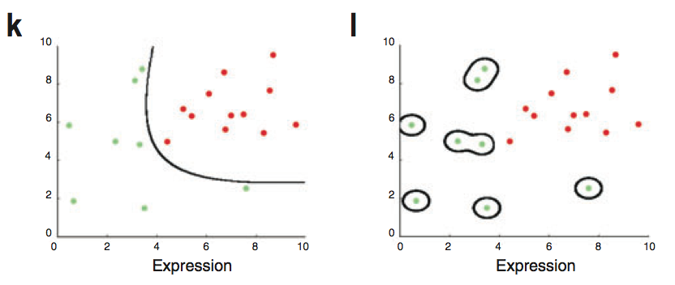
A low-degree kernel (left)
and an over-fitting high-degree kernel (right)
21 - Lectures.gersteinlab.org
William S Nobel. What is a support vector machine? Nature Biotechnology. 2006

Slide 22
References
James, Gareth, Witten, Daniela, Hastie, Trevor, Tibshirani, Robert
An Introduction to Statistical Learning: with Applications in R
[ ISLR (2nd edition) ]
https://www.amazon.com/Introduction-Statistical-Learning-Applications-Statistics/dp/1071614177/ + https://www.statlearning.com
(Chapter 9 to 9.4 gives background on SVMs.
Optional:
Chapters 3.1 and 3.2 goes over linear regression and
4.1 to 4.4 gives an overview of classification with logistic regression & LDA.)
“An Idiot’s guide to SVM”
https://web.mit.edu/6.034/wwwbob/svm.pdf
(Optional: extra background on SVMs)

