Slide 1
Biomedical Data Science (GersteinLab.org/courses/452)
Genome Annotation (Multi-omic Analyses) (25m7-part1)
Last edit in spring ’25. Just first half related to genome annotation. Reduced integration section.
Now loosely related to
1st half of 2021’s M7
[which has a video].
Mark Gerstein
Yale U.

Slide 2

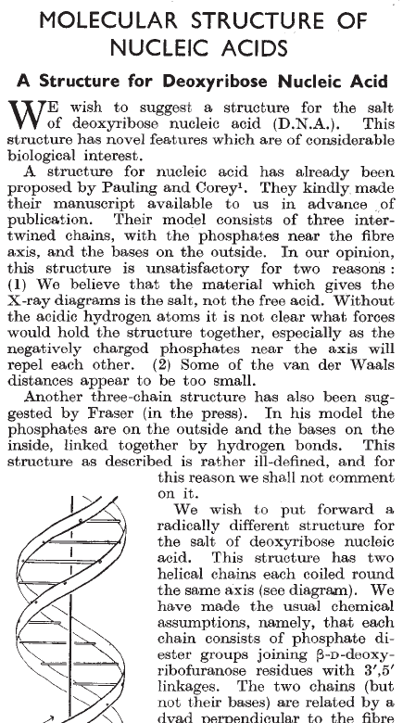
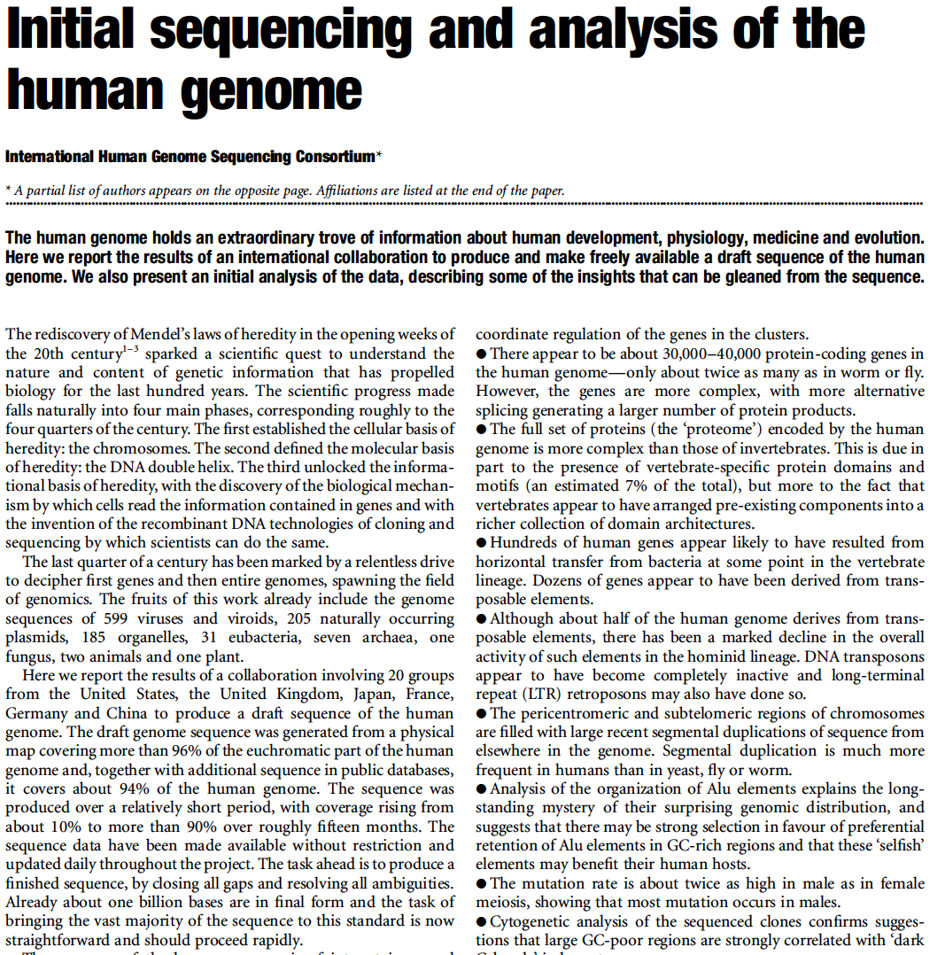
What is Annotation? (For Written Texts?)

Slide 3
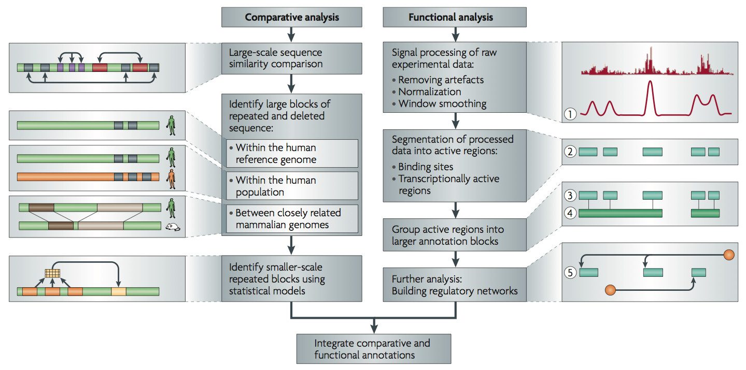
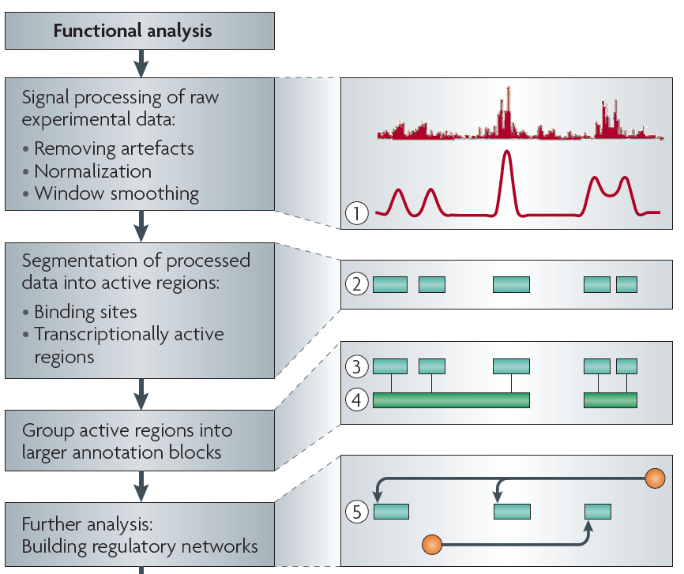
Non-coding Annotations: Overview
Features are often present on multiple ”scale” (eg elements and connected networks)
Sequence features, incl. Conservation
Functional Genomics
Chip-seq (Epigenome & seq. specific TF) and ncRNA & un-annotated transcription
[Nat. Rev. Genet. (2010) 11: 559]

Slide 4
Outline
Part 1 : Generic Annotation
(not related to an individual's variants)
  RNA-seq, Chip-seq
  Integration
  , Hi-C
Part 2 : Annotation related to an individual's variants
  ASE/ASB
  GWAS & eQTL
RNA-seq & Chip-seq

Slide 5
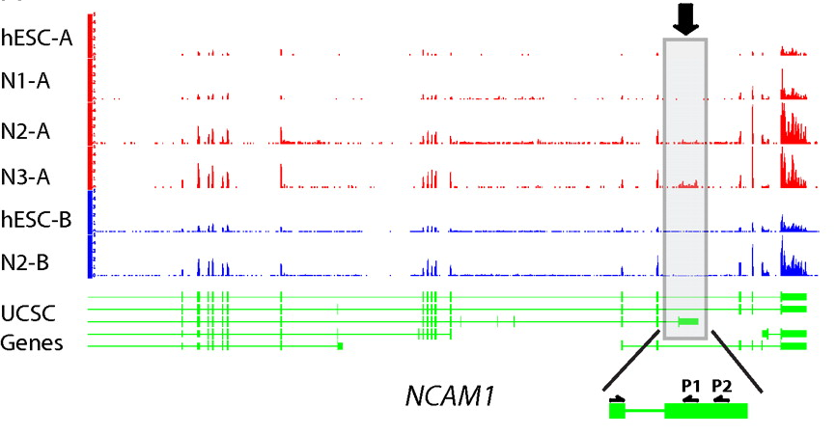
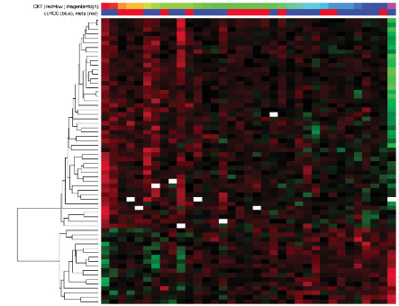
Information from
RNA-seq:
Avg. signal at exons & TARs (RPKMs)
[PNAS 4:107: 5254 ; IJC 123:569]
Notes:
RNA-Seq experiments one would keep: the expression levels (i.e. RPKMs) of ~20,000 genes, ~70,000 transcripts, ~200,000 exons, and ~2 million splices. Also, we would store information on ~15,000 novel Transcriptionally Active Regions (TARs), ~2,000 allele-specific expressed genes, ~50 chimeric transcripts as well as lists of differentially expressed elements between conditions.
Mertz, Kirsten D., Francesca Demichelis, Andrea Sboner, Michelle S. Hirsch, Paola Dal Cin, Kirsten Struckmann, Martina Storz, et al. “Association of cytokeratin 7 and 19 expression with genomic stability and favorable prognosis in clear cell renal cell cancer.” International Journal of Cancer 123, no. 3 (2008): 569-576.

Slide 6
Information from Chip-seq
TFs with Peaks
Control
His. Marks
(broad)
[Science 330: 1775
+ ENCODE Data Sources
TFs & Control: Yale
HMs: UW & Broad ]

Slide 7
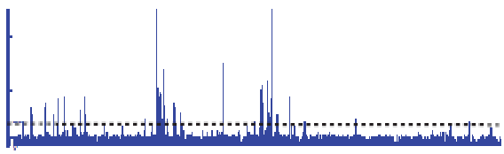

Summarizing the Signal:
"Traditional" ChipSeq Peak Calling
ChIP
Generate & threshold the signal profile to identify candidate target regions
  Simulation (PeakSeq),
  Local window-based Poisson (MACS),
  Fold change statistics (SPP)
Threshold
Potential Targets
Normalized Control
Score against the control
Significantly Enriched targets
[Rozowsky et al. ('09) Nat Biotech]

Slide 8
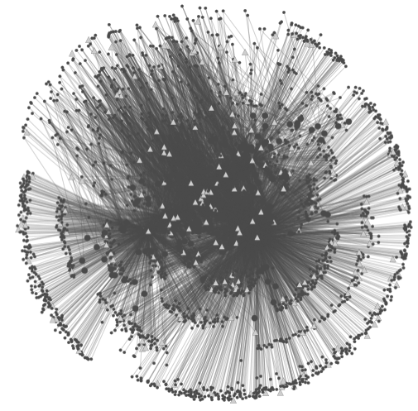
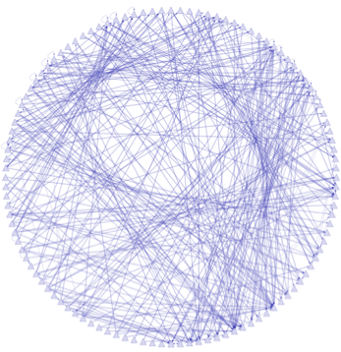
Data Flow: peaks to proximal & distal networks
Peak Calling
Assigning TF binding sites to targets
Filtering high confidence edges & distal regulation
[ Cheng et al., Bioinfo. ('11);
Gerstein et al. Nature (in press, '12) ;
Yip et al., GenomeBiology (in press, '12)]
~500K Edges
Based on stat. model combining
signal strength & location relative to typical binding
~26K Edges
TF
TF
Potential
Distal
Edge
Strong
Proximal
Edge

Slide 9
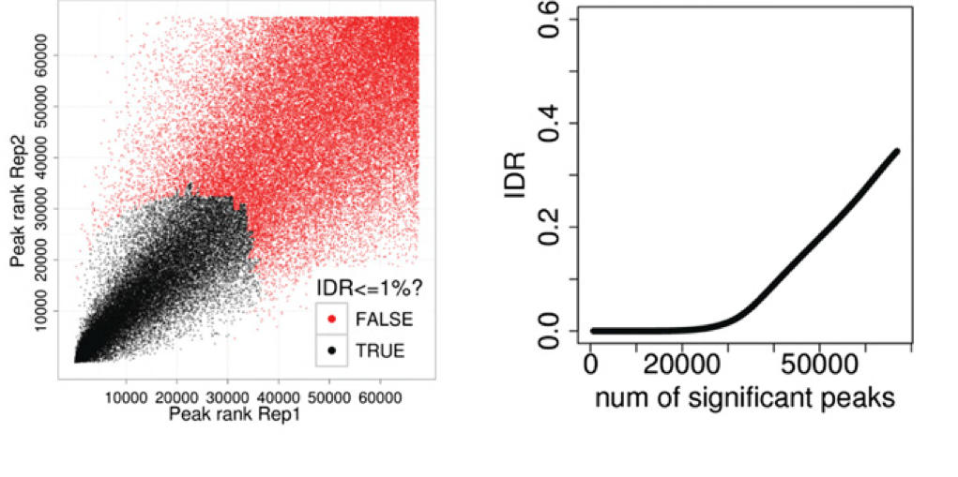
The irreproducible discovery rate (IDR)
Unified approach to measure the reproducibility of findings identified from replicate high-throughput experiments.
Idea : call peaks with low cutoff and classify peaks as reproducible or not (bivariate rank distributions) based on overlap of ranked peaks (consistency)
Genome Research 2012, 22:1813-1831

Slide 10
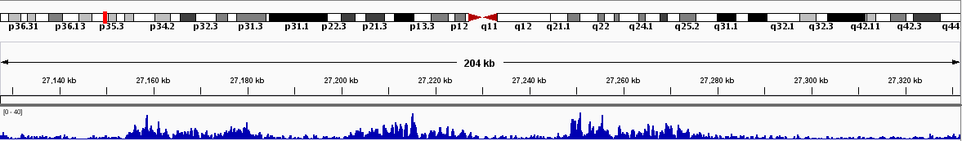
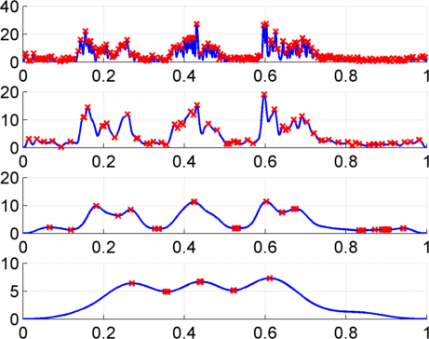
Multiscale Analysis, Minima/Maxima based Coarse Segmentation
Multiscale analysis is a natural way to analyze the ChIP-Seq data
Window Length
1kb
4kb
Harmanci et al, Genome Biology 2014, MUSIC.gersteinlab.org
16kb
Maxima
64kb
Minima
Notes:
Shown is the H3K36me3 track over 200kb regions with 3 active genes, indicated by green lines. The signal increases on the 3 genes. Our problem is to identify 3 enriched regions corresponding to these 3 genes. Thresholding usually overfragments these regions. To get around this issue, we apply a a multiscale filtering that smooths the signal with a sliding window using different window lengths, or scale lengths. At the top scale one can see that 3 peaks are identified.

Slide 11
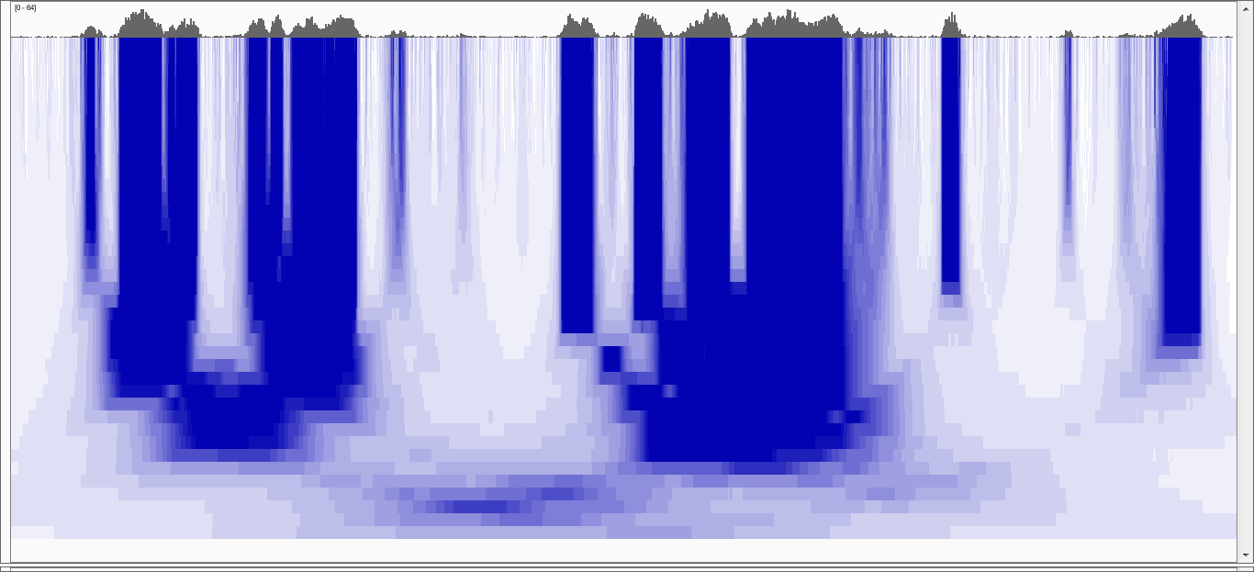
Multiscale Decomposition
20kb
100 b
Increasing Scale
100 kb
[Harmanci et al, Genome Biol. ('14)]
Notes:
To address the first issue, we use median based decomposition, which is median filtering the RD signal with increasing window lengths.
In order to perform median filtering with a window length, you take the signal and replace signal value at each point with the median of the values within the vicinity of that point.
In the figure, the RD signal is shown at the very top. In the bottom heatmap, each row is a filtered signal track in the decomposition.
White-> low, blue->high
Notice that the peaks in the signal get merged over the increasing scales.
Notice the “blocky” behavior of the decomposition where the edges are conserved over several scales before they die off rather quickly at a certain scale.

Slide 12
Multiscale Decomposition
Very
Punctate
ER
20kb
Broader
ER
Punctate
ER
Broad
ER
100 b
Increasing Scale
Very Broad
ER
100 kb
[Harmanci et al, Genome Biol. ('14)]
Notes:
In comparison with Gaussian decomp, median based decomp conserves the enriched regions upto a certain scale then removes them completely. Unlike
Gaussian, where all the signal features are transferred till the highest scale in the decomposition. This property makes median filtering a better candidate
For analysing the which scales levels are enriched in the signal

Slide 13
Outline
Part 1 : Generic Annotation
(not related to an individual's variants)
  RNA-seq, Chip-seq
  Integration
  , Hi-C
Part 2 : Annotation related to an individual's variants
  ASE/ASB
  GWAS & eQTL
Simple Integration for Elements

Slide 14
Broad ENCODE Annotation
[Encode Consortium et al. Nature (‘20)]

Slide 15
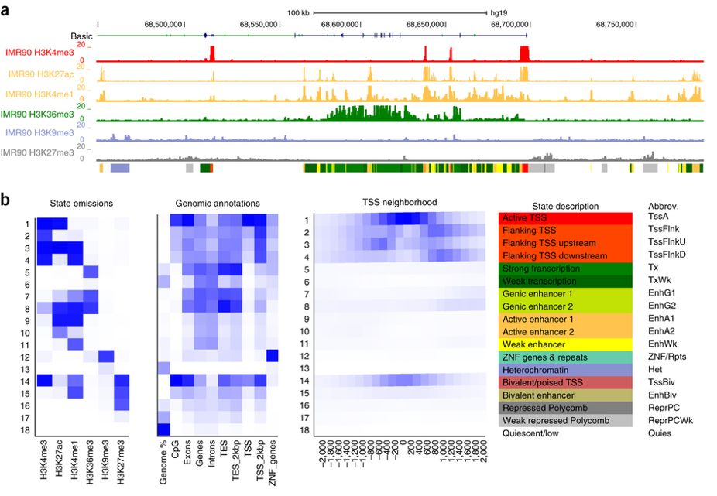
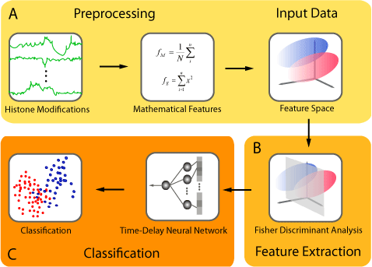
Background on computational annotation for non-coding regions
Peak calling:
  PeakSeq, SPP, MACS2, Hotspot …
  ENCODE Encyclopedia
Genome segmentation: partition the genome into regions (states) with distinct epigenomic profiles, then assign each state a functional label.
  ChromHMM: Multivariate Hidden Markov Model
  Segway: Dynamic Bayesian Network Model
Supervised regulatory prediction: learn predictive models from labeled dataset of regulatory elements.
  CSI-ANN: Time-Delay Neural Network
  RFECS: Random Forest
  DEEP: Ensemble SVM + Artificial Neural Network
  REPTILE: Random Forest
  gkm-SVM: Gapped k-mer
  Matched-Filter: Signal Processing Filters
Target finding
  Ripple, TargetFinder, JEME, PreSTIGE, IM-PET
ChromHMM
J. Ernst, M. Kellis. Nat. Protoc., 2017
CSI-ANN
H.A. Firpi, D. Ucar, K. Tian. Bioinformatics, 2010

Slide 16
Outline
Part 1 : Generic Annotation
(not related to an individual's variants)
  RNA-seq, Chip-seq
  Integration
  , Hi-C
Part 2 : Annotation related to an individual's variants
  ASE/ASB
  GWAS & eQTL
Hi-C

Slide 17
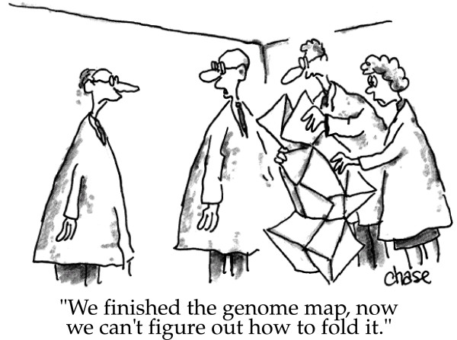
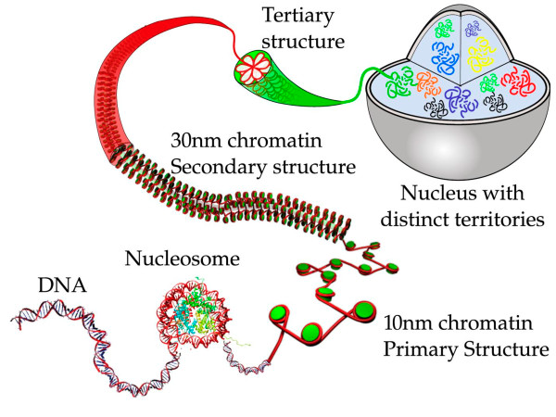
3D organization of genome
image credit: Iyer et al. BMC Biophysics 2011,
cartoonist John Chase
image credit: Iyer et al. BMC Biophysics 2011

Slide 18
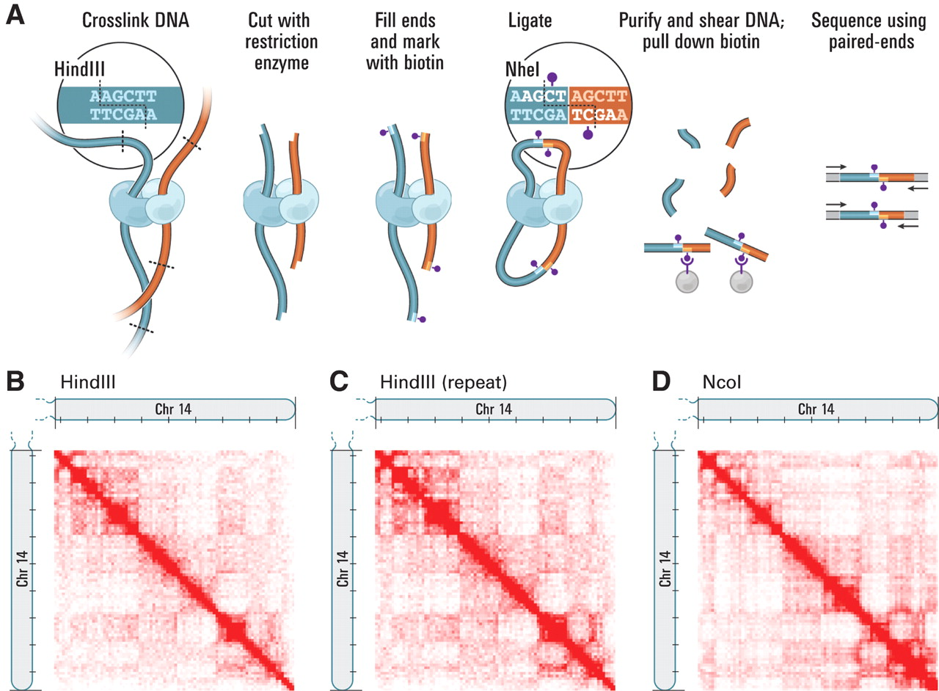
Hi-C contact map
A network can be expressed as an adjacency matrix A
where A_{ij} ≠ 0 if i and j are in contact & 0 otherwise
Science 2009, 5950: 289-293

Slide 19
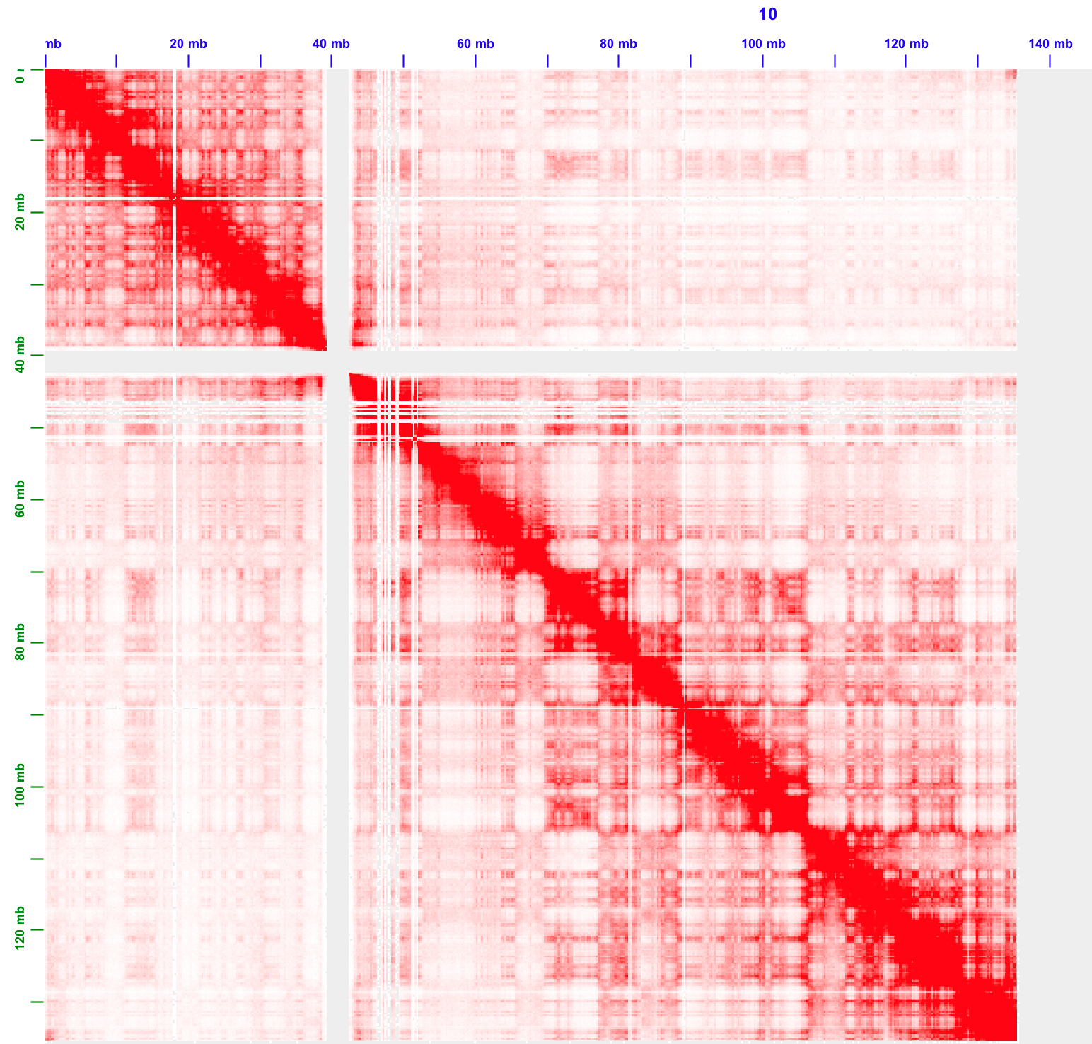
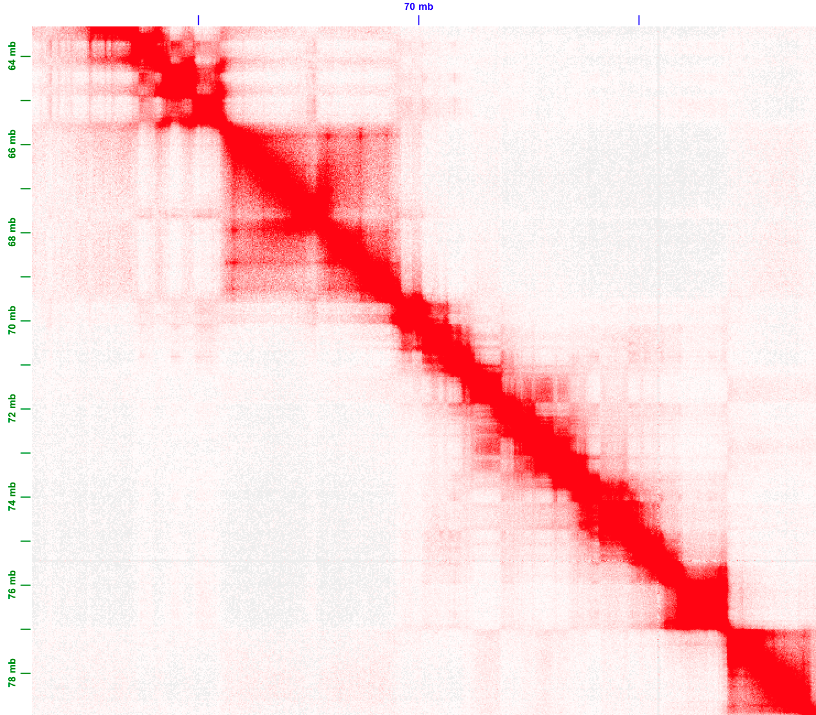
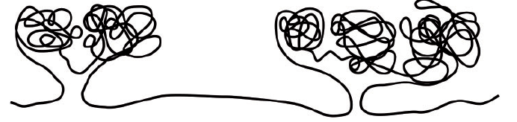
Topologically associating domains (TADs)
TADs have apparent
hierarchical organization

Slide 20
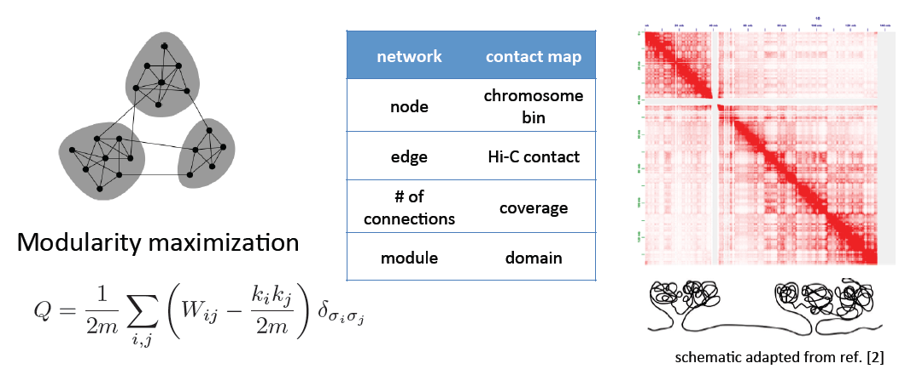
Identifying TADs in multiple resolutions
(More Later)
To be continued in network section…..
[Yan et al., PLOS Comp. Bio. (in revision, ‘17); bioRxiv 097345]

Slide 21
References for 25m7 part-1
(Functional Annotation of the Genome)
Alexander, R. P., Fang, G., Rozowsky, J., Snyder, M., & Gerstein, M. B. (2010).
Annotating non-coding regions of the genome.
Nature Reviews Genetics, 11(8), 559–571.
https://doi.org/10.1038/nrg2814
(Read whole thing.)
Expanded encyclopaedias of DNA elements in the human and mouse genomes
The ENCODE Project Consortium et al. Nature volume 583, pages 699–710 (2020)
https://www.nature.com/articles/s41586-020-2493-4
(Focus on text associated with Figs 2 and 3.)
Mackenzie, R. (2024, January 24).
RNA-Seq: Basics, applications and Protocol.
Genomics Research From Technology Networks.
https://www.technologynetworks.com/genomics/articles/rna-seq-basics-applications-and-protocol-299461
(Extra reference, optional)

