Slide 1
Biomedical Data Science (GersteinLab.org/courses/452)
Summary of Human Germline & Somatic Variation (25m6b)
Last edit in spring ’25. Now includes gnomAD. Mostly unchanged (but with slight edits) from 22m6b & 2021’s M6b [which has a video].
Mark Gerstein
Yale U.

Slide 2
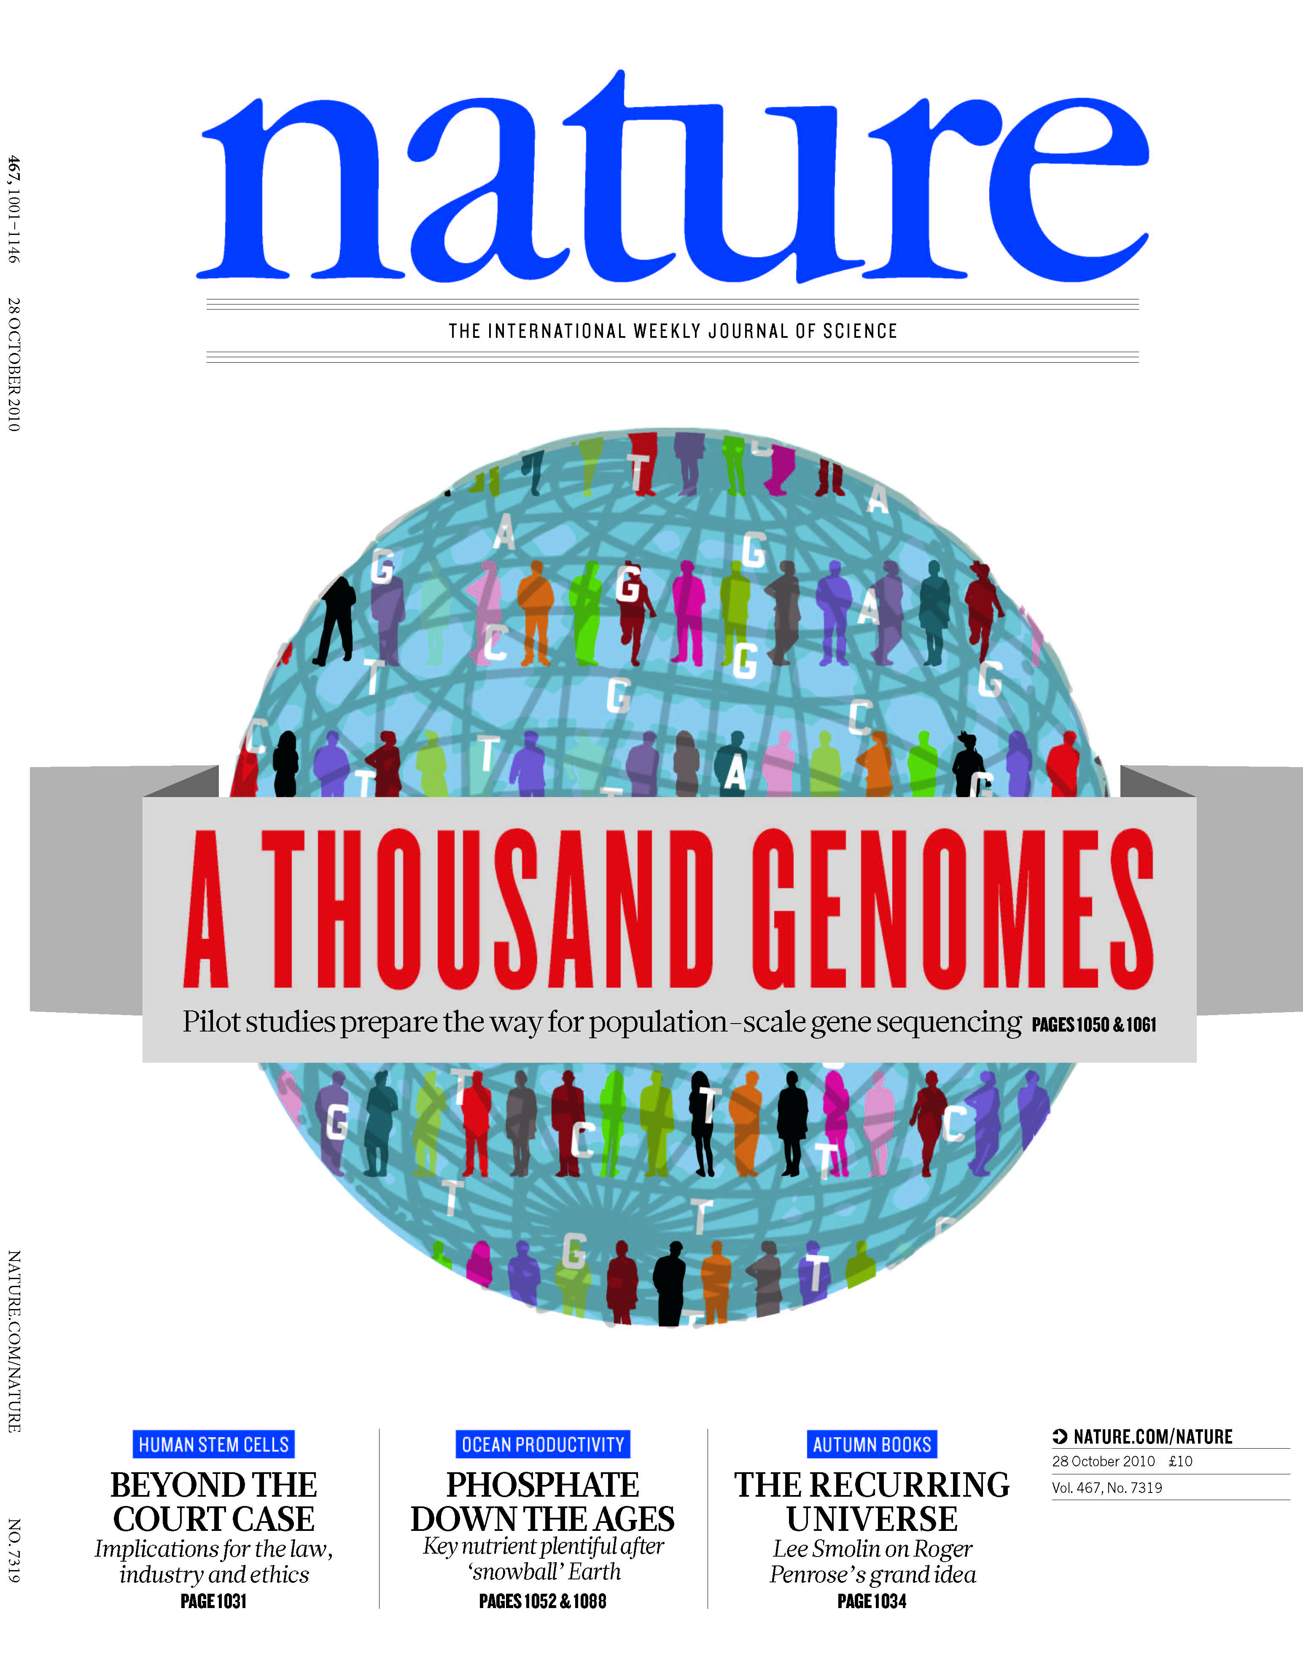
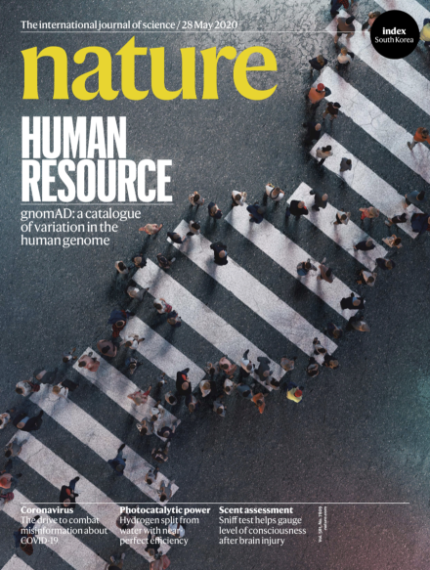
1000G SV
(Pilot, Phase I & III)
gnomAD
(ExAC, v2, v3, v4)
[1000 Genomes Consortium, Nature (2010, 2012); Mills et al., Nature (2011)]
[gnomAD v3 paper: Konrad et al., Nature (2020)]

Slide 3
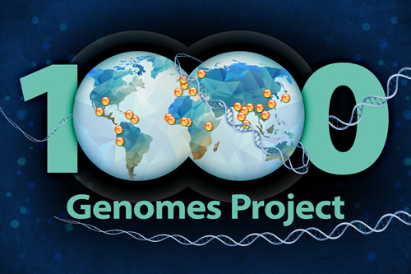

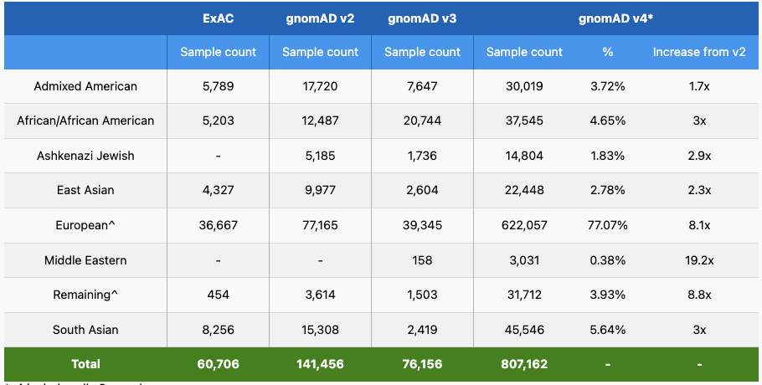
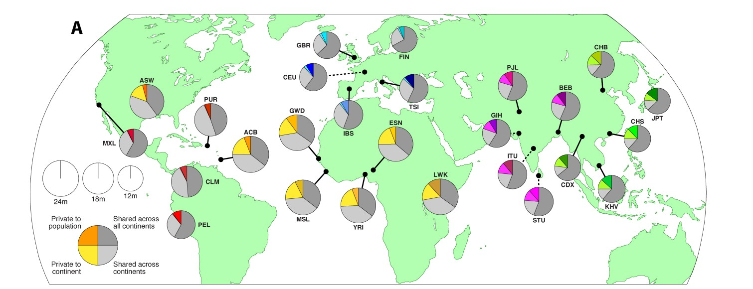
1000GP SV Phase3 (2015) and gnomAD V4 (2023) summary Stats
Increase by ~ 17.5 times
• 68,818 SVs
• 2,504 unrelated individuals
• 26 populations
• 37,250 SVs with resolved breakpoints
• 1,199,117 SVs
• 807,162 individuals
~ 322 times
[2] 1000GP Phase3 SV paper. Submided to Nature, 2015.
[3] 1000GP ConsorSum. Submided to Nature, 2015.
[4] gnomAD project https://gnomad.broadinstitute.org/
[5] gnomAD v3 paper: Konrad et al., Nature (2020)
Notes:
gnomAD v3: https://www.nature.com/articles/s41586-020-2308-7?fromPaywallRec=false

Slide 4
Rare & Common Variants
Common
Variants
Healthy
Rare or
Somatic
Variants
Pooled
Variants
High
Function
Impact
Diseased
Burden Test
GWAS Positive

Slide 5



Quantifying Selection inter- and intra-species approaches
‘Conservation’
Typically defined by comparison across species
dN/dS in coding regions
GERP noncoding
1
2
3
4
Metrics for selection within population
  SNP density (confounded by mutation rate)
Depletion of common polymorphisms for regions under selection (also an enrichment of rare variants)
Notes:
Baseline within human pop: 99.9% of the elements should be conserved

Slide 6
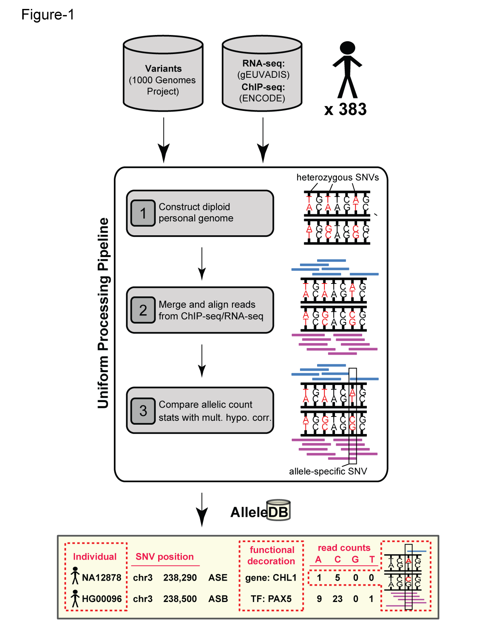
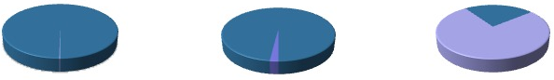
Human Genetic Variation (1000G)
Population of
2,504 peoples
A Cancer Genome
A Typical Genome
Origin of Variants
Class of Variants
 | Coding | Non-coding
Germ-line | 22K | 4.1 – 5M
Somatic | ~50 | 5K
SNP | 3.5 – 4.3M
Indel | 550 – 625K
SV | 2.1 – 2.5K (20Mb)
Total | 4.1 – 5M
SNP | 84.7M
Indel | 3.6M
SV | 60K
Total | 88.3M
Prevalence of Variants
Common
Common
Passenger
Driver (~0.1%)
Rare* (1-4%)
Rare (~75%)
* Variants with allele frequency < 0.5% are considered as rare variants in 1000 genomes project.
[6] The 1000 Genomes Project Consortium, Nature. 2015. 526:68-74
Khurana E. et al. Nat. Rev. Genet. 2016. 17:93-108

Slide 7
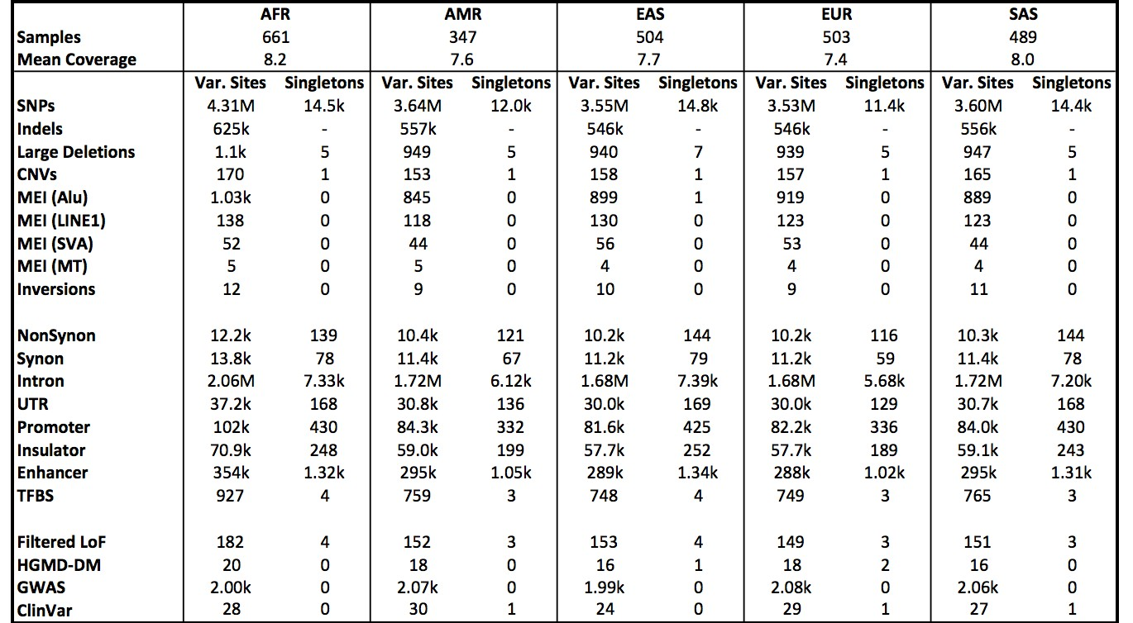
Phase 3 (‘15): Median Autosomal Variant Sites Per Genome
[9] 1000GP Consortium. Nature, 2015.

Slide 8
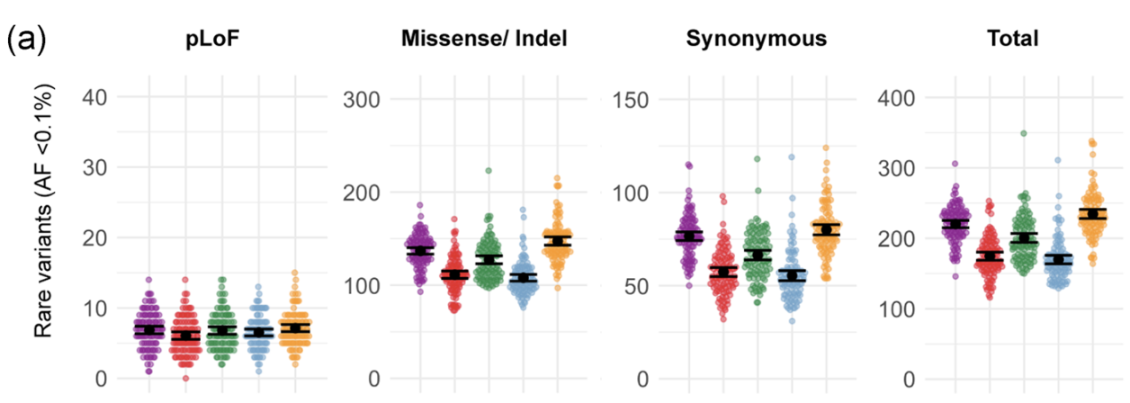
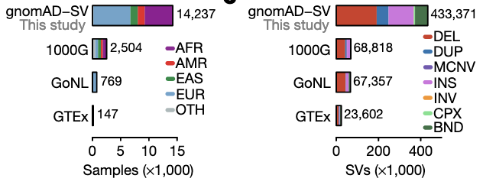
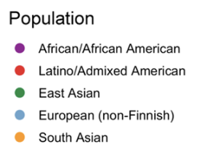
gnomAD: Mean Counts of Rare and Unique Coding Variants Across Populations
[7] Gudmundsson et al., Human Mutation 1-19 (2021)
[8] gnomAD-SV: Ryan et at., Nature (2020)

Slide 9
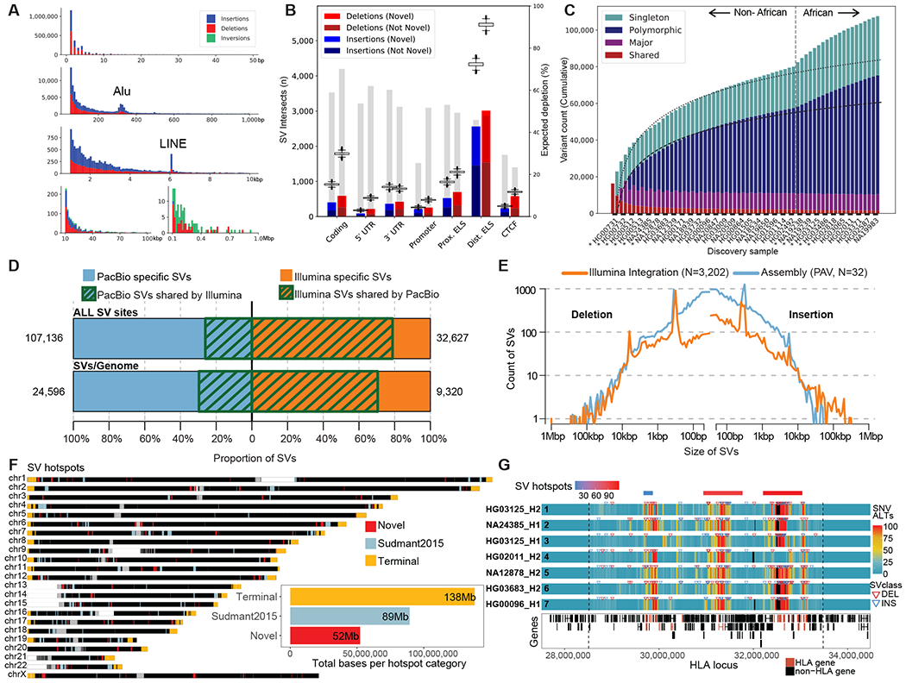
Updating the SV Numbers with Most Current Technology (PacBio HiFi)
On average, detected:
24,653 SVs,
794,406 indels, and 3,895,274 SNVs
per diploid human genome
[10] Ebert et al. Science (‘21)

Slide 10
PCAWG summary
(somatic variants)

Slide 11
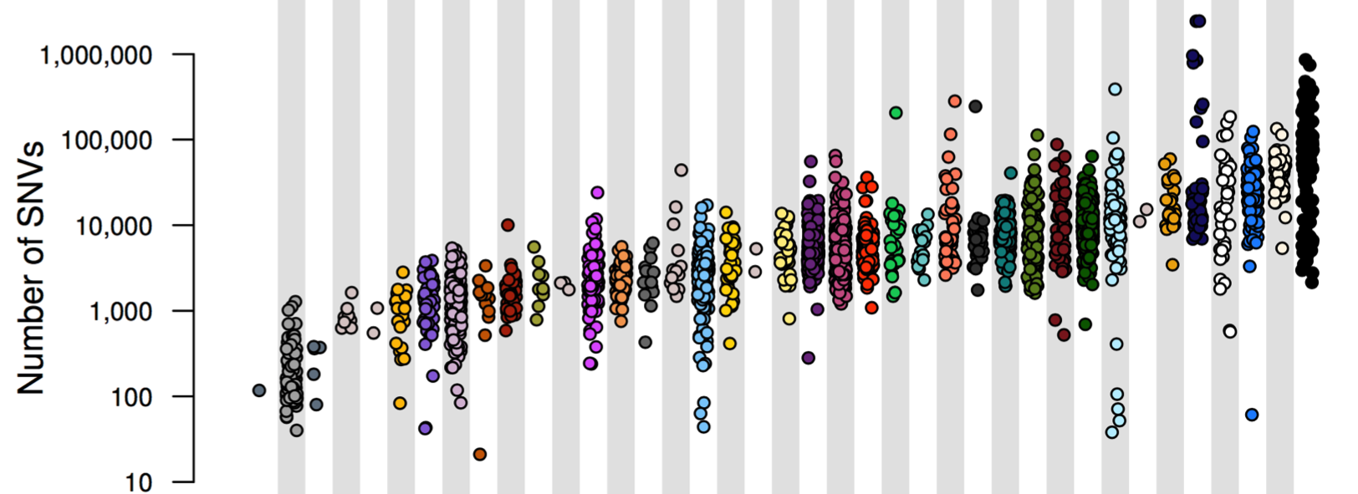
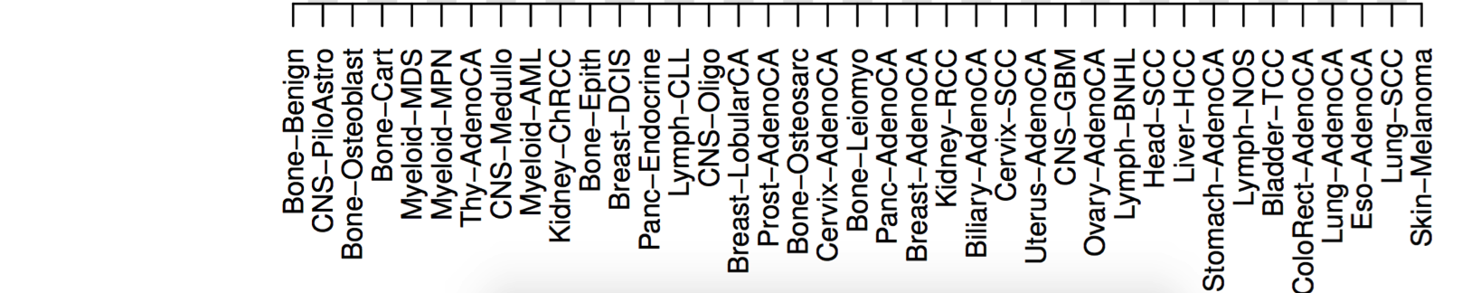
PCAWG : most comprehensive resource for
cancer whole genome analysis
Project Goals:
To understand role of non-coding regions of cancer genomes in disease progression.
Union of TCGA-ICGC efforts
Jointly analyzing ~2800 whole genome tumor/normal pairs
  > 580 researchers
  16 thematic working groups
  ~30M total somatic SNVs
[11] Adapted from Campbell et. al., bioRxiv (’17).
Now published as Nature 578: 82–93 (2020)

Slide 12
PCAWG Summary
Variant Totals
by Cancer
Nature 578: 82–93 (2020)

Slide 13
References
1000G consortium. Nature, 526(7571), 68–74.
A global reference for human genetic variation.
https://doi.org/10.1038/nature15393
(Focus on text associated with Table 1.)
PCAWG consortium. Nature, 578(7793), 82–93.
Pan-cancer analysis of whole genomes.
https://doi.org/10.1038/s41586-020-1969-6
(Focus on text associated with Extended Data Fig. 3)

