Slide 1
Biomedical Data Science (GersteinLab.org/courses/452)
Sequence Comparison (25m3)
Last edit in spring ‘25,
very similar to 22m3
& 2021’s M3
[which has a video]
Mark Gerstein
Yale U.

Slide 2
Sequence Topics (Contents)
Basic Alignment via Dynamic Programming
Suboptimal Alignment
Gap Penalties
Similarity (PAM) Matrices
Local Alignment
Notes:
RA removed FASTA, added BWA, shortened secondary structure topics listed

Slide 3
Aligning Text Strings
Raw Data ???
T C A T G
C A T T G
2 matches, 0 gaps
T C A T G
| |
C A T T G
3 matches (2 end gaps)
T C A T G .
| | |
. C A T T G
4 matches, 1 insertion
T C A - T G
| | | |
. C A T T G
4 matches, 1 insertion
T C A T - G
| | | |
. C A T T G

Slide 4
Dynamic Programming
What to do for a bigger string?
  SSDSEREEHVKRFRQALDDTGMKVPMATTNLFTHPVFKDGGFTANDRDVRRYALRKTIRNIDLAVELGAETYVAWGGREGAESGGAKDVRDALDRMKEAFDLLGEYVTSQGYDIRFAIEP
  KPNEPRGDILLPTVGHALAFIERLERPELYGVNPEVGHEQMAGLNFPHGIAQALWAGKLFHIDLNGQNGIKYDQDLRFGAGDLRAAFWLVDLLESAGYSGPRHFDFKPPRTEDFDGVWAS
Needleman-Wunsch (1970) provided first automatic method
  Dynamic Programming to Find Global Alignment
Their Test Data (J->Y)
  ABCNYRQCLCRPM
  AYCYNRCKCRBP

Slide 5
Step 1 -- Make a Dot Plot (Similarity Matrix)
Put 1's where characters are identical.

Slide 6
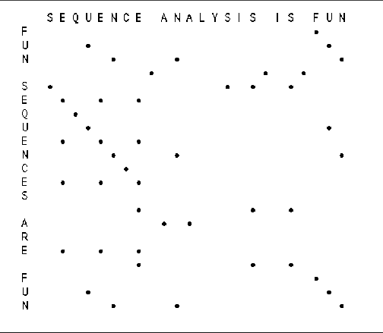
A More Interesting Dot Matrix
(adapted from R Altman)

Slide 7
Step 2 --
Start Computing the Sum Matrix
new_value_cell(R,C) <=
cell(R,C) { Old value, either 1 or 0 }
+ Max[
cell (R+1, C+1), { Diagonally Down, no gaps }
cells(R+1, C+2 to C_max),{ Down a row, making col. gap }
cells(R+2 to R_max, C+1) { Down a col., making row gap }
]

Slide 8
Step 2 --
Start Computing the Sum Matrix
new_value_cell(R,C) <=
cell(R,C) { Old value, either 1 or 0 }
+ Max[
cell (R+1, C+1), { Diagonally Down, no gaps }
cells(R+1, C+2 to C_max),{ Down a row, making col. gap }
cells(R+2 to R_max, C+1) { Down a col., making row gap }
]

Slide 9
Step 3 -- Keep Going

Slide 10
Step 4 -- Sum Matrix All Done
Alignment Score is 8 matches.

Slide 11
Step 5 -- Traceback
Find Best Score (8) and Trace Back
A B C N Y - R Q C L C R - P M
A Y C - Y N R - C K C R B P
Hansel & Gretel

Slide 12
Step 6 -- Alternate Tracebacks
A B C - N Y R Q C L C R - P M
A Y C Y N - R - C K C R B P
Also,
Suboptimal
Aligments

Slide 13
Gap Penalties
The score at a position can also factor in a penalty for introducing gaps (i. e., not going from i, j to i- 1, j- 1).
Gap penalties are often of linear form:
  GAP = a + bN
  GAP is the gap penalty
  a = cost of opening a gap
  b = cost of extending the gap by one (affine)
  N = length of the gap
  (Here assume b=0, a=1/2, so GAP = 1/2 regardless of length.)
ATGCAAAAT
ATG-AAAAT .5
ATG--AAAT .5 + (1)b [b=.1]
ATG---AAT .5 + (2)(.1) =.7

Slide 14
Step 2 -- Computing the Sum Matrix with Gaps
new_value_cell(R,C) <=
cell(R,C) { Old value, either 1 or 0 }
+ Max[
cell (R+1, C+1), { Diagonally Down, no gaps }
cells(R+1, C+2 to C_max) - GAP ,{ Down a row, making col. gap }
cells(R+2 to R_max, C+1) - GAP { Down a col., making row gap }
]
GAP
=1/2
1.5

Slide 15
All Steps in Aligning a 4-mer
C R B P
C R P M
- C R P M
C R - P M
Bottom right hand corner of previous matrices

Slide 16
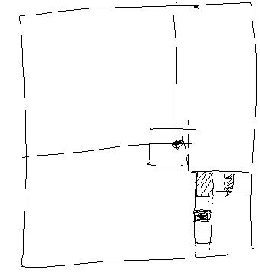
Key Idea in Dynamic Programming
  The best alignment that ends at a given pair of positions (i and j) in the 2 sequences is the score of the best alignment previous to this position PLUS the score for aligning those two positions.
  An Example Below
    Aligning R to K does not affect alignment of previous N-terminal residues. Once this is done it is fixed. Then go on to align D to E.
    How could this be violated?
    Aligning R to K changes best alignment in box.
ACSQRP--LRV-SH RSENCV
A-SNKPQLVKLMTH VKDFCV
ACSQRP--LRV-SH -R SENCV
A-SNKPQLVKLMTH VK DFCV

Slide 17
Similarity (Substitution) Matrix
A R N D C Q E G H I L K M F P S T W Y V
A 4 -1 -2 -2 0 -1 -1 0 -2 -1 -1 -1 -1 -2 -1 1 0 -3 -2 0
R -1 5 0 -2 -3 1 0 -2 0 -3 -2 2 -1 -3 -2 -1 -1 -3 -2 -3
N -2 0 6 1 -3 0 0 0 1 -3 -3 0 -2 -3 -2 1 0 -4 -2 -3
D -2 -2 1 6 -3 0 2 -1 -1 -3 -4 -1 -3 -3 -1 0 -1 -4 -3 -3
C 0 -3 -3 -3 8 -3 -4 -3 -3 -1 -1 -3 -1 -2 -3 -1 -1 -2 -2 -1
Q -1 1 0 0 -3 5 2 -2 0 -3 -2 1 0 -3 -1 0 -1 -2 -1 -2
E -1 0 0 2 -4 2 5 -2 0 -3 -3 1 -2 -3 -1 0 -1 -3 -2 -2
G 0 -2 0 -1 -3 -2 -2 6 -2 -4 -4 -2 -3 -3 -2 0 -2 -2 -3 -3
H -2 0 1 -1 -3 0 0 -2 7 -3 -3 -1 -2 -1 -2 -1 -2 -2 2 -3
I -1 -3 -3 -3 -1 -3 -3 -4 -3 4 2 -3 1 0 -3 -2 -1 -3 -1 3
L -1 -2 -3 -4 -1 -2 -3 -4 -3 2 4 -2 2 0 -3 -2 -1 -2 -1 1
K -1 2 0 -1 -3 1 1 -2 -1 -3 -2 5 -1 -3 -1 0 -1 -3 -2 -2
M -1 -1 -2 -3 -1 0 -2 -3 -2 1 2 -1 5 0 -2 -1 -1 -1 -1 1
F -2 -3 -3 -3 -2 -3 -3 -3 -1 0 0 -3 0 6 -4 -2 -2 1 3 -1
P -1 -2 -2 -1 -3 -1 -1 -2 -2 -3 -3 -1 -2 -4 6 -1 -1 -4 -3 -2
S 1 -1 1 0 -1 0 0 0 -1 -2 -2 0 -1 -2 -1 4 1 -3 -2 -2
T 0 -1 0 -1 -1 -1 -1 -2 -2 -1 -1 -1 -1 -2 -1 1 5 -2 -2 0
W -3 -3 -4 -4 -2 -2 -3 -2 -2 -3 -2 -3 -1 1 -4 -3 -2 10 2 -3
Y -2 -2 -2 -3 -2 -1 -2 -3 2 -1 -1 -2 -1 3 -3 -2 -2 2 6 -1
V 0 -3 -3 -3 -1 -2 -2 -3 -3 3 1 -2 1 -1 -2 -2 0 -3 -1 4
Identity Matrix
  Match L with L => 1
  Match L with D => 0
  Match L with V => 0??
S(aa-1,aa-2)
  Match L with L => 1
  Match L with D => 0
  Match L with V => .5
Number of Common Ones
  PAM
  Blossum
  Gonnet

Slide 18
Where do matrices come from?
+ —> More likely than random
0 —> At random base rate
- —> Less likely than random
1 Manually align protein structures
(or, more risky, sequences)
2 Look at frequency of a.a. substitutions
at structurally constant sites. -- i.e. pair i-j exchanges
3 Compute log-odds
S(aa-1,aa-2) = log₂ ( freq(O) / freq(E) )
O = observed exchanges,
E = expected exchanges
odds = freq(observed) / freq(expected)
Sij = log odds
freq(expected) = f(i)*f(j)
= is the chance of getting amino acid i in a column and then having it change to j
e.g. A-R pair observed only a tenth as often as expected
90%
AAVLL…
AAVQI…
AVVQL…
ASVLL…
45%

Slide 19
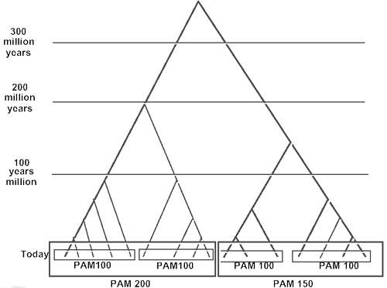
Different Matrices are Appropriate at Different Evolutionary Distances
Different gold std. sets of seq at diff ev. dist. --> matrices
Ev. Equiv. seq. (ortholog) [hb and mb]
(Adapted from D Brutlag, Stanford)

Slide 20
Change in Matrix with Ev. Dist.
PAM-250 (distant)
Chemistry (far) Vs. genetic code (near)
PAM-70
(Adapted from D Brutlag, Stanford)

Slide 21
Modifications for Local Alignment
1 The scoring system uses negative scores for mismatches
2 The minimum score for at a matrix element is zero
3 Find the best score anywhere in the matrix (not just last column or row)
These three changes cause the algorithm to seek high scoring subsequences, which are not penalized for their global effects (mod. 1), which don’t include areas of poor match (mod. 2), and which can occur anywhere (mod. 3)
VLALTVSTVVQM
MSTWNSTVVLMRFF
Local
Global
(Adapted from R Altman)

Slide 22
Global (NW) Vs. Local (SW) Alignments
-ACG–C
|| |
GACTAC
-AC-GC
|| |
GACTAC
AC–G
| |
GATTGA
A-CG
| |
GATTGA
or
or
Global : Match: +1 Mismatch: 0 Gap: -1
Local : Match: +4 Mismatch: -1 Gap: -2
[Slightly different sum matrix layout than in preceding slides]
(Adapted from Stephen F. Altschul)

Slide 23
References
Smith, T., & Waterman. (1981).
Journal of Molecular Biology, 147(1), 195–197.
Identification of common molecular subsequences.
https://doi.org/10.1016/0022-2836(81)90087-5
(http://www.gersteinlab.org/courses/452/10-spring/pdf/sw.pdf)
(Just Algorithm Section)

