Slide 1
Biomedical Data Science (GersteinLab.org/courses/452)
Network Topology – Central Points (23m10d)
Last edit in spring ’23. Very similar to 2022’s 22m10d &
2021’s M10d [which has a video].
Mark Gerstein
Yale U.

Slide 2
Network Topology
Measures of Centrality: Hubs

Slide 3
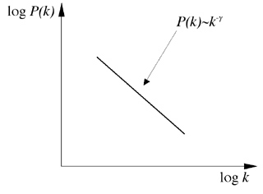
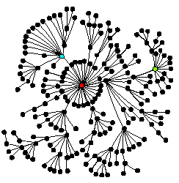
Scale-free networks in Biology
Power-law distribution
log(Frequency)
log(Degree)
Hubs dictate the structure of the network
[Barabasi]

Slide 4
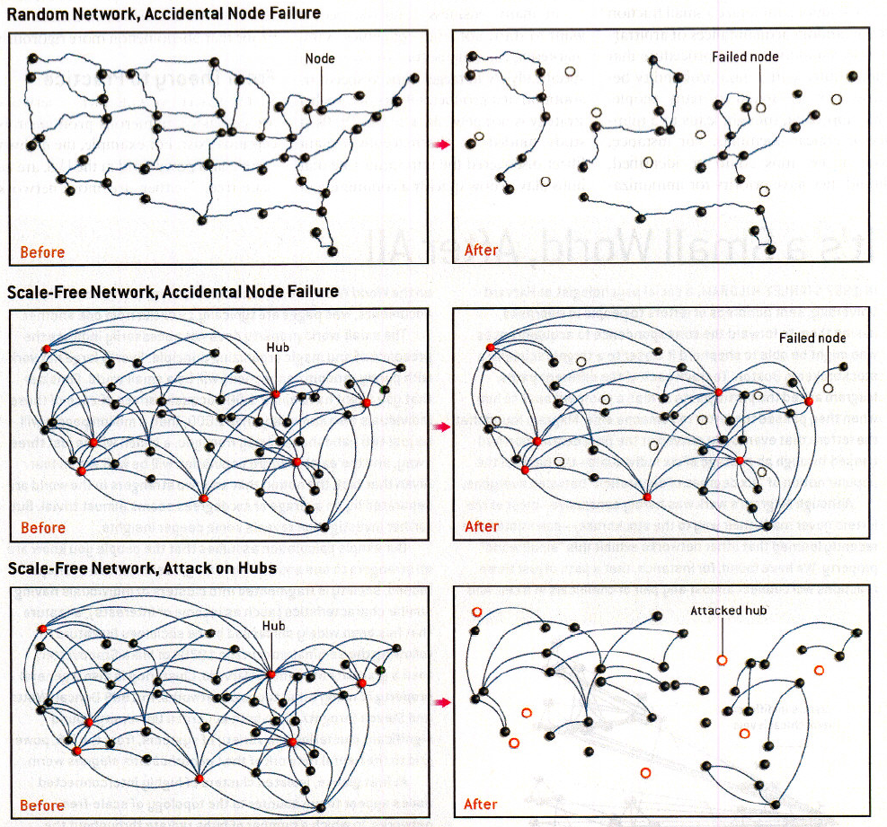
Knocking Out
Nodes in Scale-free and Random Networks
[From Barabasi & Bonabeau, Sci. Am., May '03]

Slide 5
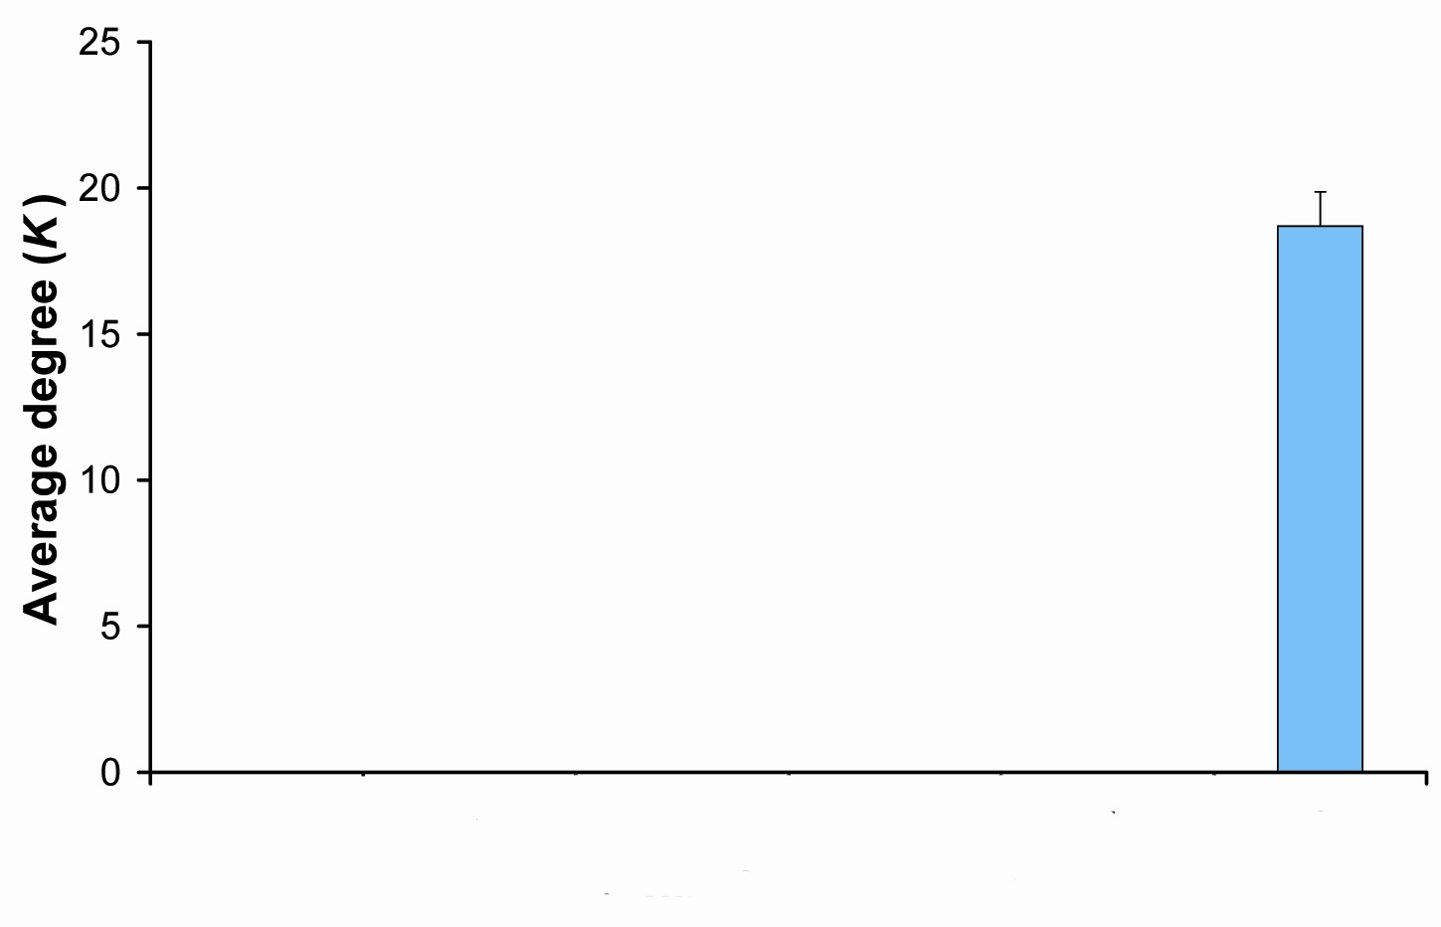
Hubs tend to be Essential
Integrate gene essentiality data with protein interaction network. Perhaps hubs represent vulnerable points?
[Lauffenburger, Barabasi]
"hubbiness"
[Yu et al., 2003, TIG]
Non- Essential
Essential

Slide 6
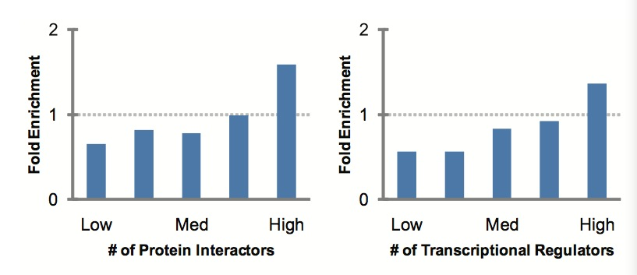
More Connectivity, More Constraint :
A theme borne out in many studies
Notably, the most highly conserved proteins were highly connected in E.coli protein interaction network. (E.coli)
- Butland et al. 2004, Nature
Connectivity of well-conserved proteins in network is negatively correlated with their rate of evolution. (Saccharomyces cerevisiae)
- Fraser et al. 2002, Science
- Fraser et al. BMC Evol. Biol. (2003)
Proteins that have a more central position evolve more slowly and are more likely to be essential for survival. (Saccharomyces cerevisiae; C. elegans; Drosophila)
- Hahn et al. 2005, Mol Biol Evol
More miRNA regulation of a target gene associated with lower dN/dS (r = -.21) (M. musculus)
- Cheng et al. 2009, BMC Genomics
Slowly evolving proteins tend to have more interaction partners. (Saccharomyces cerevisiae)
- Xia et al. 2009, Plos Comput Biol
Fold Enrichment of slowly evolved proteins - Xia et al.
Notes:
Fitness Effect: proteins with many interactors have a greater effect on organism fitness, they could evolve more slowly, not because a greater proportion of the sequence is required for proper function, but because the entire sequence is subject to stronger selection against slightly deleterious mutations
Structure Constrain: Because central net- work proteins (hubs) are likely to have a larger fraction of their surface involved in interactions, they tend to be constrained and under negative selection.
Other paper:
A negative correlation between number of interactions and evolutionary rate is observed. (Saccharomyces cerevisiae)
- Saeed et al. 2006, BMC

Slide 7
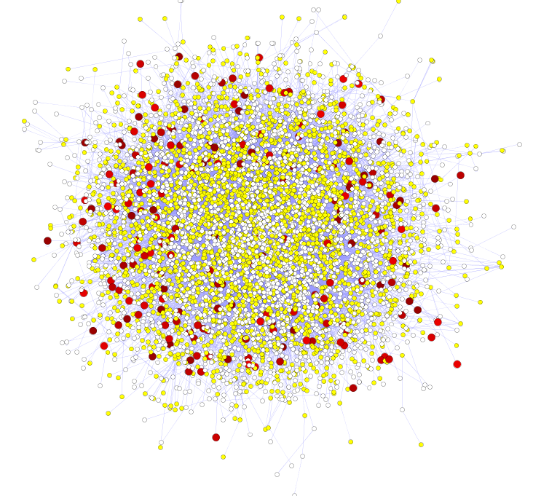
Rapid Evolution in the interaction network takes place at the periphery
Pos. sel. v. deg. centrality:
ρ = -.06, P < 1.2e-6
  Effect is independent of any bias due to gene expression differences
  Update w. 1000G Phase I
  SNP dens. v. centrality:
  ρ = -.1, p< 2.2e-16
High likelihood of positive selection
Lower likelihood of positive selection
Not under positive selection
No data about positive selection
Source: Nielsen et al. PLoS Biol. (2005), HPRD, and Kim et al. PNAS (2007)

Slide 8
Network Topology
Other Measures of Centrality besides Hubs: Bottlenecks

Slide 9
Another measure of Centrality:
Betweenness centrality
Betweenness of a node is the number of shortest paths of pairs of vertices that run through it -- a measure of information flow.
Freeman LC (1977) Set of measures of centrality based on betweenness. Sociometry 40: 35–41.
Girvan & Newman (2002) PNAS 99: 7821.

Slide 10
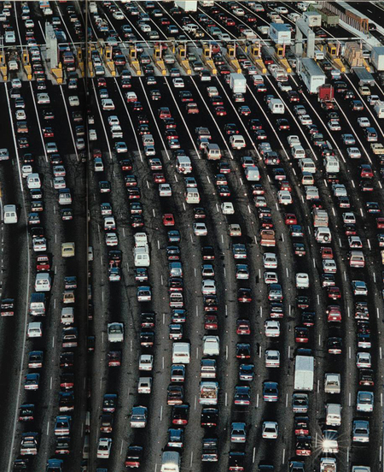
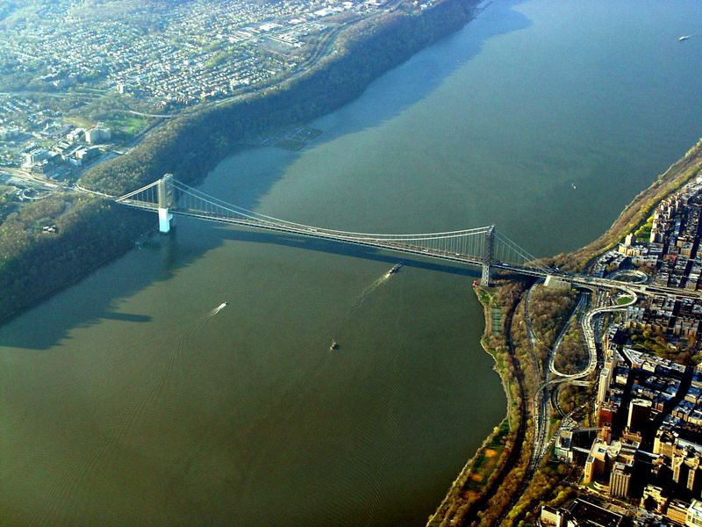
Bottlenecks & Hubs
[Yu et al., PLOS CB (2007)]

Slide 11
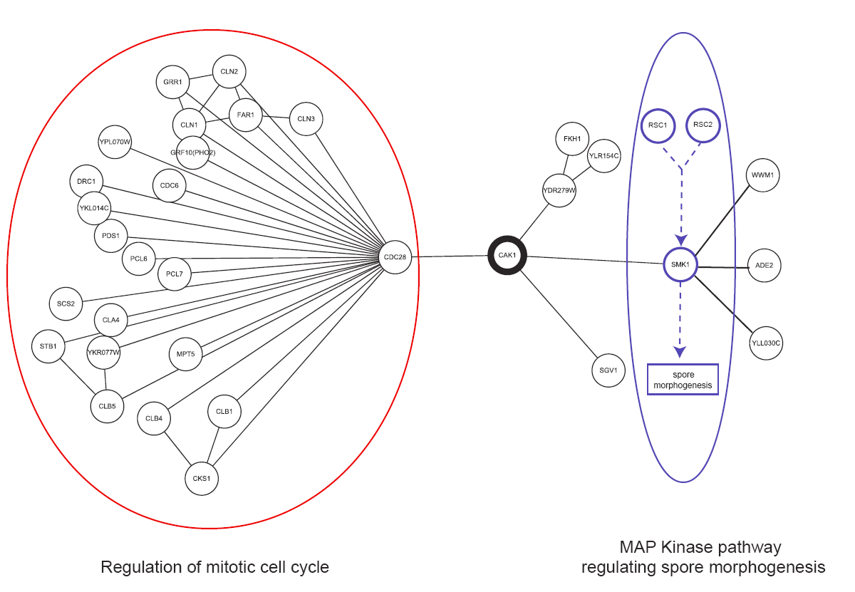
Bottleneck bridging between processes
[Yu et al., PLOS CB (2007)]
Notes:
Moreover, our approach of focusing on non-hub-bottlenecks is useful for finding proteins
that mediate different processes and are involved in cross talk. An example is Cak1p (see
Figure 5), which is a Cyclin-dependent kinase-activating kinase involved in two key
signaling-transduction pathways. It activates Cdc28p, an important regulator of the cellcycle.
Cak1p also induces Smk1p, a MAP kinase involved in sporulation [37]. Besides
these two proteins, Cak1p only has two other interaction partners (YDR279W and
Sgv1p), making its total degree 4. Therefore, it is not a hub in the interaction network.
However, since it coordinates two major signaling-transduction pathways, it is an
important non-hub bottleneck in the network with a high betweenness of 16832.95 paths.
Finally, due to its unique topological position in the network, CAK1 is an essential gene
in the cell. More interestingly, it is also a close homolog of a human cancer gene CDK6
(BLAST E value < 10-10). This example shows that bottlenecks potentially could be
applied various medical and pharmaceutical contexts to identify key proteins. We have
actually applied this measure, together with others, in finding potential targets for
structural genomics [38].

Slide 12
Shortest Paths: The Dijkstra Algorithm
B
F
Source
A
A → G (through C)
C
E
More information:
Dijkstra, E. W. (1959). "A note on two problems in connexion with graphs". Numerische Mathematik 1: 269–271
Algorithmics: Theory and Practice, Brassard and Bratley (1988), p87-92
Target
D
G
Notes:
以例子说明

Slide 13
Network Topology
Other Measures of Centrality besides Hubs: Hierarchy

Slide 14
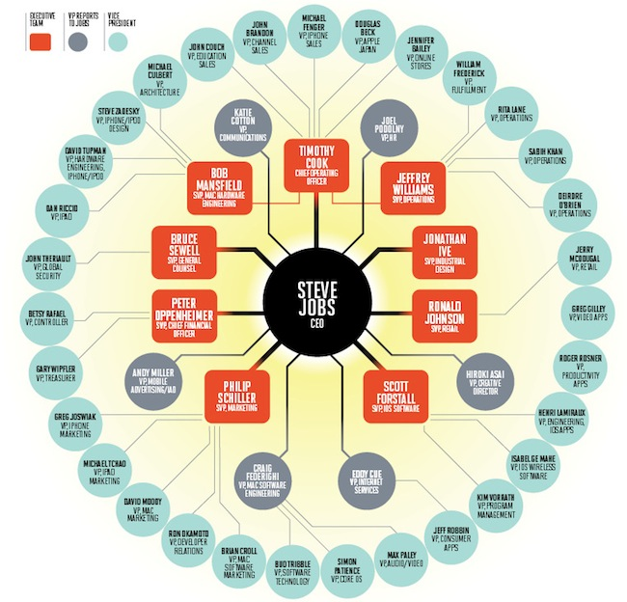
Network
Hierarchy

Slide 15
Network Stats to Identify Hierarchy
In-degree = 1
TF out-degree = 3
TF target
non-TF target
Hierarchy Height Statistic =
(normalized TF Out deg. – In deg.)

Slide 16
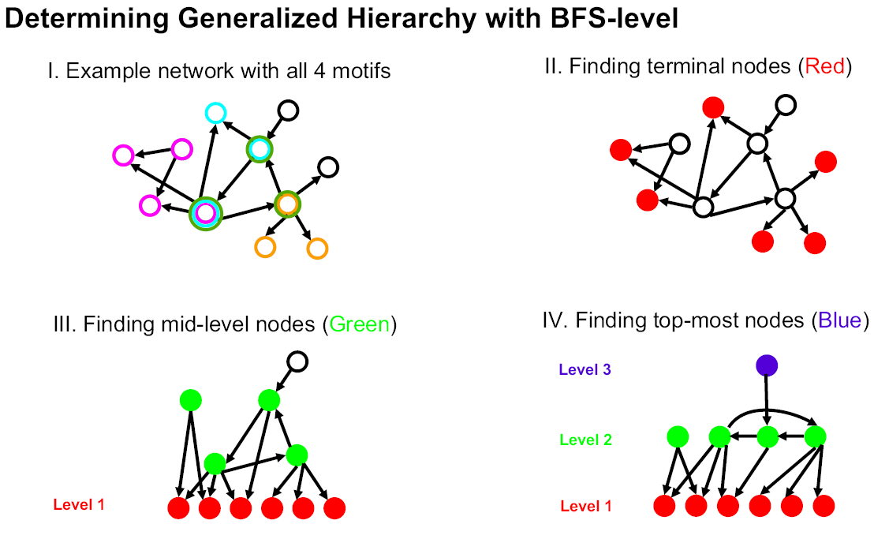
Determination of "Level" in Regulatory Network Hierarchy with Breadth-first Search
[Yu et al., PNAS (2006)]
Notes:
We call this construction method "BFS-level" (Breadth-First Search to define Level). As
described in Figure 1B, it is based on a straightforward application of breadth-first search:
we first identified all TFs at the bottom level (i.e., level 1). A TF is at the bottom level if
and only if it does not regulate other TFs. TFs that only regulate themselves (i.e., autoregulation)
are also placed at the bottom. Starting from each bottom TF, we then
performed a breadth-first search to convert the whole network into a "breadth-first tree"
(18) (see Figure 2A and Table 1A). In other words, we define the level of a non-bottom
TF in the hierarchy as its shortest distance from a bottom one. Here, the construction
procedure is only focused on inter-regulation between TFs (or officials in social
networks). A top TF could directly regulate non-TF target genes (or a higher-ranked
official could have an assistant with no managerial responsibility), but this will not affect
the constructed hierarchy. If the resulted layered structure has a pyramidal shape (i.e.,
few nodes at the top and most nodes at the bottom), we, then, considered it as a
generalized hierarchy.

Slide 17
Using Simulated Annealing to Globally Minimize the Number of Upward Pointing Edges
1
4
7
Probing direction is
an optimization problem
1
3
10
relocating nodes
2
8
5
9
7
4
9
3
10
6
2
5
6
8
￼
[ Gerstein et al. Nature ('12) ]

Slide 18
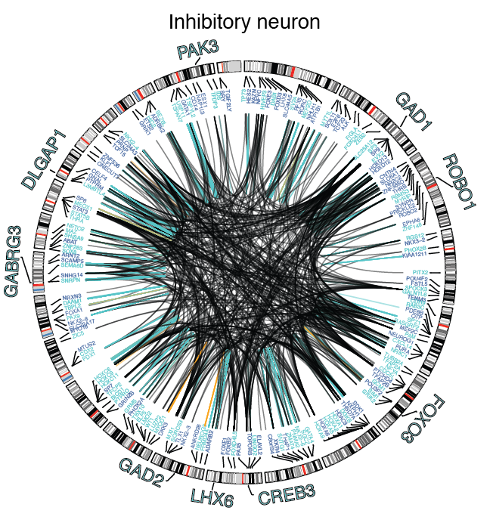
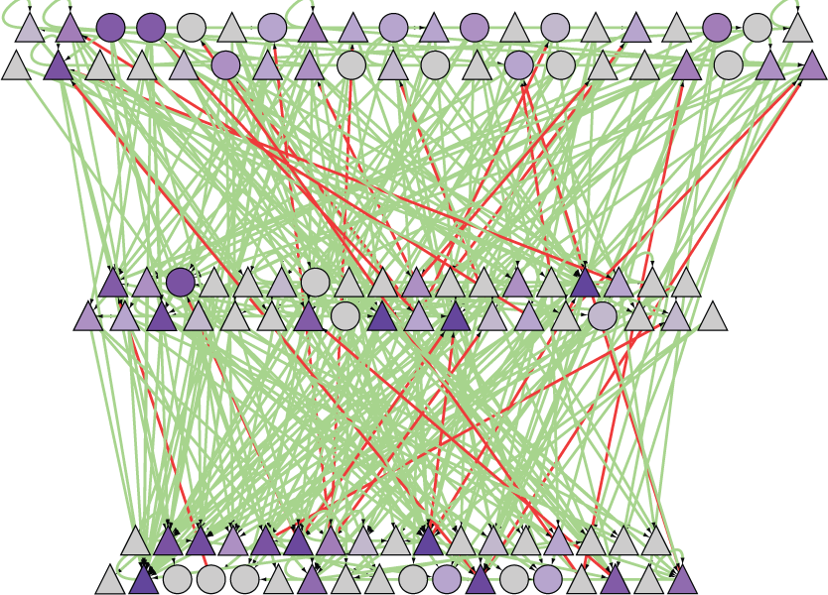
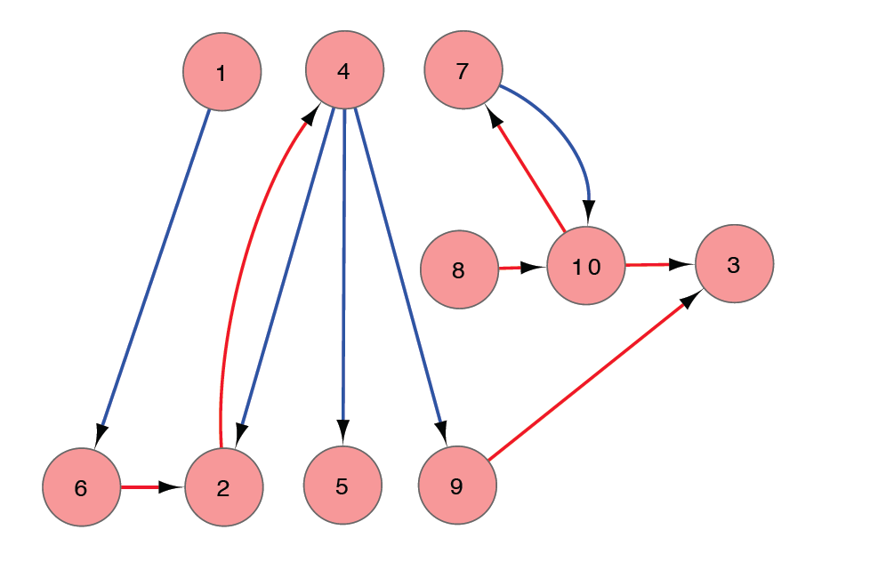
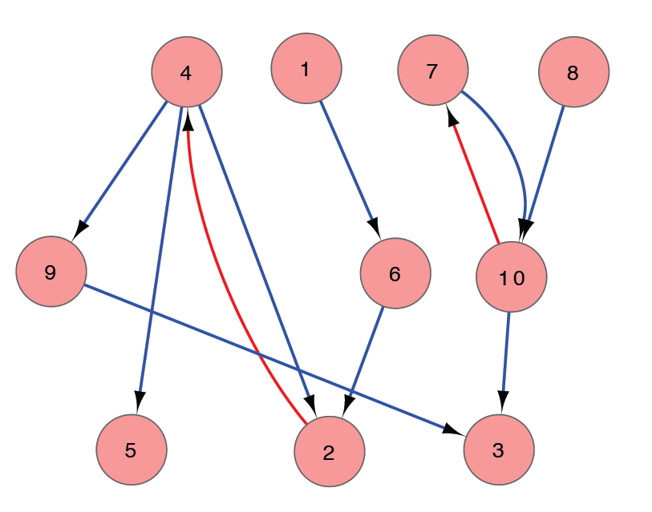
Transforming a Regulatory Network into a Hierachy
Regulatory Network
Network Hierarchy
simulated
annealing
[Wang et al. (‘18) Science, Gerstein et al. Nature ('12)]

Slide 19
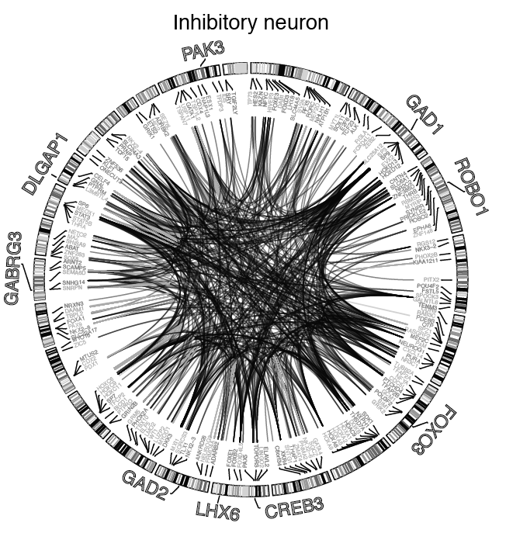
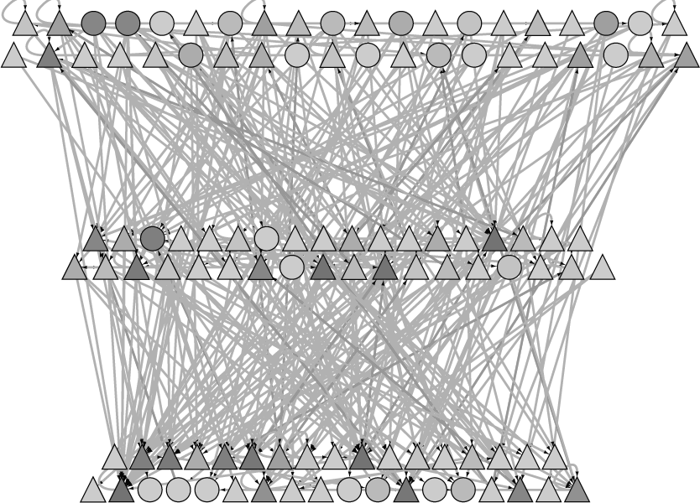
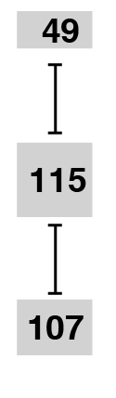
Mid-level of the hierarchy has many high-connectivity bottlenecks
betweenness
[Wang et al. (‘18) Science, Gerstein et al. Nature ('12)]

