Slide 1
Biomedical Data Science (GersteinLab.org/courses/452)
Network Topology -- Intro (23m10a)
Last edit in spring ’23. Very similar to 2022’s 22m10a &
2021’s M10a [which has a video].
Mark Gerstein
Yale U.

Slide 2
Network Topology
Reasons for Networks: Overcome shortcomings
of linear genome annotation

Slide 3
Current Annotation:
1D Browser Tracks
Will this scale to 1000+ tracks? What will next-gen annotation look like?...
Systems from Parts

Slide 4
Current Annotation:
1D Browser Tracks
Will this scale to 1000+ tracks? What will next-gen annotation look like?...
Systems from Parts

Slide 5
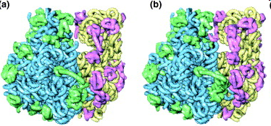
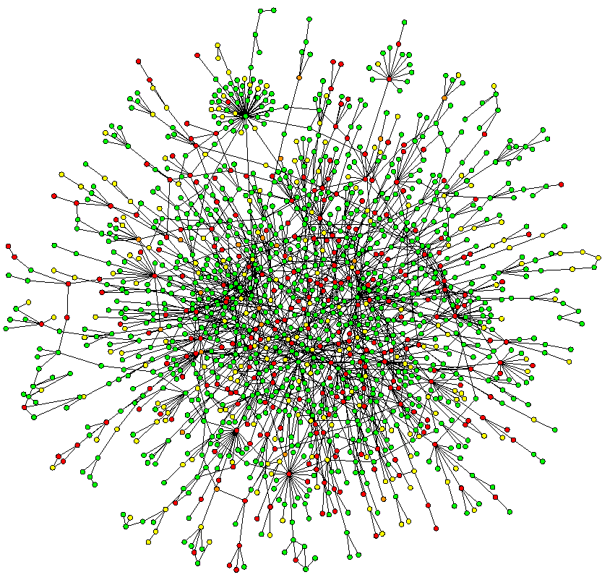
Networks occupy a midway point in terms of level of understanding
~2D: Network
Wiring Diagram of a Molecular System
3D & 4D:
Detailed structural understanding of cellular machinery
(e.g. ribosome in different functional states)
1D: Complete
Partslist
(“Elements” in genomic tracks)
[UCSC genome browser]
[Jeong et al. Nature, 41:411]
[Chiu et al. Trends in Cell Biol, 16:144]

Slide 6
Network Topology
Reasons for Networks: Useful way of thinking about disease

Slide 7
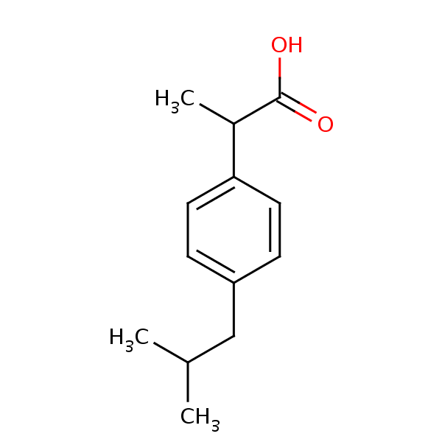
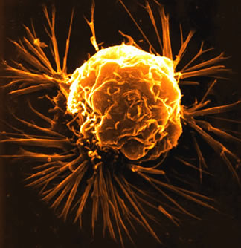
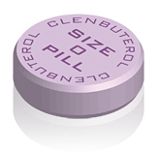
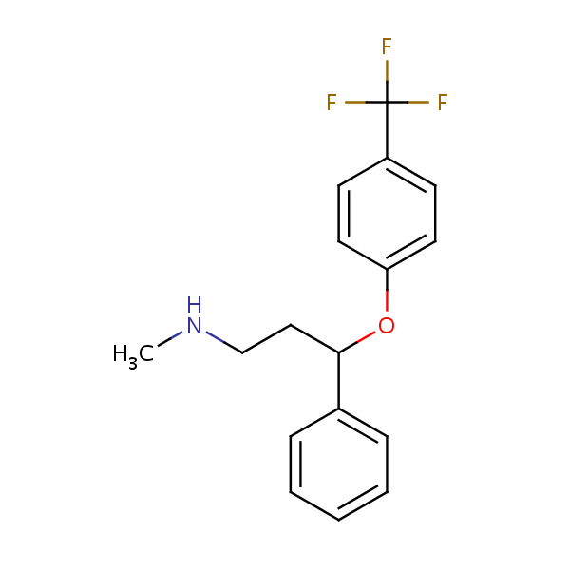
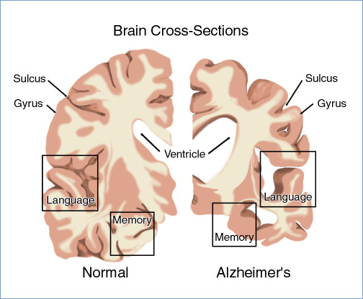
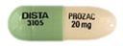
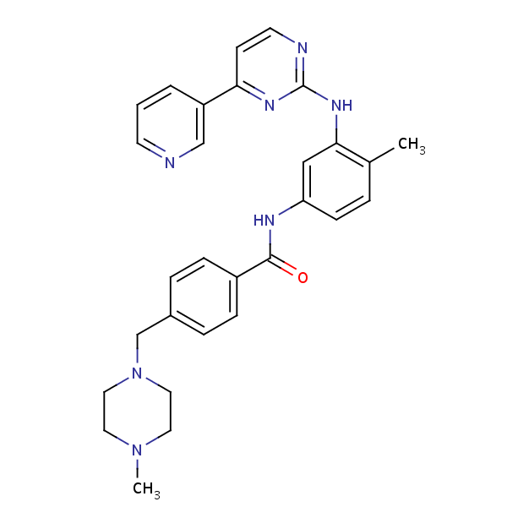

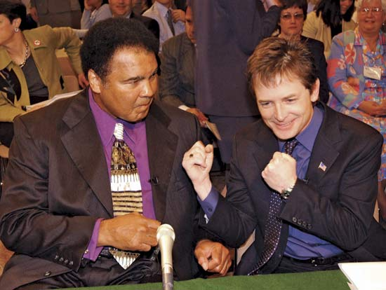
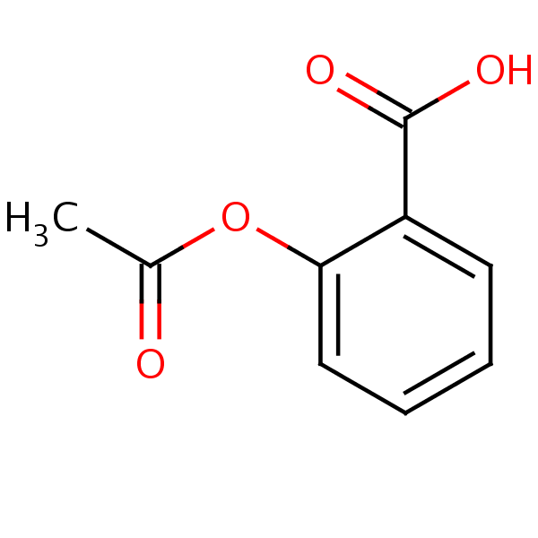
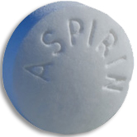
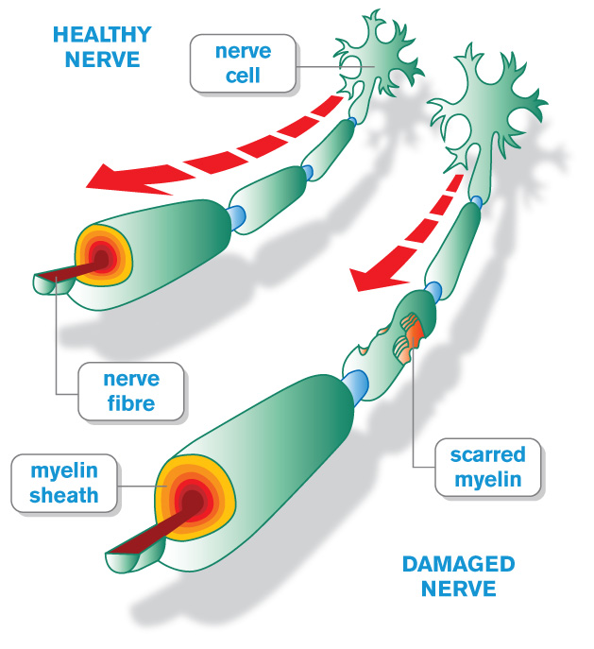
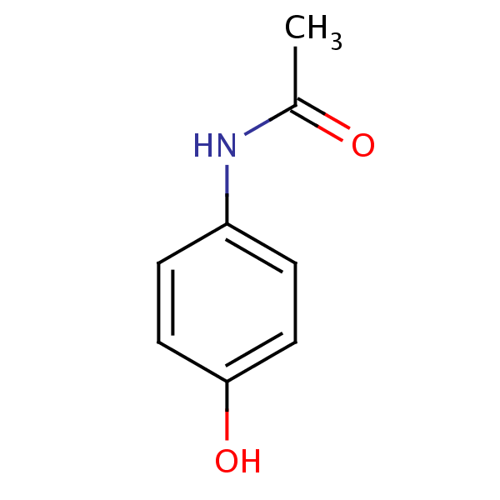
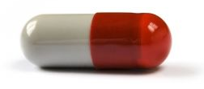
Network pathology & pharmacology
Breast
Cancer
Alzheimer’s
Disease
Parkinson’s
Disease
Multiple
Sclerosis
Interactome networks
[Adapted from H Yu]

Slide 8
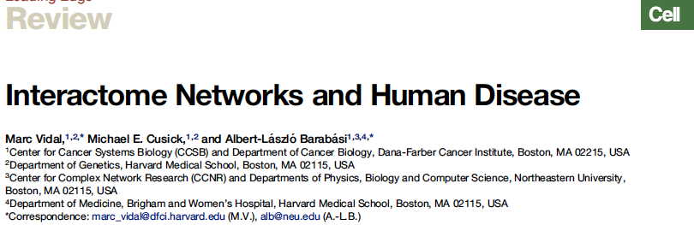
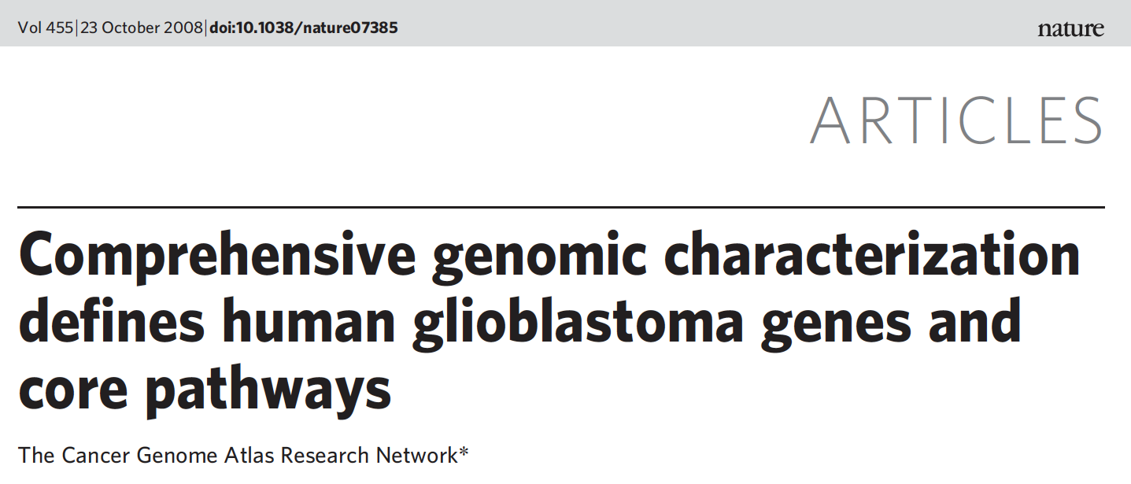
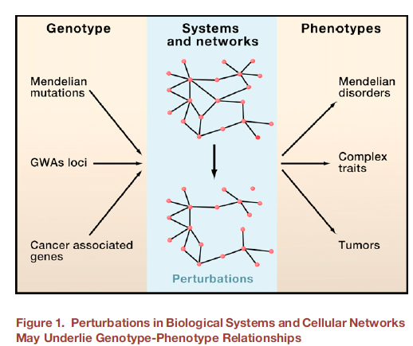
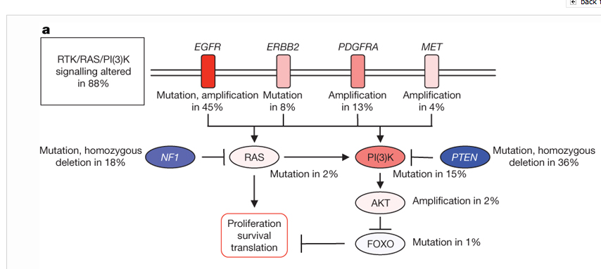

Slide 9
Network Topology
Reasons for Networks: Comprehensive representation, capable of representing many types of biological & non-biological data & bridging between disciplines

Slide 10
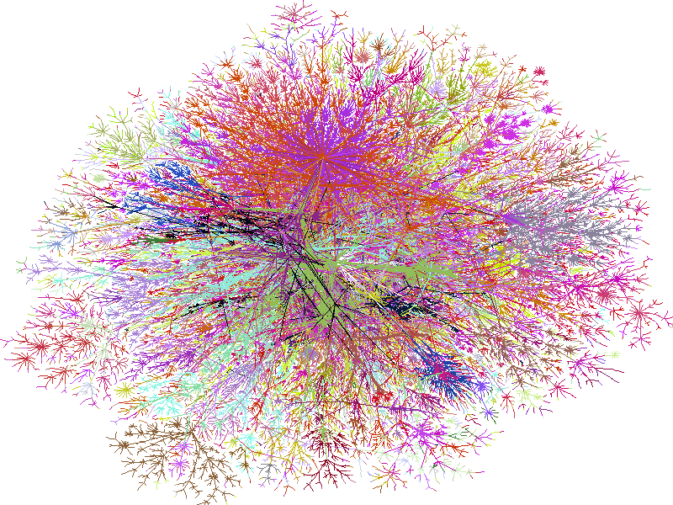
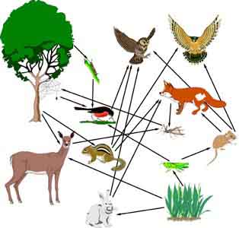
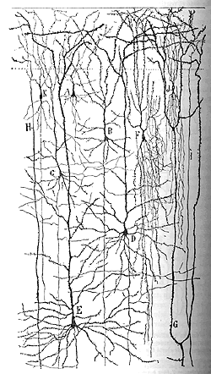
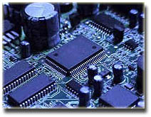
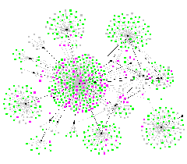
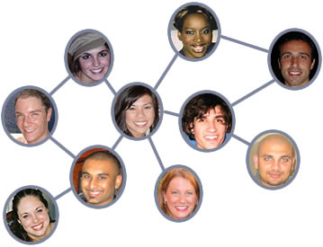
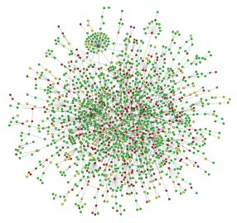
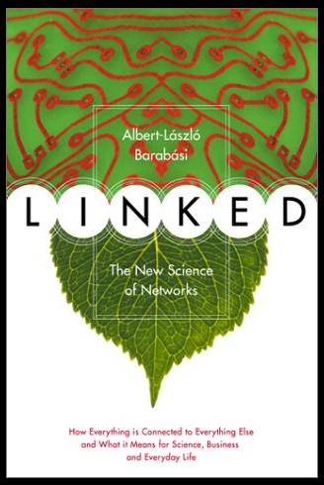
Networks as a universal language
Internet
[Burch & Cheswick]
Electronic
Circuit
Food Web
Disease Spread
[Krebs]
Neural Network
[Cajal]
Protein
Interactions
[Barabasi]
Social Network

Slide 11
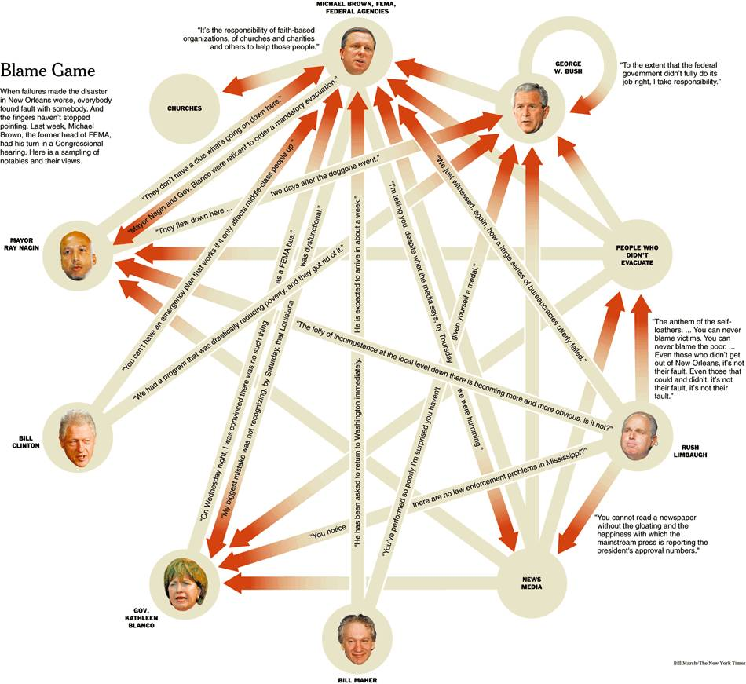
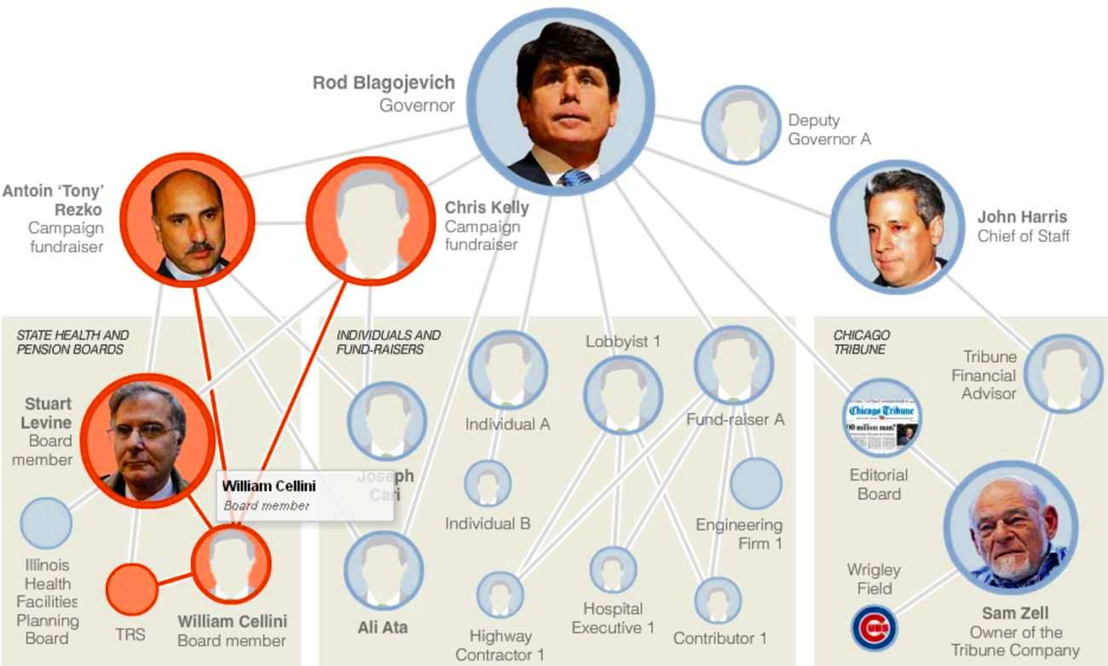
Using the position in networks to describe function
Guilt by association
Finding the causal regulator
(the "Blame Game")
[NY Times, 2-Oct-05, 9-Dec-08]

Slide 12
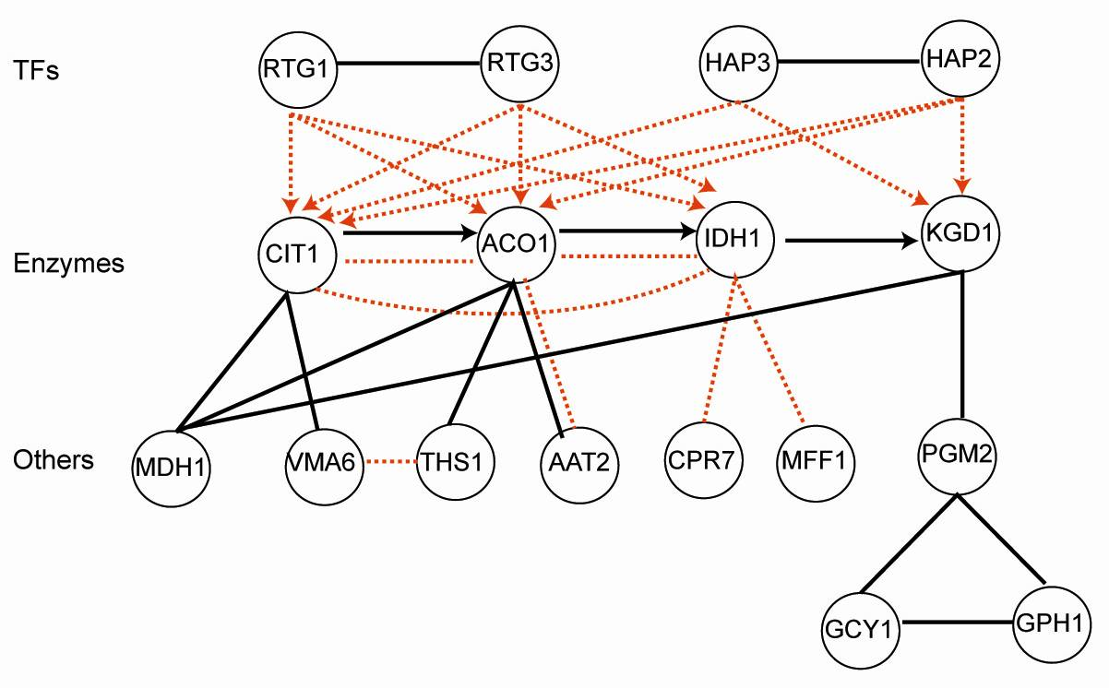
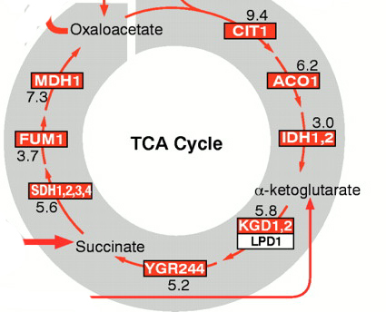
Combining networks forms an ideal way of integrating diverse information
Metabolic pathway
Transcriptional regulatory network
Physical protein-protein Interaction
Co-expression Relationship
Part of the
TCA cycle
Genetic interaction (synthetic lethal)
Signaling pathways

