Slide 1
Biomedical Data Science:
Mining and Modeling
Biosensors and Wearables
Jason Liu
Lecture for CBB 752
Biomedical Data Science: Mining and Modeling
Spring 2023
Yale University

Slide 2
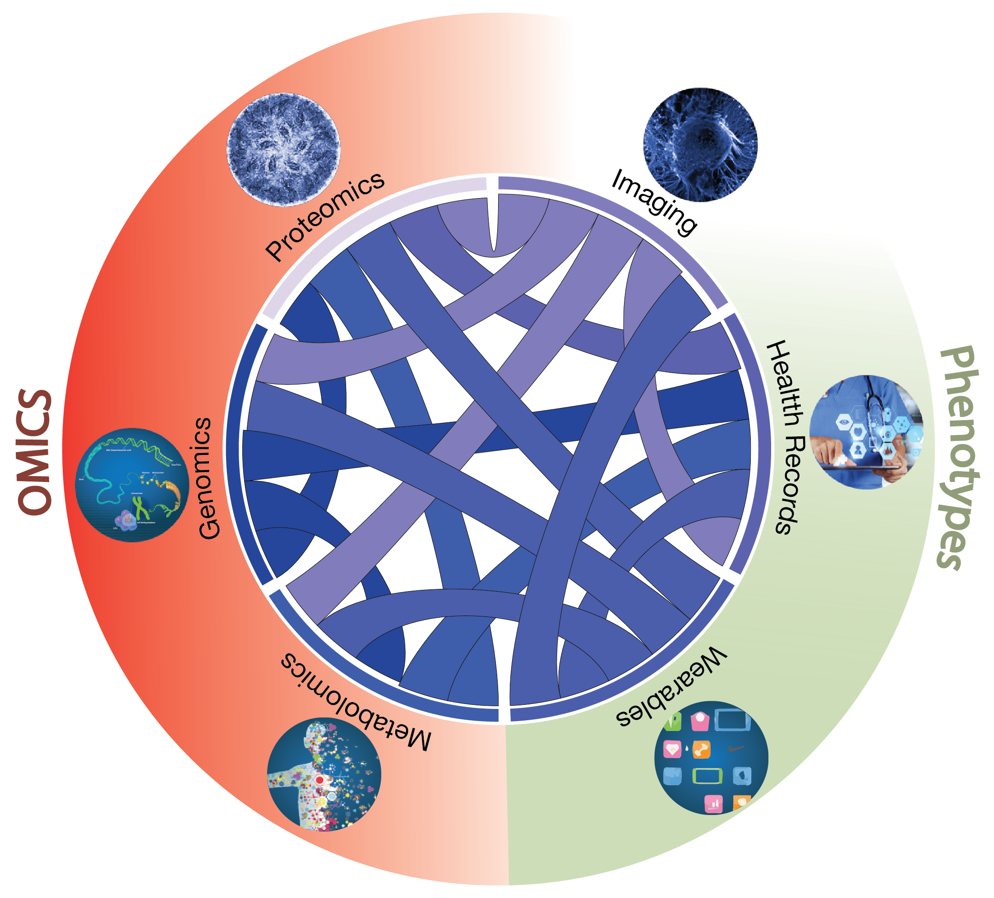
Data
Drivers for Biomedical Data Science
[Navarro et al. Genome Biol. (’19)]
Notes:
2 - slide mention link to intro from earlier lecture

Slide 3

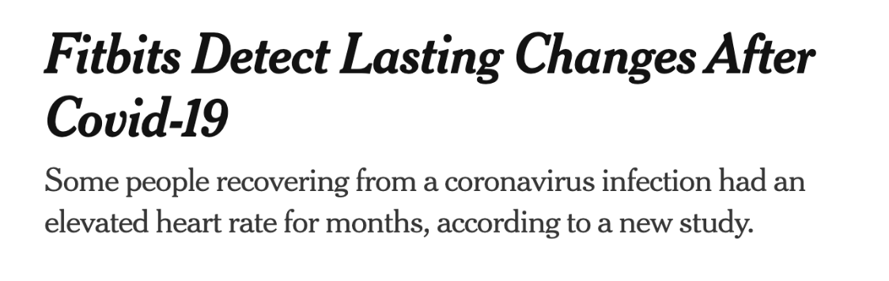
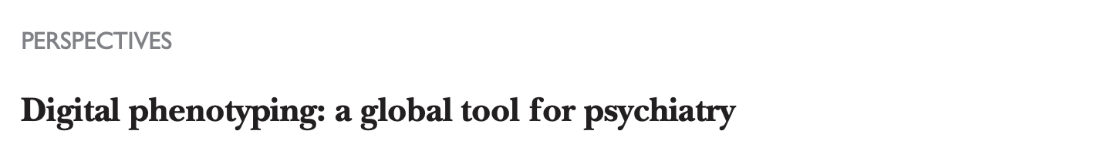
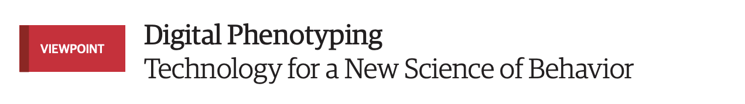

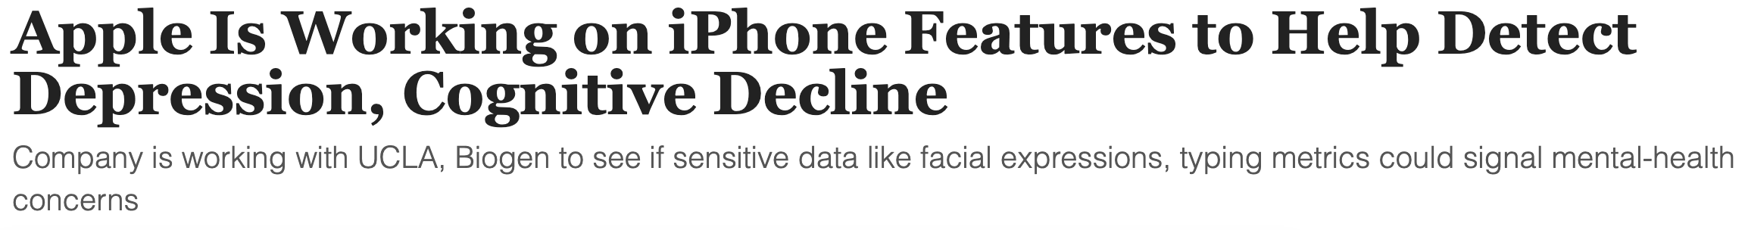
Data
Drivers for Biomedical Data Science
July 7, 2021
Thomas R. Insel
2018
Sep 21, 2021
[Navarro et al. Genome Biol. (’19)]
Notes:
Explored omics previous half of the course, now we move to wearables and other ways to better understand phenotype
Wearables are in the news a lot now. We’re going to hopefully explore why they’re so popular now.

Slide 4
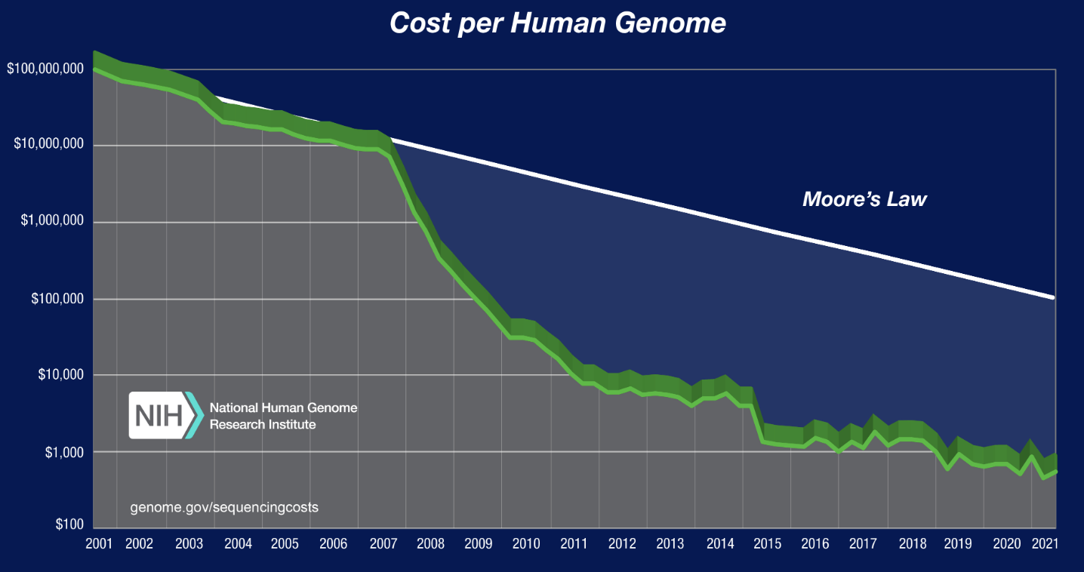
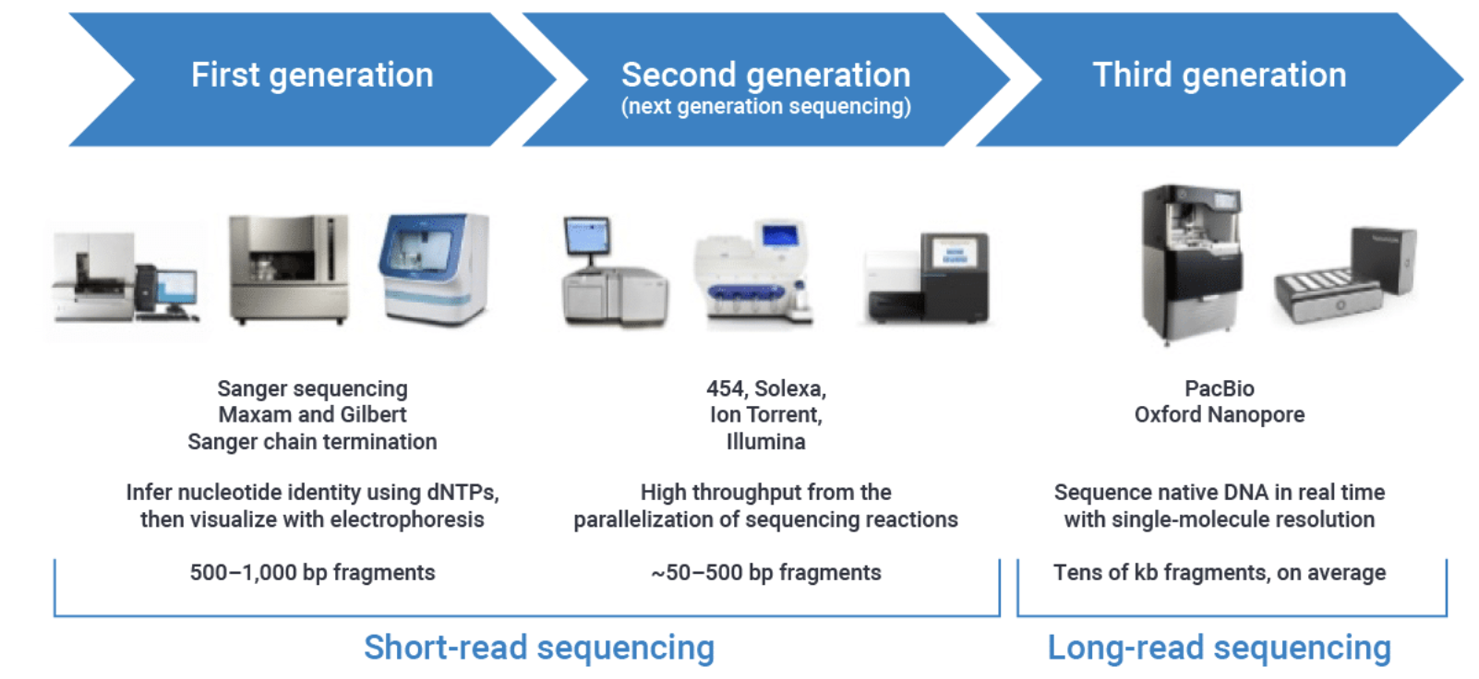
[Adapted from NIH and PacBio websites]
Notes:
5 - relate to med sensors - other sensor; nextgen v orig genome seq.
sensor monitoring/modeling , icu, bunch of sensors used before
But whats difference now is the scale – analogy is scale of nucleotide sequence (genes level) -> wgs – genome level – big data/scale
Apple watch – nextgenseq
Maybe add covariates here

Slide 5
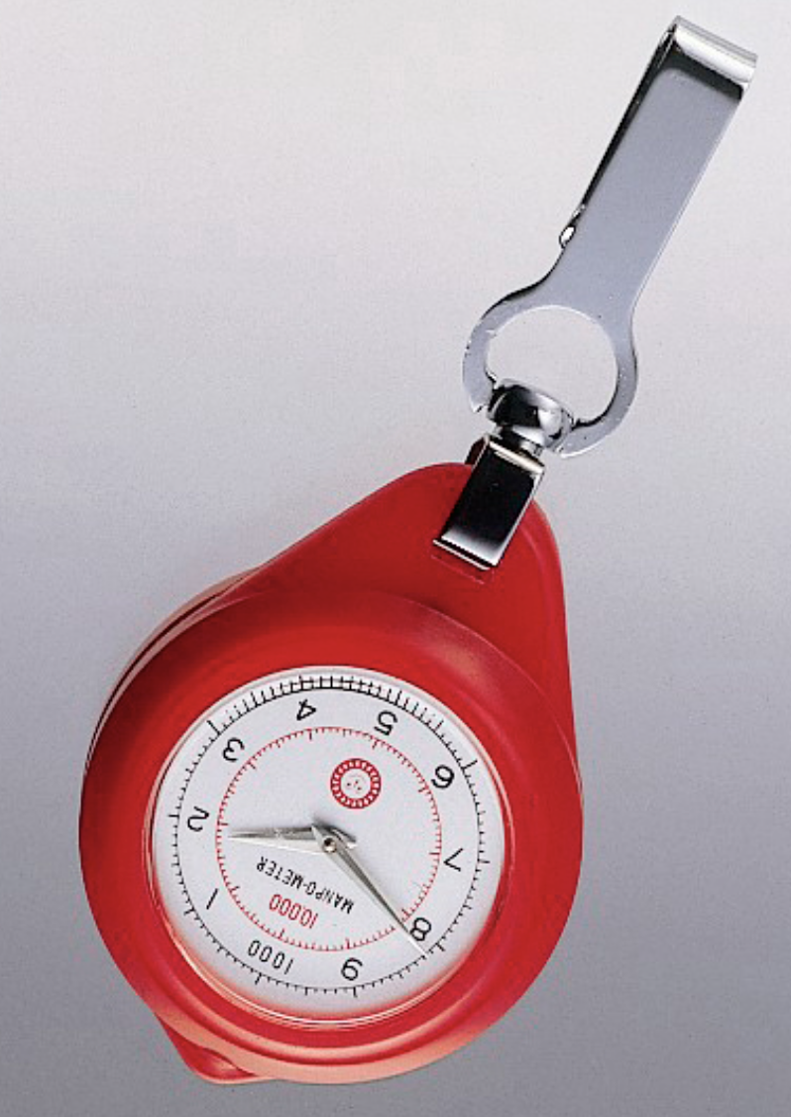
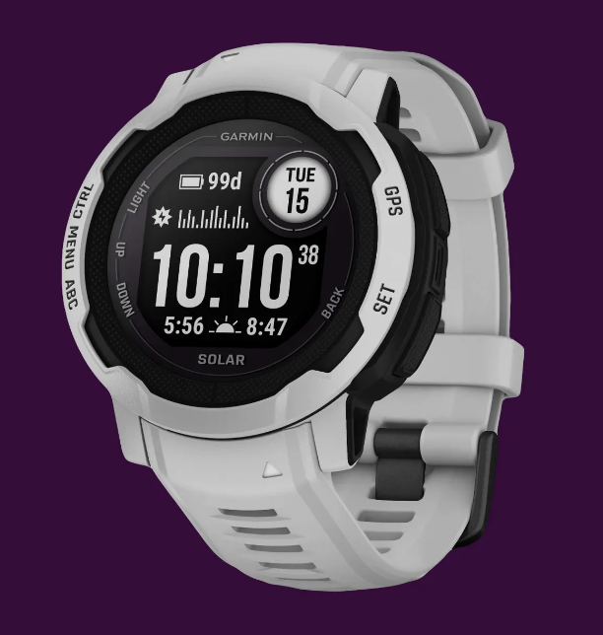
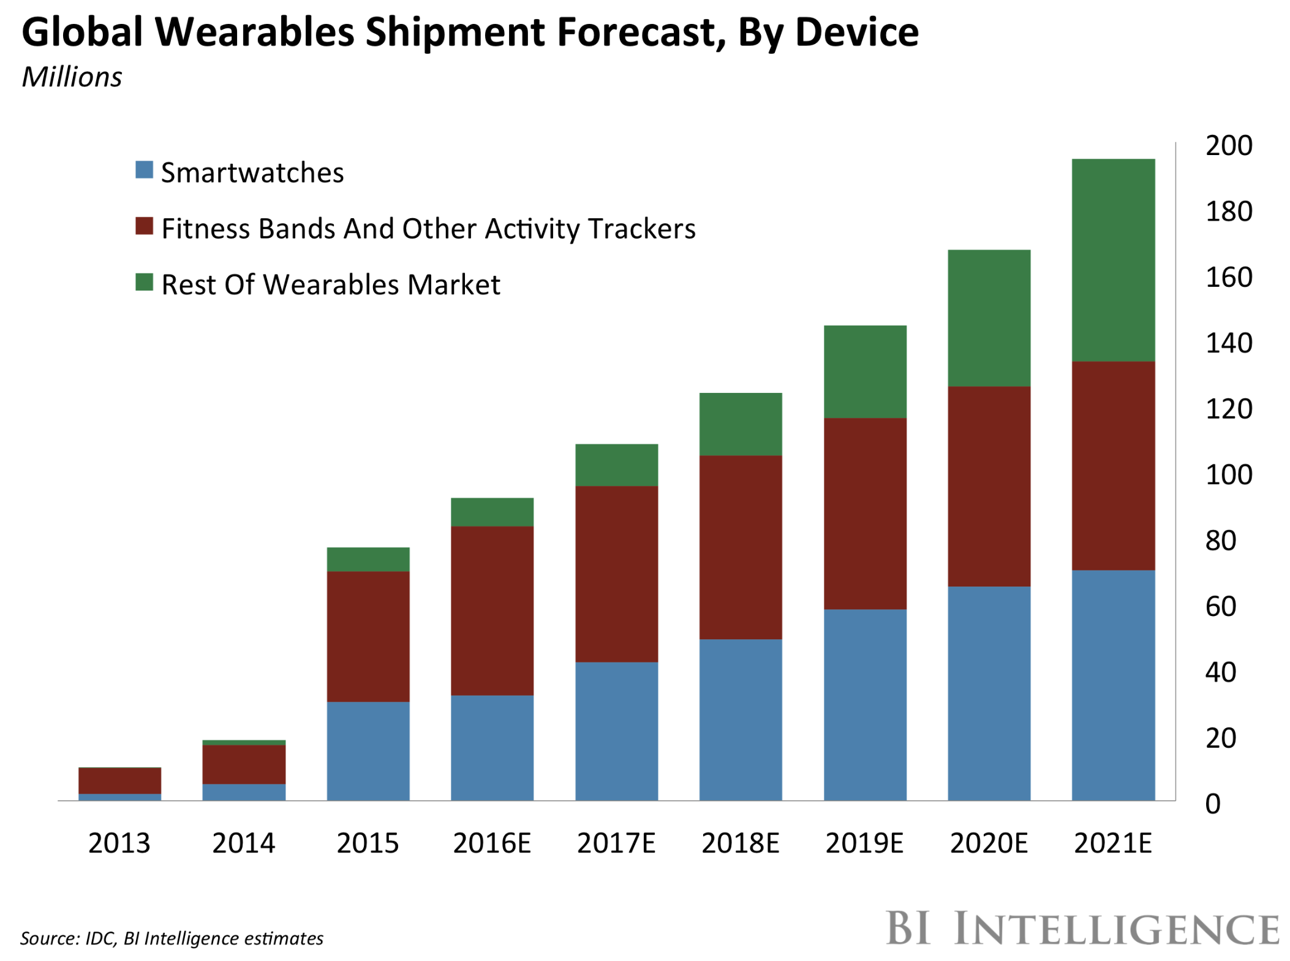

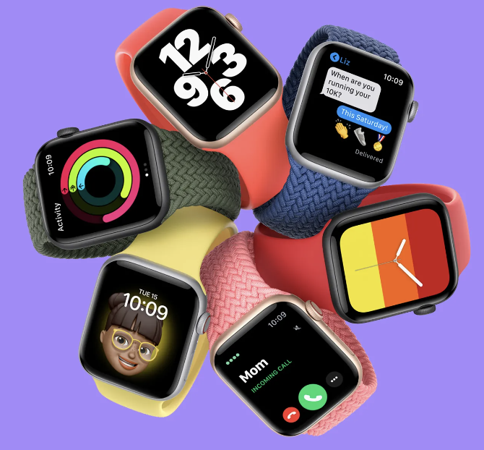
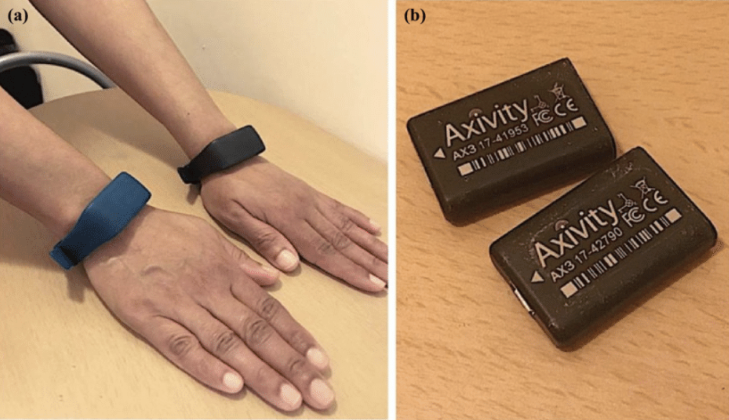
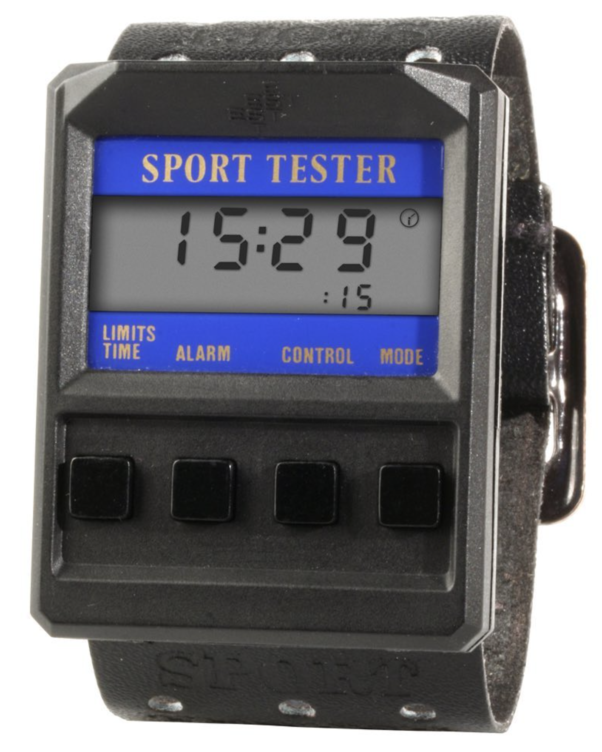
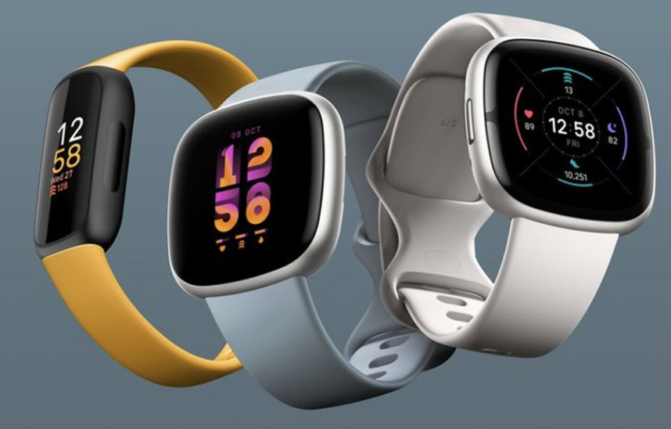
1965
Manpo-Meter
(Pedometer)
Garmin
Apple
Polar
Sport Tester PE 2000
FitBit
[Adapted from NIH, PacBio, BI Intelligence, UKBB websites]
1982
Present
Notes:
Apple watch – illumina – easy convenient cheap
Axivity – deeper sequencing
5 - relate to med sensors - other sensor; nextgen v orig genome seq.
sensor monitoring/modeling , icu, bunch of sensors used before
But whats difference now is the scale – analogy is scale of nucleotide sequence (genes level) -> wgs – genome level – big data/scale
Apple watch – nextgenseq
Apple watch – illumina – easy convenient cheap
Axivity – deeper sequencing
Maybe add covariates here

Slide 6





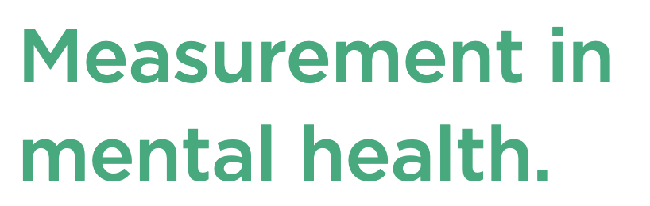
Notes:
And it’s not just UKBB that’s catching on. Many research consortium and companies are collecting wearable and biosensor data.
So why is this happening?
Well, let’s take a look at the data
You can see, it’s really about these two axis. (scale, emphasize time)

Slide 7
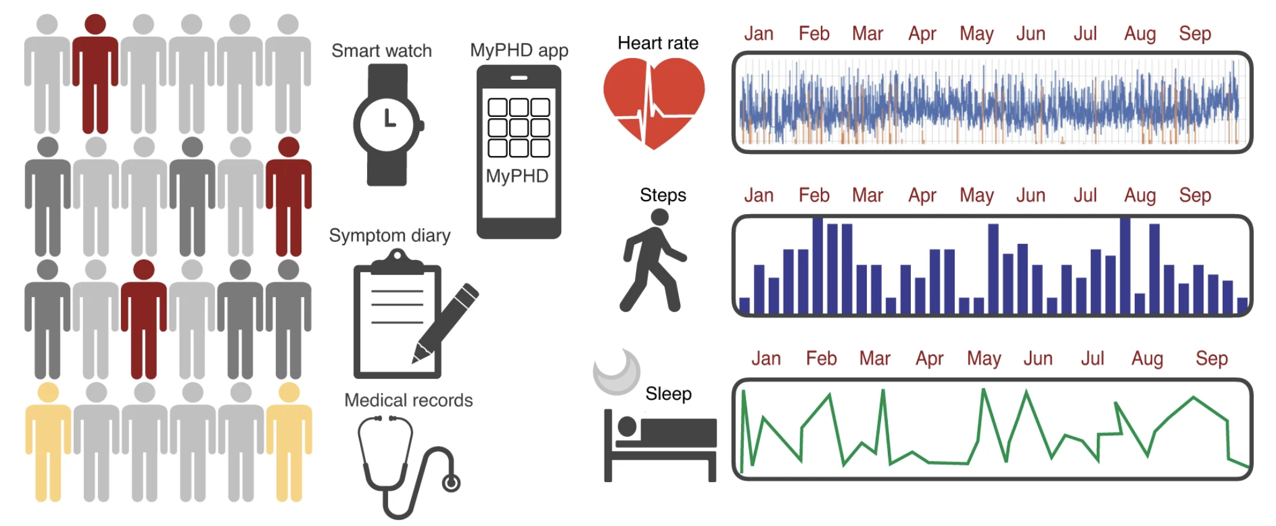
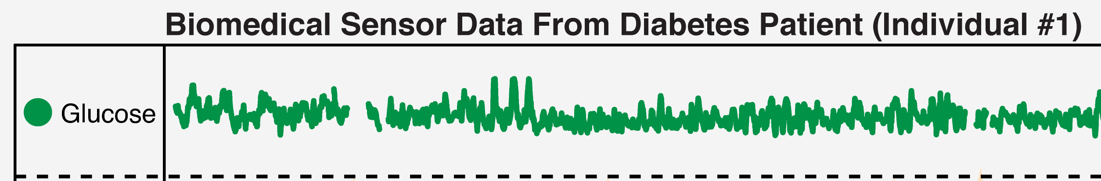
Scale
Macro Level Behavior
Organ
Chemical
Metabolome
Time
[Adapted from Mishra et al. Nat. BME (’20); Liu et al. PLOS CB (‘21)]
Notes:
And it’s not just UKBB that’s catching on. Many research consortium and companies are collecting wearable and biosensor data.
So why is this happening?
Well, let’s take a look at the data
You can see, it’s really about these two axis. (scale, emphasize time)

Slide 8
Data and Signal Processing
Feature Engineering
  Can we extract meaningful information?
Modeling
  Can we address real world clinical and biological questions?
  Can we refine phenotype-to-genotype linkages?
Notes:
So how can we leverage the strength of this data to solve real world problems?
3 steps:
Processing
Feature engineering
modeling

Slide 9
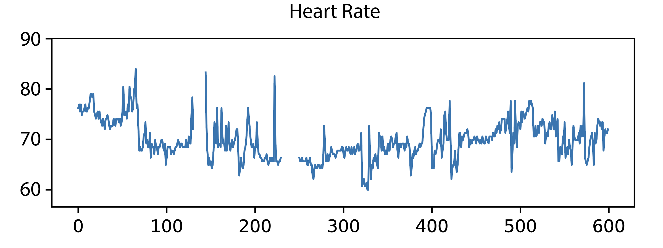
Biosensor and Wearable Time Series
Strategies for Signal Processing
Week
Weeks
Heartrate
BPM
Day
As we zoom in, challenges begin to arise
BPM
[NIMH ABCD Wearable Time Series Example]
Notes:
Week scale, you can see theres a cyclical nature high during day, low night, and cycles
Going to the day, the “pattern” falls apart,

Slide 10
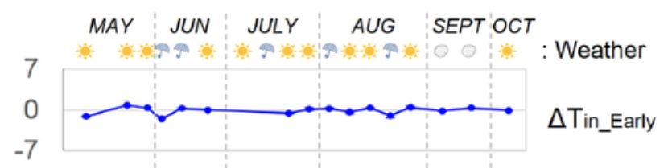
Biosensor and Wearable Time Series
Strategies for Signal Processing
Week
Weeks
Heartrate
BPM
Day
Further complicated due to other data streams
BPM
Covariates
[NIMH ABCD Wearable Time Series Example]
Notes:
To further complicate things, imagine now you have the weather and other covariates to take into account.

Slide 11
Biosensor and Wearable Time Series
Strategies for Signal Processing
Week
Weeks
Heartrate
Challenges
Missingness
Alignment/Sampling
De-noising
BPM
Day
BPM
Covariates
[NIMH ABCD Wearable Time Series Example]
Notes:
Covariates fit in the narrative here –
Genomics signal processing – 1 histone mark – process it , find peak; cross histone-mark processin g- call larger elements based on multiple marks

Slide 12
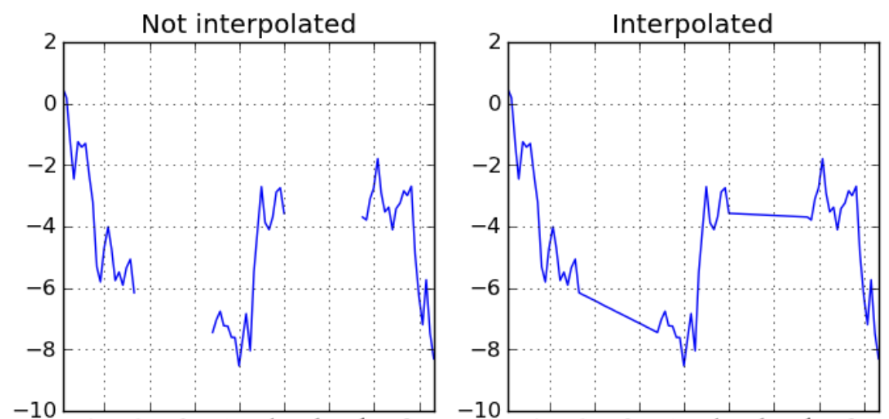
Processing the Data: Missingness
Example 1
BPM

Slide 13
Processing the Data: Missingness
Example 1
Example 2
BPM
BPM
METs

Slide 14
Processing the Data: Missingness
Example 1
Example 2
BPM
BPM
METs

Slide 15
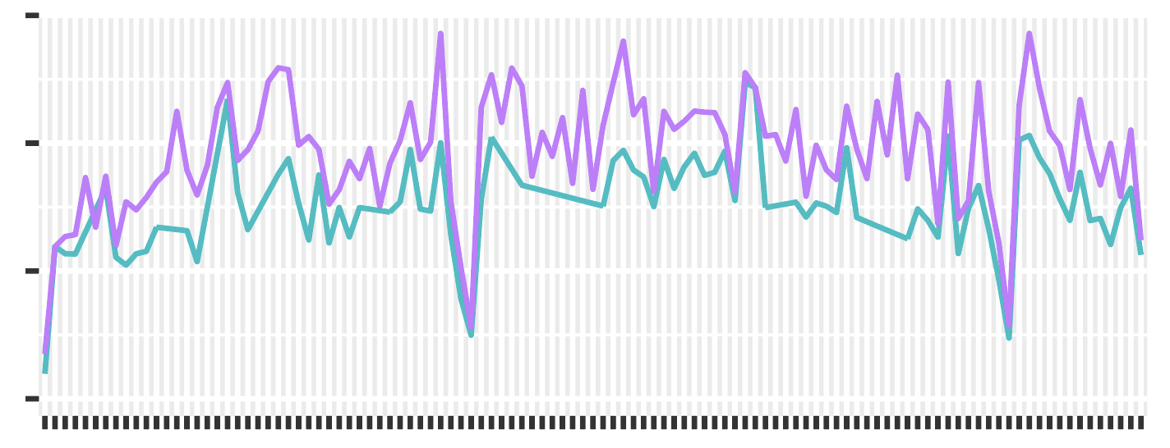
Processing the Data: Sampling/Alignment
Example 1
Heart Rate
[Adapted and modified from Snyder Lab MOVES Data]
Notes:
12 - is it alignment or sampling rate
sampling rate /freq?
Irregular sampling
Time is true continuous – but how are you sampling time (different rates) is making it hard to compare

Slide 16
Processing the Data: Sampling/Alignment
Example 1
Heart Rate
Pseudotime
1
2
n
N
Heart Rate
[Adapted and modified from Snyder Lab MOVES Data]

Slide 17
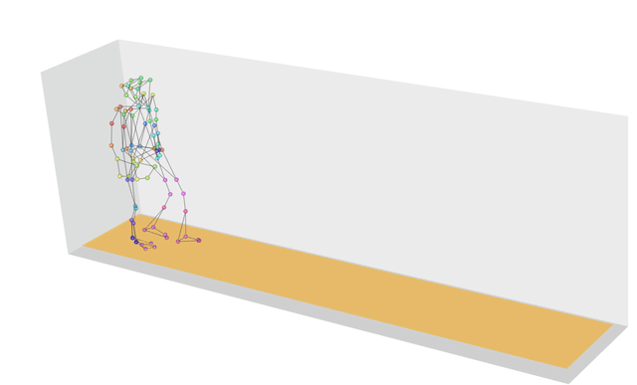
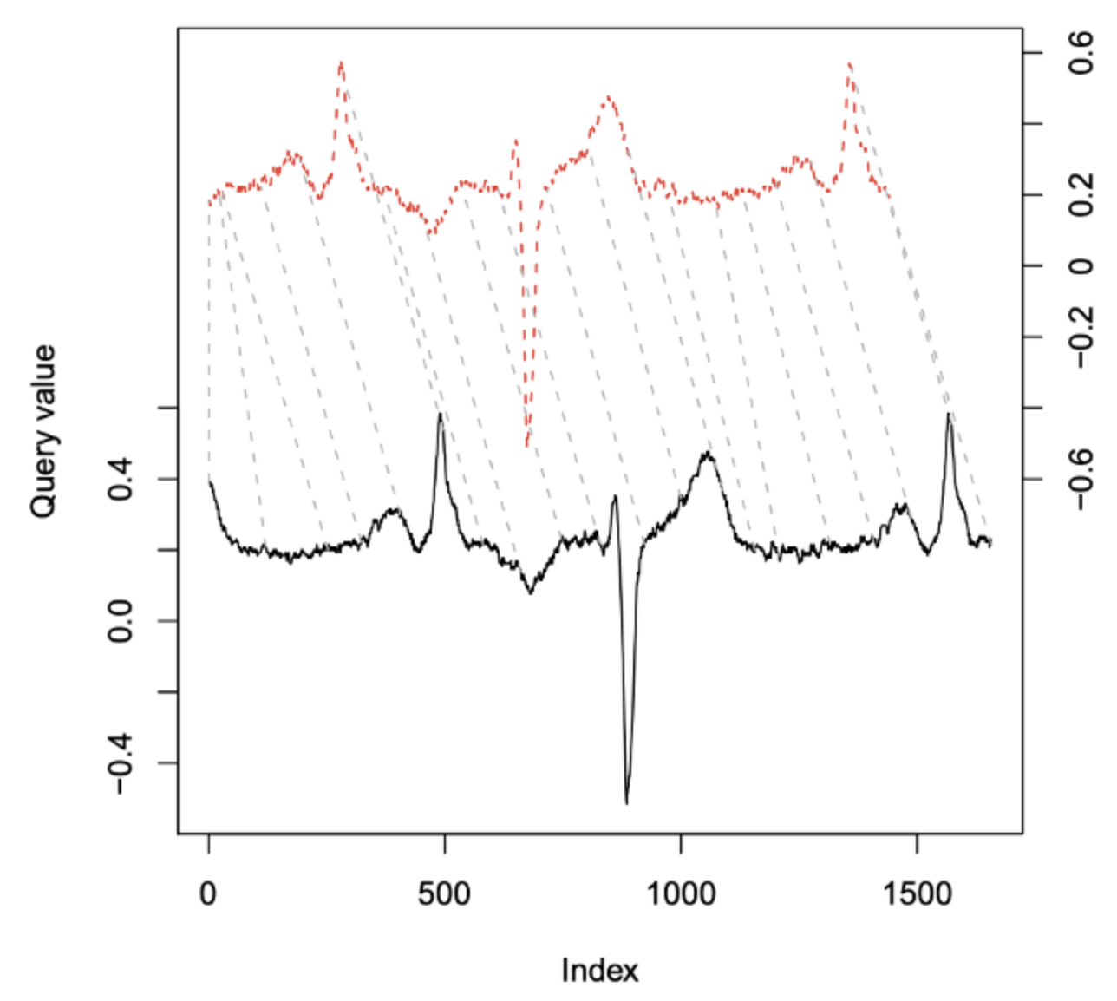
Processing the Data: Sampling/Alignment
Example 1
Example 2
Heart Rate
Dynamic Time Warping (DTW)
Pseudotime
1
2
n
N
Heart Rate
[Adapted and modified from Snyder Lab MOVES Data]
[Top: Olsen et al. J. Royal Stat Soc. (‘18); Bottom: Giorgino, Jstatsoft (‘19)]
Notes:
14 - should put this all under the head of pre processing & then modelling
many levels of processing
High level organization - introduce this
Pre-processing – fill in gaps of data, denoise, etc.
Feature engineering/extraction –
Modeling/state analysis – trying to extract meaningful states/classes – SCF – underlying states , latent variable? – or maybe “state” that you ascertain? – do you have covid in Snyder paper

Slide 18
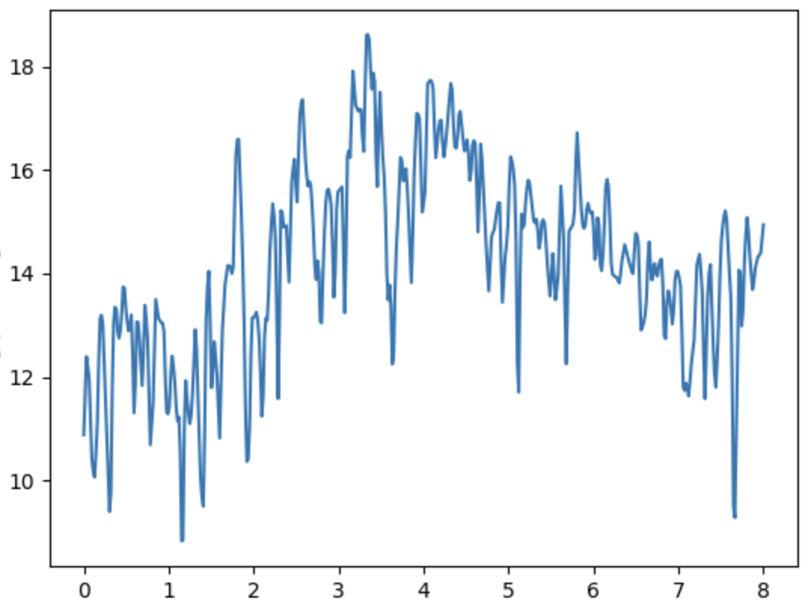
Processing the Data: Denoising
Example 1
Heart Rate
outliers
Time
[Adapted and modified from SciKit-FDA]

Slide 19
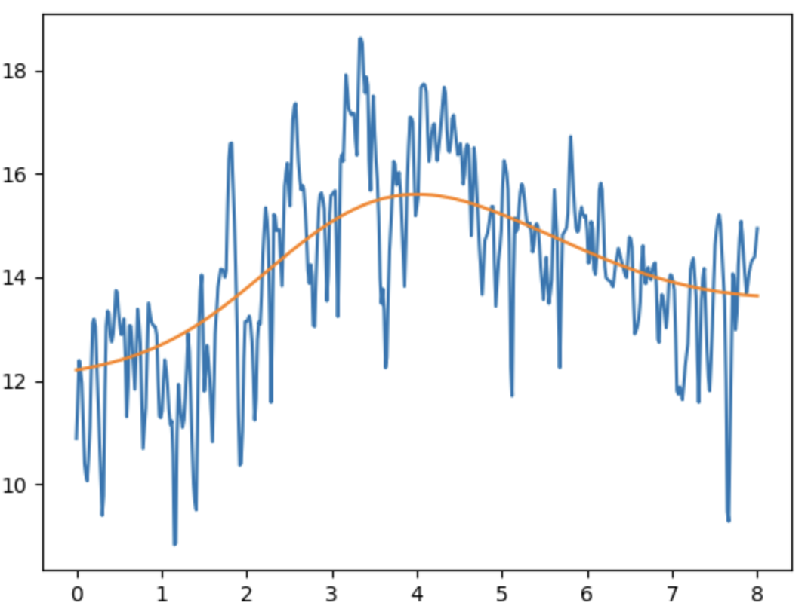
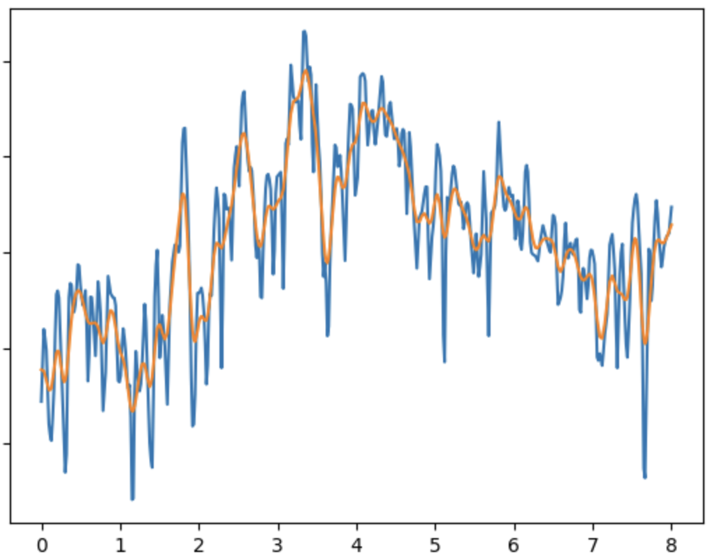
Processing the Data: Denoising
Example 1
Heart Rate
outliers
Time
Larger bandwidth
Smaller bandwidth
Kernel Smoother
[Adapted and modified from SciKit-FDA]
Notes:
16 - could you expl kernel smoother more - window avg
Say more about kernel smoothing
Window avging;
a little bit of math
Include a little more detail –
Bandwidths..

Slide 20
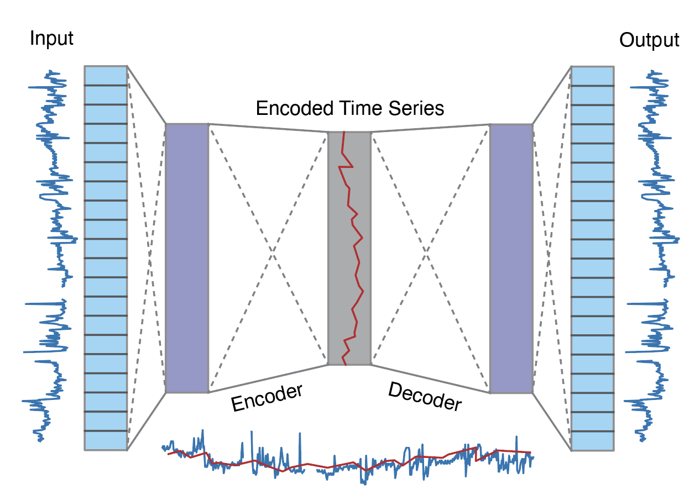
Processing the Data: Denoising
Example 1
Example 2
Similar to an autoencoder architecture
Heart Rate
outliers
Time
Larger bandwidth
Smaller bandwidth
Encoded Time Series Retains Signal and Removes Outliers
Kernel Smoother
[Adapted and modified from SciKit-FDA]
Notes:
More details on the AE here
Same ts length

Slide 21
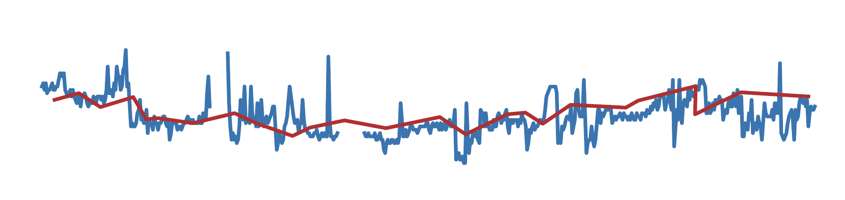
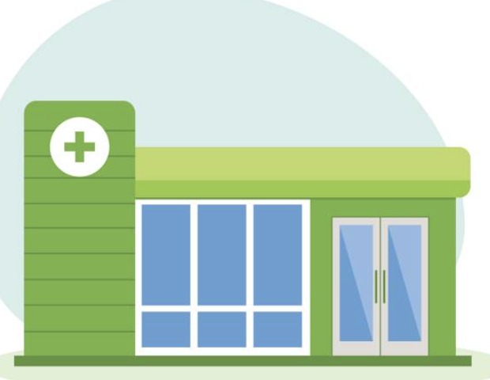
Wearables and Biosensors
Feature Engineering and Modeling

Slide 22
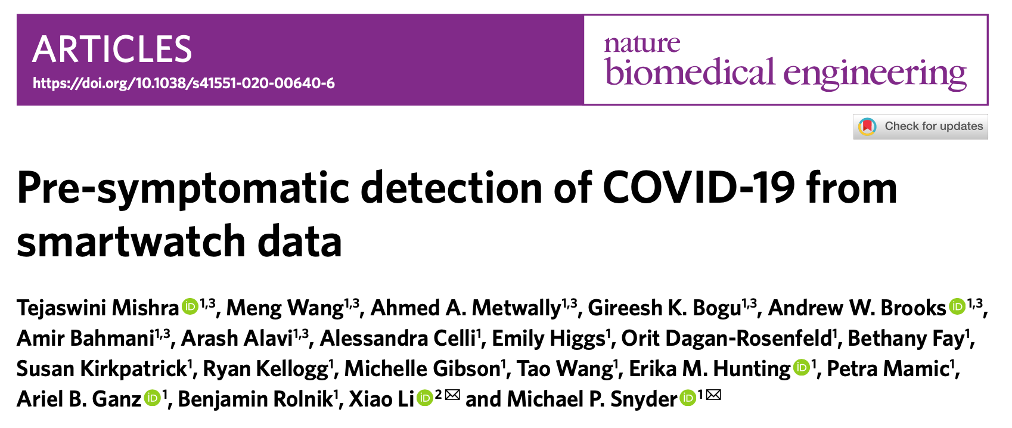
Wearable Sensors in Biomedical and Clinical Research
[Mishra et al. Nat. BME (‘20)]
Notes:
PCR assays can take up to 3 days processing
Price
What about pre-symptomatic detection?

Slide 23
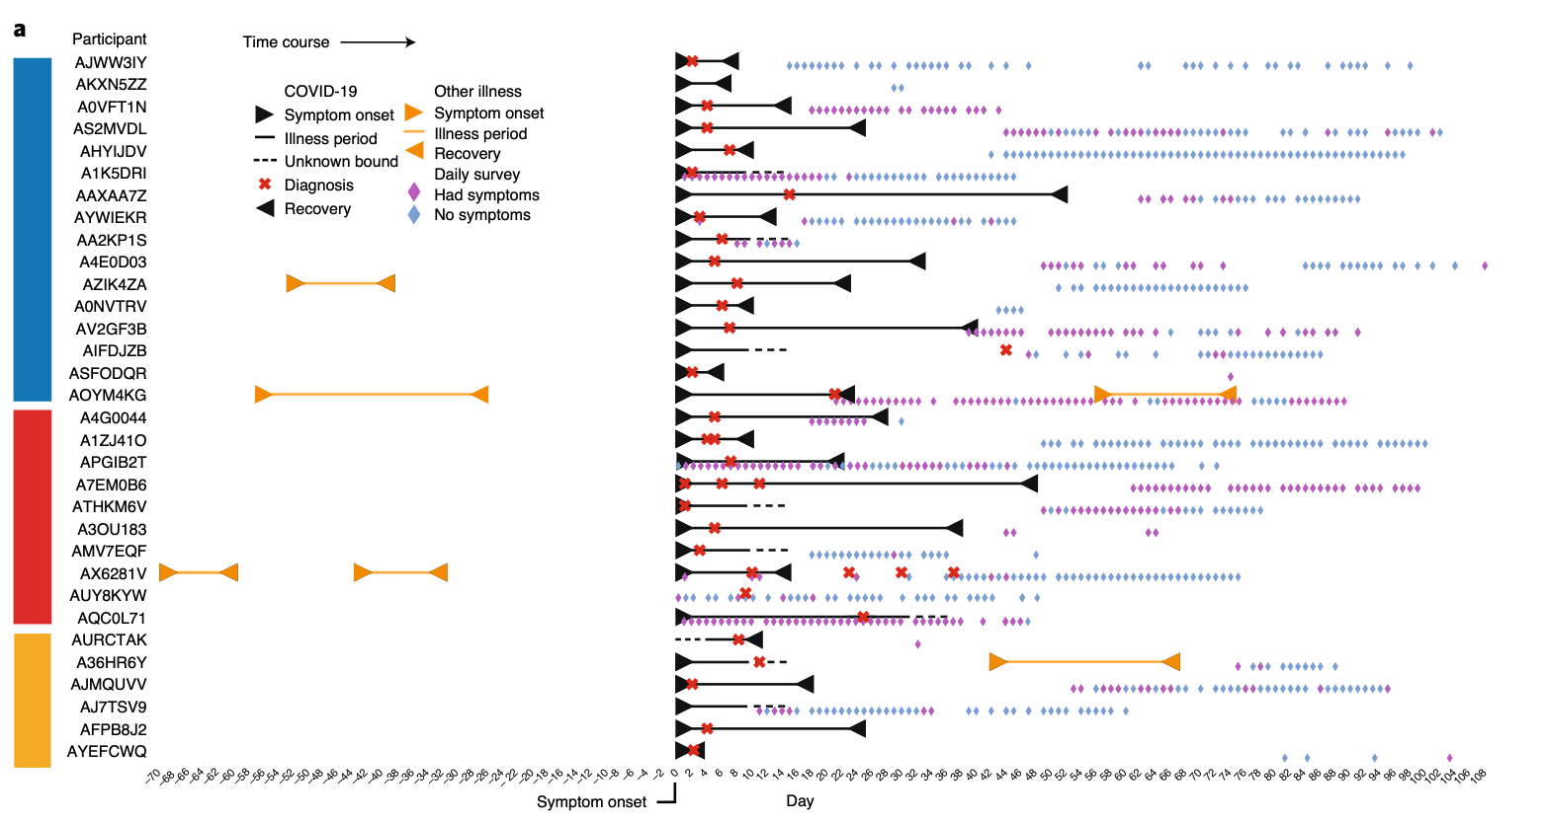
Data Collected
Clinical Metadata
[Mishra et al. Nat. BME (‘20)]

Slide 24
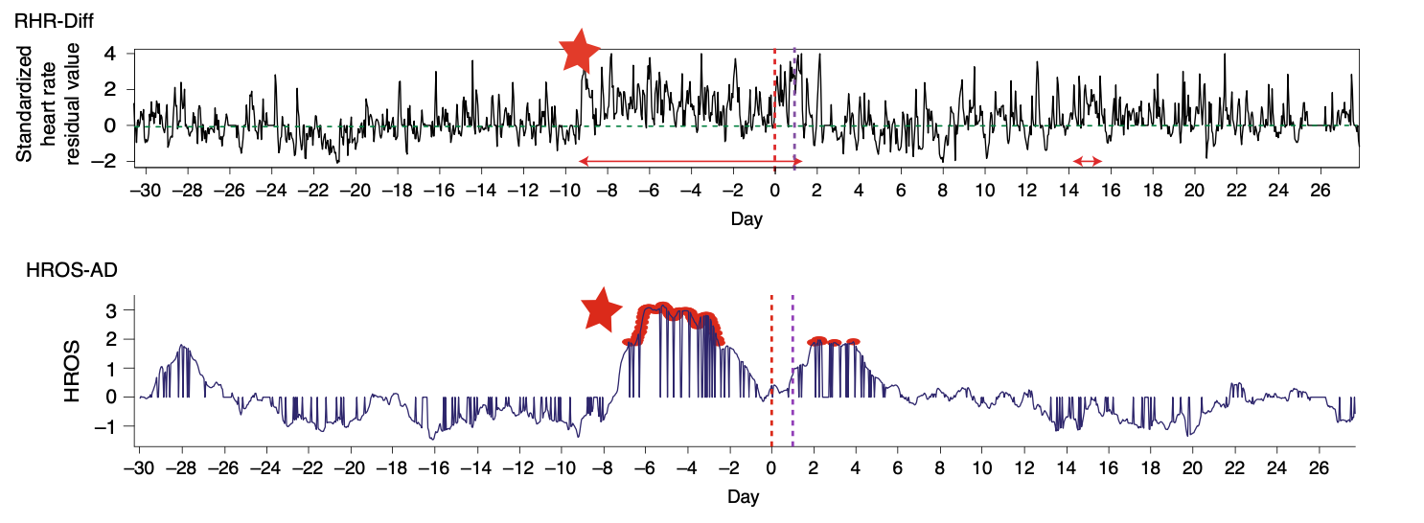
Interpretable Feature Engineering
Resting Heart Rate (RHR)
Heart rate over steps ratio (HROS)
[Mishra et al. Nat. BME (‘20)]
Notes:
Step 1 processing
step2
Feature engineering –
Explain engineered feature
Scf – step 3
Latent variables state

Slide 25
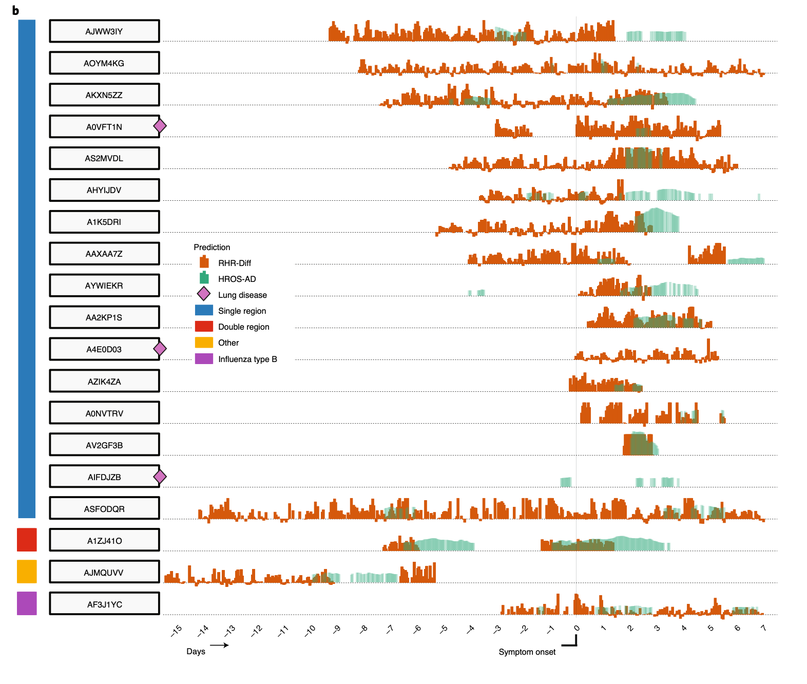
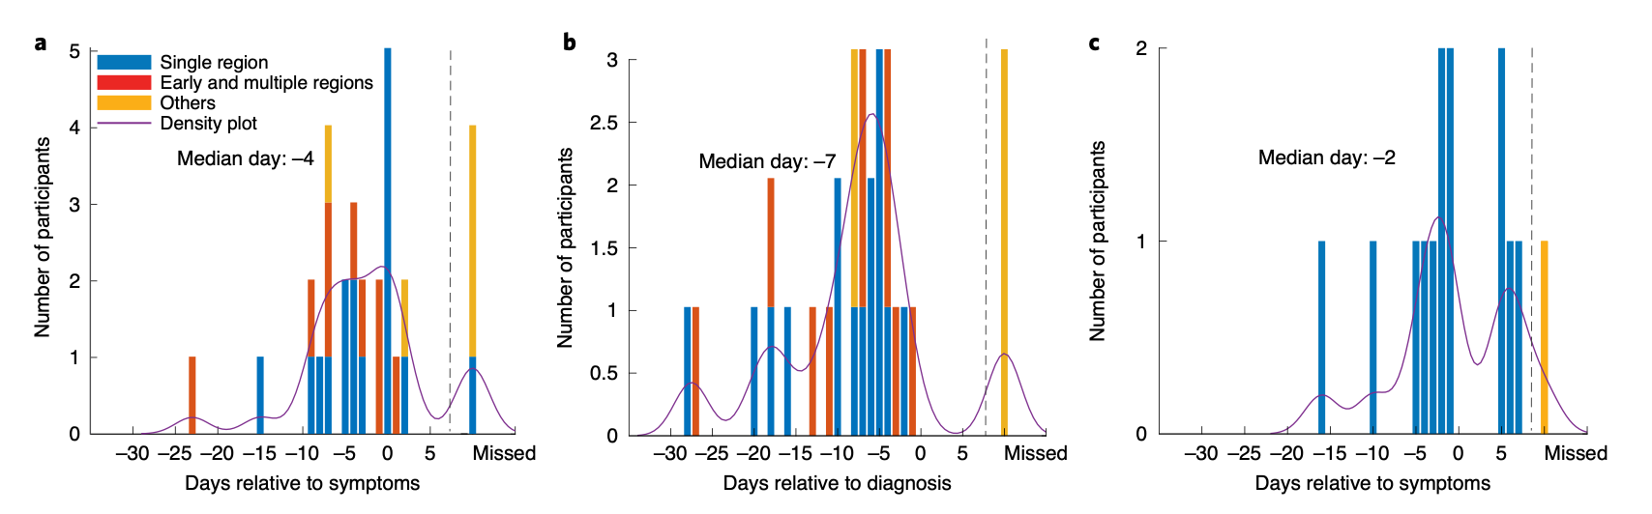
Flu
[Mishra et al. Nat. BME (‘20)]

Slide 26
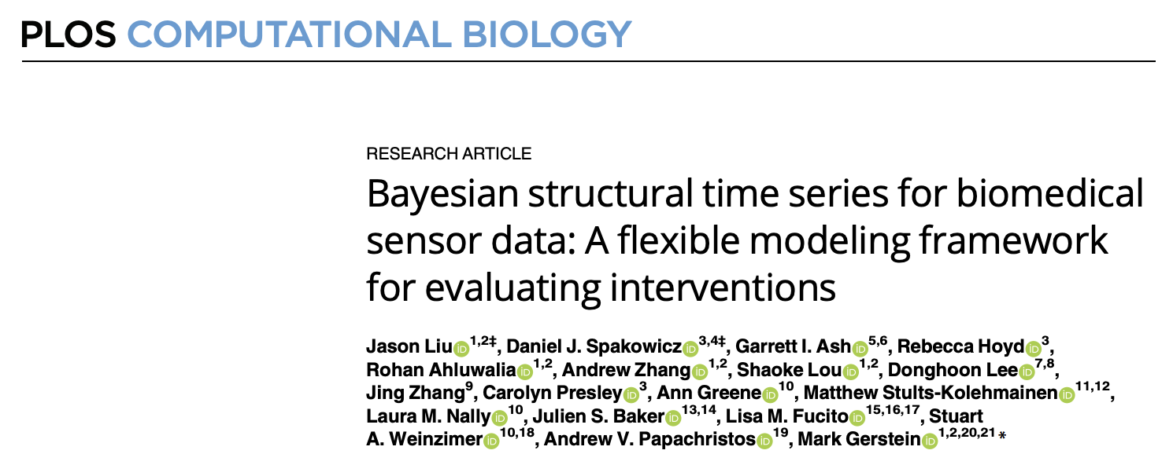
Wearable Sensors in Biomedical and Clinical Research:
Evaluating Personalized Interventions
[Liu*, Spakowicz* et al. PLOS Computational Biology (‘21)]

Slide 27
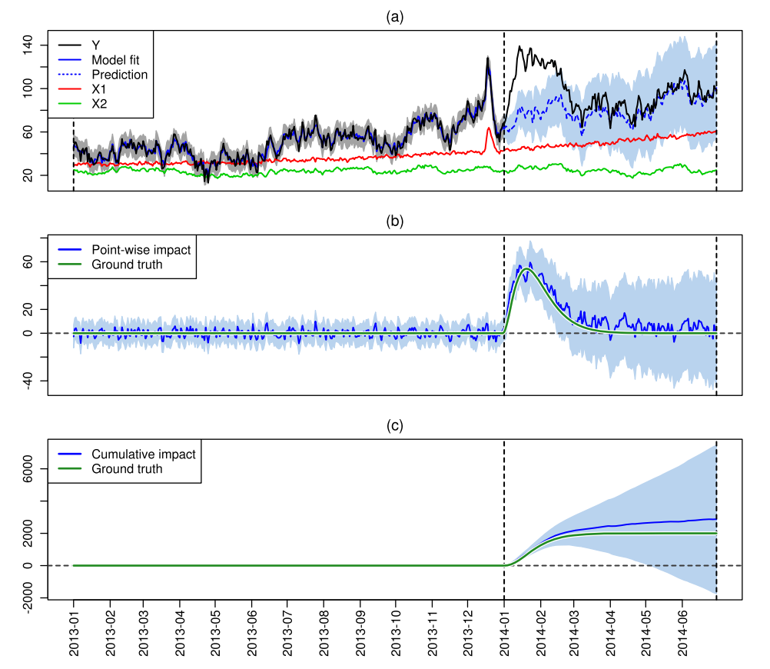
Bayesian Structural Time Series and Causal Impact
MODELING
27
[Broderson et al. Annals of Applied Stat. (’15)]
Notes:
Confidence interval

Slide 28
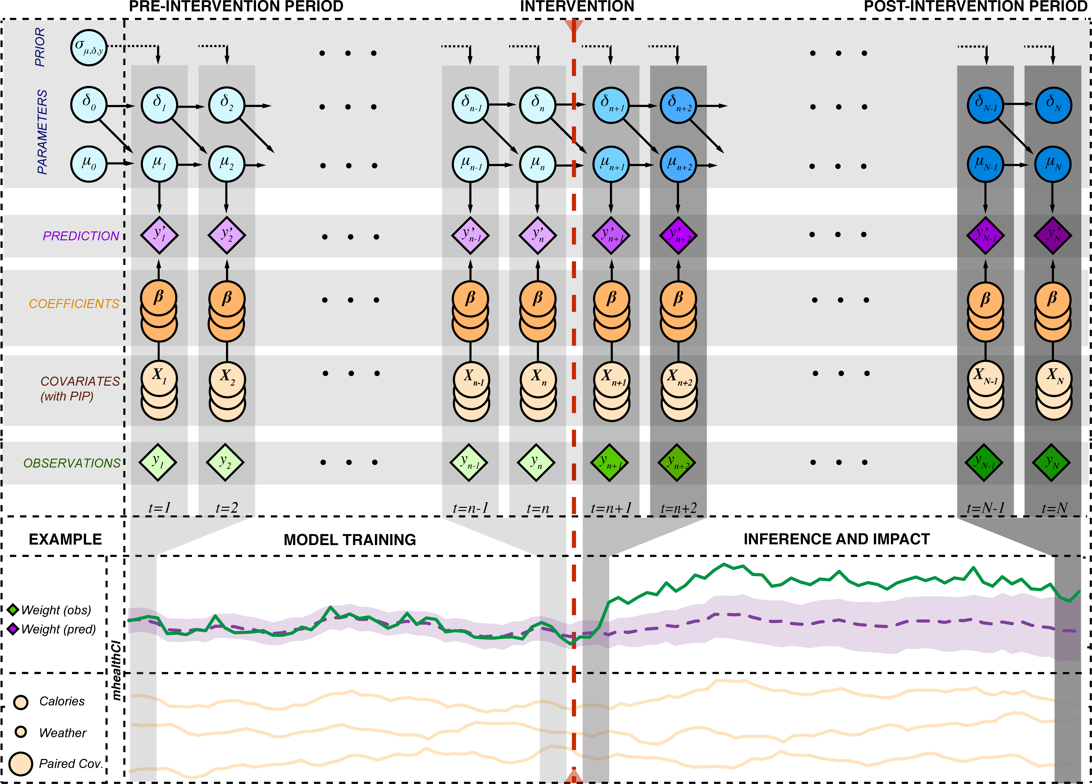



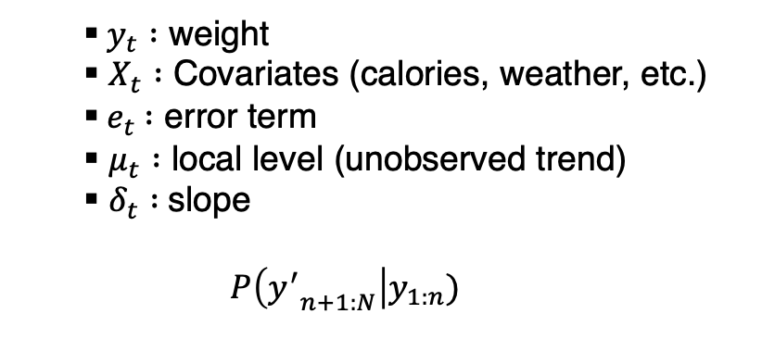
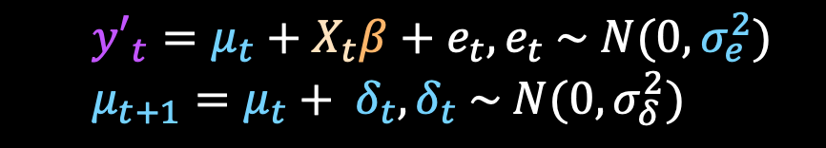
Using a Bayesian Structural Time Series Framework for Modeling Biosensor Data to Evaluate Interventions
  $${y′}_{t}=μ_{t}+X_{t}β+e_{t},e_{t} \sim N(0, σ_{e}^{2})$$
  $$μ_{t+1}=μ_{t}+ δ_{t},δ_{t} \sim N(0, σ_{δ}^{2})$$
  $y_{t} :$ weight
  $X_{t} :$ Covariates (calories, weather, etc.)
  ${ e}_{t} :$ error term
  $μ_{t} :$ local level (unobserved trend)
  $δ_{t} :$slope
  $$P\left({y^{′}}_{n+1:N}\right|y_{1:n})$$
$$y_{t}$$
$${y′}_{t}$$
Impact
$$X_{t}$$
28
[Liu*, Spakowicz* et al. PLOS Computational Biology (‘21)]

Slide 29
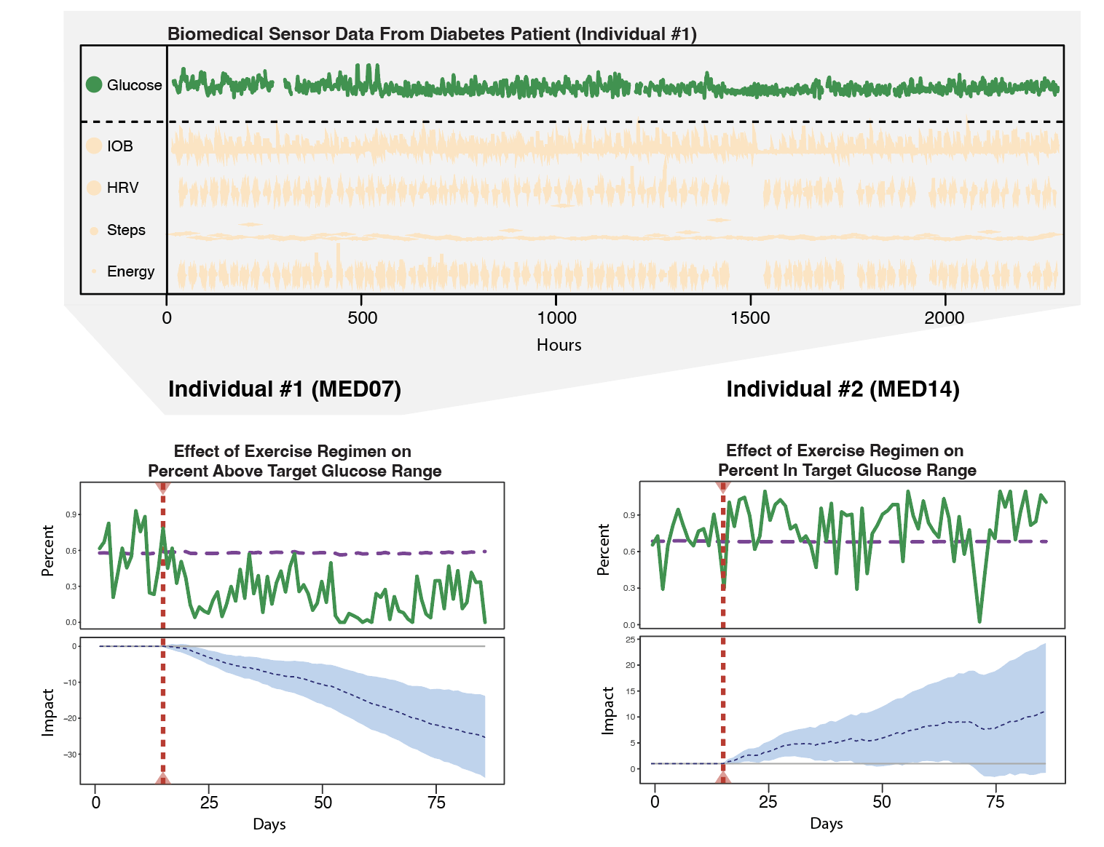
Evaluating The Efficacy of Exercise Regimens in Diabetes Patients
Green: Glucose
Dotted red: Exercise
Blue confidence:
Impact of exercise on glucose
Data Processing
Validated Blood sugar levels:
HbA1c 8.6% to 6.9%
HbA1c 5.3% to 5.2%
29
[Liu*, Spakowicz* et al. PLOS Computational Biology (‘21)]

Slide 30
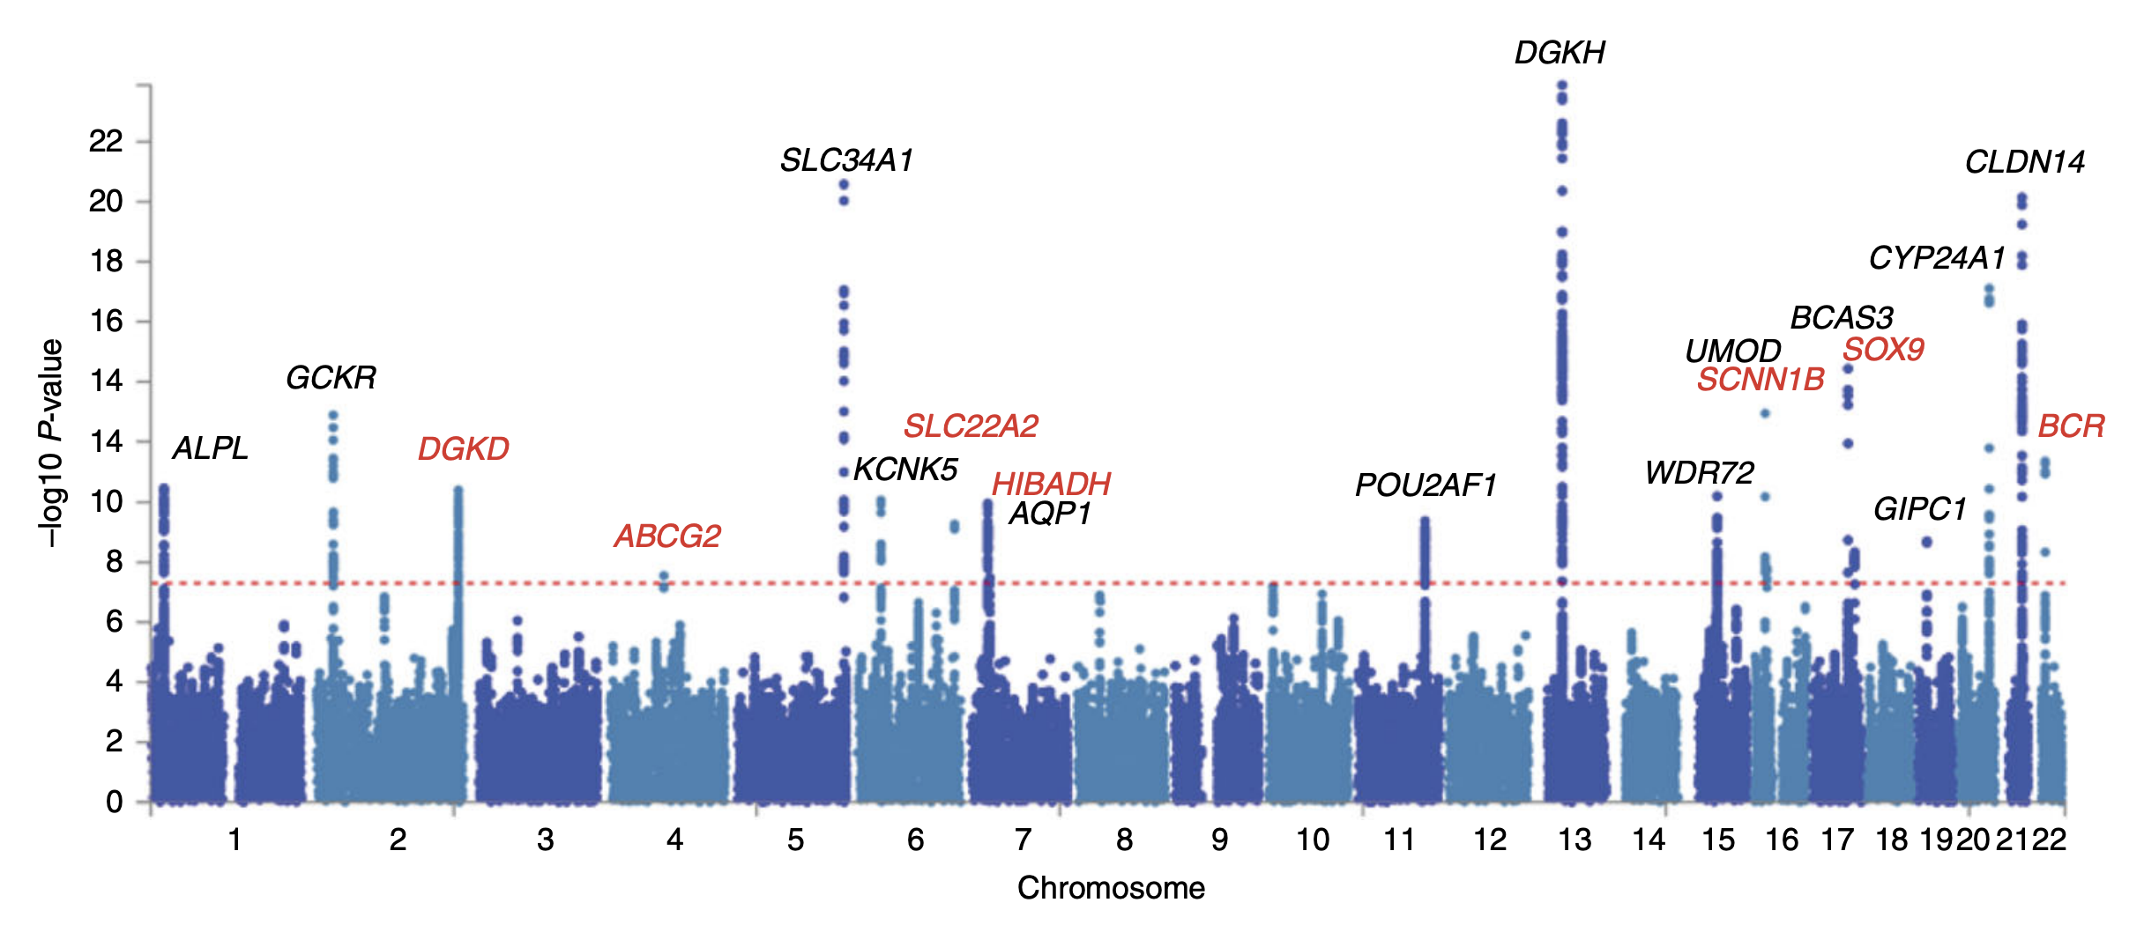
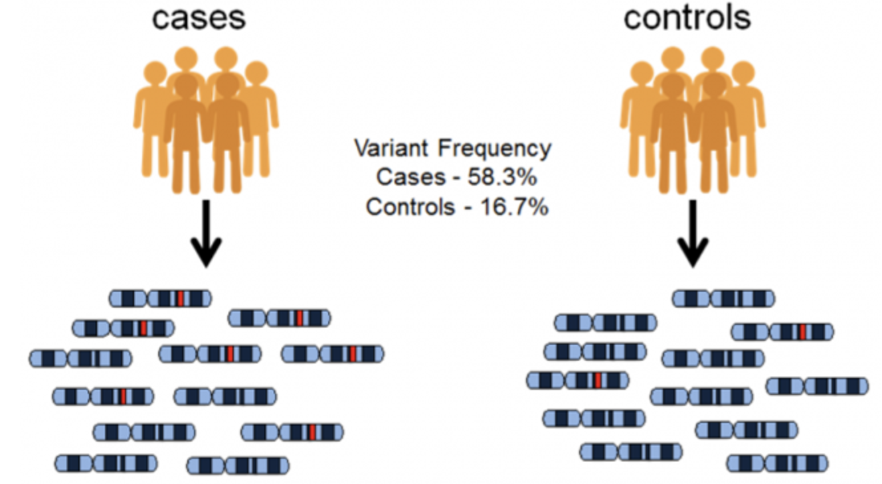
Exploring phenotype-to-genotype linkages
30
[Adapted from EMBL-EBI and Wikipedia: GWAS]

Slide 31
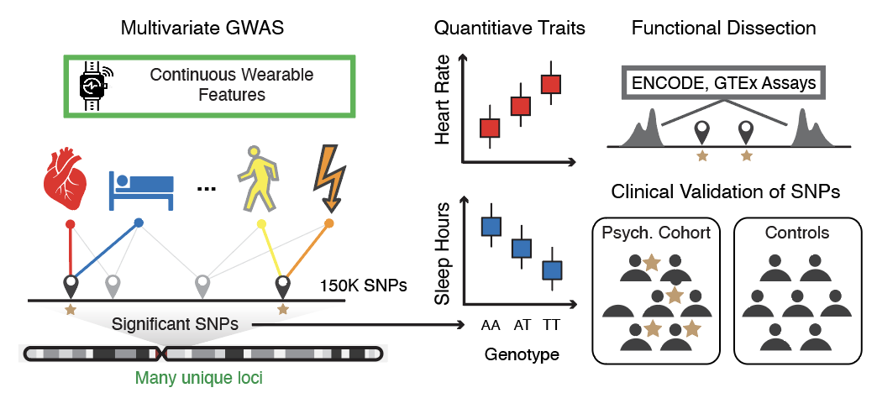
Exploring phenotype-to-genotype linkages
Quantitative Traits
31

