Slide 1
Relational (SQL) Database
Kei-Hoi Cheung, Ph.D.
Professor
Biomedical Informatics and Data Science

Slide 2
Outline
Introduction of relational database management system
Relational database design/model
Normalization
On-Line Transaction Processing (OLTP) database system & Structured Query Language (SQL)
Entity-Relationship Model/Diagram & Unified Modeling Language (UML)
On-Line Analytical Processing (OLAP) database
Data warehouse

Slide 3
The 4th paradigm: data-intensive scientific discovery
It expands the vision of Jim Gray (Mr. Database)
“The impact of Jim Gray’s thinking is continuing to get people to think in a new way about how data and software are redefining what it means to do science.”
— Bill Gates, Chairman, Microsoft Corporation
Data intensive science consists of the following activities:
Capture
Management
Curation
Analysis
Databases play a key role in supporting the above activities
Jim Gray: Turing Award receiver in 1998

Slide 4
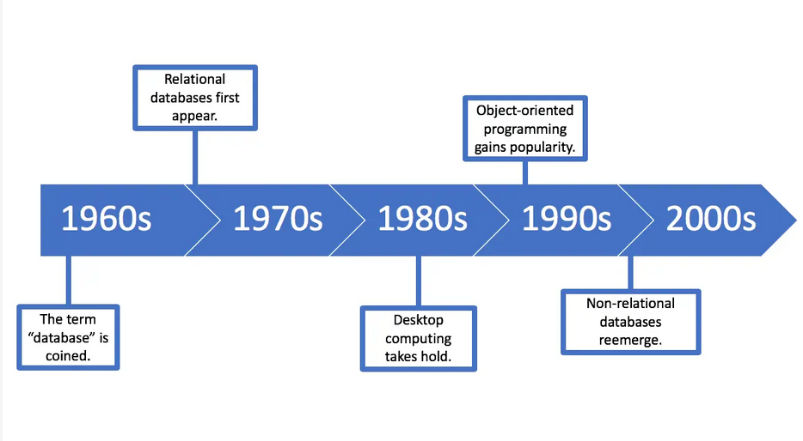
Timeline for database technologies
World Wide Web
Object-Oriented Database

Slide 5
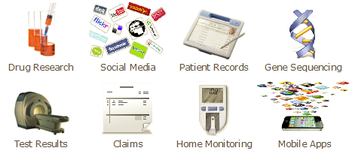
Healthcare and life sciences data sources
4Vs:
Volume – high-throughput technologies
Variety – diverse data types, different formats, structured vs. unstructured data
Velocity – data streaming
Veracity – trust worthiness of data

Slide 6
Total DBs
DBs per year

Slide 7
What is (not) a database?
It’s not just a file
It’s not just an Excel spreadsheet
It’s an organized collection of related information that can easily be accessed, managed, and updated

Slide 8
Key database concepts
Data integrity is the assurance that data are correct, complete and consistent (data correctly reflects the real world)
Data redundancy occurs if data are duplicated between files
Data dependency defines linkage between data files and their order of entry
Data security refers to data being protected so that only authorized personnel can access them
Data ethics: fairness, privacy, transparency, and accountability

Slide 9
Relational database (SQL database)
The relational model was introduced by E.F. Codd in 1970, which is based on the mathematical set theory
A relational database management system (RDBMS) is a computer application (software) of the relational data model (e.g., MS SQLServer, MySQL, Oracle, …)
It has become an industry standard with a standard query language (SQL)
Relational databases have widely been used to manage data in different domains

Slide 10
Components of Relational Database
A table (relation) represents some class of objects (e.g., patients, doctors, drugs, hospitals)
Each table consists of columns (attributes) and rows (tuples).
Each column represents some attribute of the object represented by the table (e.g., patient id, patient name)
Each row corresponds to an instance of the object represented by the table (e.g., each row in the Patient table represents a patient who has a specific patient id and name.)

Slide 11
Formal definition of relations
A relation is a collection of tuples
Given a collection of types Ti (i=1,2, …n)
Each tuple t is a set of ordered triples of the form <Ai, Ti, vi>, where Ai is an attribute name, Ti is a type name, and vi is a value of type Ti
The value n is the degree or arity of t
Each ordered triple <Ai, Ti, vi> is a component of t
Each ordered pair <Ai, Ti> is an attribute of t
The complete set of attributes is the heading of t
Properties of tuples
Every tuple contains exactly one value for each attribute
There is no left-to-right ordering to the components of a tuple
Every subset of a tuple is a tuple (and every subset of a heading is a heading)

Slide 12
How to organize data into tables

Slide 13
Keys
Primary key: Every table should have a primary key comprising a single or multiple columns that contain unique values. A primary key is the unique identifier of a table row (e.g., “sample id” is the primary key for the Sample table)
Foreign key: it is a key taken from a different table. For example, in the Experiment table, the “sample id” is the foreign key to the Sample table.

Slide 14
Data redundancy
Data redundancy occurs (accidentally or intentionally) when the same piece of data is stored in two or more separate places
It can increase database size and cause such anomalies as data inconsistency
Patient ID | Name | Address City | DOB
401 | Adam | New Haven | 1/1/1970
402 | Alex | Bridgeport | 3/16/1964
403 | Stuart | Fairfield | 8/6/2000
401 | Adam | Norwalk | 2/1/1970

Slide 15
Normalization
Normalization is a process in which we systematically organize columns and tables to eliminate anomalies due to data redundancy
It involves decomposing a (de-normalized) table into less redundant (smaller) tables without losing information
The objective is to isolate data so that additions, deletions, modifications of data can be made in just one table and then propagated to other tables using foreign keys.
Normalization is a trade-off between data redundancy and performance.
Normalizing a table reduces data redundancy but introduces the need for joins when all of the data is required for a report query.
Normal Form: A set of tables free from a certain set of addition, deletion and modification anomalies.

Slide 16
Different Normal Forms
First normal form (1NF)
Second normal form (2NF)
Third normal form (3NF)
Boyce-Codd normal form (BCNF)
Fourth normal form (4NF)
Fifth normal form (5NF)
Domain-Key normal form (DK/NF)
…

Slide 17
First Normal Form
Each column value must be a single value only.
All values for a given column must be of the same data type.
Each column name must be unique.
The order of columns is insignificant
The order of the rows is insignificant
No two rows in a table can be identical.

Slide 18
First Normal Form Example
Patient ID | Name | Age | ICD10code | Diagnosis
401 | Adam Smith | 45 | 311 | Covid
402 | Jane Doe | 54 | N18.9 | CKD
403 | Tom Steward | 67 | C18.2 | Colon cancer

Slide 19
Second Normal Form
A table is in second normal form (2NF) if it is in 1NF and if all of its non-key columns are dependent on all of the key.
A table is in second normal form if it is free from partial-key dependencies
Tables that have a single column for a key are automatically in 2NF.
This is one reason why we often use artificial identifiers (non-composite keys) as keys.
To achieve second normal form, we may need to split a table into multiple tables and match rows between tables using primary and foreign keys

Slide 20
Second Normal Form Example
Patient ID | Name | Age | ICD10code
401 | Adam Smith | 45 | 311
402 | Jane Doe | 54 | N18.9
403 | Tom Steward | 67 | C18.2
Patient ID | Name | Age | ICD10code | Diagnosis
401 | Adam Smith | 45 | 311 | Covid
402 | Jane Doe | 54 | N18.9 | CKD
403 | Tom Steward | 67 | C18.2 | Colon cancer
ICD10code | Diagnosis
311 | Covid
N18.9 | CKD
C18.2 | Colon cancer

Slide 21
Third Normal Form
Every non-primary key column must be dependent on primary key
There should not be the case that a non-primary key column is determined by another non-primary key (transitive dependency)
Patient (ID, Name, DOB, Zipcode, Country)
A table is in 3NF if the following are true:
it is in 2NF
All transitive dependencies are removed
Patient (ID, Name, DOB, Zip)
Address (Zipcode, Country)

Slide 22
Entity Relationship Diagram (ERD)

Slide 23
What is ERD
It is a data model associated with a diagrammatic method (P. Chen 1976) used to conduct/view data modeling
It describes the attributes of and the relationship between entities (data objects)
DBA uses ERD to perform data modeling and explain the diagram to stakeholders

Slide 24
Primary Components of ERD
Entity represents a collection of objects in the real world (e.g., person, place, event)
Attribute is a named property or characteristic of an entity
Relationship is an association between the instances of one or more entities

Slide 25
Relationship Cardinality
It expresses the minimum and maximum number of occurrences of one entity for a single occurrence of the other
One-to-One (1:1)
One-to-Many (1:N)
Many-to-Many (M:N)

Slide 26
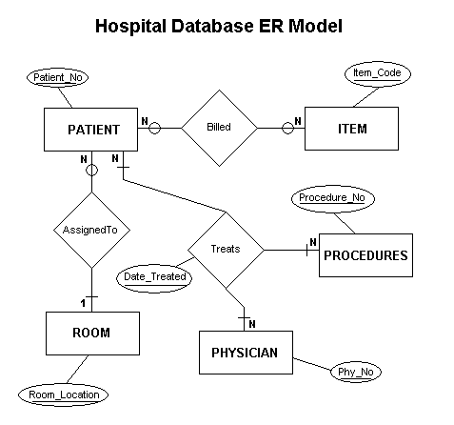
Example ERD (Hospital Database)

Slide 27
What is UML?
Unified Modeling Language
It was developed by Grady Booch, Ivar Jacobson and James Rumbaugh in 1994–1996
It is a general-purpose modeling language in software engineering
It is intended to provide a standard way to visualize the design of a system
UML was adopted as a standard by the Object Management Group (OMG) in 1997
UML was published by the International Organization for Standardization (ISO) as an approved ISO standard in 2005

Slide 28
UML as a visual diagram
Diagrams in UML can be broadly classified as:
Structural Diagrams – Capture static aspects or structure of a system including Component Diagrams, Object Diagrams, Class Diagrams and Deployment Diagrams.
Behavior Diagrams – Capture dynamic aspects or behavior of the system including: Use Case Diagrams, State Diagrams, Activity Diagrams and Interaction Diagrams.

Slide 29
UML Diagram

Slide 30
Vertabelo (https://www.vertabelo.com/)

Slide 31
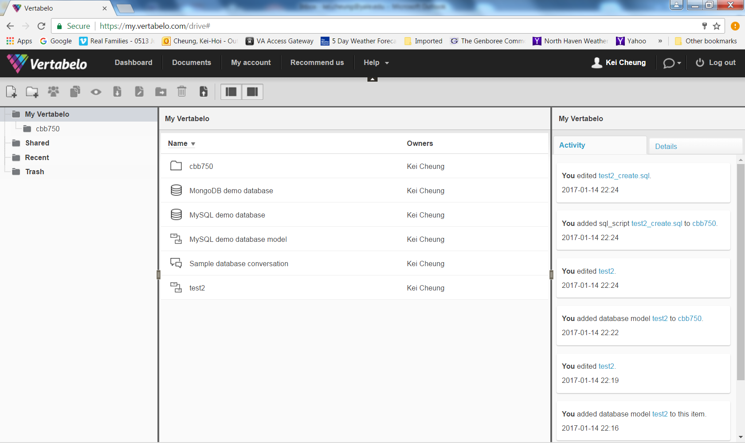

Slide 32
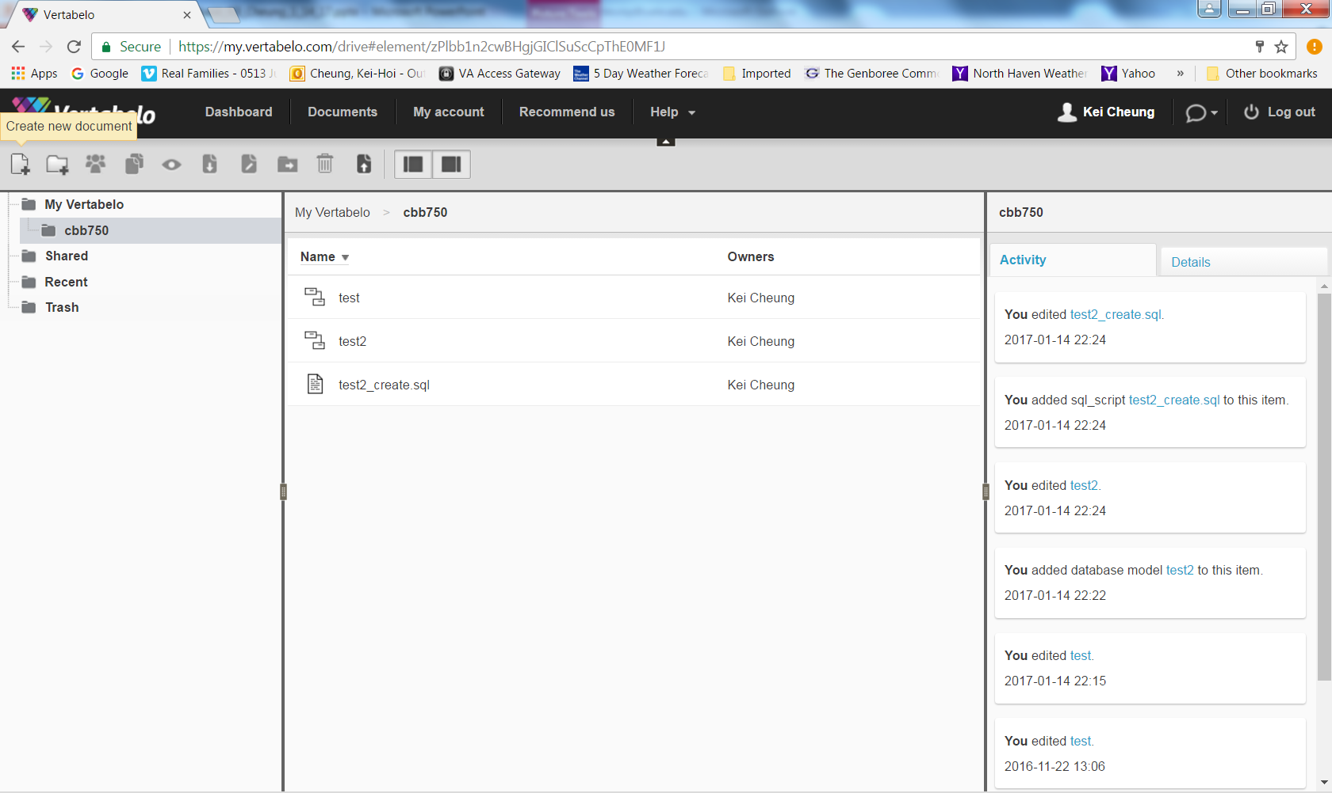
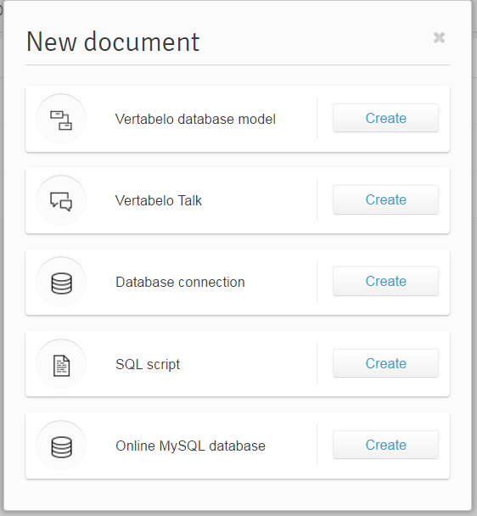

Slide 33
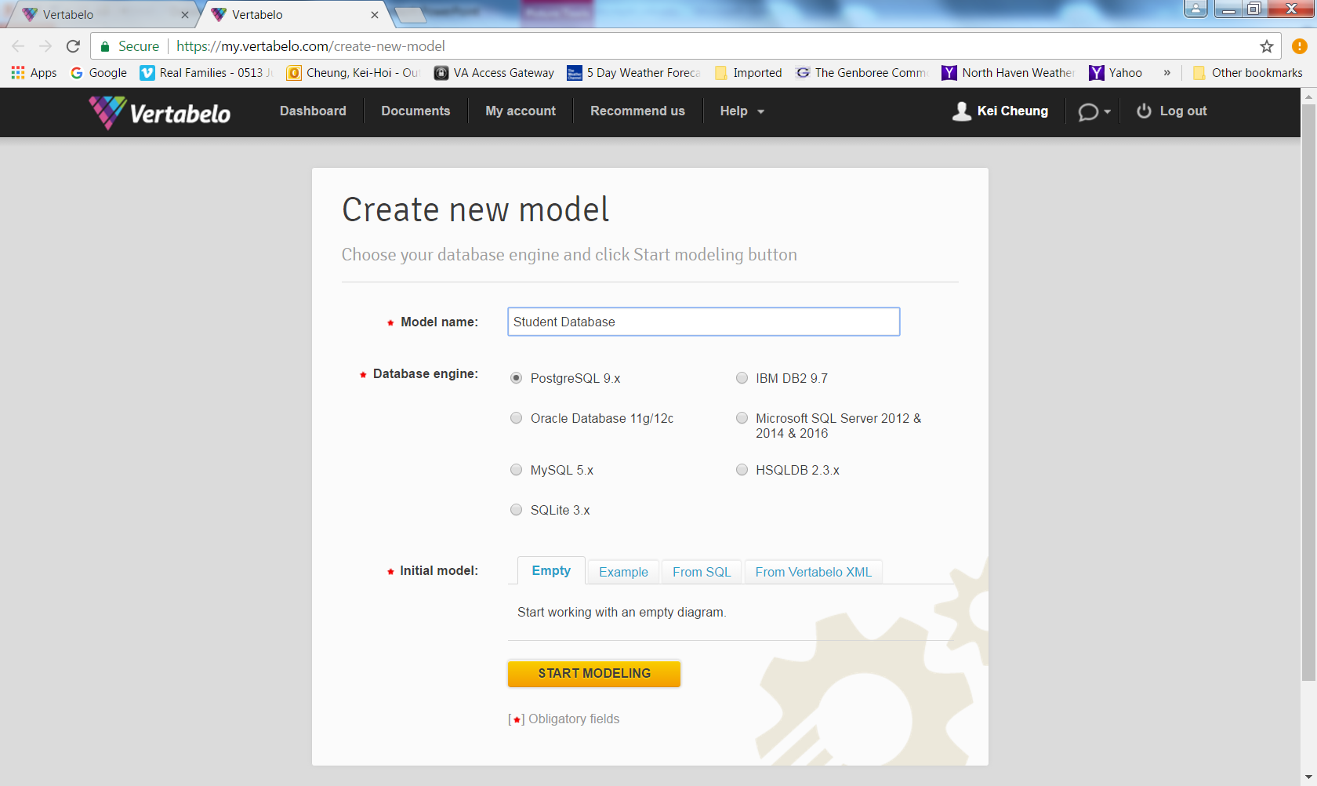

Slide 34
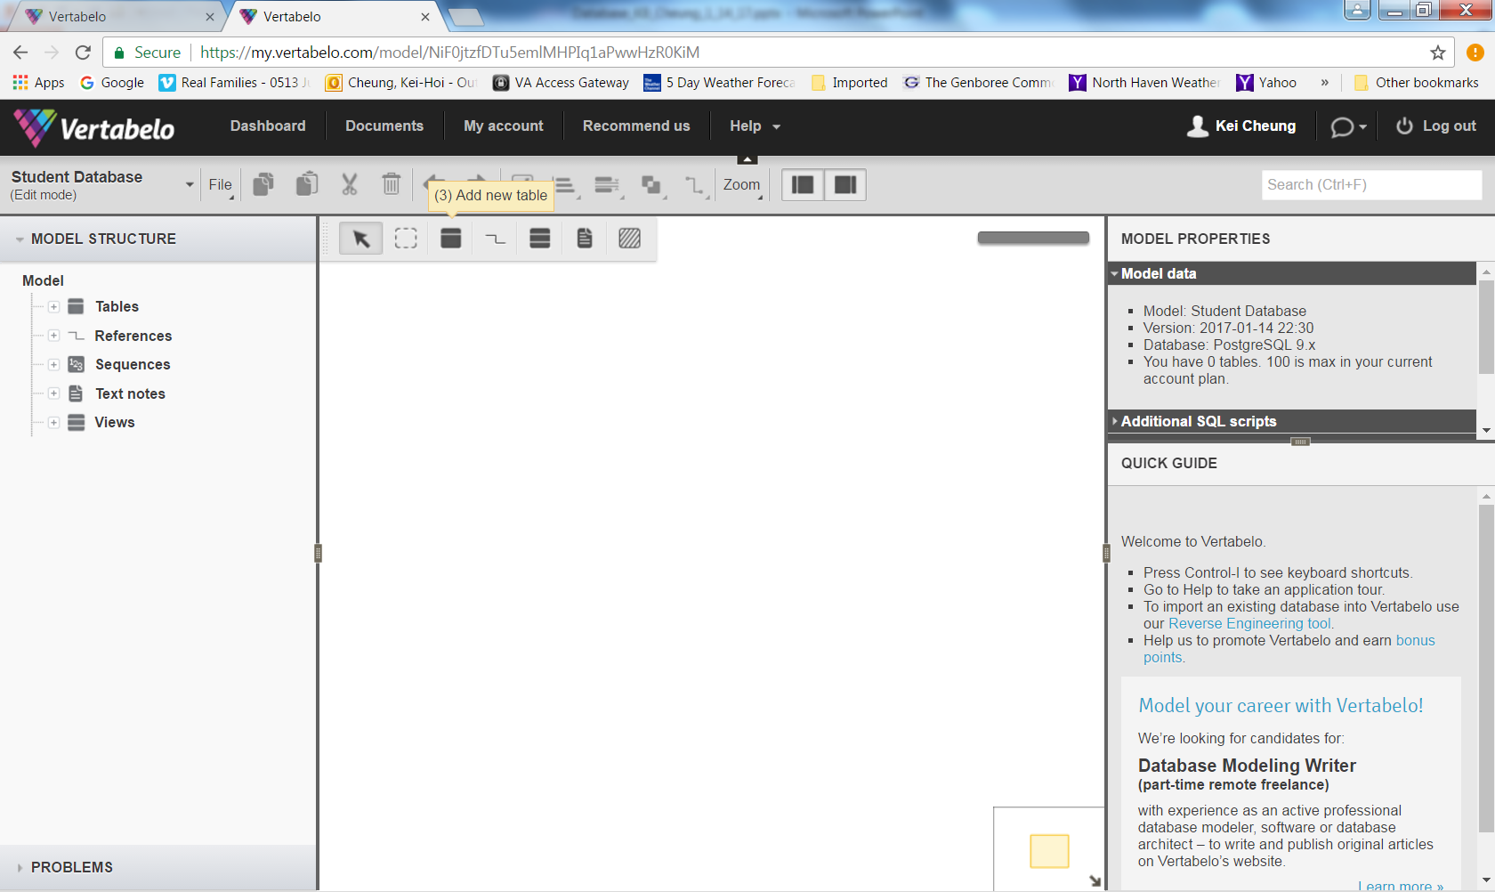

Slide 35
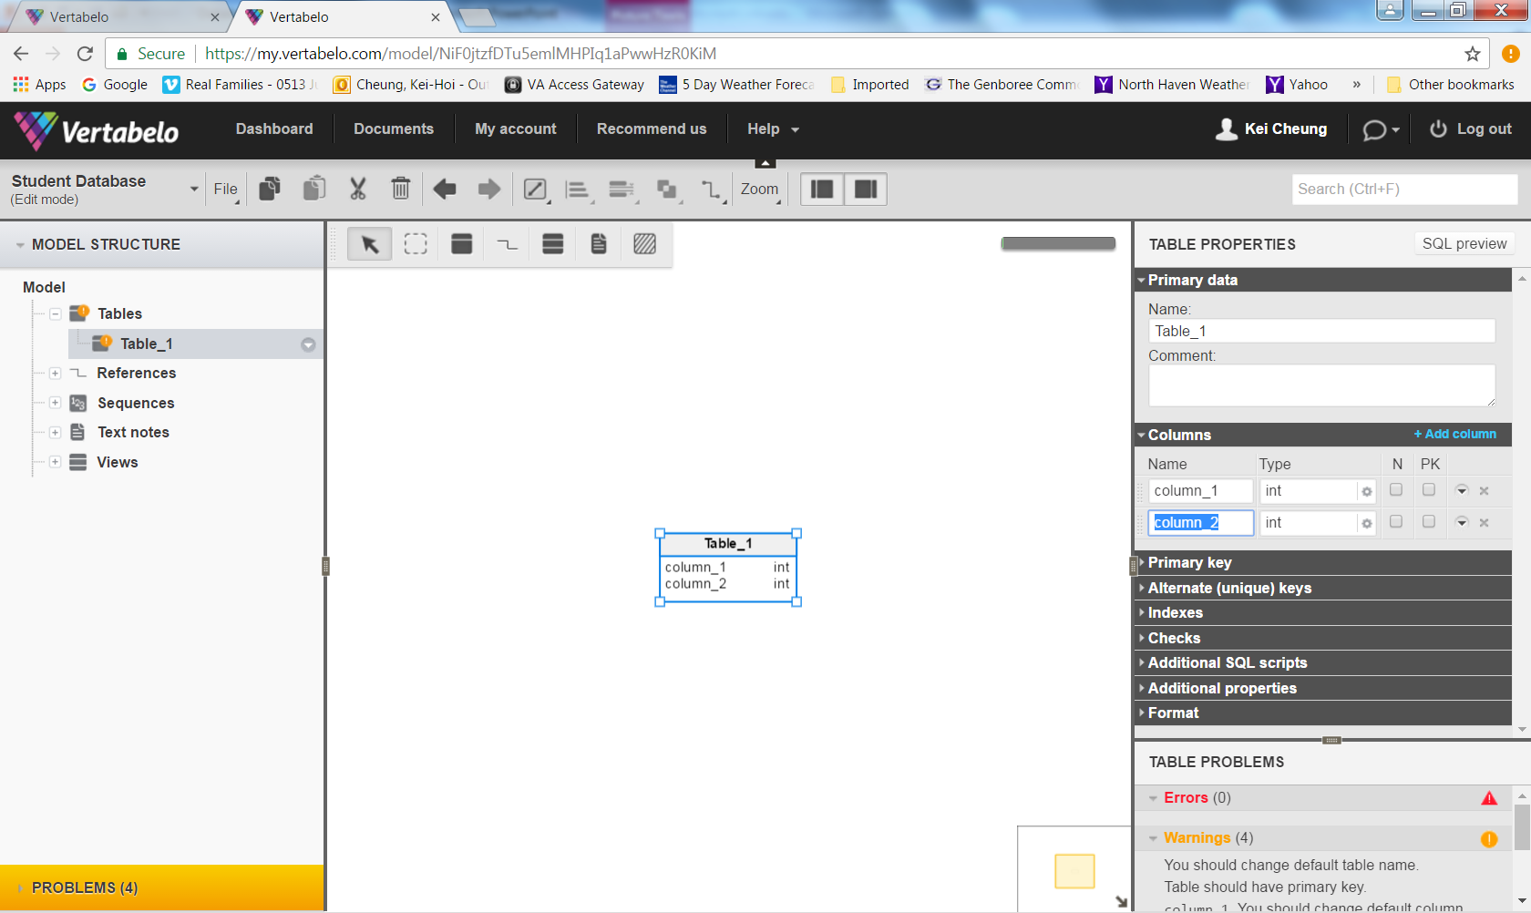

Slide 36
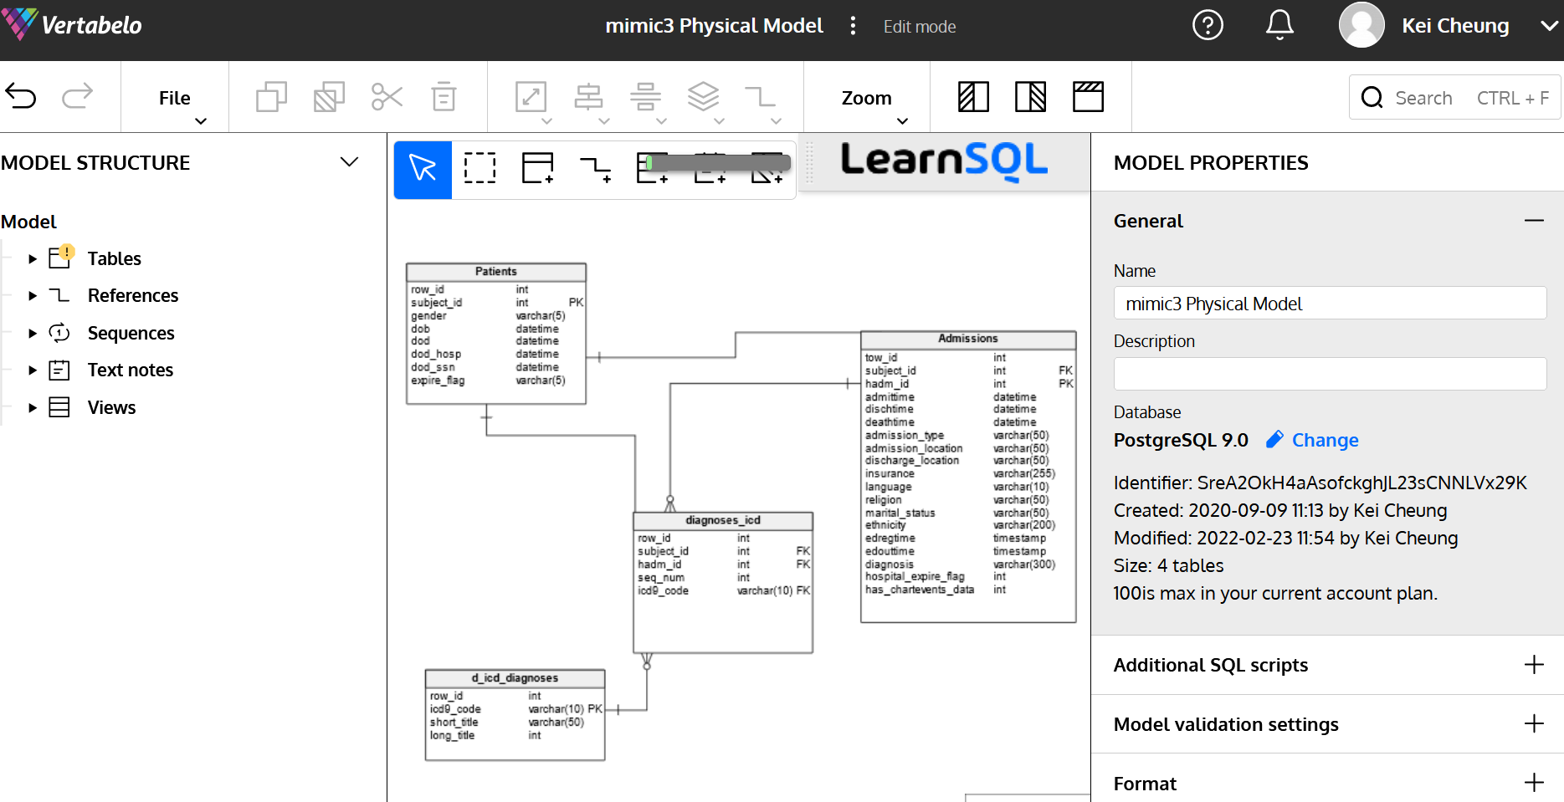

Slide 37
On-Line Transaction Processing (OLTP)

Slide 38
What is OLTP?
It is a class of information systems (e.g., databases) that facilitate and manage transaction-oriented applications, typically for data entry and retrieval transactions
A database that is based on a normalized relational model is considered an OLTP application. It supports the following transactions:
Insert new rows
Update existing rows
Delete rows
Select rows
A database transaction must be atomic, consistent, isolated and durable (ACID)

Slide 39
Structured Query Language (SQL)
It is a standard programming language for creating (CREATE) relational databases and tables as well as retrieving (SELECT), adding (INSERT), deleting (DELETE) and updating (UPDATE) data in a relational database
It is compliant with ANSI and ISO standards

Slide 40
SQL Statement (CREATE DATABASE/TABLE)
CREATE DATABASE Patient_DB;
CREATE TABLE Patient_DB.Patient
(
ID int,
Name varchar (50),
Address varchar (250),
Age smallint
Sex varchar (2)
);

Slide 41
INSERT Statement
INSERT INTO Patient_DB.Patient
(ID, Name, Address, Age, Sex)
VALUES (1, ‘John Doe’, ‘XYZ’, 40, ‘M’)
…
ID | Name | Address | Age | Sex
1 | John Doe | XYZ | 40 | M
2 | Jane Smith | ABC | 34 | F
3 | Mary Queen | PQSRT | 46 | F
4 | Mike Lee | DWQER | 60 | M

Slide 42
UPDATE Statement
UPDATE Patient_DB.Patient
SET AGE=41
WHERE ID=1
ID | Name | Address | Age | Sex
1 | John Doe | XYZ | 41 | M
2 | Jane Smith | ABC | 34 | F
3 | Mary Queen | PQSRT | 46 | F
4 | Mike Lee | DWQER | 60 | M

Slide 43
DELETE Statement
DELETE Patient_DB.Patient
WHERE Name=‘Mike Lee’
ID | Name | Address | Age | Sex
1 | John Doe | XYZ | 41 | M
2 | Jane Smith | ABC | 34 | F
3 | Mary Queen | PQSRT | 46 | F

Slide 44
SELECT Statement
SELECT ID, Name, Age, Sex
FROM Patient_DB.Patient
WHERE Age>=40
ORDER BY Age
ID | Name | Address | Age | Sex
1 | John Doe | XYZ | 40 | M
2 | Jane Smith | ABC | 34 | F
3 | Mary Queen | PQSRT | 46 | F
4 | Mike Lee | DWQER | 60 | M

Slide 45
SELECT Statement (Aggregation)
SELECT Sex, avg(Age)
FROM Patient_DB.Patient
GROUP BY SEX
Results: M 50
F 40
ID | Name | Address | Age | Sex
1 | John Doe | XYZ | 40 | M
2 | Jane Smith | ABC | 34 | F
3 | Mary Queen | PQSRT | 46 | F
4 | Mike Lee | DWQER | 60 | M

Slide 46
SELECT Statement (JOIN)
SELECT A.*, B.Report_Text
FROM Patient_DB.Patient AS A
INNER JOIN Patient_DB.LabTest. AS B
ON A.ID = B.Patient_ID
ID | Name | Address | Age | Sex
1 | John Doe | XYZ | 40 | M
2 | Jane Smith | ABC | 34 | F
3 | Mary Queen | PQSRT | 46 | F
4 | Mike Lee | DWQER | 60 | M
ID | Name | Address | Age | Sex | Report_Text
1 | John Doe | XYZ | 40 | M | …..
2 | Jane Smith | ABC | 34 | F | …..
Patient_ID | ID | Report_Text
1 | 1 | ……
2 | 2 | …….

Slide 47
CREATE VIEW
CREATE VIEW Patient_Doc AS
SELECT A.*, B.Report_Text
FROM Patient_DB.Patient AS A
INNER JOIN Patient_DB.LabTest. AS B
ON A.ID = B.Patient_ID
SELECT * FROM Patient_Doc
WHERE Age>45
ID | Name | Address | Age | Sex | Report_Text
3 | Mary Queen | PQSRT | 46 | F | …..
4 | Mike Lee | DWQER | 60 | M | …..

Slide 48
Other Types of SQL Statements
TRUNCATE TABLE
DROP TABLE
CREATE INDEX (boost query performace)
Full-Text index (e.g., part of MS SQLServer)

Slide 49
From OLTP to OLAP (On-Line Analytical Processing)

Slide 50
OLAP Overview
OLTP databases are tuned to small/medium size of data with relatively simple queries
Some applications use fewer but more time-consuming analytic queries
New architectures (data warehouses) have been developed to handle such analytic queries efficiently (De-normalization)

Slide 51
OLAP Example Queries
Amazon analyzes purchases by its customers to identify products of likely interest to customers
Analysts at Wal-Mart look for merchandise items with increasing sales in some region

Slide 52
Data Warehouse
The most common form of database integration
Copy source databases into a single database (data warehouse)
Update the data warehouse periodically (in batch mode)
Support analytic queries using a dimensional data model (vs. a normalized entity-relationship model)
Example: VA CDW

Slide 53
Star Schema
Dimension table
Dimension table
Fact table
Dimension table
Dimension table

Slide 54
Star Schema Example
Patients
Providers
ID
ID
Dimension Attributes
Dependent Attributes
Patient ID
Provider ID
Clinic ID
Procedure ID
Date
Comment
ID
ID
Clinics
Procedures

Slide 55
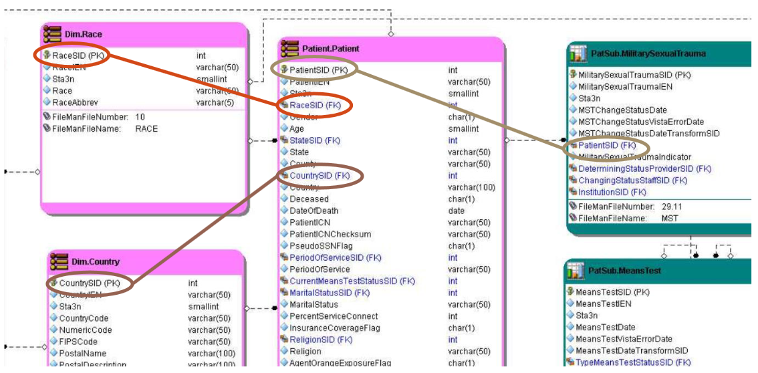
Corporate Data Warehouse

Slide 56
Example Queries
Compare numbers of patient visits across different clinics for a given year
Which are the top 10 most performed procedures among all clinics from 2010 to 2014

Slide 57
The End Thanks!

