Slide 1
Biomedical Data Science (GersteinLab.org/courses/452)
Supervised Datamining – ROC Curves & Cross-validation (23m8b)
Last edit in spring ’23. Condensed (with ~1 slide deletion) and re-arranged from 22m8b, which is similar to
2021’s M8b [which has a video].
Mark Gerstein
Yale U.

Slide 2
Supervised Mining:
Assessment, Cross-Validation & ROC Curves

Slide 3
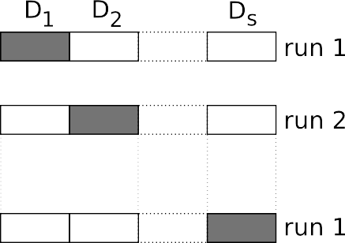
Evaluating performance: What? How?
A. What do we want to evaluate?
GENERALIZATION
Therefore, it is mandatory to divide your dataset:
Alternatively, use Cross Validation:
Slide from Alberto Paccanaro

Slide 4
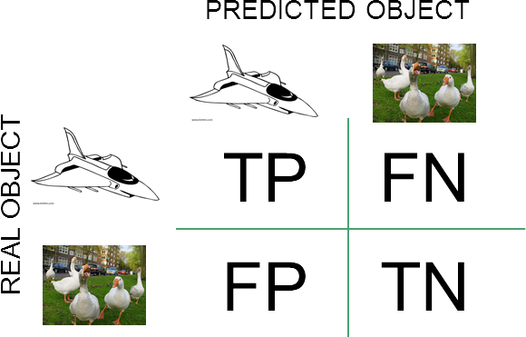
B. How do we evaluate performance?
1. Classification problems
Accuracy
TP+TN/(TP+FP+FP+TN)
Sensitivity (or TPR)
TP/P = TP/(TP+FN)
Specificity
TN/N = TN/(TN+FP)
Positive predictive value (PPV)
TP/(TP+FP)
False positive rate (FPR)
FP/N = FP/(FP+TN)
False discovery rate (FDR)
FP/(FP+TP)
2. Regression problems Sum of squares error
Root Mean Square error
Slide from Alberto Paccanaro
ROC analysis is good for comparing binary classifiers
https://en.wikipedia.org/wiki/Sensitivity_and_specificity

Slide 5
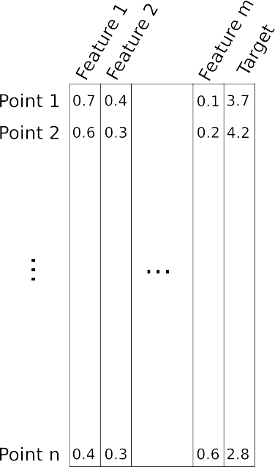
IMPORTANT: increasing the number of features may lead to a reduction in performance if the number of datapoints is not increased. Why?
Slide from Alberto Paccanaro
This is related to the “Curse of Dimensionality” Bellman, 1961.
9

Slide 6
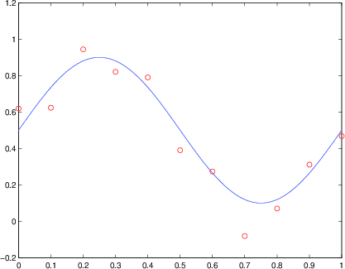
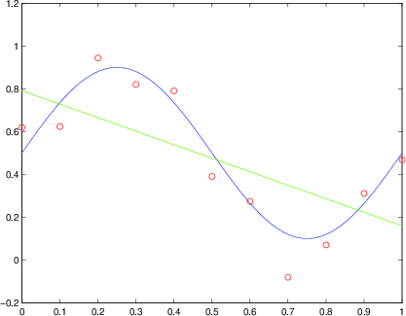
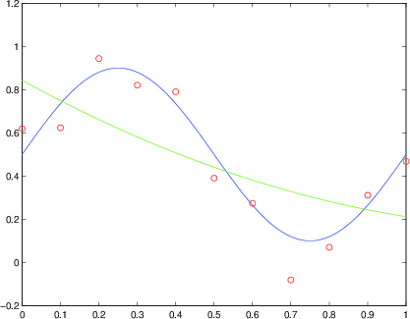
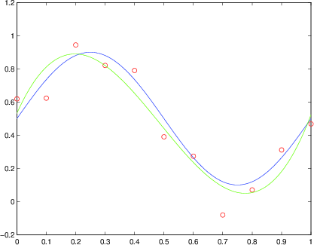
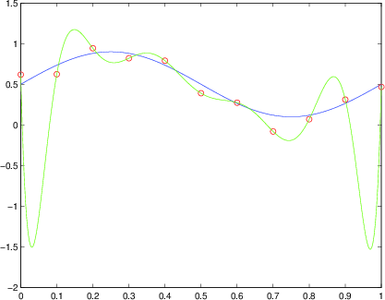
Model dimensionality and overfitting
We are given the red dots.
We assume that they are noisy samples from a signal/(function) – the blue curve – which we do not have (we only have the red dots).
We want to predict new points, i.e. the y coordinates for other values of x (e.g. x > 1)
Our model needs to approximate the blue function. We decide to do it with polynomials.
Slide from Alberto Paccanaro
Degree 1 polynomial
Degree 2 polynomial
Degree 3 polynomial
Degree 10 polynomial
Which one is best? And why?

Slide 7
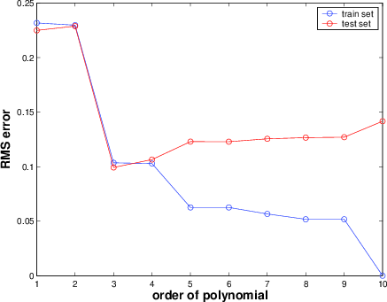
How does the GENERALIZATION performance vary, as we increase the complexity of the polynomial?
Occam's razor (William of Occam, ~1300): Accept the simplest explanation that fits the data.
We should prefer simpler models to more complex models, and this preference should be traded off against the extent to which the model fits the data.
Slide from Alberto Paccanaro
8

Slide 8
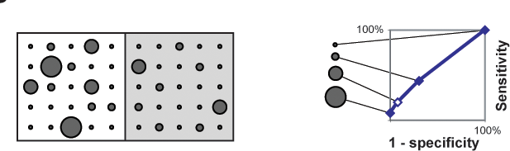
Comparison of Predictions against a Positive and Negative Gold Standard
R Jansen, M Gerstein (2004). Curr Opin Microbiol 7: 535
"Coverage” (TP/P)
Threshold "predictions" at different levels and compare to + and - gold standards
"Error Rate” (FP/N)
ROC plot
(cross validated)

Slide 9
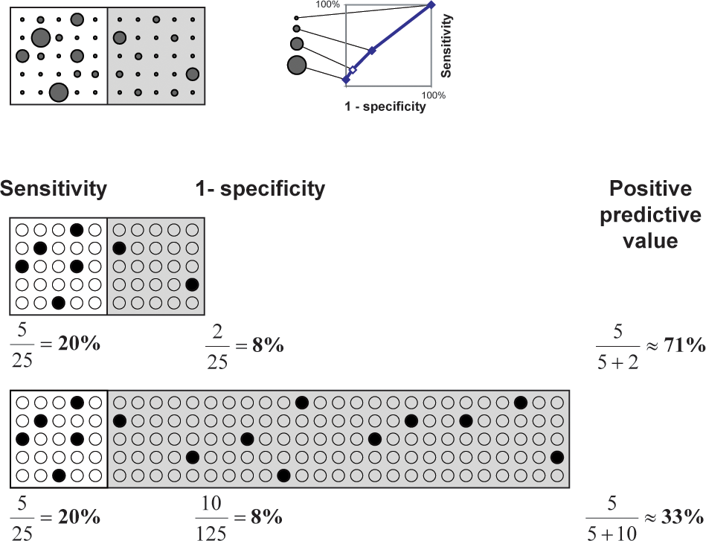
Effect on Predictions of Large Number of Negatives
(e.g. terrorist identification or breast cancer screening)
R Jansen, M Gerstein (2004). Curr Opin Microbiol 7: 535

Slide 10
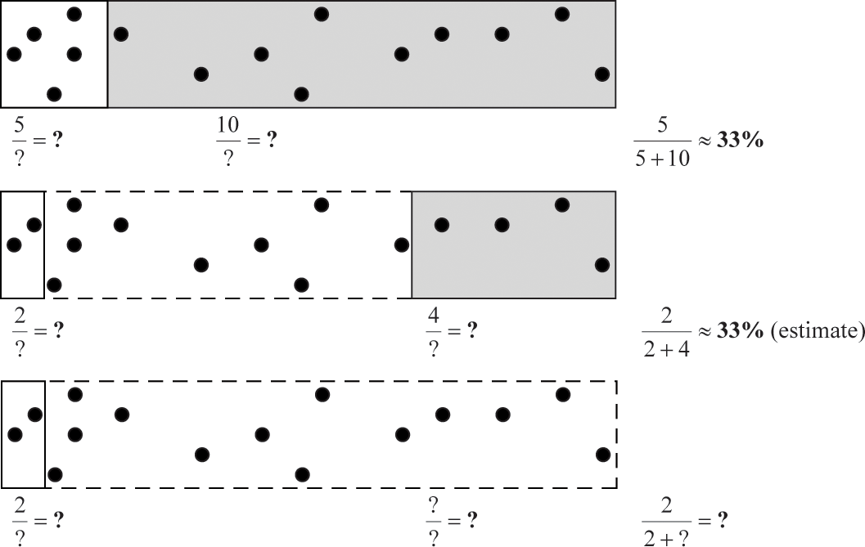
Importance of Balanced
Positive and Negative Examples
R Jansen, M Gerstein (2004). Curr Opin Microbiol 7: 535

