Slide 1
Biomedical Data Science (GersteinLab.org/courses/452)
Fast Alignment (23m5)
Last edit in spring ’23. Essentially unchanged from 22m5 & 2021’s M5 [which has a video].
Mark Gerstein
Yale U.

Slide 2
Computational Complexity
The dynamic programming alignment algorithm is
O(n m) ~ O(n²)
in speed and memory
O(n²) in speed and memory is not good enough for important applications
  database search
  short read alignment to reference genome
Note how this would scale to 3, 4, 5 sequences
N
M
M’
N’

Slide 3
Fast sequence alignment
Alignment via dynamic programming (NW/SW)
  useful for aligning the small numbers of protein, DNA sequences available in the 1980s
1990s hundreds of thousands of protein sequences
Today thousands of genome sequences
=> need for faster, more coarse-grained alignment methods
  first application: find your favorite protein in a sequence database
  next-gen seq application: align millions of short reads to a reference database
Notes:
RA

Slide 4
Computational Complexity
Designing algorithms involves a trade-off between calculation time and memory usage & sensitivity
Steps that can be pre-calculated and stored efficiently in memory speed up the algorithm
FASTA (hashing the query)
BLAST (more efficient query hashing)
BLAT (hashing the DB)
BWA / Bowtie (BW transform of the DB)

Slide 5
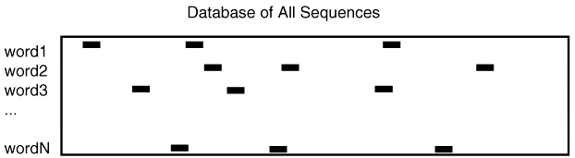
FASTA
Hash table of short words in the query sequence
Go through DB and look for matches in the query hash (linear in size of DB)
perl: $where{“ACT”} = 1,45,67,23....
K-tuple determines word size (k-tup 1 is single aa)
by Bill Pearson
VLICT = _
VLICTAVLMVLICTAAAVLICTMSDFFD

Slide 6
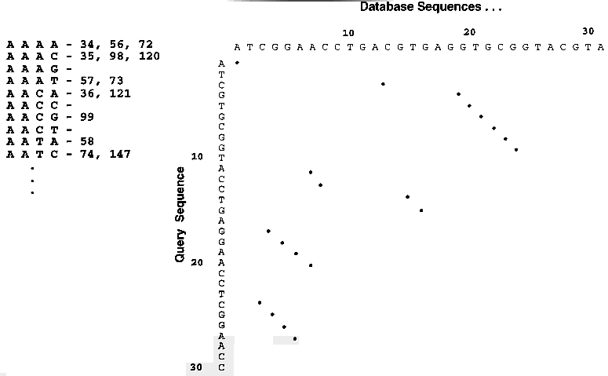
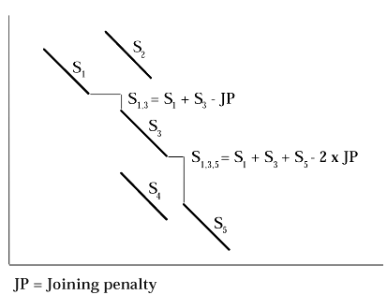
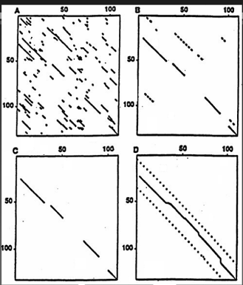
Join together query lookups into diagonals and then do a full alignment
(Adapted from D Brutlag)

Slide 7
Basic Blast
Altschul, S., Gish, W., Miller, W., Myers, E. W. & Lipman, D. J. (1990). Basic local alignment search tool. J. Mol. Biol. 215, 403-410
Indexes query
Starts with all overlapping words from query
Calculates “neighborhood” of each word using PAM matrix and probability threshold matrix and probability threshold
Looks up all words and neighbors from query in database index
Extends High Scoring Pairs (HSPs) left and right to maximal length
Finds Maximal Segment Pairs (MSPs) between query and database
Blast 1 does not permit gaps in alignments

Slide 8
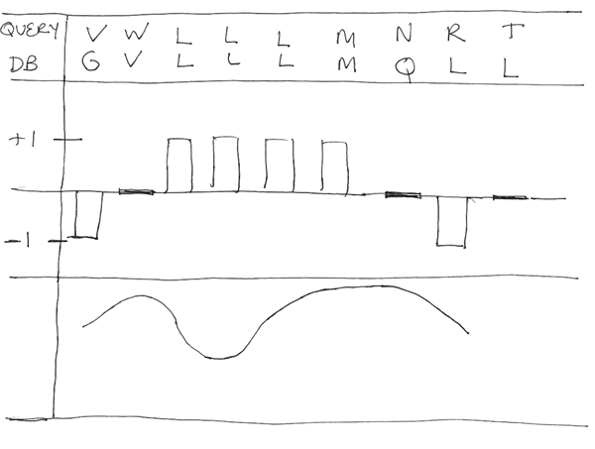
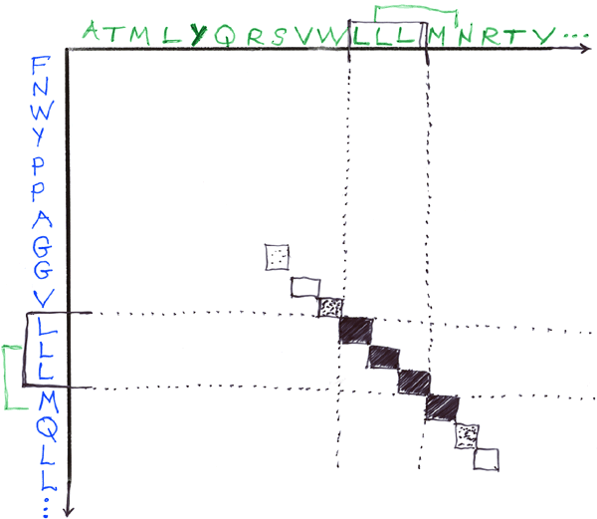
BLAST: Basic Local Alignment Search Tool
Query
DB
Extend hash hits into High Scoring Segment Pairs (HSPs)
Stop extension when total score doesn’t increase
Extension is O(N). This takes most of the time in BLAST

Slide 9
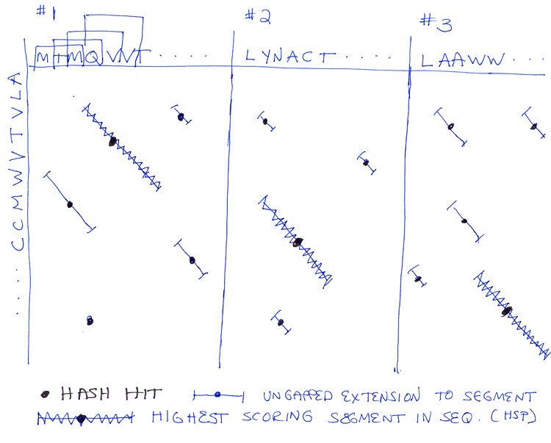
BLAST: Basic Local Alignment Search Tool
In simple BLAST algorithm, find best scoring segment in each DB sequence
Statistics of these scores determine significance
Number of hash hits
~ O(N*M*D)
where
N is query size
M is average size
of seq in DB
D is DB size

Slide 10
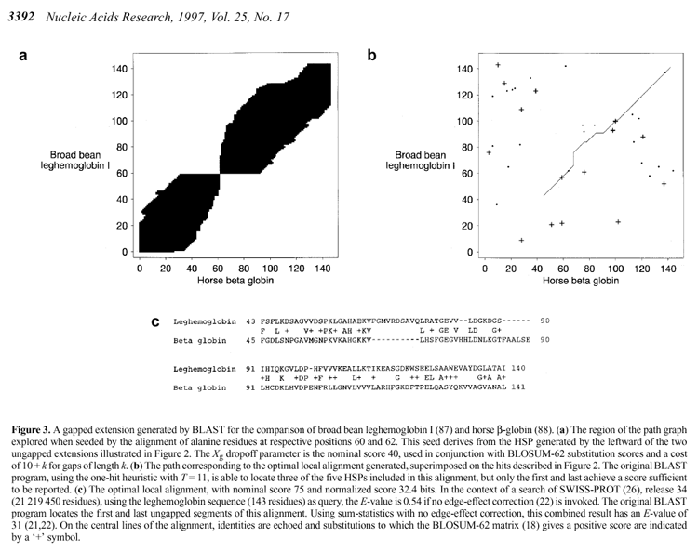
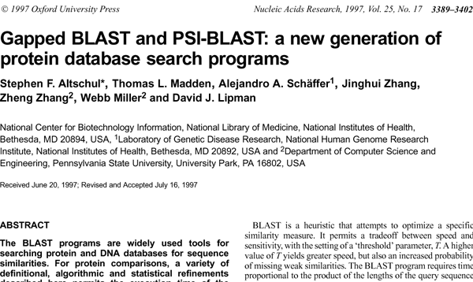
Blast2: Gapped Blast

Slide 11
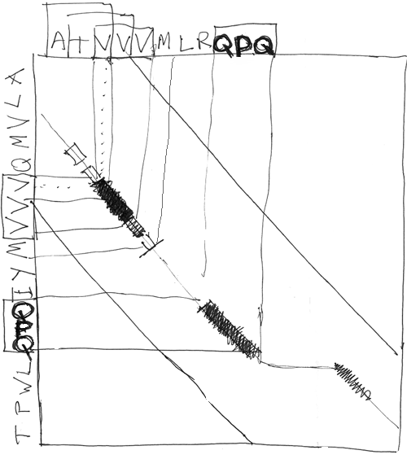
Blast2: Gapped Blast
Gapped Extension on Diagonals with two Hash Hits
Statistics of Gapped Alignments follows Extreme Value Distribution (EVD) empirically

Slide 12
Short read alignment to a reference genome
BLAT
Burrows-Wheeler transform

Slide 13
BLAT
“BLAST-like alignment tool”
created by Jim Kent (UCSC) during assembly of the human genome
Where BLAST builds an index of the query sequence, BLAT builds an index of the database.
  Obviously, this will scan more quickly through the DB at the expense of building a huge hash table of the DB initially
  DB index non-overlapping, potentially sacrificing some sensitivity for decreased memory usage
BLAT – Genome Res. (2002) 12: 656

Slide 14
Burrows Wheeler Transform
What’s next: more sophisticated ways of organizing the genome pre-search to speed things up beyond building the DB hash table as in BLAT
High Level
  Build a BWT of the genome (cyclically permuting, then sorting, then compressing)
  Then build a prefix tree of this
  Take each read and search along the prefix tree in linear time
  Reverse the transform to find the location of the read in the genome from its position in the prefix tree.
Burrows and Wheeler, A Block-sorting Lossless Data Compression Algorithm,
Digital Systems Research Center Report 124 (1994)

Slide 15
Burrows Wheeler Transform
BWT is a reversible permutation of the characters in a string X
build matrix of cyclic rotations of X
sort matrix alphabetically
example: X = acaacg
0 acaacg$ 6 $acaacg
1 caacg$a 2 aacg$ac
2 aacg$ac 0 acaacg$
3 acg$aca => 3 acg$aca
4 cg$acaa 1 caacg$a
5 g$acaac 4 cg$acaa
6 $acaacg 5 g$acaac
Bowtie – Genome Biol. (2009) 10: R25

Slide 16
Speed v Sensitivity Tradeoff
PSI Blast as a form of Semi-supervised learning
BWA
Blast
FASTA
Smith-Waterman
PSI-Blast
Profiles
HMMs
Sensitivity
Speed

Slide 17
Alignment algorithms scaling to keep pace with data generation
[Sboner et al. (‘11), Muir et al. (‘15) Genome Biology]

Slide 18
What sequence alignment algorithms need to be designed next?
A couple of important problems:
rapidly align a personal genome to a reference population of human genomes
  with clinical turn-around time; with privacy => encryption?
3rd generation sequencers: long, error-prone reads
  useful as scaffolds mixed with more accurate, cheaper short reads

