Slide 1



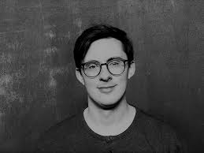
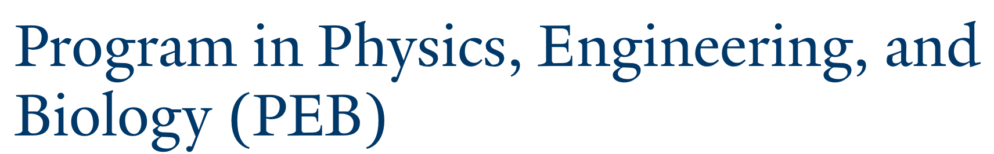


Are there any differences between x-ray crystal structures and NMR structures of proteins?
Corey S. O’Hern
Department of Mechanical Engineering & Materials Science
Department of Applied Physics
Department of Physics
Graduate Program in Computational Biology & Bioinformatics
Yale University, New Haven, CT USA
Lynne Regan,
U. Edinburgh
Alex Grigas,
CBB
Jack Treado
MEMS
Grace Meng
Chemistry
Zhuoyi Liu
MEMS

Slide 2
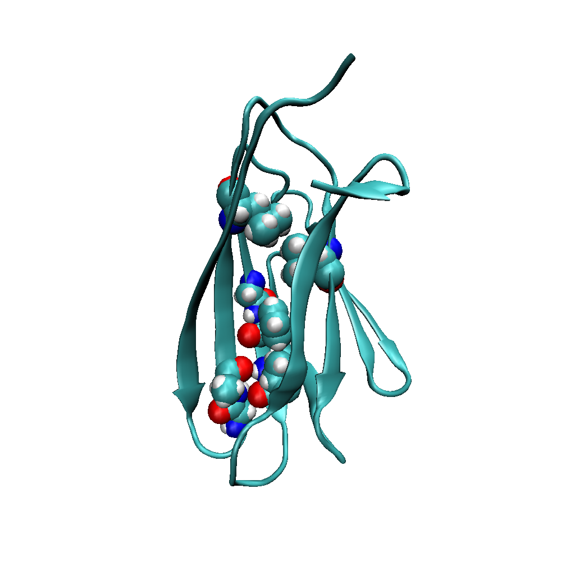
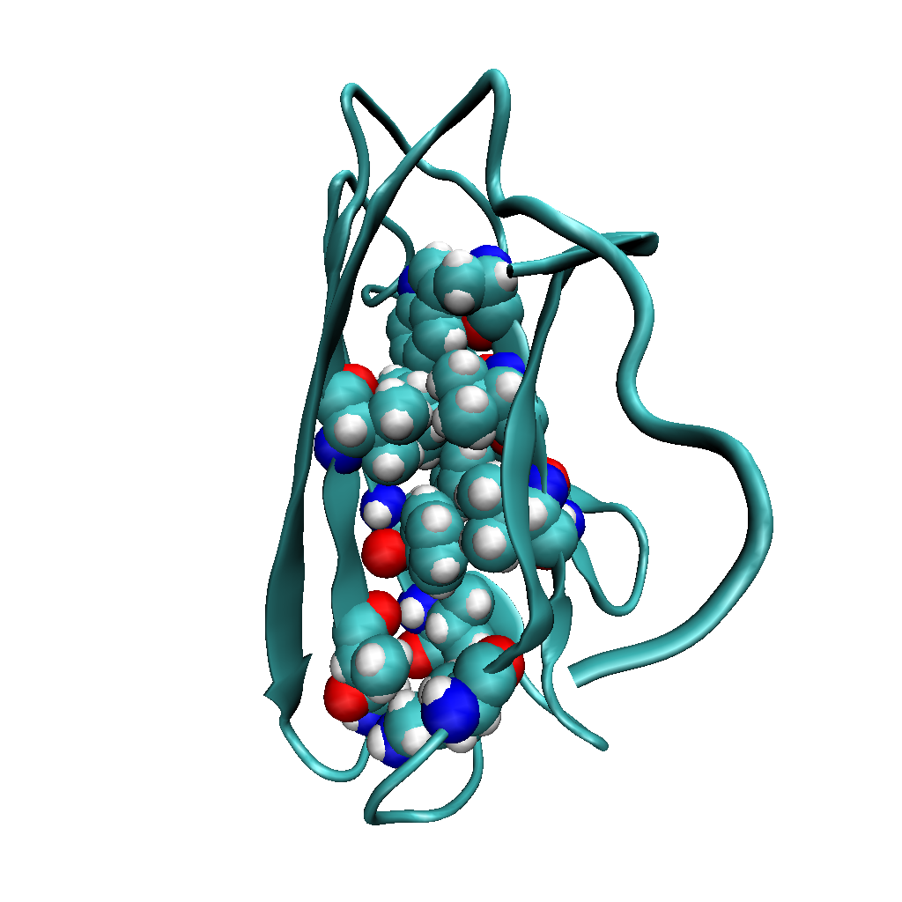
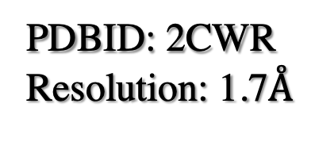
x-ray crystal structure
NMR structure
PDBID: 2CWR
Resolution: 1.7$Å$
PDBID: 2CZN
25 NOE restraints/residue
Chitin binding domain
of chitinase from
Pyrococcus furiosus; 103 AA
A. T. Grigas, Z. Liu, L. Regan, and C. S. O’Hern, “Core packing of well-defined
X-ray and NMR protein structures is the same,” to appear in Protein Science (2022).
Notes:
\Delta phi = \phi_NMR - \phi_xtal
\Delta f_c = f_c_NMR – f_c_xtal
\Delta phi > 0, \Delta f_c > 0, 1st quadrant

Slide 3
To quantify differences between x-ray crystal structures and
NMR structures, we will focus on “core” residues.
Compare average properties of high-resolution x-ray
crystal structures (5621) and high-quality NMR structures (6449).
(b) Compare NMR and x-ray crystal structures of the same
protein (702 pairs).

Slide 4
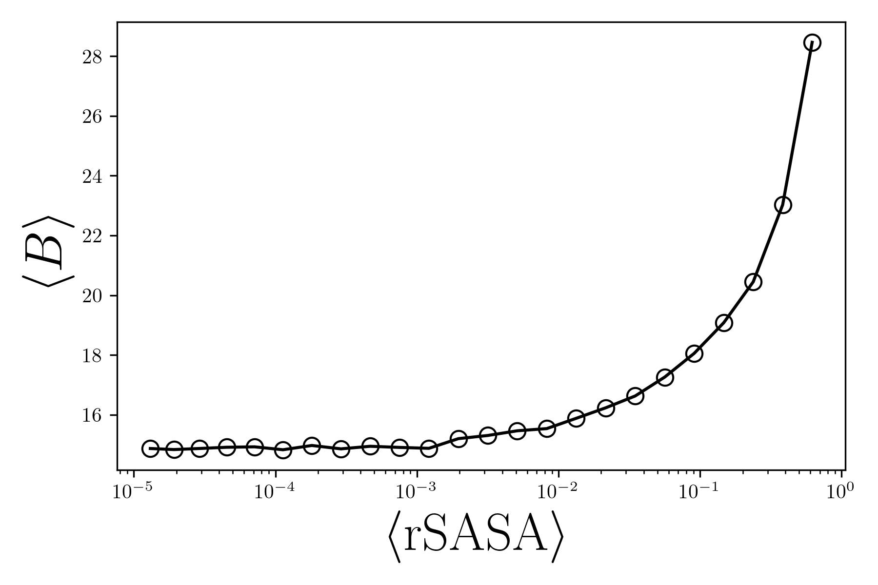
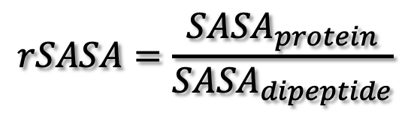

Fluctuations in x-ray crystal structures
surface
$$Å^{2}$$
core
$$rSASA=\frac{{SASA}_{protein}}{{SASA}_{dipeptide}}$$
[0,1] =
Notes:
B-factor is for all atoms

Slide 5
Features of protein cores: 1. fraction of core residues,
2. packing fraction, …

Slide 6
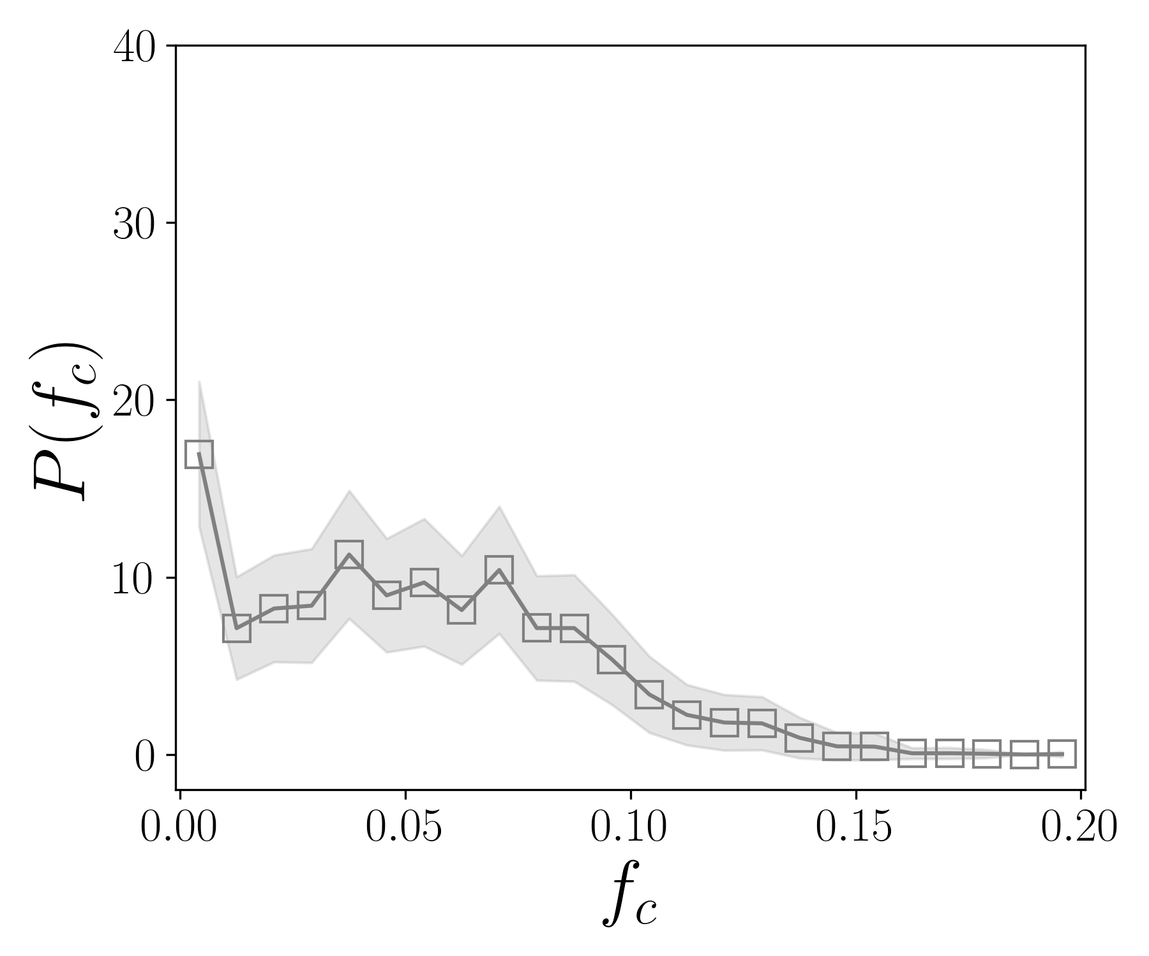
Fraction of core residues in x-ray crystal structures
< f_{c} > ~ 0.08

Slide 7
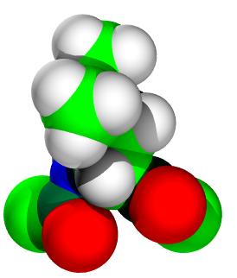
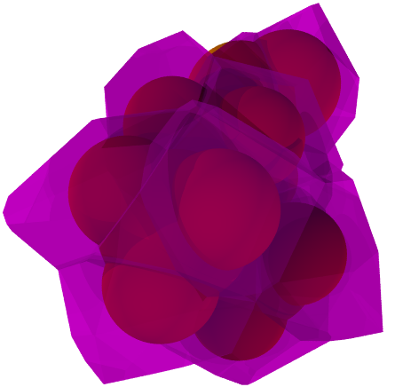

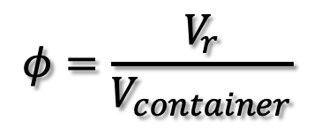

$$V_{r}$$
$$φ=\frac{V_{r}}{V_{container}}$$
$$V_{container}$$

Slide 8


Packing fraction in x-ray crystal structures
protein cores
packing simulation
$$P(φ)$$
$$φ$$

Slide 9
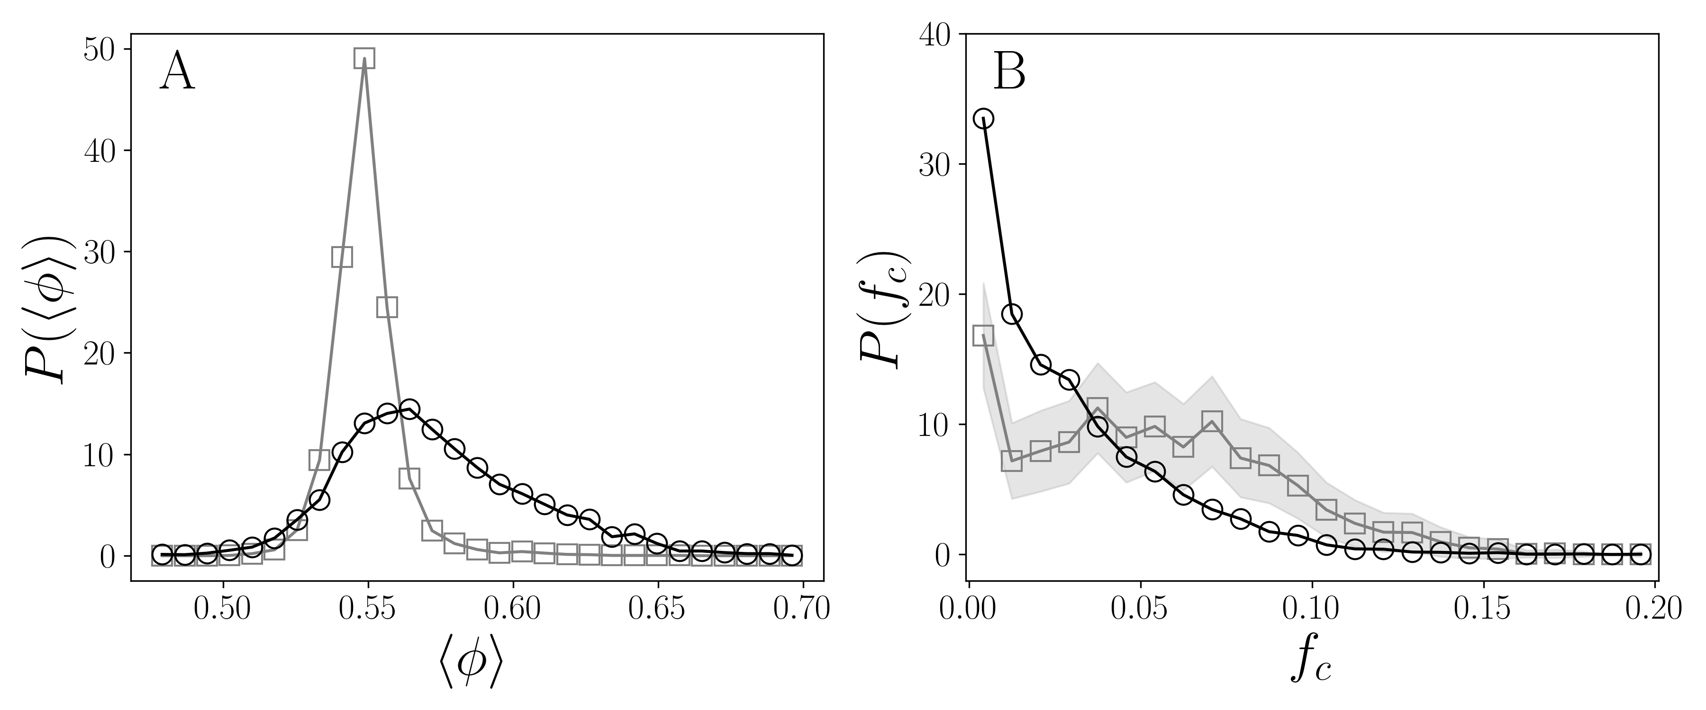
Differences in packing features between NMR and x-ray crystal structures
x-ray
NMR
x-ray
NMR

Slide 10
Are differences in packing features caused by methodological
issues or by differences in protein structure in crystalline vs.
solution conditions?

Slide 11
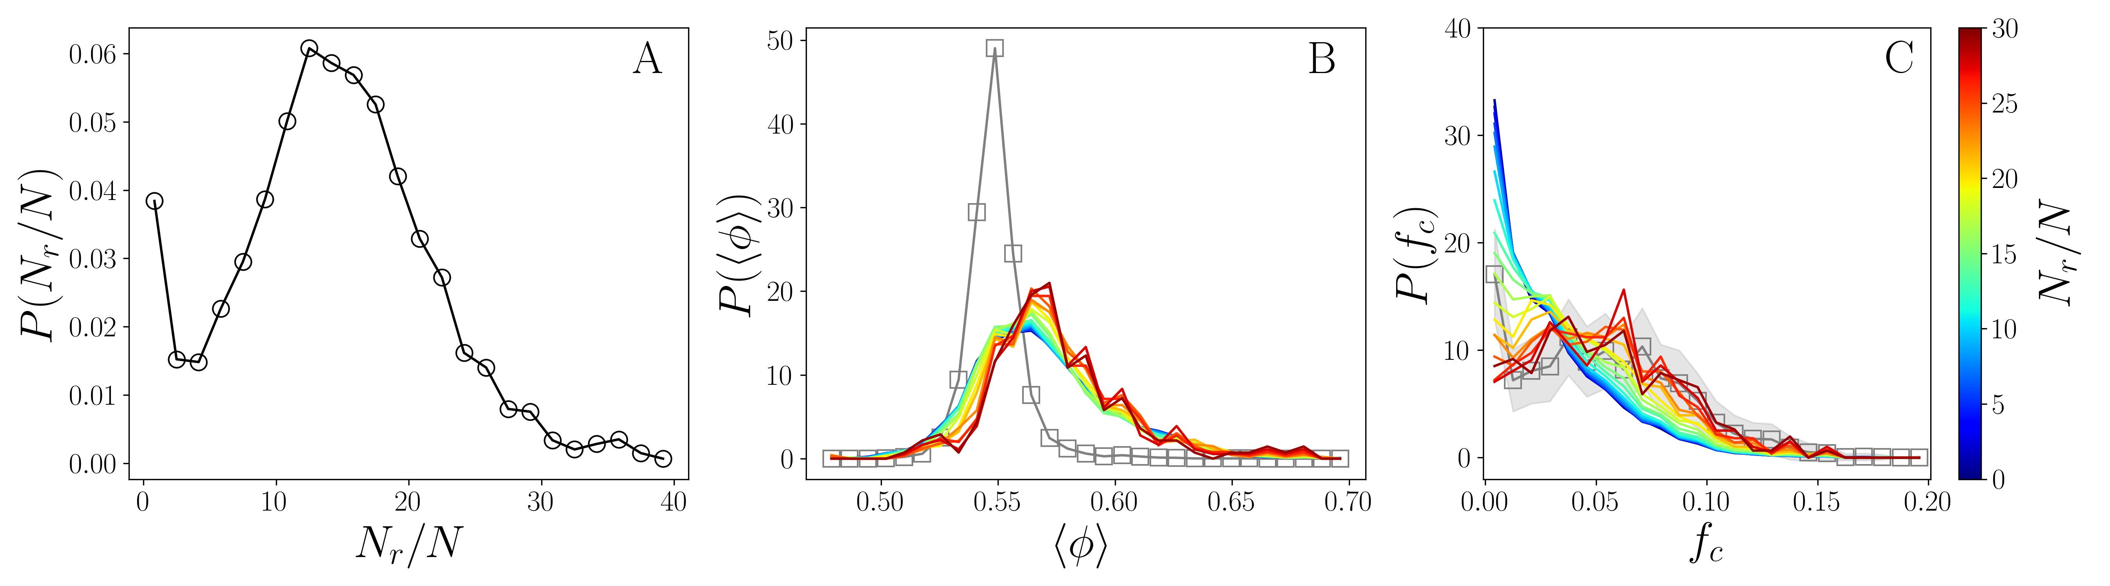
Number of NOE distance restraints
x-ray
x-ray
Notes:
Nuclear Overhauser Effect

Slide 12
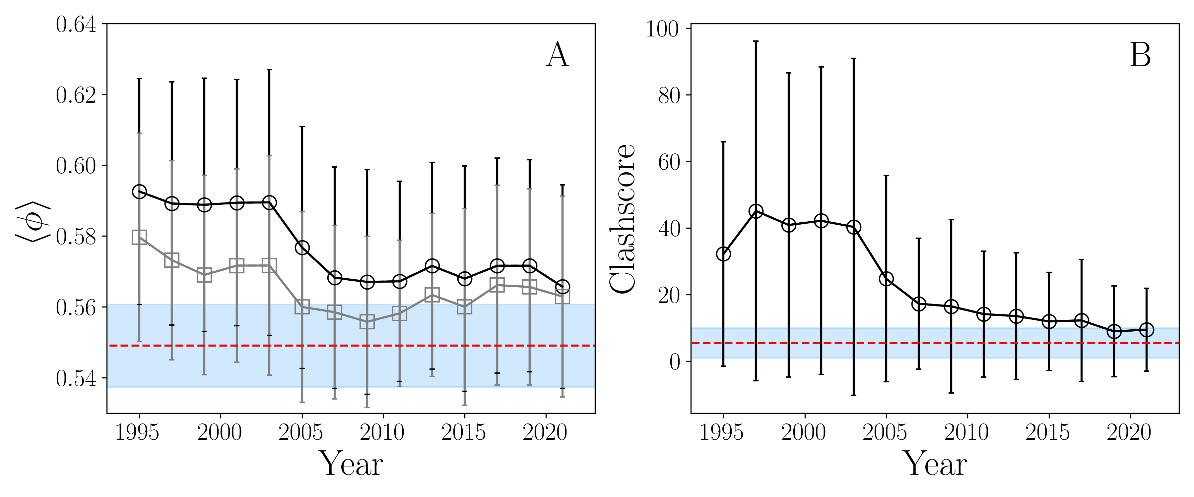
original
Clashscore.
filtered

Slide 13
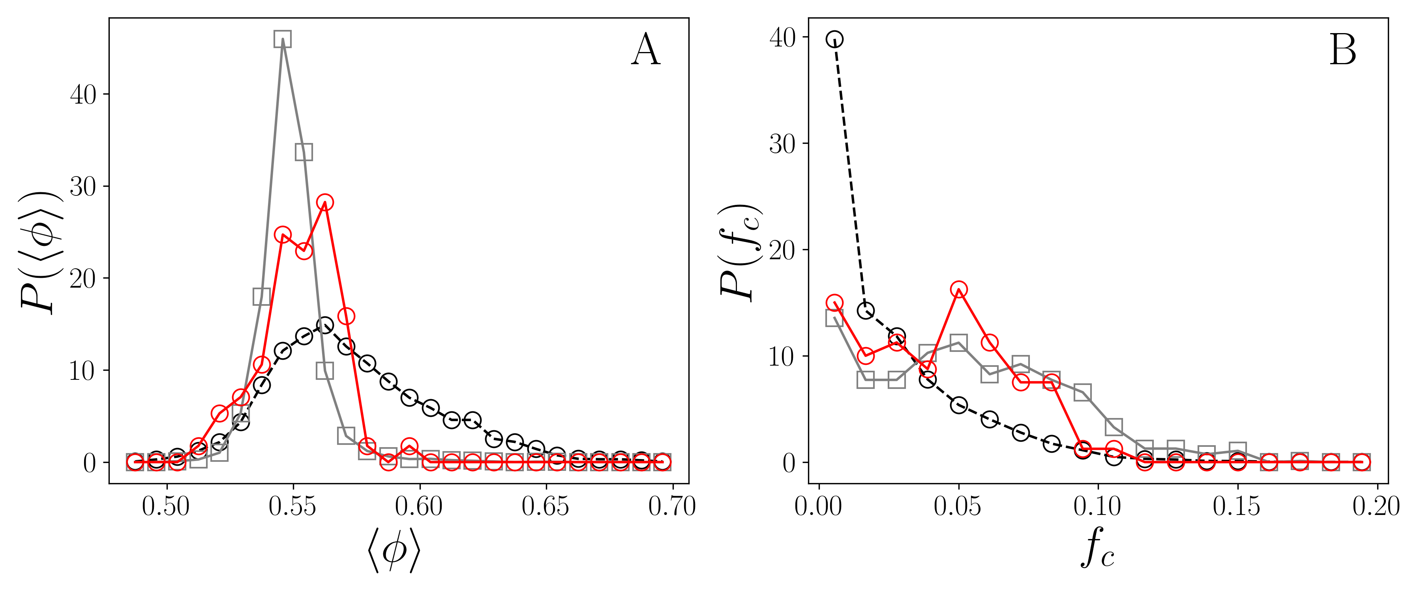
Filter NMR structures by clashscore, backbone and sidechain dihedral
angle outliers, number of NOE restraints,…
x-ray
NMR
NMR-filtered
NMR-filtered
NMR
x-ray

Slide 14
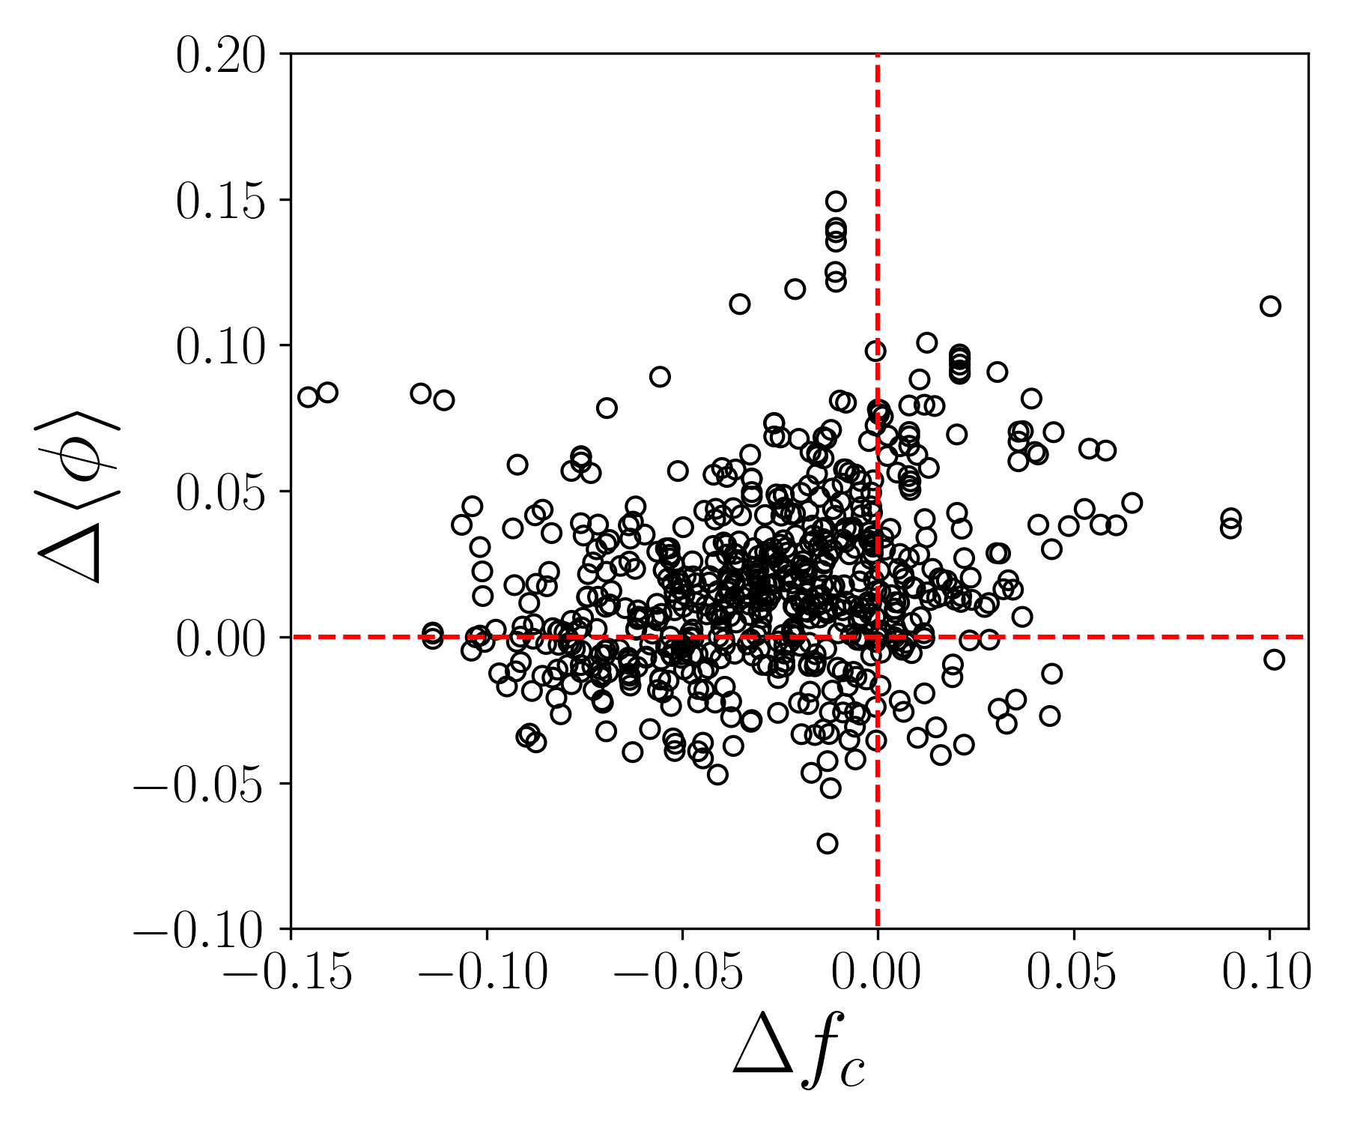
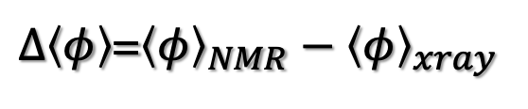
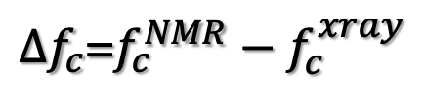
NMR and x-ray crystal structures pairs
II
I
$Δ\left\langle φ\right\rangle$=${\left\langle φ\right\rangle }_{NMR}−{\left\langle φ\right\rangle }_{xray}$
$∆f_{c}$=$f_{c}^{NMR}−f_{c}^{xray}$

Slide 15
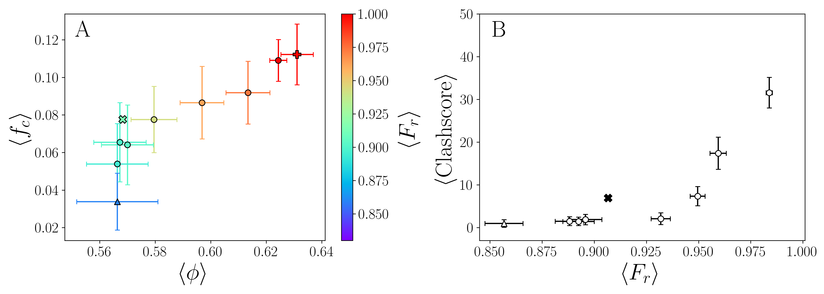
Unrestrained and NOE distance-restrained all-atom
MD simulations
NMR
xray
unrestrained
Chitin binding domain
of chitinase from
Pyrococcus furiosus; 103 AA

Slide 16
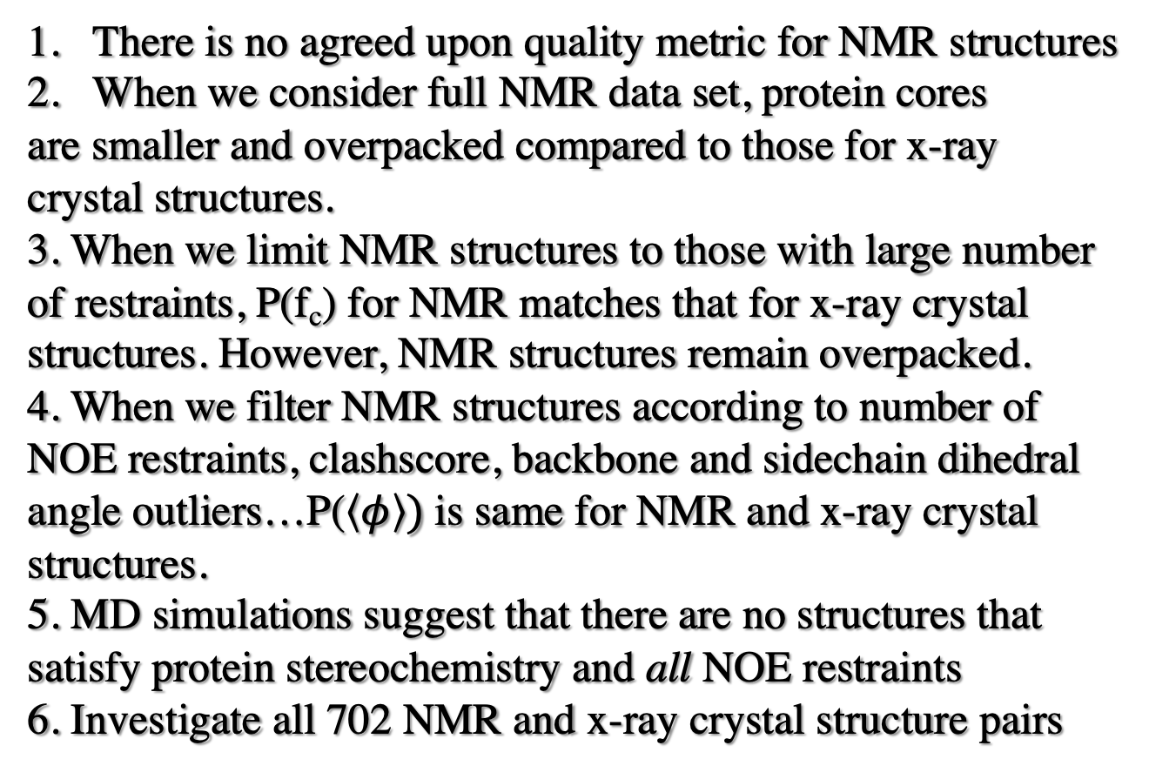
Conclusions
There is no agreed upon quality metric for NMR structures
When we consider full NMR data set, protein cores
are smaller and overpacked compared to those for x-ray
crystal structures.
3. When we limit NMR structures to those with large number
of restraints, P(f_{c}) for NMR matches that for x-ray crystal
structures. However, NMR structures remain overpacked.
4. When we filter NMR structures according to number of
NOE restraints, clashscore, backbone and sidechain dihedral
angle outliers…P($\left\langle φ\right\rangle )$is same for NMR and x-ray crystal
structures.
5. MD simulations suggest that there are no structures that
satisfy protein stereochemistry and all NOE restraints
6. Investigate all 702 NMR and x-ray crystal structure pairs

Slide 17
Protein Decoy Detection
A. T. Grigas, Z. Mei, J. D. Treado, Z. A. Levine, L. Regan, and C. S. O’Hern,
``Using physical features of protein core packing to distinguish real proteins from
Decoys,” Protein Science 29 (2020) 1931.

Slide 18
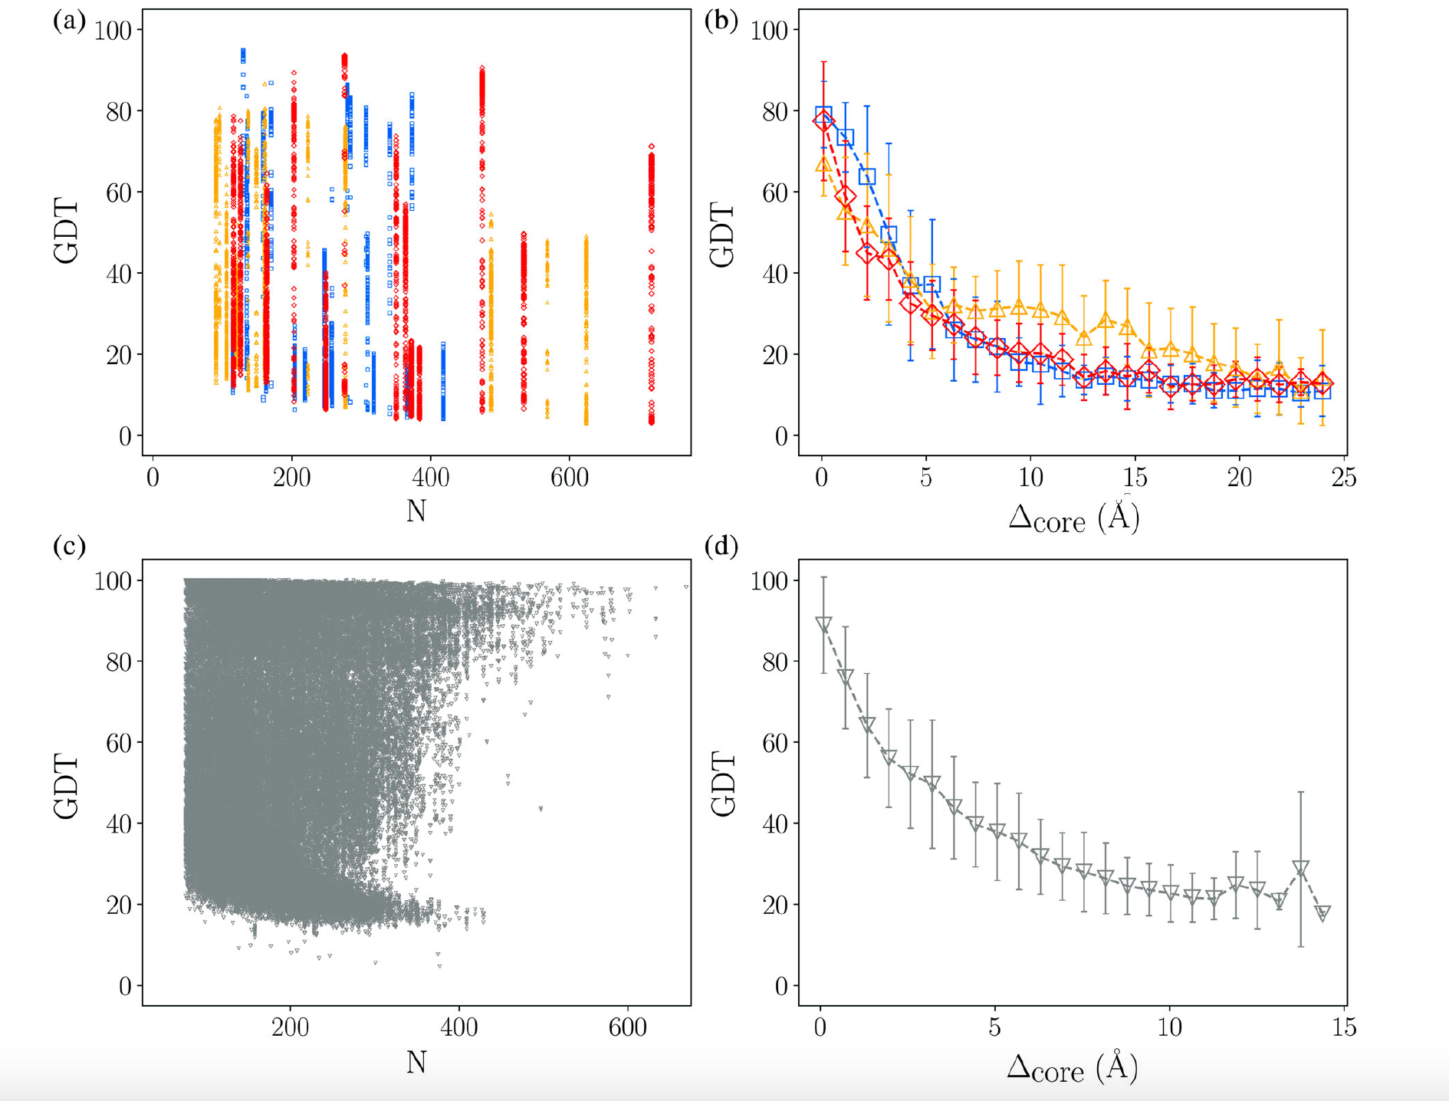
Notes:
Casp11, 12, 13
What about 14 and 15

Slide 19
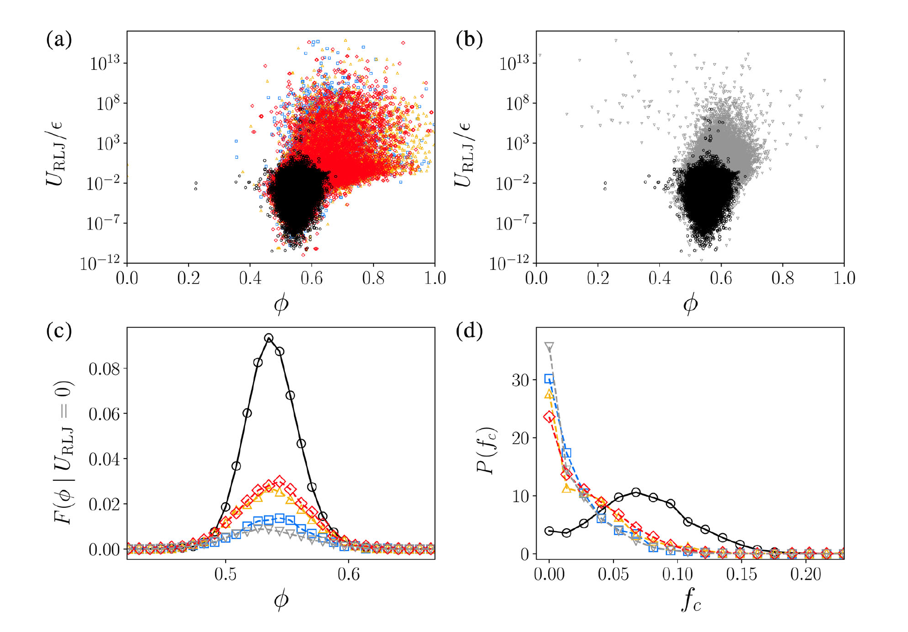
Distinguishing Features
Notes:
Overlap of side chain atoms of core residues

Slide 20
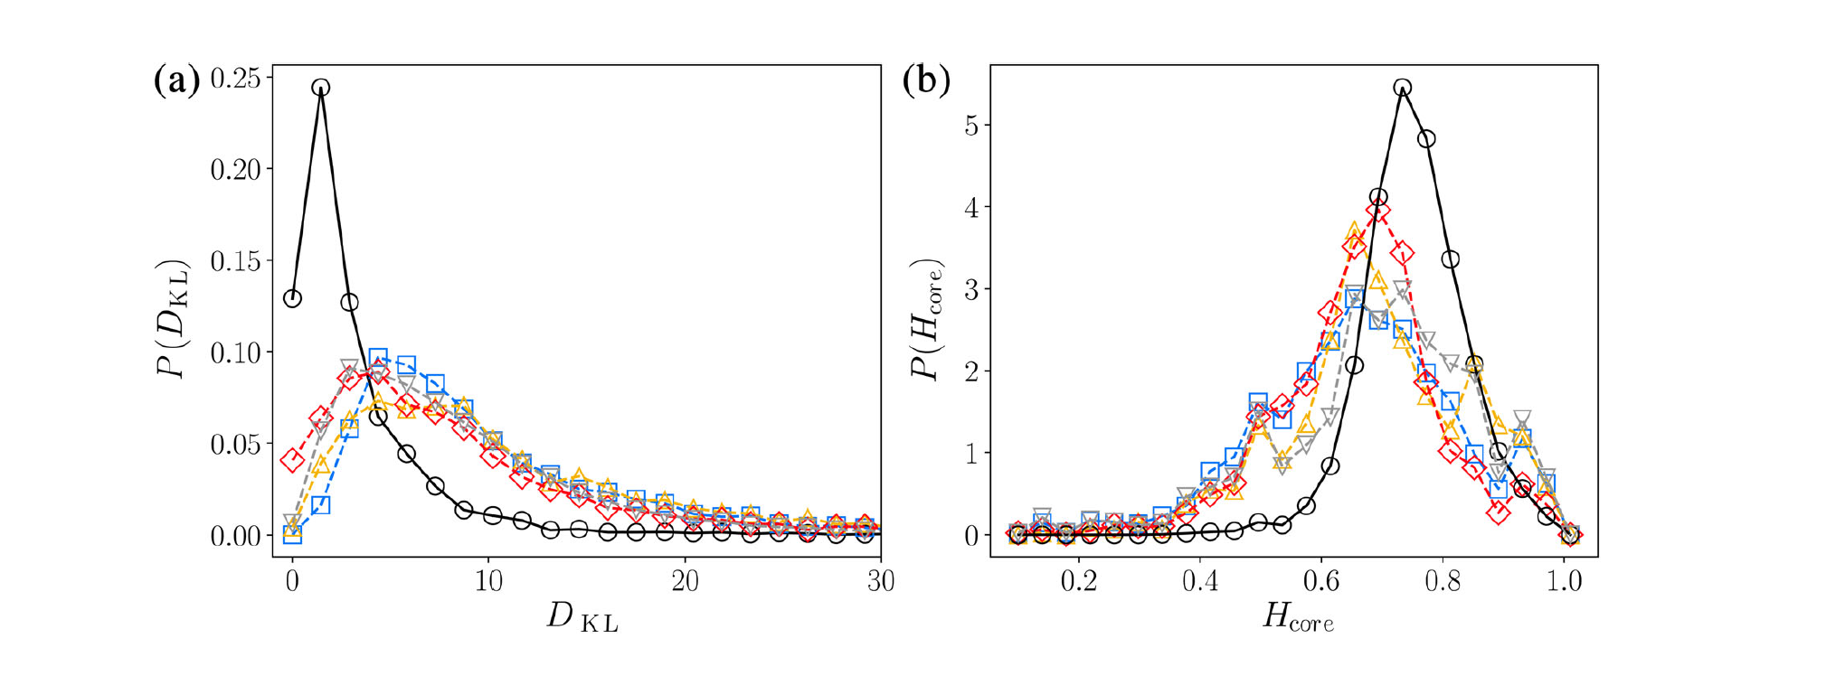
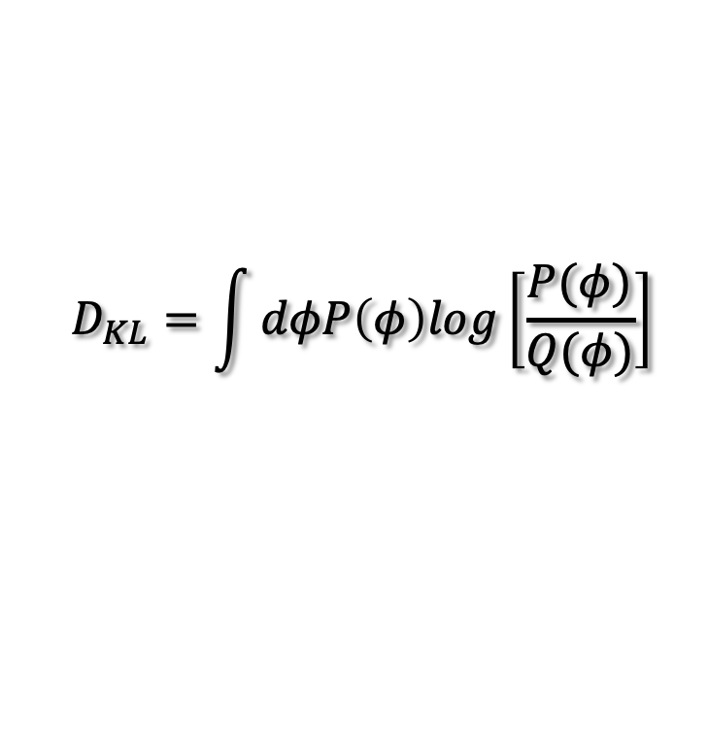
$$D_{KL}=\int{dφP\left(φ\right)log\left[\frac{P(φ)}{Q(φ)}\right]}$$

Slide 21
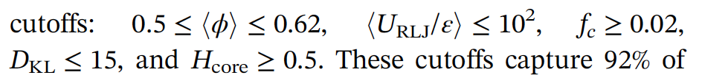
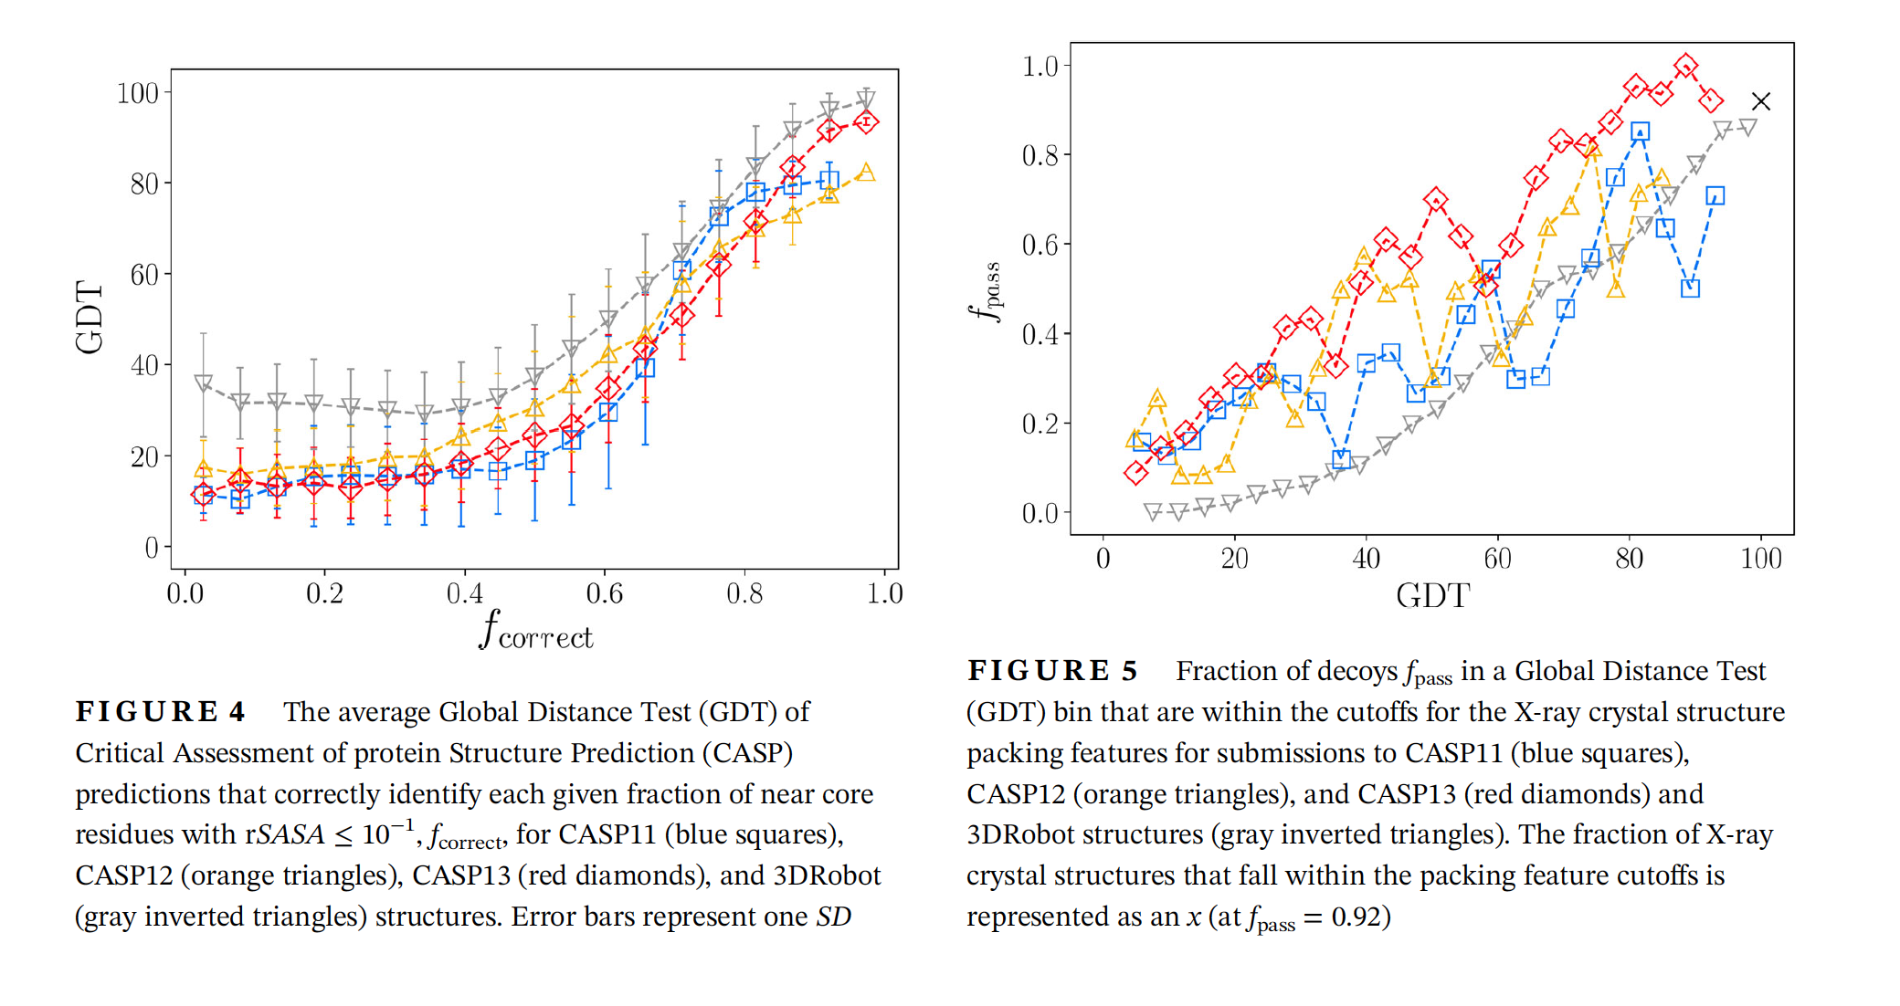
Notes:
F_correct; what fraction of core residues in the target were in the core of the model (rSASA < 10^{-1})

Slide 22
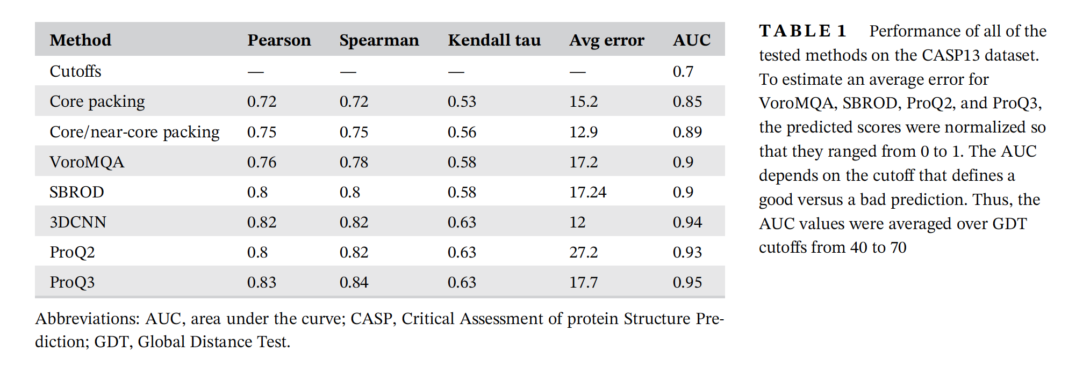
Notes:
Neural network with 6 features; train on Casp 11, 12, 3D Robot, Test on Casp 13

Slide 23
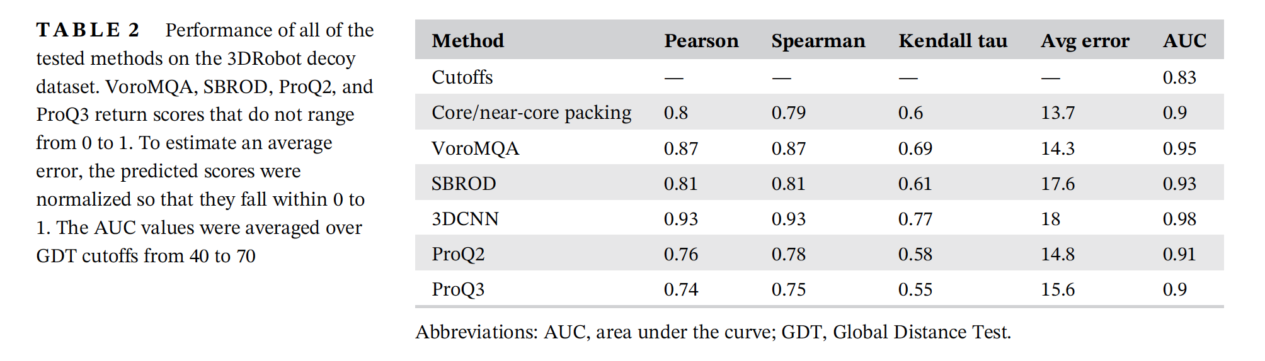

Slide 24
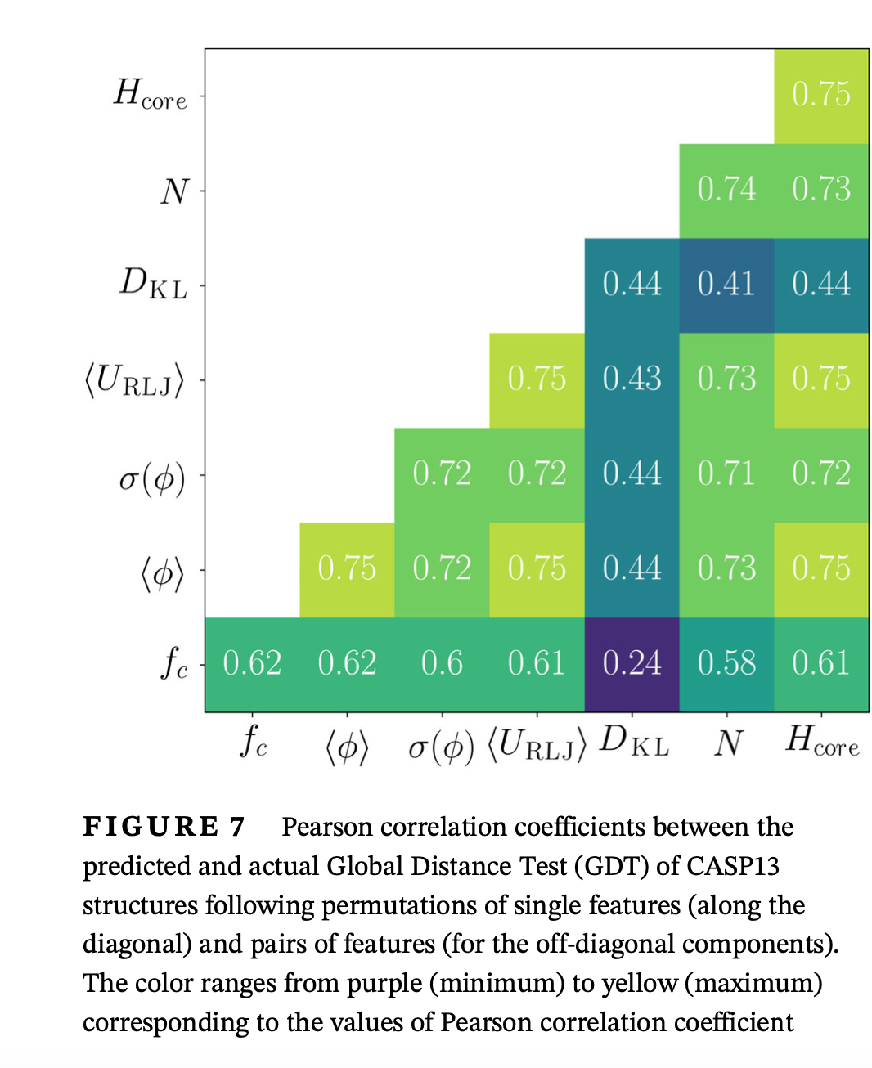
Notes:
Train on CASP 11, 12 and 3D rob

Slide 25
How do we obtain 100% correlation and zero error bars?

