Slide 1
Biomed. Data Science: Unsupervised Datamining E: LDA & tSNE
Mark Gerstein, Yale University gersteinlab.org/courses/452
(last edit in spring ’21, pack #9e, final)

Slide 2
Unsupervised Mining
LDA

Slide 3
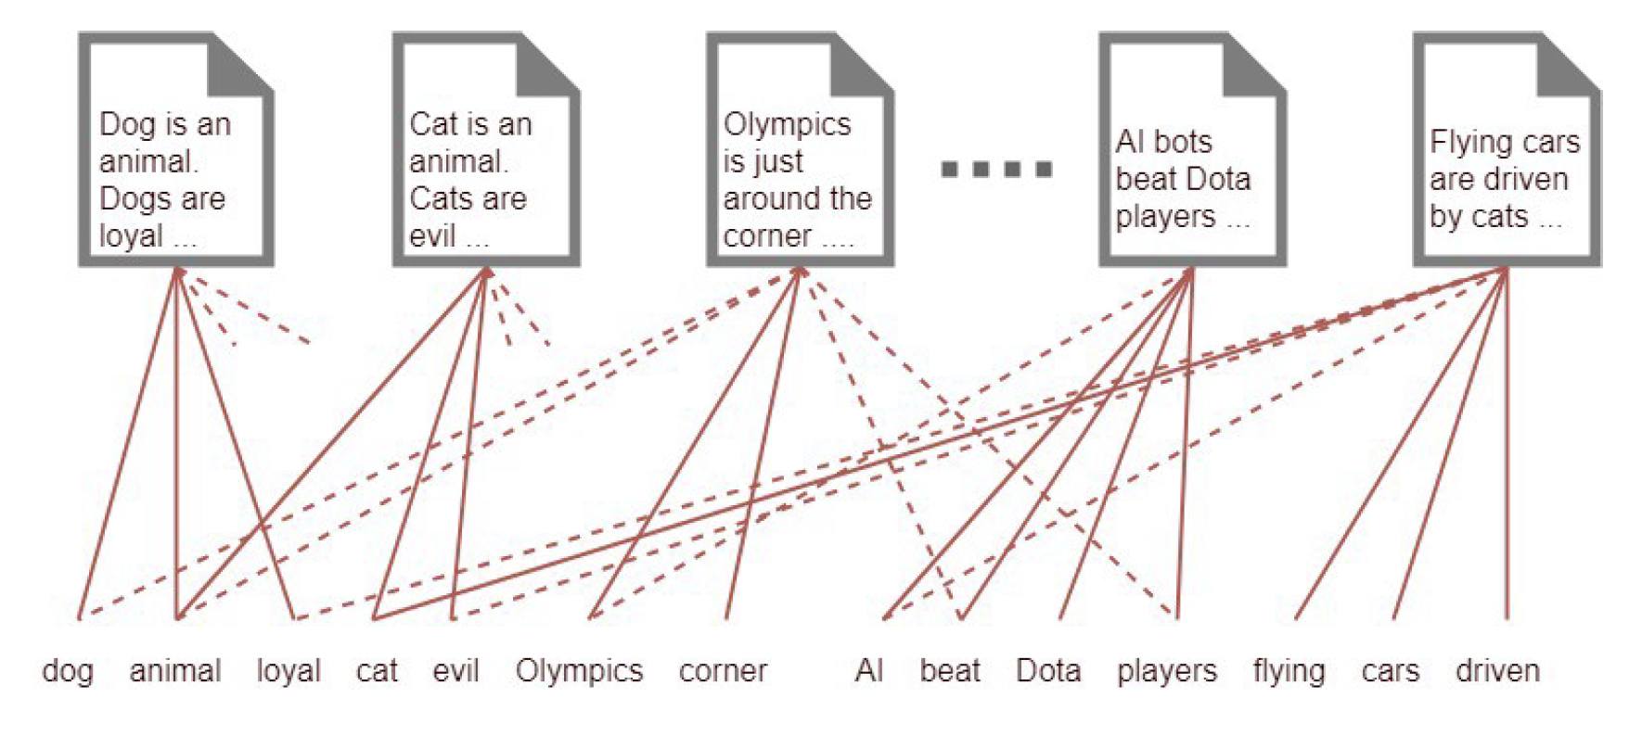
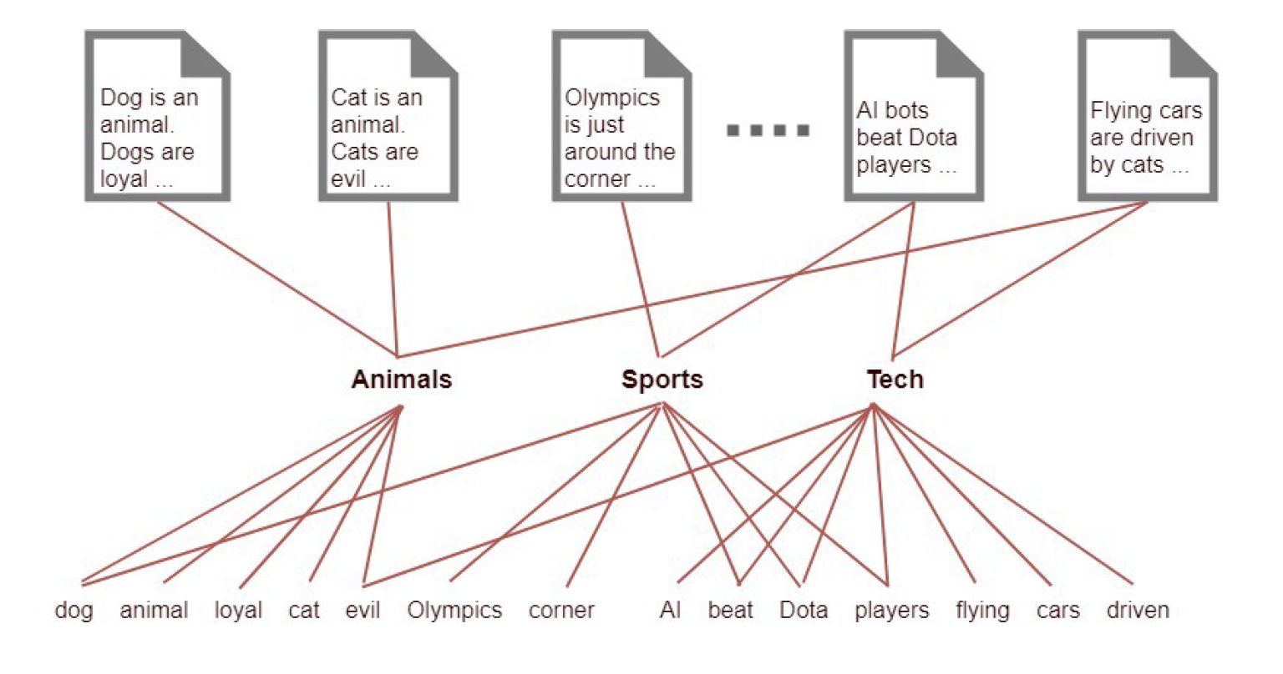
From dimension reduction view
https://towardsdatascience.com/light-on-math-machine-learning-intuitive-guide-to-latent-dirichlet-allocation-437c81220158

Slide 4
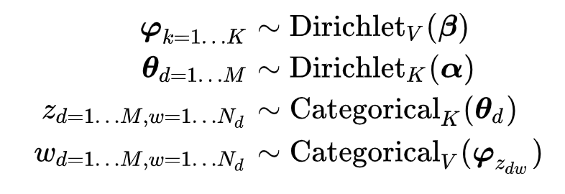
Diagram

Slide 5
Generative process
https://towardsdatascience.com/light-on-math-machine-learning-intuitive-guide-to-latent-dirichlet-allocation-437c81220158

Slide 6
The sparsity is important
In LDA analysis, alpha should be tuned for topic distribution(θ)
https://towardsdatascience.com/light-on-math-machine-learning-intuitive-guide-to-latent-dirichlet-allocation-437c81220158
How the distribution of θ changes with different α values

Slide 7
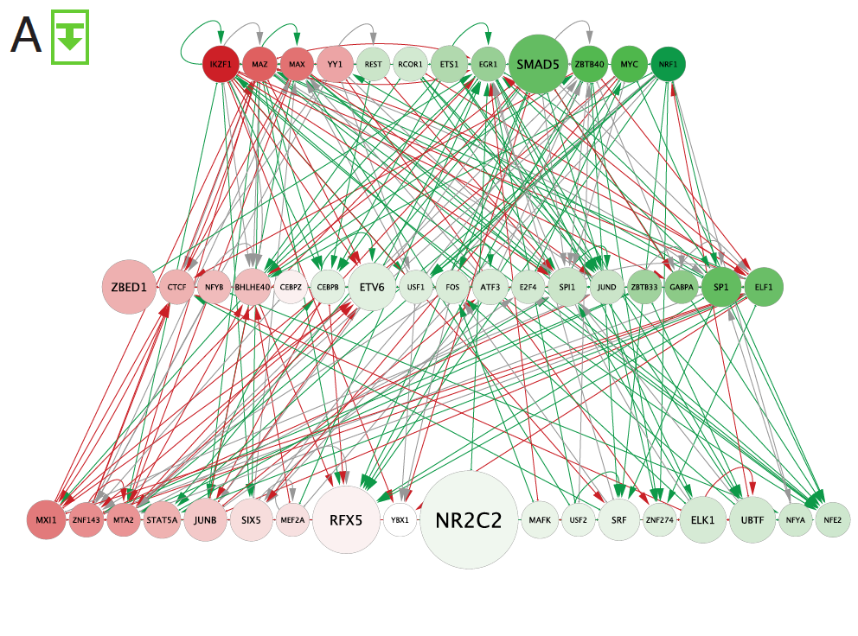
Rewired edges in
comparison of GM12878 to K562 109 node TF-TF network
(approx. CML)
[Zhang et al. (‘20), biorxiv + Nat. Comm. (in press)]

Slide 8
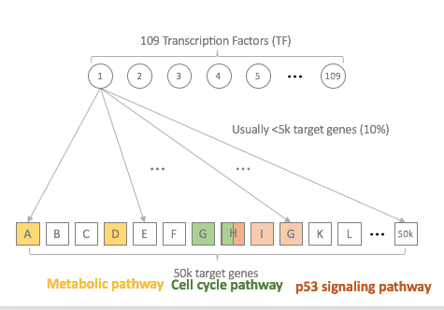
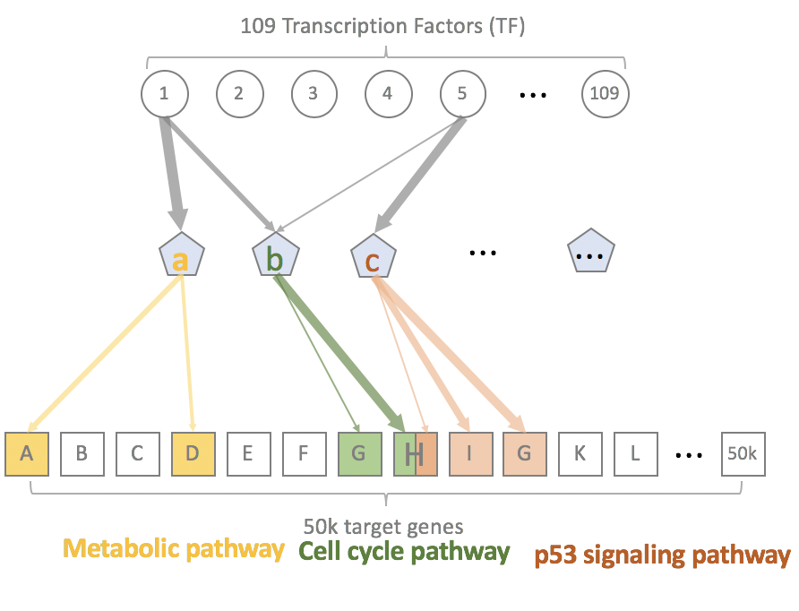
[Zhang et al. (‘20), biorxiv + Nat. Comm. (in press)]
Hidden Layer
(50 biological pathways?)

Slide 9
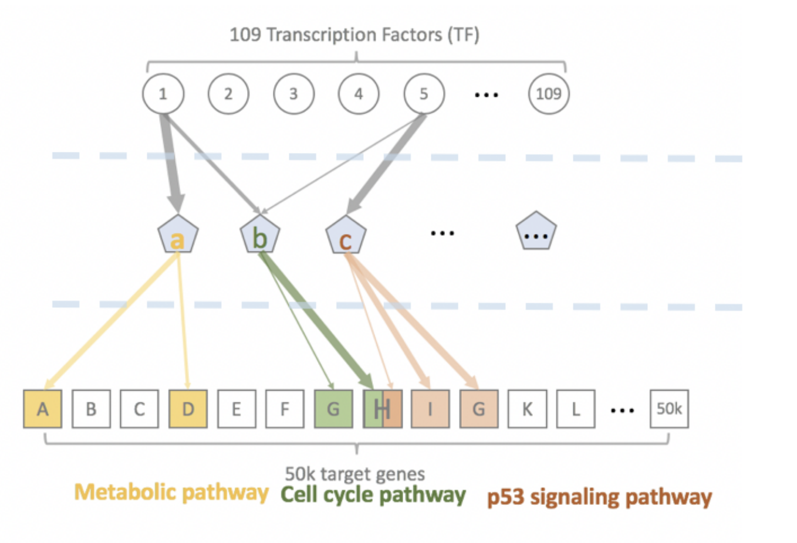
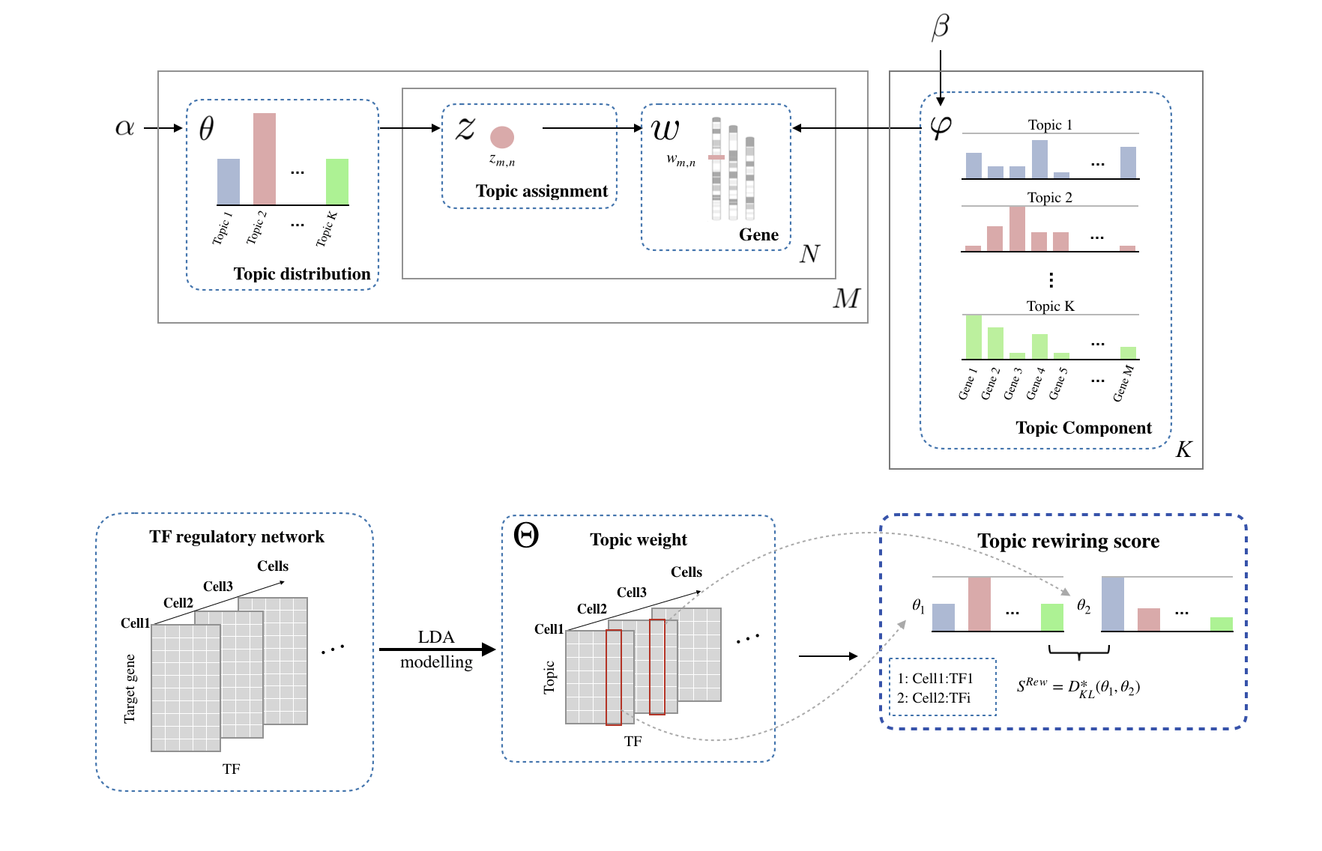
TopicNet: Measuring transcriptional regulatory network change using LDA
Documents
Topics
Words
[Lou et al. bioxriv + Bioinformatics (’20)]

Slide 10
Unsupervised Mining
tSNE

Slide 11
tSNE
a technique for dimensionality reduction that is particularly well suited for the visualization of high-dimensional datasets
original data
hyperparameters ‘perplexity’ really matter; Cluster sizes in a t-SNE plot mean nothing; Distances between clusters might not mean anything
https://distill.pub/2016/misread-tsne/
https://scikit-learn.org/stable/auto_examples/manifold/plot_t_sne_perplexity.html#sphx-glr-auto-examples-manifold-plot-t-sne-perplexity-py

Slide 12
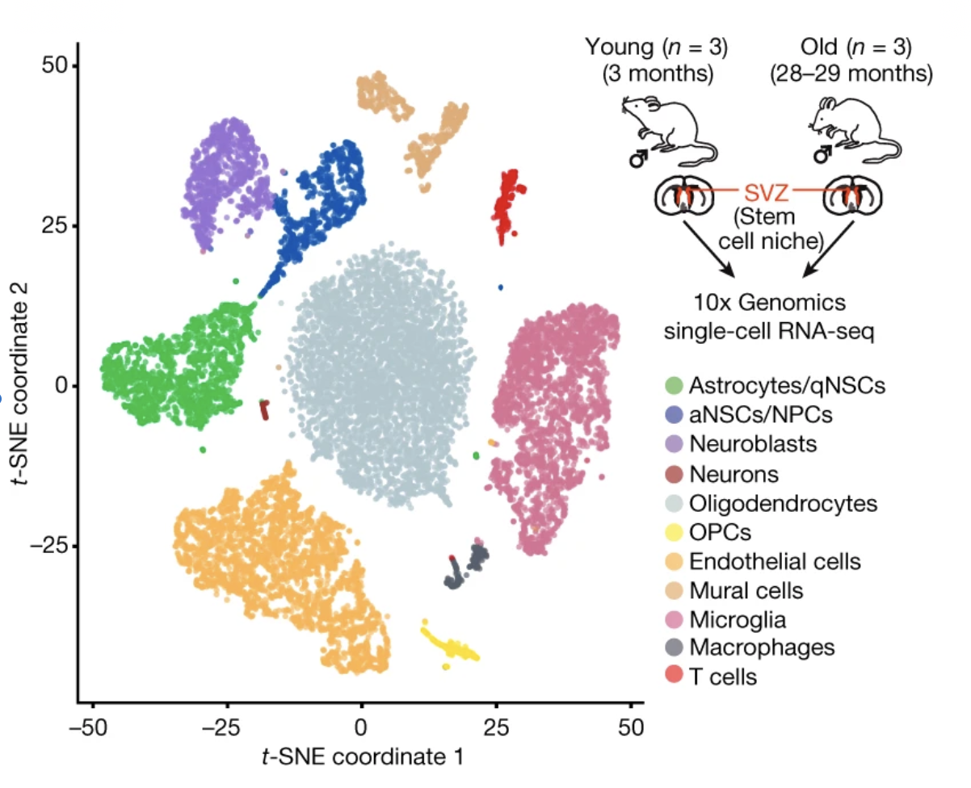
Example: t-SNE clustering of 14,685 single-cell transcriptomes
Dulken, B.W. et al. nature 2019
Notes:
Single-cell RNA-seq of the SVZ from three independent replicates of young (3 months old) and old (28–29 months old) perfused male mice using the 10x Genomics Chromium platform. t-SNE clustering of 14,685 single-cell transcriptomes (8,884 from young and 5,801 from old) coloured by significant cell-type clusters.

Slide 13
Unsupervised Mining
Comparisons

Slide 14
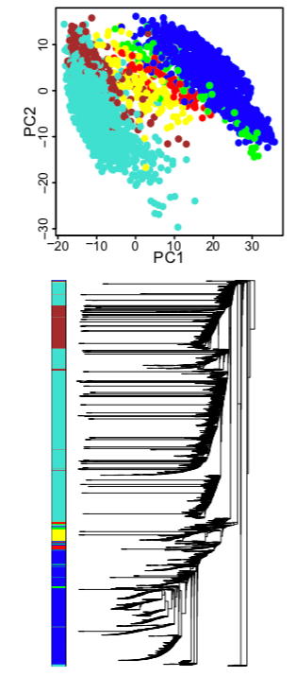
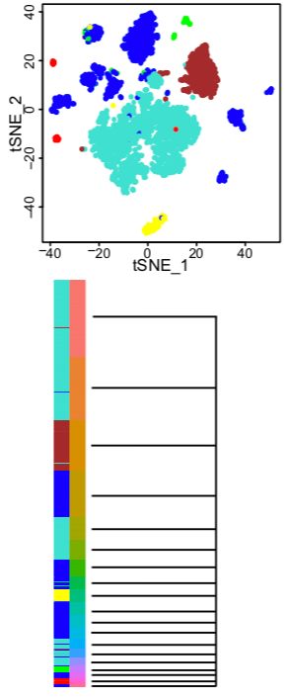
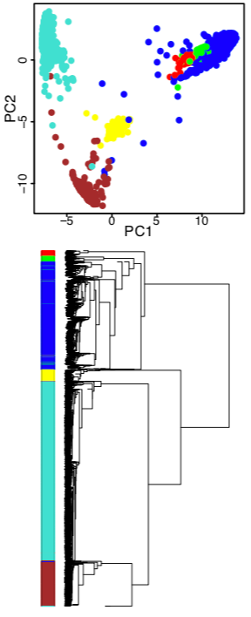
Comparison on real datasets (melanoma scRNA-seq dataset)
PCA
Seurat
RCA
Hierarchical Clustering
Hierarchical Clustering
Hierarchical Clustering

Slide 15
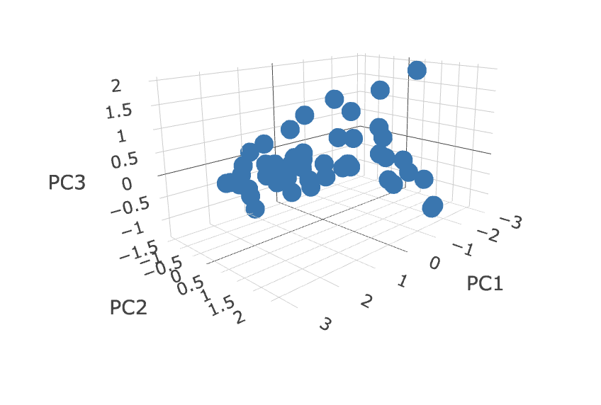
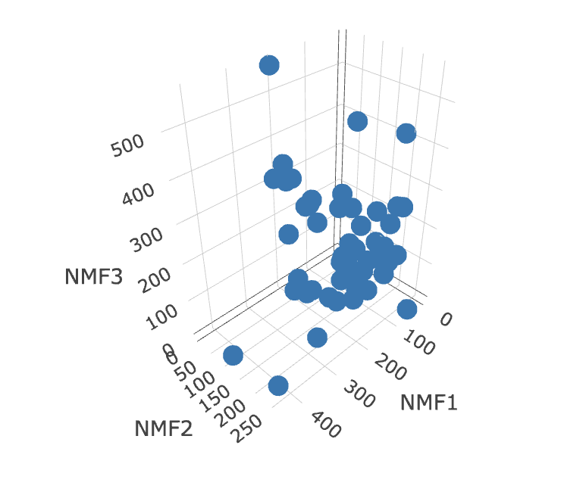
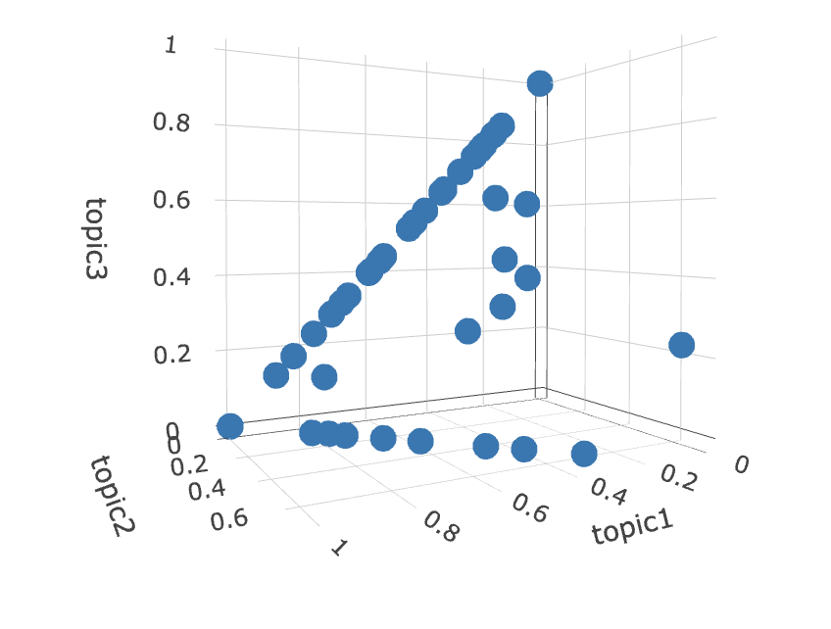
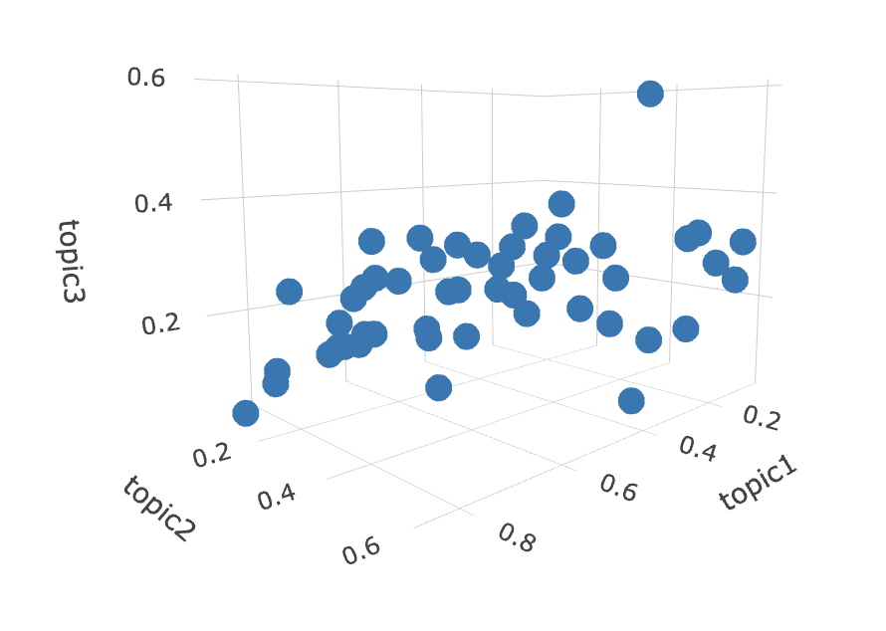
Comparison of sparsity using USArrests dataset
in a three-dimensional space
PCA
Rotation=XW(loading)
NMF (rank=3) X=W*H
W
Reference component analysis of single-cell transcriptomes elucidates cellular heterogeneity in human colorectal tumors. (2017). Nature Genetics, 49(5), 708–718. http://doi.org/10.1038/ng.3818
LDA K=3, alpha=0.2
θ
LDA K=3, alpha=5
θ

