Slide 1
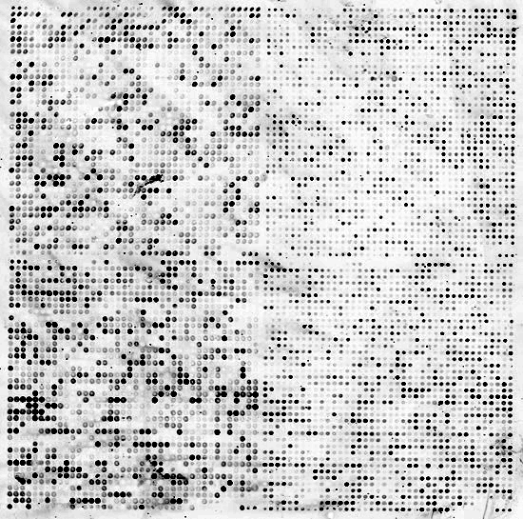


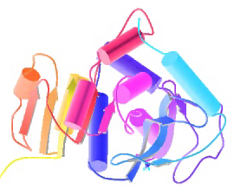
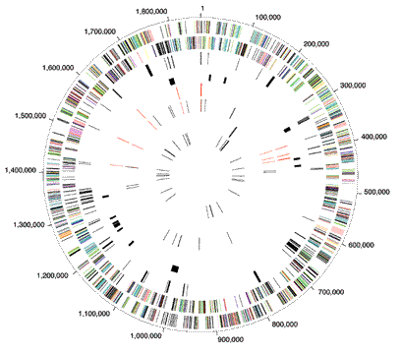


Biomed. Data Science:
Unsupervised Datamining B:
Community Detection
Mark Gerstein, Yale University
gersteinlab.org/courses/452
(last edit in spring ’21, pack #9b, final)

Slide 2
Unsupervised Mining
Graph Analysis &
Community Detection Approaches

Slide 3
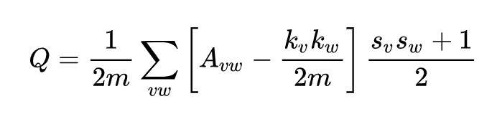
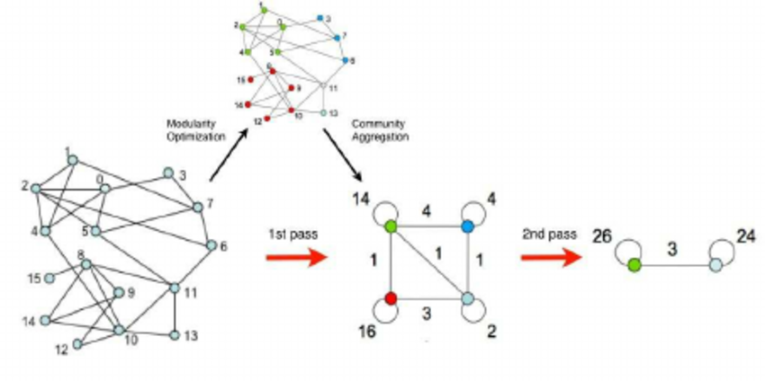
Graph Methods & Community Detection
Turn data into a graph
Alternate local and global clustering while optimizing for modularity
Can discover the number of clusters given a resolution
  Cell type detection
Fast: O(nlogn)
E.g. Louvain, Leiden Community detection
Image reference: https://sites.google.com/site/findcommunities/

Slide 4
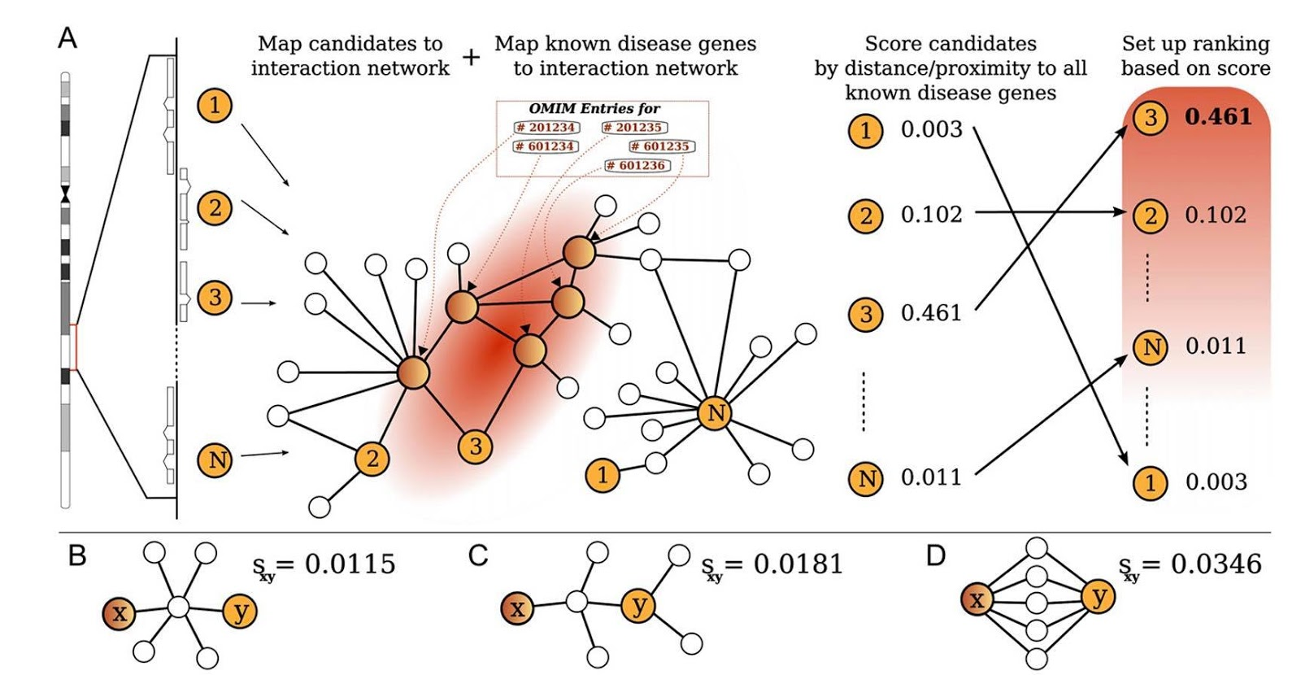
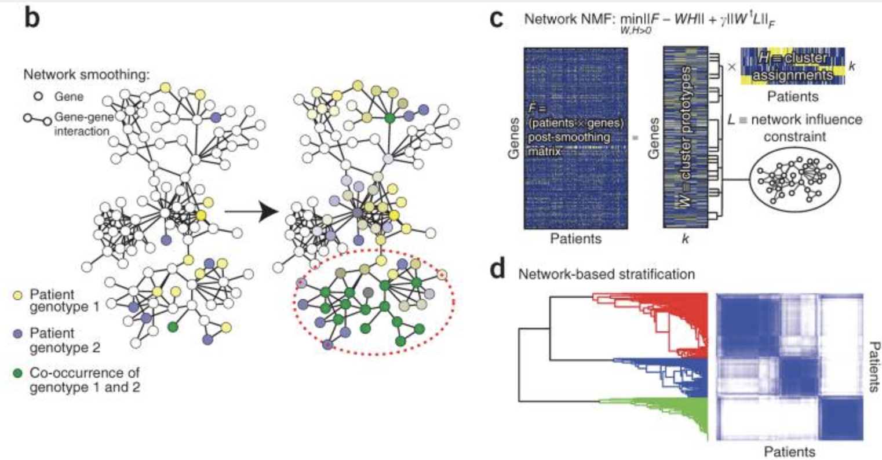
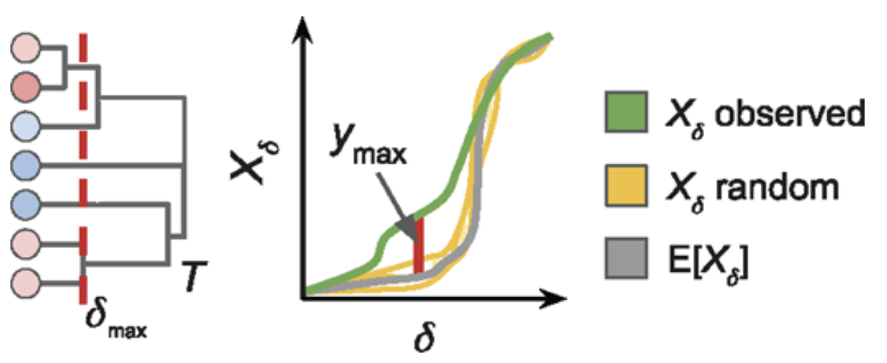
Network Propagation in Biomedicine (Label propagation & Diffusion distance)
Starting ~2008
Limitations in nearest neighbor (B) and shortest distance measures (B-D)
Leverages local and global network topology
Mathematically rigorous
Early methods: function prediction and gene-disease association
Current methods: gene ranking, subnetwork detection, gene-drug and TF-target associations, patient sample stratification, etc.
Köhler, Bauer, Horn and Robinson (2008)
Reyna, Leiserson, and Raphael (2018)
Hofree, Shen, Carter, Gross, and Ideker (2013)

Slide 5
Dimensionality Reduction
& Spectral Methods
Outline & Papers
Based on affinity matrix
PCA/SVD
Extensions: biplot, RCA, CCA….
Related papers
  O Alter et al. (2000). "Singular value decomposition for genome-wide expression data processing and modeling." PNAS 97: 10101
  Langfelder P, Horvath S (2007) Eigengene networks for studying the relationships between co-expression modules. BMC Systems Biology 2007, 1:54
  Z Zhang et al. (2007) "Statistical analysis of the genomic distribution and correlation of regulatory elements in the ENCODE regions." Genome Res 17: 787
  TA Gianoulis et al. (2009) "Quantifying environmental adaptation of metabolic pathways in metagenomics." PNAS 106: 1374.

Slide 6
Unsupervised Mining
Community Detection
Application to Hi-C

Slide 7
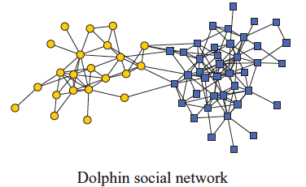
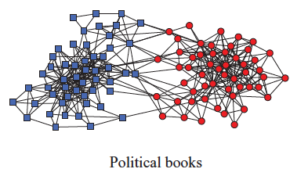
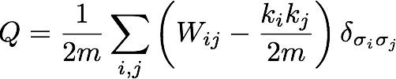
Network modularity
degree of node i
Newman Phy. Rev. E 2013
adjacency matrix
whether or not
i, j are in the
same module
number of edges
expected number of
edges between i and j

Slide 8

Network modularity
degree of node i
adjacency matrix
whether or not
i, j are in the
same module
number of edges
expected number of
edges between i and j

Slide 9

Network modularity
Optimization problem
for sim. annealing
degree of node i
adjacency matrix
whether or not
i, j are in the
same module
number of edges
expected number of
edges between i and j

Slide 10
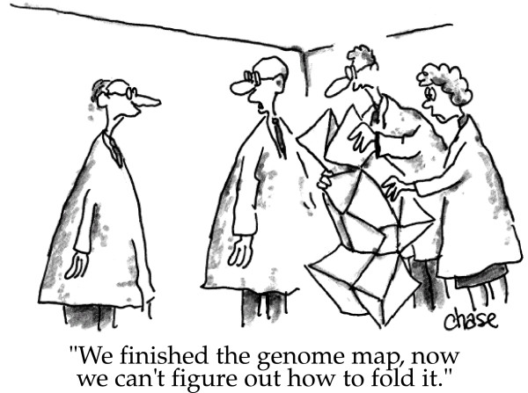
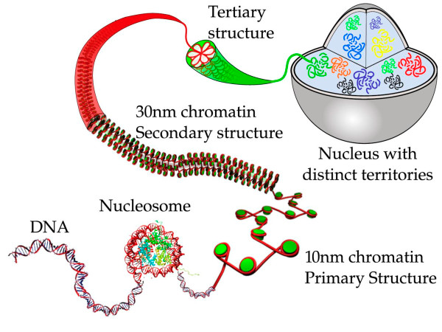
3D organization of genome
image credit: Iyer et al. BMC Biophysics 2011,
cartoonist John Chase
image credit: Iyer et al. BMC Biophysics 2011

Slide 11
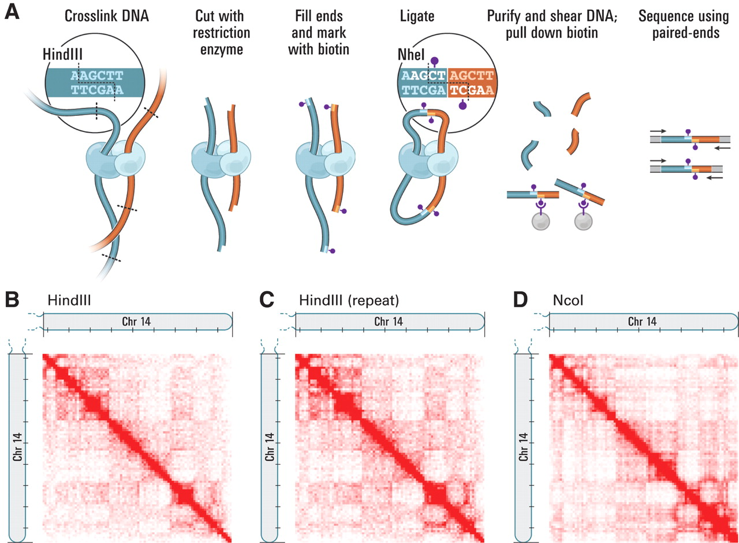
Hi-C contact map
Science 2009, 5950: 289-293

Slide 12
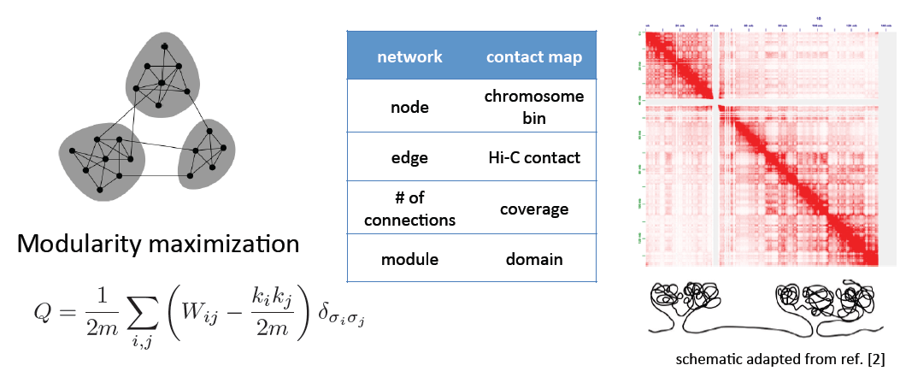
Identifying TADs in multiple resolutions
[Yan et al., PLOS Comp. Bio. (in revision, ‘17); bioRxiv 097345]

Slide 13
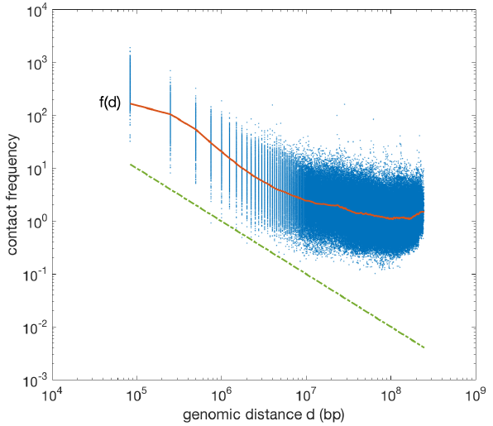


Identifying TADs in multiple resolutions
[Yan et al., PLOS Comp. Bio. (in revision, ‘17); bioRxiv 097345]

