Slide 1
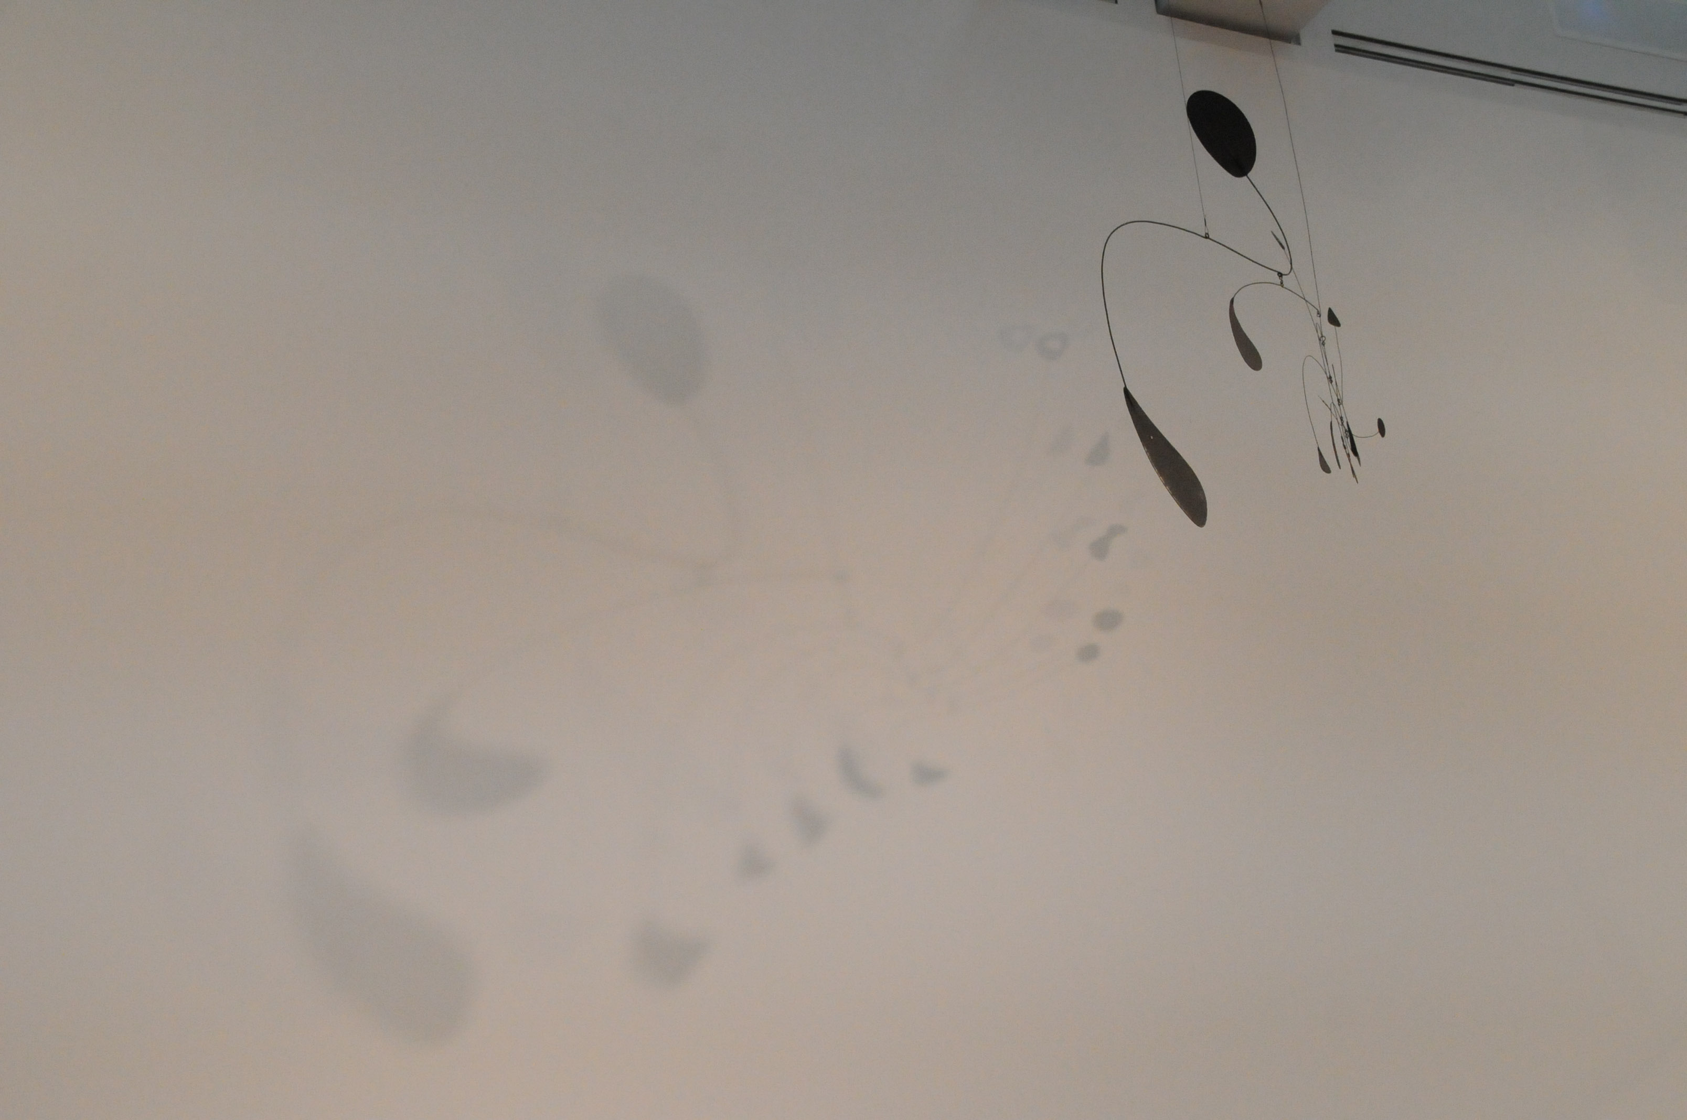
Privacy & Functional Genomics Data
Slides freely
“tweetable” (via
@MarkGerstein)
& downloadable from
Lectures.GersteinLab.org
M Gerstein
Yale
(See last slide for more info.)

Slide 2

Privacy: Does Genomics has similar "Big Data" Dilemma as in the Rest of Society?
We confront privacy risks every day we access the internet (e.g., social media, e-commerce).
Sharing & "peer-production" is central to success of many new ventures, with analogous risks to genomics
  EG web search: Large-scale mining essential
Genetic Exceptionalism :
The Genome is very fundamental data, potentially very revealing about one’s identity & characteristics
Personal Genomic info. essentially meaningless currently but will it be in 20 yrs? 50 yrs?
  Genomic sequence very revealing about one’s children. Is true consent possible?
  Once put on the web it can’t be taken back
Ethically challenged history of genetics
  Ownership of the data & what consent means (Hela)
  Could your genetic data give rise to a product line?
[Seringhaus & Gerstein ('09), Hart. Courant (Jun 5); Greenbaum & Gerstein ('11), NY Times (6 Oct), D Greenbaum & M Gerstein (’08). Am J. Bioethics; D Greenbaum & M Gerstein, Hartford Courant, 10 Jul. '08 ; SF Chronicle, 2 Nov. '08; Greenbaum et al. PLOS CB (‘11) ; Greenbaum & Gerstein ('13), The Scientist; Photos from NY Times, it.wisc.edu]

Slide 3


The Dilemma
The Other Side of the Coin
for Genomics: Why we should share
Sharing helps speed research
  Large-scale mining of this information is important for medical research
  Statistical power
  Privacy is cumbersome, particularly for big data
The individual (harmed?) v the collective (benefits)
  - But do sick patients care about their privacy?
How to balance risks v rewards – Quantification
[Economist, 15 Aug ‘15]
[Yale Law Roundtable (‘10). Comp. in Sci. & Eng. 12:8; D Greenbaum & M Gerstein (‘09). Am. J. Bioethics; D Greenbaum & M Gerstein (‘10). SF Chronicle, May 2, Page E-4; Greenbaum et al. PLOS CB (‘11)]

Slide 4
Privacy & Functional Genomics
Intro. to Genomic Privacy
  The dilemma: The genome as fundamental, inherited info that’s very private v. need for large-scale sharing & mining for med. research
Privacy & Functional Genomics Data
  2-sided nature of this data presents particularly tricky privacy issues
  Overview of types of the leakage, from obvious to subtle
Obvious leakage #1: reads
  How much leakage can we expect?
    Quantification with available data & real-world environmental samples
  Using pBAM file format to remove obvious large-scale leakage
  Using FANCY to assess the privacy leakage before release of the data
Subtle Leakage #2: eQTLs
  Quantifying & removing further variant info from expression levels w/ ICI & predictability.
  Instantiating a practical linking attack w/ noisy quasi-identifiers
Subtle Leakage #3:
Signal Profiles
  Manifest appreciable leakage from large & small deletions.
  Linking attacks possible but additional complication of SV discovery in addition to genotyping

Slide 5
Privacy & Functional Genomics
Intro. to Genomic Privacy
  The dilemma: The genome as fundamental, inherited info that’s very private v. need for large-scale sharing & mining for med. research
Privacy & Functional Genomics Data
  2-sided nature of this data presents particularly tricky privacy issues
  Overview of types of the leakage, from obvious to subtle
Obvious leakage #1: reads
  How much leakage can we expect?
    Quantification with available data & real-world environmental samples
  Using pBAM file format to remove obvious large-scale leakage
  Using FANCY to assess the privacy leakage before release of the data
Subtle Leakage #2: eQTLs
  Quantifying & removing further variant info from expression levels w/ ICI & predictability.
  Instantiating a practical linking attack w/ noisy quasi-identifiers
Subtle Leakage #3:
Signal Profiles
  Manifest appreciable leakage from large & small deletions.
  Linking attacks possible but additional complication of SV discovery in addition to genotyping

Slide 6

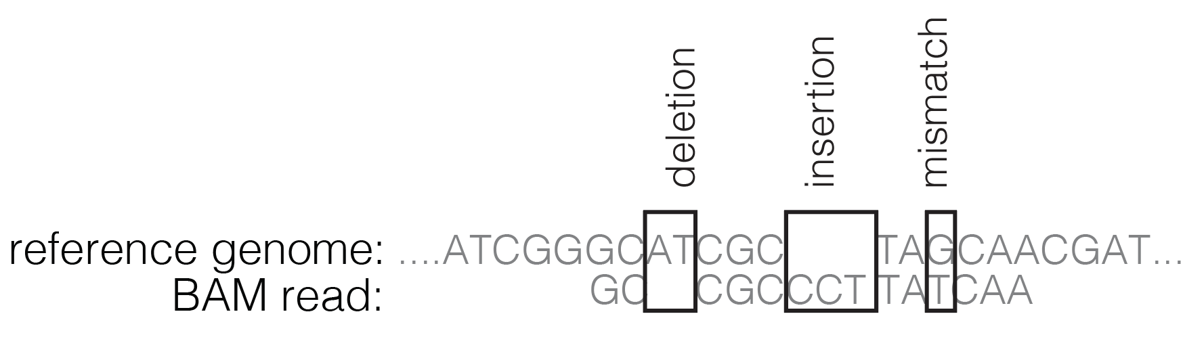
2-sided nature of functional genomics data: Analysis can be very General/Public or Individual/Private
Peculiarities of Functional Genomics Reads - 1
General quantifications related to overall aspects
of a condition – ie gene activity as a function of:
  Developmental stage, Evolutionary relationships, Cell-type, Disease
Above are not tied to an individual’s genotype. However, data is derived from individuals & tagged with their genotypes
(Note, a few calculations aim to use explicitly genotype to derive general relations related to sequence variation & gene expression - eg allelic activity)

Slide 7
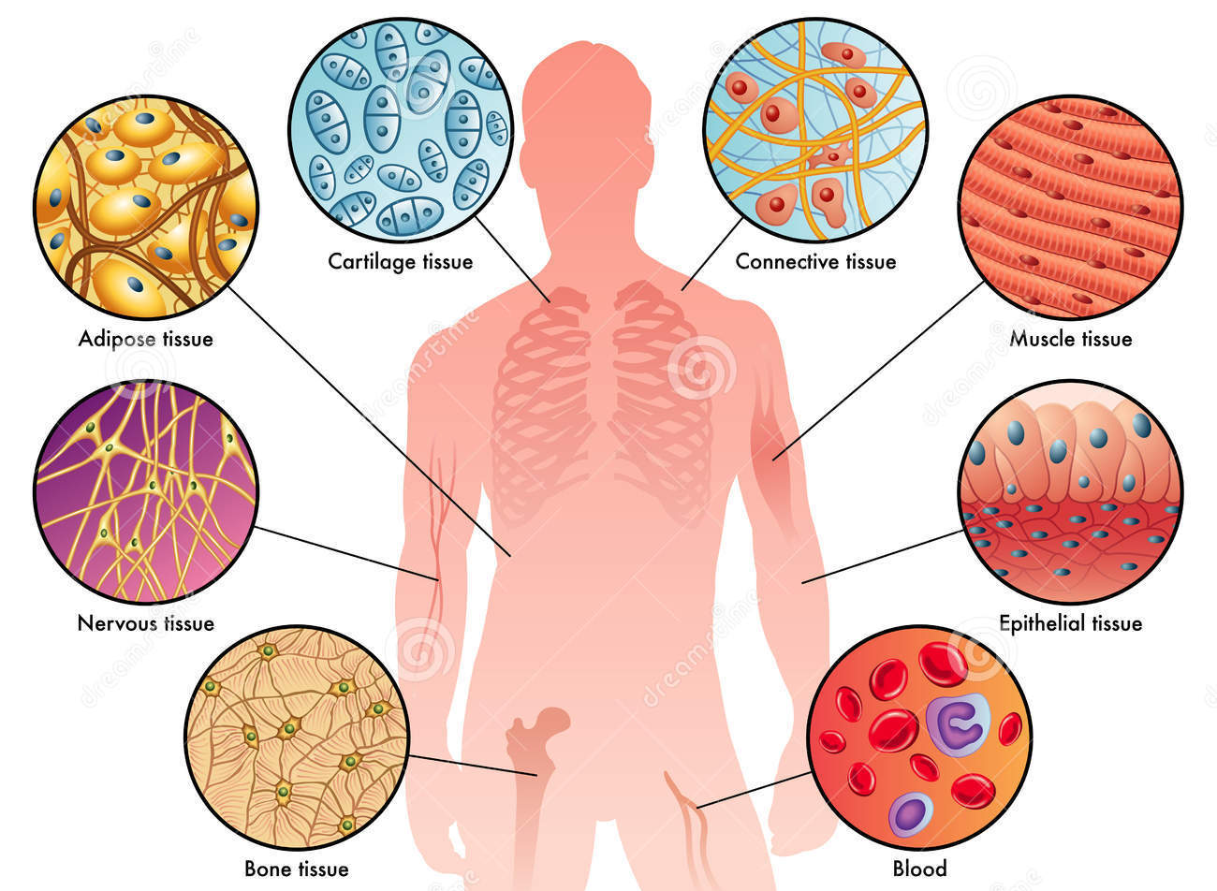
Amount of data will soon surge those from DNA sequencing different and a new problem
Peculiarities of Functional Genomics Reads - 2
DNA-seq to obtain SNPs, indels, SVs – single BAM
Aim: finding genotypes, must be protected
Multiple functional genomics assays - a BAM for each
assay and tissue per individual
Aim: activity in nucleus in disease and health
RNA-Seq
ChIP-Seq
(TFs, HMs, …)
ATAC-Seq
Dnase
Hi-C
single-cell assays
can be ~0.5 million cells
each cell x transcriptome
more data than ever before
Figure: adopted from https://www.tes.com/lessons/Q0YL_OHrNtTVGg/biology-2-topic-2-tissues-organ-systems-and-homeostasis

Slide 8
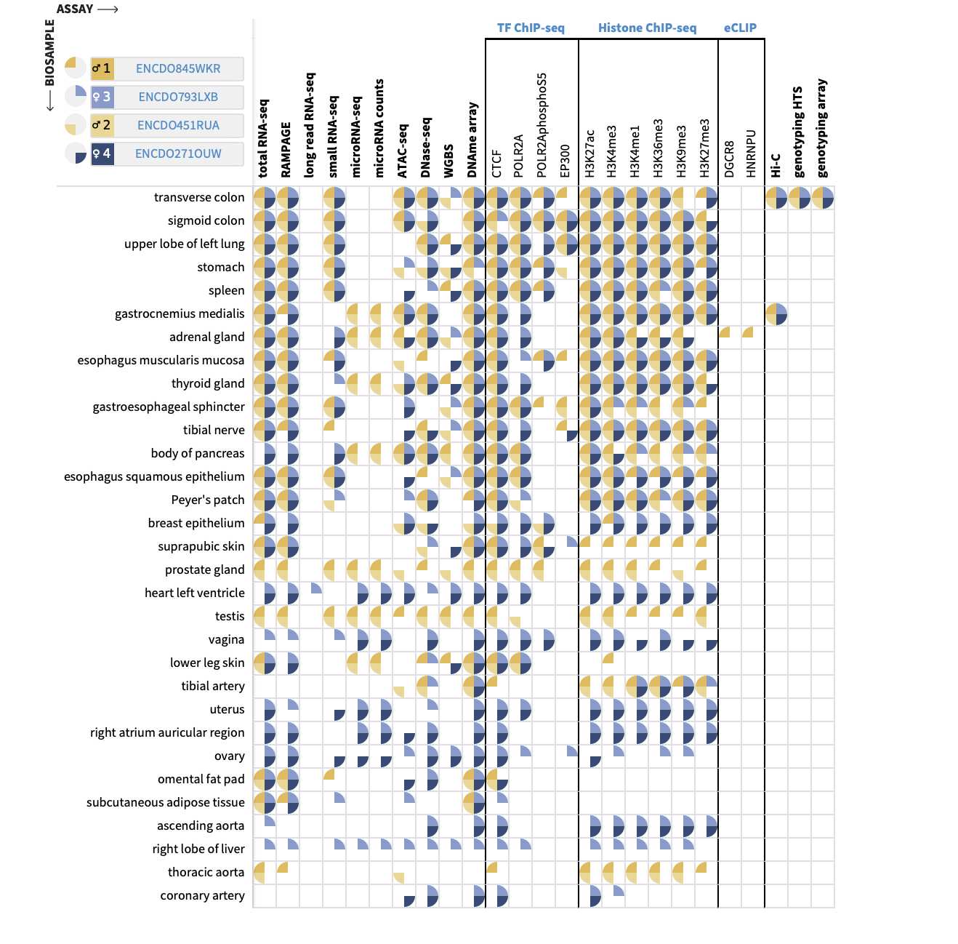
Amount of data will soon surge those from DNA sequencing different and a new problem
Peculiarities of Functional Genomics Reads - 2
DNA-seq to obtain SNPs, indels, SVs – single BAM
Aim: finding genotypes, must be protected
Multiple functional genomics assays - a BAM for each
assay and tissue per individual
Aim: activity in nucleus in disease and health
RNA-Seq
ChIP-Seq
(TFs, HMs, …)
ATAC-Seq
Dnase
Hi-C
single-cell assays
can be ~0.5 million cells
each cell x transcriptome
more data than ever before
Figure: adopted from https://www.tes.com/lessons/Q0YL_OHrNtTVGg/biology-2-topic-2-tissues-organ-systems-and-homeostasis

Slide 9
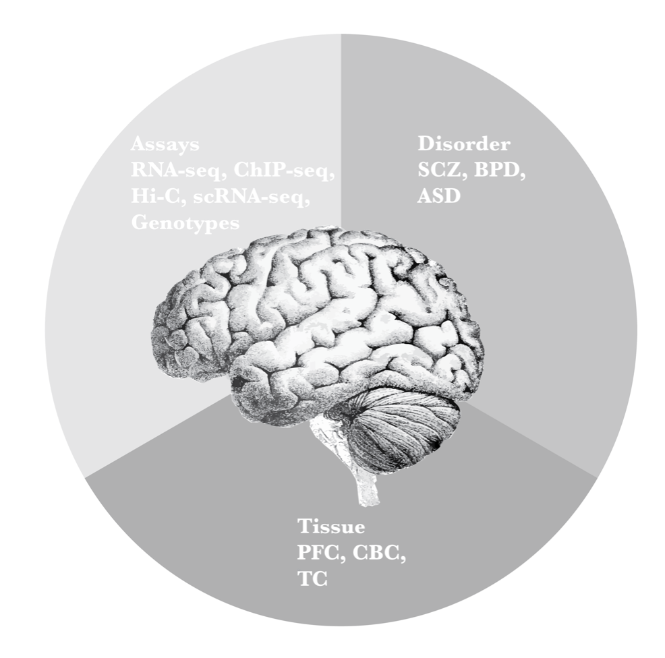
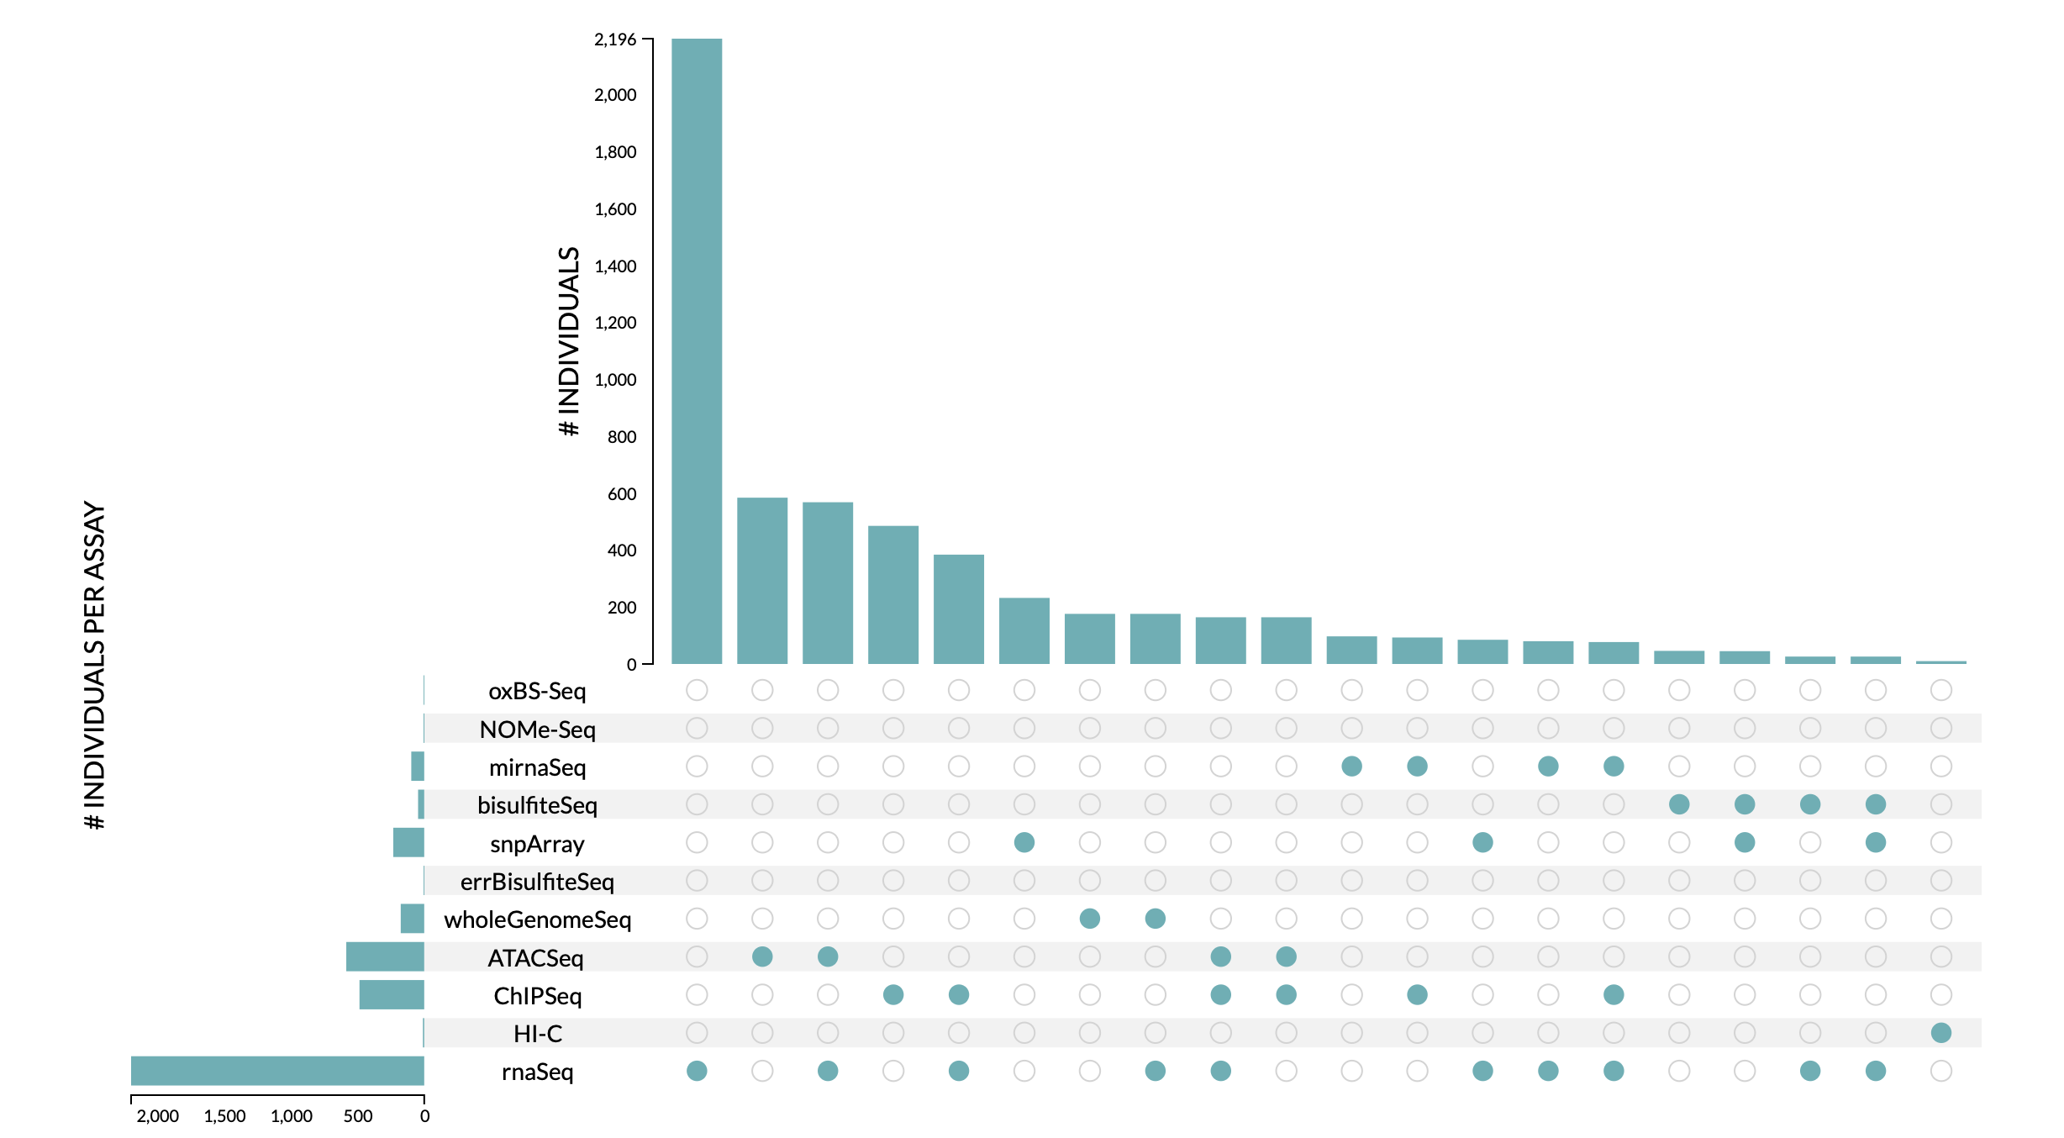
A new source of privacy leakage inferring phenotypes
Peculiarities of Functional Genomics Reads - 3
If you find out an individual is in a functional genomics cohort, you also find out potentially sensitive phenotypes
Figures: PsychENCODE consortium

Slide 10

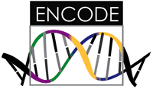

Representative Functional Genomics, Genotype, eQTL Datasets
Genotypes are available from the 1000 Genomes Project
mRNA sequencing for 462 individuals from gEUVADIS and ENCODE
  Publicly available quantification for protein coding genes
Functional genomics data (ChIP-Seq, RNA-Seq, Hi-C) available from ENCODE
Approximately 3,000 cis-eQTL (FDR<0.05)

Slide 11

Data Reduction in RNA-Seq: an Overview
ATACAAGCAAGTATAAGTTCGTATGCCGTCTT
GGAGGCTGGAGTTGGGGACGTATGCGGCATAG
TACCGATCGAGTCGACTGTAAACGTAGGCATA
ATTCTGACTGGTGTCATGCTGATGTACTTAAA
Fastq sequence files
~5-10 GB
Index-building + Alignment to reference genome
BAM files
~1-2-fold reduction
Successive steps of Data Reduction
Conversion to signal track by overlapping reads
BigWig files
~25-fold reduction
Mapping to genes
Gene/Transcript expression matrix
~20-fold reduction
Quantitative information from RNA-seq signal: average signals at exon level (RPKMs)
Reads => Signal
[NAT. REV. 10: 57; PLOS CB 4:e1000158; PNAS 4:107: 5254 ]

Slide 12
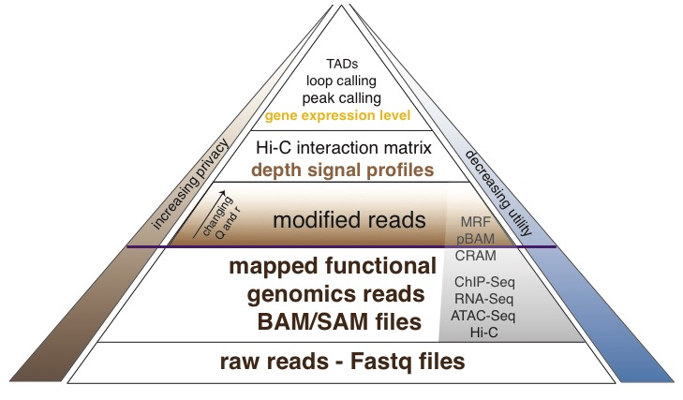
Functional genomics data comes with a great deal of sequencing;
We can quantify amount of leakage at every step of the data summarization process.
NA12878 as case study - 1000 genomes variants are used as gold standard
[Gursoy et al, Cell, in press]

Slide 13
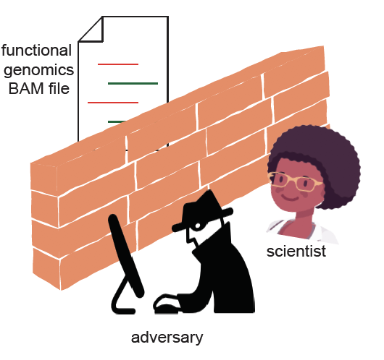
Functional Genomics Reads
Usually disseminated in the form of ”BAM” files
Contain individual’s SNPs
Traditional approach to protect
privacy: dbGAP, EGA, …
Protects the data from bad
actors, but also from scientific
community

Slide 14
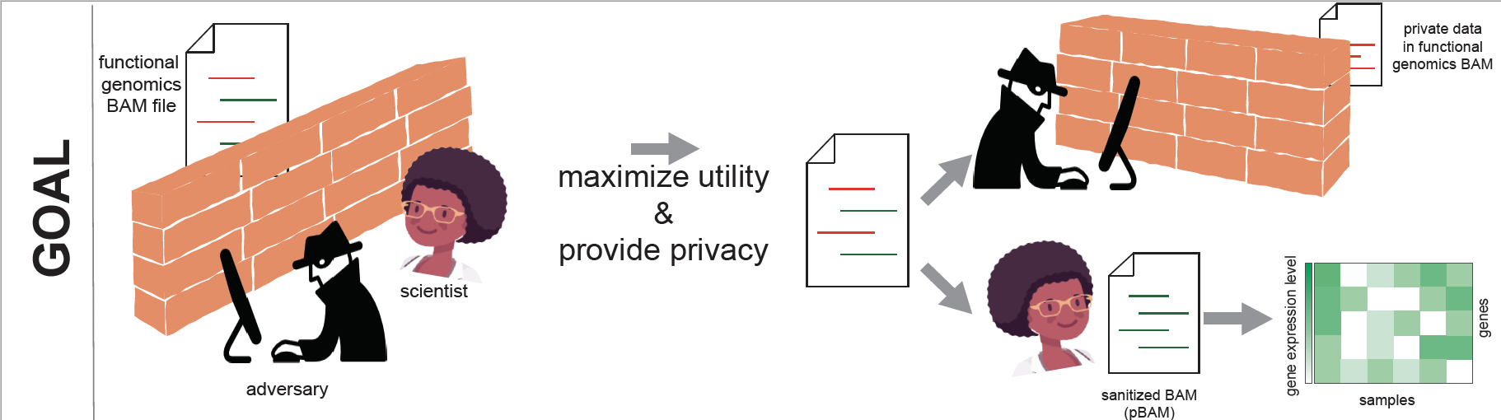
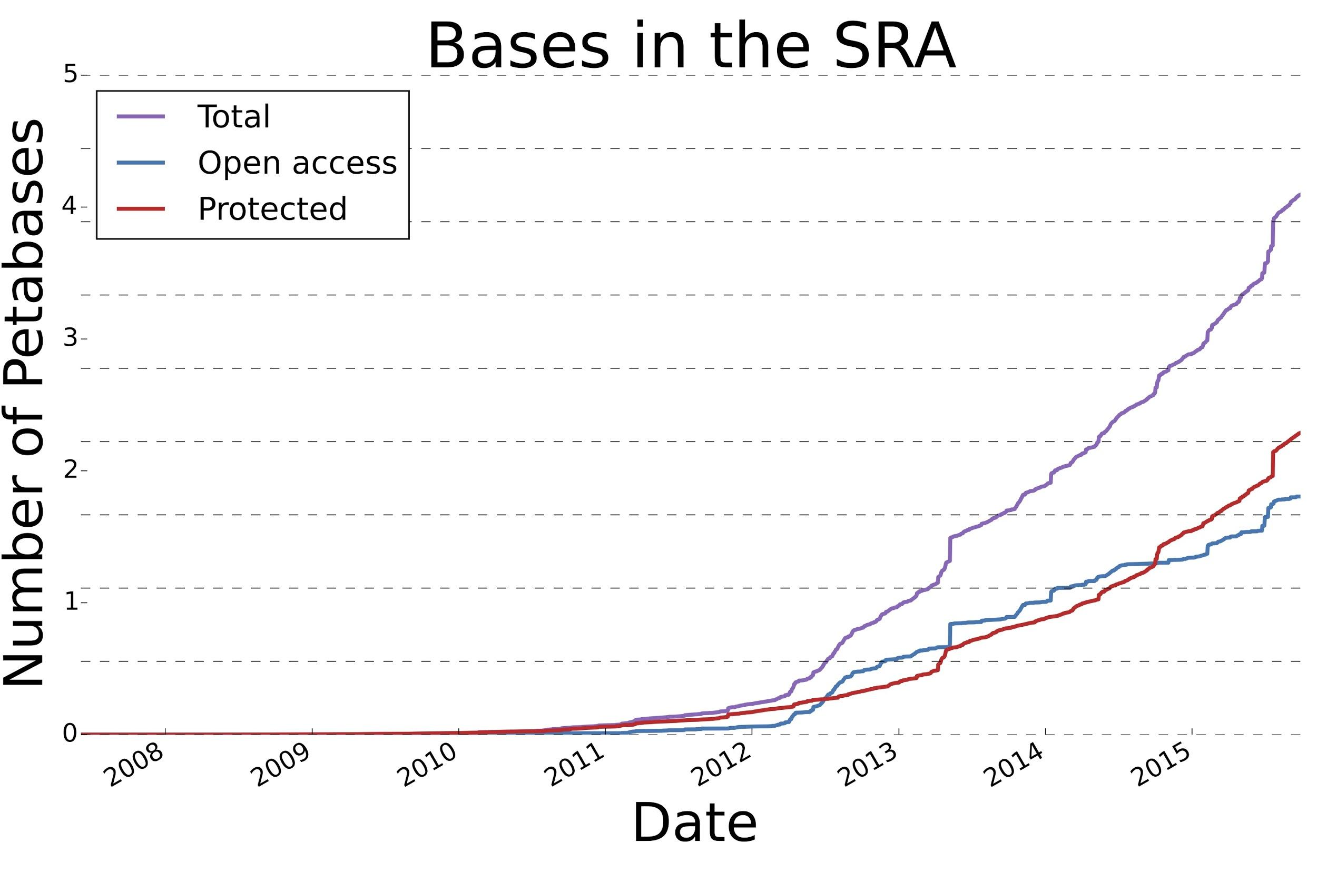
[Gursoy et al., Cell, in press]
Quantify the amount of leakage in reads
Using perfect reference public datasets
Using environmental objects (coffee cups)
Under different noise profiles
2. Develop data-sanitization protocols
based on quantifications
Bounds for privacy & utility balance
A new mode for sharing data
[Muir et al., Genome Biology, 2016]

Slide 15
Privacy & Functional Genomics
Intro. to Genomic Privacy
  The dilemma: The genome as fundamental, inherited info that’s very private v. need for large-scale sharing & mining for med. research
Privacy & Functional Genomics Data
  2-sided nature of this data presents particularly tricky privacy issues
  Overview of types of the leakage, from obvious to subtle
Obvious leakage #1: reads
  How much leakage can we expect?
    Quantification with available data & real-world environmental samples
  Using pBAM file format to remove obvious large-scale leakage
  Using FANCY to assess the privacy leakage before release of the data
Subtle Leakage #2: eQTLs
  Quantifying & removing further variant info from expression levels w/ ICI & predictability.
  Instantiating a practical linking attack w/ noisy quasi-identifiers
Subtle Leakage #3:
Signal Profiles
  Manifest appreciable leakage from large & small deletions.
  Linking attacks possible but additional complication of SV discovery in addition to genotyping

Slide 16
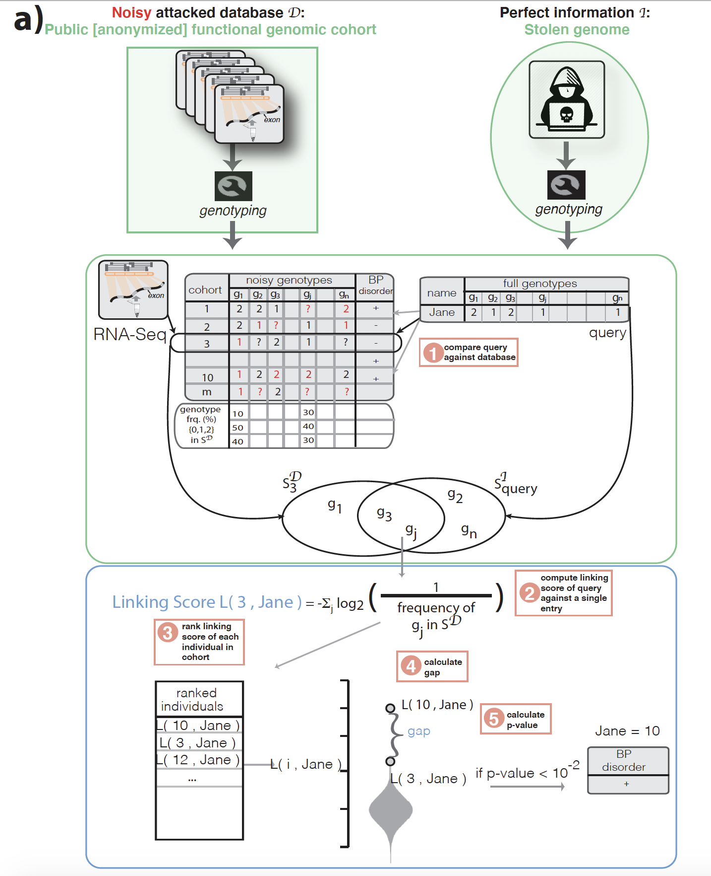
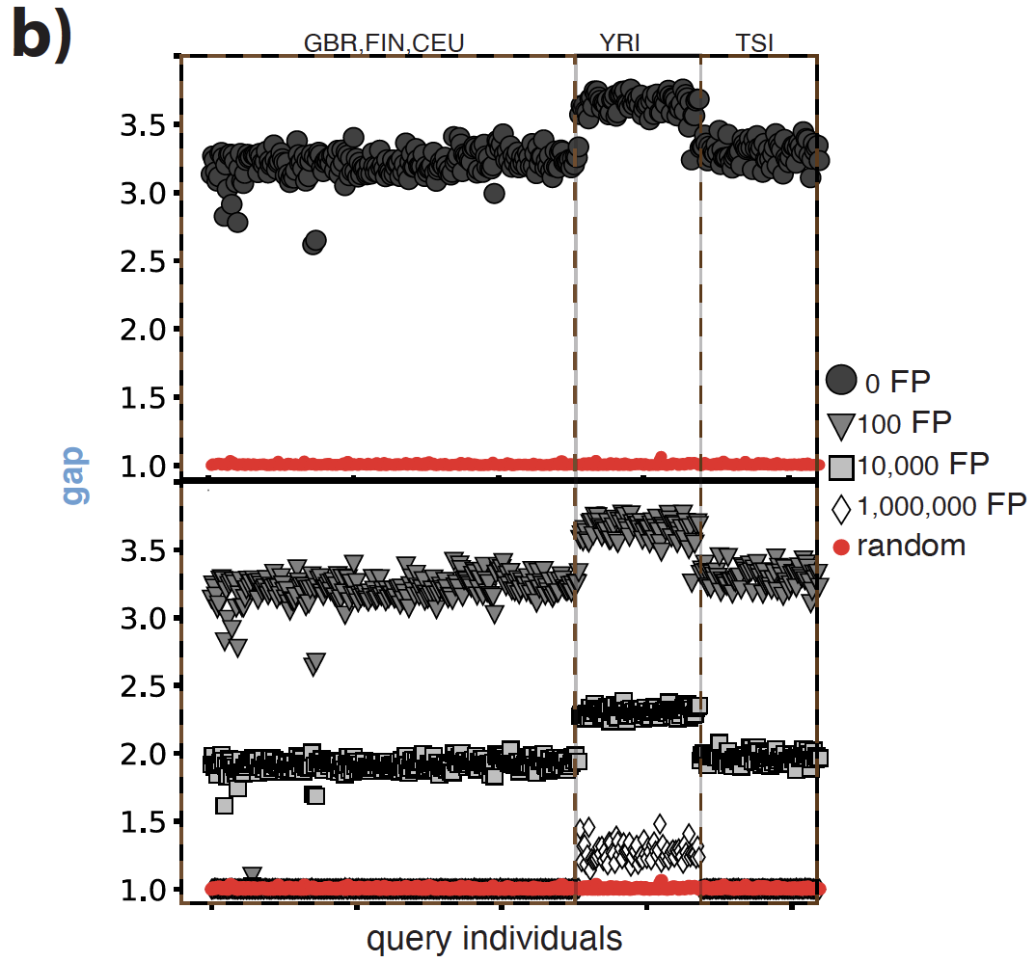
Linking a known individual with perfectly characterized genome to a functional genomics cohort & inference of sensitive phenotypes
[Gursoy et al., Cell, in press]

Slide 17
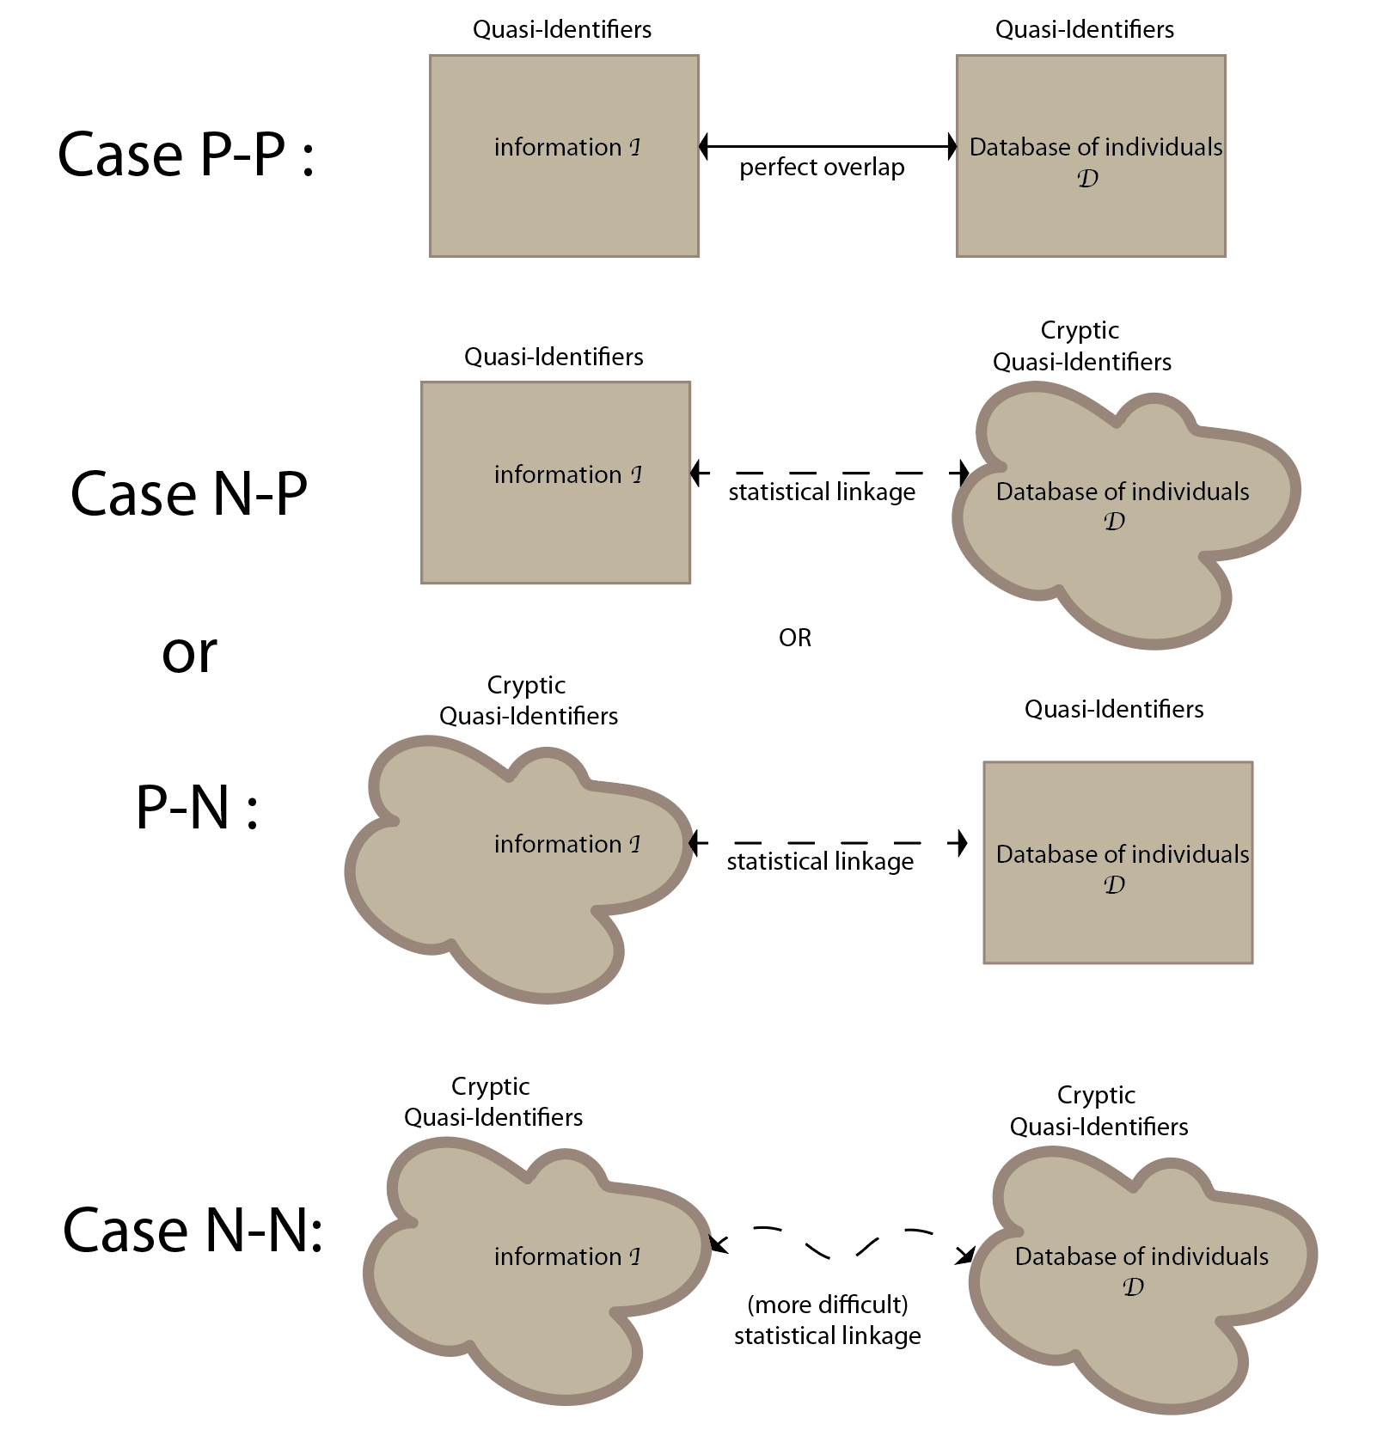
Genotypes observed from functional genomics data are noisy: How can we quantify the private information leakage under different noise profiles?

Slide 18
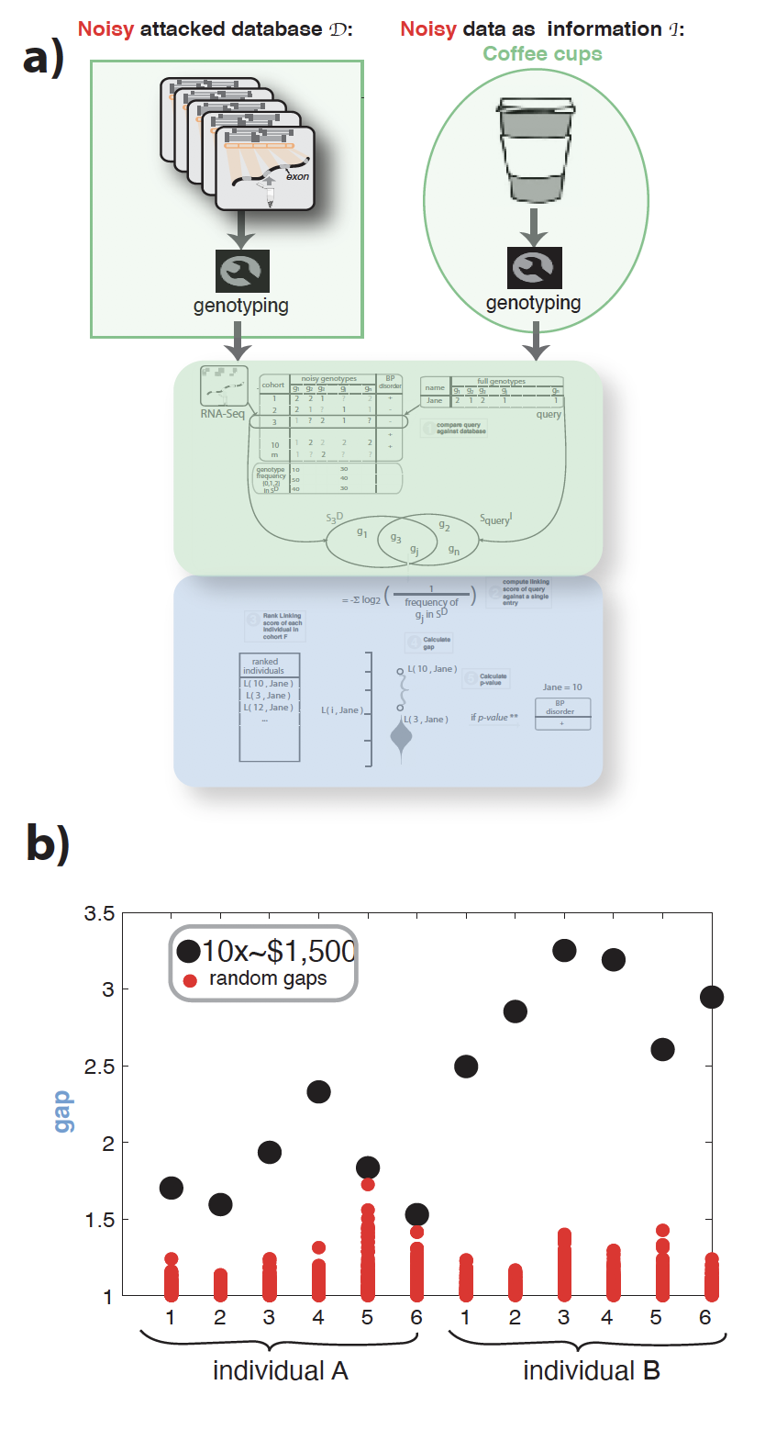
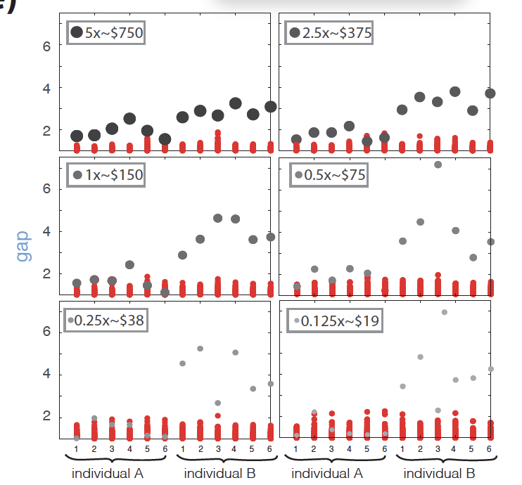
Linking a coffee cup from a known individual to a functional genomics cohort & inference of sensitive phenotypes
$19 was enough to link the coffee cup to the panel
[Gursoy et al., Cell, in press]

Slide 19
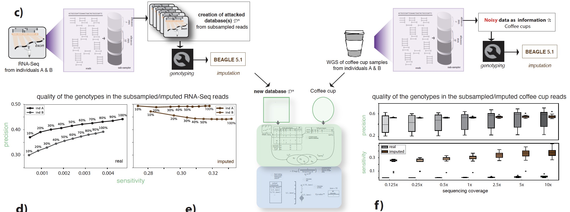
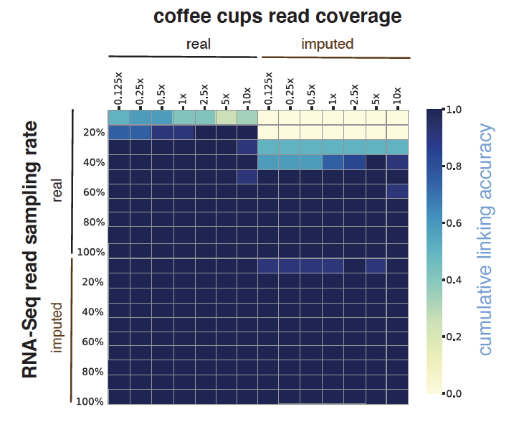
Noise can be changed with more subsampling & linking can be improved by imputation
Imputation on coffee-cups decreases
linking accuracy
Imputation on RNA-Seq increases
linking accuracy
[Gursoy et al., Cell, in press]

Slide 20
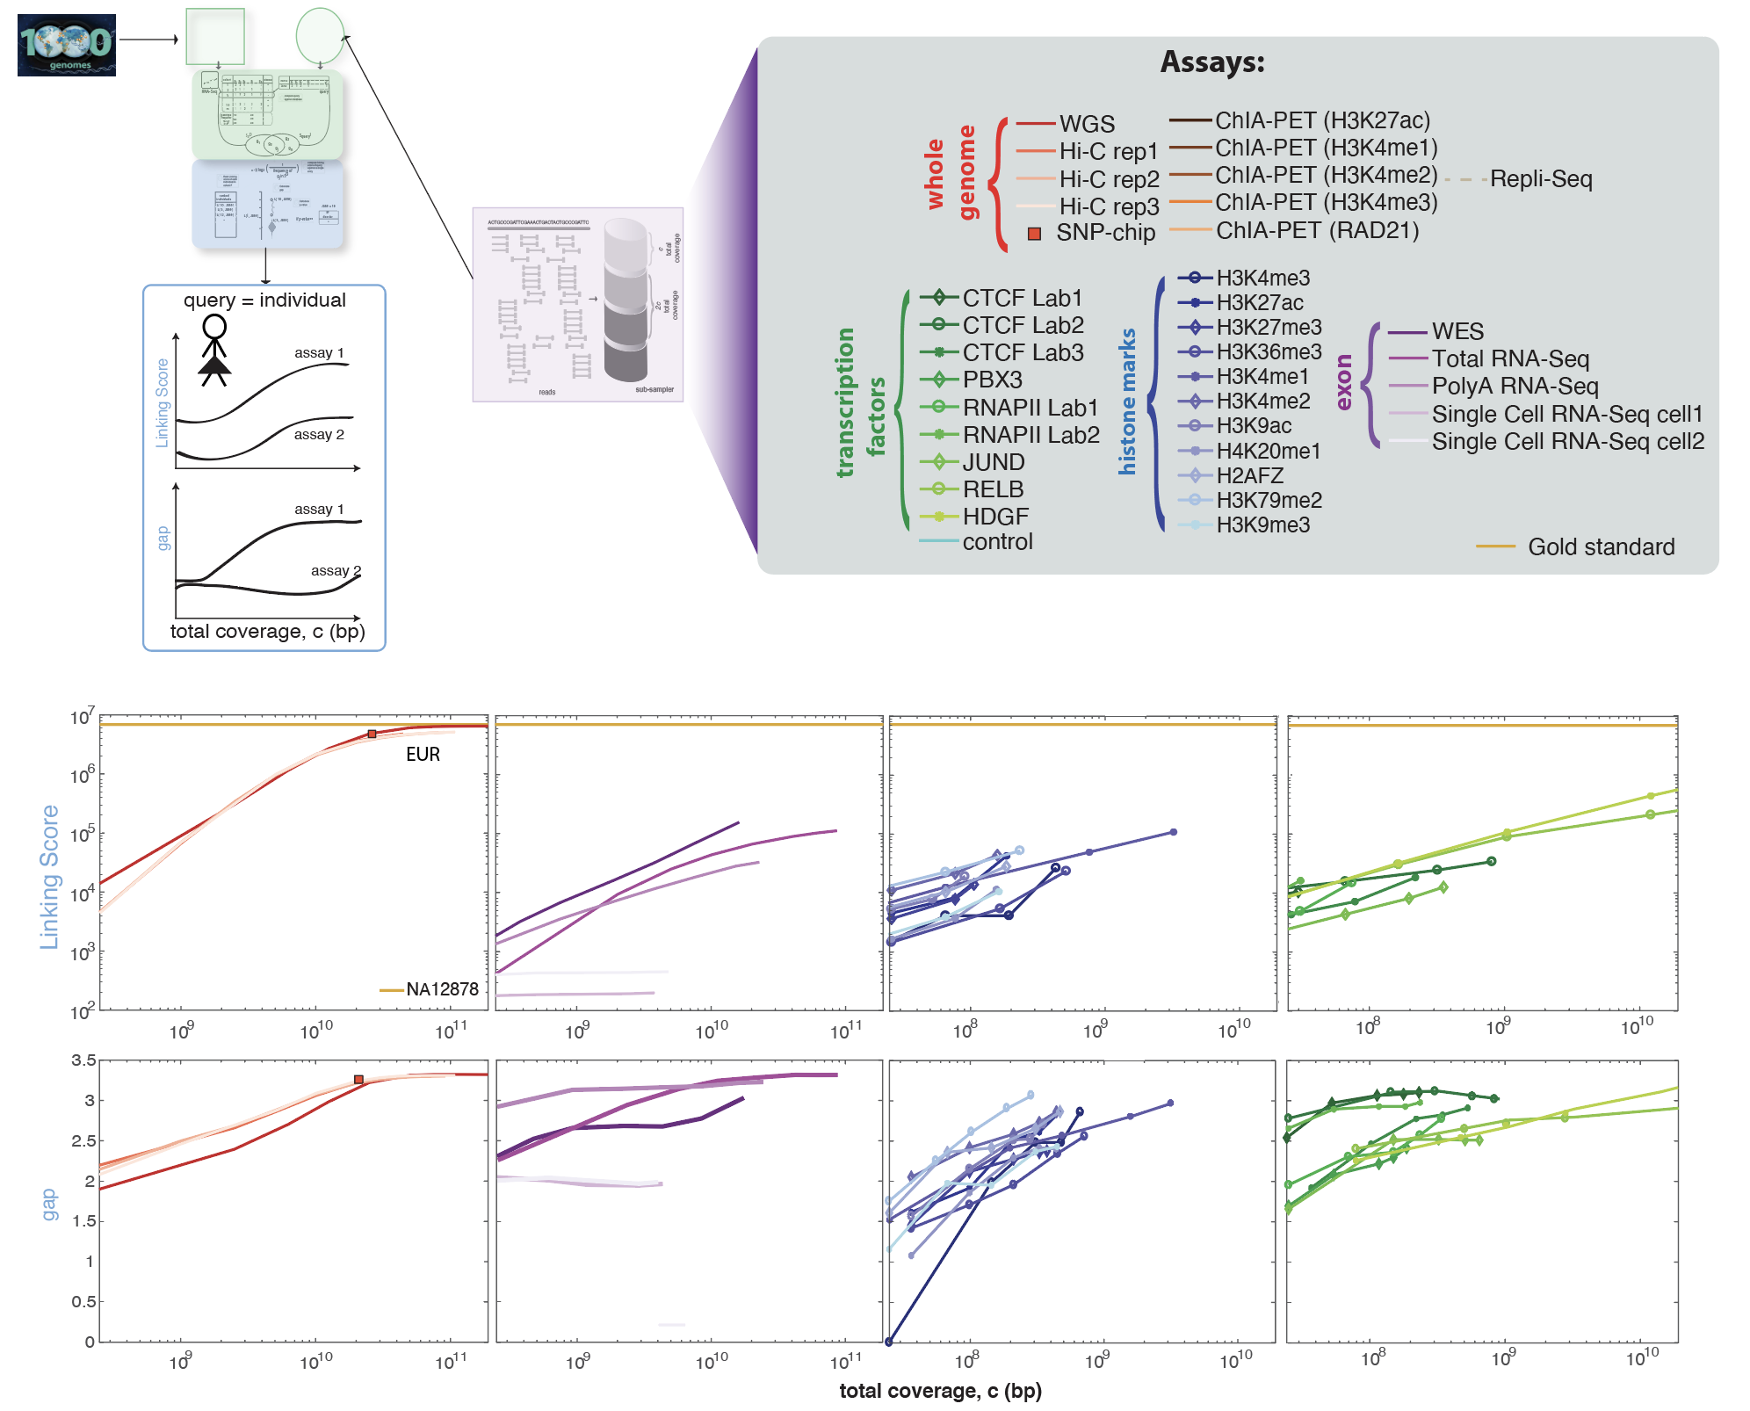
Quantifying leakage in different functional genomics assays
[Gursoy et al., Cell, in press]

Slide 21
Privacy & Functional Genomics
Intro. to Genomic Privacy
  The dilemma: The genome as fundamental, inherited info that’s very private v. need for large-scale sharing & mining for med. research
Privacy & Functional Genomics Data
  2-sided nature of this data presents particularly tricky privacy issues
  Overview of types of the leakage, from obvious to subtle
Obvious leakage #1: reads
  How much leakage can we expect?
    Quantification with available data & real-world environmental samples
  Using pBAM file format to remove obvious large-scale leakage
  Using FANCY to assess the privacy leakage before release of the data
Subtle Leakage #2: eQTLs
  Quantifying & removing further variant info from expression levels w/ ICI & predictability.
  Instantiating a practical linking attack w/ noisy quasi-identifiers
Subtle Leakage #3:
Signal Profiles
  Manifest appreciable leakage from large & small deletions.
  Linking attacks possible but additional complication of SV discovery in addition to genotyping

Slide 22
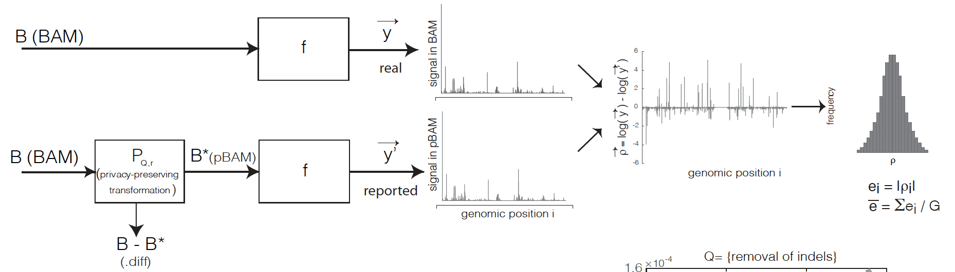
Privacy-preserving Binary Alignment Mapping (pBAM)
  No need to know the sequence of mapped reads to aggregate them
  A manipulation on Binary Alignment Files (BAM)
    Find leaky fields/tags
    Generalization
  Goal:
    Accurate gene/transcript expression quantification
    Works with the pipelines / SAMtools
[Gursoy et al., Cell, in press]

Slide 23
Privacy-preserving Binary Alignment Mapping (pBAM)
Definitions:
1. Privacy: B∗ = P_{Q,r}(B) can be viewed as δ-private with respect to operation Q, if δ = r/t,
r = non-observable (sanitized) variants in pBAM
t = all observed variants in BAM
We can reach 100% privacy when r = t.
2. Utility: B∗ = P_{Q,r}(B) can be viewed as having ε -γ -utility with respect to operation Q, if ε = (G − m)/G,
G = total number of units
m = the total number of units with e_{i} > γ
Practically, ε is the fraction of the genomic bases affected by the sanitization
& γ can be set based on difference between replicates
Note: Variants can have different effect on privacy based on their rarity; however that will make definitions to be dependent on
the composition of attacked database
[Gursoy et al., Cell, in press]

Slide 24
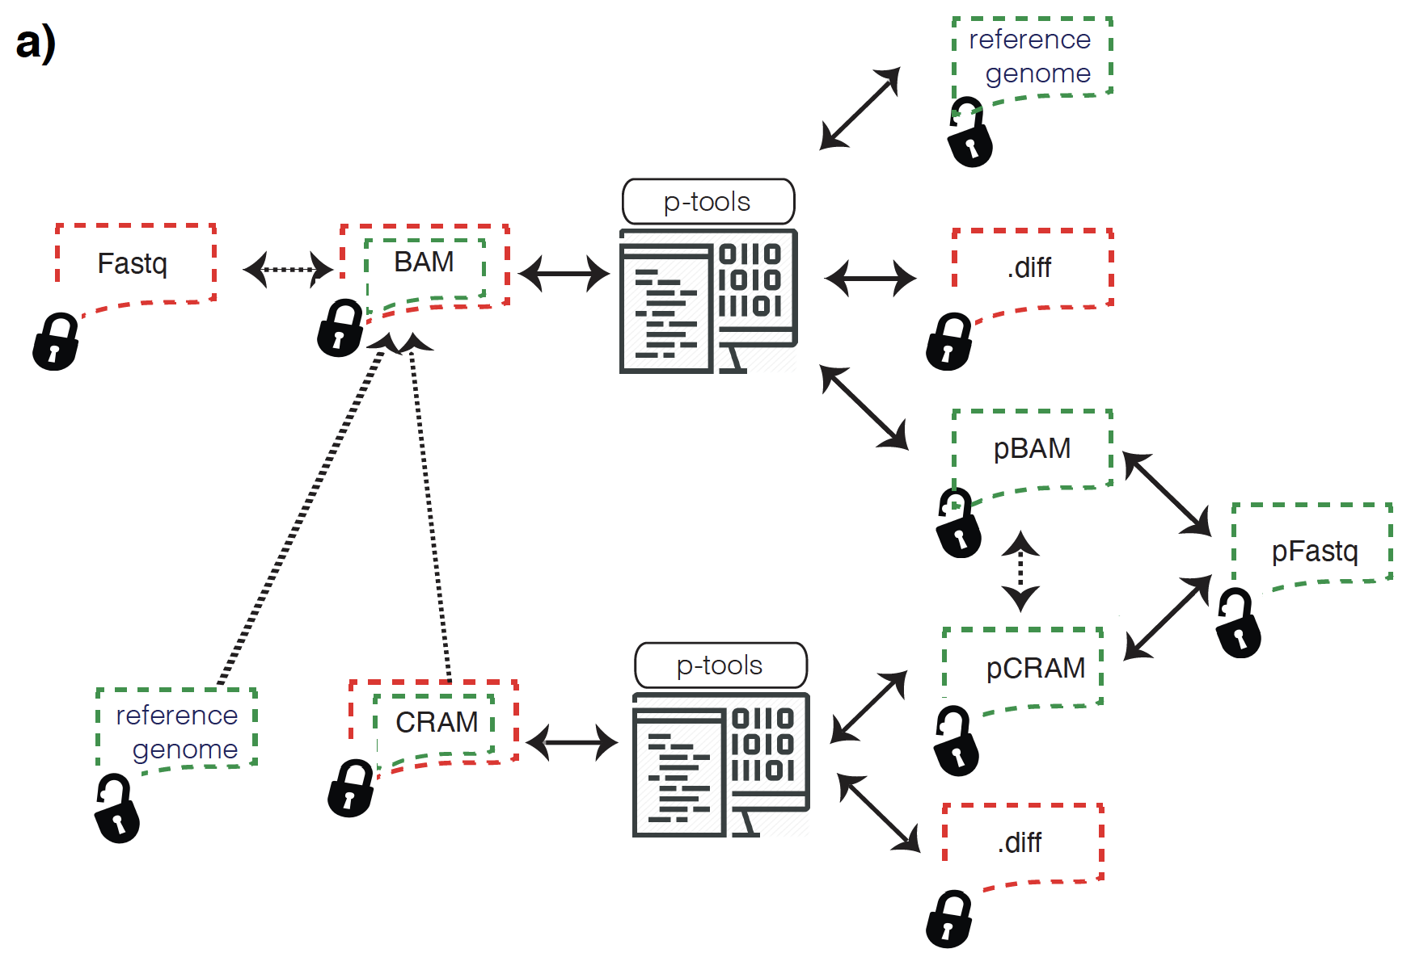
Practical Software for Sanitizing a BAM, creating a pBAM and small “.diff” file
Latest version (pTools v1.0.1): http://privaseq3.gersteinlab.org/download
Development: https://github.com/ENCODE-DCC/ptools
Test files: http://privaseq3.gersteinlab.org/data

Slide 25

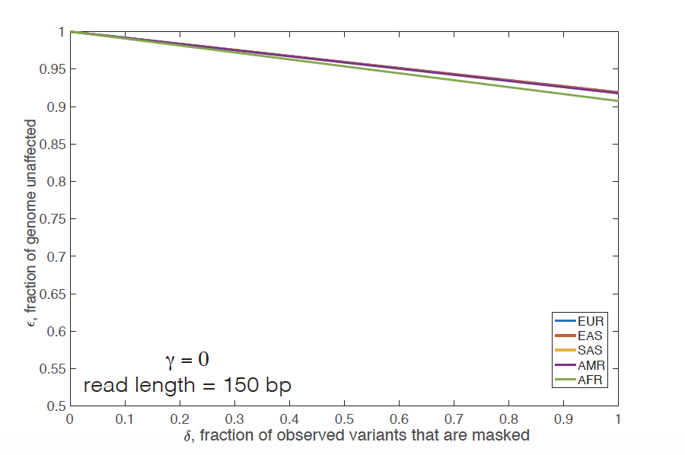
Privacy-preserving Binary Alignment Mapping (pBAM)
(numerical bounds relating privacy and utility)
read length
number of observable
variants
utility parameter
privacy
parameter
sanitized
variants
length of
the genome
Here we used average number of genotypes per ancestry as t
Extreme case as number of observable variants from a functional genomics BAM << t
Assuming a genomic signal profile, we can see how SNPs & indels maximally affect the profile, giving a numerical bounds relating δ & ε
Unit = nucleotide
[Gursoy et al., Cell, in press]

Slide 26
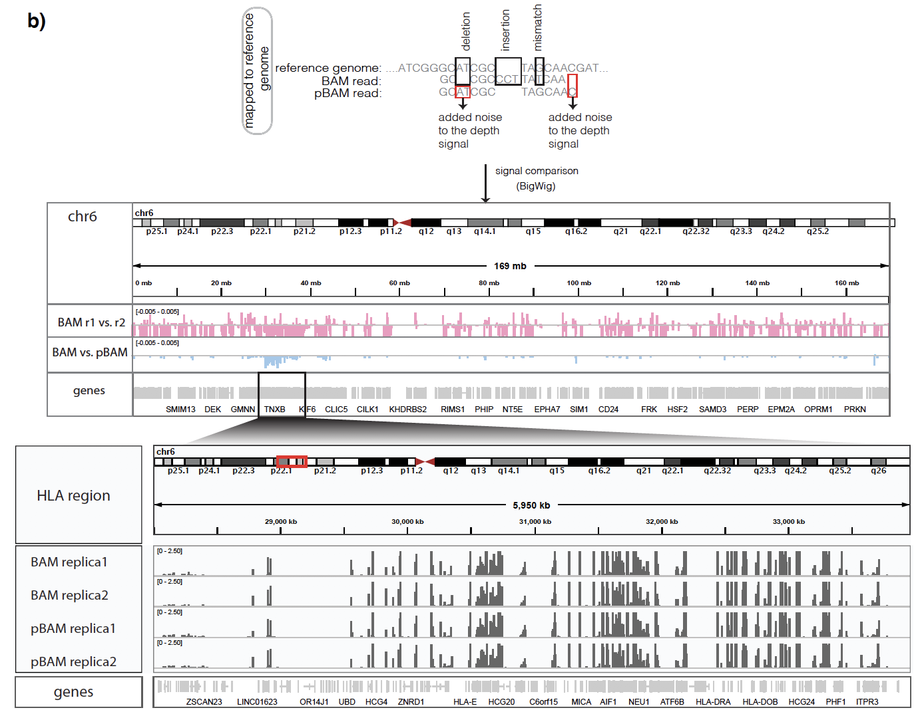
Privacy-preserving Binary Alignment Mapping (pBAM)
(empirical utility observations)
NA12878 RNA-Seq BAM files
Variation between replicates
Variation between BAM-pBAM
[Gursoy et al., Cell, in press]

Slide 27
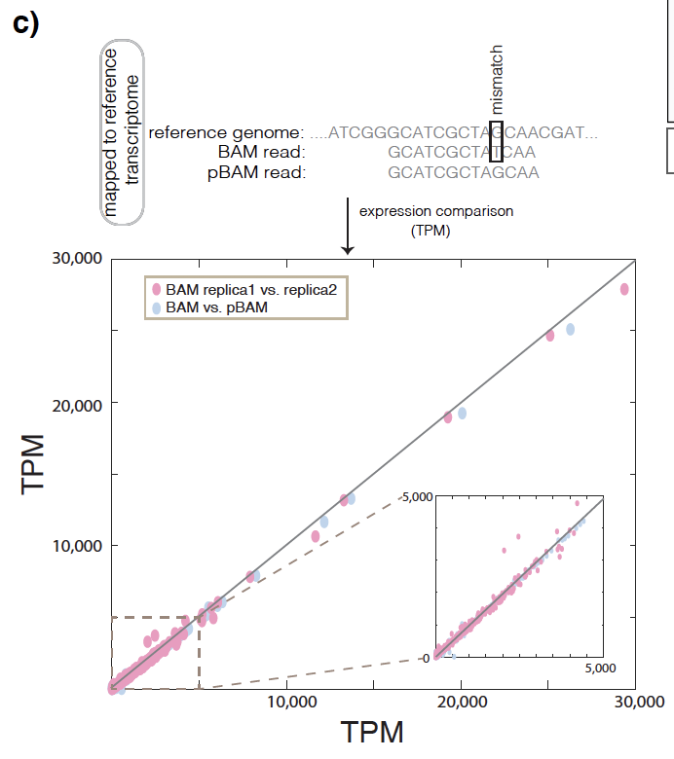
Privacy-preserving Binary Alignment Mapping (pBAM)
(empirical utility observations)
NA12878 RNA-Seq BAM files
Gene level
Variation between replicates
Variation between BAM-pBAM
[Gursoy et al., Cell, in press]

Slide 28
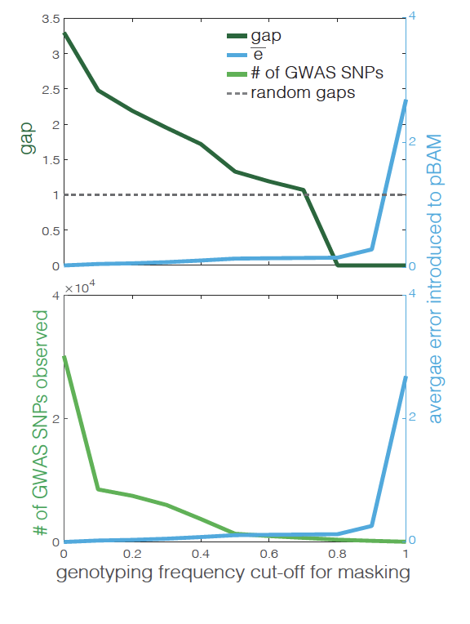
Privacy-preserving Binary Alignment Mapping (pBAM)
(grounded in privacy and utility)
x10⁻⁶
Unit = nucleotide (signal track)
NA12878 RNA-Seq data
Test the privacy for each level of masking
Measure the error introduced
𝜀 decreases as we introduce more error
x10⁻⁶
𝛿 increases as we mask more and more common variants
[Gursoy et al., Cell, in press]

Slide 29
Privacy & Functional Genomics
Intro. to Genomic Privacy
  The dilemma: The genome as fundamental, inherited info that’s very private v. need for large-scale sharing & mining for med. research
Privacy & Functional Genomics Data
  2-sided nature of this data presents particularly tricky privacy issues
  Overview of types of the leakage, from obvious to subtle
Obvious leakage #1: reads
  How much leakage can we expect?
    Quantification with available data & real-world environmental samples
  Using pBAM file format to remove obvious large-scale leakage
  Using FANCY to assess the privacy leakage before release of the data
Subtle Leakage #2: eQTLs
  Quantifying & removing further variant info from expression levels w/ ICI & predictability.
  Instantiating a practical linking attack w/ noisy quasi-identifiers
Subtle Leakage #3:
Signal Profiles
  Manifest appreciable leakage from large & small deletions.
  Linking attacks possible but additional complication of SV discovery in addition to genotyping

Slide 30
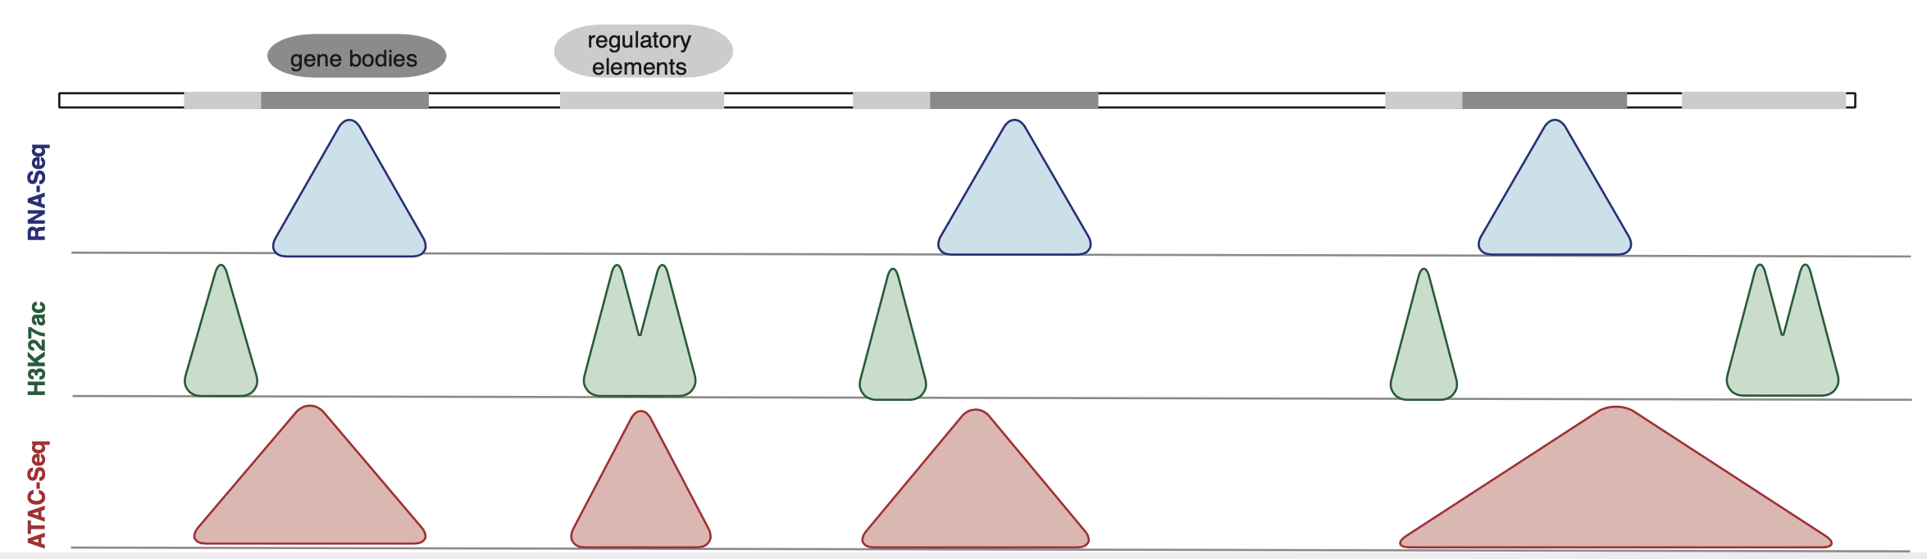
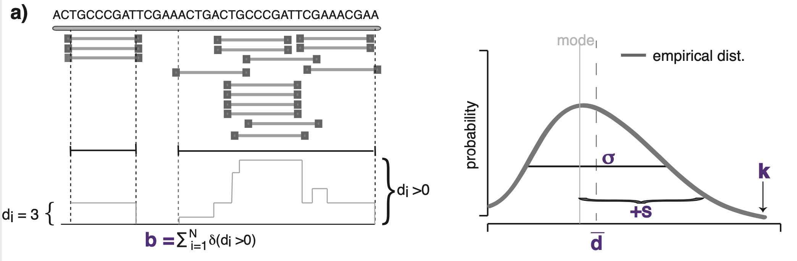
FANCY: Fast Estimation of Privacy Risk in Functional Genomics Data
Can we predict the amount of leakage before the release of the data
without the need for genotyping?
for depth
depth & breadth
[Gursoy et al., Bioinformatics, 2020]

Slide 31
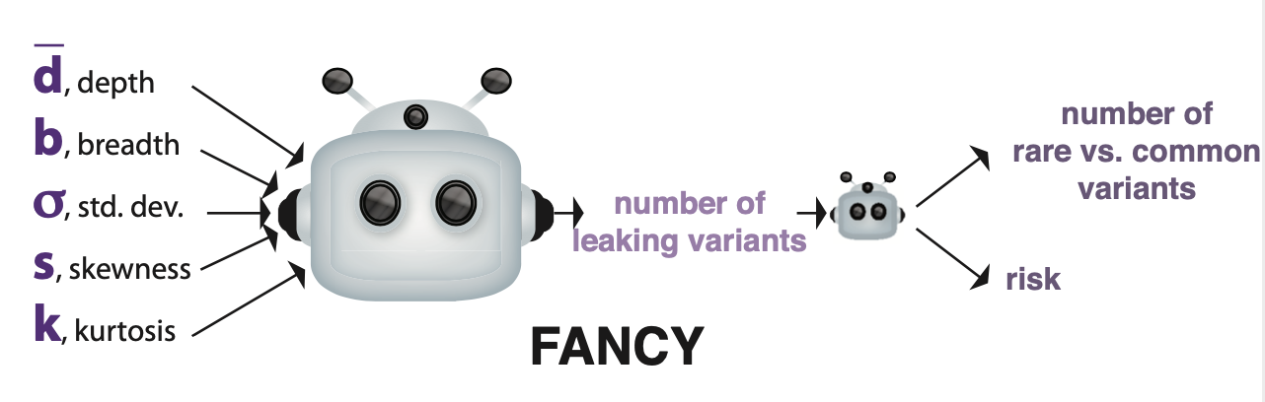
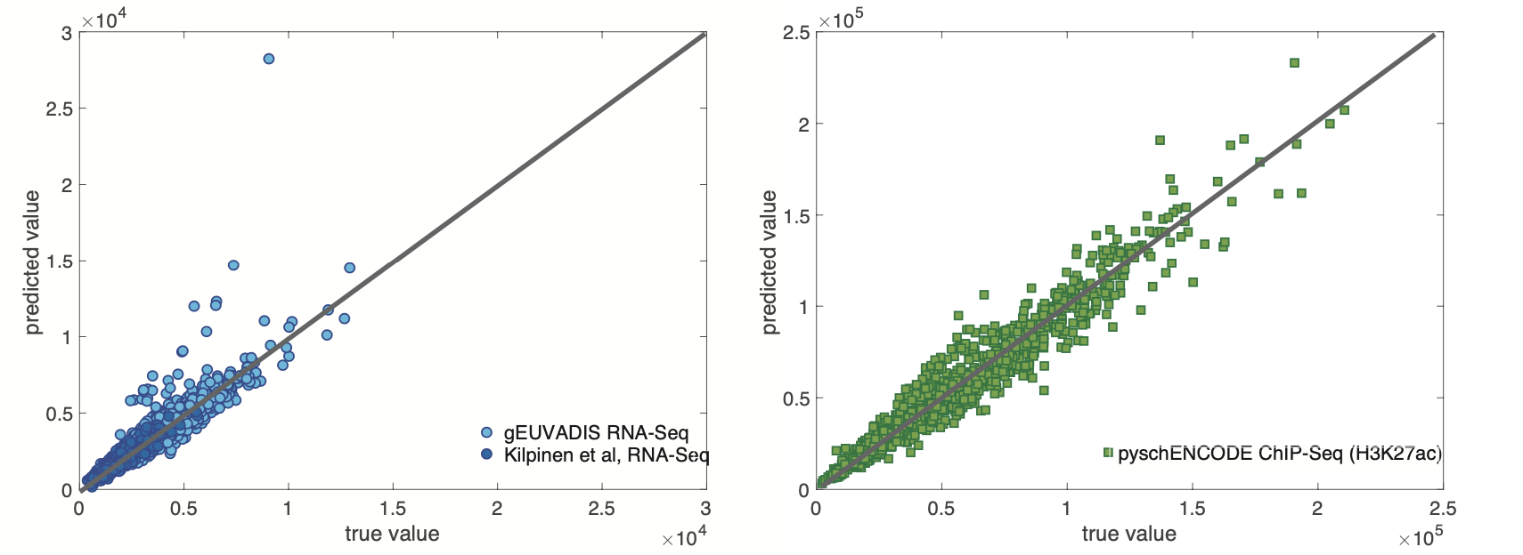
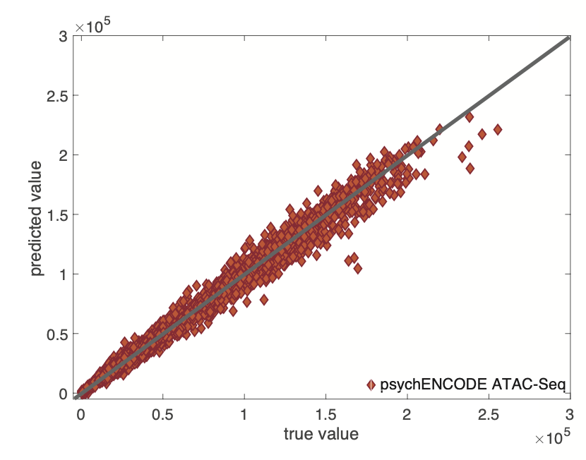
FANCY: Fast Estimation of Privacy Risk in Functional Genomics Data
Can we predict the amount of leakage before the release of the data
without the need for genotyping?
[Gursoy et al., Bioinformatics, 2020]

Slide 32
Privacy & Functional Genomics
Intro. to Genomic Privacy
  The dilemma: The genome as fundamental, inherited info that’s very private v. need for large-scale sharing & mining for med. research
Privacy & Functional Genomics Data
  2-sided nature of this data presents particularly tricky privacy issues
  Overview of types of the leakage, from obvious to subtle
Obvious leakage #1: reads
  How much leakage can we expect?
    Quantification with available data & real-world environmental samples
  Using pBAM file format to remove obvious large-scale leakage
  Using FANCY to assess the privacy leakage before release of the data
Subtle Leakage #2: eQTLs
  Quantifying & removing further variant info from expression levels w/ ICI & predictability.
  Instantiating a practical linking attack w/ noisy quasi-identifiers
Subtle Leakage #3:
Signal Profiles
  Manifest appreciable leakage from large & small deletions.
  Linking attacks possible but additional complication of SV discovery in addition to genotyping

Slide 33


eQTL Mapping Using RNA-Seq Data
eQTLs are genomic loci that contribute to variation in mRNA expression levels
eQTLs provide insights on transcription regulation, and the molecular basis of phenotypic outcomes
eQTL mapping can be done with RNA-Seq data
[Biometrics 68(1) 1–11]
Notes:
A diagram to illustrate the RNA‐seq count variation of one gene due to an cis‐eQTL. (a) RNA‐seq measurements of a hypothetic gene with two exons in three diploid individuals. The target SNP which we test for association has the genotype CT, CC, and TT for the three individuals. There is an SNP on the first exon, which has genotype AT, AT, and AA for the three individuals. ASE can be measured by those sequence reads that overlap with a heterozygous exonic SNP. Therefore we can measure ASE for individuals (i) and (ii). However, association testing by ASE is only possible if the target SNP is heterozygous, thus only individual (i) can be used to test for eQTL by ASE (b) ASE measurements for individual (i). (c) TReC measured for the three individuals across the two exons of this gene.
© IF THIS IMAGE HAS BEEN PROVIDED BY OR IS OWNED BY A THIRD PARTY, AS INDICATED IN THE CAPTION LINE, THEN FURTHER PERMISSION MAY BE NEEDED BEFORE ANY FURTHER USE. PLEASE CONTACT WILEY'S PERMISSIONS DEPARTMENT ON PERMISSIONS@WILEY.COM OR USE THE RIGHTSLINK SERVICE BY CLICKING ON THE 'REQUEST PERMISSION' LINK ACCOMPANYING THIS ARTICLE. WILEY OR AUTHOR OWNED IMAGES MAY BE USED FOR NON-COMMERCIAL PURPOSES, SUBJECT TO PROPER CITATION OF THE ARTICLE, AUTHOR, AND PUBLISHER.

Slide 34
Information Content and Predictability
Naive measure of information (no LD, distant correlations, pop. struc., &c)
Higher frequency: Lower ICI
Additive for multiple variants
Condition specific entropy
Higher cond. entropy: Lower predictability
Additive for multiple eQTLs
[Harmanci et al. Nat. Meth. 2016]

Slide 35
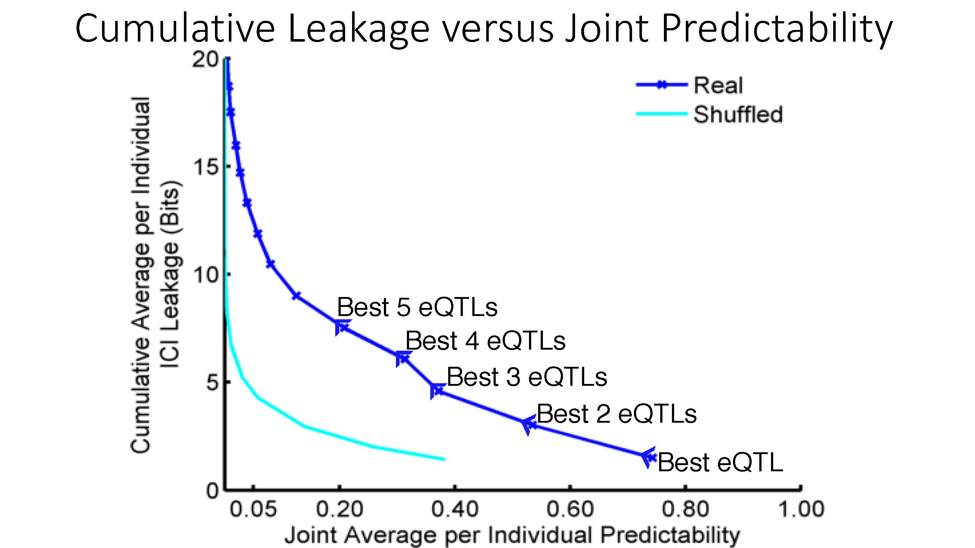

ICI Leakage versus Genotype Predictability
[Harmanciet al. Nat. Meth. (‘16]

Slide 36

Linking Attack Scenario
[Harmanciet al. Nat. Meth. (‘16)]

Slide 37
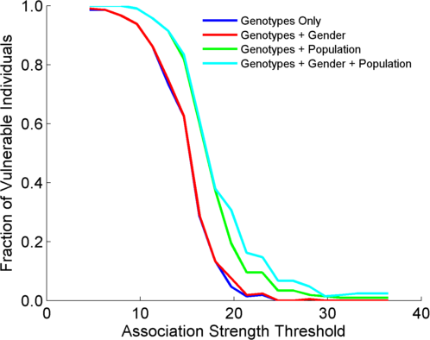
Success in Linking Attack with Extremity based Genotype Prediction
200 individuals eQTL Discovery
200 individuals in Linking Attack
High
Sensitivity
Low
Sensitivity
High Number
Of eQTLs
Low Number
Of eQTLs
[Harmanci et al. Nat. Meth. (16)]

Slide 38
Privacy & Functional Genomics
Intro. to Genomic Privacy
  The dilemma: The genome as fundamental, inherited info that’s very private v. need for large-scale sharing & mining for med. research
Privacy & Functional Genomics Data
  2-sided nature of this data presents particularly tricky privacy issues
  Overview of types of the leakage, from obvious to subtle
Obvious leakage #1: reads
  How much leakage can we expect?
    Quantification with available data & real-world environmental samples
  Using pBAM file format to remove obvious large-scale leakage
  Using FANCY to assess the privacy leakage before release of the data
Subtle Leakage #2: eQTLs
  Quantifying & removing further variant info from expression levels w/ ICI & predictability.
  Instantiating a practical linking attack w/ noisy quasi-identifiers
Subtle Leakage #3:
Signal Profiles
  Manifest appreciable leakage from large & small deletions.
  Linking attacks possible but additional complication of SV discovery in addition to genotyping

Slide 39
Detection & Genotyping of small & large
SV deletions from signal profiles
RNA-Seq
Signal
Genomic
Coordinate
ChIP-Seq
Signals
A C G T A C G
Large Deletion
Genomic
Coordinate
Small Deletion
RNA-seq also shows large deletions
[Harmanci & Gerstein, Nat. Comm. (‘18)]

Slide 40
Example of Small Deletion Evident in Signal Profile
[Harmanci & Gerstein, Nat. Comm. (‘18)]

Slide 41
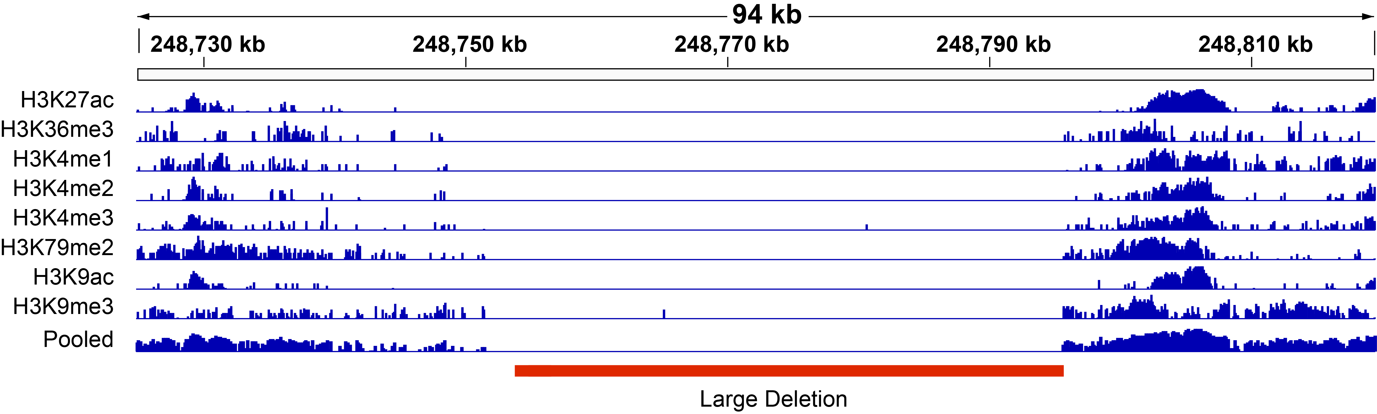
Example of Large Deletion Evident in Signal Profile
[Harmanci & Gerstein, Nat. Comm. (‘18)]

Slide 42
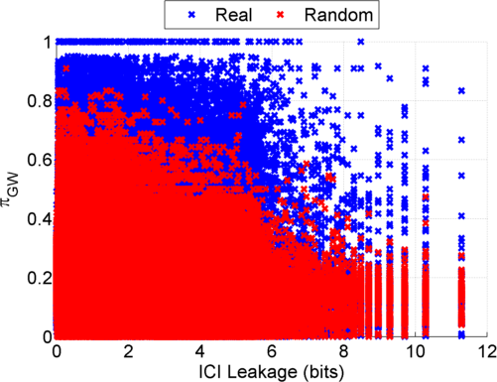
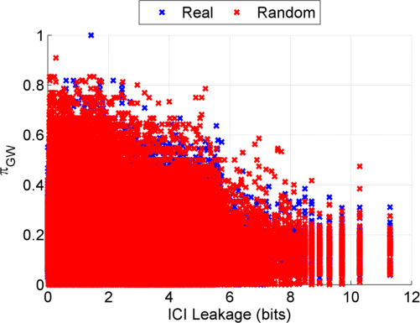
Information Leakage from SV Deletions
Before Anonymization
b) After Anonymization
Simple anonymization procedure (filling in deletion by value at endpoints) has dramatic effect
[Harmanci & Gerstein, Nat. Comm. (‘18)]
Notes:
GEUVADIS ICI-\Pi_GW estimates:

Slide 43
Another type of Linking Attack:
Linking based on SV Genotyping
[Harmanci & Gerstein, Nat. Comm. (‘18)]

Slide 44
Another type of Linking Attack:
First Doing SV Genotyping
[Harmanci & Gerstein, Nat. Comm. (‘18)]

Slide 45
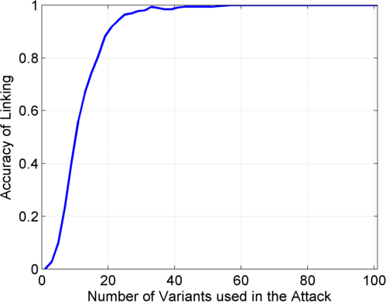
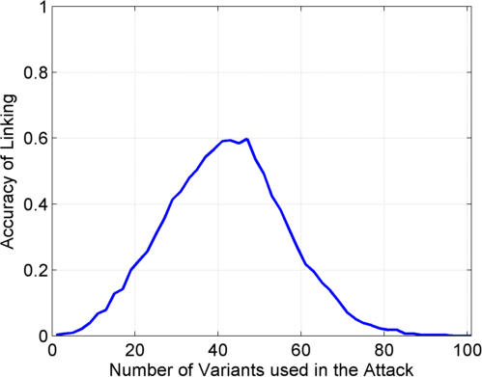
Linking Attack Based on SV Deletions in gEUVADIS Dataset
c) Genotyping
(1kG MAF>0.01)
d) Discovery + Genotyping
Sorted in Decreasing
Predictability
Sorted in Decreasing
Predictability
[Harmanci & Gerstein, Nat. Comm. (‘18)]

Slide 46
Privacy & Functional Genomics
Intro. to Genomic Privacy
  The dilemma: The genome as fundamental, inherited info that’s very private v. need for large-scale sharing & mining for med. research
Privacy & Functional Genomics Data
  2-sided nature of this data presents particularly tricky privacy issues
  Overview of types of the leakage, from obvious to subtle
Obvious leakage #1: reads
  How much leakage can we expect?
    Quantification with available data & real-world environmental samples
  Using pBAM file format to remove obvious large-scale leakage
  Using FANCY to assess the privacy leakage before release of the data
Subtle Leakage #2: eQTLs
  Quantifying & removing further variant info from expression levels w/ ICI & predictability.
  Instantiating a practical linking attack w/ noisy quasi-identifiers
Subtle Leakage #3:
Signal Profiles
  Manifest appreciable leakage from large & small deletions.
  Linking attacks possible but additional complication of SV discovery in addition to genotyping

Slide 47
Privacy & Functional Genomics
Intro. to Genomic Privacy
  The dilemma: The genome as fundamental, inherited info that’s very private v. need for large-scale sharing & mining for med. research
Privacy & Functional Genomics Data
  2-sided nature of this data presents particularly tricky privacy issues
  Overview of types of the leakage, from obvious to subtle
Obvious leakage #1: reads
  How much leakage can we expect?
    Quantification with available data & real-world environmental samples
  Using pBAM file format to remove obvious large-scale leakage
  Using FANCY to assess the privacy leakage before release of the data
Subtle Leakage #2: eQTLs
  Quantifying & removing further variant info from expression levels w/ ICI & predictability.
  Instantiating a practical linking attack w/ noisy quasi-identifiers
Subtle Leakage #3:
Signal Profiles
  Manifest appreciable leakage from large & small deletions.
  Linking attacks possible but additional complication of SV discovery in addition to genotyping

Slide 48
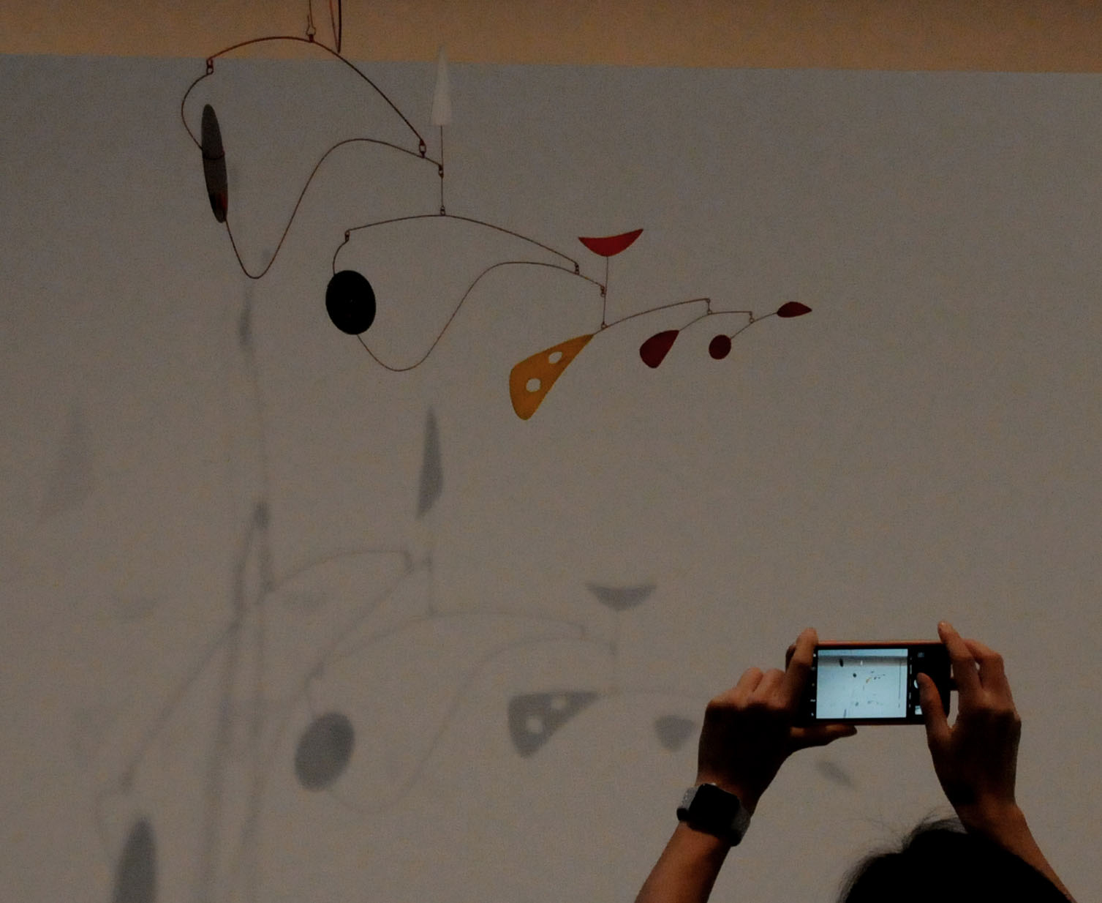
Acknowledgements
G Gürsoy,
A Harmanci,
D Greenbaum,
P Emani, C Brannon,
S Strattan, O Jolanki,
M Cherry, A Miranker,
F Navarro
papers.gersteinlab.org/subject/
privacy
PrivaSeq3.gersteinlab.org
FANCY.gersteinlab.org
PrivaSeq.gersteinlab.org
PrivaSig.gersteinlab.org
Also:
JOBS.gersteinlab.org
Hiring Postdocs. See JOBS.gersteinlab.org !

Slide 49

Extra

Slide 50
Info about content in this slide pack
No Conflicts
Unless explicitly listed below,
there are no conflicts of interest relevant to the material in this talk
General PERMISSIONS
This Presentation is copyright Mark Gerstein, Yale University, 2019.
Please read permissions statement at
sites.gersteinlab.org/Permissions
Basically, feel free to use slides & images in the talk with PROPER acknowledgement (via citation to relevant papers or website link). Paper references in the talk were mostly from Papers.GersteinLab.org.
PHOTOS & IMAGES
For thoughts on the source and permissions of many of the photos and clipped images in this presentation see streams.gerstein.info . In particular, many of the images have particular EXIF tags, such as kwpotppt , that can be easily queried from flickr, viz: flickr.com/photos/mbgmbg/tags/kwpotppt

