Slide 1
Thoughts on repurposing our current bioinformatics research to address COVID-19
M Gerstein & M Rutenberg Schoenberg
Slides freely downloadable from Lectures.GersteinLab.org &
“tweetable” (via @MarkGerstein). See last slide for more info.

Slide 2
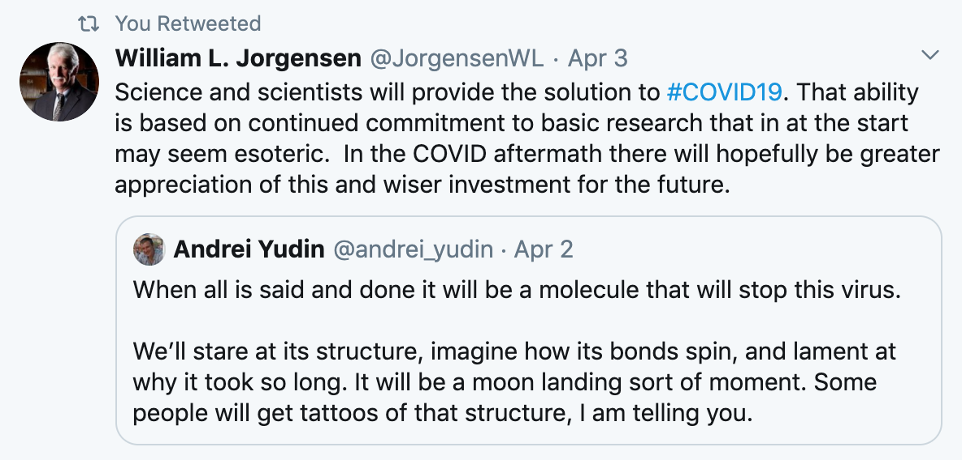
Importance of molecular data science for COVID-19 research: "Molecule to molecule combat"
[lectures.gersteinlab.org] [COVID-HASTE-042120]

Slide 3
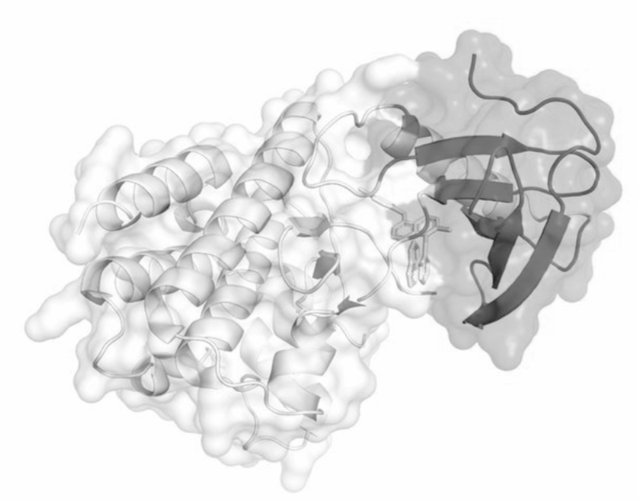
Current Lab Research Areas, which perhaps could be repurposed to address COVID-19
Studying molecular evolution of the human genome & tumor evolution => Evolutionary analysis of the SARS-CoV-2 genome
Analysis of macromolecular structures & cryo-EM images => Deep learning evaluation of variants in SARS-CoV-2 host protein structures
Studying personal genomics & neurogenomics => How human variation relates to SARS-CoV-2 host proteins & host response
Analysis of RNA-seq, ChIP-seq, Hi-C & Single-cell seq. => Studying the host response to virus with functional genomics
Analysis of molecular networks & machine learning models for gene interactions => Predicting host-virus interactions
Studying genomic privacy & security => Developing contact tracing approaches with blockchain & data sanitization
Tool development & large dataset expertise
[lectures.gersteinlab.org] [COVID-HASTE-042120]
3

Slide 4
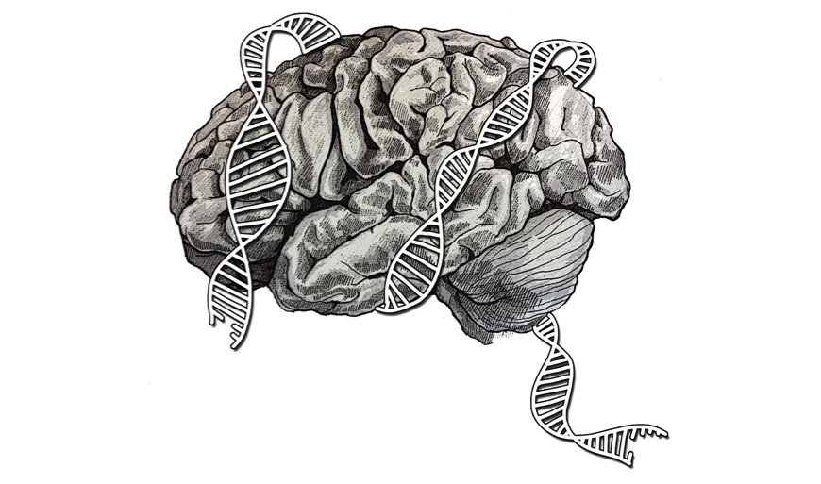
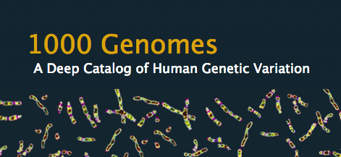
People in the Gerstein Lab + Collaborations related to COVID-19
COVID-19 subgroup Michael Rutenberg Schoenberg Prashant Emani Yucheng Yang Shaoke Lou Gamze Gursoy Charlotte Brannon
(Assoc.) Research Scientists Fabio Navarro *Jing Zhang Jinrui Xu *Joel Rozowsky Jonathan Warrell Sushant Kumar
Postdocs Christopher Cameron Garrett Ash Kun Xiong *Leonidas Salichos Timur Galeev Declan Clarke Donghoon Lee
Grad Students Hussein Mohsen Jiahao Gao Tianxiao Li William Meyerson Xiaotong Li *Jason J. Liu
Collaborators on COVID-19 and related research *Yong Xiong (Yale) *Dan Spakowicz (Ohio State) *Bian Li (Vanderbilt) *Geoff Chupp Lab (Yale) *Rob Bjornson (Yale) Consortia ENCODE PsychENCODE PCAWG ExRNA 1000 Genomes
[lectures.gersteinlab.org] [COVID-HASTE-042120]
Contributed to today’s presentation
* Contributed prior work relevant to COVID-19

Slide 5
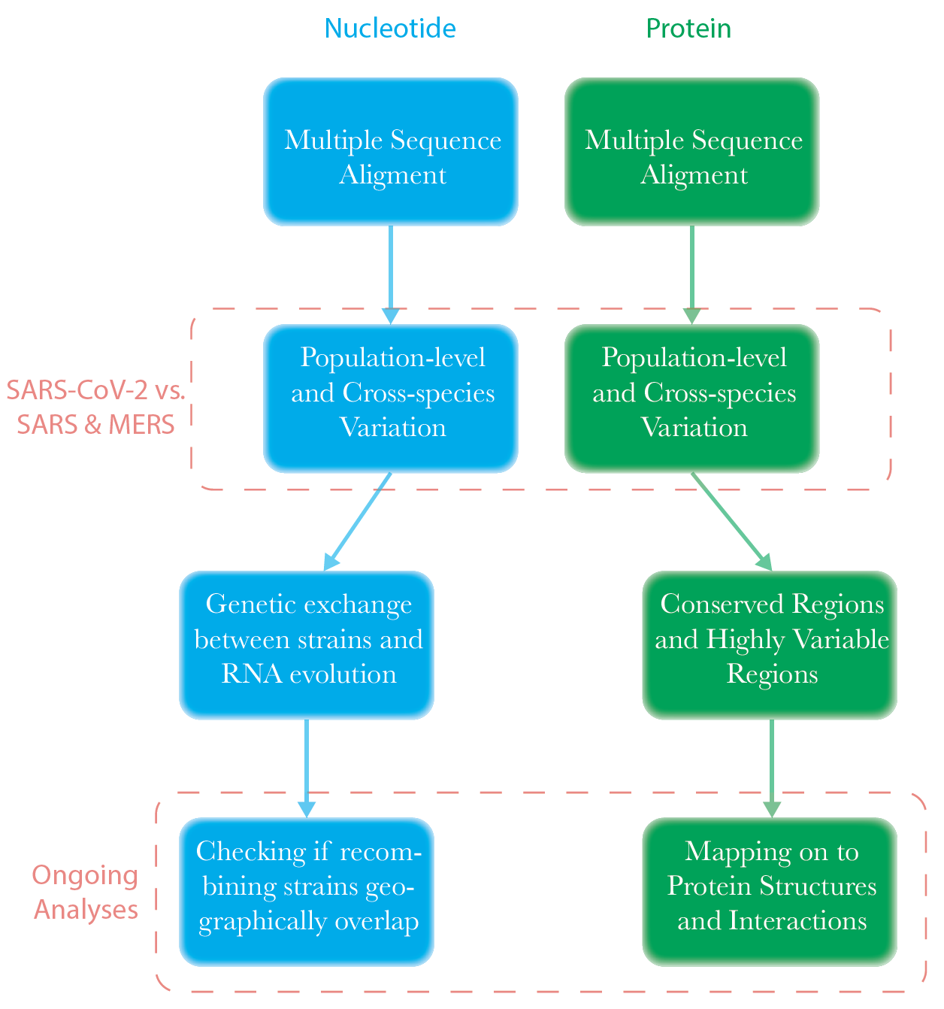
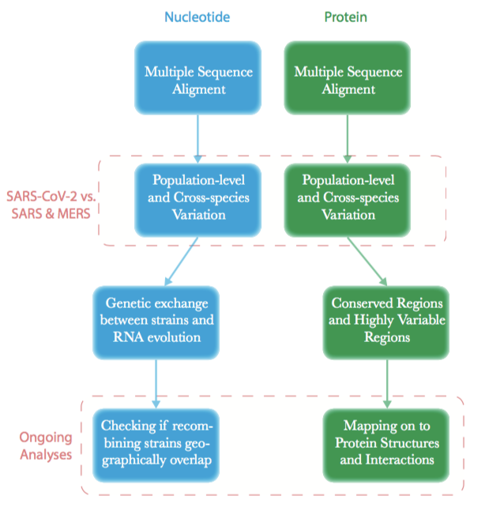
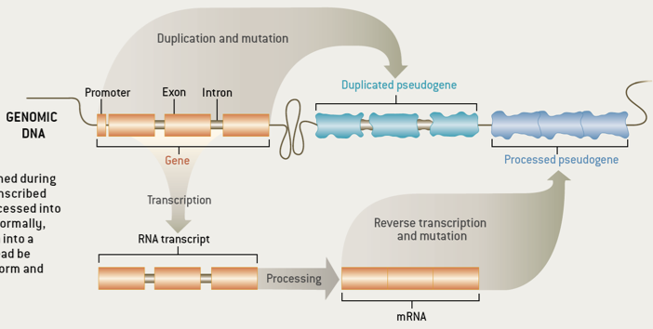
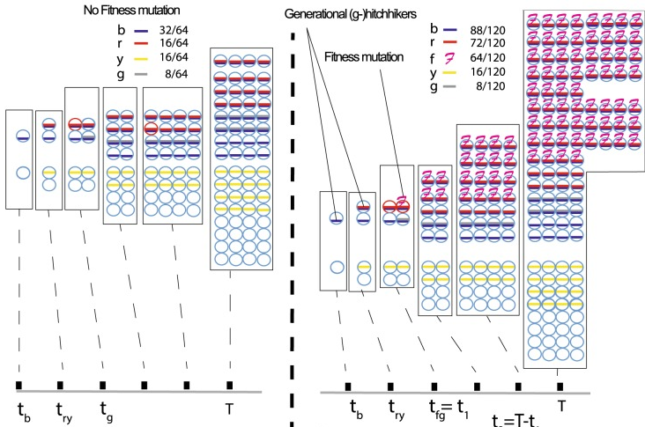
Variation & Evolution of Coronavirus Sequences
Investigation of SARS-CoV-2
Previous work: Genome & Tumor evolution
Goals for RNA alignment:
Establish evolution through mutational “distance” - Phylogenetic Analysis
Q. Did viral strains recombine when geographically co-located?
[lectures.gersteinlab.org] [COVID-HASTE-042120]
Generated Resources: Fasta files, VCF file
Data Sources: GISAID, NCBI VIRUS
www.gisaid.org https://www.ncbi.nlm.nih.gov/labs/virus/vssi/#
https://www.scientificamerican.com/article/the-real-life-of- pseudoge/
Salichos et al. Nat. Comm. 2020 Sisu et al. bioRXiv 2019, Sisu et al. 2014 PNAS
Slide: Prashant Emani + Leonidas Salichos

Slide 6
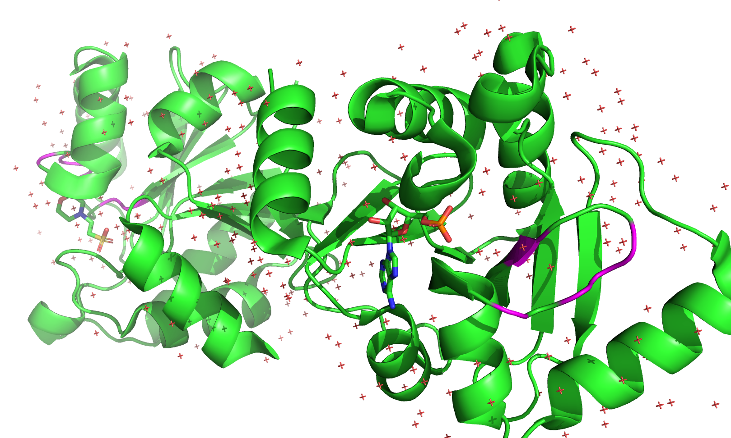
Protein Variation Maps of Coronaviruses
(Magenta: Variable regions)
[lectures.gersteinlab.org] [COVID-HASTE-042120]
SARS-CoV-2 ADP Phosphatase in Complex with AMP
(PDB ID: 6W6Y)
Key Questions
Are certain regions conserved within SARS-CoV-2, or between SARS-CoV-2 and SARS and MERS?
Some regions are highly variable: how does the virus cope with frequent variation?
SARS 3C-like Protease (in dimeric form: green and turquoise monomers) (PDB ID: 4HI3)
Slide: Prashant Emani

Slide 7
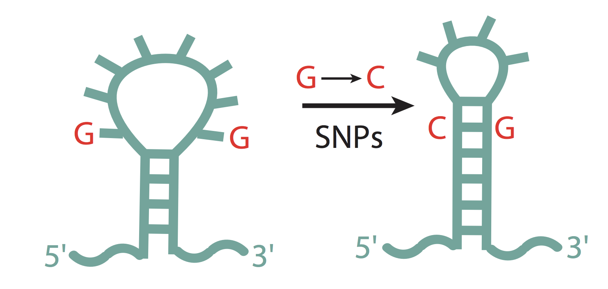
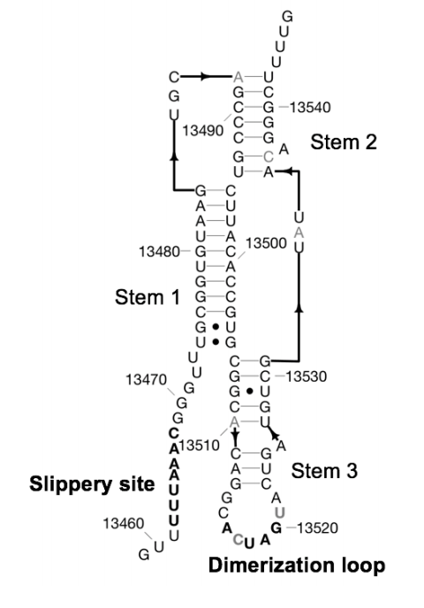
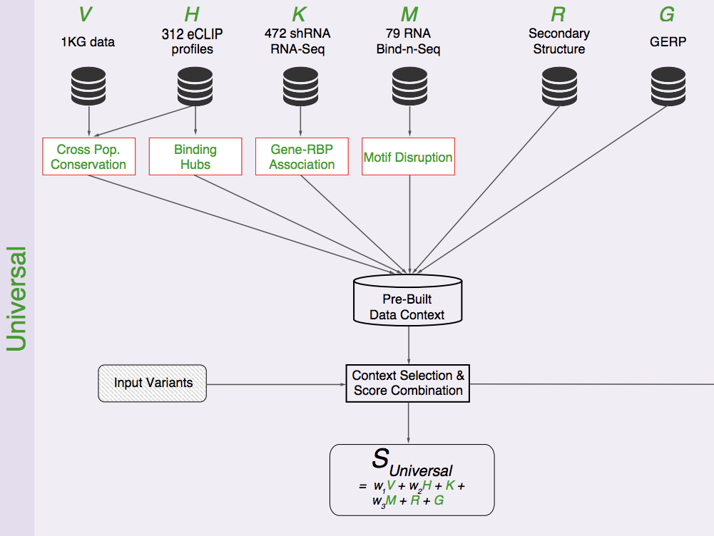
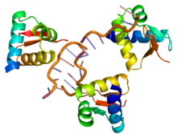
Interpreting variants in SARS-CoV-2 for their non-coding RNA properties
RADAR: Tool to interpret variants in noncoding RNA elements
RNA Secondary Structure
Apply to conserved RNA structure elements in SARS-CoV-2 + search for novel elements
[lectures.gersteinlab.org] [COVID-HASTE-042120]
Frameshifting Element Rangan et al. 2020 bioRXiV
Predicted binding to endogenous proteins
CNN
motif-breaking or gain
gain/loss of RNA binding
Zhang J, Liu JL et al bioRXiV 2019 (GenomeBiology, 2020, in press)
Slide: Michael Rutenberg Schoenberg
Goals: * Evolutionary comparison of SARS-CoV-2 and related coronaviruses to search for more conserved regions * Comparison of strains of SARS-CoV-2 to predict whether mutations in some strains disrupt these RNA structure elements
* SARS-CoV-2 is an RNA virus with conserved structured RNA elements with functions e.g. frameshifting * Investigate structural differences in these and other regions due to mutations in virus

Slide 8
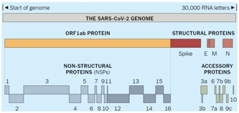
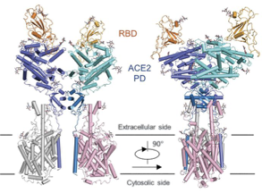
How human population variation relates to cryo-EM structures of host proteins
SARS-CoV-2 encodes 29 proteins
[lectures.gersteinlab.org] [COVID-HASTE-042120]
1000 Genome Project Consortium, Nature (‘15); Abyzov et al, Nat Commun (‘15); Chen et al, Nat Commun (‘17); Balasubramanian et al, Nat Commun (‘17)
Yan et al. 2020 Science.
Slide: Yucheng Yang

Slide 9
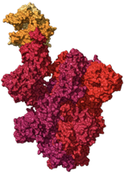
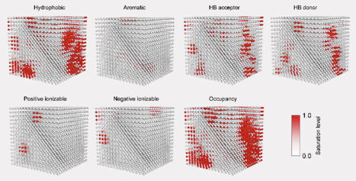
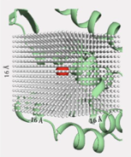
Deep learning model to predict how variants impact the stability of host proteins
RBD-ACE2 complex
Voxelize variant site into 3D grid
Parameterize the variant site in the 3D grid using biophysical properties
[lectures.gersteinlab.org] [COVID-HASTE-042120]
ThermoNet workflow
Bian Li et al. bioRXiV 2020 (PLoS CB under review)
Slide: Yucheng Yang

Slide 10
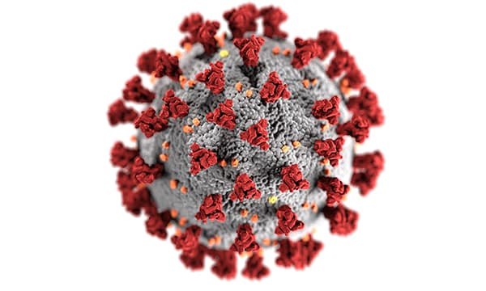
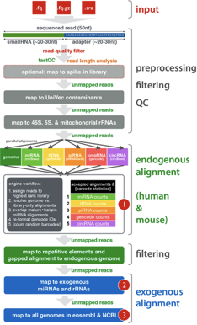
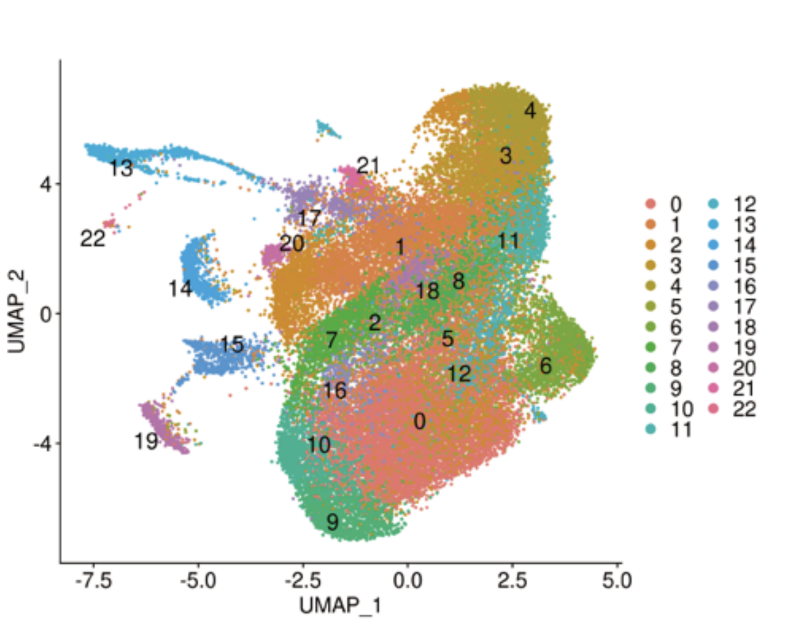
Repurposing existing RNA-seq tools for studying host/virus interactions
exceRpt pipeline
single cell RNA-Seq
Which cells have SARS-COV-2?
+
[lectures.gersteinlab.org] [COVID-HASTE-042120]
Liao et al. medRXiv 2020
COVID-19 patient sample
* Investigate connections between virus + host + other microbes * exceRpt is from the exRNA consortium
Rozowsky et al. Cell Systems 2019, Daniel Spakowicz, Shaoke Lou et al. bioRXiV 2019 (Genome Biology 2020 in press)
Slide: Michael Rutenberg Schoenberg

Slide 11
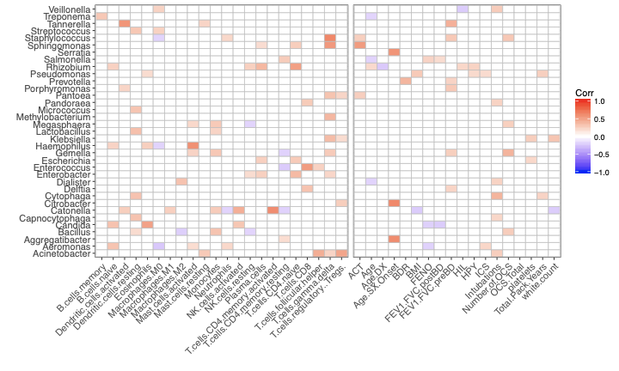
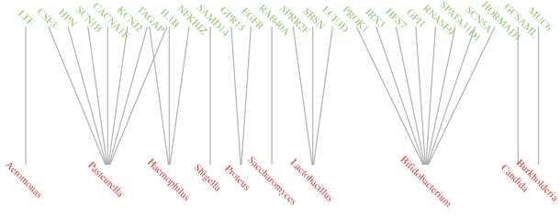
Adapting a machine learning framework for linking microbes to genes in asthma to find SARS-CoV-2 - human gene linkages
Use ExceRpt to discover
Exogenous RNAs
[lectures.gersteinlab.org] [COVID-HASTE-042120]
Microbe-gene links identified by LDA-Link framework
Collaboration with Prof. Geoffrey Chupp
Slide: Shaoke Lou
Daniel Spakowicz, Shaoke Lou et al. bioRXiV 2019 (Genome Biology 2020 in press)

Slide 12
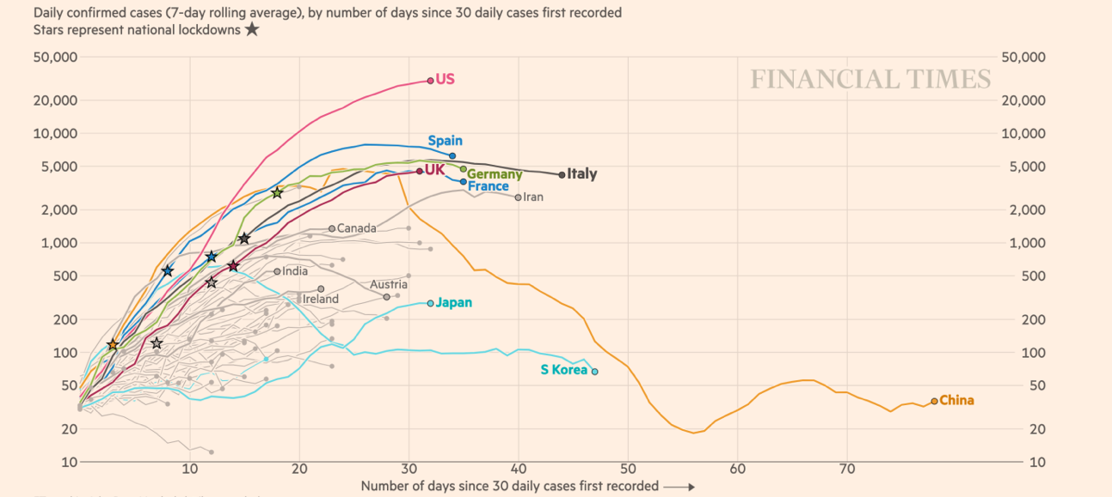
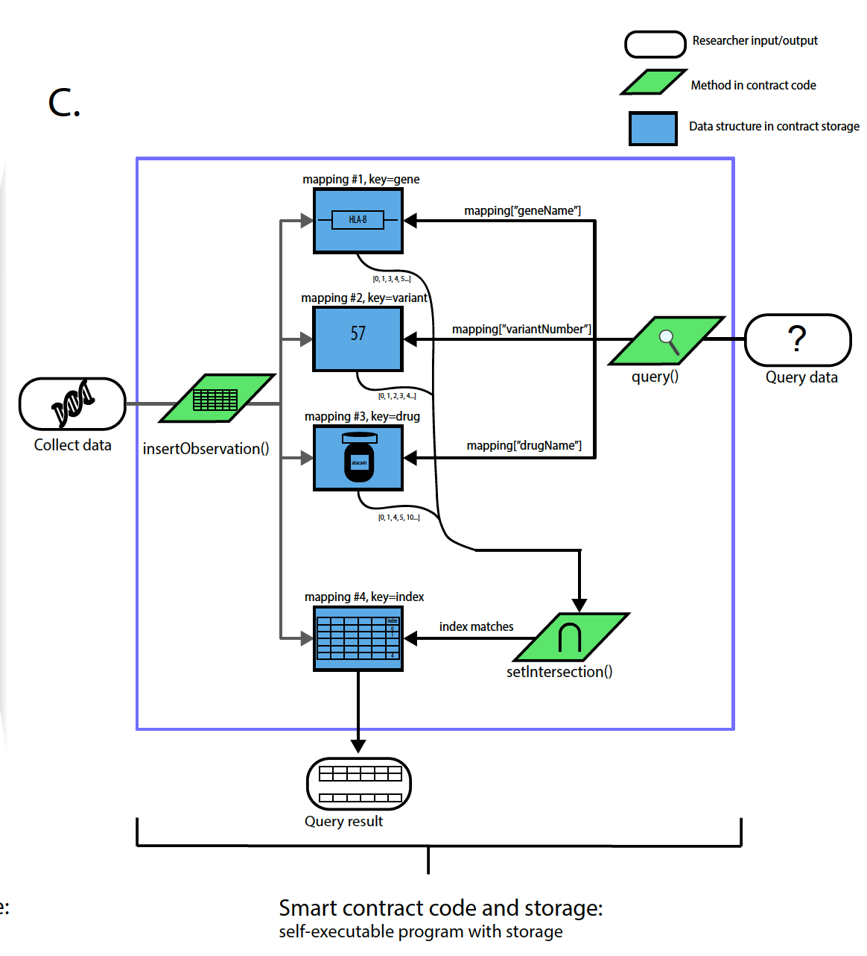
Adapting work on biomedical data privacy & security for COVID-19 contact tracing
One of the most effective ways of stopping the spread is via “contact tracing”, but may not work under certain privacy laws
Data Sanitization Techniques for Genome Privacy
Decentralized Blockchain solutions for robust storage & query
G Gursoy, P Emani, O Jolanki, C Brannon, A Harmanci, S Strattan, A Miranker, M Gerstein, Biorxiv, doi: https://doi.org/10.1101/345074
G Gursoy, R Bjornson, M Green and M Gerstein, BMC Medical Genomics
G Gursoy*, C Brannon*, and M Gerstein, BiorXiv, doi: https://doi.org/10.1101/2019.12.16.878488
G Gursoy, C Brannon, S Wagner, and M Gerstein, BiorXiv, doi: https://doi.org/10.1101/2020.03.03.975334
C Brannon and G Gursoy, https://thegccontent.wordpress.com/2020/04/13/a-practical-ethereum-and-multichain-blockchain-tutorial/
Slide: Gamze Gursoy and Charlotte Brannon

Slide 13
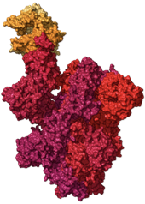
Connect with us
COVID-19 Data
[lectures.gersteinlab.org] [COVID-HASTE-042120]
Data analysis +
Integration
Biological Expertise
Analysis ideas
michael.rutenbergschoenberg@yale.edu & mark@gersteinlab.org
Photo credits:
https://pixabay.com/vectors/cartoon-icon-light-bulb-symbol-1294877/
https://www.massgeneral.org/news/coronavirus/treatment-guidance
https://gisaid.org

Slide 14
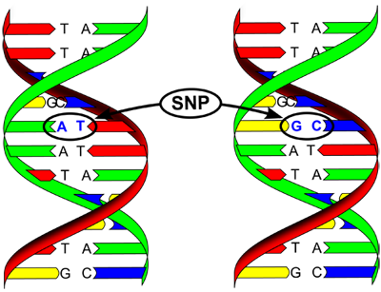
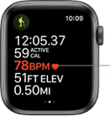
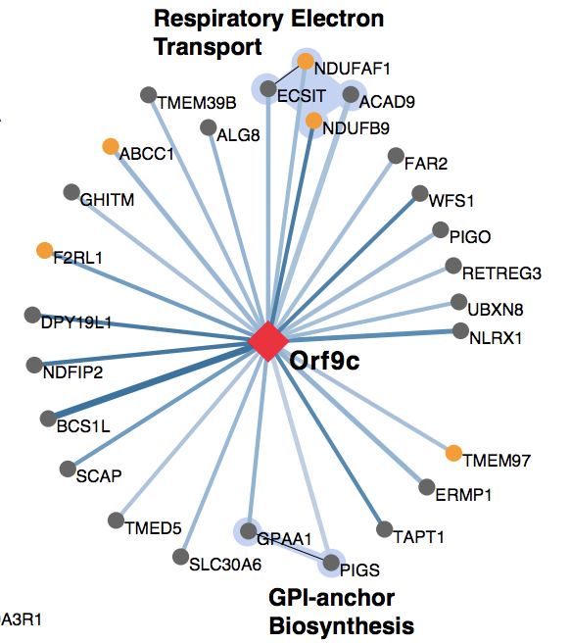
Data we’re particularly interested in
Twitter
mining
Genomes
Functional Genomics: Single-cell, RNA-Seq, ChIP-Seq, Hi-C, Microbiome, etc.
[lectures.gersteinlab.org] [COVID-HASTE-042120]
Biosensors
Epidemiology/ EHR records
Proteomics + Protein-protein interactions
Matched Host + Virus Samples
Cryo-EM & X-ray Structures
Liao et al. medRXiv 2020
https://www.gisaid.org/ Gordon et al. bioRXiV 2020
https://twitter.com/who/status/1236281806661586946

