Slide 1
Biomed. Data Sci. Personal Genomes Intro.
Mark Gerstein, Yale University
GersteinLab.org/courses/452
(last edit in spring‘20)

Slide 2
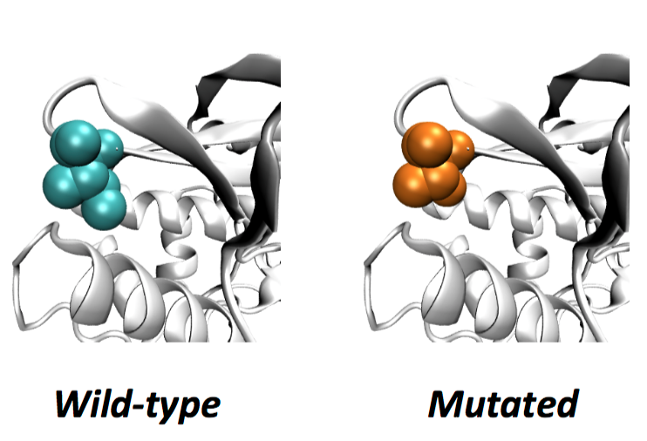
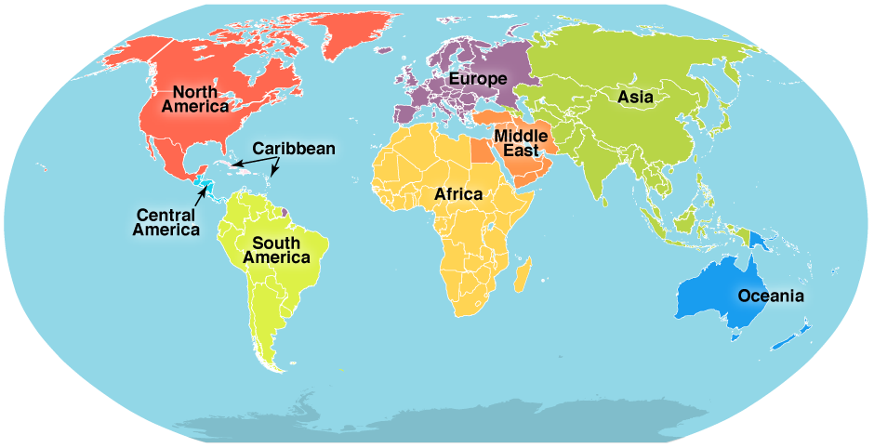
Analyzing Carl Zimmer’s genome
SNV
AAGCT
ACGCT
Protein Structure
Ancestry

Slide 3
Sequence by Illumina
Order blood draw
Arrange an exam
Cost: $3100
Illumina briefly review the sequencing data, evaluating the risk for 1200 disorders, from familiar ones like lung cancer to obscure ones like cherubism

Slide 4
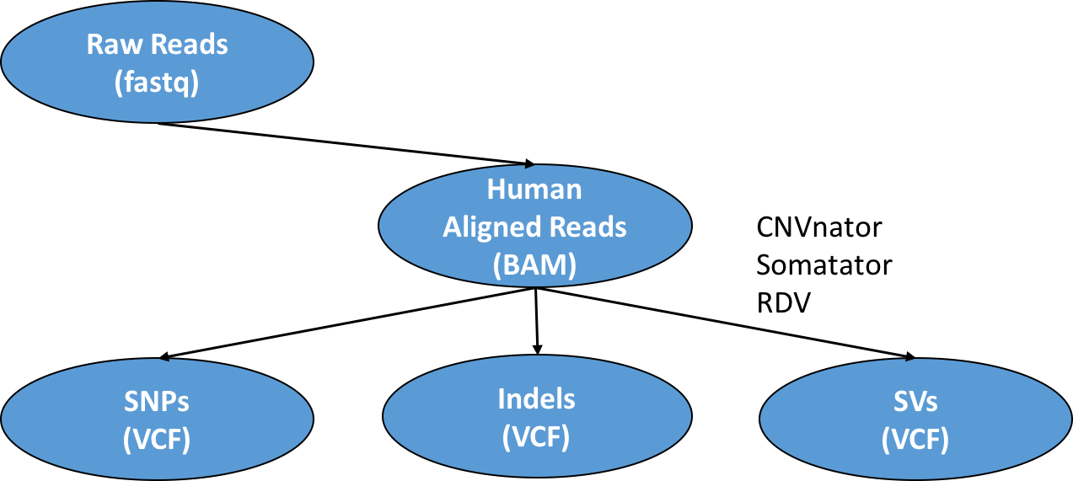
Notes:
Promise that I will cover each of them
Don’t worry.
I’m a superwomen

Slide 5
Genome Variation
TP53 Sequence:
…GGAGTCTTCCAGTGTGATGATGGTGAGGATGGGCCTCCGGTT…
Single Nucleotide Polymorphism (SNP) –1nt:
…GGAGTCTTCCAGTGTGATGATGGTGAGGATGGGCCTCCGGTT…
T or A or C
Small Insertions and DELetions (INDEL) – 1-10nt:
…GGAGTCTTCCAGTGTGATGATGGTGAGGATGGGCCTCCGGTT…
Large Structural Variations (SV) -- >100nt:
…GGAGTCTTCCAGTGTGATGATGGTGAGGATGGGCCTCCGGTT…

Slide 6
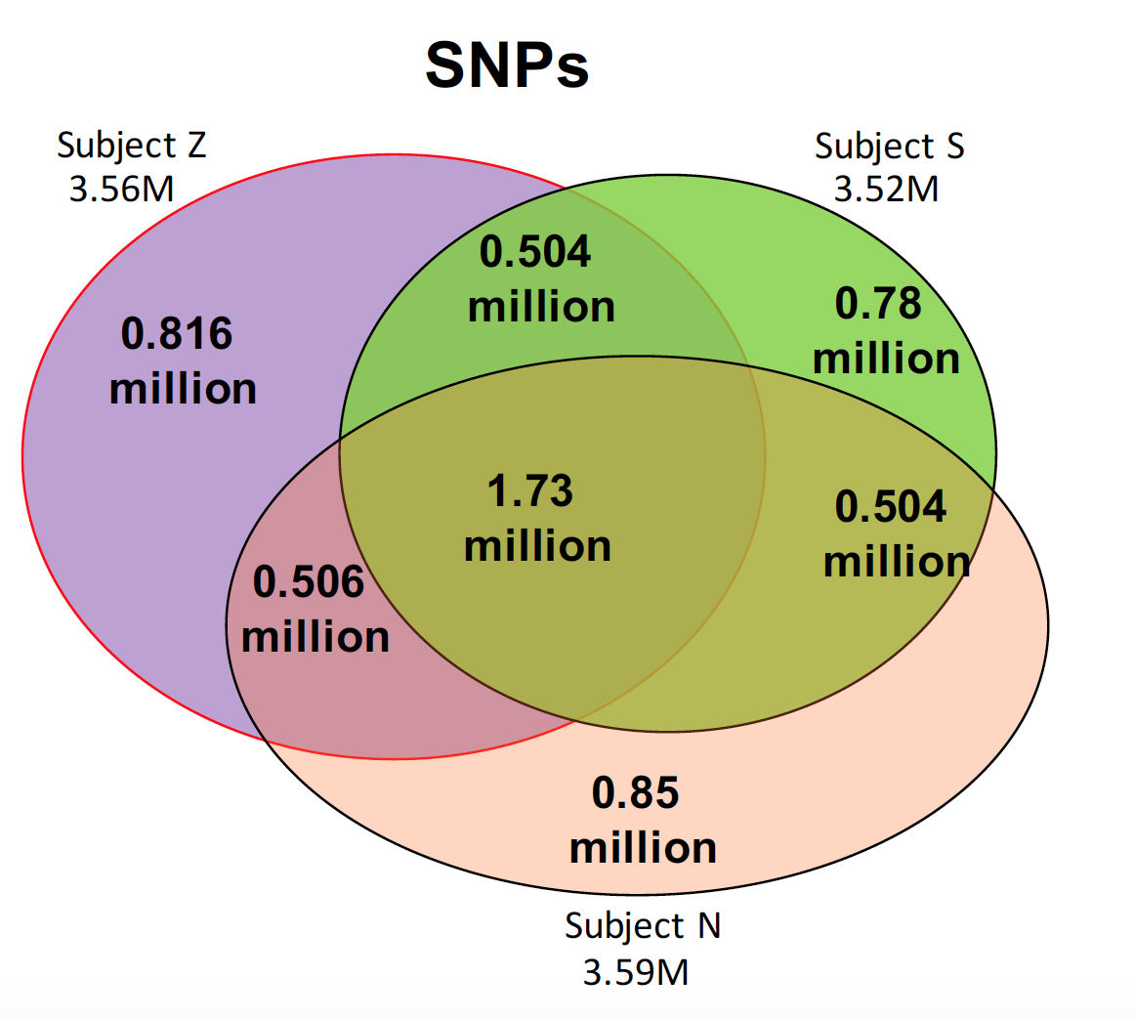
Normal range of number of SNPs
Carl’s case: more than 3M SNPs
How do we know if the SNP is harmful?
Notes:
修改slides

Slide 7
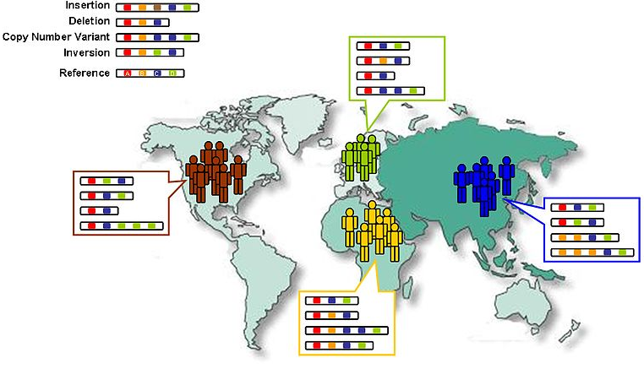
Thousand genome project
Common SNP data base found in the population
https://en.wikipedia.org/wiki/1000_Genomes_Project

Slide 8
Human Genetic Variation
Population of
2,504 peoples
A Cancer Genome
A Typical Genome
Origin of Variants
Class of Variants
 | Coding | Non-coding
Germ-line | 22K | 4.1 – 5M
Somatic | ~50 | 5K
SNP | 3.5 – 4.3M
Indel | 550 – 625K
SV | 2.1 – 2.5K (20Mb)
Total | 4.1 – 5M
SNP | 84.7M
Indel | 3.6M
SV | 60K
Total | 88.3M
Prevalence of Variants
Common
Common
Passenger
Driver (~0.1%)
Rare* (1-4%)
Rare (~75%)
* Variants with allele frequency < 0.5% are considered as rare variants in 1000 genomes project.
The 1000 Genomes Project Consortium, Nature. 2015. 526:68-74
Khurana E. et al. Nat. Rev. Genet. 2016. 17:93-108

Slide 9
Association of Variants with Diseases
Common
Variants
Healthy
Rare or
Somatic
Variants
Pooled
Variants
High
Function
Impact
Diseased
Burden Test
GWAS Positive

Slide 10
Got a variant in a gene for heart muscles, called DSG2
DSG2 gene encodes a protein in humans called Desmoglein-2
Mutations in desmoglein-2 have been associated with arrhythmogenic right ventricular cardiomyopathy
People of European descent carry this variant
---- Carl Zimmer

Slide 11
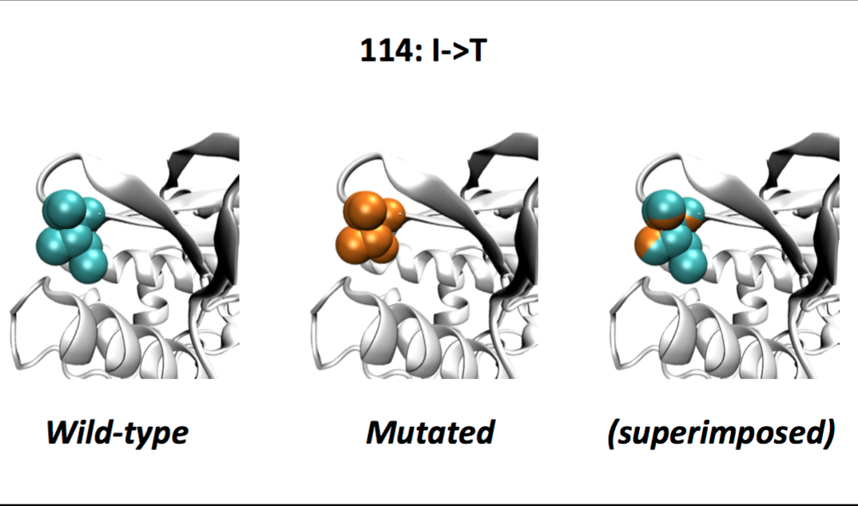
SNP changing protein structure
NAT2, an enzyme in the liver that breaks down caffeine and other toxins with a similar molecular structure.
NAT2 helps break down certain medicines too. The variant puts people at risk of bad side effects from those drugs.

Slide 12
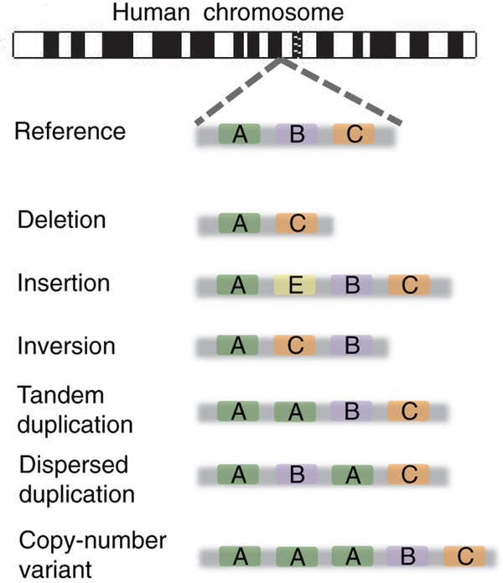
Structural Variation
Baker, M., 2012. Nature methods, 9(2), pp.133-137.

Slide 13
Structural variation
Example: HTT
Certain mutations in HTT cause Huntington’s disease.
Healthy people have a wide range of CAG repeats. It’s only when people get 37 or more CAG repeats in HTT that they are at risk of developing Huntington’s disease.
The reference genome has 19 CAG repeats. Carl has 17.
Notes:
Huntington’s disease starts in middle age, leads to dementia, and ends with death.
Repeating DNA is very hard to sequence accurately
with short reads, because there aren’t any distinctive sequences to anchor them.

Slide 14
Non-coding variant
Variant rs1421085
Located in a genetic switch that activates several genes in fat cells
The variant causes people to put on an average of 7 pounds
Claussnitzer, Melina, et al. N Engl J Med 2015.373 (2015): 895-907.
Notes:
The variant causes people to put on an average of 7 pounds

Slide 15
Integrating environmental factors, genetic background, and large-scale datasets
Difference between health and disease depends on many factors.
Environment, genome, cellular contents, etc. all play a a role.
Important to integrate information from multiple large-scale datasets.
Sun et al. Advances in Genetics 2016

Slide 16
Expanding personalized medicine beyond the genome.
An integrated personal omics profile (iPOP) is an example of a more comprehensive version of personalized medicine.
Michael Snyder had his genome sequenced and collected many other large scale datasets over an extended period of time.
https://med.stanford.edu/news/all-news/2017/01/wearable-sensors-can-tell-when-you-are-getting-sick.html

Slide 17
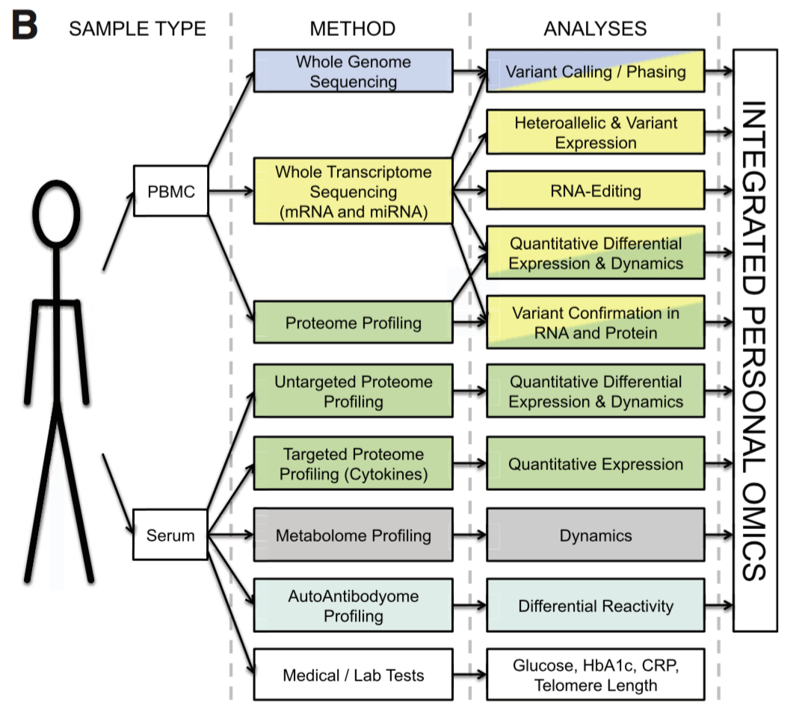
Integrated personal omics profile (iPOP)
Numerous types of data were collected, primarily from blood samples. The datasets include:
Transcriptomic
Proteomic
Metabolomic
Cytokine profiling
Autoantibody profiling
Medical exams
Chen et al. Cell 2012

Slide 18
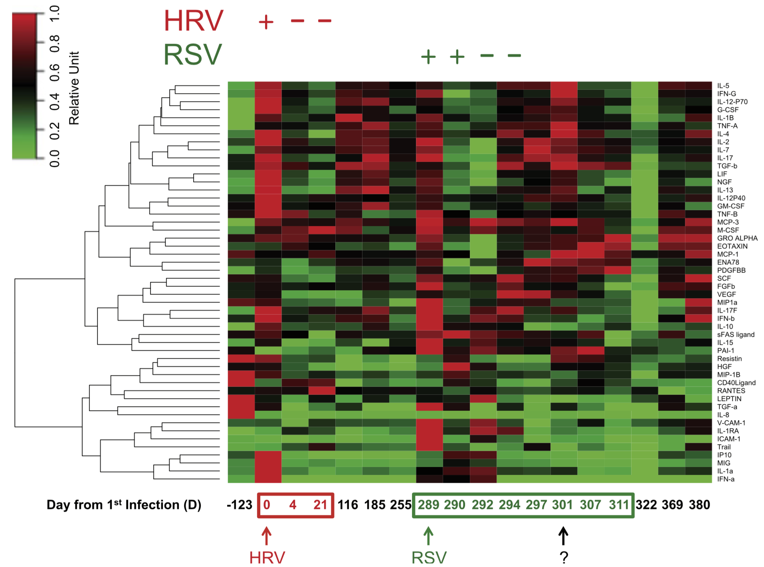
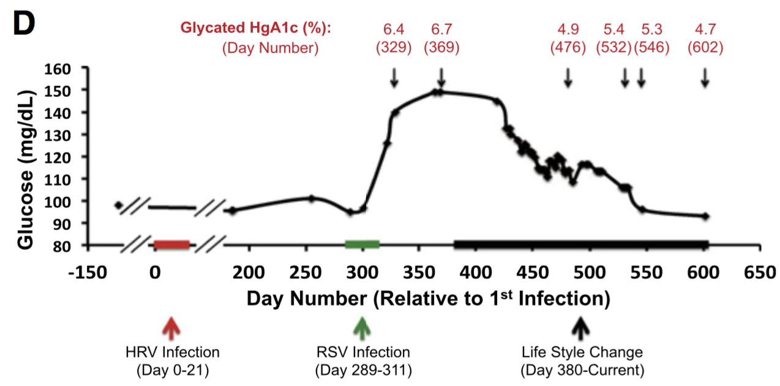
Longitudinal medical data
Tracking relevant medical (e.g. blood glucose) data over time helps link phenotypic changes with changes at the molecular level.
Chen et al. Cell 2012

