Slide 1

PsychENCODE:
Using population-scale functional genomics to understand neuro-psychiatric disease
Mark Gerstein, Yale
Slides freely downloadable from Lectures.GersteinLab.org &
“tweetable” (via @markgerstein). See last slide for more info.

Slide 2
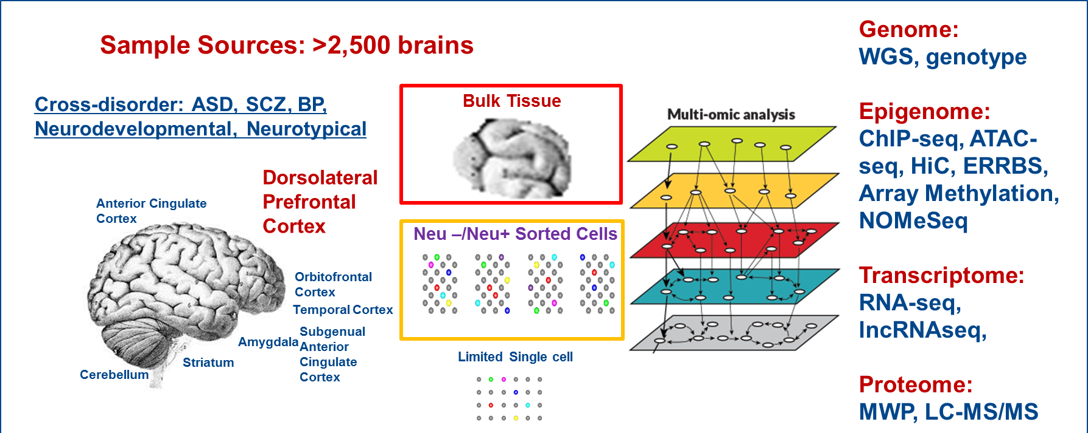
The PsychENCODE Consortium
Single Cell
Notes:
Current phase is wrapping up- we have uniformly processed data across disorders and time periods on now up to >2500 frozen postmortem brains from brain banks.
Data generation has focus on mostly DLFPC with a few other brain regions also covered.
Analyses were primarily bulk tissues with some sorted NeuN+/- cells and a limited amount of ss data generation.
Multiple assays – WGS, SNP genotypes Epigenome: ChIP-seq, ATAC-seq, HiC, ERRBS, Array Methylation, NOMeSeq Transcriptome: RNA-seq, lncRNAseq, Proteome: RPPA.
The analyses have focused on identifying brain enhancers relevant and disease-specific eQTLs and epigenomic variation.
An invaluable public resource of multidimensional genomic data
They are also collaborating with GTEX, ENCODE and other related consortia to enhance the power and impact of their analyses.

Slide 3
A core issue addressed by PsychENCODE:
Using functional genomics to reveal molecular mechanisms between genotype and phenotype in brain disorders
Disease | Heritability* | Molecular Mechanisms
Schizophrenia | 81% | (C4A)
Bipolar disorder | 70% | -
Alzheimer's disease | 58 - 79% | Apolipoprotein E (APOE), Tau
Hypertension | 30% | Renin–angiotensin–aldosterone
Heart disease | 34-53% | Atherosclerosis, VCAM-1
Stroke | 32% | Reactive oxygen species (ROS), Ischemia
Type-2 diabetes | 26% | Insulin resistance
Breast Cancer | 25-56% | BRCA, PTEN
Phenotype
SCZ
BPD
AGE
…
*https://www.snpedia.com/index.php/Heritability
pathways, circuits
Cell types
Modules
Regulatory elements
Genes
Genotype
Many psychiatric conditions are highly heritable
  Schizophrenia: up to 80%
But we don’t understand basic molecular mechanisms underpinning this association
(in contrast to many other diseases such as cancer & heart disease)
Thus, interested in developing predictive models of psychiatric traits which:
  Use observations at intermediate (molecular levels) levels to inform latent structure
  Use the predictive features of these “molecular endo phenotypes” to begin to suggest actors involved in mechanism

Slide 4
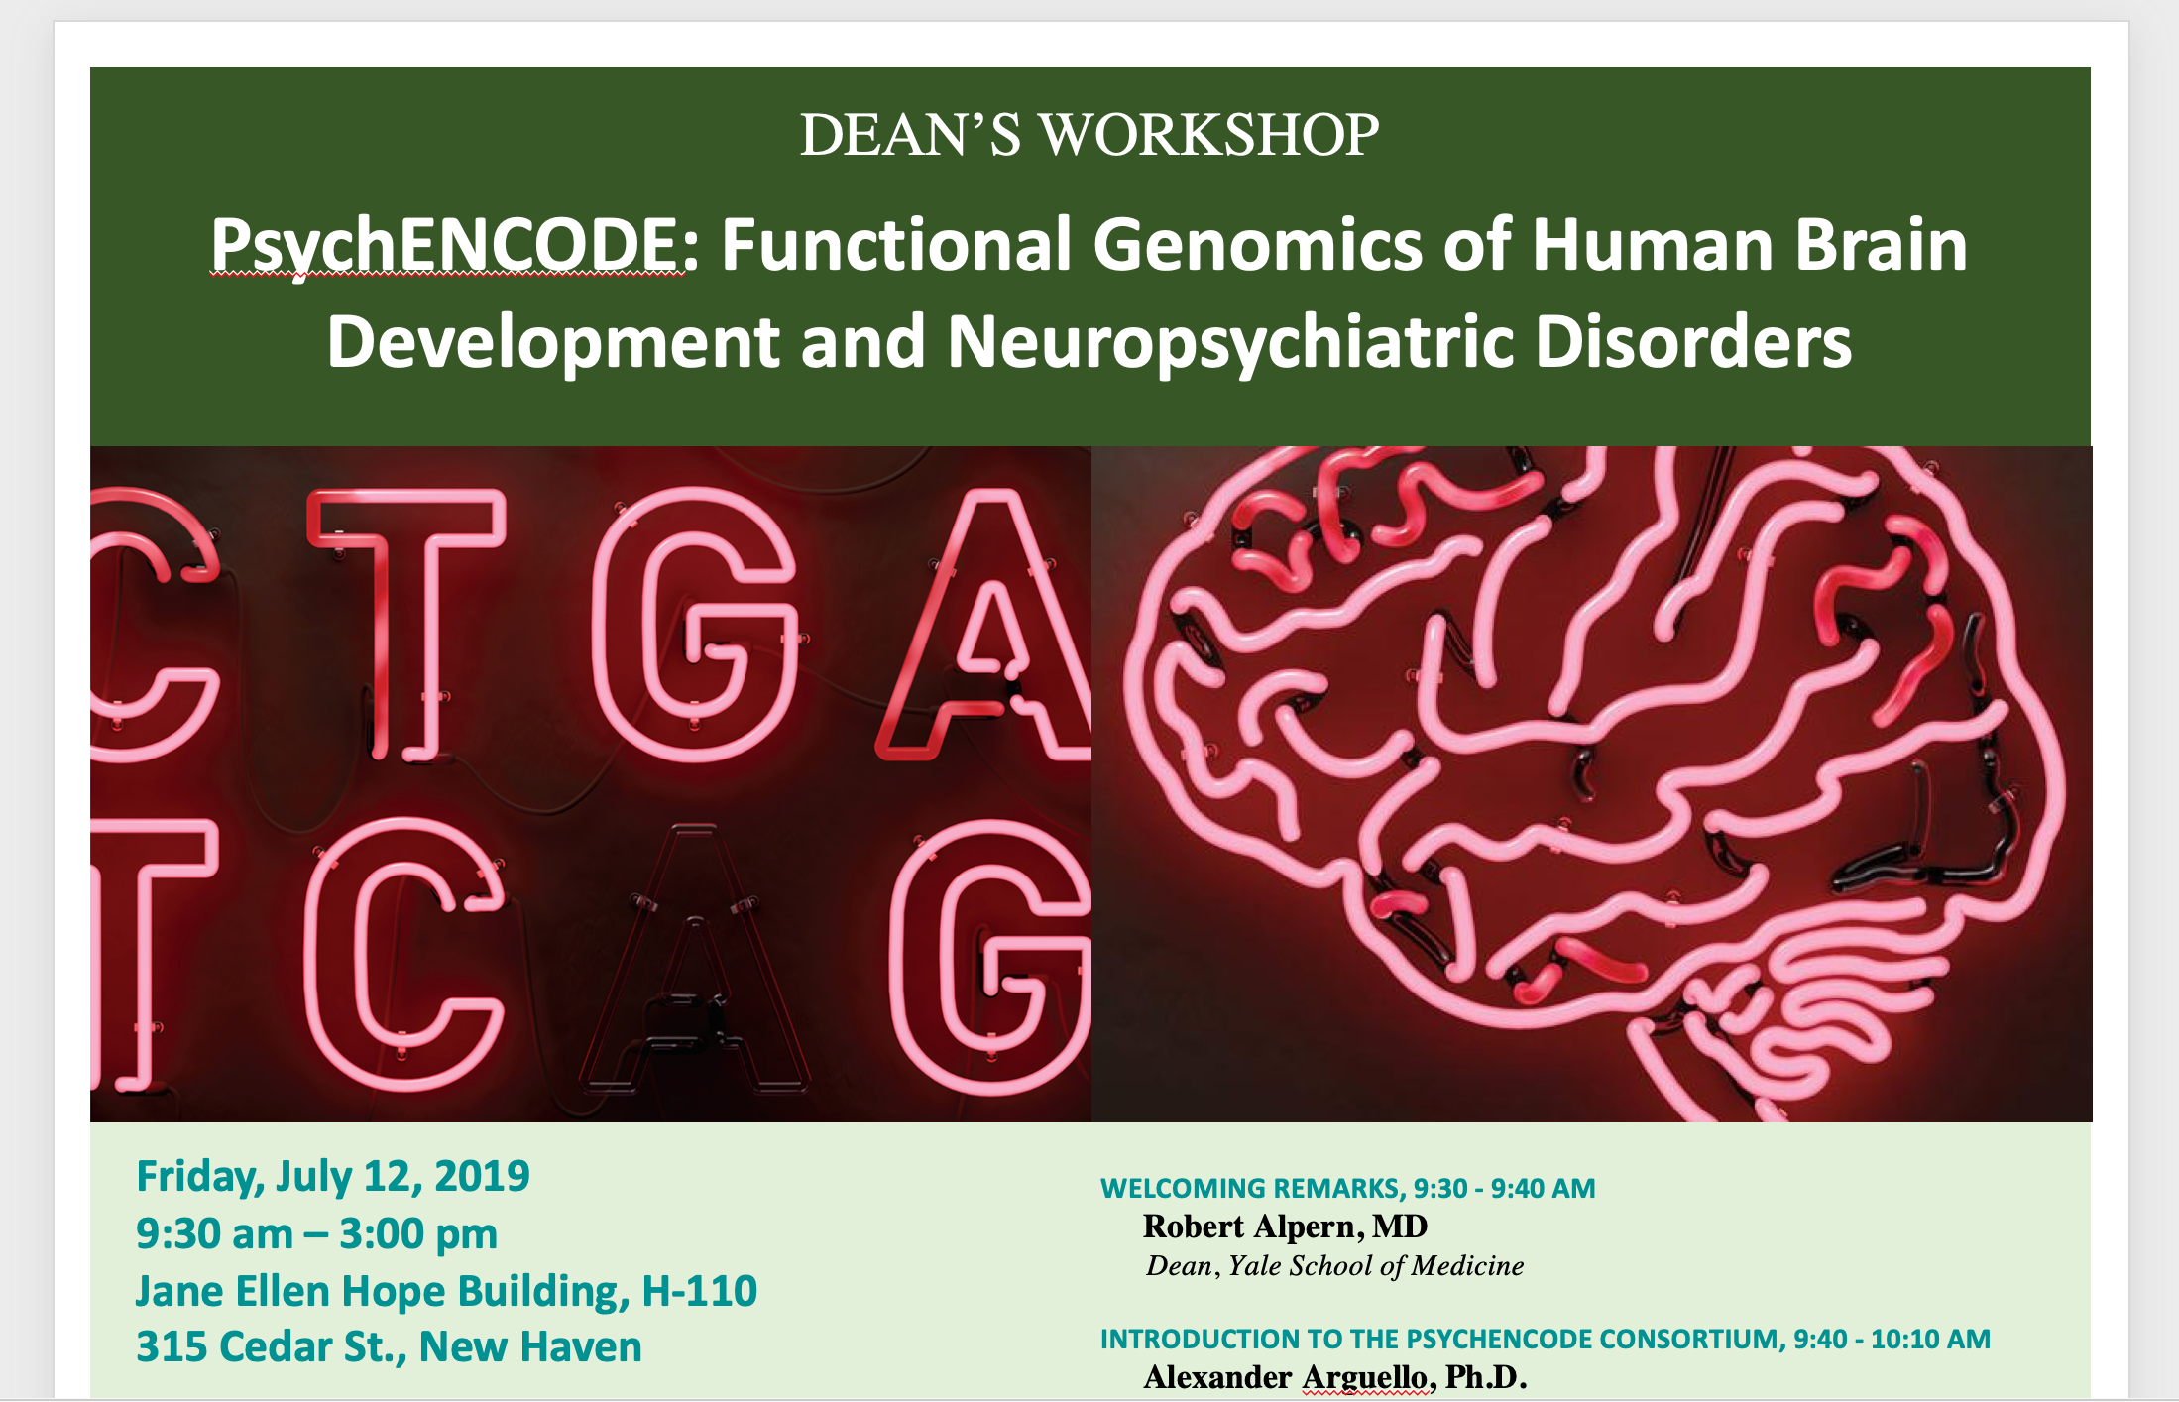
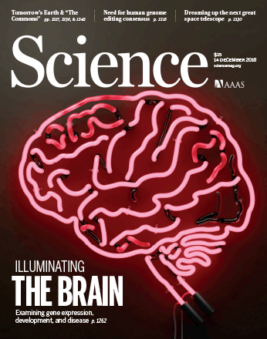

2018 PsychENCODE
“Rollout”

Slide 5
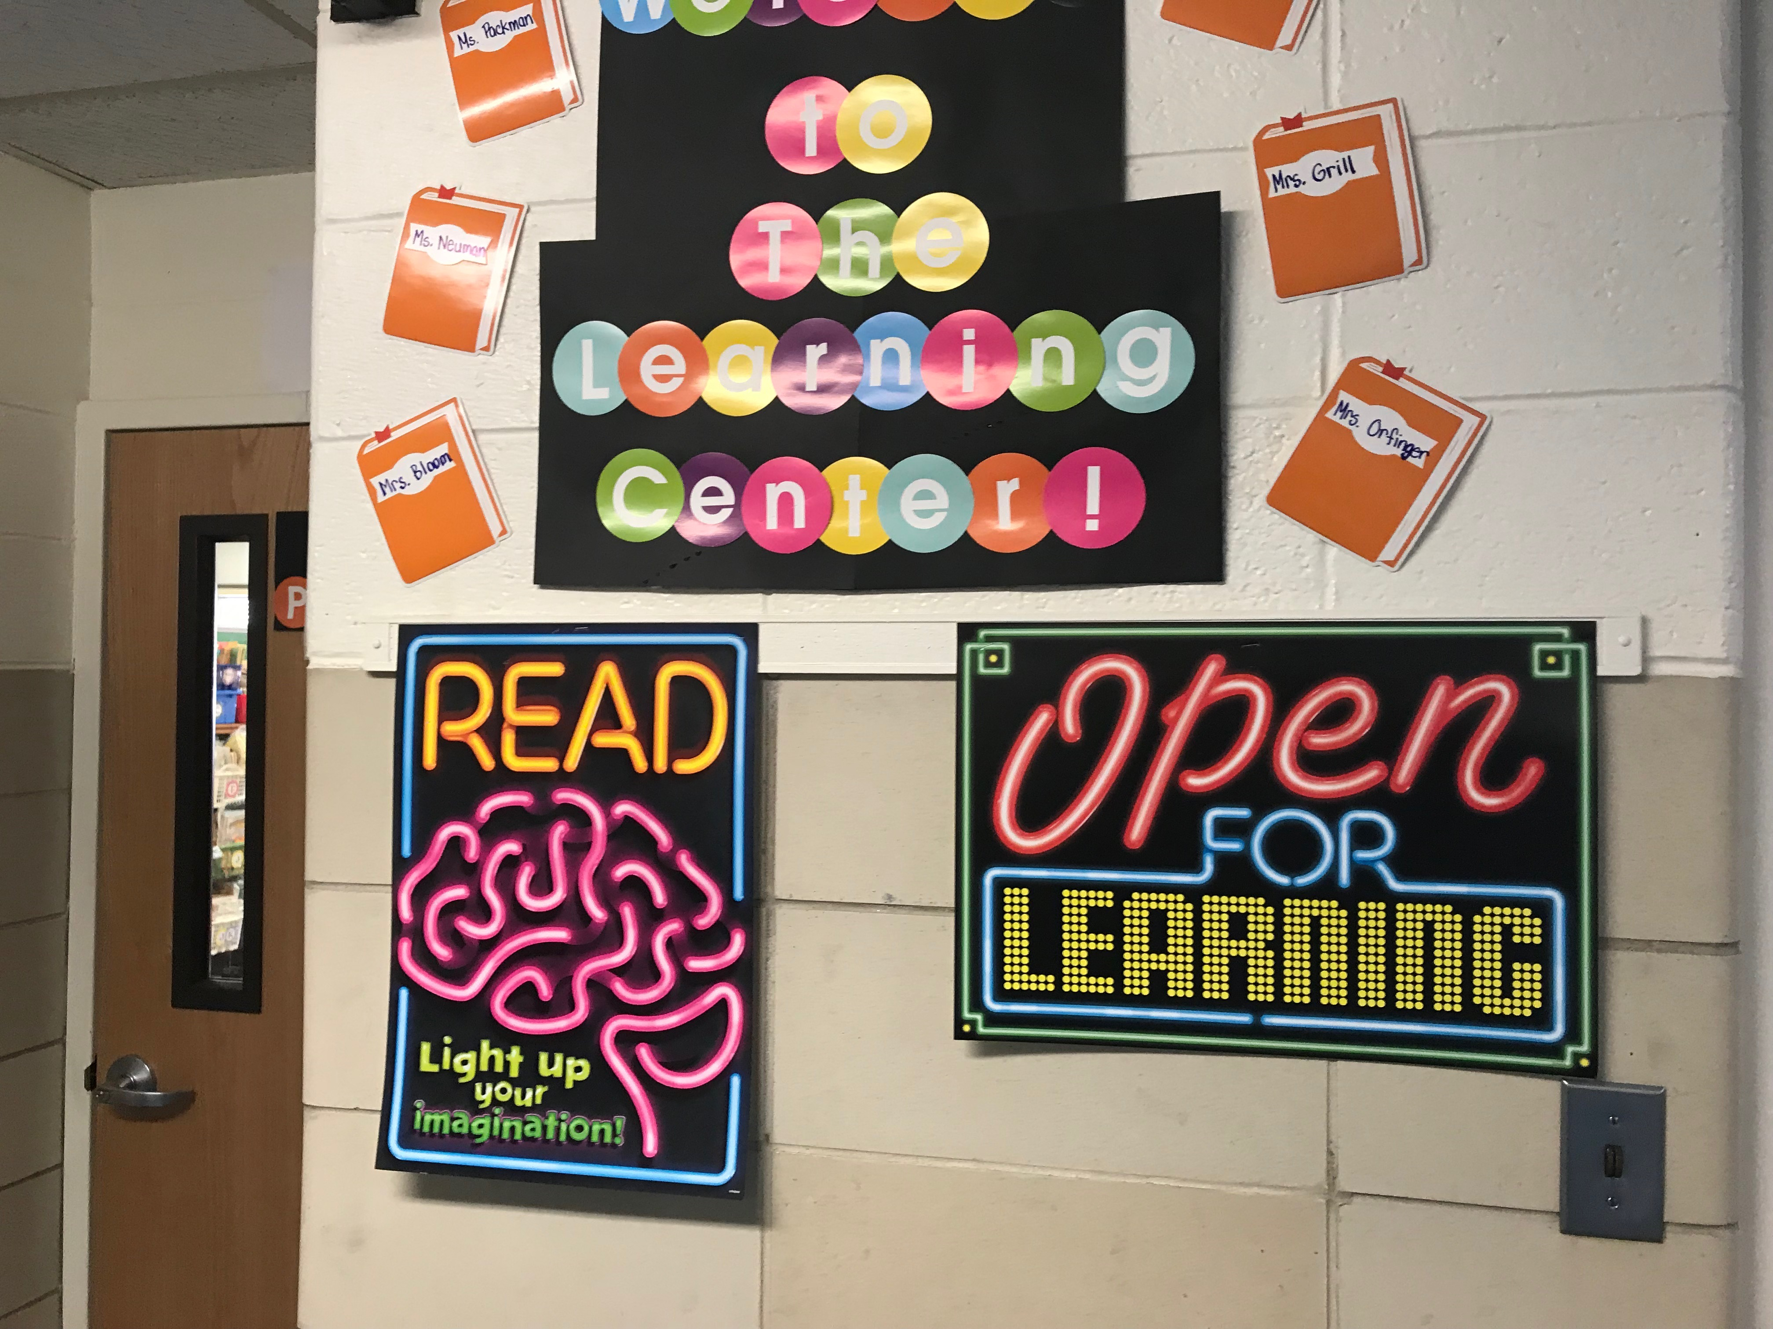
2018 PsychENCODE
“Rollout”
[School pic from D Wang]

Slide 6
PsychENCODE: Using population-scale functional genomics to understand neuropsychiatric disease
Construction of an adult brain resource with 1866 individuals,
via data set fusion and uniform processing
Using the changing proportions of cell types
(via single-cell deconvolution) to account for expression variation across a population & disorders
Large-scale processing defines ~79K PFC
enhancers & creates a comprehensive QTL resource (~2.5M eQTLs + cQTLs & fQTLs)
Connecting QTLs, enhancer activity relationships & Hi-C into a
brain regulatory network &
using this to link SCZ GWAS SNPs to genes
Embedding the regulatory network in a
deep-learning model to predict disease from genotype & transcriptome. Using this to suggest specific pathways & genes, as targets.
  Other uses for the resource: Highlighting aging related genes + consistently comparing the brain to other organs

Slide 7
PsychENCODE: Using population-scale functional genomics to understand neuropsychiatric disease
Construction of an adult brain resource with 1866 individuals,
via data set fusion and uniform processing
Using the changing proportions of cell types
(via single-cell deconvolution) to account for expression variation across a population & disorders
Large-scale processing defines ~79K PFC
enhancers & creates a comprehensive QTL resource (~2.5M eQTLs + cQTLs & fQTLs)
Connecting QTLs, enhancer activity relationships & Hi-C into a
brain regulatory network &
using this to link SCZ GWAS SNPs to genes
Embedding the regulatory network in a
deep-learning model to predict disease from genotype & transcriptome. Using this to suggest specific pathways & genes, as targets.
  Other uses for the resource: Highlighting aging related genes + consistently comparing the brain to other organs

Slide 8
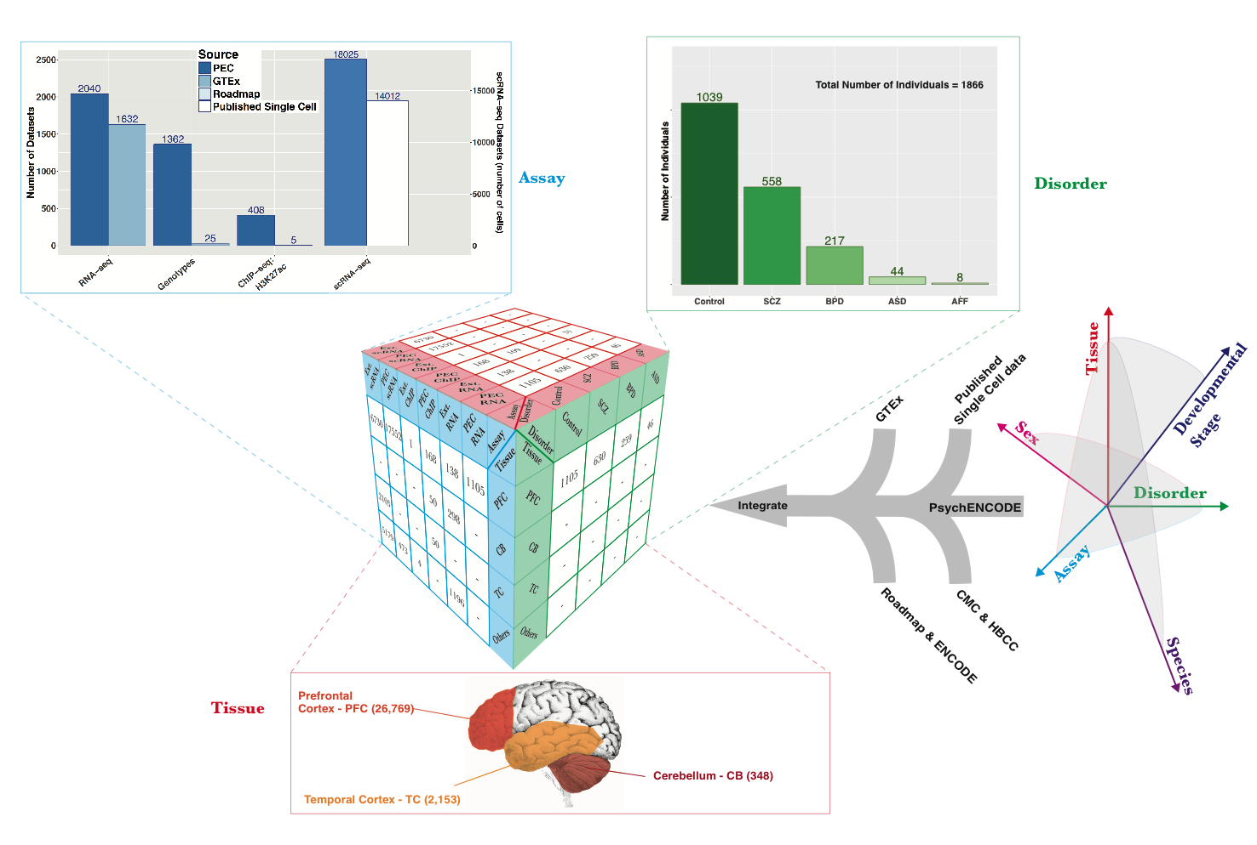
Collecting functional genomic datasets for the adult brain from PsychENCODE, other large consortia & single cell studies
1866
Individuals
~3.7K bulk RNA-seq
~32K single-cells

Slide 9
Merging & Clustering Single Cell Data Sets
Single cell signatures, from:
~14K cells
(Lake et al.,‘16 & ‘18)
~400 cells
(Darmanis et al., PNAS, ‘15)
~18K cells (PsychENCODE)
Lake et al., 2018 data
PEC adult data
[Li et al. (‘18), Science. Wang et al. (‘18). Science]

Slide 10
24 selected cell types
(Neuronal, NonNeuronal, Developmental)
1866 individuals
1866 individuals
Bulk
expression
(B)
Deconvolution
All genes
24 selected cell types
Single-cell deconvolution
Step 1:
Supervised learning to estimate cell fractions
All genes (∼20K)
≈
×
Cell fractions (W)
Single cell expression (C)
88%±4%
Individual and cross-population reconstruction accuracy via deconvolution
[Wang et al. (‘18) Science]

Slide 11
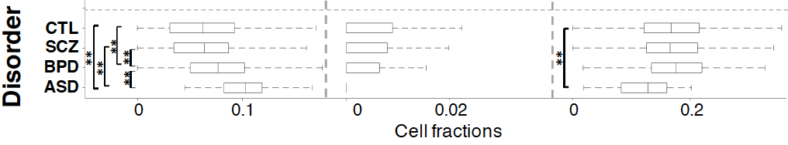
Different neuronal & glial cell fractions across disorders
Ex5
In6
Oligo
Excitatory to Inhibitory imbalance at neuronal subtype level for ASD*
* Rubenstein et al., Model of autism: increased ratio of excitation/inhibition in key neural systems, Genes Brain Behav. 2003
[Wang et al. (‘18) Science]
Notes:
* Rubenstein et al., Model of autism: increased ratio of excitation/inhibition in key neural systems, Genes Brain Behav. 2003
** Gandal et al., Shared molecular neuropathology across major psychiatric disorders parallels polygenic overlap, Science 2018

Slide 12
PsychENCODE: Using population-scale functional genomics to understand neuropsychiatric disease
Construction of an adult brain resource with 1866 individuals,
via data set fusion and uniform processing
Using the changing proportions of cell types
(via single-cell deconvolution) to account for expression variation across a population & disorders
Large-scale processing defines ~79K PFC
enhancers & creates a comprehensive QTL resource (~2.5M eQTLs + cQTLs & fQTLs)
Connecting QTLs, enhancer activity relationships & Hi-C into a
brain regulatory network &
using this to link SCZ GWAS SNPs to genes
Embedding the regulatory network in a
deep-learning model to predict disease from genotype & transcriptome. Using this to suggest specific pathways & genes, as targets.
  Other uses for the resource: Highlighting aging related genes + consistently comparing the brain to other organs

Slide 13
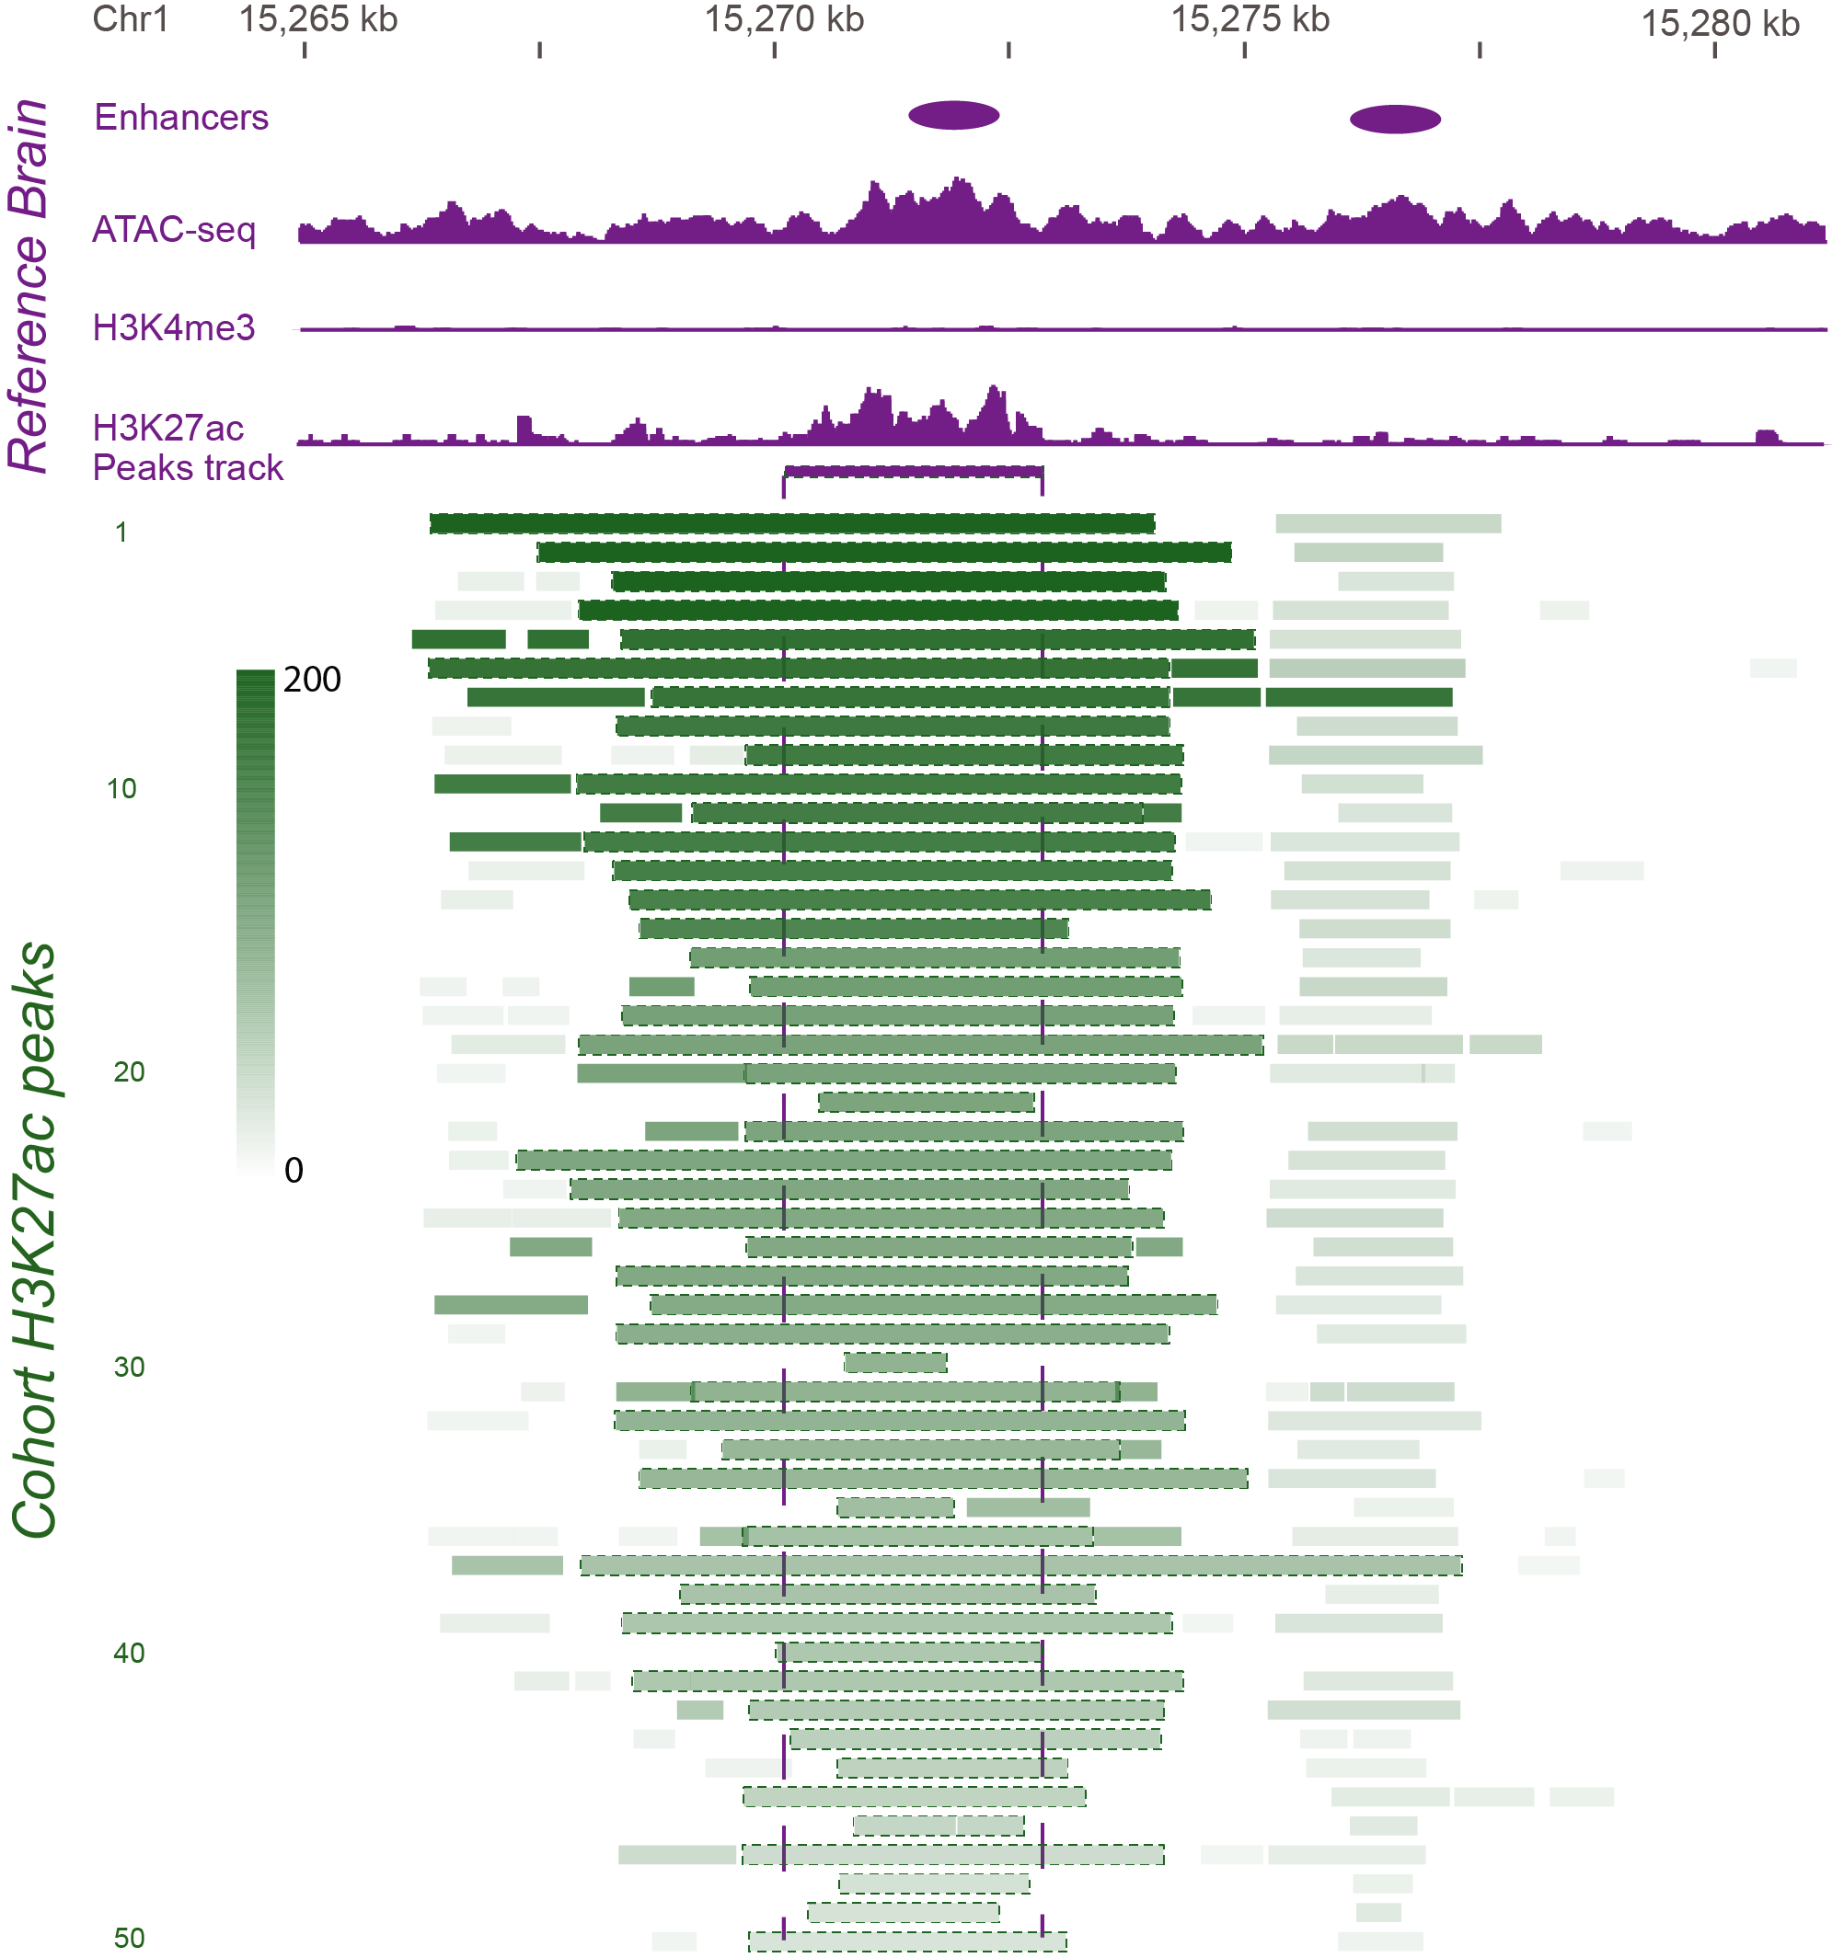
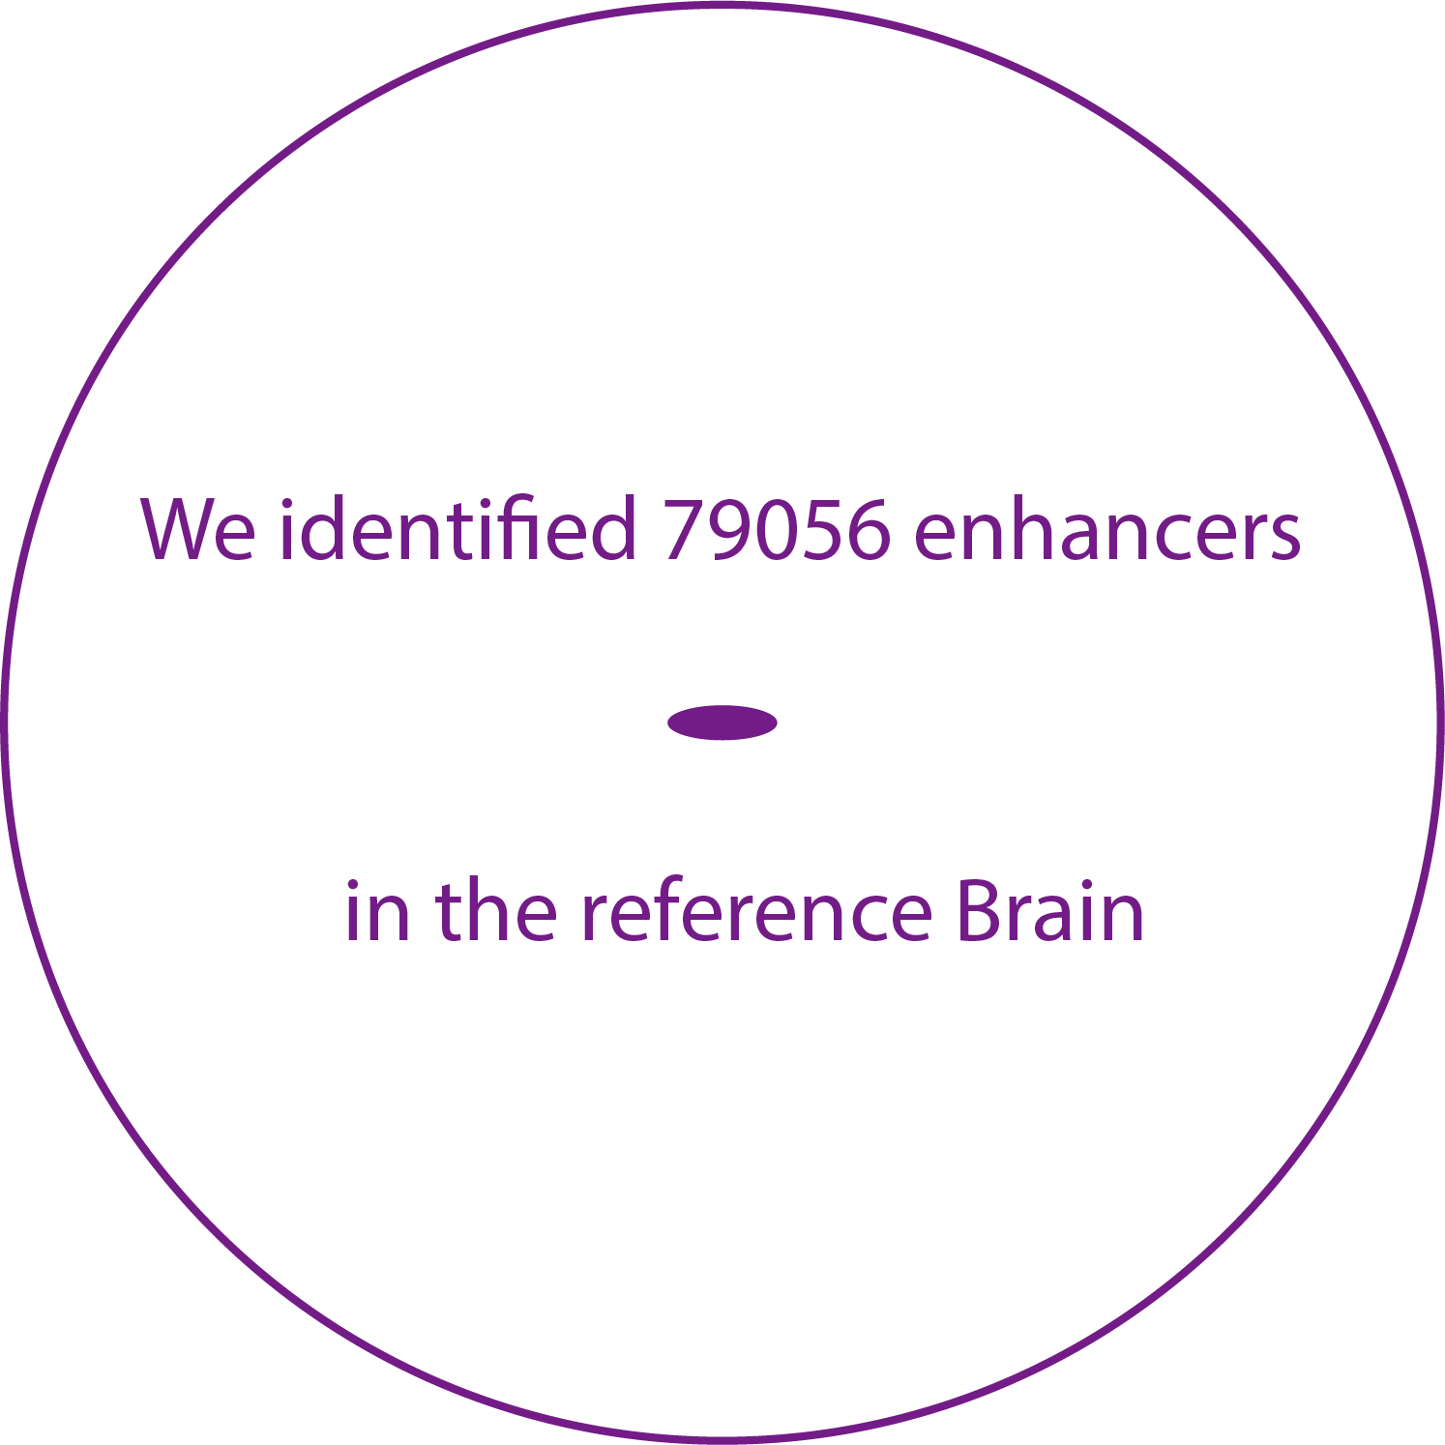
Developing a Reference Set of ~79K PFC Enhancers & Studying Their Population Variation
Characterize brain specific enhancers
Consistent with ENCODE, active enhancers are identified as open chromatin regions enriched in H3K27ac and depleted in H3K4me3
[Wang et al. (‘18) Science]

Slide 14
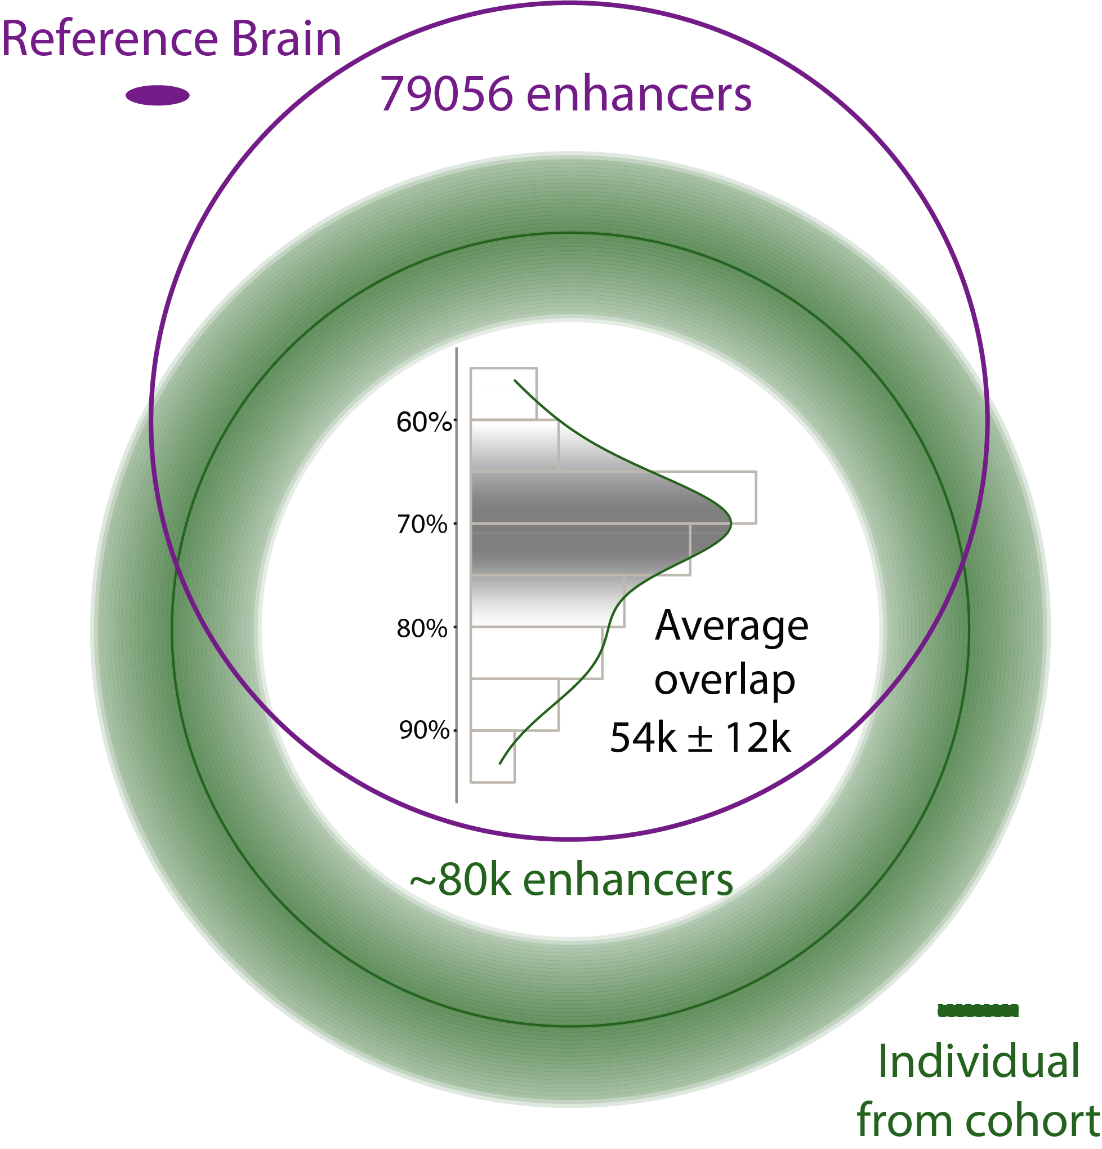
Developing a Reference Set of ~79K PFC Enhancers & Studying Their Population Variation
Characterize brain specific enhancers
[Wang et al. (‘18) Science]

Slide 15
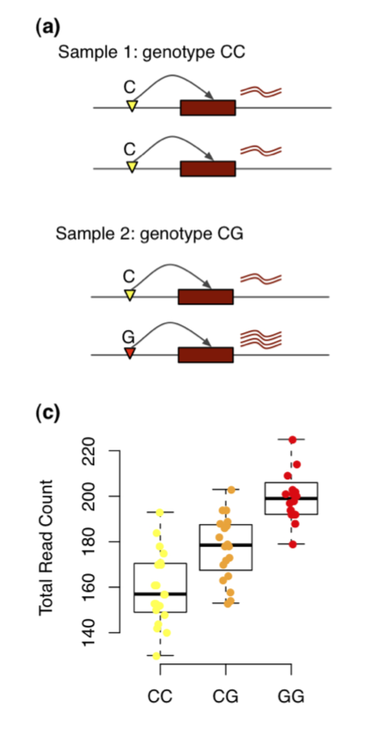
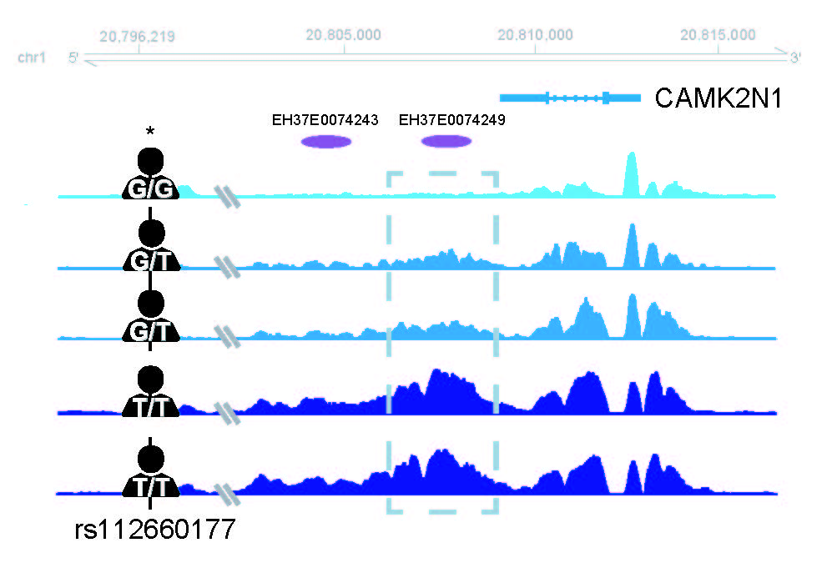
Chromatin variation in the population
Quantitaive Trait Loci (QTLs) associated with variation
Gene expression (eQTL)
Chromatin (cQTL)
Sun, Wei, and Yijuan Hu. "eQTL mapping using RNA-seq data." Statistics in biosciences 5.1 (2013): 198-219.
[Wang et al. (‘18) Science]

Slide 16
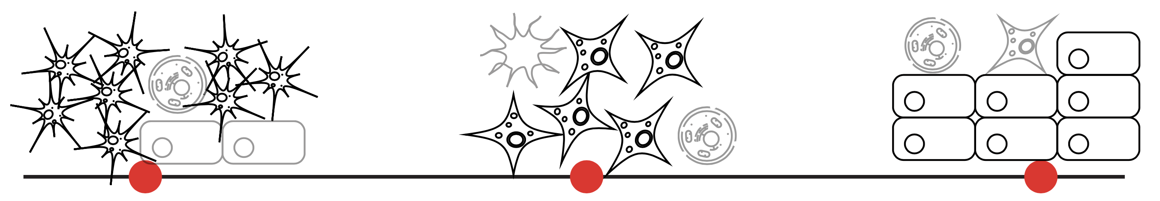
Cell fraction QTLs (fQTLs)
A→T
C→G
T→C
[Wang et al. (‘18) Science]
Notes:
Brain eQTLs
32944(75%) eGenes
2,542,908 eQTLs (3% out of 66,441,766 total pairs)
1,341,182 unique cis-eSNP (~20%) (~238K independent SNPs after linkage-disequilibrium (LD) pruning)

Slide 17
Larger brain eQTL sets than previous studies, but strong overlap with them
2,542,908 eQTLs (FDR< 0.05)
[Wang et al. (‘18) Science]
Notes:
Brain eQTLs
32944(75%) eGenes
2,542,908 eQTLs (3% out of 66,441,766 total pairs)
1,341,182 unique cis-eSNP (~20%) (~238K independent SNPs after linkage-disequilibrium (LD) pruning)

Slide 18
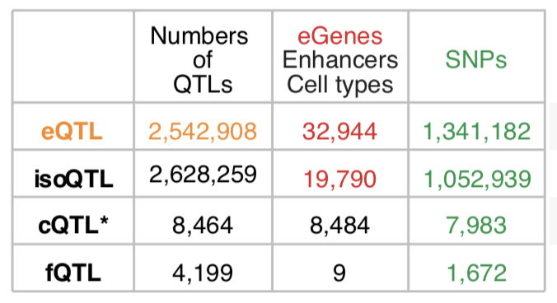
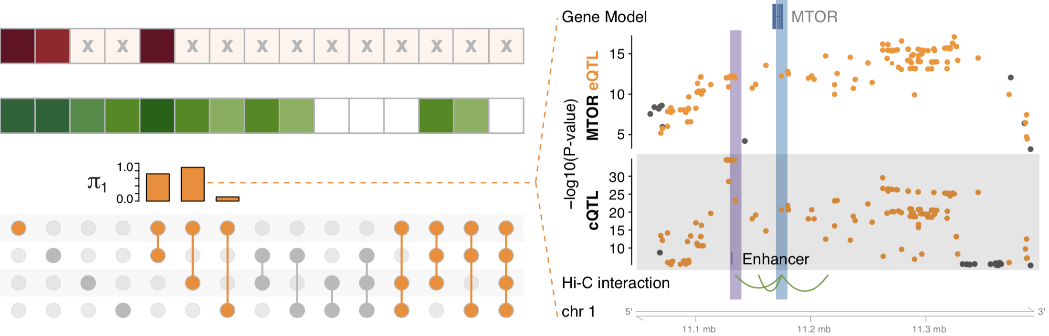
multi-QTLs from overlapping different types of QTLs: cQTL, fQTL, eQTL & isoQTL
eQTLs for mTOR mediated by cQTLs
eQTL
isoQTL
cQTL
fQTL
eQTLs and cQTLs significantly overlap
1391 SNPs (multi-QTLs)
in at least three types
among eQTLs, isoQTLs, cQTLs, fQTLs
[Wang et al. (‘18) Science]
Notes:
*top SNPs for each enhancer
To evaluate this precisely, we calculated π₁ statistics and found that the eQTL overlap with cQTLs was the most significant while that with fQTLs was lowest (0.89 vs 0.11). Moreover, eQTL-cQTL overlaps often suggested that the expression-modulating function of an eQTL derived from chromatin changes (e.g. for MTOR, Fig. 4F). Finally, 119 SNPs, which we dubbed multi-QTLs, functioned as QTLs in more than 3 different capacities (e.g. as eQTLs, cQTLs and isoQTLs).
https://www.nature.com/articles/nrn3068

Slide 19
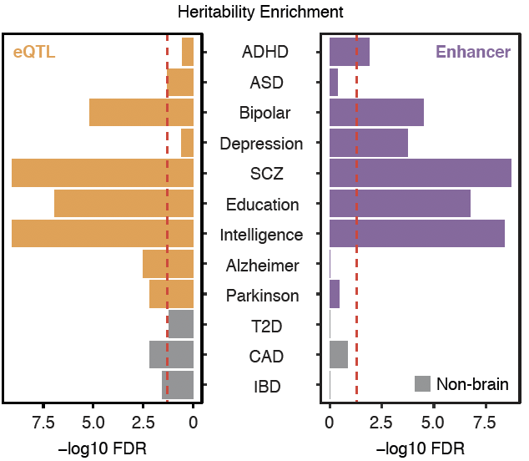
Brain eQTLs and enhancers enriched with GWAS SNPs for brain disorders
Enrichment
Wang, et al., Science, 2018
Notes:
DLPFC for psy disorders
AD/PD is not spec for DLPFC
*linkage disequilibrium score regression (LDSC, Finucane et al., 2015; https://github.com/bulik/ldsc/wiki/Partitioned-Heritability)
ADHD, attention-deficit/hyperactivity disorder; T2D, type 2 diabetes; CAD, coronary artery disease; IBD, inflammatory bowel disease.

Slide 20
PsychENCODE: Using population-scale functional genomics to understand neuropsychiatric disease
Construction of an adult brain resource with 1866 individuals,
via data set fusion and uniform processing
Using the changing proportions of cell types
(via single-cell deconvolution) to account for expression variation across a population & disorders
Large-scale processing defines ~79K PFC
enhancers & creates a comprehensive QTL resource (~2.5M eQTLs + cQTLs & fQTLs)
Connecting QTLs, enhancer activity relationships & Hi-C into a
brain regulatory network &
using this to link SCZ GWAS SNPs to genes
Embedding the regulatory network in a
deep-learning model to predict disease from genotype & transcriptome. Using this to suggest specific pathways & genes, as targets.
  Other uses for the resource: Highlighting aging related genes + consistently comparing the brain to other organs

Slide 21
Gene regulatory network inference from Hi-C, QTLs & Activity Correlations
[Wang et al. (‘18) Science]

Slide 22
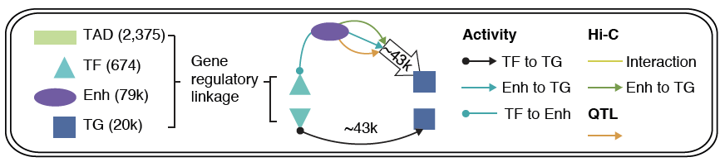
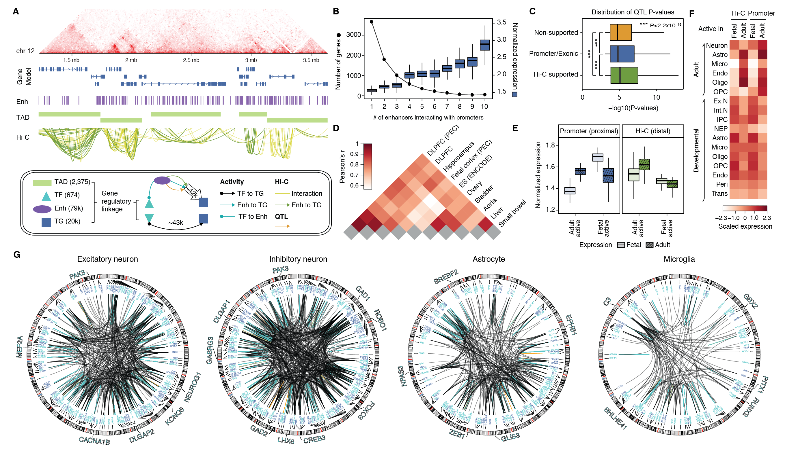
Imputed gene regulatory network for the human brain
Imputed gene regulatory network linking TFs, enhancers and genes plus QTLs
subnetworks targeting single cell marker genes
[Wang et al. (‘18) Science]

Slide 23
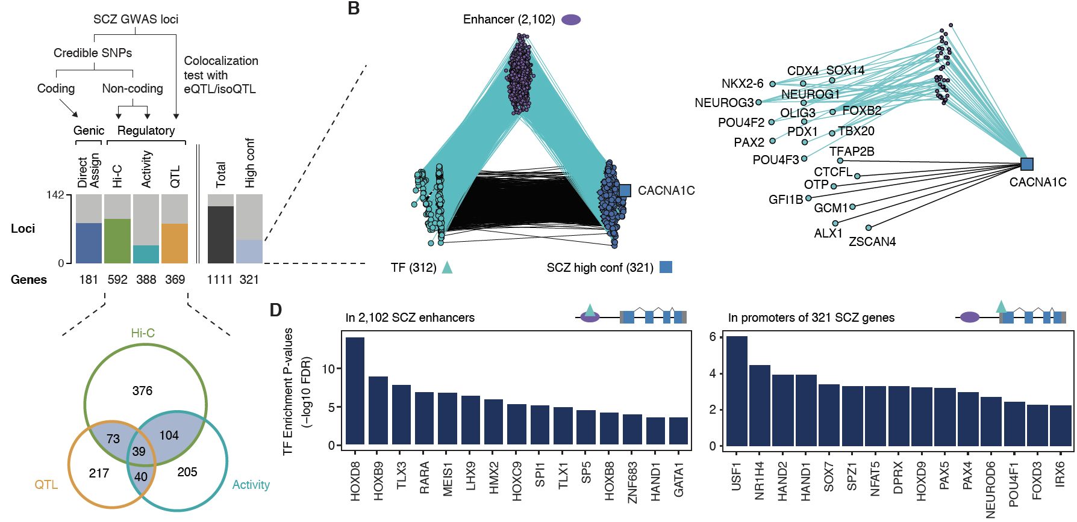
Linking GWAS SNPs to disease genes using the regulatory network
142
321
high-confident SCZ genes
Activity
[Wang et al. (‘18) Science]
Notes:
* A. F. Pardinas et al., Common schizophrenia alleles are enriched in mutation-intolerant genes and in regions under strong background selection. Nat Genet 50, 381-389 (2018)
For example, we found a set of TFs having enriched binding sites (TFBSs) on the promoters of SCZ genes, revealing potential cis-regulatory mechanisms of TFs to SCZ gene expression (Fig. 6D). Also, we found additional TFs that have enriched binding sites on the enhancers that overlap with SCZ credible SNPs (Fig. 6D), suggesting potential distal regulatory mechanisms of SCZ credible SNPs via affecting TFBSs on enhancers. In particular, these TFs include REST, a transcriptional repressor for neuronal genes \cite{16150588}, and SOX7, a TF that promotes neuronal apoptosis \cite{25847511}.

Slide 24
PsychENCODE: Using population-scale functional genomics to understand neuropsychiatric disease
Construction of an adult brain resource with 1866 individuals,
via data set fusion and uniform processing
Using the changing proportions of cell types
(via single-cell deconvolution) to account for expression variation across a population & disorders
Large-scale processing defines ~79K PFC
enhancers & creates a comprehensive QTL resource (~2.5M eQTLs + cQTLs & fQTLs)
Connecting QTLs, enhancer activity relationships & Hi-C into a
brain regulatory network &
using this to link SCZ GWAS SNPs to genes
Embedding the regulatory network in a
deep-learning model to predict disease from genotype & transcriptome. Using this to suggest specific pathways & genes, as targets.
  Other uses for the resource: Highlighting aging related genes + consistently comparing the brain to other organs

Slide 25

Deep Structured Phenotype Network
(DSPN)
Boltzmann machine
y: phenotypes
h: hidden units (e.g., circuits)
x: intermediate phenotypes (e.g., genes, enhancers)
z: genotypes (e.g., SNPs)
W: weights
(e.g., regulatory network)
Gene
regulatory network
builds
skeleton
Energy model:
$$p\left(x,y,h|z\right)∝\exp\left(−E\left(x,y, h|z\right)\right)$$
$$E\left(x,y, h|z\right)={−z}^{T}W_{1}x{−x}^{T}W_{2}x−x^{T}W_{3}h−h^{T}W_{4}h−h^{T}W_{5}y−Bias$$
[Wang et al. (‘18) Science]

Slide 26
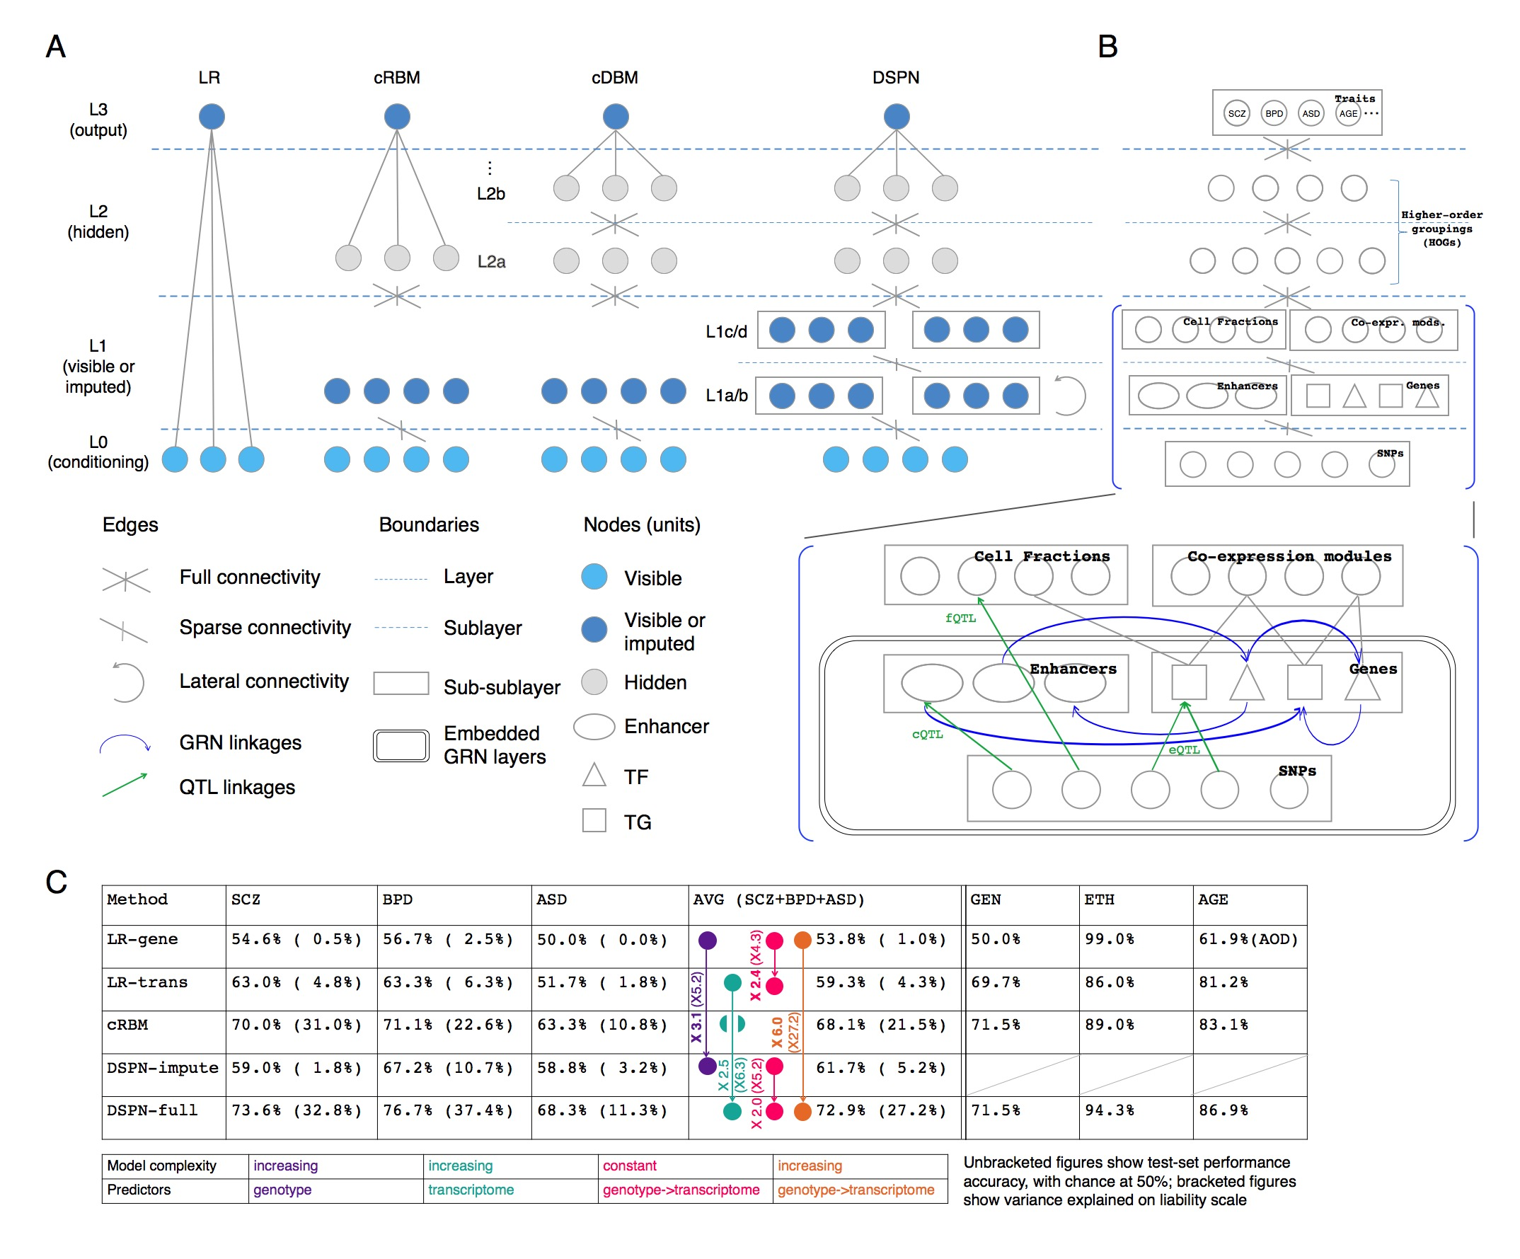
DSPN improves brain disease prediction by adding deep layers
Method | LR-genotype | LR-transcriptome | cRBM | DSPN-imputation | DSPN-full
Schizophrenia | 54.6% | 63.0% | 70.0% | 59.0% | 73.6%
Bipolar Disorder | 56.7% | 63.3% | 71.1% | 67.2% | 76.7%
Autism Spectrum Disorder | 50.0% | 51.7% | 67.2% | 62.5% | 68.3%
X 6.0
Accuracy = chance to correctly predict disease/health
[Wang et al. (‘18) Science]

Slide 27
DSPN improves brain disease prediction by adding deep layers
Method | LR-genotype | LR-transcriptome | cRBM | DSPN-imputation | DSPN-full
Schizophrenia | 54.6% | 63.0% | 70.0% | 59.0% | 73.6%
Bipolar Disorder | 56.7% | 63.3% | 71.1% | 67.2% | 76.7%
Autism Spectrum Disorder | 50.0% | 51.7% | 67.2% | 62.5% | 68.3%
X 2.5
Accuracy = chance to correctly predict disease/health
[Wang et al. (‘18) Science]

Slide 28
DSPN improves brain disease prediction by adding deep layers
Method | LR-genotype | LR-transcriptome | cRBM | DSPN-imputation | DSPN-full
Schizophrenia | 54.6% | 63.0% | 70.0% | 59.0% | 73.6%
Bipolar Disorder | 56.7% | 63.3% | 71.1% | 67.2% | 76.7%
Autism Spectrum Disorder | 50.0% | 51.7% | 67.2% | 62.5% | 68.3%
X 3.1
Accuracy = chance to correctly predict disease/health
[Wang et al. (‘18) Science]

Slide 29
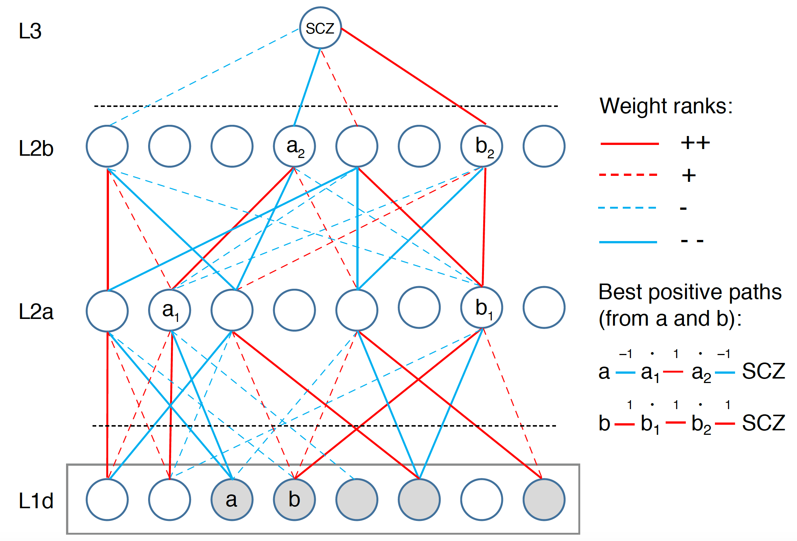
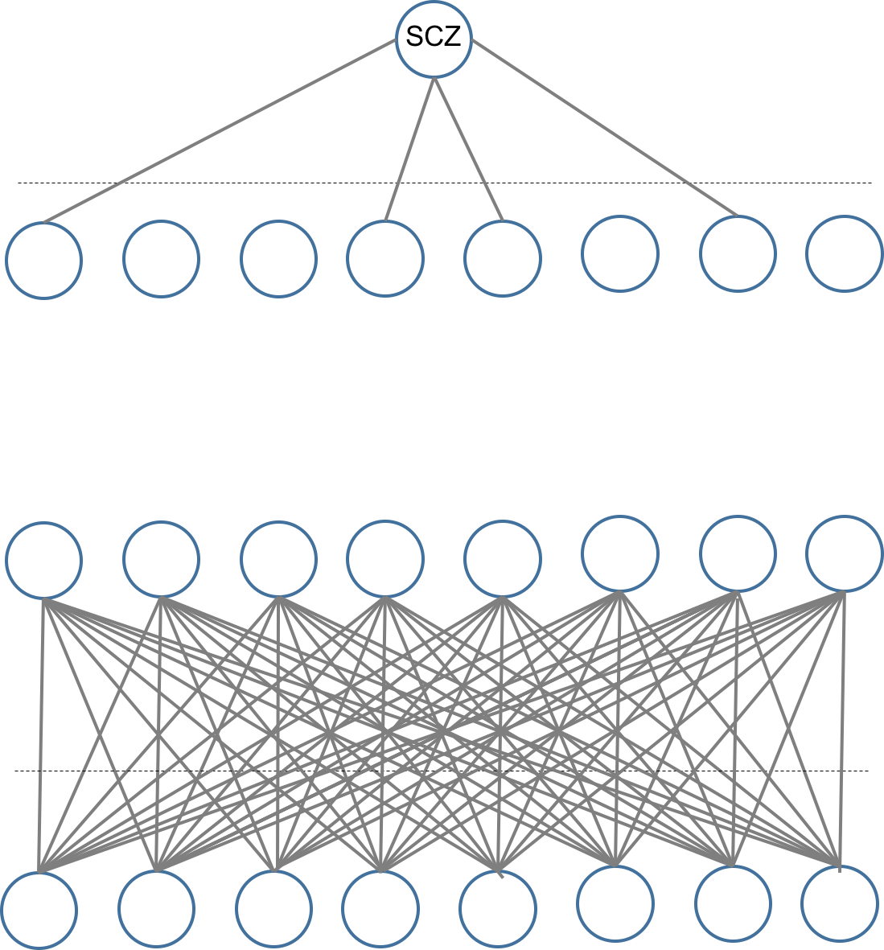
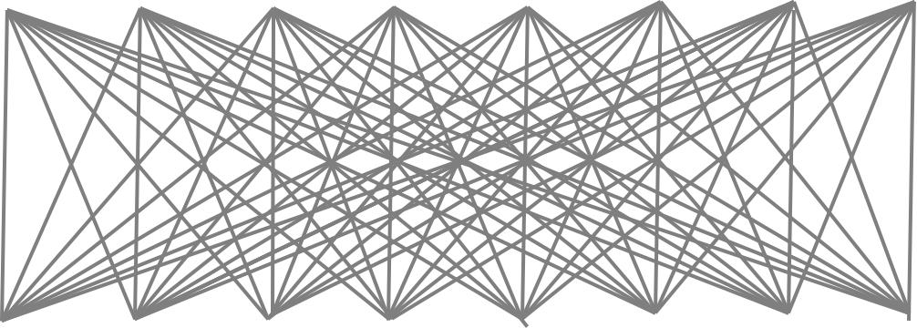
Multilevel Network Interpretation
Actual network size:
5024/400/100/1 nodes
Start with a fully connected trained network
[Wang et al. (‘18) Science]

Slide 30
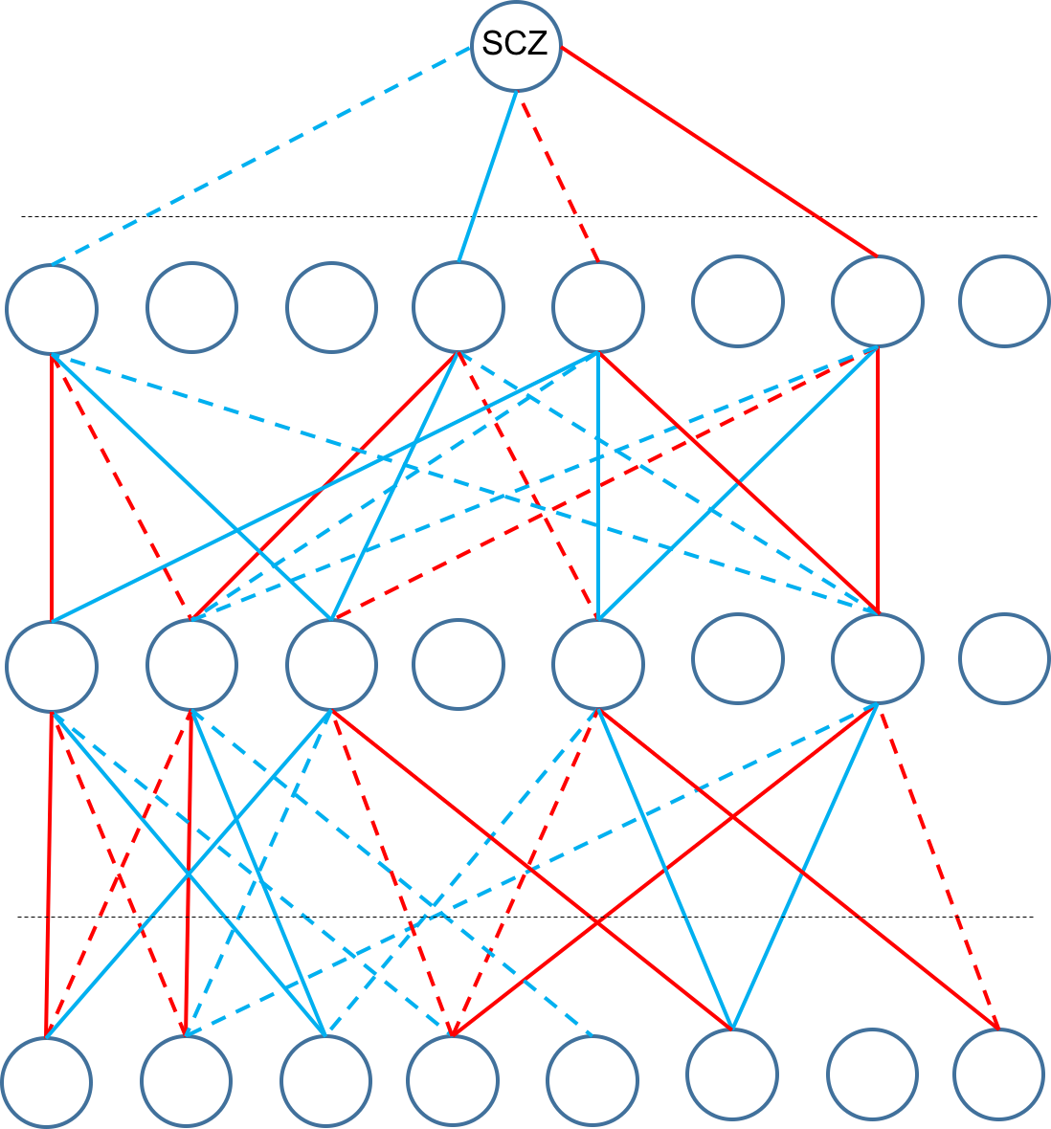
Multilevel Network Interpretation
Actual network size:
5024/400/100/1 nodes
Start with a fully connected trained network
Sparsify network using edges with largest absolute weights (+/-)
[Wang et al. (‘18) Science]

Slide 31
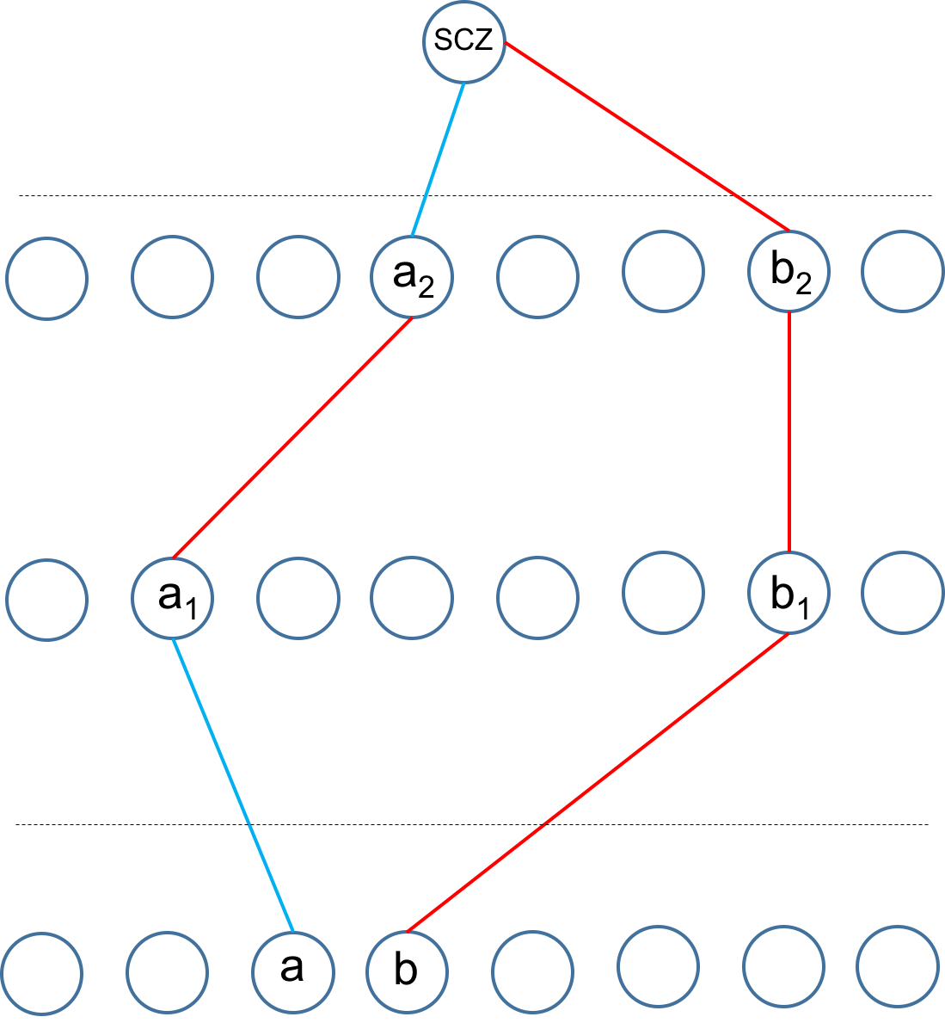
Multilevel Network Interpretation
Actual network size:
5024/400/100/1 nodes
Start with a fully connected trained network
Sparsify network using edges with largest absolute weights (+/-)
Extract ‘best positive paths’ to each prioritized module (e.g. a-a₁-a₂-SCZ) by summing weights and multiplying signs
[Wang et al. (‘18) Science]

Slide 32
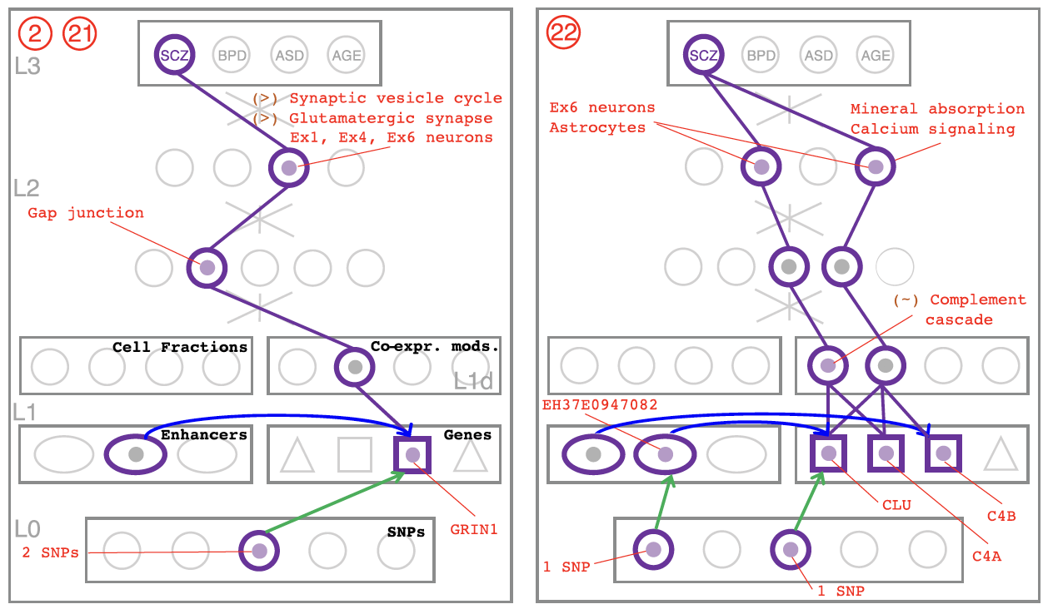
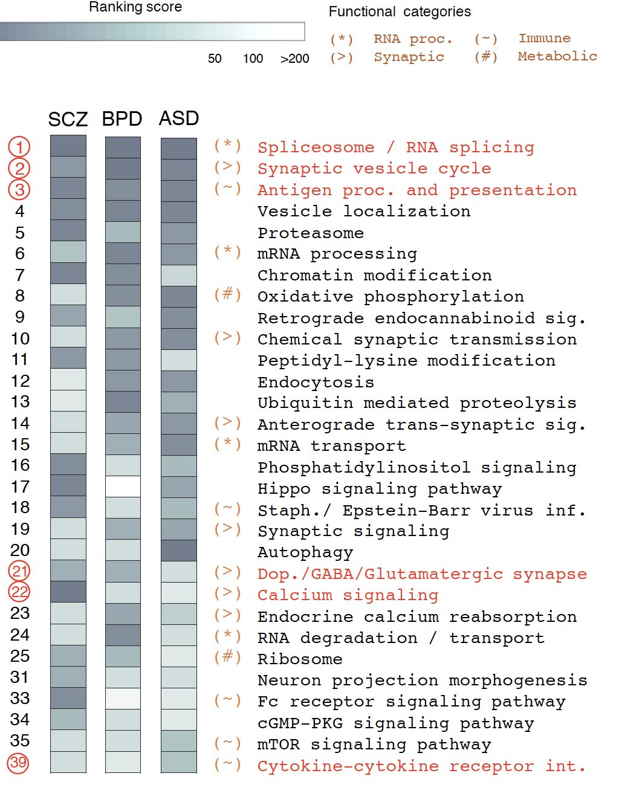
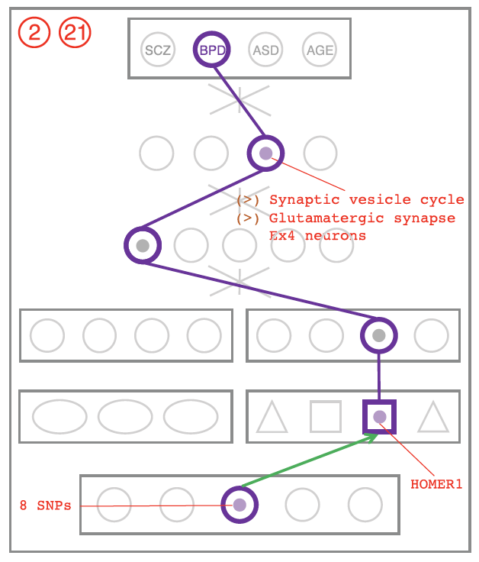
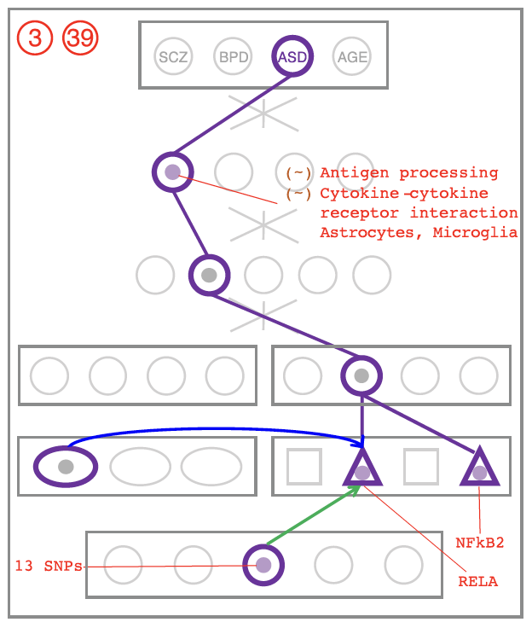
DSPN discovers enriched pathways and linkages to genetic variation
Cross-disorder MOD/HOG enrichment ranking
SCZ
BPD
ASD
[Wang et al. (‘18) Science]

Slide 33
PsychENCODE: Using population-scale functional genomics to understand neuropsychiatric disease
Construction of an adult brain resource with 1866 individuals,
via data set fusion and uniform processing
Using the changing proportions of cell types
(via single-cell deconvolution) to account for expression variation across a population & disorders
Large-scale processing defines ~79K PFC
enhancers & creates a comprehensive QTL resource (~2.5M eQTLs + cQTLs & fQTLs)
Connecting QTLs, enhancer activity relationships & Hi-C into a
brain regulatory network &
using this to link SCZ GWAS SNPs to genes
Embedding the regulatory network in a
deep-learning model to predict disease from genotype & transcriptome. Using this to suggest specific pathways & genes, as targets.
  Other uses for the resource: Highlighting aging related genes + consistently comparing the brain to other organs

Slide 34
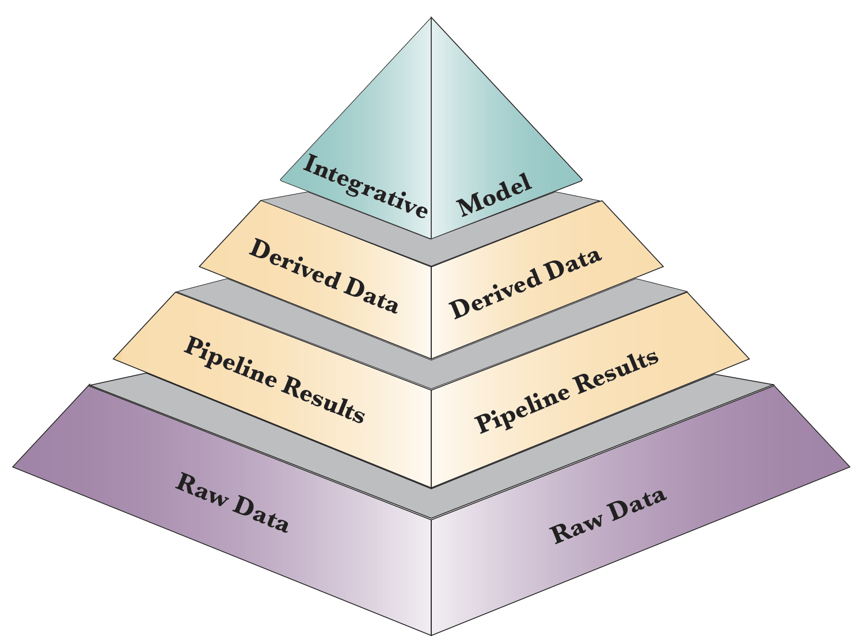
Phase 1 PsychENCODE capstone resource:
Layers of distributed information
Material in the 3 capstones:
AC - Wang et al. ('18)
DC - Li et al. ('18)
NC - Gandal et al. ('18)
Resource.psychencode.org
Development.psychencode.org

Slide 35
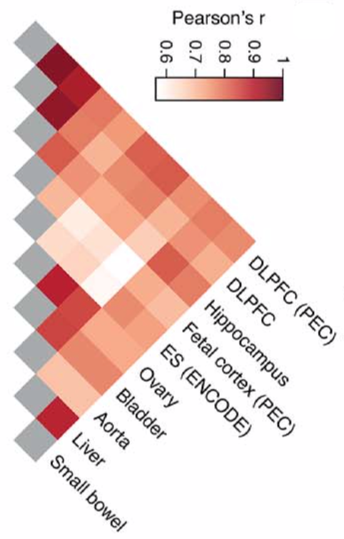
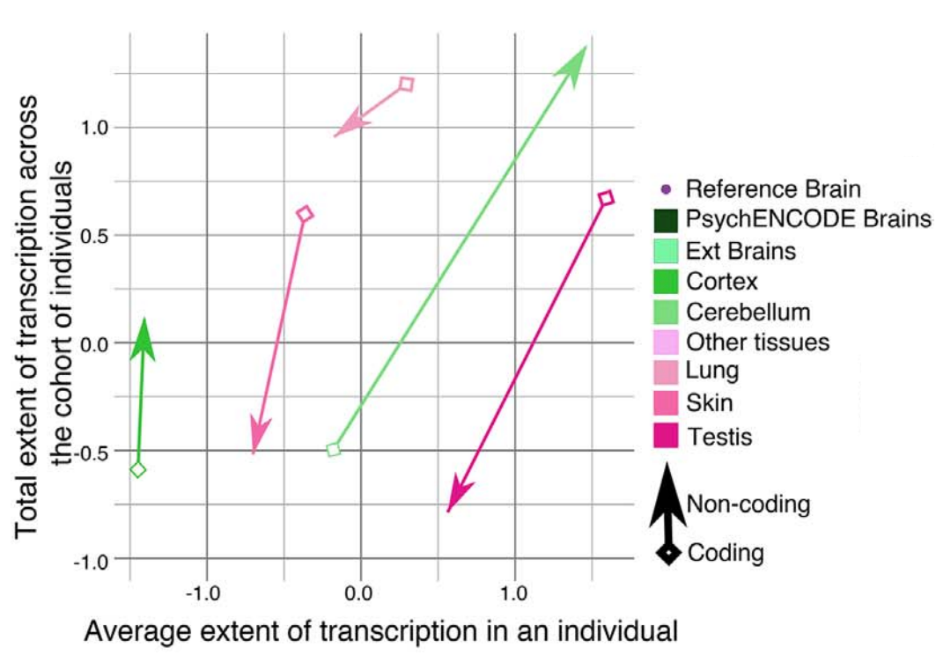
Cross tissue variation in Chromatin & Expression
Placing the
Brain in context of all other Body Tissues
Hi-C
Chromatin
Transcriptome diversity increases in the non-coding portion of the brain genome while decreases in other tissues
Expression
[Wang et al. (‘18) Science]

Slide 36
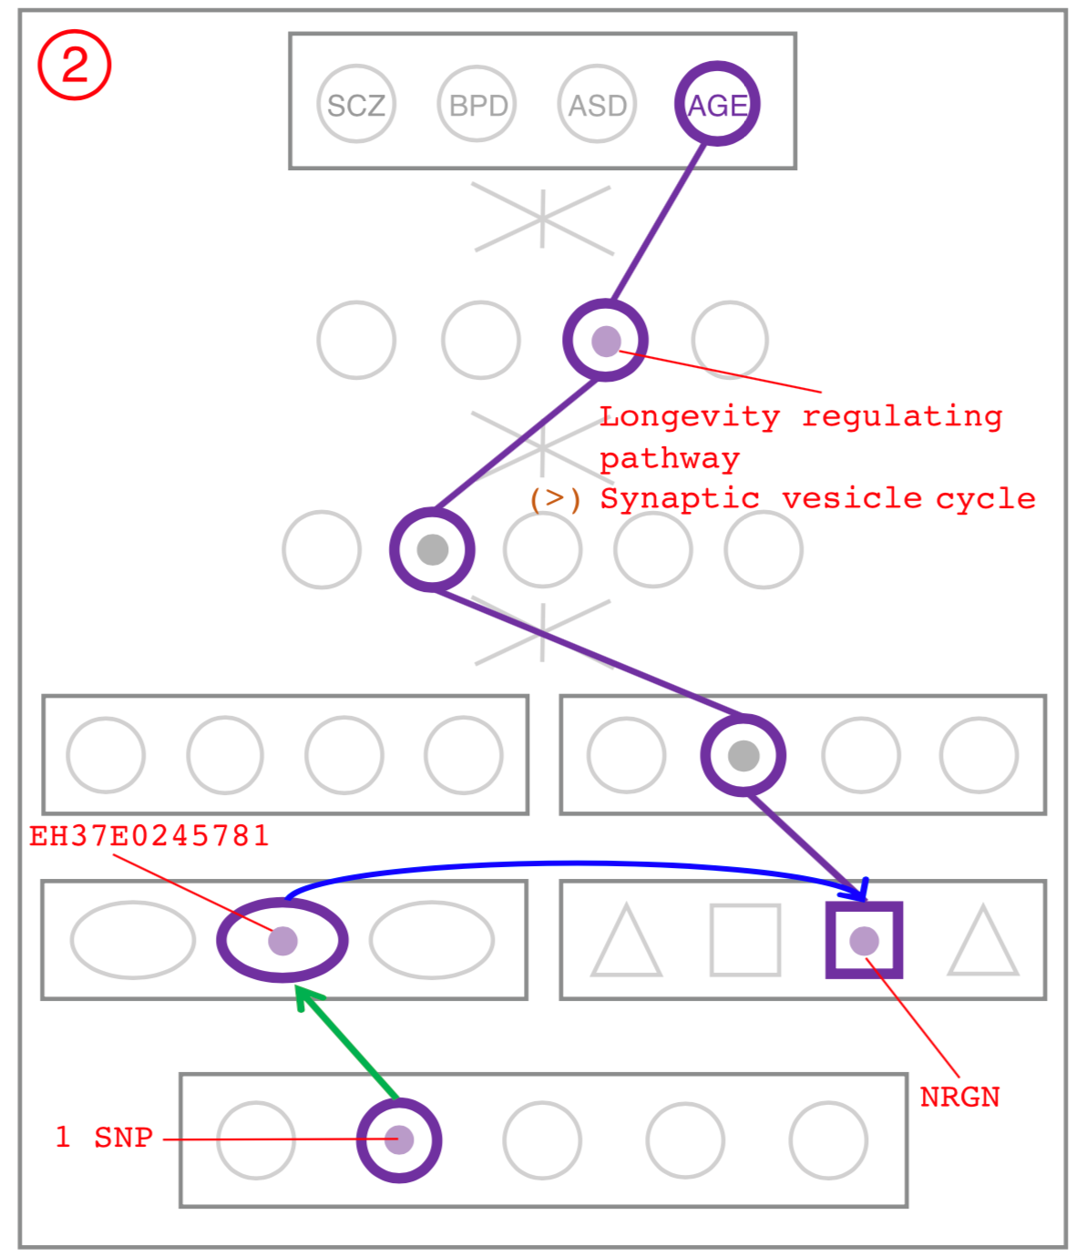
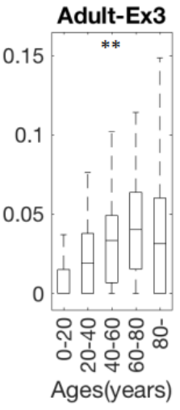
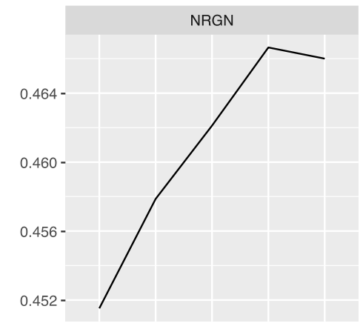

NRGN has variable expression over age and is in Synaptic vesicle cycle pathway is enriched in SCZ, BPD, ASD
NRGN
Ex3 Neuron
NGRN is a gene associated with the Synaptic vesicle pathway and NGRN expression and methylation is correlated with Age
0
2
4
0.452
0.46
0
0.05
0.1
0.15
0
20
Age (years)
40
60
0
20
40
60
80
80
Methylation
Exp.

Slide 37
PsychENCODE: Using population-scale functional genomics to understand neuropsychiatric disease
Construction of an adult brain resource with 1866 individuals,
via data set fusion and uniform processing
Using the changing proportions of cell types
(via single-cell deconvolution) to account for expression variation across a population & disorders
Large-scale processing defines ~79K PFC
enhancers & creates a comprehensive QTL resource (~2.5M eQTLs + cQTLs & fQTLs)
Connecting QTLs, enhancer activity relationships & Hi-C into a
brain regulatory network &
using this to link SCZ GWAS SNPs to genes
Embedding the regulatory network in a
deep-learning model to predict disease from genotype & transcriptome. Using this to suggest specific pathways & genes, as targets.
  Other uses for the resource: Highlighting aging related genes + consistently comparing the brain to other organs

Slide 38
PsychENCODE: Using population-scale functional genomics to understand neuropsychiatric disease
Construction of an adult brain resource with 1866 individuals,
via data set fusion and uniform processing
Using the changing proportions of cell types
(via single-cell deconvolution) to account for expression variation across a population & disorders
Large-scale processing defines ~79K PFC
enhancers & creates a comprehensive QTL resource (~2.5M eQTLs + cQTLs & fQTLs)
Connecting QTLs, enhancer activity relationships & Hi-C into a
brain regulatory network &
using this to link SCZ GWAS SNPs to genes
Embedding the regulatory network in a
deep-learning model to predict disease from genotype & transcriptome. Using this to suggest specific pathways & genes, as targets.
  Other uses for the resource: Highlighting aging related genes + consistently comparing the brain to other organs

Slide 39
PsychENCODE Acknowledgment
“Adult Capstone” Team – 1 of 3 capstones
Daifeng Wang, Shuang Liu, Jonathan Warrell, Hyejung Won, Xu Shi, Fabio Navarro, Declan Clarke, Mengting Gu, Prashant Emani, Yucheng T. Yang, Min Xu, Michael Gandal, Shaoke Lou, Jing Zhang, Jonathan J. Park, Chengfei Yan, Suhn Kyong Rhie, Kasidet Manakongtreecheep, Holly Zhou, Aparna Nathan, Mette Peters, Eugenio Mattei, Dominic Fitzgerald, Tonya Brunetti, Jill Moore, Yan Jiang, Kiran Girdhar, Gabriel Hoffman, Selim Kalayci, Zeynep Hulya Gumus, Greg Crawford,
PsychENCODE Consortium,
Panos Roussos, Schahram Akbarian, Andrew E. Jaffe, Kevin White, Zhiping Weng, Nenad Sestan, Daniel H. Geschwind, James A. Knowles
Geetha Senthil
Lora Bingaman
David Panchision
Alexander Arguello
Thomas Lehner
Dedicated to Pamela Sklar
Resource.psychencode.org
The PsychENCODE Consortium: Allison E Ashley-Koch, Duke University; Gregory E Crawford, Duke University; Melanie E Garrett, Duke University; Lingyun Song, Duke University; Alexias Safi, Duke University; Graham D Johnson, Duke University; Gregory A Wray, Duke University; Timothy E Reddy, Duke University; Fernando S Goes, Johns Hopkins University; Peter Zandi, Johns Hopkins University; Julien Bryois, Karolinska Institutet; Andrew E Jaffe, Lieber Institute for Brain Development; Amanda J Price, Lieber Institute for Brain Development; Nikolay A Ivanov, Lieber Institute for Brain Development; Leonardo Collado-Torres, Lieber Institute for Brain Development; Thomas M Hyde, Lieber Institute for Brain Development; Emily E Burke, Lieber Institute for Brain Development; Joel E Kleiman, Lieber Institute for Brain Development; Ran Tao, Lieber Institute for Brain Development; Joo Heon Shin, Lieber Institute for Brain Development; Schahram Akbarian, Icahn School of Medicine at Mount Sinai; Kiran Girdhar, Icahn School of Medicine at Mount Sinai; Yan Jiang, Icahn School of Medicine at Mount Sinai; Marija Kundakovic, Icahn School of Medicine at Mount Sinai; Leanne Brown, Icahn School of Medicine at Mount Sinai; Bibi S Kassim, Icahn School of Medicine at Mount Sinai; Royce B Park, Icahn School of Medicine at Mount Sinai; Jennifer R Wiseman, Icahn School of Medicine at Mount Sinai; Elizabeth Zharovsky, Icahn School of Medicine at Mount Sinai; Rivka Jacobov, Icahn School of Medicine at Mount Sinai; Olivia Devillers, Icahn School of Medicine at Mount Sinai; Elie Flatow, Icahn School of Medicine at Mount Sinai; Gabriel E Hoffman, Icahn School of Medicine at Mount Sinai; Barbara K Lipska, Human Brain Collection Core, National Institutes of Health, Bethesda, MD; David A Lewis, University of Pittsburgh; Vahram Haroutunian, Icahn School of Medicine at Mount Sinai and James J Peters VA Medical Center; Chang-Gyu Hahn, University of Pennsylvania; Alexander W Charney, Mount Sinai; Stella Dracheva, Mount Sinai; Alexey Kozlenkov, Mount Sinai; Judson Belmont, Icahn School of Medicine at Mount Sinai; Diane DelValle, Icahn School of Medicine at Mount Sinai; Nancy Francoeur, Icahn School of Medicine at Mount Sinai; Evi Hadjimichael, Icahn School of Medicine at Mount Sinai; Dalila Pinto, Icahn School of Medicine at Mount Sinai; Harm van Bakel, Icahn School of Medicine at Mount Sinai; Panos Roussos, Mount Sinai; John F Fullard, Mount Sinai; Jaroslav Bendl, Mount Sinai; Mads E Hauberg, Mount Sinai; Lara M Mangravite, Sage Bionetworks; Mette A Peters, Sage Bionetworks; Yooree Chae, Sage Bionetworks; Junmin Peng, St. Jude Children's Hospital; Mingming Niu, St. Jude Children's Hospital; Xusheng Wang, St. Jude Children's Hospital; Maree J Webster, Stanley Medical Research Institute; Thomas G Beach, Banner Sun Health Research Institute; Chao Chen, Central South University; Yi Jiang, Central South University; Rujia Dai, Central South University; Annie W Shieh, SUNY Upstate Medical University; Chunyu Liu, SUNY Upstate Medical University; Kay S. Grennan, SUNY Upstate Medical University; Yan Xia, SUNY Upstate Medical University/Central South University; Ramu Vadukapuram, SUNY Upstate Medical University; Yongjun Wang, Central South University; Dominic Fitzgerald, The University of Chicago; Lijun Cheng, The University of Chicago; Miguel Brown, The University of Chicago; Mimi Brown, The University of Chicago; Tonya Brunetti, The University of Chicago; Thomas Goodman, The University of Chicago; Majd Alsayed, The University of Chicago; Michael J Gandal, University of California, Los Angeles; Daniel H Geschwind, University of California, Los Angeles; Hyejung Won, University of California, Los Angeles; Damon Polioudakis, University of California, Los Angeles; Brie Wamsley, University of California, Los Angeles; Jiani Yin, University of California, Los Angeles; Tarik Hadzic, University of California, Los Angeles; Luis De La Torre Ubieta, UCLA; Vivek Swarup, University of California, Los Angeles; Stephan J Sanders, University of California, San Francisco; Matthew W State, University of California, San Francisco; Donna M Werling, University of California, San Francisco; Joon-Yong An, University of California, San Francisco; Brooke Sheppard, University of California, San Francisco; A Jeremy Willsey, University of California, San Francisco; Kevin P White, The University of Chicago; Mohana Ray, The University of Chicago; Gina Giase, SUNY Upstate Medical University; Amira Kefi, University of Illinois at Chicago; Eugenio Mattei, University of Massachusetts Medical School; Michael Purcaro, University of Massachusetts Medical School; Zhiping Weng, University of Massachusetts Medical School; Jill Moore, University of Massachusetts Medical School; Henry Pratt, University of Massachusetts Medical School; Jack Huey, University of Massachusetts Medical School; Tyler Borrman, University of Massachusetts Medical School; Patrick F Sullivan, University of North Carolina - Chapel Hill; Paola Giusti-Rodriguez, University of North Carolina - Chapel Hill; Yunjung Kim, University of North Carolina - Chapel Hill; Patrick Sullivan, University of North Carolina - Chapel Hill; Jin Szatkiewicz, University of North Carolina - Chapel Hill; Suhn Kyong Rhie, University of Southern California; Christoper Armoskus, University of Southern California; Adrian Camarena, University of Southern California; Peggy J Farnham, University of Southern California; Valeria N Spitsyna, University of Southern California; Heather Witt, University of Southern California; Shannon Schreiner, University of Southern California; Oleg V Evgrafov, SUNY Downstate Medical Center; James A Knowles, SUNY Downstate Medical Center; Mark Gerstein, Yale University; Shuang Liu, Yale University; Daifeng Wang, Stony Brook University; Fabio C. P. Navarro, Yale University; Jonathan Warrell, Yale University; Declan Clarke, Yale University; Prashant S. Emani, Yale University; Mengting Gu, Yale University; Xu Shi, Yale University; Min Xu, Yale University; Yucheng T. Yang, Yale University; Robert R. Kitchen, Yale University; Gamze Gürsoy, Yale University; Jing Zhang, Yale University; Becky C Carlyle, Yale University; Angus C Nairn, Yale University; Mingfeng Li, Yale University; Sirisha Pochareddy, Yale University; Nenad Sestan, Yale University; Mario Skarica, Yale University; Zhen Li, Yale University; Andre M.M. Sousa, Yale University; Gabriel Santpere, Yale University; Jinmyung Choi, Yale University; Ying Zhu, Yale University; Tianliuyun Gao, Yale University; Daniel J Miller, Yale University; Adriana Cherskov, Yale University; Mo Yang, Yale University; Anahita Amiri, Yale University; Gianfilippo Coppola, Yale University; Jessica Mariani, Yale University; Soraya Scuderi, Yale University; Anna Szekely, Yale University; Flora M Vaccarino, Yale University; Feinan Wu, Yale University; Sherman Weissman, Yale University; Tanmoy Roychowdhury, Mayo Clinic Rochester; Alexej Abyzov, Mayo Clinic Rochester;.

Slide 40

Extra

Slide 41
Info about content in this slide pack
General PERMISSIONS
  This Presentation is copyright Mark Gerstein,
  Yale University, 2017.
  Please read permissions statement at
  www.gersteinlab.org/misc/permissions.html .
  Feel free to use slides & images in the talk with PROPER acknowledgement
  (via citation to relevant papers or link to gersteinlab.org).
  Paper references in the talk were mostly from Papers.GersteinLab.org.
PHOTOS & IMAGES. For thoughts on the source and permissions of many of the photos and clipped images in this presentation see http://streams.gerstein.info .
  In particular, many of the images have particular EXIF tags, such as kwpotppt , that can be easily queried from flickr, viz: http://www.flickr.com/photos/mbgmbg/tags/kwpotppt

