Slide 1
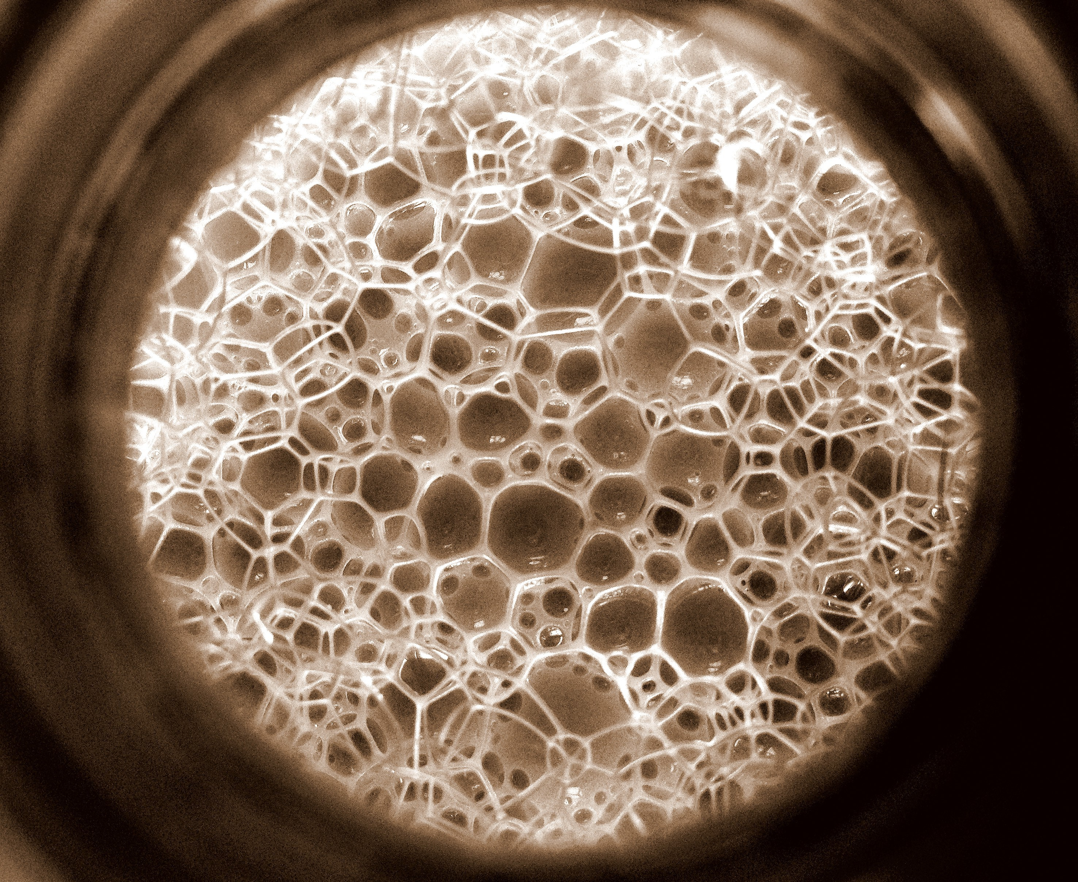
Quantification of sensitive information leakage from functional genomics data:
Obvious v subtle leakages & practical file formats for addressing this
Slides freely
“tweetable” (via
@MarkGerstein)
& downloadable from
Lectures.GersteinLab.org
M Gerstein
Yale
(See last slide for more info.)

Slide 2
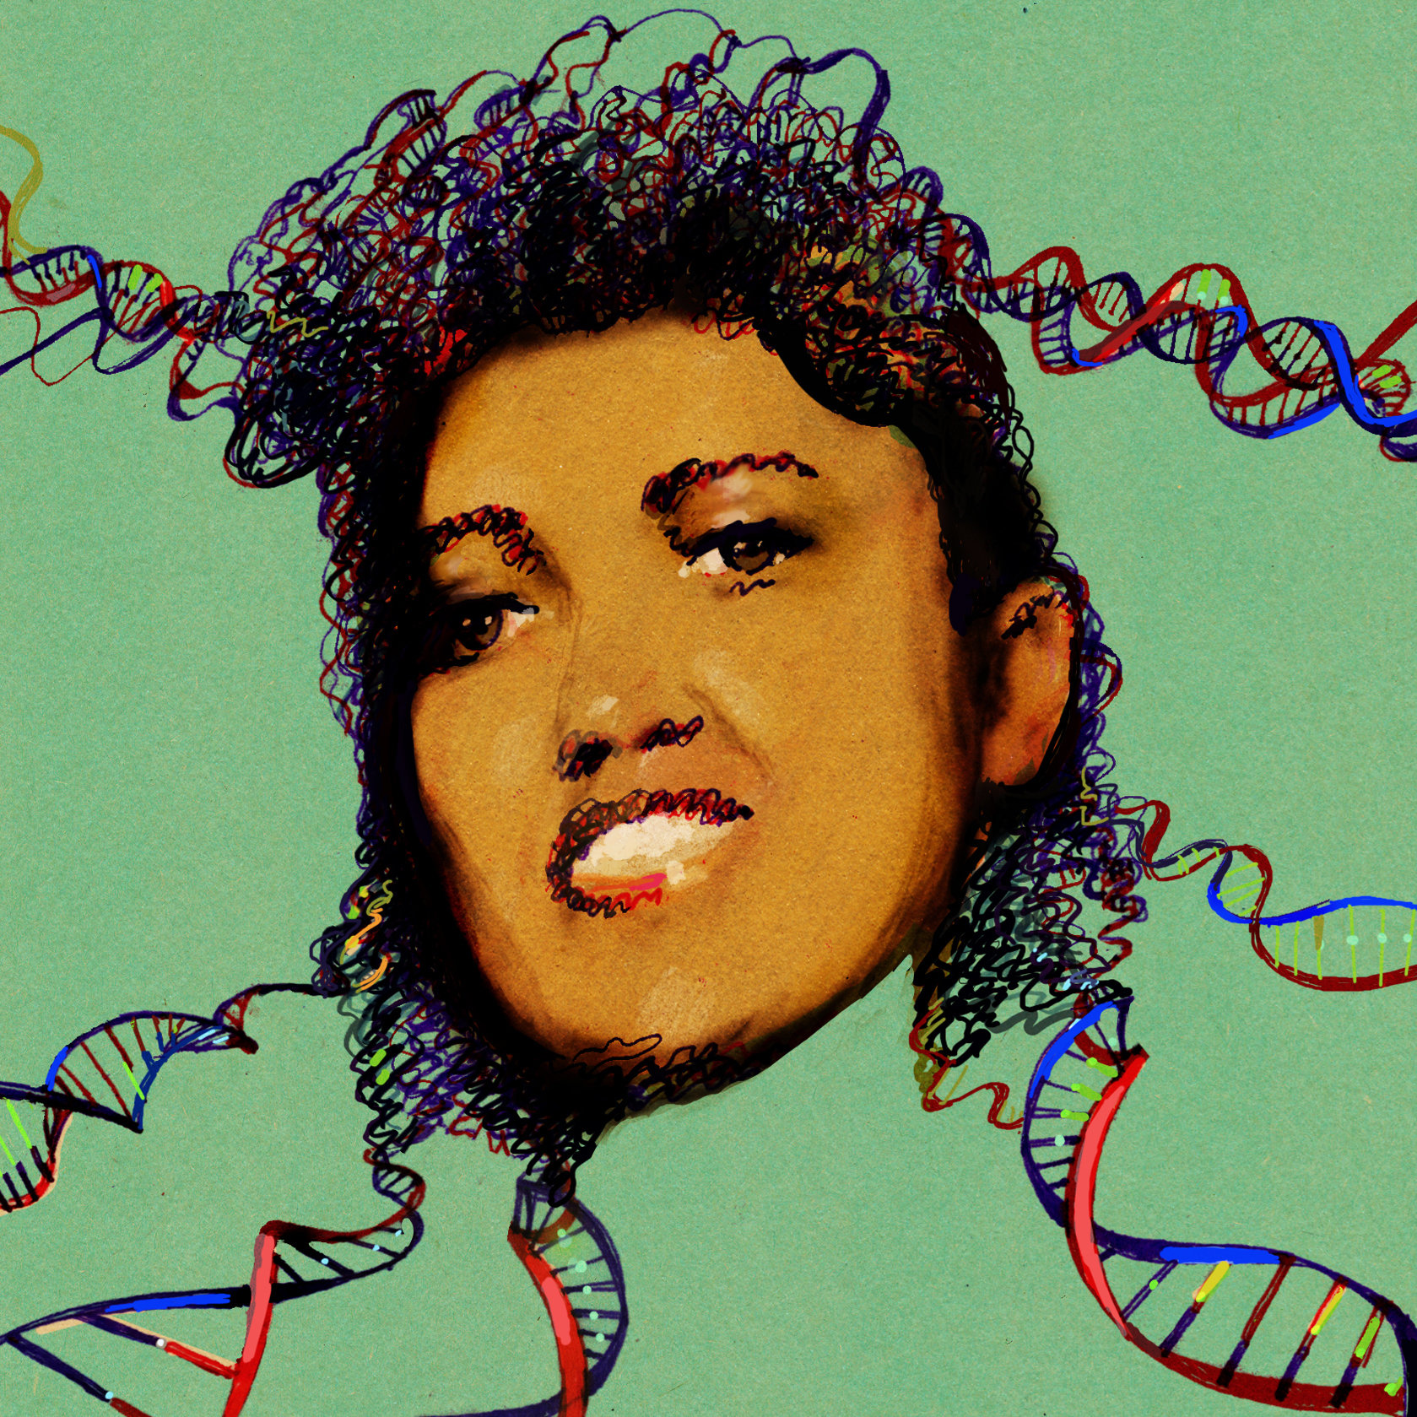
Privacy: Does Genomics has similar "Big Data" Dilemma as in the Rest of Society?
We confront privacy risks every day we access the internet (e.g., social media, e-commerce).
Sharing & "peer-production" is central to success of many new ventures, with analogous risks to genomics
  EG web search: Large-scale mining essential
Genetic Exceptionalism :
The Genome is very fundamental data, potentially very revealing about one’s identity & characteristics
Personal Genomic info. essentially meaningless currently but will it be in 20 yrs? 50 yrs?
  Genomic sequence very revealing about one’s children. Is true consent possible?
  Once put on the web it can’t be taken back
Ethically challenged history of genetics
  Ownership of the data & what consent means (Hela)
  Could your genetic data give rise to a product line?
[Seringhaus & Gerstein ('09), Hart. Courant (Jun 5); Greenbaum & Gerstein ('11), NY Times (6 Oct), D Greenbaum & M Gerstein (’08). Am J. Bioethics; D Greenbaum & M Gerstein, Hartford Courant, 10 Jul. '08 ; SF Chronicle, 2 Nov. '08; Greenbaum et al. PLOS CB (‘11) ; Greenbaum & Gerstein ('13), The Scientist; Photos from NY Times, it.wisc.edu]

Slide 3

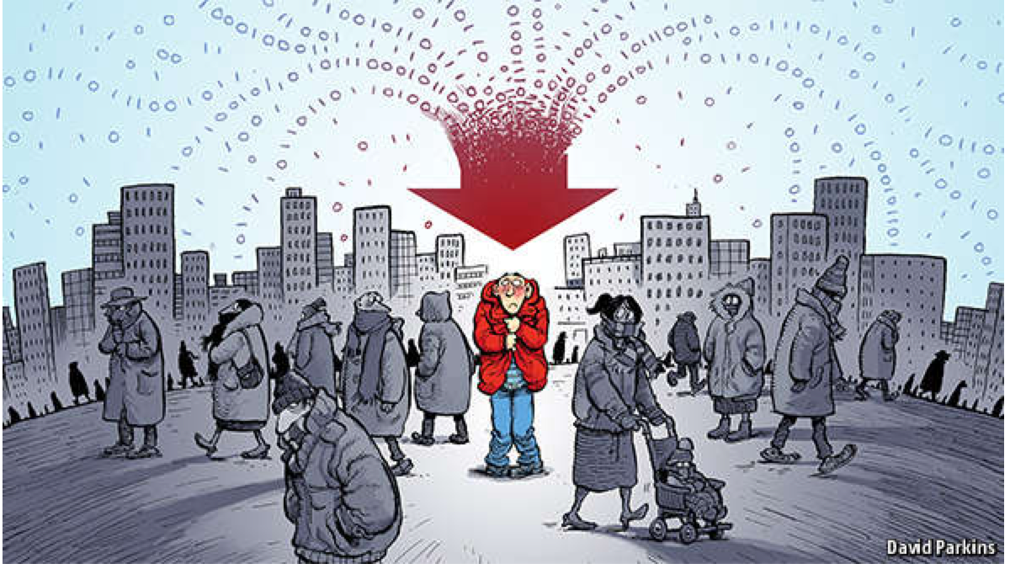
The Dilemma
The Other Side of the Coin
for Genomics: Why we should share
Sharing helps speed research
  Large-scale mining of this information is important for medical research
  Statistical power
  Privacy is cumbersome, particularly for big data
The individual (harmed?) v the collective (benefits)
  - But do sick patients care about their privacy?
How to balance risks v rewards – Quantification
[Economist, 15 Aug ‘15]
[Yale Law Roundtable (‘10). Comp. in Sci. & Eng. 12:8; D Greenbaum & M Gerstein (‘09). Am. J. Bioethics; D Greenbaum & M Gerstein (‘10). SF Chronicle, May 2, Page E-4; Greenbaum et al. PLOS CB (‘11)]

Slide 4
Current Social & Technical Solutions:
The quandary where are now
Closed Data Approach
  Consents
  “Protected” distribution via dbGAP
  Local computes on secure computer
Issues with Closed Data
  Non-uniformity of consents & paperwork
    Different, confusing int’l norms
  Computer security is burdensome
  Many schemes get “hacked” .
  Tricky aspects of high-dimensional data (leakage & ease of creating quasi-identifiers)
Open Data
  Genomic "test pilots” (ala PGP)?
    Sports stars & celebrities?
  Some public data & data donation is helpful but is this a realistic solution for an unbiased sample of ~1M
[Greenbuam et al ('04), Nat. Biotech; Greenbaum & Gerstein ('13), The Scientist; Photo: futurism.com]

Slide 5
Quantification of sensitive information leakage from functional genomics data: Obvious v subtle leakages & practical file formats for addressing this
Intro. to Genomic Privacy
  The dilemma: The genome as fundamental, inherited info that’s very private v. need for large-scale sharing & mining for med. research
Privacy &
Functional Genomics Data
  2-sided nature of this data presents particularly tricky privacy issues
  Overview of types of the leakage, from obvious to subtle
Subtle Leakage #1: eQTLs
  Quantifying & removing further variant info from expression levels w/ ICI & predictability.
  Instantiating a practical linking attack w/ noisy quasi-identifiers
Subtle Leakage #2:
Signal Profiles
  Manifest appreciable leakage from large & small deletions.
  Linking attacks possible but additional complication of SV discovery in addition to genotyping
Practical solutions & file formats
  Using pBAM file format to remove obvious large-scale leakage
  Small subtle leaks combatted by restricting large-scale access. Hence, developing secure, blockchain-based logging technology (response to the iDash challenge)

Slide 6
Quantification of sensitive information leakage from functional genomics data: Obvious v subtle leakages & practical file formats for addressing this
Intro. to Genomic Privacy
  The dilemma: The genome as fundamental, inherited info that’s very private v. need for large-scale sharing & mining for med. research
Privacy &
Functional Genomics Data
  2-sided nature of this data presents particularly tricky privacy issues
  Overview of types of the leakage, from obvious to subtle
Subtle Leakage #1: eQTLs
  Quantifying & removing further variant info from expression levels w/ ICI & predictability.
  Instantiating a practical linking attack w/ noisy quasi-identifiers
Subtle Leakage #2:
Signal Profiles
  Manifest appreciable leakage from large & small deletions.
  Linking attacks possible but additional complication of SV discovery in addition to genotyping
Practical solutions & file formats
  Using pBAM file format to remove obvious large-scale leakage
  Small subtle leaks combatted by restricting large-scale access. Hence, developing secure, blockchain-based logging technology (response to the iDash challenge)

Slide 7
Transcriptome = Gene Activity of All Genes in the Genome, usually quantified by RNA-seq
(RNA-seq is the most common type of functional genomics data)
Genes (DNA)
Transcription
Regulation
RNA transcripts
Non-coding regulatory RNAs
Protein coding mRNA
Gene Expression measured by RNA-seq
Translation
Proteins
Expression of genes is quantified by transcription:
RNA-Seq measures mRNA transcript amounts
[ NATURE 459: 927; NAT. REV. GEN. 10: 57 ]

Slide 8

2-sided nature of functional genomics data: Analysis can be very General/Public or Individual/Private
General quantifications related to overall aspects
of a condition – ie gene activity as a function of:
  Developmental stage, Evolutionary relationships, Cell-type, Disease
Above are not tied to an individual’s genotype. However, data is derived from individuals & tagged with their genotypes
(Note, a few calculations aim to use explicitly genotype to derive general relations related to sequence variation & gene expression - eg allelic activity)

Slide 9
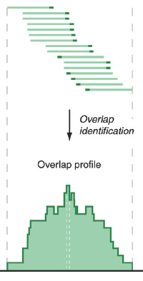
Data Reduction in RNA-Seq: an Overview
ATACAAGCAAGTATAAGTTCGTATGCCGTCTT
GGAGGCTGGAGTTGGGGACGTATGCGGCATAG
TACCGATCGAGTCGACTGTAAACGTAGGCATA
ATTCTGACTGGTGTCATGCTGATGTACTTAAA
Fastq sequence files
~5-10 GB
Index-building + Alignment to reference genome
BAM files
~1-2-fold reduction
Successive steps of Data Reduction
Conversion to signal track by overlapping reads
BigWig files
~25-fold reduction
Mapping to genes
Gene/Transcript expression matrix
~20-fold reduction
Quantitative information from RNA-seq signal: average signals at exon level (RPKMs)
Reads => Signal
[NAT. REV. 10: 57; PLOS CB 4:e1000158; PNAS 4:107: 5254 ]

Slide 10
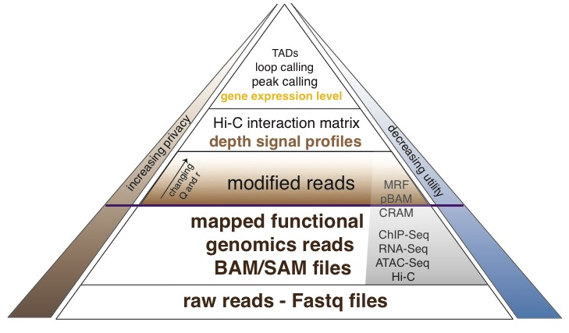
Functional genomics data comes with a great deal of sequencing;
We can quantify amount of leakage at every step of the data summarization process.
NA12878 as case study - 1000 genomes variants are used as gold standard
[Gursoy et al, bioRxiv 345074]

Slide 11

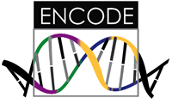
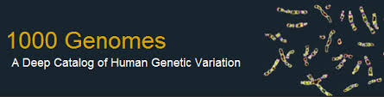
Representative Functional Genomics, Genotype, eQTL Datasets
Genotypes are available from the 1000 Genomes Project
mRNA sequencing for 462 individuals from gEUVADIS and ENCODE
  Publicly available quantification for protein coding genes
Functional genomics data (ChIP-Seq, RNA-Seq, Hi-C) available from ENCODE
Approximately 3,000 cis-eQTL (FDR<0.05)

Slide 12
How much information, for example, do RNA-Seq reads (or ChIP-Seq) reads contain? Does that information enough to identify individuals?
It might seem like we don’t infer much information from single ChIP-Seq and RNA-Seq experiments compared to WGS
  However putting 10 different ChIP-Seq experiments and RNA-Seq together with imputation provides a great deal of information about the individual
[Gursoy et al, bioRxiv 345074]

Slide 13
Quantification of sensitive information leakage from functional genomics data: Obvious v subtle leakages & practical file formats for addressing this
Intro. to Genomic Privacy
  The dilemma: The genome as fundamental, inherited info that’s very private v. need for large-scale sharing & mining for med. research
Privacy &
Functional Genomics Data
  2-sided nature of this data presents particularly tricky privacy issues
  Overview of types of the leakage, from obvious to subtle
Subtle Leakage #1: eQTLs
  Quantifying & removing further variant info from expression levels w/ ICI & predictability.
  Instantiating a practical linking attack w/ noisy quasi-identifiers
Subtle Leakage #2:
Signal Profiles
  Manifest appreciable leakage from large & small deletions.
  Linking attacks possible but additional complication of SV discovery in addition to genotyping
Practical solutions & file formats
  Using pBAM file format to remove obvious large-scale leakage
  Small subtle leaks combatted by restricting large-scale access. Hence, developing secure, blockchain-based logging technology (response to the iDash challenge)

Slide 14
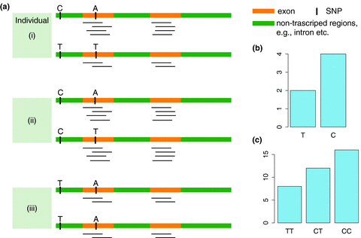
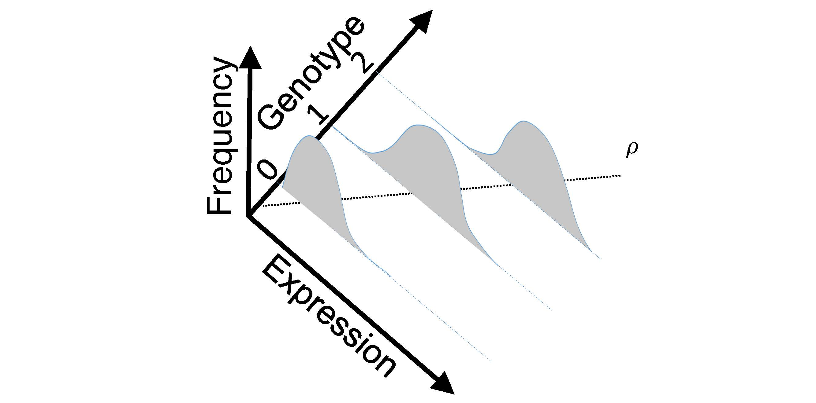
eQTL Mapping Using RNA-Seq Data
eQTLs are genomic loci that contribute to variation in mRNA expression levels
eQTLs provide insights on transcription regulation, and the molecular basis of phenotypic outcomes
eQTL mapping can be done with RNA-Seq data
[Biometrics 68(1) 1–11]
Notes:
A diagram to illustrate the RNA‐seq count variation of one gene due to an cis‐eQTL. (a) RNA‐seq measurements of a hypothetic gene with two exons in three diploid individuals. The target SNP which we test for association has the genotype CT, CC, and TT for the three individuals. There is an SNP on the first exon, which has genotype AT, AT, and AA for the three individuals. ASE can be measured by those sequence reads that overlap with a heterozygous exonic SNP. Therefore we can measure ASE for individuals (i) and (ii). However, association testing by ASE is only possible if the target SNP is heterozygous, thus only individual (i) can be used to test for eQTL by ASE (b) ASE measurements for individual (i). (c) TReC measured for the three individuals across the two exons of this gene.
© IF THIS IMAGE HAS BEEN PROVIDED BY OR IS OWNED BY A THIRD PARTY, AS INDICATED IN THE CAPTION LINE, THEN FURTHER PERMISSION MAY BE NEEDED BEFORE ANY FURTHER USE. PLEASE CONTACT WILEY'S PERMISSIONS DEPARTMENT ON PERMISSIONS@WILEY.COM OR USE THE RIGHTSLINK SERVICE BY CLICKING ON THE 'REQUEST PERMISSION' LINK ACCOMPANYING THIS ARTICLE. WILEY OR AUTHOR OWNED IMAGES MAY BE USED FOR NON-COMMERCIAL PURPOSES, SUBJECT TO PROPER CITATION OF THE ARTICLE, AUTHOR, AND PUBLISHER.

Slide 15
Information Content and Predictability
Naive measure of information (no LD, distant correlations, pop. struc., &c)
Higher frequency: Lower ICI
Additive for multiple variants
Condition specific entropy
Higher cond. entropy: Lower predictability
Additive for multiple eQTLs
[Harmanci et al. Nat. Meth. 2016]

Slide 16
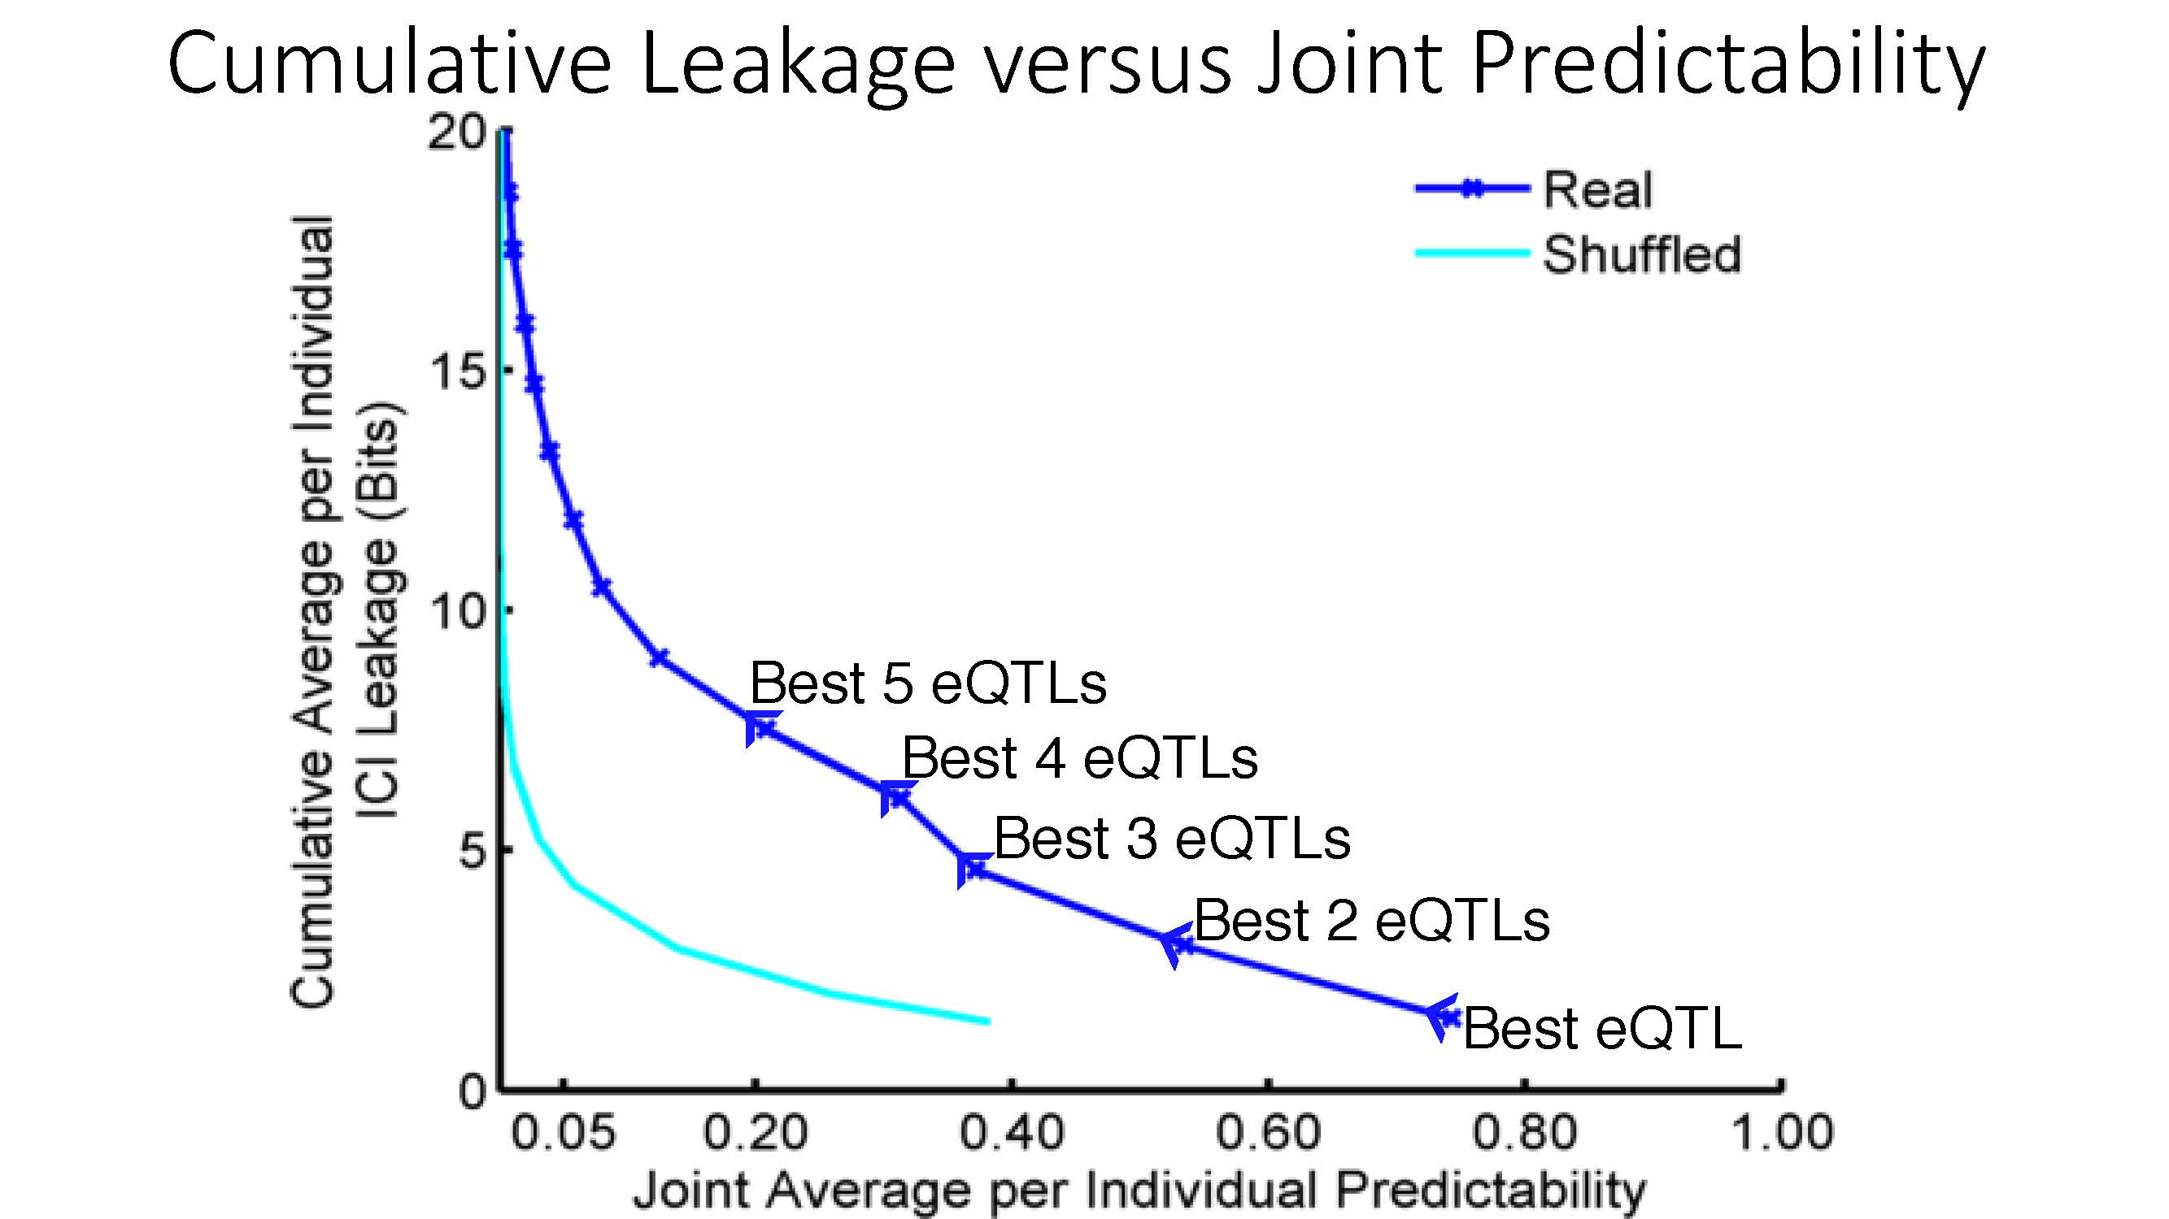
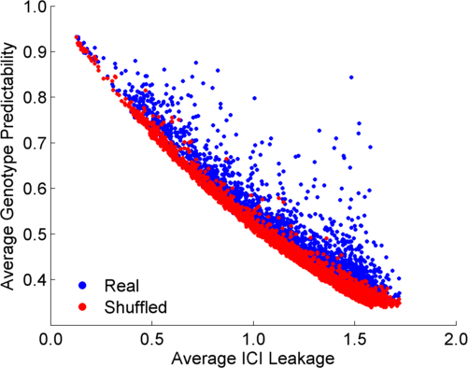
ICI Leakage versus Genotype Predictability
[Harmanciet al. Nat. Meth. (‘16]

Slide 17
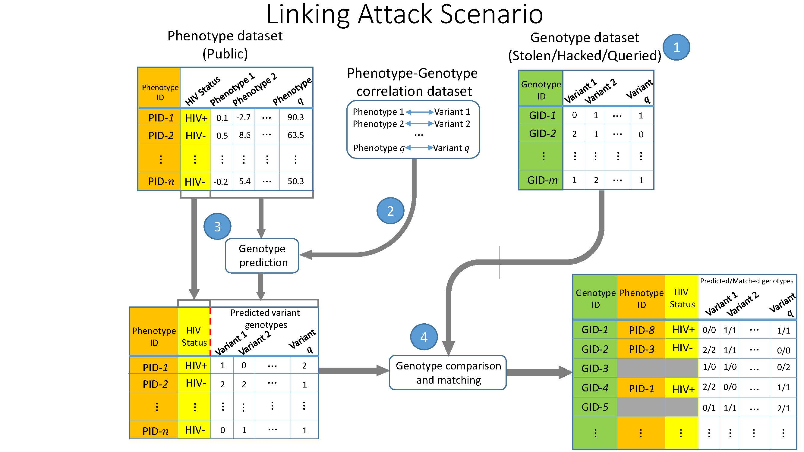
Linking Attack Scenario
[Harmanciet al. Nat. Meth. (‘16)]

Slide 18
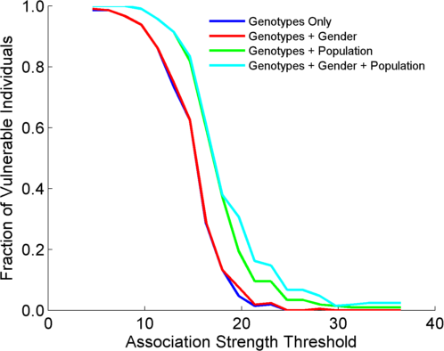
Success in Linking Attack with Extremity based Genotype Prediction
200 individuals eQTL Discovery
200 individuals in Linking Attack
High
Sensitivity
Low
Sensitivity
High Number
Of eQTLs
Low Number
Of eQTLs
[Harmanci et al. Nat. Meth. (16)]

Slide 19
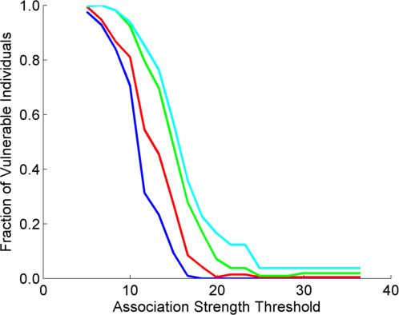
Success in Linking Attack with Extremity based Genotype Prediction
200 individuals eQTL Discovery
200 individuals in Linking Attack
200 individuals eQTL Discovery
100,200 individuals in Linking Attack
[Harmanci et al. Nat. Meth. (16)]

Slide 20
Quantification of sensitive information leakage from functional genomics data: Obvious v subtle leakages & practical file formats for addressing this
Intro. to Genomic Privacy
  The dilemma: The genome as fundamental, inherited info that’s very private v. need for large-scale sharing & mining for med. research
Privacy &
Functional Genomics Data
  2-sided nature of this data presents particularly tricky privacy issues
  Overview of types of the leakage, from obvious to subtle
Subtle Leakage #1: eQTLs
  Quantifying & removing further variant info from expression levels w/ ICI & predictability.
  Instantiating a practical linking attack w/ noisy quasi-identifiers
Subtle Leakage #2:
Signal Profiles
  Manifest appreciable leakage from large & small deletions.
  Linking attacks possible but additional complication of SV discovery in addition to genotyping
Practical solutions & file formats
  Using pBAM file format to remove obvious large-scale leakage
  Small subtle leaks combatted by restricting large-scale access. Hence, developing secure, blockchain-based logging technology (response to the iDash challenge)

Slide 21
Detection & Genotyping of small & large
SV deletions from signal profiles
RNA-Seq
Signal
Genomic
Coordinate
ChIP-Seq
Signals
A C G T A C G
Large Deletion
Genomic
Coordinate
Small Deletion
RNA-seq also shows large deletions
[Harmanci & Gerstein, Nat. Comm. (‘18)]

Slide 22
Example of Small Deletion Evident in Signal Profile
[Harmanci & Gerstein, Nat. Comm. (‘18)]

Slide 23
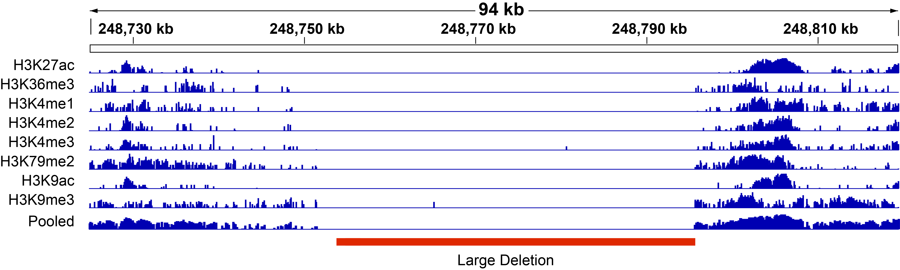
Example of Large Deletion Evident in Signal Profile
[Harmanci & Gerstein, Nat. Comm. (‘18)]

Slide 24
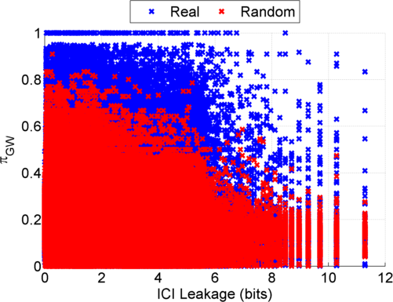
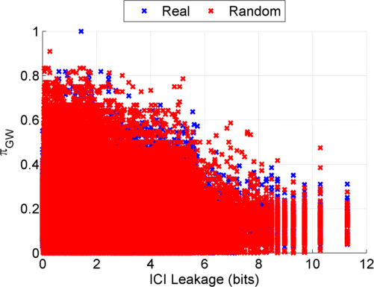
Information Leakage from SV Deletions
Before Anonymization
b) After Anonymization
Simple anonymization procedure (filling in deletion by value at endpoints) has dramatic effect
[Harmanci & Gerstein, Nat. Comm. (‘18)]
Notes:
GEUVADIS ICI-\Pi_GW estimates:

Slide 25
Another type of Linking Attack:
Linking based on SV Genotyping
[Harmanci & Gerstein, Nat. Comm. (‘18)]

Slide 26
Another type of Linking Attack:
First Doing SV Genotyping
[Harmanci & Gerstein, Nat. Comm. (‘18)]

Slide 27
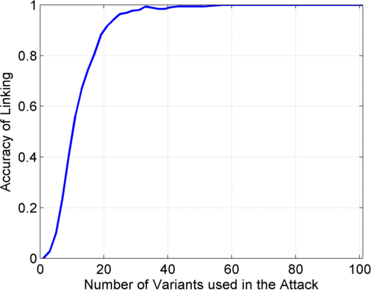
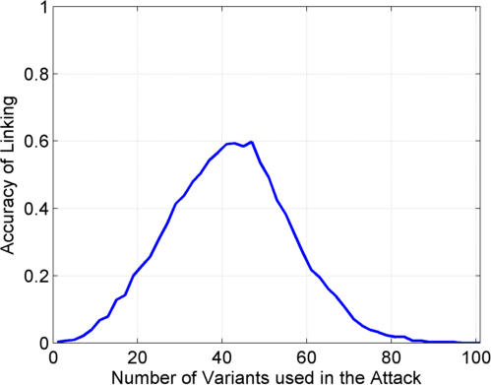
Linking Attack Based on SV Deletions in gEUVADIS Dataset
c) Genotyping
(1kG MAF>0.01)
d) Discovery + Genotyping
Sorted in Decreasing
Predictability
Sorted in Decreasing
Predictability
[Harmanci & Gerstein, Nat. Comm. (‘18)]

Slide 28
Quantification of sensitive information leakage from functional genomics data: Obvious v subtle leakages & practical file formats for addressing this
Intro. to Genomic Privacy
  The dilemma: The genome as fundamental, inherited info that’s very private v. need for large-scale sharing & mining for med. research
Privacy &
Functional Genomics Data
  2-sided nature of this data presents particularly tricky privacy issues
  Overview of types of the leakage, from obvious to subtle
Subtle Leakage #1: eQTLs
  Quantifying & removing further variant info from expression levels w/ ICI & predictability.
  Instantiating a practical linking attack w/ noisy quasi-identifiers
Subtle Leakage #2:
Signal Profiles
  Manifest appreciable leakage from large & small deletions.
  Linking attacks possible but additional complication of SV discovery in addition to genotyping
Practical solutions & file formats
  Using pBAM file format to remove obvious large-scale leakage
  Small subtle leaks combatted by restricting large-scale access. Hence, developing secure, blockchain-based logging technology (response to the iDash challenge)

Slide 29
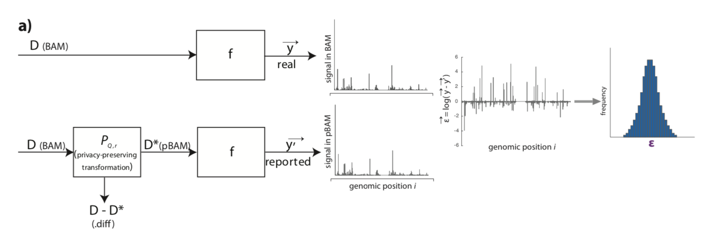
Privacy-aware Binary Alignment Mapping (pBAM)
  No need to know the sequence of mapped reads to aggregate them
  A manipulation on Binary Alignment Files (BAM)
    Find leaky fields/tags
    Suppression
    Generalization
  Goal:
    Accurate gene/transcript expression quantification
    Works with the pipelines / SAMtools
[Gursoy et al, BMC Med. Inform. (in press)]

Slide 30
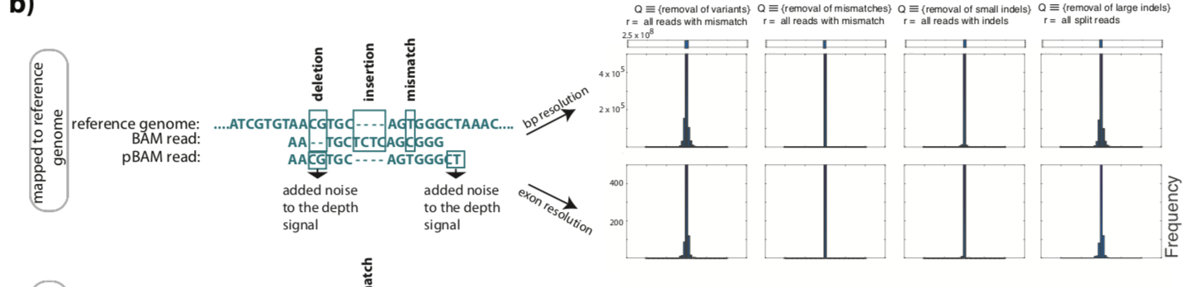
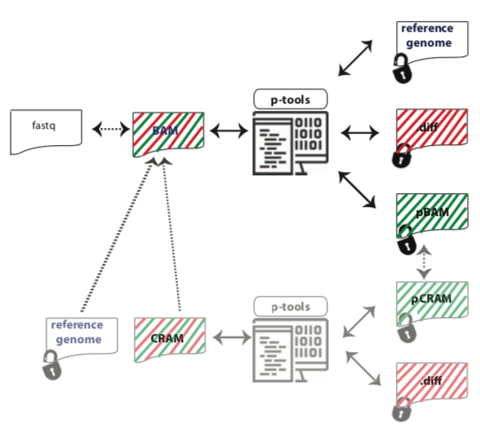
pBAMs are high in utility and can be converted BAM
  Works well with
    STAR signal tracks,
    RSEM gene expression and quantification
    MACS2 for ChIP-Seq peak calling.
  The original BAM does not need be stored.
    a smaller file called .diff
[Gursoy et al, BMC Med. Inform. (in press)]

Slide 31
Quantification of sensitive information leakage from functional genomics data: Obvious v subtle leakages & practical file formats for addressing this
Intro. to Genomic Privacy
  The dilemma: The genome as fundamental, inherited info that’s very private v. need for large-scale sharing & mining for med. research
Privacy &
Functional Genomics Data
  2-sided nature of this data presents particularly tricky privacy issues
  Overview of types of the leakage, from obvious to subtle
Subtle Leakage #1: eQTLs
  Quantifying & removing further variant info from expression levels w/ ICI & predictability.
  Instantiating a practical linking attack w/ noisy quasi-identifiers
Subtle Leakage #2:
Signal Profiles
  Manifest appreciable leakage from large & small deletions.
  Linking attacks possible but additional complication of SV discovery in addition to genotyping
Practical solutions & file formats
  Using pBAM file format to remove obvious large-scale leakage
  Small subtle leaks combatted by restricting large-scale access. Hence, developing secure, blockchain-based logging technology (response to the iDash challenge)

Slide 32

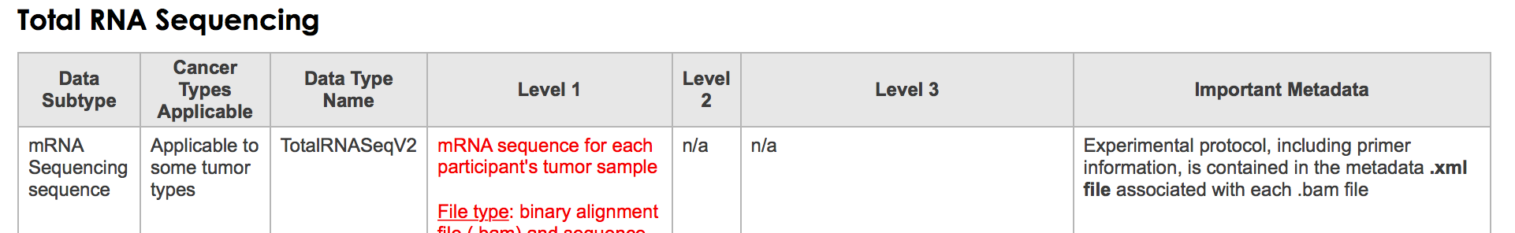
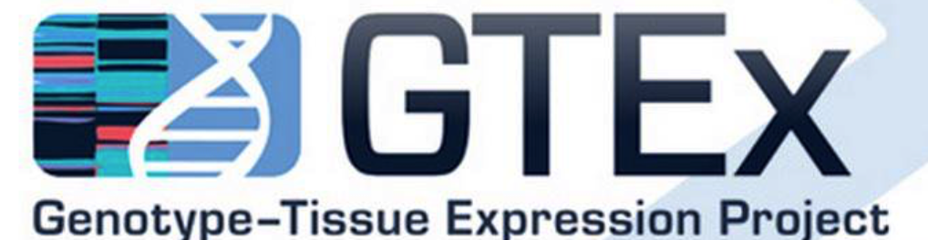
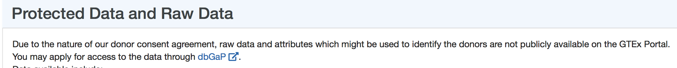
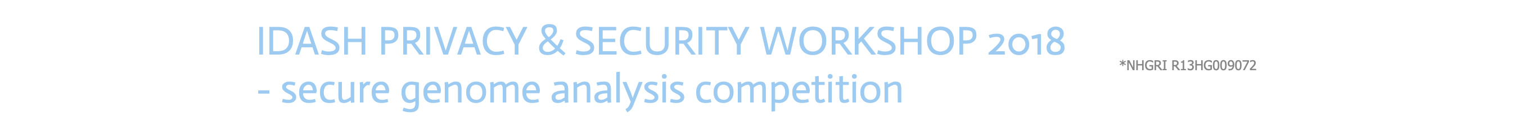
  As one accesses the protected data, privacy leakage/gb increases
  To prevent more than certain amount of leakage → log user access
  Can we securely store and query these logs?
Goal: Develop blockchain-based ledgering solutions to log and query the user activities of accessing genomic datasets across multiple sites
Find a way of storing it in the chain so you can access quickly!

Slide 33
Take advantage of data stream property of Multichain API
Every transaction appends a list of data items
key-value property
[Gursoy et al, BMC Med. Gen. (in press)]

Slide 34
Challenge Solution
LOG
Save each entry as a key to a stream item
For query
  Download all the keys
  Create a dataframe
  Query locally on the dataframe
Quick but memory intensive for millions of entries
[Gursoy et al, BMC Med. Gen. (in press)]

Slide 35
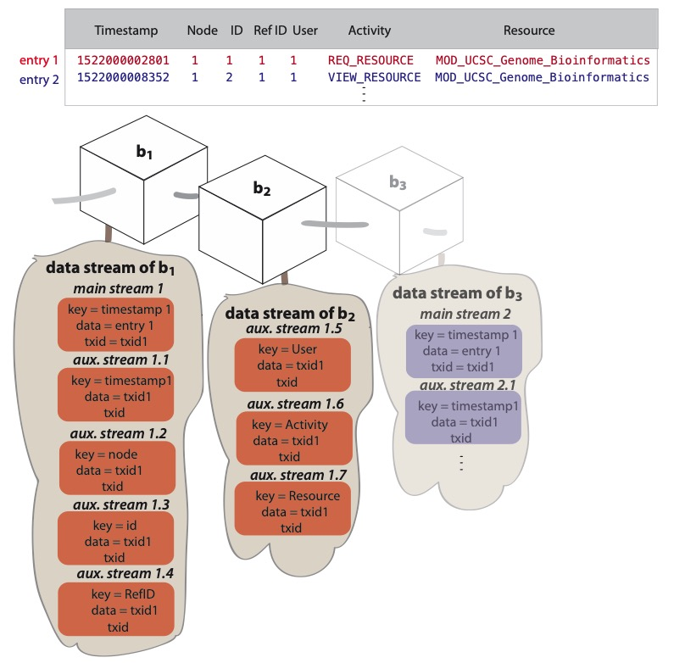
Bigmem Solution
LOG
Create a main stream item for each entry and 7 auxiliary stream items
Save txid of main stream as data in auxiliary streams
For query
  Query on keys
  Return txids of results
  List main streams with above txids
  Set intersection of lists
[Gursoy et al, BMC Med. Gen. (in press)]

Slide 36
Bigmem Solution
LOG
Example query: Node =1 AND User=1
Node =1
User =1
Txid = List data with key = {Node=1}
Txid = List data with key = {User=1}
Data = list data with Txid
Data = list data with Txid
Only operation in the local memory
Results = set intersection
[Gursoy et al, BMC Med. Gen. (in press)]

Slide 37
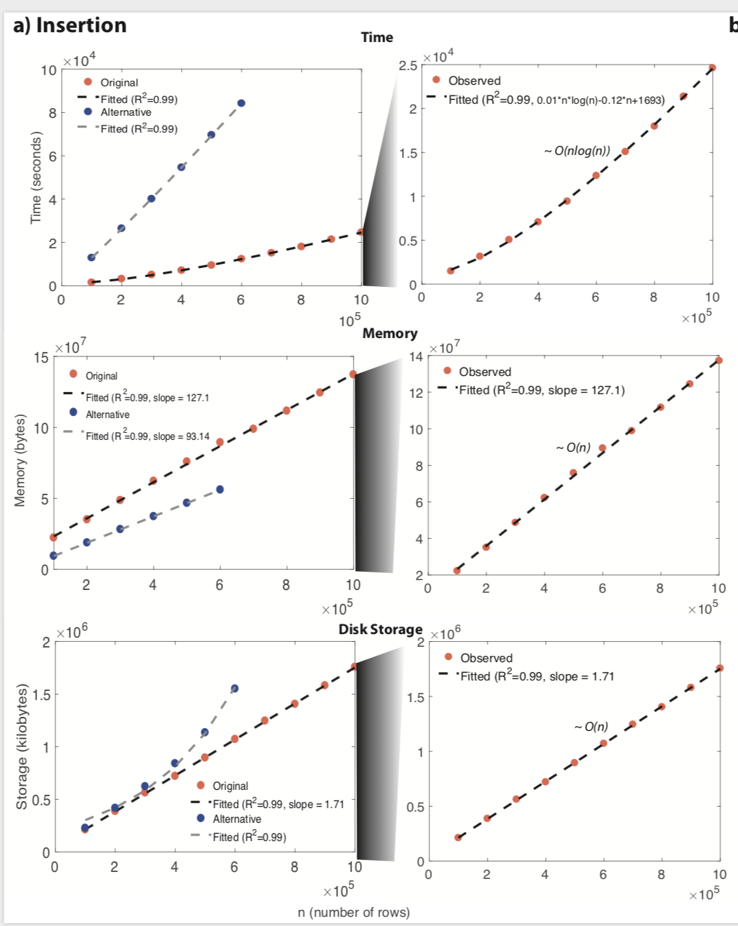
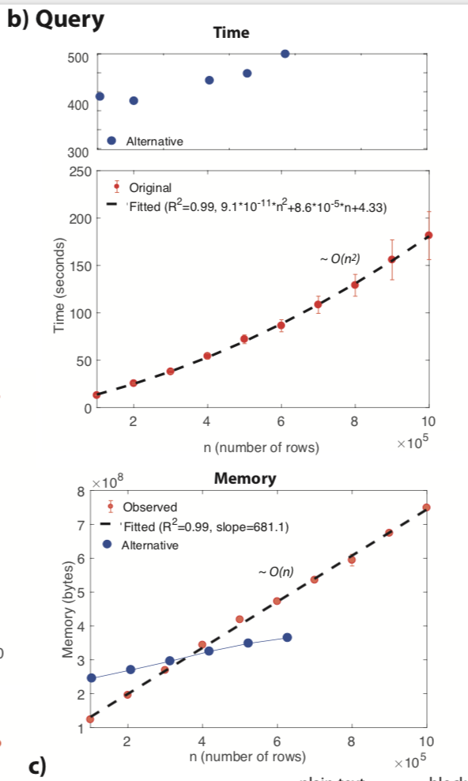
Reasonable time/space efficiency
insertion
query
[Gursoy et al, BMC Med. Gen. (in press)]

Slide 38
Quantification of sensitive information leakage from functional genomics data: Obvious v subtle leakages & practical file formats for addressing this
Intro. to Genomic Privacy
  The dilemma: The genome as fundamental, inherited info that’s very private v. need for large-scale sharing & mining for med. research
Privacy &
Functional Genomics Data
  2-sided nature of this data presents particularly tricky privacy issues
  Overview of types of the leakage, from obvious to subtle
Subtle Leakage #1: eQTLs
  Quantifying & removing further variant info from expression levels w/ ICI & predictability.
  Instantiating a practical linking attack w/ noisy quasi-identifiers
Subtle Leakage #2:
Signal Profiles
  Manifest appreciable leakage from large & small deletions.
  Linking attacks possible but additional complication of SV discovery in addition to genotyping
Practical solutions & file formats
  Using pBAM file format to remove obvious large-scale leakage
  Small subtle leaks combatted by restricting large-scale access. Hence, developing secure, blockchain-based logging technology (response to the iDash challenge)

Slide 39
Quantification of sensitive information leakage from functional genomics data: Obvious v subtle leakages & practical file formats for addressing this
Intro. to Genomic Privacy
  The dilemma: The genome as fundamental, inherited info that’s very private v. need for large-scale sharing & mining for med. research
Privacy &
Functional Genomics Data
  2-sided nature of this data presents particularly tricky privacy issues
  Overview of types of the leakage, from obvious to subtle
Subtle Leakage #1: eQTLs
  Quantifying & removing further variant info from expression levels w/ ICI & predictability.
  Instantiating a practical linking attack w/ noisy quasi-identifiers
Subtle Leakage #2:
Signal Profiles
  Manifest appreciable leakage from large & small deletions.
  Linking attacks possible but additional complication of SV discovery in addition to genotyping
Practical solutions & file formats
  Using pBAM file format to remove obvious large-scale leakage
  Small subtle leaks combatted by restricting large-scale access. Hence, developing secure, blockchain-based logging technology (response to the iDash challenge)

Slide 40

Acknowledgements
A Harmanci,
D Greenbaum,
G Gürsoy,
R Bjornson, M Green,
S Strattan, O Jolanki,
F Navarro
papers.gersteinlab.org/subject/
privacy
PrivaSig.gersteinlab.org
PrivaSeq.gersteinlab.org
PrivaSeq3.gersteinlab.org
github.com/gersteinlab/
iDASH-blockchain
Also:
JOBS.gersteinlab.org
Hiring Postdocs. See JOBS.gersteinlab.org !

Slide 41

Extra

Slide 42
Info about content in this slide pack
General PERMISSIONS
  This Presentation is copyright Mark Gerstein,
  Yale University, 2019.
  Please read permissions statement at
  www.gersteinlab.org/misc/permissions.html .
  Feel free to use slides & images in the talk with PROPER acknowledgement
  (via citation to relevant papers or link to gersteinlab.org).
  Paper references in the talk were mostly from Papers.GersteinLab.org.
PHOTOS & IMAGES. For thoughts on the source and permissions of many of the photos and clipped images in this presentation see http://streams.gerstein.info .
  In particular, many of the images have particular EXIF tags, such as kwpotppt , that can be easily queried from flickr, viz: http://www.flickr.com/photos/mbgmbg/tags/kwpotppt

