Slide 1
Comparing RNA & Protein Abundance
M Gerstein & P Emani

Slide 2
Outline: Comparing Protein & RNA Abundance
Past Context: to work in the Center
Quantifying the moderate statistical correlation between protein & RNA
PARE server
EMpire (Current result)
Leveraging the correlation to better assign peptides to isoforms
EM algorithm better assigns dominant isoforms, with greater interpretability
uORFs (Current result)
Affect translation & relationship between protein & RNA
Feature integration to find small subset of uORFs that most alter translation
Future Direction: Protein v RNA using matched samples in the Brainspan dataset + single-cell data

Slide 3
Why relate amounts of protein & mRNA?
Gene expression - major place for regulation (easy to measure)
vs.
Concentration of protein - major determinant of activity
Expectations from simple kinetic models:
dPi
dt
= k_{s,i} [mRNA_{i} ] – k_{d,i} P_{i}
k_{s;i} [mRNA_{i} ]
At steady state: P_{i} =
k_{d,i}
where k_{s,i} and k_{d,i} are the protein synthesis and degradation rate constants
[Greenbaum et al. Bioinformatics 2002, 18, 587]
Outliers from trend interesting
Notes:
‹#›

Slide 4
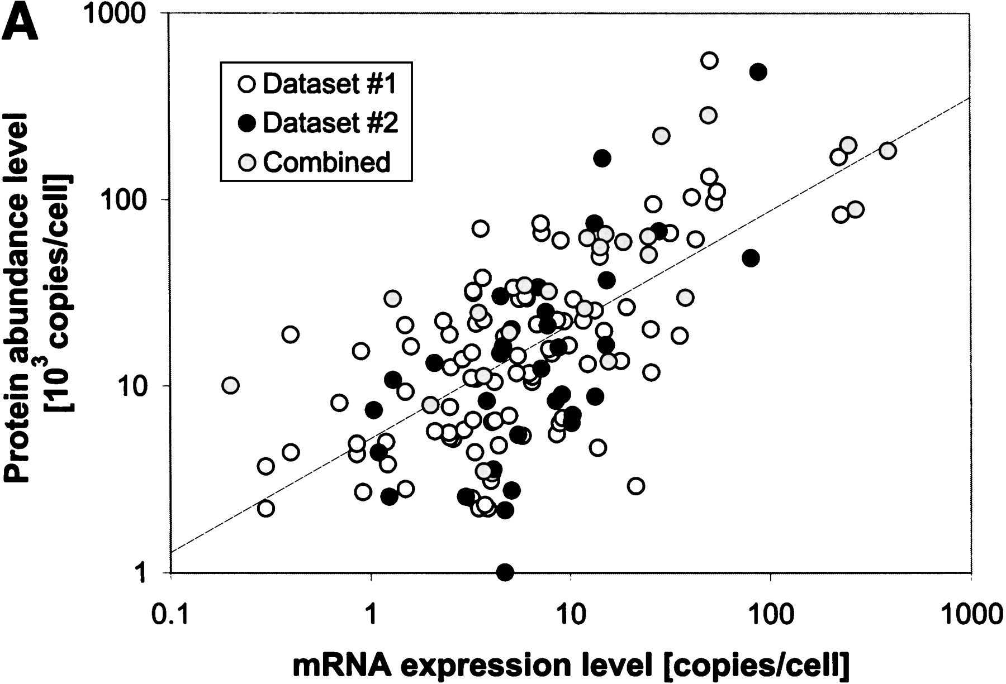
Early result on mRNA vs Protein, using 2D gels
r =0.67
[Greenbaum et al. Bioinformatics 2002, 18, 587]

Slide 5
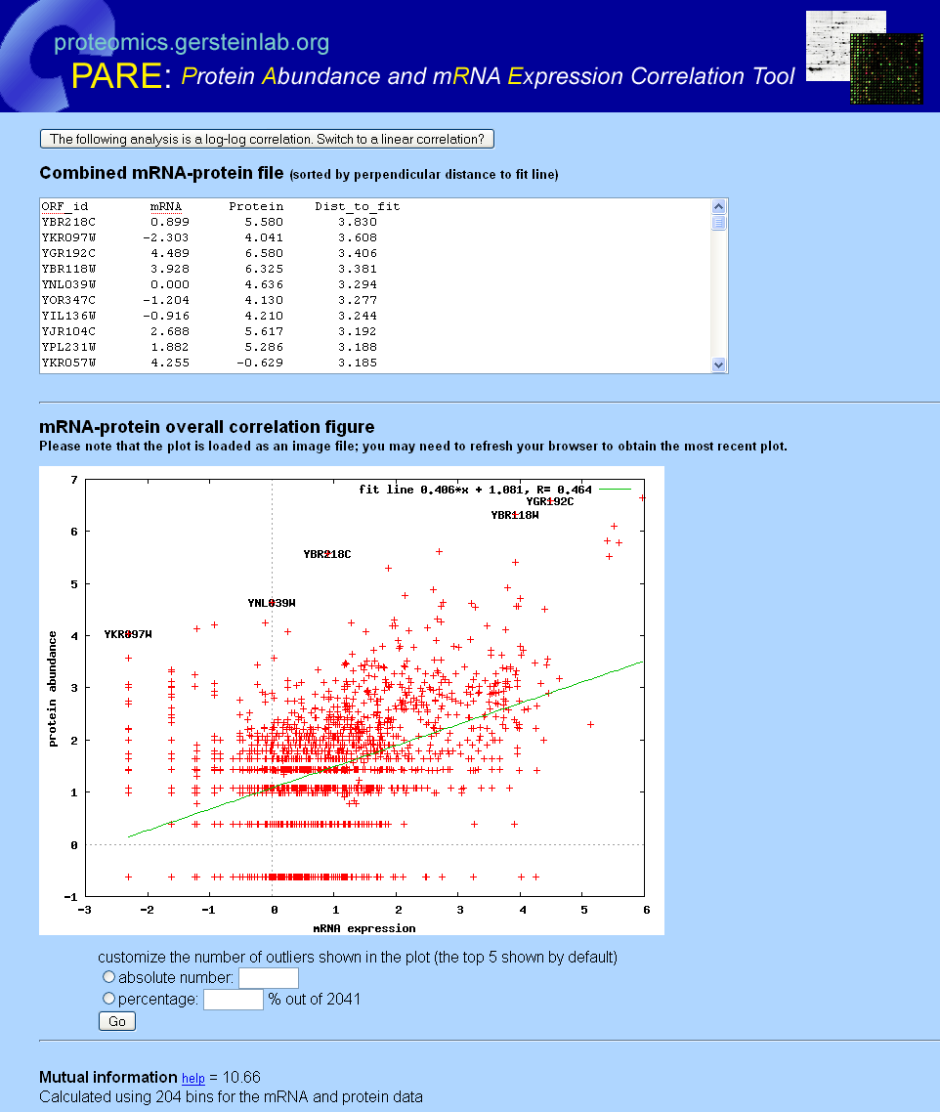
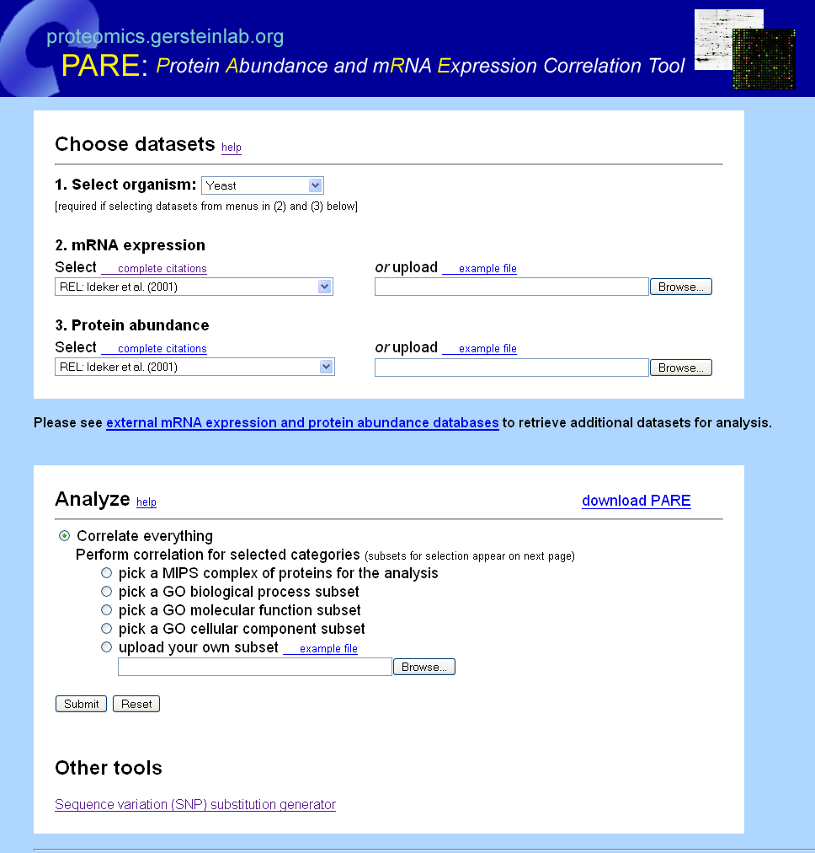
PARE
Open-source code Downloadable
Analyze all or GO subset
Log-log plot of correlation
-linear fit
-outliers labeled
Calculation of
mutual information
[Yu et al., BMC Bioinfo. '07]
Notes:
‹#›

Slide 6
Outline: Comparing Protein & RNA Abundance
Past Context: to work in the Center
Quantifying the moderate statistical correlation between protein & RNA
PARE server
EMpire (Current result)
Leveraging the correlation to better assign peptides to isoforms
EM algorithm better assigns dominant isoforms, with greater interpretability
uORFs (Current result)
Affect translation & relationship between protein & RNA
Feature integration to find small subset of uORFs that most alter translation
Future Direction: Protein v RNA using matched samples in the Brainspan dataset + single-cell data

Slide 7
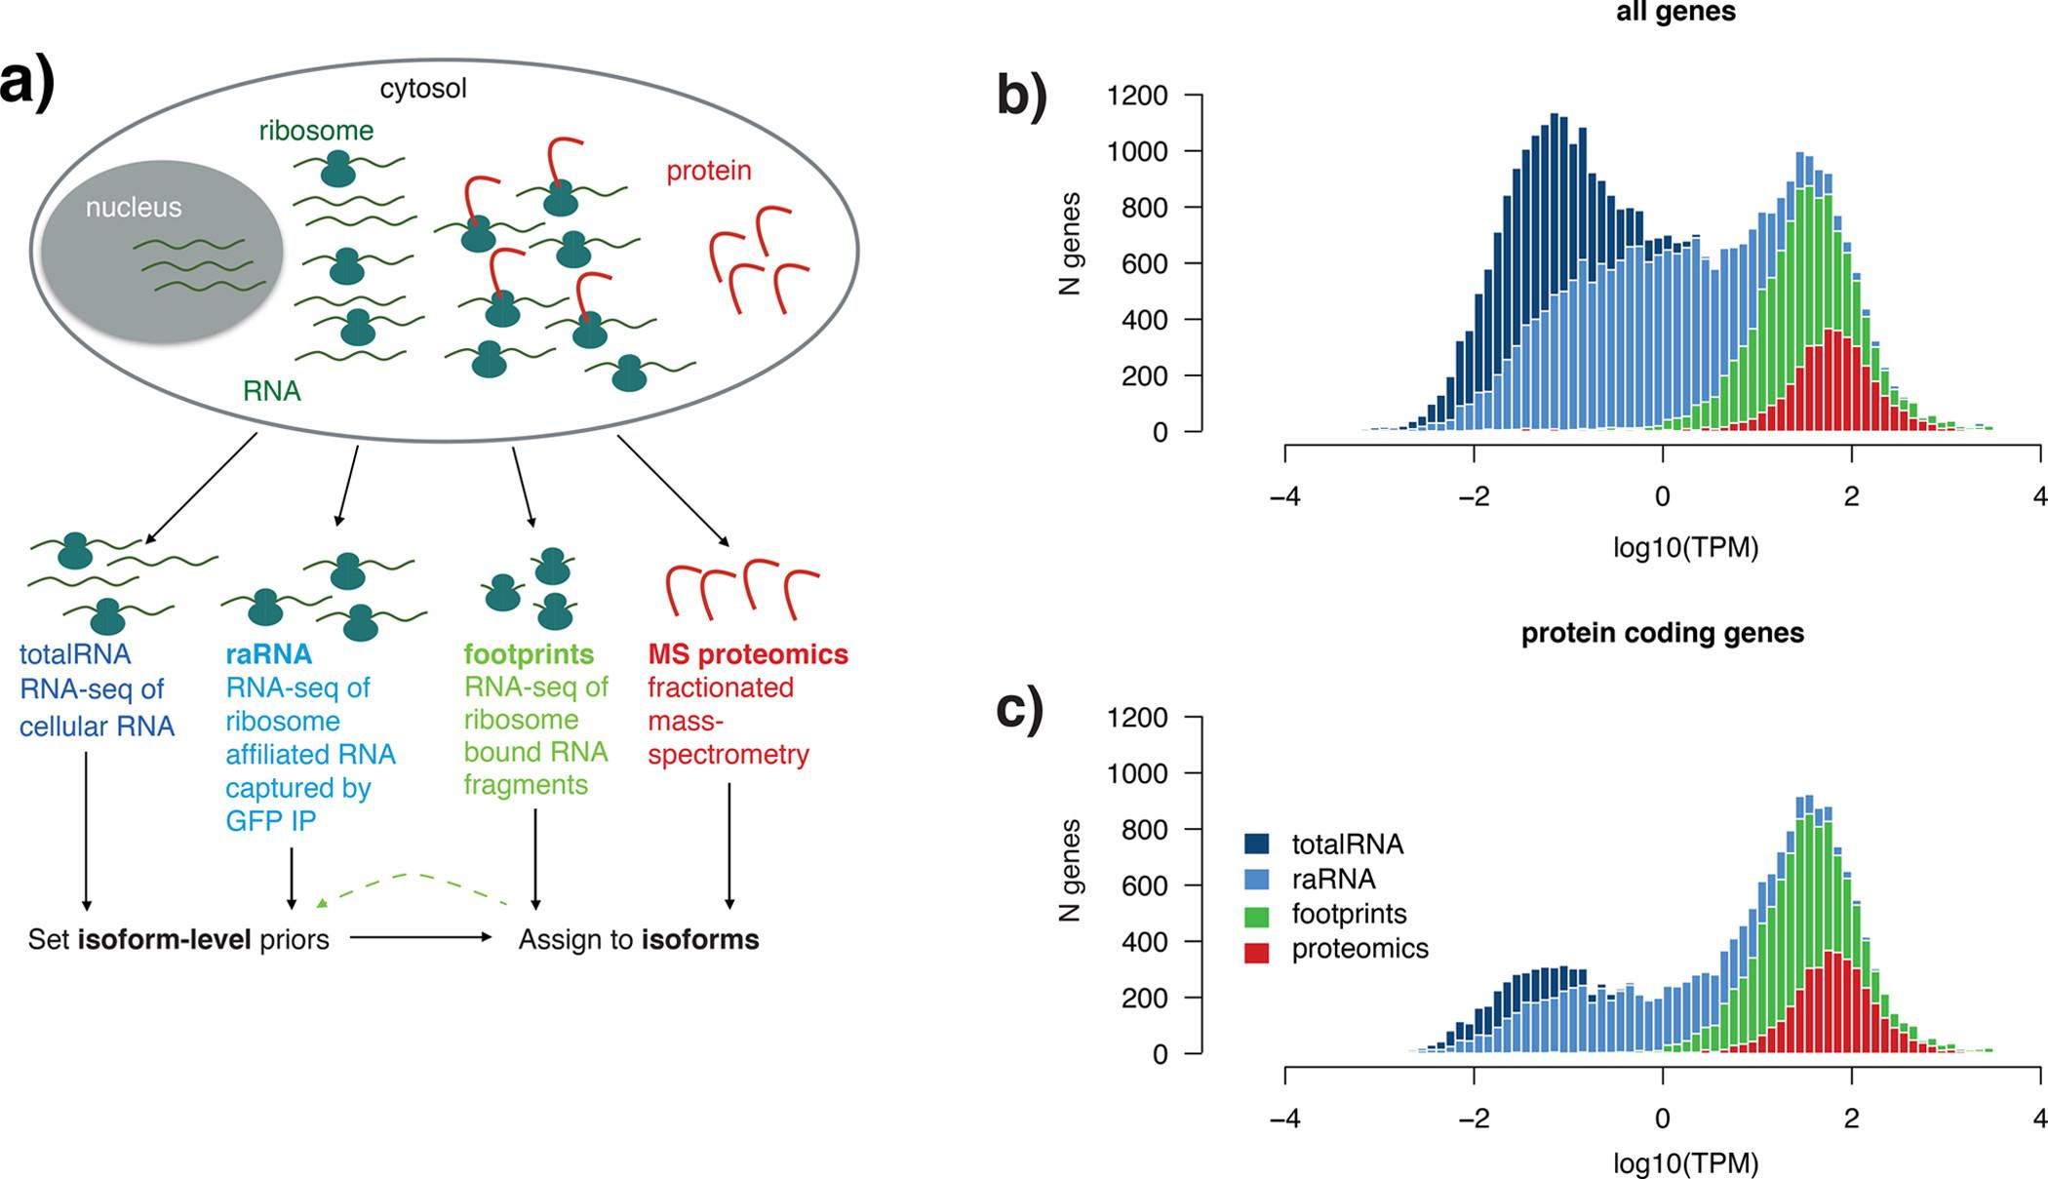
Integration of RNA-seq and Proteomic Data for Isoform Interpretation
[Carlyle, Kitchen et al. (2018) Journal of Proteome Research]

Slide 8
Challenge for Isoform-Level Interpretation of Proteomics Data
Multimapping
Different assays reflecting expression at various levels
More reads at earlier stage assay (RNA-Seq > FP > MS)
Leverage other assays for better estimation
[Carlyle, Kitchen et al. (2018) Journal of Proteome Research]

Slide 9
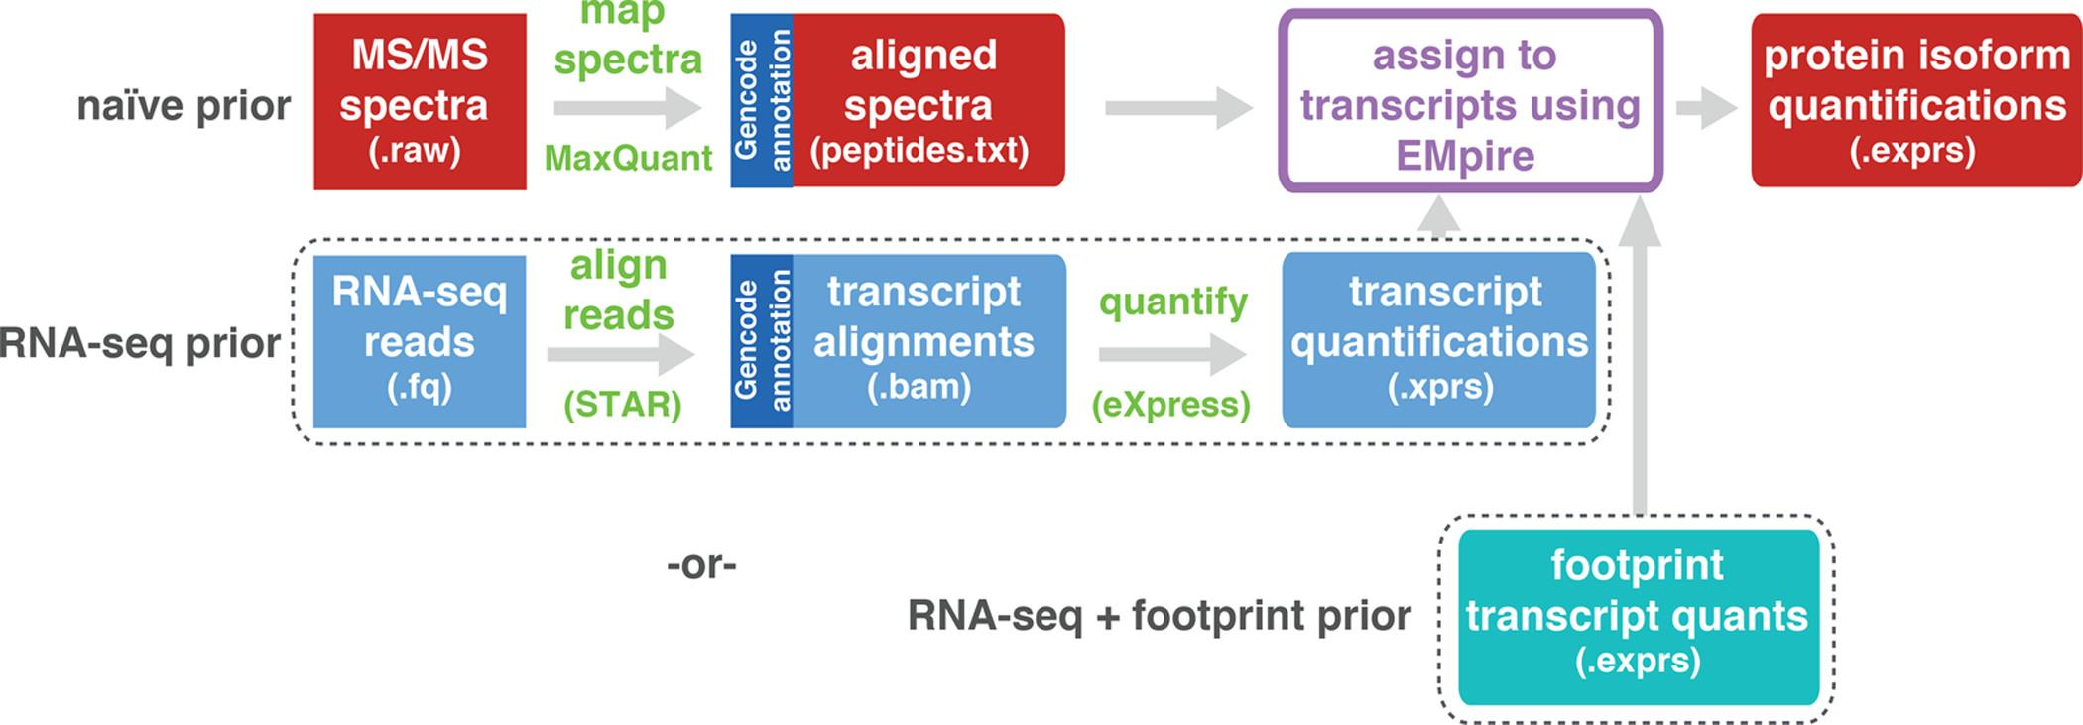
EMpire (Expectation Maximisation Propagation of Isoform abundance from RNA Expression)
[Carlyle, Kitchen et al. (2018) Journal of Proteome Research]

Slide 10
EMpire (Expectation Maximisation Propagation of Isoform abundance from RNA Expression)
[Carlyle, Kitchen et al. (2018) Journal of Proteome Research]

Slide 11
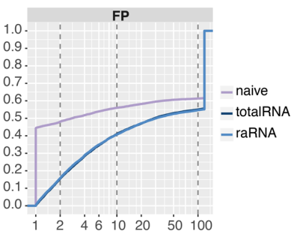
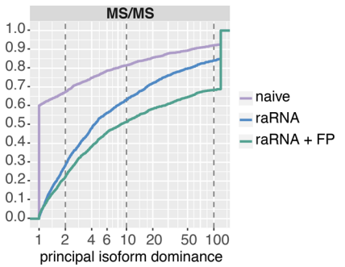
[Carlyle, Kitchen et al. (2018) Journal of Proteome Research]
Cumulative Fraction
Cumulative Fraction
Larger principal isoform dominance = Less ambiguity in major isoform identification

Slide 12
Biologically informative priors improve isoform level interpretation of MS/MS peptides, by increasing dominance of principal isoform
[Carlyle, Kitchen et al. (2018) Journal of Proteome Research]
Notes:
Figure S8 | Use of a biologically informative prior improves isoform level interpretation of ribosome footprints and
MS/MS peptides
Heatmaps show the effect of using different priors on the dominance of the principal isoform following the EM. In
each doublet row, the top row represents assignment of reads/peptides before EM, the second row represents
updated ratios after iterations of EM with a naive or biological prior. Clusters of principal isoforms (x-axes) are
indicated by dendrogram colours (top) and numeric IDs (bottom), the latter matching the cluster IDs in Figure 4.
a) The heatmap plots the principal isoform fraction for the 6,650 multi-isoform genes with at least 3 footprint
reads. Using a biological prior improved the ability to resolve the principal isoform in 3,795 genes (57.1%) and
converged on the same isoform as the naive prior in 2,747 genes (41.3%).
b) The heatmap plots the principal isoform fraction for the 1,212 multi-isoform genes with at least 2 peptides.
Using a biological prior improved the ability to resolve the principal isoform in 663 genes (54.7%) and converged
on the same isoform as the naive prior in 408 genes (33.7%).

Slide 13
Outline: Comparing Protein & RNA Abundance
Past Context: to work in the Center
Quantifying the moderate statistical correlation between protein & RNA
PARE server
EMpire (Current result)
Leveraging the correlation to better assign peptides to isoforms
EM algorithm better assigns dominant isoforms, with greater interpretability
uORFs (Current result)
Affect translation & relationship between protein & RNA
Feature integration to find small subset of uORFs that most alter translation
Future Direction: Protein v RNA using matched samples in the Brainspan dataset + single-cell data

Slide 14
Upstream open reading frames (uORFs) may shift the expected balance between mRNA & protein
[Zhang et al., Trends in Biochemical Sciences (‘19)]
uORF regulation can be affected by mutation
In Battle et al. 2014 data uORF gain & loss assoc. protein level change.
[McGillivray et al., NAR (‘18)]

Slide 15
The population of functional uORFs may be significant
Ribosome profiling experiments have low overlap in identified uORFs.
This suggests high false-negative rate, and more functional uORFs than currently known.
From a “Universe” of 1.3 M pot. uORFs
[McGillivray et al., NAR (‘18)]

Slide 16
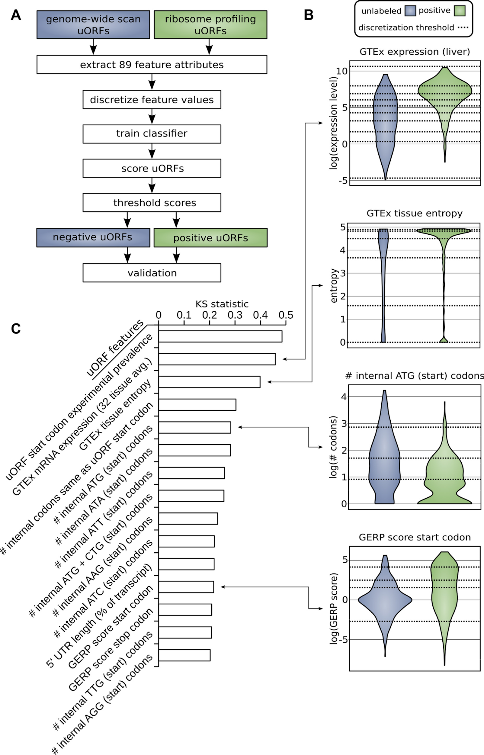
Prediction & validation of
functional uORFs using 89 features
Expr.
Level
All near-cognate start codons predicted.
Cross-validation on independent ribosome profiling datasets and validation using in vivo protein levels and ribosome occupancy in humans (Battle et al. 2014).
Tissue
Dist.
Int.
ATG
Start
Cons-
ervation
[McGillivray et al., NAR (‘18)]

Slide 17
A comprehensive catalog of functional uORFs
Universe of 1.3M uORFs scored via Simple Bayes algo.
180K: Large predicted positive set likely to affect translation
Calibration on gold standards, suggests getting ~70% of known
Predicted functional uORFs may be intersected with disease associated variants.
[McGillivray et al., NAR (‘18)]

Slide 18
Outline: Comparing Protein & RNA Abundance
Past Context: to work in the Center
Quantifying the moderate statistical correlation between protein & RNA
PARE server
EMpire (Current result)
Leveraging the correlation to better assign peptides to isoforms
EM algorithm better assigns dominant isoforms, with greater interpretability
uORFs (Current result)
Affect translation & relationship between protein & RNA
Feature integration to find small subset of uORFs that most alter translation
Future Direction: Protein v RNA using matched samples in the Brainspan dataset + single-cell data

Slide 19
Leveraging New Datasets
Availability of single-cell RNA-seq datasets warrants revisiting mRNA-protein dynamics with an eye towards cell-type-specific characterizations:
Can the rich information on mRNA distributions from single-cell data provide clues to the origin of mRNA-protein discrepancies in the bulk data?
What can we learn about cell-type specifics of the mRNA-to-protein relationship?
The Brainspan dataset considered in the NIDA grant research represents a unique opportunity for individual-specific study:
Individual-matched bulk RNA-seq, smallRNA-seq and proteomics data are available for several individuals in several brain regions
AGO2 HITS-CLIP data is also available to link microRNA to potential mRNA targets
Combining all these modalities into a coherent framework suggests a return to first principles

Slide 20
Schematic workflow
Estimate cell-type-specific mRNA transcription parameters from single-cell distributions
Use cell fractions to construct bulk distributions from single-cell dist.
Estimate ‘burst’ translation and protein decay parameters
Issue: must contend with lack of cell-type-specific proteomics profiles (workarounds)
Use AGO2 HITS-CLiP to identify interactions; look for microRNA expression correlations in mRNA numbers and protein-to-mRNA ratios
Identify and quantify microRNA interventions in mRNA-protein dynamics

Slide 21
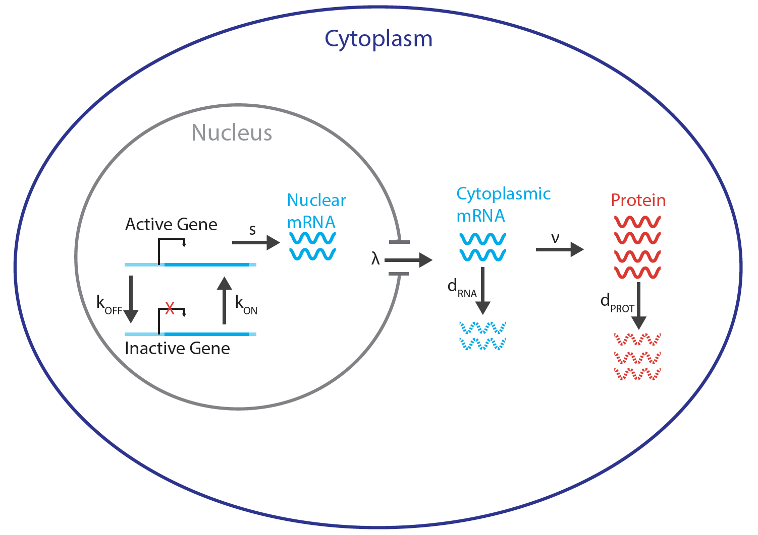
mRNA-Protein dynamics
Use normalized single-cell mRNA distributions:
Infer cell-type-specific k_{ON}, k_{OFF} and s (Kim and Marioni 2013) using Poisson-Beta model of ‘burst’ transcription
Replace decay rate by nuclear export rate λ
Use two-state model of protein translation (Shahrezaei and Swain 2008):
Obtain cell-type-specific cyto. RNA and Protein numbers in terms of λ, ν, d_{RNA}, d_{PROT}.
Use bulk mRNA and Protein data as constraints
Kim and Marioni, Genome Biology 2013, 14:R7.
Shahrezaei and Swain, PNAS 2008, 105(45), Pgs. 17256–17261.

Slide 22
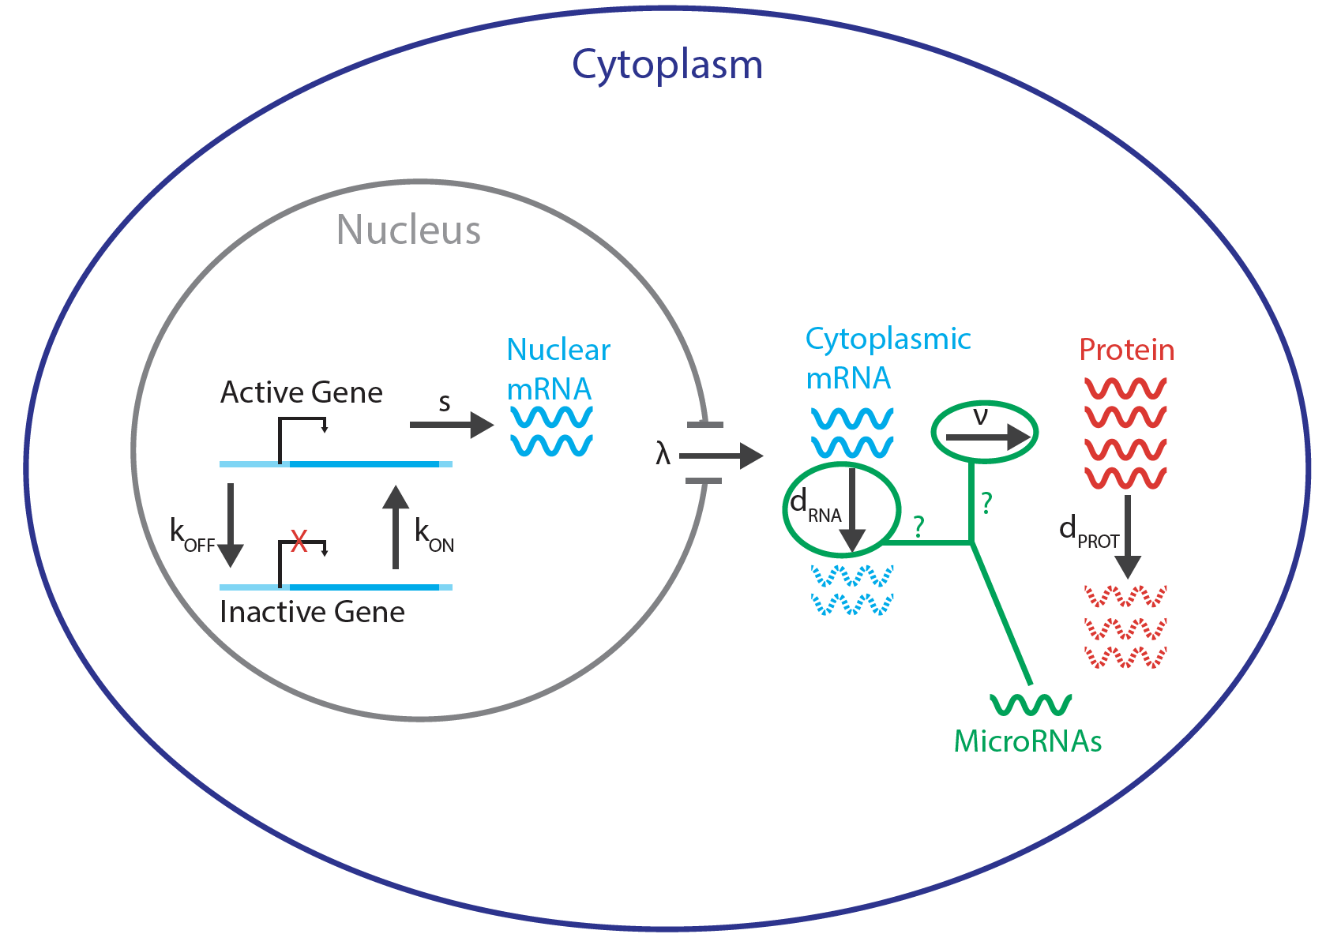
MicroRNA intervention
Use AGO2 HITS-CLIP binding data on microRNA-mRNA interactions in the brain (Sousa et al 2017):
Compare mRNAs with multiple targeting microRNAs to those with one or none; expression levels and inferred parameters
Use smallRNA-seq expression data:
Directly correlate with protein-to-mRNA ratios and mRNA expression levels
Correlate with inferred parameters to determine whether microRNA impacts mRNA degradation, protein translation, or both
Sousa et al., Science 2017, 358, Pgs. 1027–1032.

Slide 23
Outline: Comparing Protein & RNA Abundance
Past Context: to work in the Center
Quantifying the moderate statistical correlation between protein & RNA
PARE server
EMpire (Current result)
Leveraging the correlation to better assign peptides to isoforms
EM algorithm better assigns dominant isoforms, with greater interpretability
uORFs (Current result)
Affect translation & relationship between protein & RNA
Feature integration to find small subset of uORFs that most alter translation
Future Direction: Protein v RNA using matched samples in the Brainspan dataset + single-cell data

Slide 24
genecensus.org/expression/translatome
D Greenbaum, R Jansen, M Gerstein
Proteomics.gersteinlab.org (PARE)
E Yu, A Burba, M Gerstein
github.com/rkitchen/EMpire
B Carlyle, R Kitchen, J Zhang, R Wilson, T Lam, J Rozowsky, K Williams, N Sestan, M Gerstein, A Nairn
github.gersteinlab.org/uORFs
P McGillivray, R Ault, M Pawashe, R Kitchen, S Balasubramanian, M Gerstein
Brainspan data
P Emani, T Galeev, N Sestan, A Nairn
Acknowledgments!

