Slide 1

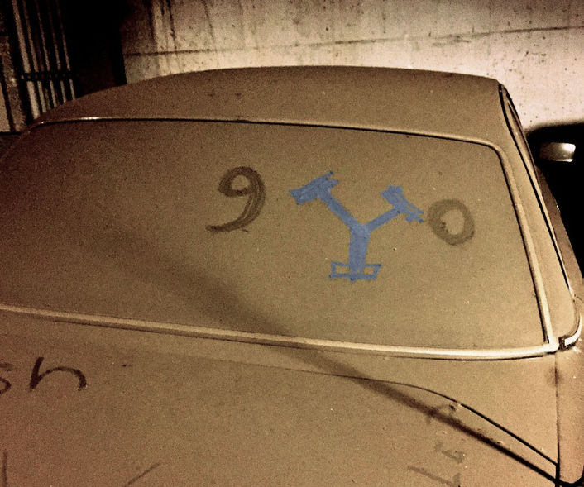
Genomics
&
Data Science
M Gerstein, Yale
(See last slide for more info.)
Credits & references on each slide
Slides freely downloadable
from Lectures.GersteinLab.org
& “tweetable” (via @MarkGerstein)

Slide 2
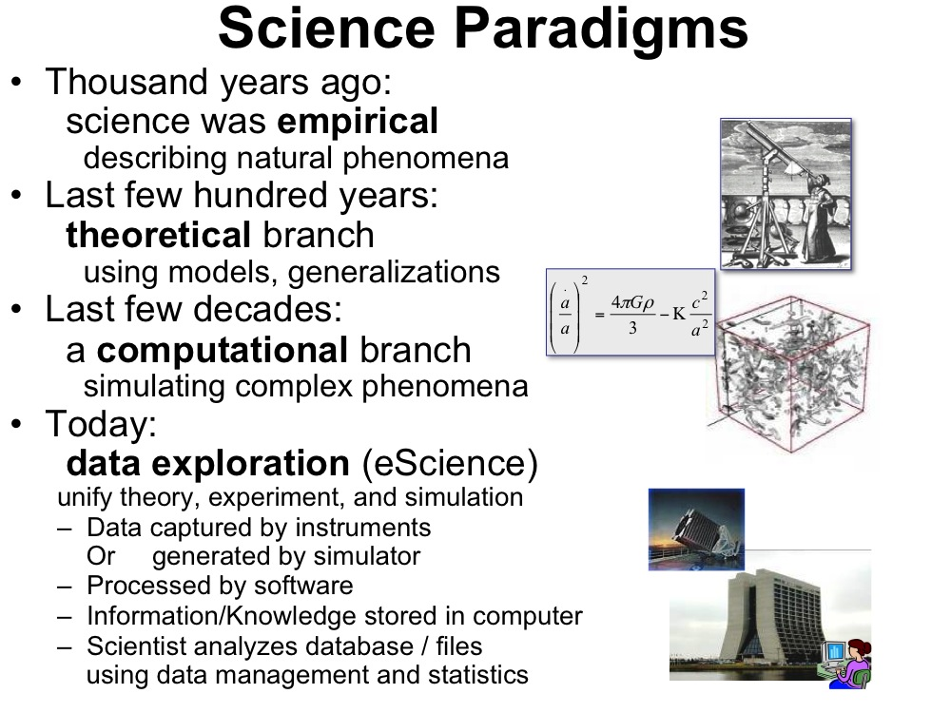
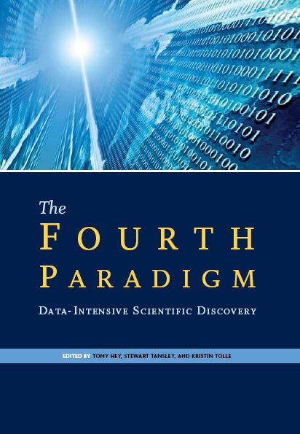
Jim Gray’s 4th Paradigm
#3 - Simulation
  Prediction based on physical principles (eg Exact Determination of Rocket Trajectory)
  Emphasis on: Supercomputers
#4 - Data Science
  Data gathering and storing
  Data analysis including data mining, modeling, visualizing
  Creative use of data exhaust and protection of privacy
  Emphasis: networks, “federated” DBs
Gray died in ’07.
Book about his ideas came out in ‘09…..
[Slide from : http://research.microsoft.com/en-us/um/people/gray/talks/stanford%2520symbolic%2520systems%2520seminar.ppt]

Slide 3
What is Data Science? An overall, bland definition…
Data Science encompasses the study of the entire lifecycle of data
  Understanding of how data are gathered &
  the issues that arise in its collection
  Knowledge of what data sources are available
  & how they may be synthesized to solve problems
  The storage, access, annotation, management, &
  transformation of data
Data Science encompasses many aspects of data analysis
  Statistical inference, machine learning, & the design of algorithms and computing systems that enable data mining
  Connecting this mining where possible with physical modeling
  The presentation and visualization of data analysis
  The use of data analysis to make practical decisions & policy
Secondary aspects of data, not its intended use – eg the data exhaust
  The appropriate protection of privacy
  Creative secondary uses of data – eg for Science of science
  The elimination of inappropriate bias in the entire process

Slide 4
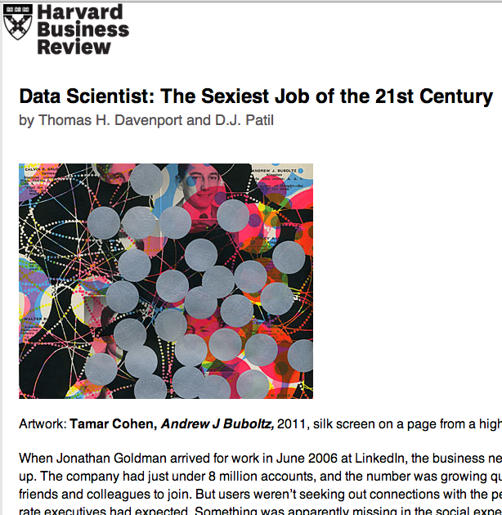
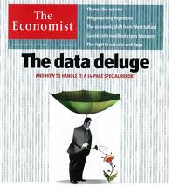
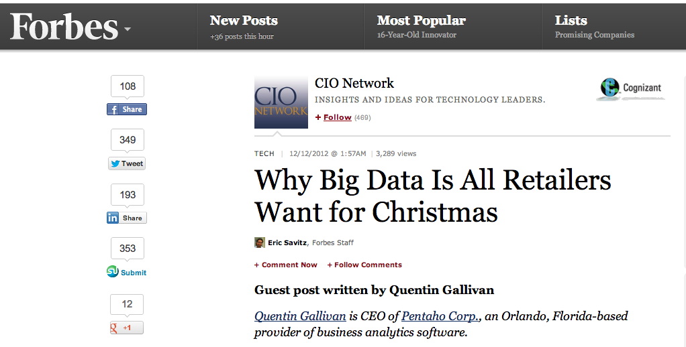
Data Science in the “Big Tech”: a buzz-word for successful Ads
Ads, media, product placement,
supply optimization,
Integral to success of GOOG, FB, AMZN, WMT…
[Oct. ‘12 issue]

Slide 5
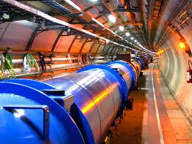
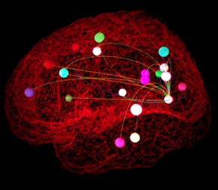
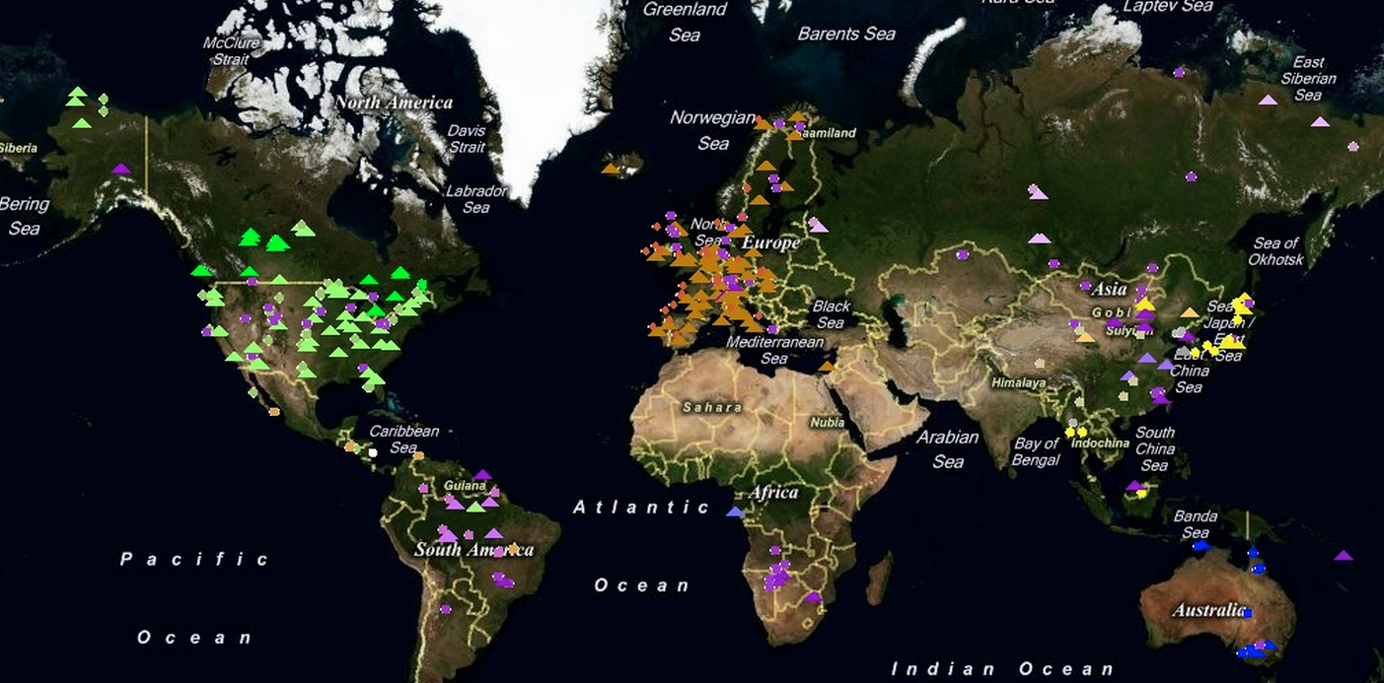
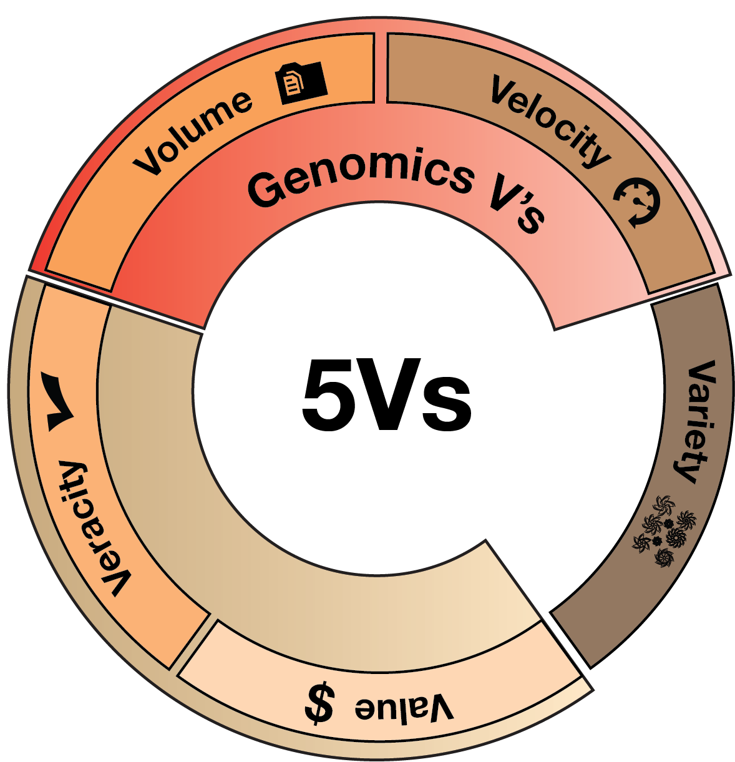
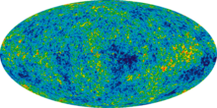
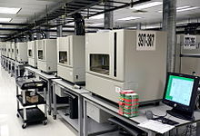
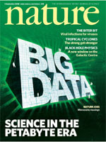

Data Science in Traditional Science
Pre-dated commercial mining
Instrument generated
Large data sets often created by large teams not to answer one Q but to be mined broadly
Often coupled to a physical/biological model
Interplay w/ experiments
[Navarro et al. GenomeBiol. (’19, in press)]
Ecology
& Earth Sci.
- Fluxnet
High energy physics -
Large Hadron Collider
Neuroscience -
The Human Connectome Project
Astronomy -
Sloan Digital Sky survey
Genomics
DNA sequencer

Slide 6
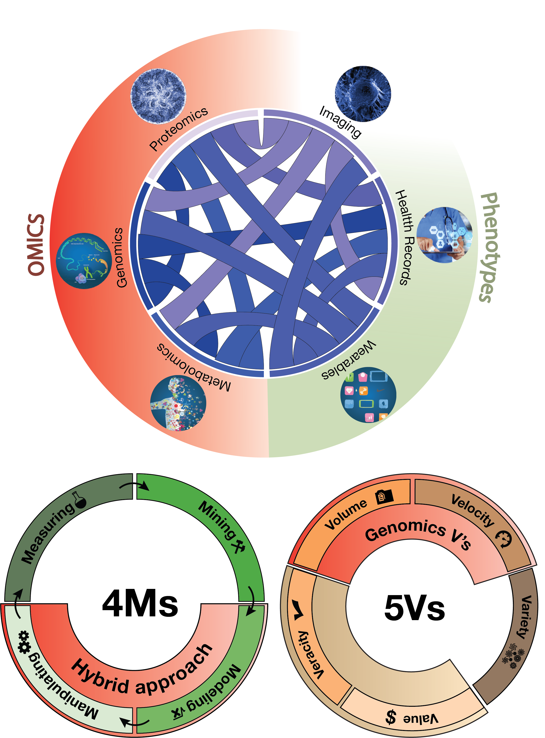
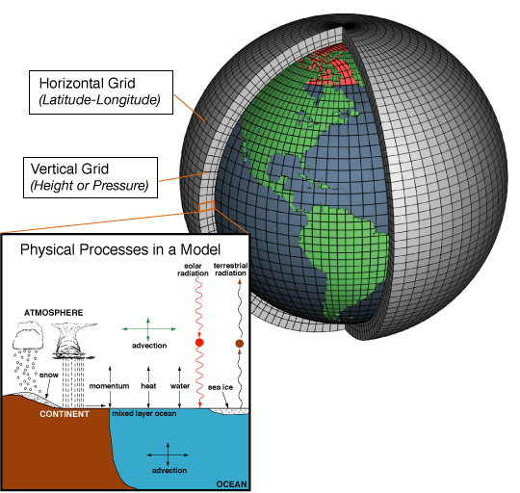
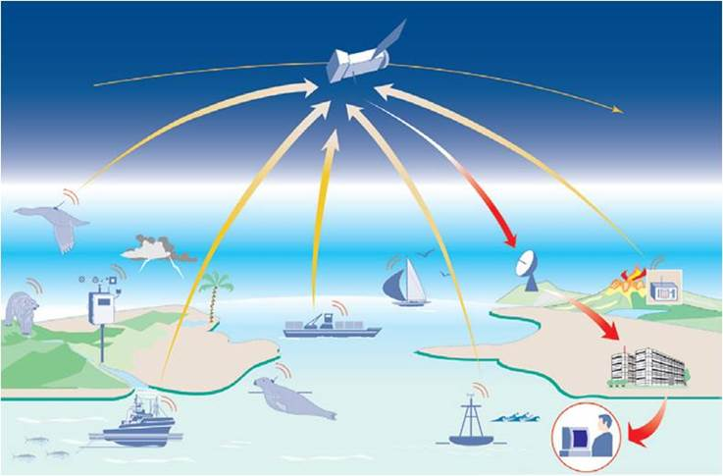
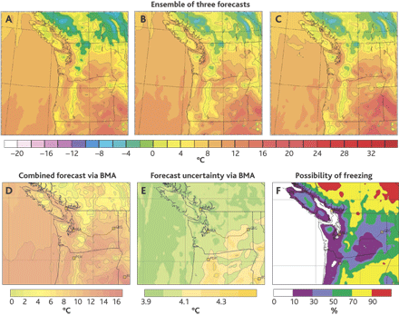
Coupling of Scientific Data to Models & Experiments
  Scientific data often coupled to a physical/biological model
Lauffenburger’s Sys. Biol. 4Ms:
Measurement, Mining, Modeling & Manipulation
(Ideker et al.’06. Annals of Biomed. Eng.)
Weather forecasting as an exemplar
  Physical models & simulation useful but not sufficient (“butterfly” effect)
  Success via coupling to large-scale sensor data collection
Models + Data Mining
Forecasts
[Navarro et al. GenomeBiol. (’19,
in press)]
Image from http://web.aibn.uq.edu.au/cssb/ResearchProjects.htm
NOAA

Slide 7
Genomics & Data Science
Background on data science & the biomed. sub-domain
  Placing genomics in this context -- 3V & 4M frameworks
  Types of data & integration betw. types + Moore’s law scaling
Main practical heath applications
  Designing drugs, customizing treatments….
  Focused example on identifying drug targets
  for neuropsych. diseases
Another application: “Bioinspired” insights on systems design
  Reducing bottlenecks in the middle of a network hierarchy
  Different patterns of connectivity & constraint in natural v engineered systems
Mining the data exhaust (from personal genomics)
  SOS
  Privacy

Slide 8
Genomics & Data Science
Background on data science & the biomed. sub-domain
  Placing genomics in this context -- 3V & 4M frameworks
  Types of data & integration betw. types + Moore’s law scaling
Main practical heath applications
  Designing drugs, customizing treatments….
  Focused example on identifying drug targets
  for neuropsych. diseases
Another application: “Bioinspired” insights on systems design
  Reducing bottlenecks in the middle of a network hierarchy
  Different patterns of connectivity & constraint in natural v engineered systems
Mining the data exhaust (from personal genomics)
  SOS
  Privacy

Slide 9
Drivers of Biomedical Data Science
Integration across data types
Scaling
of individual data types
[Navarro et al. GenomeBiol. (’19, in press)]

Slide 10
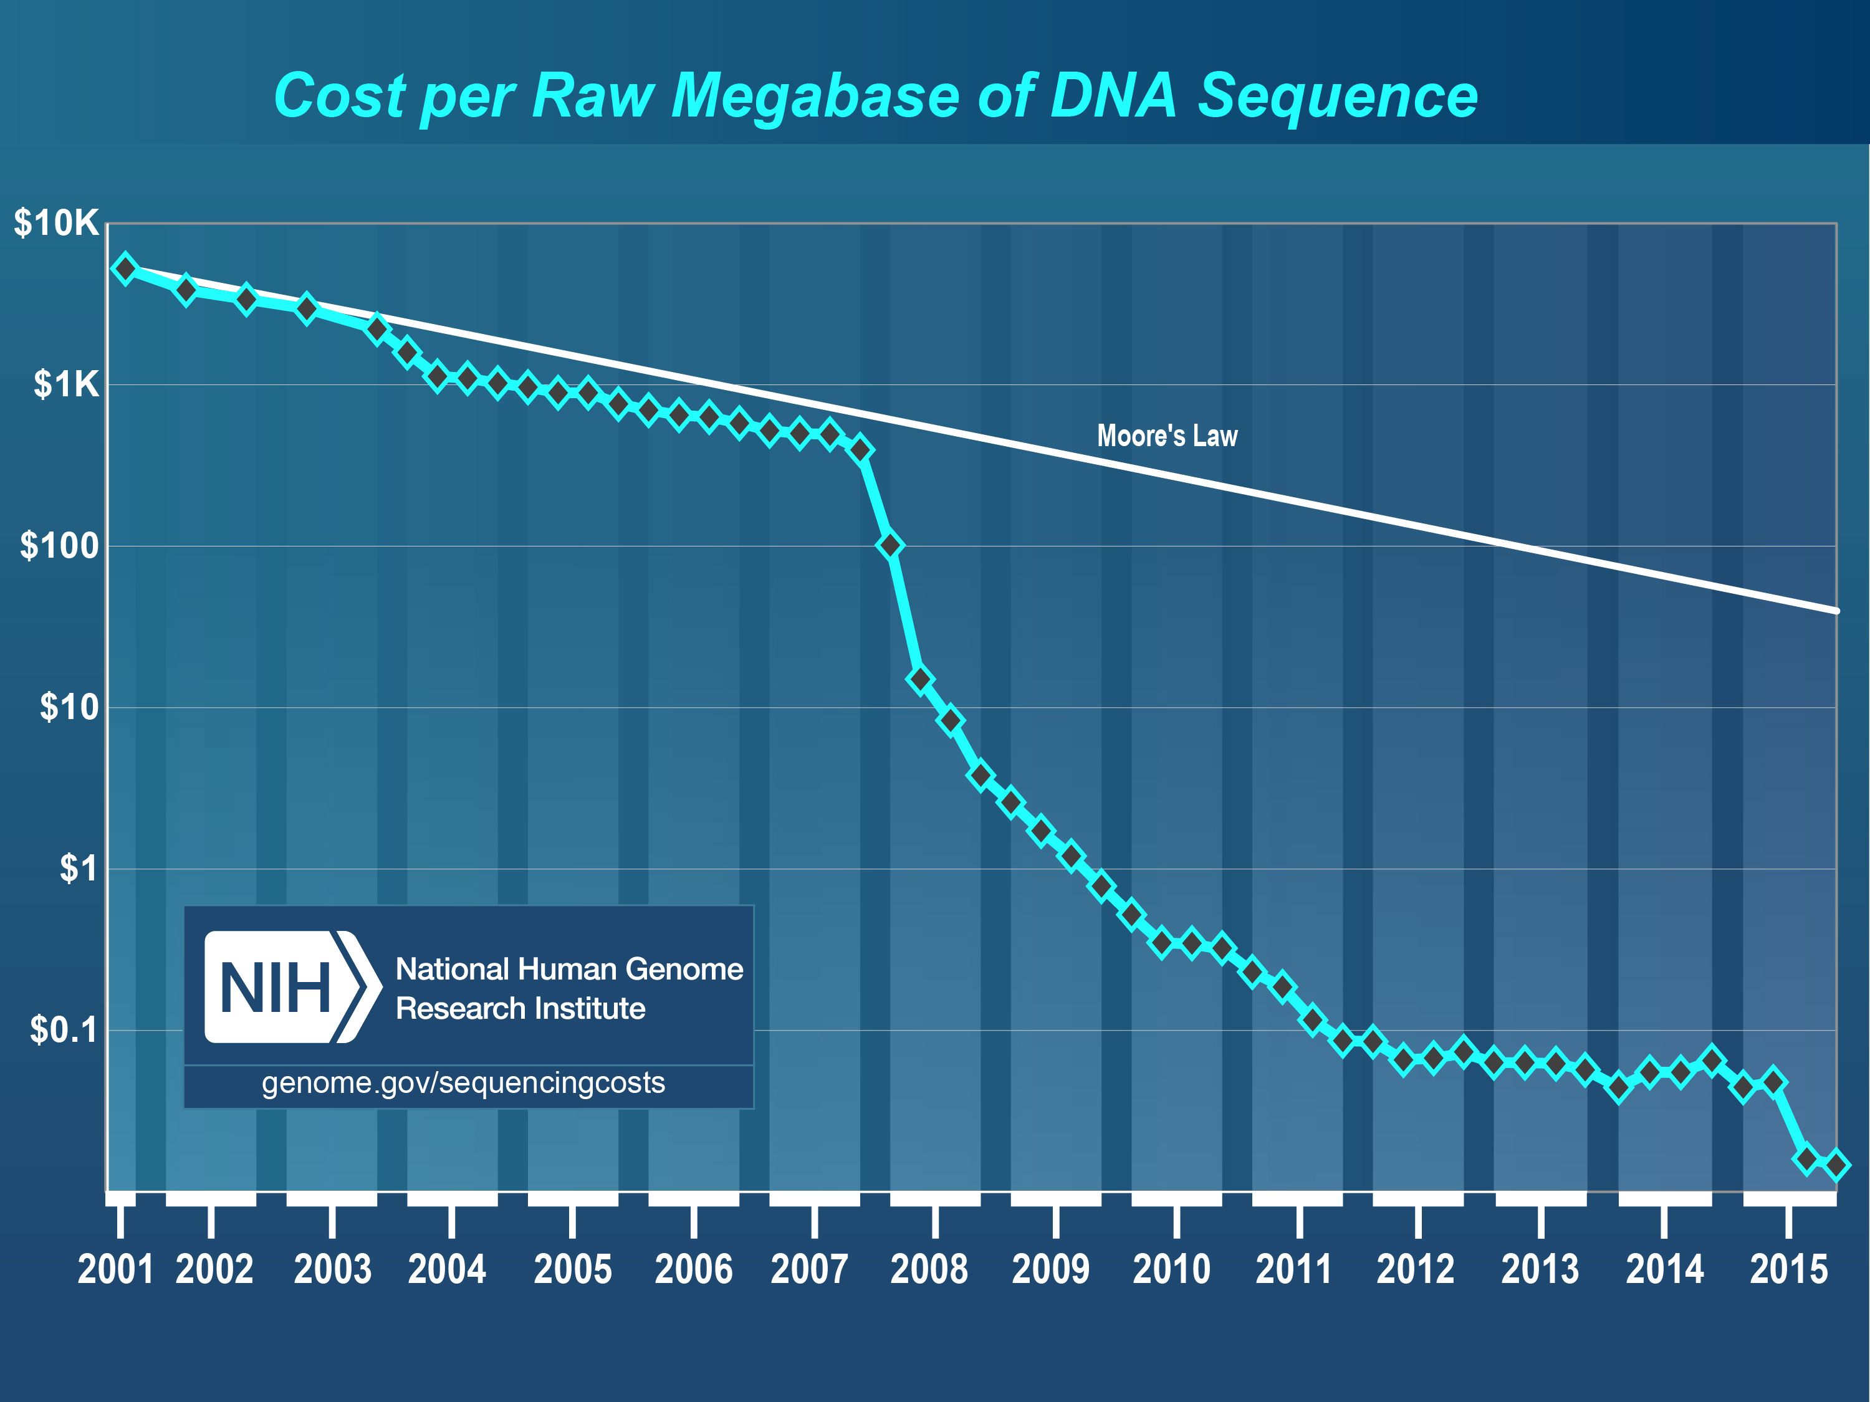
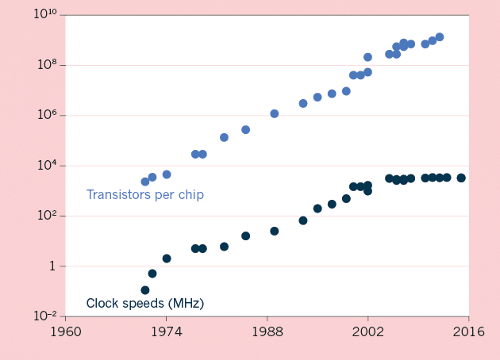
The Scaling of Genomic Data Science:
Powered by exponential increases in data & computing
(Moore’s Law)
[NHGRI website + Waldrop (‘15) Nature]

Slide 11
Kryder’s Law and S-curves underlying exponential growth
Exponential increase seen in Kryder’s law is a superposition of
S-curves for different technologies
[Muir et al. (‘15) GenomeBiol.]

Slide 12
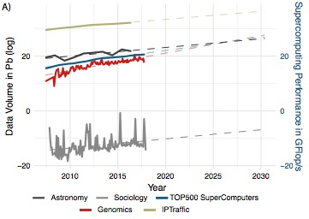
Sequencing cost reductions have resulted in an explosion of data
[Muir et al. (‘15) GenomeBiol.
Navarro et al. GenomeBiol.
(’19, in press)]
The type of sequence data deposited has changed as well.

Slide 13
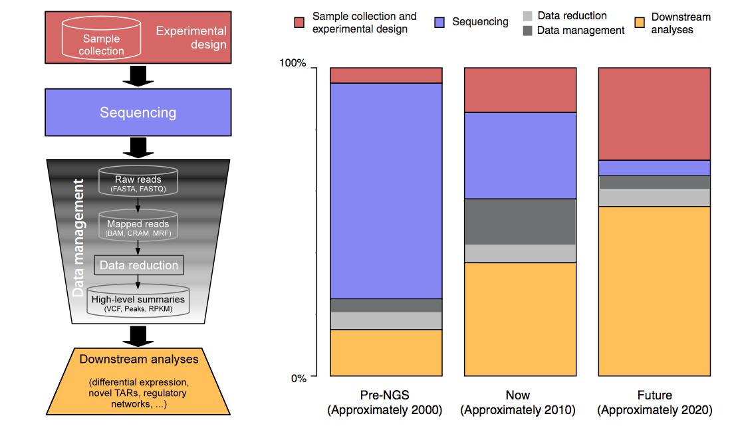
The changing costs of a sequencing pipeline
From ‘00 to ~’20,
cost of DNA sequencing expt. shifts from the actual seq. to sample
collection & analysis
[Sboner et al. (‘11), Muir et al. (‘15) Genome Biology]

Slide 14
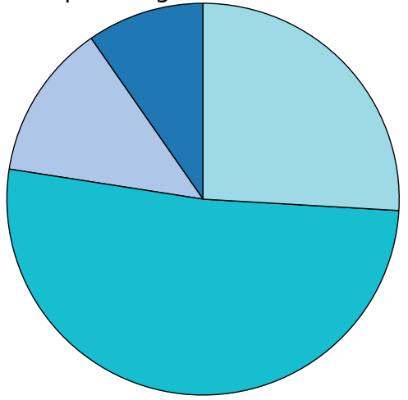
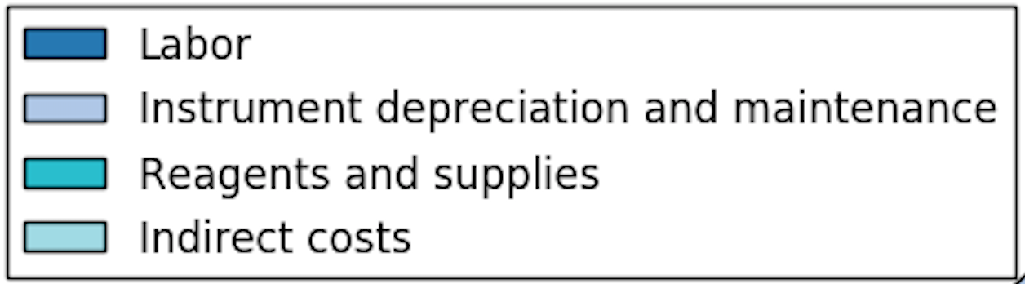
The changing costs of a sequencing pipeline
From ‘00 to ~’20,
cost of DNA sequencing expt. shifts from the actual seq. to sample
collection & analysis
[Sboner et al. (‘11), Muir et al. (‘15) Genome Biology]

Slide 15
The changing costs of a sequencing pipeline
From ‘00 to ~’20,
cost of DNA sequencing expt. shifts from the actual seq. to sample
collection & analysis
Alignment algorithms scaling to keep pace with data generation
[Sboner et al. (‘11), Muir et al. (‘15) Genome Biology]

Slide 16
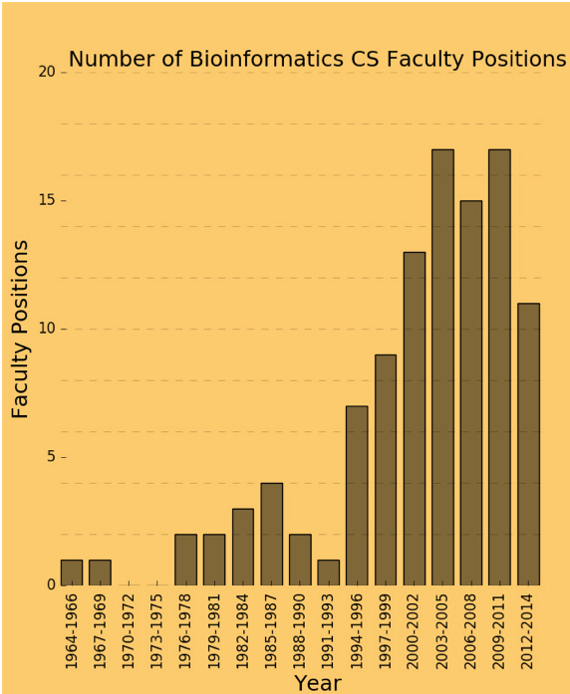
The changing costs of a sequencing pipeline
From ‘00 to ~’20,
cost of DNA sequencing expt. shifts from the actual seq. to sample
collection & analysis
[Sboner et al. (‘11), Muir et al. (‘15) Genome Biology]

Slide 17
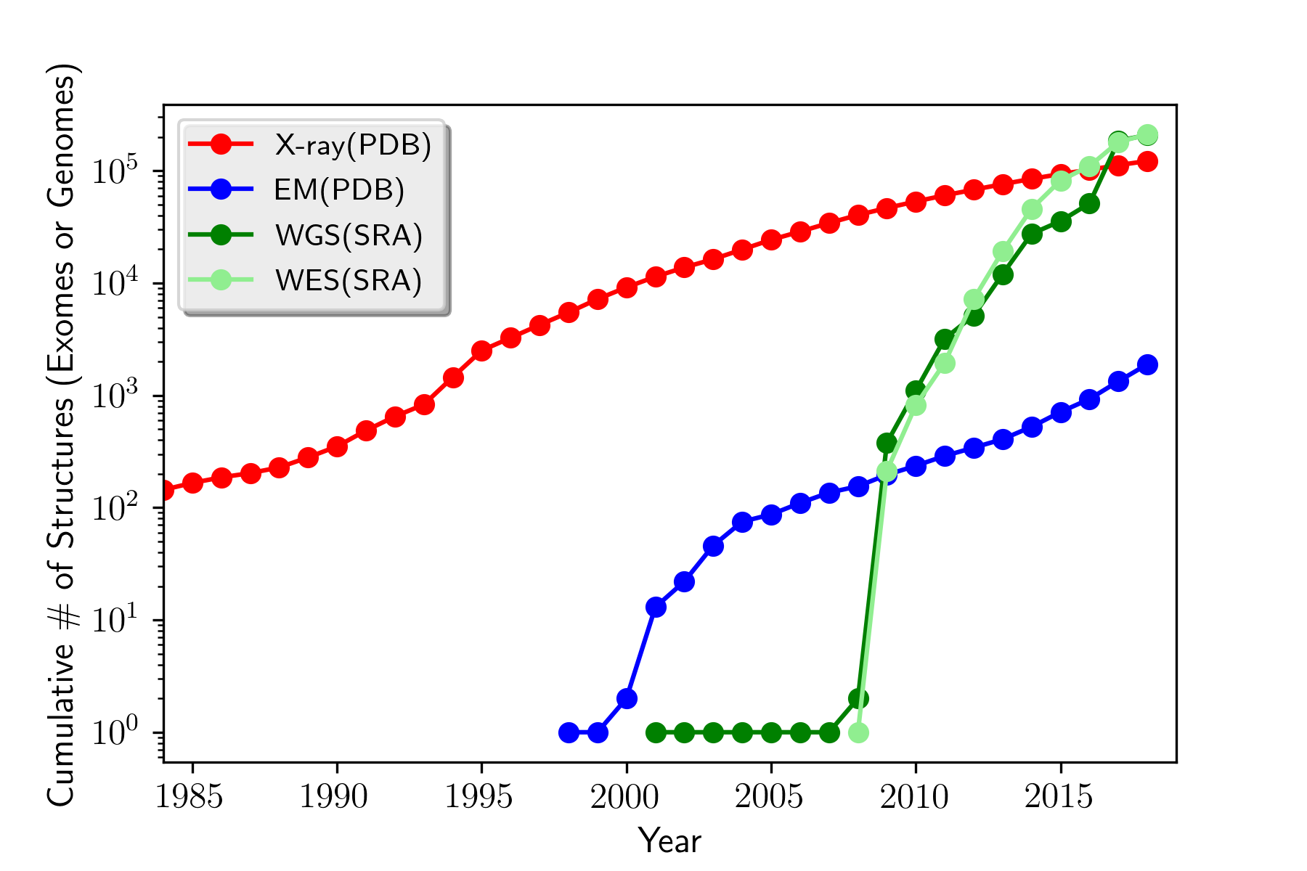
How will the Data Scaling Continue?
The Past, Present & Future Ecosystem of Large-scale Biomolecular Data
[Navarro et al. GenomeBiol. (’19, in press)]
Molecular Structures
Seqences (Human WGS & WES)
Images (Cryo-EM)

Slide 18
Genomics & Data Science
Background on data science & the biomed. sub-domain
  Placing genomics in this context -- 3V & 4M frameworks
  Types of data & integration betw. types + Moore’s law scaling
Main practical heath applications
  Designing drugs, customizing treatments….
  Focused example on identifying drug targets
  for neuropsych. diseases
Another application: “Bioinspired” insights on systems design
  Reducing bottlenecks in the middle of a network hierarchy
  Different patterns of connectivity & constraint in natural v engineered systems
Mining the data exhaust (from personal genomics)
  SOS
  Privacy

Slide 19
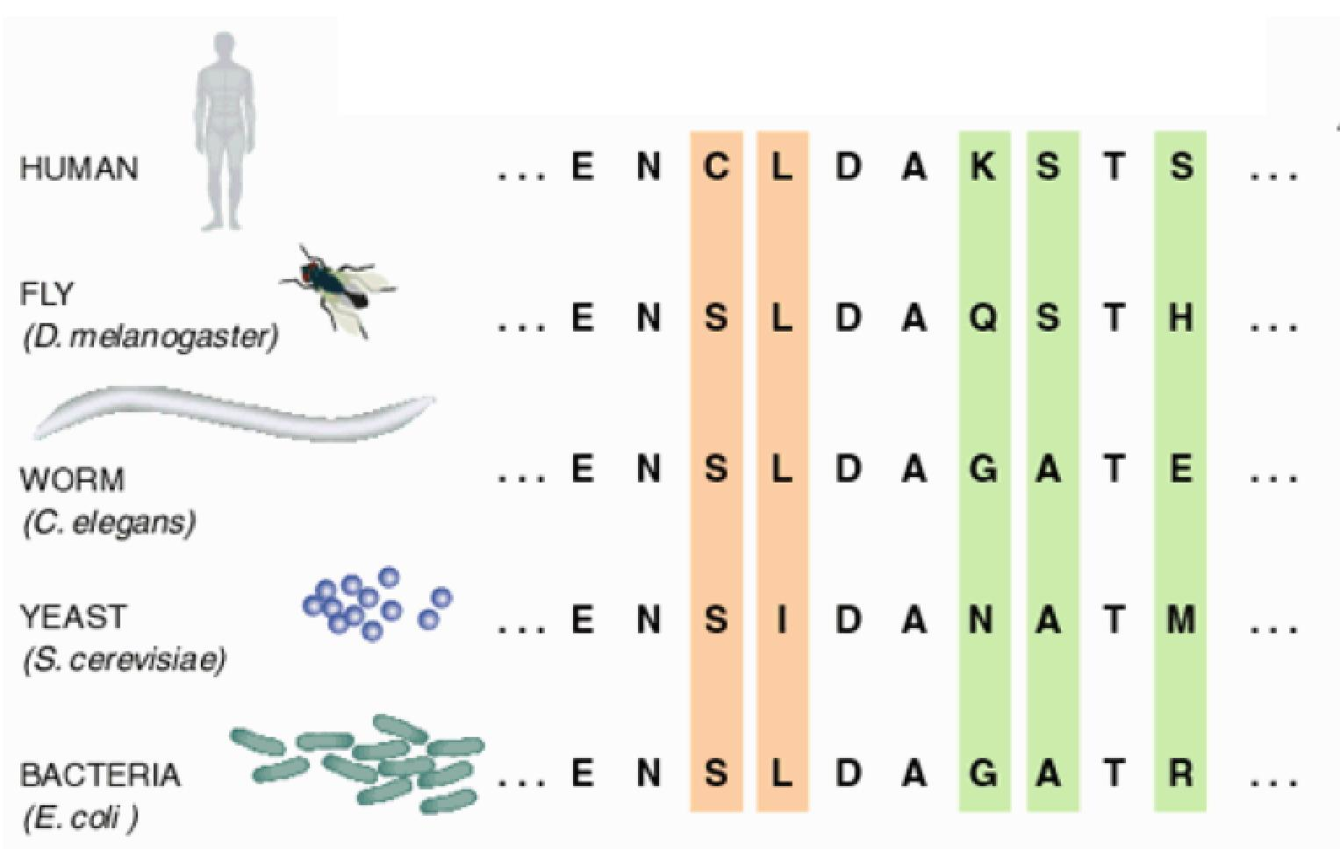
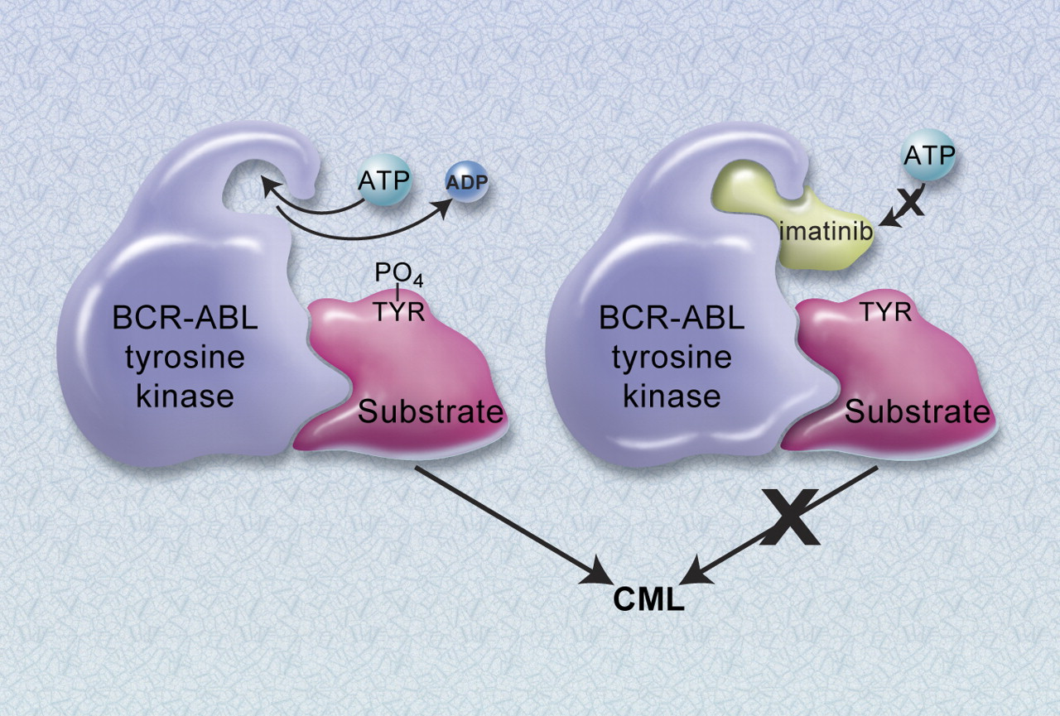
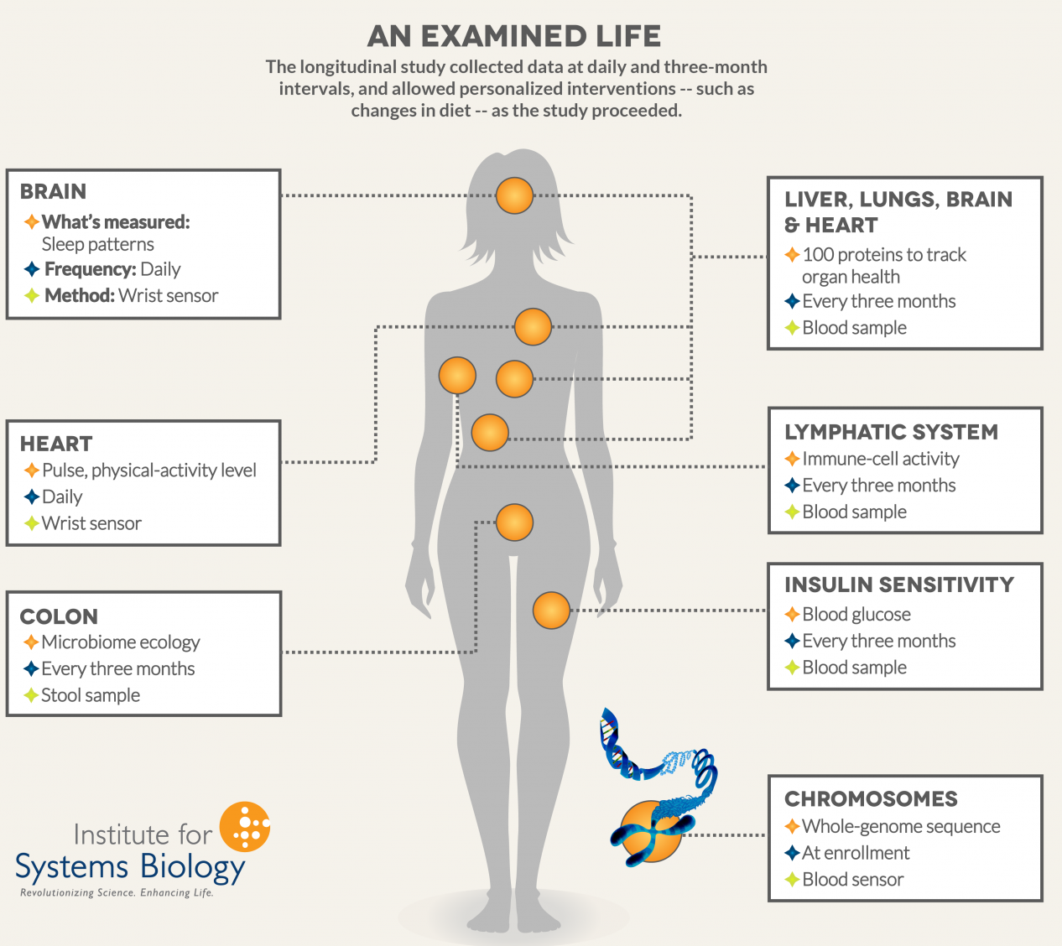
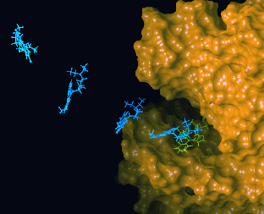
Major Bioinformatics Applications
I. Designing Drugs from Structural Targets
Understanding how structures bind other molecules
Designing inhibitors using docking, structure modeling
Adapted from Olsen Group
Docking Page at Scripps
II. Finding Homologs
Model structures based on currently available structures
Find experimentally tractable gene targets
III. Customizing treatment in oncology
Identifying key disease causing mutations
Cancer immunotherapies targeting neo-antigens
IV. Personal Genome Characterization
Identify mutations in personal genomes (SNPs, SVs, &c)
Integrate with digital phenotyping (eg wearables)
  (From top to bottom: figures adapted from Olsen Group Docking Page at Scripps, Sci. Am., Druker BJ. Blood 2008, Institute for Systems Biology)

Slide 20
Major Application V:
Finding molecular mechanisms & drug targets for diseases we know little about (Neuropsychiatric Diseases)
Disease | Heritability* | Molecular Mechanisms
Schizophrenia | 81% | C4A
Bipolar disorder | 70% | -
Alzheimer's disease | 58 - 79% | Apolipoprotein E (APOE), Tau
Hypertension | 30% | Renin–angiotensin–aldosterone
Heart disease | 34-53% | Atherosclerosis, VCAM-1
Stroke | 32% | Reactive oxygen species (ROS), Ischemia
Type-2 diabetes | 26% | Insulin resistance
Breast Cancer | 25-56% | BRCA, PTEN
Phenotype
SCZ
BPD
AGE
…
*https://www.snpedia.com/index.php/Heritability
pathways, circuits
Cell types
Modules
Regulatory elements
Genes
Genotype
Many psychiatric conditions are highly heritable
  Schizophrenia: up to 80%
But we don’t understand basic molecular mechanisms underpinning this association
(in contrast to many other diseases such as cancer & heart disease)
Thus, interested in developing predictive models of psychiatric traits which:
  Use observations at intermediate (molecular levels) levels to inform latent structure.
  Use the predictive features of these “molecular endo phenotypes” to begin to suggest actors involved in mechanism

Slide 21
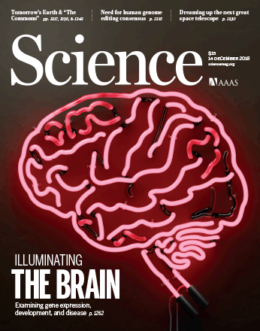

Major Application V:
Finding molecular mechanisms & drug targets for diseases we know little about (Neuropsychiatric Diseases)
Disease | Heritability* | Molecular Mechanisms
Schizophrenia | 81% | -
Bipolar disorder | 70% | -
Alzheimer's disease | 58 - 79% | Apolipoprotein E (APOE), Tau
Hypertension | 30% | Renin–angiotensin–aldosterone
Heart disease | 34-53% | Atherosclerosis, VCAM-1
Stroke | 32% | Reactive oxygen species (ROS), Ischemia
Type-2 diabetes | 26% | Insulin resistance
Breast Cancer | 25-56% | BRCA, PTEN
*https://www.snpedia.com/index.php/Heritability
Many psychiatric conditions are highly heritable
  Schizophrenia: up to 80%
But we don’t understand basic molecular mechanisms underpinning this association
(in contrast to many other diseases such as cancer & heart disease)
Thus, interested in developing predictive models of psychiatric traits which:
  Use observations at intermediate (molecular levels) levels to inform latent structure.
  Use the predictive features of these “molecular endo phenotypes” to begin to suggest actors involved in mechanism
Recent Rollout in Science
addressing this, involving many Yale Researchers

Slide 22
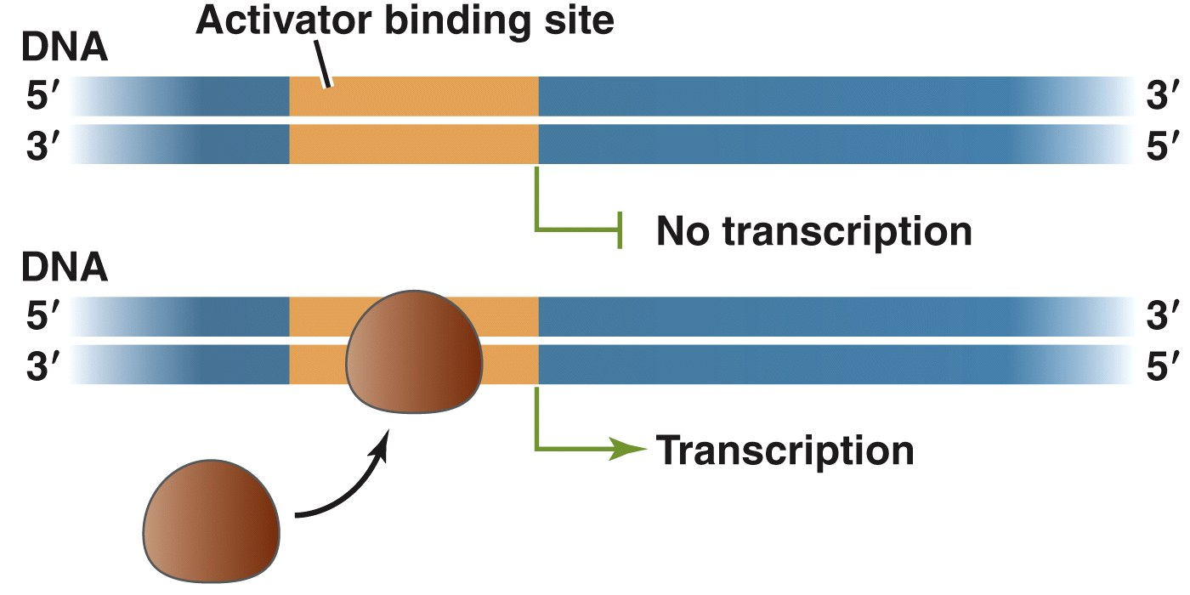
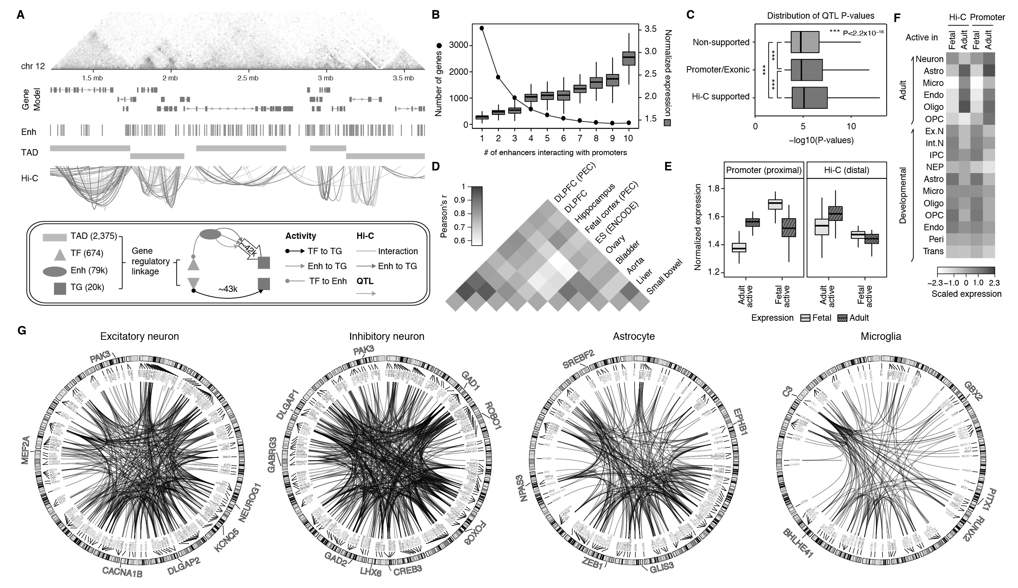
Developing a gene regulatory network for the human brain
[Illustration: Principles of Life 1st Ed., Hillis]
Many such gene regulatory relationships form a network
[Wang et al. (‘18) Science]

Slide 23
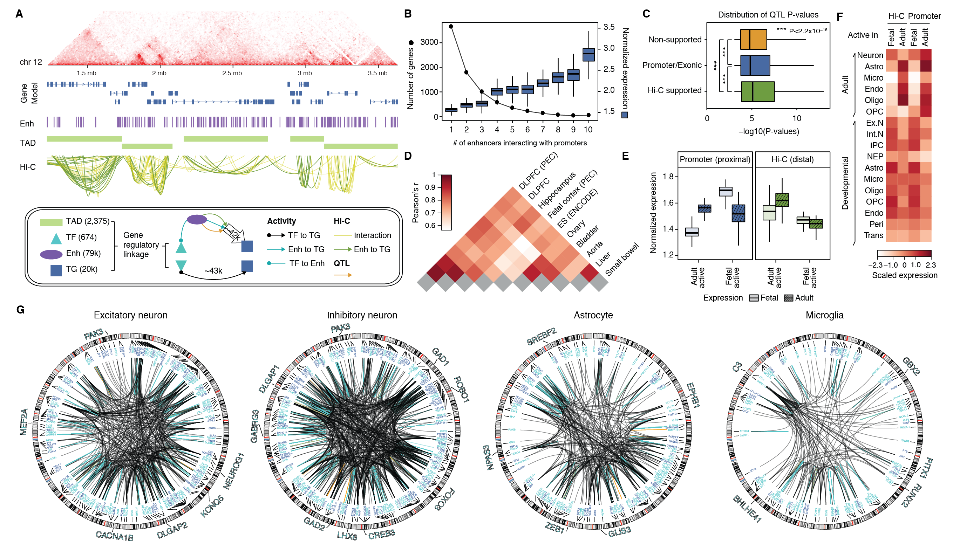
Developing a gene regulatory network for the human brain
B
A
[Illustration: Principles of Life 1st Ed., Hillis]
Many such gene regulatory relationships form a network
[Wang et al. (‘18) Science]

Slide 24
Deep Structured Phenotype Network (DSPN)
Embed Gene Regulatory Network in deep neural network
Allows transcriptome (+other) imputation & trait prediction
y
h
x
z
GRN
y: phenotypes
h: hidden units (e.g., circuits)
x: intermediate phenotypes (e.g. expression, enhancers)
z: genotypes (e.g., SNPs)
Deep Boltzmann Machine Energy model:
[Wang et al. (‘18) Science]

Slide 25
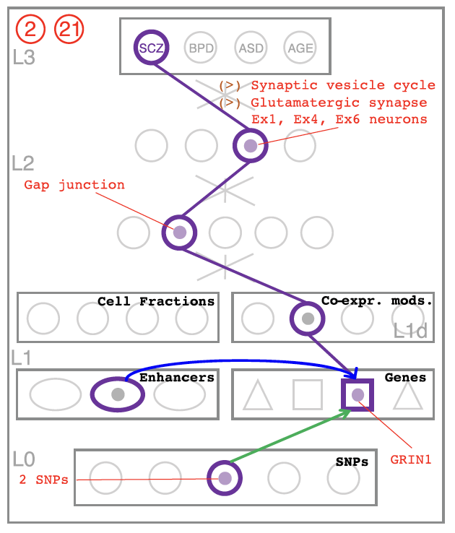
Deep Structured Phenotype Network (DSPN)
Allows prioritization of genes / modules through network interpretation (using path tracing)
y
h
x
z
SCZ
y: phenotypes
h: hidden units (e.g., circuits)
x: intermediate phenotypes (e.g. expression, enhancers)
z: genotypes (e.g., SNPs)
Deep Boltzmann Machine Energy model:
[Wang et al. (‘18) Science]

Slide 26
Genomics & Data Science
Background on data science & the biomed. sub-domain
  Placing genomics in this context -- 3V & 4M frameworks
  Types of data & integration betw. types + Moore’s law scaling
Main practical heath applications
  Designing drugs, customizing treatments….
  Focused example on identifying drug targets
  for neuropsych. diseases
Another application: “Bioinspired” insights on systems design
  Reducing bottlenecks in the middle of a network hierarchy
  Different patterns of connectivity & constraint in natural v engineered systems
Mining the data exhaust (from personal genomics)
  SOS
  Privacy

Slide 27
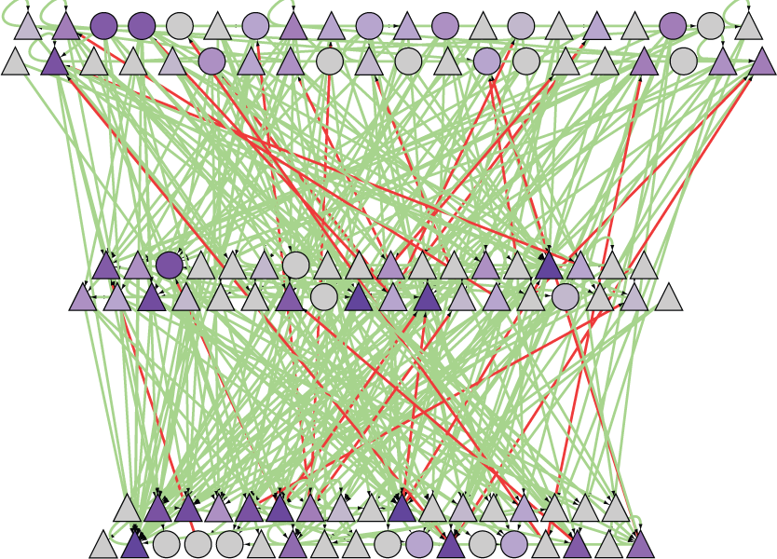
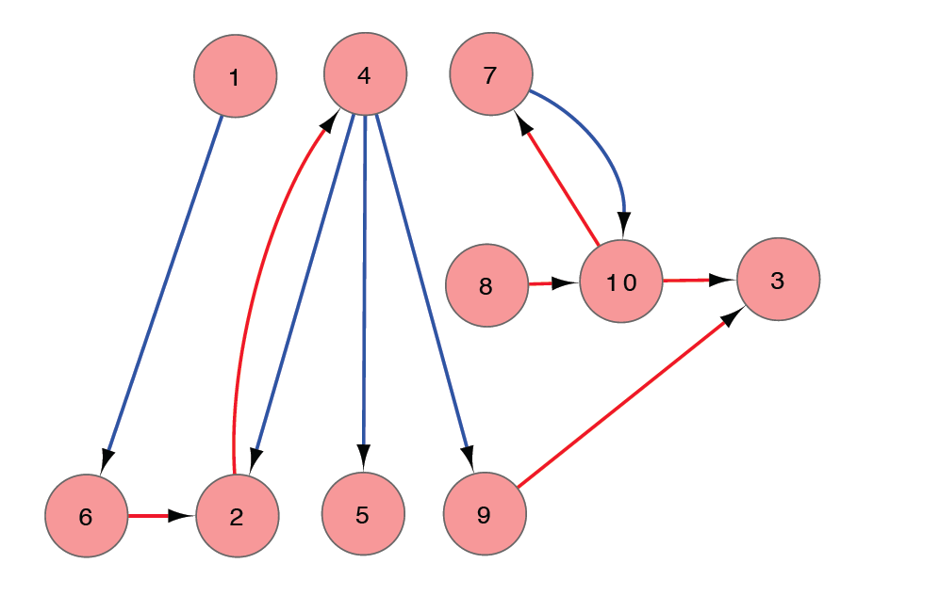
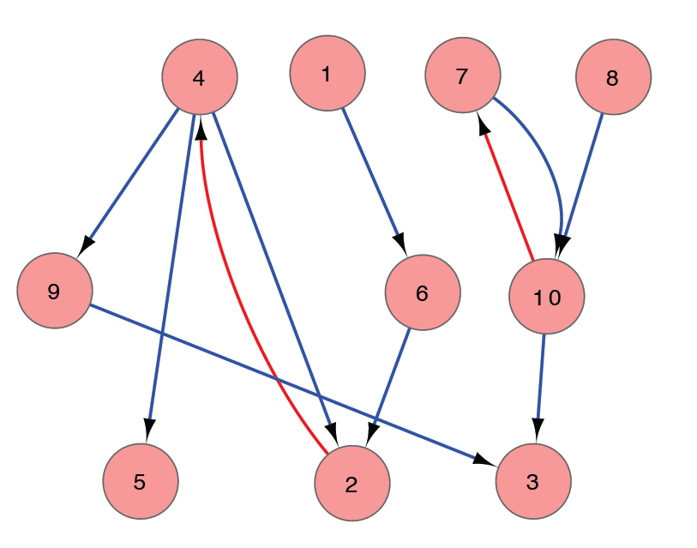
Transforming a Regulatory Network into a Hierachy
Regulatory Network
Network Hierarchy
simulated
annealing
[Wang et al. (‘18) Science, Gerstein et al. Nature ('12)]

Slide 28

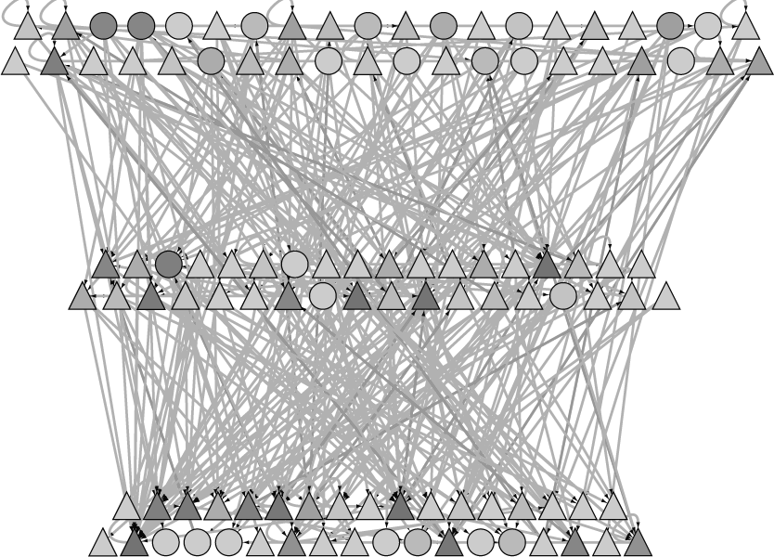
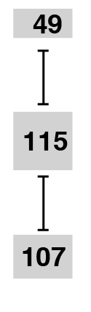
Mid-level of the hierarchy has many high-connectivity bottlenecks
betweenness
[Wang et al. (‘18) Science, Gerstein et al. Nature ('12)]

Slide 29
Governmental hierachies exhibit even more pronounced mid-level bottlenecks
[Yu et al., PNAS ’06 ]
[Yu et al., PNAS (‘06)]

Slide 30
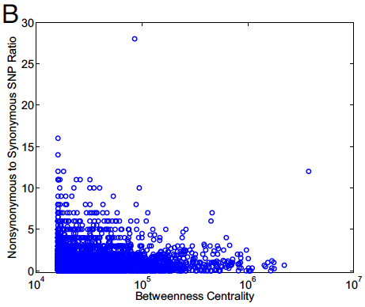
Connectivity v. Constraint: in biological networks, less mutations tolerated at hubs & bottlenecks
Genes & proteins that have a more central position in the network tend to evolve more slowly and are more likely to be essential. This phenomenon is observed in
many organisms & different kinds of networks – e.g. Protein-Protein Interaction Networks (human, yeast, E coli, worm, fly), miRNA networks, regulatory networks, &c
r= -0.1, P=4x10⁻⁴
==Rate of Mutation==>
==Centrality=>
Kim et a. PNAS 2007
Notes:
We further look at where are the guys that required tweaking in the network? A theme borne out in many evolutionary studied of biological network is, more connectivity, more constraint. One of the first paper is by Fraser, studied the relationship between the number of interacting partners, and the rate of evolution, measured by number of substitution per site. The more substitution, the faster is the evolution. The observation is, they are negatively correlated. The intuition is, being related to many others, it all sort of constraint and forbid a fast evolution. In the case of Linux, the situation is exactly opposite. Degree is positively correlated with the rate of evolution. This is essentially how an intelligent designer works. Hubs, more useful, more central of the networks, require more fine-tune.

Slide 31
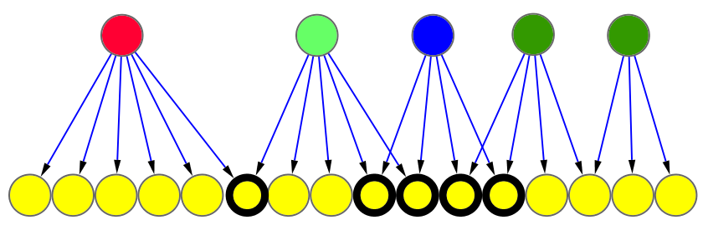
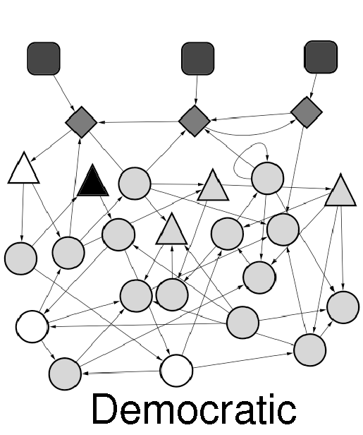
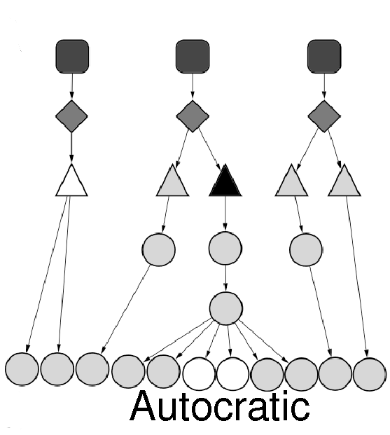
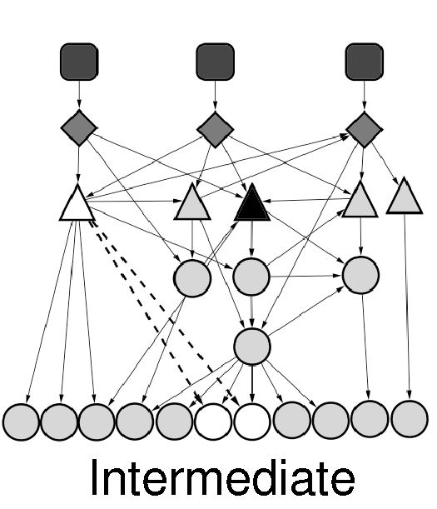
Biological Networks tend to have more “democratic” hierarchies, easing bottlenecks, than many social ones
Degree of
Collaboration
1/6=0.16
4/4=1
“Autocratic”
“Democratic”
[Bhardwaj et al., PNAS (2010)]

Slide 32
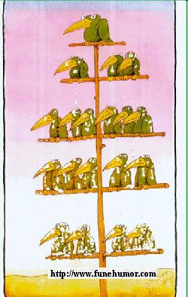
Middle Managers Interact the Most in Efficient Corporate Settings
Floyd, S. W. et al (1992)
Middle management involvement in strategy and its association with strategic type Strategic Management Journal 13, 153-167.
Woodward, J. (1982) Industrial Organization: Theory and Practice (Oxford University Press, Oxford).
Floyd, S. W. et al (1993)
Dinosaurs or Dynamos? Recognizing Middle Management's Strategic Role
The Academy of Management Executive 8, 47-57.
Floyd, S. W. et al (1997)
Middle management's strategic influence and organizational performance
Journal of Management Studies 34, 465-485.
[Bhardwaj et al., PNAS (2010), in press]

Slide 33
Genomics & Data Science
Background on data science & the biomed. sub-domain
  Placing genomics in this context -- 3V & 4M frameworks
  Types of data & integration betw. types + Moore’s law scaling
Main practical heath applications
  Designing drugs, customizing treatments….
  Focused example on identifying drug targets
  for neuropsych. diseases
Another application: “Bioinspired” insights on systems design
  Reducing bottlenecks in the middle of a network hierarchy
  Different patterns of connectivity & constraint in natural v engineered systems
Mining the data exhaust (from personal genomics)
  SOS
  Privacy

Slide 34
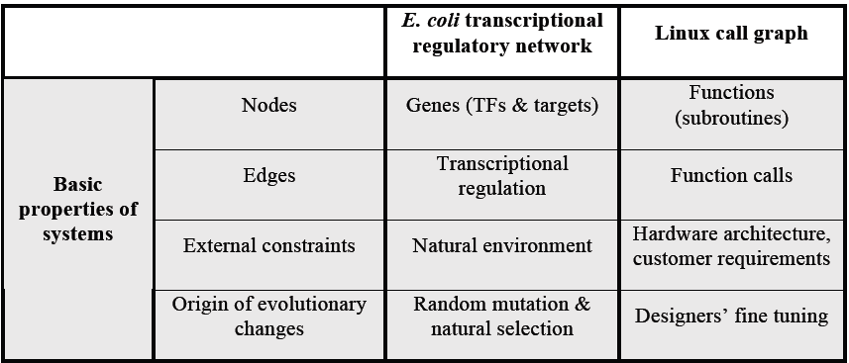

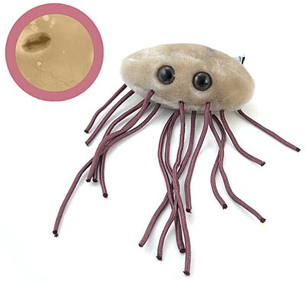
Transcriptional regulatory network vs Linux call graph
A subnetwork in the Linux call graph
from CodeViz
[Yan et al., PNAS ’10]

Slide 35
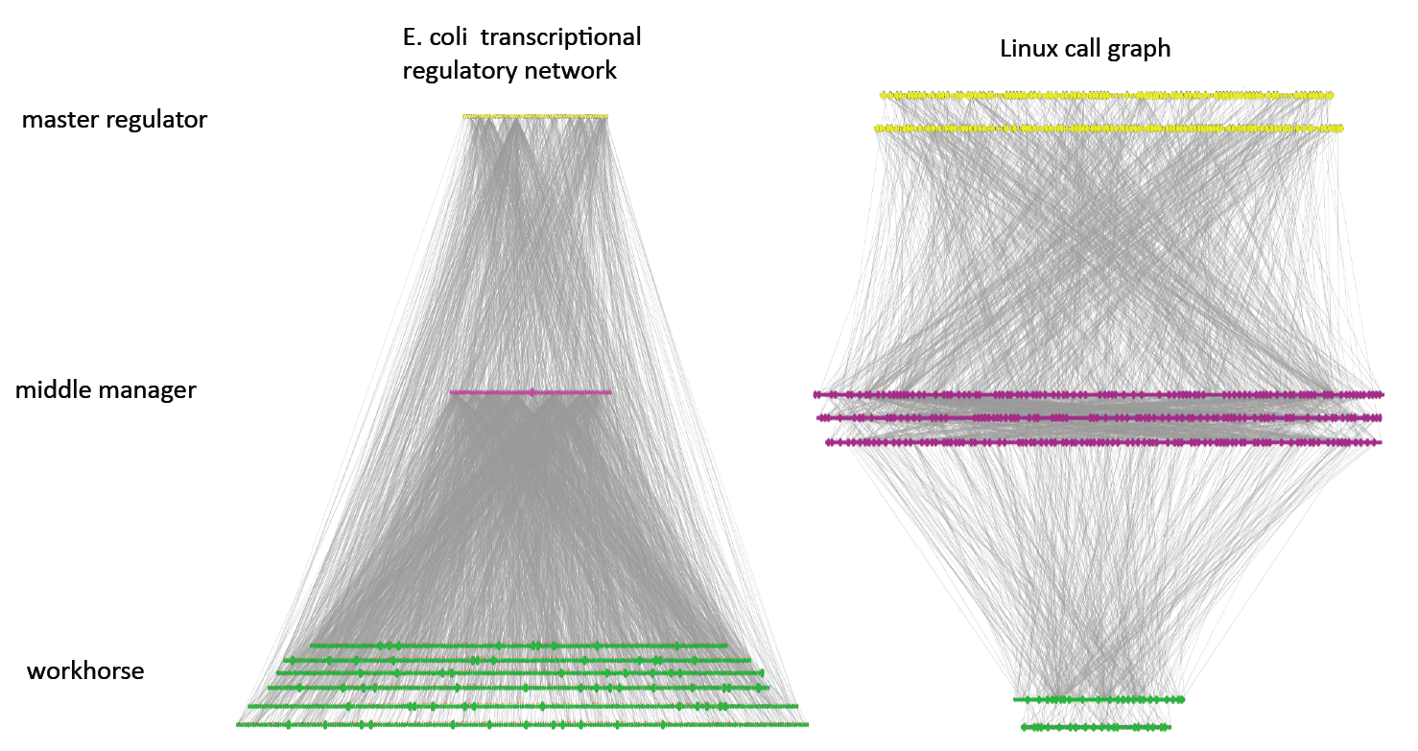
Dominated by “out hubs” - crp
E. coli transcriptional
regulatory network0
Linux call graph
Dominated by “in hubs” - printf
[Yan et al., PNAS (2010), in press]
Notes:
35
These are the networks
Define 3 layers
Hierarchy exists
Pyramidal vs top heavy
Charcteristics hubs
Persistent (later)
35

Slide 36
Connectivity v. Constraint: differences betw. biological & technological networks
More Connectivity, More Constraint : A theme borne out in many evolutionary studies of biological network
  Variation in call graph measured from number of edits to Linux source
r= -0.1, P=4x10⁻⁴
==Rate of Mutation==>
r= +0.29, P=3x10⁻⁹⁷
==Centrality=>
Kim et a. PNAS 2007
Yan KK et al. PNAS 2010
Notes:
We further look at where are the guys that required tweaking in the network? A theme borne out in many evolutionary studied of biological network is, more connectivity, more constraint. One of the first paper is by Fraser, studied the relationship between the number of interacting partners, and the rate of evolution, measured by number of substitution per site. The more substitution, the faster is the evolution. The observation is, they are negatively correlated. The intuition is, being related to many others, it all sort of constraint and forbid a fast evolution. In the case of Linux, the situation is exactly opposite. Degree is positively correlated with the rate of evolution. This is essentially how an intelligent designer works. Hubs, more useful, more central of the networks, require more fine-tune.

Slide 37
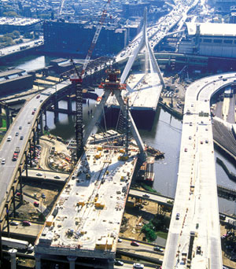
Perspectives on
Random Change v Intelligent Design
Central points = hubs & bottlenecks
If changes random, best not to put them in central pts.
If changes made rationally, can put them into central pts.
  Moreover, good to do this, as these more often used – i.e more efficient
  Why there’s so much GWB construction

Slide 38
Genomics & Data Science
Background on data science & the biomed. sub-domain
  Placing genomics in this context -- 3V & 4M frameworks
  Types of data & integration betw. types + Moore’s law scaling
Main practical heath applications
  Designing drugs, customizing treatments….
  Focused example on identifying drug targets
  for neuropsych. diseases
Another application: “Bioinspired” insights on systems design
  Reducing bottlenecks in the middle of a network hierarchy
  Different patterns of connectivity & constraint in natural v engineered systems
Mining the data exhaust (from personal genomics)
  SOS
  Privacy

Slide 39


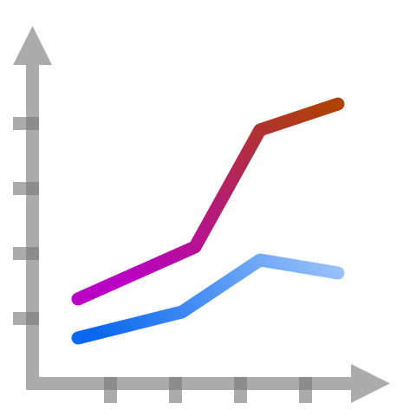



Data Exhaust
Creative use of data is key to data science!
Data exhaust = exploitable byproducts of big data collection and analysis
Data collection and analysis
metadata
data on
collaboration
data on
publication
Data exhaust
Core scientific purposes
infrastructure
[photos: wikipedia/wikimedia]

Slide 40


Exhaust Mining Application:
Using Science to Study Science (SOS)
Mining output of science (Scientific Publications) to understand how science works as a social enterprise
Co-authorship network of members of the human genome annotation group (ENCODE) & users of this groups data
co-authorship
[Wang et al., TIG (’16)]

Slide 41

Quantifying
Imports & exports from/to Genomics
& other
Data Science subfields
Genomics adoption of open source
Genomics contribution of HMM and Network papers
[Navarro et al. GenomeBiol.
(’19, in press)]

Slide 42
Genomics & Data Science
Background on data science & the biomed. sub-domain
  Placing genomics in this context -- 3V & 4M frameworks
  Types of data & integration betw. types + Moore’s law scaling
Main practical heath applications
  Designing drugs, customizing treatments….
  Focused example on identifying drug targets
  for neuropsych. diseases
Another application: “Bioinspired” insights on systems design
  Reducing bottlenecks in the middle of a network hierarchy
  Different patterns of connectivity & constraint in natural v engineered systems
Mining the data exhaust (from personal genomics)
  SOS
  Privacy

Slide 43

Genomics has similar "Big Data" Dilemma as in the Rest of Society
We confront privacy risks every day we access the internet (e.g., social media, e-commerce).
Sharing & "peer-production" is central to success of many new ventures, with analogous risks to genomics
  EG web search: Large-scale mining essential
Genetic Exceptionalism :
The Genome is very fundamental data, potentially very revealing about one’s identity & characteristics
Personal Genomic info. essentially meaningless currently but will it be in 20 yrs? 50 yrs?
  Genomic sequence very revealing about one’s children. Is true consent possible?
  Once put on the web it can’t be taken back
Ethically challenged history of genetics
  Ownership of the data & what consent means (Hela)
  Could your genetic data give rise to a product line?
[Seringhaus & Gerstein ('09), Hart. Courant (Jun 5); Greenbaum & Gerstein ('11), NY Times (6 Oct), D Greenbaum & M Gerstein (’08). Am J. Bioethics; D Greenbaum & M Gerstein, Hartford Courant, 10 Jul. '08 ; SF Chronicle, 2 Nov. '08; Greenbaum et al. PLOS CB (‘11) ; Greenbaum & Gerstein ('13), The Scientist; Photos from NY Times, it.wisc.edu]

Slide 44


The Dilemma
The Other Side of the Coin:
Why we should share
Sharing helps speed research
  Large-scale mining of this information is important for medical research
  Statistical power
  Privacy is cumbersome, particularly for big data
The individual (harmed?) v the collective (benefits)
  - But do sick patients care about their privacy?
How to balance risks v rewards – Quantification
[Economist, 15 Aug ‘15]
[Yale Law Roundtable (‘10). Comp. in Sci. & Eng. 12:8; D Greenbaum & M Gerstein (‘09). Am. J. Bioethics; D Greenbaum & M Gerstein (‘10). SF Chronicle, May 2, Page E-4; Greenbaum et al. PLOS CB (‘11)]

Slide 45
Current Social & Technical Solutions:
The quandary where are now
Closed Data Approach
  Consents
  “Protected” distribution via dbGAP
  Local computes on secure computer
Issues with Closed Data
  Non-uniformity of consents & paperwork
    Different, confusing int’l norms
  Computer security is burdensome
  Many schemes get “hacked” .
  Tricky aspects of high-dimensional data (ease of creating quasi-identifiers)
Open Data
  Genomic "test pilots” (ala PGP)?
    Sports stars & celebrities?
  Some public data & data donation is helpful but is this a realistic solution for an unbiased sample of ~1M
[Greenbuam et al ('04), Nat. Biotech; Greenbaum & Gerstein ('13), The Scientist; Photo: futurism.com]

Slide 46

Linking Attack Scenario
[Harmanciet al. Nat. Meth. (in revision)]

Slide 47
Linking Attack Scenario
[Harmanciet al. Nat. Meth. (in revision)]

Slide 48


Linking Attacks: Case of Netflix Prize
Names available for many users!
User (ID) | Movie (ID) | Date of Grade | Grade [1,2,3,4,5]
NTFLX-0 | NTFLX-19 | 10/12/2008 | 1
NTFLX-1 | NTFLX-116 | 4/23/2009 | 3
NTFLX-2 | NTFLX-92 | 5/27/2010 | 2
NTFLX-1 | NTFLX-666 | 6/6/2016 | 5
… | … | … | …
… | … | … | …
User (ID) | Movie (ID) | Date of Grade | Grade [0-10]
IMDB-0 | IMDB-173 | 4/20/2009 | 5
IMDB-1 | IMDB-18 | 10/18/2008 | 0
IMDB-2 | IMDB-341 | 5/27/2010 | -
… | … | … | …
… | … | … | …
… | … | … | …
Many users are shared
The grades of same users are correlated
A user grades one movie around the same date in two databases
Anonymized Netflix Prize Training Dataset
made available to contestants
Notes:
This figure illustrates what these datasets look like. The movie titles can be matched directly. Date of ratings and rating values are expected to be similar to each other

Slide 49
Linking Attacks: Case of Netflix Prize
Names available for many users!
User (ID) | Movie (ID) | Date of Grade | Grade [1,2,3,4,5]
NTFLX-0 | NTFLX-19 | 10/12/2008 | 1
NTFLX-1 | NTFLX-116 | 4/23/2009 | 3
NTFLX-2 | NTFLX-92 | 5/27/2010 | 2
NTFLX-1 | NTFLX-666 | 6/6/2016 | 5
… | … | … | …
… | … | … | …
User (ID) | Movie (ID) | Date of Grade | Grade [0-10]
IMDB-0 | IMDB-173 | 4/20/2009 | 5
IMDB-1 | IMDB-18 | 10/18/2008 | 0
IMDB-2 | IMDB-341 | 5/27/2010 | -
… | … | … | …
… | … | … | …
… | … | … | …
Many users are shared
The grades of same users are correlated
A user grades one movie around the same date in two databases
IMDB users are public
NetFLIX and IMdB moves are public
Notes:
As you can see, Netflx-1 user can be matched to IMDB-0 user since the date of rating is very close and the ratings are very similar. The rating in imdb is from 0 to 10. So 5 is a similar score to 3 in Netflix rating system.

Slide 50
Linking Attacks: Case of Netflix Prize
Names available for many users!
User (ID) | Movie (ID) | Date of Grade | Grade [1,2,3,4,5]
NTFLX-0 | NTFLX-19 | 10/12/2008 | 1
NTFLX-1 | NTFLX-116 | 4/23/2009 | 3
NTFLX-2 | NTFLX-92 | 5/27/2010 | 2
NTFLX-1 | NTFLX-666 | 6/6/2016 | 5
… | … | … | …
… | … | … | …
User (ID) | Movie (ID) | Date of Grade | Grade [0-10]
IMDB-0 | IMDB-173 | 4/20/2009 | 5
IMDB-1 | IMDB-18 | 10/18/2008 | 0
IMDB-2 | IMDB-341 | 5/27/2010 | -
… | … | … | …
… | … | … | …
… | … | … | …
Many users are shared
The grades of same users are correlated
A user grades one movie around the same date in two databases
Notes:
The key idea is that in imdb, the names are available for many users. Also,
Secondly, although another movie in Netflix system is not rated by this user in imdb system, namely the netflx666, the adversary can see the rating of the individual for this movie.

Slide 51
Genomics & Data Science
Background on data science & the biomed. sub-domain
  Placing genomics in this context -- 3V & 4M frameworks
  Types of data & integration betw. types + Moore’s law scaling
Main practical heath applications
  Designing drugs, customizing treatments….
  Focused example on identifying drug targets
  for neuropsych. diseases
Another application: “Bioinspired” insights on systems design
  Reducing bottlenecks in the middle of a network hierarchy
  Different patterns of connectivity & constraint in natural v engineered systems
Mining the data exhaust (from personal genomics)
  SOS
  Privacy

Slide 52
Genomics & Data Science
Background on data science & the biomed. sub-domain
  Placing genomics in this context -- 3V & 4M frameworks
  Types of data & integration betw. types + Moore’s law scaling
Main practical heath applications
  Designing drugs, customizing treatments….
  Focused example on identifying drug targets
  for neuropsych. diseases
Another application: “Bioinspired” insights on systems design
  Reducing bottlenecks in the middle of a network hierarchy
  Different patterns of connectivity & constraint in natural v engineered systems
Mining the data exhaust (from personal genomics)
  SOS
  Privacy

Slide 53
Genomics
&
Data Science
Thanks for your attention
Teaching pack with no explicit credits.
Credits & references on each slide

Slide 54

Extra

Slide 55
Info about content in this slide pack
General PERMISSIONS
  This Presentation is copyright Mark Gerstein,
  Yale University, 2019.
  Please read permissions statement at
  www.gersteinlab.org/misc/permissions.html .
  Feel free to use slides & images in the talk with PROPER acknowledgement
  (via citation to relevant papers or link to gersteinlab.org).
  Paper references in the talk were mostly from Papers.GersteinLab.org.
PHOTOS & IMAGES. For thoughts on the source and permissions of many of the photos and clipped images in this presentation see http://streams.gerstein.info .
  In particular, many of the images have particular EXIF tags, such as kwpotppt , that can be easily queried from flickr, viz: http://www.flickr.com/photos/mbgmbg/tags/kwpotppt

