Slide 1
Biomed. Data Science: Transition from Mining to Modeling
Mark Gerstein, Yale University gersteinlab.org/courses/452
(last edit in spring ’19, pack #14)

Slide 2
Combining Mining & Modeling
Complementarity of physical & ML approaches
“Physical approaches in principle being directly interpretable and offering the potential of extrapolation beyond observed conditions, whereas data-driven approaches are highly flexible in adapting to data”
Hybrid #1: ML into physical
e.g. Emulation of specific parts of a physical for computational efficiency
More..
Hybrid #2: Physical knowledge can be integrated into ML framework
Network architecture
Physical constraints in the cost function
Expansion of the training dataset for under sampled domains (ie physically based data augmentation) [More….]
https://www.nature.com/articles/s41586-019-0912-1 2019 Nature volume 566, pages195–204 (2019)

Slide 3
Hybrid #1: ML into physical models
https://www.nature.com/articles/s41586-019-0912-1 2019 Nature volume 566, pages195–204 (2019)
(1) Improving parameterizations
(2) Replacing a ‘physical’ sub-model with a machine learning model
(3) Analysis of model–observation mismatch
(4) Constraining submodels
(5) Surrogate modelling or emulation

Slide 4
Example of Hybrid #2: Integrating Physical Knowledge into Machine Learning
Physical Data Augmentation for Hybrid Physical-Statistical Model Construction
The Major Hurdle:
Highly Scant Ligand Binding Assay Data for $∆$BA
The Physically-based Data Augmentation Approach:
Leveraging Physical Calculations of $∆$BA to Fill the Gap
(Reichstein et al., Nature, 2019 & Xie et al., preprint, 2018)
>10M
SNV
Number of sequenced exonic SNVs
Expansion of the training dataset for under sampled domains
Data augmentation is crucial to avoid overfitting
~2.6K
SNV+Drug
~10K
~2.6k drug ligands associated with ~60k SNVs
SNV-protein-drug tuple in GenoDock
~175K
SNV+PDB
~175k SNVs mapped with at least one human PDB (>2.8Å )
~10K
SNV-protein
-drug
~0.1K
Physically-based Data Augmenting
experimental $∆$BA records
(under-sampled)
SNV-drug-structure tuples in GenoDock Dataset
~0.1k
~10K
(*87 human protein records from Platinum)
Too scant to train or to parameterize a statistical learning model
$∆$BA for each SNV-protein-drug tuple
(pseudo gold-standard)
experimental $∆$BA records of human protein from Platinum Dataset
(gold-standard for $∆$BA )

Slide 5
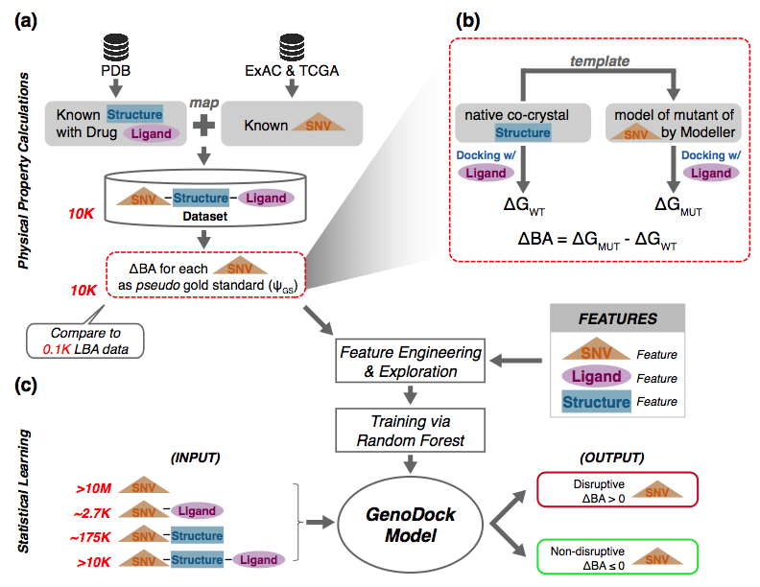
Framework of the GenoDock Project - from Dataset Preparation to Model Construction
a
collecting and processing raw data
b
Ligand binding model for $∆$BA calc.
c
Wang et al., accepted by Structure, 2019
Statistical model training and testing
Notes:
(a) A flowchart for collecting and processing raw data to construct the GenoDock database from the protein structure data source (RCSB PDB), SNV data sources (ExAC and TCGA), and drug ligand data source (PubChem Compound). SNVs were mapped with protein drug co-crystal structures to form each SNV-Structure-Ligand entry in our database. We then calculated the binding affinity change for each mutation to construct the pseudo gold-standard for the machine-learning model.
(b) Illustration of protein-ligand binding affinity change calculations. For each native co-crystal structure in our dataset, we generated a mutant structure using Modeller. For each native and mutated structure pair, we calculated the binding affinity using Vina, in order to obtain the binding affinity change ($∆BA)$ upon the point mutation. $∆BA$ for each SNV served as the pseudo gold-standard set for the subsequent classification model.
(c) Construction of the random forest model to predict the direction of protein-ligand binding affinity change ($∆BA>0 or ∆BA≤0)$. With feature engineering and exploration, several SNV features, drug ligand features, and structure features were combined to predict the direction of protein-ligand binding affinity change. The GenoDock program suite was trained based on Random Forest, with four application models available. We employed the Platinum dataset as our “real” gold standard providing about 100 LBA records for human protein mutations. By constructing docking calculations for binding affinity changes, we calculated the binding affinity change for each of the ~10,000 mutations in GenoDock database, making it possible to train a supervised learning model with confidence. With the trained GenoDock model, it is then possible to screen large-scale datasets for drug ligands (e.g. ~2.6k drug ligands associated with ~60k SNVs), human protein structures (~30,000 from RCSB PDB website with resolution higher than 3.0 Å), and exonic SNVs (~1,000,000 sequenced exonic SNVs; ~175,000 SNVs mapped with at least one human protein structure with 2.8Å or higher resolution from RCSB PDB database).

