Slide 1
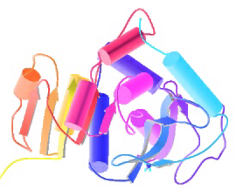
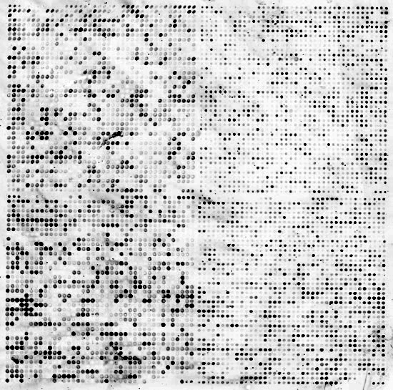


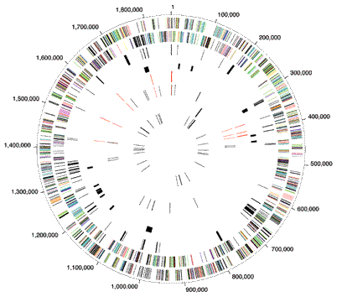
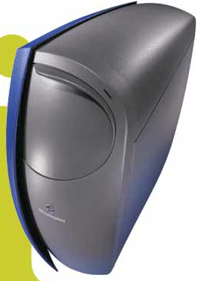

Biomed. Data Science:
Privacy & Mining the “Data Exhaust”
Mark Gerstein, Yale University
gersteinlab.org/courses/452
(last edit in spring ’19, pack #13)

Slide 2
Privacy

Slide 3


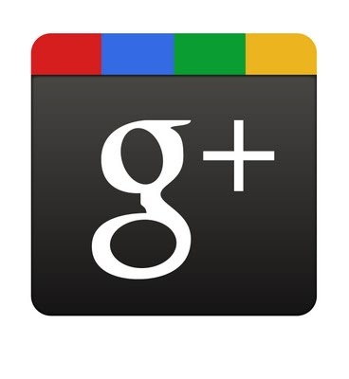
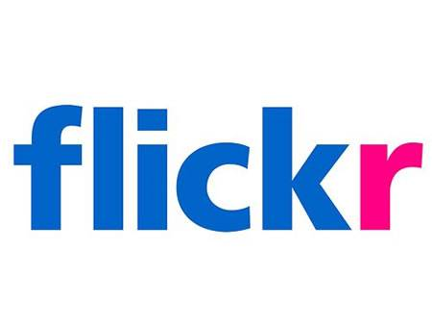



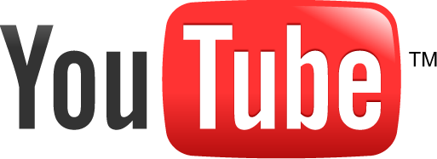




Genomics has similar "Big Data" Dilemma in the Rest of Society
Sharing & "peer-production" is central to success of many new ventures, with the same risks as in genomics
  EG web search: Large-scale mining essential
We confront privacy risks every day we access the internet
[Seringhaus & Gerstein ('09), Hart. Courant (Jun 5); Greenbaum & Gerstein ('11), NY Times (6 Oct)]

Slide 4
Specific Genomic Privacy Issues

Slide 5
From Personal Genomics to Genome Privacy
Genome of an Individual
Sequencing, analysis and interpretation
Soon will become part of medical practice
NCI: prevent, diagnose, and treat disease through personalized medicine
Privacy risk
Identity tracing
  Link between unknown genome to a panel of individual through quasi-identifiers
Attribute Disclosure Attacks
  Known DNA sample to private data such as HIV status or drug abuse
Completion Techniques
  Impute sensitive information from partial genomic data (e.g. bipolar disorder risk)
Image L: http://calorierestrictiondietplan.com/customizing-a-cr-way-lifestyle-for-your-genome/
Image R: https://www.genome.gov/27561246/privacy-in-genomics/

Slide 6
Genetic Data: Traditionally focus of genome privacy
Participation Attacks
  Homer at al., 2008
  Detecting an individual with known genotypes in a mixture
  Allele frequency of a SNP in study vs. in population
  If allele frequency of a SNP of an individual is more similar to the sudy than to the population → individual is in the mixture
  Implications for GWAS
  Shaped NIH GWAS sharing policy until ’18
Im et al., 2012
  Regression coefficients of GWAS summary statistics
  Created a statistics using the regression coefficients and compute the statistics for an individual
    If individual falls within the reference distribution → no participation
    If individual is in the tail → participation is inferred!

Slide 7
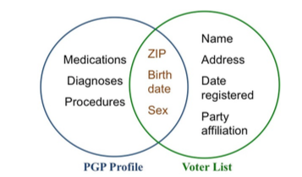
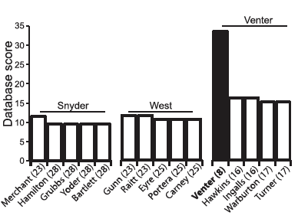
Genetic Data: Traditionally focus of genome privacy
Re-identification Attacks
In 1997, Latanya Sweeney successfully identified then Massachusetts governor, William Weld to his medical records using publicly accessible records.
significant impact on privacy centered policymaking including the health privacy legislation HIPAA
publication of the experiment was rejected twenty times!
In fact, a court ruling in Southern Illinois v. Department of Public Health barred her from publication and sharing of her
  Sweeney et al., 2013
  Re-Identification by cross-referencing independent datasets
  Gymrek et al., 2013
    Y-STRs with recreational genetic genealogy database
    Majority of surnames are transferred from males in the family
    STRs are unique to an individual, Y-STRs are unique to male individuals
    Cross reference Y-STRs with genealogy database and find surname of the individual

Slide 8
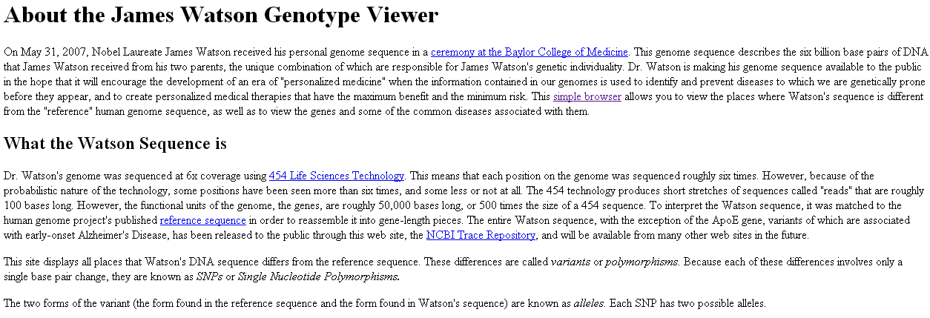
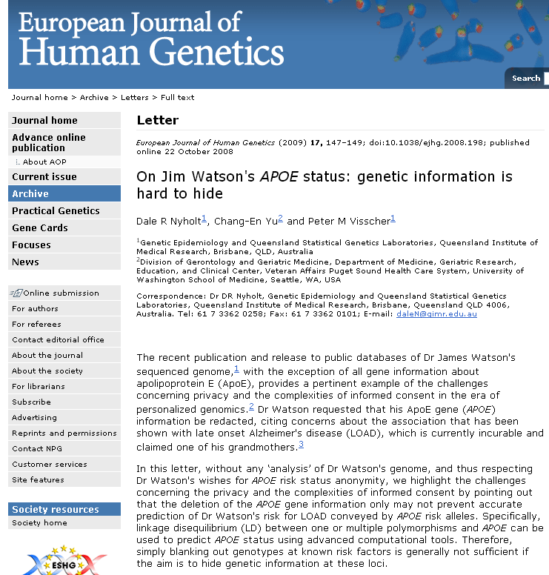
Genetic Data: Traditionally focus of genome privacy
Characterization Attacks

Slide 9
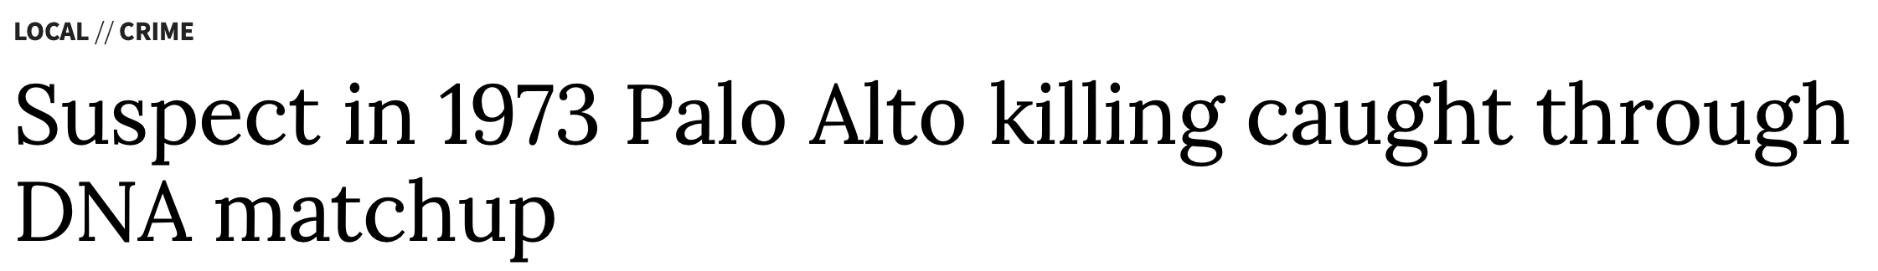
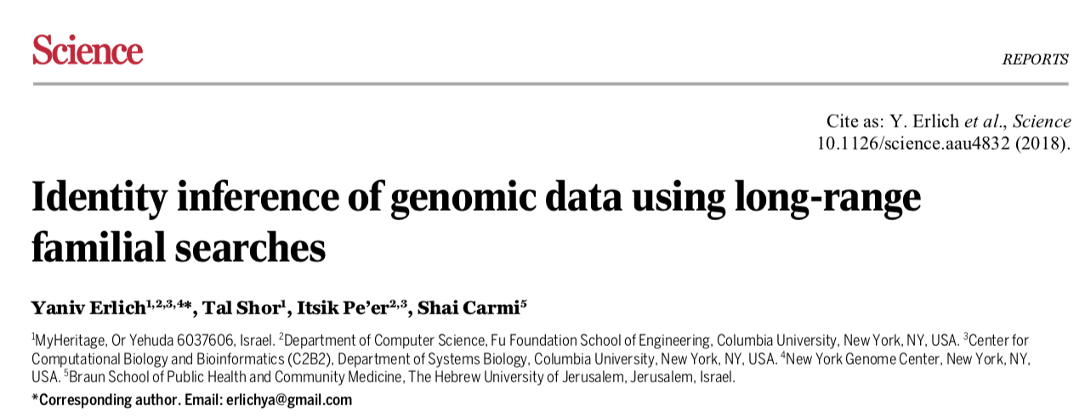
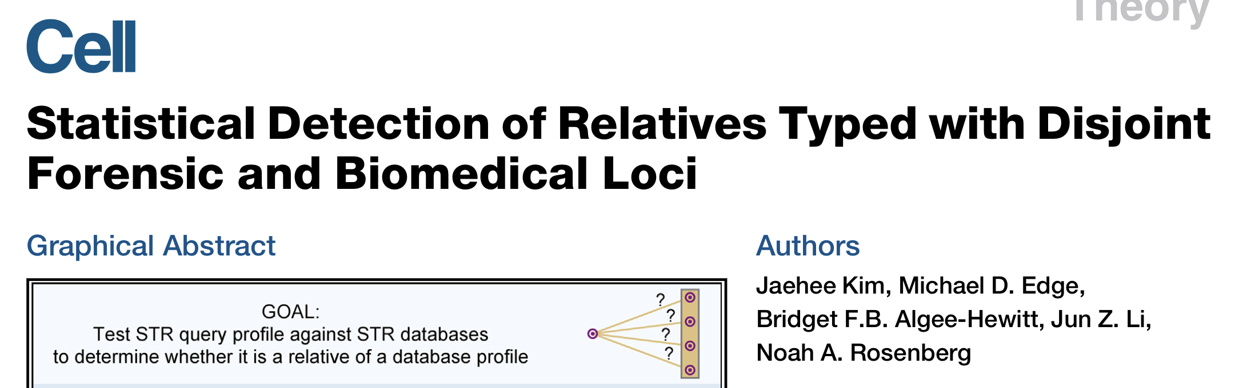
Genetic Data: Now with a focus on forensic applications

Slide 10

Tricky Privacy Considerations in Personal Genomics
Genetic Exceptionalism :
The Genome is very fundamental data, potentially very revealing about one’s identity & characteristics
Personal Genomic info. essentially meaningless currently but will it be in 20 yrs? 50 yrs?
  Genomic sequence very revealing about one’s children. Is true consent possible?
  Once put on the web it can’t be taken back
Culture Clash:
Genomics historically has been a proponent of “open data” but not clear personal genomics fits this.
  Clinical Medline has a very different culture.
Ethically challenged history of genetics
  Ownership of the data & what consent means (Hela)
    Could your genetic data give rise to a product line?
[D Greenbaum & M Gerstein (’08). Am J. Bioethics; D Greenbaum & M Gerstein, Hartford Courant, 10 Jul. '08 ; SF Chronicle, 2 Nov. '08;
Greenbaum et al. PLOS CB (‘11) ; Greenbaum & Gerstein ('13), The Scientist; Photo from NY Times]

Slide 11
Sharing

Slide 12

The Other Side of the Coin:
Why we should share
Sharing helps speed research
  Large-scale mining of this information is important for medical research
  Privacy is cumbersome, particularly for big data
Sharing is important for reproducible research
Sharing is useful for education
  More fun to study a known person’s genome
    Eg Zimmer’s Game of Genomes in STAT
[Yale Law Roundtable (‘10). Comp. in Sci. & Eng. 12:8; D Greenbaum & M Gerstein (‘09). Am. J. Bioethics; D Greenbaum & M Gerstein (‘10). SF Chronicle, May 2, Page E-4;
Greenbaum et al. PLOS CB (‘11)]

Slide 13
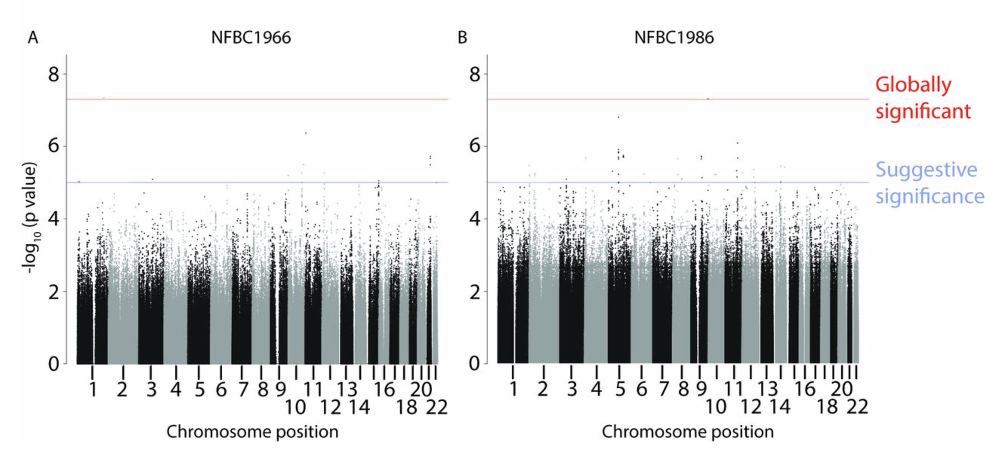
Statistical power
The genomic characterization of millions of individuals is useful for medical research
Having a larger number of studied individuals is assured to boost statistical power, hence discoveries
Expected to have genomes from increasingly more individuals will be sequenced going forward

Slide 14
Reproducibility
“The idea is: An article about computational science in a scientific publication is not the scholarship itself, it is merely advertising of the scholarship. The actual scholarship is the complete ... set of instructions [and data] which generated the figures.”
David Donoho, 1998

Slide 15
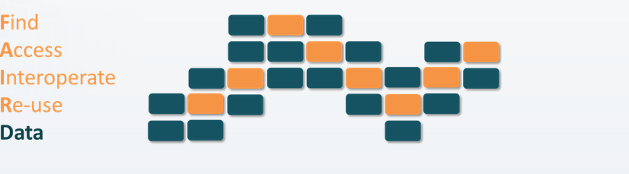
FAIR
Data should be findable
both for human researchers as well as computers
requires unique and persistent identifiers for the data.
Data ought to be accessible.
good data stewardship
long term electronic storage,
legally in terms of licensing and access conditions that easily provide for authentication of authorized

Slide 16
FAIR
  Data needs to be interoperable
human readers can clearly
  understand the connection of the data to the main text.
  appreciate the nature of the data from the presentation of the data
  easily able to digested by computational systems, e.g., in an standard that allows for straightforward data manipulation.
  Data needs to be reusable
  both humans and machines should be able to either apply the data to follow-up research or additional computational analysis

Slide 17
Balancing Privacy & Sharing

Slide 18

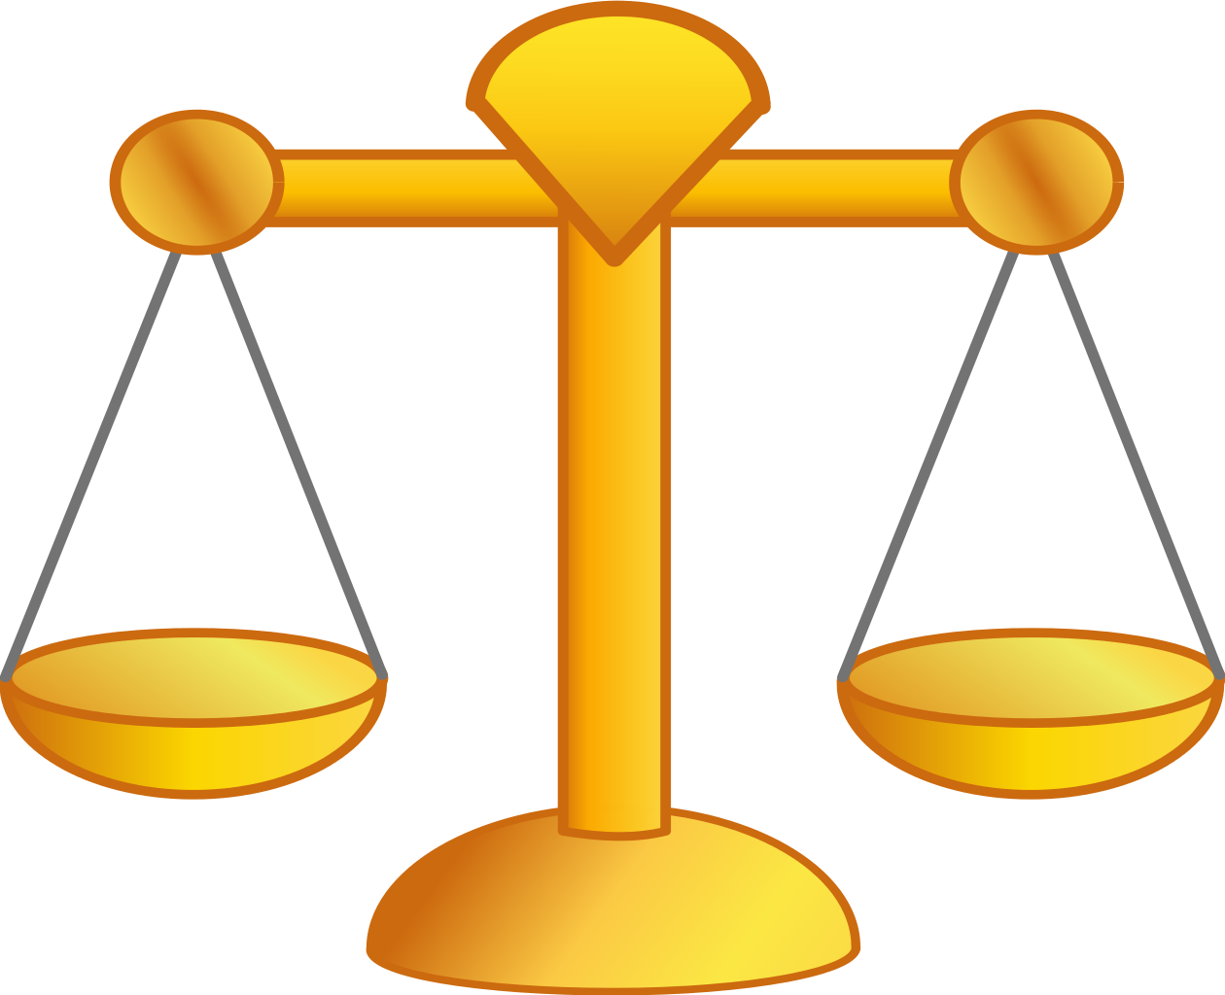
Goal is to find the balance
PRIVACY
UTILITY

Slide 19

The Dilemma
[Economist, 15 Aug ‘15]
The individual (harmed?) v the collective (benefits)
  But do sick patients care about their privacy?
How to balance risks v rewards - Quantification
  What is acceptable risk?
  Can we quantify leakage?
    Ex: photos of eye color
  Cost Benefit Analysis

Slide 20
Current Social & Technical Solutions
Closed Data Approach
  Consents
  “Protected” distribution via dbGAP
  Local computes on secure computer
Issues with Closed Data
  Non-uniformity of consents & paperwork
    Different international norms, leading to confusion
  Encryption & computer security creates burdensome requirements on data sharing & large scale analysis
  Many schemes get “hacked”
Open Data
  Genomic "test pilots” (ala PGP)?
    Sports stars & celebrities?
  Some public data & data donation is helpful but is this a realistic solution for an unbiased sample of ~1M
[Greenbuam et al ('04), Nat. Biotech; Greenbaum & Gerstein ('13), The Scientist]

Slide 21
Strawman Hybrid Social & Tech Proposed Solution?
Fundamentally, researchers have to keep genetic secrets.
  Need for an (international) legal framework
  Genetic Licensure & training for individuals
  (similar to medical license, drivers license)
Technology to make things easier
  Cloud computing & enclaves (eg solution of Genomics England)
Technological barriers shouldn't create a social incentive for “hacking”
Quantifying Leakage & allowing a small amounts of it
Careful separation & coupling of private & public data
  Lightweight, freely accessible secondary datasets coupled to underlying variants
  Selection of stub & "test pilot" datasets for benchmarking
  Develop programs on public stubs on your laptop, then move the program to the cloud for private production run
[D Greenbaum, M Gerstein (‘11). Am J Bioeth 11:39. Greenbaum & Gerstein, The Scientist ('13)]

Slide 22
Privacy & Functional Genomics Data – the Data Exhaust

Slide 23
Transcriptome = Gene Activity of All Genes in the Genome, usually quantified by RNA-seq
Genes (DNA)
Transcription
Regulation
RNA transcripts
Non-coding regulatory RNAs
Protein coding mRNA
Gene Expression measured by RNA-seq
Translation
Proteins
Expression of genes is quantified by transcription:
RNA-Seq measures mRNA transcript amounts
[ NATURE 459: 927; NAT. REV. GEN. 10: 57 ]

Slide 24
Some Core Science Qs Addressed by RNA-seq
Gene activity as a function of:
  Developmental stage: basic patterns of co-active genes across development
  Cell-type & Tissue: relationship to specialized functions
  Evolutionary relationships: behavior preserved across a wide range of organisms; patterns in model organisms in relation to those in humans
  Individual, across the human population
  Disease phenotypes: disruption of patterns in disease
Some overarching Qs:
Are there core patterns of gene activity ?
How do they vary across individual ?
Are they disrupted by disease?

Slide 25
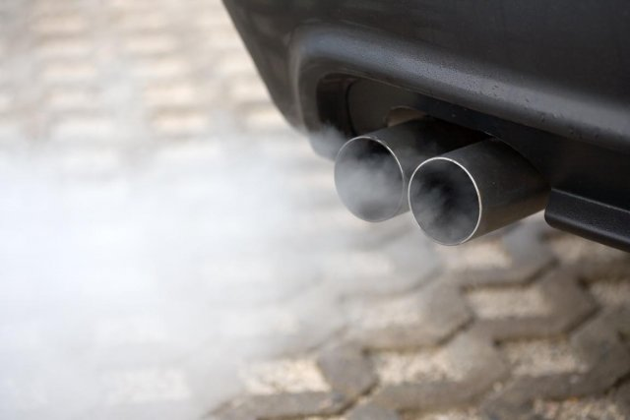
Studying large-scale transcriptome data also produces
Data Exhaust
Metadata
Core scientific purposes
Front End
Data collection and analysis
Back end
Data Exhaust
Data on Collaboration, publication and Infrastructure
Data Exhaust = Exploitable byproducts of big data collection and analysis
Creative use of Data is key to Data Science !
[PHOTO: RELAXNEWS; from http://www.lapresse.ca]

Slide 26
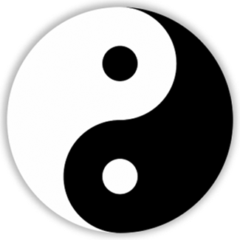
2-sided nature of functional genomics data: Analysis can be very General/Public or Individual/Private
General quantifications related to overall aspects
of a condition – ie gene activity as a function of:
  Developmental stage, Evolutionary relationships, Cell-type, Disease
Above are not tied to an individual’s genotype. However, data is derived from individuals & tagged with their genotypes
(Note, a few calculations aim to use explicitly genotype to derive general relations related to sequence variation & gene expression - eg allelic activity)

Slide 27



Representative Functional Genomics, Genotype, eQTL Datasets
Genotypes are available from the 1000 Genomes Project
mRNA sequencing for 462 individuals from gEUVADIS and ENCODE
  Publicly available quantification for protein coding genes
Functional genomics data (ChIP-Seq, RNA-Seq, Hi-C) available from ENCODE
Approximately 3,000 cis-eQTL (FDR<0.05)

Slide 28
Information Content and Predictability
Naive measure of information (no LD, distant correlations, pop. struc., &c)
Higher frequency: Lower ICI
Additive for multiple variants
Condition specific entropy
Higher cond. entropy: Lower predictability
Additive for multiple eQTLs
[Harmanci et al. Nat. Meth. 2016]

Slide 29
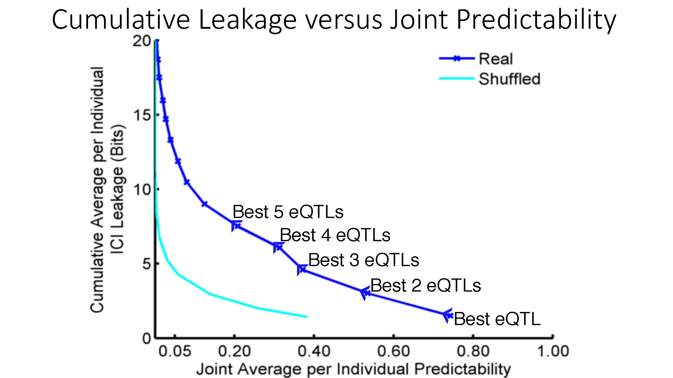

ICI Leakage versus Genotype Predictability
[Harmanciet al. Nat. Meth. (‘16]

Slide 30
Linking Attacks

Slide 31

Linking Attack Scenario
[Harmanciet al. Nat. Meth. (in revision)]

Slide 32
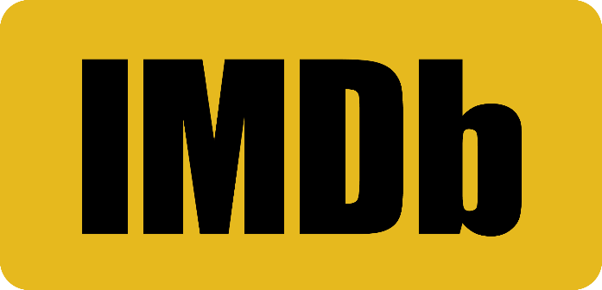

Linking Attacks: Case of Netflix Prize
Names available for many users!
User (ID) | Movie (ID) | Date of Grade | Grade [1,2,3,4,5]
NTFLX-0 | NTFLX-19 | 10/12/2008 | 1
NTFLX-1 | NTFLX-116 | 4/23/2009 | 3
NTFLX-2 | NTFLX-92 | 5/27/2010 | 2
NTFLX-1 | NTFLX-666 | 6/6/2016 | 5
… | … | … | …
… | … | … | …
User (ID) | Movie (ID) | Date of Grade | Grade [0-10]
IMDB-0 | IMDB-173 | 4/20/2009 | 5
IMDB-1 | IMDB-18 | 10/18/2008 | 0
IMDB-2 | IMDB-341 | 5/27/2010 | -
… | … | … | …
… | … | … | …
… | … | … | …
Many users are shared
The grades of same users are correlated
A user grades one movie around the same date in two databases
Anonymized Netflix Prize Training Dataset
made available to contestants
Notes:
This figure illustrates what these datasets look like. The movie titles can be matched directly. Date of ratings and rating values are expected to be similar to each other

Slide 33
Linking Attacks: Case of Netflix Prize
Names available for many users!
User (ID) | Movie (ID) | Date of Grade | Grade [1,2,3,4,5]
NTFLX-0 | NTFLX-19 | 10/12/2008 | 1
NTFLX-1 | NTFLX-116 | 4/23/2009 | 3
NTFLX-2 | NTFLX-92 | 5/27/2010 | 2
NTFLX-1 | NTFLX-666 | 6/6/2016 | 5
… | … | … | …
… | … | … | …
User (ID) | Movie (ID) | Date of Grade | Grade [0-10]
IMDB-0 | IMDB-173 | 4/20/2009 | 5
IMDB-1 | IMDB-18 | 10/18/2008 | 0
IMDB-2 | IMDB-341 | 5/27/2010 | -
… | … | … | …
… | … | … | …
… | … | … | …
Many users are shared
The grades of same users are correlated
A user grades one movie around the same date in two databases
IMDB users are public
NetFLIX and IMdB moves are public
Notes:
As you can see, Netflx-1 user can be matched to IMDB-0 user since the date of rating is very close and the ratings are very similar. The rating in imdb is from 0 to 10. So 5 is a similar score to 3 in Netflix rating system.

Slide 34
Linking Attacks: Case of Netflix Prize
Names available for many users!
User (ID) | Movie (ID) | Date of Grade | Grade [1,2,3,4,5]
NTFLX-0 | NTFLX-19 | 10/12/2008 | 1
NTFLX-1 | NTFLX-116 | 4/23/2009 | 3
NTFLX-2 | NTFLX-92 | 5/27/2010 | 2
NTFLX-1 | NTFLX-666 | 6/6/2016 | 5
… | … | … | …
… | … | … | …
User (ID) | Movie (ID) | Date of Grade | Grade [0-10]
IMDB-0 | IMDB-173 | 4/20/2009 | 5
IMDB-1 | IMDB-18 | 10/18/2008 | 0
IMDB-2 | IMDB-341 | 5/27/2010 | -
… | … | … | …
… | … | … | …
… | … | … | …
Many users are shared
The grades of same users are correlated
A user grades one movie around the same date in two databases
Notes:
The key idea is that in imdb, the names are available for many users. Also,
Secondly, although another movie in Netflix system is not rated by this user in imdb system, namely the netflx666, the adversary can see the rating of the individual for this movie.

Slide 35
Linking Attack Scenario
[Harmanciet al. Nat. Meth. (in revision)]

Slide 36
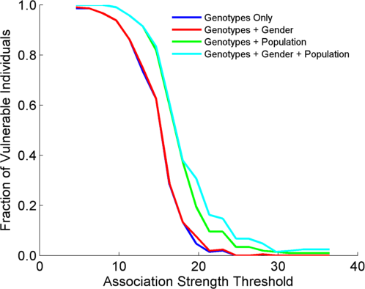
Success in Linking Attack with Extremity based Genotype Prediction
200 individuals eQTL Discovery
200 individuals in Linking Attack
High
Sensitivity
Low
Sensitivity
High Number
Of eQTLs
Low Number
Of eQTLs
[Harmanci et al. Nat. Meth. (16)]

Slide 37
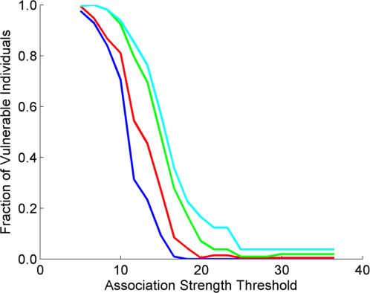
Success in Linking Attack with Extremity based Genotype Prediction
200 individuals eQTL Discovery
200 individuals in Linking Attack
200 individuals eQTL Discovery
100,200 individuals in Linking Attack
[Harmanci et al. Nat. Meth. (16)]

