Slide 1
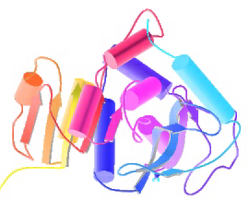
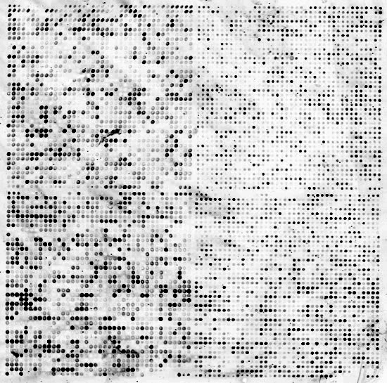


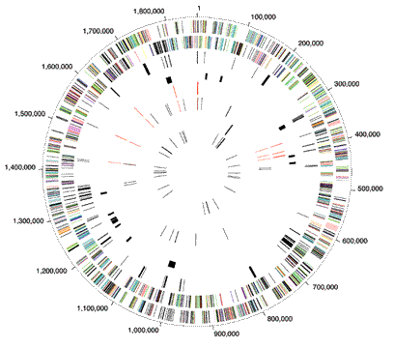
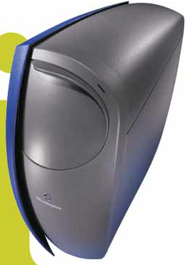

Biomedical Data Science:
Predicting Networks
Mark Gerstein, Yale University
gersteinlab.org/courses/452
(last edit in Spring '19, pack #11)

Slide 2
Predicting Networks via Bayesian Integration: Problem Motivation

Slide 3
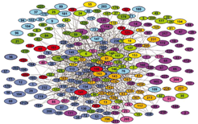
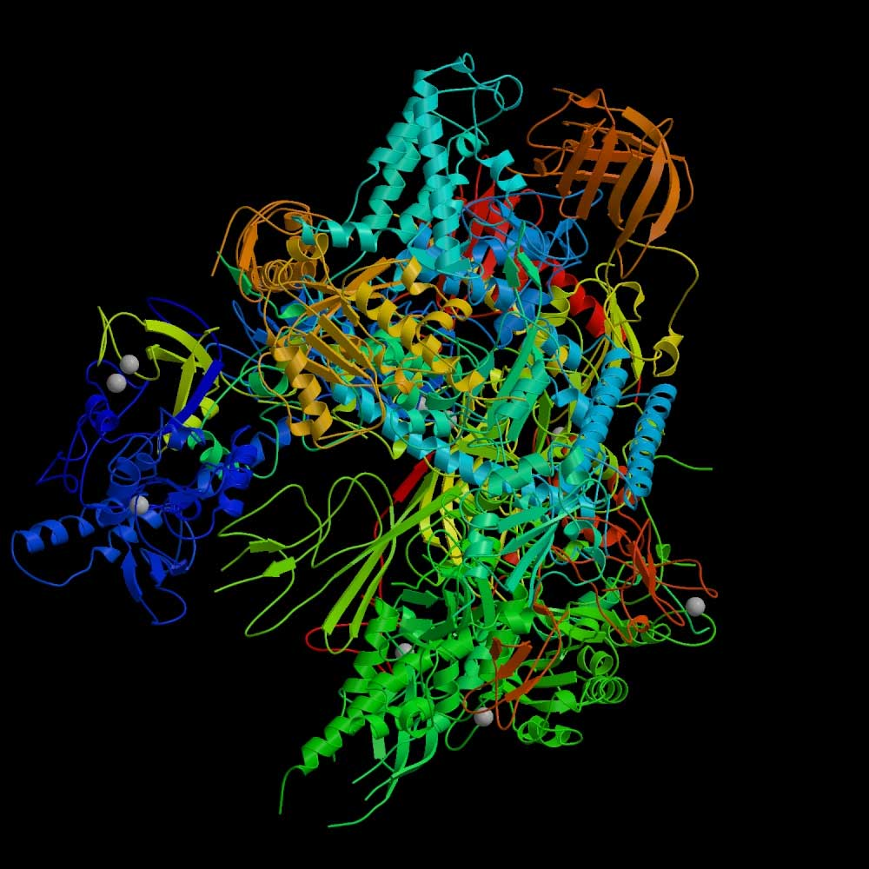
RNA polymerase II: Structure
Which subunits interact?
Based on Binding
experiments
Compare with Gold Std. Structure
5
3
6
2
8
1
9
12
10
11
Source: Cramer et al., 2000, Science, 288:632-633
Source: Edwards et al., 2002, Trends in Genetics

Slide 4
Binding Experiments on Subunit Pairs
Subunits
1
1
1
1
1
1
1
1
1
2
2
2
2
2
2
2
2
3
3
3
3
3
3
3
5
5
5
5
5
5
6
6
6
6
6
8
8
8
8
9
9
9
10
10
12
Subunits
2
3
5
6
8
9
10
11
12
3
5
6
8
9
10
11
12
5
6
8
9
10
11
12
6
8
9
10
11
12
8
9
10
11
12
9
10
11
12
10
11
12
11
11
12
Pull-down 1
1
1
0
1
0
1
0
1
1
0
1
0
1
0
1
1
1
0
1
1
1
1
0
1
0
0
0
0
0
0
1
0
0
0
0
Pull-down 2
1
1
1
1
0
1
0
1
1
0
1
0
1
0
1
1
1
0
1
1
0
1
0
1
0
0
0
0
0
0
0
0
0
0
0
Pull-down 3
1
1
1
0
1
0
0
1
0
Cross-linking
1
1
1
1
1
0
1
1
1
1
1
0
1
1
1
1
1
1
0
1
Far Western 1
1
1
1
1
1
0
0
0
0
0
0
1
0
0
0
Far Western 2
1
1
1
1
1
1
1
1
1
1
0
0
0
1
0
0
0
0
0
0
0
0
0
0
0
0
0
0
0
0
Far Western 3
1
0
0
0
1
0
Interaction experiments
before structure was known

Slide 5
Gold-Standard Positives
Subunits
1
1
1
1
1
1
1
1
1
2
2
2
2
2
2
2
2
3
3
3
3
3
3
3
5
5
5
5
5
5
6
6
6
6
6
8
8
8
8
9
9
9
10
10
12
Subunits
2
3
5
6
8
9
10
11
12
3
5
6
8
9
10
11
12
5
6
8
9
10
11
12
6
8
9
10
11
12
8
9
10
11
12
9
10
11
12
10
11
12
11
11
12
Gold-Standard Positive (GSTD+): 13
5
3
6
2
8
1
9
12
10
11

Slide 6
Gold-Standard Negatives
Subunits
1
1
1
1
1
1
1
1
1
2
2
2
2
2
2
2
2
3
3
3
3
3
3
3
5
5
5
5
5
5
6
6
6
6
6
8
8
8
8
9
9
9
10
10
12
Subunits
2
3
5
6
8
9
10
11
12
3
5
6
8
9
10
11
12
5
6
8
9
10
11
12
6
8
9
10
11
12
8
9
10
11
12
9
10
11
12
10
11
12
11
11
12
Gold-Standard Negative (GSTD-): 32
5
3
6
2
8
1
9
12
10
11

Slide 7
RNA Polymerase II: Gold-Standards
Subunits
1
1
1
1
1
1
1
1
1
2
2
2
2
2
2
2
2
3
3
3
3
3
3
3
5
5
5
5
5
5
6
6
6
6
6
8
8
8
8
9
9
9
10
10
12
Subunits
2
3
5
6
8
9
10
11
12
3
5
6
8
9
10
11
12
5
6
8
9
10
11
12
6
8
9
10
11
12
8
9
10
11
12
9
10
11
12
10
11
12
11
11
12
Gold-Standard Positive (GSTD+): 13
Gold-Standard Negative (GSTD-): 32
5
3
6
2
8
1
9
12
10
11

Slide 8
Assess Quality and Coverage of PPints
Subunits
1
1
1
1
1
1
1
1
1
2
2
2
2
2
2
2
2
3
3
3
3
3
3
3
5
5
5
5
5
5
6
6
6
6
6
8
8
8
8
9
9
9
10
10
12
Subunits
2
3
5
6
8
9
10
11
12
3
5
6
8
9
10
11
12
5
6
8
9
10
11
12
6
8
9
10
11
12
8
9
10
11
12
9
10
11
12
10
11
12
11
11
12
Pull-down 1
1
1
0
1
0
1
0
1
1
0
1
0
1
0
1
1
1
0
1
1
1
1
0
1
0
0
0
0
0
0
1
0
0
0
0
Pull-down 2
1
1
1
1
0
1
0
1
1
0
1
0
1
0
1
1
1
0
1
1
0
1
0
1
0
0
0
0
0
0
0
0
0
0
0
Pull-down 3
1
1
1
0
1
0
0
1
0
Cross-linking
1
1
1
1
1
0
1
1
1
1
1
0
1
1
1
1
1
1
0
1
Far Western 1
1
1
1
1
1
0
0
0
0
0
0
1
0
0
0
Far Western 2
1
1
1
1
1
1
1
1
1
1
0
0
0
1
0
0
0
0
0
0
0
0
0
0
0
0
0
0
0
0
Far Western 3
1
0
0
0
1
0
GSTD+
GSTD-
True
False

Slide 9
Re-drawn in a different color scheme

Slide 10
Data integration: RNA polymerase II
Integrate using naive Bayes classifier

Slide 11
Data integration: RNA polymerase II
Integrate using naive Bayes classifier

Slide 12
Data integration: RNA polymerase II
Integrate using naive Bayes classifier
(Cross validate)

Slide 13
Weighted Voting: the Likelihood Ratio
Maj. Vote: 0 = round(avg( 0 + 0 + 0 + 1 + 1 + 0 + 0 )
With weights: likelihood ratio L = L₁ + L₂ + L₃ …

Slide 14
Predicting Networks via Bayesian Integration: Intuition & Formalism

Slide 15
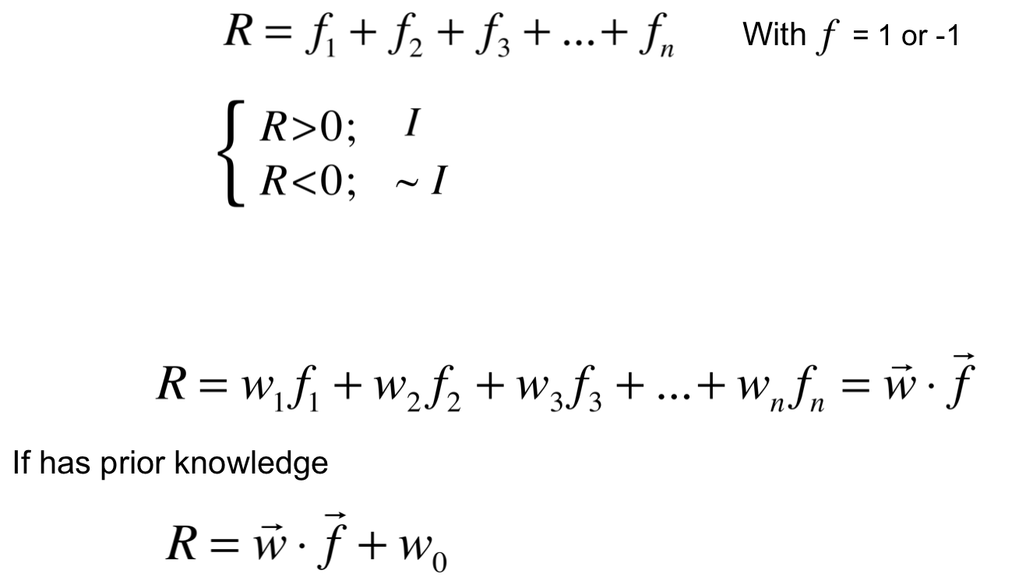
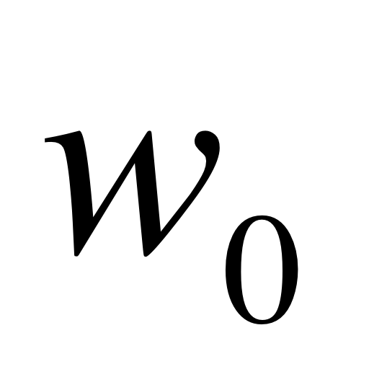
Supervised
Classification by Weighted Voting
Derived from
"perceptron model”
R = <w,f> + b
Simple Vote:
Interact
If
No interaction
Modify with feature weight:

Slide 16
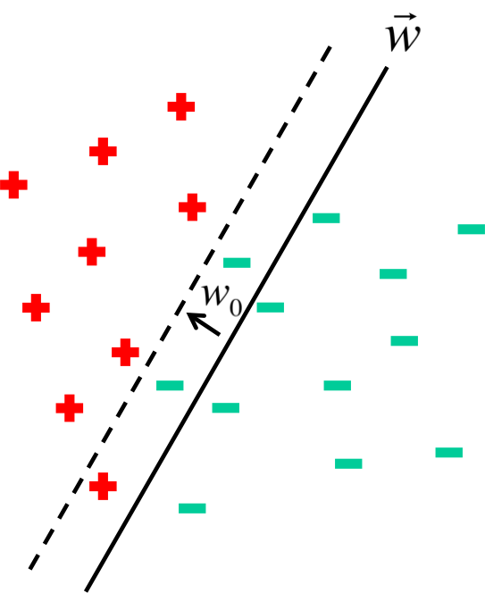
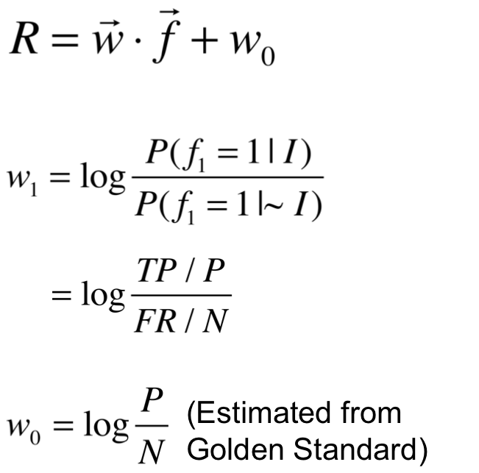
Classification by Voting
On Training Set

Slide 17
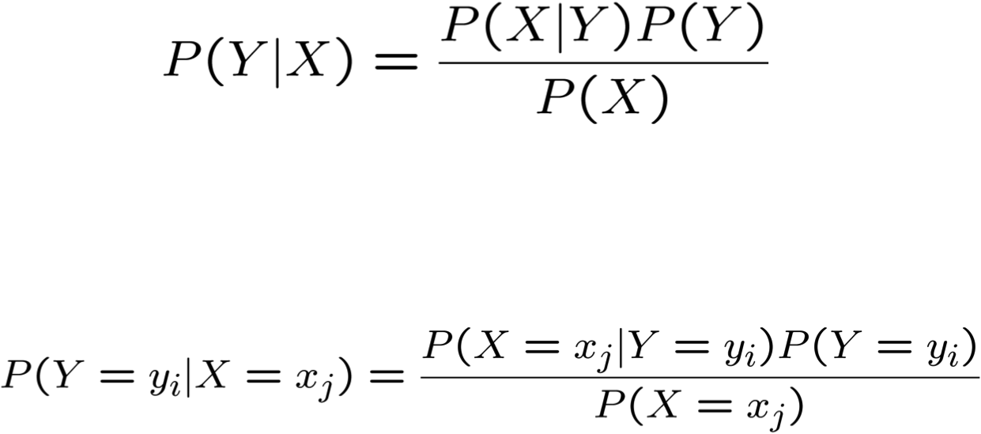
Bayes Rule
Which is shorthand for:
[From Mitchell, Machine Learning]

Slide 18
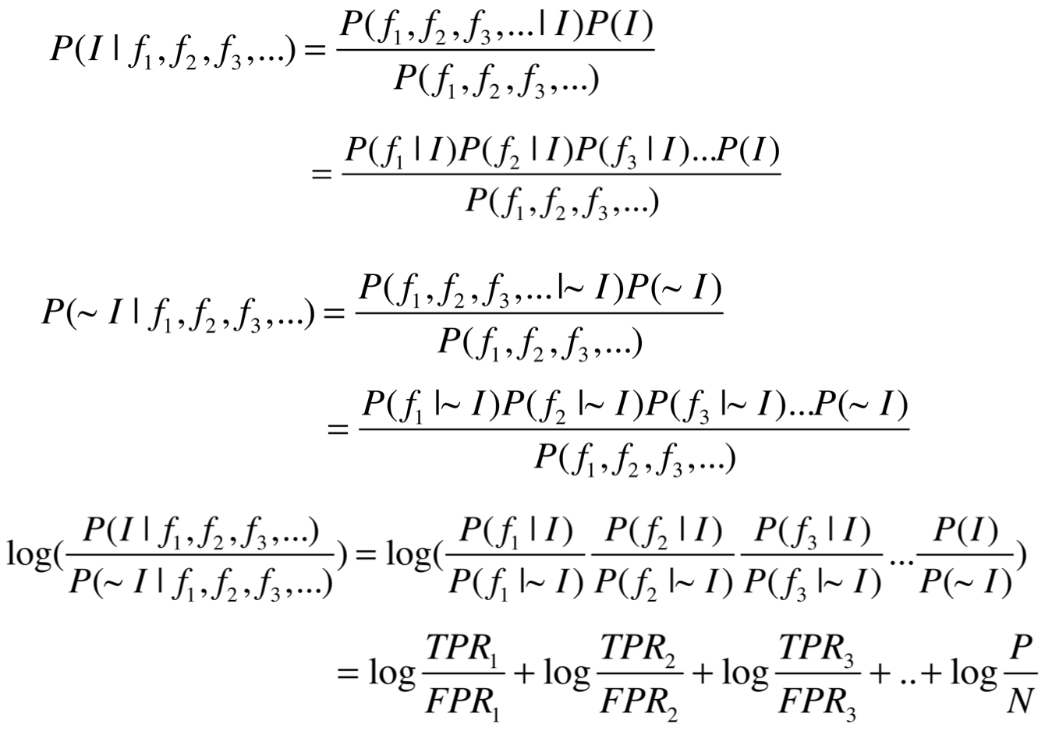
More Bayes Rule
Thus
Assume Naïve Bayes (independent)

Slide 19
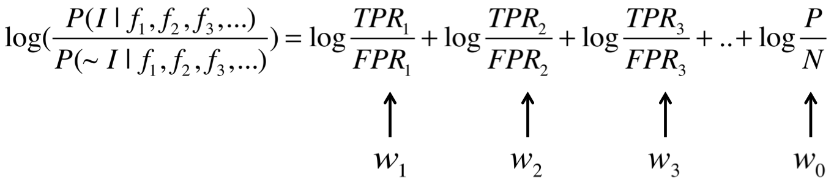
More Bayes Rule

Slide 20
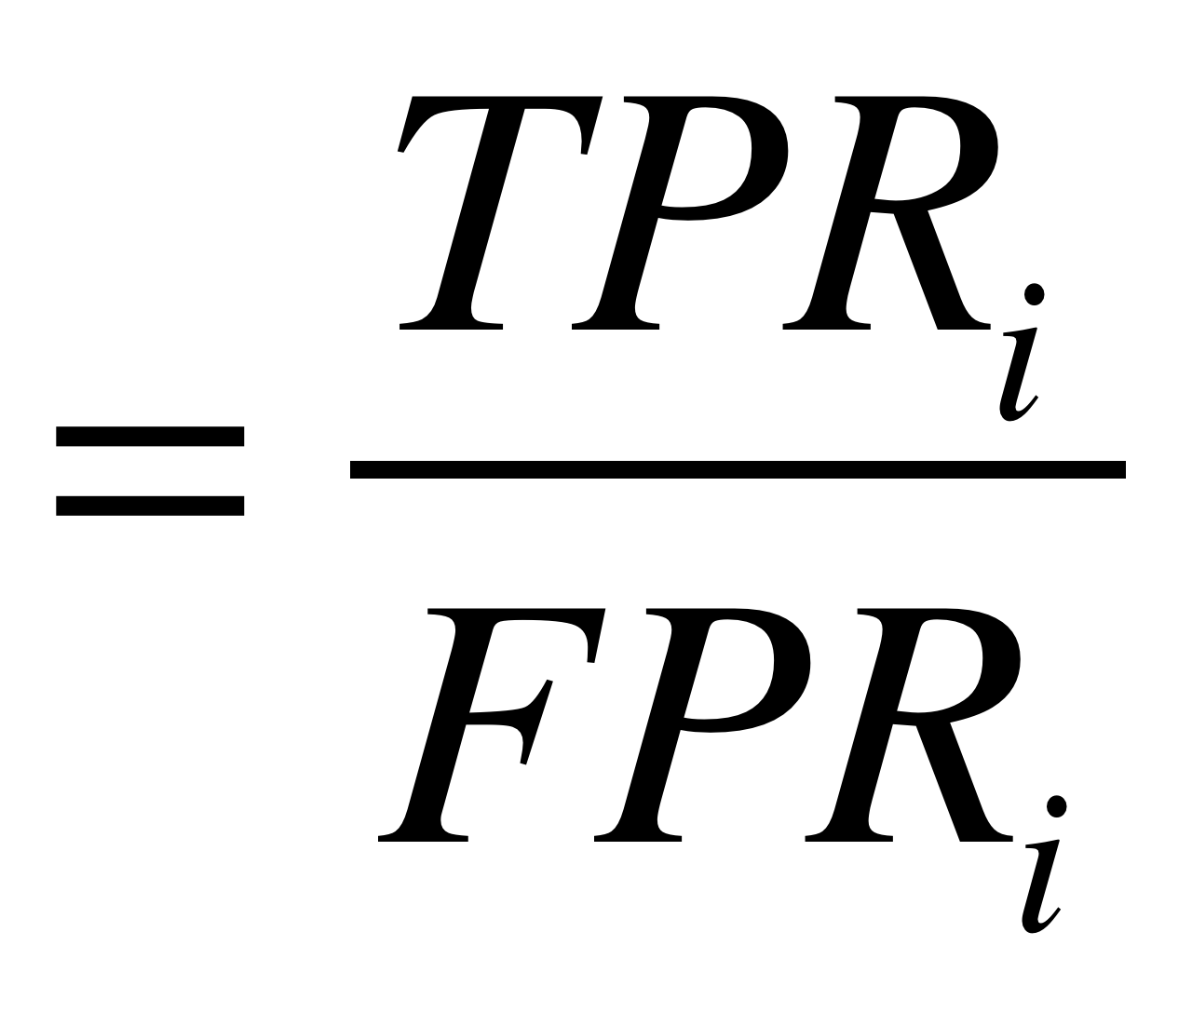
Estimating Probabilities
We have so far estimated P(X=x | Y=y) by the fraction n_{x|y}/n_{y}, where n_{y} is the number of instances for which Y=y and n_{x|y} is the number of these for which X=x
This is a problem when n_{x} is small
  E.g., assume P(X=x | Y=y)=0.05 and the training set is s.t. that n_{y}=5. Then it is highly probable that n_{x|y}=0
  The fraction is thus an underestimate of the actual probability
  It will dominate the Bayes classifier for all new queries with X=x
# count with feature i in GS+
# count with feature i in GS-

Slide 21
m-estimate
Replace n_{x|y}/n_{y} by:
Dummy Counts
Where p is our prior estimate of the probability we wish to determine and m is a constant
  Typically, p = 1/k (where k is the number of possible values of X)
  m acts as a weight (similar to adding m virtual instances distributed according to p)

Slide 22
Predicting Networks via Bayesian Integration: Worked Examples

Slide 23
Likelihood Ratios
Subunits
1
1
1
1
1
1
1
1
1
2
2
2
2
2
2
2
2
3
3
3
3
3
3
3
5
5
5
5
5
5
6
6
6
6
6
8
8
8
8
9
9
9
10
10
12
Subunits
2
3
5
6
8
9
10
11
12
3
5
6
8
9
10
11
12
5
6
8
9
10
11
12
6
8
9
10
11
12
8
9
10
11
12
9
10
11
12
10
11
12
11
11
12
Pull-down 1
1
1
0
1
0
1
0
1
1
0
1
0
1
0
1
1
1
0
1
1
1
1
0
1
0
0
0
0
0
0
1
0
0
0
0
Likelihood Ratio
for Feature f:
GSTD+
GSTD-
True
False

Slide 24
Calculating Likelihood Ratios
Subunits
1
1
1
1
1
1
1
1
1
2
2
2
2
2
2
2
2
3
3
3
3
3
3
3
5
5
5
5
5
5
6
6
6
6
6
8
8
8
8
9
9
9
10
10
12
Subunits
2
3
5
6
8
9
10
11
12
3
5
6
8
9
10
11
12
5
6
8
9
10
11
12
6
8
9
10
11
12
8
9
10
11
12
9
10
11
12
10
11
12
11
11
12
Pull-down 1
1
0
1
0
0
1
0
1
1
1
GSTD+
GSTD-
True
False

Slide 25
Calculating Likelihood Ratios
Subunits
1
1
1
1
1
1
1
1
1
2
2
2
2
2
2
2
2
3
3
3
3
3
3
3
5
5
5
5
5
5
6
6
6
6
6
8
8
8
8
9
9
9
10
10
12
Subunits
2
3
5
6
8
9
10
11
12
3
5
6
8
9
10
11
12
5
6
8
9
10
11
12
6
8
9
10
11
12
8
9
10
11
12
9
10
11
12
10
11
12
11
11
12
Pull-down 1
Pull-down 1
1
1
1
0
1
0
1
1
0
1
1
1
0
0
1
1
0
1
0
0
1
1
1
1
1
1
0
0
1
1
1
1
1
1
0
0
1
1
0
0
0
0
0
0
0
0
0
0
0
0
1
1
0
0
0
0
0
0
0
0
=1.34
=0.70
GSTD+
GSTD-
True
False

Slide 26
Calculating Likelihood Ratios
Subunits
1
1
1
1
1
1
1
1
1
2
2
2
2
2
2
2
2
3
3
3
3
3
3
3
5
5
5
5
5
5
6
6
6
6
6
8
8
8
8
9
9
9
10
10
12
Subunits
2
3
5
6
8
9
10
11
12
3
5
6
8
9
10
11
12
5
6
8
9
10
11
12
6
8
9
10
11
12
8
9
10
11
12
9
10
11
12
10
11
12
11
11
12
Pull-down 1
1
1
0
1
0
1
0
1
1
0
1
0
1
0
1
1
1
0
1
1
1
1
0
1
0
0
0
0
0
0
1
0
0
0
0
Pull-down 2
1
1
1
1
0
1
0
1
1
0
1
0
1
0
1
1
1
0
1
1
0
1
0
1
0
0
0
0
0
0
0
0
0
0
0
Pull-down 3
1
1
1
0
1
0
0
1
0
Cross-linking
1
1
1
1
1
0
1
1
1
1
1
0
1
1
1
1
1
1
0
1
Far Western 1
1
1
1
1
1
0
0
0
0
0
0
1
0
0
0
Far Western 2
1
1
1
1
1
1
1
1
1
1
0
0
0
1
0
0
0
0
0
0
0
0
0
0
0
0
0
0
0
0
Far Western 3
1
0
0
0
1
0
Pull-down 1
L1 = (6/13) / (11/32) = 1.34
L0 = (4/13) / (14/32) = 0.70
Pull-down 2
L1 = (7/13) / (9/32) = 1.91
L0 = (2/13) / (16/32) = 0.31
Pull-down 3
L1 = (2/13) / (3/32) = 1.64
L0 = (2/13) / (2/32) = 2.46
Cross-linking
L1 = (10/13) / (7/32) = 3.52
L0 = (0/13) / (3/32) = 0
Far Western 1
L1 = (2/13) / (4/32) = 1.23
L0 = (3/13) / (6/32) = 1.23
Far Western 2
L1 = (6/13) / (5/32) = 2.95
L0 = (2/13) / (17/32) = 0.29
Far Western 3
L1 = (1/13) / (1/32) = 2.46
L0 = (2/13) / (2/32) = 2.46
GSTD+
GSTD-
True
False

Slide 27
Data Integration: ROC-Curve
Subunits
1
1
1
1
1
1
1
1
1
2
2
2
2
2
2
2
2
3
3
3
3
3
3
3
5
5
5
5
5
5
6
6
6
6
6
8
8
8
8
9
9
9
10
10
12
Subunits
2
3
5
6
8
9
10
11
12
3
5
6
8
9
10
11
12
5
6
8
9
10
11
12
6
8
9
10
11
12
8
9
10
11
12
9
10
11
12
10
11
12
11
11
12
Pull-down 1
1
1
0
1
0
1
0
1
1
0
1
0
1
0
1
1
1
0
1
1
1
1
0
1
0
0
0
0
0
0
1
0
0
0
0
Pull-down 2
1
1
1
1
0
1
0
1
1
0
1
0
1
0
1
1
1
0
1
1
0
1
0
1
0
0
0
0
0
0
0
0
0
0
0
Pull-down 3
1
1
1
0
1
0
0
1
0
Cross-linking
1
1
1
1
1
0
1
1
1
1
1
0
1
1
1
1
1
1
0
1
Far Western 1
1
1
1
1
1
0
0
0
0
0
0
1
0
0
0
Far Western 2
1
1
1
1
1
1
1
1
1
1
0
0
0
1
0
0
0
0
0
0
0
0
0
0
0
0
0
0
0
0
Far Western 3
1
0
0
0
1
0
3.52
18.2
11.1
13.9
26.6
0.22
0
2.25
10.4
18.2
11.1
2.25
0
0.22
26.6
2.25
10.4
12.7
5.52
3.68
0.53
19.5
132
2.16
0.52
0
0.22
0.91
0.08
0.36
0.22
0.22
0.06
0.06
0.29
0.22
0.12
0.06
0.29
0.22
0.22
0
0.06
0.29
0.29
Combined (Bayes)
1
1
1
1
1
0
0
0
1
1
1
0
0
0
1
0
1
1
0
0
0
1
1
0
0
0
0
0
0
0
0
0
0
0
0
0
0
0
0
0
0
0
0
0
0
GSTD+
“Weighted Voting”
GSTD-
True
False

Slide 28
Data Integration: ROC Curve
Subunits
1
1
1
1
1
1
1
1
1
2
2
2
2
2
2
2
2
3
3
3
3
3
3
3
5
5
5
5
5
5
6
6
6
6
6
8
8
8
8
9
9
9
10
10
12
Subunits
2
3
5
6
8
9
10
11
12
3
5
6
8
9
10
11
12
5
6
8
9
10
11
12
6
8
9
10
11
12
8
9
10
11
12
9
10
11
12
10
11
12
11
11
12
3.52
18.2
11.1
13.9
26.6
0.22
0
2.25
10.4
18.2
11.1
2.25
0
0.22
26.6
2.25
10.4
12.7
5.52
3.68
0.53
19.5
132
2.16
0.52
0
0.22
0.91
0.08
0.36
0.22
0.22
0.06
0.06
0.29
0.22
0.12
0.06
0.29
0.22
0.22
0
0.06
0.29
0.29
Combined (Bayes)
1
1
1
1
1
0
0
0
1
1
1
0
0
0
1
0
1
1
0
0
0
1
1
0
0
0
0
0
0
0
0
0
0
0
0
0
0
0
0
0
0
0
0
0
0
Majority
1
1
1
1
1
0
1
0
1
1
1
0
1
0
1
0
1
1
0
0
0
0
1
0
0
1
0
0
0
0
0
0
0
0
0
0
0
0
0
0
0
0
0
0
0
Intersection
1
1
1
0
1
0
0
0
1
1
1
0
0
0
1
0
1
1
0
0
0
0
0
0
0
0
0
0
0
0
0
0
0
0
0
0
0
0
0
0
0
0
0
0
0
Union
1
1
1
1
1
0
1
1
1
1
1
1
1
0
1
1
1
1
1
1
0
1
1
0
1
1
0
1
0
0
1
0
0
0
0
0
1
0
0
0
0
0
0
0
0
1.0
0.8
0.6
Bayesian Integration
Majority
Intersection
Union
TPR=TP/P=Sensitivity
0.4
GSTD+
GSTD-
0.2
True
ROC Curves of RNA Polymerase II
False
0.2
0.4
0.6
0.8
1.0
FPR=FP/N=1-Specificity

Slide 29
Predicting Networks via Bayesian Integration: Features Correlation

Slide 30
Correlations between similar features

Slide 31
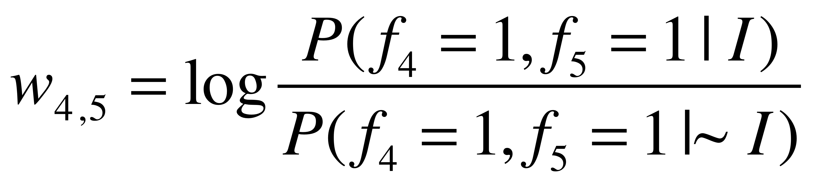
Feature Correlation and Fully Connected Bayes
GS | 1 | 0 | 0 | 1 | 1 | 1 | …
F1 | 1 | 0 | 0 | 1 | 0 | 0 | ...
F2 | 1 | 0 | 0 | 1 | 0 | 0 | …
F3 | 0 | 0 | 1 | 0 | 1 | 0 | …
F4 | 0 | 1 | 0 | 0 | 1 | 0 | …
F5 | 0 | 1 | 0 | 0 | 1 | 0 | …
F6 | 1 | 0 | 1 | 1 | 0 | 0 | …

Slide 32
Naive Bayes

Slide 33
A ‘correct’ factorisation

Slide 34
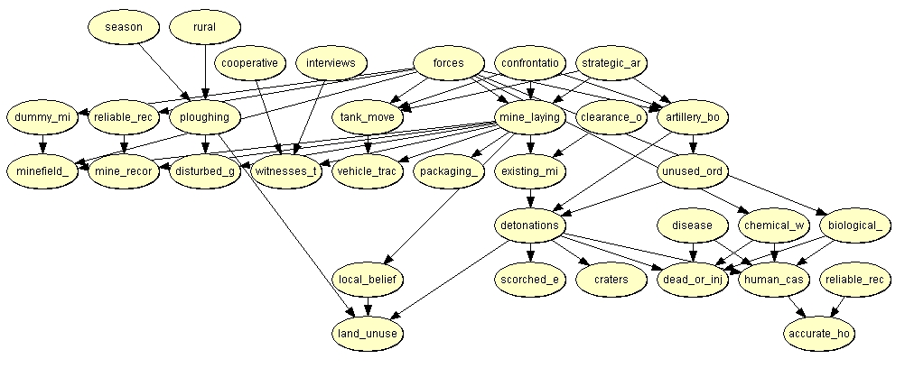
A Typical BBN

Slide 35
Predicting Networks via Bayesian Integration: Real Thing but with a few features

Slide 36
Papers on Predicting Protein Interactions
  A Enright et al. (1999) "Protein interaction maps for complete genomes based on gene fusion events." Nature. 402(6757):86-90.
  E Marcotte et al. (1999) "A Combined Algorithm for Genome-Wide Prediction of Protein Function." Nature 402, 83-86 (1999).
  E Marcotte et al. (1999) "Detecting Protein Function & Protein-Protein Interactions from Genome Sequences." Science 285, 751-753
  M Pellegrini et al. (1999) "Assigning protein functions by comparative genome analysis: protein phylogenetic profiles." Proc.Natl. Acad. Sci. 96, 4285-4288.
  R Jansen et al. (2003). "A Bayesian networks approach for predicting protein-protein interactions from genomic data." Science 302: 449-53.
  I Lee et al. (2004) "A Probabilistic Functional Network of Yeast Genes". Science 206: 1555-1558
  H Yu et al. (2004) "Annotation transfer between genomes: protein-protein interologs and protein-DNA regulogs." Genome Res 14: 1107-18.
  L Lu et al. (2005) "Assessing the limits of genomic data integration for predicting protein networks." Genome Res 15: 945-53.
  A Ramani et al. (2005) "Consolidating the set of known human protein-protein interactions in preparation for large-scale mapping of the human interactome." Genome Biology 6:r40.
  Xia et al. (2006) "Integrated prediction of the helical membrane protein interactome in yeast." J Mol Biol. 357:339-49

