Slide 1
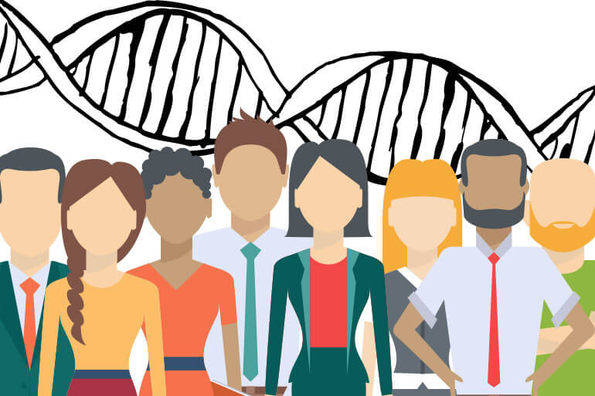
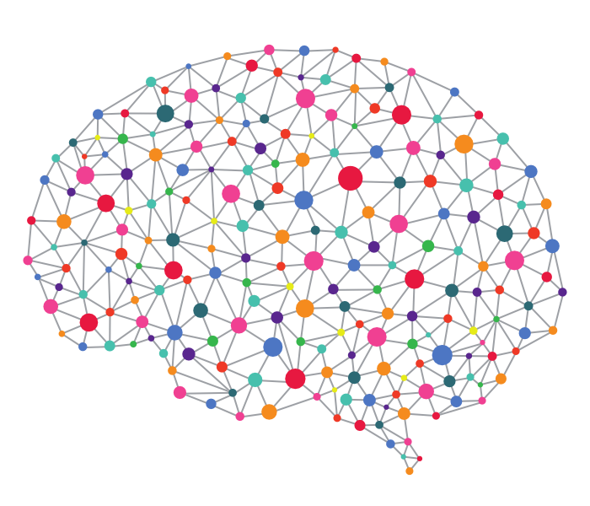
Deep Learning
in Biomedical Data Science
Hussein Mohsen
CBB752 Spring 2019
Hussein Mohsen
CBB752 Spring 2019

Slide 2
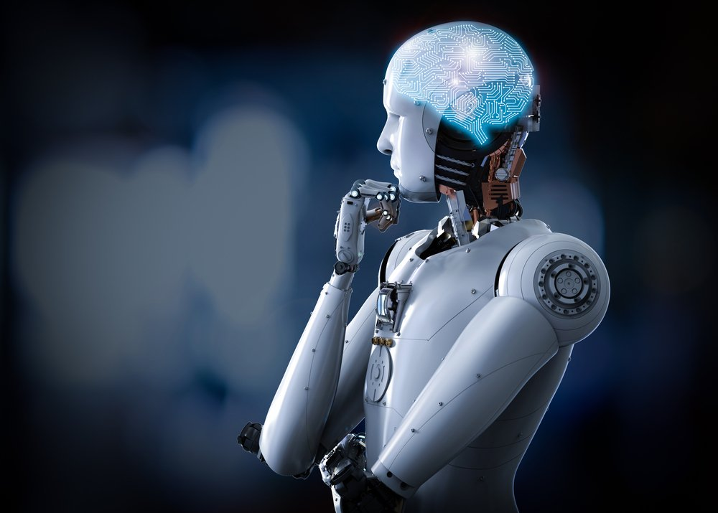
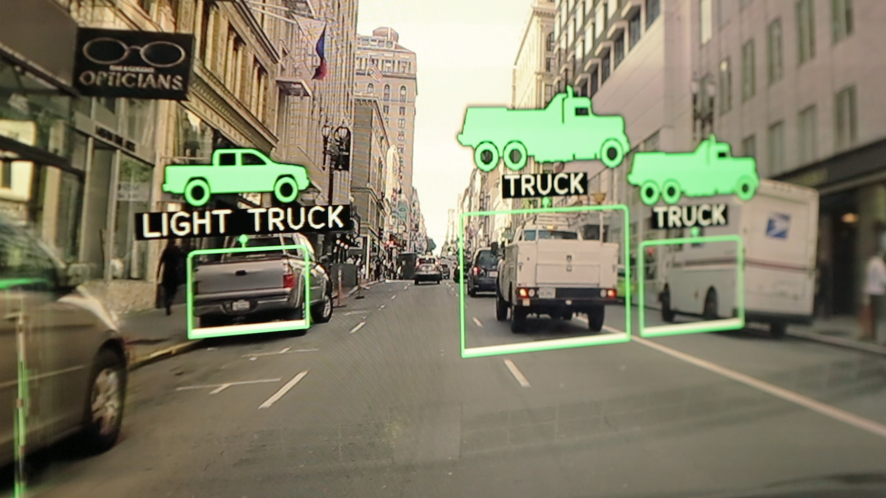
Applications
Image Color Restoration
Image Captioning
Object Classification
Robotics
Self-driving Cars
Machine Translation
Speech Recognition
Text Generation
Handwriting Generation
Music Composition
& more

Slide 3
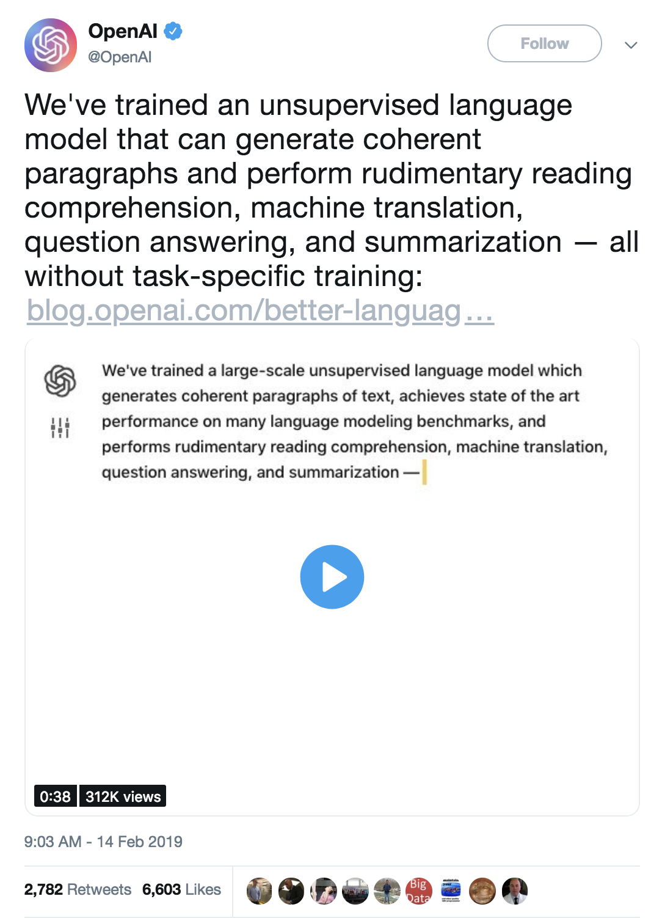
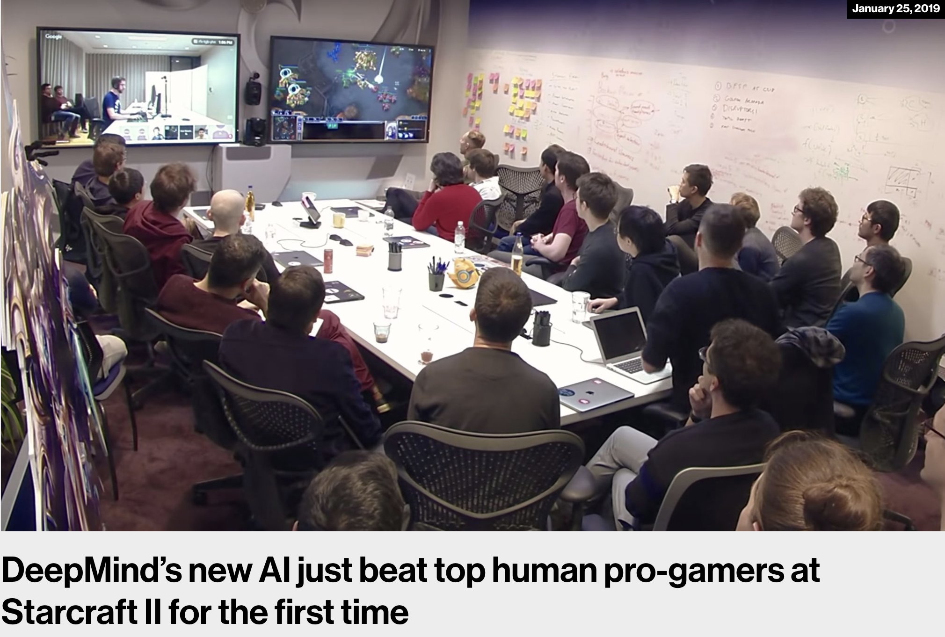
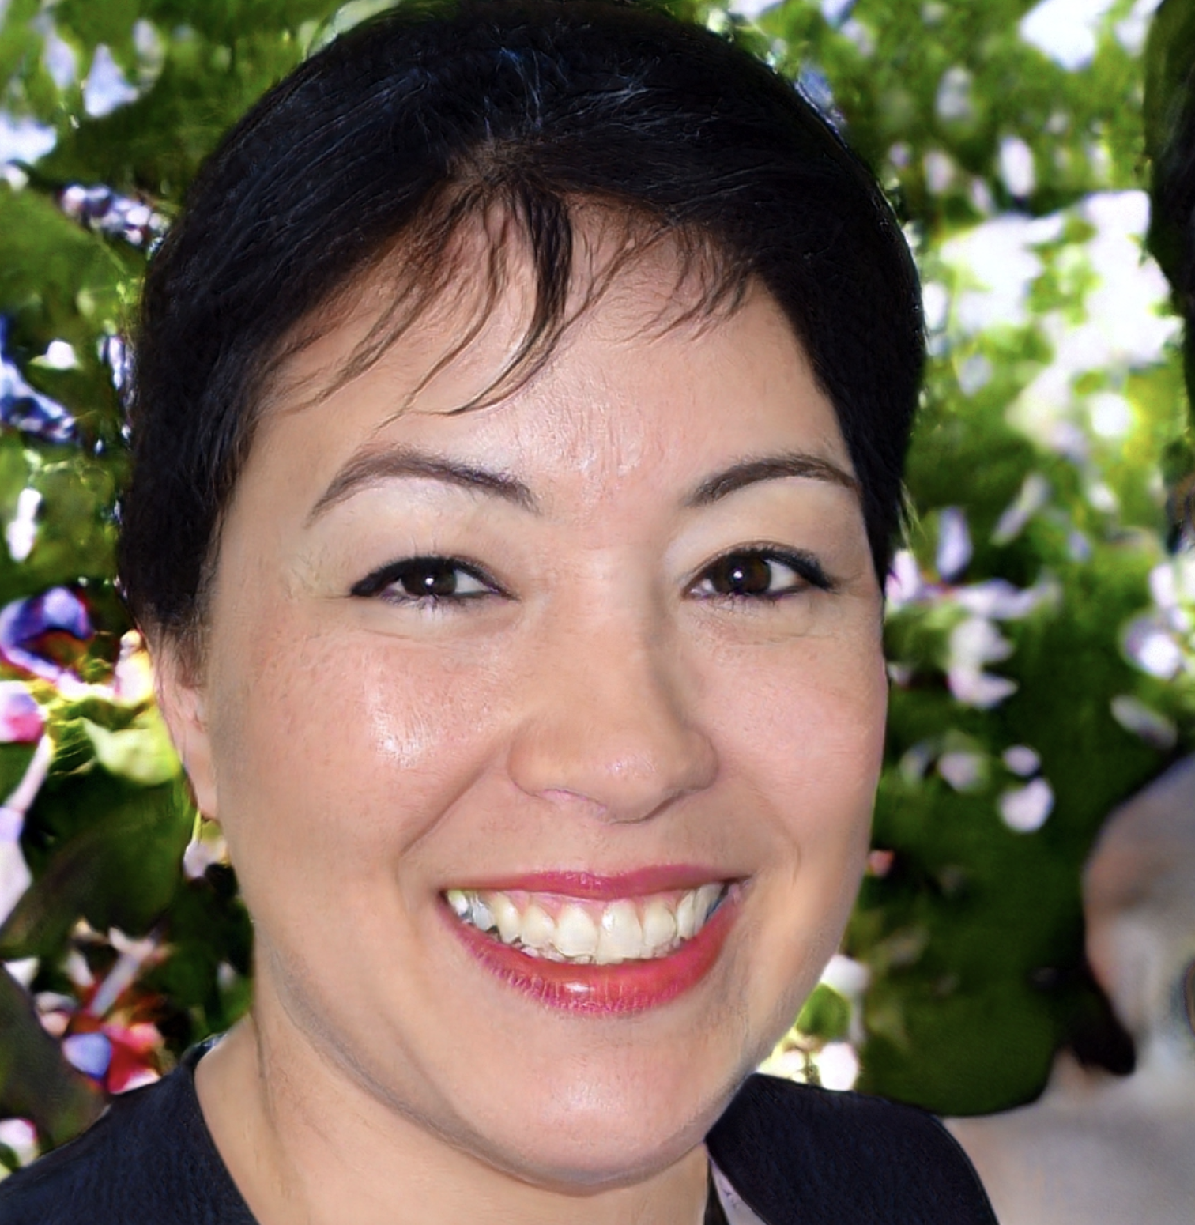
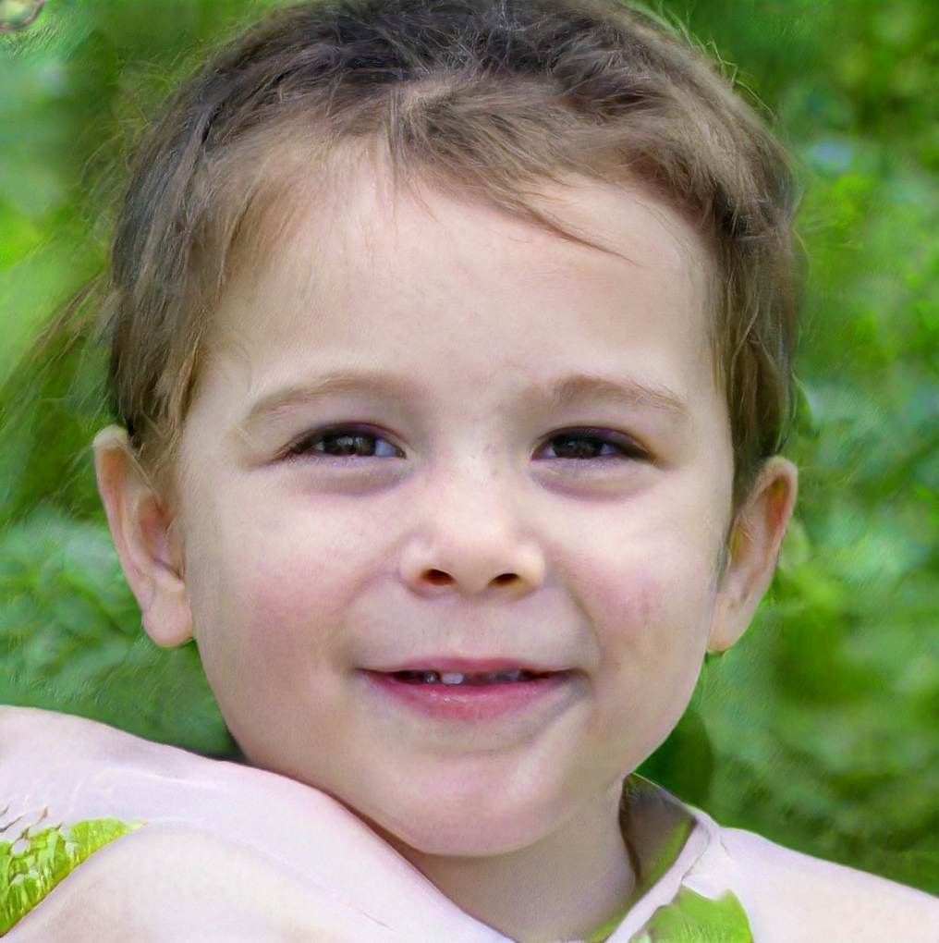
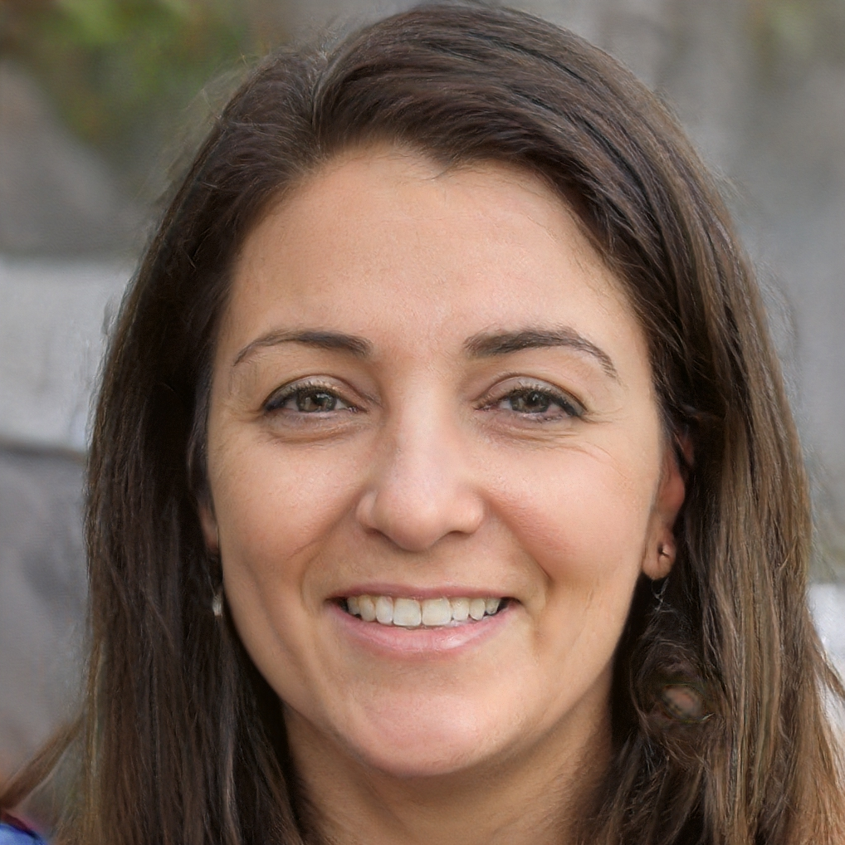
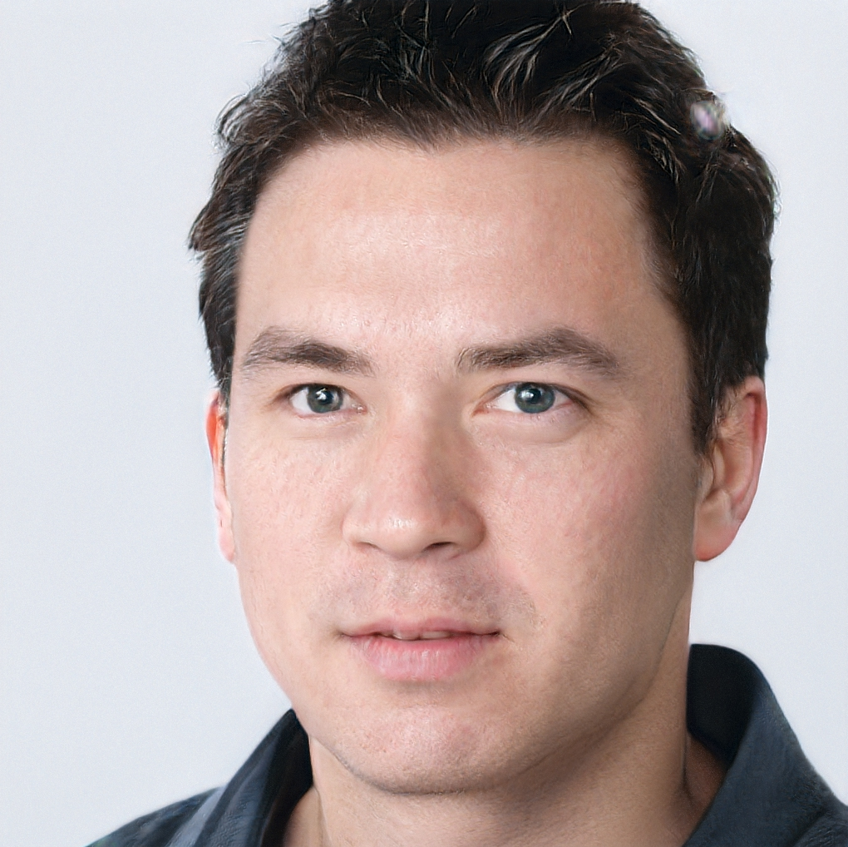
Applications
[https://thispersondoesnotexist.com]
Notes:
Computer Vision application
Matrices + one-hot encoding

Slide 4
One-Hot Encoding of Sequences
C | C | A | A | T | T | G | T | T | T | T | G
C | C | A | A | T | T | G | T | T | T | T | G
A
C
T
G
0 | 0 | 1 | 1 | 0 | 0 | 0 | 0 | 0 | 0 | 0 | 0
1 | 1 | 0 | 0 | 0 | 0 | 0 | 0 | 0 | 0 | 0 | 0
0 | 0 | 0 | 0 | 1 | 1 | 0 | 1 | 1 | 1 | 1 | 0
0 | 0 | 0 | 0 | 0 | 0 | 1 | 0 | 0 | 0 | 0 | 1

Slide 5
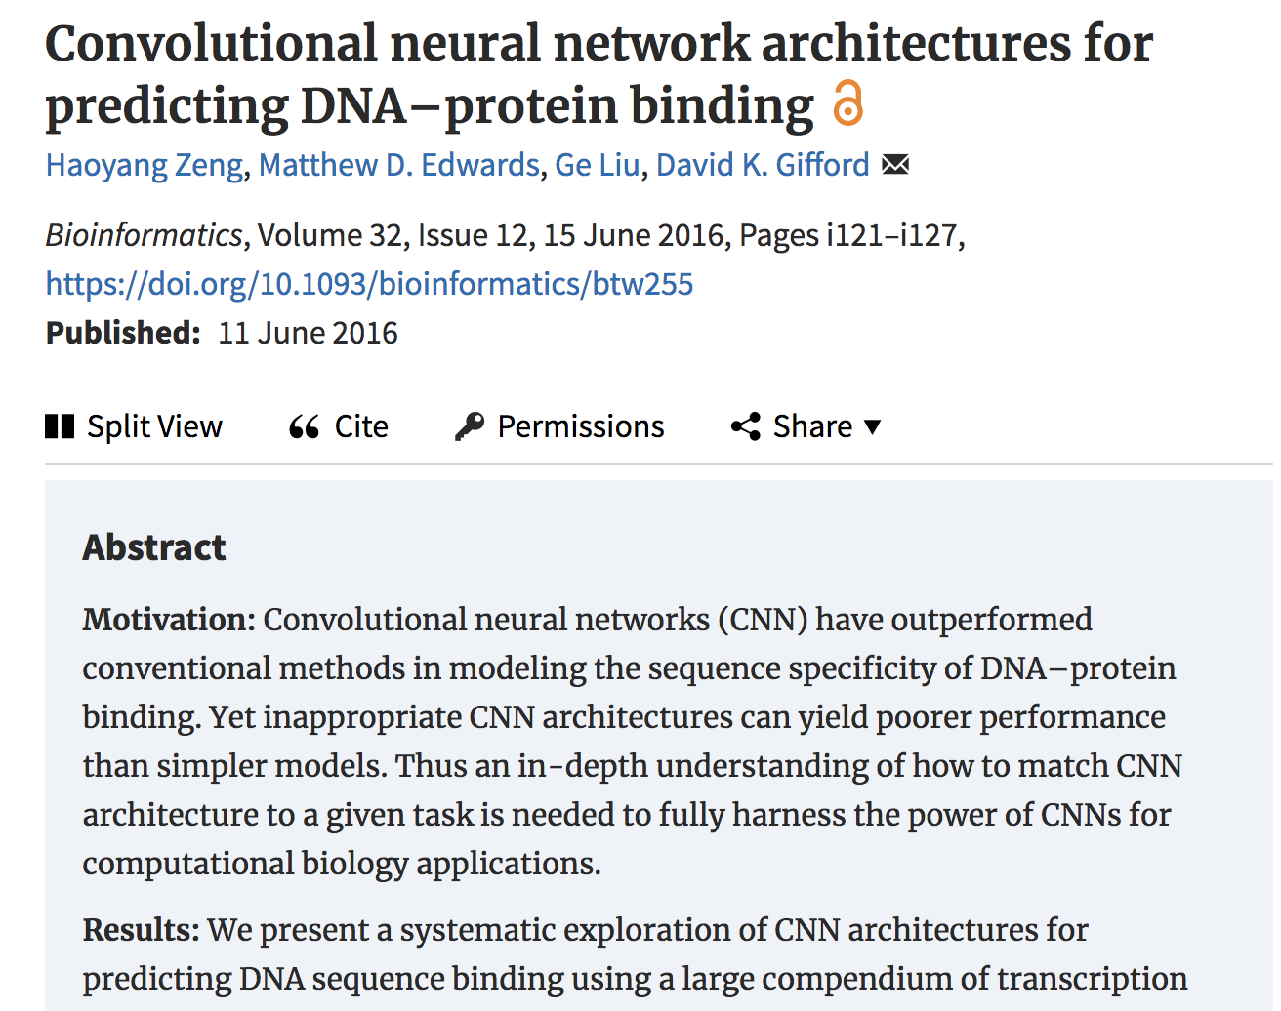
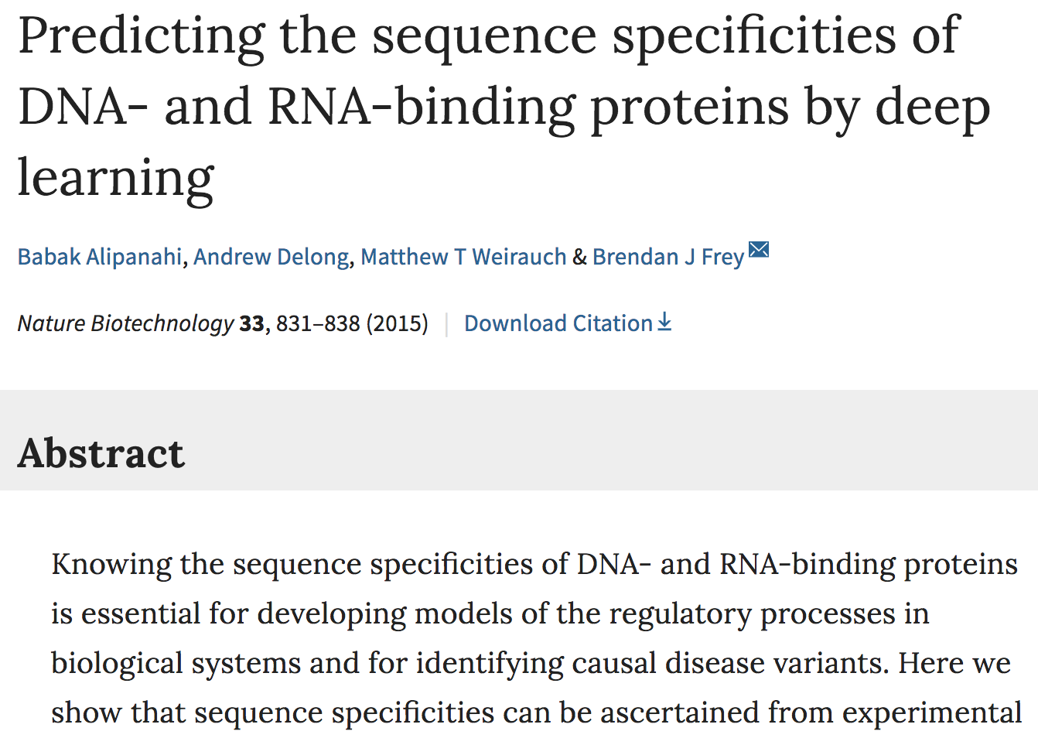
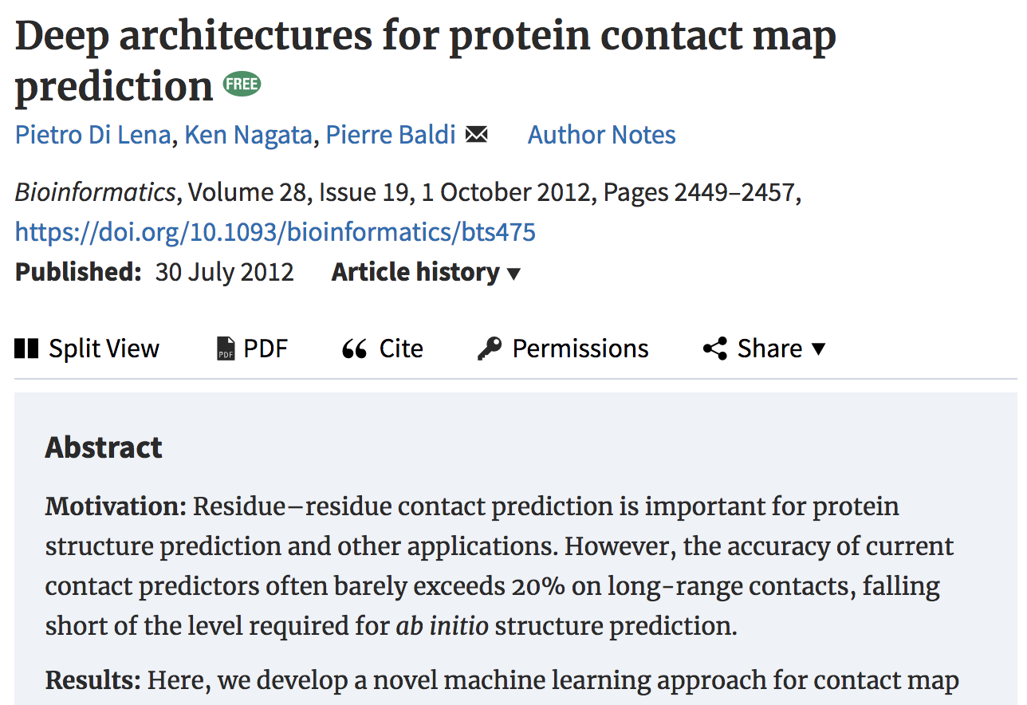
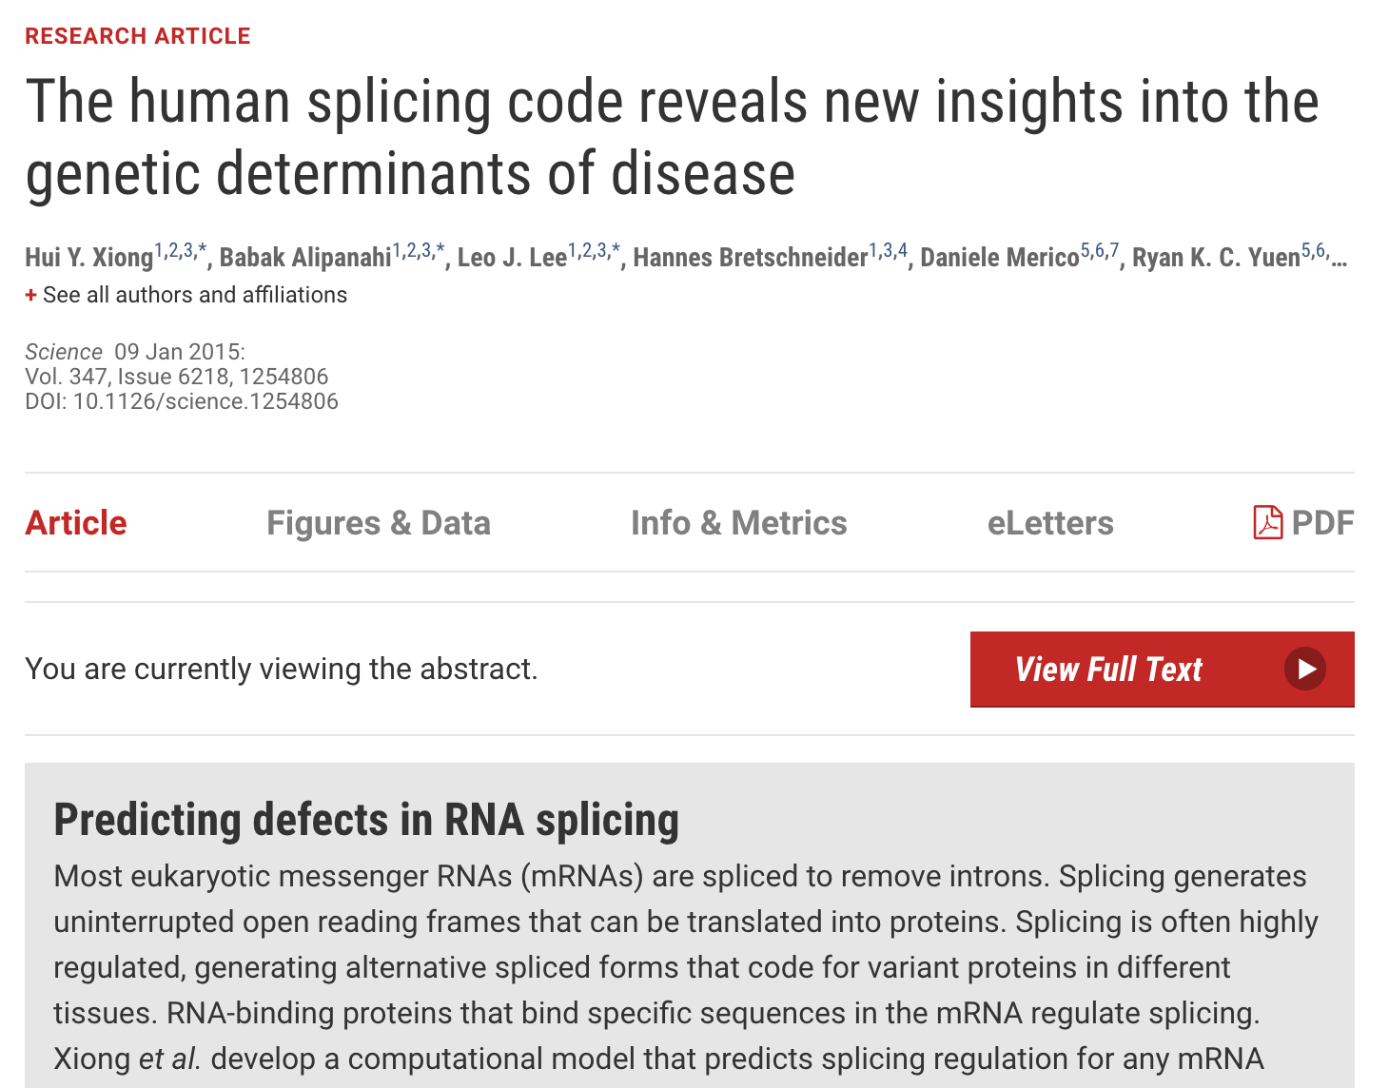
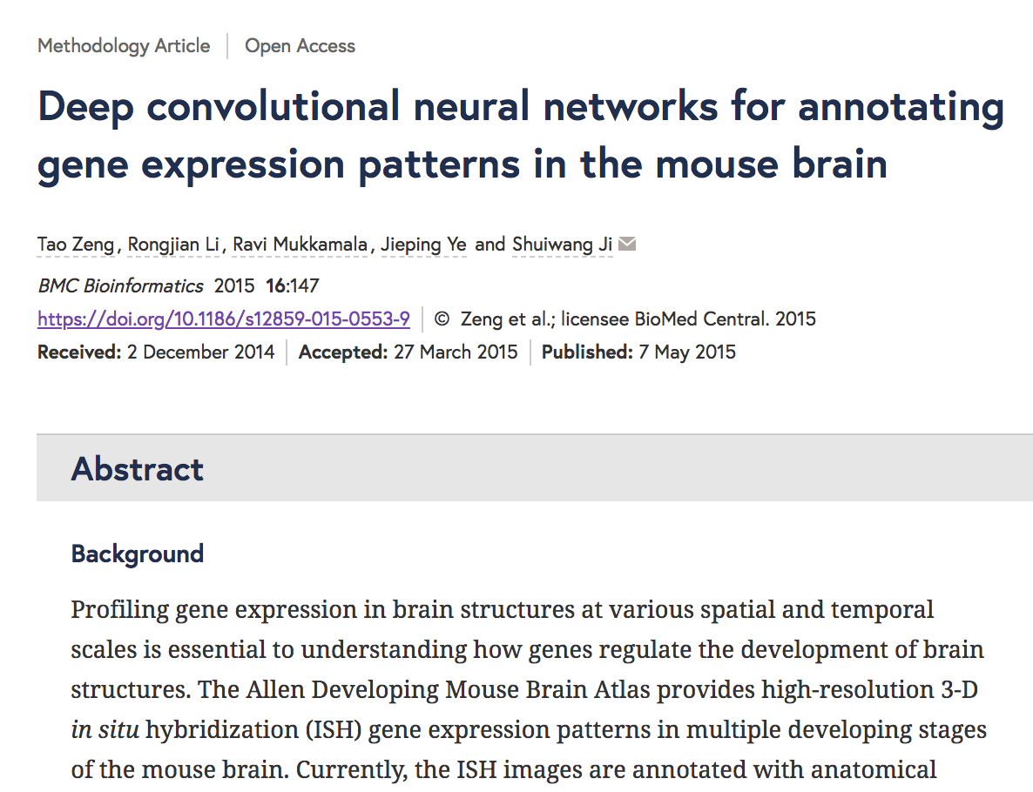
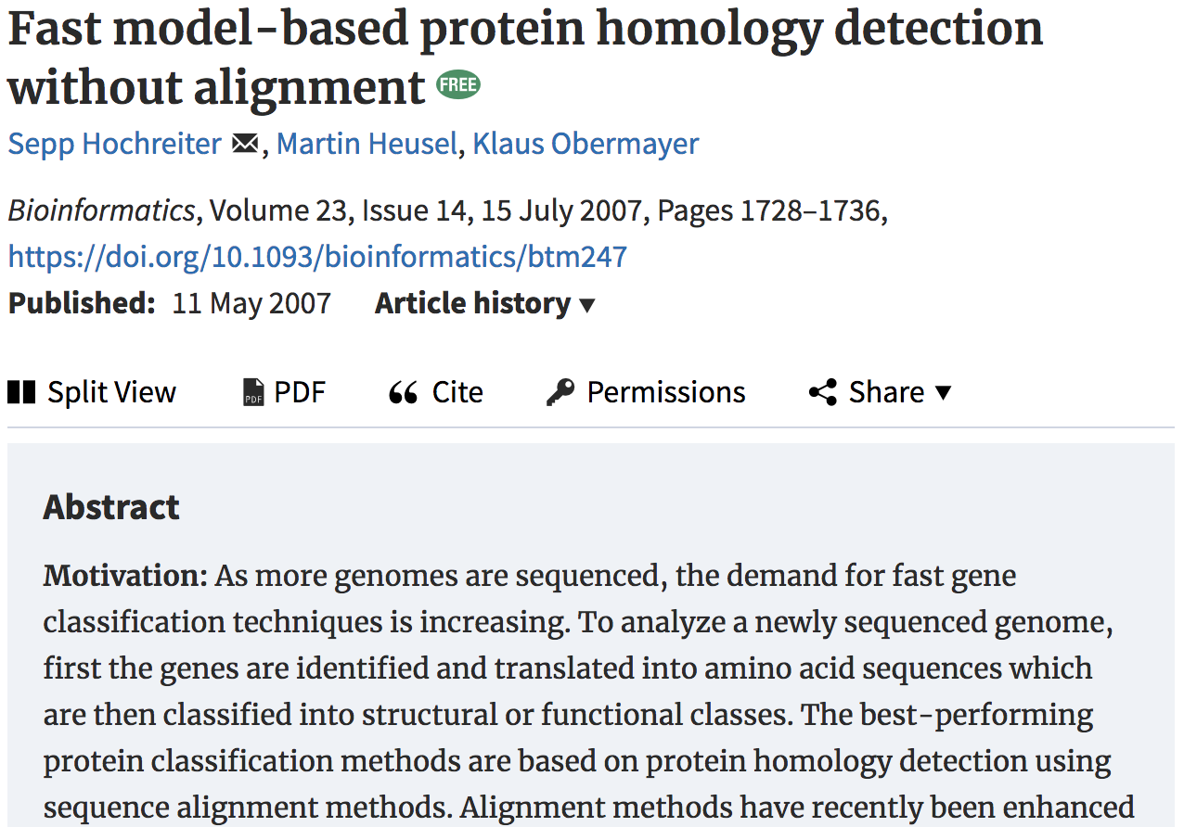
Applications
Biomedical Data Science
2007
2012
2015
2015
2015
2016
Notes:
Avalanche

Slide 6
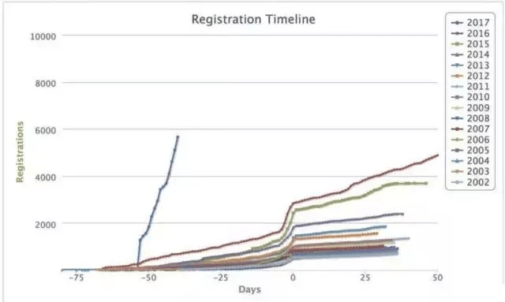
Applications
Biomedical Data Science
DeepBind, DeepFold, DeepSEA, DeepCNF, DeepVariant, DeepMotif, DeepLNC, DeepCpG, DeepCyTOF, DeepChrome, DeepWAS, DeepSplice, and other methods
NeurIPS Registration Timeline [2002-17] @lxbrun
Notes:
Chossing applications: different tasks, different data types, different trends

Slide 7
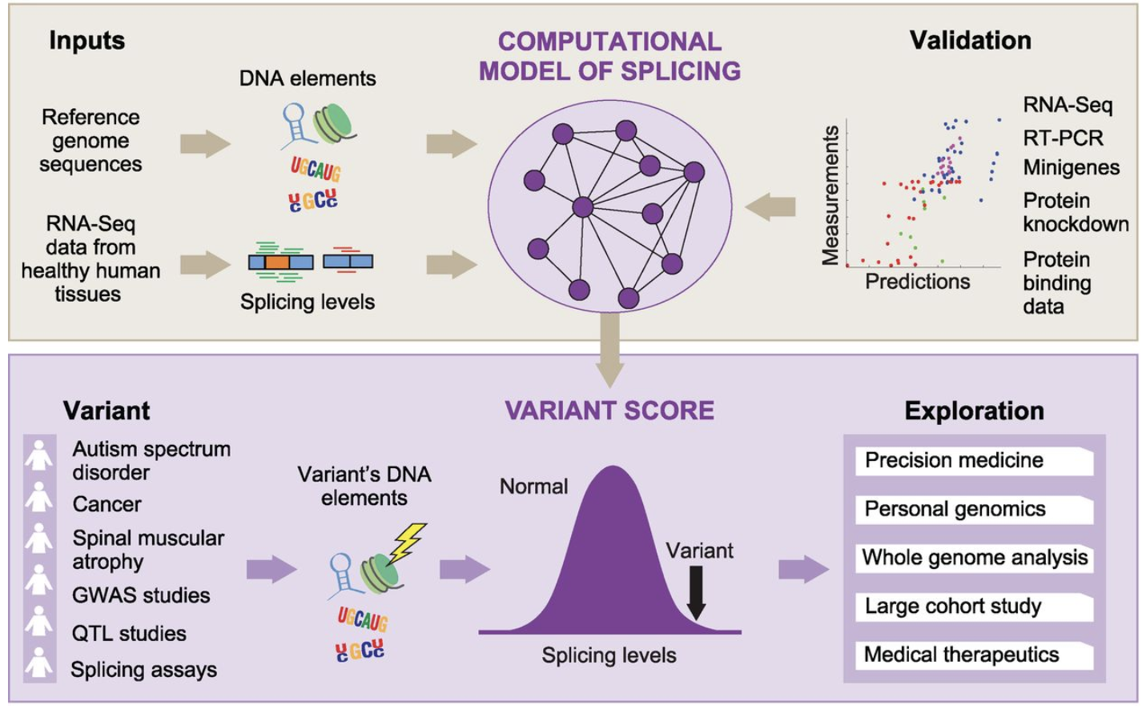
Applications
Biomedical Data Science
Prediction of RNA Splicing
1393 sequence features as input
Fully-connected neural networks
RNA-seq from Illumina Human Body Map 2.0 project
Assessment of >650,000 SNPs effect on splicing regulation from the NCBI database of genetic variation (dbSNP) and Human Gene Mutation Database (HGMD)
[2015]
Notes:
Notice how nnets are represented

Slide 8
Applications
Biomedical Data Science
Skin cancer classification
129,450 clinical images from public repositories and SUMC
757 training classes
Task 1: Lesions
CNN: >72% accuracy
Dermatologists: 65-66%
Task 2: Lesions
CNN: >55% accuracy
Dermatologists: 53-55%
[2017]
Notes:
Networks are becoming more complicated

Slide 9
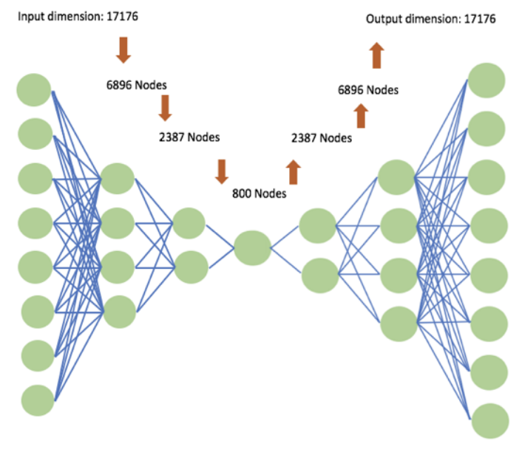
Applications
Biomedical Data Science
Denoising Autoencoder (AE) for genomic data imputation
| I | = | O |, bottleneck layer | B | << | I |, | O |
17,000+ genes, 269,000+ CpG sites
Pan-Cancer RNA-seq and DNA Methylation data from The Cancer Genome Atlas (TCGA)
[2018]
Notes:
Relates to SVD? Yes.

Slide 10
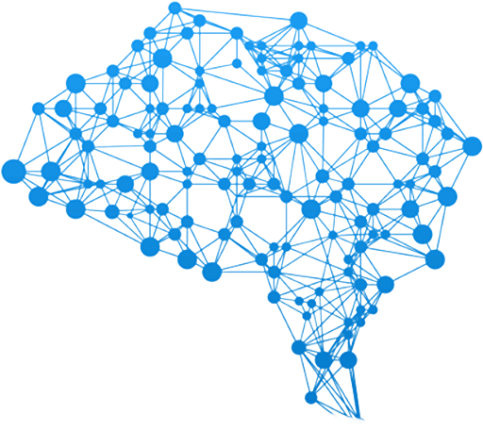
Challenges
Interpretability
Different from interpretability in Optimization
Weight matrix interpretation
Input feature prioritization
Biologically or clinically-driven
Earlier and later layers usually have more importance
Data availability
Hyperparamter Optimization
Set before training
Finding suboptimal combinations can be time consuming

Slide 11
Interpretability
DeepBind
Interpretability
Different from interpretability in Optimization
Weight matrix interpretation
Input feature prioritization
Biologically or clinically-driven
Earlier and later layers usually have more importance
What would happen if the number of convolution filters is quite high?
Known
motifs
DeepBind
motifs

Slide 12
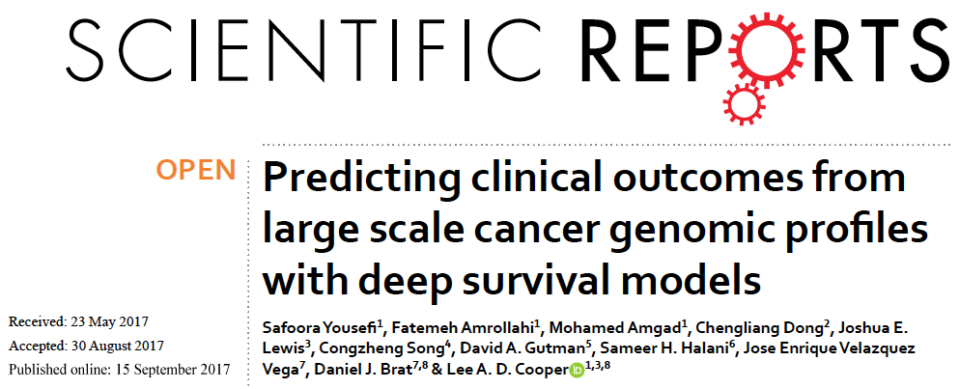
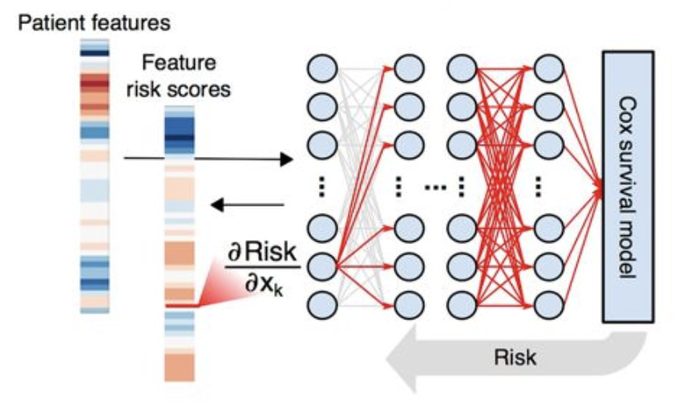
Interpretability
SurvivalNet
Interpretability
Different from interpretability in Optimization
Weight matrix interpretation
Input feature prioritization
Biologically or clinically-driven
Earlier and later layers usually have more importance
17,000-18,000 features dominated by gene expression and clinical variables
Why would features be prioritized? What would potential downstream analyses be?

Slide 13
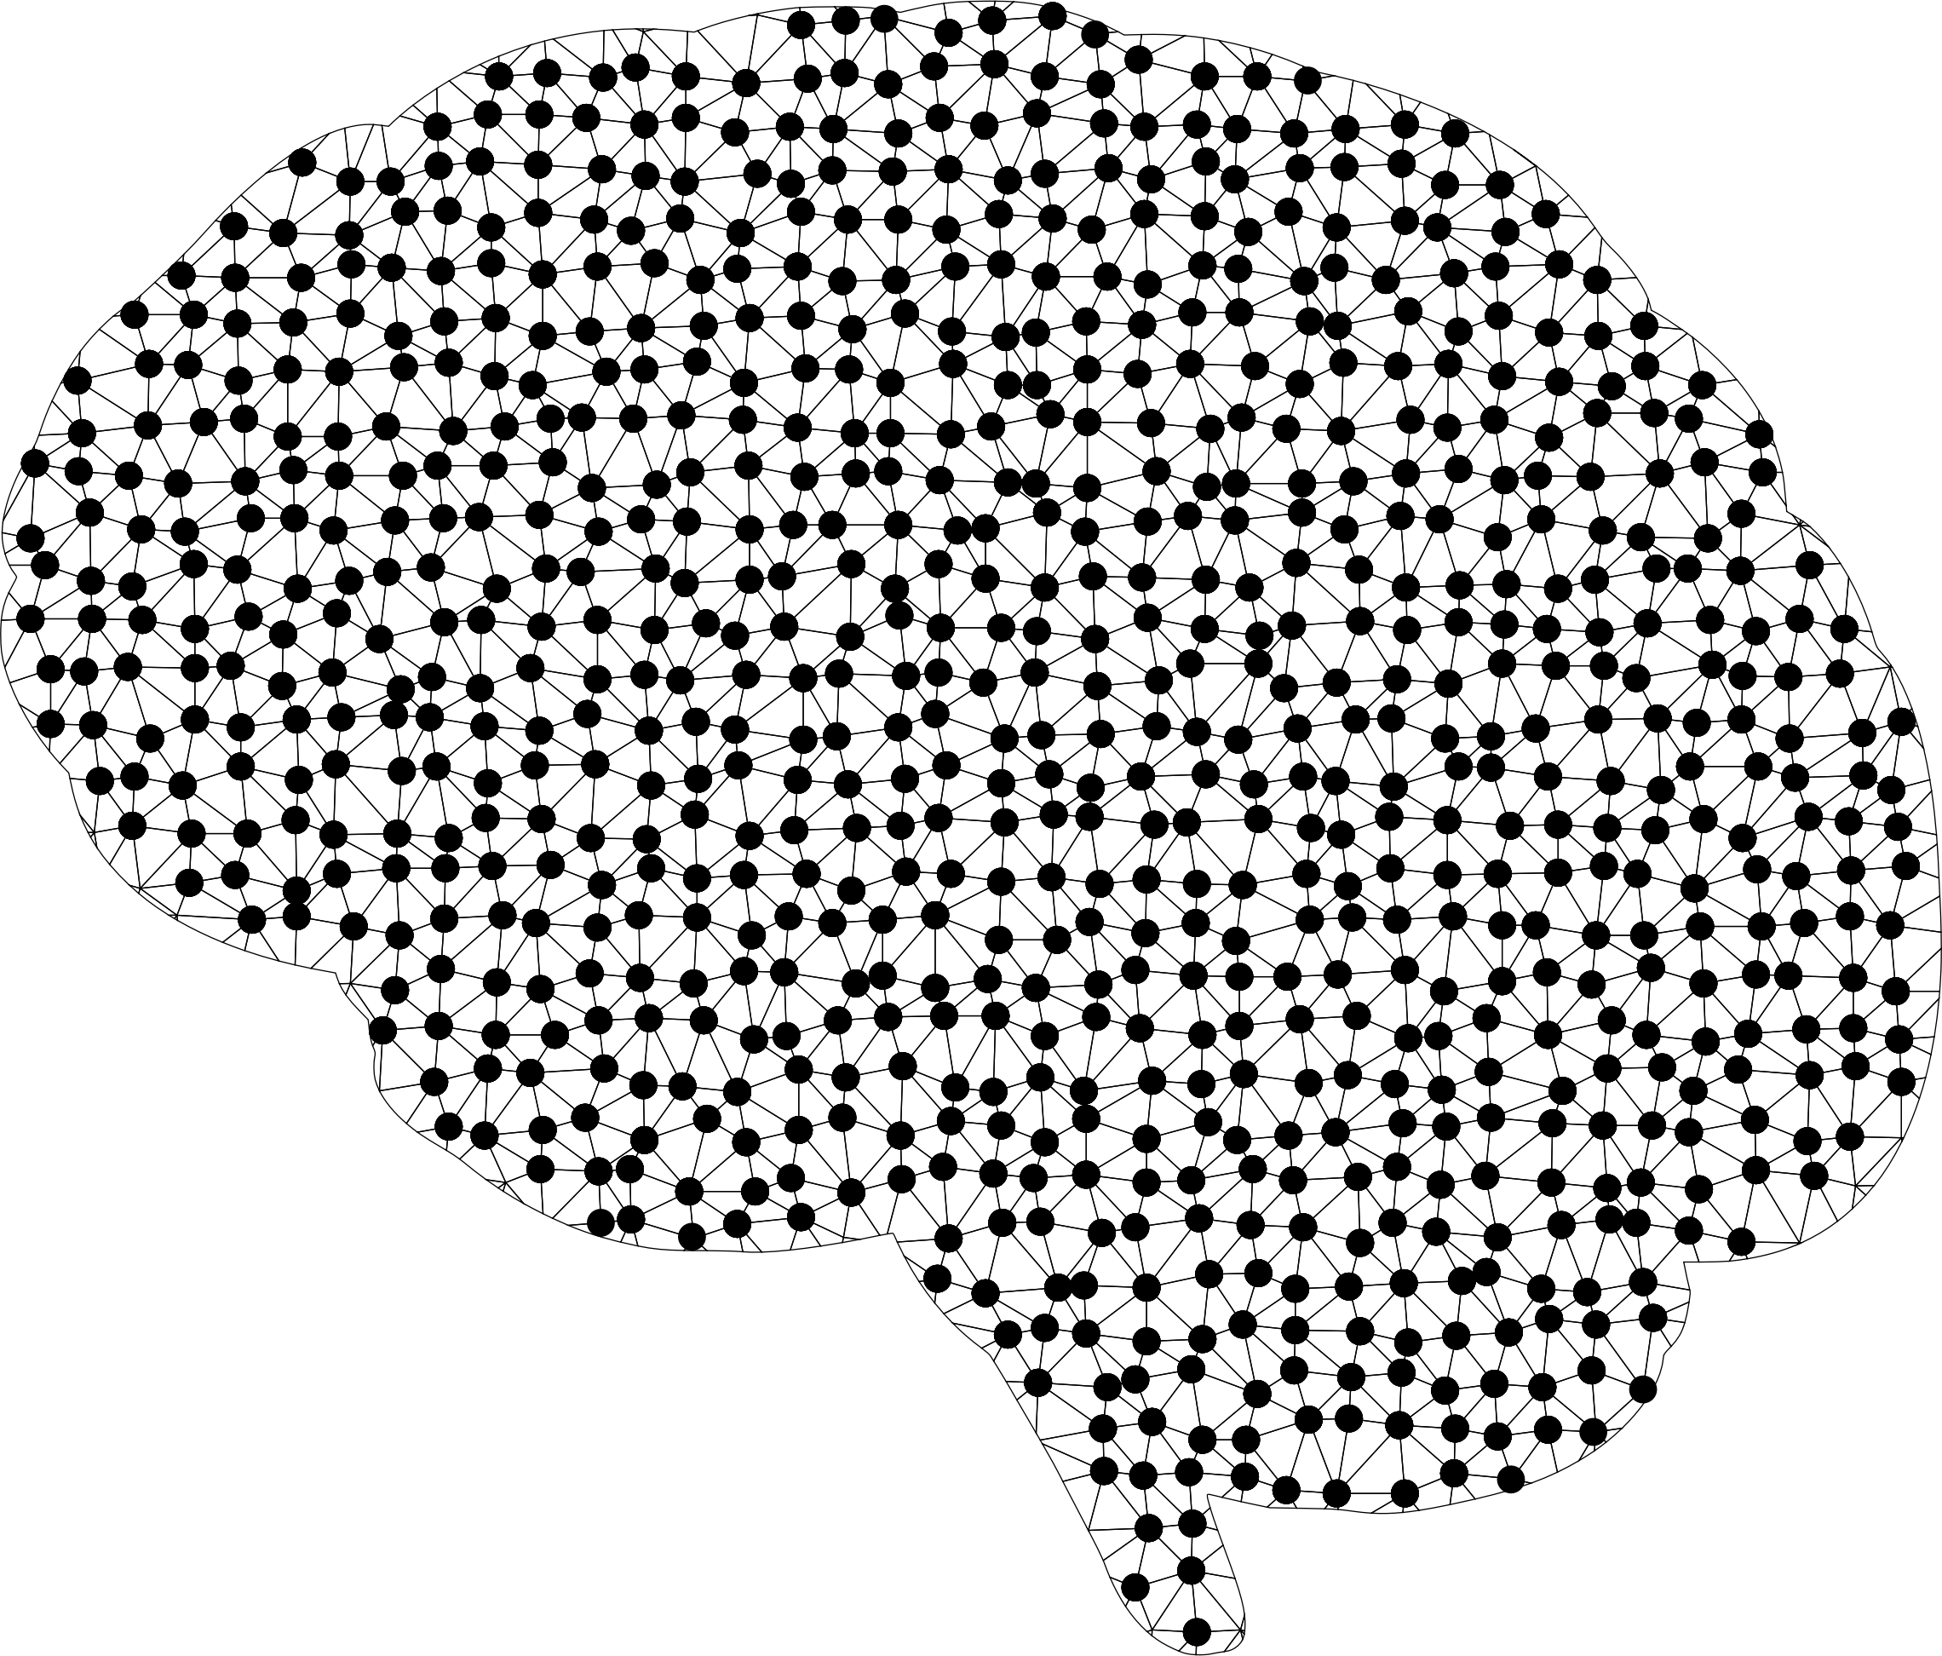
Notes
Advances in computing
Availability of large datasets
Ability to detect highly complex, non-linear patterns
Ability to predict many outputs at once
Transfer learning to transfer patterns learned by one model to another

Slide 14
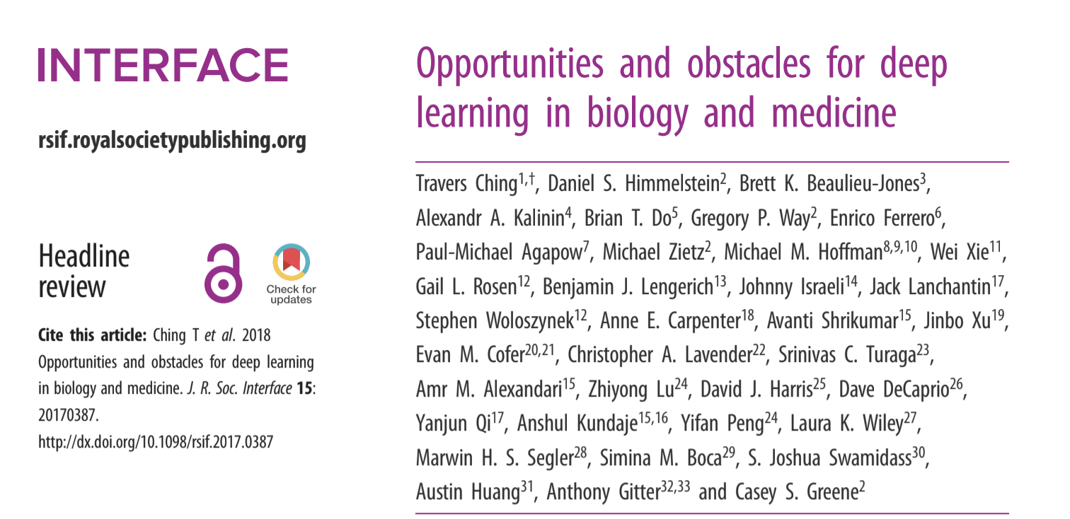
Resources

Slide 15
Resources
Neural Networks and Deep Learning by Michael Neilson [http://neuralnetworksanddeeplearning.com/]
Deep Learning by Ian Goodfellow and Yoshua Bengio and Aaron Courville
[http://www.deeplearningbook.org/]
DeepLearning.ai on Coursera
[https://www.coursera.org/deeplearning-ai]

Slide 16
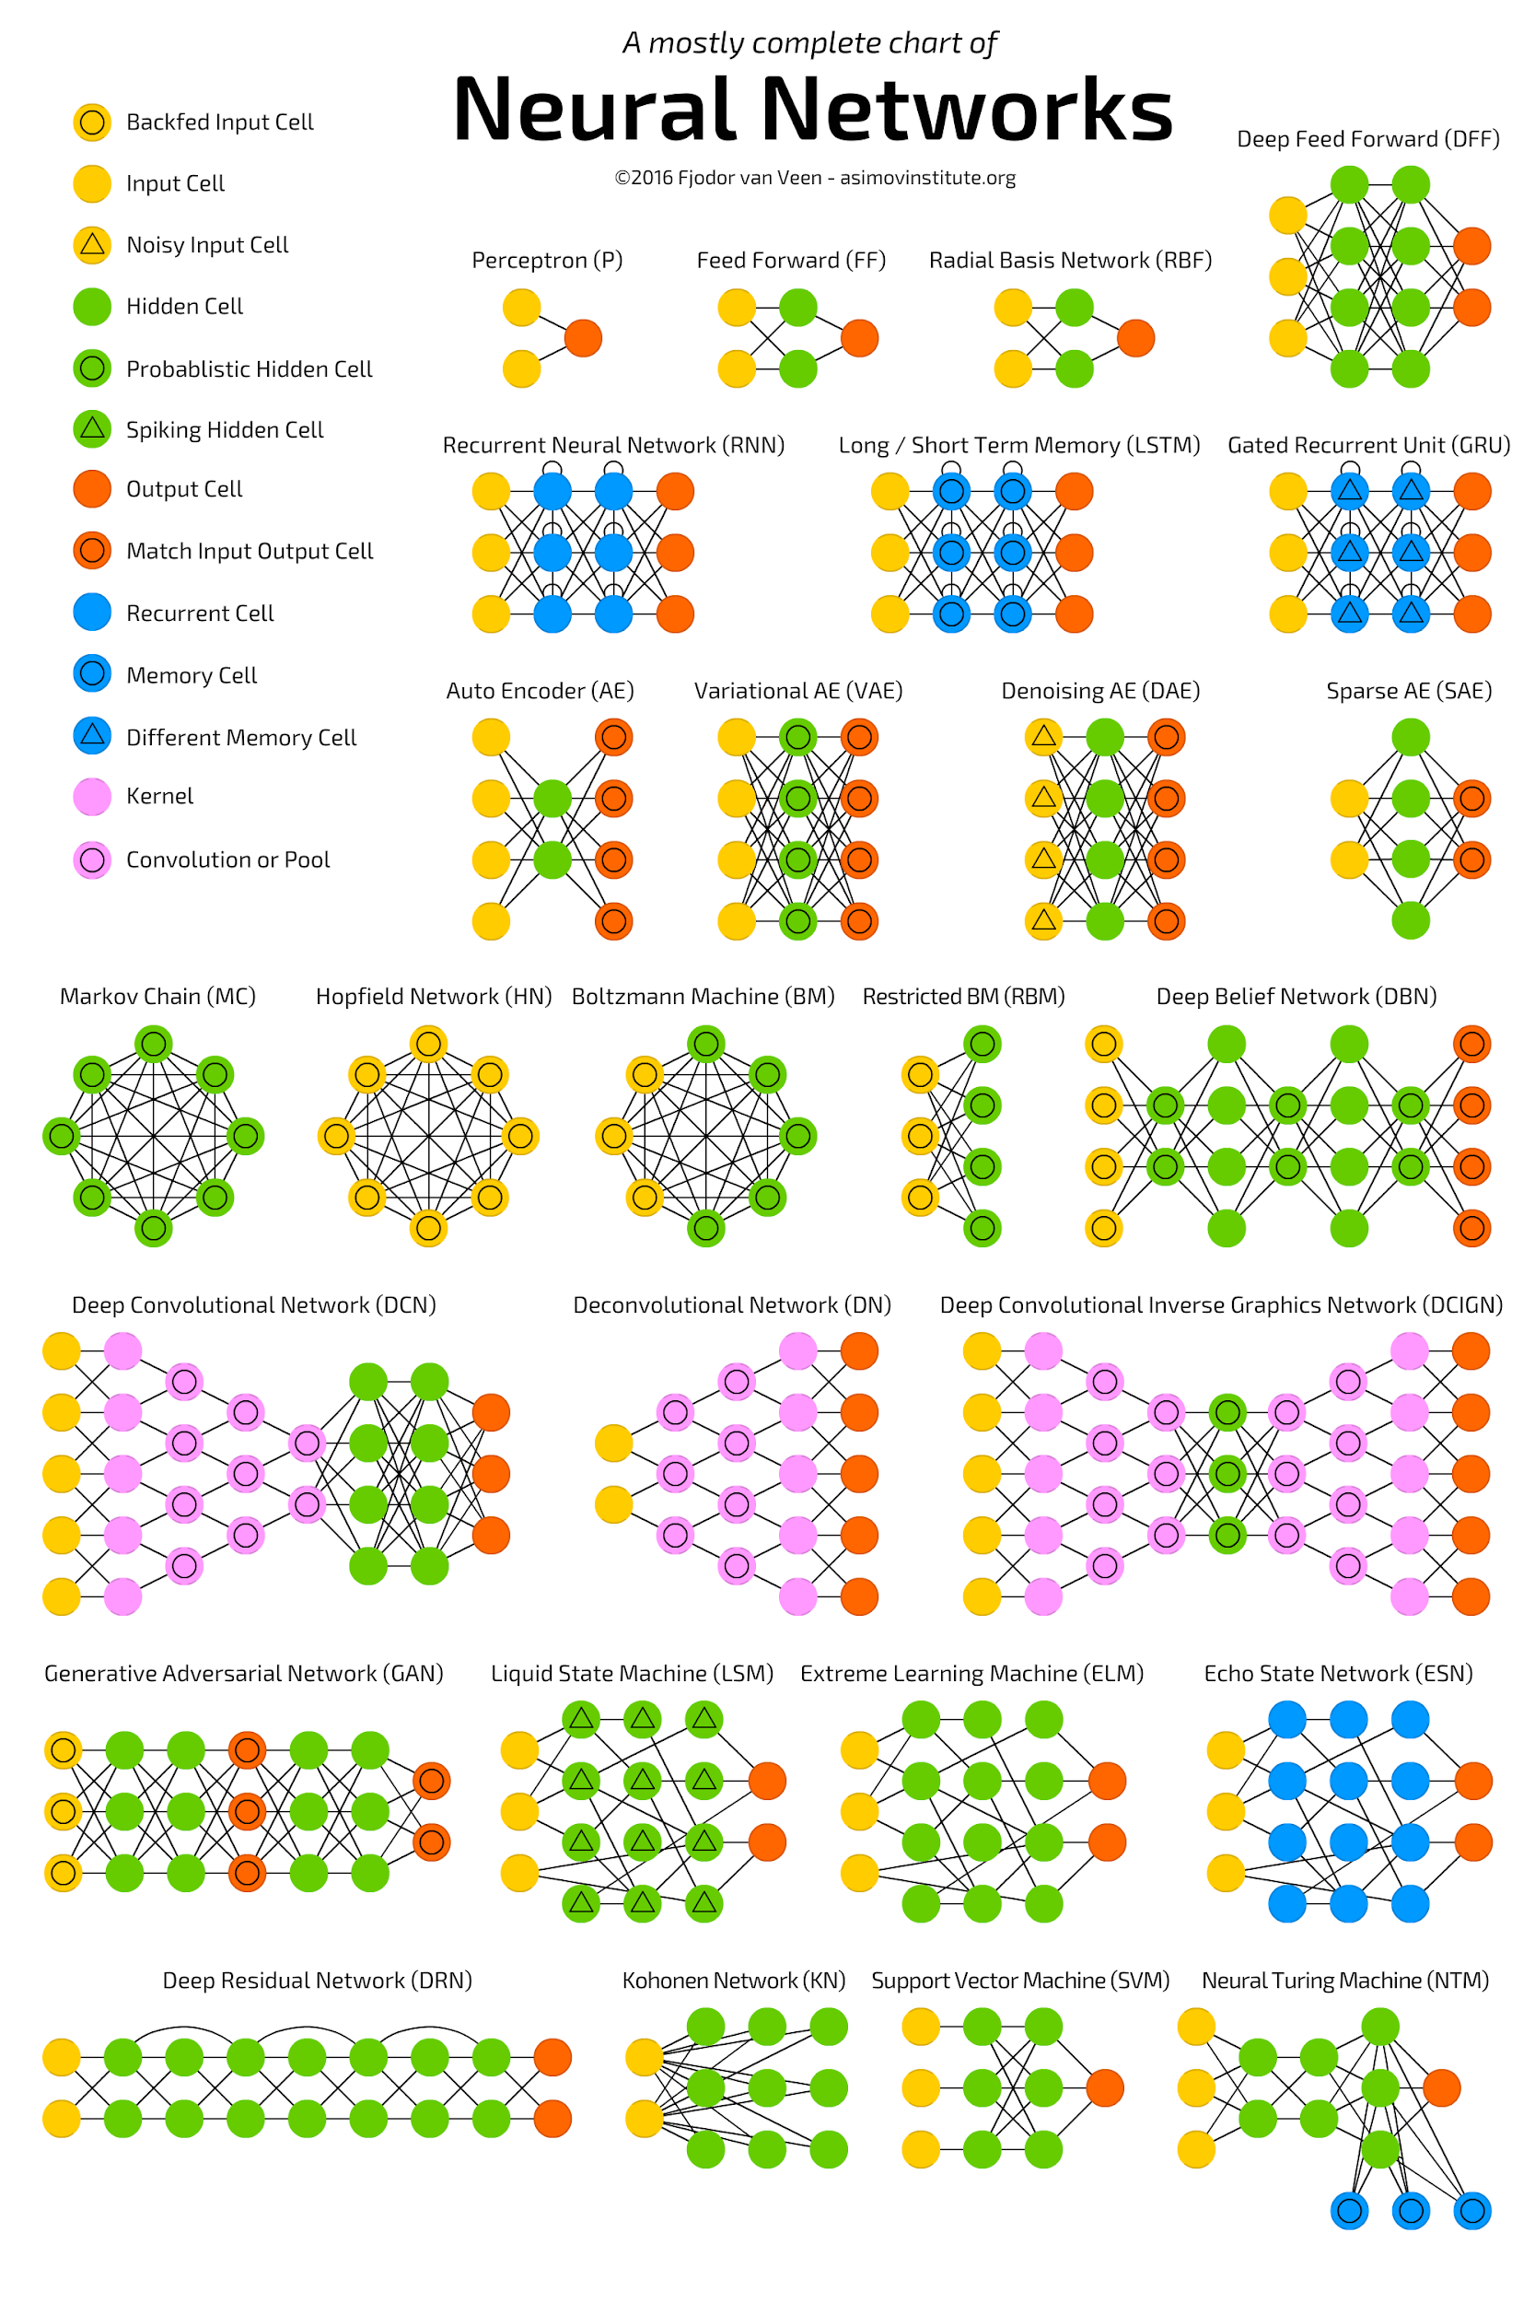
Resources

