Slide 1
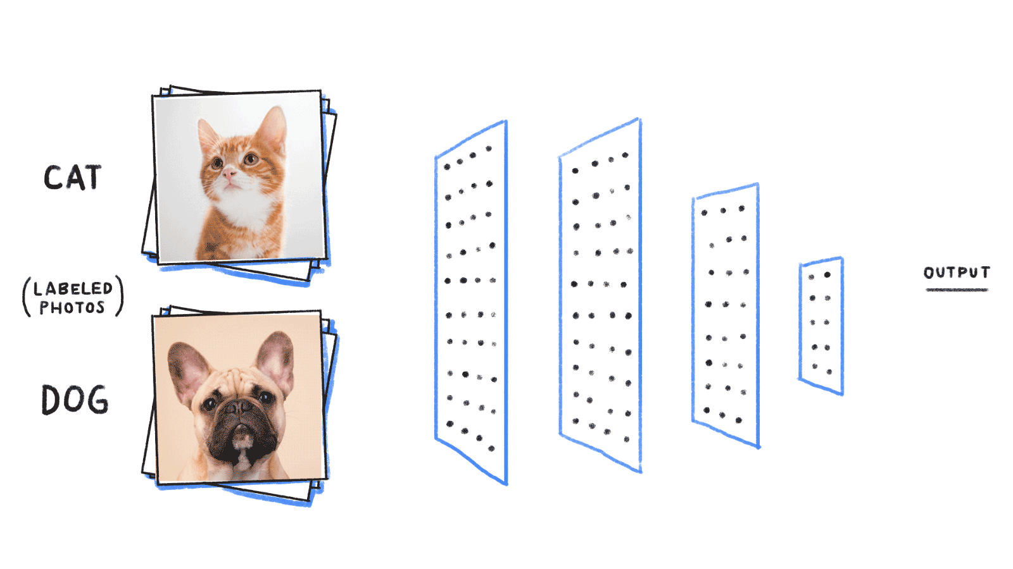
Artificial Neural Network & Deep Learning
Donghoon Lee
CBB 752 Spring 2019
Photo credit: bit.ly/2ScVugE

Slide 2

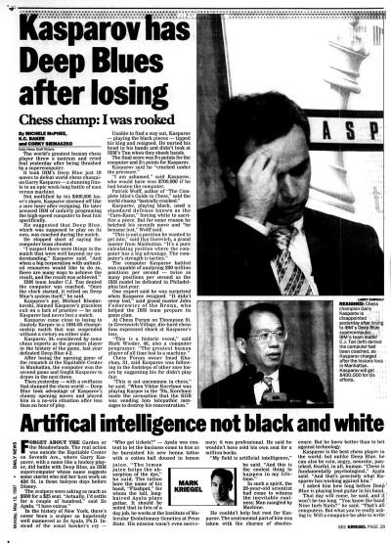
In 1997, Deep Blue, IBM's supercomputer, defeats chess world champion Garry Kasparov
Notes:
It took IBM's Deep Blue just 19 moves to defeat world chess champion
Kasparov accused IBM of cheating and demanded a rematch. IBM refused and retired Deep Blue.

Slide 3
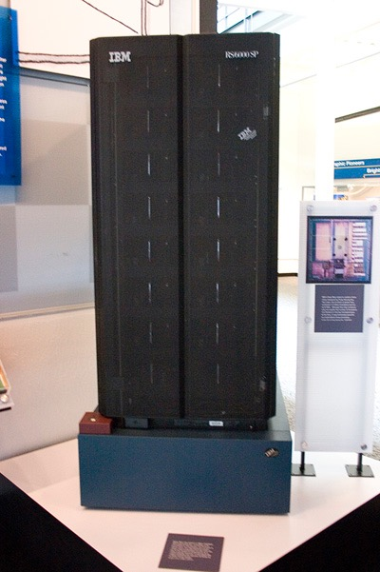
Mainly from brute force computing power
It was capable of evaluating 200 million positions per second
Search to a depth of between six and eight moves to a maximum of twenty or even more moves in some situations
Notes:
A.I. behind Deep Blue
rely on thousands of rules and heuristics handcrafted by strong human players that try to account for every eventuality in a game.

Slide 4
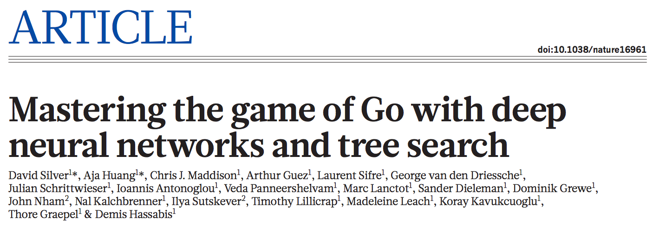
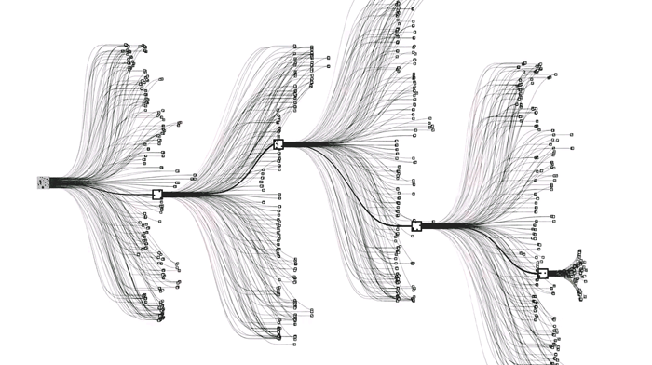
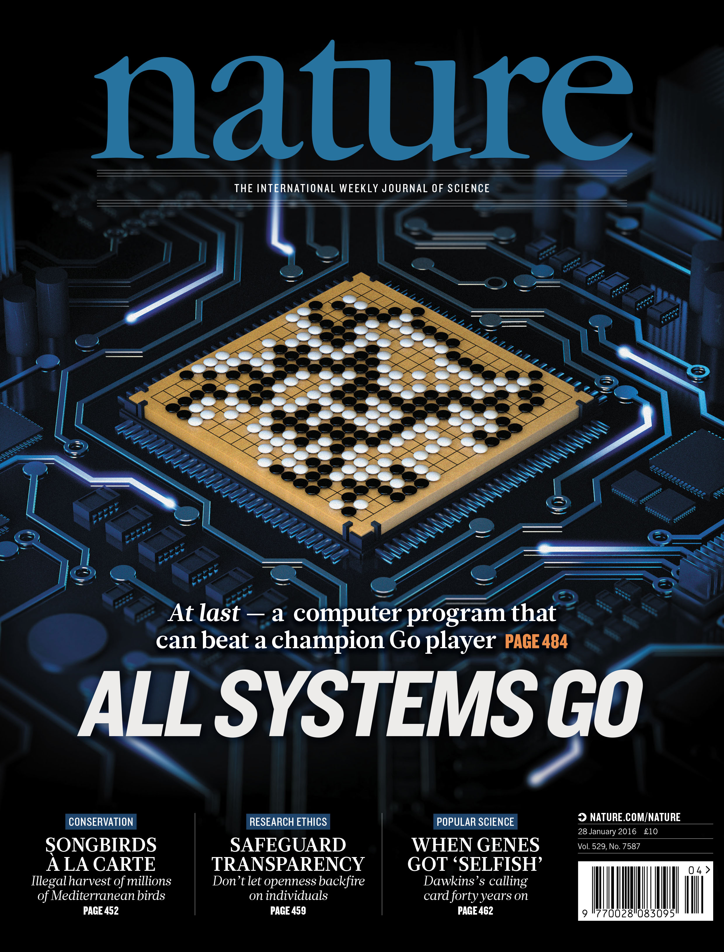
January 2016
Chess ~35 moves per turn, Go ~250
Notes:
Google DeepMind
training two deep neural networks to work in tandem
the number of possible games is vast (10^761 compared, for example, to the estimated 10^120 possible in chess)

Slide 5
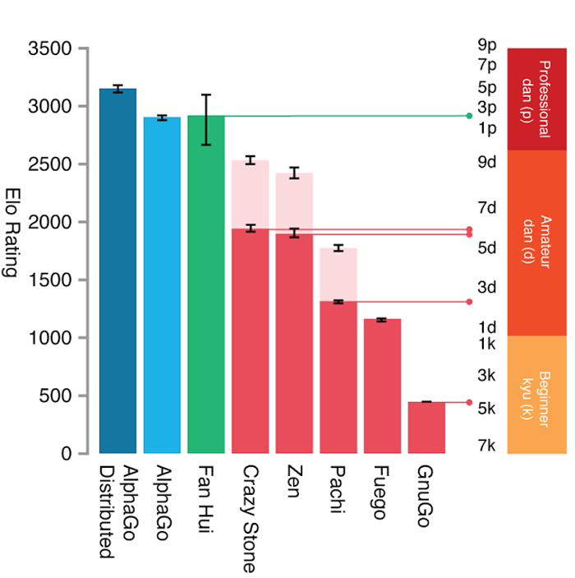
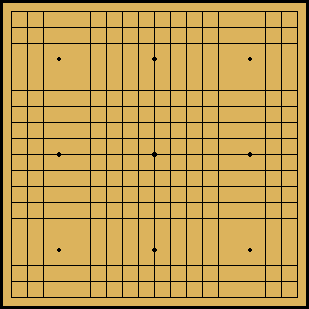
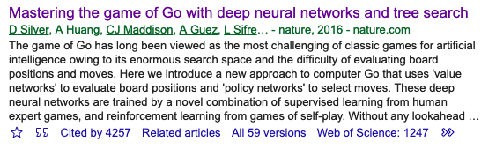

AlphaGo defeated the world champion, Lee Sedol (9p), in a match took place in Seoul, Korea, March 2016
Notes:
AlphaGo’s displays of game-winning creativity, in some cases finding moves that challenged millennia of Go wisdom.
AlphaGo takes a totally different approach, replacing these hand-crafted rules with a deep neural network and general purpose algorithms that know nothing about the game beyond the basic rules.

Slide 6
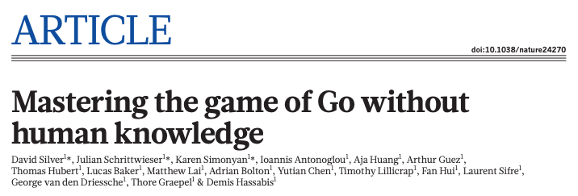
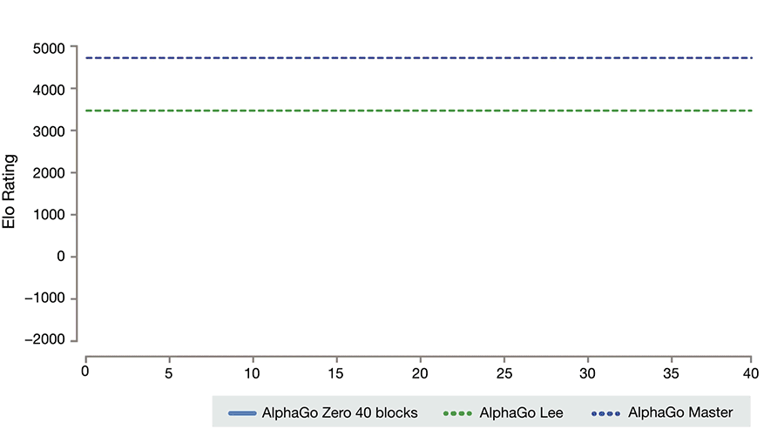
October 2017
Notes:
the earlier versions of AlphaGo which trained on thousands of human amateur and professional games to learn how to play the game
Reinforcement learning:
AlphaGo Zero bypasses this process and learns to play the game of Go without human data, simply by playing games against itself.

Slide 7
Any gamer in the audience?
Think playing with bots are boring?

Slide 8
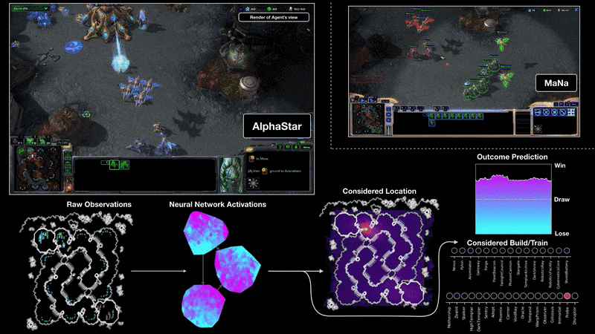
December 2018

Slide 9
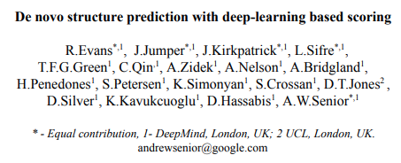
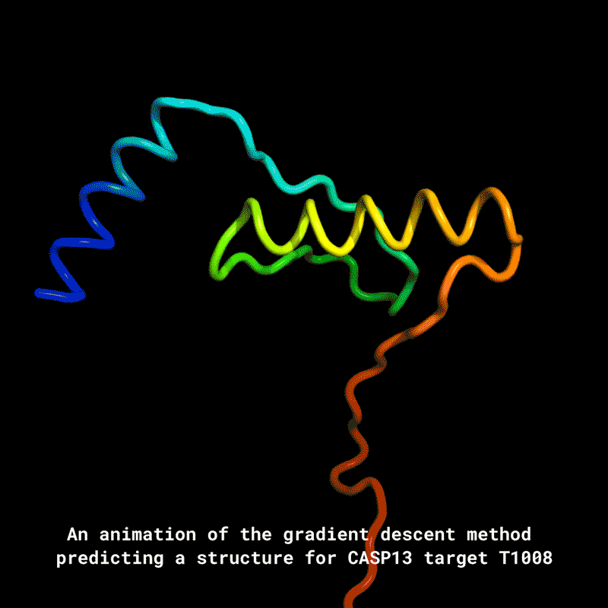
December 2018
Global competition for protein structure prediction:
Critical Assessment of Protein Structure Prediction (CASP) 1st place in 2018
Notes:
figuring out the 3D shape of a protein purely from its genetic sequence is a complex task that scientists have found challenging for decades
CASP taking place every two years since 1994
Targets for structure prediction are either structures soon-to-be solved by X-ray crystallography or NMR spectroscopy

Slide 10
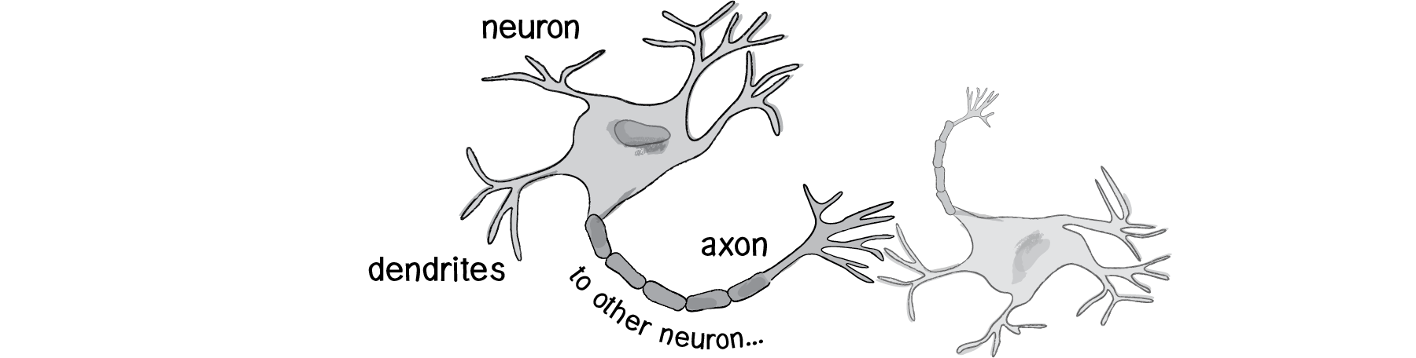
Neural Networks
Signal input
New signal output
Artificial Neural Network is loosely connected to biological neural networks
A simple artificial node known as “neuron” (or “unit”) has
  Inputs
  Outputs
  Adaptive weights
  Activation
10
Daniel Shiffman - The Nature of Code
Notes:
loosely based on interpretation of information processing and communication patterns in a nervous system

Slide 11
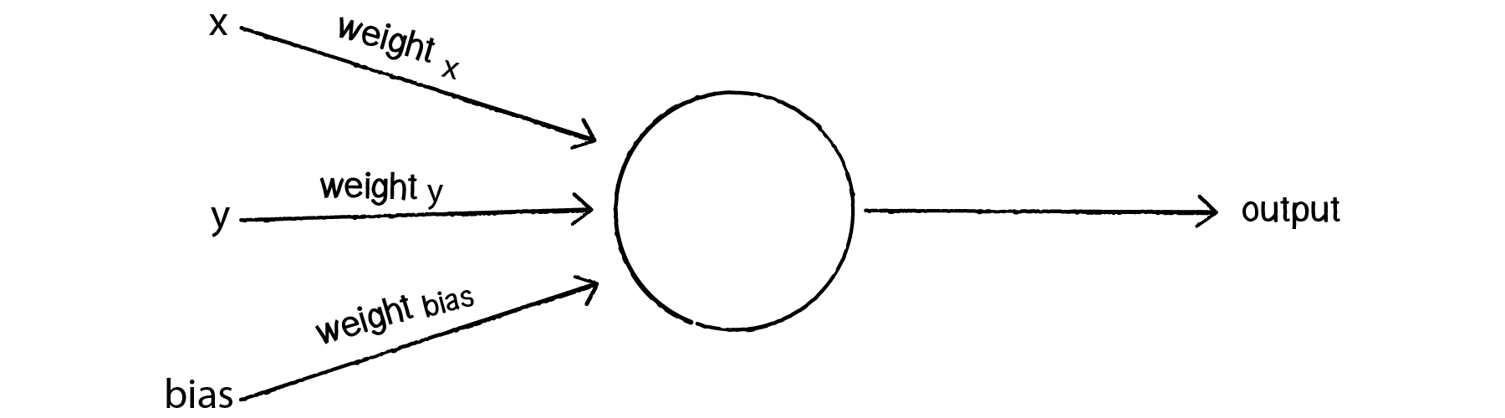
Perceptron
A perceptron is the simplest neural network possible: a computational model of a single neuron
Works as a linear classifier with n-1 dimension hyperplane
It computes the elementary logical functions we usually think of as underlying computation, functions such as AND, OR, and NAND
11

Slide 12
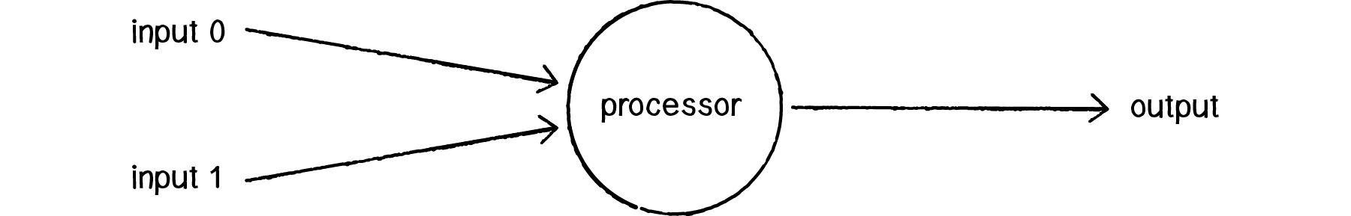
Example
Multiply each input by its weight.
Sum all of the weighted inputs.
Compute the output of the perceptron based on that sum passed through an activation function (e.g., the sign of the sum).
12

Slide 13
Example
e.g., input 0 = 12
weight 0 = 0.5
output = +1
weight 1 = -1
e.g., input 1= 4
sum = 2
Input 0 * Weight 0 ⇒ 12 * 0.5 = 6
Input 1 * Weight 1 ⇒ 4 * -1 = -4
Sum = 6 + -4 = 2
Activation function: the sign of the sum: sign(2) = +1
13

Slide 14


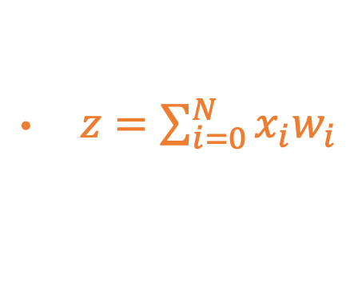

Example
x₀
w₀
y = σ(z)
w₁
x₁
Σ
$x=[x_{0},x_{1}]$
$w=[w_{0},w_{1}]$
$z=\sum_{i=0}^{N}{x_{i}w_{i}}$
$y=sign(z)$
14

Slide 15
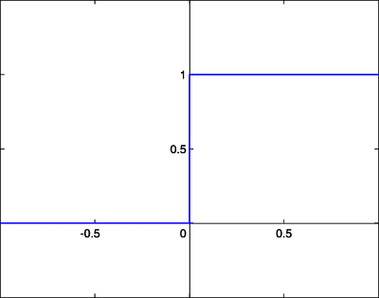
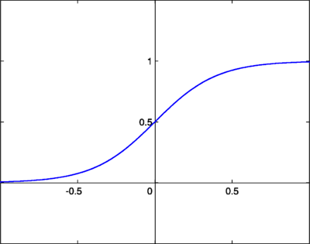

Activation Function
step function
sigmoid function
In biologically inspired neural networks, the activation function is usually an abstraction representing the rate of action potential firing in the cell.
In its simplest form, this function is binary; that is, either the neuron is firing or not.
Alternatively, activation functions can have a form of sigmoid function (a region of uncertainty)
https://en.wikipedia.org/wiki/Activation_function

Slide 16
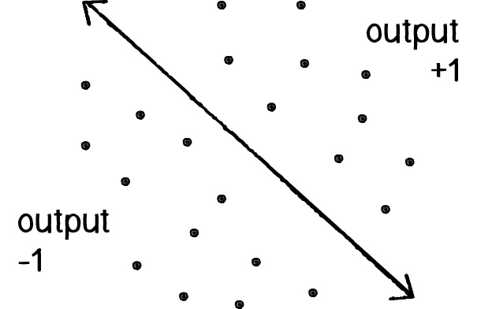

Bias
Suppose, input 0 as x and input 1 as y: a point in x, y axis (0,0)
0 * weight for x = 0
0 * weight for y = 0
1 * weight for bias = weight for bias
Think of “intercept” in linear model

Slide 17
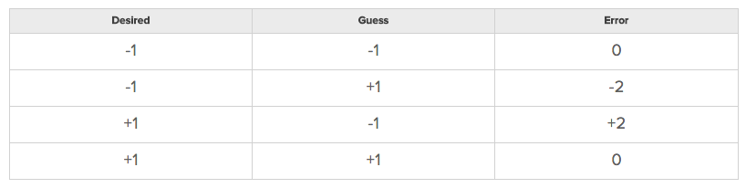
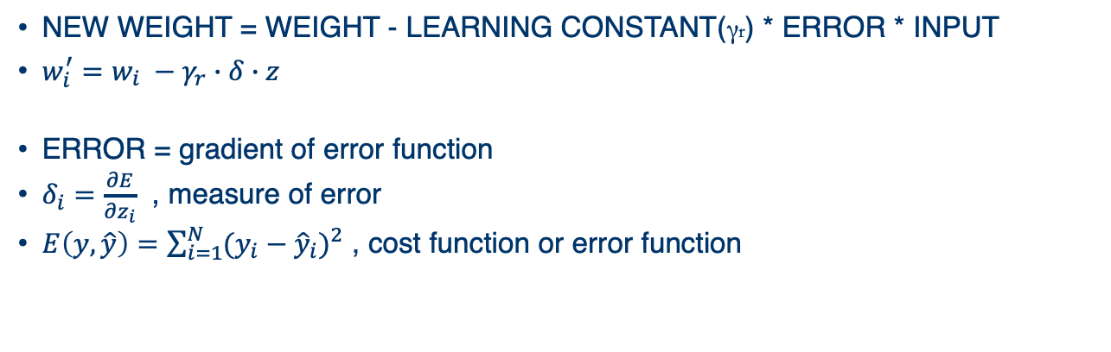
Supervised learning
NEW WEIGHT = WEIGHT - LEARNING CONSTANT(γr) * ERROR * INPUT
$w_{i}^{′}=w_{i} −γ_{r}∙δ∙z$
ERROR = gradient of error function
$δ_{i}=\frac{∂E}{∂z_{i}}$ , measure of error
$E\left(y,\hat{y}\right)=\sum_{i=1}^{N}{{(y_{i}−{\hat{y}}_{i})}^{2}}$ , cost function or error function

Slide 18
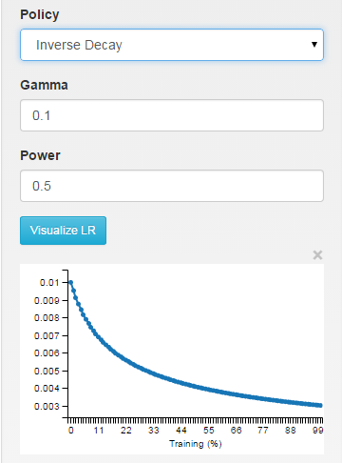
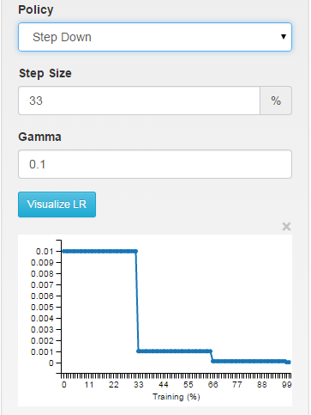
Learning rate (γr)
It is a common practice to decrease the learning rate (γr) as the optimization/learning process progresses

Slide 19
NAND Gate Example
 | 0 | 1
0 | 1 | 1
1 | 1 | -1
weight 0 = -2
weight 1 = -2
bias = 3
input (0,0) ⇒ (-2) * 0 + (-2) * 0 + 3 = 3 ⇒ sign(3) = 1
input (0,1) ⇒ (-2) * 0 + (-2) * 1 + 3 = 1 ⇒ sign(1) = 1
input (1,0) ⇒ (-2) * 1 + (-2) * 0 + 3 = 1 ⇒ sign(1) = 1
input (1,1) ⇒ (-2) * 1 + (-2) * 1 + 3 = -1 ⇒ sign(-1) = -1
Michael Nielsen - Neural Networks and Deep Learning
Notes:
http://neuralnetworksanddeeplearning.com/chap1.html

Slide 20
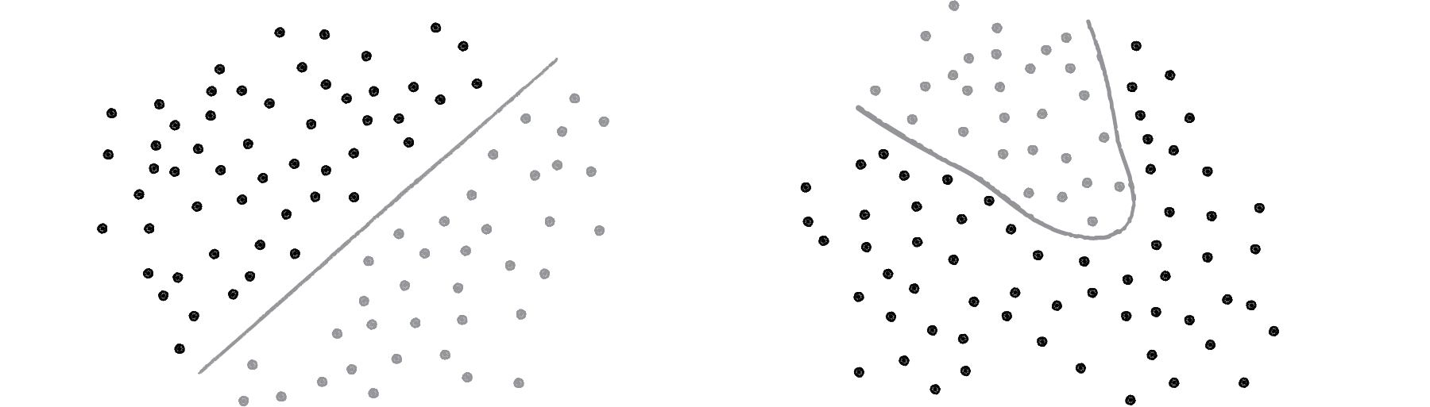
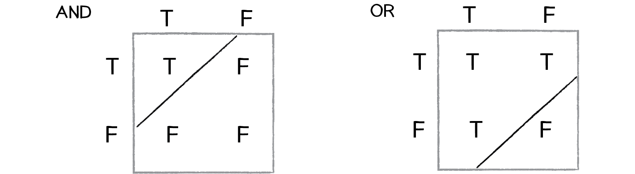

Network of Perceptrons
A single perceptron can only solve linearly separable problems
XOR is the equivalent of OR and NOT AND
However, if one perceptron can solve OR and one perceptron can solve NOT AND, then two perceptrons combined can solve XOR

Slide 21
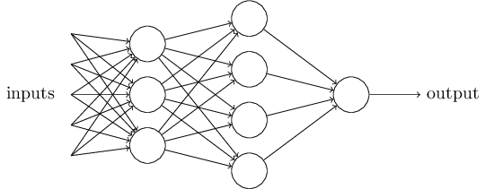
Network of Perceptrons
The first layer of perceptrons is making three very simple decisions
The second layer can make a decision at a more complex and more abstract level than perceptrons in the first layer
Even more complex decisions can be made by the perceptron in the third layer
In this way, a many-layer network of perceptrons can engage in sophisticated decision making

Slide 22
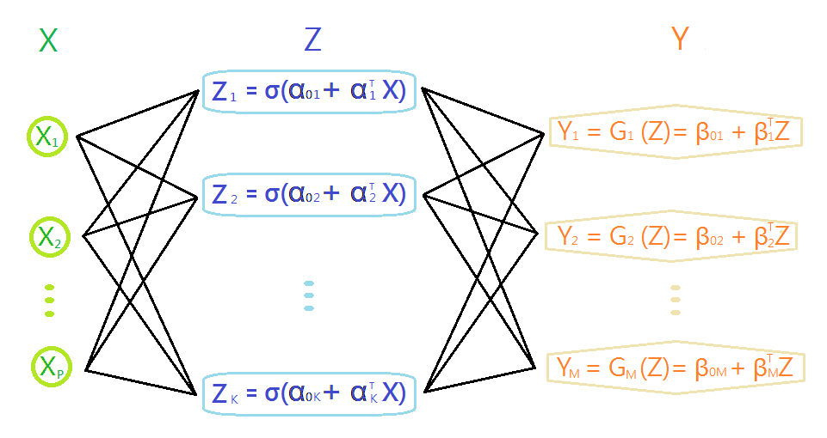
Slightly more complex example..
Input layer
Hidden layer
Output layer
Error function (sum of squared residuals):
https://pjdelta.wordpress.com/2014/02/10/artificial-neural-network-an-overview/
Notes:
Generalization of what we saw..

Slide 23
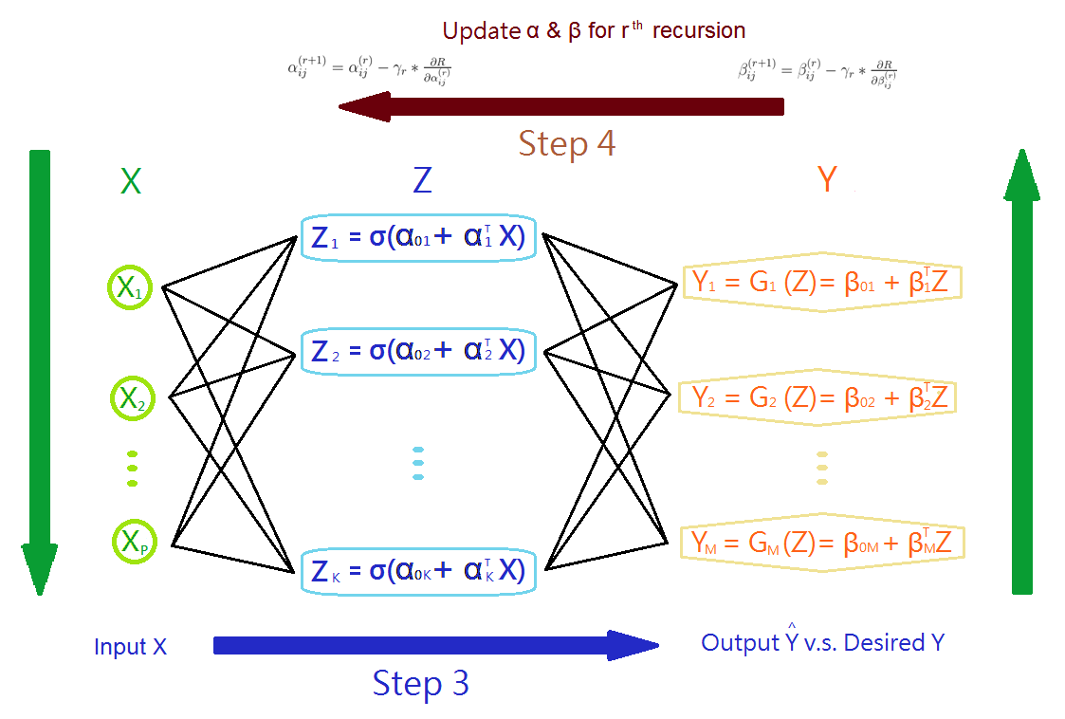
Repeat Step 3 to Step 4 until results of weightings converge

Slide 24



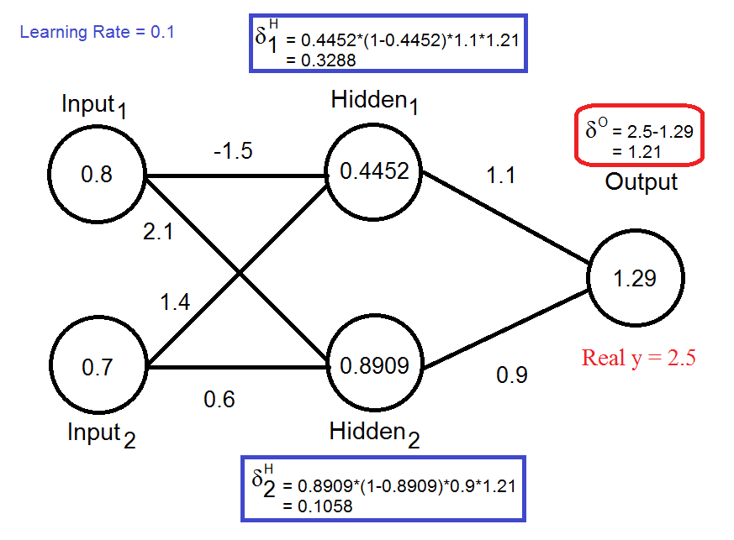
k refers next layer i+1

Slide 25
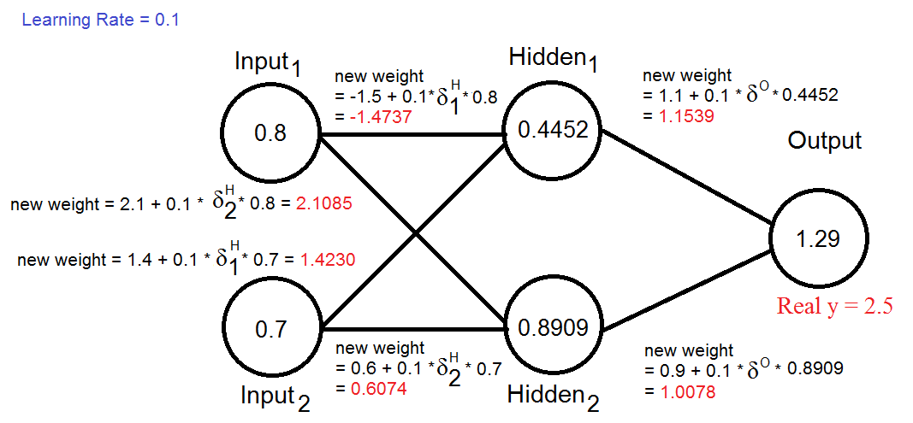
https://pjdelta.wordpress.com/2014/03/03/artificial-neural-network-examples/

Slide 26
What’s Deep Learning?
TL;DR: Basically a rebranding of neural networks
Networks with multi-layer structure - two or more hidden layers - are called deep neural networks
Use learning algorithms so that the network can automatically learn the weights and biases
Stochastic gradient descent (SGD) and back-propagation to train deep networks (since 80s and 90s)
People now routinely train networks with >10 hidden layers
Perform far better on many problems than shallow neural networks, i.e., networks with just a single hidden layer

Slide 27
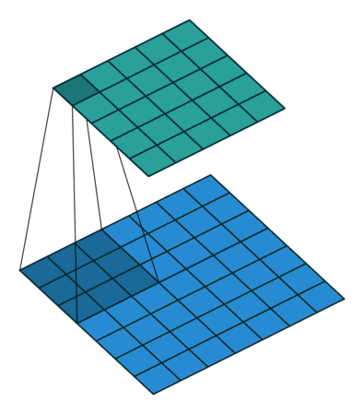
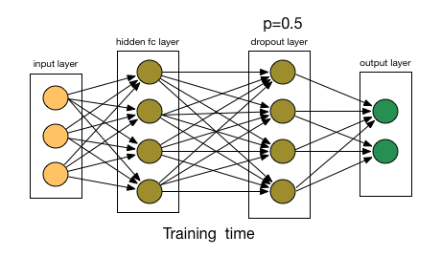
Several Key Concepts in Deep Learning
Back-propagation: a method to optimize weight. It calculates the gradient of a loss function and updates the weights that minimize the loss function.
Convolutional layer: a layer used in image and video processing. Each individual neuron look at small portions of the input image, called receptive fields. They are tiled in such a way that they overlap to obtain a better representation of the original image.
Dropouts: a method used to prevent overfitting. Individual nodes are "dropped out" of the net with probability p.

Slide 28
Caveats
Requires lots of training data
Designing and optimizing a “net” is hard (lots of parameters)
Blackbox approach: (arguably) hard to interpret results
Consensus: the performance improvement from adding additional hidden layers (i.e., second or third, etc.) is very small. One hidden layer is sufficient for the large majority of problems
So what about size of the hidden layer(s)? How many neurons? There are some empirically-derived rules-of-thumb, of these, the most commonly relied on is 'the optimal size of the hidden layer is usually between the size of the input and size of the output layers’
Jeff Heaton, author of Introduction to Neural Networks in Java offers a few more. “In sum, for most problems, one could probably get decent performance (even without a second optimization step) by setting the hidden layer configuration using just two rules: (i) number of hidden layers equals one; and (ii) the number of neurons in that layer is the mean of the neurons in the input and output layers.”

Slide 29
Suggested readings
Free online books
The Nature of Code by Daniel Shiffman- 10. Neural Networks (easy to read): http://natureofcode.com/book/chapter-10-neural-networks/
Neural Networks and Deep Learning by Michael Nielsen: http://neuralnetworksanddeeplearning.com/index.html
Review articles
Yann LeCun, Yoshua Bengio, Geoffrey Hinton. Deep learning. Nature 521, 436–444 (28 May 2015)

