Slide 1
BIOINFORMATICS Personal Genomes Intro.
Mark Gerstein, Yale University
GersteinLab.org/courses/452
(last edit in spring‘19, MG lecture #2, final edit)

Slide 2
Personal Genomics as an an organizing theme for this class
A personal genome can reveal a lot about an individual.
Disease risks, ancestry, personal traits, etc.
Personal genome annotation combined with multi-omic and longitudinal health data can inform new links between genotype and phenotype relevant to an individual and the larger population.
Genomic privacy will become increasingly important as precision medicine becomes more common.
In this class, we will look at how to identify key genomic variants with the most impact.
We will also use analysis techniques including systems and network modeling as well as structural modeling to contextualize and interpret the mechanisms through which these variants impact health.
Notes:
Figure on the left: Integrated personal omics
Figure on the right: Zoom in to a specific region of the genome, summarizing iPOP. From bottom to up: chromosome ideogram; genomic data (pale blue ring), structural variants > 50 bp (deletions [blue tiles], duplications [red tiles]), indels (green triangles); transcriptomic data (yellow ring), expression ratio of HRV infection to healthy states; proteomic data (light purple ring), ratio of protein levels during HRV infection to healthy states; transcriptomic data (yellow ring), differential heteroallelic expression ratio of alternative allele to reference allele for missense and synonymous variants (purple dots) and candidate RNA missense and synonymous edits (red triangles, purple dots, orange triangles and green dots, respectively)

Slide 3
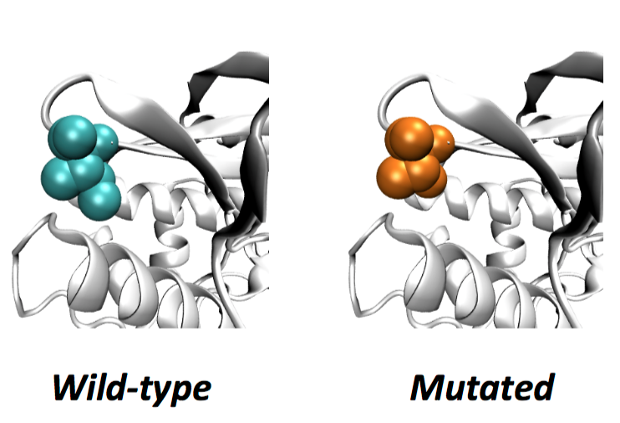
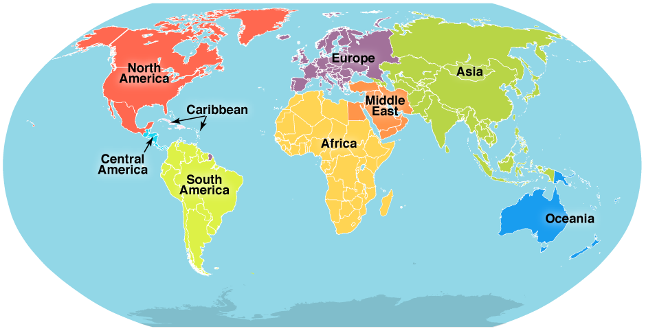
Analyzing Carl Zimmer’s genome
SNV
AAGCT
ACGCT
Protein Structure
Ancestry

Slide 4
Sequence by Illumina
Order blood draw
Arrange an exam
Cost: $3100
Illumina briefly review the sequencing data, evaluating the risk for 1200 disorders, from familiar ones like lung cancer to obscure ones like cherubism

Slide 5
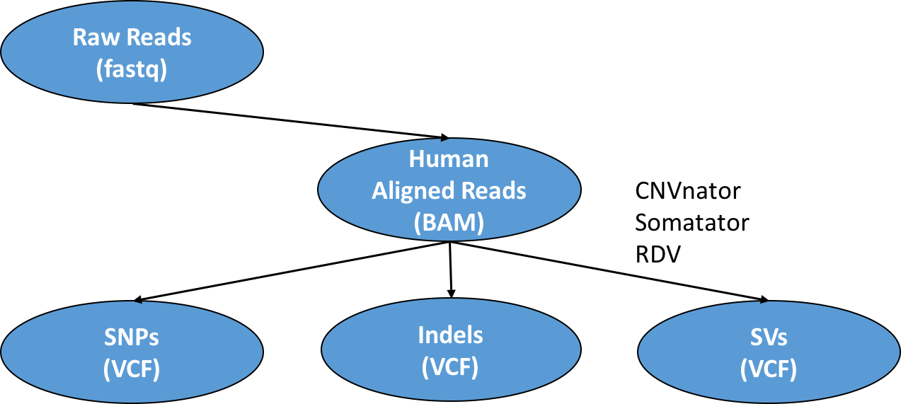
Notes:
Promise that I will cover each of them
Don’t worry.
I’m a superwomen

Slide 6
Genome Variation
TP53 Sequence:
…GGAGTCTTCCAGTGTGATGATGGTGAGGATGGGCCTCCGGTT…
Single Nucleotide Polymorphism (SNP) –1nt:
…GGAGTCTTCCAGTGTGATGATGGTGAGGATGGGCCTCCGGTT…
T or A or C
Small Insertions and DELetions (INDEL) – 1-10nt:
…GGAGTCTTCCAGTGTGATGATGGTGAGGATGGGCCTCCGGTT…
Large Structural Variations (SV) -- >100nt:
…GGAGTCTTCCAGTGTGATGATGGTGAGGATGGGCCTCCGGTT…

Slide 7
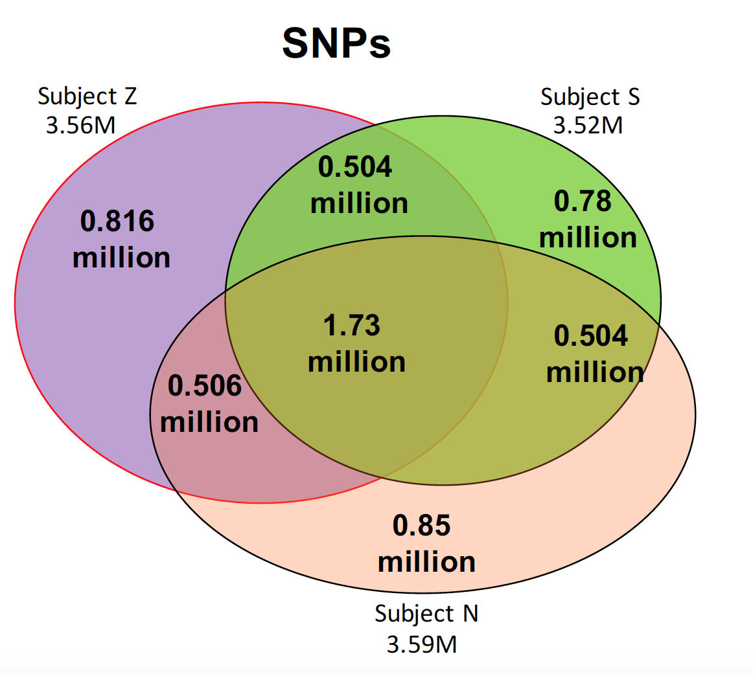
Normal range of number of SNPs
Carl’s case: more than 3M SNPs
How do we know if the SNP is harmful?
Notes:
修改slides

Slide 8
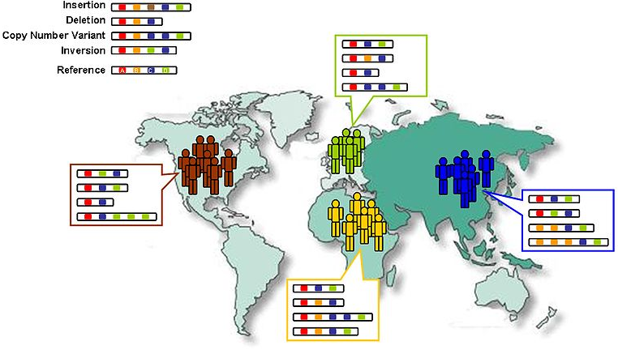
Thousand genome project
Common SNP data base found in the population
https://en.wikipedia.org/wiki/1000_Genomes_Project

Slide 9
Got a variant in a gene for heart muscles, called DSG2
DSG2 gene encodes a protein in humans called Desmoglein-2
Mutations in desmoglein-2 have been associated with arrhythmogenic right ventricular cardiomyopathy
People of European descent carry this variant
---- Carl Zimmer

Slide 10
Human Genetic Variation
Population of
2,504 peoples
A Cancer Genome
A Typical Genome
Origin of Variants
Class of Variants
 | Coding | Non-coding
Germ-line | 22K | 4.1 – 5M
Somatic | ~50 | 5K
SNP | 3.5 – 4.3M
Indel | 550 – 625K
SV | 2.1 – 2.5K (20Mb)
Total | 4.1 – 5M
SNP | 84.7M
Indel | 3.6M
SV | 60K
Total | 88.3M
Prevalence of Variants
Common
Common
Passenger
Driver (~0.1%)
Rare* (1-4%)
Rare (~75%)
* Variants with allele frequency < 0.5% are considered as rare variants in 1000 genomes project.
The 1000 Genomes Project Consortium, Nature. 2015. 526:68-74
Khurana E. et al. Nat. Rev. Genet. 2016. 17:93-108

Slide 11
Association of Variants with Diseases
Common
Variants
Healthy
Rare or
Somatic
Variants
Pooled
Variants
High
Function
Impact
Diseased
Burden Test
GWAS Positive

Slide 12
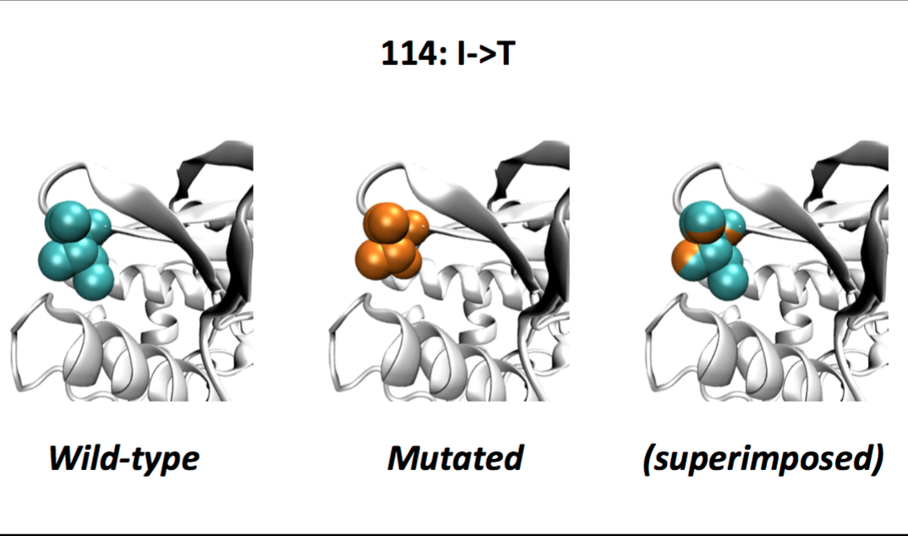
SNP changing protein structure
NAT2, an enzyme in the liver that breaks down caffeine and other toxins with a similar molecular structure.
NAT2 helps break down certain medicines too. The variant puts people at risk of bad side effects from those drugs.

Slide 13
Indels (Insertions/deletions)
In coding regions, unless the length of an indel is a multiple of 3, it will produce frameshift mutation
Likely to disrupt genes (loss-of-function variant)
Example: Non-functional F8 gene
Can’t make essential clotting protein
Get hemophilia and can bleed to death from a little cut
Notes:
Eg. Non-functional F8 gene:
Can’t make essential clotting protein
Get hemophilia and can bleed to death from a little cut

Slide 14
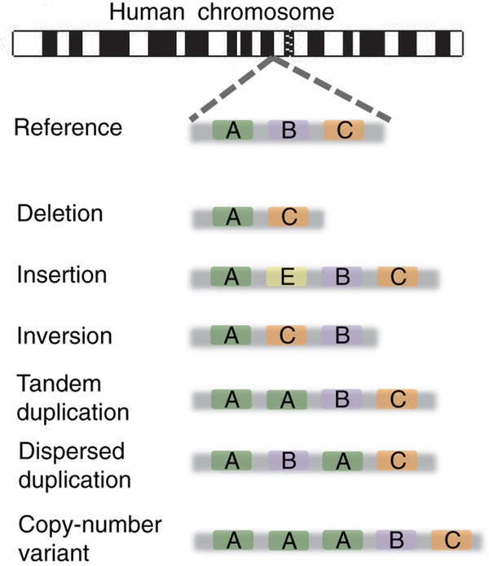
Structural Variation
Baker, M., 2012. Nature methods, 9(2), pp.133-137.

Slide 15
Structural variation
Example: HTT
Certain mutations in HTT cause Huntington’s disease.
Healthy people have a wide range of CAG repeats. It’s only when people get 37 or more CAG repeats in HTT that they are at risk of developing Huntington’s disease.
The reference genome has 19 CAG repeats. Carl has 17.
Notes:
Huntington’s disease starts in middle age, leads to dementia, and ends with death.
Repeating DNA is very hard to sequence accurately
with short reads, because there aren’t any distinctive sequences to anchor them.

Slide 16
Non-coding variant
Variant rs1421085
Located in a genetic switch that activates several genes in fat cells
The variant causes people to put on an average of 7 pounds
Claussnitzer, Melina, et al. N Engl J Med 2015.373 (2015): 895-907.
Notes:
The variant causes people to put on an average of 7 pounds

Slide 17
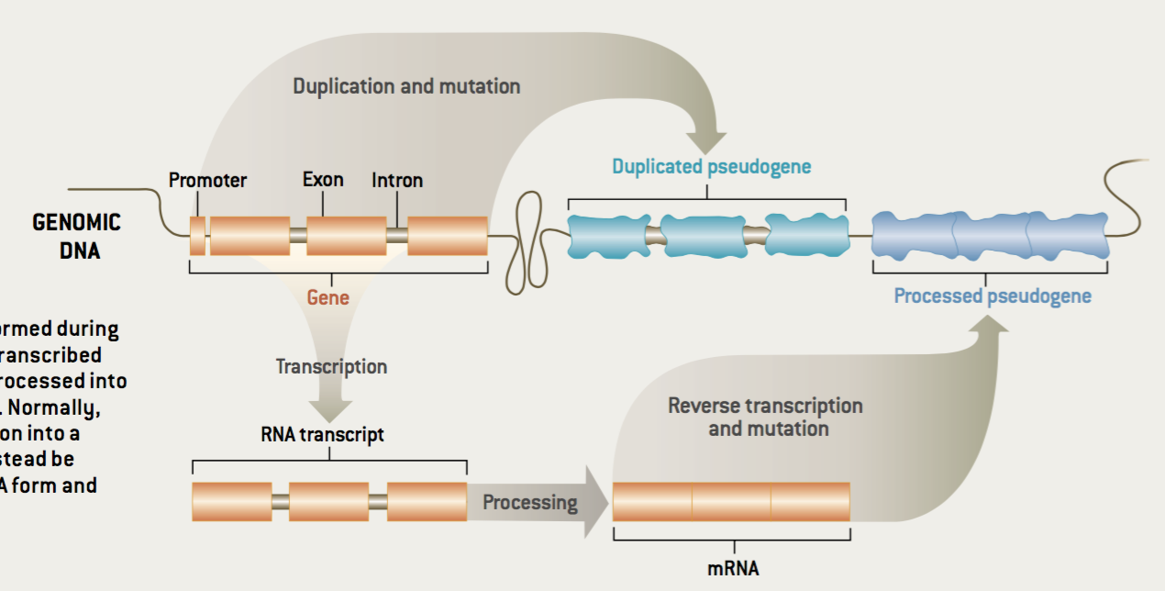
What else are in the genome?
Pseudogenes
About 14000 pseudogenes carried in our genome
Gerstein and Zheng SiAm 2006

Slide 18
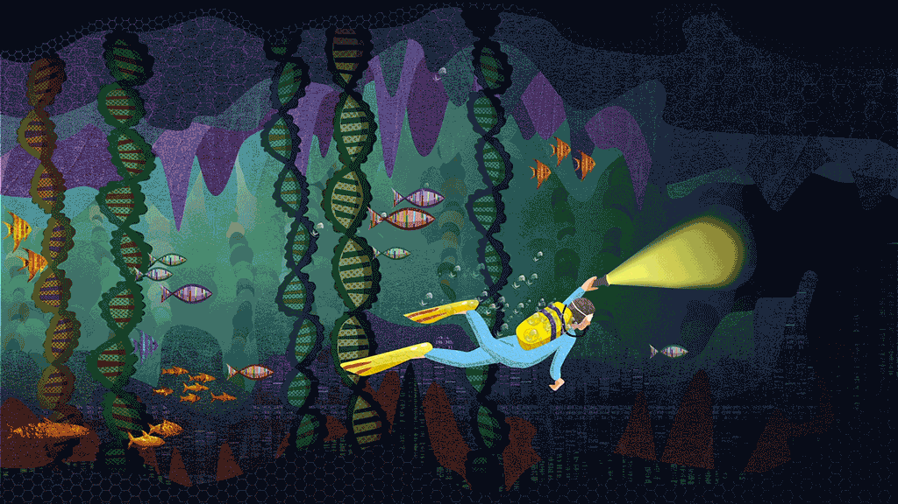
Looking beyond the genome
In the Game of Genomes Carl Zimmer explored his genomic sequence.
The genome provides a mostly static view.
Misses the active regulation, transcription, and translation
https://www.statnews.com/feature/game-of-genomes/

Slide 19
Integrating environmental factors, genetic background, and large scale datasets
Difference between health and disease depends on many factors.
Environment, genome, cellular contents, etc. all play a a role.
Important to integrate information from multiple large-scale datasets.
Sun et al. Advances in Genetics 2016

Slide 20
Expanding personalized medicine beyond the genome.
An integrated personal omics profile (iPOP) is an example of a more comprehensive version of personalized medicine.
Michael Snyder had his genome sequenced and collected many other large scale datasets over an extended period of time.
https://med.stanford.edu/news/all-news/2017/01/wearable-sensors-can-tell-when-you-are-getting-sick.html

Slide 21
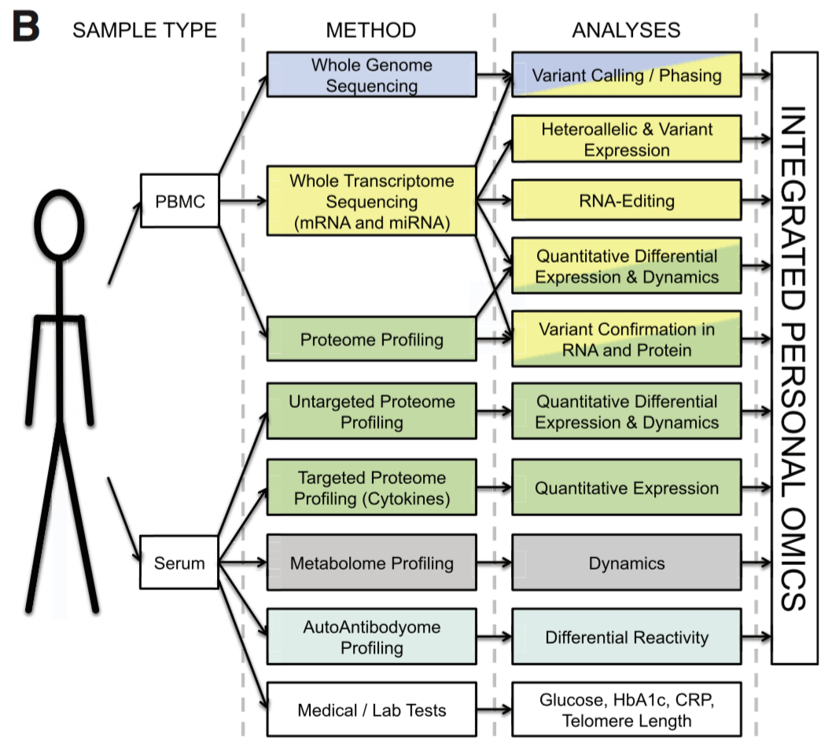
Integrated personal omics profile (iPOP)
Numerous types of data were collected, primarily from blood samples. The datasets include:
Transcriptomic
Proteomic
Metabolomic
Cytokine profiling
Autoantibody profiling
Medical exams
Chen et al. Cell 2012

Slide 22
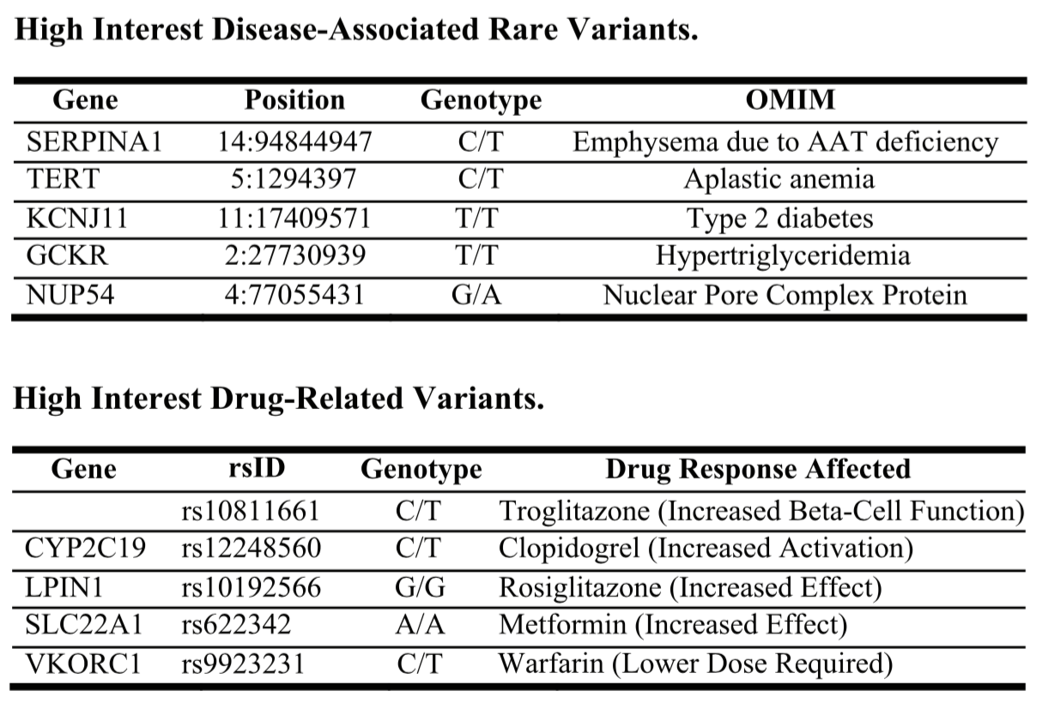
Prioritizing variants by leveraging mutation databases
Using existing databases of population level genetic variation, rare and disease associated variants could be identified.
Helped prioritize medical conditions for monitoring (e.g. glucose for diabetes)
Chen et al. Cell 2012

Slide 23
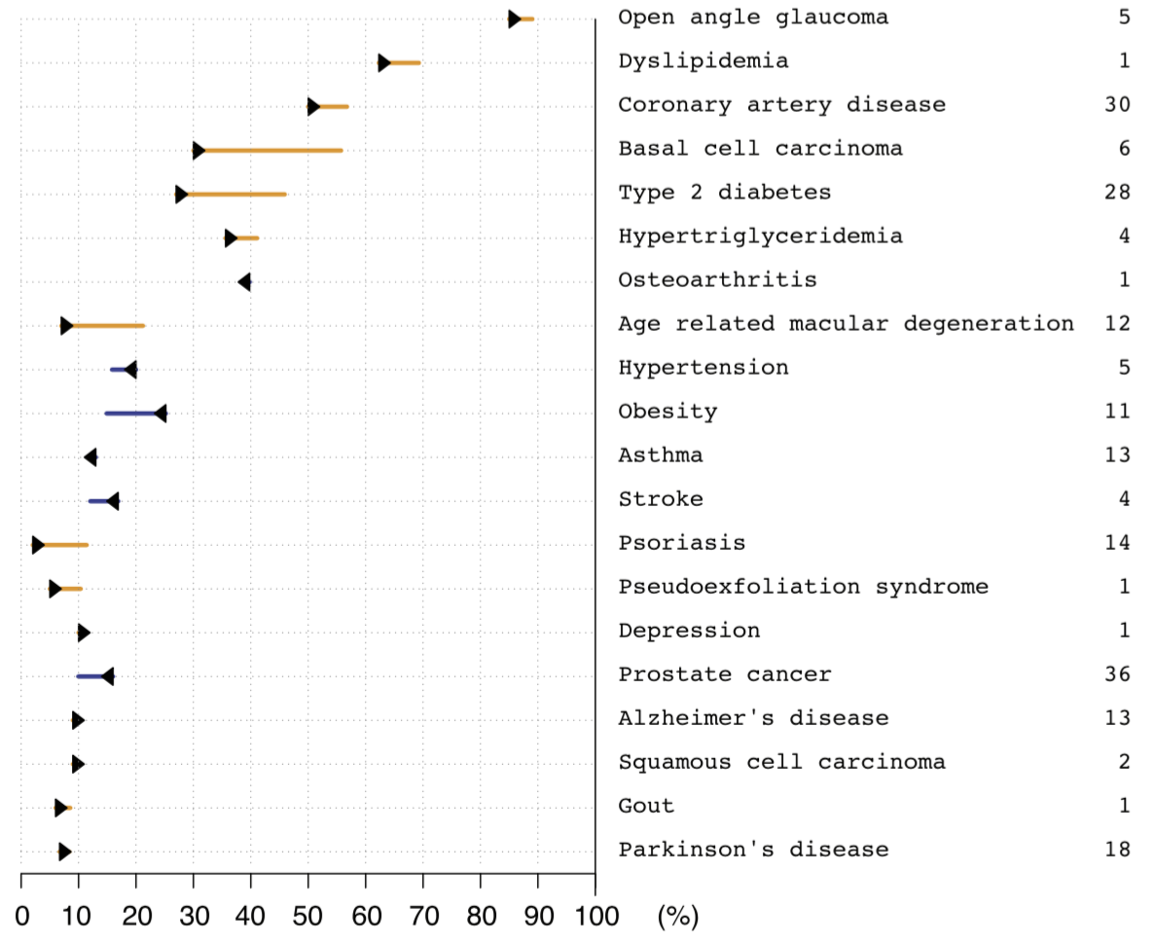
Genomic information helps refine disease risk estimates
Chen et al. Cell 2012

Slide 24
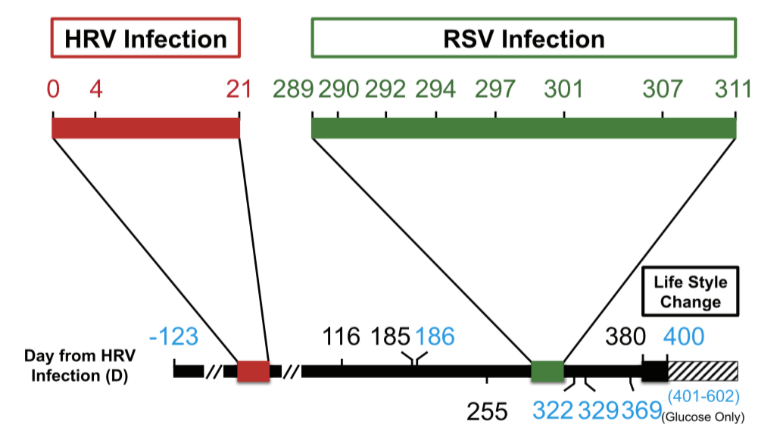
Personal omics profiling time course
Changing cellular state and environmental perturbations impact the genome.
Longitudinal data collection tracks the dynamic regulation of the genome.
Chen et al. Cell 2012

Slide 25
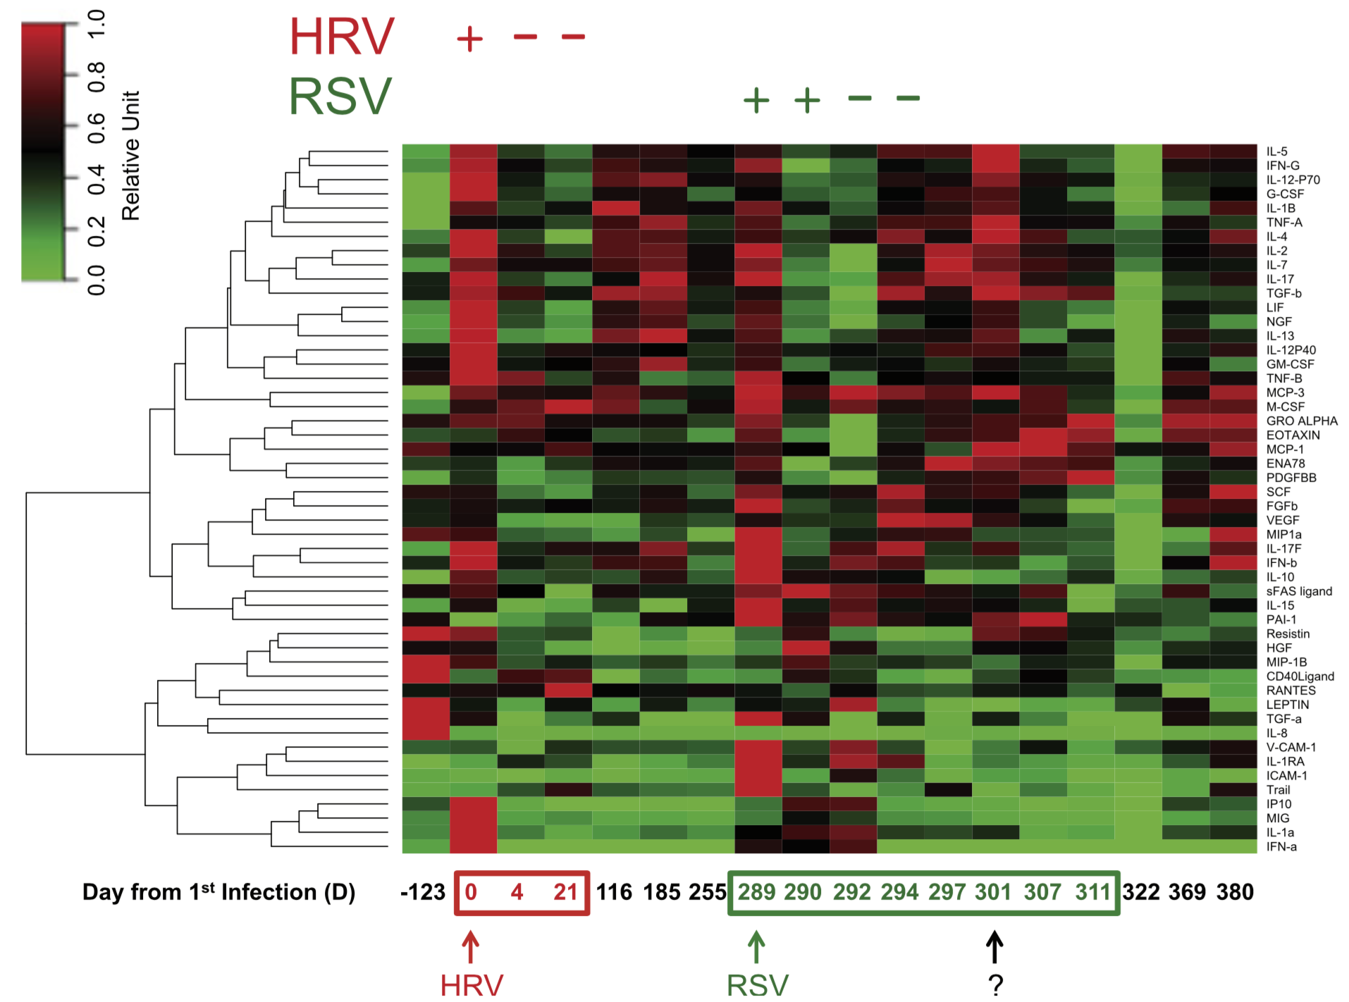
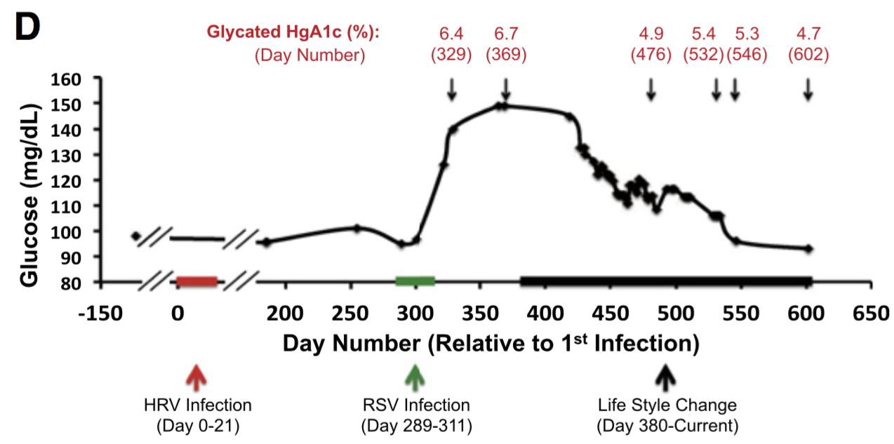
Longitudinal medical data
Tracking relevant medical (e.g. blood glucose) data over time helps link phenotypic changes with changes at the molecular level.
Chen et al. Cell 2012

Slide 26
Precision medicine in the clinic
Precision medicine is leading to better defining and treating disease at the molecular level.
It is both changing the prescription of existing medications and inspiring new targeted therapies.
Precision medicine requires high quality patient genome sequences be obtained at reasonable cost.

