Slide 1
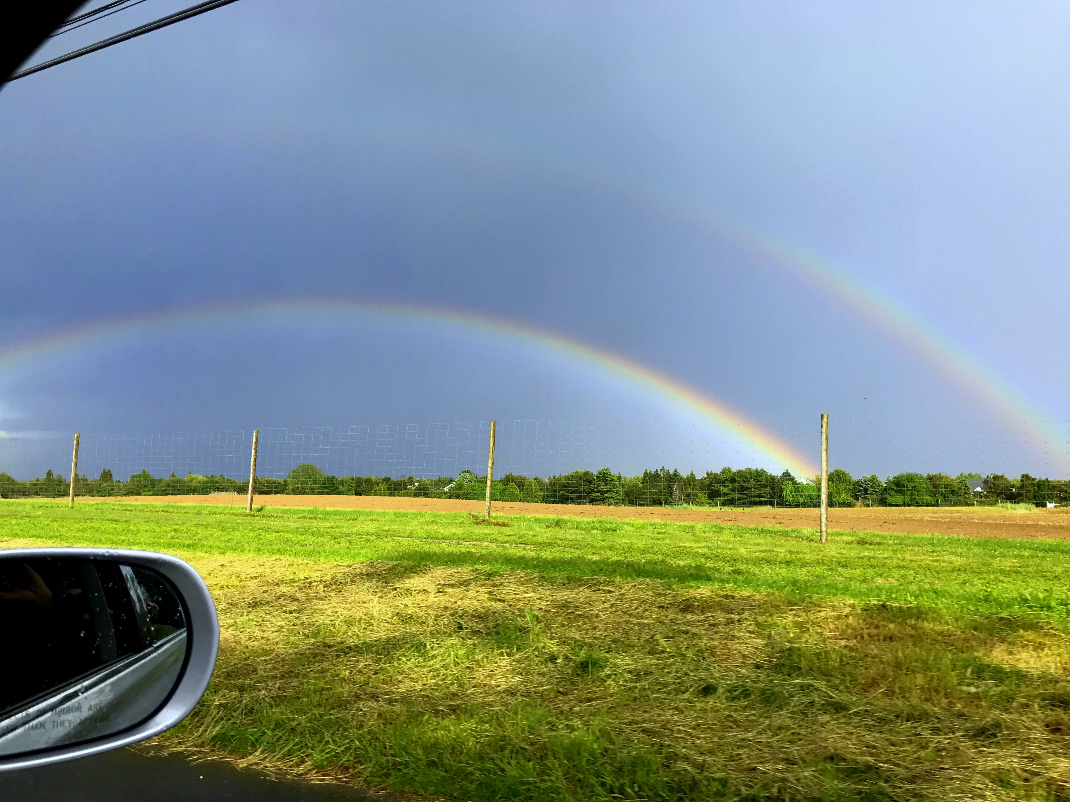
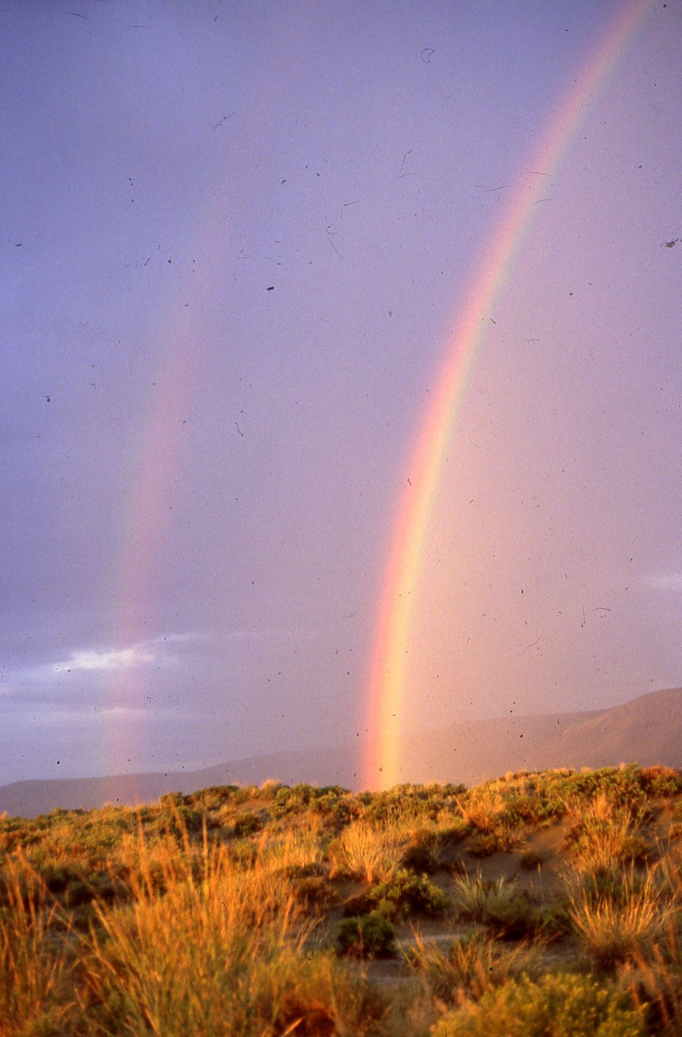
Summer Camp ‘18 Event!
2 Sides of the Coin for RNA-seq:
Ensuring Individual Privacy v. Allowing Easy Mining
Mark Gerstein, Yale
Slides freely downloadable from Lectures.GersteinLab.org
& “tweetable” (via @markgerstein). See last slide for more info.

Slide 2

2-sided nature of functional genomics data: Analysis can be very General/Public or Individual/Private
General quantifications related to overall aspects
of a condition – ie gene activity as a function of:
  Developmental stage, Evolutionary relationships, Cell-type, Disease
Above are not tied to an individual’s genotype. However, data is derived from individuals & tagged with their genotypes
(Note, a few calculations aim to use explicitly genotype to derive general relations related to sequence variation & gene expression - eg allelic activity)

Slide 3
2 Sides of a Coin: Individual Privacy v. Easy RNA-Seq Mining
Introduction
to Genomic Privacy
  The dilemma: The genome as fundamental, inherited info that’s very private v need for large-scale mining for med. research
  2-sided nature of RNA-seq presents a particularly tricky privacy issue
Measuring Leakage
from eQTLs
  Quantifying & removing further variant info from expression levels + eQTLs using ICI & predictability
Linking Attacks from eQTLs
  Instantiating a practical linking attack using extreme expression levels
Signal Profiles
  Appreciable leakage from large & small deletions evident in signal profiles
  Linking attacks also possible but additional complication of SV discovery in addition to genotyping

Slide 4
2 Sides of a Coin: Individual Privacy v. Easy RNA-Seq Mining
Introduction
to Genomic Privacy
  The dilemma: The genome as fundamental, inherited info that’s very private v need for large-scale mining for med. research
  2-sided nature of RNA-seq presents a particularly tricky privacy issue
Measuring Leakage
from eQTLs
  Quantifying & removing further variant info from expression levels + eQTLs using ICI & predictability
Linking Attacks from eQTLs
  Instantiating a practical linking attack using extreme expression levels
Signal Profiles
  Appreciable leakage from large & small deletions evident in signal profiles
  Linking attacks also possible but additional complication of SV discovery in addition to genotyping

Slide 5


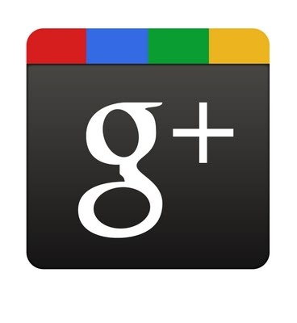
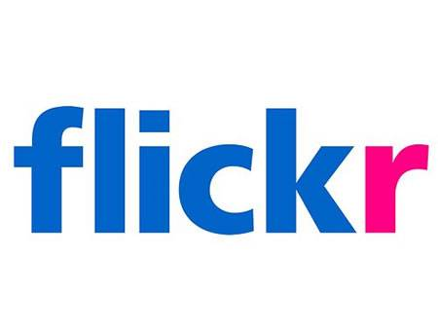








Genomics has similar "Big Data" Dilemma in the Rest of Society
Sharing & "peer-production" is central to success of many new ventures, with the same risks as in genomics
  EG web search: Large-scale mining essential
We confront privacy risks every day we access the internet
[Seringhaus & Gerstein ('09), Hart. Courant (Jun 5); Greenbaum & Gerstein ('11), NY Times (6 Oct)]

Slide 6

Tricky Privacy Considerations in Personal Genomics
Genetic Exceptionalism :
The Genome is very fundamental data, potentially very revealing about one’s identity & characteristics
Personal Genomic info. essentially meaningless currently but will it be in 20 yrs? 50 yrs?
  Genomic sequence very revealing about one’s children. Is true consent possible?
  Once put on the web it can’t be taken back
Culture Clash:
Genomics historically has been a proponent of “open data” but not clear personal genomics fits this.
  Clinical Medline has a very different culture.
Ethically challenged history of genetics
  Ownership of the data & what consent means (Hela)
    Could your genetic data give rise to a product line?
[D Greenbaum & M Gerstein (’08). Am J. Bioethics; D Greenbaum & M Gerstein, Hartford Courant, 10 Jul. '08 ; SF Chronicle, 2 Nov. '08;
Greenbaum et al. PLOS CB (‘11) ; Greenbaum & Gerstein ('13), The Scientist; Photo from NY Times]

Slide 7

The Other Side of the Coin:
Why we should share
Sharing helps speed research
  Large-scale mining of this information is important for medical research
  Privacy is cumbersome, particularly for big data
Sharing is important for reproducible research
Sharing is useful for education
  More fun to study a known person’s genome
[Yale Law Roundtable (‘10). Comp. in Sci. & Eng. 12:8; D Greenbaum & M Gerstein (‘09). Am. J. Bioethics; D Greenbaum & M Gerstein (‘10). SF Chronicle, May 2, Page E-4;
Greenbaum et al. PLOS CB (‘11)]

Slide 8

The Dilemma
[Economist, 15 Aug ‘15]
The individual (harmed?) v the collective (benefits)
  But do sick patients care about their privacy?
How to balance risks v rewards - Quantification
  What is acceptable risk?
  Can we quantify leakage?
    Ex: photos of eye color
  Cost Benefit Analysis

Slide 9
Current Social & Technical Solutions
Closed Data Approach
  Consents
  “Protected” distribution via dbGAP
  Local computes on secure computer
Issues with Closed Data
  Non-uniformity of consents & paperwork
    Different international norms, leading to confusion
  Encryption & computer security creates burdensome requirements on data sharing & large scale analysis
  Many schemes get “hacked”
Open Data
  Genomic "test pilots” (ala PGP)?
    Sports stars & celebrities?
  Some public data & data donation is helpful but is this a realistic solution for an unbiased sample of ~1M
[Greenbuam et al ('04), Nat. Biotech; Greenbaum & Gerstein ('13), The Scientist]

Slide 10
2 Sides of a Coin: Individual Privacy v. Easy RNA-Seq Mining
Introduction
to Genomic Privacy
  The dilemma: The genome as fundamental, inherited info that’s very private v need for large-scale mining for med. research
  2-sided nature of RNA-seq presents a particularly tricky privacy issue
Measuring Leakage
from eQTLs
  Quantifying & removing further variant info from expression levels + eQTLs using ICI & predictability
Linking Attacks from eQTLs
  Instantiating a practical linking attack using extreme expression levels
Signal Profiles
  Appreciable leakage from large & small deletions evident in signal profiles
  Linking attacks also possible but additional complication of SV discovery in addition to genotyping

Slide 11

RNA-Seq Overview
ATACAAGCAAGTATAAGTTCGTATGCCGTCTT
GGAGGCTGGAGTTGGGGACGTATGCGGCATAG
TACCGATCGAGTCGACTGTAAACGTAGGCATA
ATTCTGACTGGTGTCATGCTGATGTACTTAAA
Fastq sequence files
~5-10 GB
Index-building + Alignment to reference genome
BAM files
~1-2-fold reduction
Successive steps of Data Reduction
Conversion to signal track by overlapping reads
BigWig files
~25-fold reduction
Mapping to genes
Gene/Transcript expression matrix
~20-fold reduction
Quantitative information from RNA-seq signal: average signals at exon level (RPKMs)
Reads => Signal
[NAT. REV. 10: 57; PLOS CB 4:e1000158; PNAS 4:107: 5254 ]

Slide 12


eQTL Mapping Using RNA-Seq Data
eQTLs are genomic loci that contribute to variation in mRNA expression levels
eQTLs provide insights on transcription regulation, and the molecular basis of phenotypic outcomes
eQTL mapping can be done with RNA-Seq data
[Biometrics 68(1) 1–11]
Notes:
A diagram to illustrate the RNA‐seq count variation of one gene due to an cis‐eQTL. (a) RNA‐seq measurements of a hypothetic gene with two exons in three diploid individuals. The target SNP which we test for association has the genotype CT, CC, and TT for the three individuals. There is an SNP on the first exon, which has genotype AT, AT, and AA for the three individuals. ASE can be measured by those sequence reads that overlap with a heterozygous exonic SNP. Therefore we can measure ASE for individuals (i) and (ii). However, association testing by ASE is only possible if the target SNP is heterozygous, thus only individual (i) can be used to test for eQTL by ASE (b) ASE measurements for individual (i). (c) TReC measured for the three individuals across the two exons of this gene.
© IF THIS IMAGE HAS BEEN PROVIDED BY OR IS OWNED BY A THIRD PARTY, AS INDICATED IN THE CAPTION LINE, THEN FURTHER PERMISSION MAY BE NEEDED BEFORE ANY FURTHER USE. PLEASE CONTACT WILEY'S PERMISSIONS DEPARTMENT ON PERMISSIONS@WILEY.COM OR USE THE RIGHTSLINK SERVICE BY CLICKING ON THE 'REQUEST PERMISSION' LINK ACCOMPANYING THIS ARTICLE. WILEY OR AUTHOR OWNED IMAGES MAY BE USED FOR NON-COMMERCIAL PURPOSES, SUBJECT TO PROPER CITATION OF THE ARTICLE, AUTHOR, AND PUBLISHER.

Slide 13

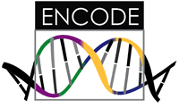

Representative Functional Genomics, Genotype, eQTL Datasets
Genotypes are available from the 1000 Genomes Project
mRNA sequencing for 462 individuals from gEUVADIS and ENCODE
  Publicly available quantification for protein coding genes
Functional genomics data (ChIP-Seq, RNA-Seq, Hi-C) available from ENCODE
Approximately 3,000 cis-eQTL (FDR<0.05)

Slide 14
Strawman Hybrid Social & Tech Proposed Solution?
Fundamentally, researchers have to keep genetic secrets.
  Need for an (international) legal framework
  Genetic Licensure & training for individuals
  (similar to medical license, drivers license)
Technology to make things easier
  Cloud computing & enclaves (eg solution of Genomics England)
Technological barriers shouldn't create a social incentive for “hacking”
Quantifying Leakage & allowing a small amounts of it
Careful separation & coupling of private & public data
  Lightweight, freely accessible secondary datasets coupled to underlying variants
  Selection of stub & "test pilot" datasets for benchmarking
  Develop programs on public stubs on your laptop, then move the program to the cloud for private production run
[D Greenbaum, M Gerstein (‘11). Am J Bioeth 11:39. Greenbaum & Gerstein, The Scientist ('13)]

Slide 15
Information Content and Predictability
Naive measure of information (no LD, distant correlations, pop. struc., &c)
Higher frequency: Lower ICI
Additive for multiple variants
Condition specific entropy
Higher cond. entropy: Lower predictability
Additive for multiple eQTLs
[Harmanci et al. Nat. Meth. 2016]

Slide 16
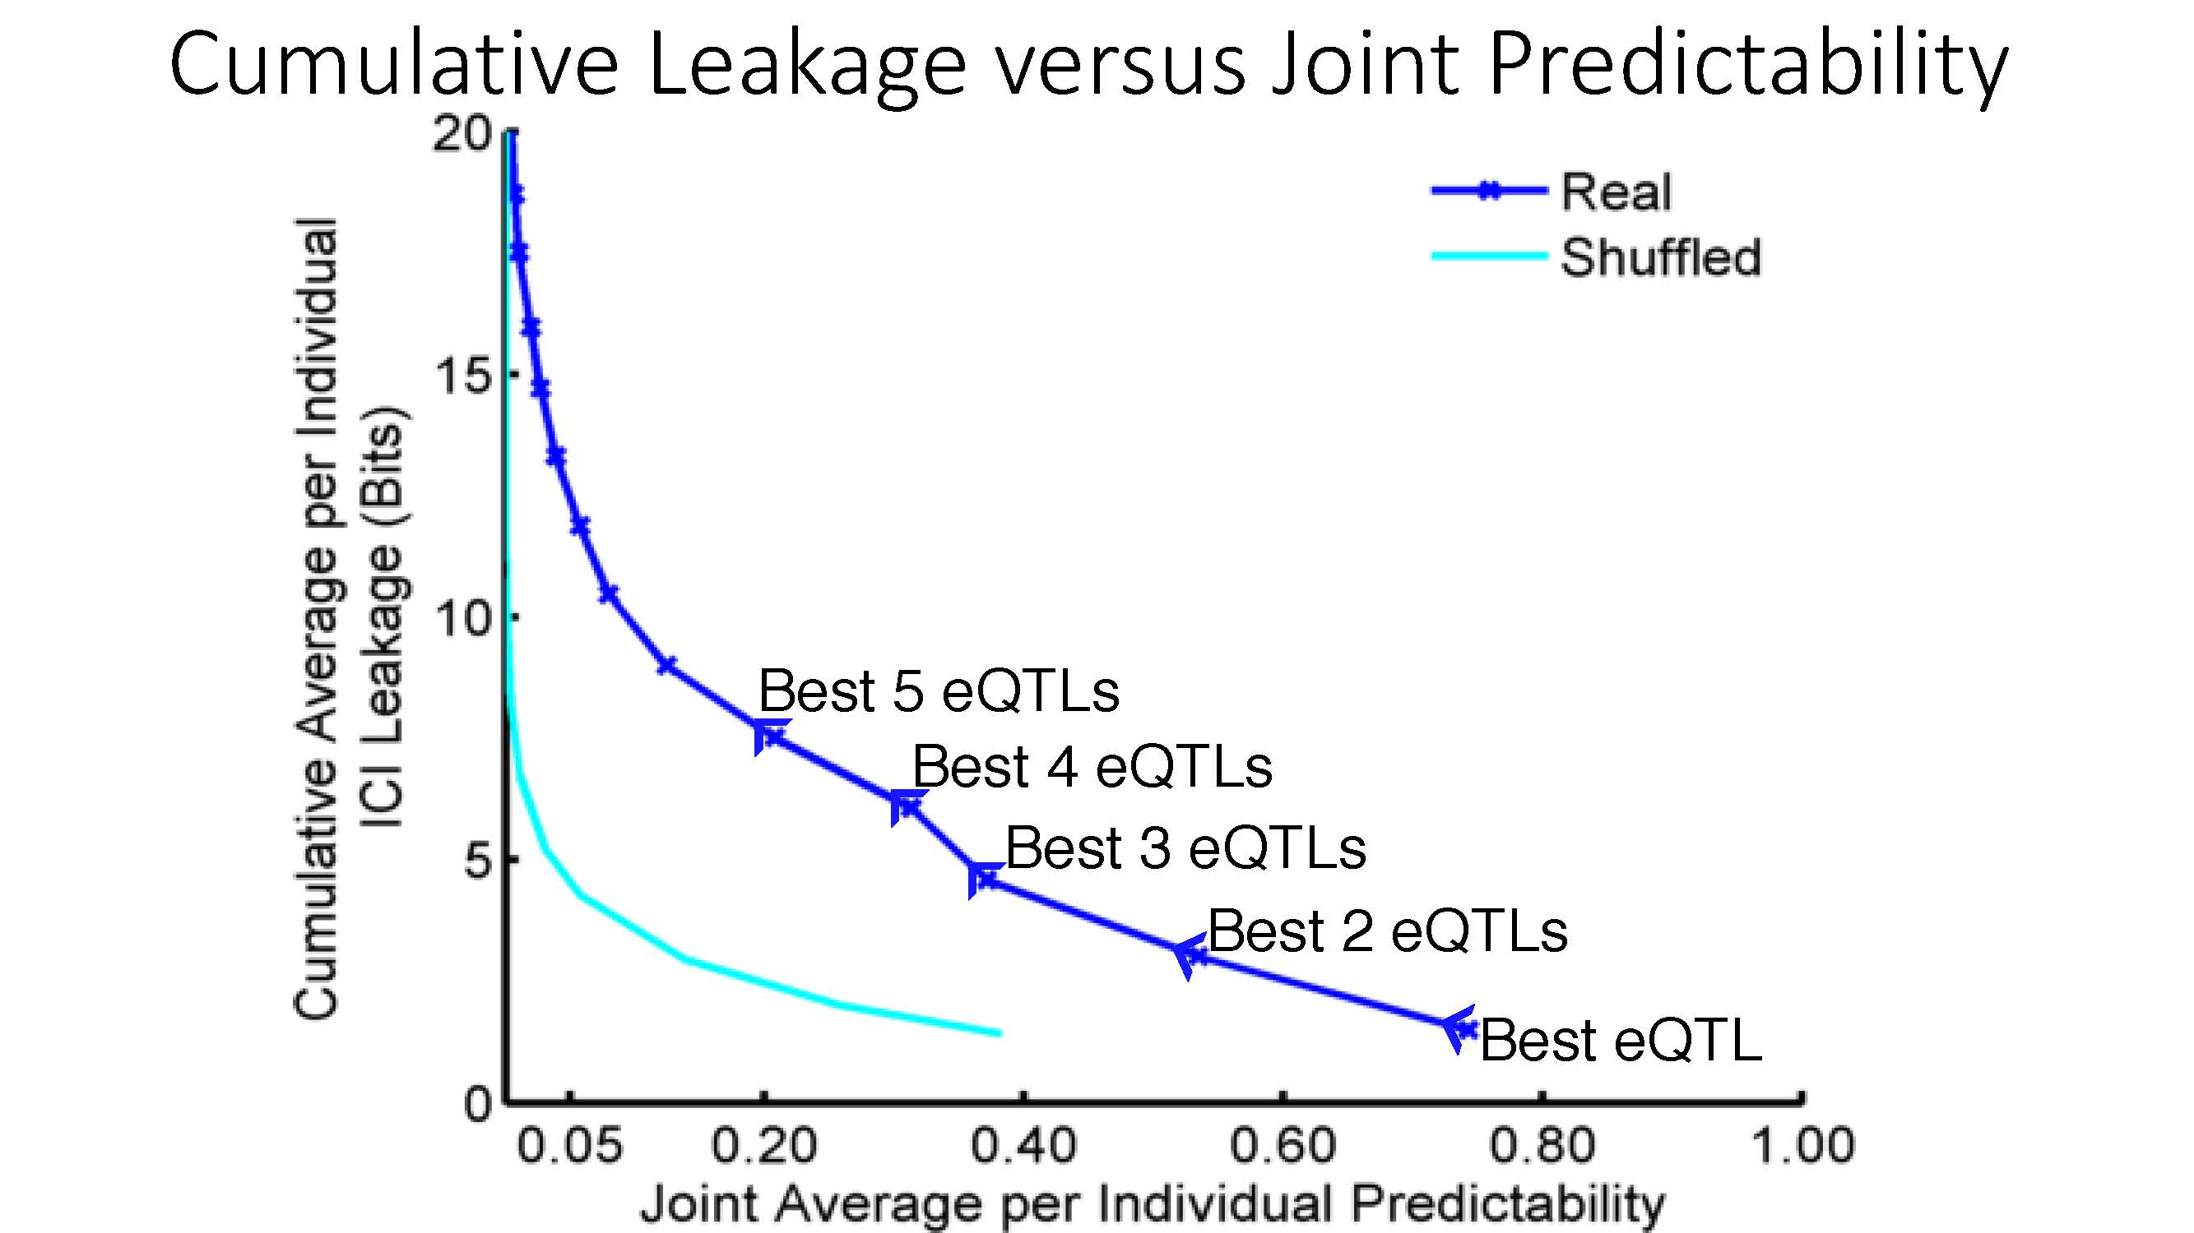

ICI Leakage versus Genotype Predictability
[Harmanciet al. Nat. Meth. (‘16]

Slide 17
2 Sides of a Coin: Individual Privacy v. Easy RNA-Seq Mining
Introduction
to Genomic Privacy
  The dilemma: The genome as fundamental, inherited info that’s very private v need for large-scale mining for med. research
  2-sided nature of RNA-seq presents a particularly tricky privacy issue
Measuring Leakage
from eQTLs
  Quantifying & removing further variant info from expression levels + eQTLs using ICI & predictability
Linking Attacks from eQTLs
  Instantiating a practical linking attack using extreme expression levels
Signal Profiles
  Appreciable leakage from large & small deletions evident in signal profiles
  Linking attacks also possible but additional complication of SV discovery in addition to genotyping

Slide 18

Linking Attack Scenario
[Harmanciet al. Nat. Meth. (’16)]

Slide 19


Linking Attacks: Case of Netflix Prize
Names available for many users!
User (ID) | Movie (ID) | Date of Grade | Grade [1,2,3,4,5]
NTFLX-0 | NTFLX-19 | 10/12/2008 | 1
NTFLX-1 | NTFLX-116 | 4/23/2009 | 3
NTFLX-2 | NTFLX-92 | 5/27/2010 | 2
NTFLX-1 | NTFLX-666 | 6/6/2016 | 5
… | … | … | …
… | … | … | …
User (ID) | Movie (ID) | Date of Grade | Grade [0-10]
IMDB-0 | IMDB-173 | 4/20/2009 | 5
IMDB-1 | IMDB-18 | 10/18/2008 | 0
IMDB-2 | IMDB-341 | 5/27/2010 | -
… | … | … | …
… | … | … | …
… | … | … | …
Many users are shared
The grades of same users are correlated
A user grades one movie around the same date in two databases
Anonymized Netflix Prize Training Dataset
made available to contestants
Notes:
This figure illustrates what these datasets look like. The movie titles can be matched directly. Date of ratings and rating values are expected to be similar to each other

Slide 20
Linking Attacks: Case of Netflix Prize
Names available for many users!
User (ID) | Movie (ID) | Date of Grade | Grade [1,2,3,4,5]
NTFLX-0 | NTFLX-19 | 10/12/2008 | 1
NTFLX-1 | NTFLX-116 | 4/23/2009 | 3
NTFLX-2 | NTFLX-92 | 5/27/2010 | 2
NTFLX-1 | NTFLX-666 | 6/6/2016 | 5
… | … | … | …
… | … | … | …
User (ID) | Movie (ID) | Date of Grade | Grade [0-10]
IMDB-0 | IMDB-173 | 4/20/2009 | 5
IMDB-1 | IMDB-18 | 10/18/2008 | 0
IMDB-2 | IMDB-341 | 5/27/2010 | -
… | … | … | …
… | … | … | …
… | … | … | …
Many users are shared
The grades of same users are correlated
A user grades one movie around the same date in two databases
IMDB users are public
NetFLIX and IMdB moves are public
Notes:
As you can see, Netflx-1 user can be matched to IMDB-0 user since the date of rating is very close and the ratings are very similar. The rating in imdb is from 0 to 10. So 5 is a similar score to 3 in Netflix rating system.

Slide 21
Linking Attacks: Case of Netflix Prize
Names available for many users!
User (ID) | Movie (ID) | Date of Grade | Grade [1,2,3,4,5]
NTFLX-0 | NTFLX-19 | 10/12/2008 | 1
NTFLX-1 | NTFLX-116 | 4/23/2009 | 3
NTFLX-2 | NTFLX-92 | 5/27/2010 | 2
NTFLX-1 | NTFLX-666 | 6/6/2016 | 5
… | … | … | …
… | … | … | …
User (ID) | Movie (ID) | Date of Grade | Grade [0-10]
IMDB-0 | IMDB-173 | 4/20/2009 | 5
IMDB-1 | IMDB-18 | 10/18/2008 | 0
IMDB-2 | IMDB-341 | 5/27/2010 | -
… | … | … | …
… | … | … | …
… | … | … | …
Many users are shared
The grades of same users are correlated
A user grades one movie around the same date in two databases
Notes:
The key idea is that in imdb, the names are available for many users. Also,
Secondly, although another movie in Netflix system is not rated by this user in imdb system, namely the netflx666, the adversary can see the rating of the individual for this movie.

Slide 22
Linking Attack Scenario
[Harmanciet al. Nat. Meth. (‘16)]

Slide 23
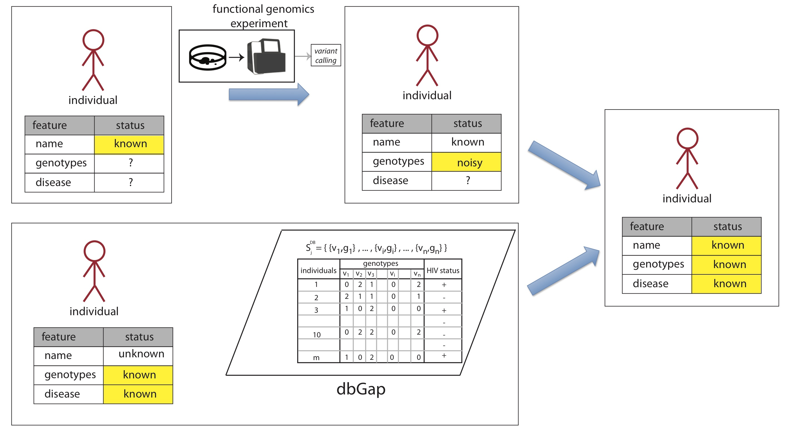

Summary of a Linking Attack
Attacked (query) individual
Fully Characterized individual
Population of individuals

Slide 24
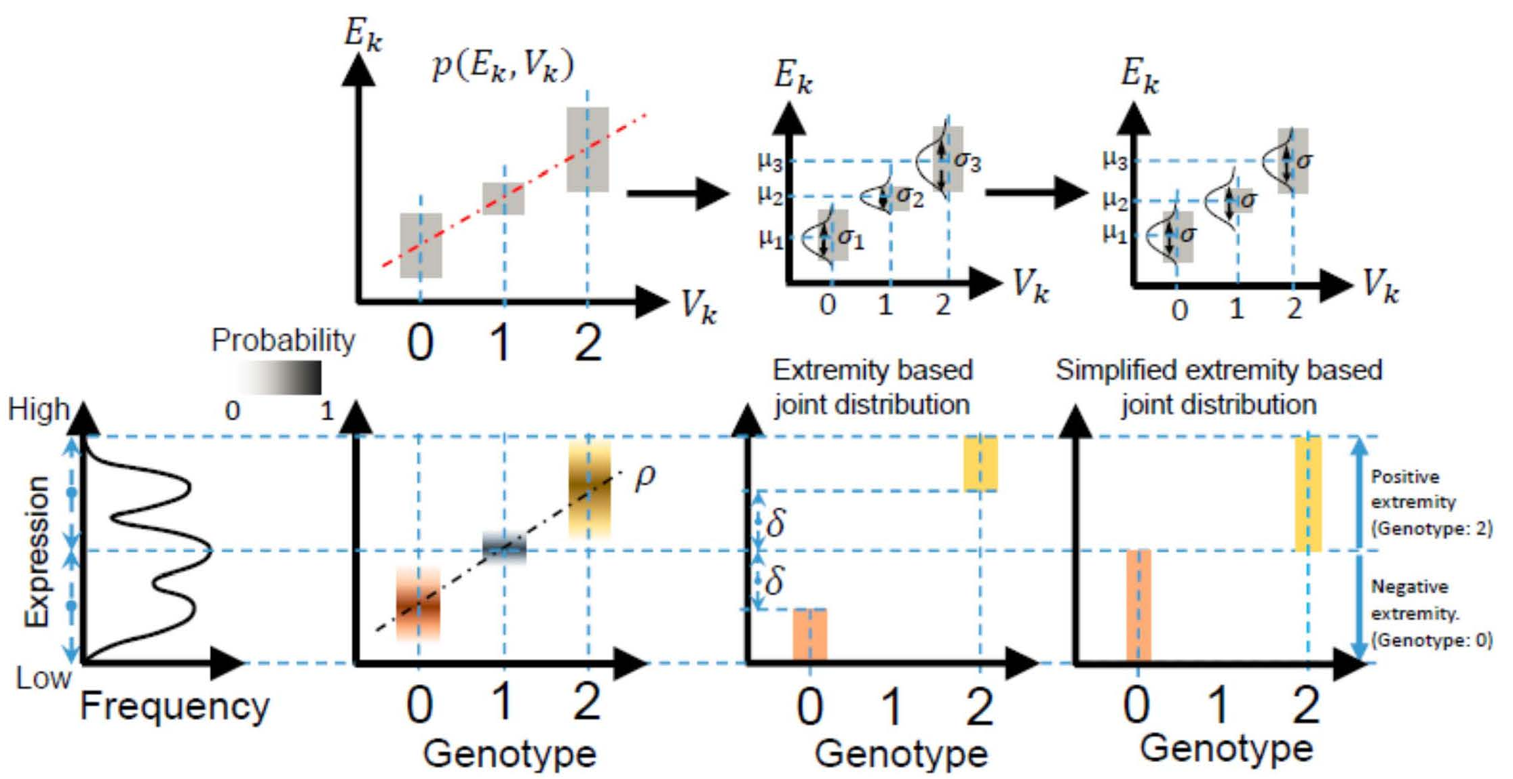
Levels of Expression-Genotype Model Simplifications for Genotype Prediction
[Harmanci et al. Nat. Meth. (16)]

Slide 25
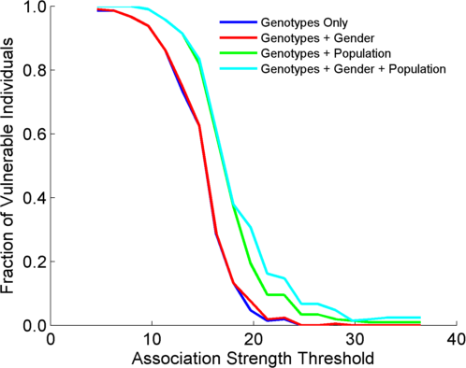
Success in Linking Attack with Extremity based Genotype Prediction
200 individuals eQTL Discovery
200 individuals in Linking Attack
High
Sensitivity
Low
Sensitivity
High Number
Of eQTLs
Low Number
Of eQTLs
[Harmanci et al. Nat. Meth. (16)]

Slide 26
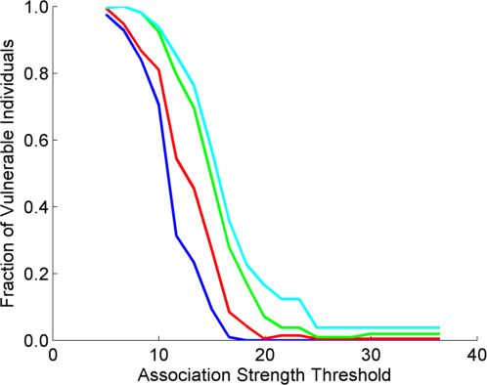
Success in Linking Attack with Extremity based Genotype Prediction
200 individuals eQTL Discovery
200 individuals in Linking Attack
200 individuals eQTL Discovery
100,200 individuals in Linking Attack
[Harmanci et al. Nat. Meth. (16)]

Slide 27
2 Sides of a Coin: Individual Privacy v. Easy RNA-Seq Mining
Introduction
to Genomic Privacy
  The dilemma: The genome as fundamental, inherited info that’s very private v need for large-scale mining for med. research
  2-sided nature of RNA-seq presents a particularly tricky privacy issue
Measuring Leakage
from eQTLs
  Quantifying & removing further variant info from expression levels + eQTLs using ICI & predictability
Linking Attacks from eQTLs
  Instantiating a practical linking attack using extreme expression levels
Signal Profiles
  Appreciable leakage from large & small deletions evident in signal profiles
  Linking attacks also possible but additional complication of SV discovery in addition to genotyping

Slide 28
Detection & Genotyping of small & large
SV deletions from signal profiles
RNA-Seq
Signal
Genomic
Coordinate
ChIP-Seq
Signals
A C G T A C G
Large Deletion
Genomic
Coordinate
Small Deletion
RNA-seq also shows large deletions
[Harmanci & Gerstein, Nat. Comm. (‘18)]

Slide 29
Example of Small Deletion Evident in Signal Profile
[Harmanci & Gerstein, Nat. Comm. (‘18)]

Slide 30
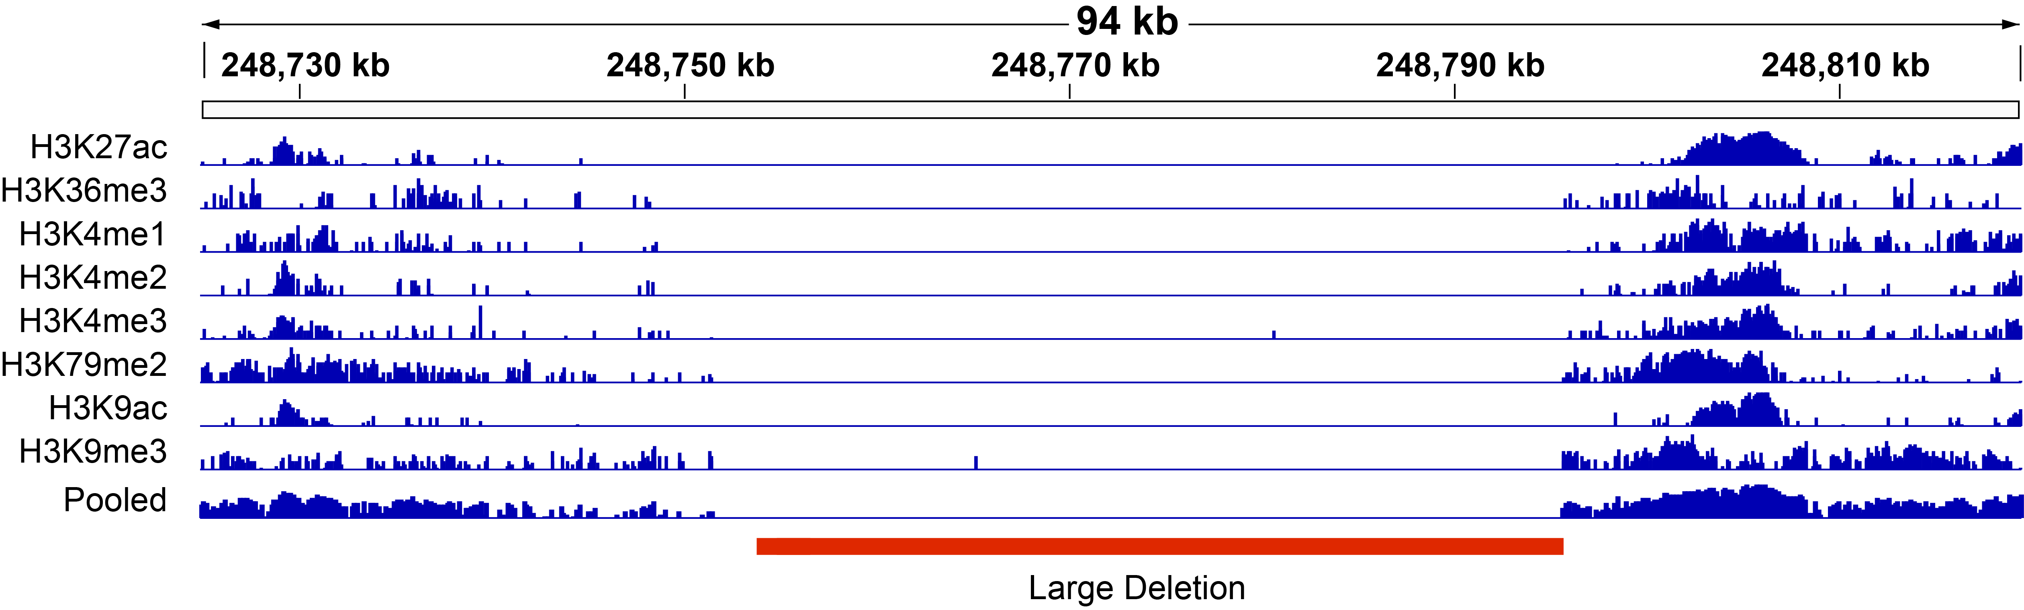
Example of Large Deletion Evident in Signal Profile
[Harmanci & Gerstein, Nat. Comm. (‘18)]

Slide 31
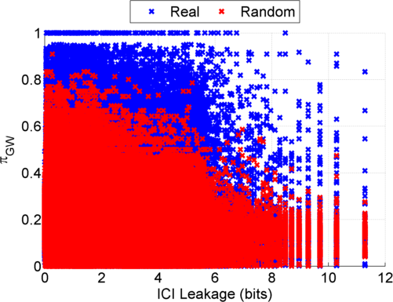
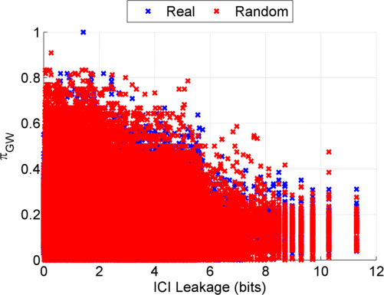
Information Leakage from SV Deletions
Before Anonymization
b) After Anonymization
Simple anonymization procedure (filling in deletion by value at endpoints) has dramatic effect
[Harmanci & Gerstein, Nat. Comm. (‘18)]
Notes:
GEUVADIS ICI-\Pi_GW estimates:

Slide 32
Another type of Linking Attack:
Linking based on SV Genotyping
[Harmanci & Gerstein, Nat. Comm. (‘18)]

Slide 33
Another type of Linking Attack:
First Doing SV Genotyping
[Harmanci & Gerstein, Nat. Comm. (‘18)]

Slide 34
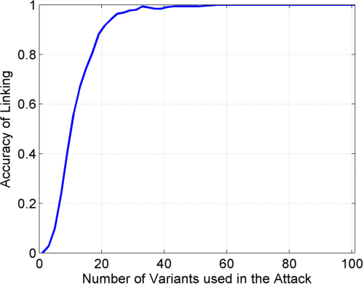
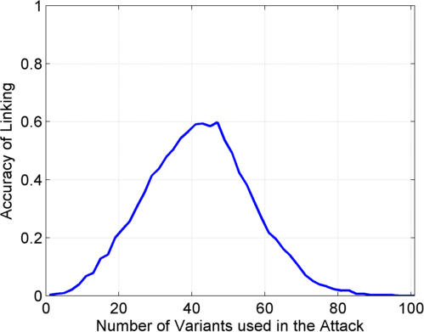
Linking Attack Based on SV Deletions in gEUVADIS Dataset
c) Genotyping
(1kG MAF>0.01)
d) Discovery + Genotyping
Sorted in Decreasing
Predictability
Sorted in Decreasing
Predictability
[Harmanci & Gerstein, Nat. Comm. (‘18)]

Slide 35
2 Sides of a Coin: Individual Privacy v. Easy RNA-Seq Mining
Introduction
to Genomic Privacy
  The dilemma: The genome as fundamental, inherited info that’s very private v need for large-scale mining for med. research
  2-sided nature of RNA-seq presents a particularly tricky privacy issue
Measuring Leakage
from eQTLs
  Quantifying & removing further variant info from expression levels + eQTLs using ICI & predictability
Linking Attacks from eQTLs
  Instantiating a practical linking attack using extreme expression levels
Signal Profiles
  Appreciable leakage from large & small deletions evident in signal profiles
  Linking attacks also possible but additional complication of SV discovery in addition to genotyping

Slide 36
2 Sides of a Coin: Individual Privacy v. Easy RNA-Seq Mining
Introduction
to Genomic Privacy
  The dilemma: The genome as fundamental, inherited info that’s very private v need for large-scale mining for med. research
  2-sided nature of RNA-seq presents a particularly tricky privacy issue
Measuring Leakage
from eQTLs
  Quantifying & removing further variant info from expression levels + eQTLs using ICI & predictability
Linking Attacks from eQTLs
  Instantiating a practical linking attack using extreme expression levels
Signal Profiles
  Appreciable leakage from large & small deletions evident in signal profiles
  Linking attacks also possible but additional complication of SV discovery in addition to genotyping

Slide 37

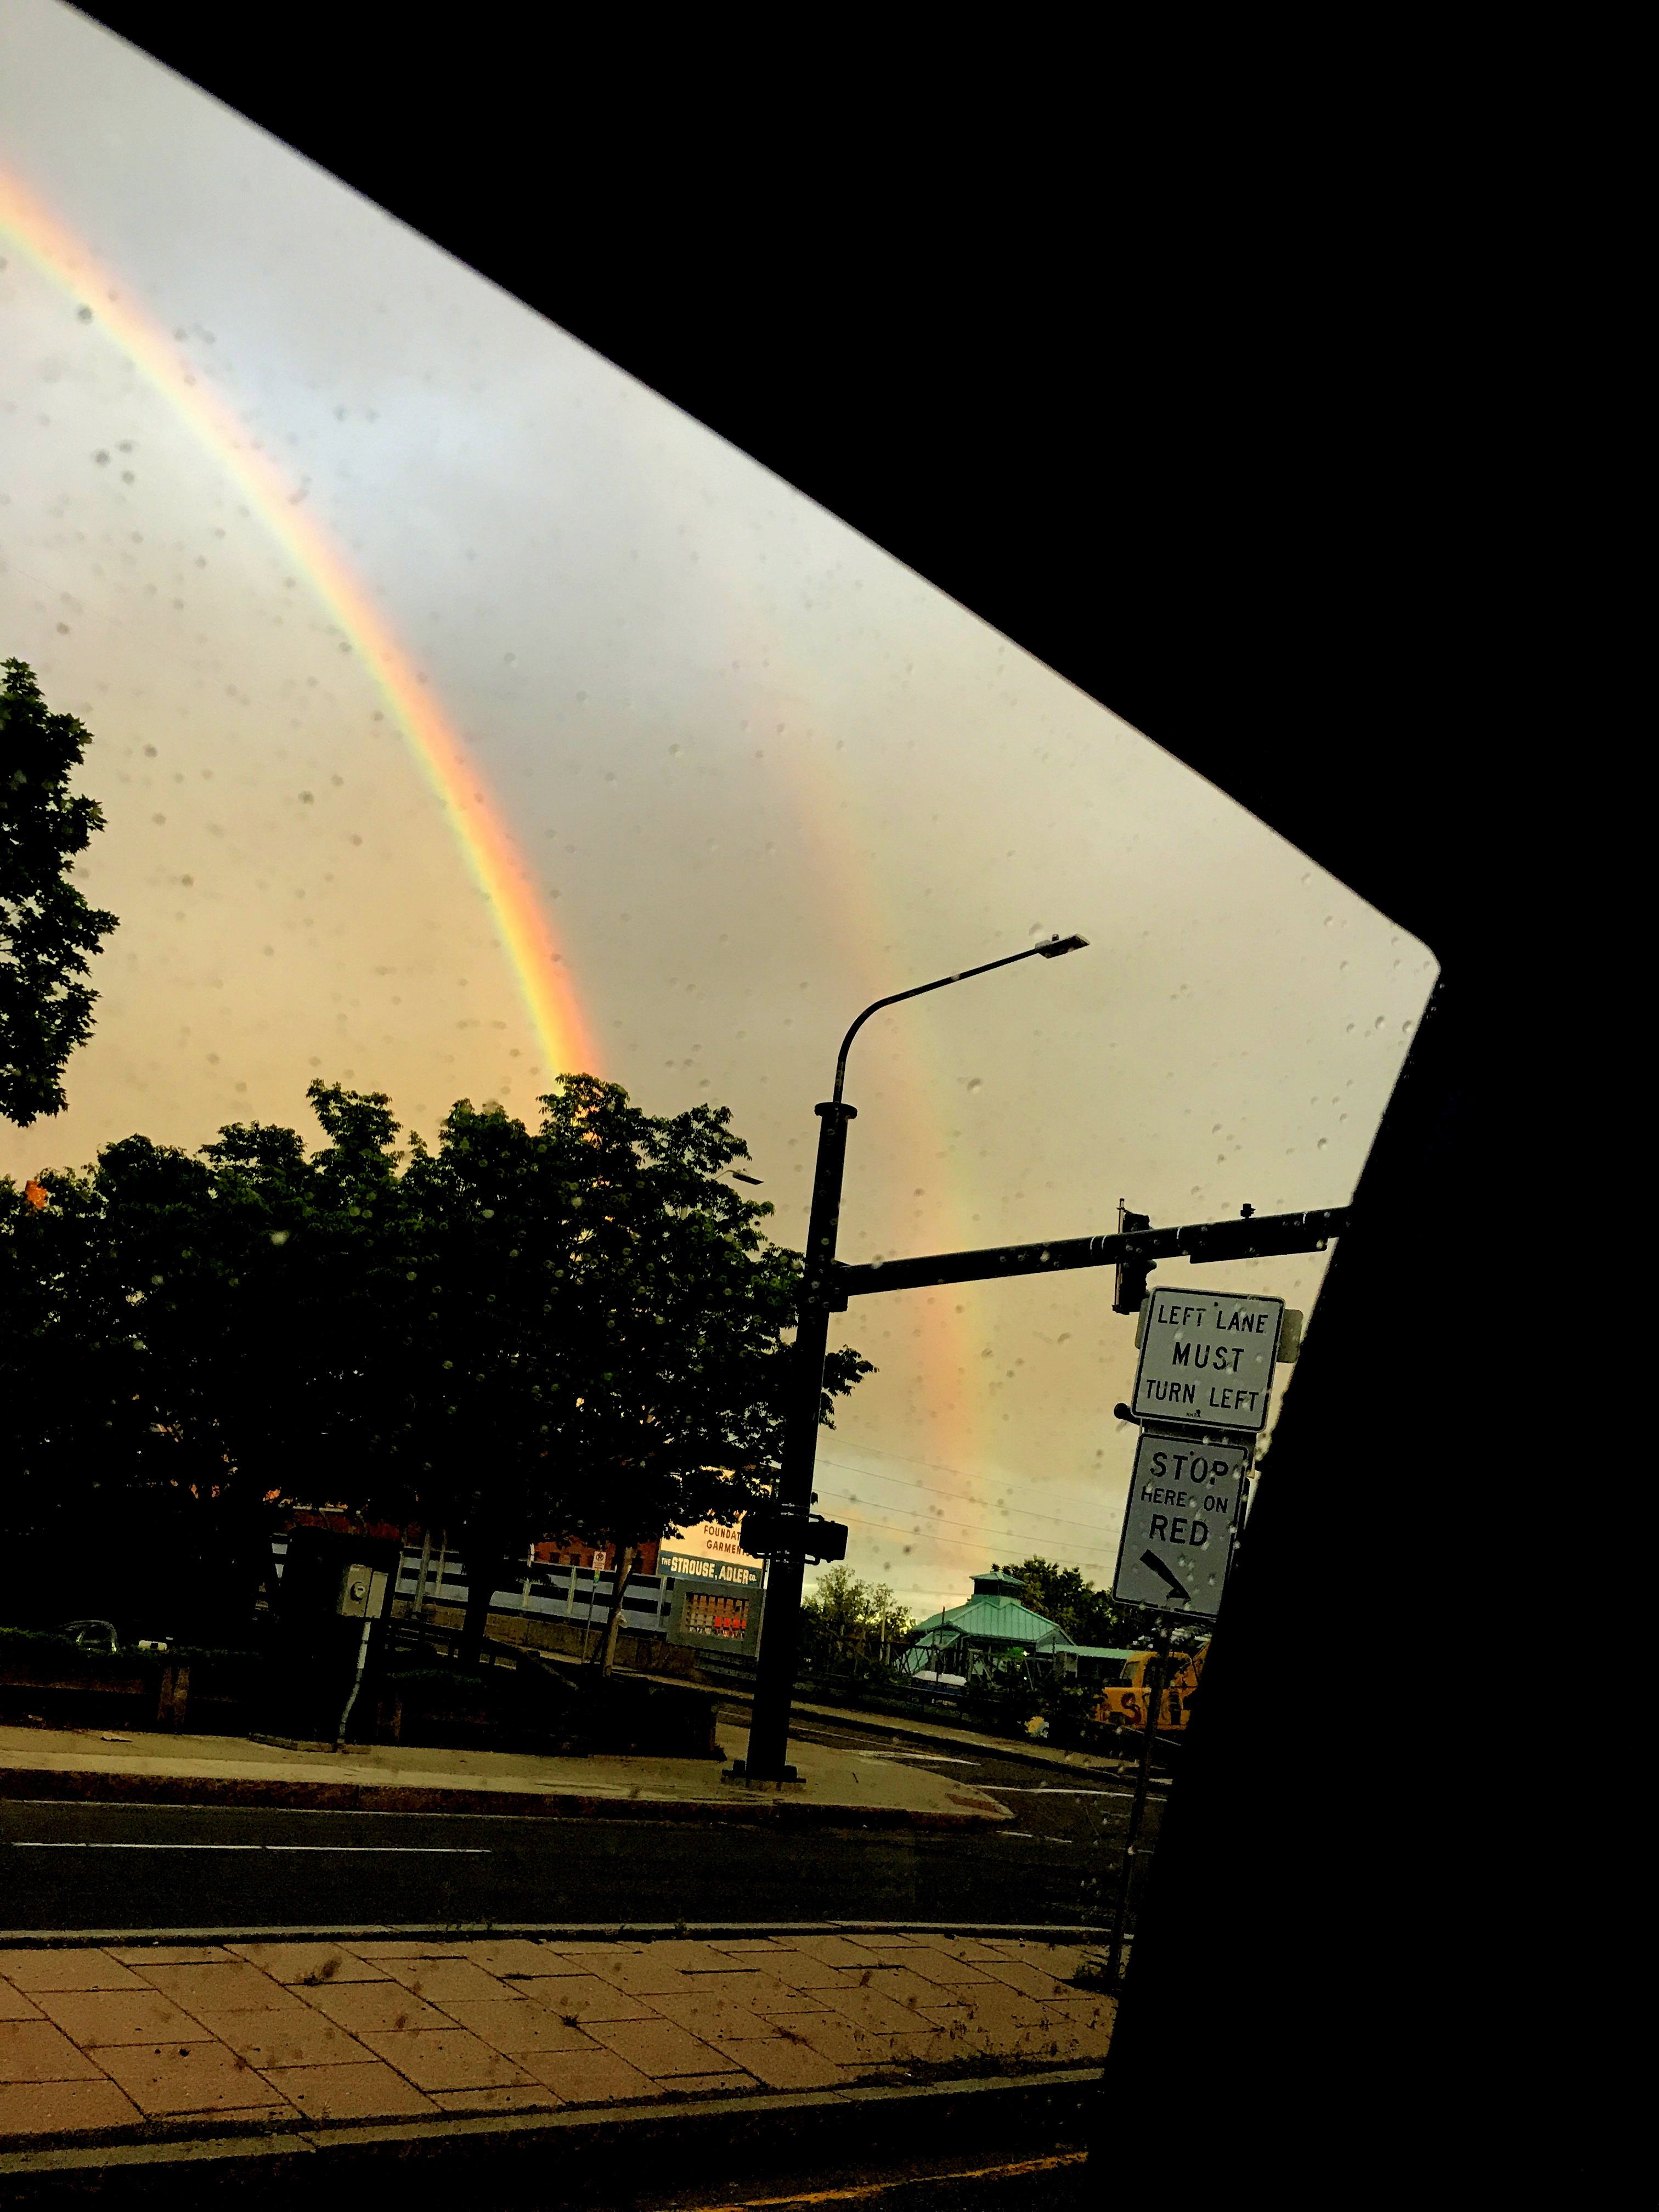
Acknowledgements
papers.gersteinlab.org/subject/privacy –
D Greenbaum
PrivaSeq.gersteinlab.org
PrivaSig.gersteinlab.org
A Harmanci

Slide 38
Info about content in this slide pack
General PERMISSIONS
  This Presentation is copyright Mark Gerstein,
  Yale University, 2017.
  Please read permissions statement at
  www.gersteinlab.org/misc/permissions.html .
  Feel free to use slides & images in the talk with PROPER acknowledgement
  (via citation to relevant papers or link to gersteinlab.org).
  Paper references in the talk were mostly from Papers.GersteinLab.org.
PHOTOS & IMAGES. For thoughts on the source and permissions of many of the photos and clipped images in this presentation see http://streams.gerstein.info .
  In particular, many of the images have particular EXIF tags, such as kwpotppt , that can be easily queried from flickr, viz: http://www.flickr.com/photos/mbgmbg/tags/kwpotppt

