Slide 1

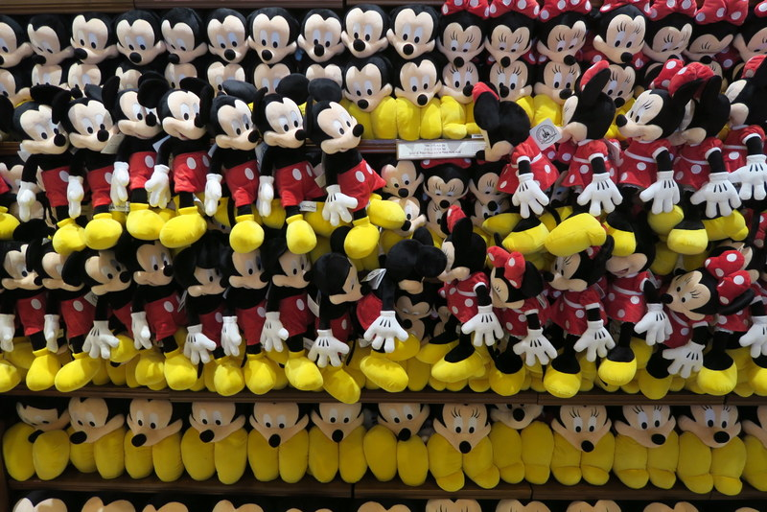
Leveraging Protein Structure & Dynamics for Variant Interpretation in Coding Regions
Mark Gerstein
Yale
Slides freely downloadable from Lectures.GersteinLab.org & “tweetable” (via @MarkGerstein).
No Conflicts for this Talk. See last slide for more info.

Slide 2
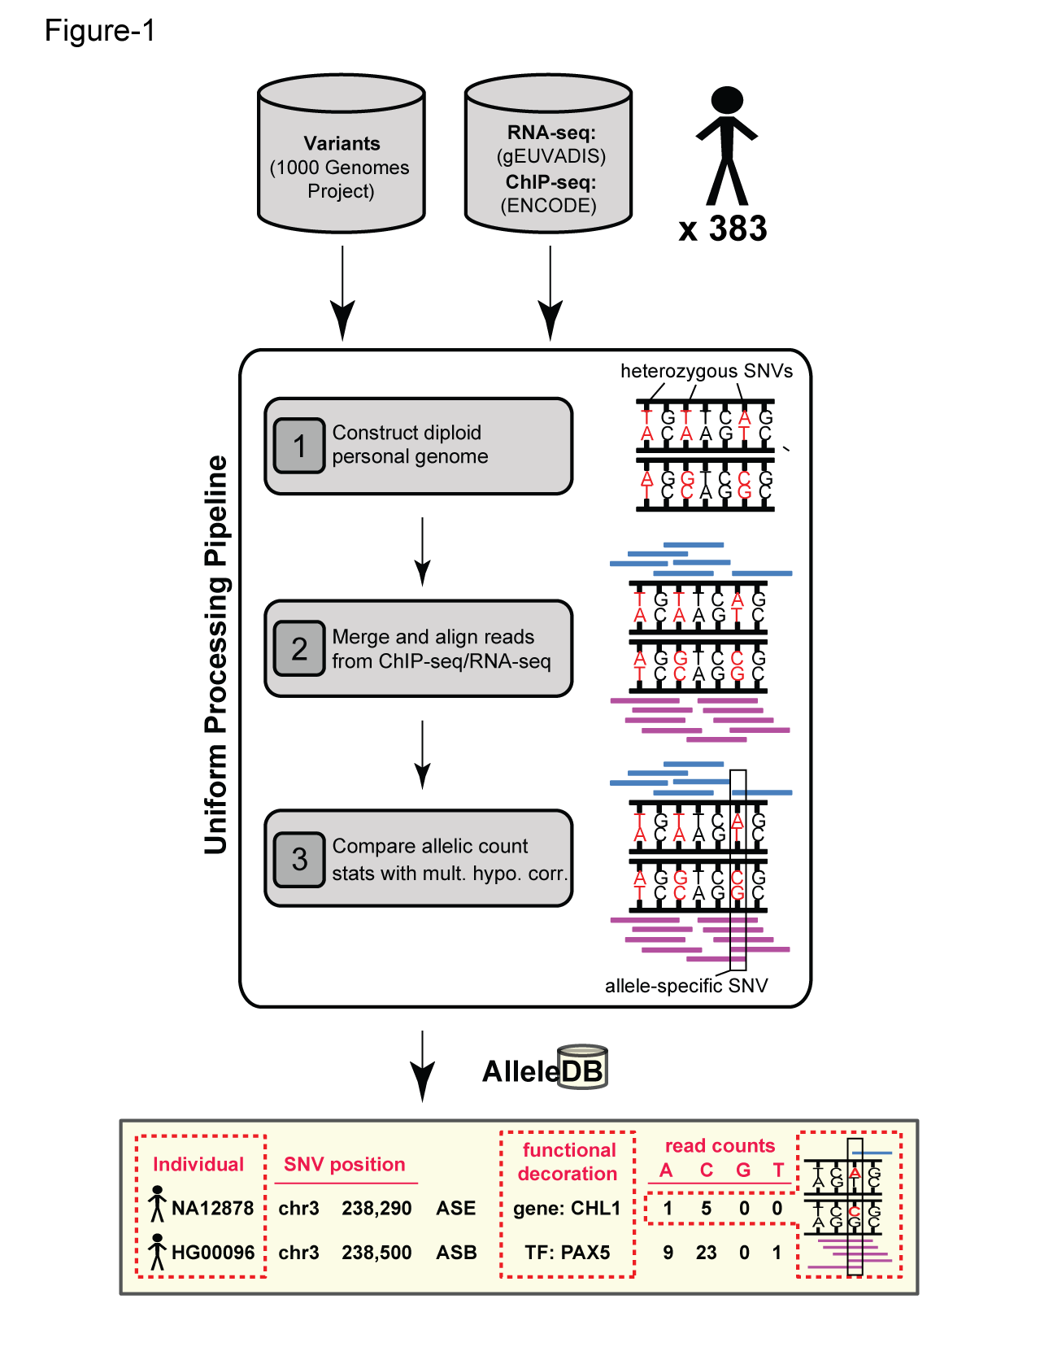
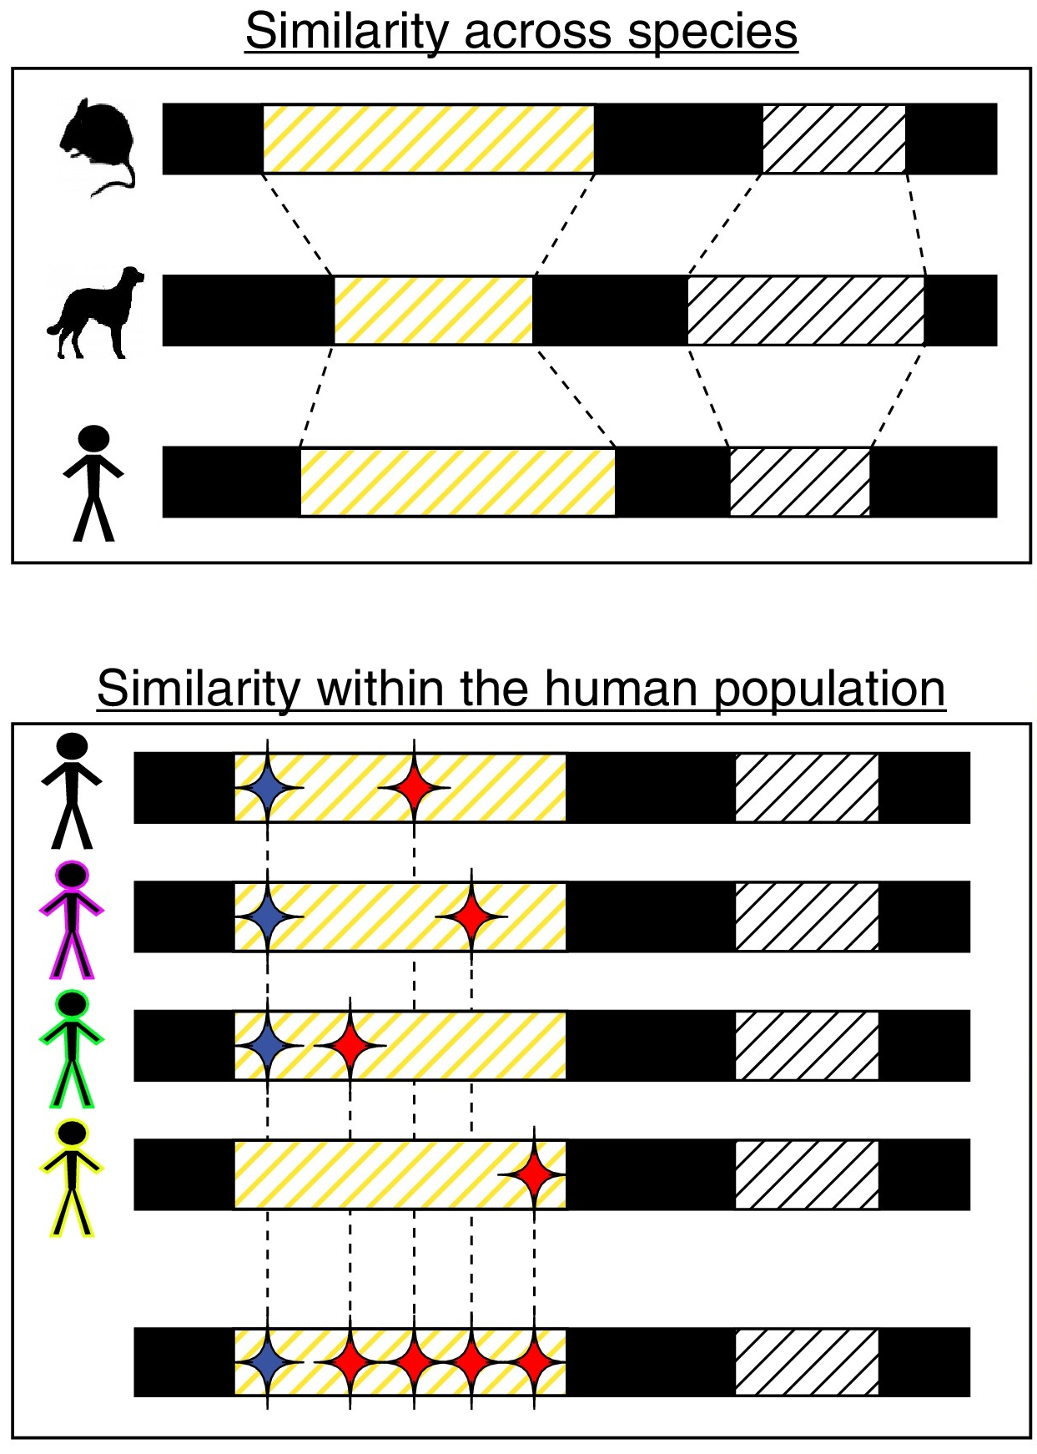


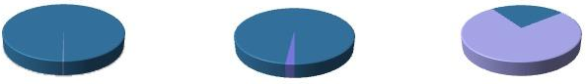
Human Genetic Variation:
the prevalence of rare variants in population studies
Population of
2,504 peoples
A Cancer Genome
A Typical Genome
Origin of Variants
Class of Variants
 | Coding | Non- coding
Germ- line | 22K | 4.1 – 5M
Somatic | ~50 | 5K
SNP | 3.5 – 4.3M
Indel | 550 – 625K
SV | 2.1 – 2.5K (20Mb)
Total | 4.1 – 5M
SNP | 84.7M
Indel | 3.6M
SV | 60K
Total | 88.3M
Prevalence of Variants
Common
Common
Passenger
Driver (~0.1%)
Rare* (1-4%)
Rare (~75%)
* Variants with allele frequency < 0.5% are considered as rare variants in 1000 genomes project.
The 1000 Genomes Project Consortium, Nature. 2015. 526:68-74
Khurana E. et al. Nat. Rev. Genet. 2016. 17:93-108
[Sethi et al. COSB (’15)]

Slide 3

Rare variant analysis particularly applicable at the moment because of the many exomes
CMG rare disease variants & TCGA somatic variants
  Main NIH disease genomic project
  Both of these focus on ”rare” variant for which GWAS is not meaningful
  Larger numbers of individual exomes more important than WGS
Exomes have the current potential for great scale with the better impact interpretability of coding variants, often in a region of known protein structure
  Scale of EXAC, >60K exomes
  [Lek et al. ‘16]

Slide 4
Structure & genomics
Structure particularly useful for interpreting the impact of the many rare variants whose effect can not be found via GWAS
Also, integration of structure data with genomic variants, EHR & drug data will be key for realizing the goal of precision medicine.
Gerstein et al., Nat. Struct. Bio. 2000
Hauser et al., Cell 2018

Slide 5
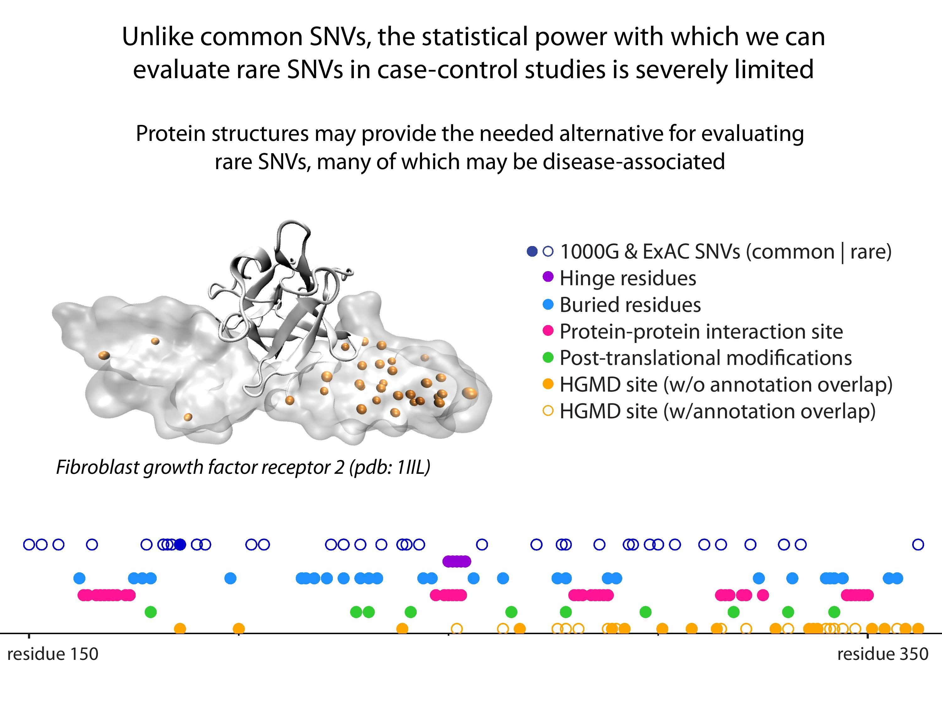
[Sethi et al. COSB (’15)]

Slide 6
Leveraging Protein Structure and Dynamics for Variant Interpretation in Coding Regions
Background on rare & common variants
Identifying cryptic allosteric sites with STRESS
  On surface & in interior bottlenecks
Frustration as a localized metric of SNV impact
  Differential profiles for oncogenes v. TSGs
ALoFT: Annotation of Loss-of-Function Transcripts

Slide 7
Leveraging Protein Structure and Dynamics for Variant Interpretation in Coding Regions
Background on rare & common variants
Identifying cryptic allosteric sites with STRESS
  On surface & in interior bottlenecks
Frustration as a localized metric of SNV impact
  Differential profiles for oncogenes v. TSGs
ALoFT: Annotation of Loss-of-Function Transcripts

Slide 8
Models of Protein Conformational Change
Motion Vectors from Normal Modes (ANMs)
PDB ID: 3RFU
Adapted from Fuglebakk et al, 2014
Characterizing uncharacterized variants
<= Finding Allosteric sites
<= Modeling motion

Slide 9
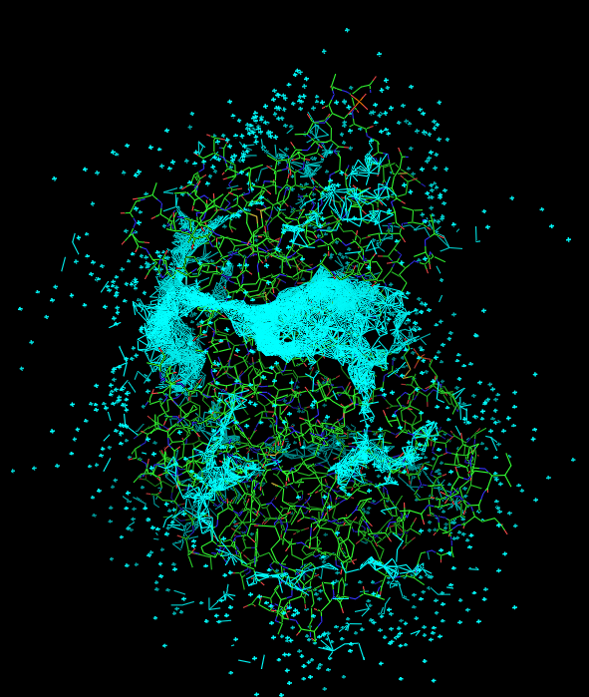
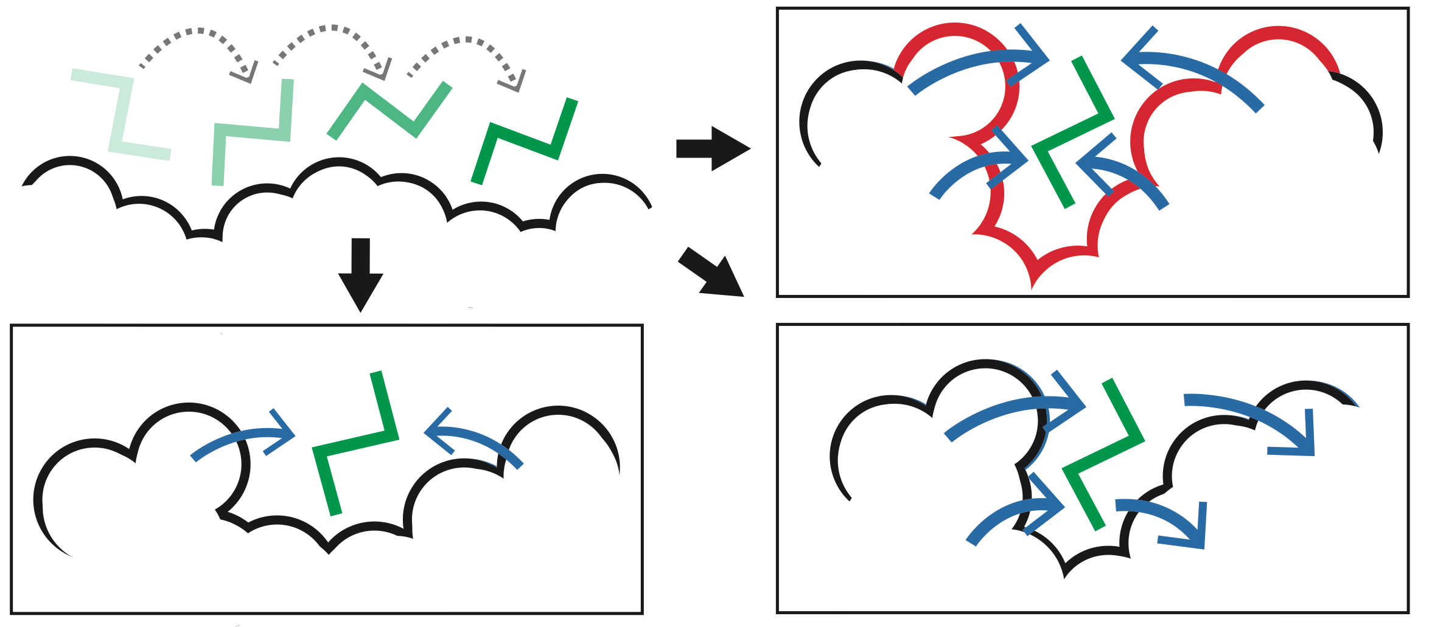
Predicting Allosterically-Important Residues at the Surface
MC simulations generate a large number of candidate sites
Score each candidate site by the degree to which it perturbs large-scale motions
Prioritize & threshold the list to identify the set of high confidence-sites
pdb 1J3H
Surface region with high
density of candidate sites
Surface region with low density of candidate sites
Adapted from Clarke*, Sethi*, et al (‘16)

Slide 10
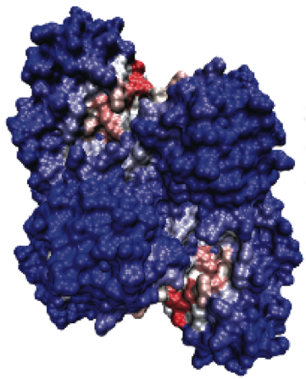
Predicting Allosterically-Important Residues at the Surface
PDB: 3PFK
Adapted from Clarke*, Sethi*, et al (‘16)

Slide 11
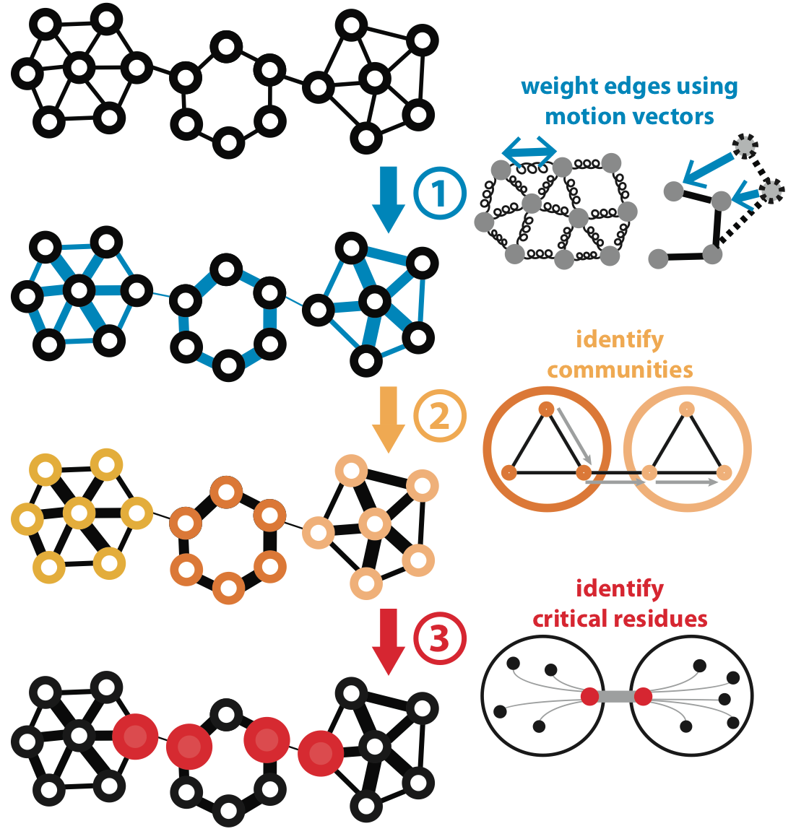
Predicting Allosterically-Important Residues within the Interior
Adapted from Clarke*, Sethi*, et al (‘16)

Slide 12
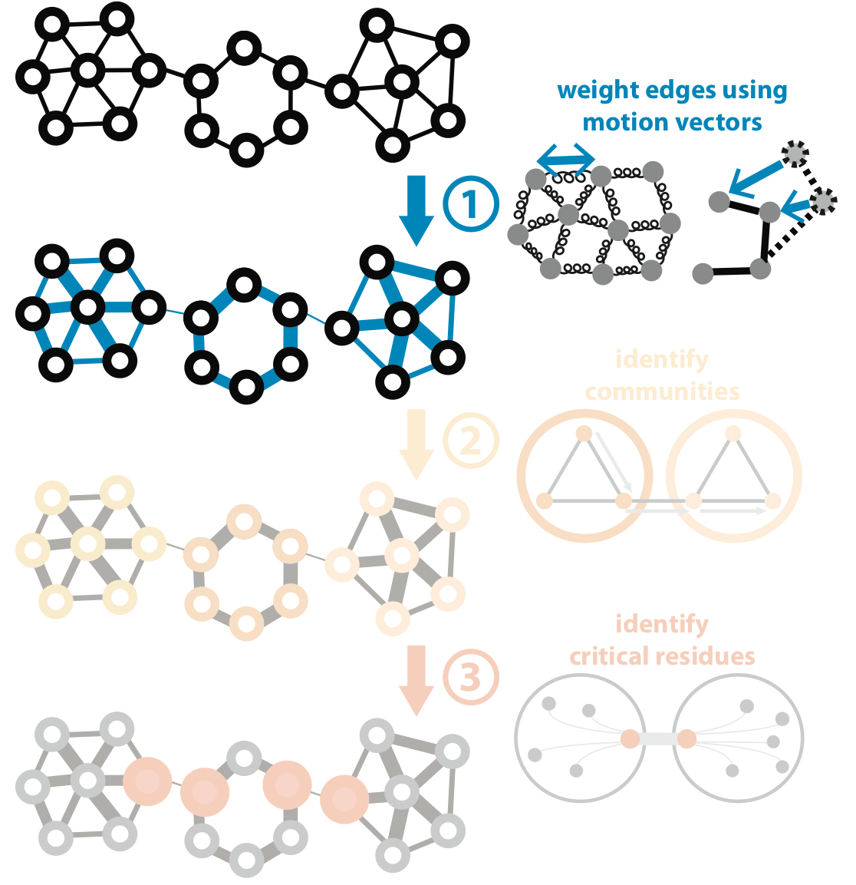
Predicting Allosterically-Important Residues within the Interior
Adapted from Clarke*, Sethi*, et al (‘16)

Slide 13
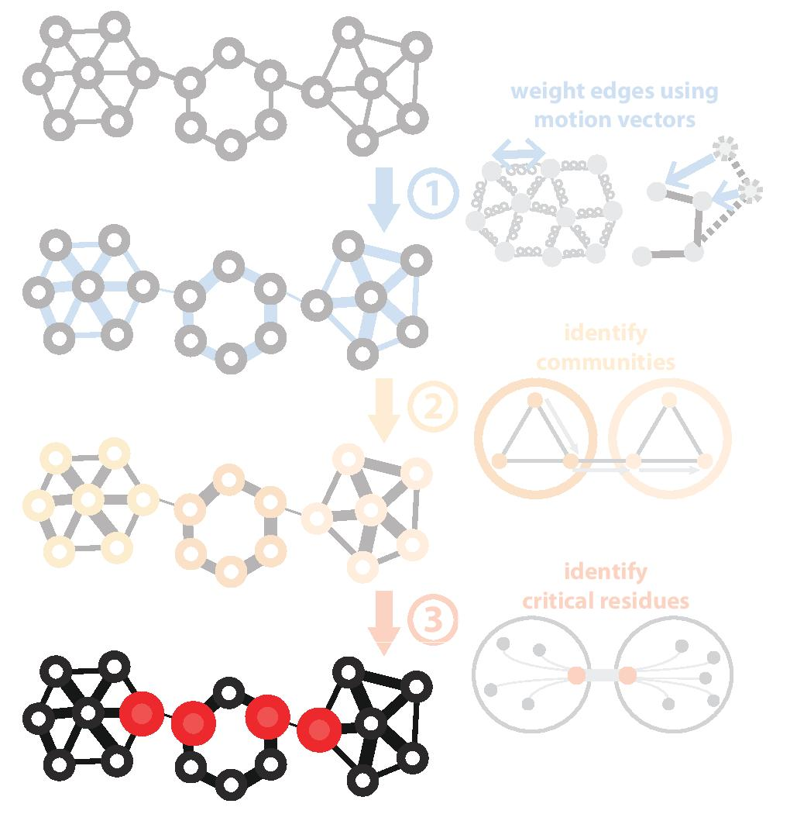
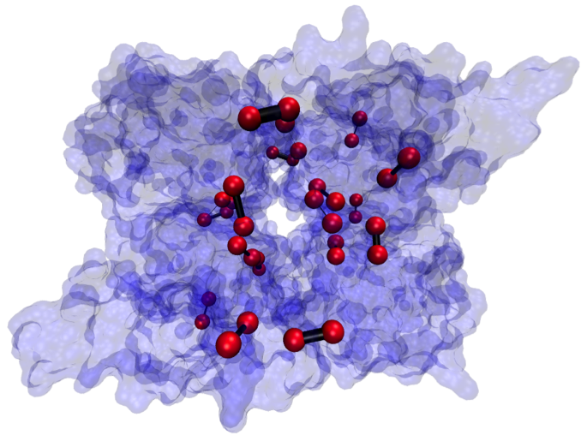
Predicting Allosterically-Important Residues within the Interior
PDB: 1XTT
Adapted from Clarke*, Sethi*, et al (‘16)

Slide 14
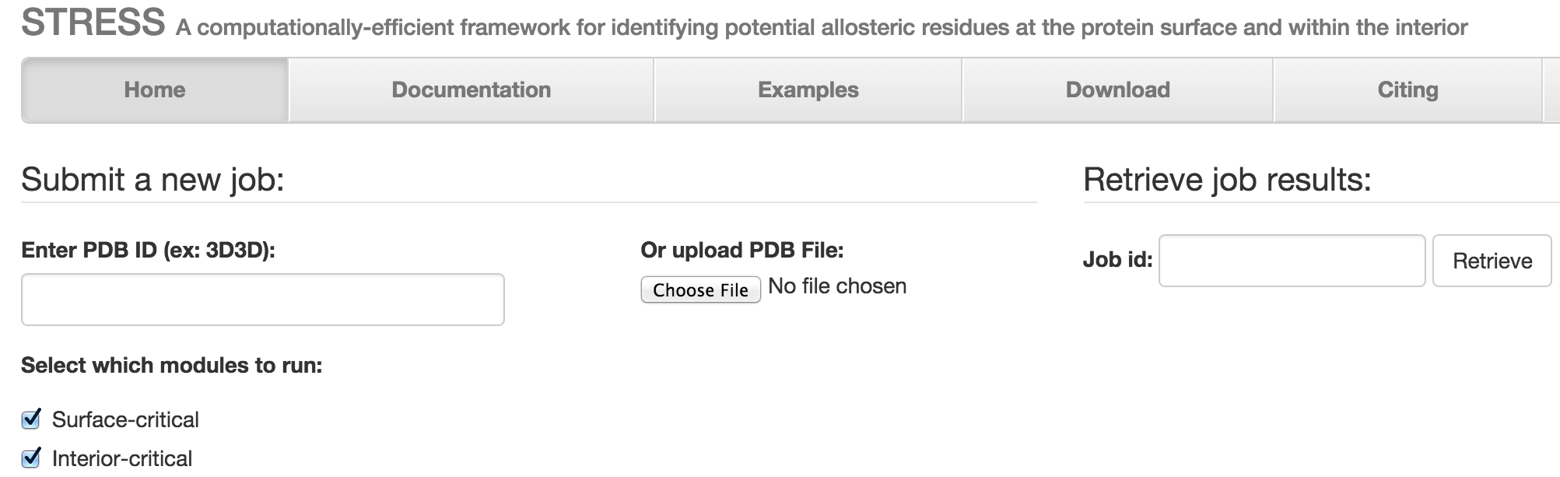
STRESS Server Architecture: Highlights
stress.molmovdb.org
A light front-end server handles incoming requests, and powerful back-end servers perform calculations.
Auto Scaling adjusts the number of back-end servers as needed.
A typical structure takes ~30 minutes on a E5-2660 v3 (2.60GHz) core.
Input & output (i.e., predicted allosteric residues) are stored in S3 buckets.
Adapted from Clarke*, Sethi*, et al (‘16)

Slide 15
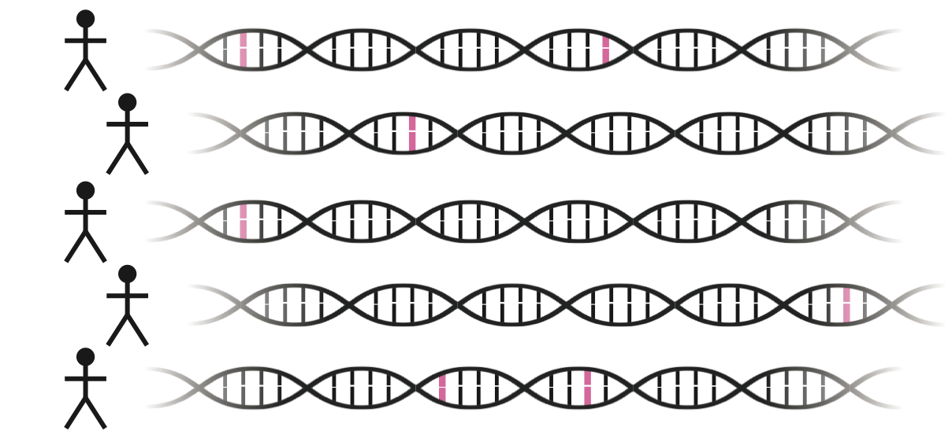
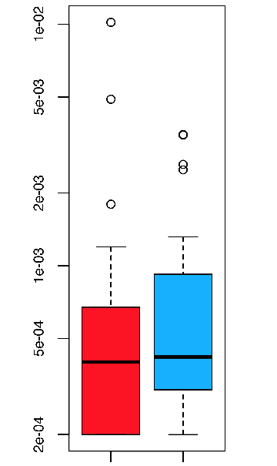
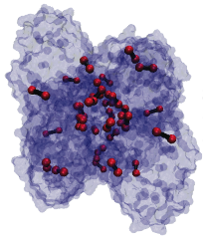
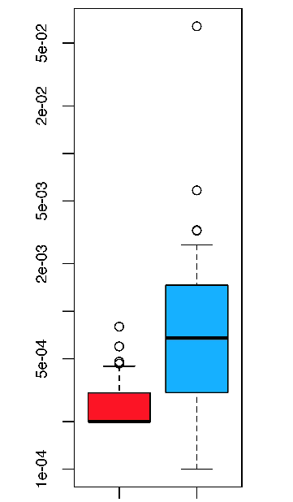
Intra-species conservation of predicted allosteric residues
1000 Genomes
Surface
Interior
Derived Allele Freq.
Derived Allele Freq.
p=0.309
p=1.80e-05
Adapted from Clarke*, Sethi*, et al (‘16)

Slide 16
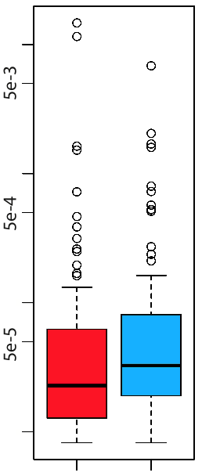
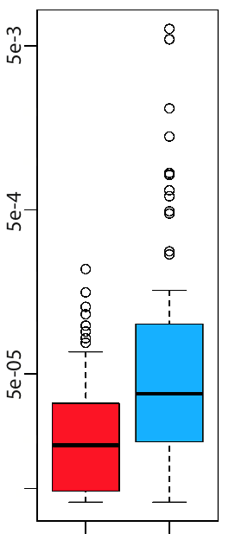
Intra-species conservation of predicted allosteric residues
ExAC
Surface
Interior
Minor Allele Freq.
Minor Allele Freq.
p=1.49e-3
p=7.98e-09
Adapted from Clarke*, Sethi*, et al (‘16)

Slide 17
[Sethi et al. COSB (’15)]

Slide 18
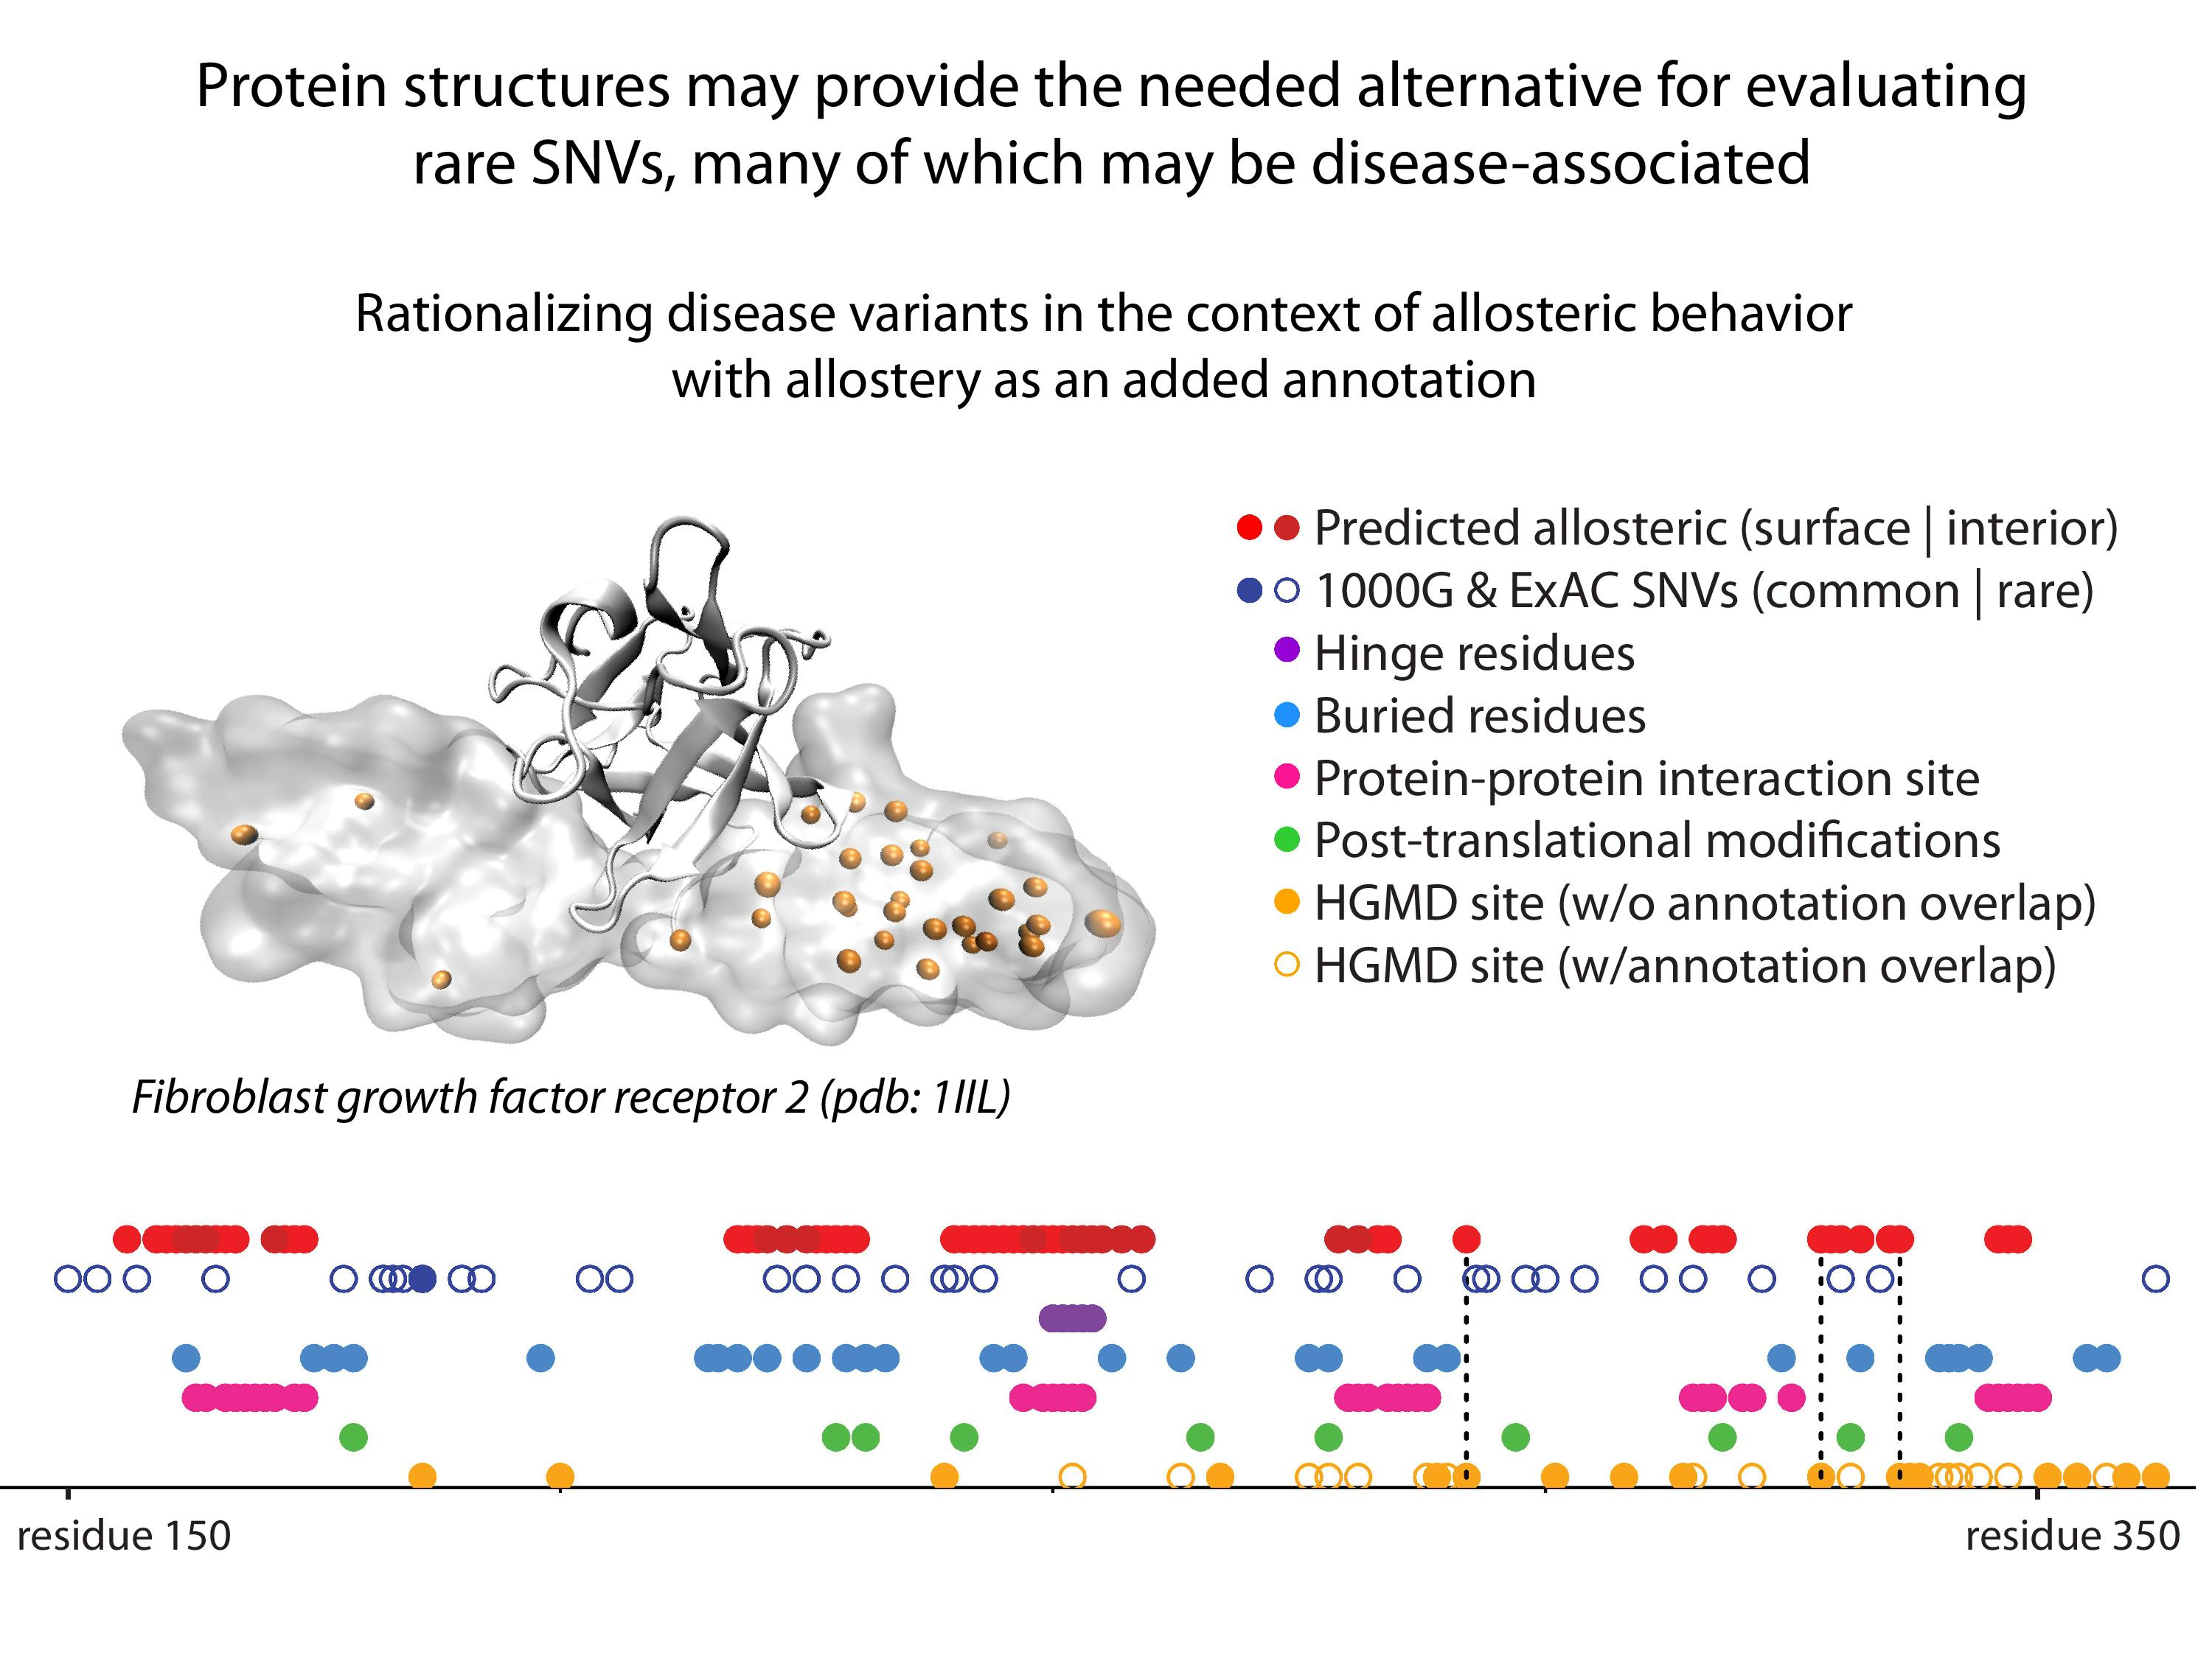
18
[Sethi et al. COSB (’15)]
Adapted from Clarke*, Sethi*, et al (in press)

Slide 19
Leveraging Protein Structure and Dynamics for Variant Interpretation in Coding Regions
Background on rare & common variants
Identifying cryptic allosteric sites with STRESS
  On surface & in interior bottlenecks
Frustration as a localized metric of SNV impact
  Differential profiles for oncogenes v. TSGs
ALoFT: Annotation of Loss-of-Function Transcripts

Slide 20
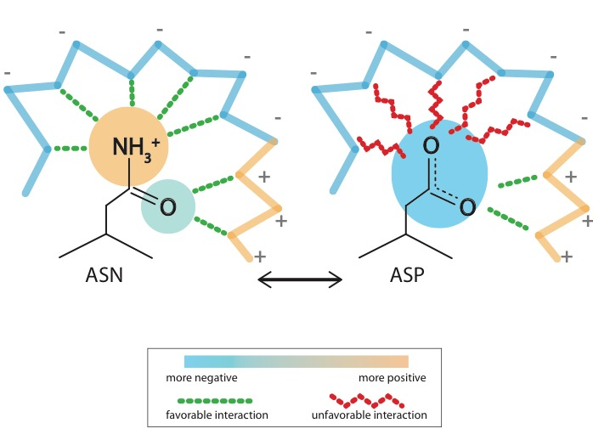
What is localized frustration?
[Ferreiro et al., PNAS (’07)]

Slide 21
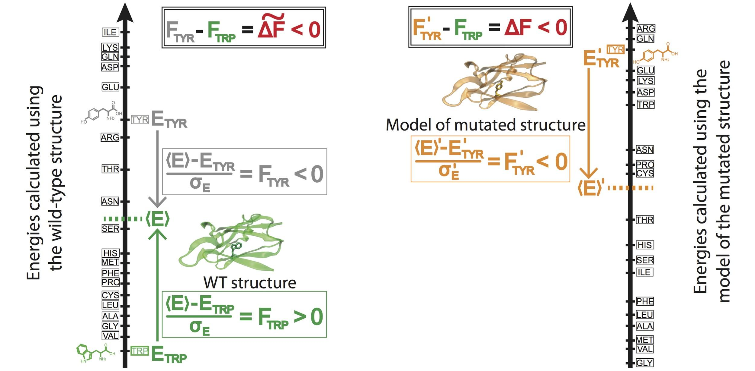
Workflow for evaluating localized frustration changes (∆F)
[Kumar et al. NAR (2016)]
Notes:
An example illustrating the case in which ∆F < 0. The ∆F associated with an SNV is negative if the SNV introduces a destabilizing effect. Shown here is the result of changing residue ID 31 in plastocyanin (pdb ID 3CVD) from the wild-type residue (Trp) to a mutated residue (Tyr). Left) The protein in its wild-type form (in green), in which the tryptophan residue at position 31 is substantially more energetically favorable relative to the mean energy ⟨E⟩ that would result from having any of the possible 20 amino acids at that position. This disparity is designated by (⟨E⟩ - E_{nat})/σ_{E} = F_{nat} > 0. Right) The entire protein structure is then modeled to generate the mutated structure after the SNV W31Y is introduced, thereby changing the relative energetic distributions for the different amino acids. The new mean and standard deviation associated with the energies of the modeled structure are designated by ⟨E⟩’ and σ_{E}’, respectively. In this case, the SNV that introduces 31Y results in an energy that is higher than the mean energy of all possible 20 amino acids at that position. This disparity is designated by (⟨E⟩’ - E_{mut})/σ_{E}’ = F_{mut} < 0. Taken together, the negative value associated with the disparity between the F_{mut} and F_{nat} values (F_{mut} - F_{nat} = ∆F < 0) indicates that the this SNV is locally unfavorable.

Slide 22
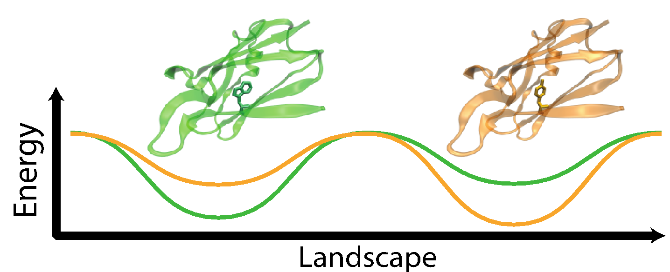
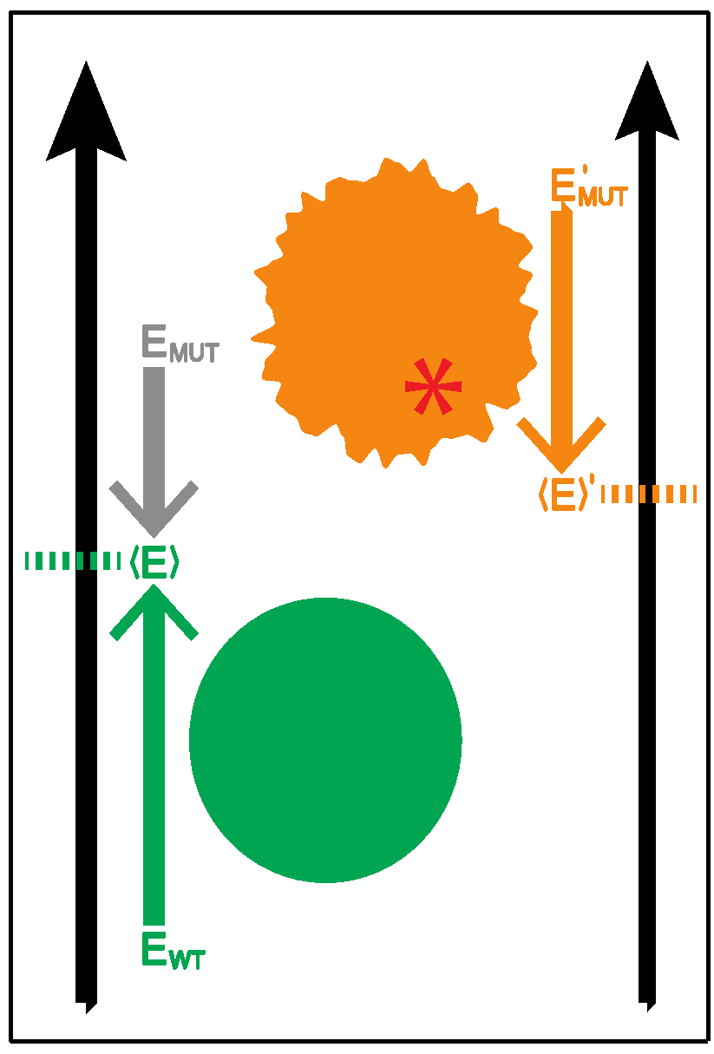
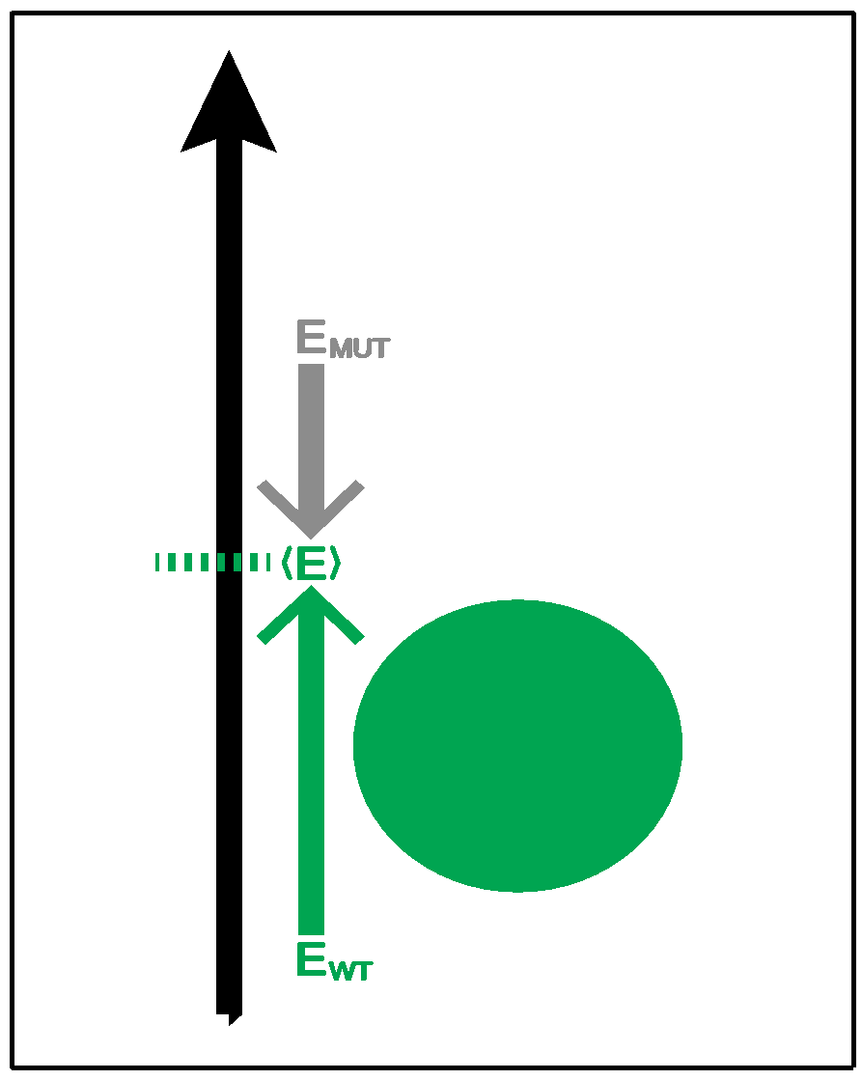
Complexity of the second order frustration calculation
MD-assisted free energy calculation (∆G)
Second order frustration calculation (∆F)
Time
First order frustration calculation (F)
Accuracy

Slide 23
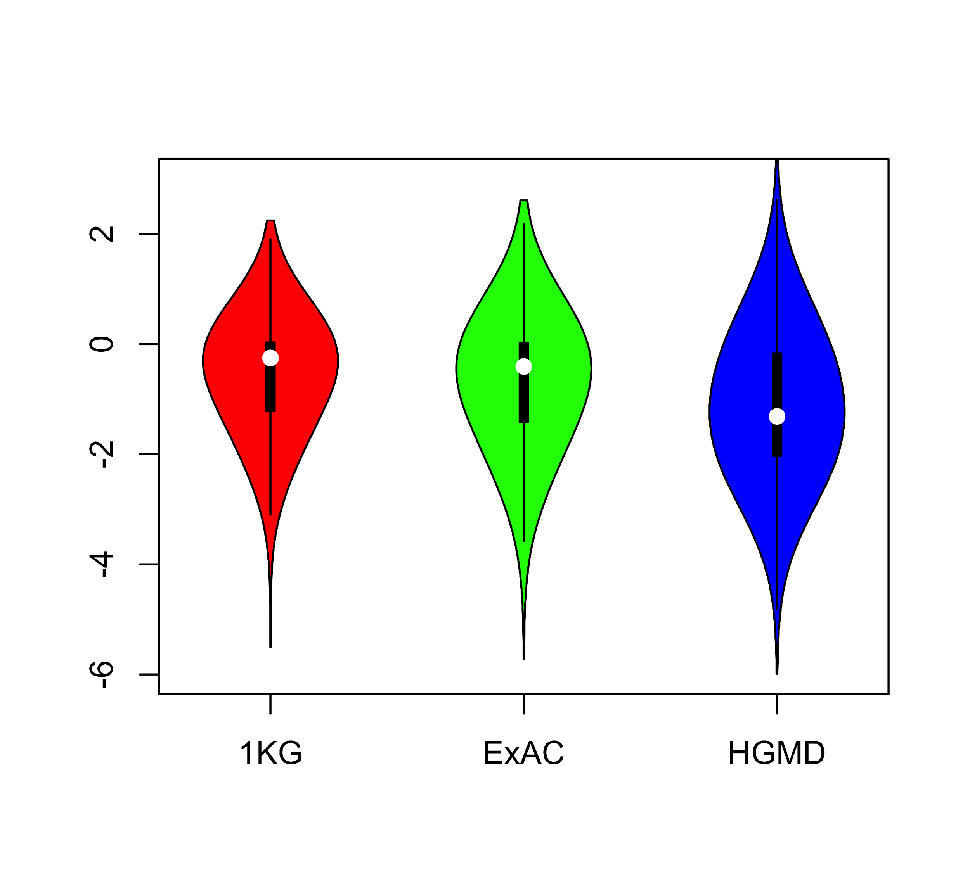
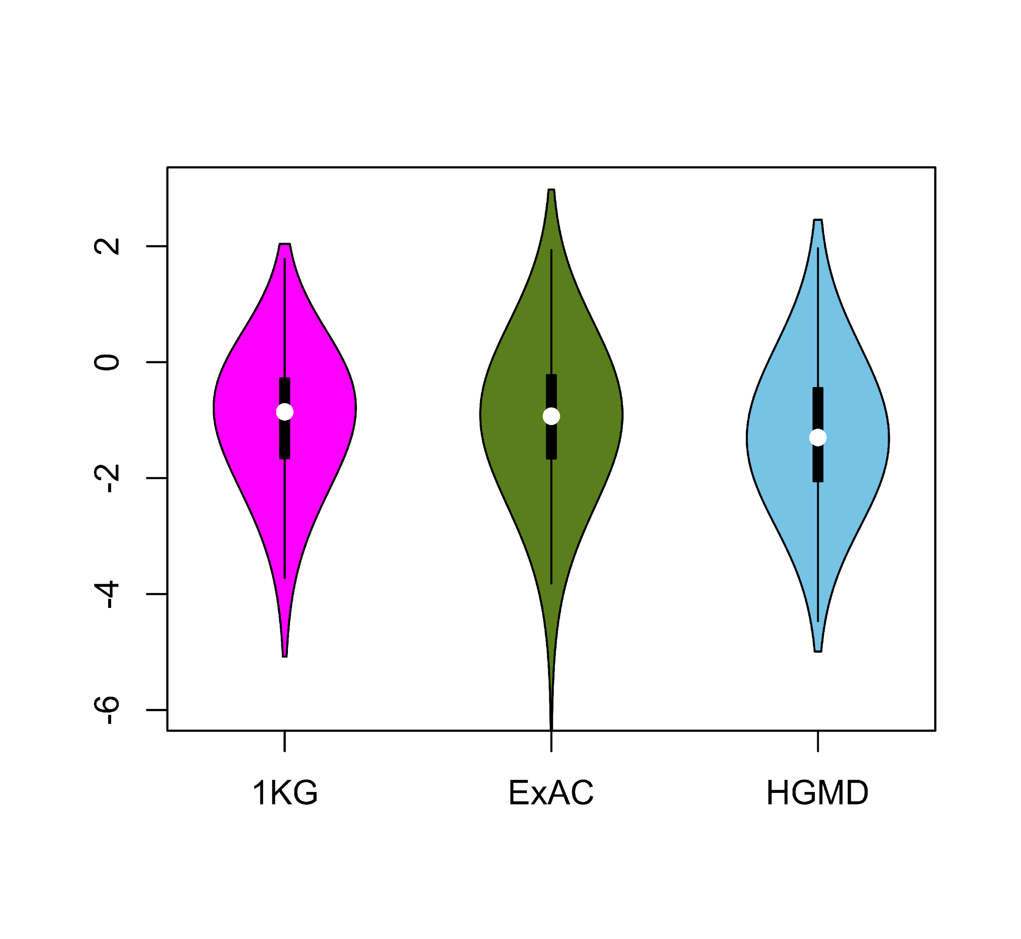
Comparing ∆F values across different SNV categories: disease v normal
Loss of frustration
Gain of frustration
Core residues
Surface residues
Normal mutations (1000G) tend to unfavorably frustrate (less frustrated) surface more than core,
but for disease mutations (HGMD)
no trend & greater changes
[Kumar et al, NAR (2016)]
Notes:
We observed that benign SNVs lead to greater disruptions within minimally frustrated surface residues compared to core residues in the native structure, and this trend is observed when using both ExAC and 1KG (Figure A & B). However, SNVs from HGMD that impact minimally frustrated core residues induce stronger perturbations than benign SNVs influencing minimally frustrated core residues (Figure C). This suggest that the mechanistic difference between benign and disease SNVs can be attributed to their impact on the local environment of core residues. Within the core, disease-associated SNVs result in more severe perturbations to local interactions relative to those introduced by benign SNVs. These local disruptions are propagated throughout the core and, in turn, drive the deleteriousness of various disease-associated SNVs.

Slide 24
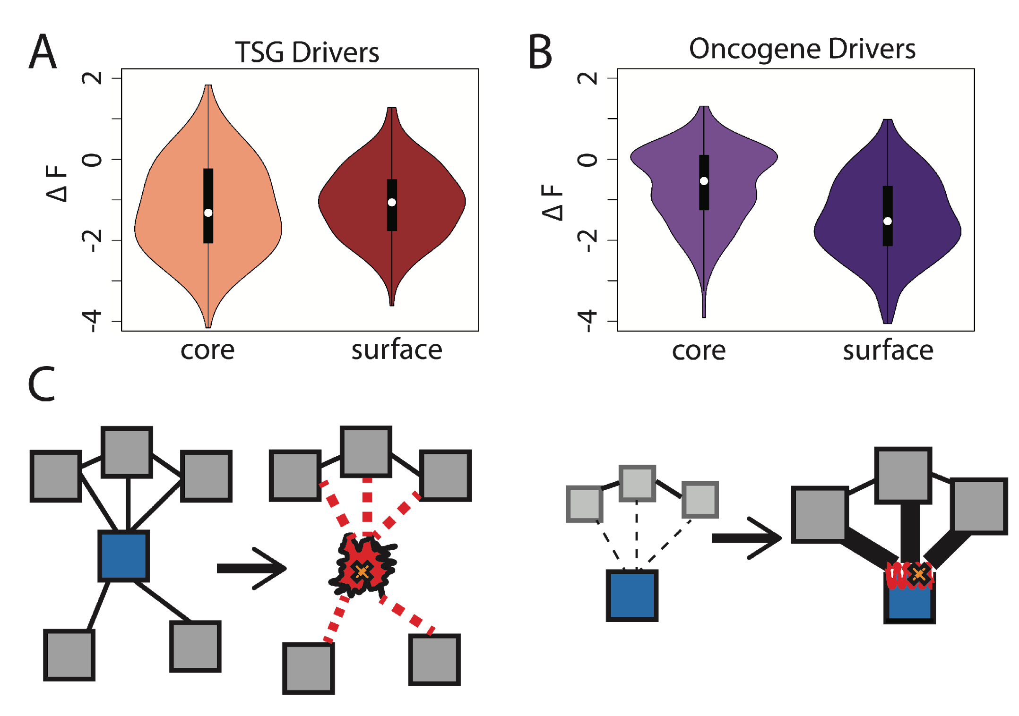
Comparison between ∆F distributions: TSGs v. oncogenes
[Kumar et al, NAR (2016)]
SNVs in TSGs change frustration more in core than the surface, whereas those associated with oncogenes manifest the opposite pattern. This is consistent with differences in LOF v GOF mechanisms.
Notes:
we observe that somatic SNVs associated with TSGs change the frustration more in core than the surface, whereas those associated with oncogenes manifest the opposite pattern. This is consistent with LOF and GOF mechanism proposed for TSG and oncogene driven cancer progression.

Slide 25
Leveraging Protein Structure and Dynamics for Variant Interpretation in Coding Regions
Background on rare & common variants
Identifying cryptic allosteric sites with STRESS
  On surface & in interior bottlenecks
Frustration as a localized metric of SNV impact
  Differential profiles for oncogenes v. TSGs
ALoFT: Annotation of Loss-of-Function Transcripts

Slide 26
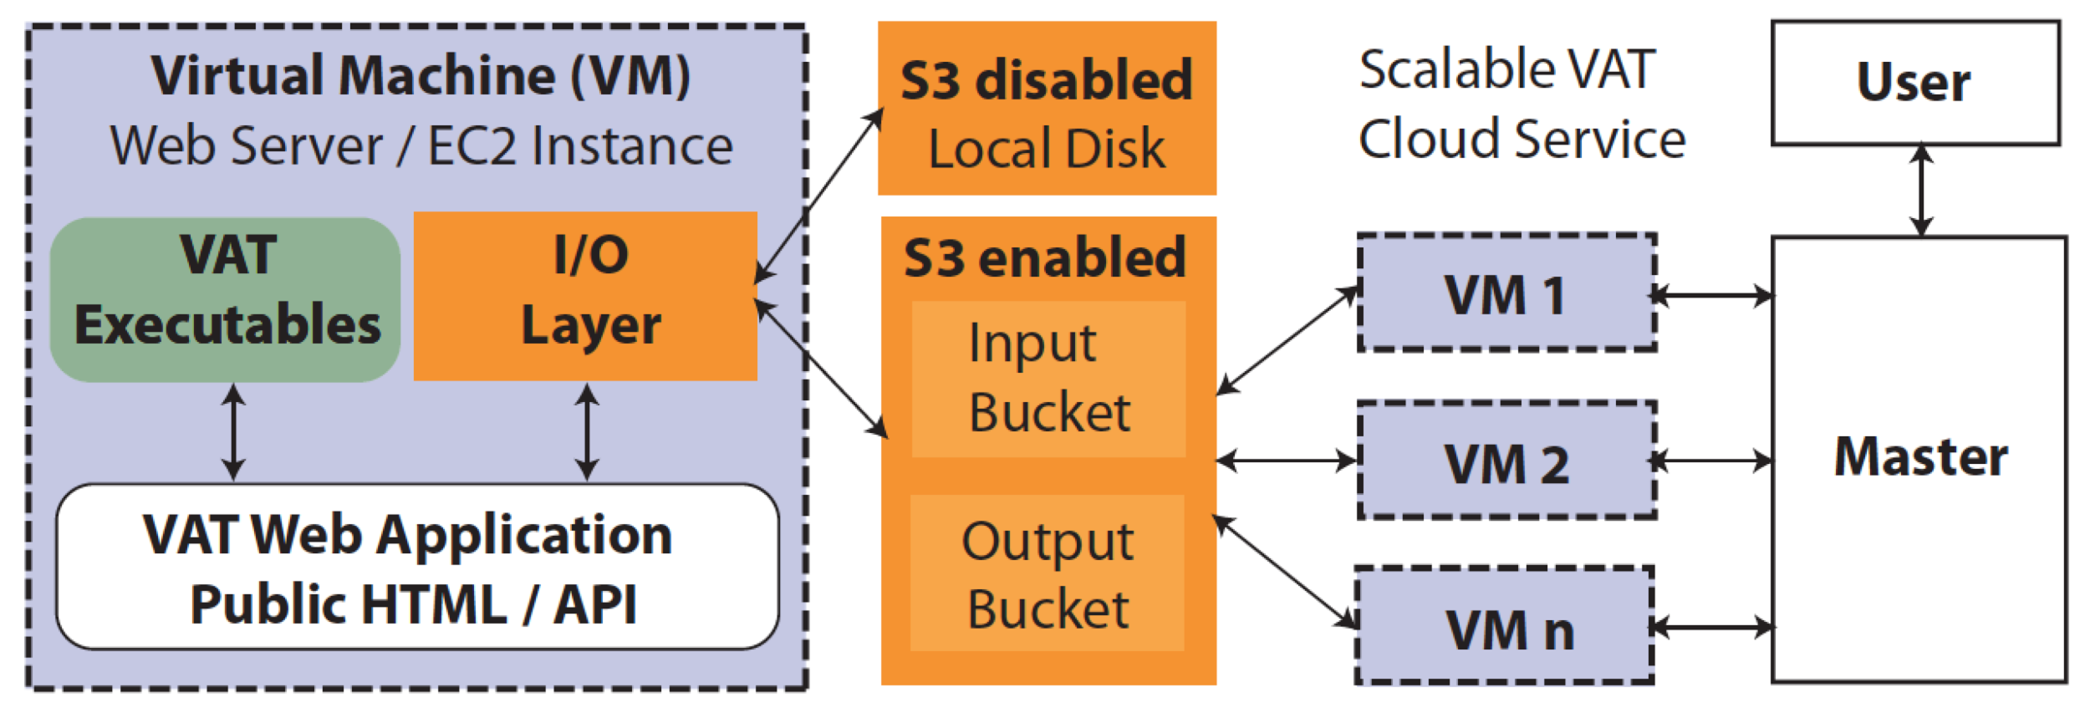
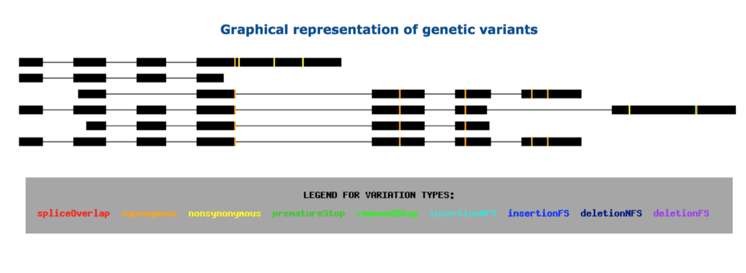
vat.gersteinlab.org
Variant Annotation Tool (VAT), developed for 1000G FIG
VCF Input
Output:
Annotated VCFs
Graphical representations of functional impact on transcripts
Access:
Webserver
AWS cloud instance
Source freely available
CLOUD APPLICATION
Habegger L.*, Balasubramanian S.*, et al. Bioinformatics, 2012
Notes:
26
Big data challenge, graphical interface is important

Slide 27
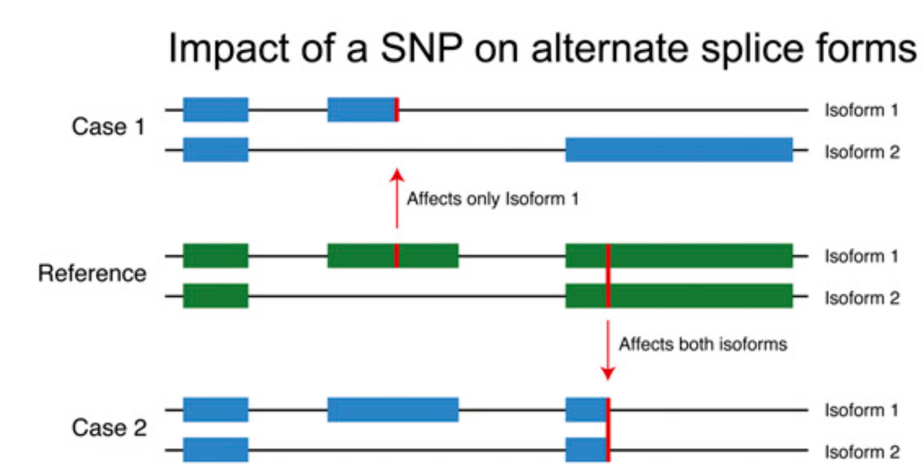
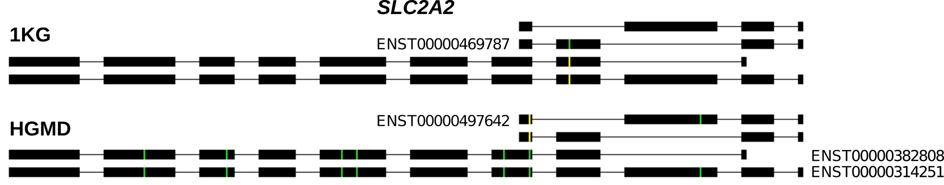
Complexities in LOF annotation
Transcript isoforms,
distance to stop,
functional domains,
protein folding,
etc.
Balasubramanian S. et al., Genes Dev., ’11
Balasubramanian S.*, Fu Y.* et al., NComms., ’17

Slide 28
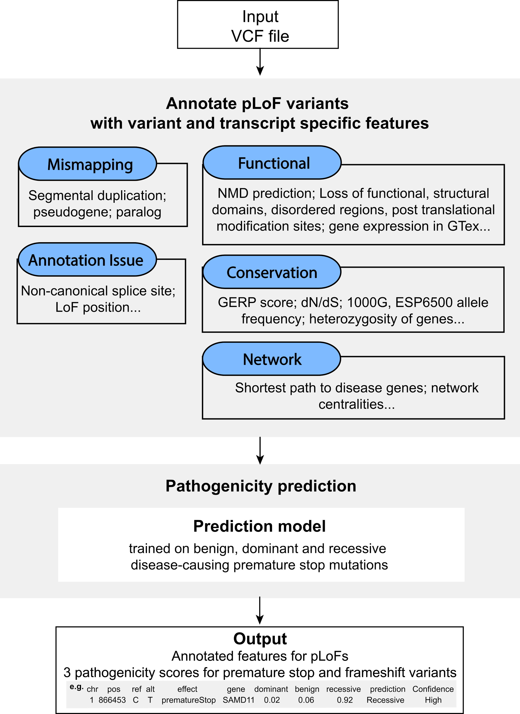
Annotation of
Loss-of-Function
Transcripts (ALoFT)
Runs on top of VAT
Output:
Impact score: benign or deleterious.
Decorated VCF.
Balasubramanian S.*, Fu Y.* et al., NComms., ’17

Slide 29
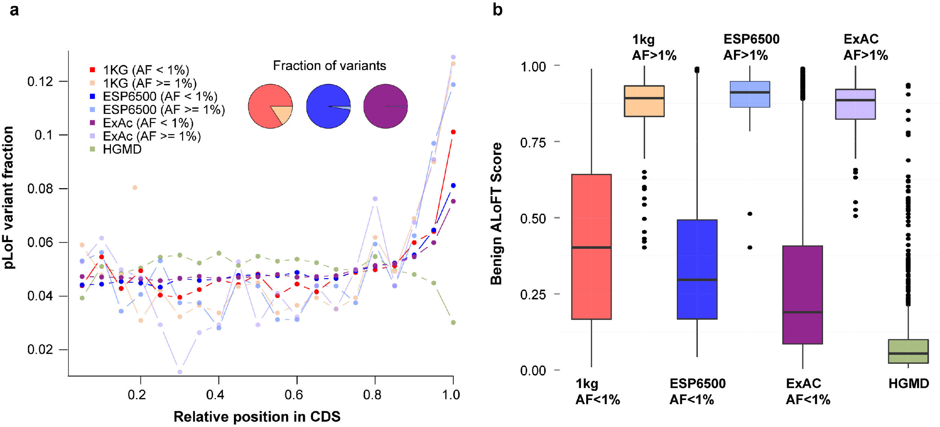
LoF distribution varies as expected by mutation set (from healthy people v from disease)
Balasubramanian S.*, Fu Y.* et al., NComms., ’17

Slide 30
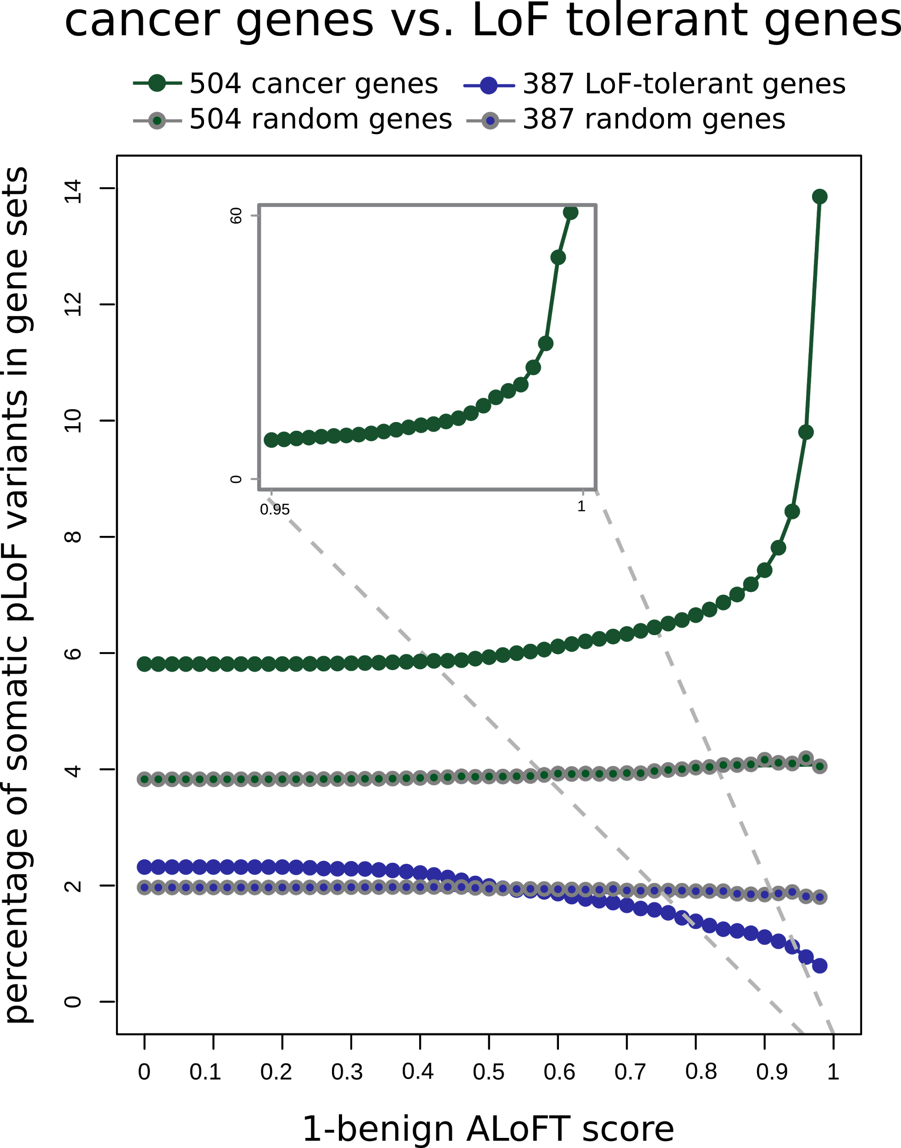
ALoFT identifies deleterious
somatic LoF variants
Cancer genes:
COSMIC consensus.
Enriched in deleterious LoFs.
LoF tolerant genes:
LoF in the 1KG cohort.
Depleted in deleterious LoFs.
Balasubramanian S.*, Fu Y.* et al., NComms., ’17

Slide 31
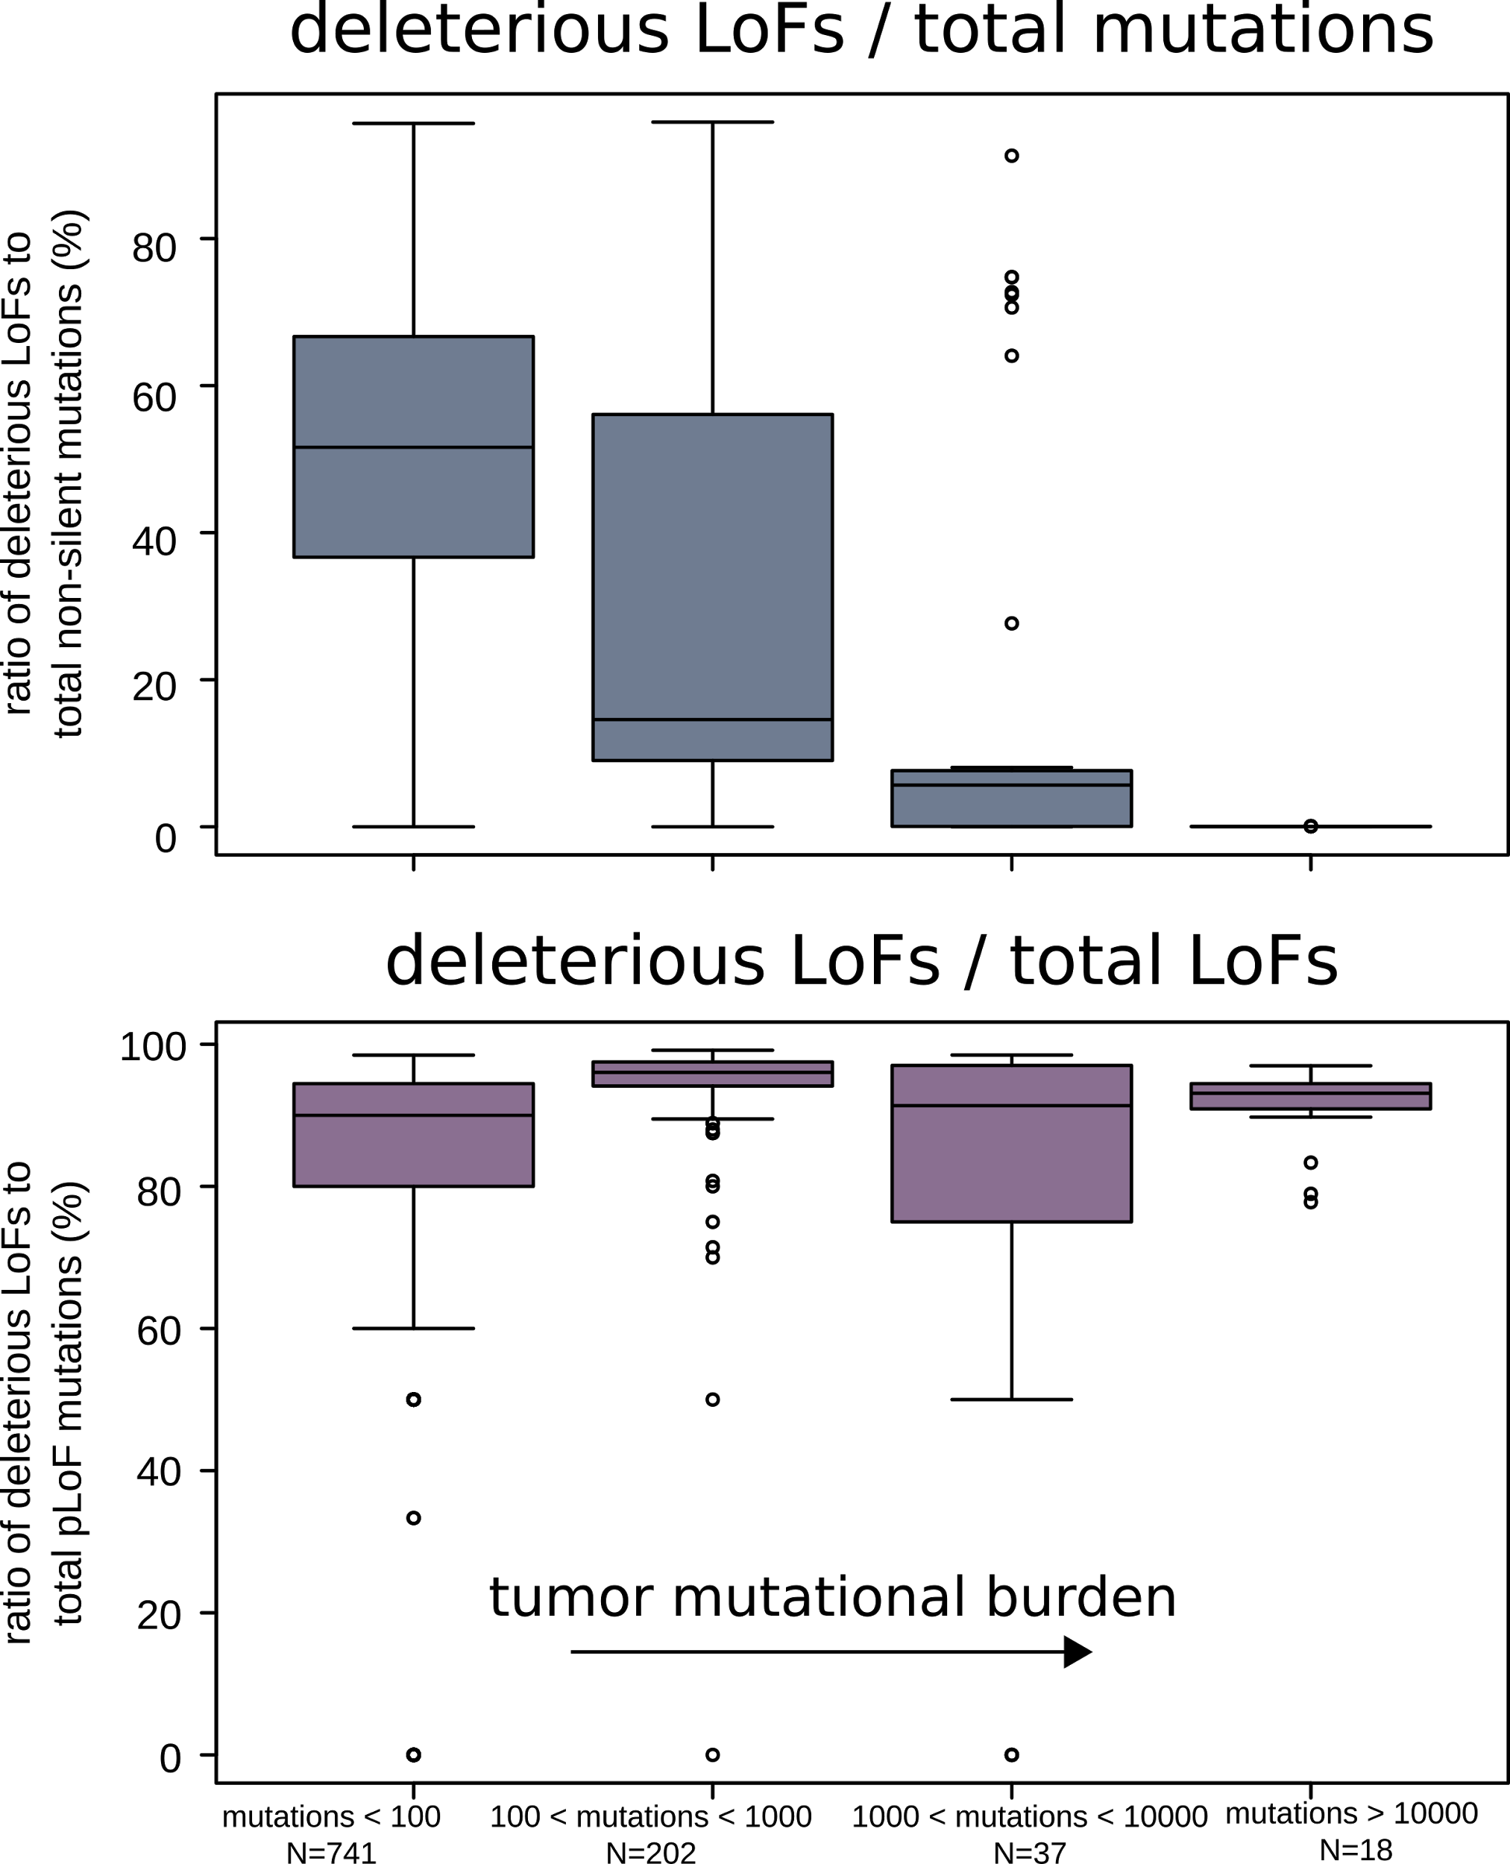
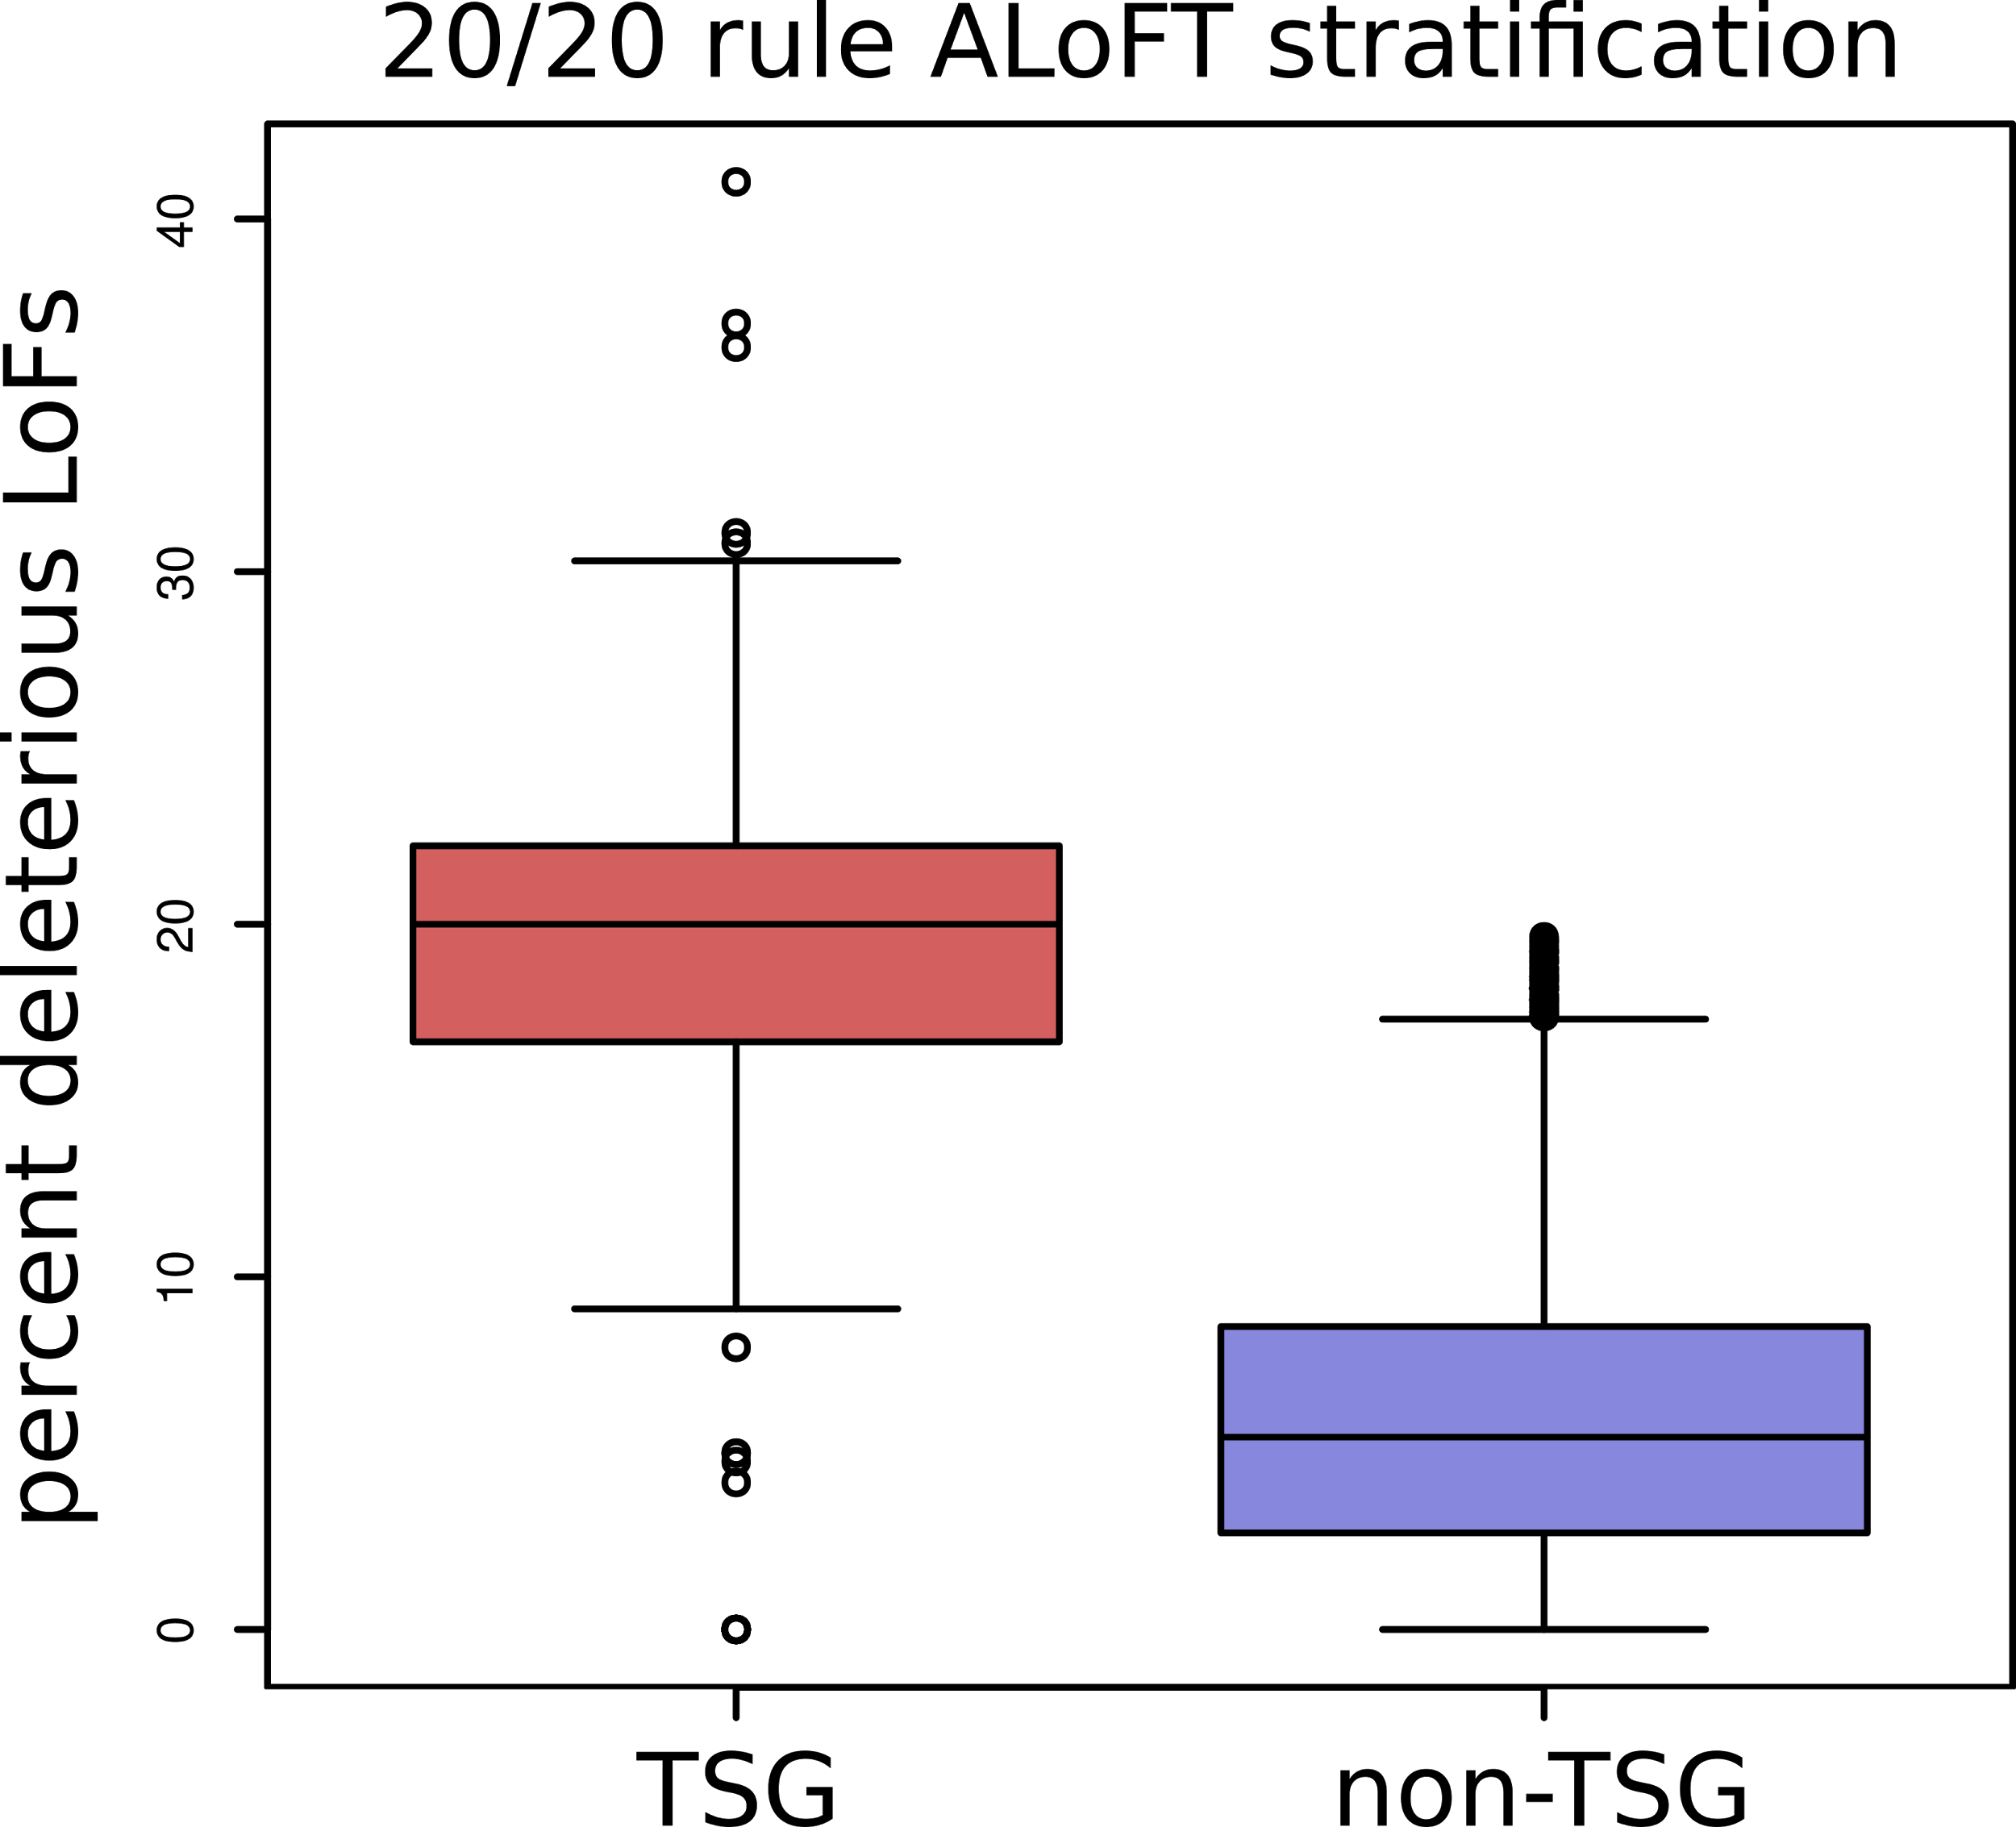
ALoFT refines cancer mutation characterization
Vogelstein et al. '13: if >20% of mutations in gene inactivating → tumor suppressor gene (TSG).
ALoFT further refines 20/20 rule predictions.
Balasubramanian S.*, Fu Y.* et al., NComms., ’17

Slide 32
Leveraging Protein Structure and Dynamics for Variant Interpretation in Coding Regions
Background on rare & common variants
Identifying cryptic allosteric sites with STRESS
  On surface & in interior bottlenecks
Frustration as a localized metric of SNV impact
  Differential profiles for oncogenes v. TSGs
ALoFT: Annotation of Loss-of-Function Transcripts

Slide 33
Leveraging Protein Structure and Dynamics for Variant Interpretation in Coding Regions
Background on rare & common variants
Identifying cryptic allosteric sites with STRESS
  On surface & in interior bottlenecks
Frustration as a localized metric of SNV impact
  Differential profiles for oncogenes v. TSGs
ALoFT: Annotation of Loss-of-Function Transcripts

Slide 34

STRESS.molmovdb.org
D Clarke, A Sethi,
S Li, S Kumar,
R Chang, J Chen
Acknowledgments! Also, Hiring: See Jobs.gersteinlab.org
github.com/gersteinlab/Frustration
S Kumar, D Clarke
ALoFT.gersteinlab.org
S Balasubramanian,
Y Fu, M Pawashe, P McGillivray,
M Jin, J Liu, K Karczewski, D MacArthur

Slide 35


Slide 36
Info about this talk
No Conflicts
Unless explicitly listed here. There are no conflicts of interest relevant to the material in this talk
General PERMISSIONS
This Presentation is copyright Mark Gerstein, Yale University, 2017.
Please read permissions statement at
sites.gersteinlab.org/Permissions
Basically, feel free to use slides & images in the talk with PROPER acknowledgement (via citation to relevant papers or website link). Paper references in the talk were mostly from Papers.GersteinLab.org.
PHOTOS & IMAGES
For thoughts on the source and permissions of many of the photos and clipped images in this presentation see streams.gerstein.info . In particular, many of the images have particular EXIF tags, such as kwpotppt , that can be easily queried from flickr, viz: flickr.com/photos/mbgmbg/tags/kwpotppt

