Slide 1
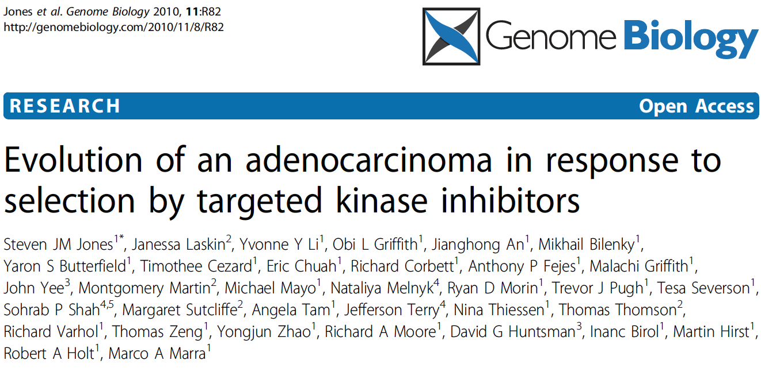
Case study
¹Genome Sciences Centre, British Columbia Cancer Agency
²British Columbia Cancer Agency
³Vancouver General Hospital
⁴Centre for Translational and Applied Genomics of British Columbia Cancer Agency and the Provincial Health Services Authority Laboratories
⁵Molecular Oncology, BC Cancer Research Centre
Slides credit: www.bioinformatics.ca

Slide 2
Initial presentation
78 year-old Caucasian man
Fit and active
Presented in August 2007 with throat discomfort
Examination found a 2 cm mass at left base of tongue
Minimal comorbidities
No obvious risk factors for oropharyngeal malignancy
Notes:
comorbidity [kemɔr'bidəti]
oropharyngeal [ɔ:rəufə'rindʒiəl]
malignancy [mə'lɪɡnənsi]

Slide 3
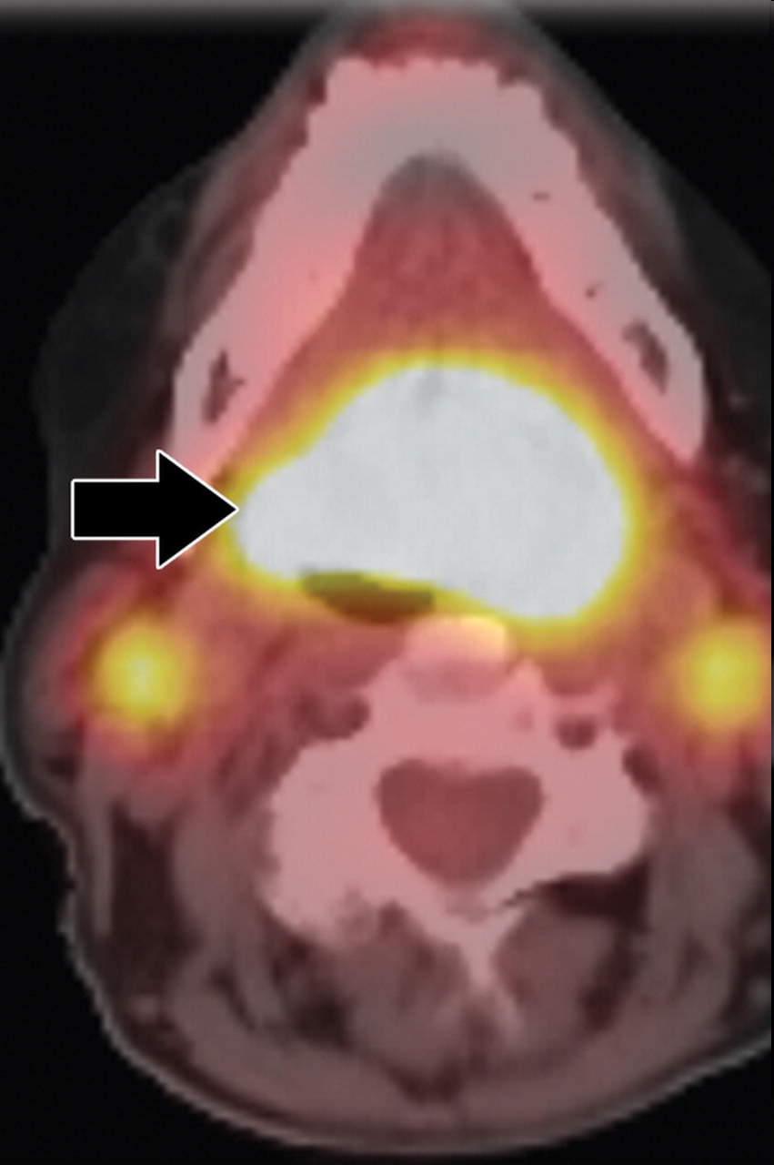
PET-CT scan & subsequent biopsy
20X
Fukui et al. Radiographics.
2005 Jul-Aug;25(4):913-30.
Primary tongue mass,
H&E stain, 20X objective
PET-CT scan identified suspicious uptake in the primary mass and two local lymph nodes.
A small biopsy of the tongue lesion revealed a papillary adenocarcinoma
Notes:
positron emission tomography-computed tomography (PET-CT) scan identified suspicious uptake in the primary mass and two local lymph nodes. A small biopsy of the tongue lesion revealed a papillary adenocarcinoma, although the presence in the tongue may indicate an origin in a minor salivary gland.
lesion ['liːʒ(ə)n]
papillary [pə'piləri]

Slide 4
Surgery & further pathology
Laser resection of tumor & lymph nodes in Nov. 2007
Primary: 1.5 cm poorly differentiated adenocarcinoma with micropapillary & mucinous features
Lymph nodes: 3 of 21 neck nodes contain metastatic adenocarcinoma
60 Gy of adjuvant radiation therapy completed in Feb. 2008
Good quality of life, returned to work for four months
Then…numerous small (< 1.2 cm) bilateral pulmonary metastases
Notes:
mucinous [‘mju:cnous]
bilateral [,baɪ'lætərəl]
pulmonary ['pʌlmənɛri]

Slide 5
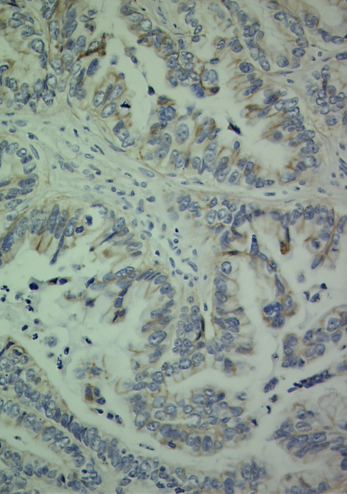
EGFR positive expression
+2 EGFR expression by Zymed immunohistochemistry protein expression assay
Treatments?
40X
Notes:
immunohistochemistry (IHC)

Slide 6
6 week trial of erlotinib
All pulmonary nodules grew while on erlotinib
Largest lesion grew from 1.5 to 2.1 cm
Erlotinib discontinued in August
What next?
August
Initial presentation
November
Surgical resection
February
Radiation complete
June
Lung mets, erlotinib begun
August
Erlotinib failure

Slide 7
What are the targets in our case?
Having exhausted standard of care, BC Cancer Agency oncologist turned to the Genome Sciences Centre (a large research group) for new leads
Special meeting of the BCCA Research Ethnics Board approved a single-case analysis for this patient
Patient consented to full genomic sequencing and analysis with the understanding that novel treatment options may be suggested
Notes:
What can genome studies do? We don’t know but are willing to try!

Slide 8
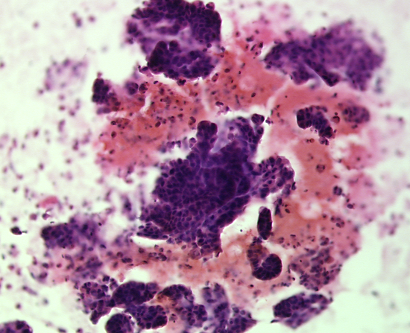
Samples for RNA-seq & DNA-seq
40X
RNA sequencing
  fine-needle aspirates taken from large lung lesion
  Pathologist reviewed, used samples with highest tumor content (~80%)
DNA sequencing
  FFPE DNA from surgical resection & normal DNA
Notes:
aspirate ['æspərət]
FFPE: formalin-fixed, paraffin-embedded

Slide 9
Somatic Mutations
TP53 | p.D259Y | Located in region of LOH Known somatic mutation in 7 cancer types (16 entries + 4 alternate mutations across 28 tumors in the Catalogue of Somatic Mutations in Cancer)
RB1 | p.L234* | Novel truncating mutation Results in loss of 75% of protein sequence Loss of RB1 and PTEN result in gefitinib resistance (Albitar et al. Gynecol Oncol. 2007 Jul;106(1):94-104.)
ZNF187 | p.G63C | Novel mutation of unknown significance Zinc-finger protein
ZFPM2 | p.K785E | Novel mutation of unknown significance Zinc-finger protein
Confirmed by secondary sequencing method (Sanger)

Slide 10
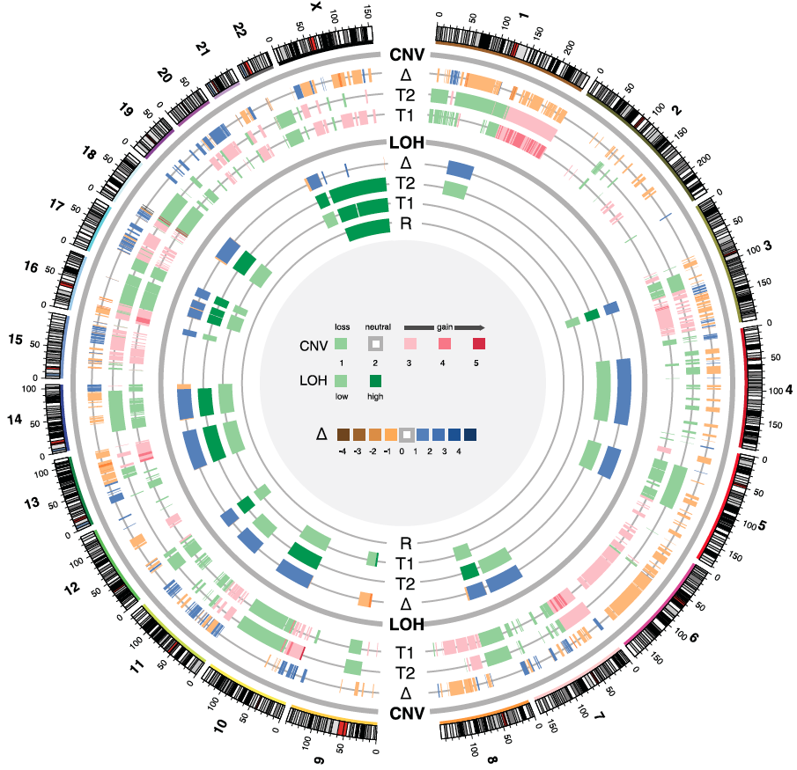
Copy number alterations
18q loss (SMAD4)
with focal amps.
TP53 LOH
MAPK3
amplification
10q loss (PTEN)
Focal RET amplification
EGFR
amplification
Notes:
17 genes highly amplified
18q loss frequently seen in colorectal mets

Slide 11
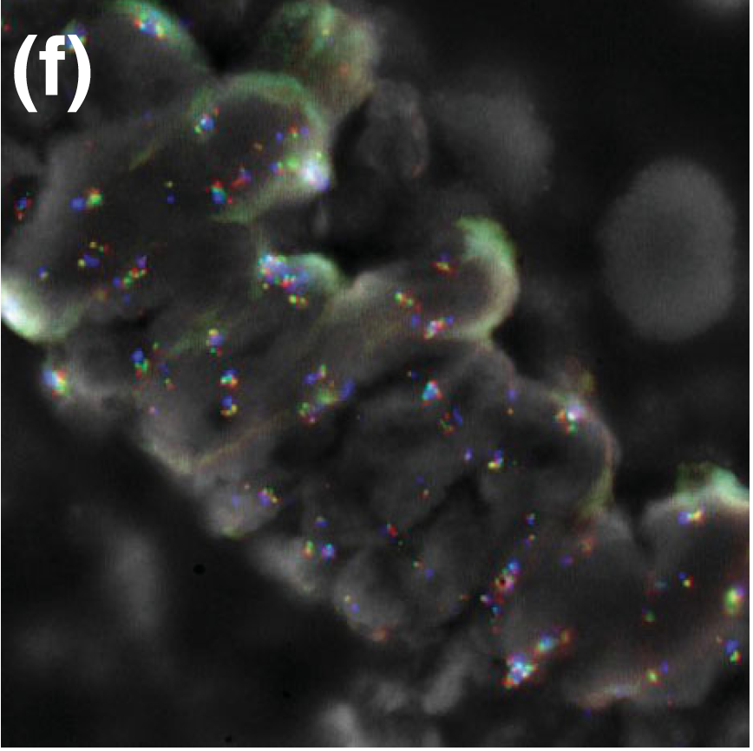
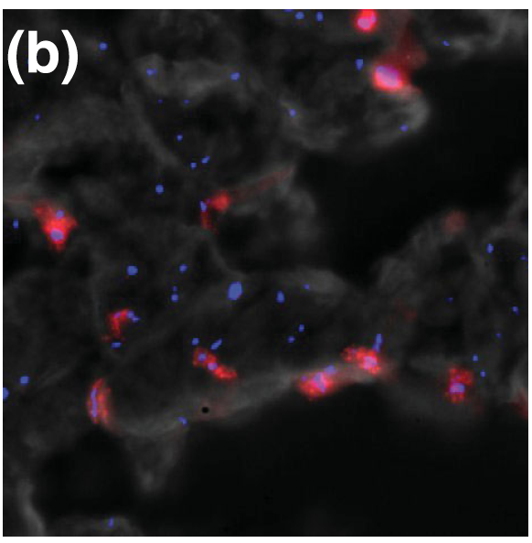
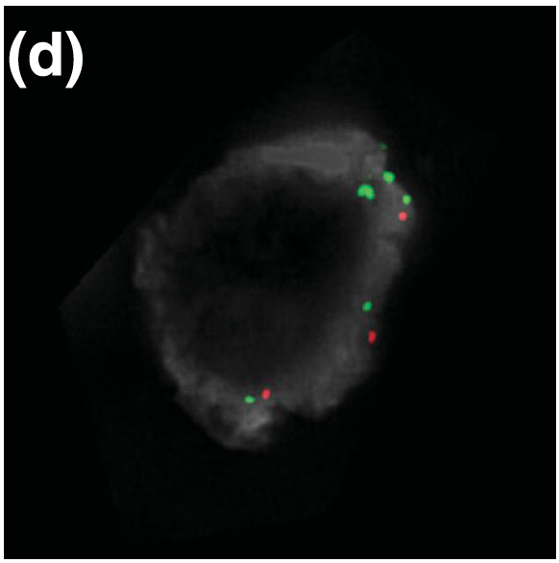
FISH confirmation of copy number alterations
40X
100X
40X
RBBP8
amplification
PTEN single
copy loss
Focal RET
amplification

Slide 12
Tumour gene expression levels compared against reference set of
50 tumors & matched blood sample
SMAD4 expression 43X lower vs compendium
deleted & down-regulated, associated with metastasis of colorectal cancer
RET in top 5% of expressed genes, 34X vs compendium most highly expressed oncogene
PTEN in bottom 5% of expressed genes,
significantly under-expressed

Slide 13
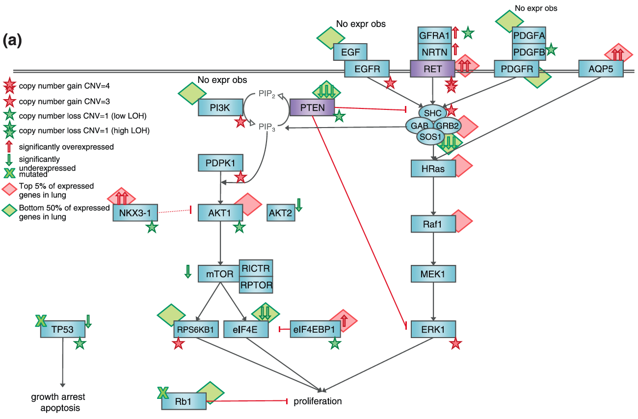
Tumor driven by RET up-regulation,
PTEN loss, not AKT
Notes:
Cancer signaling pathways affected within the tumor

Slide 14
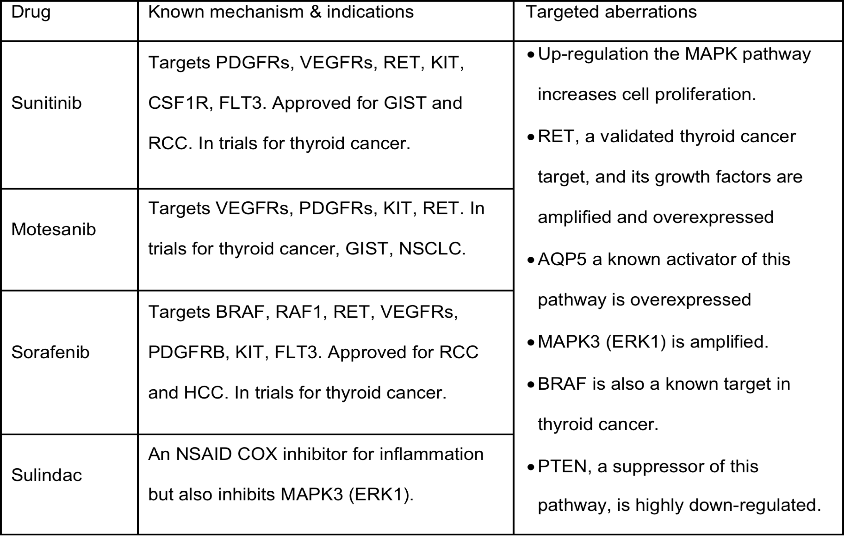
Short list presented to oncologist

Slide 15
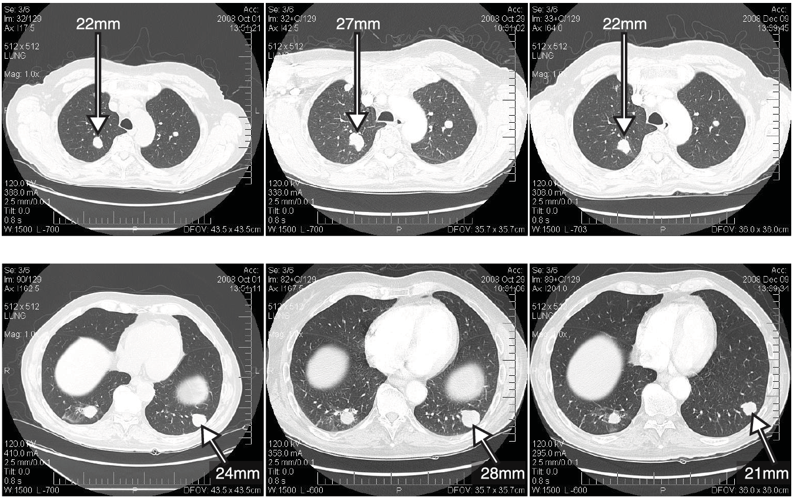
22% decrease after 4 weeks on sunitinib
(16% growth prior to sunitinib)
Nodule 1
Nodule 2
Oct 1st 2008
Biopsy taken
Oct 29th 2008
Sunitinib begun
Dec 9th 2008
4 wks 50mg daily Sunitinib

Slide 16
Stabilization for 7 months
Sunitinib dose reduced due to known side-effects, otherwise excellent quality of life
Repeated scans showed no new nodules and disease stabilization and 4 months
…then, existing lung mets began to grow
Switched to sorafenib & sulindac
Disease again stabilized within 4 weeks and continued for 3 months

Slide 17
Recurrent disease after 7 months
Recurrent disease at primary site on tongue
New neck skin nodule
Progressive & new metastases in lung
Deteriorating quality of life
What changed?
Notes:
deteriorating [dɪ'tɪrɪə,retɪŋ]

Slide 18
Skin metastasis contains new mutations
ZMYM4 | p.Q317H | Zinc-finger
DNAH7 | p.V2590L | Force generating protein of respiratory cilia
CXCL13 | p.R56H | B-cell attracting chemokine
HSD17B8 | p.A141T | hydroxysteroid (17-beta) dehydrogenase 8
PCLO | p.T2759A | presynaptic cytomatrix protein
GRIA4 | p.R872C | glutamate receptor
OR4K2 | p.L197F | olfactory receptor
SYNE2 | p.A302G | tethers the nucleus to the cytoskeleton
PTPRM | p.A929T | cell-cell adhesion, possibly signal transduction & growth
No evidence of these in the pre-treatment biopsy, even at low frequency
Notes:
(Single Illumina HiSeq sequencer run today generates ~150-200 Gigabases)

Slide 19
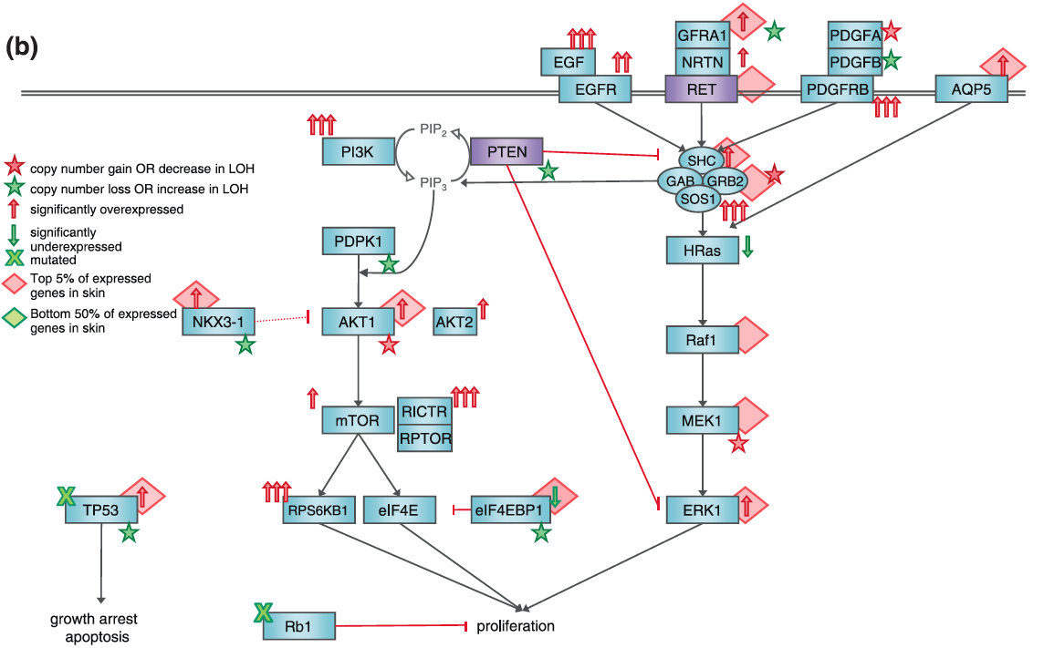
Resistance due to intensified RET and new AKT signaling?

Slide 20
Overcoming mechanisms of resistance
Cocktail of targeted drugs against multiple members of activated and parallel pathways?
- RET, EGFR, mTOR, Akt, etc.
- untested, risk of adverse side-effects
Detection of resistance mechanisms in pre-treatment
→ none of the new mutations were evident in pre-treatment
Can resistance be modeled & monitored?
- serial biopsies? blood test?

Slide 21
Conclusions
Complete genomic characterization of a rare tumor has the potential to aid in clinical decision making and identifying therapeutic approaches where no established treatment protocols exist.
These results also provide direct in vivo genomic evidence for mutational evolution within a tumor under drug selection and potential mechanisms of drug resistance accrual.
We envisage that as sequencing costs continue to decline, whole genome characterization will become a routine part of cancer pathology.
Notes:
accrual [ə'krʊəl]

