Slide 1
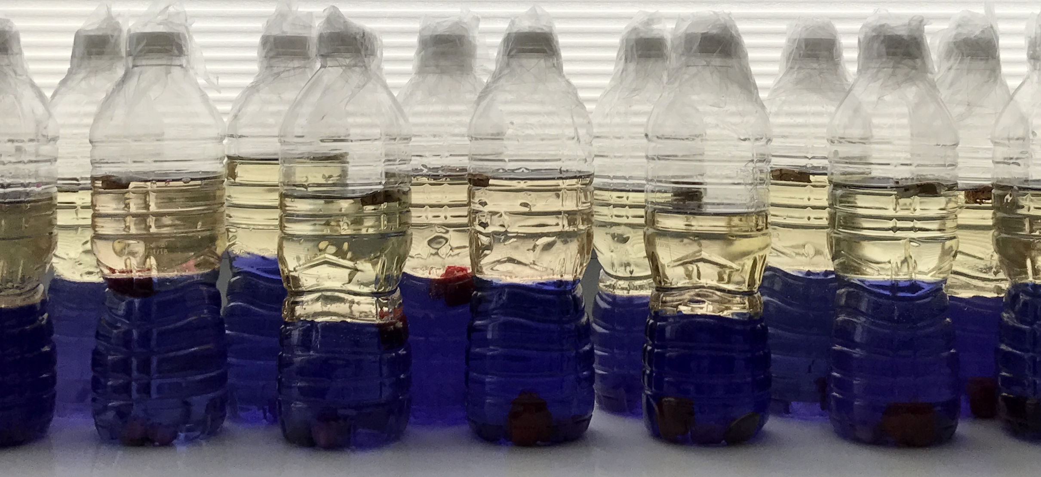
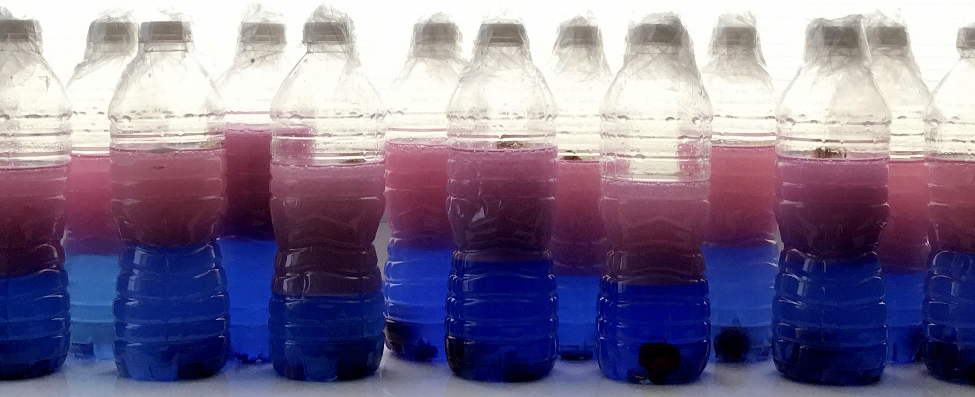
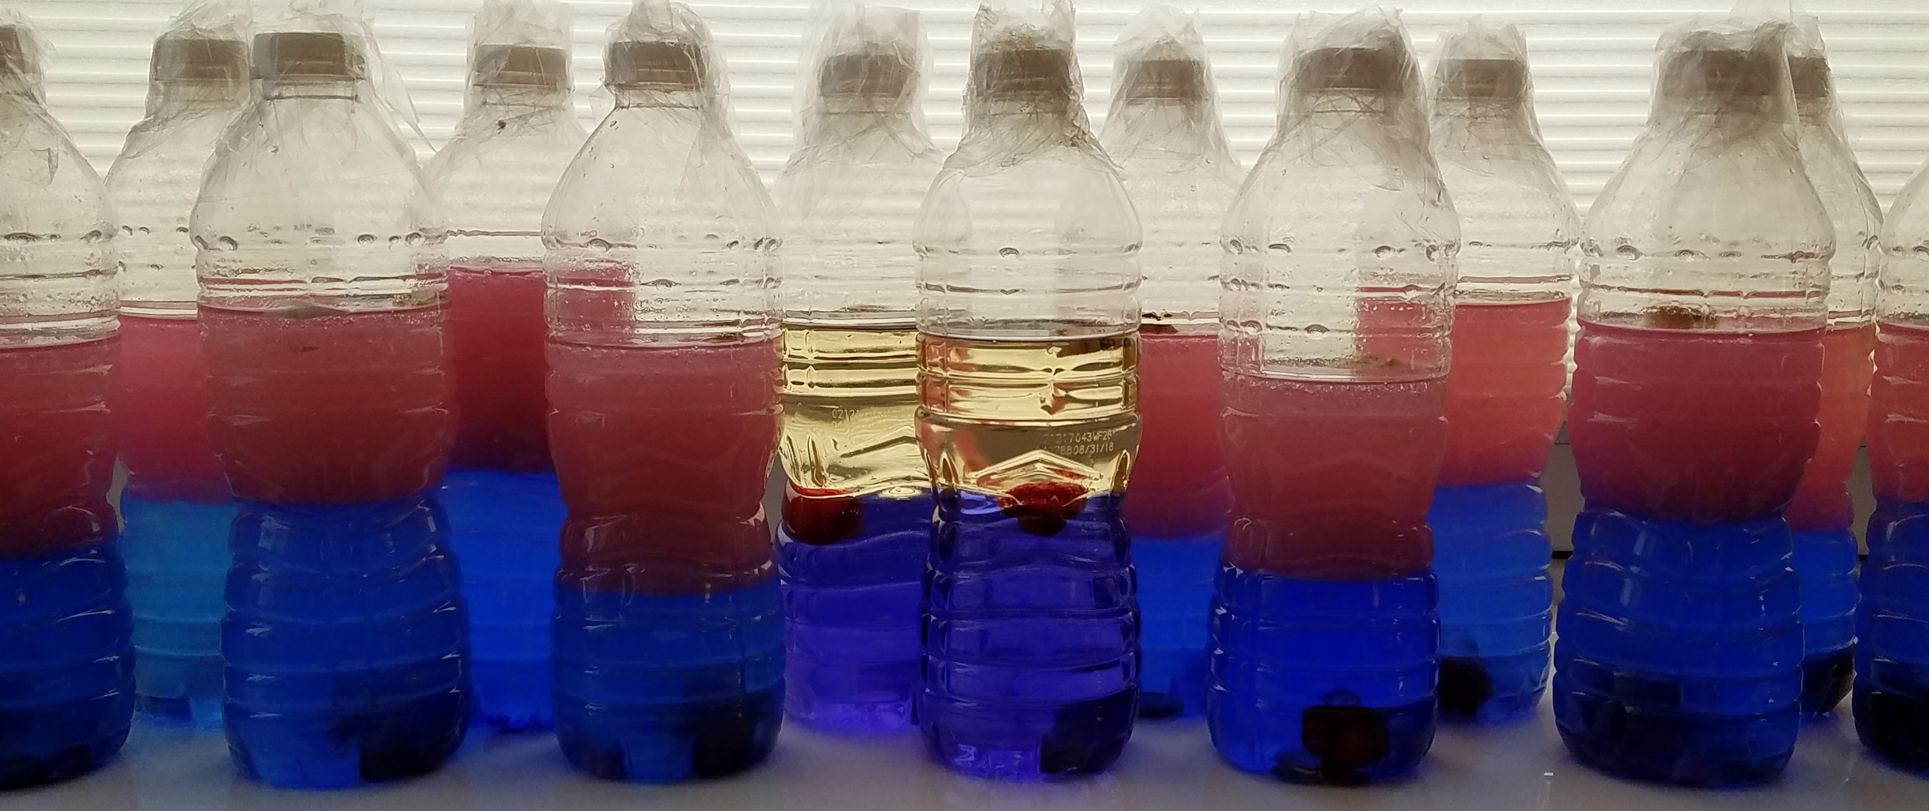
Prioritizing Variants in Personal Genomes:
Using functional impact & recurrence, with particular application to cancer
Mark Gerstein
Yale
Slides freely
downloadable from Lectures.GersteinLab.org
& “tweetable” (via @MarkGerstein).
No Conflicts for this Talk
See last slide for more info.

Slide 2
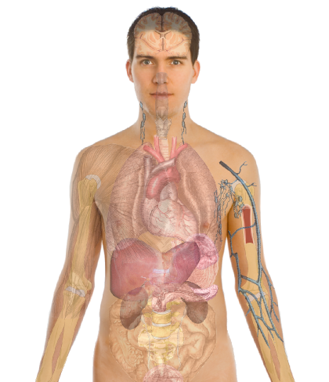
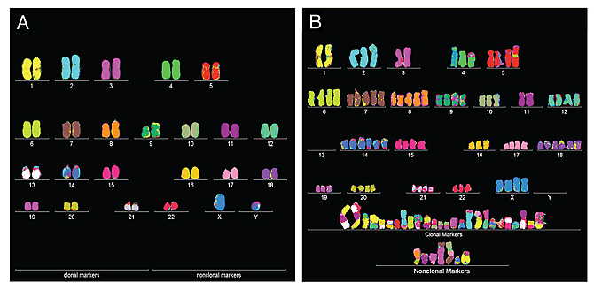

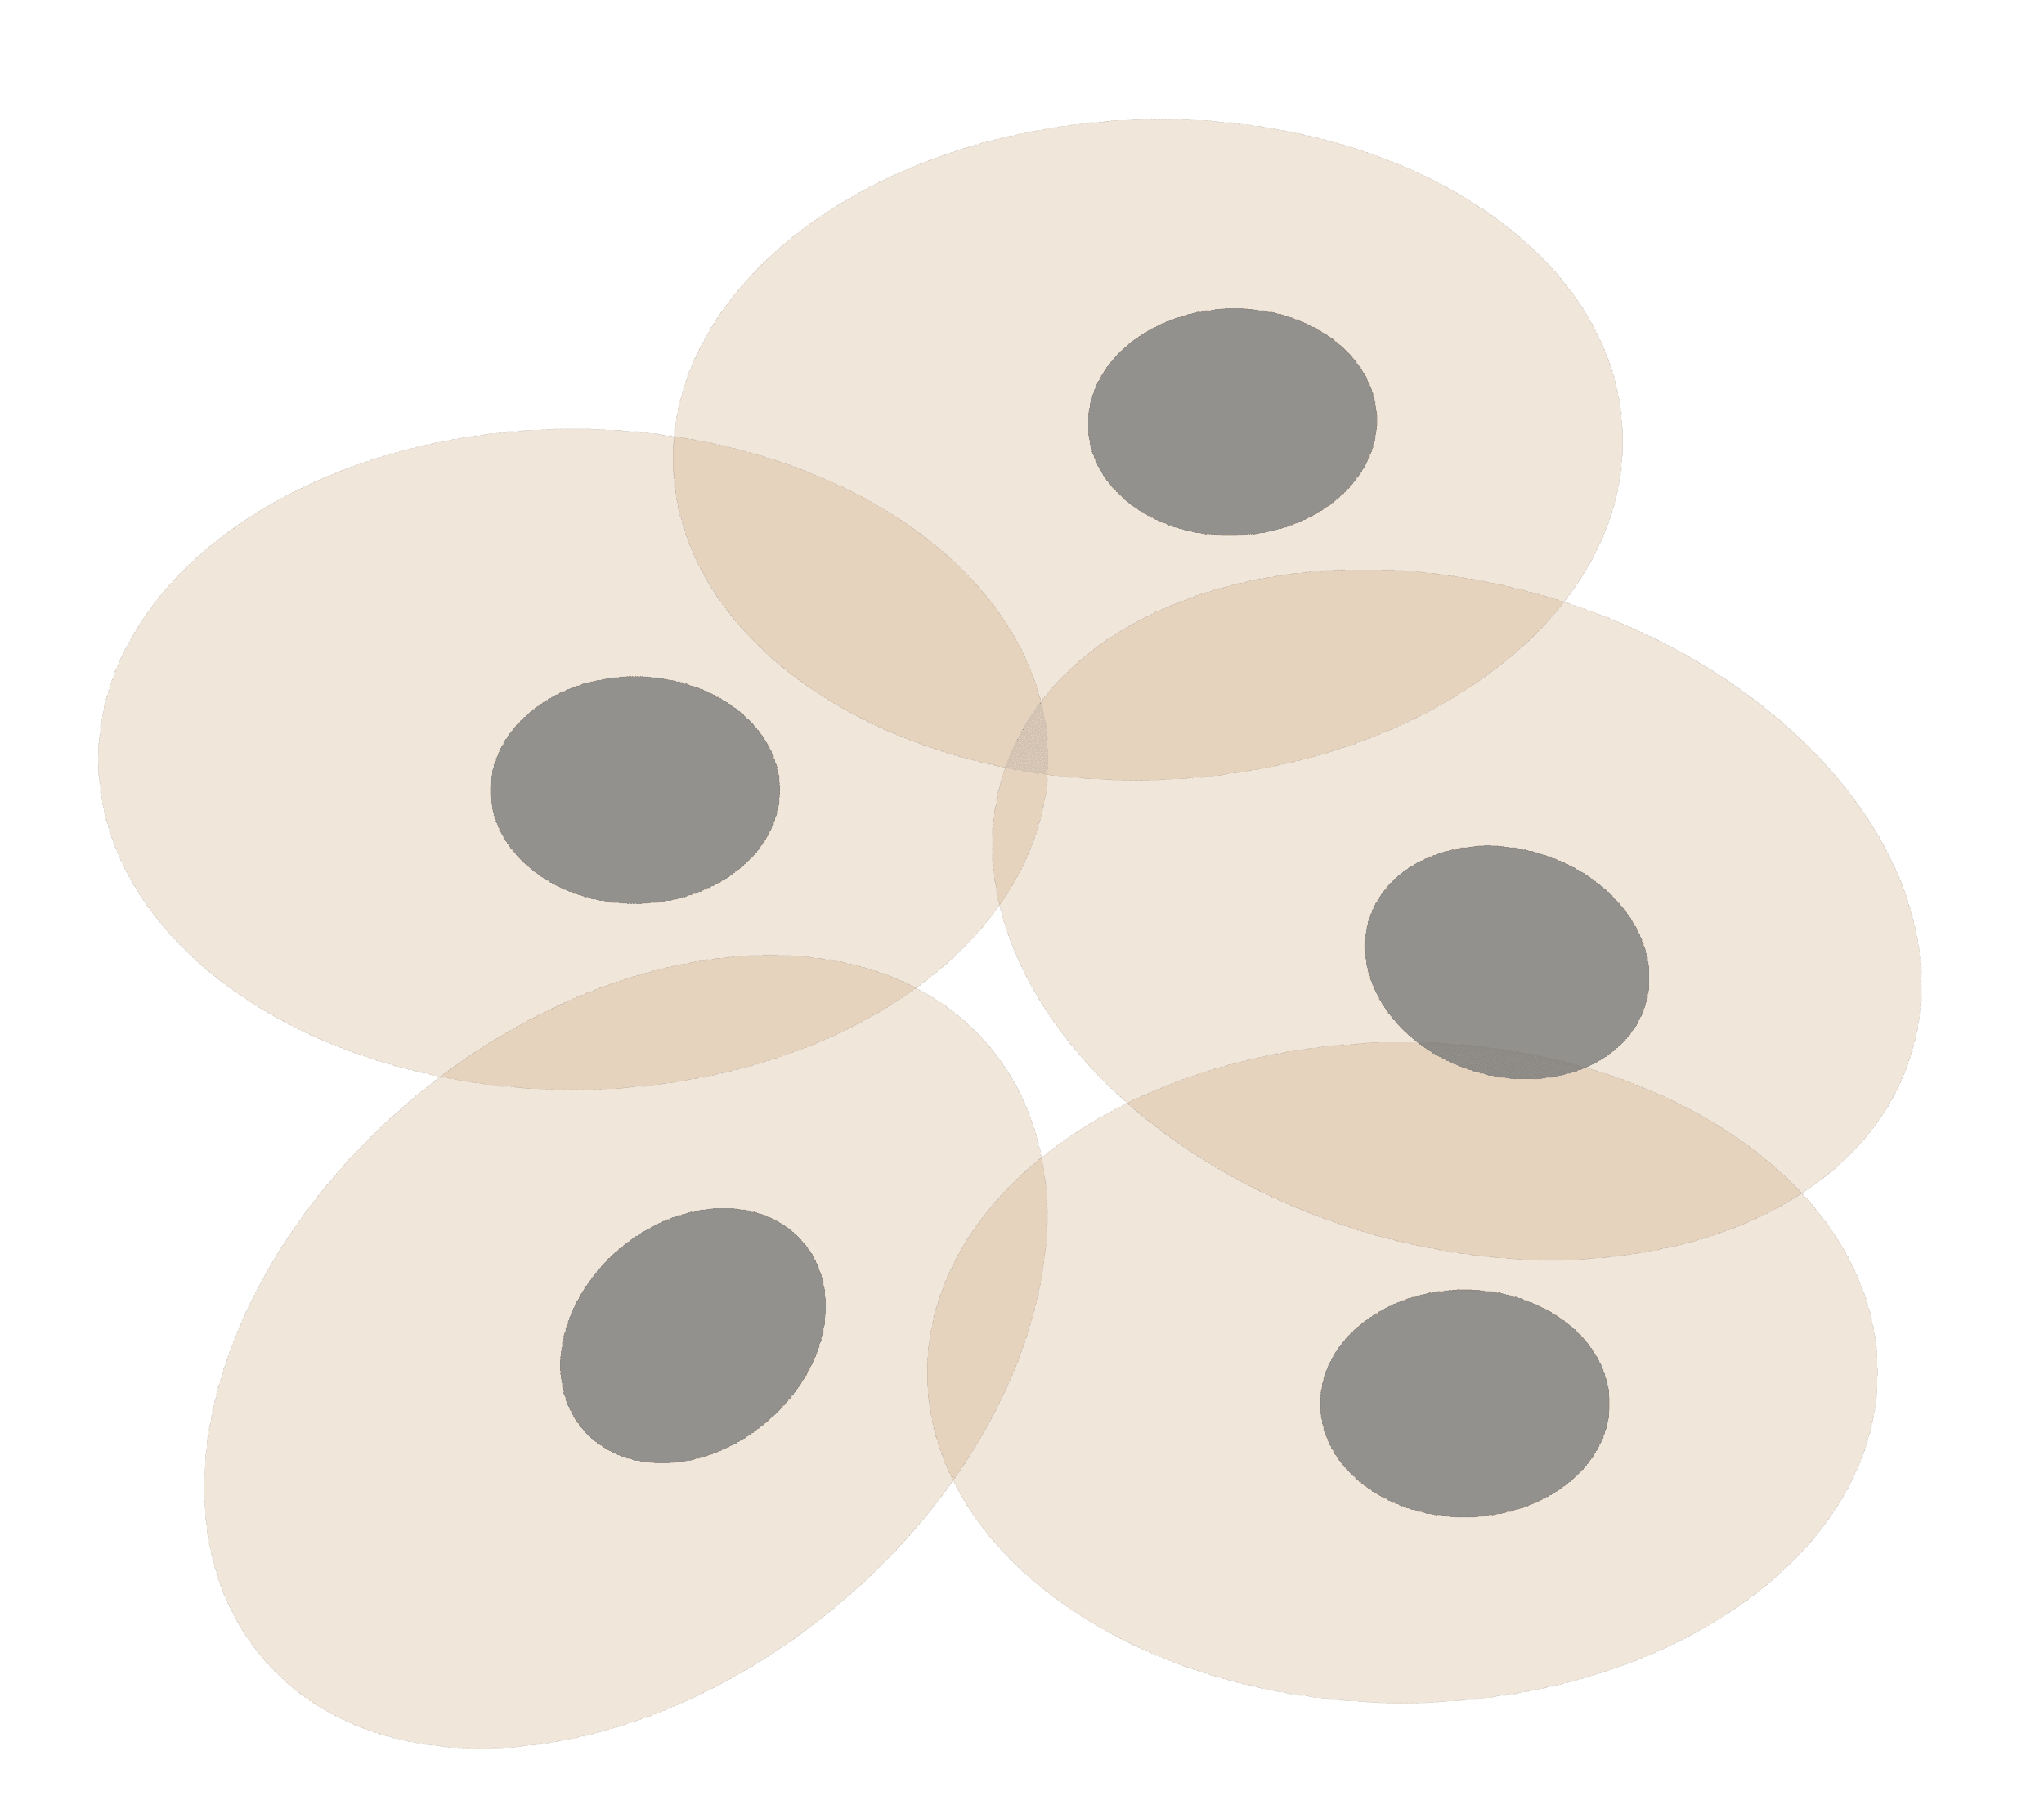
Personal Genomics
as a Gateway into Biology
Personal genomes will soon become a commonplace part of medical research & eventually treatment (esp. for cancer). They will provide a primary connection for biological science to the general public.
normal
tumor

Slide 3
Personal Genomics
as a Gateway into Biology
Personal genomes will soon become a commonplace part of medical research & eventually treatment (esp. for cancer). They will provide a primary connection for biological science to the general public.

Slide 4

Keys to genome interpretation
Relating individuals' variants to DBs
Scaling DBs to the population
Identifying key variants -
separating into rare, recurrent, common, &c

Slide 5
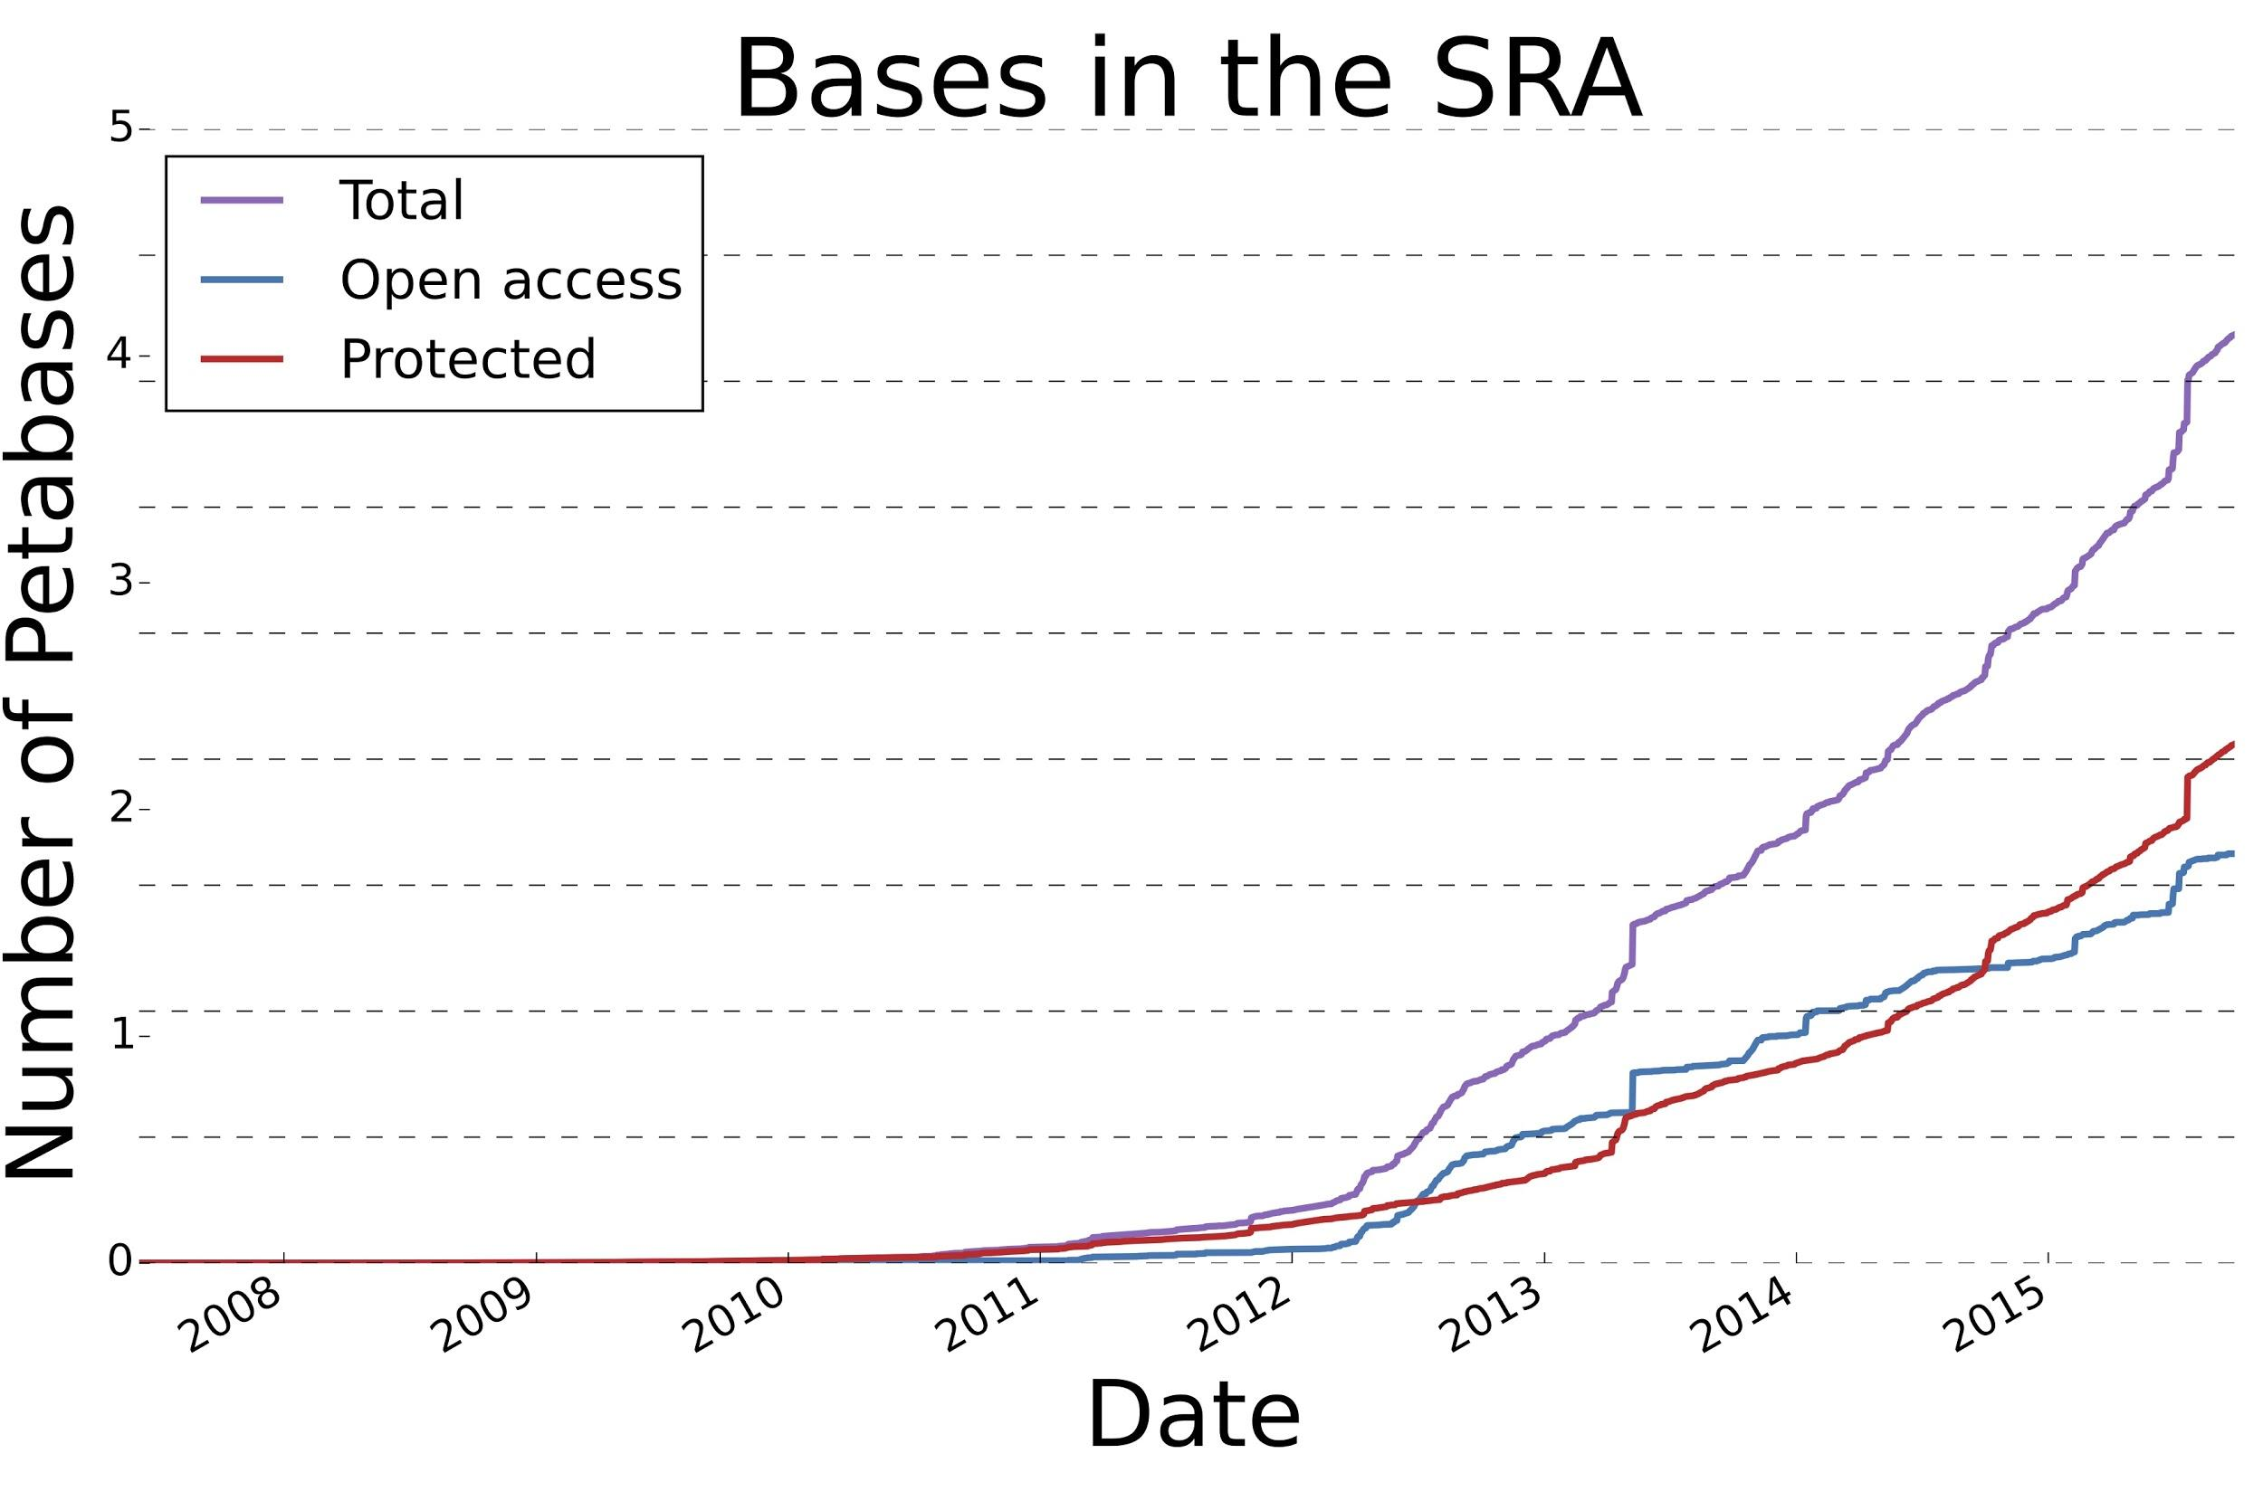
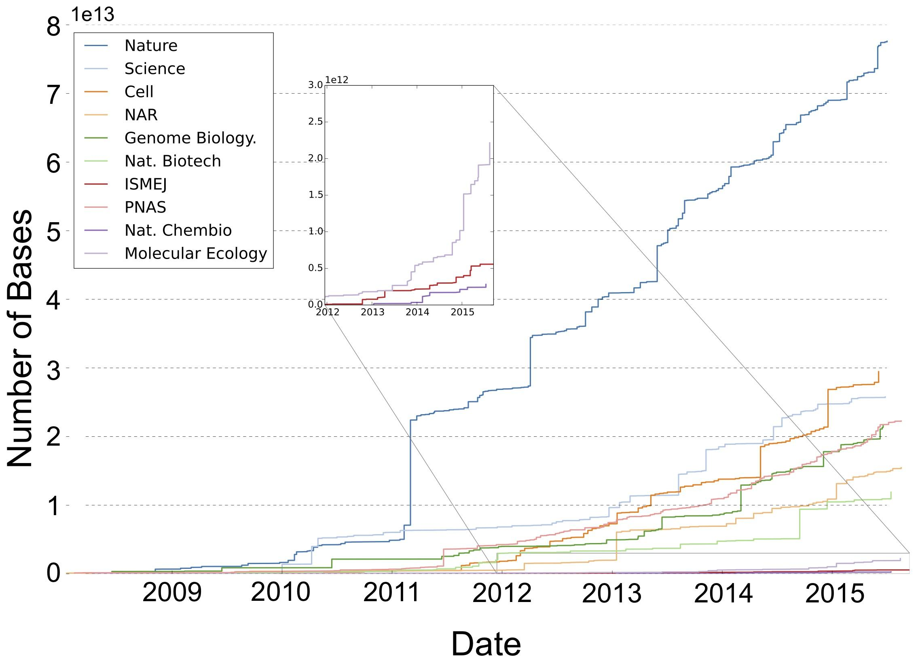
DB Growth: explosion of data scale
& a diversity of uses
The type of sequence data deposited has changed as well.
  Protected data represents an increasing fraction of all submitted sequences.
[Muir et al. (‘15) GenomeBiol.]

Slide 6
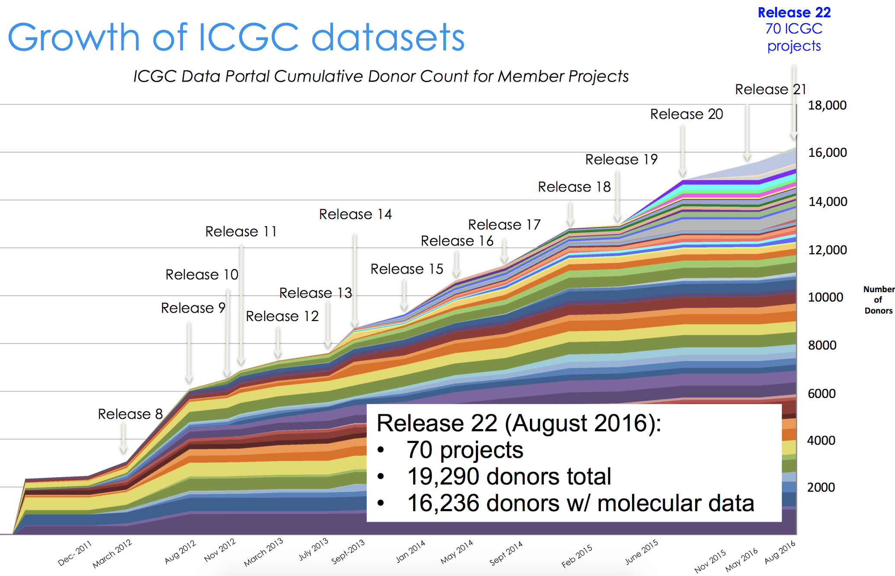
Growth of ICGC datasets
Hardeep Nahal , 12th Scientific
ICGC Workshop (Sept 2016)

Slide 7
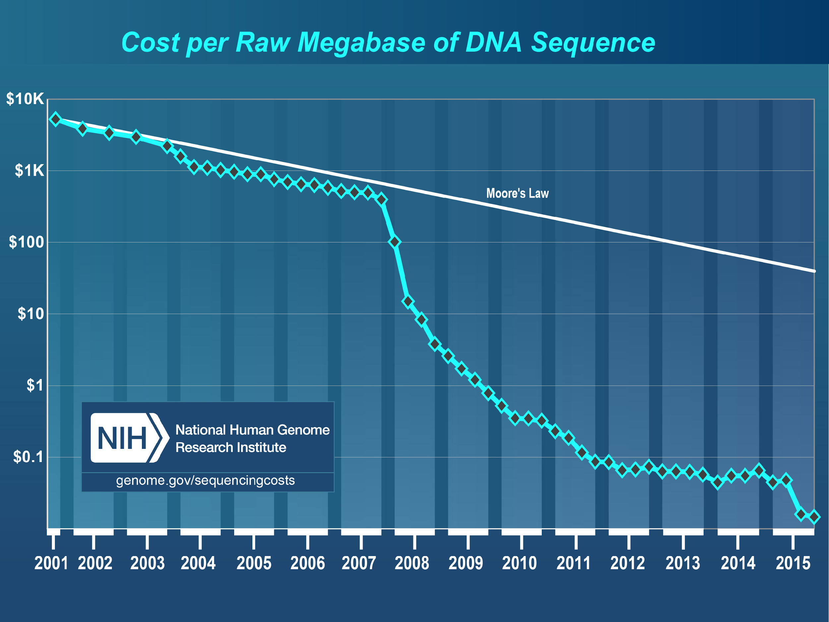
Sequencing Data Explosion:
Faster than Moore’s Law?
  In the early 2000’s, improvements in Sanger sequencing produced a scaling pattern similar to Moore’s law.
  The advent of NGS was a shift to a new technology with dramatic decrease in cost).

Slide 8
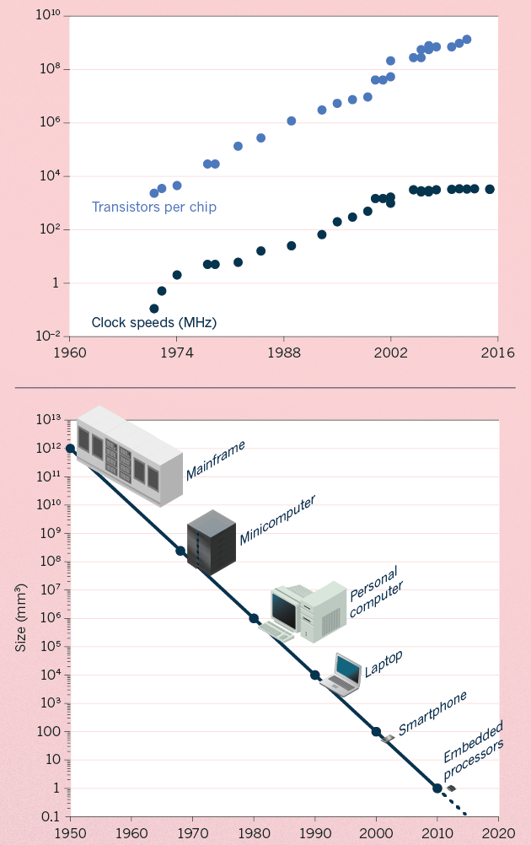
Moore’s Law:
Exponential Scaling of Computer Technology
Exponential increase in the number of transistors per chip.
Led to improvements in speed and miniaturization.
Drove widespread adoption and novel applications of computer technology.
[Waldrop (‘15) Nature]

Slide 9
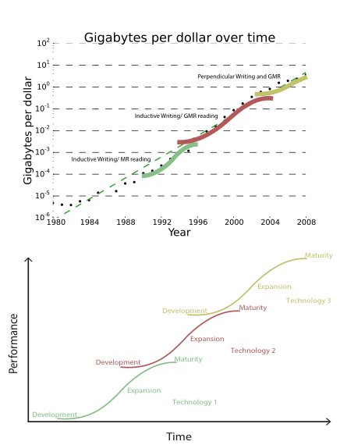
Kryder’s Law and S-curves underlying exponential growth
Moore’s & Kryder’s Laws
  As important as the increase in computer speed has been, the ability to store large amounts of information on computers is even more crucial
Exponential increase seen in Kryder’s law is a superposition of
S-curves for different technologies
[Muir et al. (‘15) GenomeBiol.]

Slide 10
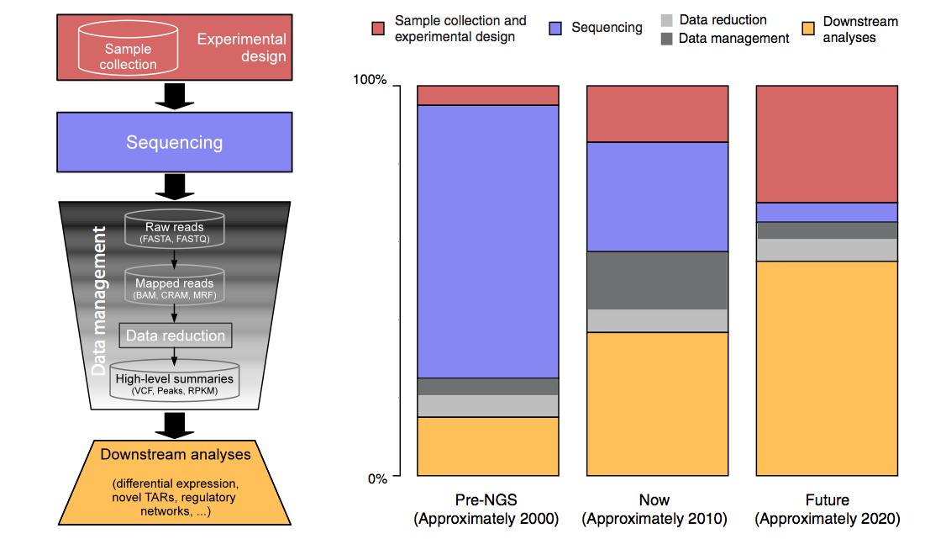
The changing costs of a sequencing pipeline
From ‘00 to ~’20,
cost of DNA sequencing expt. shifts from the actual seq. to sample
collection & analysis
[Sboner et al. (‘11), Muir et al. (‘15) Genome Biology]

Slide 11
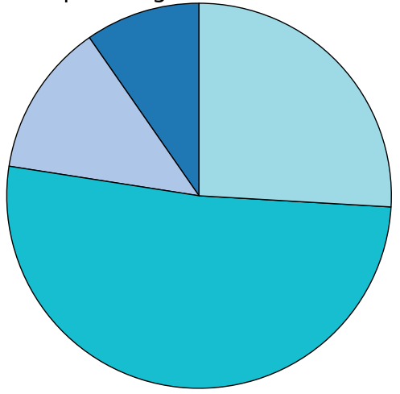
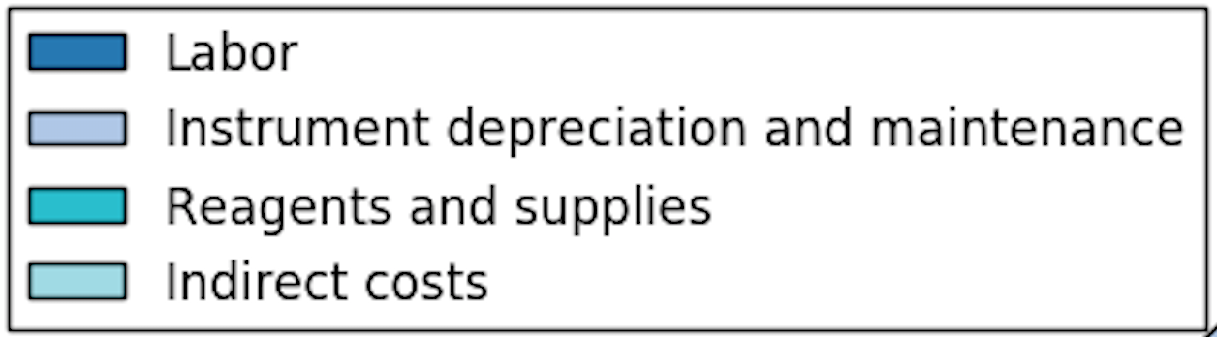
The changing costs of a sequencing pipeline
From ‘00 to ~’20,
cost of DNA sequencing expt. shifts from the actual seq. to sample
collection & analysis
[Sboner et al. (‘11), Muir et al. (‘15) Genome Biology]

Slide 12
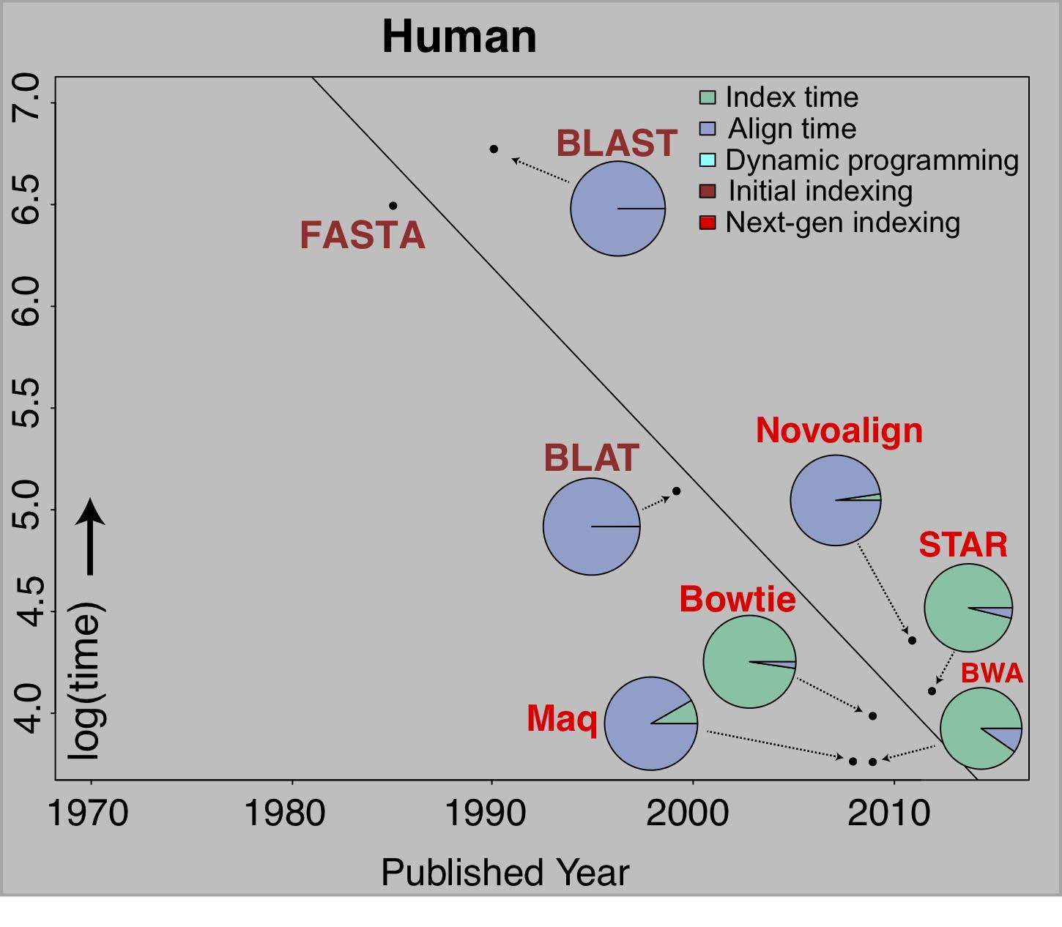
The changing costs of a sequencing pipeline
From ‘00 to ~’20,
cost of DNA sequencing expt. shifts from the actual seq. to sample
collection & analysis
Alignment algorithms scaling to keep pace with data generation
[Sboner et al. (‘11), Muir et al. (‘15) Genome Biology]

Slide 13
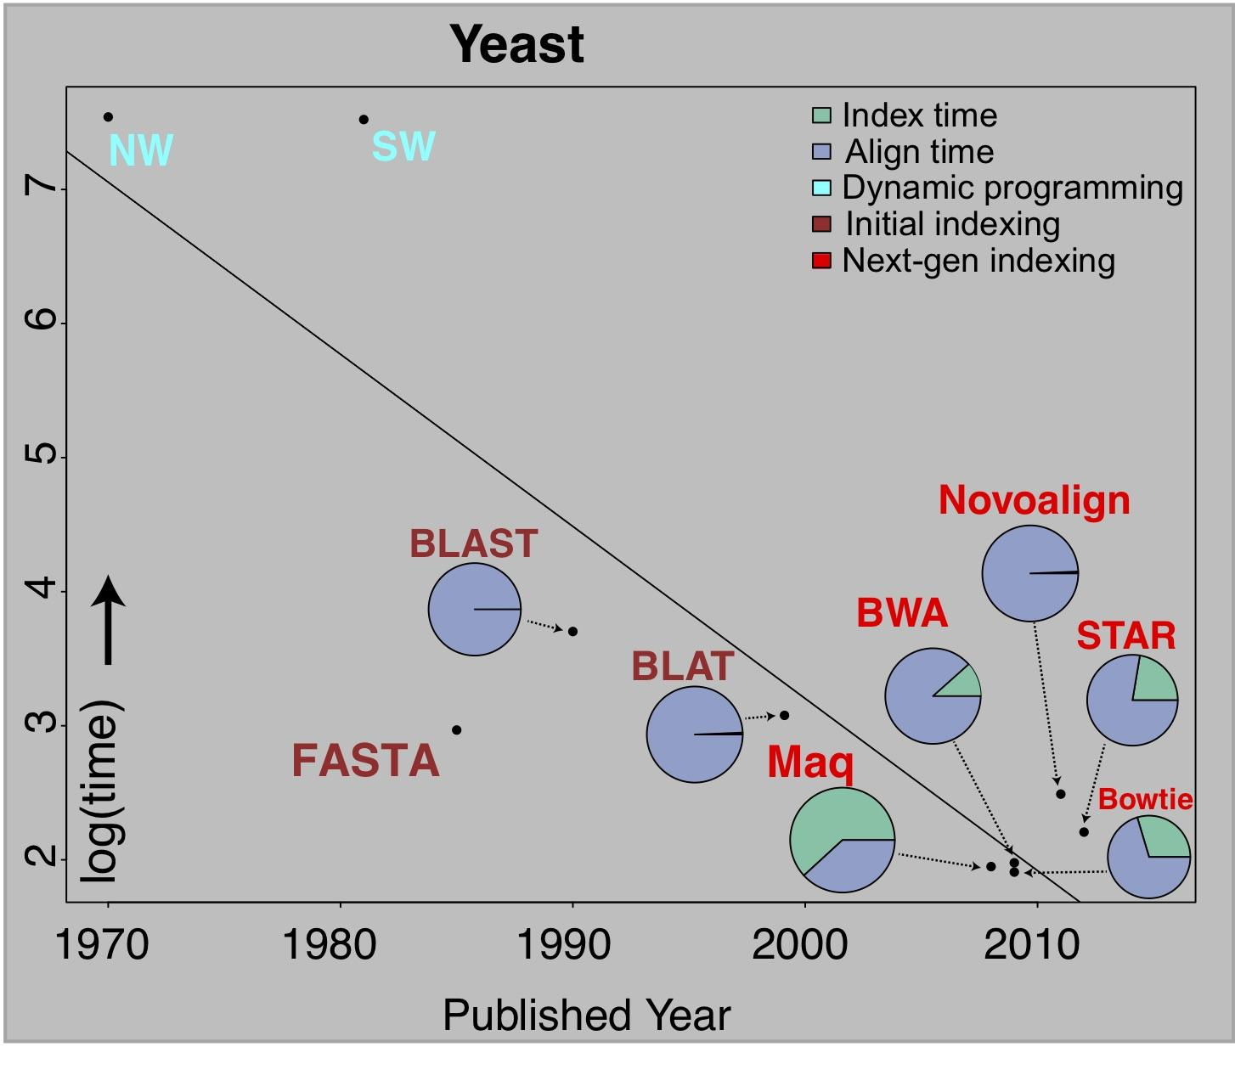
The changing costs of a sequencing pipeline
From ‘00 to ~’20,
cost of DNA sequencing expt. shifts from the actual seq. to sample
collection & analysis
Alignment algorithms scaling to keep pace with data generation
[Sboner et al. (‘11), Muir et al. (‘15) Genome Biology]

Slide 14
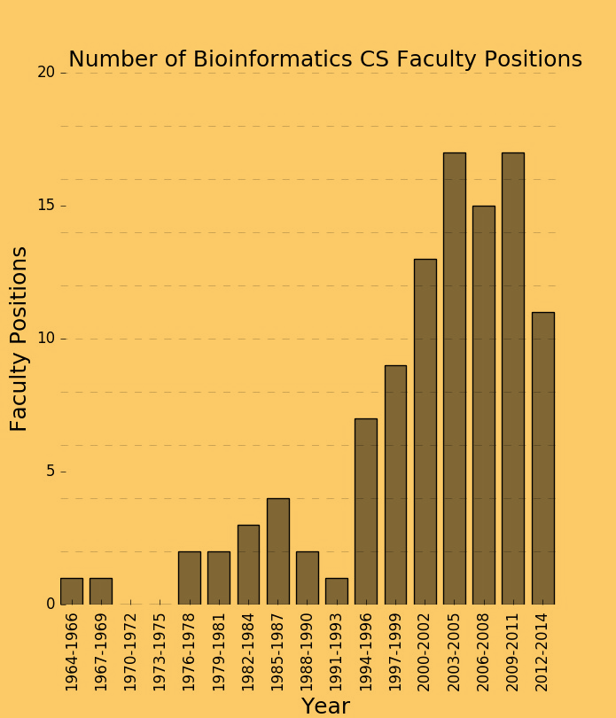
The changing costs of a sequencing pipeline
From ‘00 to ~’20,
cost of DNA sequencing expt. shifts from the actual seq. to sample
collection & analysis
[Sboner et al. (‘11), Muir et al. (‘15) Genome Biology]

Slide 15
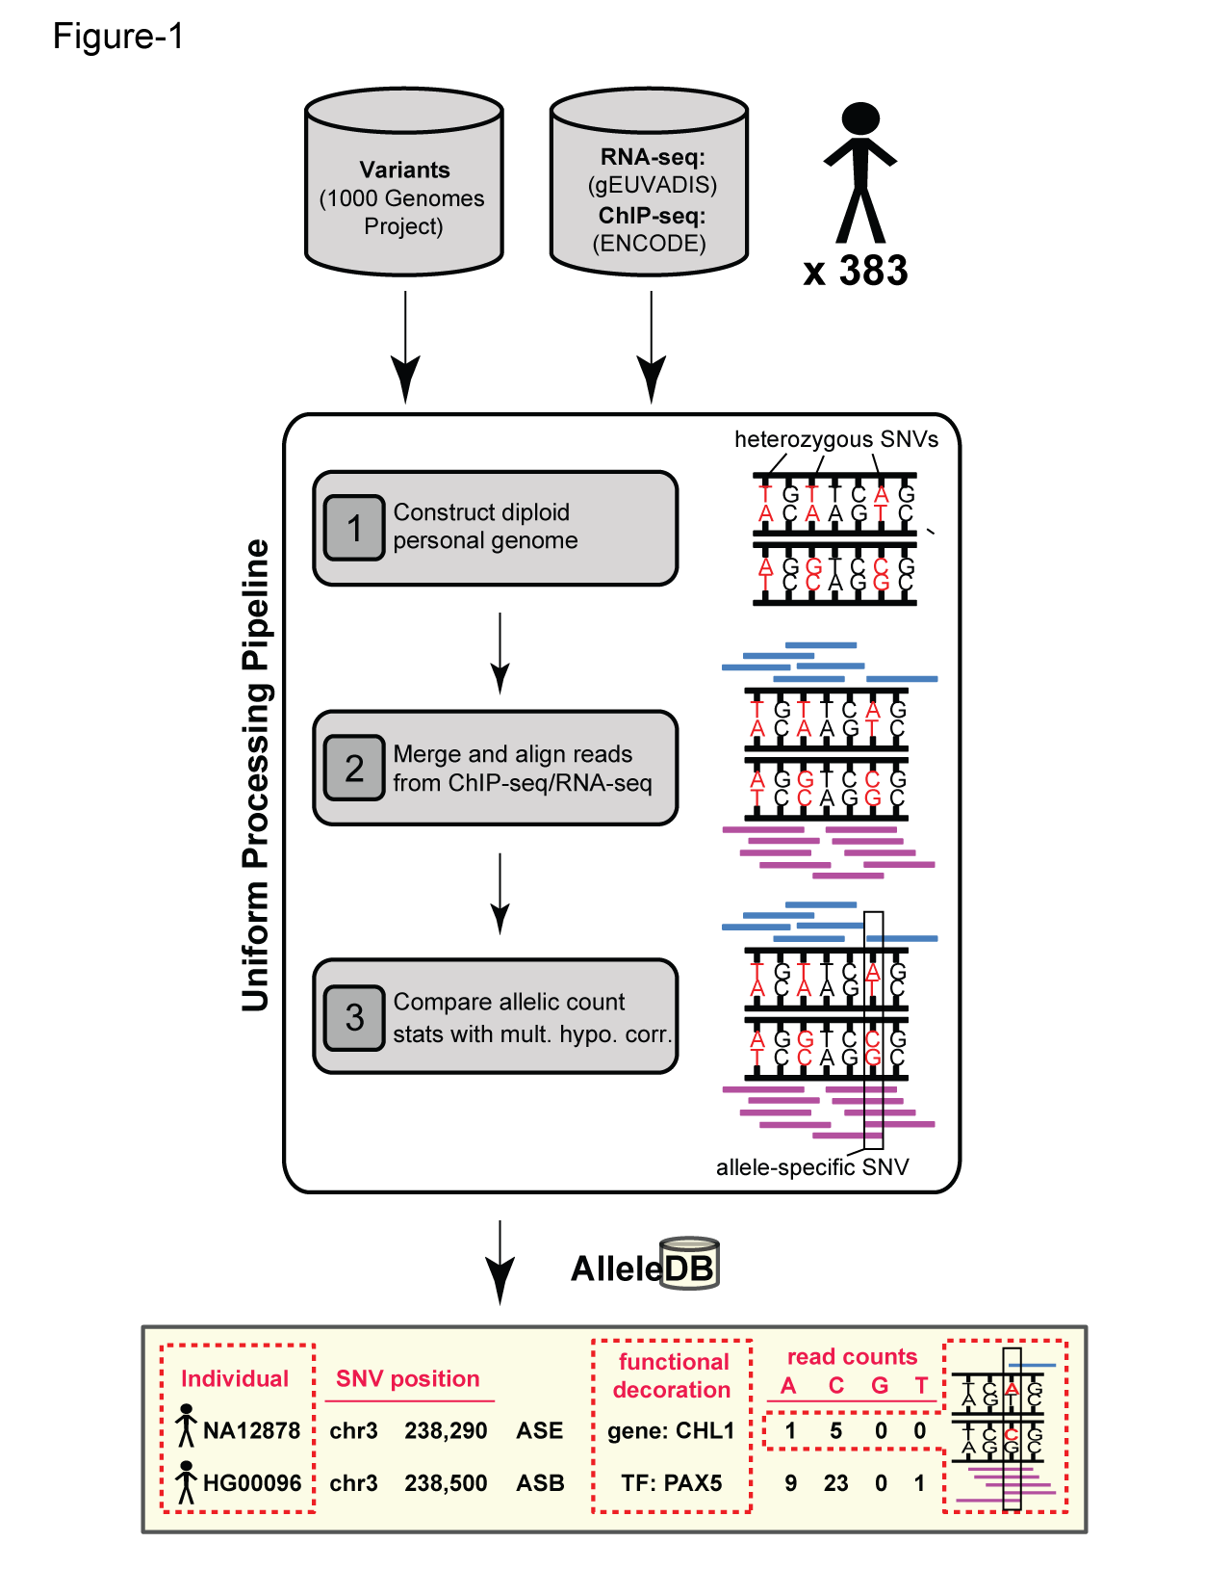


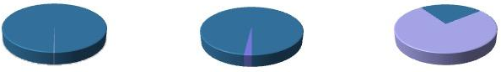
Human Genetic Variation
Population of
2,504 peoples
A Cancer Genome
A Typical Genome
Origin of Variants
Class of Variants
 | Coding | Non- coding
Germ- line | 22K | 4.1 – 5M
Somatic | ~50 | 5K
SNP | 3.5 – 4.3M
Indel | 550 – 625K
SV | 2.1 – 2.5K (20Mb)
Total | 4.1 – 5M
SNP | 84.7M
Indel | 3.6M
SV | 60K
Total | 88.3M
Prevalence of Variants
Common
Common
Passenger
Driver (~0.1%)
Rare* (1-4%)
Rare (~75%)
* Variants with allele frequency < 0.5% are considered as rare variants in 1000 genomes project.
The 1000 Genomes Project Consortium, Nature. 2015. 526:68-74
Khurana E. et al. Nat. Rev. Genet. 2016. 17:93-108

Slide 16

Finding Key Variants
Germline
CAN YOU FIND THE PANDA?
Common variants
  Can be most readily associated with phenotype (ie disease) via GWAS
  Usually their functional effect is weaker
  Many are non-coding
  Issue of LD in identifying the actual causal variant.
Rare variants
  Associations are usually underpowered due to low frequencies but often have larger functional impact
  Can be collapsed in the same element to gain statistical power (burden tests).
McCarthy, M. et al. Nat. Rev. Genet. 2008. 9, 356-369, Zuk, O. et al. PNSA. 2014. Vol. 11, no. 4, MacArthur DG et al. Nature 2014. 508:469-476

Slide 17
Finding Key Variants
Somatic
CAN YOU FIND THE PANDA?
Overall
  Often these can be thought of as very rare variants
Drivers
  Driver mutation is a mutation that directly or indirectly confers a selective growth advantage to the cell in which it occurs.
  A typical tumor contains 2-8 drivers; the remaining mutations are passengers.
Passengers
  Conceptually, a passenger mutation has no direct or indirect effect on the selective growth advantage of the cell in which it occurred.
Vogelstein B. Science 2013. 339(6127):1546-1558

Slide 18
Prioritizing Variants in Personal Genomes: Using functional impact & recurrence, with particular application to cancer
Introduction
  An individual's disease variants as the public's gateway into genomics & biology
  The exponential scaling of data generation & processing
  Mining big data to prioritize key variants
  as cancer drivers
  Functional impact #1: Coding
  ALoFT: Annotation of Loss-of-Function Transcripts.
  LoF annotation as a complex problem + finding deleterious LoFs
  Frustration as a localized metric of SNV impact. Differential profiles for oncogenes v. TSGs
Functional impact #2: Non-coding
  FunSeq integrates evidence,
  with a “surprisal” based weighting scheme
  Prioritizing rare variants with “sensitive sites”
  (human conserved)
Recurrence:
Statistics for driver identification
  Background mutation rate significantly varies & is correlated with replication timing & TADs
  Developed a variety of parametric & non-parametric methods taking this into account
  LARVA uses parametric beta-binomial model, explicitly modeling covariates
  MOAT does a variety of non-parm. shuffles (annotation, variants, &c). Useful when explicit covariates not available. Slower
  but speeded up w/ GPUs
Recurrence #2:
(Low-power) application to pRCC
  WGS finds additional facts on the canonical driver, MET. Other suggestive non-coding hotspots.
  Analysis of signatures & tumor evolution helps identify key mutations in different ways

Slide 19
Prioritizing Variants in Personal Genomes: Using functional impact & recurrence, with particular application to cancer
Introduction
  An individual's disease variants as the public's gateway into genomics & biology
  The exponential scaling of data generation & processing
  Mining big data to prioritize key variants
  as cancer drivers
  Functional impact #1: Coding
  ALoFT: Annotation of Loss-of-Function Transcripts.
  LoF annotation as a complex problem + finding deleterious LoFs
  Frustration as a localized metric of SNV impact. Differential profiles for oncogenes v. TSGs
Functional impact #2: Non-coding
  FunSeq integrates evidence,
  with a “surprisal” based weighting scheme
  Prioritizing rare variants with “sensitive sites”
  (human conserved)
Recurrence:
Statistics for driver identification
  Background mutation rate significantly varies & is correlated with replication timing & TADs
  Developed a variety of parametric & non-parametric methods taking this into account
  LARVA uses parametric beta-binomial model, explicitly modeling covariates
  MOAT does a variety of non-parm. shuffles (annotation, variants, &c). Useful when explicit covariates not available. Slower
  but speeded up w/ GPUs
Recurrence #2:
(Low-power) application to pRCC
  WGS finds additional facts on the canonical driver, MET. Other suggestive non-coding hotspots.
  Analysis of signatures & tumor evolution helps identify key mutations in different ways

Slide 20
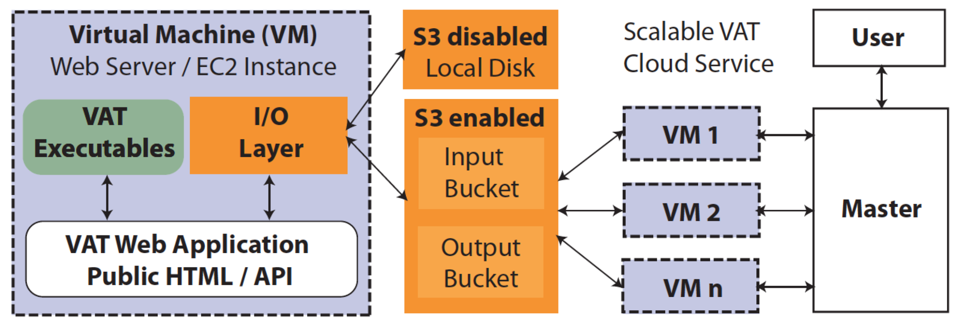
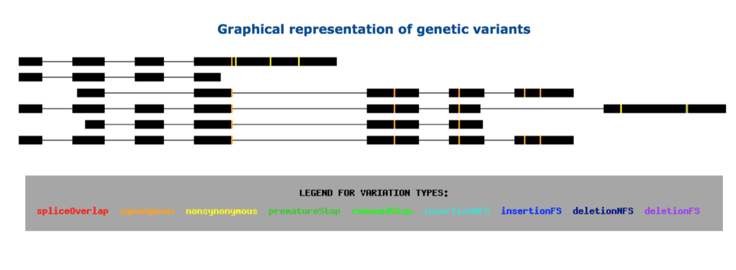
vat.gersteinlab.org
Variant Annotation Tool (VAT), developed for 1000G FIG
VCF Input
Output:
Annotated VCFs
Graphical representations of functional impact on transcripts
Access:
Webserver
AWS cloud instance
Source freely available
CLOUD APPLICATION
Habegger L.*, Balasubramanian S.*, et al. Bioinformatics, 2012
Notes:
20
Big data challenge, graphical interface is important

Slide 21
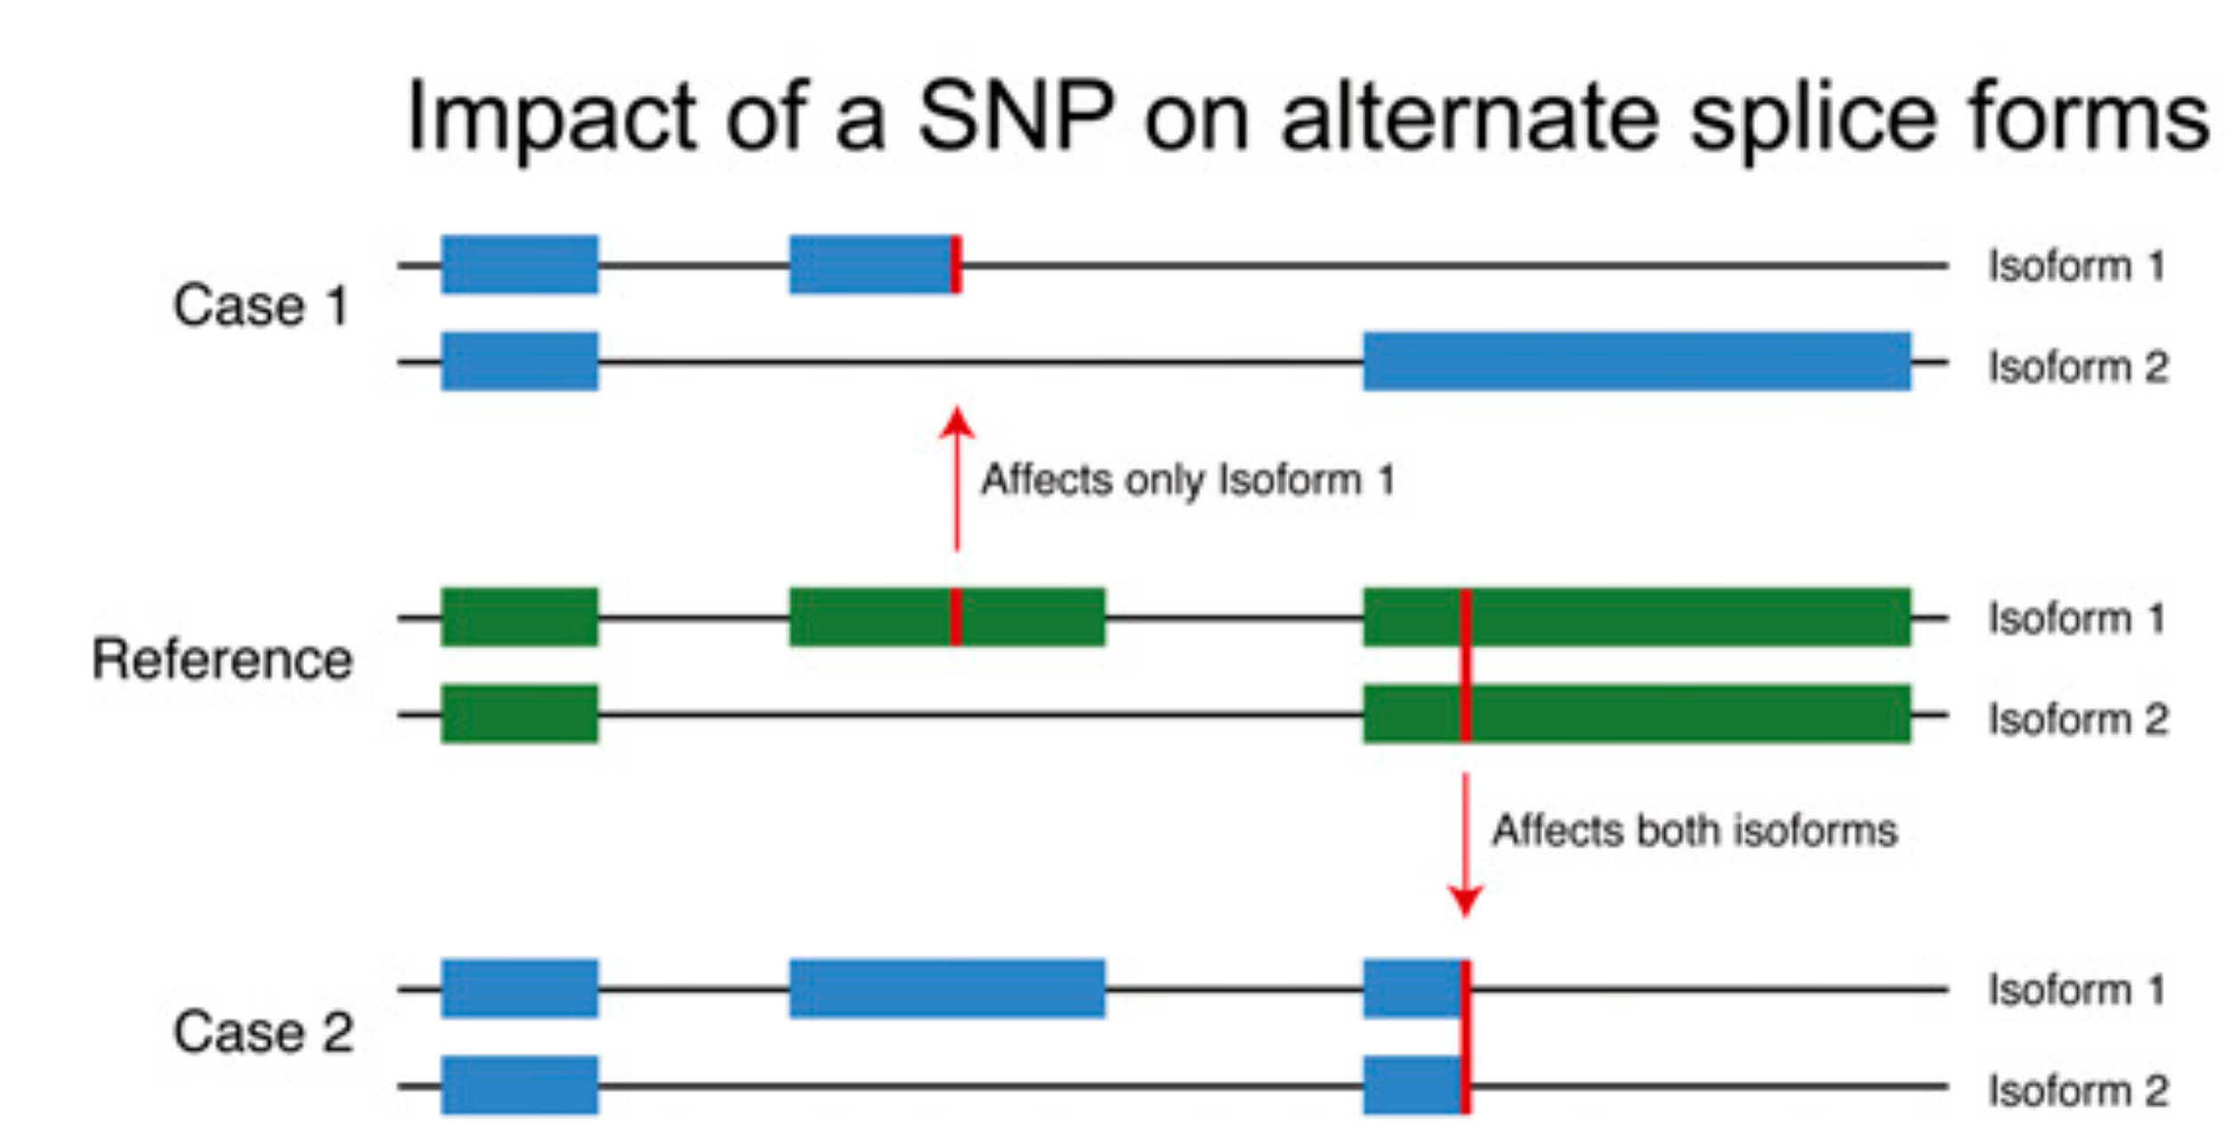
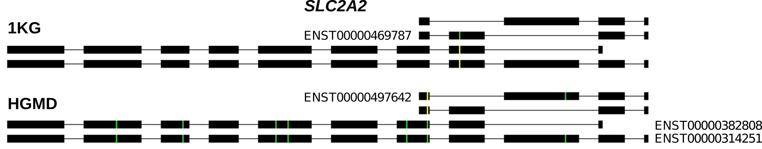
Complexities in LOF annotation
Transcript isoforms,
distance to stop,
functional domains,
protein folding,
etc.
Balasubramanian S. et al., Genes Dev., ’11
Balasubramanian S.*, Fu Y.* et al., NComms., ’17

Slide 22
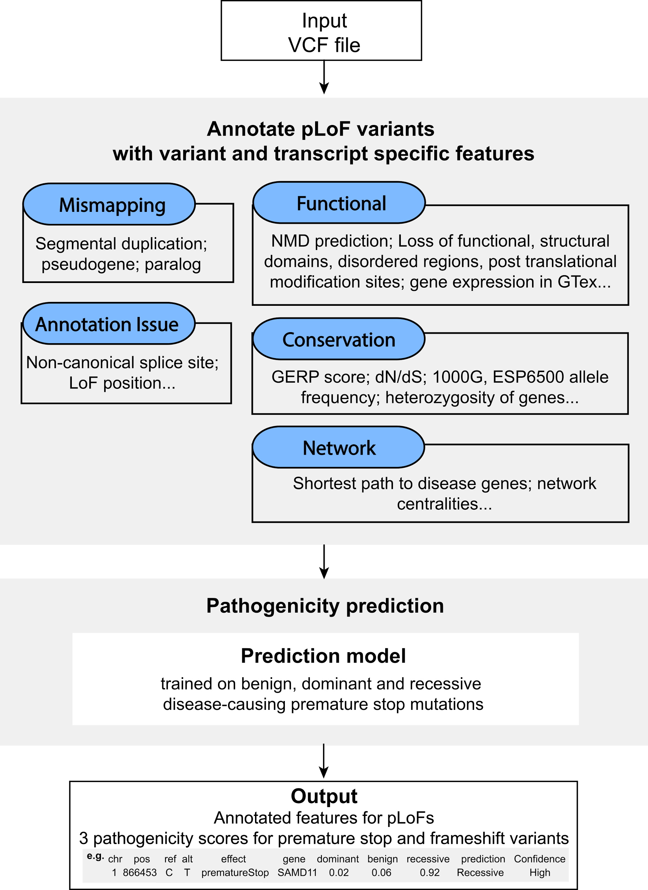
Annotation of
Loss-of-Function
Transcripts (ALoFT)
Runs on top of VAT
Output:
Impact score: benign or deleterious.
Decorated VCF.
Balasubramanian S.*, Fu Y.* et al., NComms., ’17

Slide 23
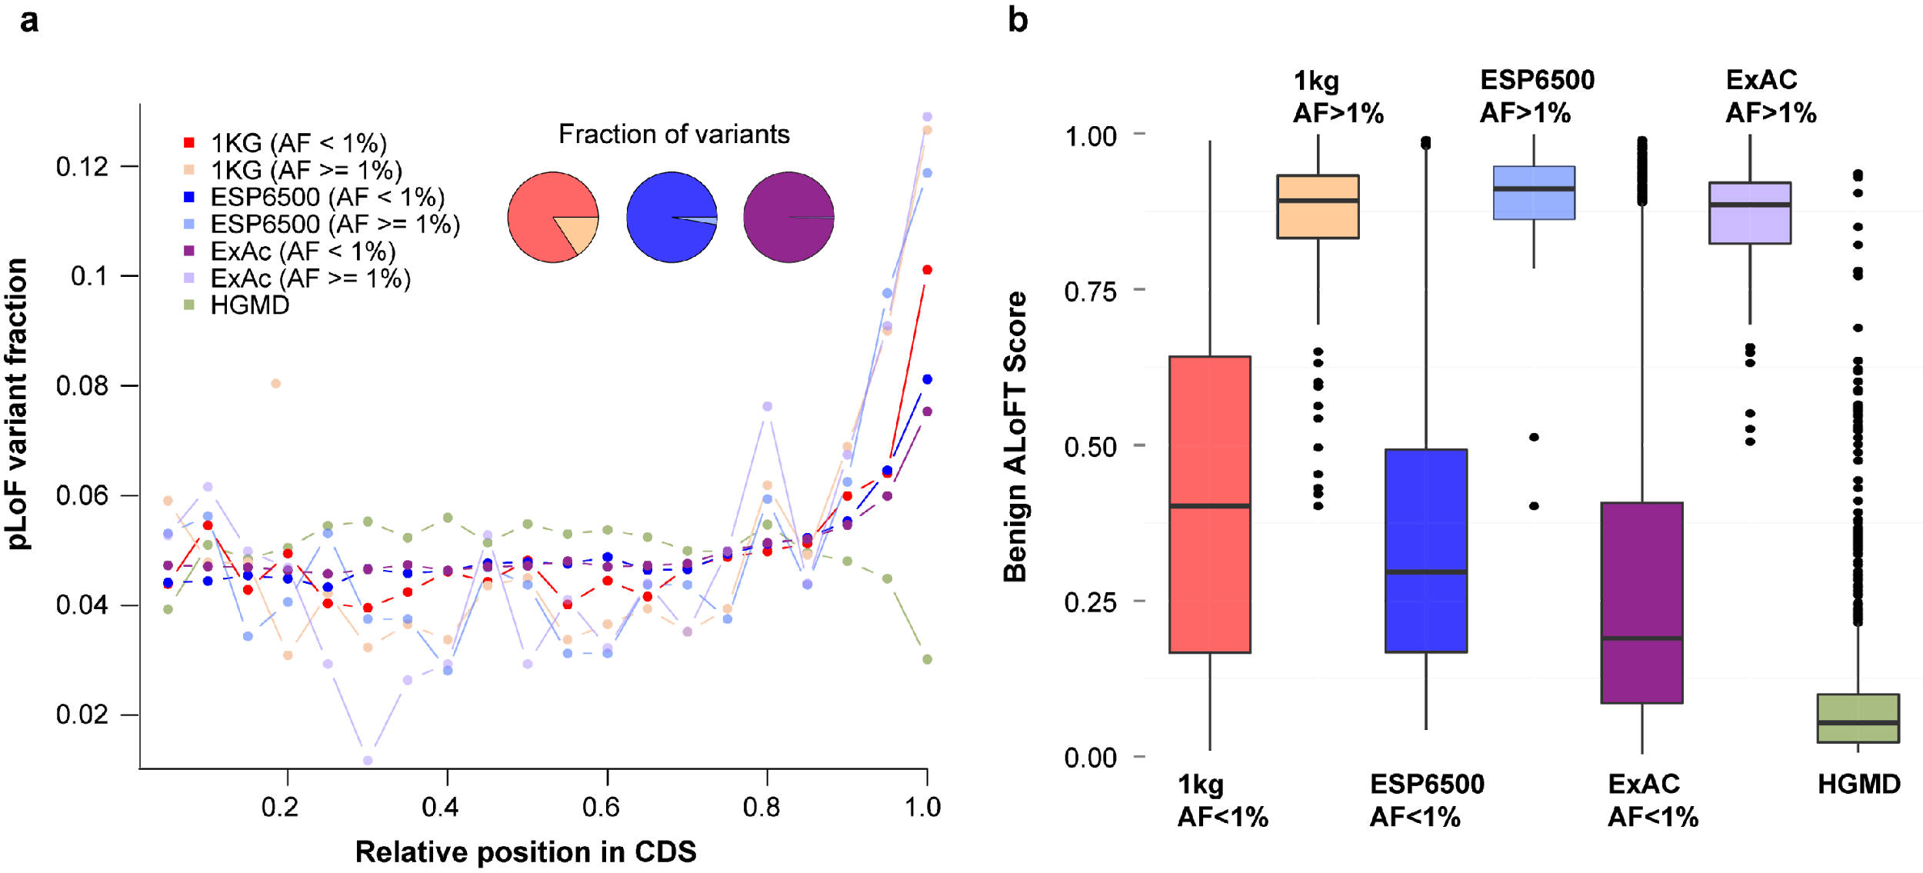
LoF distribution varies as expected by mutation set (from healthy people v from disease)
Balasubramanian S.*, Fu Y.* et al., NComms., ’17

Slide 24
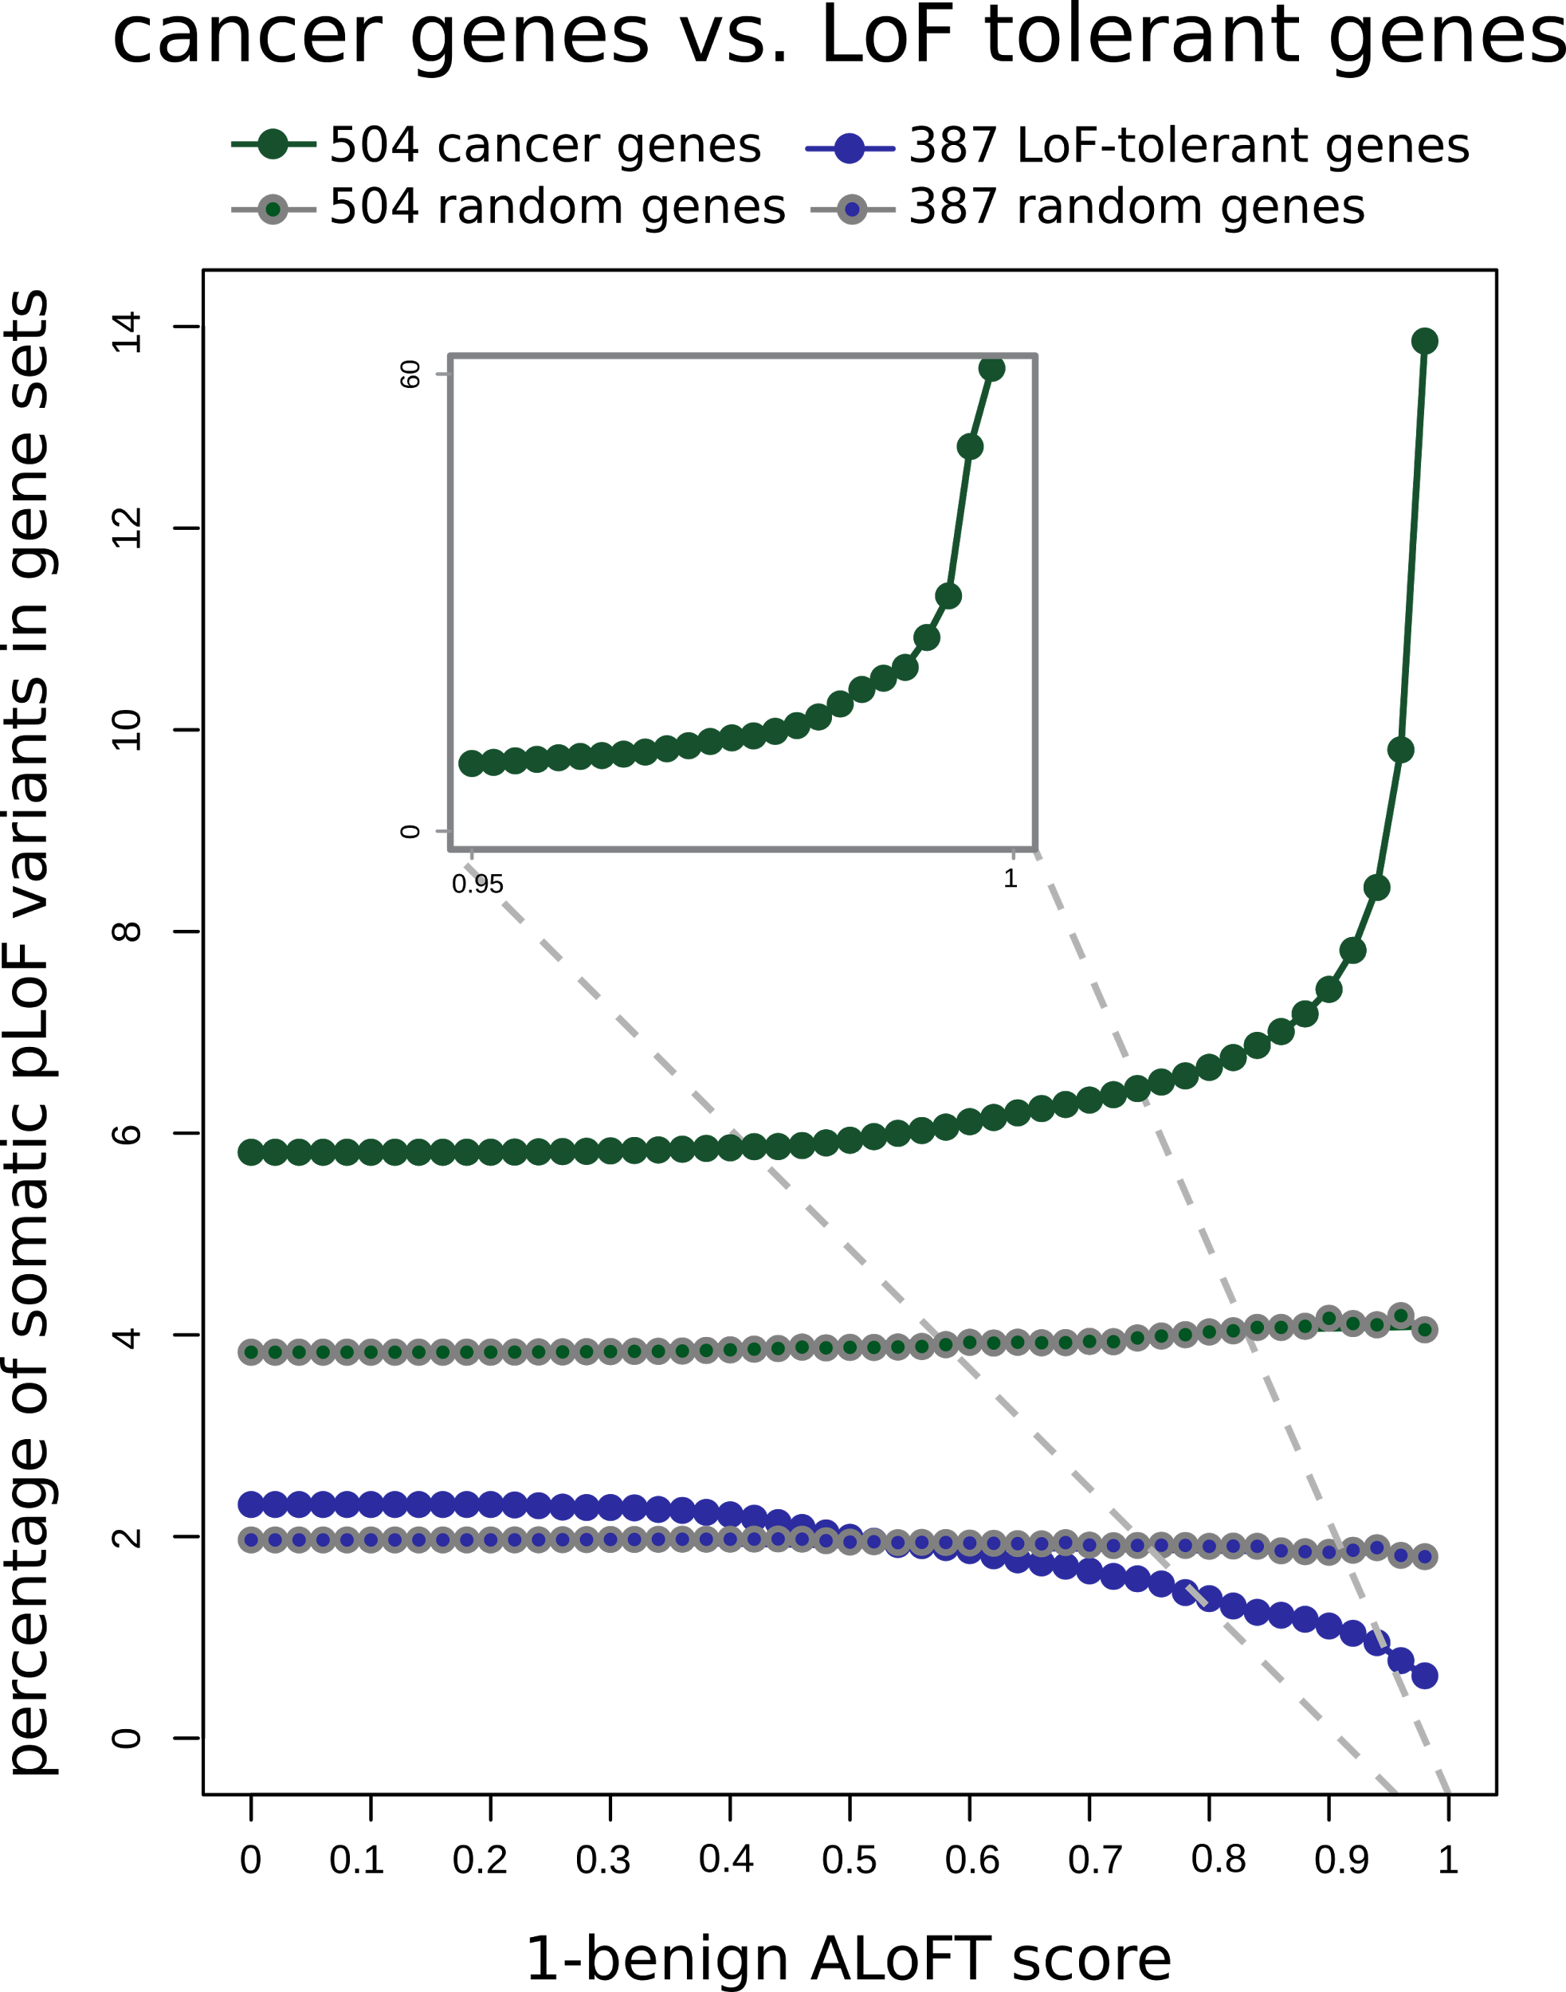
ALoFT identifies deleterious
somatic LoF variants
Cancer genes:
COSMIC consensus.
Enriched in deleterious LoFs.
LoF tolerant genes:
LoF in the 1KG cohort.
Depleted in deleterious LoFs.
Balasubramanian S.*, Fu Y.* et al., NComms., ’17

Slide 25
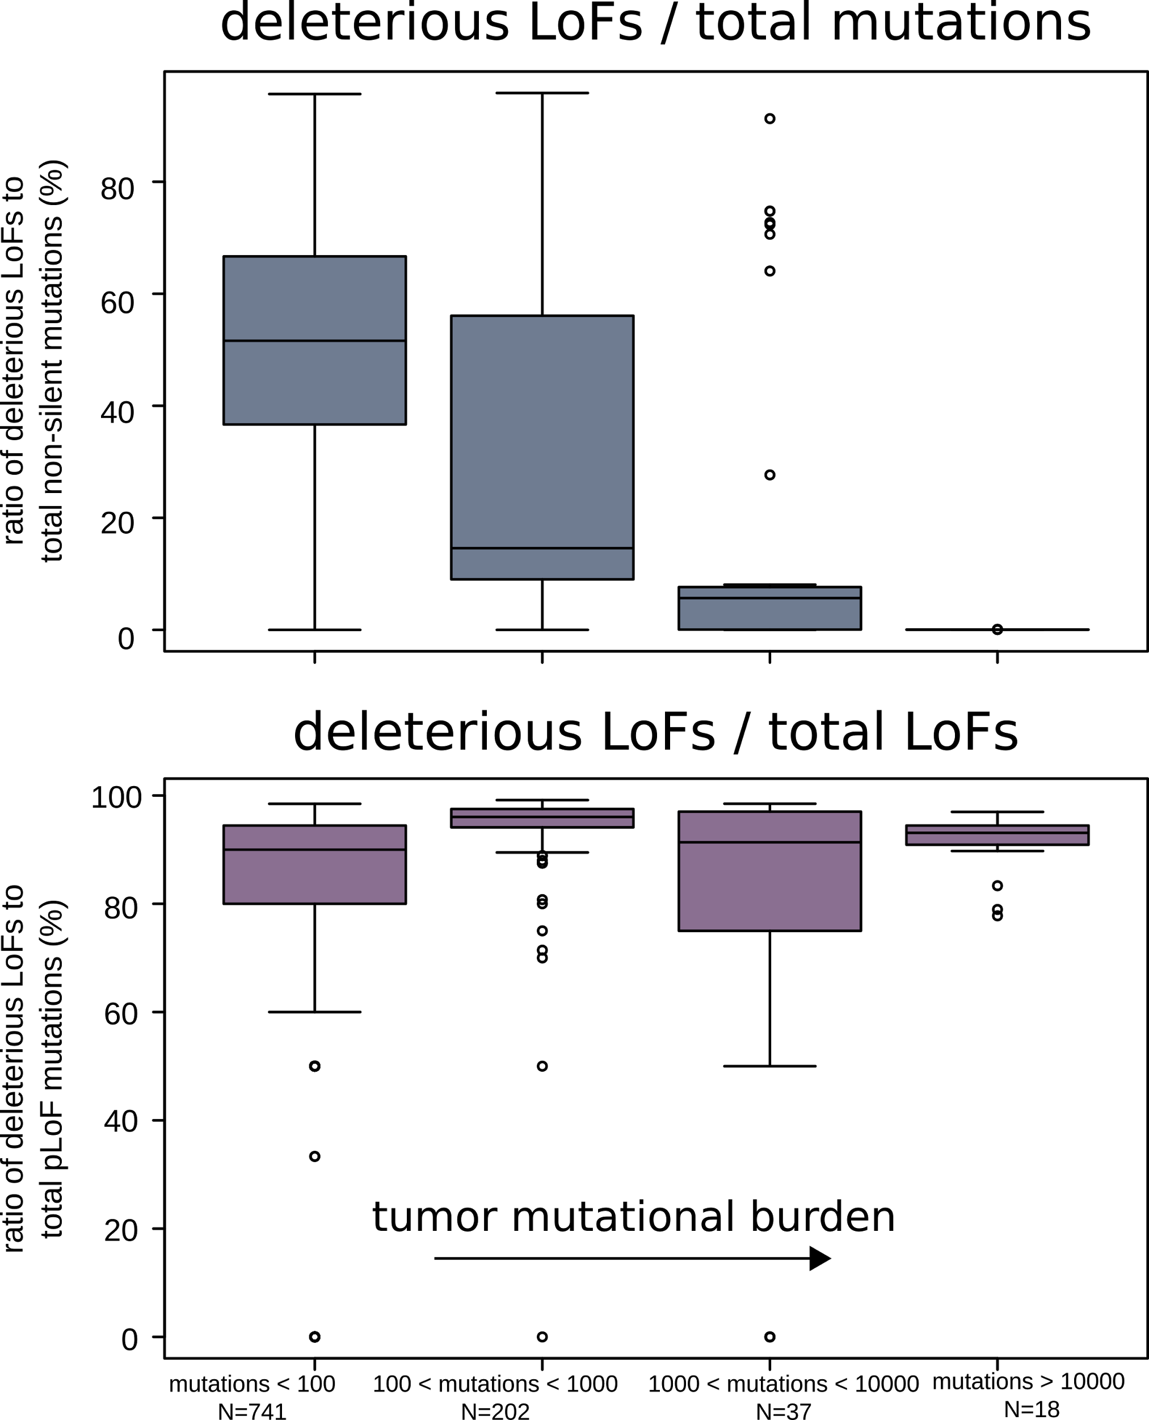
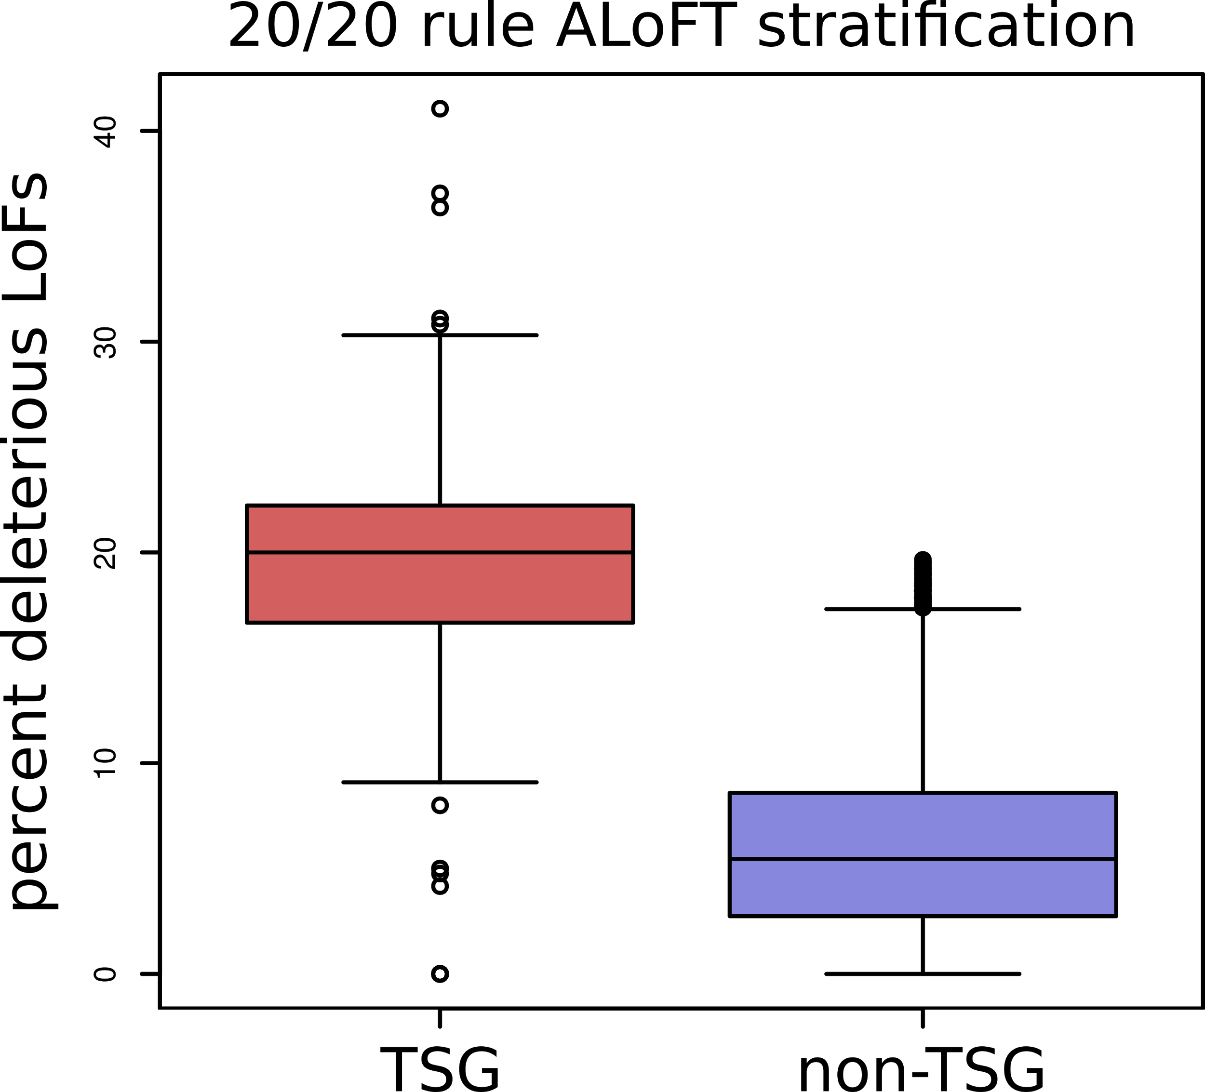
ALoFT refines cancer mutation characterization
Vogelstein et al. '13: if >20% of mutations in gene inactivating → tumor suppressor gene (TSG).
ALoFT further refines 20/20 rule predictions.
Balasubramanian S.*, Fu Y.* et al., NComms., ’17

Slide 26
Prioritizing Variants in Personal Genomes: Using functional impact & recurrence, with particular application to cancer
Introduction
  An individual's disease variants as the public's gateway into genomics & biology
  The exponential scaling of data generation & processing
  Mining big data to prioritize key variants
  as cancer drivers
  Functional impact #1: Coding
  ALoFT: Annotation of Loss-of-Function Transcripts.
  LoF annotation as a complex problem + finding deleterious LoFs
  Frustration as a localized metric of SNV impact. Differential profiles for oncogenes v. TSGs
Functional impact #2: Non-coding
  FunSeq integrates evidence,
  with a “surprisal” based weighting scheme
  Prioritizing rare variants with “sensitive sites”
  (human conserved)
Recurrence:
Statistics for driver identification
  Background mutation rate significantly varies & is correlated with replication timing & TADs
  Developed a variety of parametric & non-parametric methods taking this into account
  LARVA uses parametric beta-binomial model, explicitly modeling covariates
  MOAT does a variety of non-parm. shuffles (annotation, variants, &c). Useful when explicit covariates not available. Slower
  but speeded up w/ GPUs
Recurrence #2:
(Low-power) application to pRCC
  WGS finds additional facts on the canonical driver, MET. Other suggestive non-coding hotspots.
  Analysis of signatures & tumor evolution helps identify key mutations in different ways

Slide 27
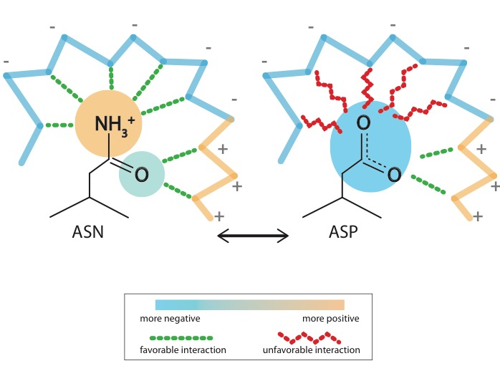
What is localized frustration?
[Ferreiro et al., PNAS (’07)]

Slide 28
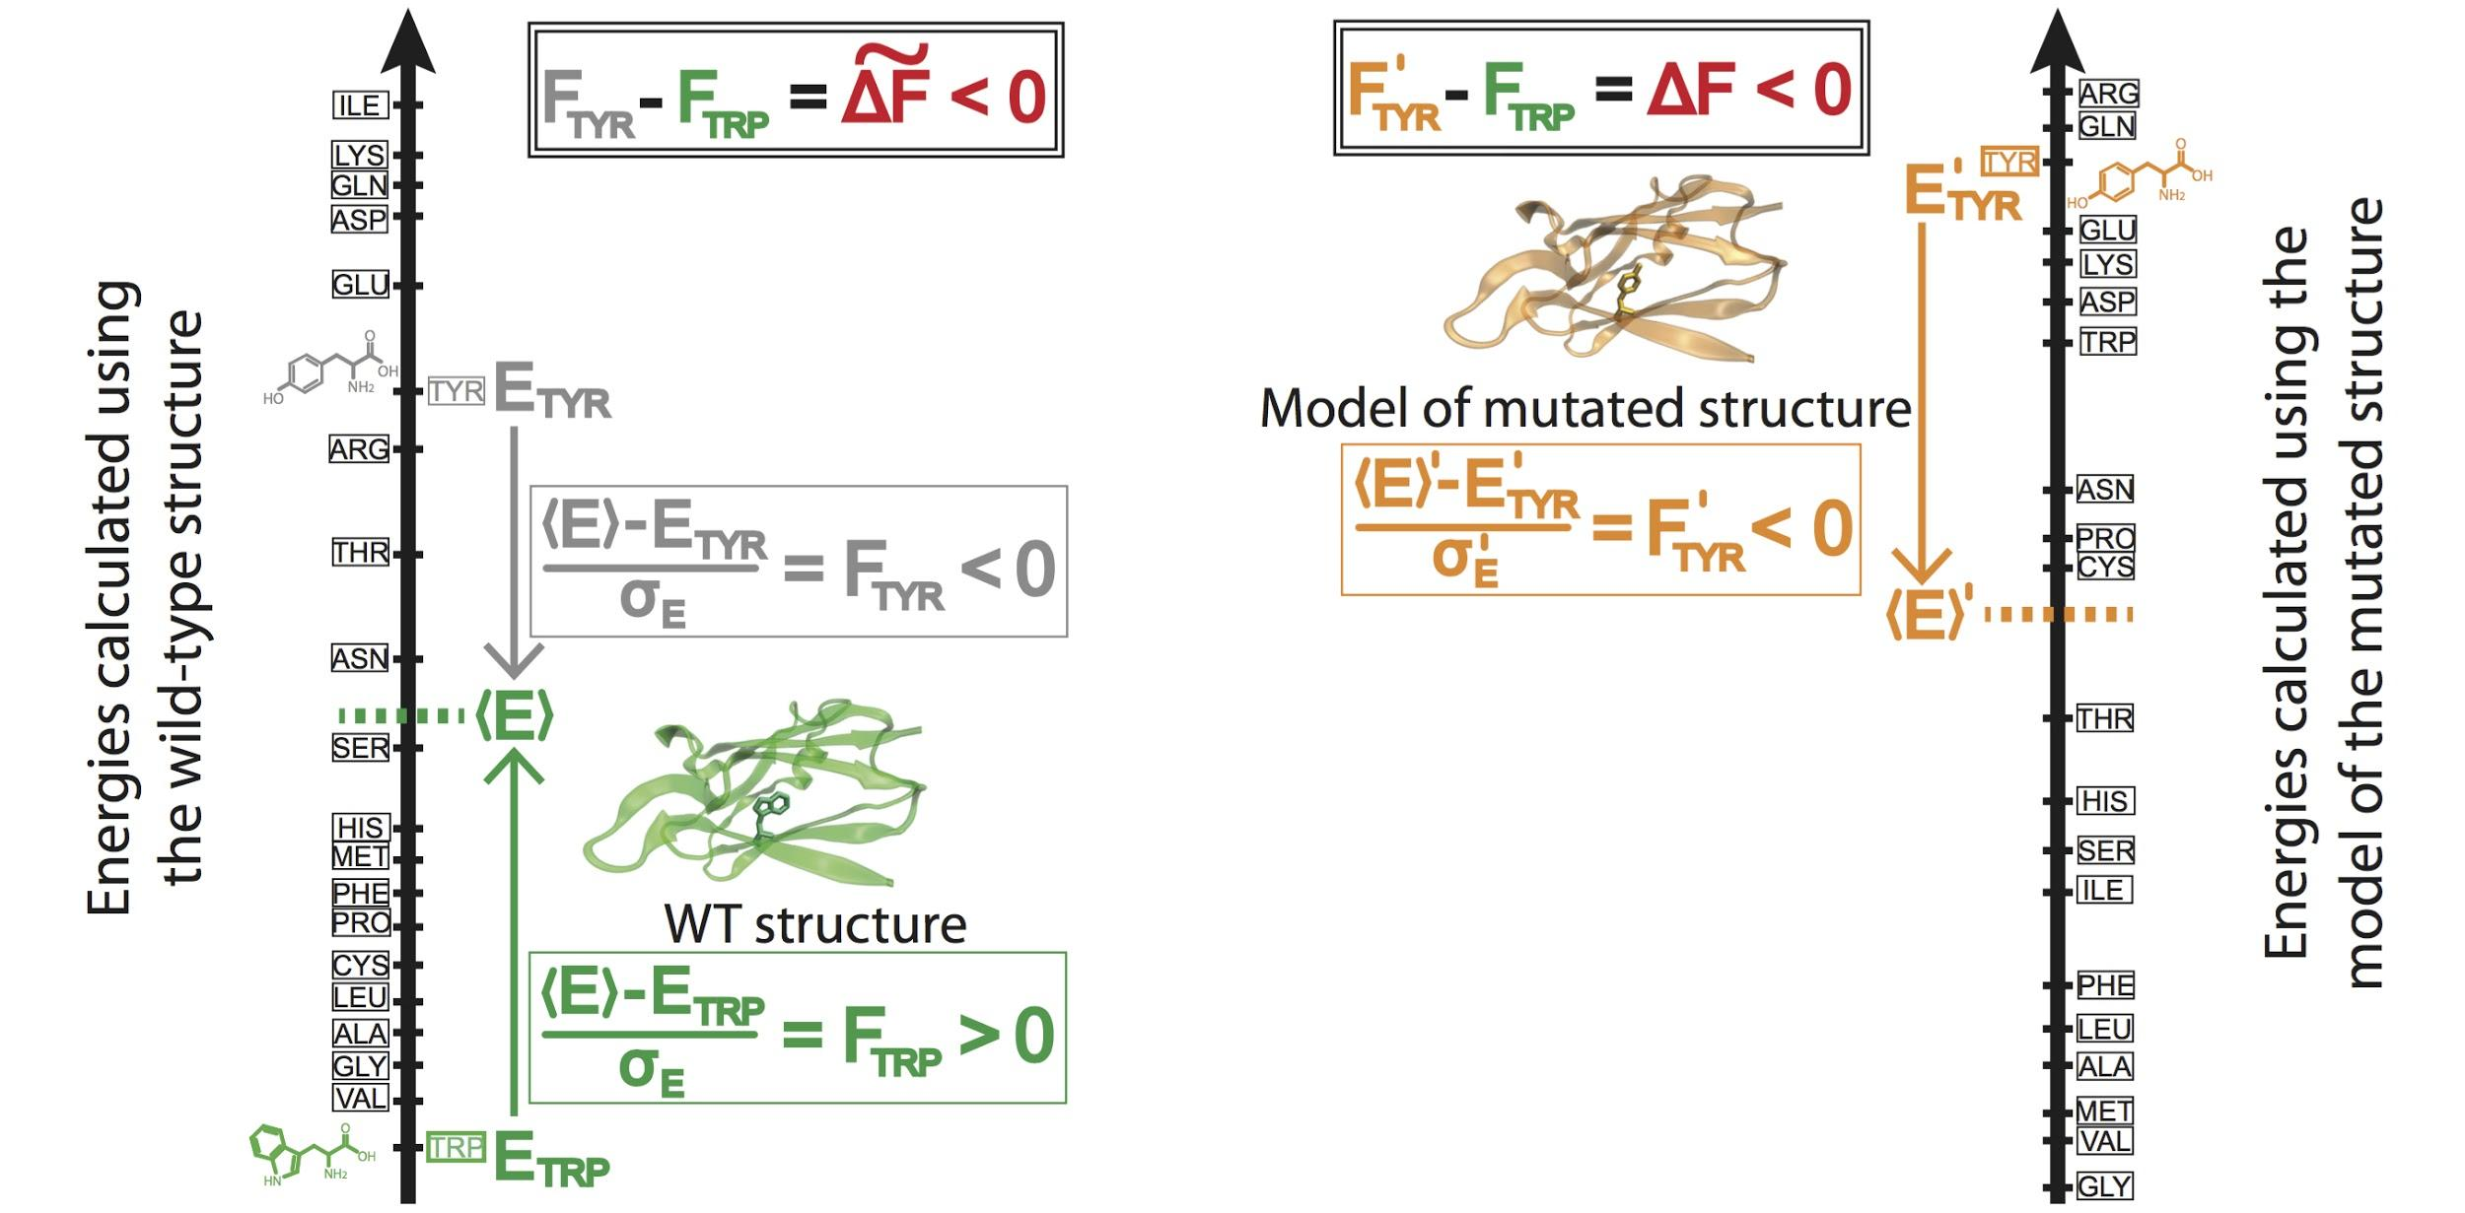
Workflow for evaluating localized frustration changes (∆F)
[Kumar et al. NAR (2016)]
Notes:
An example illustrating the case in which ∆F < 0. The ∆F associated with an SNV is negative if the SNV introduces a destabilizing effect. Shown here is the result of changing residue ID 31 in plastocyanin (pdb ID 3CVD) from the wild-type residue (Trp) to a mutated residue (Tyr). Left) The protein in its wild-type form (in green), in which the tryptophan residue at position 31 is substantially more energetically favorable relative to the mean energy ⟨E⟩ that would result from having any of the possible 20 amino acids at that position. This disparity is designated by (⟨E⟩ - E_{nat})/σ_{E} = F_{nat} > 0. Right) The entire protein structure is then modeled to generate the mutated structure after the SNV W31Y is introduced, thereby changing the relative energetic distributions for the different amino acids. The new mean and standard deviation associated with the energies of the modeled structure are designated by ⟨E⟩’ and σ_{E}’, respectively. In this case, the SNV that introduces 31Y results in an energy that is higher than the mean energy of all possible 20 amino acids at that position. This disparity is designated by (⟨E⟩’ - E_{mut})/σ_{E}’ = F_{mut} < 0. Taken together, the negative value associated with the disparity between the F_{mut} and F_{nat} values (F_{mut} - F_{nat} = ∆F < 0) indicates that the this SNV is locally unfavorable.

Slide 29
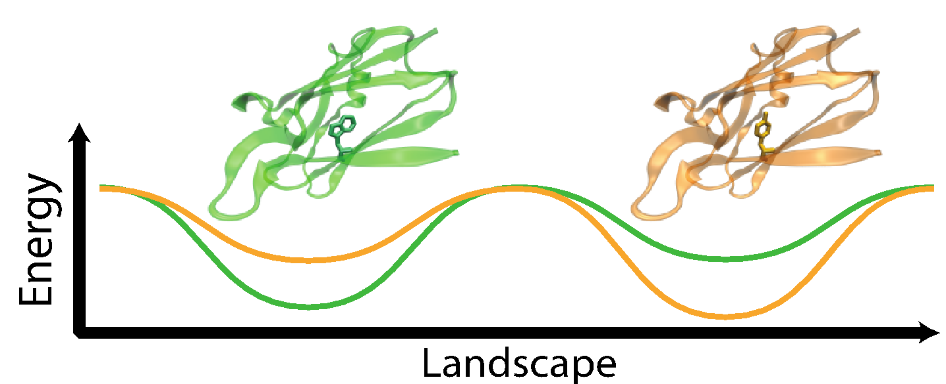
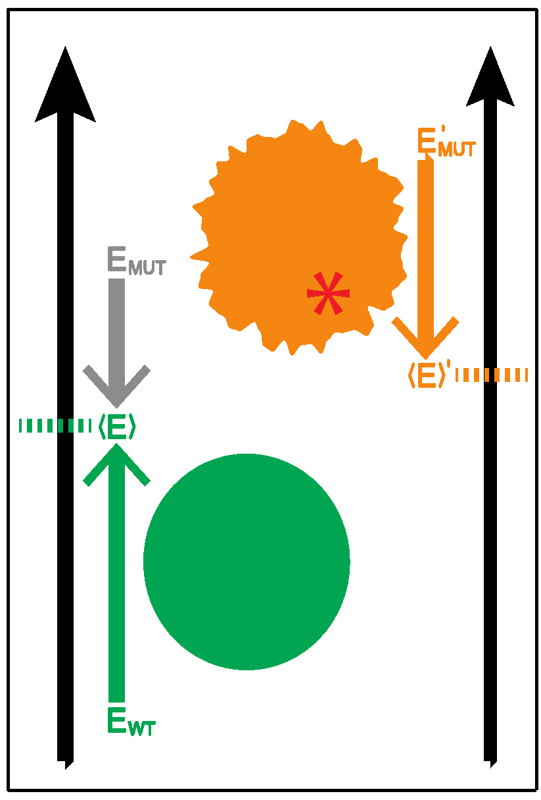
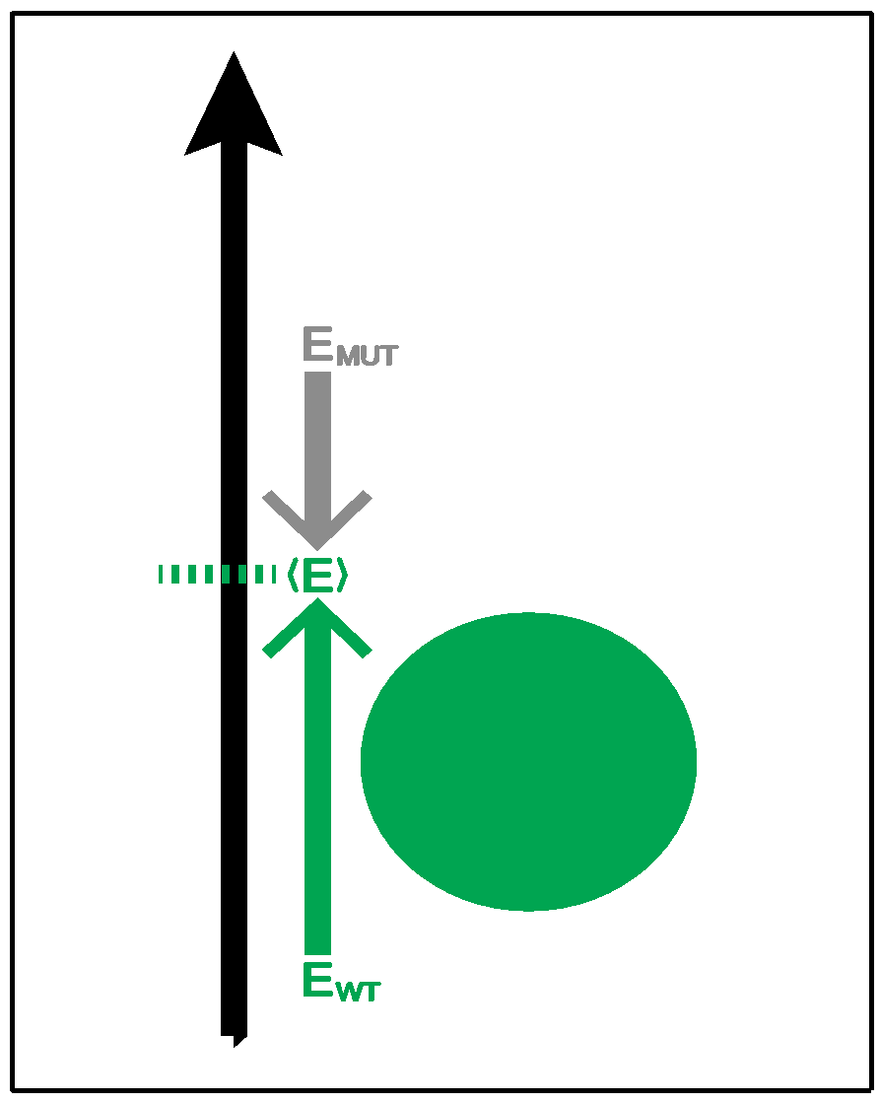
Complexity of the second order frustration calculation
MD-assisted free energy calculation (∆G)
Second order frustration calculation (∆F)
Time
First order frustration calculation (F)
Accuracy

Slide 30
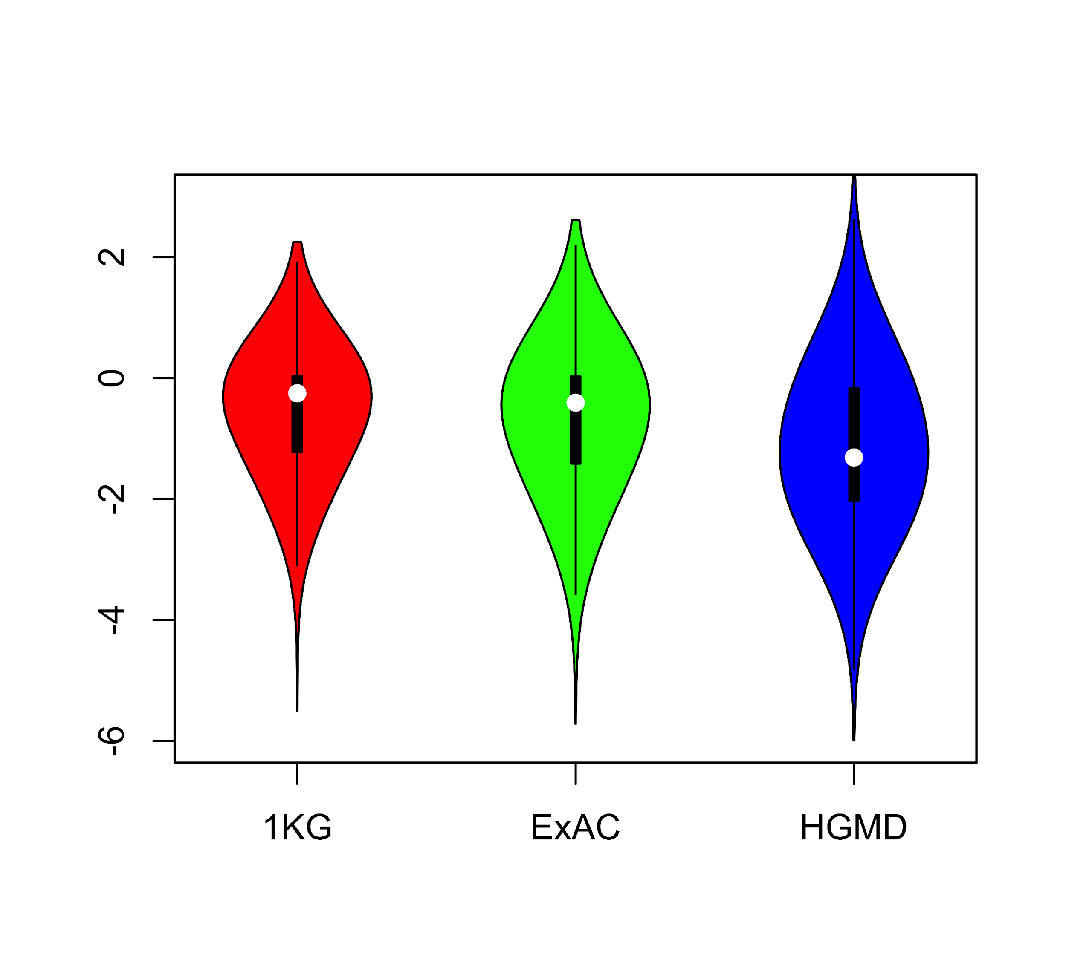
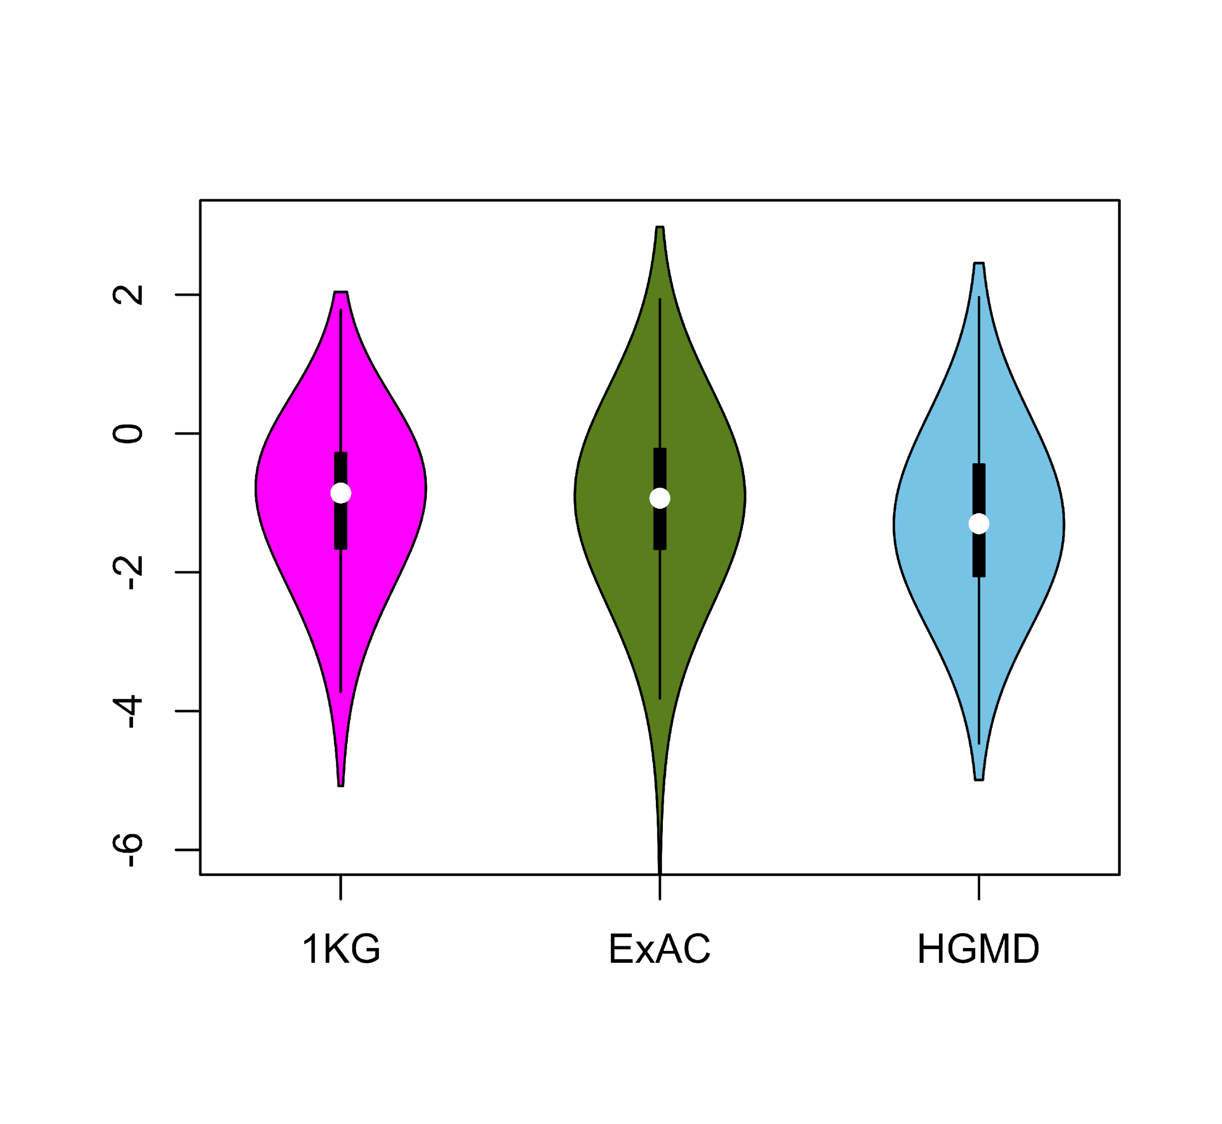
Comparing ∆F values across different SNV categories: disease v normal
Loss of frustration
Gain of frustration
Core residues
Surface residues
Normal mutations (1000G) tend to unfavorably frustrate (less frustrated) surface more than core,
but for disease mutations (HGMD)
no trend & greater changes
[Kumar et al, NAR (2016)]
Notes:
We observed that benign SNVs lead to greater disruptions within minimally frustrated surface residues compared to core residues in the native structure, and this trend is observed when using both ExAC and 1KG (Figure A & B). However, SNVs from HGMD that impact minimally frustrated core residues induce stronger perturbations than benign SNVs influencing minimally frustrated core residues (Figure C). This suggest that the mechanistic difference between benign and disease SNVs can be attributed to their impact on the local environment of core residues. Within the core, disease-associated SNVs result in more severe perturbations to local interactions relative to those introduced by benign SNVs. These local disruptions are propagated throughout the core and, in turn, drive the deleteriousness of various disease-associated SNVs.

Slide 31
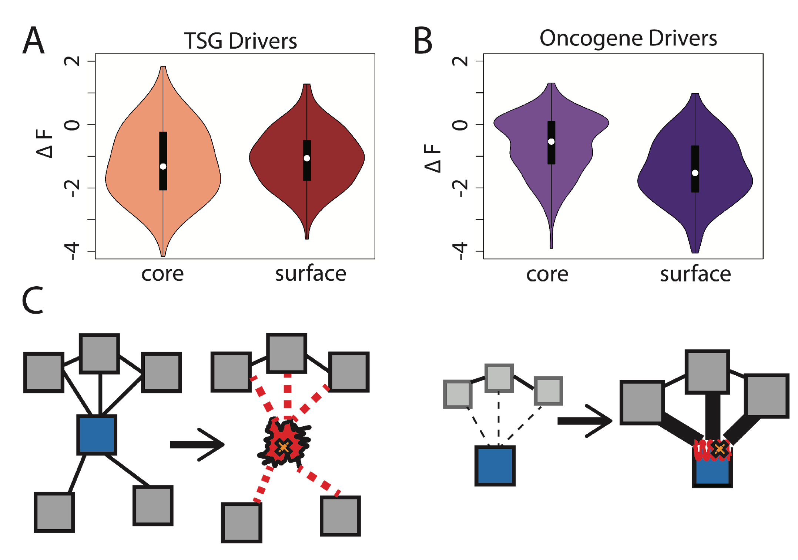
Comparison between ∆F distributions: TSGs v. oncogenes
[Kumar et al, NAR (2016)]
SNVs in TSGs change frustration more in core than the surface, whereas those associated with oncogenes manifest the opposite pattern. This is consistent with differences in LOF v GOF mechanisms.
Notes:
we observe that somatic SNVs associated with TSGs change the frustration more in core than the surface, whereas those associated with oncogenes manifest the opposite pattern. This is consistent with LOF and GOF mechanism proposed for TSG and oncogene driven cancer progression.

Slide 32
Prioritizing Variants in Personal Genomes: Using functional impact & recurrence, with particular application to cancer
Introduction
  An individual's disease variants as the public's gateway into genomics & biology
  The exponential scaling of data generation & processing
  Mining big data to prioritize key variants
  as cancer drivers
  Functional impact #1: Coding
  ALoFT: Annotation of Loss-of-Function Transcripts.
  LoF annotation as a complex problem + finding deleterious LoFs
  Frustration as a localized metric of SNV impact. Differential profiles for oncogenes v. TSGs
Functional impact #2: Non-coding
  FunSeq integrates evidence,
  with a “surprisal” based weighting scheme
  Prioritizing rare variants with “sensitive sites”
  (human conserved)
Recurrence:
Statistics for driver identification
  Background mutation rate significantly varies & is correlated with replication timing & TADs
  Developed a variety of parametric & non-parametric methods taking this into account
  LARVA uses parametric beta-binomial model, explicitly modeling covariates
  MOAT does a variety of non-parm. shuffles (annotation, variants, &c). Useful when explicit covariates not available. Slower
  but speeded up w/ GPUs
Recurrence #2:
(Low-power) application to pRCC
  WGS finds additional facts on the canonical driver, MET. Other suggestive non-coding hotspots.
  Analysis of signatures & tumor evolution helps identify key mutations in different ways

Slide 33
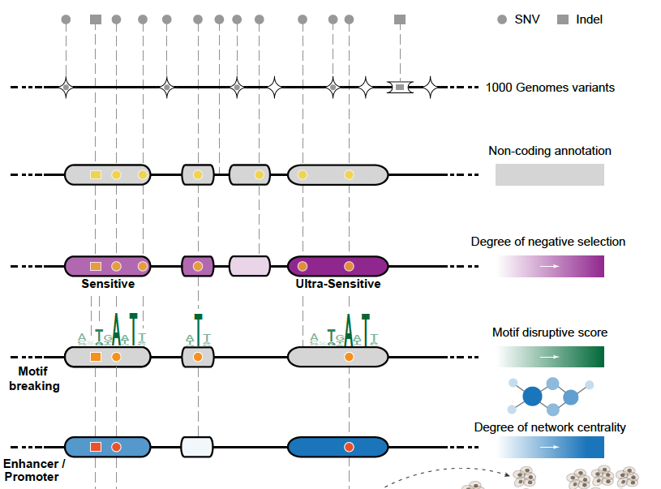
Funseq: a flexible framework to determine
functional impact & use this to prioritize variants
Annotation (tf binding sites open chromatin, ncRNAs) & Chromatin Dynamics
Conservation
(GERP, allele freq.)
Mutational impact (motif breaking, Lof)
Network (centrality position)
[Fu et al., GenomeBiology ('14), , Khurana et al., Science ('13)]

Slide 34
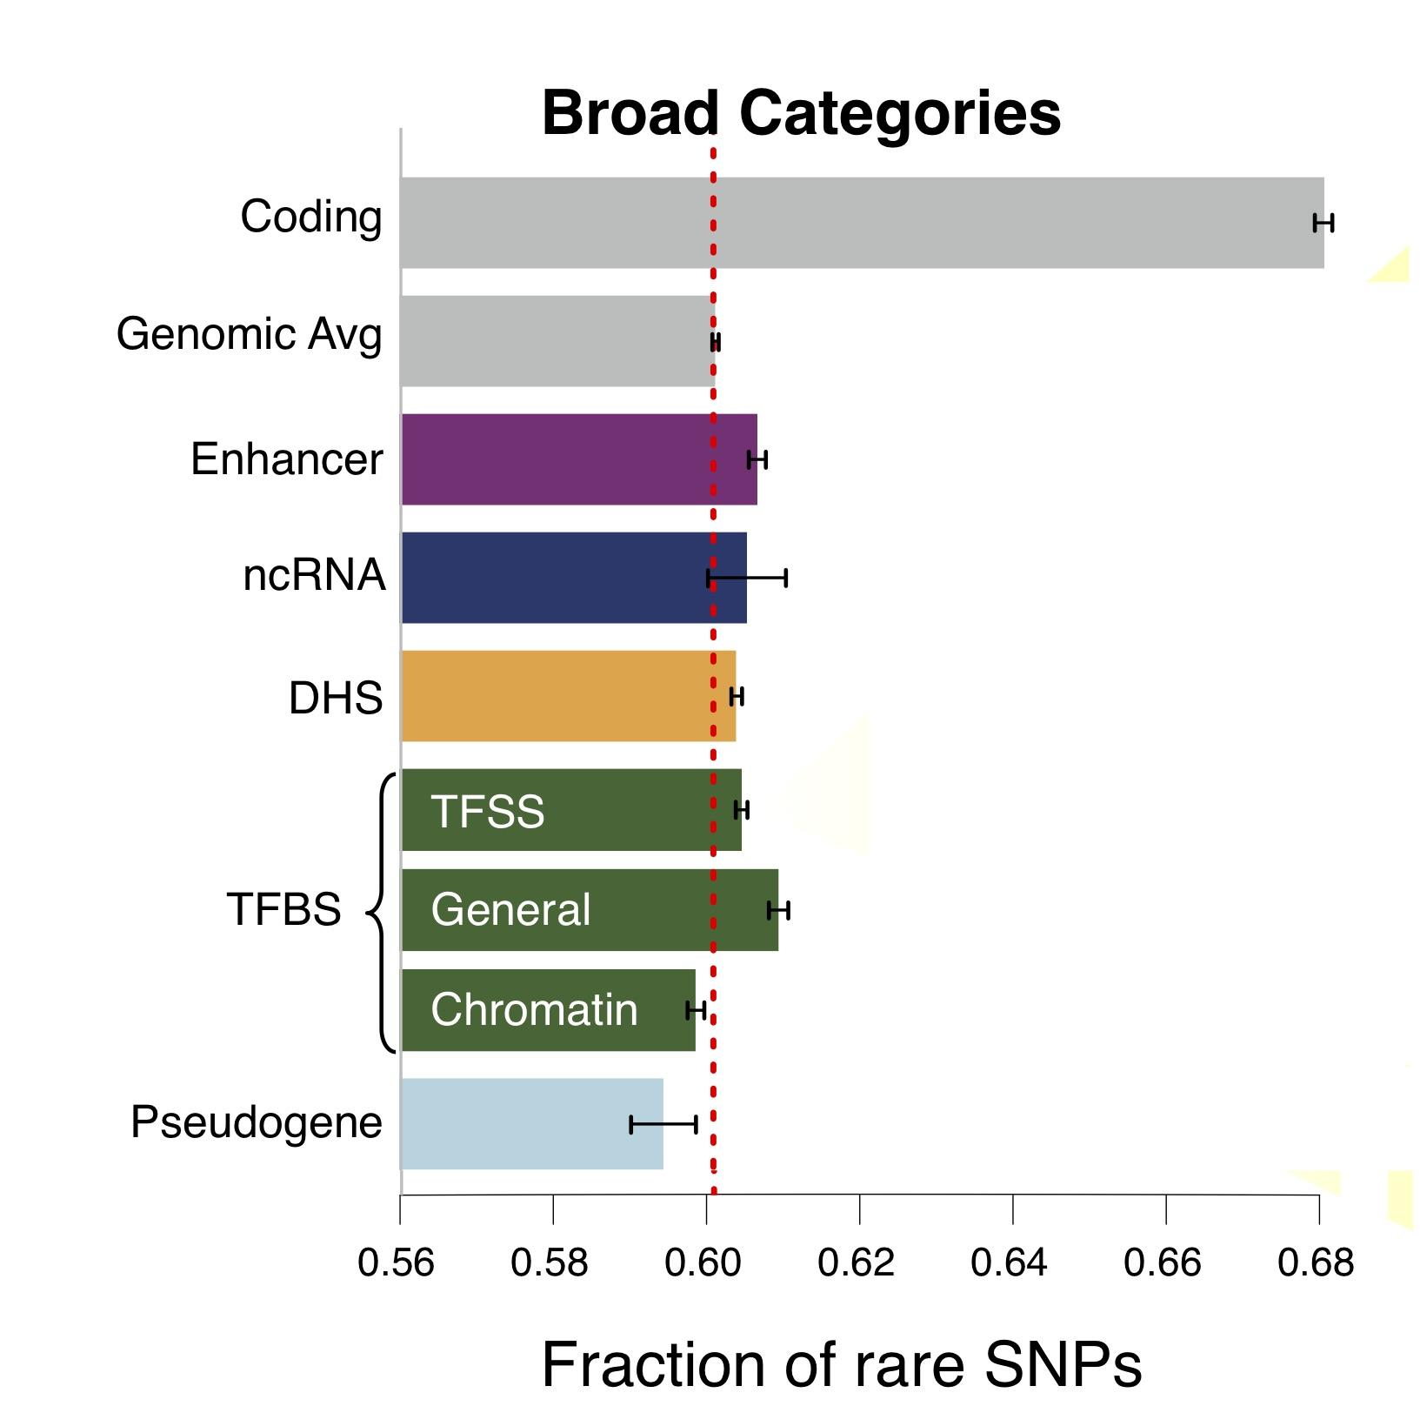
Finding "Conserved” Sites in the Human Population:
Negative selection in non-coding elements based on
Production ENCODE & 1000G Phase 1
Broad categories of regulatory regions under negative selection
Related to:
ENCODE, Nature, 2012
Ward & Kellis, Science, 2012
Mu et al, NAR, 2011
(Non-coding RNA)
(DNase I hypersensitive sites)
(TFSS: Sequence-specific TFs)
(Transcription factor binding sites)
Depletion of Common Variants
in the Human Population

Slide 35
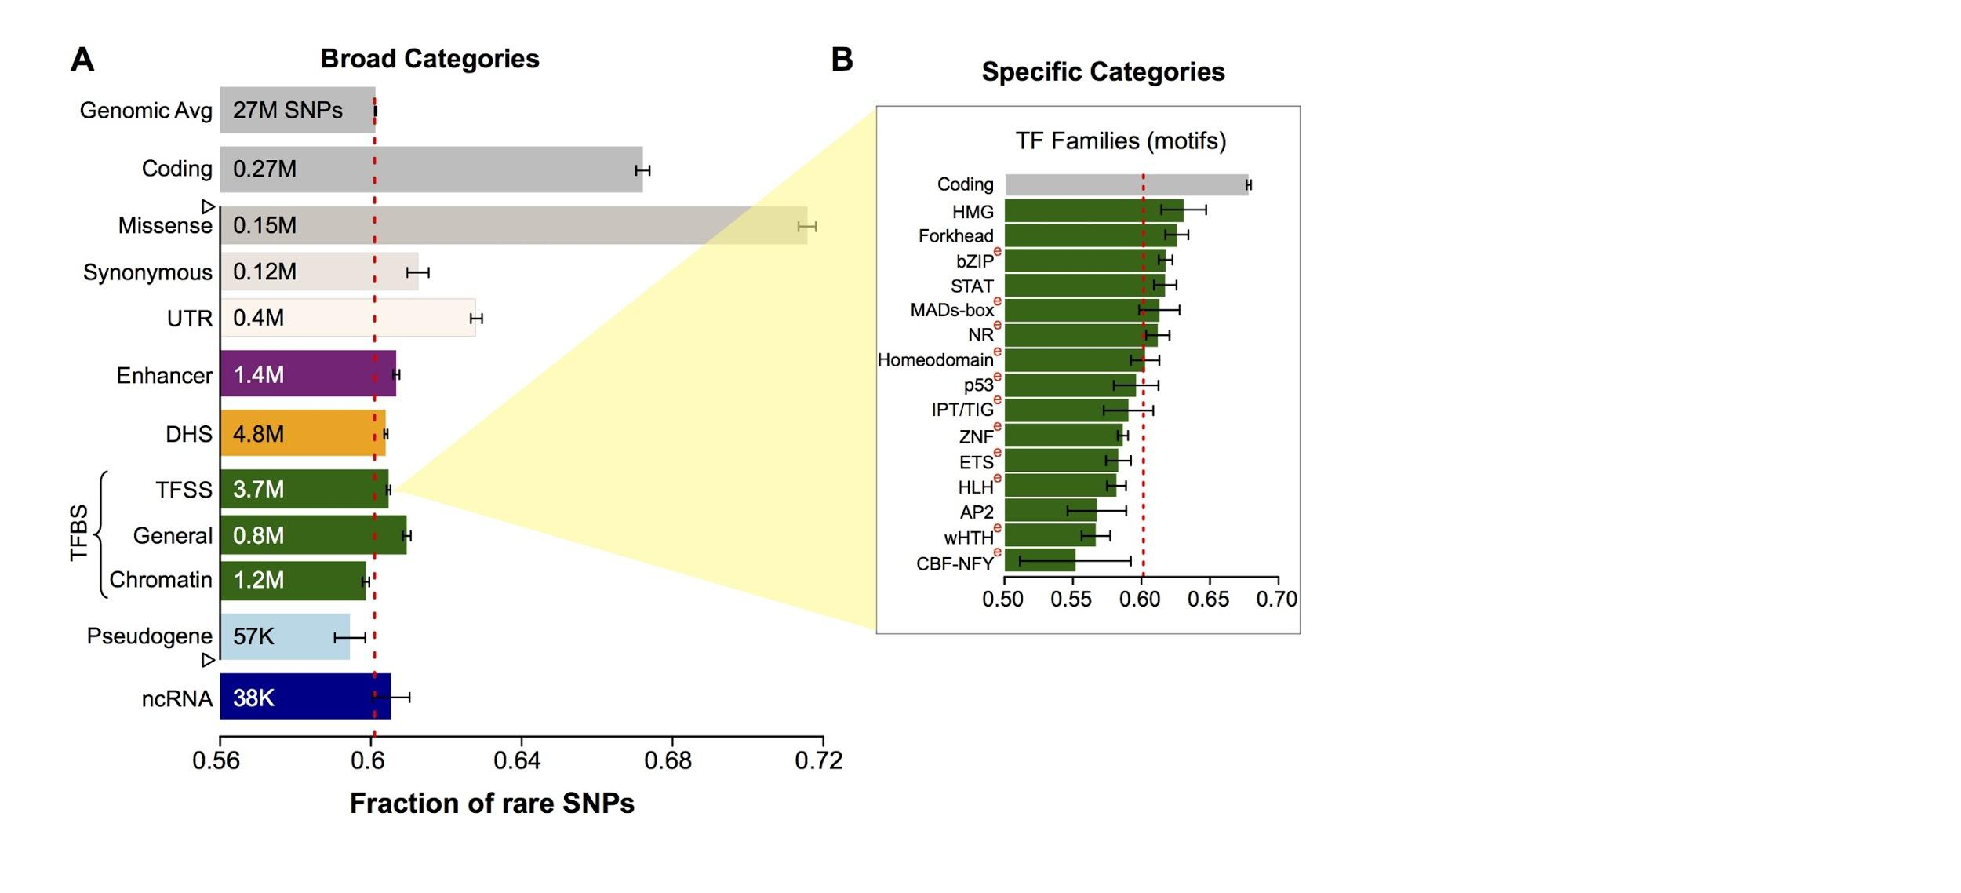
Differential selective constraints
among specific sub-categories
Sub-categorization possible because of better statistics from 1000G phase 1 v pilot
[Khurana et al., Science (‘13)]

Slide 36
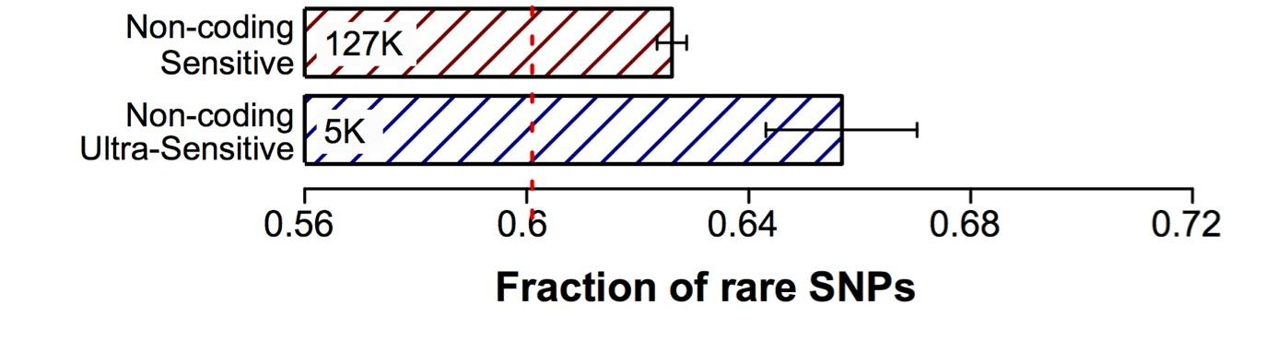
Defining Sensitive
non-coding Regions
~0.4% genomic coverage (~ top 25)
~0.02% genomic coverage (top 5)
Start 677 high-resolution non-coding categories; Rank & find those under strongest selection
Sub-categorization possible because of better statistics from 1000G phase 1 v pilot
[Khurana et al., Science (‘13)]

Slide 37
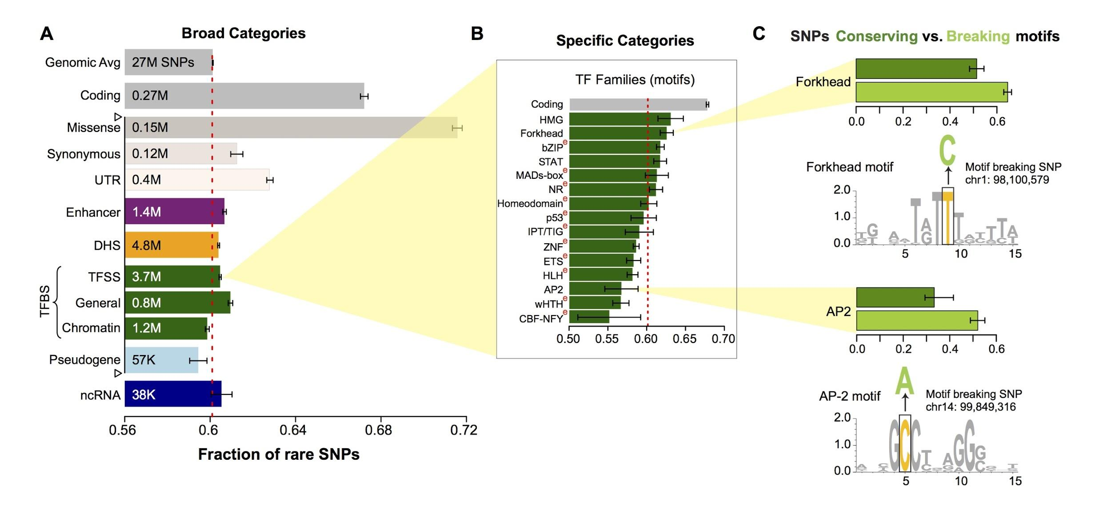
SNPs which break TF motifs are under stronger selection
[Khurana et al., Science (‘13)]

Slide 38
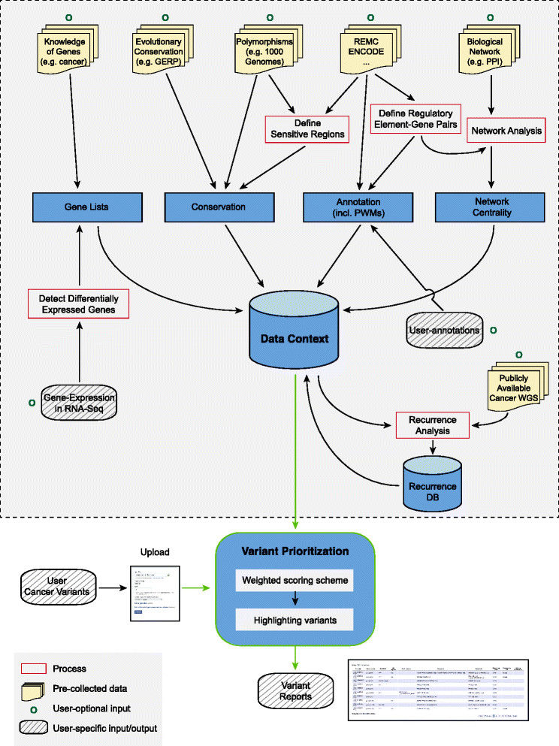
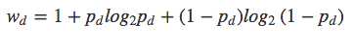
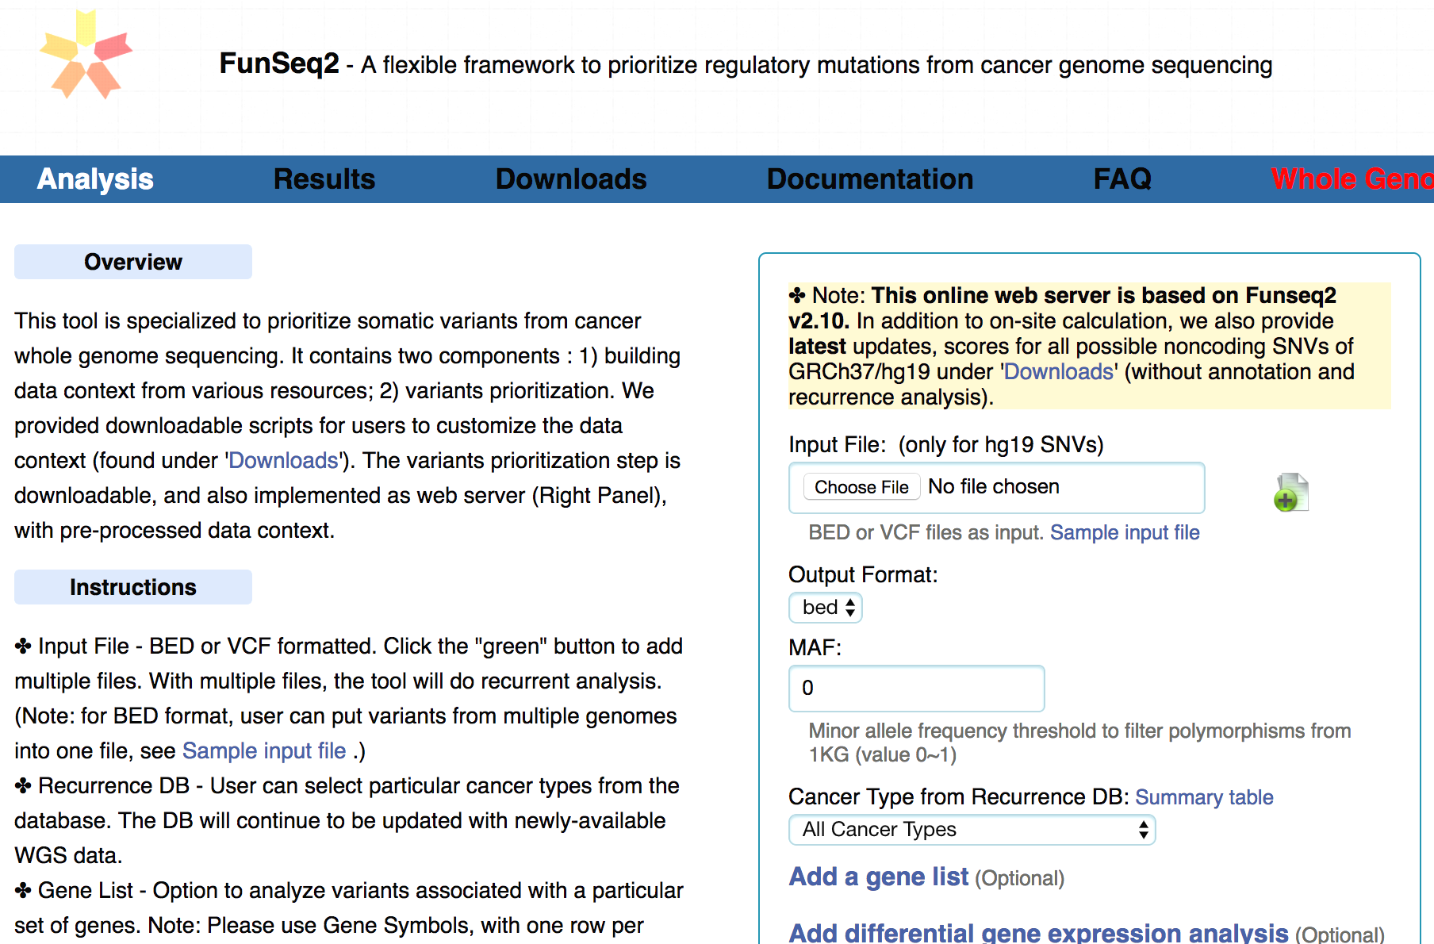
FunSeq.gersteinlab.org
HOT region
Sensitive region
Polymorphisms
Genome
Info. theory based method (ie annotation “surprisal”) for weighting consistently many genomic features
Practical web server
Submission of variants & pre-computed large data context from uniformly processing large-scale datasets
[Fu et al., GenomeBiology ('14)]

Slide 39
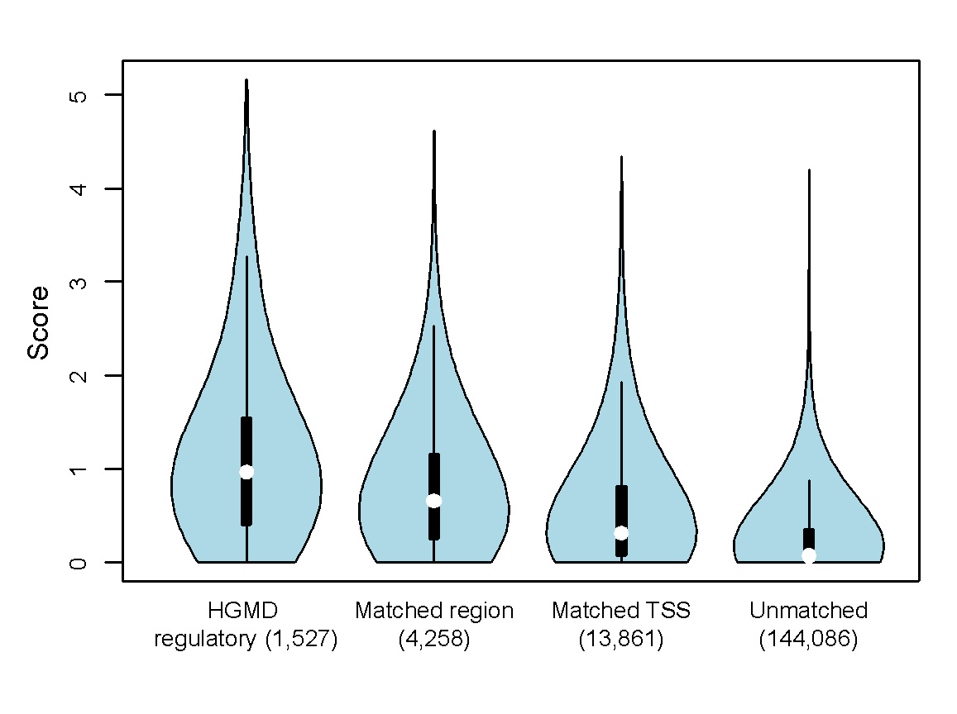
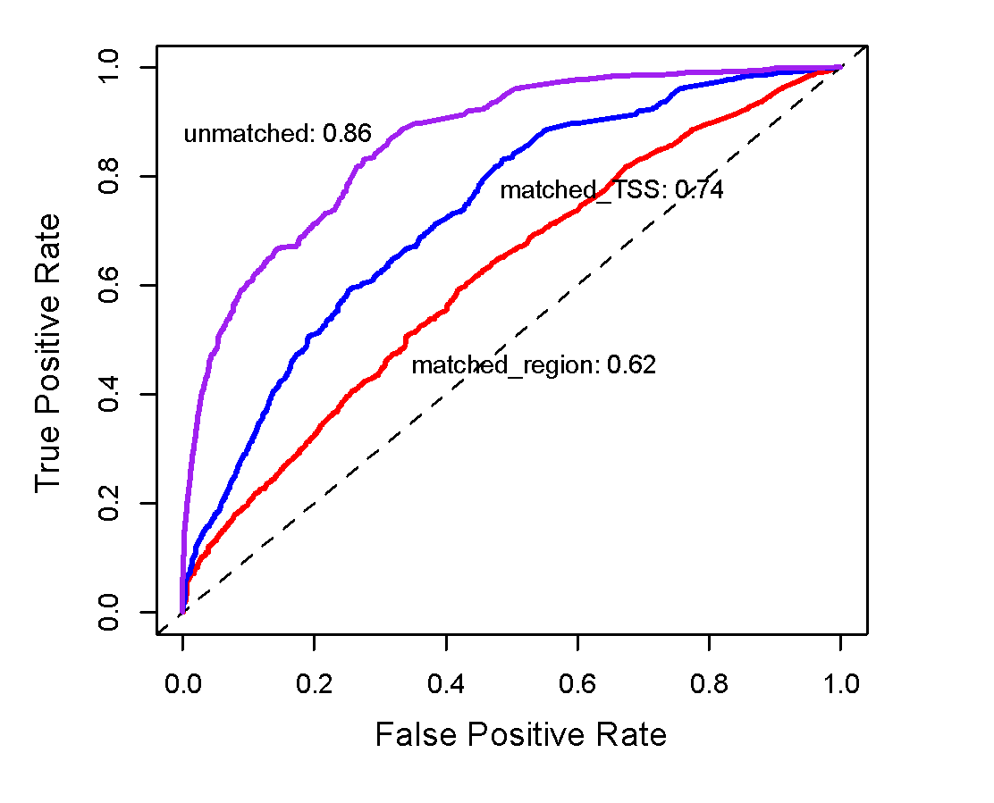
Germline pathogenic variants show higher core scores than controls
3 controls with natural polymorphisms (allele frequency >= 1% )
1. Matched region: 1kb around HGMD variants
2. Matched TSS: matched for distance to TSS
3. Unmatched: randomly selected
Ritchie et al., Nature Methods, 2014
[Fu et al., GenomeBiology ('14, in revision)]

Slide 40
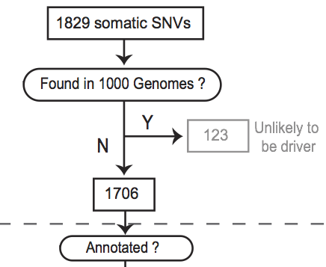
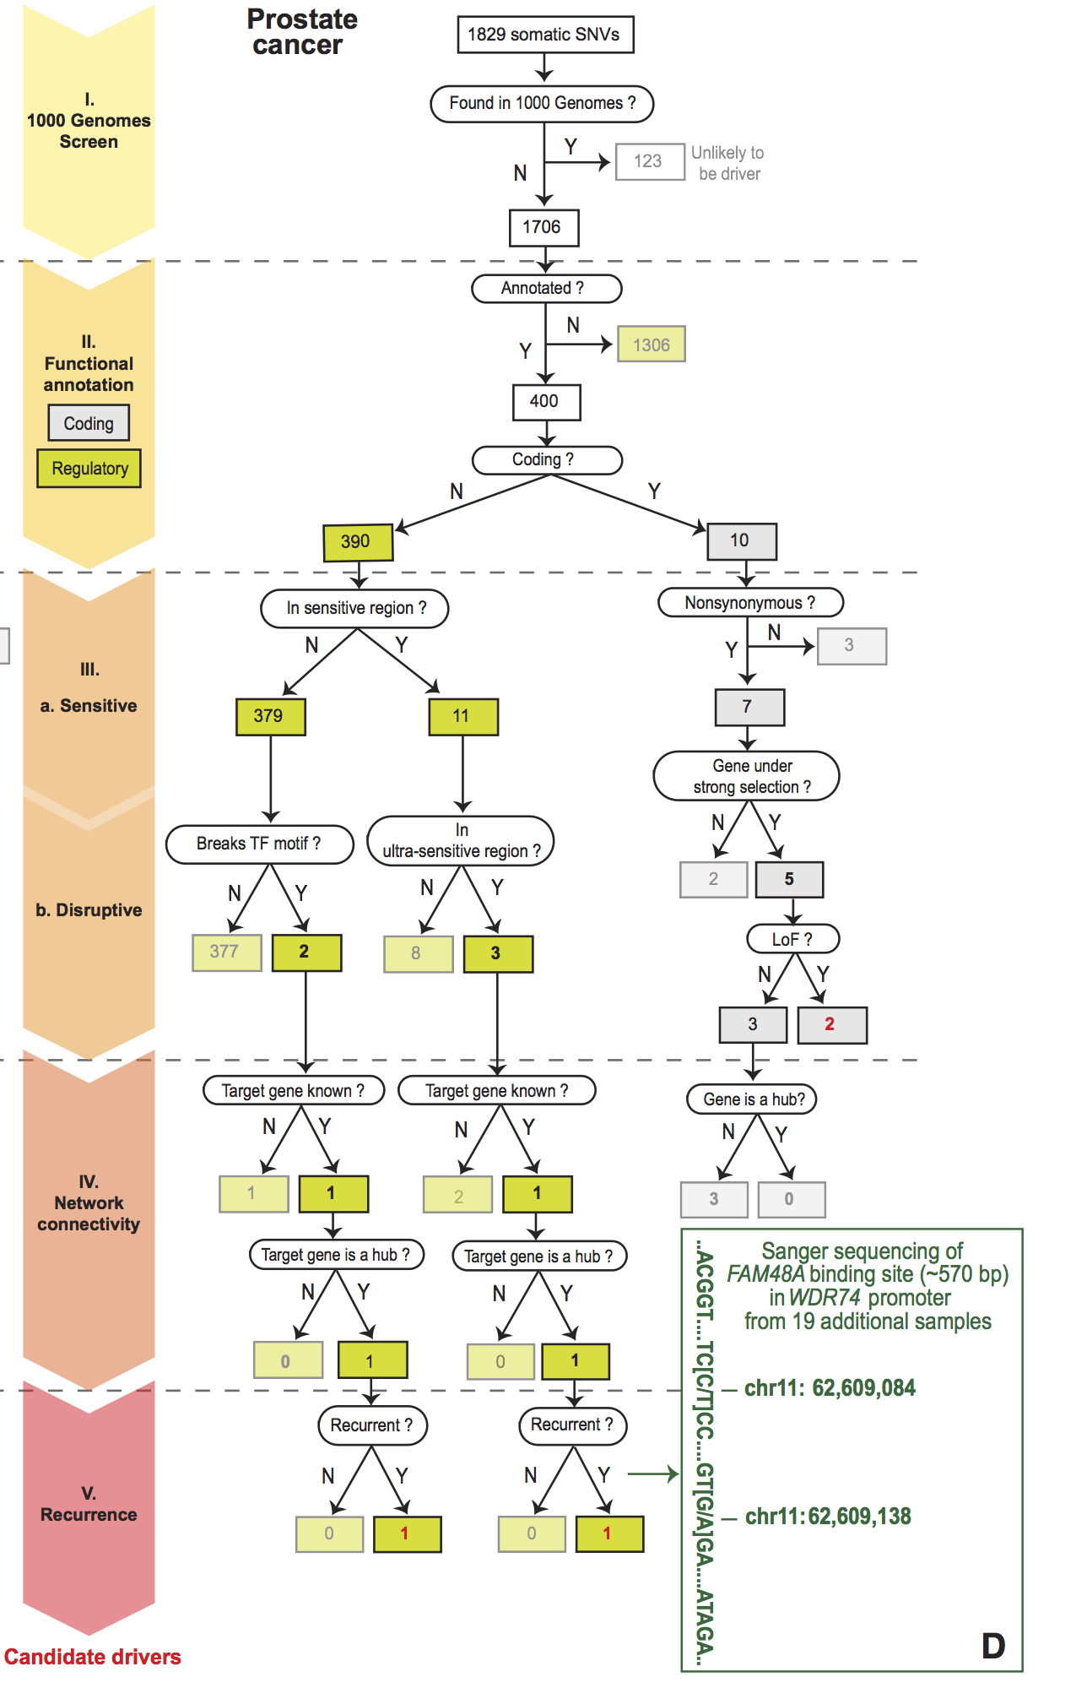
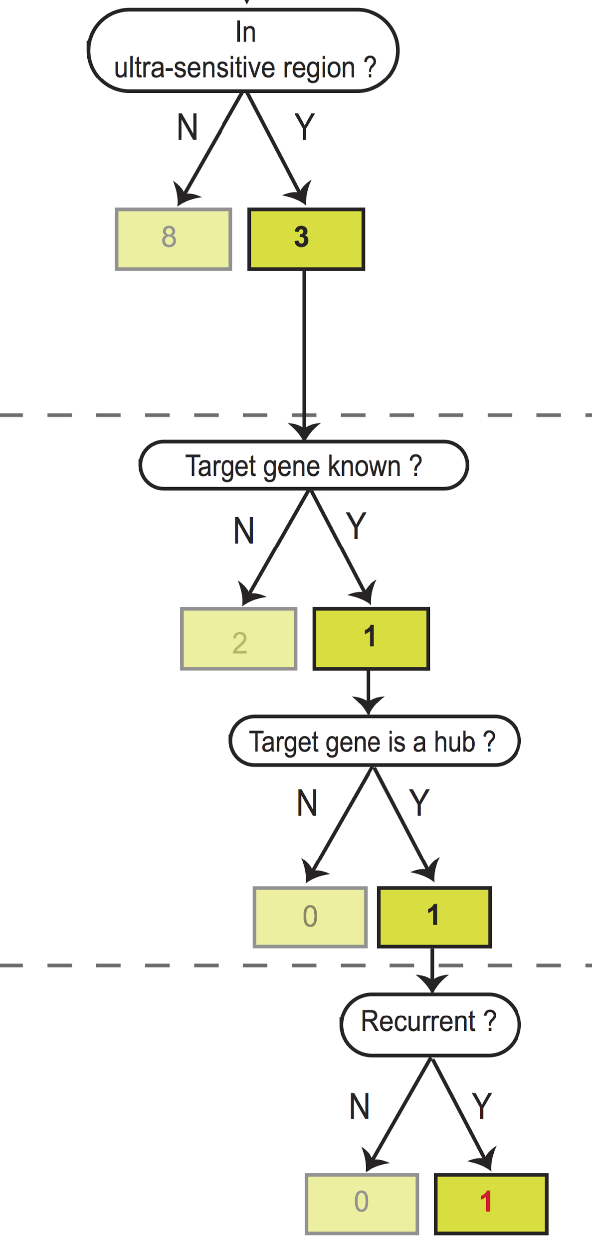
Flowchart for 1 Prostate Cancer
Genome (from Berger et al. '11)
[Khurana et al., Science (‘13)]

Slide 41
Prioritizing Variants in Personal Genomes: Using functional impact & recurrence, with particular application to cancer
Introduction
  An individual's disease variants as the public's gateway into genomics & biology
  The exponential scaling of data generation & processing
  Mining big data to prioritize key variants
  as cancer drivers
  Functional impact #1: Coding
  ALoFT: Annotation of Loss-of-Function Transcripts.
  LoF annotation as a complex problem + finding deleterious LoFs
  Frustration as a localized metric of SNV impact. Differential profiles for oncogenes v. TSGs
Functional impact #2: Non-coding
  FunSeq integrates evidence,
  with a “surprisal” based weighting scheme
  Prioritizing rare variants with “sensitive sites”
  (human conserved)
Recurrence:
Statistics for driver identification
  Background mutation rate significantly varies & is correlated with replication timing & TADs
  Developed a variety of parametric & non-parametric methods taking this into account
  LARVA uses parametric beta-binomial model, explicitly modeling covariates
  MOAT does a variety of non-parm. shuffles (annotation, variants, &c). Useful when explicit covariates not available. Slower
  but speeded up w/ GPUs
Recurrence #2:
(Low-power) application to pRCC
  WGS finds additional facts on the canonical driver, MET. Other suggestive non-coding hotspots.
  Analysis of signatures & tumor evolution helps identify key mutations in different ways

Slide 42



Mutation recurrence
Cancer Type 1
Cancer Type 2
Cancer Type 3

Slide 43
Mutation recurrence
Cancer Type 1
Cancer Type 2
Cancer Type 3
Early replicated regions
Late replicated regions

Slide 44
Noncoding annotations
Cancer Type 1
Cancer Type 2
Cancer Type 3
Early replicated regions
Late replicated regions

Slide 45
Noncoding annotations
Cancer Type 1
Cancer Type 2
Cancer Type 3
Early replicated regions
Late replicated regions

Slide 46

Cancer Somatic Mutational Heterogeneity, across cancer types, samples & regions
[Lochovsky et al. NAR (’15)]

Slide 47



Chromatin remodeling failure leads to more mutations in early-replicating regions
[Lochovsky et al. NAR (‘15)]
Variation in somatic mutations is closely associated with chromatin structure (TADs) & replication timing
genomic distance from the TAD boundary
[Yan et al., PLOS Comp. Bio. (‘17); S. Li et al., PLOS Genetics (‘17)] ]

Slide 48


mrTADFinder: Identifying TADs at multiple resolutions by maximizing modularity vs appropriate null
[Yan et al., PLOS Comp. Bio. (‘17)]

Slide 49
Prioritizing Variants in Personal Genomes: Using functional impact & recurrence, with particular application to cancer
Introduction
  An individual's disease variants as the public's gateway into genomics & biology
  The exponential scaling of data generation & processing
  Mining big data to prioritize key variants
  as cancer drivers
  Functional impact #1: Coding
  ALoFT: Annotation of Loss-of-Function Transcripts.
  LoF annotation as a complex problem + finding deleterious LoFs
  Frustration as a localized metric of SNV impact. Differential profiles for oncogenes v. TSGs
Functional impact #2: Non-coding
  FunSeq integrates evidence,
  with a “surprisal” based weighting scheme
  Prioritizing rare variants with “sensitive sites”
  (human conserved)
Recurrence:
Statistics for driver identification
  Background mutation rate significantly varies & is correlated with replication timing & TADs
  Developed a variety of parametric & non-parametric methods taking this into account
  LARVA uses parametric beta-binomial model, explicitly modeling covariates
  MOAT does a variety of non-parm. shuffles (annotation, variants, &c). Useful when explicit covariates not available. Slower
  but speeded up w/ GPUs
Recurrence #2:
(Low-power) application to pRCC
  WGS finds additional facts on the canonical driver, MET. Other suggestive non-coding hotspots.
  Analysis of signatures & tumor evolution helps identify key mutations in different ways

Slide 50







Cancer Somatic Mutation Modeling
PARAMETRIC MODELS
Suppose there are k genome elements. For element i, define:
  n_{i}: total number of nucleotides
  x_{i}: the number of mutations within the element
  p: the mutation rate
  R_{i}: the covariate rank of the element
Non-parametric model is useful when covariate data is missing for the studied annotations
  Also sidesteps issue of properly identifying and modeling every relevant covariate
  (possibly hundreds)
NON-PARAMETRIC MODELS
Model 1: Constant Background Mutation Rate (Model from Previous Work)
Assume constant background mutation rate in local regions.
Model 3a: Random Permutation of Input Annotations
Model 2a: Varying Mutation Rate
with Single Covariate Correction
Shuffle annotations within local region to assess background mutation rate.
Model 3b: Random Permutation of Input Variants
Shuffle variants within local region to assess background mutation rate.
Model 2b: Varying Mutation Rate
with Multiple Covariate Correction
[Lochovsky et al. Bioinformatics in press]
[Lochovsky et al. NAR (’15)]

Slide 51

MOAT-a: Annotation-based permutation
[Lochovsky et al. Bioinformatics in press]
Notes:
Formally, this method incorporates the annotation length l, the number of random bins we’re going to place in the surrounding genome, n, and two parameters that determine the boundaries of the local genome in which we place random bins, d_min and d_max. d_max has to be small enough that the background mutation rate is roughly constant, while d_min exists to ensure that, if there’s some transitionary region between the mutation rate of a and the mutation rate of the surrounding genome, that the signal from a won’t bleed into our analysis of the local genome context.

Slide 52



MOAT-v: Variant-based Permutation
Can preserve tri-nt context in shuffle
[Lochovsky et al. Bioinformatics in press]
Notes:
The second version of MOAT operates on the idea of variant-based permutation. We place bins over the entire genome that each represent a local genome context, shuffle the variants in each bin, and track permuted variant counts for the annotation we’re studying.

Slide 53

MOAT-s: a variant on MOAT-v
A somatic variant simulator
  Given a set of input variants, shuffle to new locations, taking genome structure into account
[Lochovsky et al. Bioinformatics in press]

Slide 54

LARVA Model Comparison
Comparison of mutation count frequency implied by the binomial model (model 1) and the beta-binomial model (model 2) relative to the empirical distribution
The beta-binomial distribution is significantly better, especially for accurately modeling the over-dispersion of the empirical distribution
[Lochovsky et al. NAR (’15)]

Slide 55


Slide 56

MOAT: recapitulates LARVA with GPU-driven runtime scalability
Computational efficiency of MOAT’s NVIDIA™ CUDA™ version, with respect to the number of permutations, is dramatically enhanced compared to CPU version.
.
Number of permutations | Fold speedup of CUDA version
1k | 14x
10k | 100x
100k | 256x
.
.
MOAT’s high mutation burden elements recapitulate LARVA’s results & published noncoding cancer-associated elements.
[Lochovsky et al. Bioinformatics in press]

Slide 57
Prioritizing Variants in Personal Genomes: Using functional impact & recurrence, with particular application to cancer
Introduction
  An individual's disease variants as the public's gateway into genomics & biology
  The exponential scaling of data generation & processing
  Mining big data to prioritize key variants
  as cancer drivers
  Functional impact #1: Coding
  ALoFT: Annotation of Loss-of-Function Transcripts.
  LoF annotation as a complex problem + finding deleterious LoFs
  Frustration as a localized metric of SNV impact. Differential profiles for oncogenes v. TSGs
Functional impact #2: Non-coding
  FunSeq integrates evidence,
  with a “surprisal” based weighting scheme
  Prioritizing rare variants with “sensitive sites”
  (human conserved)
Recurrence:
Statistics for driver identification
  Background mutation rate significantly varies & is correlated with replication timing & TADs
  Developed a variety of parametric & non-parametric methods taking this into account
  LARVA uses parametric beta-binomial model, explicitly modeling covariates
  MOAT does a variety of non-parm. shuffles (annotation, variants, &c). Useful when explicit covariates not available. Slower
  but speeded up w/ GPUs
Recurrence #2:
(Low-power) application to pRCC
  WGS finds additional facts on the canonical driver, MET. Other suggestive non-coding hotspots.
  Analysis of signatures & tumor evolution helps identify key mutations in different ways

Slide 58

Power, as an issue in driver discovery
[Kumar & Gerstein, Nature ('17)]
Better annotation or large number of samples could help.

Slide 59

An (underpowered) case study: pRCC
Kidney cancer lifetime risk of 1.6% & the papillary type (pRCC) counts for ~10% of all cases
TCGA project sequenced 161 pRCC exomes & classified them into subtypes
  Yet, cannot pin down the cause for a significant portion of cases....
35 WGS of TN pairs,
perhaps useful? But not that definitive from a recurrence perspective
[Cancer Genome Atlas Research Network N Engl J Med. (‘16) ]

Slide 60


Tyr-kinase MET:
Known Facts & New Results
MET is long known pRCC driver
In MET, TCGA found somatic SNVs, dup-
lications & an alt. splicing event as drivers (43/161).
In addition, from 35 WGS we found
  A noncoding hotspot associated with MET
  Lack of SVs & breakpoints disrupting MET
  Germline SNP (rs11762213) predicts survival
  in type 2 patients
[A. Gentile, L. Trusolino and PM. Comoglio, Cancer and Metastasis Reviews (‘08); S. Li, B. Shuch and M. Gerstein PLOS Genetics (‘17)]

Slide 61

Beyond MET: 2 non-coding hotspots in NEAT & ERRFl1,
supported by expr. changes & survival analysis
[Li et al. PLOS Genetics (‘17)]

Slide 62

Tumor Evolution: Highlight the Ordering of Key Mutations
Yates et al, NRG (2012)

Slide 63



Construct evolutionary trees in pRCC
Infer mutation order and tree structure based on mutation abundance (PhyloWGS, Deshwar et al., 2015)
Some of the key mutations occur in all the clones while others are just in some parts of the tree
MET: noncoding
ERRFI1: noncoding
DNMT3A: premature stop
NEAT1: noncoding
SMARCA4: missense
KDM6A: missense
[S. Li, B. Shuch and M. Gerstein PLOS Genetics (‘17)]

Slide 64

Mutation
distance
Populations
(%)
0.5
Germline
[S. Li, B. Shuch and M. Gerstein PLOS Genetics (‘17)]

Slide 65
Mutation
distance
Populations
(%)
0.5
Germline
[S. Li, B. Shuch and M. Gerstein PLOS Genetics (‘17)]

Slide 66

Tree topology correlates with molecular subtypes
[Li et al., PLOS Genetics (‘17)]

Slide 67




Mutational processes carry context-specific signatures
A[C>T]G
C[C>T]G
S: Mutation signature inferred
M = S × W+ ε
M: Mutation spectrum observed
[T. Helleday, S. Eshtad & S. Nik-Zainal,
Nature Reviews Genetics (’14), L. Alexandrov et al., Nature (‘13) ]
Notes:
Mutation spectrum is further broken down to mutation signatures, which represent mutational processes

Slide 68




CpGs drive inter-patient variation in pRCC mutational spectra
The loadings on PC1 are mostly [C>T]G
Confirmed by higher C>T% in CpGs in the hypermethylated group (cluster1)
A[C>T]G
G[C>T]G
C[C>T]G
T[C>T]G
[S. Li, B. Shuch and M. Gerstein PLOS Genetics (‘17)]

Slide 69


Key mutation affects mutational landscape which, in turn, affects overall burden in pRCC
Chromatin remodeling defect (“mut”) leads to more mutations in open chromatin (raw number & fraction) in those pRCC cases w/ the mutation
[S. Li, B. Shuch and M. Gerstein PLOS Genetics (‘17)]

Slide 70
Prioritizing Variants in Personal Genomes: Using functional impact & recurrence, with particular application to cancer
Introduction
  An individual's disease variants as the public's gateway into genomics & biology
  The exponential scaling of data generation & processing
  Mining big data to prioritize key variants
  as cancer drivers
  Functional impact #1: Coding
  ALoFT: Annotation of Loss-of-Function Transcripts.
  LoF annotation as a complex problem + finding deleterious LoFs
  Frustration as a localized metric of SNV impact. Differential profiles for oncogenes v. TSGs
Functional impact #2: Non-coding
  FunSeq integrates evidence,
  with a “surprisal” based weighting scheme
  Prioritizing rare variants with “sensitive sites”
  (human conserved)
Recurrence:
Statistics for driver identification
  Background mutation rate significantly varies & is correlated with replication timing & TADs
  Developed a variety of parametric & non-parametric methods taking this into account
  LARVA uses parametric beta-binomial model, explicitly modeling covariates
  MOAT does a variety of non-parm. shuffles (annotation, variants, &c). Useful when explicit covariates not available. Slower
  but speeded up w/ GPUs
Recurrence #2:
(Low-power) application to pRCC
  WGS finds additional facts on the canonical driver, MET. Other suggestive non-coding hotspots.
  Analysis of signatures & tumor evolution helps identify key mutations in different ways

Slide 71
Prioritizing Variants in Personal Genomes: Using functional impact & recurrence, with particular application to cancer
Introduction
  An individual's disease variants as the public's gateway into genomics & biology
  The exponential scaling of data generation & processing
  Mining big data to prioritize key variants
  as cancer drivers
  Functional impact #1: Coding
  ALoFT: Annotation of Loss-of-Function Transcripts.
  LoF annotation as a complex problem + finding deleterious LoFs
  Frustration as a localized metric of SNV impact. Differential profiles for oncogenes v. TSGs
Functional impact #2: Non-coding
  FunSeq integrates evidence,
  with a “surprisal” based weighting scheme
  Prioritizing rare variants with “sensitive sites”
  (human conserved)
Recurrence:
Statistics for driver identification
  Background mutation rate significantly varies & is correlated with replication timing & TADs
  Developed a variety of parametric & non-parametric methods taking this into account
  LARVA uses parametric beta-binomial model, explicitly modeling covariates
  MOAT does a variety of non-parm. shuffles (annotation, variants, &c). Useful when explicit covariates not available. Slower
  but speeded up w/ GPUs
Recurrence #2:
(Low-power) application to pRCC
  WGS finds additional facts on the canonical driver, MET. Other suggestive non-coding hotspots.
  Analysis of signatures & tumor evolution helps identify key mutations in different ways

Slide 72

CostSeq2 - P Muir, S Li, S Lou, D Wang, DJ Spakowicz,
L Salichos, J Zhang, GM Weinstock, F Isaacs, J Rozowsky
LARVA.gersteinlab.org
L Lochovsky, J Zhang, Y Fu, E Khurana
MOAT.gersteinlab.org - L Lochovsky, J Zhang
github.com/gersteinlab/Frustration
S Kumar, D Clarke
github.com/gersteinlab/MrTADfinder
KK Yan, S Lou
VAT.gersteinlab.org
L Habegger, S Balasubramanian,
DZ Chen, E Khurana, A Sboner, A Harmanci,
J Rozowsky, D Clarke, M Snyder
ALoFT.gersteinlab.org
S Balasubramanian, Y Fu,
M Pawashe, P McGillivray, M Jin, J Liu,
K Karczewski, D MacArthur
FunSeq.gersteinlab.org
Y Fu, E Khurana, Z Liu,
S Lou, J Bedford, XJ Mu, KY Yip
pRCC - S Li, B Shuch
Acknowledgments! Also, Hiring: See Jobs.gersteinlab.org

Slide 73


Slide 74
Info about this talk
No Conflicts
Unless explicitly listed here. There are no conflicts of interest relevant to the material in this talk
General PERMISSIONS
This Presentation is copyright Mark Gerstein, Yale University, 2017.
Please read permissions statement at
sites.gersteinlab.org/Permissions
Basically, feel free to use slides & images in the talk with PROPER acknowledgement (via citation to relevant papers or website link). Paper references in the talk were mostly from Papers.GersteinLab.org.
PHOTOS & IMAGES
For thoughts on the source and permissions of many of the photos and clipped images in this presentation see streams.gerstein.info . In particular, many of the images have particular EXIF tags, such as kwpotppt , that can be easily queried from flickr, viz: flickr.com/photos/mbgmbg/tags/kwpotppt

