Slide 1


Large-scale Transcriptome Mining:
Building Integrative Regulatory Models, while Protecting Individual Privacy
Mark Gerstein, Yale
Slides freely downloadable from Lectures.GersteinLab.org & “tweetable” (via @markgerstein)
See last slide for more info.

Slide 2
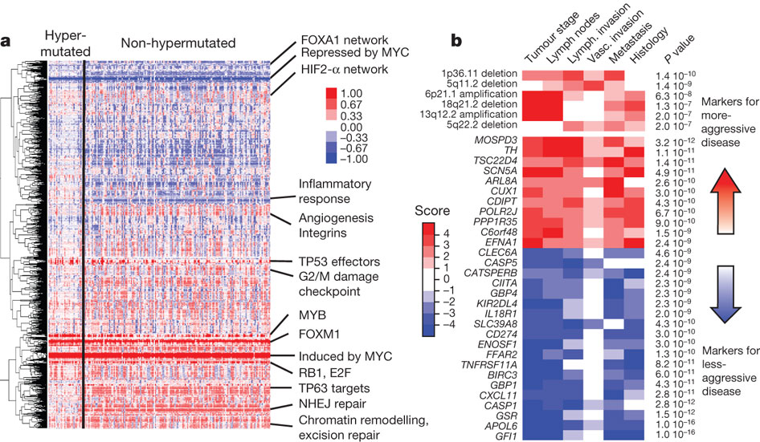
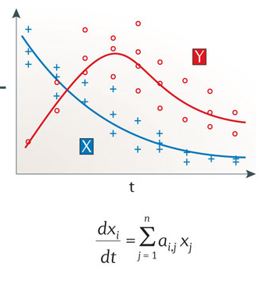
Modeling for RNA-seq data across many samples & individuals… while still protecting individual privacy
* Recent advent of much large scale RNA-seq (& other functional genomics data) following on DNA sequencing
* Often this is of human subjects & produced by large consortia (eg TCGA, PCAWG, GTEx) and needs to be protected
* Useful to build tools & approaches that interact with these data
Logical model
Continuous model
Probabilistic model
Population
Gene
Over expressed
Under expressed
Gene Regulatory Mechanisms
The Cancer Genome Atlas Network Nature 487, 330-337 (2012) doi:10.1038/nature11252
Istrail & Davidson, PNAS, ‘04
Nicolas Le Novère, Nature Reviews Genetics, ‘15

Slide 3

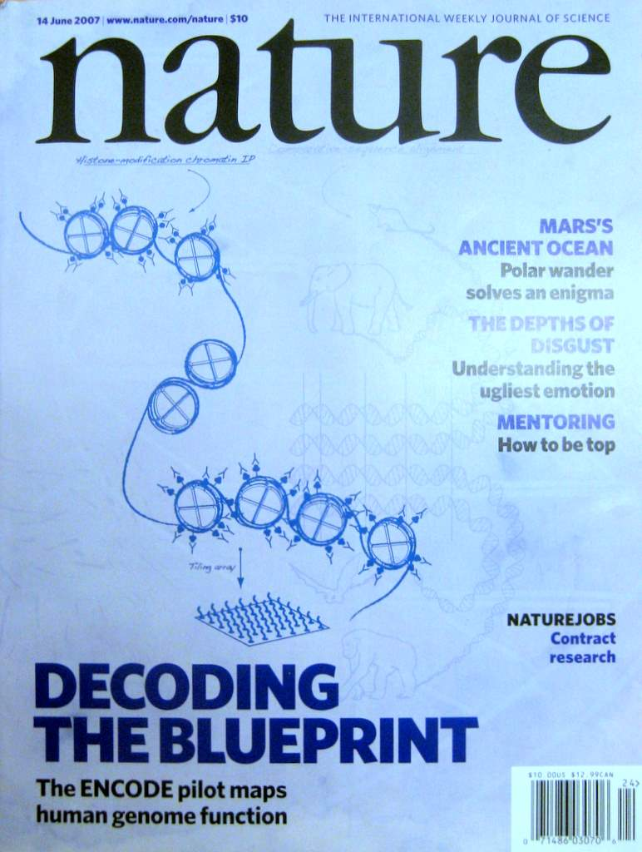
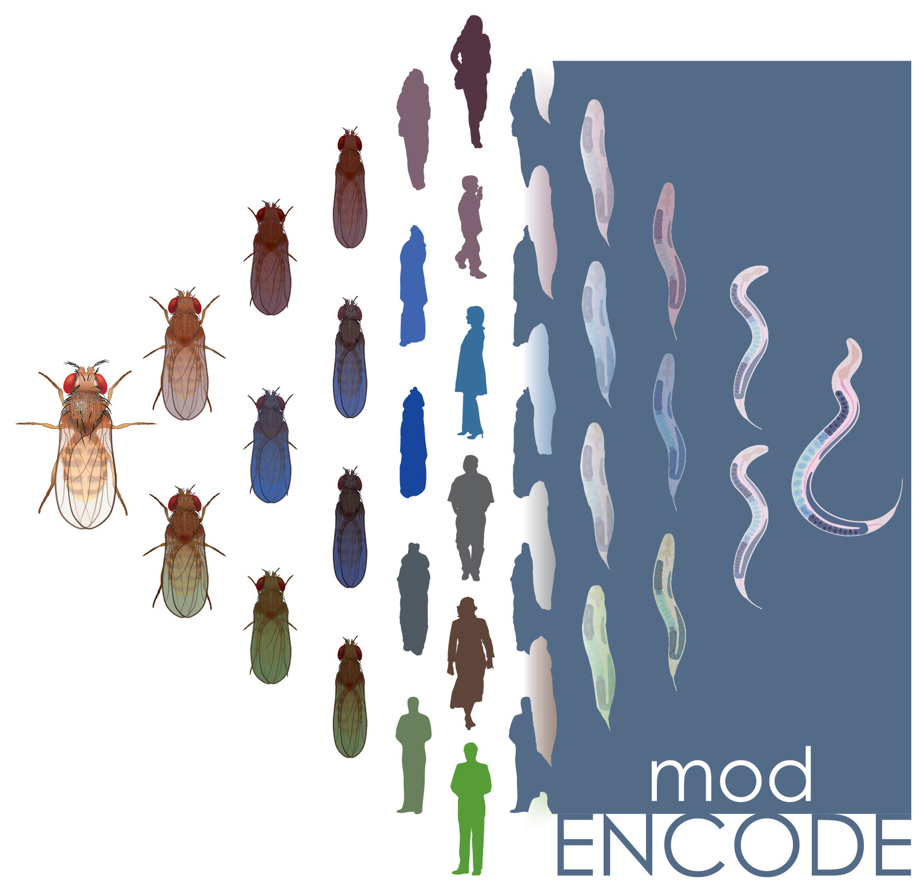

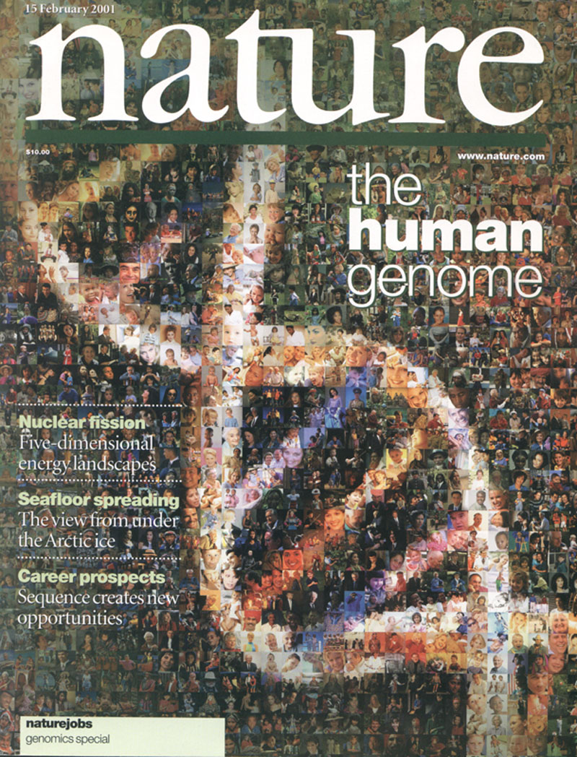



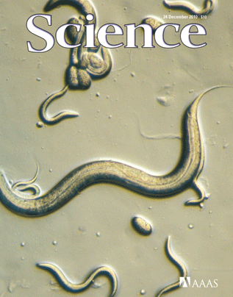



The Human
Genome Project
ENCODE
Pilot
ENCODE
Production
Comparative
ENCODE
Epigenome
Roadmap
2000
2005
2010
2015
Worm
Genome
modENCODE
1000 Genomes
Pilot
1000 Genomes
Phase 3
GTEx

Slide 4

2-sided nature of functional genomics data: Analysis can be very General/Public or Individual/Private
General quantifications related to overall aspects of a condition & are not tied to an individual’s genotype - ie what genes go up in cancer
  However, data is derived from an individual & tagged with an individual’s genotype
Other calculations aim to use genotype & specific aspects of the quantification to derive general relations related to sequence variation & gene expression
Some calculations and data derive finding very specific to the variants in a particular individual

Slide 5
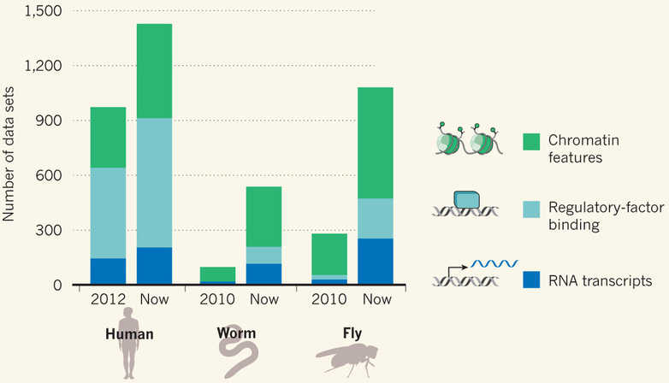
Comparative ENCODE Functional Genomics Resource
(EncodeProject.org/comparative)
Broad sampling of conditions across transcriptomes & regulomes for human, worm & fly
  embryo & ES cells
  developmental time course (worm-fly)
In total: ~3000 datasets (~130B reads)

Slide 6
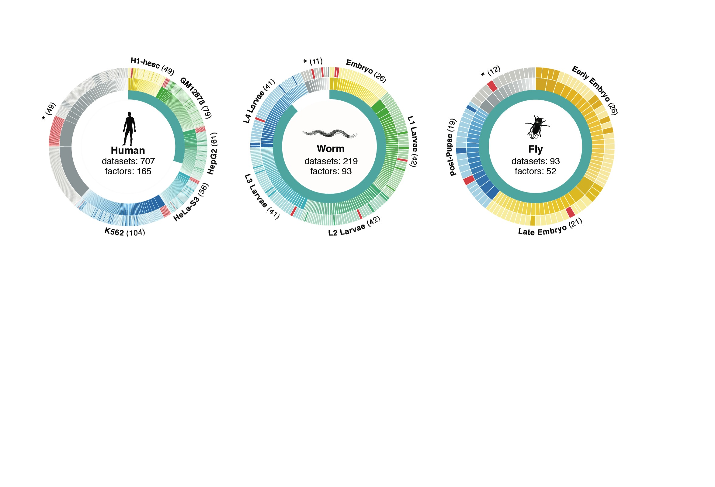
Time-course gene expression data of worm & fly development
[Nature 512:445 ('14); doi: 10.1038/nature13424]
Organism | Major developmental stages
worm (C. elegans) | 33 stages: 0, 0.5, 1, …, 12 hours, L1, L2, L3, L4, …, Young Adults, Adults
fly (D. mel.) | 30 stages: 0, 2, 4, 6, 8,…, 20, 22 hours, L1-L4, Pupaes, Adults

Slide 7


Representative Expression, Genotype, eQTL Datasets
Genotypes are available from the 1000 Genomes Project
mRNA sequencing for 462 individuals
  Publicly available quantification for protein coding genes
Approximately 3,000 cis-eQTL (FDR<0.05)

Slide 8
Large-scale Transcriptome Mining:
Building Integrative Regulatory Models, while Protecting Individual Privacy
Transcriptome analysis data
  Comparative ENCODE –
  Lots of Matched Data
  1000G+Geuvadis for privacy
Expression Clustering, Cross-species
  Potts-model optimization gives 16 conserved co-expression modules (which can potentially annotate ncRNAs/TARs)
State Space Models of Gene Expression
  Using dimensionality reduction to help determine internal & external drivers
  Decoupling expression changes into those driven by worm-fly conserved genes vs species-specific ones.
  Also, conserved genes have similar canonical patterns (iPDPs) in contrast to species specific ones (Ex of ribosomal v signaling genes)
The General Dilemma of Genomic Privacy
  Fundamental, inherited info that’s very private v need for large-scale mining for med. research
  Issues w/ current social & tech approaches: inconsistencies & burdensome security
  Strawman Hybrid Soc-Tech Proposal (Cloud Enclaves. Quantifying Leaks & Closely Coupled priv.-public datasets)
  Details on Relevant Hacks: Genomic, Computer Security, & Netfix
RNA-seq: How to Publicly Share Some of it
  Presents a tricky privacy issue since much of the sequencing is for general, non-individual specific results yet it’s tagged with individual information
  Removing SNVs in reads w/ MRF
  Quantifying & removing variant info from expression levels +
  eQTLs using ICI & predictability
  Instantiating a practical linking attack using extreme expression levels
  Quantifying accuracy of prediction, via gap between best & 2nd best match

Slide 9
Large-scale Transcriptome Mining:
Building Integrative Regulatory Models, while Protecting Individual Privacy
Transcriptome analysis data
  Comparative ENCODE –
  Lots of Matched Data
  1000G+Geuvadis for privacy
Expression Clustering, Cross-species
  Potts-model optimization gives 16 conserved co-expression modules (which can potentially annotate ncRNAs/TARs)
State Space Models of Gene Expression
  Using dimensionality reduction to help determine internal & external drivers
  Decoupling expression changes into those driven by worm-fly conserved genes vs species-specific ones.
  Also, conserved genes have similar canonical patterns (iPDPs) in contrast to species specific ones (Ex of ribosomal v signaling genes)
The General Dilemma of Genomic Privacy
  Fundamental, inherited info that’s very private v need for large-scale mining for med. research
  Issues w/ current social & tech approaches: inconsistencies & burdensome security
  Strawman Hybrid Soc-Tech Proposal (Cloud Enclaves. Quantifying Leaks & Closely Coupled priv.-public datasets)
  Details on Relevant Hacks: Genomic, Computer Security, & Netfix
RNA-seq: How to Publicly Share Some of it
  Presents a tricky privacy issue since much of the sequencing is for general, non-individual specific results yet it’s tagged with individual information
  Removing SNVs in reads w/ MRF
  Quantifying & removing variant info from expression levels +
  eQTLs using ICI & predictability
  Instantiating a practical linking attack using extreme expression levels
  Quantifying accuracy of prediction, via gap between best & 2nd best match

Slide 10
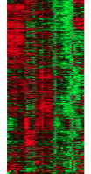
Expression clustering:
revisiting an ancient problem
Species A
Species B
Clustering
algorithm
Clustering
algorithm
co-expressed genes
responsible for the same
function in a species
co-expressed genes
responsible for the same
function in a species
Eisen MB et al. PNAS 1998
Langfelder P et al. BMC Bioinfo. 2008
Tamayo P et al. PNAS 1999
Kluger Y et al. Genome Res. 2003
two independent sets
of modules
Cross species
co-expression modules

Slide 11
Expression clustering:
revisiting an ancient problem
Species A
Orthologous pairs
between species
Species B
A novel unified framework to integrate co-expression data across species
OrthoClust
cross species modules
Yan et al. Genome Biol. 2014
Cross species
co-expression modules

Slide 12
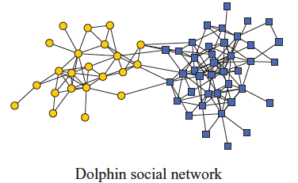
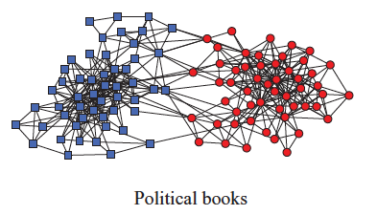
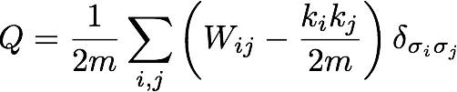
Network modularity
degree of node i
Newman Phy. Rev. E 2013
adjacency matrix
whether or not
i, j are in the
same module
number of edges
expected number of
edges between i and j

Slide 13

Network modularity
degree of node i
adjacency matrix
whether or not
i, j are in the
same module
number of edges
expected number of
edges between i and j

Slide 14

Network modularity
Optimization problem
degree of node i
adjacency matrix
whether or not
i, j are in the
same module
number of edges
expected number of
edges between i and j

Slide 15
A toy example [orthoclust]
[Yan et al. GenomeBiol 15:R100 ('14)]
2
Every node i is assigned with a spin value σ_{i} (labels of modules: 1,2,…q).
4
4
co-expressed
1
1
2
2
orthologs
Species A
3
3
Species B
reward an orthologous pair
with the same value
4
4
4
1
2
1
3
1
reward a co-expressed
pair with the same value
punish a non co-expressed
pair with the same value
Favorableness = "Modularity" in species A + "Modularity" in species B + consistency betw. A & B

Slide 16
A toy example [orthoclust]
[Yan et al. GenomeBiol 15:R100 ('14)]
2
2
4
co-expressed
2
4
2
4
orthologs
Species A
2
4
Species B
4
1
4
1
4
4
1
1
species A specific
conserved modules
species B specific
Use Potts model (generalized Ising model) to simultaneously cluster co-expressed genes within an organism as well as orthologs shared between organisms. Here, the ground state configuration correspond to three modules: 1, 2, 4.

Slide 17
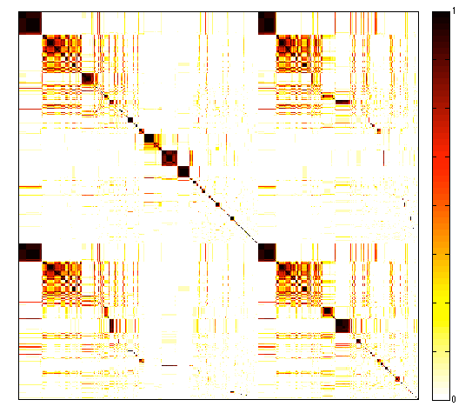
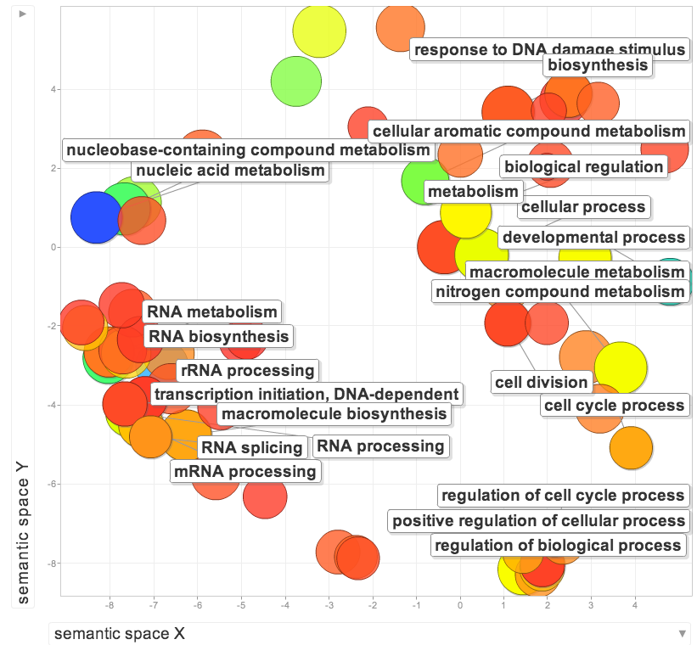
Cross-species clusters for worm and fly
GO terms of conserved modules
Worm genes (20377)
Fly genes (13623)
GO terms of specific modules
worm specific | dauer entry
fly specific | chitin activities
co-association
frequency
Yan KK et al. Genome Biology. 2014

Slide 18
Large-scale Transcriptome Mining:
Building Integrative Regulatory Models, while Protecting Individual Privacy
Transcriptome analysis data
  Comparative ENCODE –
  Lots of Matched Data
  1000G+Geuvadis for privacy
Expression Clustering, Cross-species
  Potts-model optimization gives 16 conserved co-expression modules (which can potentially annotate ncRNAs/TARs)
State Space Models of Gene Expression
  Using dimensionality reduction to help determine internal & external drivers
  Decoupling expression changes into those driven by worm-fly conserved genes vs species-specific ones.
  Also, conserved genes have similar canonical patterns (iPDPs) in contrast to species specific ones (Ex of ribosomal v signaling genes)
The General Dilemma of Genomic Privacy
  Fundamental, inherited info that’s very private v need for large-scale mining for med. research
  Issues w/ current social & tech approaches: inconsistencies & burdensome security
  Strawman Hybrid Soc-Tech Proposal (Cloud Enclaves. Quantifying Leaks & Closely Coupled priv.-public datasets)
  Details on Relevant Hacks: Genomic, Computer Security, & Netfix
RNA-seq: How to Publicly Share Some of it
  Presents a tricky privacy issue since much of the sequencing is for general, non-individual specific results yet it’s tagged with individual information
  Removing SNVs in reads w/ MRF
  Quantifying & removing variant info from expression levels +
  eQTLs using ICI & predictability
  Instantiating a practical linking attack using extreme expression levels
  Quantifying accuracy of prediction, via gap between best & 2nd best match

Slide 19
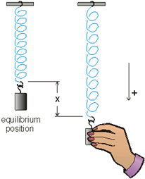
Internal & external gene regulatory networks
Internal Group
External Group
How to identify gene expression dynamics driven by internal/external regulation?
Internal regulation
External regulation
Interested system | Internal regulatory network | External regulatory network
Cross-species conserved genes | Conserved transcriptional factors (TFs) | Non-conserved TFs
Protein-coding genes | TFs | micro-RNAs
Individual’s protein coding genes | Wild-type TFs | Somatic mutated TFs
Protein-coding genes in brain | Commonly expressed TFs | Brain-specific expressed TFs
Protein-coding genes in development | House-keeping TFs | Developmental TFs
External force
[Wang et al. PLOS CB (in revision, ‘15)]
Notes:
connect loregic to here too! to see regulatory mechanisms similar too

Slide 20
State-space model for internal and external gene regulatory networks
Internal Group
External Group
How to identify gene expression dynamics driven by internal/external regulation?
Internal regulation
External regulation
Control: Gene expression vector of external factors at time t
State space model
X_{t+1}
A
X_{t}
B
U_{t}
B_{kl} captures temporal casual influence from external factor k to Gene l in internal group
State: Gene expression vector of Group X at time t+1
A_{ij} captures temporal casual influence from Gene i to Gene j in internal group
State: Gene expression vector of internal group at time t
[Wang et al. PLOS CB, ‘16]
Notes:
connect loregic to here too! to see regulatory mechanisms similar too

Slide 21
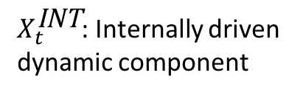
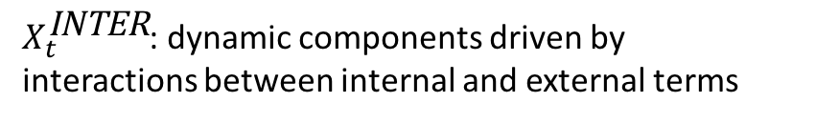
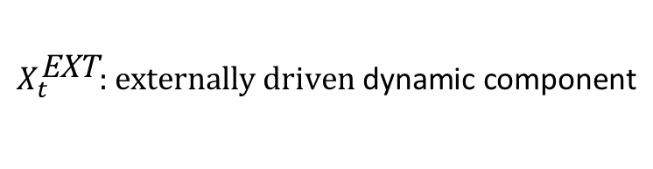
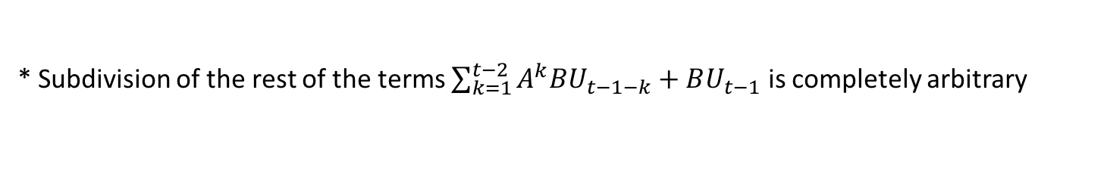
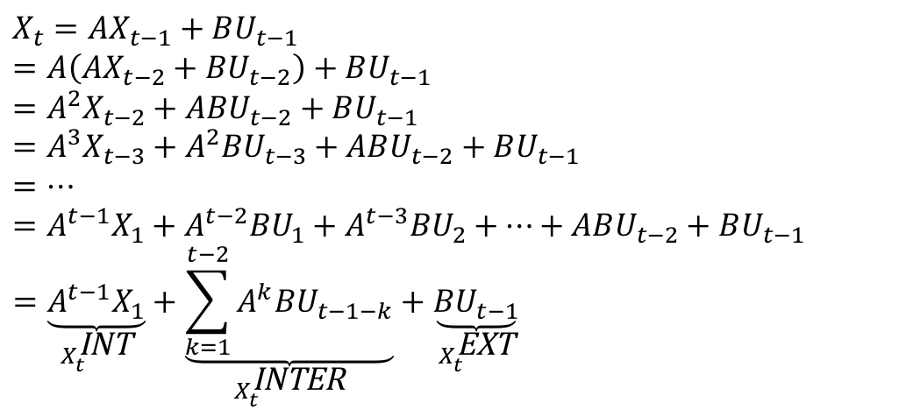
Decomposition of internal and external-related dynamic components
$$X_{t}=AX_{t−1}+BU_{t−1}$$
$$=A\left(AX_{t−2}+BU_{t−2}\right)+BU_{t−1}$$
$$=A^{2}X_{t−2}+ABU_{t−2}+BU_{t−1}=A^{3}X_{t−3}+A^{2}{BU}_{t−3}+ABU_{t−2}+BU_{t−1}$$
$$=…$$
$$=A^{t−1}X_{1}+A^{t−2}{BU}_{1}+A^{t−3}{BU}_{2}+…+ABU_{t−2}+BU_{t−1}=\underset{X_{t}^{\text{INT}}}{\underbrace{A^{t−1}X_{1}}}+\underset{X_{t}^{\text{INTER}}}{\underbrace{\sum_{k=1}^{t−2}{A^{k}BU_{t−1−k}}}}+\underset{X_{t}^{\text{EXT}}}{\underbrace{BU_{t−1}}}$$
$$X_{t}^{\text{EXT}}\text{: }\text{externally} \text{driven} \text{dynamic} \text{component}$$
$X_{t}^{\text{INTER}}$: dynamic components driven by interactions between internal and external terms
$X_{t}^{\text{INT}}$: Internally driven dynamic component
* Subdivision of the rest of the terms $\sum_{k=1}^{t−2}{A^{k}BU_{t−1−k}}+BU_{t−1}$ is completely arbitrary
[Wang et al. PLOS CB, ‘16]

Slide 22
Effective state space model for meta-genes
Not enough data to estimate state space model for genes
(e.g., 25 time points per gene to estimate 4 million elements of A or B for 2000 genes)
Dimensionality reduction from genes to meta-genes (e.g., SVD)
Effective state space model for meta-genes
(e.g., 250 time points to estimate 50 matrix elements if 5 meta-genes)
[Wang et al. PLOS CB, ‘16]

Slide 23
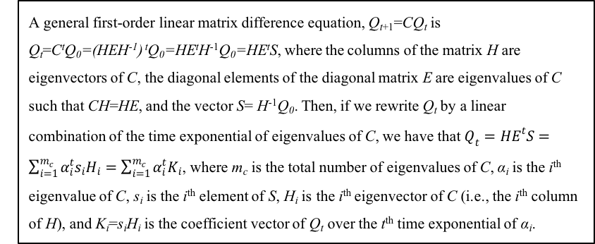
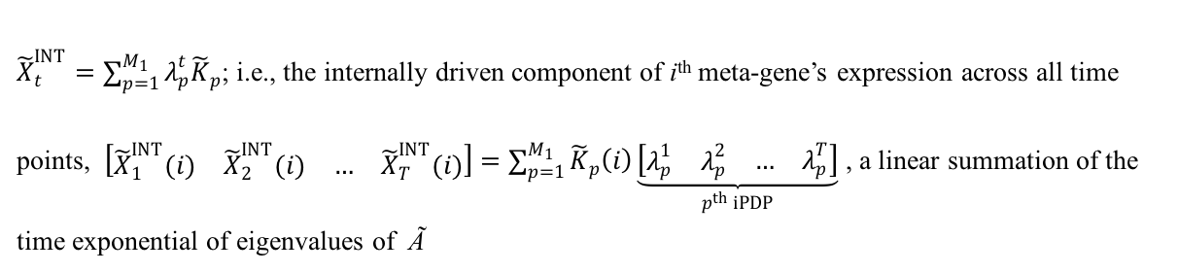
Eigenvalues of Ã determine internal dynamics
First-order linear matrix difference equation
Analytic solution
A general first-order linear matrix difference equation, Q_{t+1}=CQ_{t} is
Q_{t}=C^{t}Q₀=(HEH⁻¹) ^{t}Q₀=HE^{t}H⁻¹Q₀=HE^{t}S, where the columns of the matrix H are eigenvectors of C, the diagonal elements of the diagonal matrix E are eigenvalues of C such that CH=HE, and the vector S= H⁻¹Q₀. Then, if we rewrite Q_{t} by a linear combination of the time exponential of eigenvalues of C, we have that $Q_{t}=HE^{t}S=\sum_{i=1}^{m_{c}}{α_{i}^{t}s_{i}H_{i}=\sum_{i=1}^{m_{c}}{α_{i}^{t}K_{i}}}$, where m_{c} is the total number of eigenvalues of C, α_{i} is the i^{th} eigenvalue of C, s_{i} is the i^{th} element of S, H_{i} is the i^{th} eigenvector of C (i.e., the i^{th} column of H), and K_{i}=s_{i}H_{i} is the coefficient vector of Q_{t} over the t^{th} time exponential of α_{i}.
INT
INT
${\tilde{X}}_{t}^{INT}=\sum_{p=1}^{M_{1}}{λ_{p}^{t}{\tilde{K}}_{p}}$; i.e., the internally driven component of i^{th} meta-gene’s expression across all time points, $\left[\begin{matrix}\begin{matrix}{\tilde{X}}_{1}^{INT}(i) & {\tilde{X}}_{2}^{INT}(i)\end{matrix} & \begin{matrix}… & {\tilde{X}}_{T}^{INT}(i)\end{matrix}\end{matrix}\right]=\sum_{p=1}^{M_{1}}{{\tilde{K}}_{p}\left(i\right)\underset{p^{th} iPDP}{\underbrace{\left[\begin{matrix}\begin{matrix}λ_{p}^{1} & λ_{p}^{2}\end{matrix} & \begin{matrix}… & λ_{p}^{T}\end{matrix}\end{matrix}\right]}}}$ , a linear summation of the time exponential of eigenvalues of Ã

Slide 24
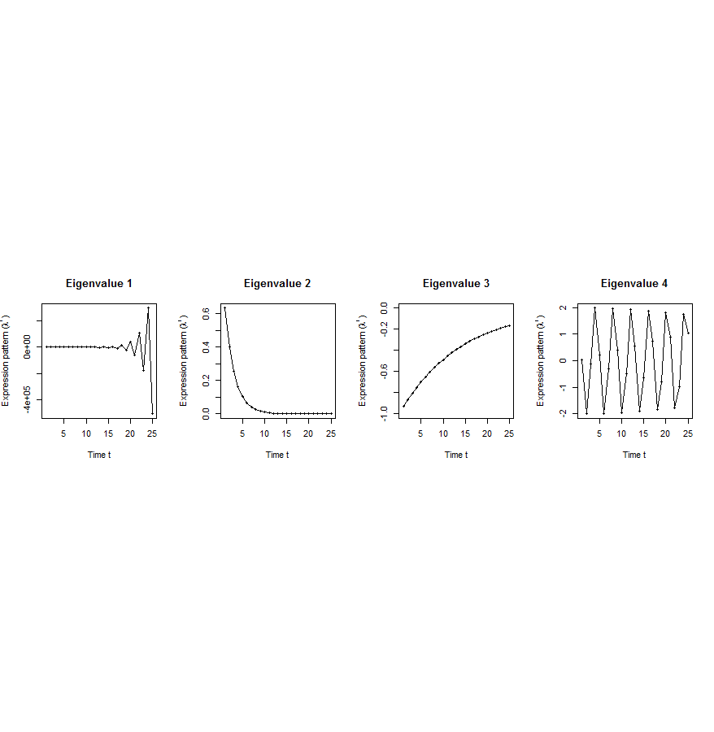
Canonical temporal expression trajectories from effective state space model
Internal driven dynamics
p^{th} internal principal dynamic pattern (iPDP): [λ_{p}¹, λ_{p}², …, λ_{p}^{T}],
where λ_{p} is p^{th} eigenvalue of Ã.
Canonical temporal expression trajectories
(e.g., degradation, growth, damped oscillation, etc.)
iPDP expression
time
[Wang et al. PLOS CB, ‘16]
Notes:
if we look at A tilde, it controls the dynamic trajectory of expression part internally driven by meta-genes of X. according to the analytic solution, the internally driven expression part Xtilde I can be linear combinations of A tilde’s eigenvalue’s exponentials across time, which are defined by us as internal principal dynamic pattern (iPDP). B tilde controls the dynamic trajectory of X’s metagene expression part externally driven by U. similarly, we can find external principal dynamic pattern (ePDP) based on B tilde’s eigenvalue exponentials across time. Actually, those patterns are canonical temporal expression trajectories, which are as simple as degradation, growth, damped oscillation temporal processes). In short, from metagene effective model, we are able to identify internal and external driven canonical temporal expression trajectories.

Slide 25
Are gene regulations among orthologs conserved across species?
Are gene regulatory networks among orthologs conserved across species?
Species A
Species B
orthologs
co-expressed
Regulation among orthologs (internal)
Regulation from species-specific factors (external)
Orthologous genes (orthologs)
Species-specific transcription factors
To what degree can’t ortholog expression levels be predicted due to species-specific regulation
[Wang et al. PLOS CB, ‘16]
Notes:
connect loregic to here too! to see regulatory mechanisms similar too

Slide 26
Are there any conserved regulatory networks between worm and fly during embryonic development?
Not enough time samples!
Dataset | Internal Group | External Group | Developmental stages | # of unknown parameters in A and B | # of available time samples
worm (C. elegans) | N₁=3147 worm-fly orthologs (incl. ortholog TFs) | N₂=509 worm-specific transcription factors | T=25 time points: 0, 0.5, 1, …, 12 hours | 3147*3147+3147*509=11.5M | 3147*25+509*25=91400
fly (D. mel.) |  | N₂=442 fly-specific transcription factors | T=12 time points: 0, 2, 4, 6, 8,…, 20, 22 hours | 3147*3147+3147*442=11.3M | 3147*25+442*25=89725
A_{w}
B_{w}
A_{f}
B_{f}
worm
fly
If A_{w} and A_{f} have similarities, cross-species conserved regulatory networks in embryonic development
Embryonic stem cells (ESCs)
Notes:
we apply this method to time-series gene expression data in embryonic development of worm and fly in modENCODE, and identified internal principal dynamic patterns of ortholog gene expressions driven by orthologous TFs, and external patterns driven by species-specific TFs.

Slide 27
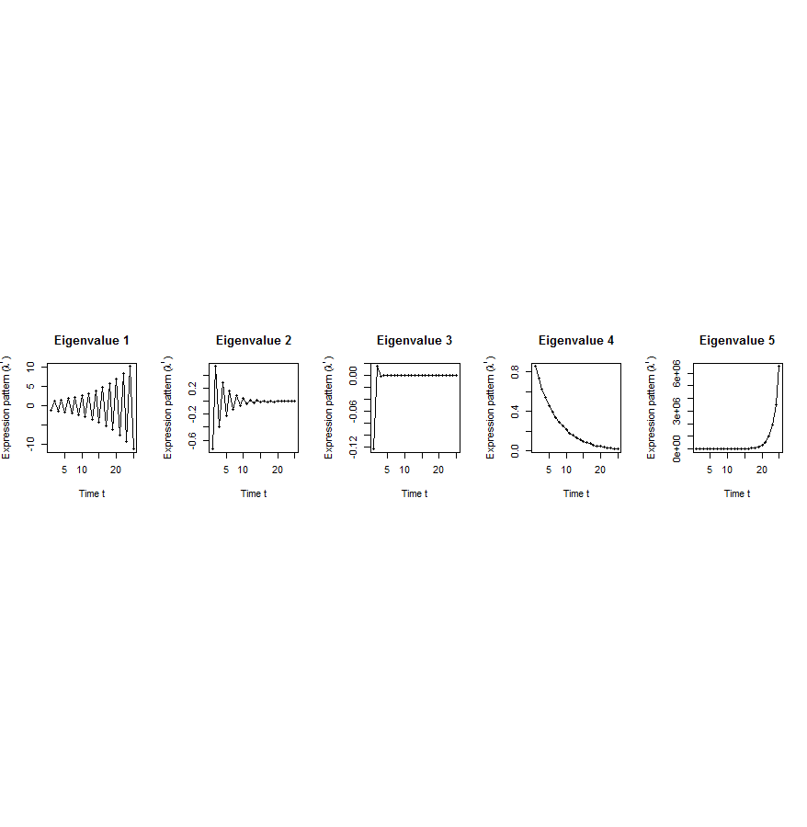
Flowchart
[Wang et al. PLOS CB, ‘16]
A. Gene state-space model
C. Meta-gene state-space model
B. Dimensionality Reduction
X_{t+1}=AX_{t}+BU_{t}
Genes of X
Meta-genes of X
time
E. Gene’s internal (INT) and external (EXT) driven expression dynamics composed of PDPs
time
D. Internal/External Principal Dynamic Patterns (PDPs)
x^{INT} = c₁ +c₂
+c₃ +c₄
[λ_{p}¹, λ_{p}², …, λ_{p}^{T}]
Genes of U
Meta-genes of U
time
time
x^{EXT} = d₁ +d₂
+d₃ +d₄
/
Internal regulation among internal genes/meta-genes by A/Ã
/
External regulation from external genes/meta-genes to internal genes/meta-genes in Group X by B/
/
/
External genes/meta-genes
Internal genes/meta-genes

Slide 28
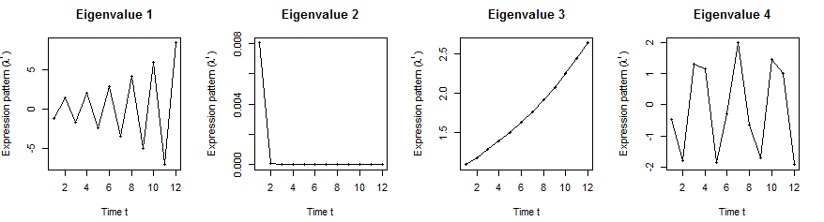
Orthologs have similar internal but different external dynamic patterns during embryonic development
Worm’s effective state space model
A
B
iPDPs: time exponentials of Ã eigenvalues in worm
ePDPs: in worm
1st iPDP
2nd iPDP
3rd iPDP
4th iPDP
1st ePDP
2nd ePDP
3rd ePDP
4th ePDP
5th ePDP
Expression
Expression
Similar iPDPs
Different ePDPs
1st iPDP
2nd iPDP
3rd iPDP
4th iPDP
1st ePDP
2nd ePDP
3rd ePDP
4th ePDP
5th ePDP
Expression
Expression
iPDPs: time exponentials of Ã eigenvalues in fly
ePDPs: in fly
Fly’s effective state space model
[Wang et al. PLOS CB, ‘16]

Slide 29
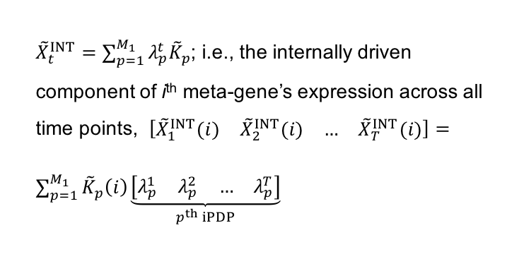

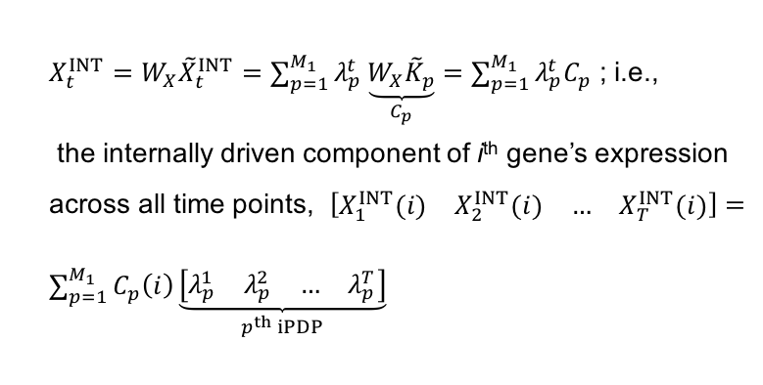
Projection back to gene space to get gene coefficients on iPDPs
X_{t}
Internal component of meta-genes: ${\tilde{X}}_{t+1}^{INT}=\tilde{A}{\tilde{X}}_{t}^{INT}$
=>
${\tilde{X}}_{t}^{INT}=\sum_{p=1}^{M_{1}}{λ_{p}^{t}{\tilde{K}}_{p}}$; i.e., the internally driven component of i^{th} meta-gene’s expression across all time points, $\left[\begin{matrix}\begin{matrix}{\tilde{X}}_{1}^{INT}(i) & {\tilde{X}}_{2}^{INT}(i)\end{matrix} & \begin{matrix}… & {\tilde{X}}_{T}^{INT}(i)\end{matrix}\end{matrix}\right]=\sum_{p=1}^{M_{1}}{{\tilde{K}}_{p}\left(i\right)\underset{p^{th} iPDP}{\underbrace{\left[\begin{matrix}\begin{matrix}λ_{p}^{1} & λ_{p}^{2}\end{matrix} & \begin{matrix}… & λ_{p}^{T}\end{matrix}\end{matrix}\right]}}}$
Linear transformation between genes and meta-genes
${{X_{t}^{INT}=W}_{X}\tilde{X}}_{t}^{INT}=\sum_{p=1}^{M_{1}}{λ_{p}^{t}\underset{C_{p}}{\underbrace{W_{X}{\tilde{K}}_{p}}}}=\sum_{p=1}^{M_{1}}{λ_{p}^{t}C_{p}}$ ; i.e.,
the internally driven component of i^{th} gene’s expression across all time points, $\left[\begin{matrix}\begin{matrix}X_{1}^{INT}(i) & X_{2}^{INT}(i)\end{matrix} & \begin{matrix}… & X_{T}^{INT}(i)\end{matrix}\end{matrix}\right]=\sum_{p=1}^{M_{1}}{C_{p}\left(i\right)\underset{p^{th} iPDP}{\underbrace{\left[\begin{matrix}\begin{matrix}λ_{p}^{1} & λ_{p}^{2}\end{matrix} & \begin{matrix}… & λ_{p}^{T}\end{matrix}\end{matrix}\right]}}}$
…
x^{INT}=c₁ +c₂ +c₃ +c₄
* V(i) represents i^{th} element of vector V
Individual gene x’s coefficients on iPDPs

Slide 30
Orthologs have correlated iPDP coefficients
1st iPDP
2nd iPDP
r=+0.33
r=+0.66
Coefficients of orthologs on fly iPDPs
3rd iPDP
4th iPDP
r=+0.67
r=+0.73
Coefficients of orthologs on worm iPDPs
[Wang et al. PLOS CB, ‘16]

Slide 31
Evolutionarily conserved and younger genes exhibit the opposite internal and external PDP coefficients
p<2.2e-16
p<2.6e-13
p<5.6e-11
p<8.3e-4
Worm
Fly
Ribosomal genes have significantly larger coefficients for the internal than external PDPs, but signaling genes exhibit the opposite trend
[Wang et al. PLOS CB, ‘16]

Slide 32
Large-scale Transcriptome Mining:
Building Integrative Regulatory Models, while Protecting Individual Privacy
Transcriptome analysis data
  Comparative ENCODE –
  Lots of Matched Data
  1000G+Geuvadis for privacy
Expression Clustering, Cross-species
  Potts-model optimization gives 16 conserved co-expression modules (which can potentially annotate ncRNAs/TARs)
State Space Models of Gene Expression
  Using dimensionality reduction to help determine internal & external drivers
  Decoupling expression changes into those driven by worm-fly conserved genes vs species-specific ones.
  Also, conserved genes have similar canonical patterns (iPDPs) in contrast to species specific ones (Ex of ribosomal v signaling genes)
The General Dilemma of Genomic Privacy
  Fundamental, inherited info that’s very private v need for large-scale mining for med. research
  Issues w/ current social & tech approaches: inconsistencies & burdensome security
  Strawman Hybrid Soc-Tech Proposal (Cloud Enclaves. Quantifying Leaks & Closely Coupled priv.-public datasets)
  Details on Relevant Hacks: Genomic, Computer Security, & Netfix
RNA-seq: How to Publicly Share Some of it
  Presents a tricky privacy issue since much of the sequencing is for general, non-individual specific results yet it’s tagged with individual information
  Removing SNVs in reads w/ MRF
  Quantifying & removing variant info from expression levels +
  eQTLs using ICI & predictability
  Instantiating a practical linking attack using extreme expression levels
  Quantifying accuracy of prediction, via gap between best & 2nd best match

Slide 33


The Conundrum of Genomic Privacy: Is it a Problem?
Yes
Genetic Exceptionalism :
The Genome is very fundamental data, potentially very revealing about one’s identity & characteristics
Identification Risk: Find that someone participated in a study [eg Craig, Erlich]
Characterization Risk: Finding that you have a particular trait from studying your identified genome [eg Watson ApoE status]
No
Shifting societal foci
No one really cares
about your genes
You might not care
[Klitzman & Sweeney ('11), J Genet Couns 20:98l; Greenbaum & Gerstein ('09), New Sci. (Sep 23) ]

Slide 34












Genomics has similar "Big Data" Dilemma in the Rest of Society
Sharing & "peer-production" is central to success of many new ventures, with the same risks as in genomics
  EG web search: Large-scale mining essential
We confront privacy risks every day we access the internet
(...or is the genome more exceptional & fundamental?)
[Seringhaus & Gerstein ('09), Hart. Courant (Jun 5); Greenbaum & Gerstein ('11), NY Times (6 Oct)]

Slide 35

Tricky Privacy Considerations in Personal Genomics
Personal Genomic info. essentially meaningless currently but will it be in 20 yrs? 50 yrs?
  Genomic sequence very revealing about one’s children. Is true consent possible?
  Once put on the web it can’t be taken back
Culture Clash:
Genomics historically has been a proponent of “open data” but not clear personal genomics fits this.
  Clinical Medline has a very different culture.
Ethically challenged history of genetics
  Ownership of the data & what consent means (Hela)
    Could your genetic data give rise to a product line?
[D Greenbaum & M Gerstein (’08). Am J. Bioethics; D Greenbaum & M Gerstein, Hartford Courant, 10 Jul. '08 ; SF Chronicle, 2 Nov. '08;
Greenbaum et al. PLOS CB (‘11) ; Greenbaum & Gerstein ('13), The Scientist; Photo from NY Times]

Slide 36

The Other Side of the Coin:
Why we should share
Sharing helps speed research
  Large-scale mining of this information is important for medical research
  Privacy is cumbersome, particularly for big data
Sharing is important for reproducible research
Sharing is useful for education
  More fun to study a known person’s genome
    Eg Zimmer’s Game of Genomes in STAT
[Yale Law Roundtable (‘10). Comp. in Sci. & Eng. 12:8; D Greenbaum & M Gerstein (‘09). Am. J. Bioethics; D Greenbaum & M Gerstein (‘10). SF Chronicle, May 2, Page E-4;
Greenbaum et al. PLOS CB (‘11)]

Slide 37

The Dilemma
[Economist, 15 Aug ‘15]
The individual (harmed?) v the collective (benefits)
  But do sick patients care about their privacy?
How to balance risks v rewards - Quantification
  What is acceptable risk? What is acceptable data leakage? Can we quantify leakage?
    Ex: photos of eye color
  Cost Benefit Analysis: how helpful is identifiable data in genomic research v. potential harm from a breach?

Slide 38
Current Social & Technical Solutions
Closed Data Approach
  Consents
  “Protected” distribution via dbGAP
  Local computes on secure computer
Issues with Closed Data
  Non-uniformity of consents & paperwork
    Different international norms, leading to confusion
  Encryption & computer security creates burdensome requirements on data sharing & large scale analysis
  Many schemes get “hacked”
Open Data
  Genomic "test pilots” (ala PGP)?
    Sports stars & celebrities?
  Some public data & data donation is helpful but is this a realistic solution for an unbiased sample of ~1M
[Greenbuam et al ('04), Nat. Biotech; Greenbaum & Gerstein ('13), The Scientist]

Slide 39
Strawman Hybrid Social & Tech Proposed Solution?
Fundamentally, researchers have to keep genetic secrets.
  Need for an (international) legal framework
  Genetic Licensure & training for individuals
  (similar to medical license, drivers license)
Technology to make things easier
  Cloud computing & enclaves (eg solution of Genomics England)
Technological barriers shouldn't create a social incentive for “hacking”
Quantifying Leakage & allowing a small amounts of it
Careful separation & coupling of private & public data
  Lightweight, freely accessible secondary datasets coupled to underlying variants
  Selection of stub & "test pilot" datasets for benchmarking
  Develop programs on public stubs on your laptop, then move the program to the cloud for private production run
[D Greenbaum, M Gerstein (‘11). Am J Bioeth 11:39. Greenbaum & Gerstein, The Scientist ('13)]

Slide 40
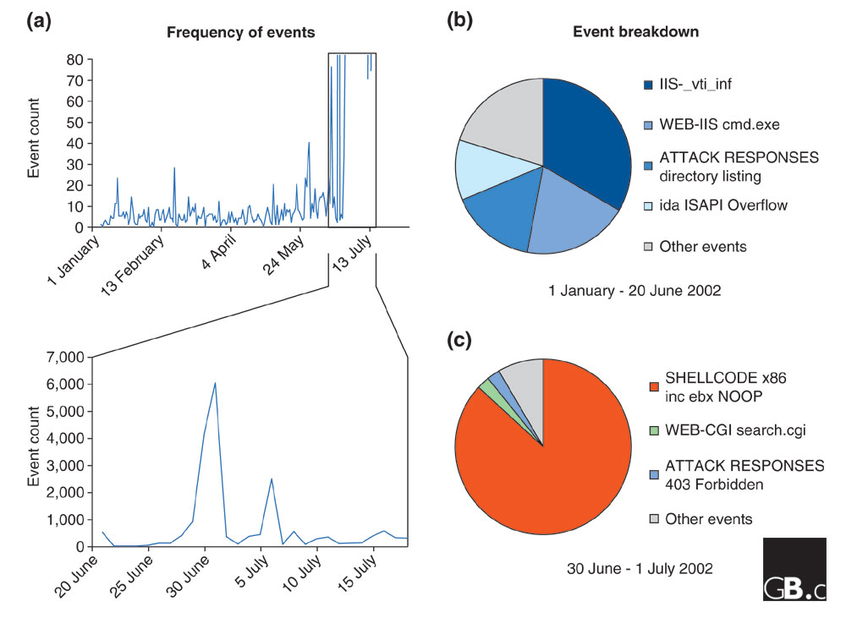
Difficulty in Securing Computers & Data
[Smith et al ('05), Genome Bio]

Slide 41
Genomic Privacy Hacks,
Mostly Focusing on Identification
Early genomic studies were based on small cohorts
  Individuals give consent to participate but request anonymity
    HAPMAP, PGP, 1000 Genomes…
  Focus on hiding the participation of individuals
  Attacks aimed at detecting whether an individual with known genotypes participated a study
    “Detection of genomes in a mixture” (Homer et al 2008, Im et al 2012)
As more people are genotyped, more individuals are in large private genomic databases
  Detection of an individual is irrelevant, as their participation is already known
    Current EX: “An individual’s genomic/phenotypic data is most certainly stored in their hospital”
    Future: >1M people’s health information is part of a NIH/PMI or NHS databases
Identification attacks now focus on pinpointing individuals by cross-referencing large seemingly independent datasets
  Illustrates that a leaked/hacker/stolen dataset, even when anonymized, can leak information
  Sweeney et al 2013, Gymrek et al 2013
Gymrek et al, “Identifying Personal Genomes by Surname Inference” (2013)
Homer et al, “Resolving individuals contributing trace amounts of DNA to highly complex mixtures using high-density SNP genotyping microarrays.” (2008)
Im et al, “On Sharing Quantitative Trait GWAS Results in an Era of Multiple-omics Data and the Limits of Genomic Privacy” (2012)
Sweeney et al, “Identifying Participants in the Personal Genome Project by Name” (2013)

Slide 42


What is a linking attack? Case of Netflix Prize
Very large datasets
A lot of users have a Netflix and an IMDb account
A user rates similar scores to a movie in Netflix and IMDb
A user rates a particular movie around the same date in Netflix and IMDb
Notes:
Two researchers, however, came up with a fairly simple scheme to reveal identities of users from this training dataset. They did this by linking the Netflix training data to IMDB’s online database.
There are several key points here. Firstly these two databases are independent, very large, and many users will be shared. Both datasets contain movie ratings and one user will likely rate a movie with similar scores and around the same date.

Slide 43



What is a linking attack? Case of Netflix Prize
Anonymized Netflix Prize Training Dataset
made available to contestants
Movie ratings database
User (ID) | Movie (ID) | Date of Rating | Rating [1,2,3,4,5]
NTFLX-0 | NTFLX-19 | 10/12/2008 | 1
NTFLX-1 | NTFLX-116 | 4/23/2009 | 3
NTFLX-2 | NTFLX-92 | 5/27/2010 | 2
NTFLX-1 | NTFLX-666 | 6/6/2016 | 5
… | … | … | …
… | … | … | …
100 million ratings
500,000 users
200 movie ratings/user
5,000 users/movie rating
Notes:
Before presenting our work in detail, I would like to motivate the our study with an example.
Netflix, the movie rental company, had organized these contests to improve their movie recommendation system.
The setup was like this: Netflix released this huge data matrix with user ids, movie titles, date of movie rating and the actual rating. There were 100 million entries for 500k users. On average each user rated 200 movies and each movie has been rated, on average by 5000 users.
This data matrix was used to train recommendation algorithms, which were then tested on other datasets.
This dataset was anonymized by removing names of users but Netflix also added noise and removed some other entries in the matrix to make it more secure.

Slide 44


Linking Attacks: Case of Netflix Prize
Names available for many users!
User (ID) | Movie (ID) | Date of Grade | Grade [1,2,3,4,5]
NTFLX-0 | NTFLX-19 | 10/12/2008 | 1
NTFLX-1 | NTFLX-116 | 4/23/2009 | 3
NTFLX-2 | NTFLX-92 | 5/27/2010 | 2
NTFLX-1 | NTFLX-666 | 6/6/2016 | 5
… | … | … | …
… | … | … | …
User (ID) | Movie (ID) | Date of Grade | Grade [0-10]
IMDB-0 | IMDB-173 | 4/20/2009 | 5
IMDB-1 | IMDB-18 | 10/18/2008 | 0
IMDB-2 | IMDB-341 | 5/27/2010 | -
… | … | … | …
… | … | … | …
… | … | … | …
Many users are shared
The grades of same users are correlated
A user grades one movie around the same date in two databases
Notes:
This figure illustrates what these datasets look like. The movie titles can be matched directly. Date of ratings and rating values are expected to be similar to each other

Slide 45
Linking Attacks: Case of Netflix Prize
Names available for many users!
User (ID) | Movie (ID) | Date of Grade | Grade [1,2,3,4,5]
NTFLX-0 | NTFLX-19 | 10/12/2008 | 1
NTFLX-1 | NTFLX-116 | 4/23/2009 | 3
NTFLX-2 | NTFLX-92 | 5/27/2010 | 2
NTFLX-1 | NTFLX-666 | 6/6/2016 | 5
… | … | … | …
… | … | … | …
User (ID) | Movie (ID) | Date of Grade | Grade [0-10]
IMDB-0 | IMDB-173 | 4/20/2009 | 5
IMDB-1 | IMDB-18 | 10/18/2008 | 0
IMDB-2 | IMDB-341 | 5/27/2010 | -
… | … | … | …
… | … | … | …
… | … | … | …
Many users are shared
The grades of same users are correlated
A user grades one movie around the same date in two databases
IMDB users are public
NetFLIX and IMdB moves are public
Notes:
As you can see, Netflx-1 user can be matched to IMDB-0 user since the date of rating is very close and the ratings are very similar. The rating in imdb is from 0 to 10. So 5 is a similar score to 3 in Netflix rating system.

Slide 46
Linking Attacks: Case of Netflix Prize
Names available for many users!
User (ID) | Movie (ID) | Date of Grade | Grade [1,2,3,4,5]
NTFLX-0 | NTFLX-19 | 10/12/2008 | 1
NTFLX-1 | NTFLX-116 | 4/23/2009 | 3
NTFLX-2 | NTFLX-92 | 5/27/2010 | 2
NTFLX-1 | NTFLX-666 | 6/6/2016 | 5
… | … | … | …
… | … | … | …
User (ID) | Movie (ID) | Date of Grade | Grade [0-10]
IMDB-0 | IMDB-173 | 4/20/2009 | 5
IMDB-1 | IMDB-18 | 10/18/2008 | 0
IMDB-2 | IMDB-341 | 5/27/2010 | -
… | … | … | …
… | … | … | …
… | … | … | …
Many users are shared
The grades of same users are correlated
A user grades one movie around the same date in two databases
Notes:
The key idea is that in imdb, the names are available for many users. Also,
Secondly, although another movie in Netflix system is not rated by this user in imdb system, namely the netflx666, the adversary can see the rating of the individual for this movie.

Slide 47
Large-scale Transcriptome Mining:
Building Integrative Regulatory Models, while Protecting Individual Privacy
Transcriptome analysis data
  Comparative ENCODE –
  Lots of Matched Data
  1000G+Geuvadis for privacy
Expression Clustering, Cross-species
  Potts-model optimization gives 16 conserved co-expression modules (which can potentially annotate ncRNAs/TARs)
State Space Models of Gene Expression
  Using dimensionality reduction to help determine internal & external drivers
  Decoupling expression changes into those driven by worm-fly conserved genes vs species-specific ones.
  Also, conserved genes have similar canonical patterns (iPDPs) in contrast to species specific ones (Ex of ribosomal v signaling genes)
The General Dilemma of Genomic Privacy
  Fundamental, inherited info that’s very private v need for large-scale mining for med. research
  Issues w/ current social & tech approaches: inconsistencies & burdensome security
  Strawman Hybrid Soc-Tech Proposal (Cloud Enclaves. Quantifying Leaks & Closely Coupled priv.-public datasets)
  Details on Relevant Hacks: Genomic, Computer Security, & Netfix
RNA-seq: How to Publicly Share Some of it
  Presents a tricky privacy issue since much of the sequencing is for general, non-individual specific results yet it’s tagged with individual information
  Removing SNVs in reads w/ MRF
  Quantifying & removing variant info from expression levels +
  eQTLs using ICI & predictability
  Instantiating a practical linking attack using extreme expression levels
  Quantifying accuracy of prediction, via gap between best & 2nd best match

Slide 48

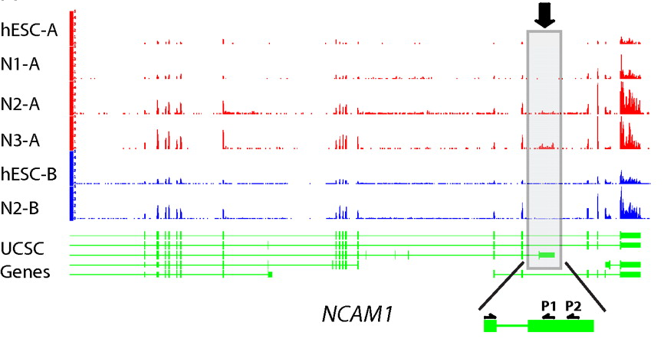
RNA-seq
RNA-seq uses next-generation sequencing technologies to reveal RNA presence and quantity within a biological sample.
ATACAAGCAAGTATAAGTTCGTATGCCGTCTT
GGAGGCTGGAGTTGGGGACGTATGCGGCATAG
TACCGATCGAGTCGACTGTAAACGTAGGCATA
ATTCTGACTGGTGTCATGCTGATGTACTTAAA
Reads (fasta)
－ Quality scores (fastq)
－ Mapping (BAM)
－ Contain variant information in transcribed regions
Quantitative information from RNA-seq signal: average signals at exon level (RPKMs)
Reads => Signal
[PLOS CB 4:e1000158; PNAS 4:107: 5254 ; IJC 123:569 ]

Slide 49
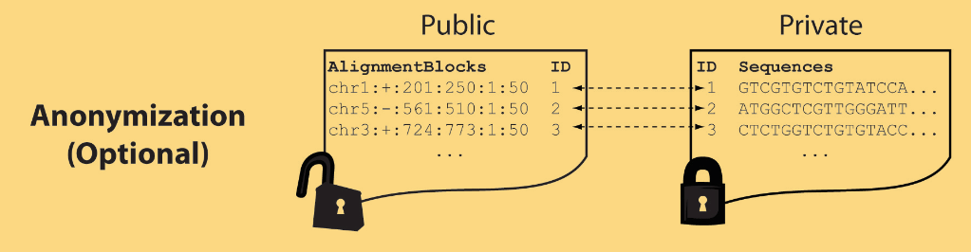
Light-weight formats
Some lightweight format clearly separate public & private info., aiding exchange
Files become much smaller
Distinction between formats to compute on and those to archive with – become sharper with big data
Reads
(linked via ID,
10X larger than
mapping coord.)
Mapping coordinates without variants (MRF)
[Bioinformatics 27: 281]

Slide 50
MRF Examples
chr2:+:601:630:1:30,chr2:+:921:940:31:50
TS
TE
TS
TE
Reference
AlignmentBlock 1
AlignmentBlock 2
Reference based compression
(ie CRAM)
is similar but it stores actual variant beyond just position of alignment block
Splice junction Read
QS
QE/QS
QE
Legend: TS = TargetStart, TE = TargetEnd, QS = QueryStart, QE = QueryEnd
chr9:+:431:480:1:50|chr9:+:945:994:1:50
TS
TE
TS
TE
Reference
AlignmentBlock 1
AlignmentBlock 2
Paired-end Read
QS
QE
QS
QE
Legend: TS = TargetStart, TE = TargetEnd, QS = QueryStart, QE = QueryEnd
[Habegger et al., Bioinformatics (‘11)]

Slide 51


eQTL Mapping Using RNA-Seq Data
eQTLs are genomic loci that contribute to variation in mRNA expression levels
eQTLs provide insights on transcription regulation, and the molecular basis of phenotypic outcomes
eQTL mapping can be done with RNA-Seq data
[Biometrics 68(1) 1–11]
Notes:
A diagram to illustrate the RNA‐seq count variation of one gene due to an cis‐eQTL. (a) RNA‐seq measurements of a hypothetic gene with two exons in three diploid individuals. The target SNP which we test for association has the genotype CT, CC, and TT for the three individuals. There is an SNP on the first exon, which has genotype AT, AT, and AA for the three individuals. ASE can be measured by those sequence reads that overlap with a heterozygous exonic SNP. Therefore we can measure ASE for individuals (i) and (ii). However, association testing by ASE is only possible if the target SNP is heterozygous, thus only individual (i) can be used to test for eQTL by ASE (b) ASE measurements for individual (i). (c) TReC measured for the three individuals across the two exons of this gene.
© IF THIS IMAGE HAS BEEN PROVIDED BY OR IS OWNED BY A THIRD PARTY, AS INDICATED IN THE CAPTION LINE, THEN FURTHER PERMISSION MAY BE NEEDED BEFORE ANY FURTHER USE. PLEASE CONTACT WILEY'S PERMISSIONS DEPARTMENT ON PERMISSIONS@WILEY.COM OR USE THE RIGHTSLINK SERVICE BY CLICKING ON THE 'REQUEST PERMISSION' LINK ACCOMPANYING THIS ARTICLE. WILEY OR AUTHOR OWNED IMAGES MAY BE USED FOR NON-COMMERCIAL PURPOSES, SUBJECT TO PROPER CITATION OF THE ARTICLE, AUTHOR, AND PUBLISHER.

Slide 52
Information Content and Predictability
Higher frequency: Lower ICI
Lower frequency: Higher ICI
Additive for multiple variants
Higher cond. entropy: Lower predictability
Lower cond. entropy: Higher predictability
Additive for multiple eQTLs
[Harmanci et al. Nat. Meth. 2016]

Slide 53

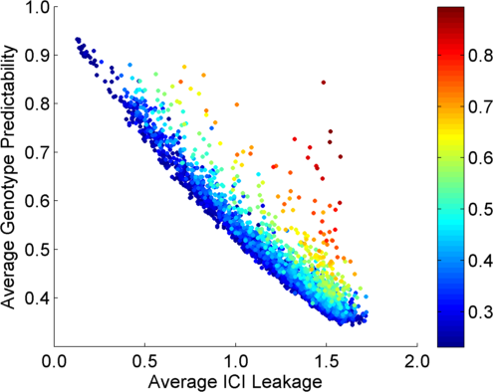
Per eQTL and ICI Cumulative Leakage versus Genotype Predictability
Colors by absolute correlation
Absolute Correlation
[Harmanciet al. Nat. Meth. (in revision)]

Slide 54
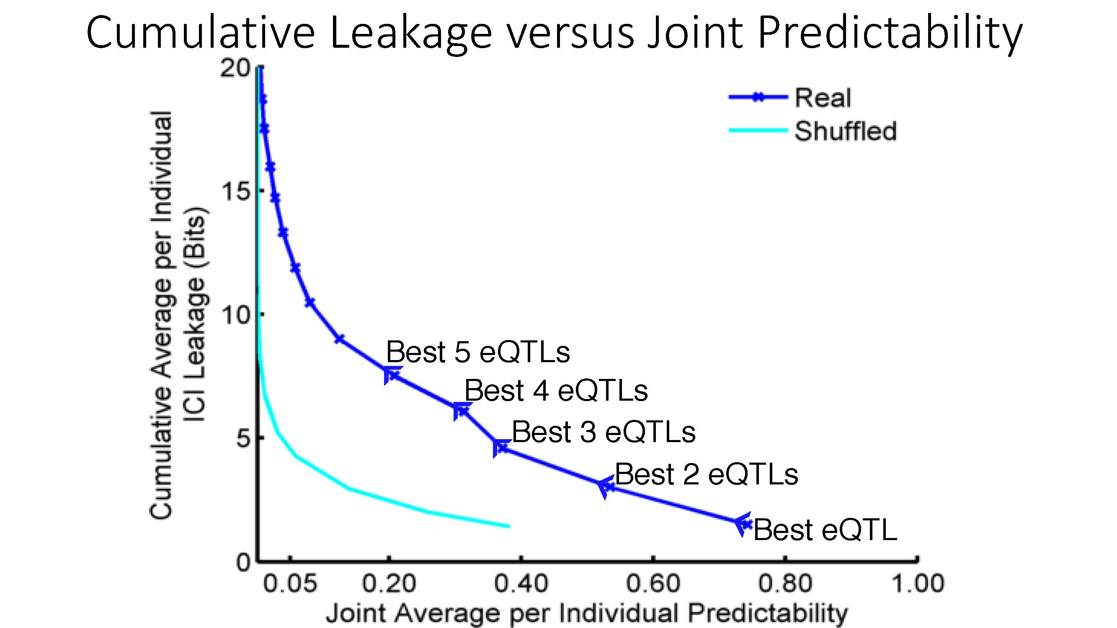
Cumulative Leakage versus Joint Predictability
More #
Vulnerable
Less #
Vulnerable
[Harmanciet al. Nat. Meth. (in revision)]

Slide 55

Linking Attack Scenario
[Harmanciet al. Nat. Meth. (in revision)]

Slide 56
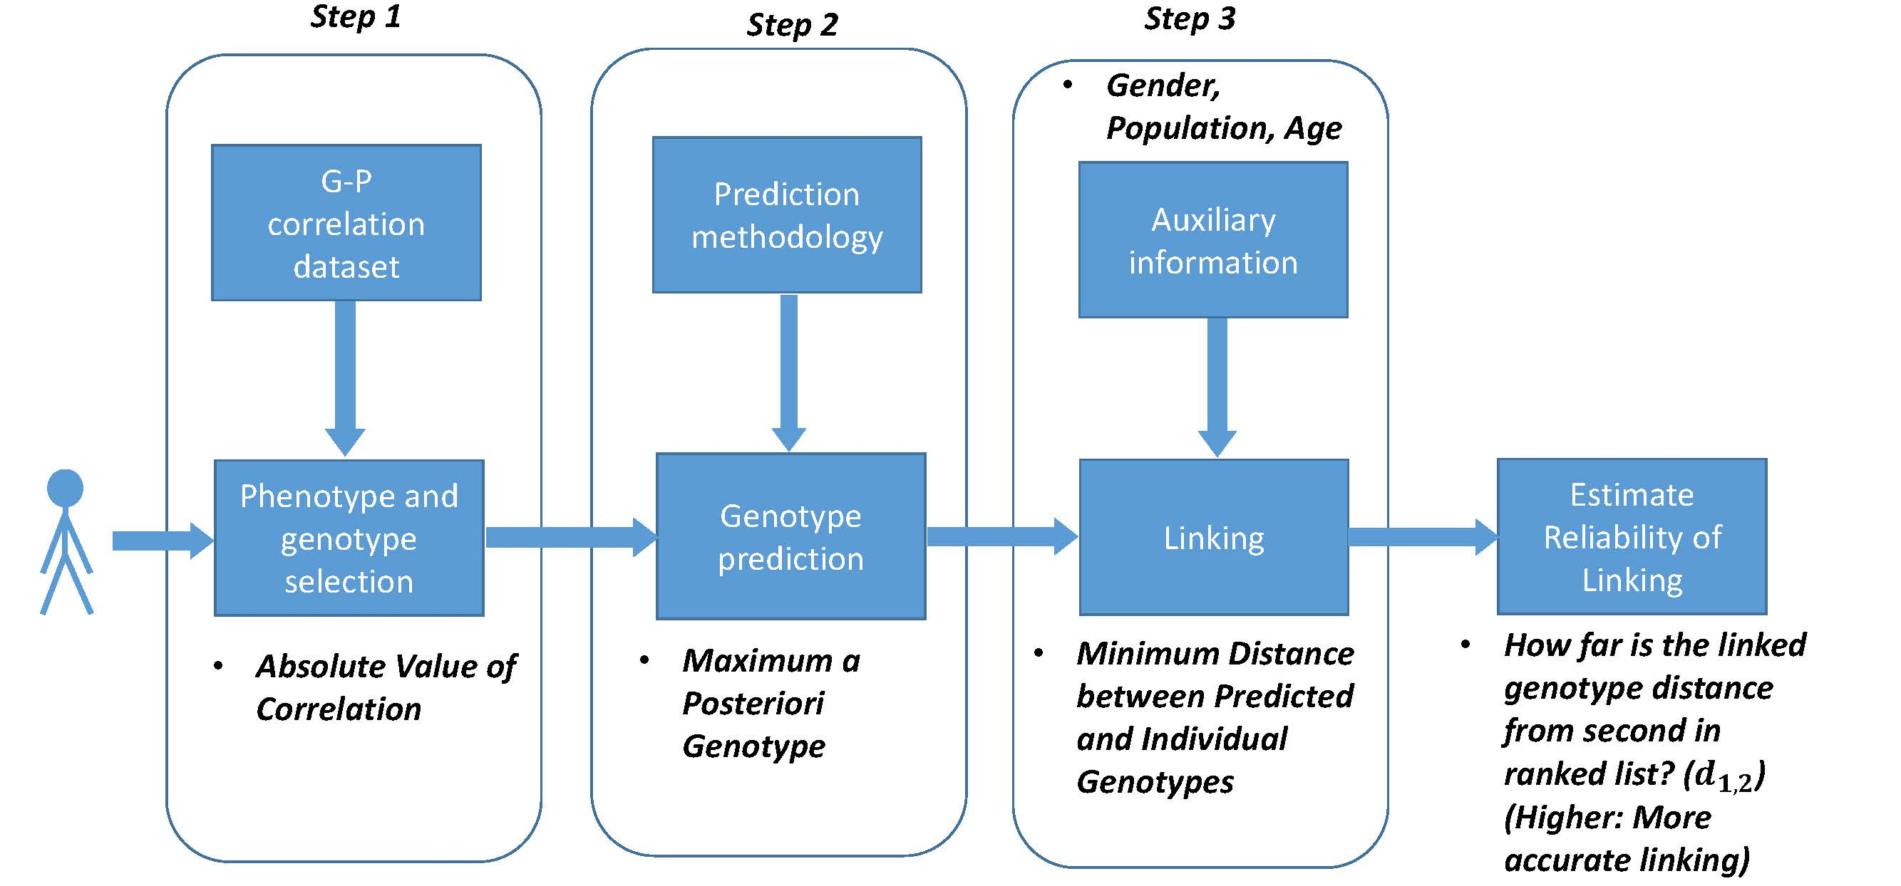
Steps in Instantiation of a (Mock) Linking Attack
[Harmanci et al. Nat. Meth. (16)]

Slide 57
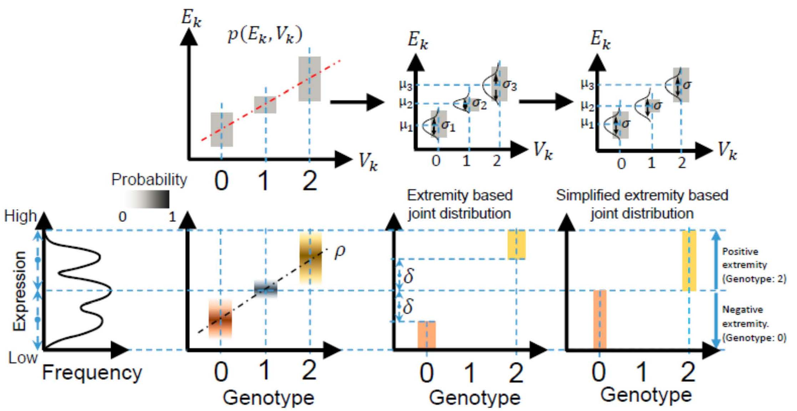
Levels of Expression-Genotype Model Simplifications
[Harmanci et al. Nat. Meth. (16)]

Slide 58
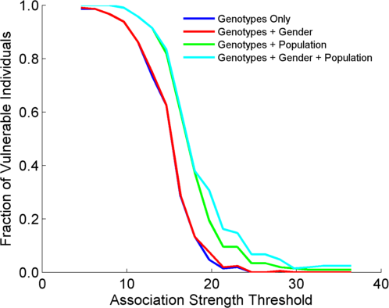
Linking Attack with Extremity based Genotype Prediction
200 individuals eQTL Discovery
200 individuals in Linking Attack
High
Sensitivity
X-axis: The threshold of association for selecting the eQTLs
  Higher threshold: Smaller number of eQTLs
Y-axis: Fraction of correctly linked individuals
  Measures the Sensitivity of the attack
Low
Sensitivity
High Number
Of eQTLs
Low Number
Of eQTLs
[Harmanci et al. Nat. Meth. (16)]

Slide 59
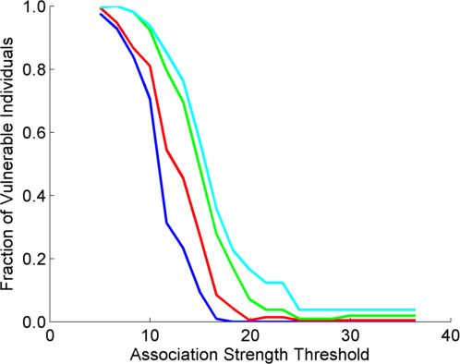
Linking Attack with Extremity based Genotype Prediction
200 individuals eQTL Discovery
200 individuals in Linking Attack
200 individuals eQTL Discovery
100,200 individuals in Linking Attack
[Harmanci et al. Nat. Meth. (16)]

Slide 60
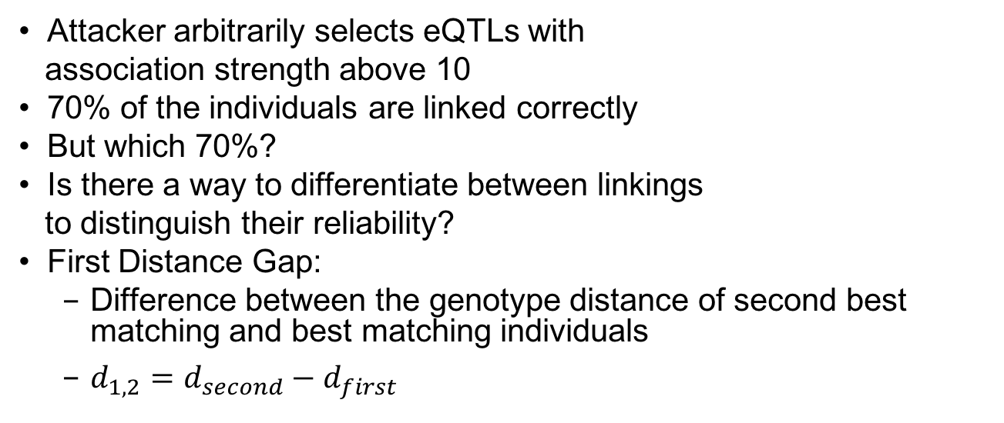
Which 70%?
70%
Attacker arbitrarily selects eQTLs with
association strength above 10
70% of the individuals are linked correctly
But which 70%?
Is there a way to differentiate between linkings
to distinguish their reliability?
First Distance Gap:
  Difference between the genotype distance of second best matching and best matching individuals
  $d_{1,2}=d_{second}−d_{first}$
[Harmanci et al. Nat. Meth. (16)]

Slide 61
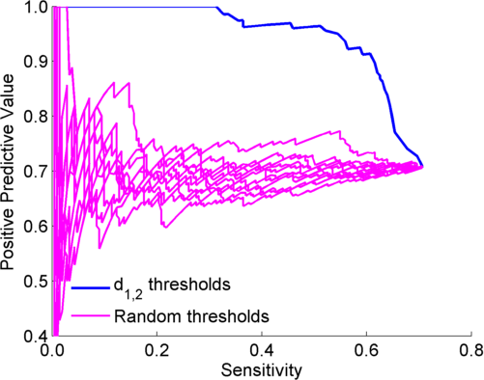
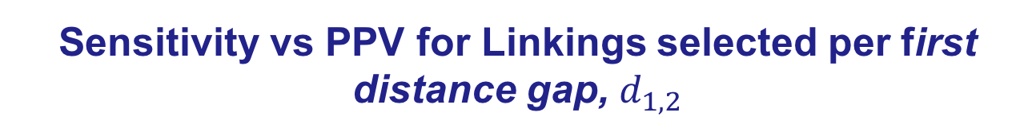
Sensitivity vs PPV for Linkings selected per first distance gap, $d_{1,2}$
Decreasing $d_{1,2}$
52%
[Harmanci et al. Nat. Meth. (16)]

Slide 62
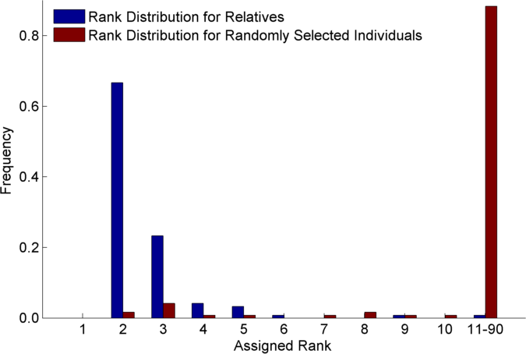
Relatives are also vulnerable
(30 CEU Trios)
1st rank is individual’s
self
[Harmanci et al. Nat. Meth. (16)]

Slide 63
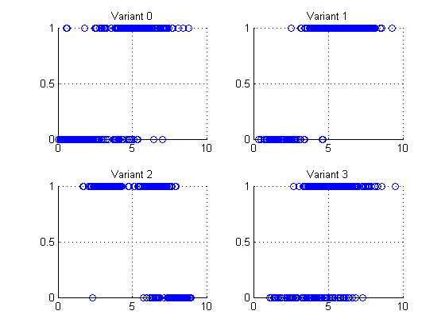
Small Data Leakage from just Gene Expression Data:
4 eQTL-SNP genotypes
Expression levels are outliers and are predictive of the genotype!
Example: Vulnerable sample variants, expressions
Variant 0 (1, 6)
Variant 1 (0, 2)
Variant 2 (1, 3)
Variant 3 (0, 2)
Genotype (0,1)
Log RPKM of overlapping gene

Slide 64
Large-scale Transcriptome Mining:
Building Integrative Regulatory Models, while Protecting Individual Privacy
Transcriptome analysis data
  Comparative ENCODE –
  Lots of Matched Data
  1000G+Geuvadis for privacy
Expression Clustering, Cross-species
  Potts-model optimization gives 16 conserved co-expression modules (which can potentially annotate ncRNAs/TARs)
State Space Models of Gene Expression
  Using dimensionality reduction to help determine internal & external drivers
  Decoupling expression changes into those driven by worm-fly conserved genes vs species-specific ones.
  Also, conserved genes have similar canonical patterns (iPDPs) in contrast to species specific ones (Ex of ribosomal v signaling genes)
The General Dilemma of Genomic Privacy
  Fundamental, inherited info that’s very private v need for large-scale mining for med. research
  Issues w/ current social & tech approaches: inconsistencies & burdensome security
  Strawman Hybrid Soc-Tech Proposal (Cloud Enclaves. Quantifying Leaks & Closely Coupled priv.-public datasets)
  Details on Relevant Hacks: Genomic, Computer Security, & Netfix
RNA-seq: How to Publicly Share Some of it
  Presents a tricky privacy issue since much of the sequencing is for general, non-individual specific results yet it’s tagged with individual information
  Removing SNVs in reads w/ MRF
  Quantifying & removing variant info from expression levels +
  eQTLs using ICI & predictability
  Instantiating a practical linking attack using extreme expression levels
  Quantifying accuracy of prediction, via gap between best & 2nd best match

Slide 65
Large-scale Transcriptome Mining:
Building Integrative Regulatory Models, while Protecting Individual Privacy
Transcriptome analysis data
  Comparative ENCODE –
  Lots of Matched Data
  1000G+Geuvadis for privacy
Expression Clustering, Cross-species
  Potts-model optimization gives 16 conserved co-expression modules (which can potentially annotate ncRNAs/TARs)
State Space Models of Gene Expression
  Using dimensionality reduction to help determine internal & external drivers
  Decoupling expression changes into those driven by worm-fly conserved genes vs species-specific ones.
  Also, conserved genes have similar canonical patterns (iPDPs) in contrast to species specific ones (Ex of ribosomal v signaling genes)
The General Dilemma of Genomic Privacy
  Fundamental, inherited info that’s very private v need for large-scale mining for med. research
  Issues w/ current social & tech approaches: inconsistencies & burdensome security
  Strawman Hybrid Soc-Tech Proposal (Cloud Enclaves. Quantifying Leaks & Closely Coupled priv.-public datasets)
  Details on Relevant Hacks: Genomic, Computer Security, & Netfix
RNA-seq: How to Publicly Share Some of it
  Presents a tricky privacy issue since much of the sequencing is for general, non-individual specific results yet it’s tagged with individual information
  Removing SNVs in reads w/ MRF
  Quantifying & removing variant info from expression levels +
  eQTLs using ICI & predictability
  Instantiating a practical linking attack using extreme expression levels
  Quantifying accuracy of prediction, via gap between best & 2nd best match

Slide 66



Acknowledgements
DREISS.gersteinlab.org - D Wang, F He, S Maslov
papers.gersteinlab.org/subject/privacy - D Greenbaum
PrivaSeq.gersteinlab.org - A Harmanci
github.com/gersteinlab/OrthoClust - K Yan, D Wang, J Rozowsky, H Zheng, C Cheng
Hiring Postdocs.
See gersteinlab.org/jobs !

Slide 67

Extra

Slide 68
Info about content in this slide pack
General PERMISSIONS
  This Presentation is copyright Mark Gerstein,
  Yale University, 2016.
  Please read permissions statement at
  www.gersteinlab.org/misc/permissions.html .
  Feel free to use slides & images in the talk with PROPER acknowledgement
  (via citation to relevant papers or link to gersteinlab.org).
  Paper references in the talk were mostly from Papers.GersteinLab.org.
PHOTOS & IMAGES. For thoughts on the source and permissions of many of the photos and clipped images in this presentation see http://streams.gerstein.info .
  In particular, many of the images have particular EXIF tags, such as kwpotppt , that can be easily queried from flickr, viz: http://www.flickr.com/photos/mbgmbg/tags/kwpotppt

