Slide 1
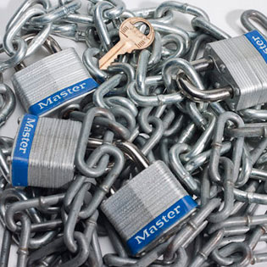
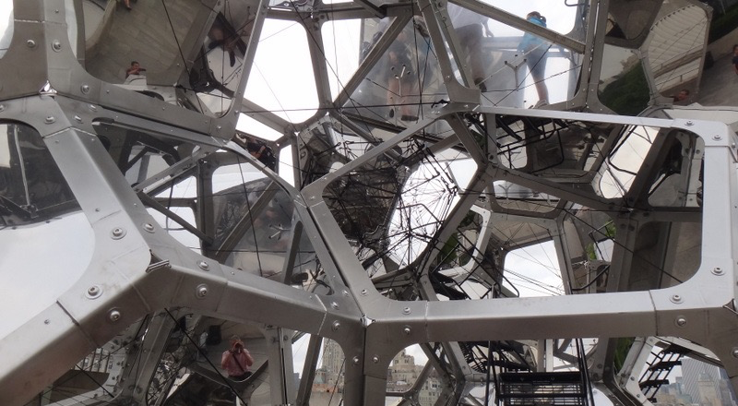
Genomic Privacy:
Intertwined Social & Technical Aspects
1 (c) Mark Gerstein, 2002, Yale, bioinfo.mbb.yale.edu
Mark Gerstein, Yale
Slides freely downloadable from Lectures.GersteinLab.org
& “tweetable” (via @markgerstein). See last slide for more info.
Notes:
1

Slide 2
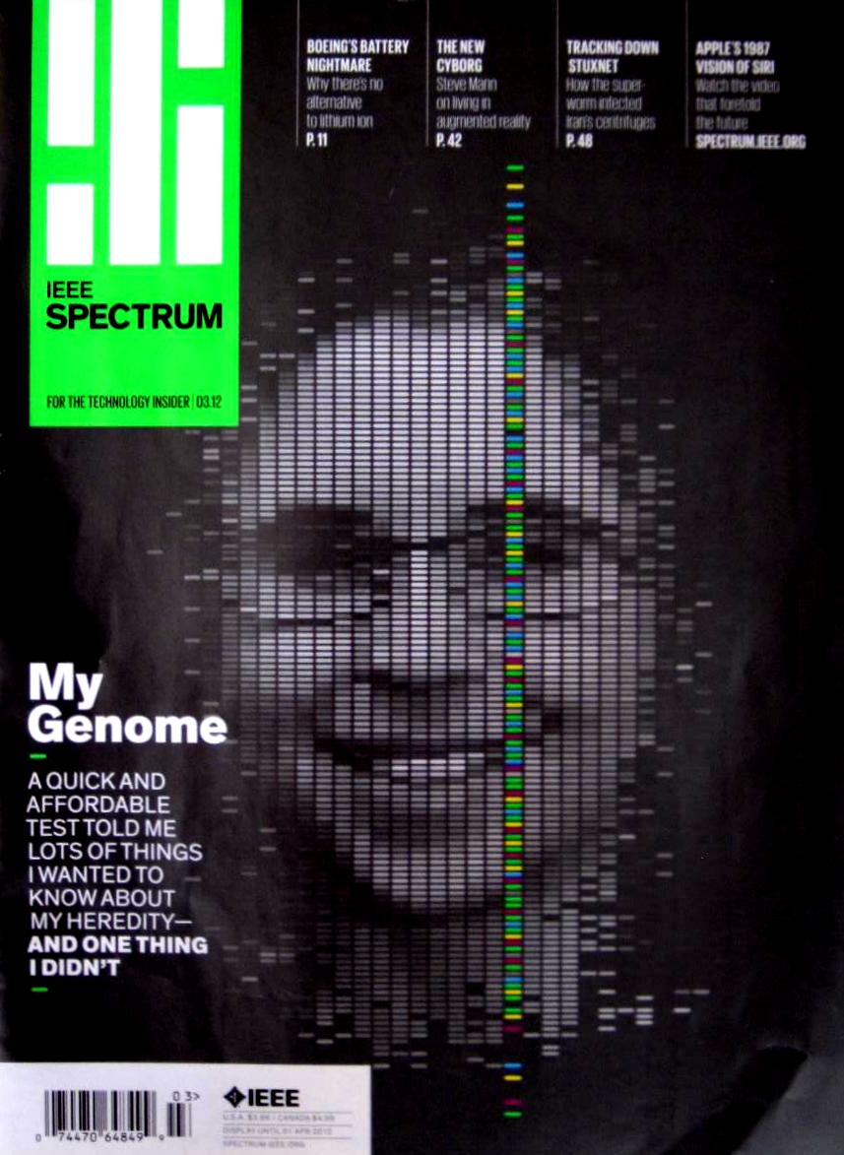
Setting the Stage: the Advent of Personal Genomics
Human Genome sequence in 2000 for >$2 billion
A Human Genome can be sequenced today for ~$1000
Hundreds of thousands of SNPs can be interrogated for ~$99

Slide 3
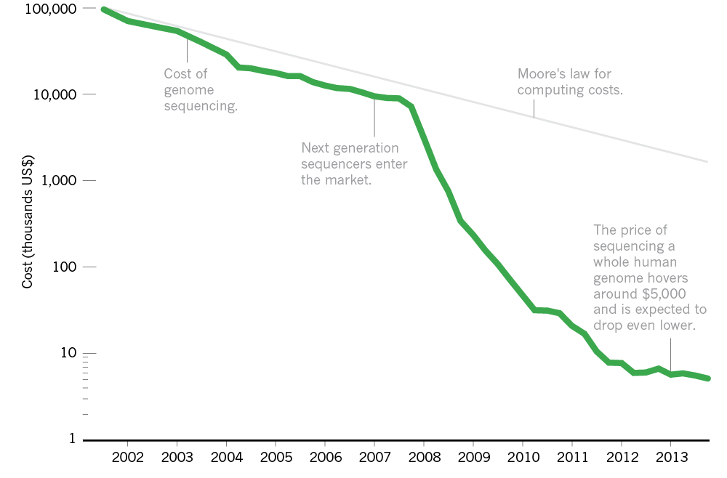
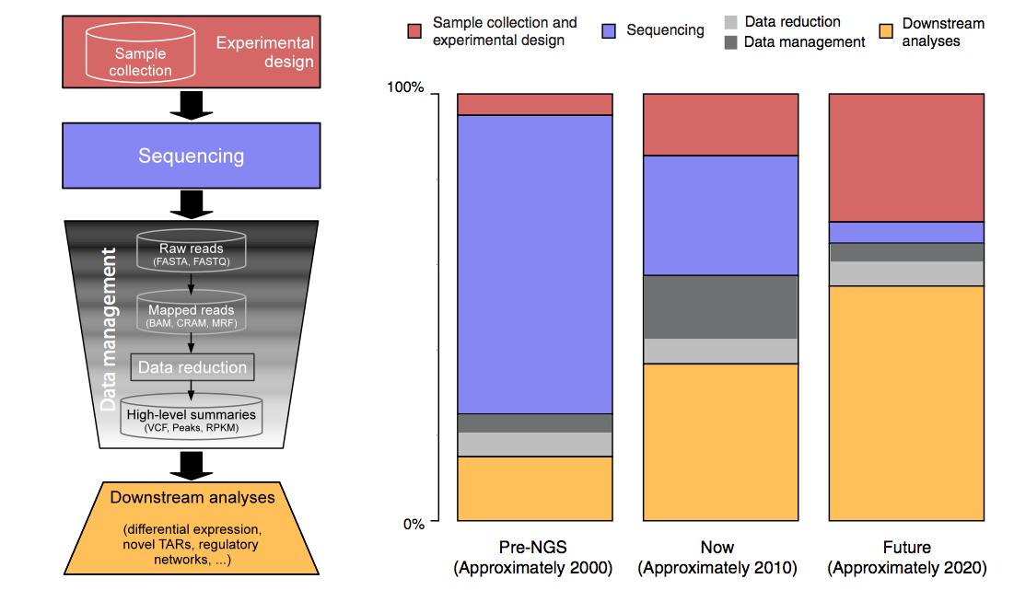
The Explosion of Data in Genomics: the Numbers
$5K
'07
From ‘00 to ~’20,
cost of DNA sequencing expt. shifts from the actual seq. to sample
collection & analysis
[Nature 507, 294; Sboner et al. (‘11) GenomeBiology ]

Slide 4
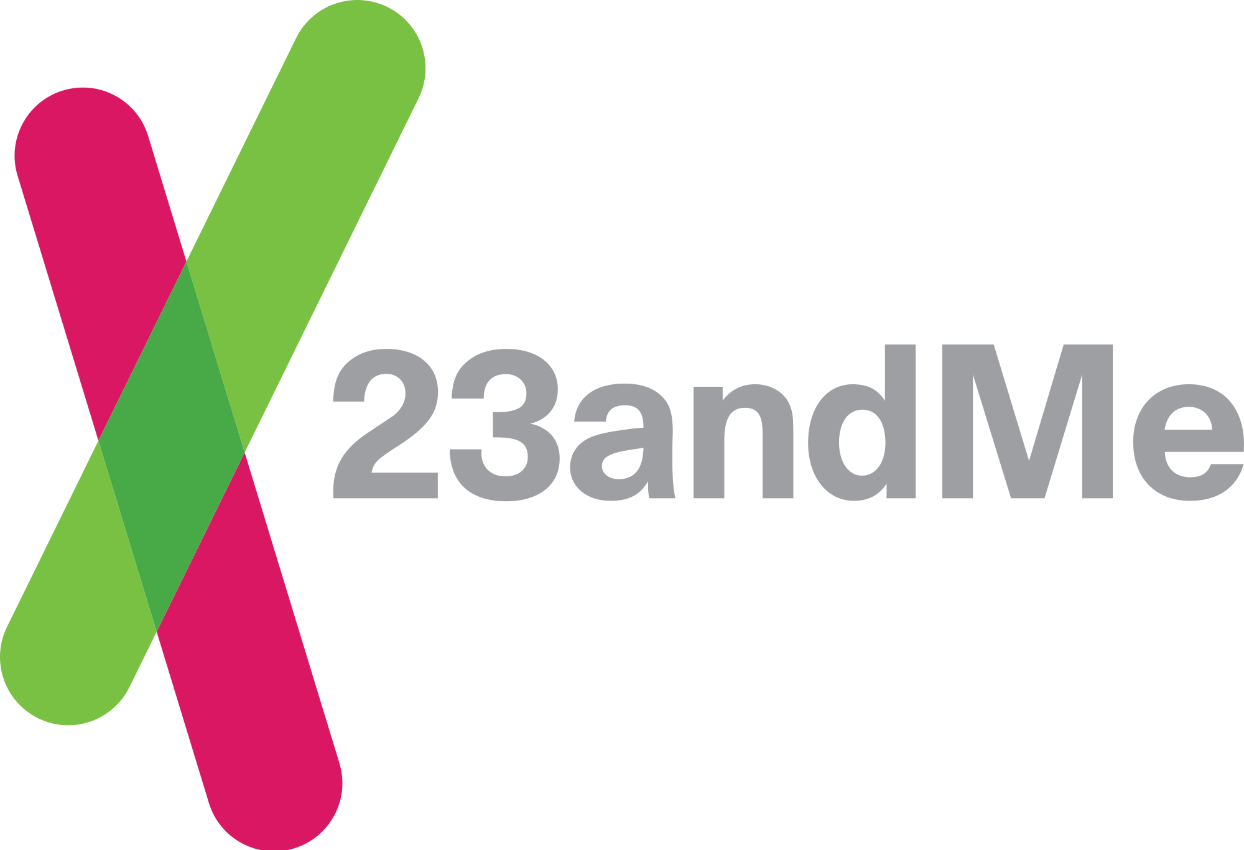
DTC Genomics
Industry spurred by falling prices of sequencing and computation
Major players were Navigenics, DeCode & 23andMe.
23andMe
  has >1M Customers
  $99 per analysis
  Promotes sharing of Data
  Currently in trouble with the FDA & limited to only recreational (e.g., ancestry related) analysis
  Millions in VC funding

Slide 5
Genomic Privacy: Intertwined Social & Technical Issues
Setting the Stage: the Advent of Personal Genomics
The Dilemma of Genomic Privacy
  Fundamental, inherited info that’s very private vs the need for large-scale data-sharing to enable med. research
Current Social & Tech Approaches
  GINA, Consents &
  "Secure" use of dbGAP
  Issues: burdensome security, inconsistencies + ways the solutions have been partially "hacked”
  Strawman Hybrid Soc-Tech Proposal (Licensure, Cloud Enclaves. Quantifying Leaks, & Closely Coupled priv.-public data)
RNA-seq – practical problem of publicly sharing some of the info
  Removing SNVs in reads using MRF
  Quantifying & removing variant info from expression levels + eQTLs
  Further complications: SVs in pervasive transcription?

Slide 6
Genomic Privacy: Intertwined Social & Technical Issues
Setting the Stage: the Advent of Personal Genomics
The Dilemma of Genomic Privacy
  Fundamental, inherited info that’s very private vs the need for large-scale data-sharing to enable med. research
Current Social & Tech Approaches
  GINA, Consents &
  "Secure" use of dbGAP
  Issues: burdensome security, inconsistencies + ways the solutions have been partially "hacked”
  Strawman Hybrid Soc-Tech Proposal (Licensure, Cloud Enclaves. Quantifying Leaks, & Closely Coupled priv.-public data)
RNA-seq – practical problem of publicly sharing some of the info
  Removing SNVs in reads using MRF
  Quantifying & removing variant info from expression levels + eQTLs
  Further complications: SVs in pervasive transcription?

Slide 7
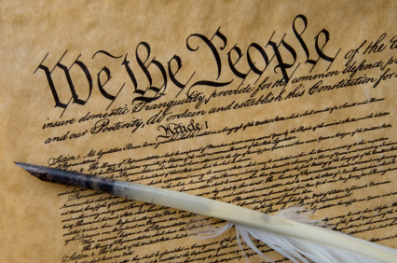
Privacy
  Privacy is a personal and fundamental right guaranteed by the US Constitution
  Privacy Act 1974
  Including:
  Inherent in the limits on the First Amendment is a constitutional right to privacy.
  Fourth Amendment against search and seizure US v Amerson 483 F. 3d 73 (2d Cir. 2007);
  Due Process Clauses of the Fifth and Fifteenth Amendments.

Slide 8


The Conundrum of Genomic Privacy: Is it a Problem?
Yes
Genetic Exceptionalism :
genome is potentially very revealing about one’s identity & characteristics
Most discussion of Identification Risk but what about Characterization Risk?
  Finding you were in study X vs identifying that you have trait Y from studying your identified genome
No
Shifting societal foci
No one really cares
about your genes
You might not care
[Klitzman & Sweeney ('11), J Genet Couns 20:98l; Greenbaum & Gerstein ('09), New Sci. (Sep 23) ]

Slide 9

Tricky Privacy Considerations in Personal Genomics
Personal Genomic info. essentially meaningless currently but will it be in 20 yrs? 50 yrs?
  Genomic sequence very revealing about one’s children. Is true consent possible?
  Once put on the web it can’t be taken back
Culture Clash: Genomics historically has been a proponent of “open data” but not clear personal genomics fits this
Ethically challenged history of genetics
Ownership of the data & what consent means (Hela)
  Could your genetic data give rise to a product line?
[D Greenbaum & M Gerstein (’08). Am J. Bioethics; D Greenbaum & M Gerstein, Hartford Courant, 10 Jul. '08 ; SF Chronicle, 2 Nov. '08;
Greenbaum et al. PLOS CB (‘11) ; Greenbaum & Gerstein ('13), The Scientist; Photo from NY Times]

Slide 10

The Other Side of the Coin:
Why we should share
Sharing helps speed research
  Large-scale mining of this information is important for medical research
  Privacy is cumbersome, particularly for big data
  Sharing is important for reproducible research
Sharing is useful for education
[Yale Law Roundtable (‘10). Comp. in Sci. & Eng. 12:8; D Greenbaum & M Gerstein (‘09). Am. J. Bioethics; D Greenbaum & M Gerstein (‘10). SF Chronicle, May 2, Page E-4;
Greenbaum et al. PLOS CB (‘11)]

Slide 11

The Dilemma
[Economist, 15 Aug ‘15]
What is acceptable risk? What is acceptable data leakage? Can we quantify leakage?
Cost Benefit Analysis: how helpful is identifiable data in genomic research v. potential harm from a breach?
The individual (harmed?) v the collective (benefits)
  But do sick patients care about their privacy?
Maybe a we need a few "test pilots” (ala PGP)?
  Sports stars & celebrities?

Slide 12












Genomics has similar "Big Data" Dilemma in the Rest of Society
Sharing & "peer-production" is central to success of many new ventures, with the same risks as in genomics
We confront privacy risks every day we access the internet
(...or is the genome more exceptional & fundamental?)
[Seringhaus & Gerstein ('09), Hart. Courant (Jun 5); Greenbaum & Gerstein ('11), NY Times (6 Oct)]

Slide 13
Genomic Privacy: Intertwined Social & Technical Issues
Setting the Stage: the Advent of Personal Genomics
The Dilemma of Genomic Privacy
  Fundamental, inherited info that’s very private vs the need for large-scale data-sharing to enable med. research
Current Social & Tech Approaches
  GINA, Consents &
  "Secure" use of dbGAP
  Issues: burdensome security, inconsistencies + ways the solutions have been partially "hacked”
  Strawman Hybrid Soc-Tech Proposal (Licensure, Cloud Enclaves. Quantifying Leaks, & Closely Coupled priv.-public data)
RNA-seq – practical problem of publicly sharing some of the info
  Removing SNVs in reads using MRF
  Quantifying & removing variant info from expression levels + eQTLs
  Further complications: SVs in pervasive transcription?

Slide 14

Genetic Information Nondisclosure Act of 2008
Title I relating to Health Insurance
Title II relating to Employment Discrimination
GINA Prohibits:
  group and individual health insurers from using genetic data for determining eligibility or premiums
  insurers from requesting that the insured undergo genetic testing
  employers from using genetic data to may employment decisions
  Employers from requesting genetic data about an employee or their family
14

Slide 15
Current Social & Technical Solutions
Consents
“Protected” distribution of data (dbGAP)
Local computes on secure computer
Issues
  Non-uniformity of consents & paperwork
    Different international norms, leading to confusion
  Encryption & computer security creates burdensome requirements on data sharing & large scale analysis
  Many schemes get “hacked”
[Greenbuam et al ('04), Nat. Biotech; Greenbaum & Gerstein ('13), The Scientist]

Slide 16
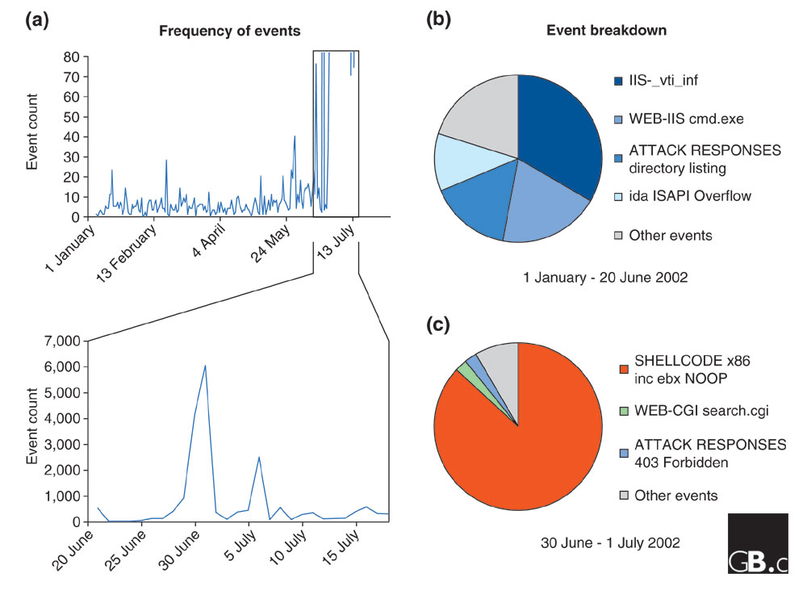
Difficulty in Securing Computers & Data
[Smith et al ('05), Genome Bio]

Slide 17
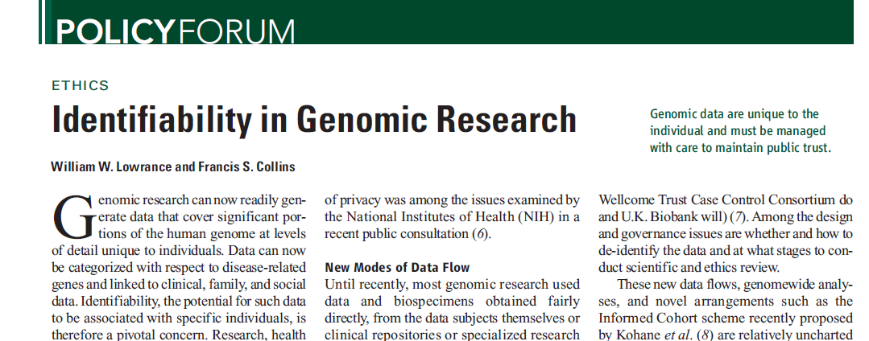
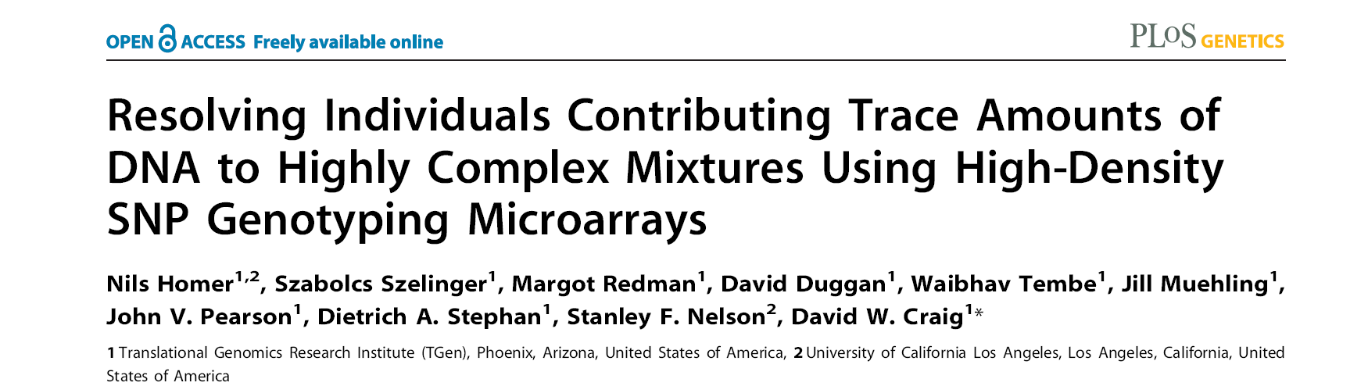
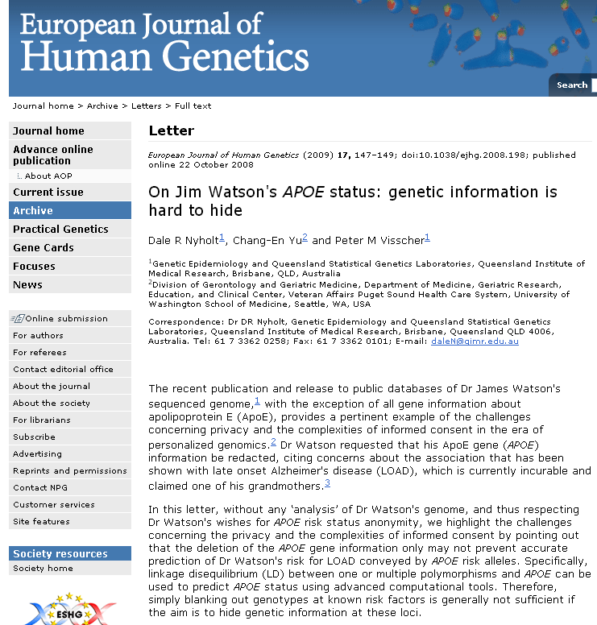
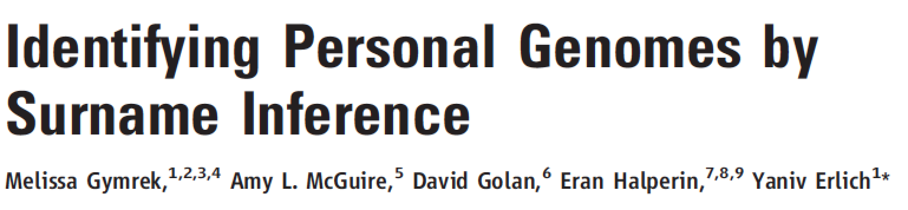
Matching against reference genotype. The number of DNA markers such as single-nucleotide polymorphisms (SNPs) that are needed to uniquely identify a single person is small; Lin et al. estimate that only 30 to 80 SNPs could be sufficient
Linking to nongenetic databases. A second route to identifying genotyped subjects is deduction by linking and then matching geno-type- plus-associated data (such as gender, age, or disease being studied) with data in health-care, administrative, criminal, disaster response, or other databases … If the nongenetic data are overtly identified, the task is straightforward
A framework for accurately and robustly resolving whether individuals are in a complex genomic DNA mixture using high-density single nucleotide polymorphism (SNP) genotyping microarrays.
We demonstrate an approach for rapidly and sensitively determining whether a trace amount (<1%) of genomic DNA from an individual is present within a complex DNA mixture
Identifying anonymized 1000G individuals through DB xref

Slide 18

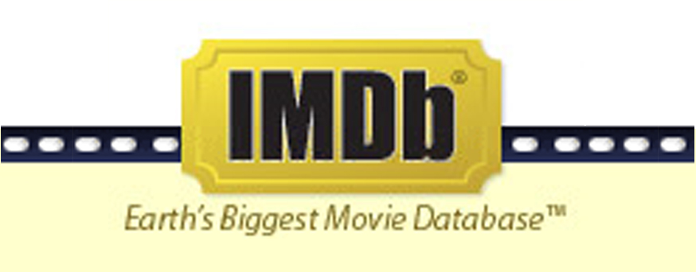
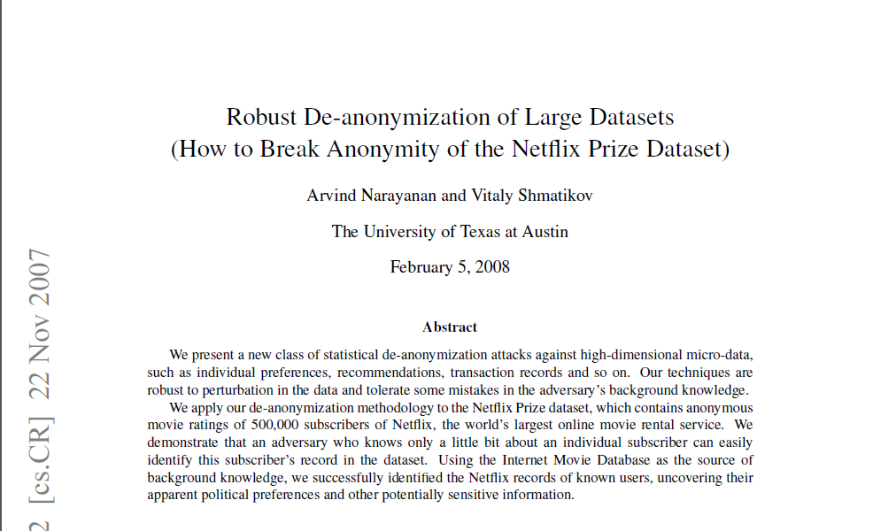
Cross correlated small set of identifiable IMDB movie database rating
records with large set of “anonymized” Netflix customer ratings

Slide 19
Strawman Hybrid Social & Tech Proposed Solution?
Fundamentally, researchers have to keep genetic secrets
  Genetic Licensure & training for individuals
  (similar to medical license, drivers license)
Technology to make things easier
  Cloud computing & enclaves (eg solution of Genomics England)
Technological barriers shouldn't create a social incentive for “hacking”
Quantifying Leakage & allowing a small amounts of it (eg photos of eye color)
Careful separation & coupling of private & public data
  Lightweight, freely accessible secondary datasets coupled to underlying variants
  Selection of stub & "test pilot" datasets for benchmarking
  Develop programs on public stubs on your laptop, then move the program to the cloud for private production run
[D Greenbaum, M Gerstein (‘11). Am J Bioeth 11:39. Greenbaum & Gerstein, The Scientist ('13)]

Slide 20
Genomic Privacy: Intertwined Social & Technical Issues
Setting the Stage: the Advent of Personal Genomics
The Dilemma of Genomic Privacy
  Fundamental, inherited info that’s very private vs the need for large-scale data-sharing to enable med. research
Current Social & Tech Approaches
  GINA, Consents &
  "Secure" use of dbGAP
  Issues: burdensome security, inconsistencies + ways the solutions have been partially "hacked”
  Strawman Hybrid Soc-Tech Proposal (Licensure, Cloud Enclaves. Quantifying Leaks, & Closely Coupled priv.-public data)
RNA-seq – practical problem of publicly sharing some of the info
  Removing SNVs in reads using MRF
  Quantifying & removing variant info from expression levels + eQTLs
  Further complications: SVs in pervasive transcription?

Slide 21
RNA-seq
Genome-wide transcription
  Gene transcription and non-canonical transcription
  Fusion transcripts
  Alternative splicing
  Allele specific expression
Large magnitude of RNA-seq data generated
  ENCODE, modENCODE, TCGA, GTEx, Roadmap, psychENCODE, etc.
  Mostly the data is about the phenotype (e.g., cancer gene expression), but the individual information often comes along as collateral
  Maybe we can separate private info but couple it with the public presentation?

Slide 22

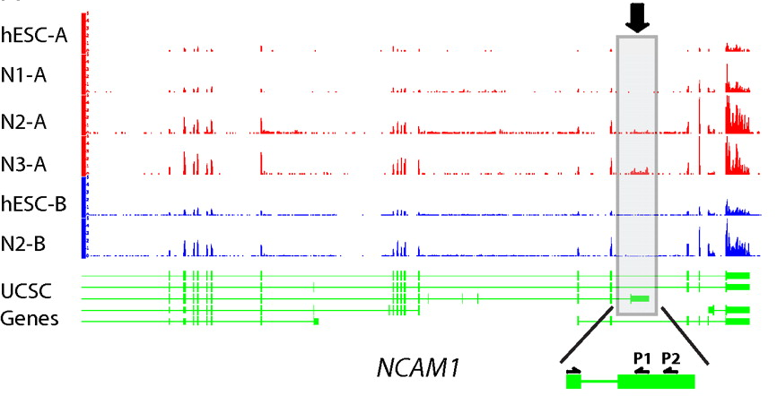
RNA-seq
RNA-seq uses next-generation sequencing technologies to reveal RNA presence and quantity within a biological sample.
ATACAAGCAAGTATAAGTTCGTATGCCGTCTT
GGAGGCTGGAGTTGGGGACGTATGCGGCATAG
TACCGATCGAGTCGACTGTAAACGTAGGCATA
ATTCTGACTGGTGTCATGCTGATGTACTTAAA
Reads (fasta)
－ Quality scores (fastq)
－ Mapping (BAM)
－ Contain variant information in transcribed regions
Quantitative information from RNA-seq signal: average signals at exon level (RPKMs)
Reads => Signal
[PLOS CB 4:e1000158; PNAS 4:107: 5254 ; IJC 123:569 ]

Slide 23
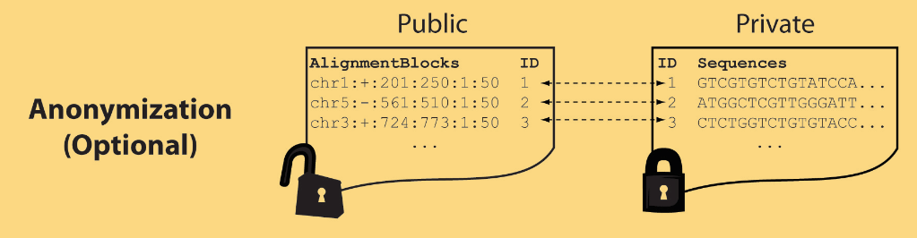
Light-weight formats
Some lightweight format clearly separate public & private info., aiding exchange
Files become much smaller
Distinction between formats to compute on and those to archive with – become sharper with big data
Reads
(linked via ID,
10X larger than
mapping coord.)
Mapping coordinates without variants (MRF)
[Bioinformatics 27: 281]

Slide 24
MRF Examples
chr2:+:601:630:1:30,chr2:+:921:940:31:50
TS
TE
TS
TE
Reference
AlignmentBlock 1
AlignmentBlock 2
10X Compression Ex.
Raw ELAND export file has uncompressed file size: ∼4 GB; total number of reads: ∼20 million; number of mapped reads: ∼12 million .
MRF file is significantly smaller (∼400 MB uncompressed, ∼130 MB compressed with gzip).
BAM file
has a size of ∼1.2 GB.
Splice junction Read
QS
QE/QS
QE
Legend: TS = TargetStart, TE = TargetEnd, QS = QueryStart, QE = QueryEnd
chr9:+:431:480:1:50|chr9:+:945:994:1:50
TS
TE
TS
TE
Reference
AlignmentBlock 1
AlignmentBlock 2
Reference based compression (ie CRAM) is similar but it stores actual variant beyond just position of alignment block
Paired-end Read
QS
QE
QS
QE
Legend: TS = TargetStart, TE = TargetEnd, QS = QueryStart, QE = QueryEnd
[Habegger et al., Bioinformatics (‘11)]

Slide 25
Genomic Privacy: Intertwined Social & Technical Issues
Setting the Stage: the Advent of Personal Genomics
The Dilemma of Genomic Privacy
  Fundamental, inherited info that’s very private vs the need for large-scale data-sharing to enable med. research
Current Social & Tech Approaches
  GINA, Consents &
  "Secure" use of dbGAP
  Issues: burdensome security, inconsistencies + ways the solutions have been partially "hacked”
  Strawman Hybrid Soc-Tech Proposal (Licensure, Cloud Enclaves. Quantifying Leaks, & Closely Coupled priv.-public data)
RNA-seq – practical problem of publicly sharing some of the info
  Removing SNVs in reads using MRF
  Quantifying & removing variant info from expression levels + eQTLs
  Further complications: SVs in pervasive transcription?

Slide 26

eQTL Mapping Using RNA-Seq Data
eQTLs are genomic loci that contribute to variation in mRNA expression levels
eQTLs provide insights on transcription regulation, and the molecular basis of phenotypic outcomes
eQTL mapping can be done with RNA-Seq data
[Biometrics 68(1) 1–11]
Notes:
A diagram to illustrate the RNA‐seq count variation of one gene due to an cis‐eQTL. (a) RNA‐seq measurements of a hypothetic gene with two exons in three diploid individuals. The target SNP which we test for association has the genotype CT, CC, and TT for the three individuals. There is an SNP on the first exon, which has genotype AT, AT, and AA for the three individuals. ASE can be measured by those sequence reads that overlap with a heterozygous exonic SNP. Therefore we can measure ASE for individuals (i) and (ii). However, association testing by ASE is only possible if the target SNP is heterozygous, thus only individual (i) can be used to test for eQTL by ASE (b) ASE measurements for individual (i). (c) TReC measured for the three individuals across the two exons of this gene.
© IF THIS IMAGE HAS BEEN PROVIDED BY OR IS OWNED BY A THIRD PARTY, AS INDICATED IN THE CAPTION LINE, THEN FURTHER PERMISSION MAY BE NEEDED BEFORE ANY FURTHER USE. PLEASE CONTACT WILEY'S PERMISSIONS DEPARTMENT ON PERMISSIONS@WILEY.COM OR USE THE RIGHTSLINK SERVICE BY CLICKING ON THE 'REQUEST PERMISSION' LINK ACCOMPANYING THIS ARTICLE. WILEY OR AUTHOR OWNED IMAGES MAY BE USED FOR NON-COMMERCIAL PURPOSES, SUBJECT TO PROPER CITATION OF THE ARTICLE, AUTHOR, AND PUBLISHER.

Slide 27
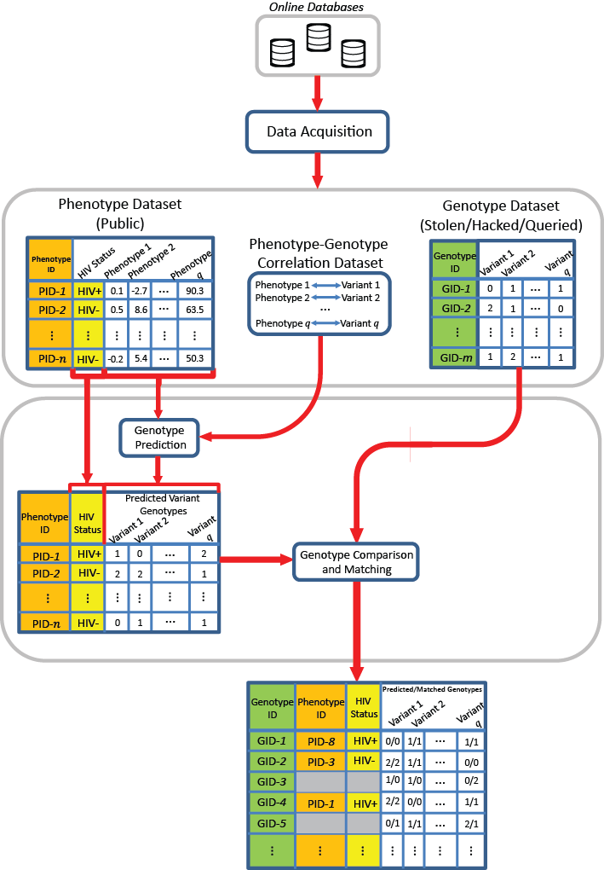
Linking Attack Scenario
[Harmanciet al. Nat. Meth. (in revision)]

Slide 28
Linking Attack Scenario
[Harmanciet al. Nat. Meth. (in revision)]

Slide 29
Quantifying ICI Leaked and Predictability
Amount of individual characterizing Information (ICI) in a set of n variants:
  How many rare genotypes there are in the set?
Predictability of genotypes given expression levels (π): Given that the k_{th} gene’s expression level is e_{k,j} , how much randomness is left in the genotype?
[Harmanciet al. Nat. Meth. (in revision)]

Slide 30
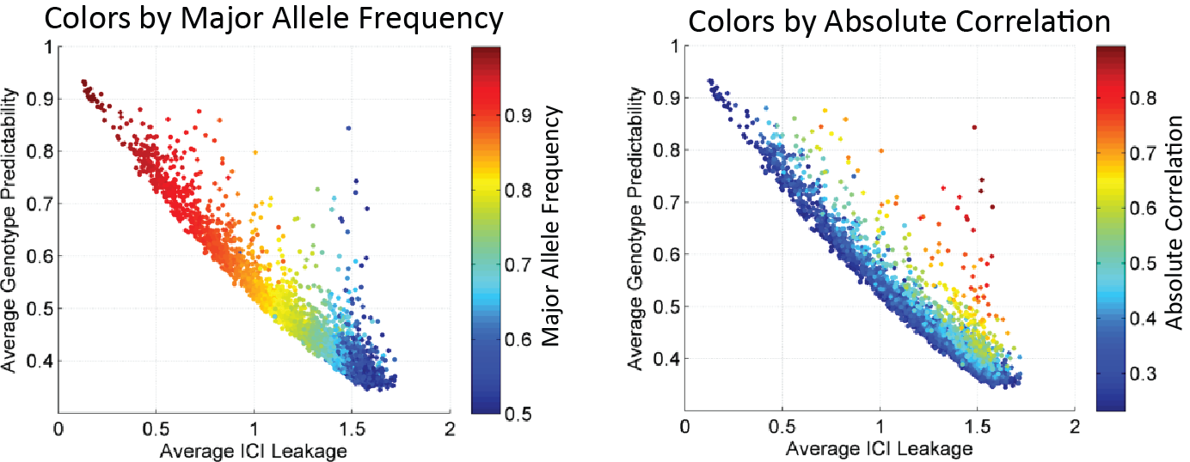
Relating Predictability to ICI Leakage – A few key SNPs with good predictability & Great Leakage.
Perhaps these could removed?
[Harmanciet al. Nat. Meth. (in revision)]

Slide 31
Genomic Privacy: Intertwined Social & Technical Issues
Setting the Stage: the Advent of Personal Genomics
The Dilemma of Genomic Privacy
  Fundamental, inherited info that’s very private vs the need for large-scale data-sharing to enable med. research
Current Social & Tech Approaches
  GINA, Consents &
  "Secure" use of dbGAP
  Issues: burdensome security, inconsistencies + ways the solutions have been partially "hacked”
  Strawman Hybrid Soc-Tech Proposal (Licensure, Cloud Enclaves. Quantifying Leaks, & Closely Coupled priv.-public data)
RNA-seq – practical problem of publicly sharing some of the info
  Removing SNVs in reads using MRF
  Quantifying & removing variant info from expression levels + eQTLs
  Further complications: SVs in pervasive transcription?

Slide 32
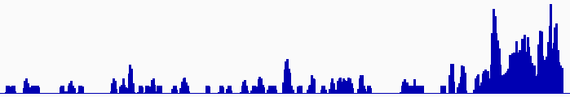
Discovering Transcriptionally Active Regions
(novel RNA contigs)
Cluster reads setting minimum-run and maximum gap parameters for newly identified transcribed regions (TARs)
Assess exon discovery rates for known genes and noncoding RNAs
Known exon
Known exon
TAR
TAR
TAR
novel TAR
correct identification
ENCODE RNA-Seq Data
[Nature 512:445 ('14)]

Slide 33
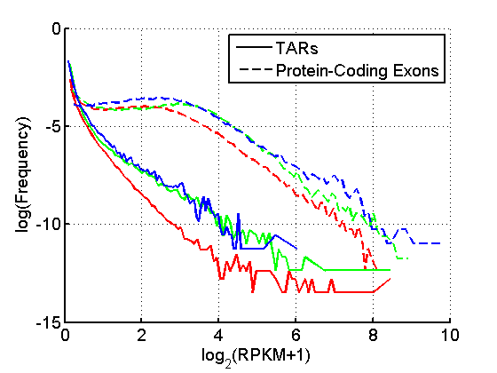
Non-Canonical Transcription
 |  | Human
 |  | Elements | Genome Coverage
 |  |  | Kb | %
mRNAs (exons) |  | 20,007 | 86,560 | 3.0
Pseudogenes |  | 11,216 | 27,089 | 0.95
Total ncRNAs |  | 22,154 | 17,770 | 0.62
Regions Excluding mRNAs, Pseudogenes or Annotated ncRNAs |  | 283,816 | 2,731,811 | 95.5
 | Transcription Detected (TARs) | 708,253 | 916,401 | 32.0
4.5% of human genome are transcribed and associated with standard annotations;
32% of human genome give rise to TARs or non-canonical transcription, i.e., transcription from genomic regions not associated with standard annotations;
Non-canonical transcripts show lower transcription level compared to protein coding transcripts
[Nature 512(7515):445-8]

Slide 34
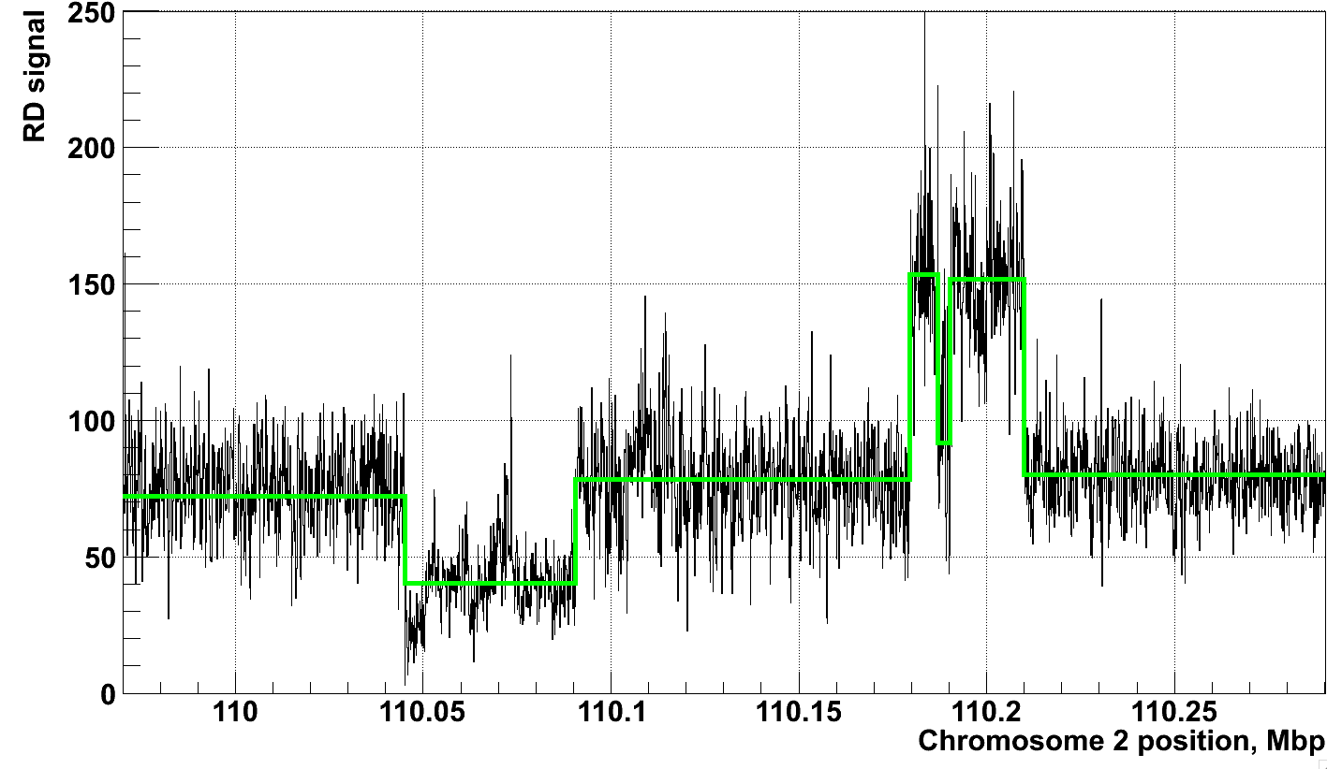
Example of Application of CNVnator to RD data
[Abyzov et al. Gen. Res. (’11)]
NA12878, Solexa 36 bp paired reads, ~30x coverage

Slide 35
Many non-canonical transcripts are real but some
potentially reflecting mis-mapping from genes
Pseudogene: ENSG00000225648.1
Parent: ENSG00000126524.4
Pseudogene: ENSG00000232553.2
Parent: ENSG00000176444.13
Non-coding transcription may correlate with coding transcription
Potential mapping artifacts: reads from coding regions mapped to non-coding elements or vice versa due to sequence similarity
[Genome Biol. 13: R51]

Slide 36
Genomic Privacy: Intertwined Social & Technical Issues
Setting the Stage: the Advent of Personal Genomics
The Dilemma of Genomic Privacy
  Fundamental, inherited info that’s very private vs the need for large-scale data-sharing to enable med. research
Current Social & Tech Approaches
  GINA, Consents &
  "Secure" use of dbGAP
  Issues: burdensome security, inconsistencies + ways the solutions have been partially "hacked”
  Strawman Hybrid Soc-Tech Proposal (Licensure, Cloud Enclaves. Quantifying Leaks, & Closely Coupled priv.-public data)
RNA-seq – practical problem of publicly sharing some of the info
  Removing SNVs in reads using MRF
  Quantifying & removing variant info from expression levels + eQTLs
  Further complications: SVs in pervasive transcription?

Slide 37
Genomic Privacy: Intertwined Social & Technical Issues
Setting the Stage: the Advent of Personal Genomics
The Dilemma of Genomic Privacy
  Fundamental, inherited info that’s very private vs the need for large-scale data-sharing to enable med. research
Current Social & Tech Approaches
  GINA, Consents &
  "Secure" use of dbGAP
  Issues: burdensome security, inconsistencies + ways the solutions have been partially "hacked”
  Strawman Hybrid Soc-Tech Proposal (Licensure, Cloud Enclaves. Quantifying Leaks, & Closely Coupled priv.-public data)
RNA-seq – practical problem of publicly sharing some of the info
  Removing SNVs in reads using MRF
  Quantifying & removing variant info from expression levels + eQTLs
  Further complications: SVs in pervasive transcription?

Slide 38

Acknowledgements
CNVnator
A Abyzov
Cost of sequencing
A Sboner, XJ Mu
Data privacy
A Harmanci, D Greenbaum
ENCODE pseudogenes & transcriptome
B Pei, L Habegger, J Rozowsky, A Harmanci, KK Yan
RSEQtools
L Habegger, A Sboner, TA Gianoulis, J Rozowsky, A Agarwal, M Snyder
Hiring Postdocs. See gersteinlab.org/jobs !
[papers.gersteinlab.org/subject/privacy]

Slide 39
Default Theme
Default Outline Level 1
  Level 2

Slide 40
More Information on this Talk
SUBJECT: Networks
DESCRIPTION:
NOTES:
This PPT should work on mac & PC. Paper references in the talk were mostly from Papers.GersteinLab.org.
PERMISSIONS: This Presentation is copyright Mark Gerstein, Yale University, 2010. Please read permissions statement at http://www.gersteinlab.org/misc/permissions.html . Feel free to use images in the talk with PROPER acknowledgement (via citation to relevant papers or link to gersteinlab.org).
PHOTOS & IMAGES. For thoughts on the source and permissions of many of the photos and clipped images in this presentation see http://streams.gerstein.info . In particular, many of the images have particular EXIF tags, such as kwpotppt , that can be easily queried from flickr, viz: http://www.flickr.com/photos/mbgmbg/tags/kwpotppt .
Notes:
40

