Slide 1
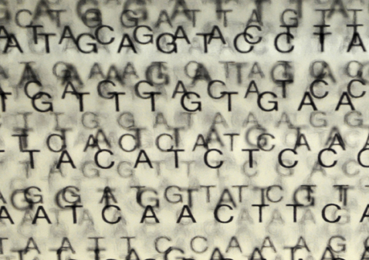
Personal genome construction with SVs
M Gerstein (Yale)

Slide 2
What we have contributed to the SV Group
Deletion Calling
Breakpoint Assembly & Characterization
Mechanism assignment
Functional Impact of SVs
Retroduplication Calling
SVs & personalized genome construction
...

Slide 3
Future directions
Personal Diploid Genome and Effects on SVs
Functional Impact of Various SVs
SV Formation Mechanism Annotation Using Long Reads
Loss-of-function Annotation
SVs and Disease Associated lncRNAs
Breakpoint Identification
Mobile Elements Using PacBio and 10x Data
CNVnator Calls on the Trios

Slide 4
Future directions
Personal Diploid Genome and Effects on SVs
Functional Impact of Various SVs
SV Formation Mechanism Annotation Using Long Reads
Loss-of-function Annotation
SVs and Disease Associated lncRNAs
Breakpoint Identification
Mobile Elements Using PacBio and 10x Data
CNVnator Calls on the Trios
-- one of the main purposes of having a good SV call set is to be able to build a genome for each person
-- can we move beyond a call-set-centric mindset to a personal-genome-centric mindset?

Slide 5
Personalized genomes analyses in Sudmant et al., Nature (2015)
Constructed 2 personal genomes of NA12878 based on GRCh37 reference genome
1000 GP P3 SNVs and indels integrated call set (low coverage)
1000 GP P3 SNVs, indels and SVs with breakpoint information from SVG
Jieming Chen

Slide 6
Personalized genomes analyses in Sudmant et al., Nature (2015)
Number of exons
Ref
Pg: snvs+ indels+svs
Pg: snvs+ indels
280,123 GENCODE consensus exons
-- this is a conservative set
-- we are also interested in SVs
that completely knock genes out in the personal genomes (these would not have been included)
Oliver Stegle

Slide 7
Utility of SVs: Exons with direct SV overlap
Comparing between Pgenome-SVs and Pgenome-snpsIndels
-- 18 exons with a direct SV overlap
-- 6/18 exons were expressed (>10 reads)
-- 4/6 showed substantial changes in expression (≥ 2-fold change)
[Sudmant et al., Nature (2015)]

Slide 8
Metrics for Success
How can see how much better a personal genome is than the reference?
How can we compare one personal genome to another?
Formal Arguments Quantities like N50, Ts/Tv

Slide 9
Personal genome is a better reference for alignment: a simple example
[Chen et al. Nat. Comm. (in rev.)]

Slide 10
Personal genome is a better reference for alignment : more complex
[Chen et al. Nat. Comm. (in rev.)]

Slide 11
Alignment gets better as variant sets are more complete: NA12878 Pol2 ChIP-seq
 | Ref genome | Pgenome: snvs only | Pgenome: snvs + indels only | Pgenome: snvs + indels + SVs
Reads processed | 208,051,087 | 208,051,087 | 208,051,087 | 208,051,087
# reads uniquely aligned | 171,944,588 (82.65%) | 172,591,380 (82.96%) M: 171,965,218 (82.66%) P: 171,969,566 (82.66%) | 172,738,321 (83.03%) M: 171,982,014 (82.66%) P: 171,982,614 (82.66%) | 172,743,175 (83.03%) M: 171,977,765 (82.66%) P: 171,978,147 (82.66%)
# reads that failed to align | 18,279,824 (8.79%) | M: 18,290,611 (8.79%) P: 18,276,409 (8.78%) | M: 18,286,906 (8.79%) P: 18,270,944 (8.78%) | M: 18,293,522 (8.79%) P: 18,277,990 (8.79%)
# reads that multimap | 17,826,675 (8.57%) | M: 17,795,258 (8.55%) P: 17,805,112 (8.56%) | M: 17,782,167 (8.55%) P: 17,797,529 (8.55%) | M: 17,779,800 (8.55%) P: 17,794,950 (8.55%)
Almost 1M increase in reads
[Chen et al. Nat. Comm. (in rev.)]

Slide 12
Alignment gets better as variant sets are more complete: NA12878 RNA-seq (Kilpinen et al. 2013)
 | Ref genome | Pgenome: snvs only | Pgenome: snvs + indels only | Pgenome: snvs + indels + SVs
Reads processed | 37,558,398 | 37,558,398 | 37,558,398 | 37,558,398
# reads uniquely aligned | 25,303,498 (67.37%) | 25,486,837 (67.86%) M: 25,345,119 (67.48%) P: 25,352,964 (67.50%) | 25,538,449 (68.00%) M: 25,371,892 (67.55%) P: 25,383,016 (67.58%) | 25,568,042 (68.08%) M: 25,394,098 (67.61%) P: 25,412,184 (67.66%)
# reads that failed to align | 8,213,405 (21.87%) | M: 8,195,227 (21.82%) P: 8,195,017 (21.82%) | M: 8,174,209 (21.76%) P: 8,172,957 (21.76%) | M: 8,181,317 (21.78%) P: 8,173,224 (21.76%)
# reads that multimap | 4,041,495 (10.76%) | M: 4,018,052 (10.70%) P: 4,010,417 (10.68%) | M: 4,012,297 (10.68%) P: 4,002,425 (10.66%) | M: 3,982,983 (10.60%) P: 3,972,990 (10.58%)
[Chen et al. Nat. Comm. (in rev.)]

Slide 13
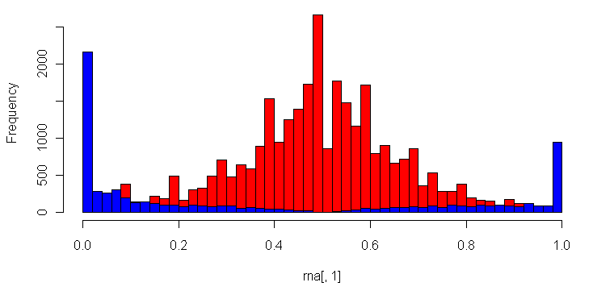
Reference Bias in functional read mapping (naïve alignment against reference)
ASE/ASB Example:
…GTCAATGCAC
…GTCAATGCACG
…GTCAATGCACGTC
…GTCAATGCACGTCG
…GTCAACGCACGTCGGGA
GTCAATGCACGTCGAGAG
CAATGCACGTCGGGAGTT
AATGCACGTCGGGAGTTG
Null Example:
ACTTTGATAGCGTCAATG
CTTTGATAGCGTCAACGC
TTGACAGCGTCAATGCAC
ATAGCGTCAATGCACGT…
TAGCGTCAACGCACGT…
CGTCAACGCACGT…
CAATGCACGT…
AATGCACGT…
Allele-specific SNVs
Binomial Null distribution
(no allele-specific behavior)
Reference Allele
Fraction of reads mapping to alternate allele
Alternate Allele
[Rozowsky et al. MSB (‘11)]

Slide 14
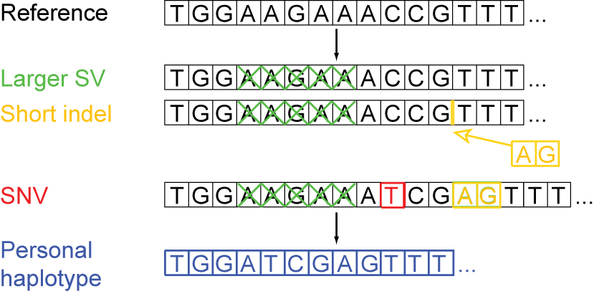
Personal genome construction
M
P
[Rozowsky et al. MSB (‘11)]

Slide 15
Construction considerations
1. Choice of call set(s)
-- e.g. different versions of 1000GP call sets
2. Choice of reference
-- choose the reference genome in which the call set is derived from
3. Choice of variants
-- e.g. SVs or indels or SNVs only
4. Order of incorporation
-- SVs > indels > SNVs
-- Increased SNV density around SV breakpoints (Abyzov et al. 2015)

Slide 16
Many choices of NA12878 call sets: Which one do we use?
Genome in a bottle
Complete Genomics
Illumina Platinum Genomes
Broad’s GATK Best Practices bundles
1000 Genomes Project -- low/high coverage -- long reads: PacBio, Moleculo

Slide 17
Assessing quality of call set: Mendelian inconsistency (e.g. GATK HC PCR-free CEU trio)
NA12891 Father | NA12892 Mother | NA12878 |  |  | total | %Err
 |  | RR | RA | AA
RR | RR | 0 | 6072 | 311 | --- | ---
RR | RA | 518631 | 505499 | 1215 | 1025345 | 0.12
RR | AA | 1659 | 194589 | 1806 | 198054 | 1.75
RA | RR | 507750 | 506699 | 1110 | 1015559 | 0.11
RA | RA | 194409 | 397233 | 195245 | 786887 | ---
RA | AA | 742 | 194722 | 206720 | 402184 | 0.18
AA | RR | 1485 | 193636 | 1551 | 196672 | 1.54
AA | RA | 653 | 198416 | 202366 | 401435 | 0.16
AA | AA | 113 | 1316 | 816825 | 818254 | 0.17
*Autosomes only
Jieming Chen

Slide 18
Future development of personal genome construction
Iterative personal genome construction
iteration 1: construct pgenome per before
-- map DNA reads to pgenome
-- refine variants on pgenome
iteration 2: rebuild pgenome
What makes a personal genome ‘better’ than the other one
-- metrics to describe a ‘good’ personal genome

Slide 19
Current and future efforts in personal genome construction
382 personal genomes from 1000 Genomes Project with RNA-seq and/or ChIP-seq sets -- with only SNVs and indels
Other high coverage trios in 1000GP and Svtrios

Slide 20
Acknowledgements
SV Group
Alexej Abyzov
Sushant Kumar
Shantao Li
Fabio Navarro
Yan Zhang
Personal genomes
Jieming Chen
Joel Rozowsky
Rob Kitchen
Timur Galeev
Alexej Abyzov
Arif Harmanci

