Slide 1


Biological Network Analysis:
Hierarchies, Mutational Constraints & Logical Circuits in Regulation
Mark Gerstein
Yale
Slides freely downloadable from
Lectures.GersteinLab.org
& “tweetable” (via @markgerstein).
See last slide
for references & more info.
1 (c) Mark Gerstein, 2002, Yale, bioinfo.mbb.yale.edu
Notes:
1

Slide 2
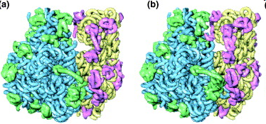
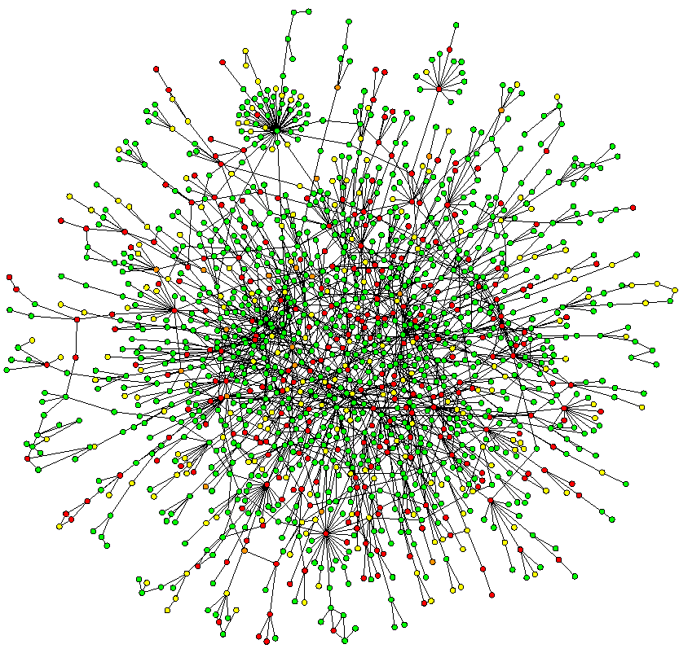
Networks for Genome Annotation: midway point in terms of level of understanding
~2D: Network
Wiring Diagram of a Molecular System
3D & 4D:
Detailed structural understanding of cellular machinery
1D: Complete
Partslist
(“Elements” in genomic tracks)
[UCSC genome browser]
[Jeong et al. Nature, 41:411]
Connecting systems biology to genomics
[Chiu et al. Trends in Cell Biol, 16:144]

Slide 3
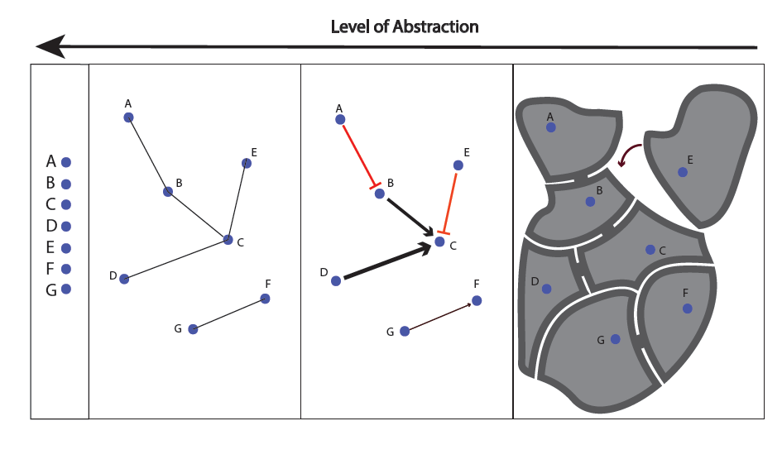
[Yan et al., PLOS Biol. (’15, in revision)]

Slide 4
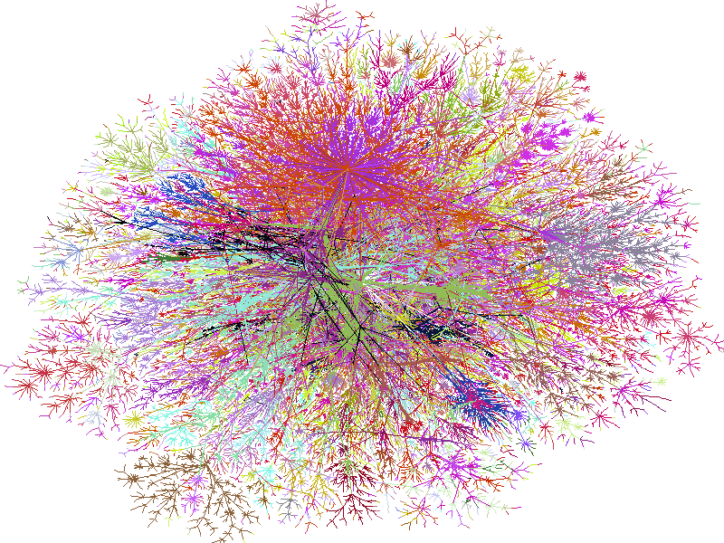
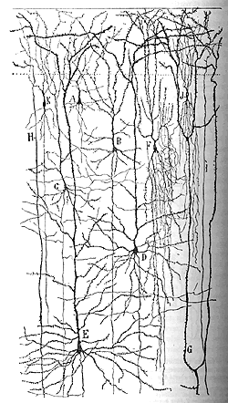
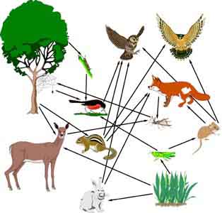
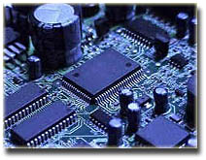
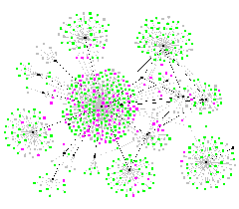
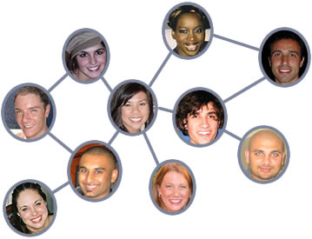
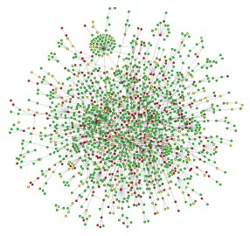
Networks as a common language in many scientific contexts
Internet
Electronic
Circuit
Food Web
Disease Spread
Neural Network
Protein
Interactions
Social Network

Slide 5
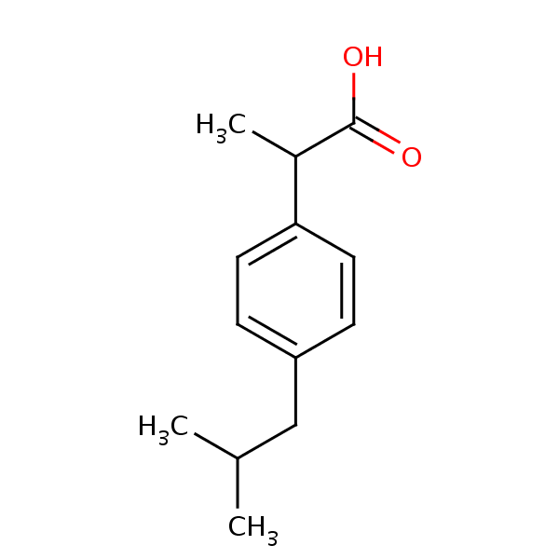
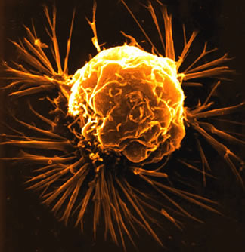
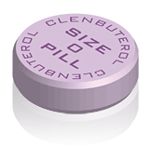
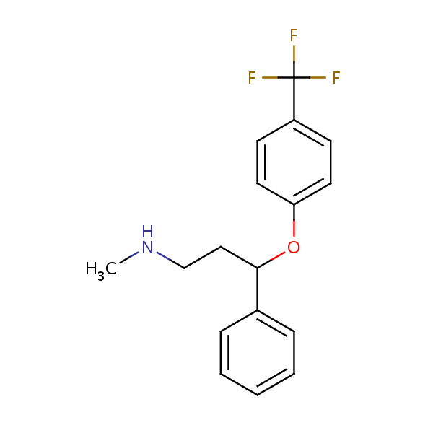
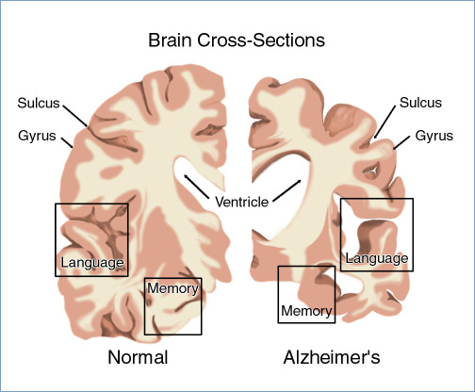
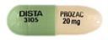
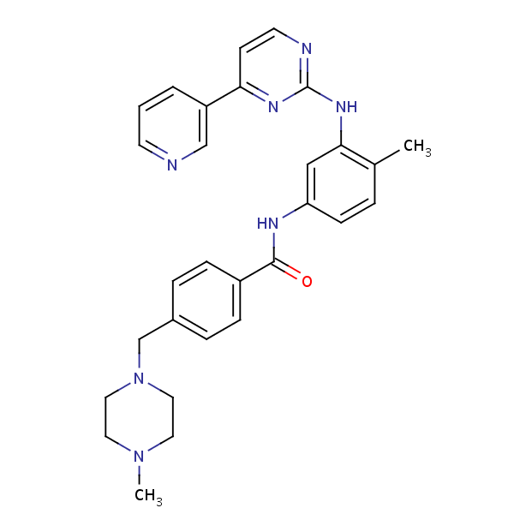

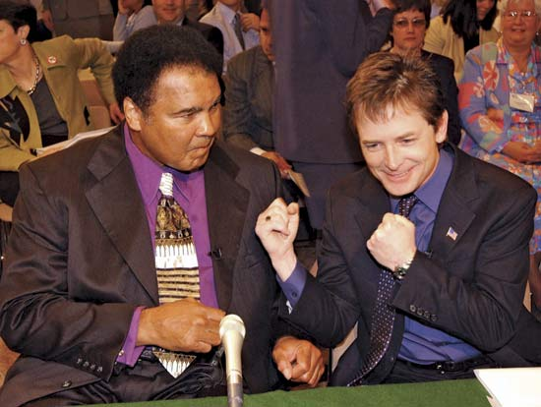
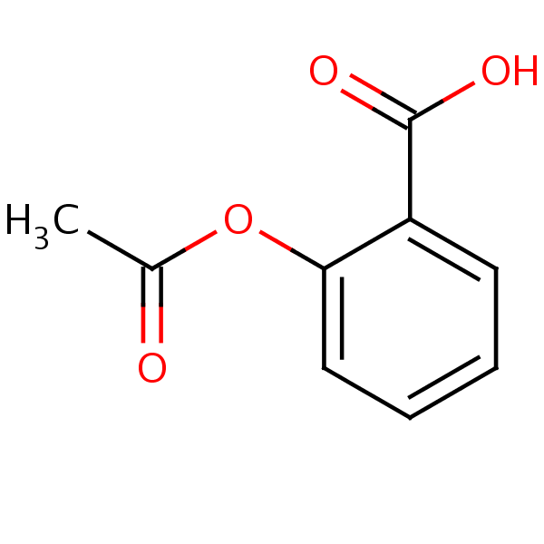
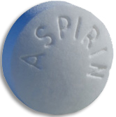
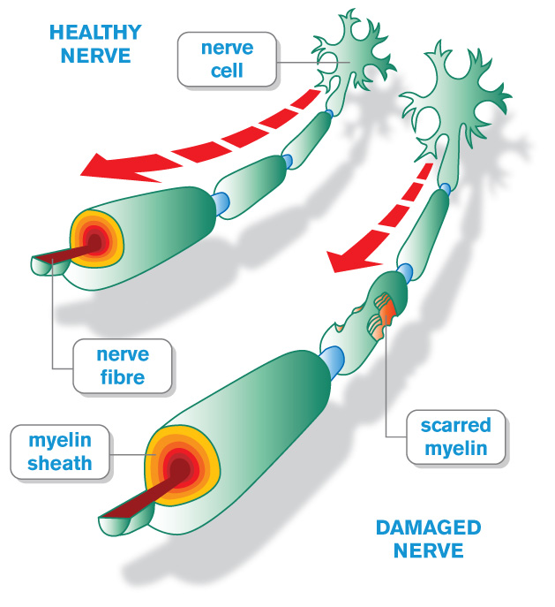
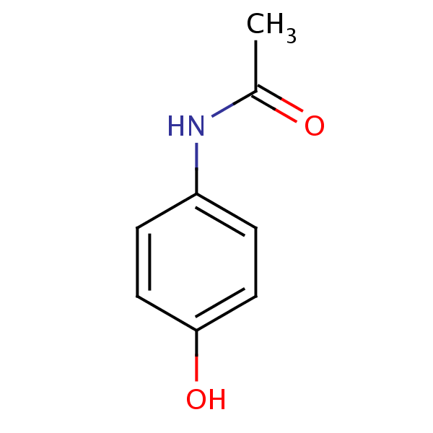

Network pathology & pharmacology
Breast
Cancer
Alzheimer’s
Disease
Parkinson’s
Disease
Multiple
Sclerosis
Interactome networks
[Adapted from H Yu]

Slide 6
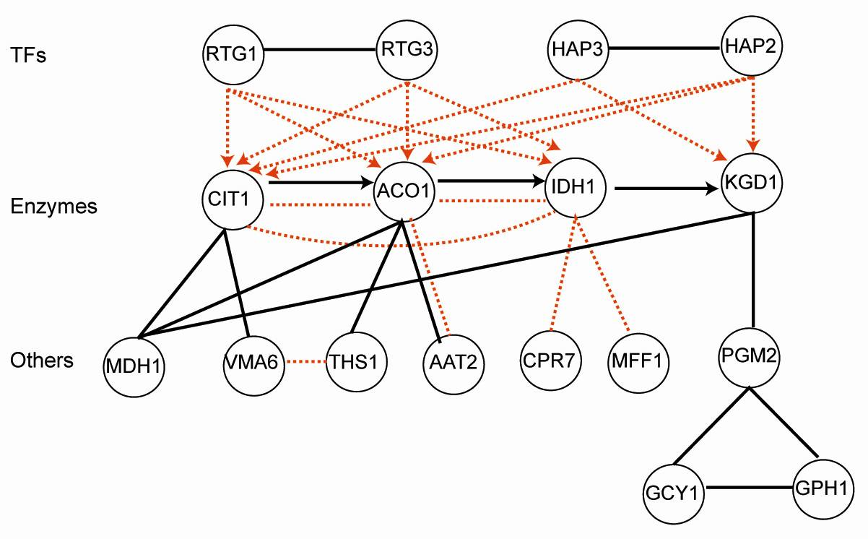
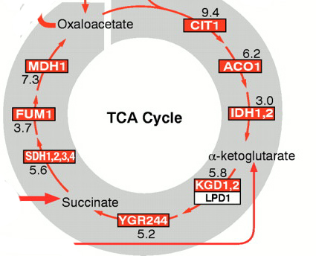
Combining networks forms an ideal way of integrating diverse information
Metabolic pathway
Transcriptional regulatory network
Physical protein-protein Interaction
Co-expression Relationship
Part of the
TCA cycle
Genetic interaction (synthetic lethal)
Signaling pathways

Slide 7
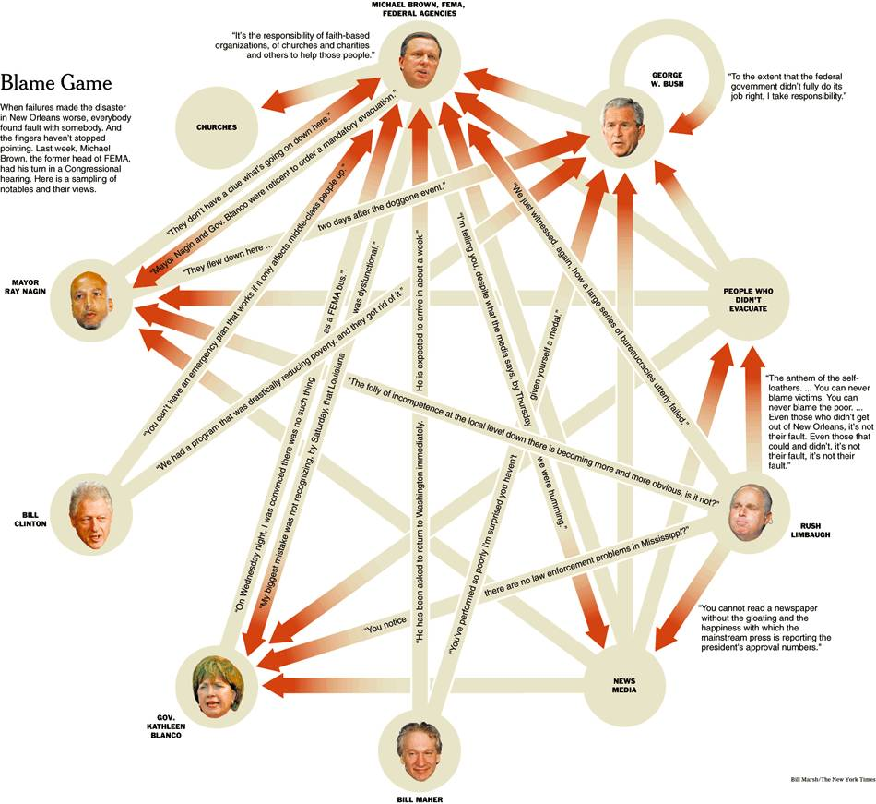
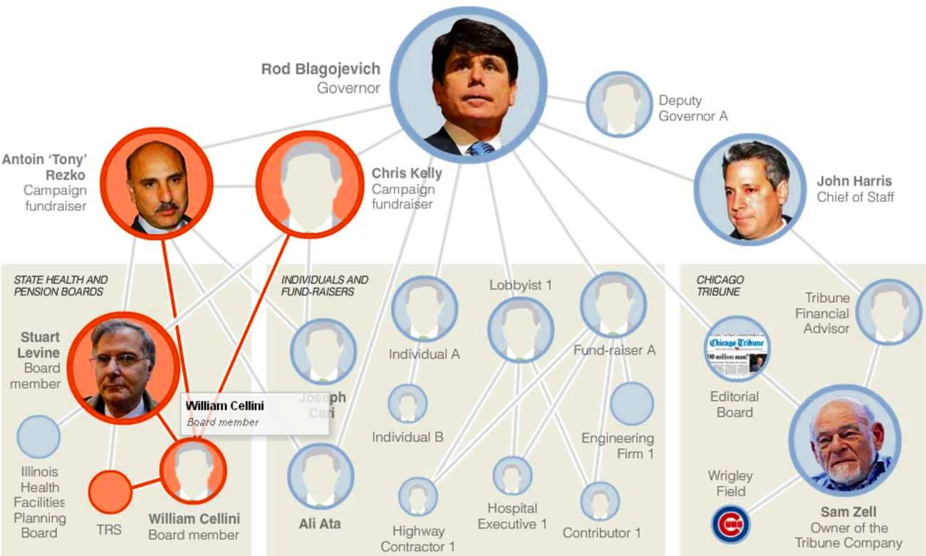
Exploiting Network Analogies to Gain Intuition
Guilt by association
Finding the causal regulator
(the "Blame Game")
[NY Times, 2-Oct-05, 9-Dec-08]

Slide 8
Biological Network Analysis:
Hierarchies, Mutational Constraints & Logical Circuits in Regulation
Why Networks ?
  Representational sweet spot + Intuition from cross-disciplinary comparisons
Organizing the Regulatory Network into a Hierarchy
  Construction: local BFS v global simulated annealing
  Information flow bottlenecks in the middle & greater mid-level collaboration to ease them, esp. in more complex organisms
  Differences between kinase & TF hierarchy
Analyzing the Impact of Variation on the Network
  Node Variation: more connectivity = more constraint
  Useful analogies to designed systems
Going from Regulatory Networks to Logical Circuits
  Preponderance of OR gates in the human network v yeast
  Relation to cancer (myc)
  More logical structure at top of heirarchy

Slide 9
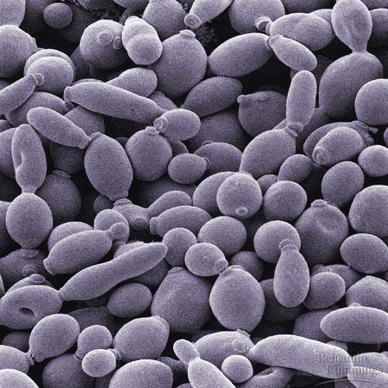


Regulatory networks: from yeast to human
Also: Regulatory networks from E. coli, mouse, rat, &c for comparison
 | 150 TFs, 6000 genes | 1300 TFs, 20000 genes
 | 130 kinases, 1000 targets | 500 kinases, up to 6000 targets
Transcriptional regulatory network
transcription
factor
target
transcription
regulation
Kinase network
(regulation in translational level)
kinase
target
phosphorylation

Slide 10
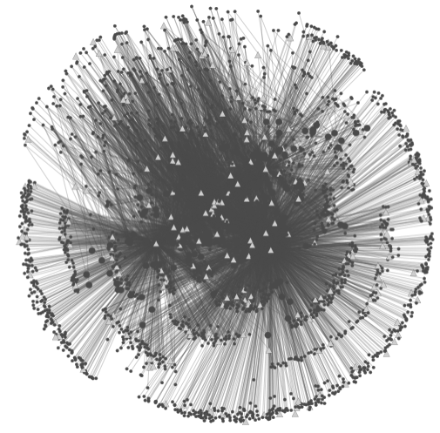
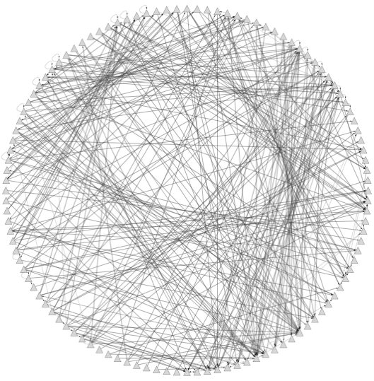
Data Flow: peaks to proximal & distal networks
Peak Calling
Assigning TF binding sites to targets
Filtering high confidence edges & distal regulation
[ Cheng et al., Bioinfo. ('11);
Gerstein et al. Nature (in press, '12) ;
Yip et al., GenomeBiology (in press, '12)]
~500K Edges
Based on stat. model combining
signal strength & location relative to typical binding
~26K Edges
TF
TF
Potential
Distal
Edge
Strong
Proximal
Edge

Slide 11
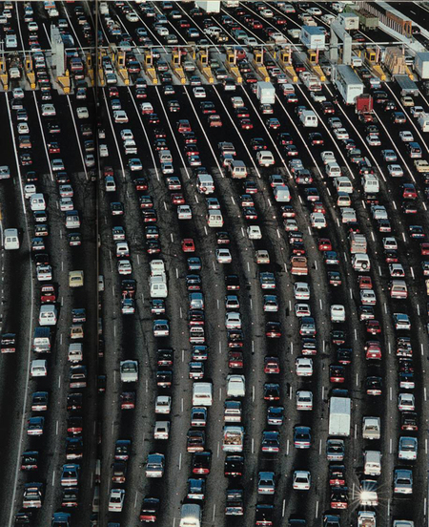
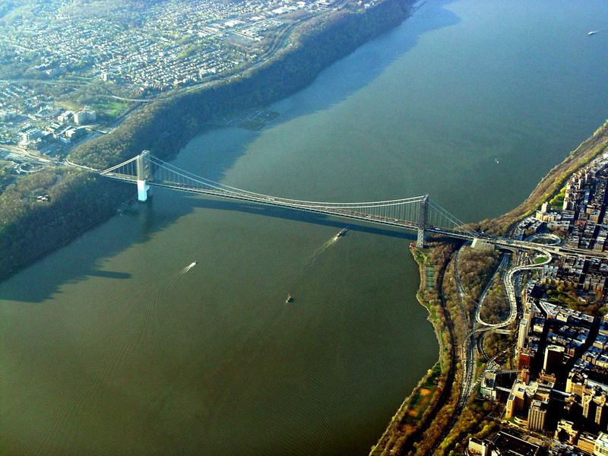
Network Stats to Identify Bottlenecks & Hubs
[Yu et al., PLOS CB (2007)]

Slide 12
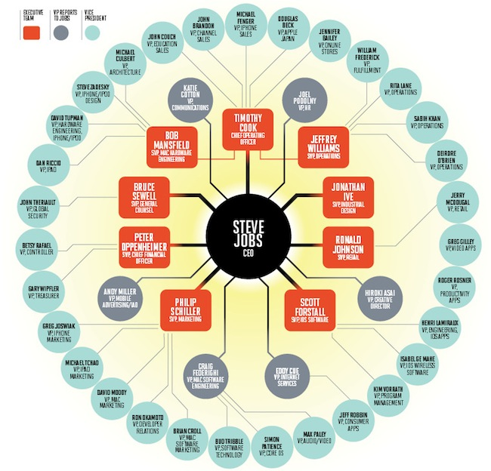
Network Stats to Identify Hierarchy
In-degree = 1
TF out-degree = 3
TF target
non-TF target
Hierarchy Height Statistic =
(normalized TF Out deg. – In deg.)

Slide 13
Biological Network Analysis:
Hierarchies, Mutational Constraints & Logical Circuits in Regulation
Why Networks ?
  Representational sweet spot + Intuition from cross-disciplinary comparisons
Organizing the Regulatory Network into a Hierarchy
  Construction: local BFS v global simulated annealing
  Information flow bottlenecks in the middle & greater mid-level collaboration to ease them, esp. in more complex organisms
  Differences between kinase & TF hierarchy
Analyzing the Impact of Variation on the Network
  Node Variation: more connectivity = more constraint
  Useful analogies to designed systems
Going from Regulatory Networks to Logical Circuits
  Preponderance of OR gates in the human network v yeast
  Relation to cancer (myc)
  More logical structure at top of heirarchy

Slide 14
Hierarchy algorithm: from Hairball to Hierarchy
[ Cheng et al. GenomeBiol. (in press, ’15) ]

Slide 15
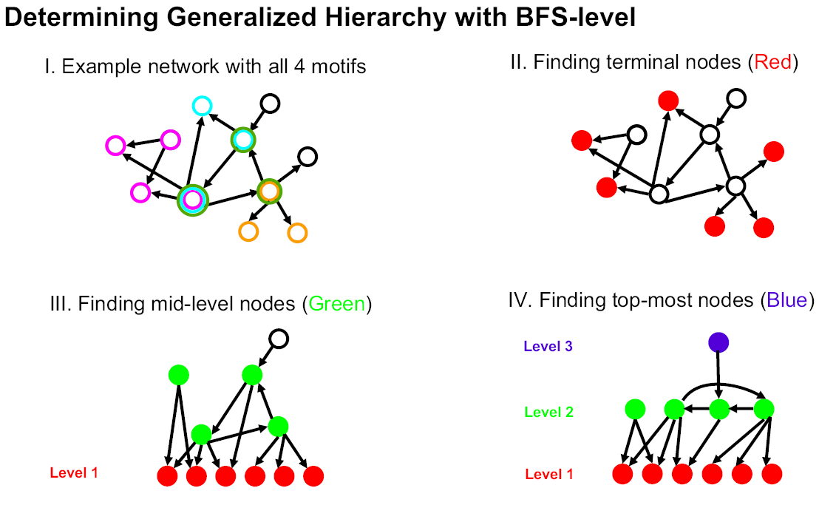
Determination of "Level" in Regulatory Network Hierarchy with Breadth-first Search
[Yu et al., PNAS (2006)]
Notes:
We call this construction method "BFS-level" (Breadth-First Search to define Level). As
described in Figure 1B, it is based on a straightforward application of breadth-first search:
we first identified all TFs at the bottom level (i.e., level 1). A TF is at the bottom level if
and only if it does not regulate other TFs. TFs that only regulate themselves (i.e., autoregulation)
are also placed at the bottom. Starting from each bottom TF, we then
performed a breadth-first search to convert the whole network into a "breadth-first tree"
(18) (see Figure 2A and Table 1A). In other words, we define the level of a non-bottom
TF in the hierarchy as its shortest distance from a bottom one. Here, the construction
procedure is only focused on inter-regulation between TFs (or officials in social
networks). A top TF could directly regulate non-TF target genes (or a higher-ranked
official could have an assistant with no managerial responsibility), but this will not affect
the constructed hierarchy. If the resulted layered structure has a pyramidal shape (i.e.,
few nodes at the top and most nodes at the bottom), we, then, considered it as a
generalized hierarchy.

Slide 16
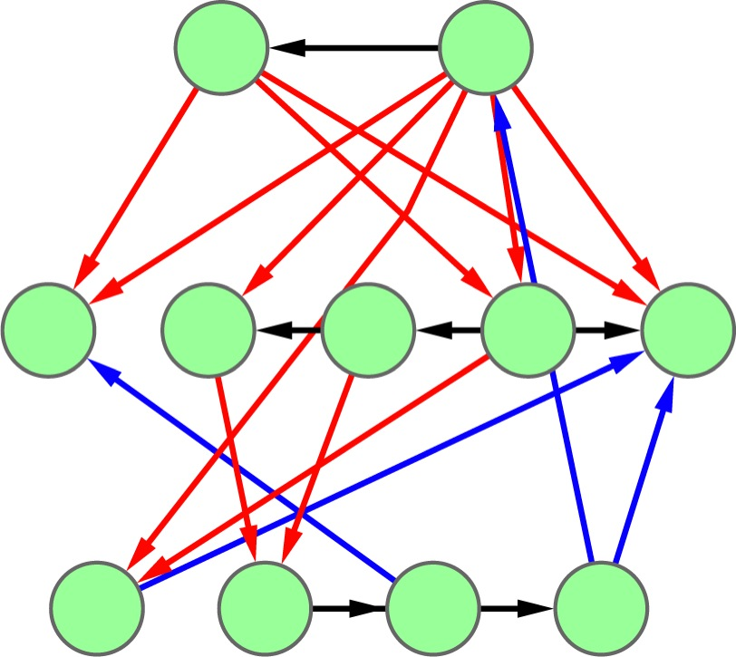
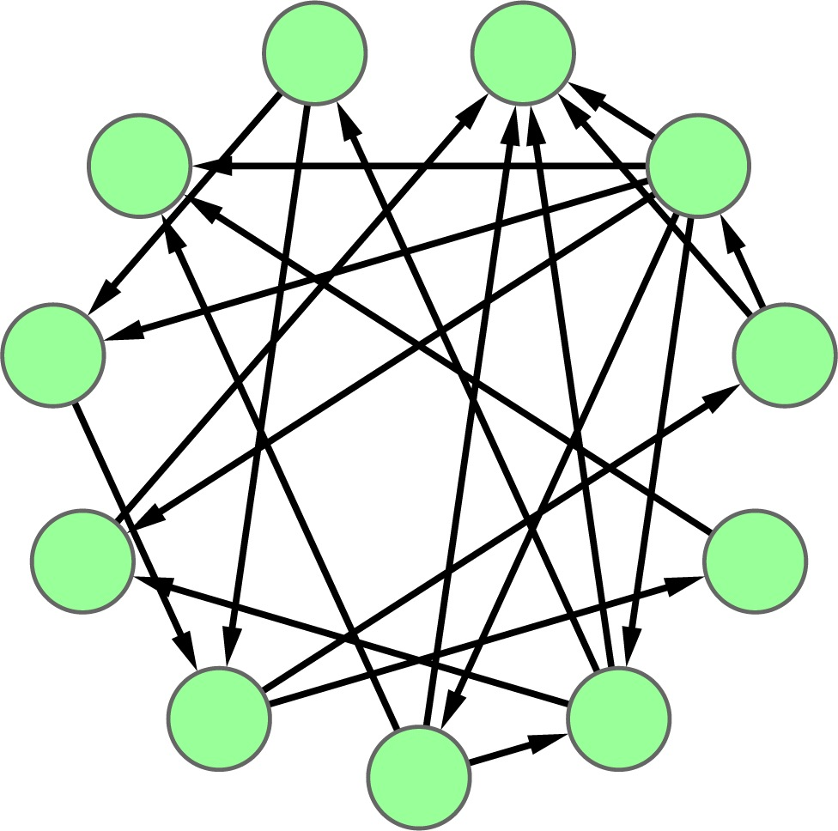
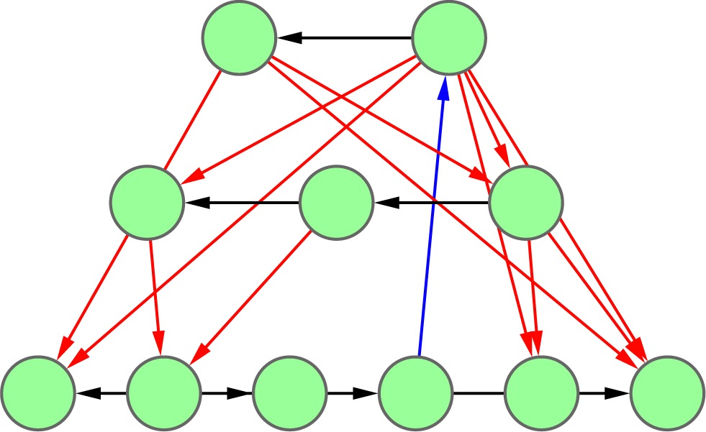
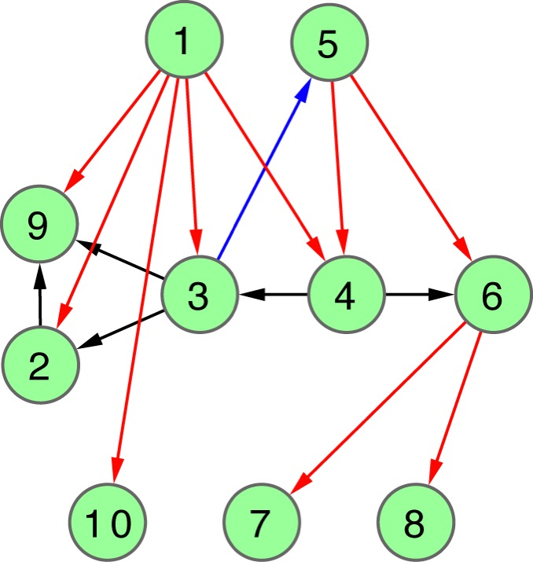
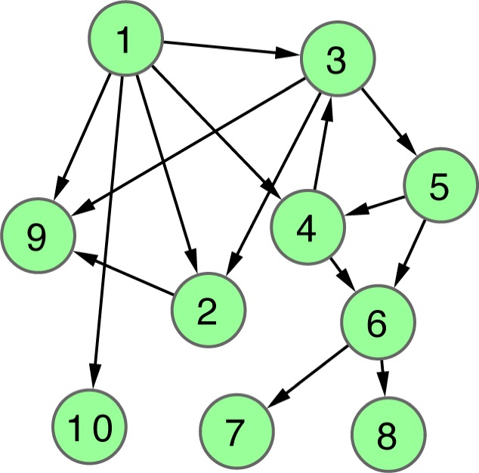
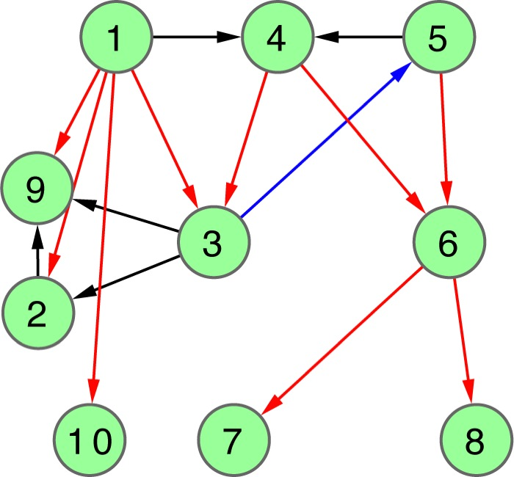
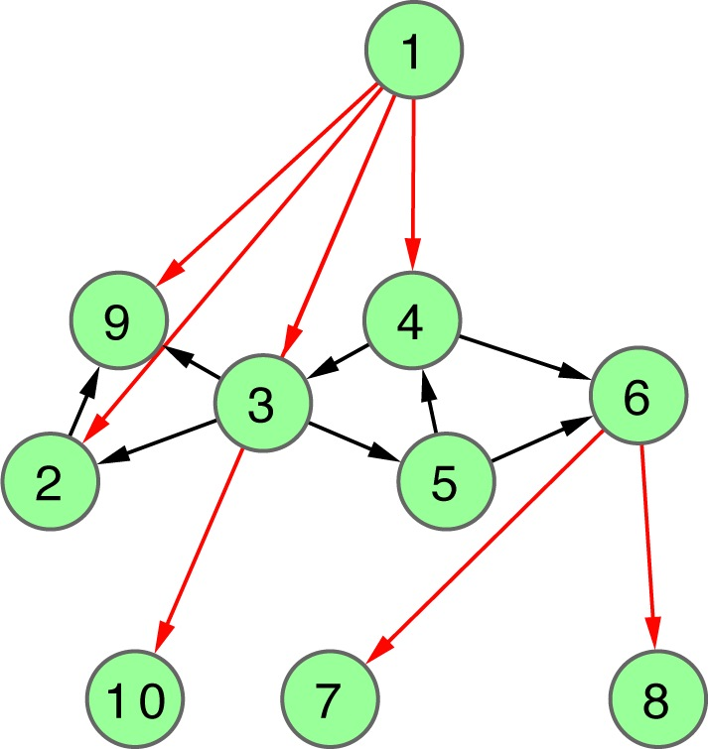
Hierarchy Score Maximization Algorithm
Definition
Simulated annealing
maximize HS
HSM algorithm
L1 L2 L3
N1
N2
N3
N4
N5
N6
N7
N8
N9
N10
L3
.
L2
.
repeat k times
.
L1
Discretized hierarchy network
Probabilistic hierarchy network
[ Cheng et al. GenomeBiol. (in press, ’15) ]

Slide 17
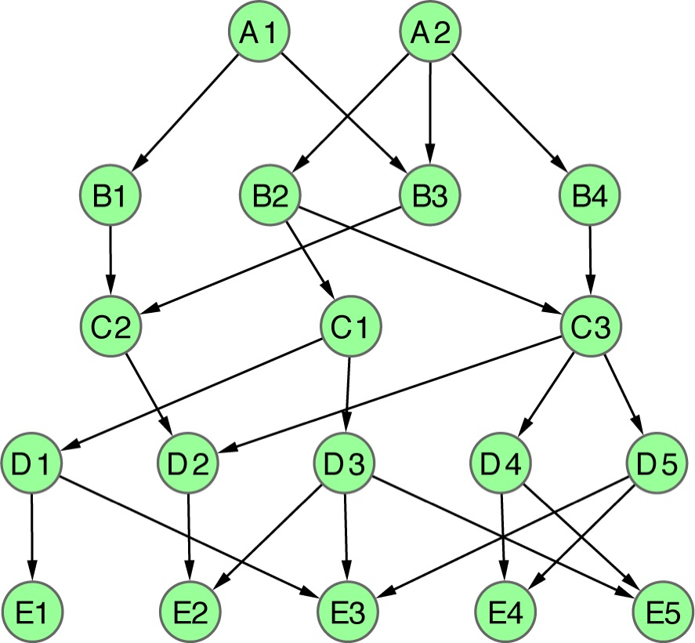
Apply HSM to a toy example
L=5
L=4
L=3
L=2
L=1
1 2
1 2 3
1 2 3 4
1 2 3 4 5
1 2 3 4 5 6
1 2 3 4 5 6 7
1 2 3 4 5 6 7 8
A1
A2
B1
B2
B3
B4
C1
C2
C3
D1
D2
D3
D4
D5
E1
E2
E3
E4
E5
[ Cheng et al. GenomeBiol. (in press, ’15) ]
|L|=2
HS=2.1
CHS=2.4
PHS=2.1
|L|=3
HS=5.5
CHS=5.5
PHS=5.5
|L|=4
HS=8.7
CHS=5.4
PHS=8.7
|L|=5
HS=∞
CHS=∞
PHS=∞
|L|=6
HS=∞
CHS=∞
PHS=16.1
|L|=7
HS=∞
CHS=∞
CHS=10.4
|L|=8
HS=∞
CHS=∞
PHS=9.4
Notes:
Fig. 2

Slide 18
Biological Network Analysis:
Hierarchies, Mutational Constraints & Logical Circuits in Regulation
Why Networks ?
  Representational sweet spot + Intuition from cross-disciplinary comparisons
Organizing the Regulatory Network into a Hierarchy
  Construction: local BFS v global simulated annealing
  Information flow bottlenecks in the middle & greater mid-level collaboration to ease them, esp. in more complex organisms
  Differences between kinase & TF hierarchy
Analyzing the Impact of Variation on the Network
  Node Variation: more connectivity = more constraint
  Useful analogies to designed systems
Going from Regulatory Networks to Logical Circuits
  Preponderance of OR gates in the human network v yeast
  Relation to cancer (myc)
  More logical structure at top of heirarchy

Slide 19
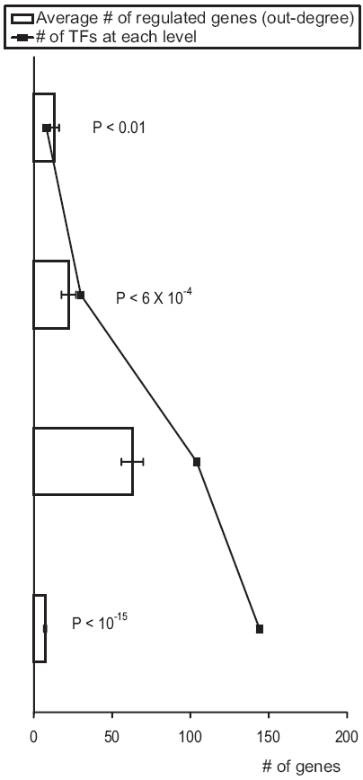
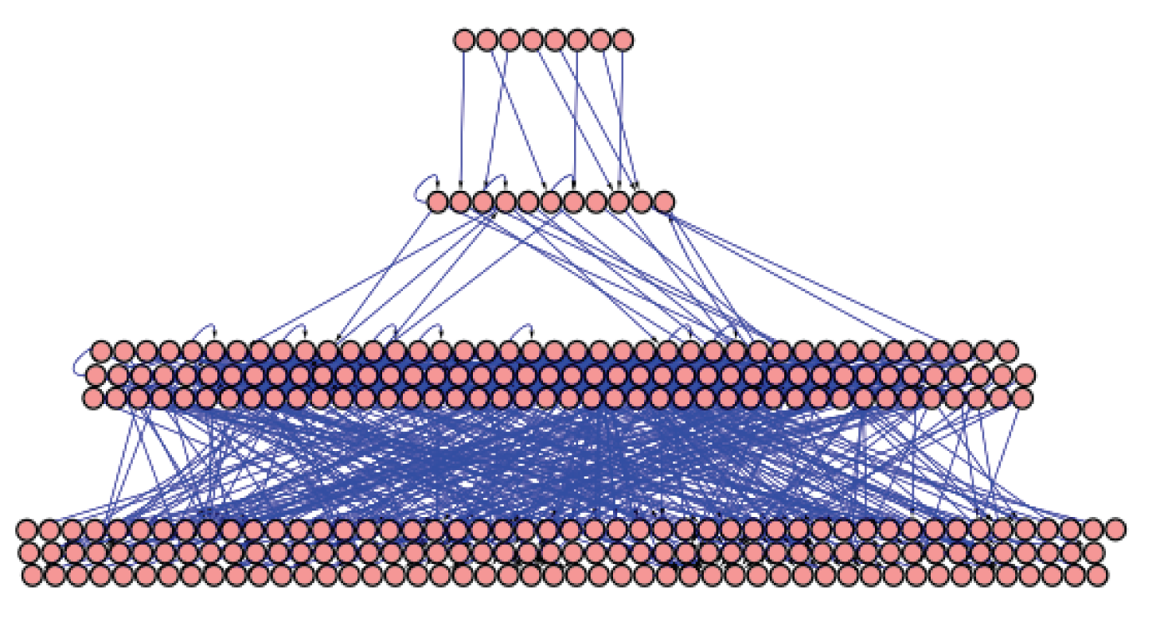
Yeast Regulatory Hierarchy:
Middle-managers Rule
Avg. Betweenness (x1000)
[Yu et al., PNAS (‘06)]

Slide 20
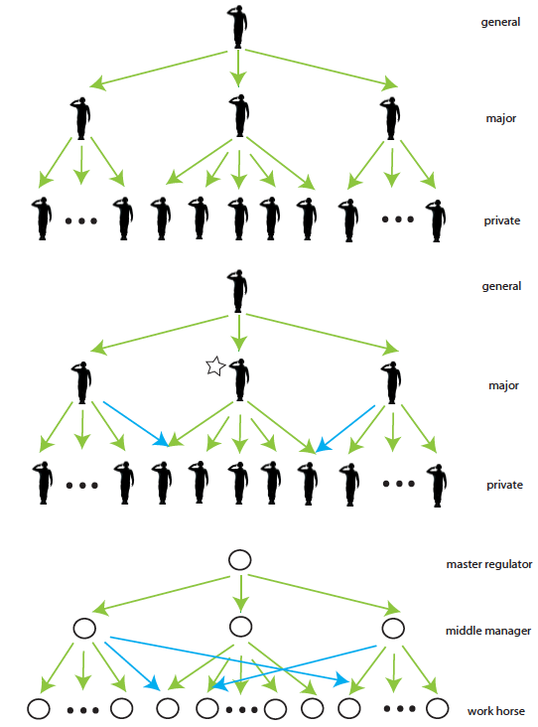
[Yan et al., PLOS Biol. (’15, in revision)]

Slide 21
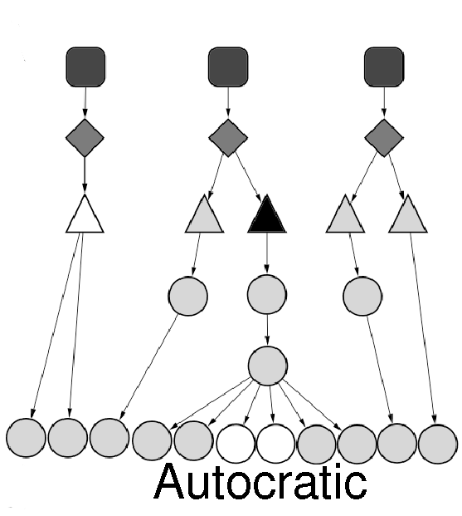
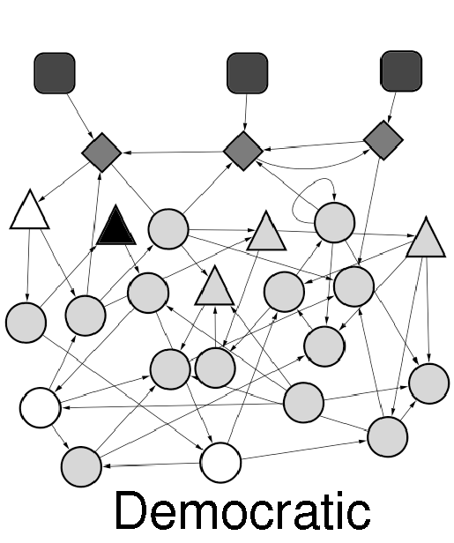
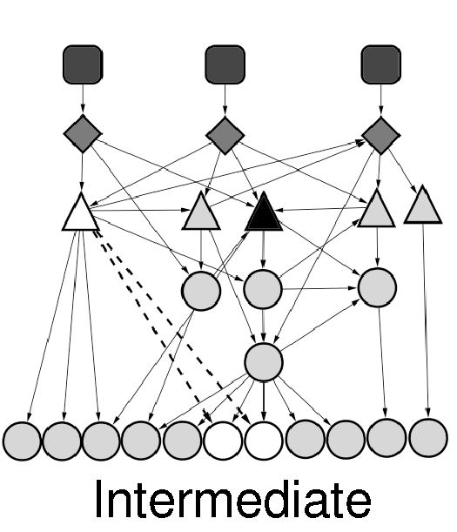
Different kinds of Hierarchies
Well-defined levels and a clear chain of command
A military hierarchy
Without well-defined levels & with more co-regulatory partnerships
A club or a scientific
collaboration network
High degree of co-regulation and can be organized into hierarchies
A law firm
[Bhardwaj et al., PNAS (2010), in press]

Slide 22
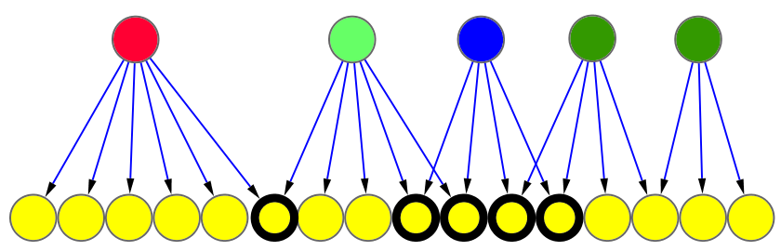
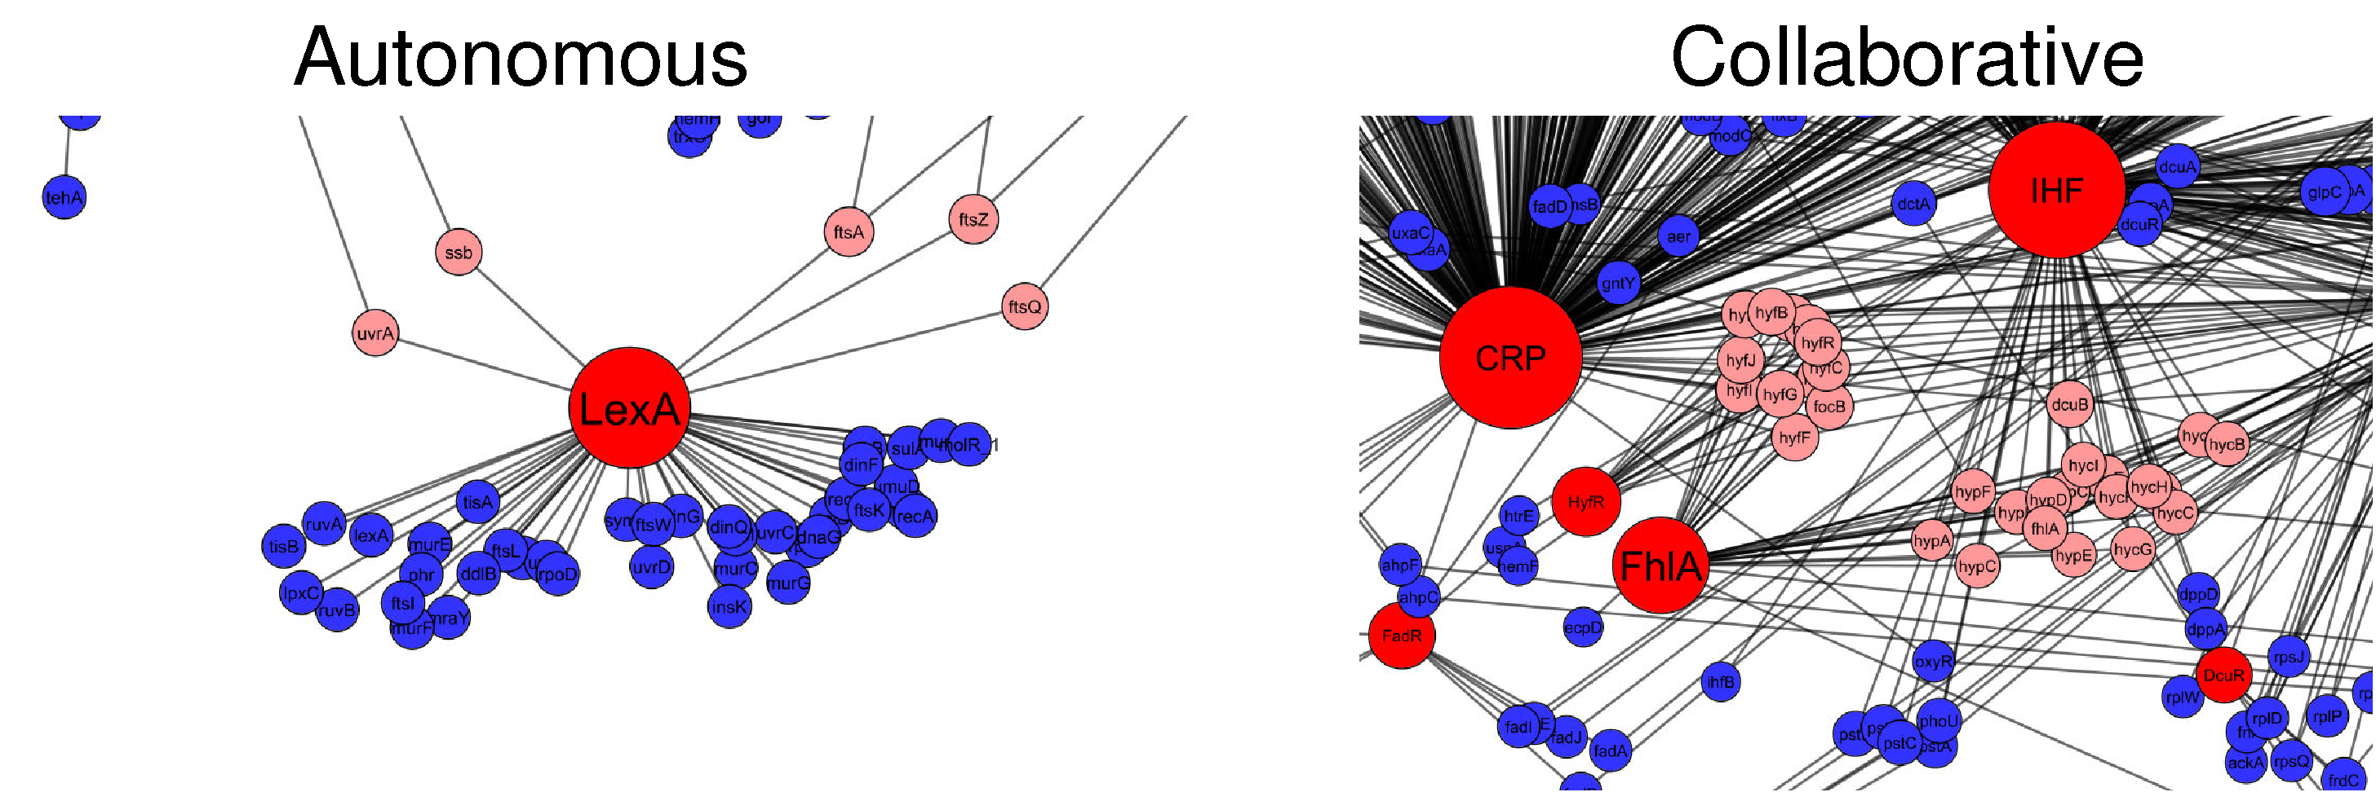
Collaborative Nature of the Nodes
Autonomous
Collaborative
Degree of
Collaboration
1/6=0.16
4/4=1
More Collaborative: Democratic
More Autonomous: Autocratic
[Bhardwaj et al., PNAS (2010), in press]

Slide 23
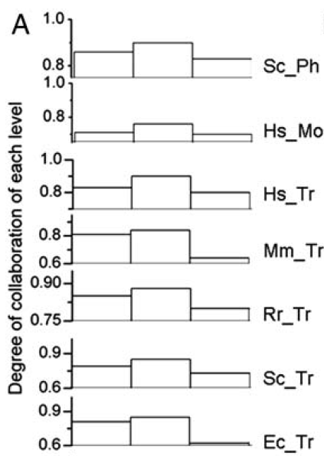

Most collaboration involves middle level
Top
Middle
Bottom
[Bhardwaj et al., PNAS (2010), in press]

Slide 24

Higher species have more collaborative nodes
[Bhardwaj et al., PNAS ‘10]

Slide 25
Yeast Network Similar in Structure to Government Hierarchy with Respect to Middle-managers
[Yu et al., PNAS ’06 ]
[Yu et al., PNAS (‘06)]

Slide 26

Middle Managers Interact the Most in Efficient Corporate Settings
Floyd, S. W. et al (1992)
Middle management involvement in strategy and its association with strategic type Strategic Management Journal 13, 153-167.
Woodward, J. (1982) Industrial Organization: Theory and Practice (Oxford University Press, Oxford).
Floyd, S. W. et al (1993)
Dinosaurs or Dynamos? Recognizing Middle Management's Strategic Role
The Academy of Management Executive 8, 47-57.
Floyd, S. W. et al (1997)
Middle management's strategic influence and organizational performance
Journal of Management Studies 34, 465-485.
[Bhardwaj et al., PNAS (2010), in press]

Slide 27

Kinase network is more hierarchical than the TF reg. network
[ Cheng et al. GenomeBiol. (in press, ’15) ]

Slide 28
Application: yeast TF regulatory network
P=0.03
T<(M+B) P=0.008
M>(T+B) P=0.04
BFS(L=4)
VS(L=3)
HSM(L=4)
VS(L=7)
HSM(L=3)
up-edge
horizontal
down-edge
HSM(L=3)
BFS(L=4)
VS(L=3)
T>(M+B) P=0.03
[ Cheng et al. GenomeBiol. (in press, ’15) ]

Slide 29

Application: yeast kinase network
[ Cheng et al. GenomeBiol. (in press, ’15) ]

Slide 30
Biological Network Analysis:
Hierarchies, Mutational Constraints & Logical Circuits in Regulation
Why Networks ?
  Representational sweet spot + Intuition from cross-disciplinary comparisons
Organizing the Regulatory Network into a Hierarchy
  Construction: local BFS v global simulated annealing
  Information flow bottlenecks in the middle & greater mid-level collaboration to ease them, esp. in more complex organisms
  Differences between kinase & TF hierarchy
Analyzing the Impact of Variation on the Network
  Node Variation: more connectivity = more constraint
  Useful analogies to designed systems
Going from Regulatory Networks to Logical Circuits
  Preponderance of OR gates in the human network v yeast
  Relation to cancer (myc)
  More logical structure at top of heirarchy

Slide 31




Optimally arrange TFs into 3 levels by simulated annealing, maximizing downward-pointing edges
Hierarchy height distribution approximated by 3 levels
Probing direction framed as an optimization problem
simulated
annealing
[ Gerstein et al. Nature (in press, '12) ]

Slide 32


Avg. correlation betw. binding signal of TF & gene expr. of its target
Integration of TF hierarchy
with other ‘omic information :
more influential & connected TFs on the top
[ Gerstein et al. Nature (in press, '12) ; Cheng et al. Gen. Res. (in press, '12) ]

Slide 33


Avg. #
of PPI for each TF
Integration of TF hierarchy
with other ‘omic information :
more influential & connected TFs on the top
[ Gerstein et al. Nature (in press, '12) ; Cheng et al. Gen. Res. (in press, '12) ]

Slide 34



Integration of TF hierarchy with other ‘omic information : more influential & connected TFs on the top
[ Gerstein et al. Nature (in press, '12) ]
Sig. corr. w/ TF hubbiness
(.24 & .62)
Avg. values
# regulating miRNAs & # regulated miRNAs

Slide 35

Strongest Proximal Regulatory Edges Can be Arranged into a Hierarchy
betweenness
Global wiring pattern of TFs
Middle level has highest betweenness, creating info. flow bottlenecks
[ Gerstein et al. Nature (in press, '12) ]

Slide 36
Biological Network Analysis:
Hierarchies, Mutational Constraints & Logical Circuits in Regulation
Why Networks ?
  Representational sweet spot + Intuition from cross-disciplinary comparisons
Organizing the Regulatory Network into a Hierarchy
  Construction: local BFS v global simulated annealing
  Information flow bottlenecks in the middle & greater mid-level collaboration to ease them, esp. in more complex organisms
  Differences between kinase & TF hierarchy
Analyzing the Impact of Variation on the Network
  Node Variation: more connectivity = more constraint
  Useful analogies to designed systems
Going from Regulatory Networks to Logical Circuits
  Preponderance of OR gates in the human network v yeast
  Relation to cancer (myc)
  More logical structure at top of heirarchy

Slide 37


TFs at the Top Under Stronger Negative Selection
[ Gerstein et al. Nature (in press, '12) ]

Slide 38
More connected components (“hubs”) have less variation
Integrate TFs & their binding sites with
1000G variation data & primate alignments (GERP score).
This shows:
TF target in-degree
Neg. corr. with
(SCC=-.2, P<0.5)
dN/dS
(from chimp alignments)
TF target in-degree
&
TF out-degree
Neg. corr. with
ns SNP density, pN/pS, avg. DAF,
frac rare SNPs
[ Gerstein et al. Nature (in press, '12) ]

Slide 39


More Connectivity, More Constraint : A theme borne out in many studies
Result for Yeast PPI
[Xia et al. PLOS CB ('09)]
Seq. Conservation
High likelihood of positive selection
Not under positive selection
Lower likelihood of positive selection
No data about positive selection
Sequence variation v. centrality
  Nonsyn / synonymous SNPs v. deg. centrality
  ρ = -.1, P < 4.0e-4
  ρ = -.3, P < 2.2.0e-16
  (updated to 1000G phase I)
Proteins that have a more central position evolve more slowly and are more likely to be essential. This phenomenon is observed in many organisms and different kind of networks: Fraser et al. ('02) Science, ('03) BMC Evo. Bio. [yeast PPI]; Butland et al. ('04) Nature [E coli. PPI]; Hahn et al. ('05), MBE [worm, fly PPI]; Cheng et al. ('09), BMC Genomics [miRNA nets]
[Nielsen et al. PLoS Biol. (2005), HPRD, Kim et al. PNAS (2007)]

Slide 40
Biological Network Analysis:
Hierarchies, Mutational Constraints & Logical Circuits in Regulation
Why Networks ?
  Representational sweet spot + Intuition from cross-disciplinary comparisons
Organizing the Regulatory Network into a Hierarchy
  Construction: local BFS v global simulated annealing
  Information flow bottlenecks in the middle & greater mid-level collaboration to ease them, esp. in more complex organisms
  Differences between kinase & TF hierarchy
Analyzing the Impact of Variation on the Network
  Node Variation: more connectivity = more constraint
  Useful analogies to designed systems
Going from Regulatory Networks to Logical Circuits
  Preponderance of OR gates in the human network v yeast
  Relation to cancer (myc)
  More logical structure at top of heirarchy

Slide 41



E. Coli Transcriptional regulatory network vs Linux call graph
A subnetwork in the Linux call graph
from CodeViz
[Yan et al., PNAS ’10]

Slide 42

E. coli transcriptional
regulatory network0
Linux call graph
[Yan et al., PNAS (2010), in press]
Notes:
42
These are the networks
Define 3 layers
Hierarchy exists
Pyramidal vs top heavy
Charcteristics hubs
Persistent (later)
42

Slide 43

Comparison: hierarchical organization
 | % in E. coli regulatory network | % in Linux call graph
master regulator | 4.6 | 29.6
middle manager | 5.1 | 58.2
workhorse | 90.2 | 12.3
out-degree hubs
e.g. “crp”
in-degree hubs
e.g. “printk”, “spin_lock”
[Yan et al., PNAS ('10)]
Notes:
43
43

Slide 44


The Linux Kernel Evolves!
We can track the evolution of a function as the
“rate of evolution of a function”
~
the number of times it got revised
Line of code: 6 million
Line of code: 4 million
From Wikipedia
Notes:
For those who are not really a computer geek, let me say a few sentence on the Linux kernel. I refer to kernel of the OS, not the whole distribution
Just to make it clear, I here show

Slide 45

Distribution of Evolutionary Rates of components in E. coli vs Linux
purifying
selection
adaptive evolution
purifying selection
adaptive
evolution
E. coli
Linux
Higher reuse
e.g. dnaA
e.g. strlen
srandom32
counter_set
e.g. mem_read
release_dev
swap_free
Persistent genes evolve slowly
Two classes of persistent functions
[Yan et al., PNAS ‘10]
Notes:
Reuse and Overlap between modules suggest a design principle. Tradeoff between reusability and robustness. dnaA is a replication initiation factor which promotes the unwinding or denaturation of DNA at oriC (around 240bp in Escherichia coli), during DNA replication in prokaryotes.
….
This comparison suggests that the reusability is not for free. The price is a constant update. When we want to use an existing component for a new function, the designer has to do some tweaking. Which is not likely to happen for nature. Cannot afford to pay for the price, natural systems are comparably more independent

Slide 46

Tinkering versus Design: Connectivity and Constraint
More Connectivity, More Constraint : A theme borne out in many evolutionary studies of biological network
  Centrality is correlated with variation in technological systems
r= -0.1, P=4x10⁻⁴
==Rate of Mutation==>
r= +0.29, P=3x10⁻⁹⁷
==Centrality=>
Kim et a. PNAS 2007
Yan KK et al. PNAS 2010
Notes:
We further look at where are the guys that required tweaking in the network? A theme borne out in many evolutionary studied of biological network is, more connectivity, more constraint. One of the first paper is by Fraser, studied the relationship between the number of interacting partners, and the rate of evolution, measured by number of substitution per site. The more substitution, the faster is the evolution. The observation is, they are negatively correlated. The intuition is, being related to many others, it all sort of constraint and forbid a fast evolution. In the case of Linux, the situation is exactly opposite. Degree is positively correlated with the rate of evolution. This is essentially how an intelligent designer works. Hubs, more useful, more central of the networks, require more fine-tune.

Slide 47


Network of R package dependencies
~5700 packages
boot
mixtools
MASS
segmented
image: tlfvincent R Bloggers

Slide 48

Tinkering versus Design: Connectivity and Constraint
rate of evolution
centrality
Kim et al. PNAS 2007
[Yan et al., PLOS Biol. (’15, in revision)]

Slide 49

Perspectives on
Random Change v Intelligent Design
Central points = hubs & bottlenecks
If changes random, best not to put them in central pts.
If changes made rationally, can put them into central pts.
  Moreover, good to do this, as these more often used – i.e more efficient
  Why there’s so much GWB construction

Slide 50

[Yan et al., PLOS Biol. (’15, in revision)]

Slide 51
Biological Network Analysis:
Hierarchies, Mutational Constraints & Logical Circuits in Regulation
Why Networks ?
  Representational sweet spot + Intuition from cross-disciplinary comparisons
Organizing the Regulatory Network into a Hierarchy
  Construction: local BFS v global simulated annealing
  Information flow bottlenecks in the middle & greater mid-level collaboration to ease them, esp. in more complex organisms
  Differences between kinase & TF hierarchy
Analyzing the Impact of Variation on the Network
  Node Variation: more connectivity = more constraint
  Useful analogies to designed systems
Going from Regulatory Networks to Logical Circuits
  Preponderance of OR gates in the human network v yeast
  Relation to cancer (myc)
  More logical structure at top of heirarchy

Slide 52

Loregic: A method to characterize the cooperative logic of regulatory factors
Wang, et al., PLoS Computational Biology, in press, 2015
Notes:
we called our method Loregic, which uses logic gate models to characterize the cooperative logic of gene regulatory factors. we published Loregic in Plos comp. bio.

Slide 53
Modeling cooperativity between RFs to target gene using logic gates
A regulatory triplet
2-input-1-output logic gate
10110101…
10110101…
RF1
RF1
?
T
00110101…
T
00110101…
10110101…
01110111…
RF2
RF2
0 – gene off
1 – gene on
after binarizing gene expression data*
Input type (RF1, RF2) | RF1 | 0 | 0 | 1 | 1
 | RF2 | 0 | 1 | 0 | 1
Output | T | X | X | X | X
Binarized expression
X can be 0 or 1, so there are 2⁴=16 possible output combinations, each of which corresponds to a unique 2-input-1-output logic gate
…
*BoolNet, R package
Notes:
let’s look at a particular triplet, TF1 and TF2 regulate Gene 1. At logical level, gene expression has two states, gene is on or off, i.e., 1 represents gene is expressed or 0 represents gene is not expressed. So, then we can look at the triplet as 2-input-1-output system. TF1 and TF2 are inputs, and Gene 1 are output, and then use a 2-input-1-output logic gate to model this triplet. As shown in a truth table, there are 4 different types of input of TF1 and TF2, 00, 01, 10, 11, and for each input type, there are 2 possible output types, 1 or 0. so in total, we have 2^4 = 16 possible logic gates that can be used to describe the triplet.

Slide 54
An example: selection of the best-matched logic gate
Laplace’s rule of succession
s=(# of selected output state for the input type + 1)
/(# of input type + 2)
Wang, et al., PLoS Computational Biology, in press, 2015
Notes:
*********************************************
This toy example demonstrates that how we choose the best matched logic gates. first, for each input type of TF1, TF2 like 01, green, we count numbers of 0 and 1 output from Gene 1 data. and select the most state as output of this input type. e.g., we have 4 zeros and 1 one, then 0 is considered as output of input type 01. we also calculate the output’s succession prob using laplace’s rule of succession derived from Bayes' theorem, like 5/7. after we go thru all four input types, we get a truth table. Here, it’s the table for the AND gate. Also, we define production of four output succession probs as consistency score to the matched logic gate. e.g. the consistency score is 0.37 for AND gate.

Slide 55
Application 1 – transcription factor cooperativity in Yeast cell cycle
Target gene | 2464
TF | 176
Triplet | 39,011
Time point | 59
Wang, et al., PLoS Computational Biology, 2015
Notes:
First, we apply Loregic to characterize TF cooperativity during yeast cell cycle, and found AND gate matches the most triplets, which implies that yeast TFs need to cooperate during cell cycle.

Slide 56
Application – transcription factor cooperativity in Acute Myeloid Leukemia (AML)
number of logic-gate consistent triplets
Target gene | 1824
TF | 70
Triplet | 50,865
Patient | 197
Wang, et al., PLoS Computational Biology, in press, 2015
Notes:
Then, we apply Loregic to the human cancer data. e.g., we characterized the TF cooperativity in leukemia cancer using 70 TF chip-seq data in ENCODE and gene expression data across 200 patients in TCGA. it is interesting to find that OR gate matches the most triplets, which implies that TF may not cooperate with each other in human cancer.

Slide 57

Cancer-related TF, MYC universally amplifies target expression
2,153 (RF1=MYC, RF2=other TFs, T=all common targets) triplets
RF1
OR(RF1, RF2)
OR(RF1, NOT RF2)
High expression of MYC is sufficient for high target gene expression
Predict outcomes of genome engineering in leukemia
Wang, et al., PLoS Computational Biology, in press, 2015
Notes:
So, we then look at triplets with cancer-related TFs, e.g., MYC. biologists found that MYC universally amplifies target gene expressions in lymphocytes. we checked 2000 MYC associated triplets where MYC is 1st RF, and found the most MYC associated triplets are consistent with three logic gates, RF1, RF1+RF2 and RF1+~RF2 with significant enrichments. all three logic gates mean that high expression of MYC is sufficient for high target gene expression, which supports that MYC is a universal amplifier.
then use MYC to slince targe gene expresison in cancer

Slide 58

Gene regulatory pathways have logic-circuit behaviors
Immunological gene, HIV
Wang, et al., PLoS Computational Biology, in press, 2015
Notes:
Going beyond the prediction of the cooperative logics of individual RFs that directly regulate a target, we are interested in identifying all the logic gates matching triplets involved in the target regulatory pathway, in order to obtain a coherent logic circuit pathway. For example in Figure 7A, Loregic found that there are two regulatory pathways regulating the target gene, PPIL2 in human K562. PPIL2 is an important cyclophilin member in immunological suppression. These two pathways contain 4 logic-gate-consistent triplets forming a two-layer hierarchical structure. By replacing these triplets with corresponding matched logic gates, we obtain the logic circuit regulatory pathways for the target gene (Figure 7B).

Slide 59
Logical cooperativity across hierarchical layers in gene regulatory network
Hierarchical gene regulatory network
Consistency score
The regulations of middle and top TFs more likely follow logical operations than the bottom TFs.
Wang, et al., PLoS Computational Biology, in press, 2015
Notes:
We also constructed the regulatory hierarchical networks with top, middle and bottom layers using yeast TFs [5], and found that the scores for the gate-consistent triplets targeting the bottom TFs are lower than the ones targeting middle and top TFs (Fig. S3), which implies that the regulations of middle and top TFs more likely follow logical operations than the bottom TFs. Also, this tells us that we may need more detailed models such as continuous models than boolean logics to study gene regulation.

Slide 60
Biological Network Analysis:
Hierarchies, Mutational Constraints & Logical Circuits in Regulation
Why Networks ?
  Representational sweet spot + Intuition from cross-disciplinary comparisons
Organizing the Regulatory Network into a Hierarchy
  Construction: local BFS v global simulated annealing
  Information flow bottlenecks in the middle & greater mid-level collaboration to ease them, esp. in more complex organisms
  Differences between kinase & TF hierarchy
Analyzing the Impact of Variation on the Network
  Node Variation: more connectivity = more constraint
  Useful analogies to designed systems
Going from Regulatory Networks to Logical Circuits
  Preponderance of OR gates in the human network v yeast
  Relation to cancer (myc)
  More logical structure at top of heirarchy

Slide 61




TopNet – an automated web tool
(vers. 2 :
"TopNet-like
Yale Network Analyzer")
  Encodenets.gersteinlab.org, networks.gersteinlab.org
  (tYNA: Normal website + Downloaded code (JAVA) + Web service (SOAP) with Cytoscape plugin)
[Yu et al., NAR (2004); Yip et al. Bioinfo. (2006);
Similar tools include Cytoscape.org, Idekar, Sander et al]

Slide 62


Network
Acknowledgements
A Kundaje, M Hariharan,
S Landt, K Yan, C Cheng,
X Mu, E Khurana,
J Rozowsky,
R Alexander, R Min, P Alves,
A Abyzov, N Addleman, N Bhardwaj,
A Boyle, P Cayting, A Charos, D Chen,
Y Cheng, D Clarke, C Eastman,
G Euskirchen, S Frietze, Y Fu, J Gertz,
F Grubert, A Harmanci, P Jain,
M Kasowski, P Lacroute, J Leng, J Lian,
H Monahan, H O'Geen, Z Ouyang,
E Partridge, D Patacsil, F Pauli, D Raha,
L Ramirez, T Reddy, B Reed, M Shi, T Slifer, J Wang, L Wu, X Yang, K Yip,
G Zilberman-Schapira, S Batzoglou,
A Sidow, P Farnham, R Myers,
S Weissman, M Snyder
(11 Main Projects, ~50 labs, >700 substantial contributors + NHGRI)
Networks/Elements
(~60 participants):
Hiring Postdocs. See gersteinlab.org/jobs !

Slide 63

Acknowledgements
Hierarchy Construction –
Chao Cheng, Erik Andrews, Koon-Kiu Yan, Matthew Ung, Daifeng Wang
[papers.gersteinlab.org/papers/hinet coming soon]
Loregic –
Daifeng Wang, Koon-Kiu Yan, Cristina Sisu, Chao Cheng, Joel Rozowsky, William Meyerson [papers.gersteinlab.org/papers/loregic coming soon]
Net hierarchy analysis –
N Bhardwaj, KK Yan
[papers.gersteinlab.org/netheir]
Call graph analysis –
KK Yan, G Fang, N Bhardwaj, RP Alexander [papers.gersteinlab.org/callgraph]
Network Sci. Analogies –
Koon-Kiu Yan, Daifeng Wang, Anurag Sethi, Paul Muir, Robert Kitchen, Chao Cheng
[papers.gersteinlab.org/papers/netessay coming soon]
Hiring Postdocs. See gersteinlab.org/jobs !

Slide 64
Info about content in this slide pack
General PERMISSIONS
  This Presentation is copyright Mark Gerstein,
  Yale University, 2014.
  Please read permissions statement at
  http://www.gersteinlab.org/misc/permissions.html .
  Feel free to use slides & images in the talk with PROPER acknowledgement
  (via citation to relevant papers or link to gersteinlab.org).
  Paper references in the talk were mostly from Papers.GersteinLab.org.
For SeqUniverse slide, please contact Heidi Sofia, NHGRI
PHOTOS & IMAGES. For thoughts on the source and permissions of many of the photos and clipped images in this presentation see http://streams.gerstein.info .
  In particular, many of the images have particular EXIF tags, such as kwpotppt , that can be easily queried from flickr, viz: http://www.flickr.com/photos/mbgmbg/tags/kwpotppt

