Slide 1
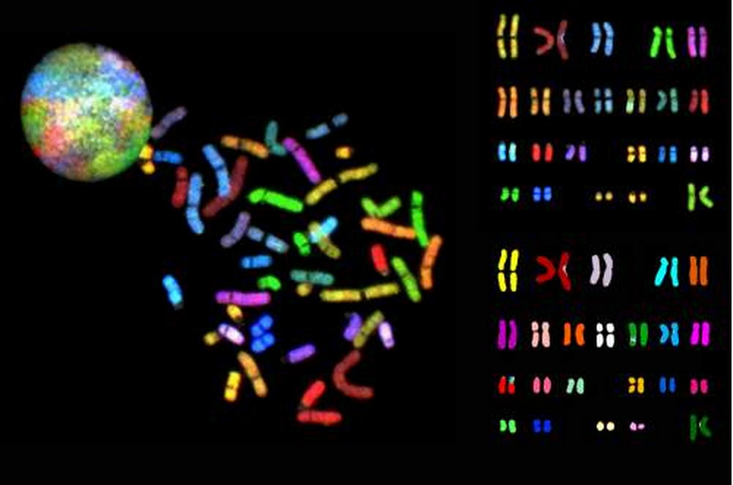
Cancer genomics
Yao Fu
March 4, 2015

Slide 2
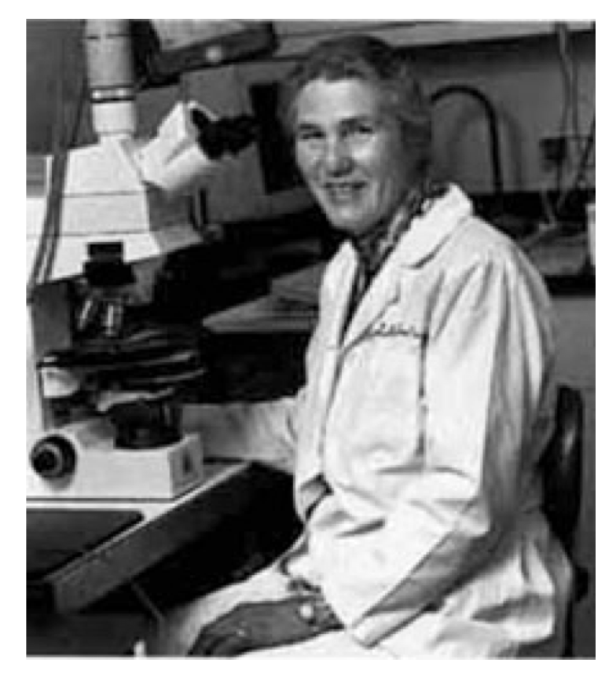
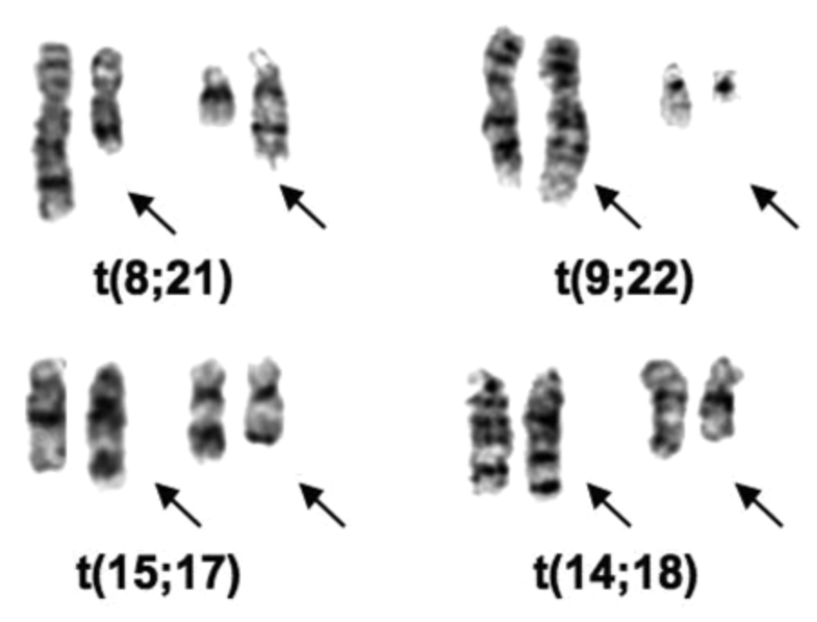
Cancer is a genetic disease
In the early 1970’s, Janet Rowley’s microscopy studies of leukemia cell chromosomes suggested that specific alterations led to cancer, laying the foundation for cancer genomics.
From: E Mardis, NHGRI Current Topics in Genome Analysis 2014
J Rowley, 2008, Blood
Notes:
Understanding the 9;22 translocation eventually led to the development of the drug imatinib (Gleevec), one of the most successful targeted cancer therapies to date. Gleevec blocks the function of the abnormal protein produced by that translocation. Her discovery of the acute promyelocytic leukemia translocation led to effective treatment with high-dose retinoic acid, a vitamin A derivative. - See more at: http://news.uchicago.edu/article/2013/12/17/janet-rowley-cancer-genetics-pioneer-1925-2013#sthash.dSal25EU.dpuf

Slide 3
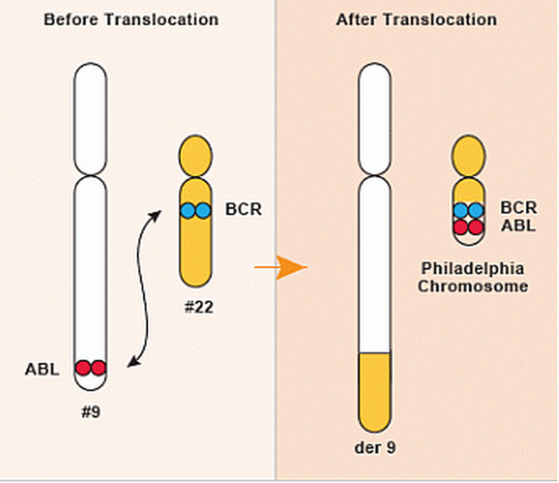
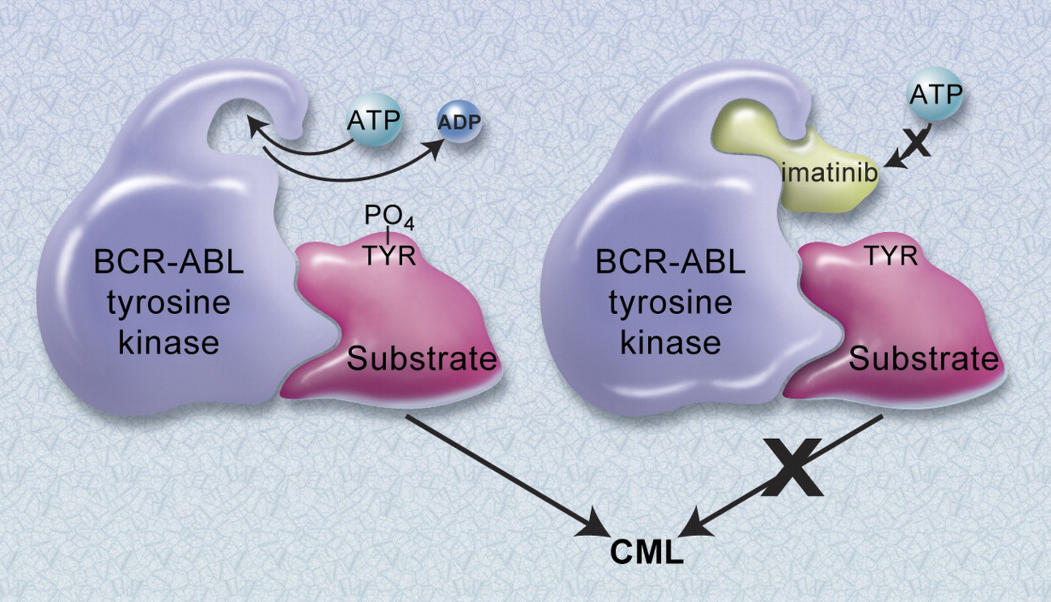
It took ~40 years from the discovery of the translocation to the drug – Gleevec
Can we scale up from this example to all cancer genes ?

Slide 4
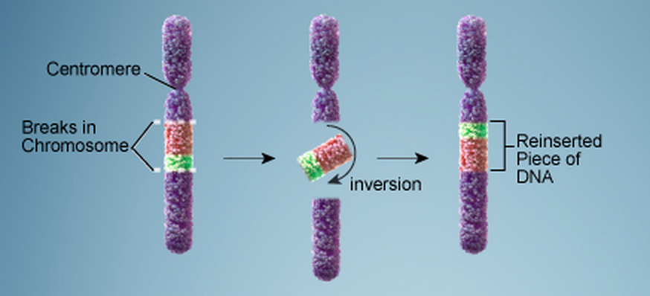
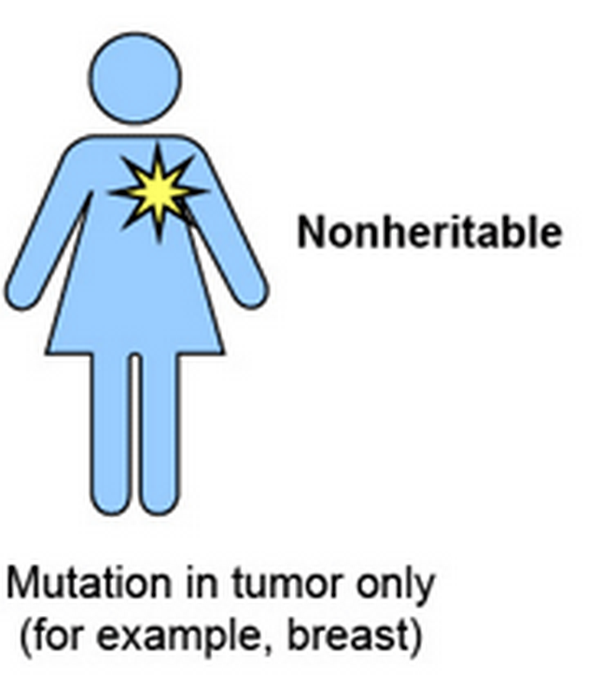
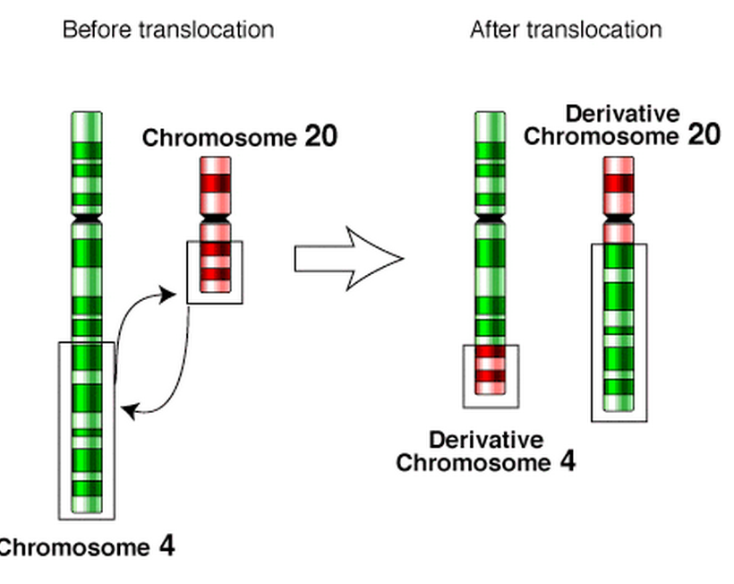
Somatic Mutations
- DNA mitosis
- Not subjected to natural selection
SNV – single nucleotide variants
Indel – small insertion / deletion
SVs – structural variations, include
Copy number variants
Deletions
Insertions/duplications
Inversions
Translocations
Feuk et al. Nature Reviews Genetics 7, 85-97
Notes:
Rare variant ~3.5 M, whereas for somatic ~1000 mutations
Recurrent – gwas for exact position, recurrent for regions
See ncvarg grant introduction….

Slide 5
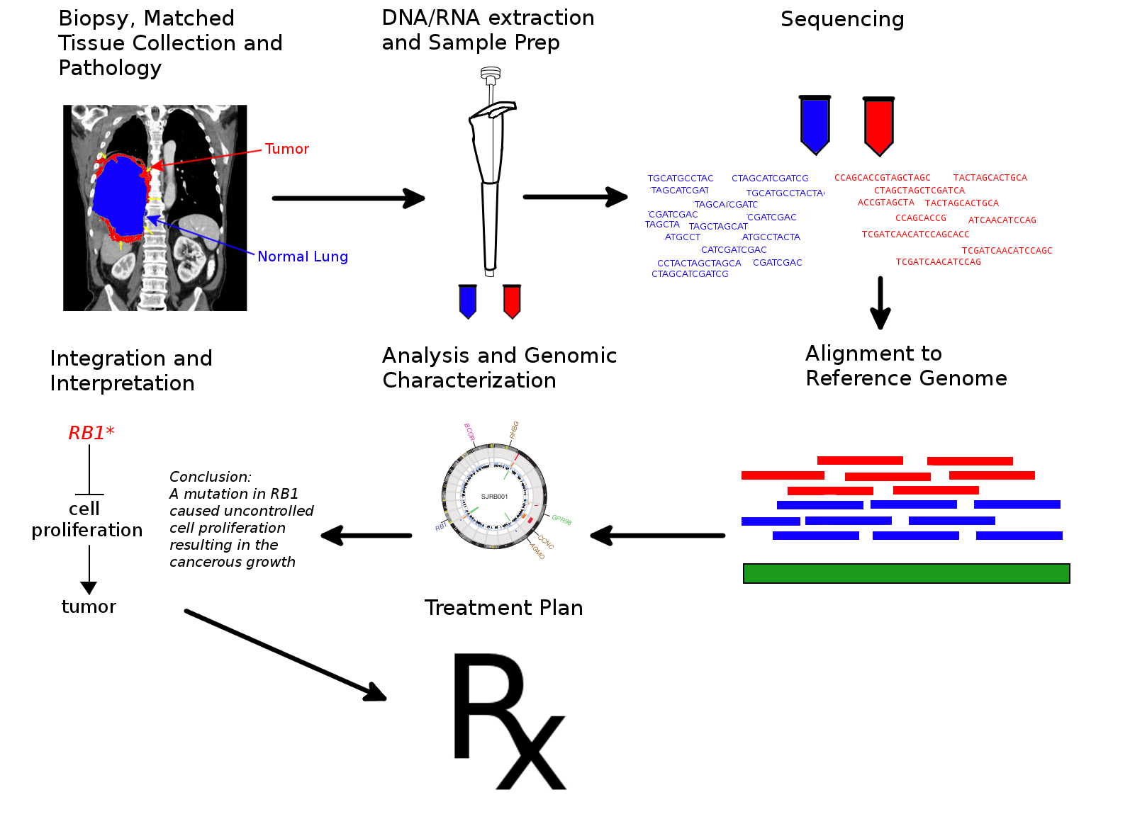
Cancer genome sequencing
From: wikipedia

Slide 6
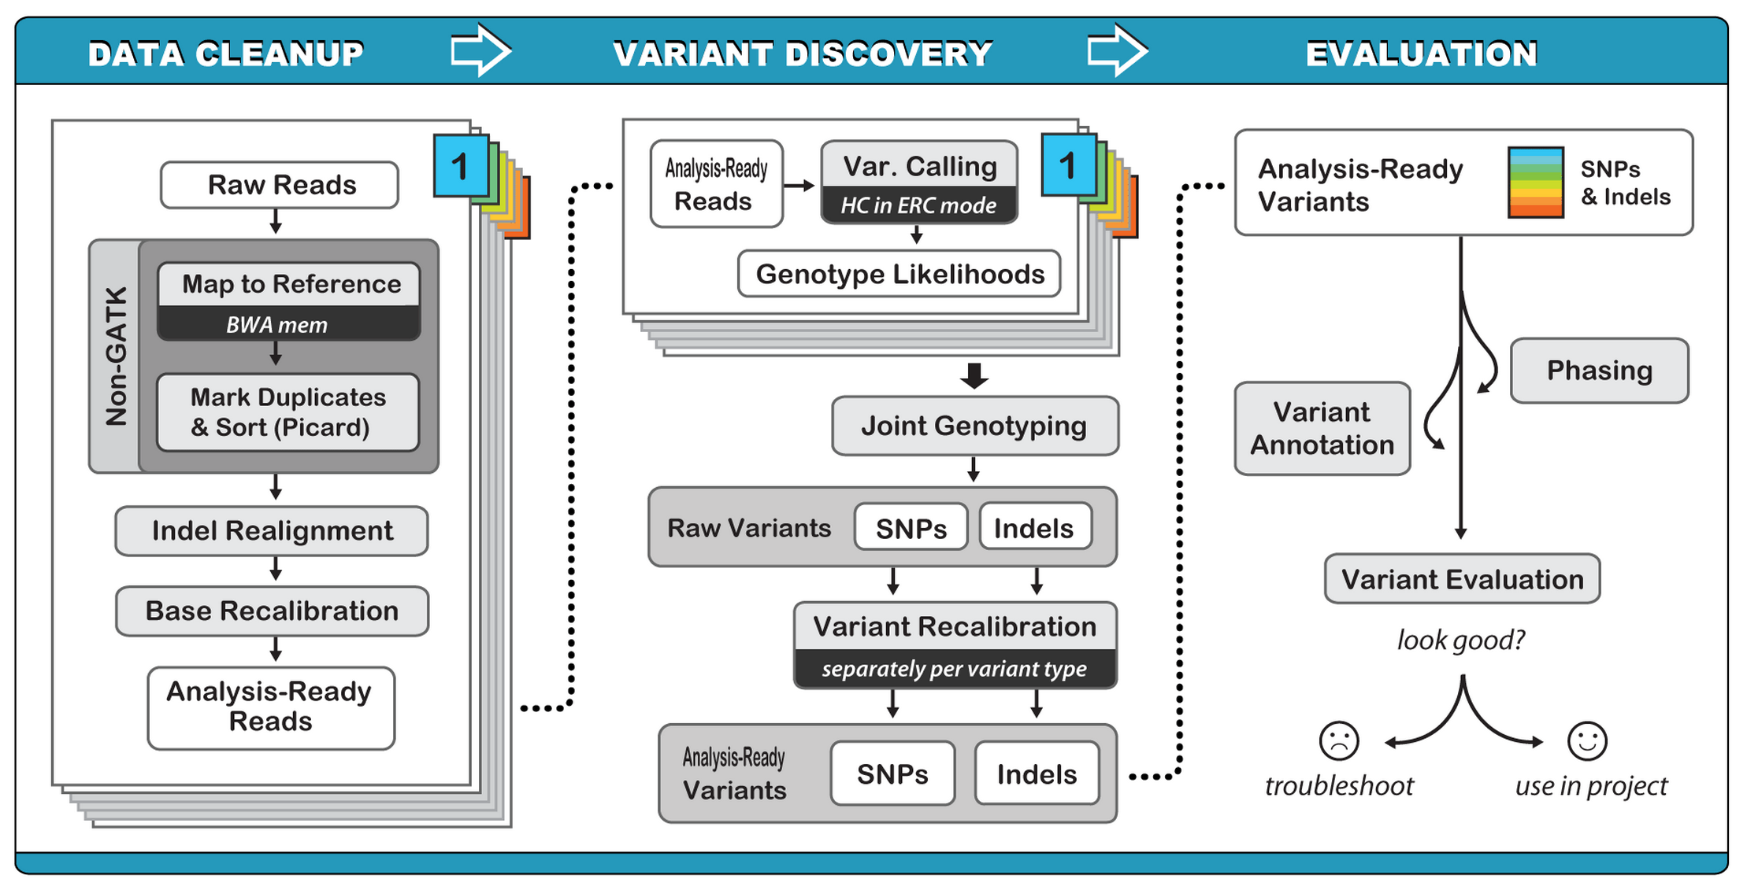
Variant calling – SNP, Indels
The Genome Analysis Tool Kit (GATK)
Broad Institute

Slide 7
Genetic variant or random noise ?
-- large scale Bayesian inference
UnifiedGenotyper
- Call SNPs and indels separately by considering each variant locus independently
HaplotypeCaller
- Call SNPs, indels and some SVs simultaneously by performing a local de novo assembly
Broad Institute

Slide 8
UnifiedGenotyper
Broad Institute

Slide 9
Variant calling – SNP, Indels
MuTect
Reliable and accurate identification of somatic point mutations in cancer genomes.
Preprocessing the aligned reads in the tumor and normal sequencing data.
Two Bayesian classifiers
- whether tumor is non-reference at a given site
- makes sure the normal does not carry the variant allele
3. Post-processing of candidate somatic mutations
K Cibulskis et al., Nature biotechnology, 2013

Slide 10
Variant calling – SNP, Indels
Other Methods:
VarScan
Strelka
SomaticSniper
JointSNVMix
Notes:
GATK for calling tumor/normal samples because our tools make assumptions about allele frequencies that are tuned for germline mutations, not somatic ones.
haplotypecaller only for diploid genome

Slide 11
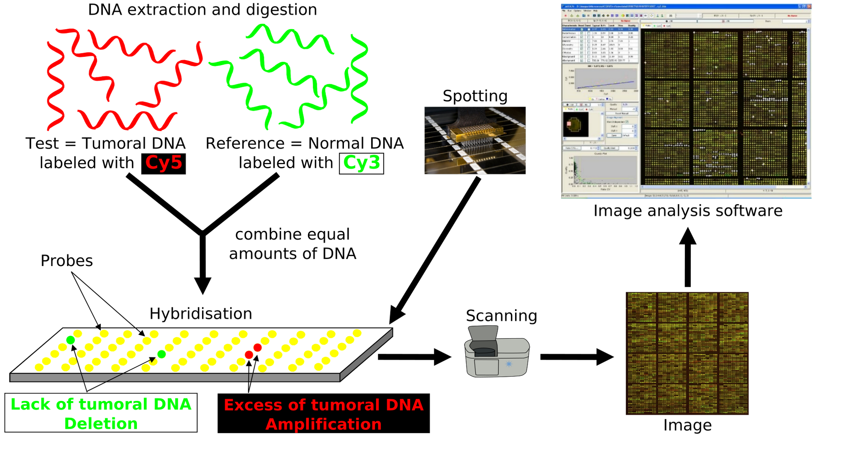
Submicroscopic CNVs: Array CGH*
*Frequently referred to as “chromosome microarray”
From: wikipedia

Slide 12
Limitations of Array CGH
Can’t detect translocations and inversions
Resolution still limited by number of probes on the array—typical resolution about 100 kb
Still a fair amount of variability in results depending on exactly which array is used
Adopted from Allen E. Bale

Slide 13
Variant calling - SVs
Copy number variation
Inversions
Translocations
Depth-of-coverage methods
Regions that are deleted or duplicated should yield lesser or greater numbers of reads
Paired-end mapping approach
Are the sequences at two ends of a fragment both from the same chromosome? Are they the right distance apart?
Split-read approach
Direct sequencing of breakpoints
Sequence assembly comparison
De novo assembly
Adopted from Allen E. Bale

Slide 14
Copy number neutral events
repeat-rich regions
Image: Snyder et al. Genes Dev. 2010 Mar 1;24(5):423-31.
Ref: Yoon et al. Genome Res. 2009 September; 19(9): 1586–1592.

Slide 15
Paired-End Mapping
Breakpoint
Breakpoint
Breakpoint
Breakpoint
Breakpoint
Reference
Deletion
Inversion
Target
Insertion
Inversion
Paired-End Sequencing and Mapping
Reference
Span << expected
Span >> expected
Altered end orientation
Both paired-ends map within repeats.
Limited the distance between pairs; therefore, neither large nor very small rearrangements can be detected
From: Hugo

Slide 16
Split-read Analysis
Breakpoint
Breakpoint
Reference
Deletion
Read
Target Genome
Breakpoint
Reference
Read
Target Genome
Insertion
From: Hugo
Notes:
This schematic shows you the idea of a split-read analysis. Its simple but powerful enough to identify nucleotide-resolution SVs. Before we talk about how it works, we should know that by convention, when say it’s a deletion, it’s a deletion relative to the reference genome. In other words, the affected sequence actually exists in the reference genome, but is deleted in the query genome. Similar idea for insertion. So a split-read analysis is straight-forward.

Slide 17
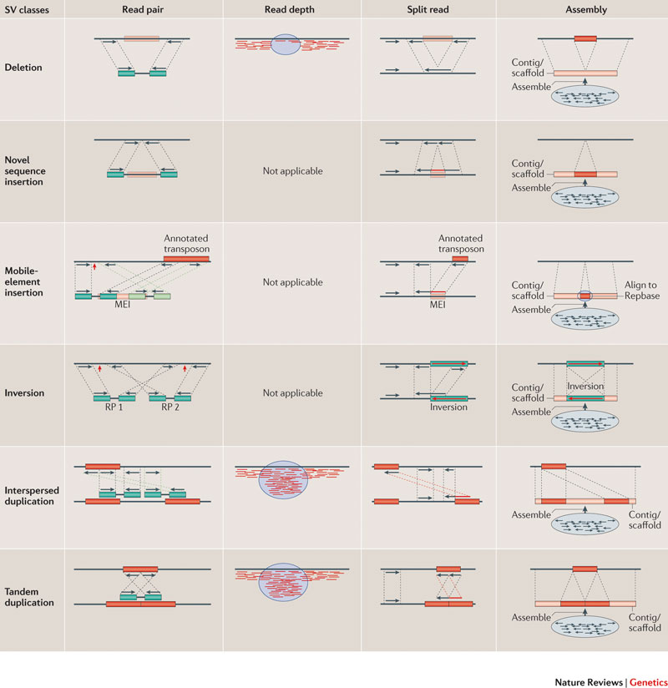

Slide 18
Depth-of-coverage
CNVnator (Abyzov et al., 2011)
Paired-end mapping
PEMer (Korbel et al., 2009): For discovery of CNVs and inversions; could also be implemented for translocations
Breakdancer (Chen et al., 2009): For discovery of CNVs, inversions, and translocations
GenomeSTRiP (Broad institute): whole-genome, integrating read depth, paired end; population level feature
Programs for analysis of longer reads that directly sequence breakpoints
CREST (Wang et. al., 2011): Detects small and large structural variants by direct sequencing of breakpoints.
SRiC (Zhang et al., 2011): Similar to CREST
Algorithm for strobe reads (Ritz et al., 2010)
Adopted from Allen E. Bale

Slide 19
Driver vs. Passenger mutations
The driver genes are selected for by the growth process. The passenger genes are defined by mutations that occurred in the process but have no effect on the tumor.

Slide 20
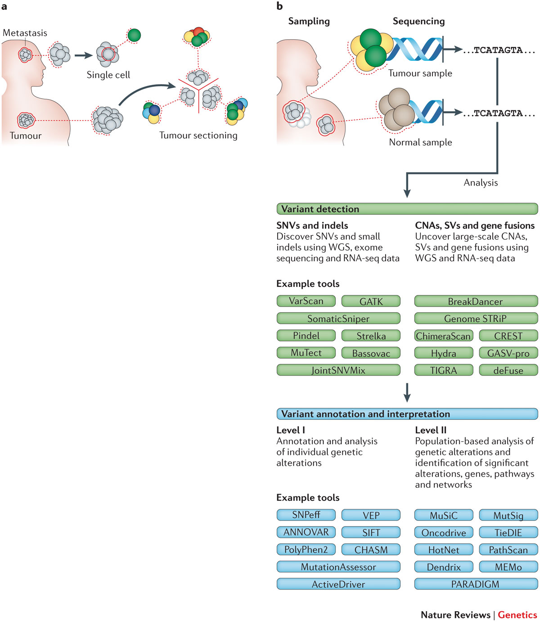
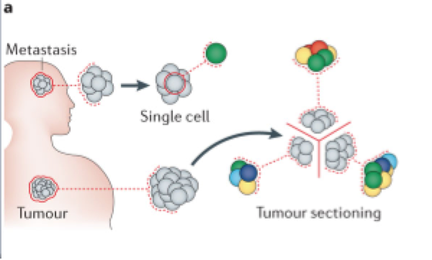
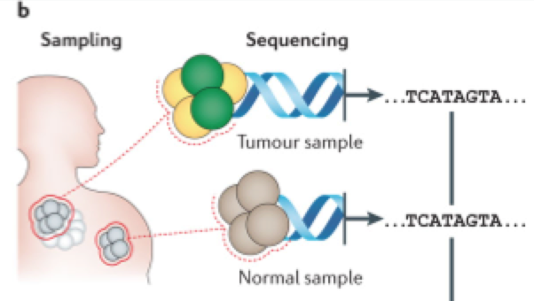
Identify functional genetic variants in cancer

Slide 21
Annotate and analyze individual genetic alterations
SIFT (Ng et al., 2003): missense SNPs
Polyphen2 (Adzhubei et al., 2010): missense SNPs, machine-learning method
ANNOVAR (Wang et al., 2010): variant annotation tool
CHASM (Cater et al., 2009): trained on known driver missense mutations.
PANTHER (Thomas et al., 2006): missense variants
MutationAssessor (Reva et al., 2011): missense variants, evolutionary conserved positions that contribute to protein functional specificity.
…
Base-wise: PhyloP, GERP
Small regions: PhastCons

Slide 22
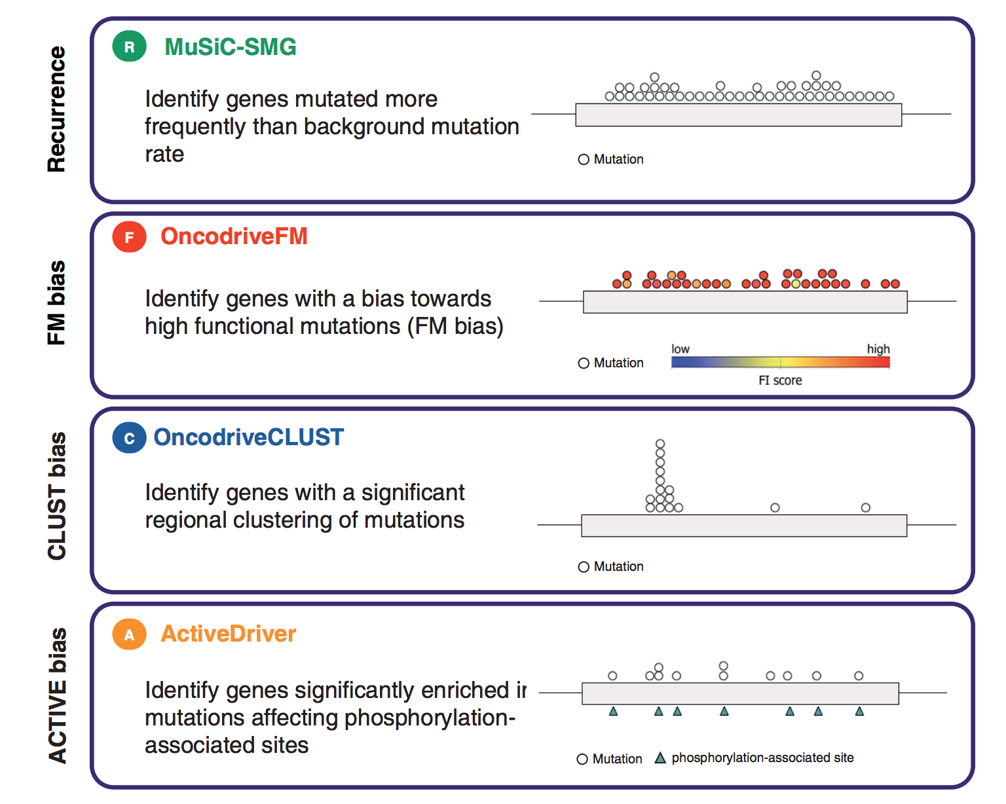
Population based analysis to identify driver genes
D Tamborero et al., Comprehensive identification of mutational cancer driver genes across 12 tumor types, nature 2013

Slide 23
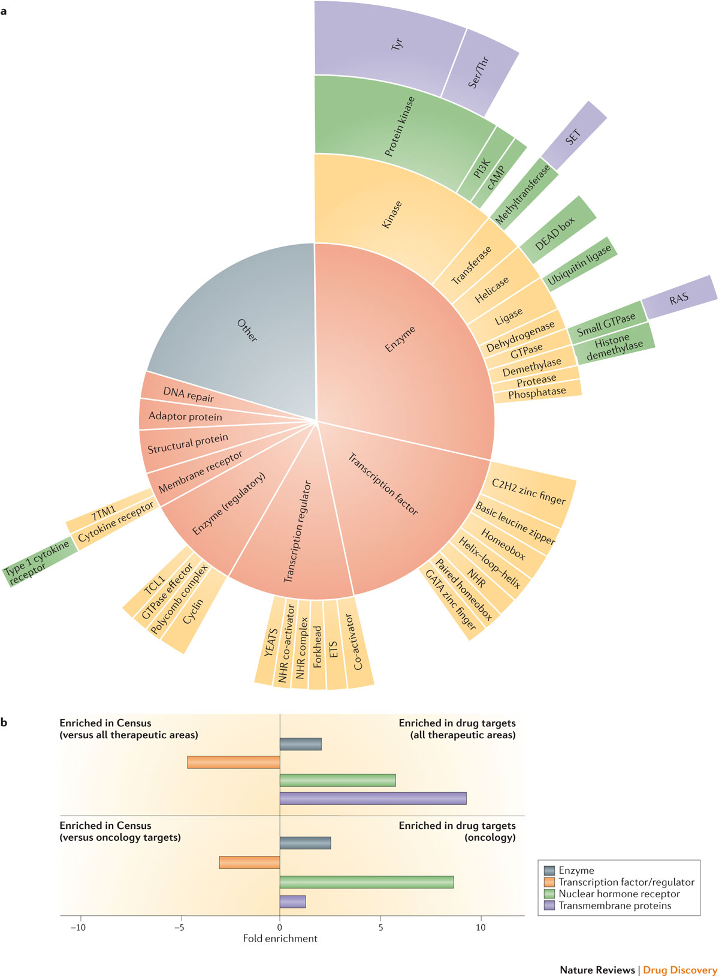
Cancer Gene Census
The Cancer Gene Census is an ongoing effort to catalogue those genes for which mutations have been causally implicated in cancer.
M Patel et al., nature reviews drug discovery 2013

Slide 24
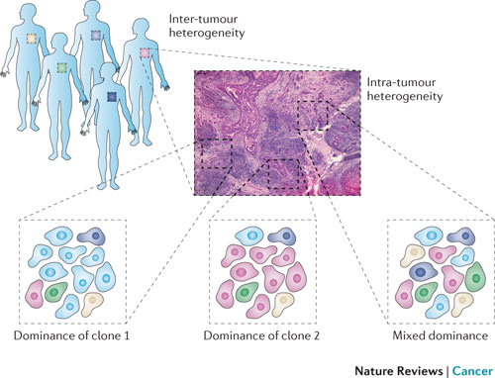
Tumor heterogeneity
Tumor heterogeneity describes differences between tumors of the same type in different patients, and between cancer cells within a tumor.

Slide 25
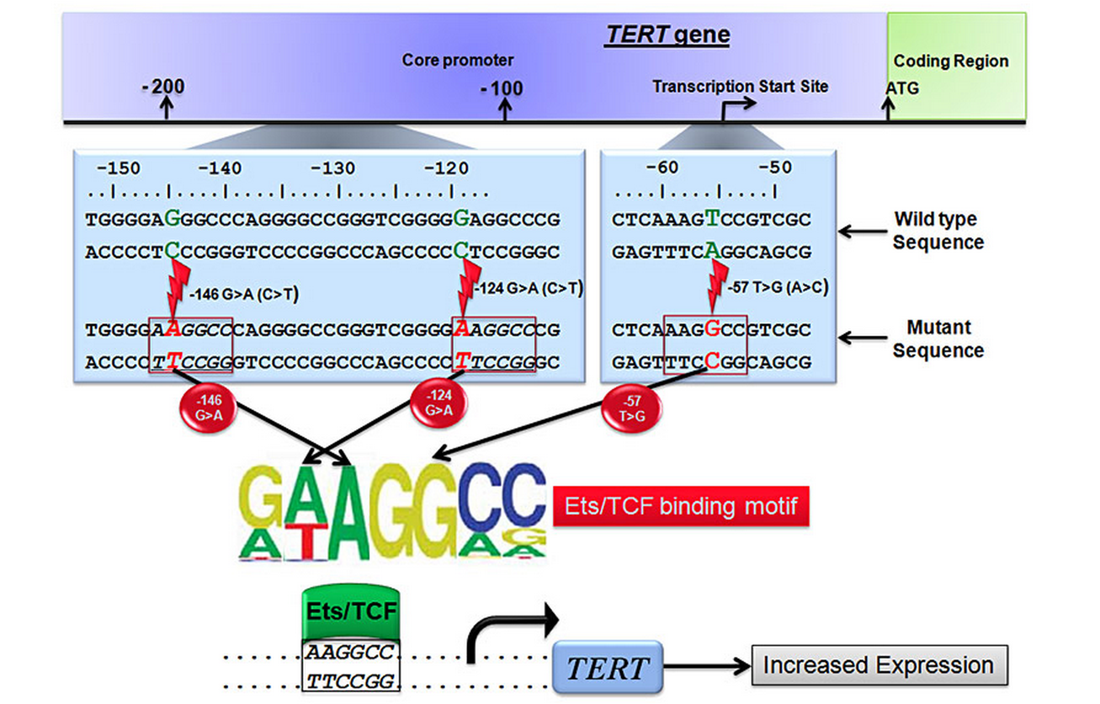
Whole-exome or whole-genome sequencing?
CNV, SV detection
Noncoding cancer drivers

Slide 26
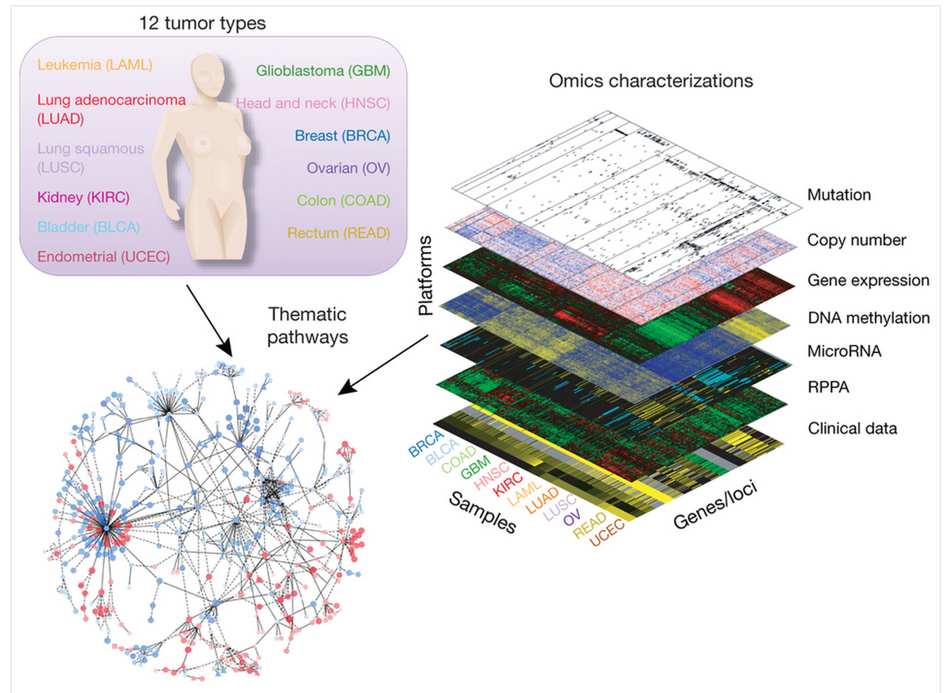
Pan-Cancer Analysis of Whole Genomes
The goal is to analyze the genomes, including genome-wide sequence data, of approximately 2000 pairs of tumor and normal samples, and integrate those results with clinical and other molecular data on the same cases

Slide 27
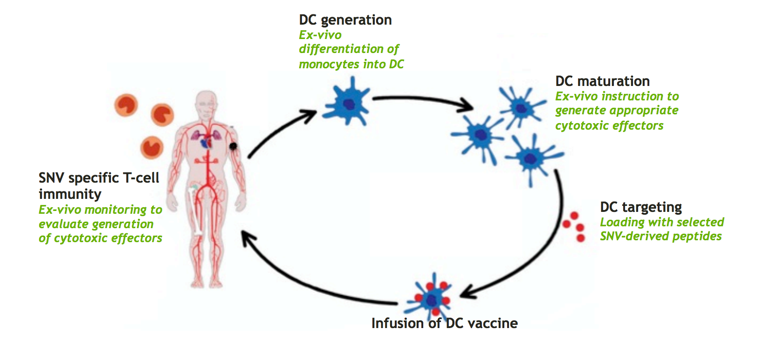
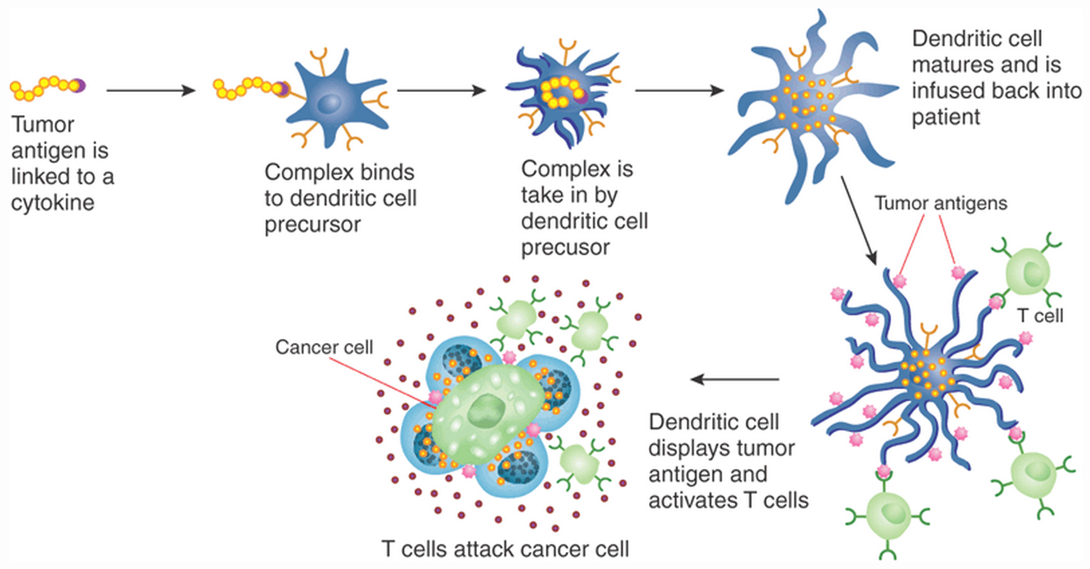
Dendritic Cell-based Vaccination
From: E Mardis, NHGRI Current Topics in Genome Analysis 2014
B Goldman et al., Nature Biotechnology, 2009

Slide 28
Thank you for listening

